Slide 1
The Mad Hedge Fund Trader “The Melt Up, Down, Up of 2018”
With John Thomas from Silicon Valley, CA, February 28, 2018 www.madhedgefundtrader.com
Notes:
*

Slide 2
Trade Alert Performance New All Time High!!
*January 4.09% MTD *July +1.95% Final *February +5.25% MTD *August +18.38% Final *March +4.87% Final *September +7.65% Final *April +1.84% Final *October +1.39% Final *May -0.45% Final *November +2.08% Final *June +0.70% Final *December +3.76% Final *2018 Year to Date 9.34% compared to 3.2% for the Dow Average *Trailing One year return +54.88%, +285.81% since inception, *Average annualized return of 34.64%

Slide 3
Portfolio Review 20%/20% Balanced Long/Short Portfolio with long technology weighting
Current Capital at Risk
Risk On
World is Getting Better
(AAPL) 6/$130-$140 call spread | 10.00%
(FB) 3/$155-$165 call spread | 10.00%
(FXY) 3/$91-$93 put spread | 10.00%
Risk Off
(FXE) 3/$120-$123 put apread | -10.00%
(FB) 3/190-$195 puts spread | -10.00%
Total Net Position | 10.00%

Slide 4
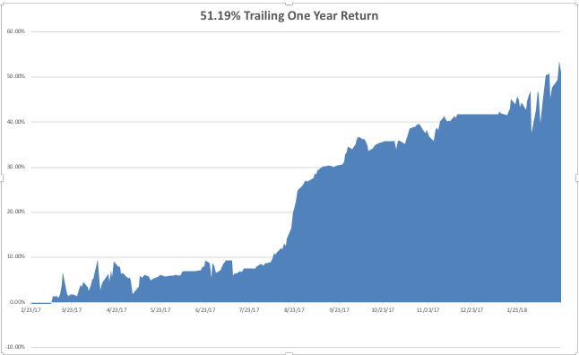
GTD Daily Audited Performance

Slide 5
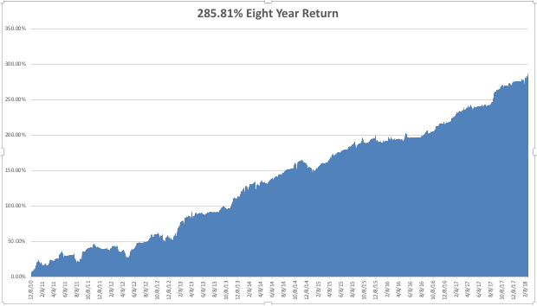
GTD Eight Year Daily Audited Performance 34.64% Average Annualized Return

Slide 6
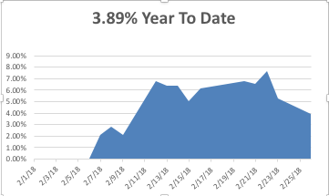
Mad Hedge Technology Letter Performance

Slide 7
The Method to My Madness The Fake Bear Market-Not Justified by Fundamentals
*Bailed out of risk positions early in melt down, then doubled up at bottom, record number of stop losses in Feb for risk control *Then gave back most profits with short positions in two days *We are now close to the same overbought condition we saw in January *Sell every bond rally….The Fed is now engaged in major Quantitative Tightening (QT?) in the face of exploding deficits *Keep a sharp focus on the the FANG’s an all other tech stocks *Short Euro and Yen on “Risk On” move and rising US rates

Slide 8
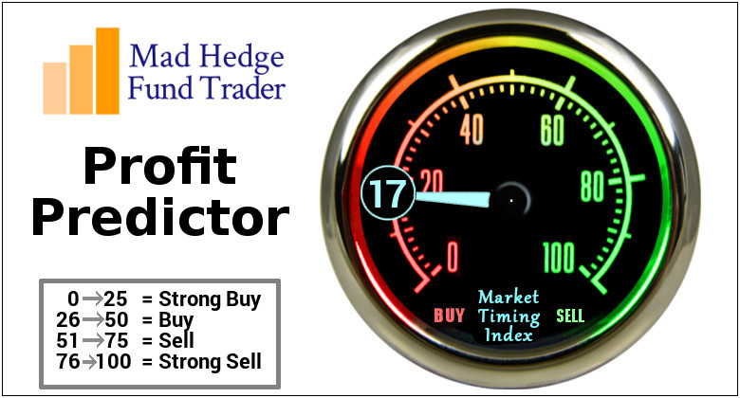
The Mad Hedge Profit Predictor Market Timing Index An artificial intelligence driven algorithm that analyzes 30 different economic, technical, and momentum driven indicators

Slide 9
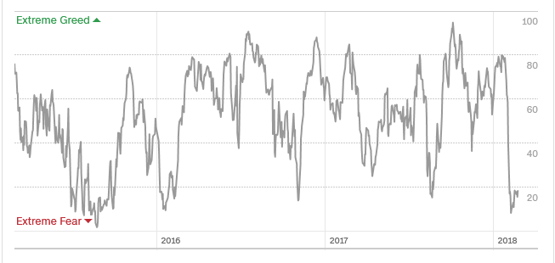
The Mad Hedge Profit Predictor A 9 Year Low!

Slide 10
The Global Economy-Bouncing Back
*Fed governor Powell signals a stringer US economy *It’s all about the January Consumer Price Index, which rose a hot 0.5%, one more hot number like this and the market will crash again, January Retail Sales down -.3% *University of Michigan January Consumer Sentiment pops from 95 to 99.9, January Small Business Optimism Index rockets from 104.9 to 106.9 *January Consumer Confidence rockets from 124 to 131, a 20 year high *February German ZEW Institute Index slows from 20.4 to 17.8, hinting at slowdown in Europe *It’s back to happy days as recession fears fade for another year

Slide 11
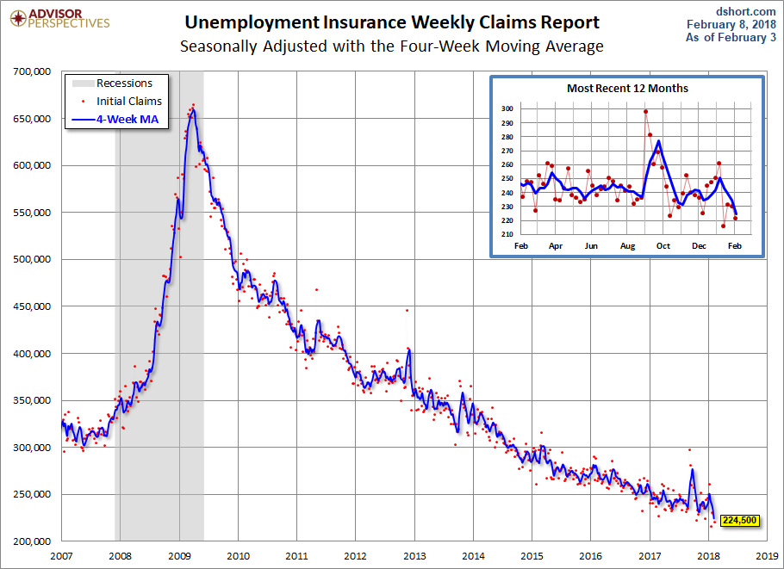
Weekly Jobless Claims –The Most Important Statistic -7,000 to 222,000 at 44 Year Low!

Slide 12
Stocks-Risks Rebuilding
*2018 has been the most volatile year in market history, up 2,000, down 3,000, up 2,000, dividend payouts now growing at fastest rate in history *VIX collapses from $52.50 to $15 in three weeks, death of short volatility industry was a major factor allowing melt up *Massive capitulation on Friday, February 9 will be the Dow low for the year at $23,800, with a PE multiple at 16X *Market blew through the 50-day MA on the upside on the first try, new all time highs are next *Risks are building again, next big data points are the Feb Nonfarm Payroll Report on March 9 and the Feb CPI on March 12 *Volatility has not gone away

Slide 13
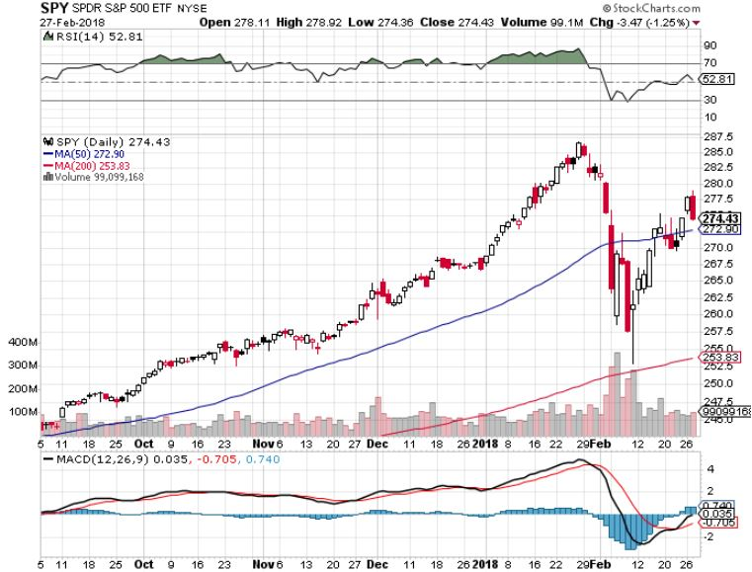
S&P 500-New Highs stopped out of Long 3/$275-$280 bear put spread

Slide 14
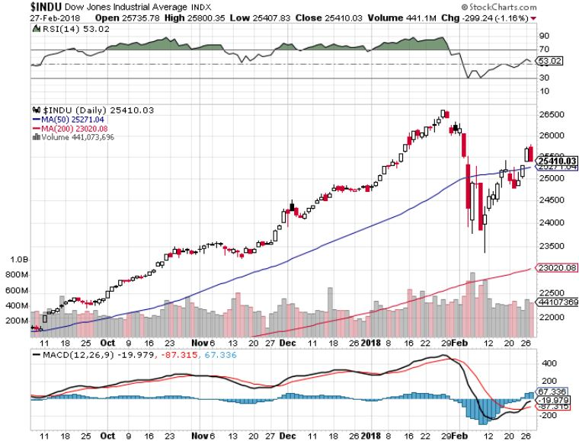
Dow Average-13.33% Correction

Slide 15
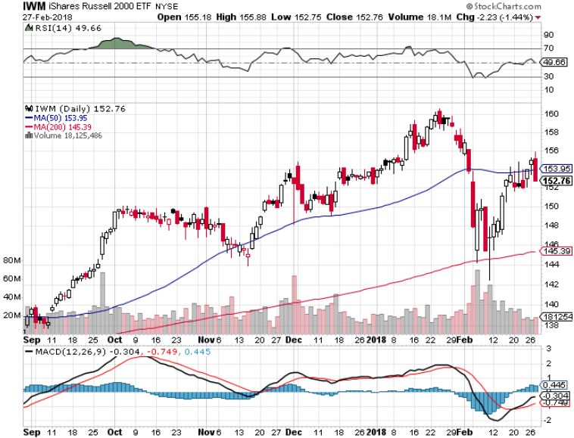
Russell 2000 (IWM)-Peaked Out stopped out of long the (IWM) 12/$152-$155 bear put spread

Slide 16
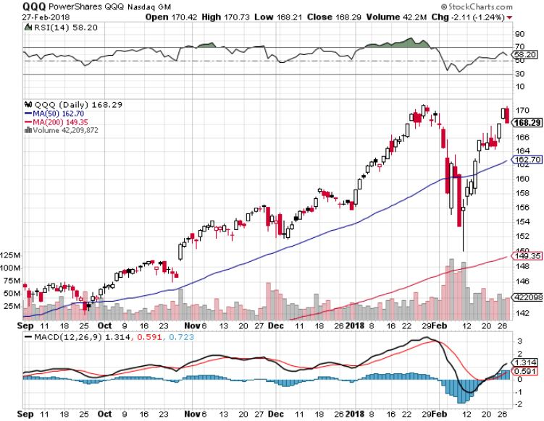
NASDAQ (QQQ)-Crushed

Slide 17
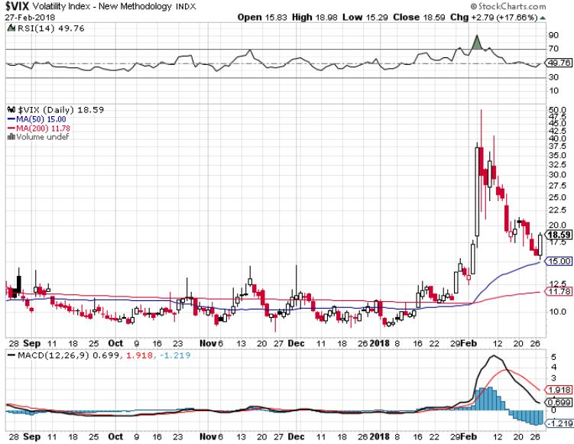
(VIX)-Nine Year High

Slide 18
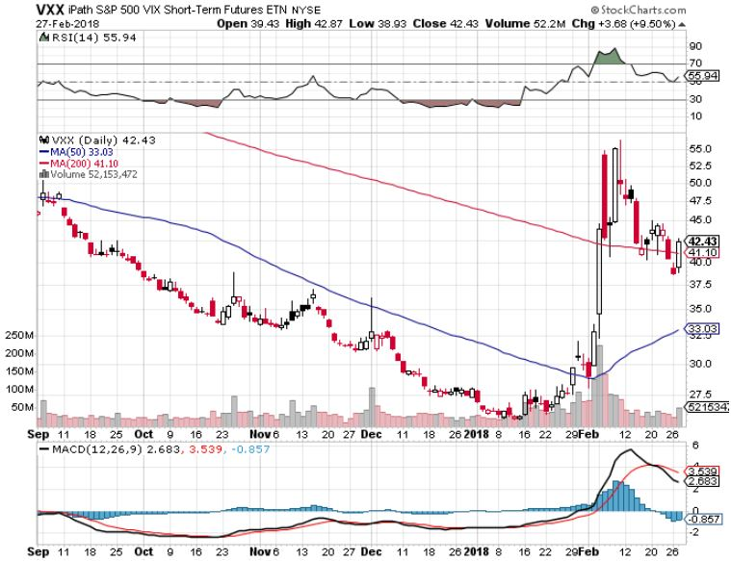
iPath S&P 500 VIX Short-Term Futures ETN (VXX) long 3/$55-$60 bear put spread-puts staying at artificially high levels took profits on long 11/$20 calls

Slide 19
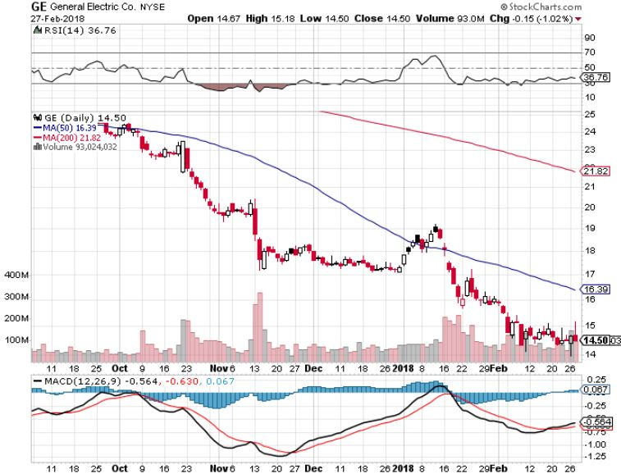
General Electric (GE)-No Recovery Breakup Value is $15

Slide 20
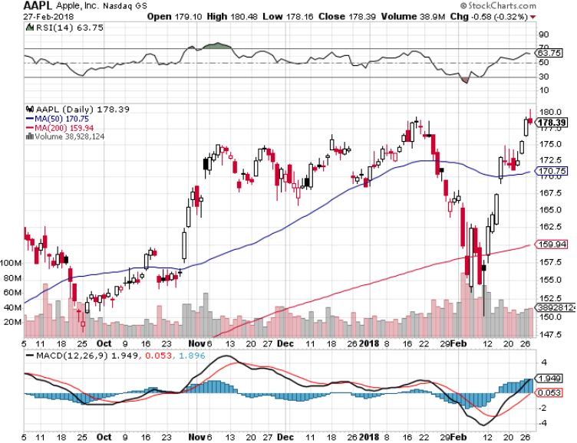
Apple (AAPL)-Waiting for Buy Backs took profits on long 3/$140-$145 calls stopped out of long 3/$170-$175 put spread long 6/$130-$140 calls spread

Slide 21
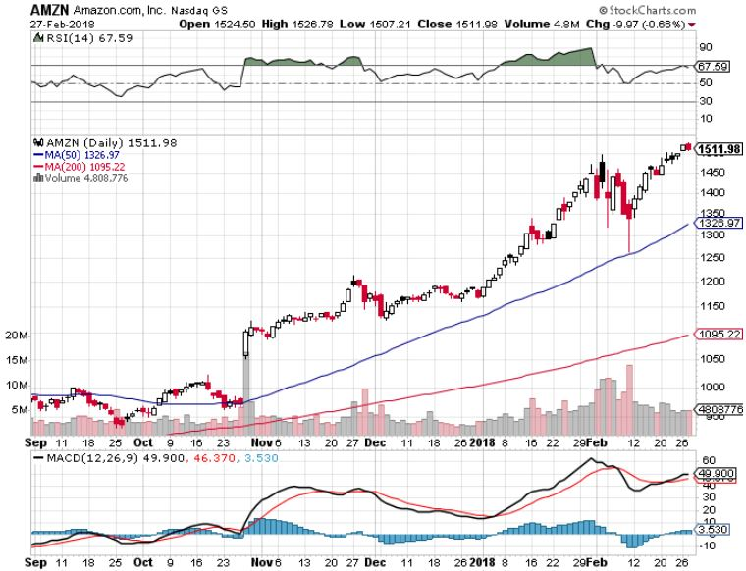
Amazon (AMZN) took profits on long 3/$1200-$1250 call spread

Slide 22
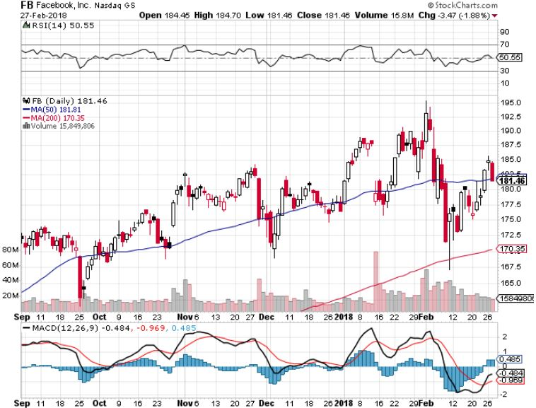
Facebook (FB)- long 3/$155-$165 bull call spread Long 3/$190-$195 bear put spread

Slide 23
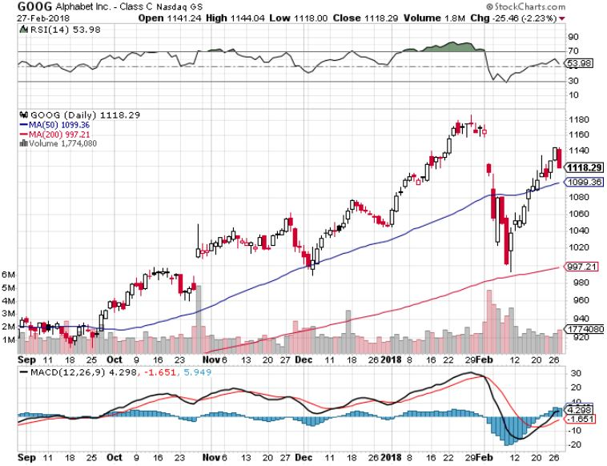
Alphabet (GOOG)-

Slide 24
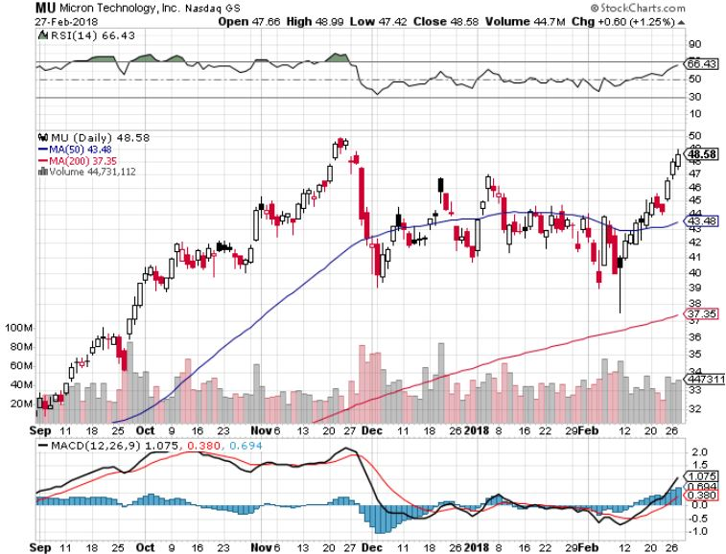
Micron Technology (MU)-Awaiting Earnings took profits on long 3/$34-$37 bull call spread in Mad Hedge Technology Letter Only

Slide 25
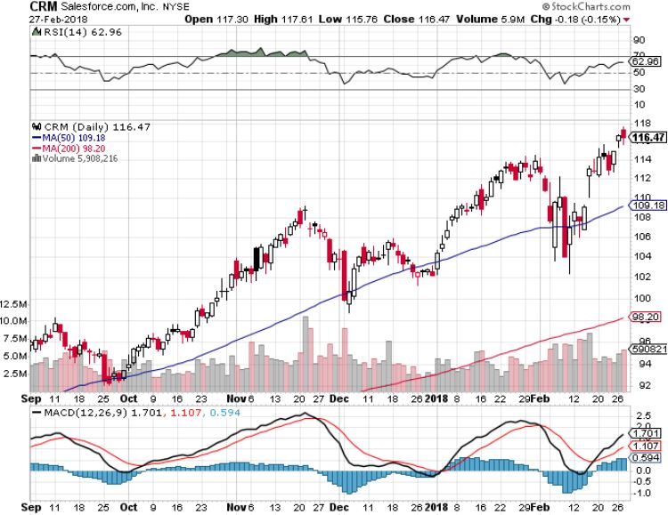
Salesforce (CRM)-New High took profits on long 3/$90-$95 bull call spread in Mad Hedge Technology Letter Only

Slide 26
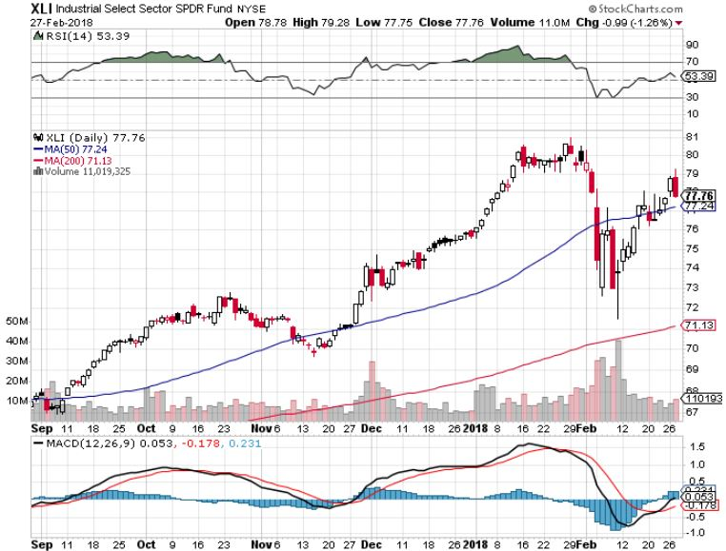
Industrials Sector SPDR (XLI)- (GE), (MMM), (UNP), (UTX), (BA), (HON)

Slide 27
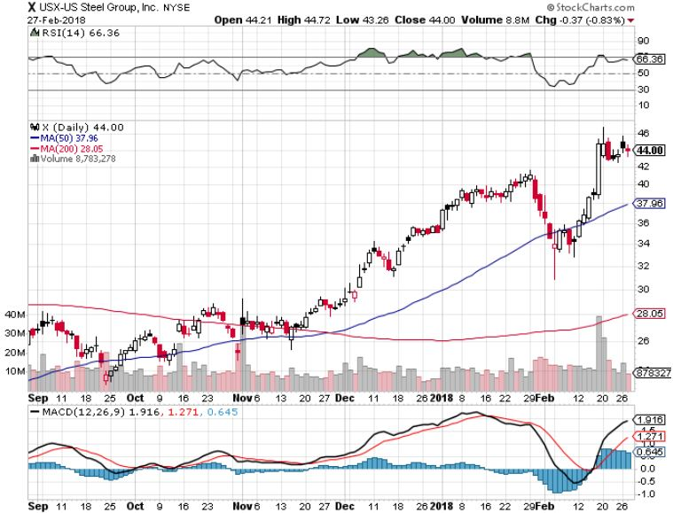
US Steel (X)-New High took profits on long the 9/$21-$22 vertical bull call spread

Slide 28
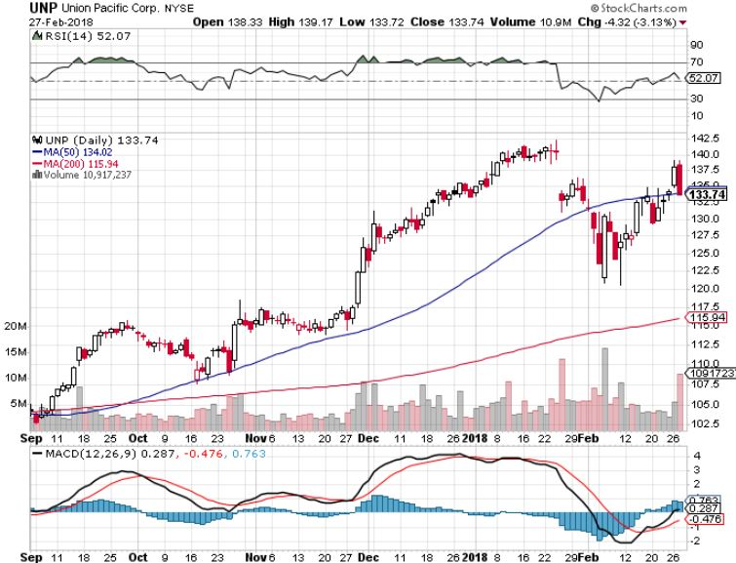
Union Pacific Railroad (UNP)- took profits on long the 9/$100-$102 vertical bull call spread

Slide 29
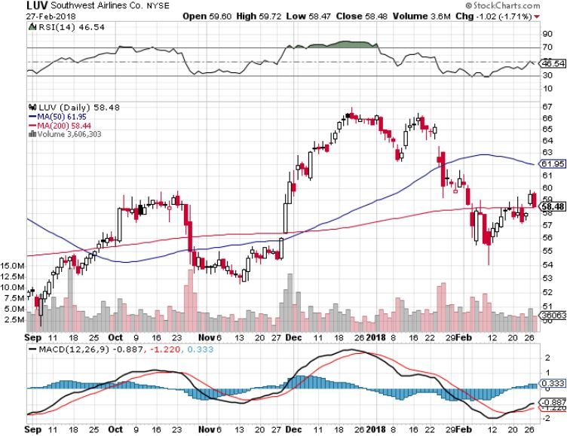
Southwest Airlines (LUV)- Warren Buffett’s Favorite Airline

Slide 30
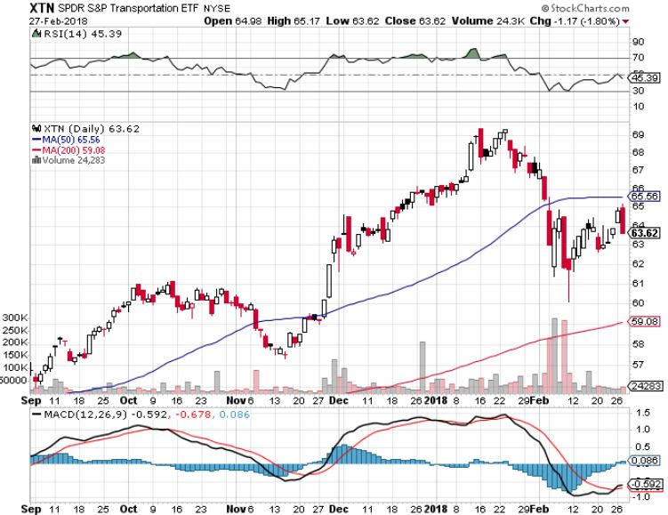
Transports Sector SPDR (XTN)- (ALGT), (ALK), (JBLU), (LUV), (CHRW), (DAL)

Slide 31
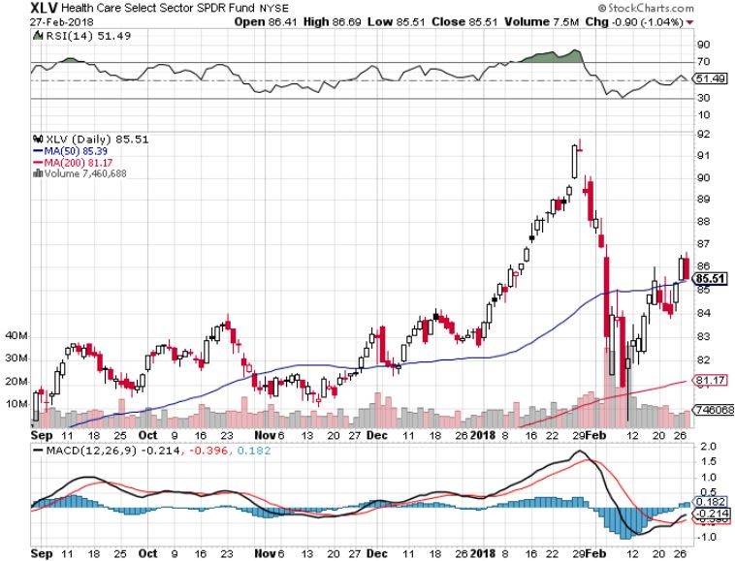
Health Care Sector (XLV), (RXL)-The New FANG? (JNJ), (PFE), (MRK), (GILD), (ACT), (AMGN)

Slide 32
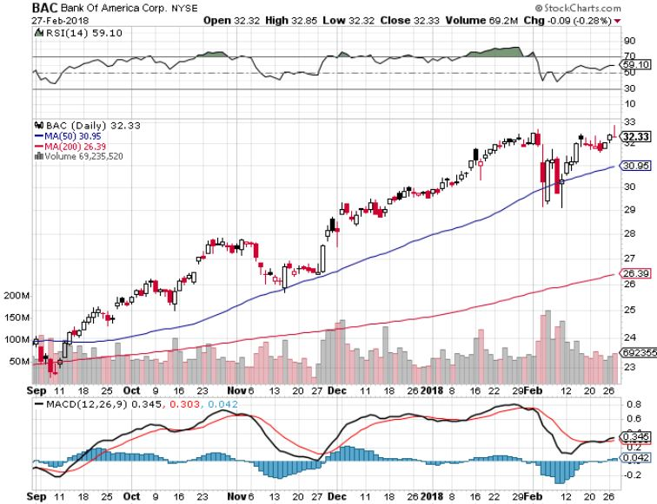
Bank of America (BAC)-New Highs (BLK/B), (WFC), (JPM), (BAC), (C), (GS) took profits on long 12/$25.50-$27 bull call spread-expires in 7 trading days

Slide 33
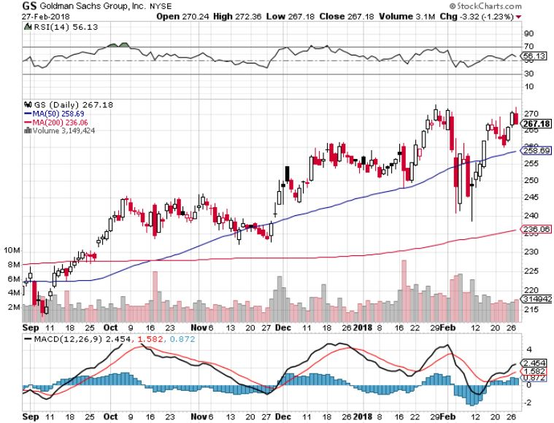
Goldman Sachs (GS)-New High stopped out of long 10/$220-$225 vertical bull call spread took profits on long 10/$227.50-$232.50 vertical bull call spread

Slide 34
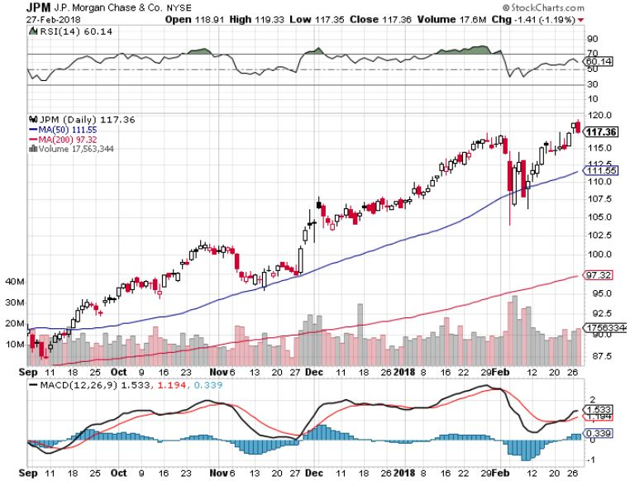
JP Morgan (JPM)-New High stopped out of long 2/$53-$55 call spread

Slide 35
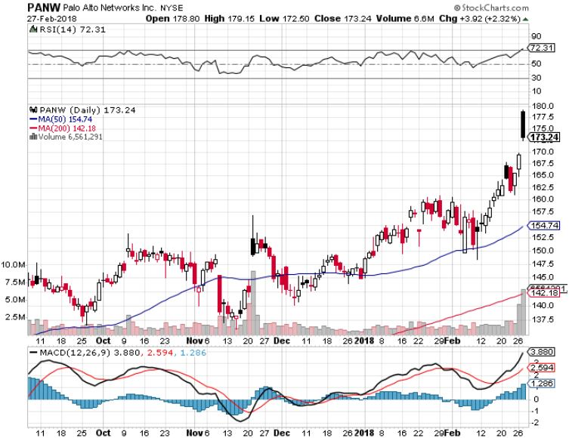
Palo Alto Networks (PANW)-Earnings Blast Off

Slide 36
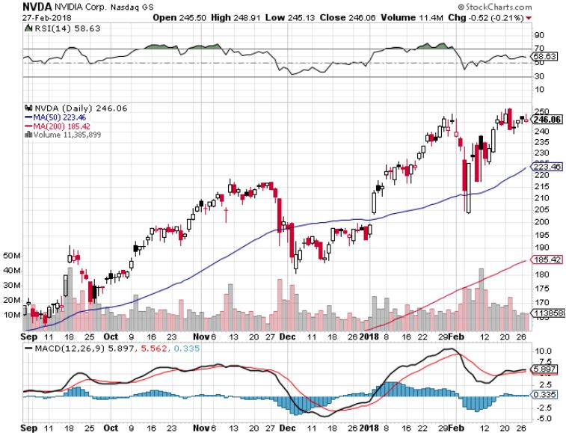
NVIDIA (NVDA)-Fabulous Earnings

Slide 37
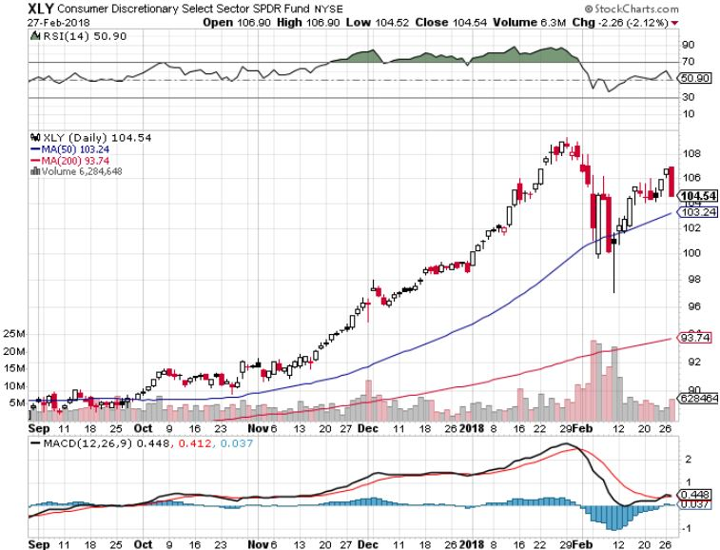
Consumer Discretionary SPDR (XLY) (DIS), (AMZN), (HD), (CMCSA), (MCD), (SBUX)

Slide 38
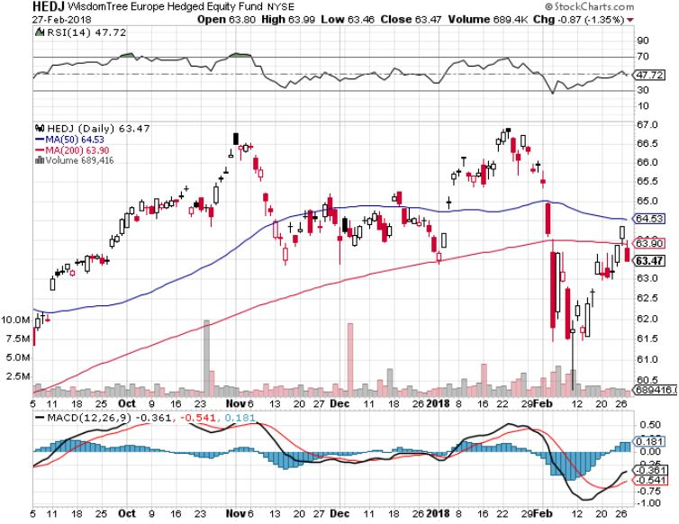
Europe Hedged Equity (HEDJ)-Global Rally

Slide 39
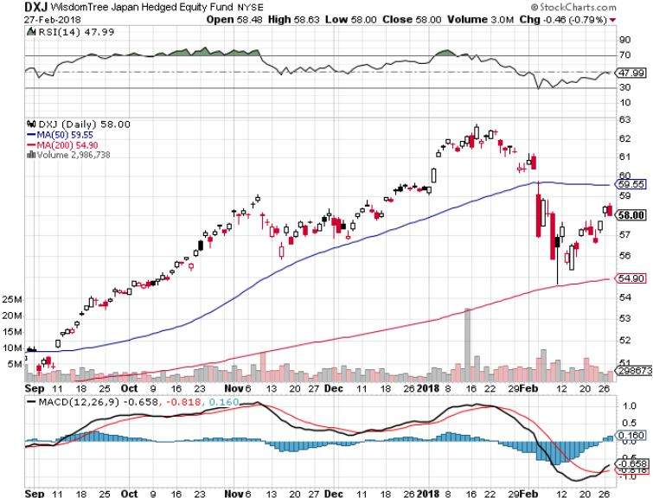
Japan (DXJ)-More Global Rally

Slide 40
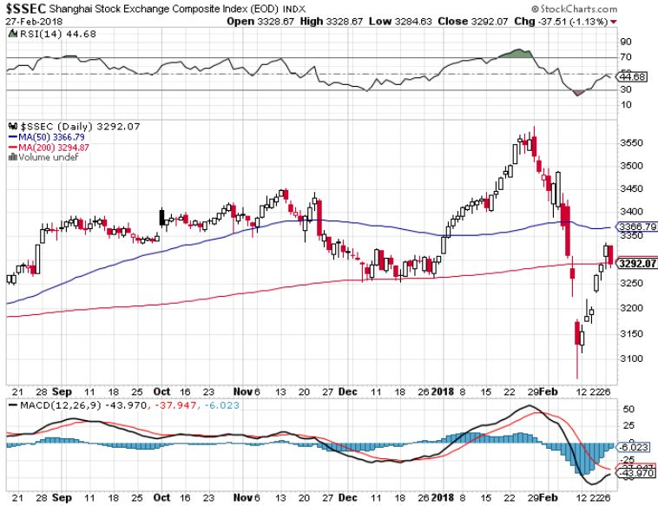
China ($SSEC)-Economic Recovery on Track

Slide 41
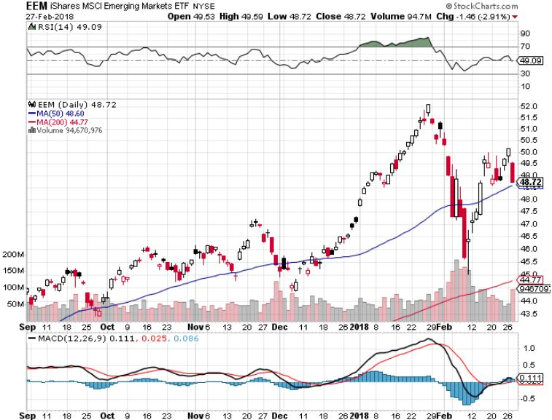
Emerging Markets (EEM)- New High

Slide 42
Bonds-Stalling Out
*Ten year Treasury bonds hit new ten year high at 2.95%, market is begging for 3%. Two year yields already at a ten year high *Bonds reaching the tag ends of an eight month, 92 basis point move to a four year high in rates *The easy money on the bond short has been made, I’ll cherry pick new positions from here *Still looking for 3.25%-3.5% ten year US Treasury yield by yearend *$1.2 trillion budget deficit for 2018 still provide a terrible backdrop for bonds *Chinese boycott of new US bond issues makes matters worse, as does QT

Slide 43
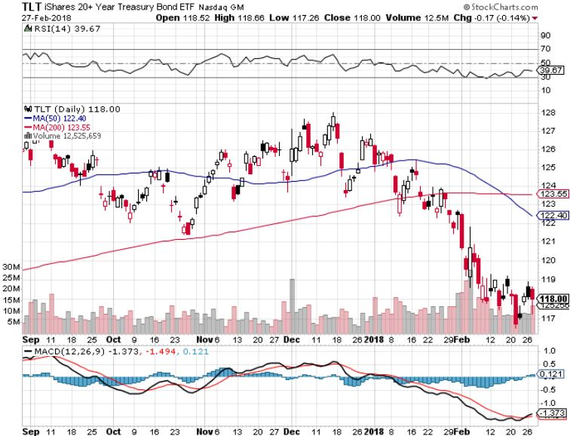
Treasury ETF (TLT) – 2.95 Topping Out stopped out of long 2/$114-$117 bull call spread Took profits on long the (TLT) 2/$124-$127 vertical bear put spread Took profits on long the (TLT) 2/$127-$130 vertical bear put spread

Slide 44
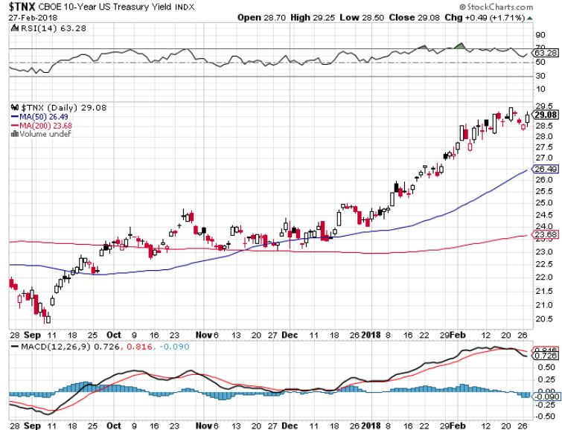
Ten Year Treasury Yield ($TNX) 2.87% Breakdown, Now major Support

Slide 45
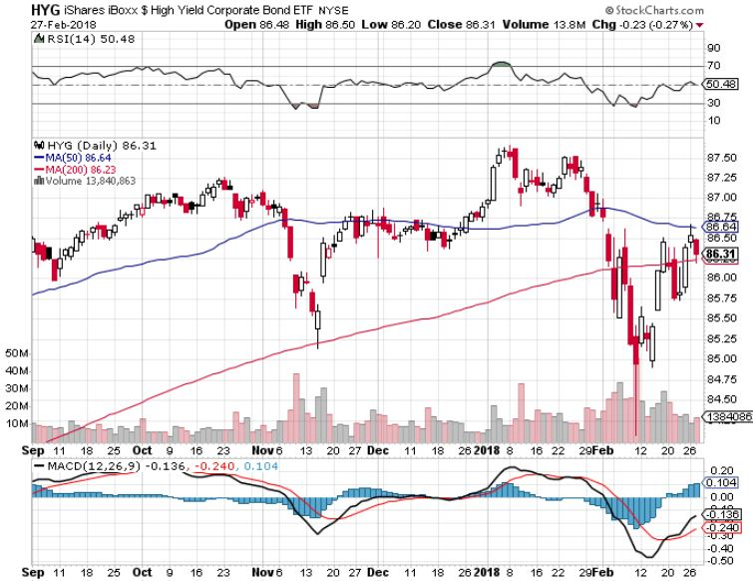
Junk Bonds (HYG) 5.39% Yield 60 basis point pop in yield on stock crash

Slide 46
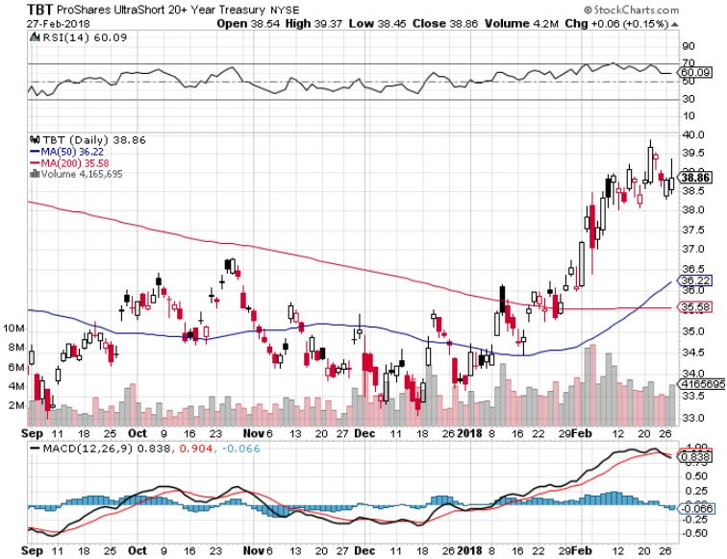
2X Short Treasuries (TBT)-

Slide 47
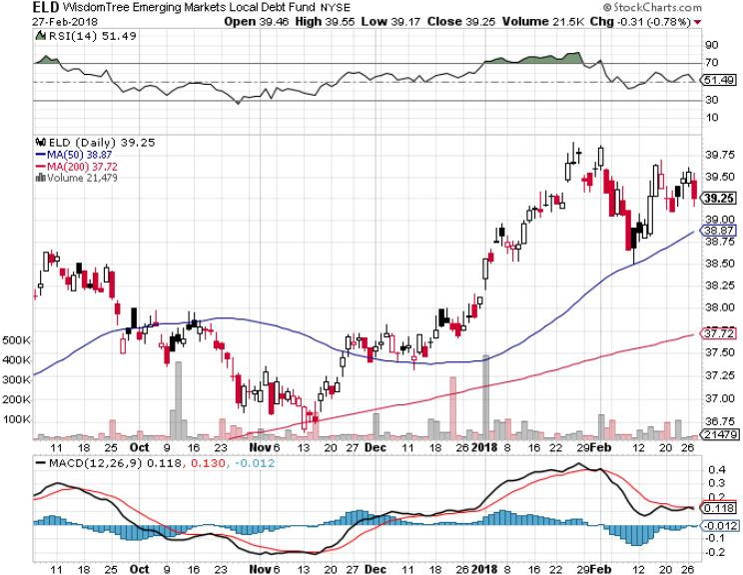
Emerging Market Debt (ELD) 5.58% Yield-

Slide 48
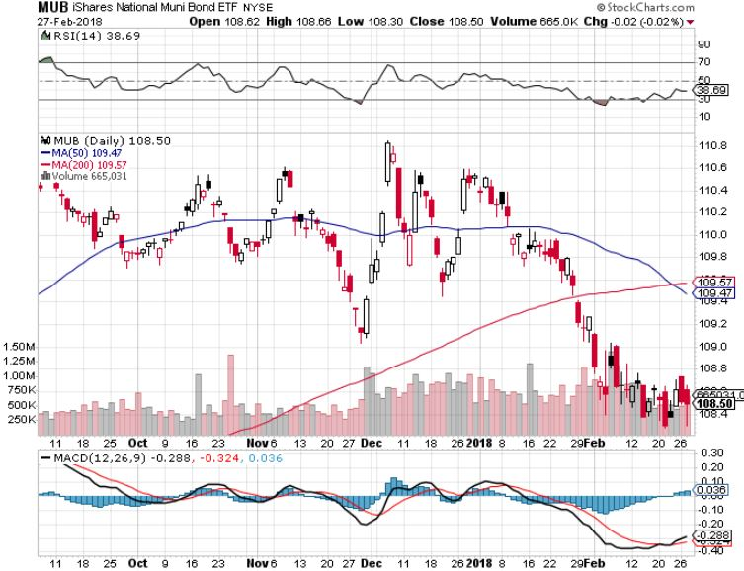
Municipal Bonds (MUB)-2.08% Mix of AAA, AA, and A rated bonds Huge 40 basis point yield pop on tax bill

Slide 49
Foreign Currencies- Stronger US Economy
*Signs of strengthening US economy brings ”RISK ON” and a short term rally in the dollar, dive in the currencies *Rising inflation and the rising rates they bring is now the market focus *Speculator Euro (FXE) position has flipped from massive short to massively long in two years, from 70,000 contracts short to 160,000 contracts long last week. *Sell short Euro on time political instability? *Yen spikes on US bond top out, BOJ commitment to more QE *Bitcoin tracks 1:1 with stocks to the upside, and the downside

Slide 50
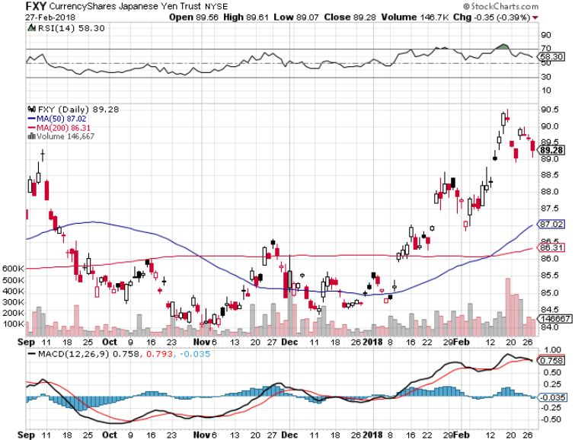
Japanese Yen (FXY), (YCS)-Peaking Out long (FXY) 3/$91-$93 bear put spread

Slide 51
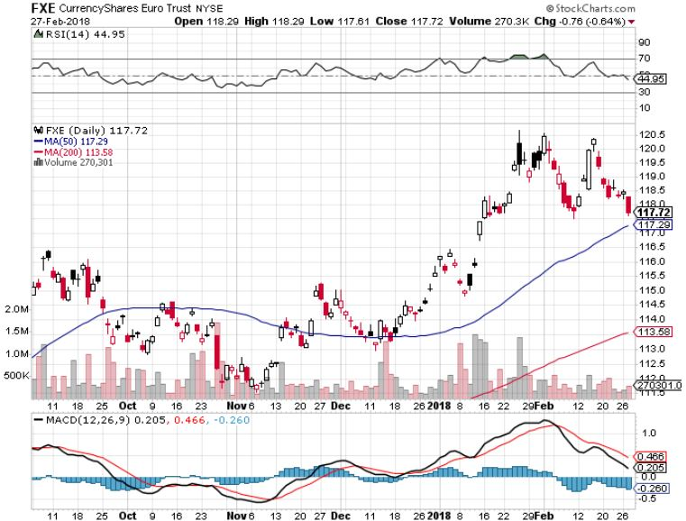
Euro ($XEU), (FXE), (EUO)- Double Top! took profits on long (FXE) 12/$116-$118 vertical bear put spread took profits on long (FXE) 12/$111-$113 vertical bull call spread

Slide 52
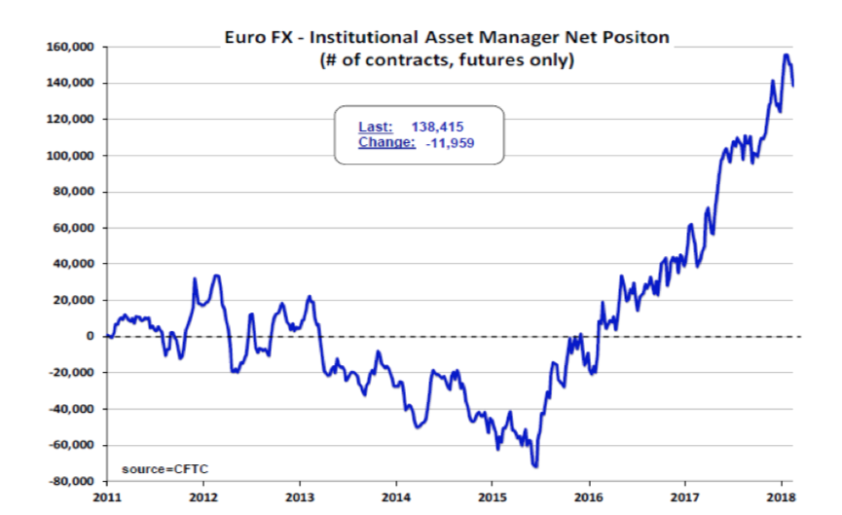

Slide 53
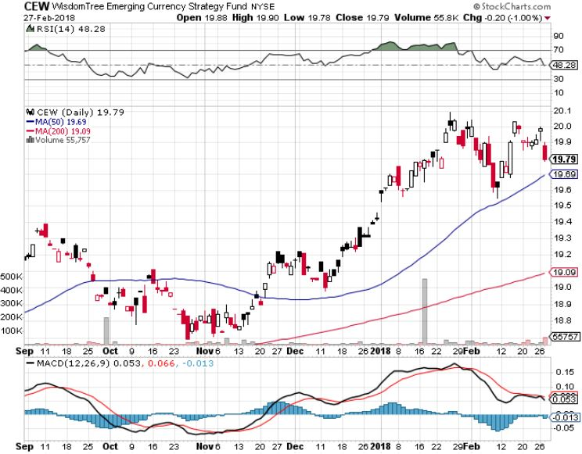
Emerging Market Currencies (CEW)

Slide 54
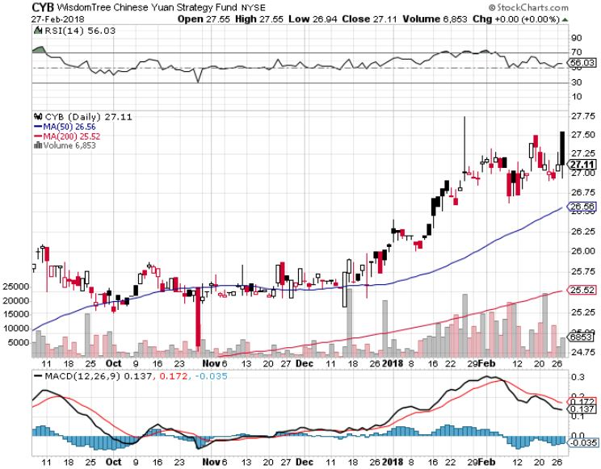
Chinese Yuan- (CYB)-Stabilizing on Government Support

Slide 55
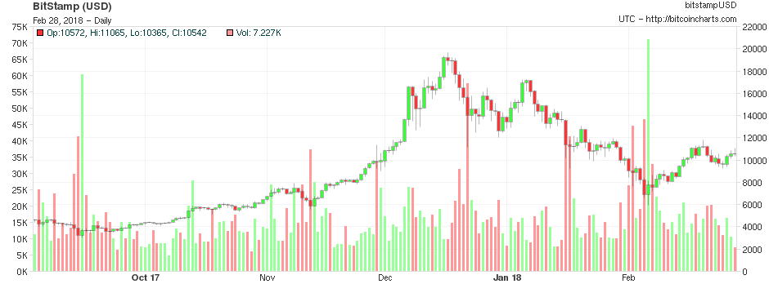
Bitcoin-Modern Day Tulips! Recovering from the latest 70% Plunge
$6,000 Bottom
$6,000 Bottom

Slide 56
Energy-Back to “RISK ON”
*Stock market flash recovery says no recession coming, so oil recovers *OPEC raises global oil production forecast by 1.4 million barrels, with all the increase coming from the US *The proposed new 25 cent per gallon gasoline tax will certainly raise prices and cut demand *Oil futures move to backwardation, pointing to lower prices *Fracking supply is on the rebound, Baker Hughes US Rig Count surges by 3 to 978 *Buy the dips in energy stocks

Slide 57
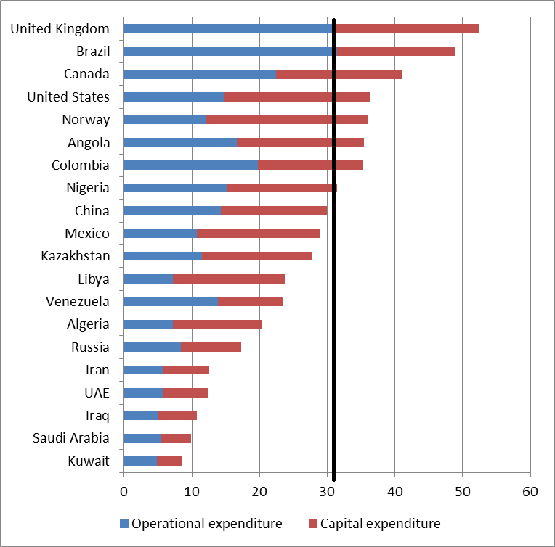
Crude Oil Production Cost

Slide 58
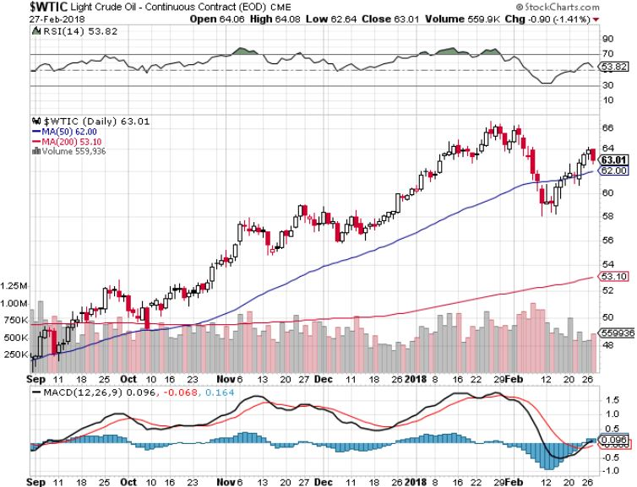
Oil-

Slide 59
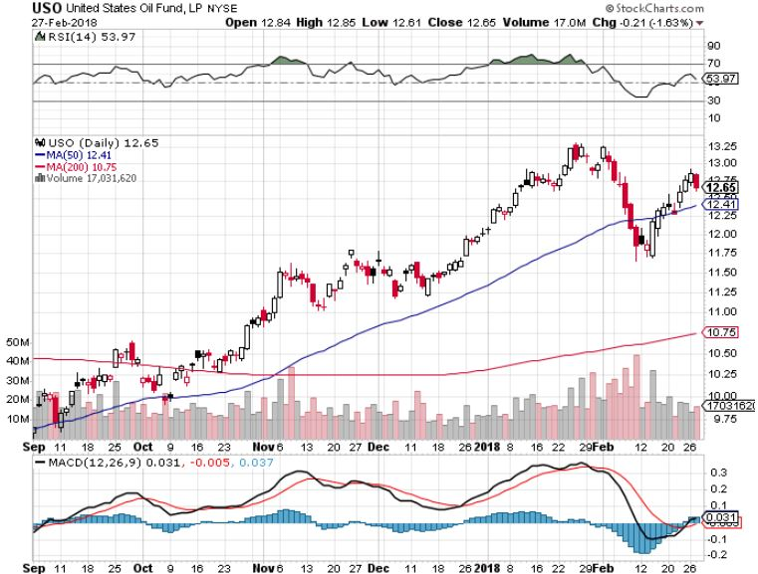
United States Oil Fund (USO)

Slide 60
Energy Select Sector SPDR (XLE)- (XOM), (CVX), (SLB), (KMI), (EOG), (COP)

Slide 61
Alerian MLP ETF (AMLP)- Basket Approach

Slide 62
Exxon (XOM)-

Slide 63
Schlumberger (SLB)-

Slide 64
Halliburton (HAL)-

Slide 65
Natural Gas (UNG)-

Slide 66
Copper (COPX)-

Slide 67
Precious Metals-The Focus is Elsewhere
*Margin calls on stocks but the cap on gold for now *Sharply rising US rates also averts traders’ gaze away from gold *Gold is now tracking the Euro 1:1 to the downside for same reasons *Weakness in gold stocks hint at lower lows to come *Gold is seeing a sideways “time” correction prior to the next upside breakout *Buy gold and silver stocks on the next big dip, as it is still early days for the bull market

Slide 68
Gold (GLD)-Double Top Stopped out of 2/$122-$125 bull call spread for small loss took profits on long (GLD) $12/$116-$119 bull call spread

Slide 69
Market Vectors Gold Miners ETF- (GDX) Took profits on long the 9/$20.50-$21.50 bull call spread

Slide 70
Barrick Gold (ABX) stopped out of long 9/$15-16 call spread

Slide 71
Newmont Mining- (NEM)-Breakout stopped out of 2/$36-$39 bull call spread for small loss took profits on long the 9/$32-$34 bull call spread

Slide 72
Global X Silver Miners ETF- (SIL)-Breakout took profits on long the 9/$31-$33 bull call spread

Slide 73
Bitcoin-Modern Day Tulips! Recovering from the latest 70% Plunge

Slide 74
Real Estate-Extreme Shortage
*January Home Construction up a massive 9.7% as homebuilding rush to meet severe structural shortage, model homes selling out *January Existing Home Sales down 3.2% on extreme inventory shortages, Pending Home Sales down -4.7% *January New Homes Sales down a stunning 9.7% *30 year fixed rate mortgage hits 4.65%, a four year high, cutting first time home buyers off at the knees *Are hedge funds hogging homes they bought during the crash? *S&P 500 Case-Shiller maintains strong 6.3%, with absolute prices hitting new all time highs,

Slide 75
December S&P7500/Case–Shiller Home Price Index +6.2% YOY, Seattle (+12.7%), Las Vegas (+11.1%), San Francisco (+9.2%) still leaders price rises accelerating

Slide 76
Simon Property Group (SPG)-

Slide 77
US Home Construction Index (ITB) (DHI), (LEN), (PHM), (TOL), (NVR)

Slide 78
Trade Sheet- So What Do We Do About All This?
*Stocks- Buy next big dip *Bonds-sell any and all rallies *Commodities-buy industrials, energy *Currencies-sell Euro and Yen-Risk On *Precious Metals –buy dips *Volatility-go short on runs up to $35 *Real estate-buy dips

Slide 79
Next Strategy Webinar 12:00 EST Wednesday, March 14, 2018 San Francisco, CA madhedgefundtrader.com
Good Luck and Good Trading!
Notes:
*

