Slide 1
Mad Day Trader
Bill Davis
Webinar – March 21, 2018

Slide 2
Long Term

Slide 3
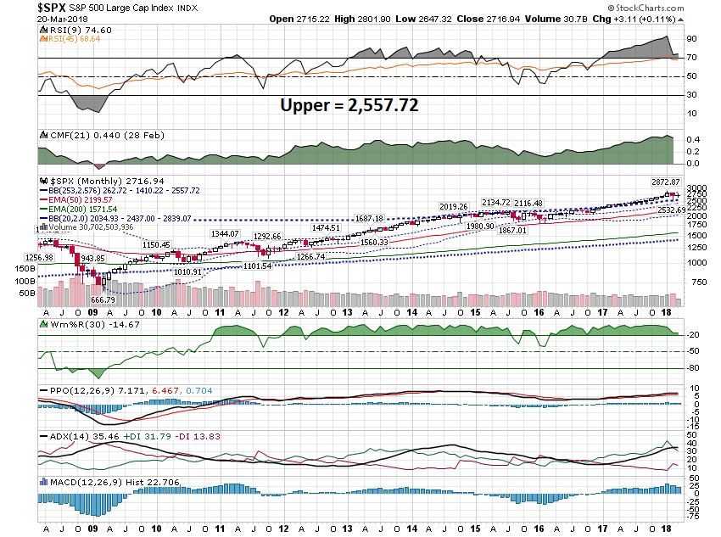

Slide 4
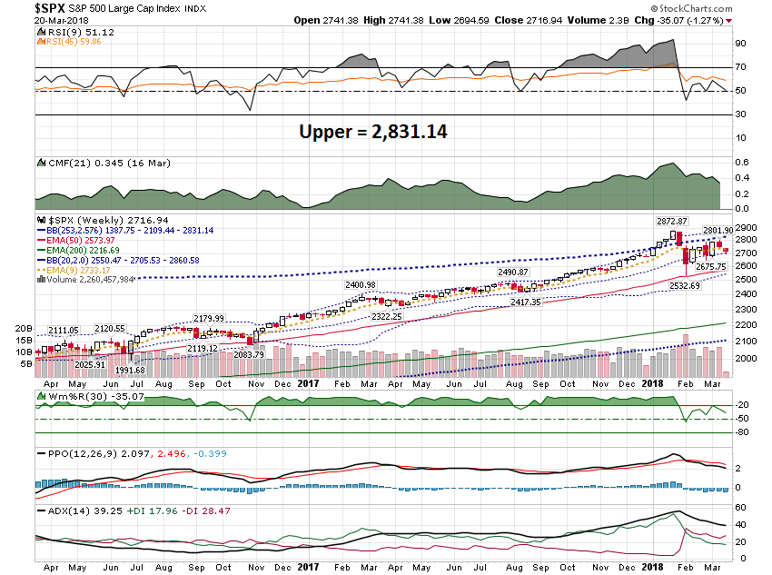

Slide 5
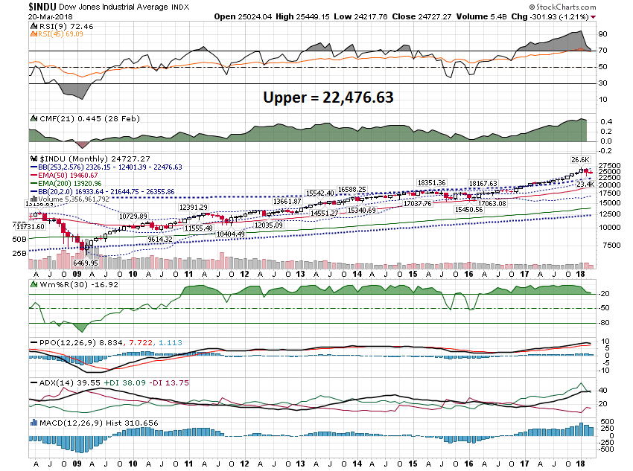

Slide 6
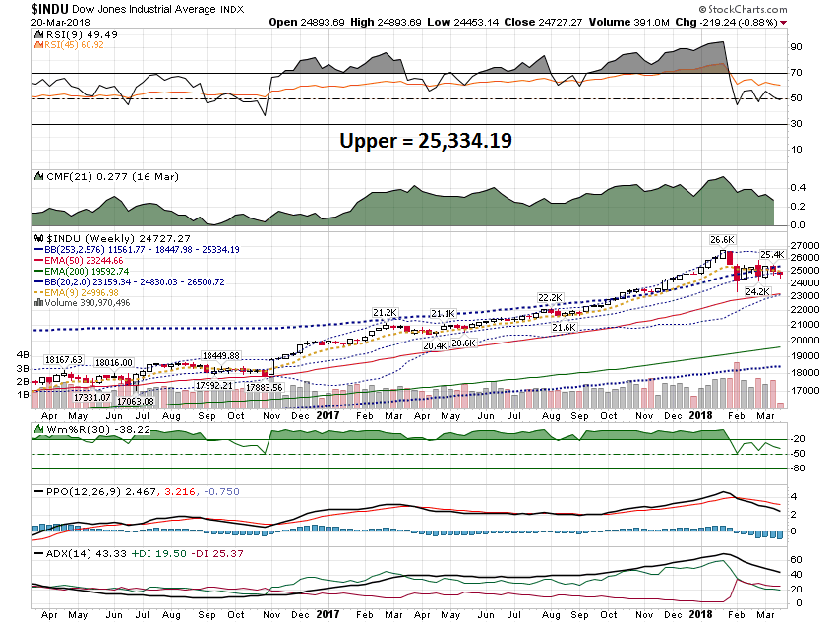

Slide 7
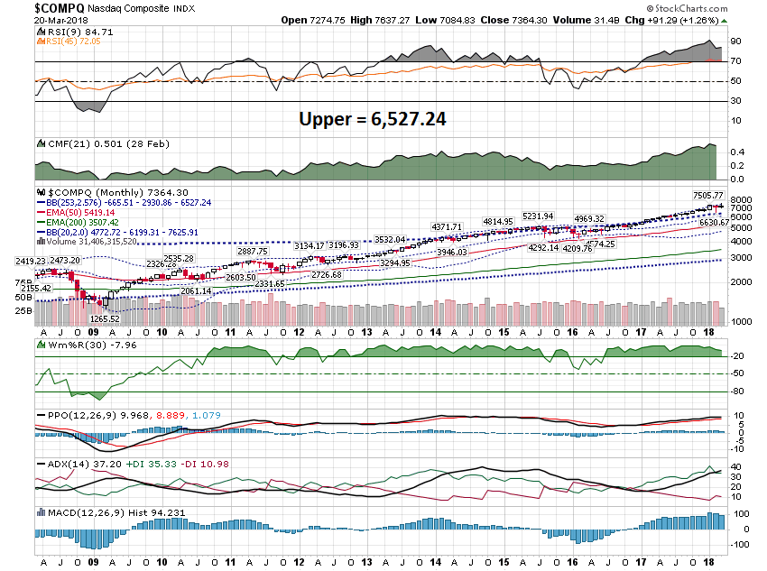

Slide 8
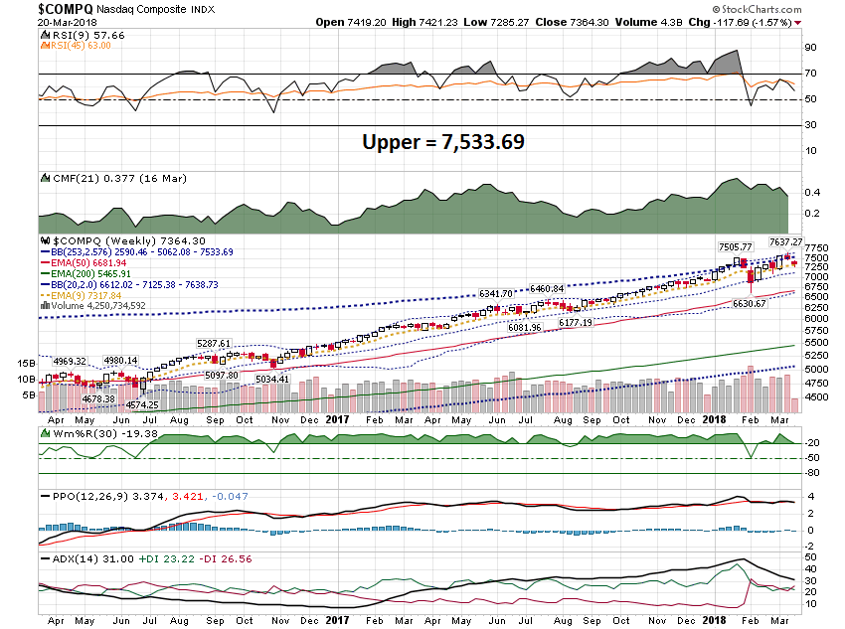

Slide 9
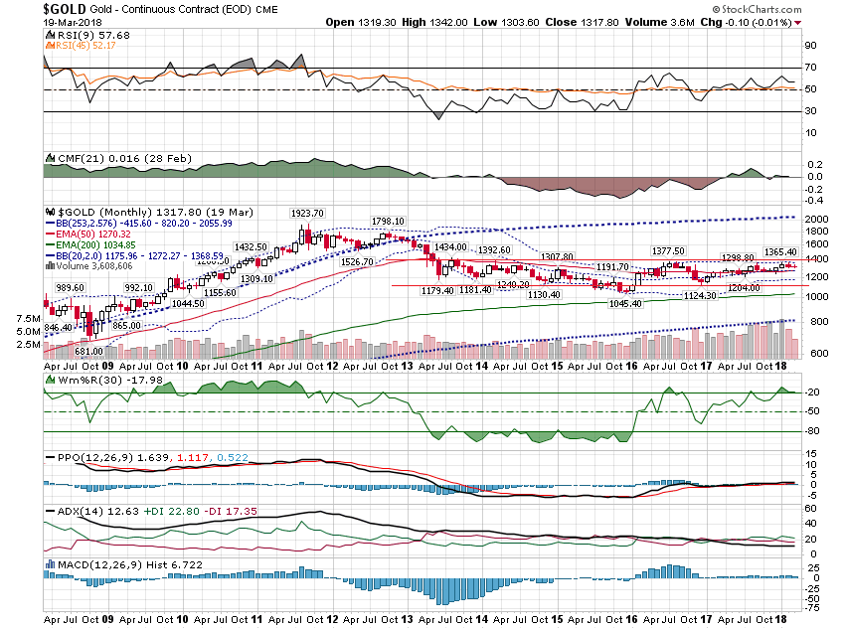

Slide 10
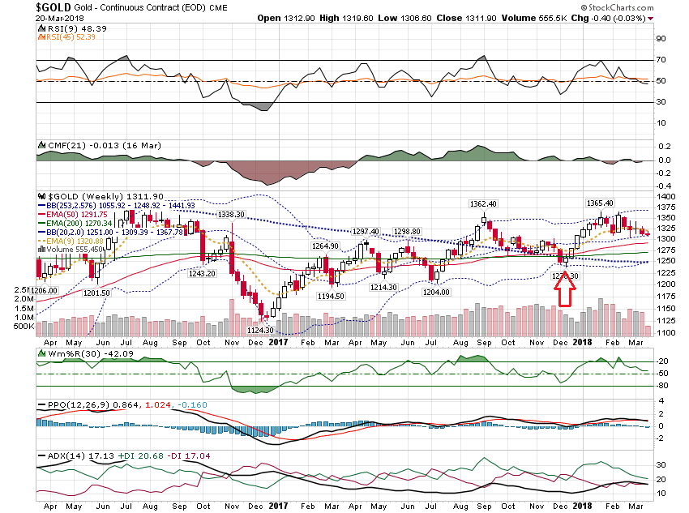

Slide 11
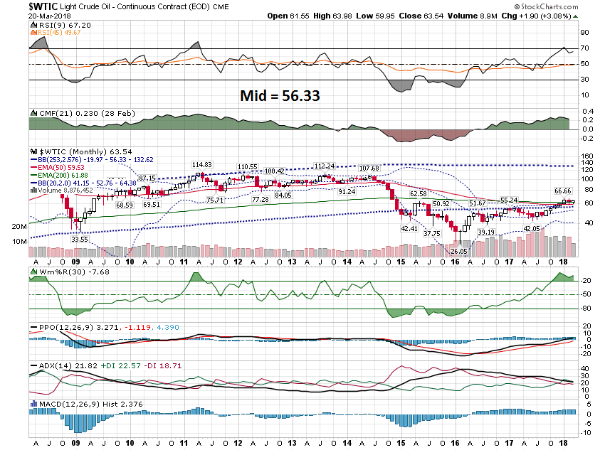

Slide 12
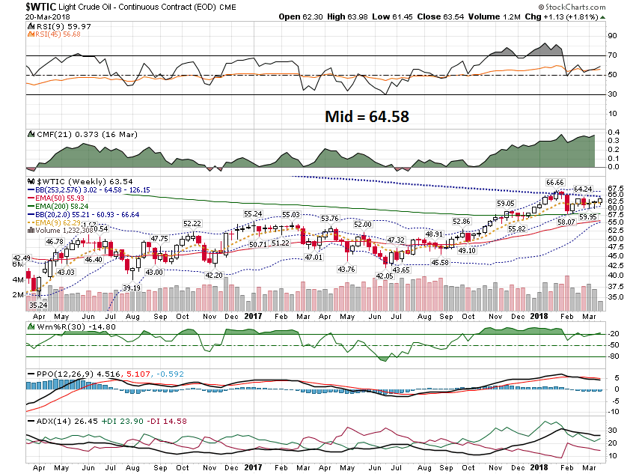

Slide 13
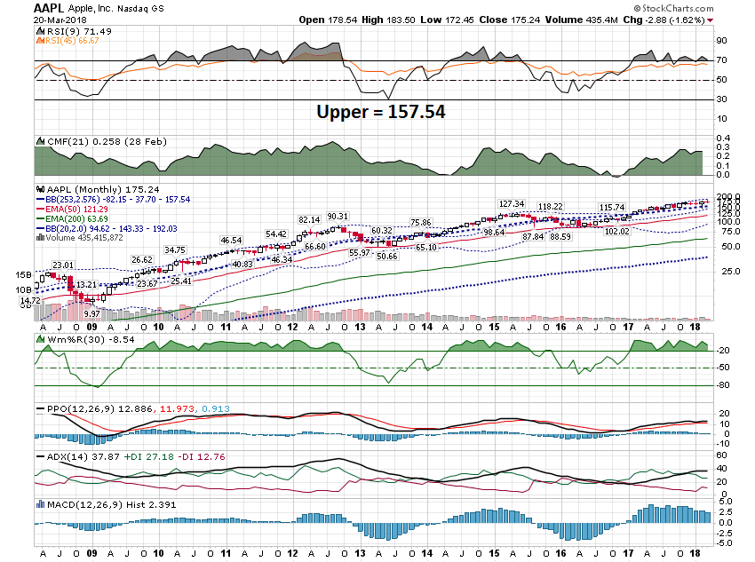

Slide 14
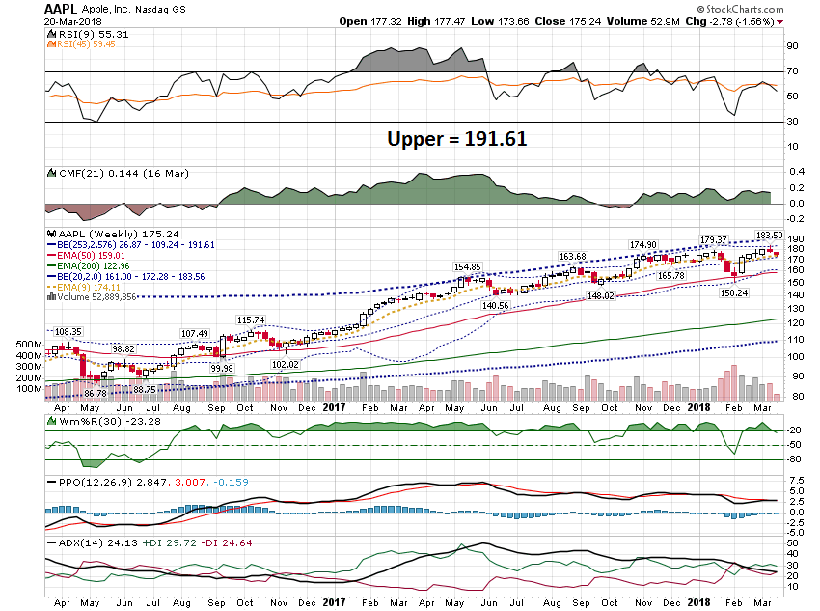

Slide 15
Short Term

Slide 16
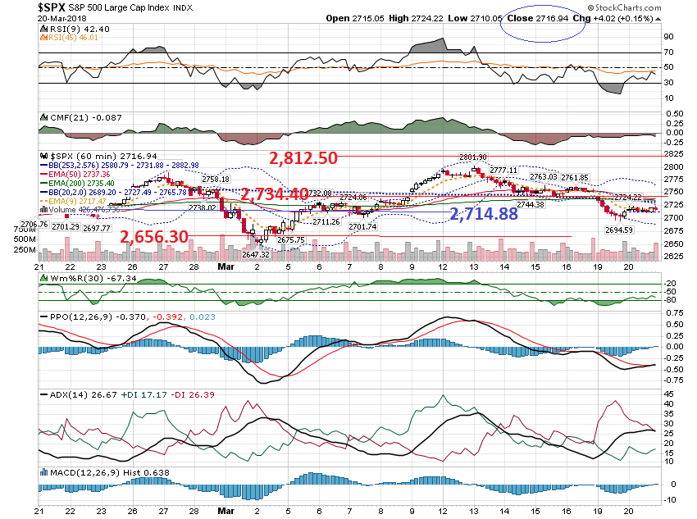

Slide 17
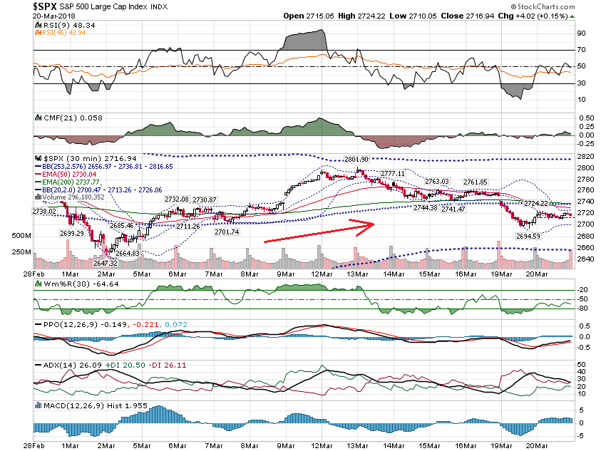

Slide 18
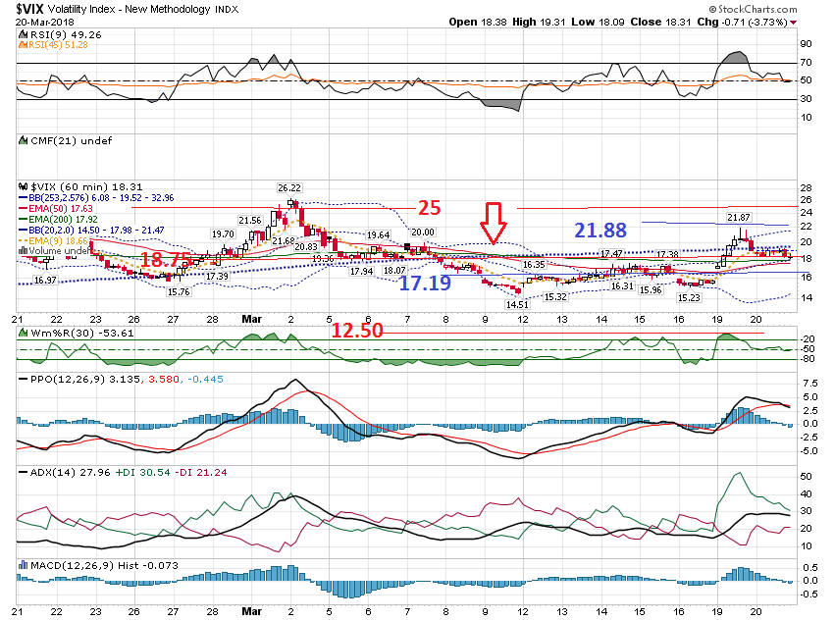

Slide 19
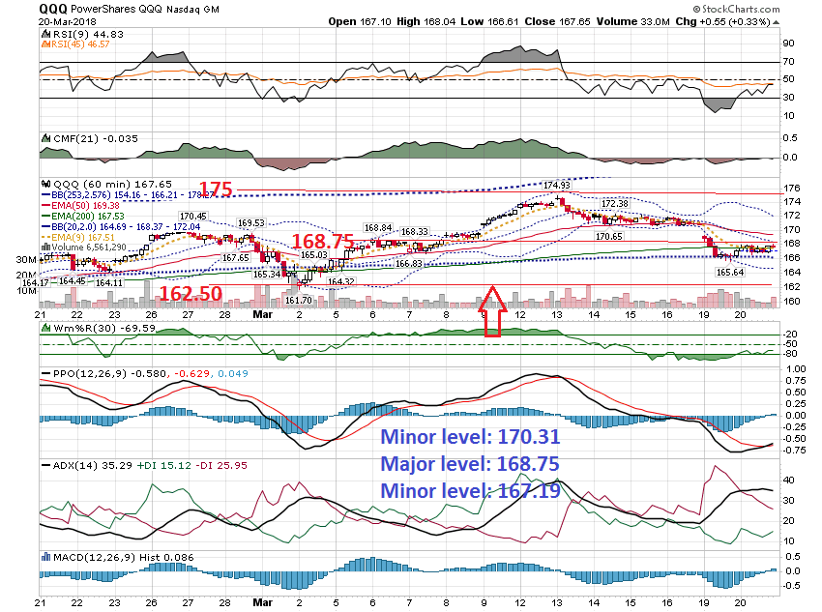

Slide 20
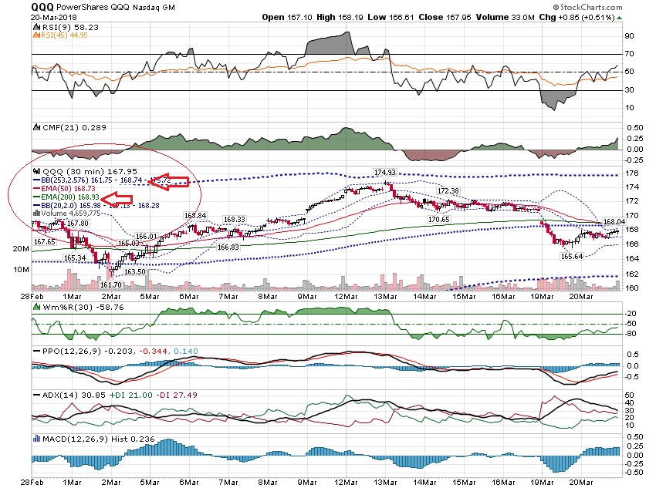

Slide 21
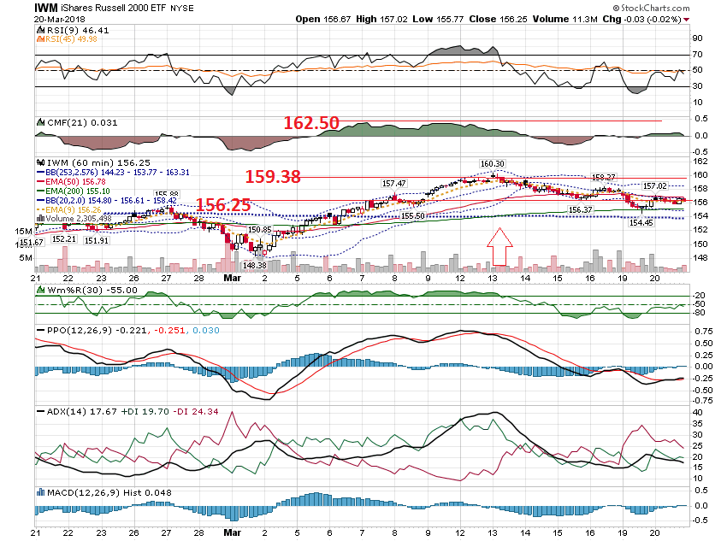

Slide 22
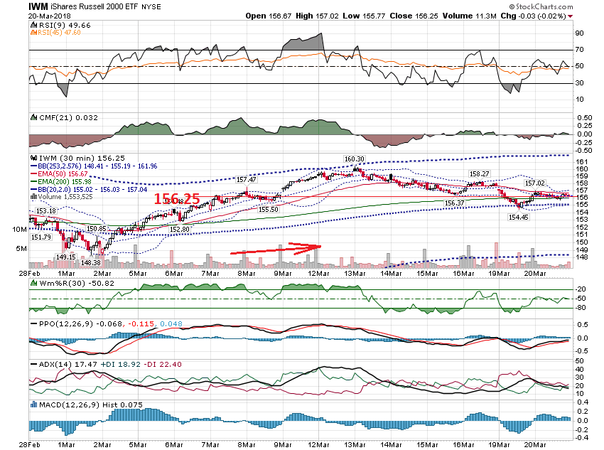

Slide 23
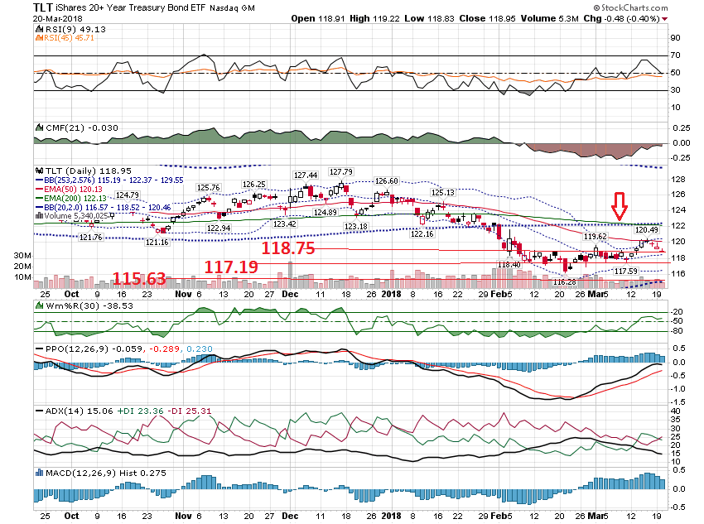

Slide 24
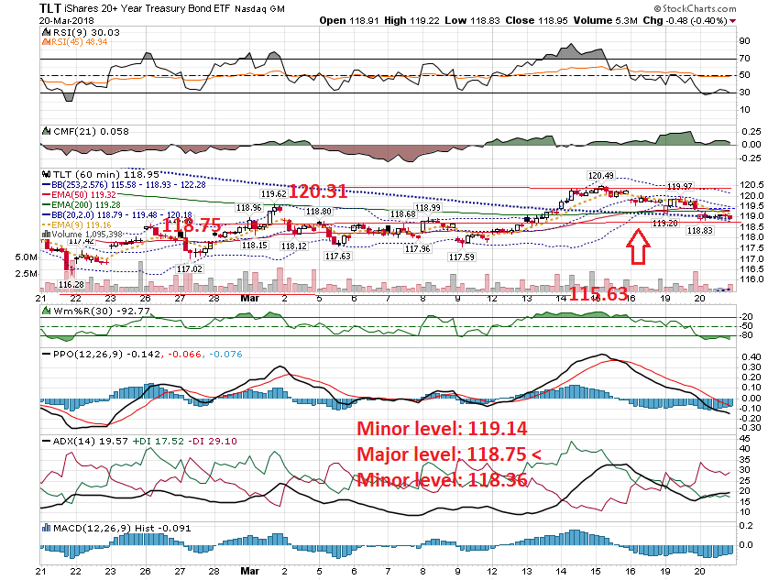

Slide 25
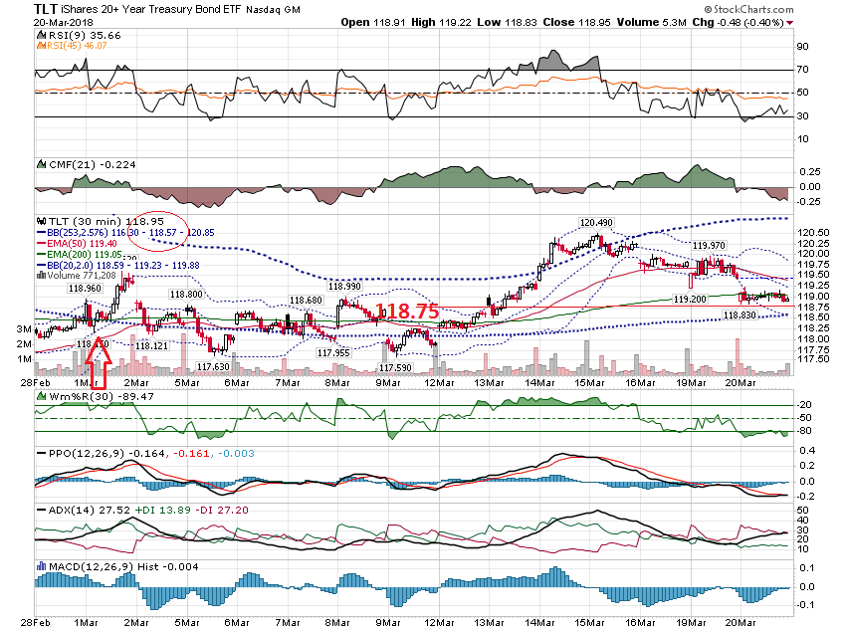

Slide 26
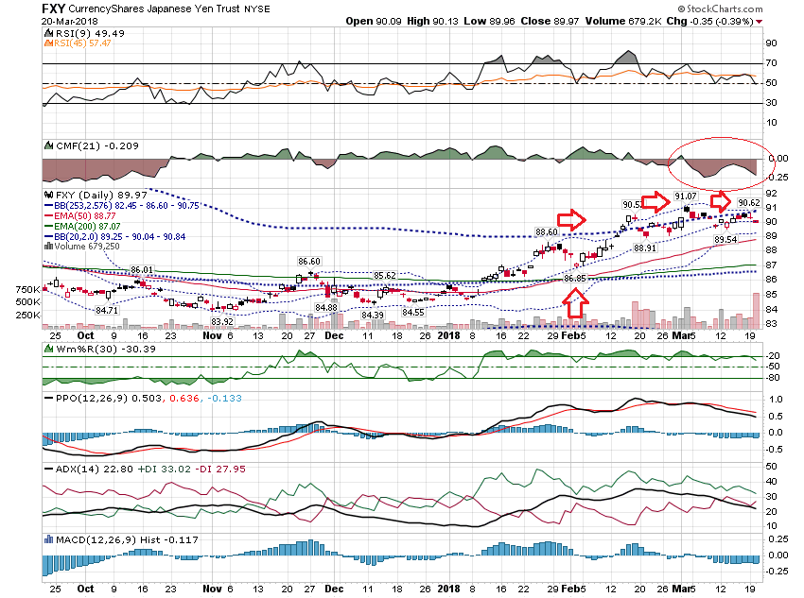

Slide 27
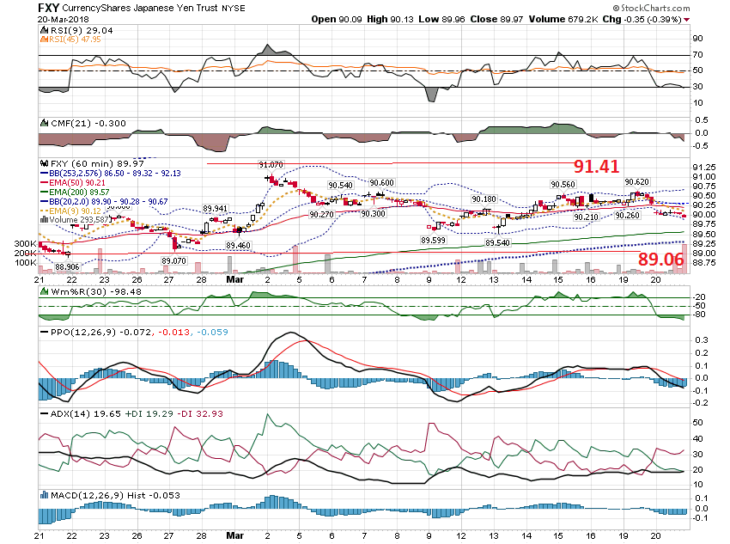

Slide 28
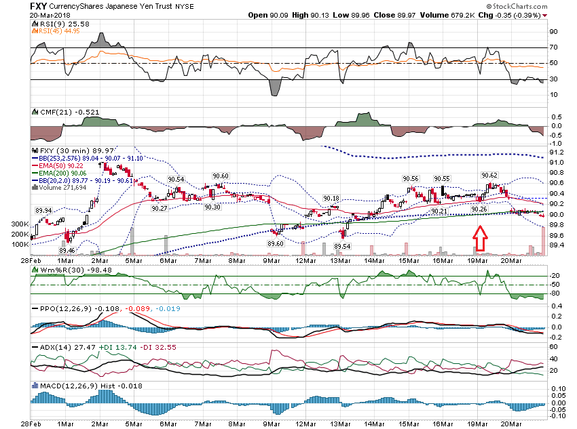

Slide 29
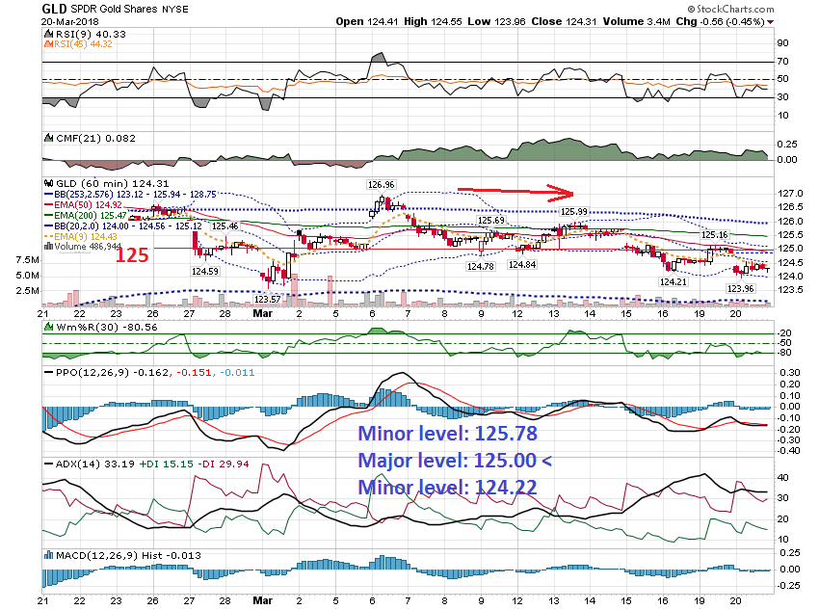

Slide 30
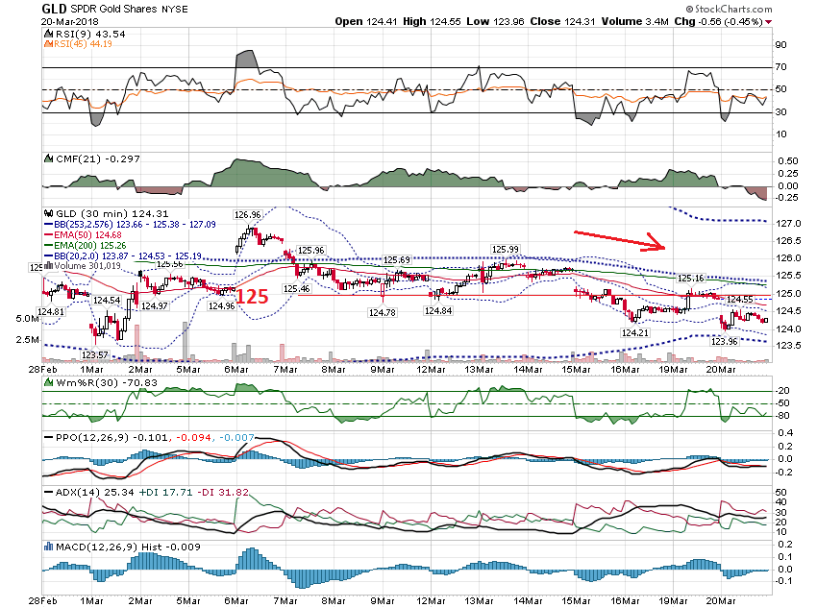

Slide 31
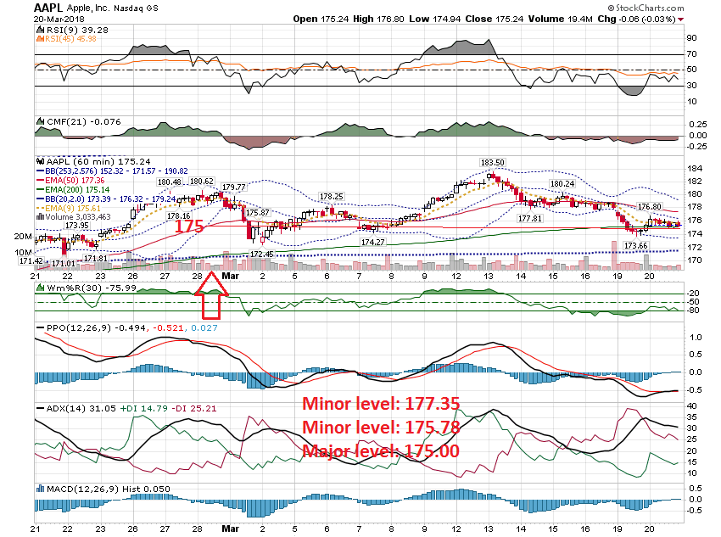

Slide 32
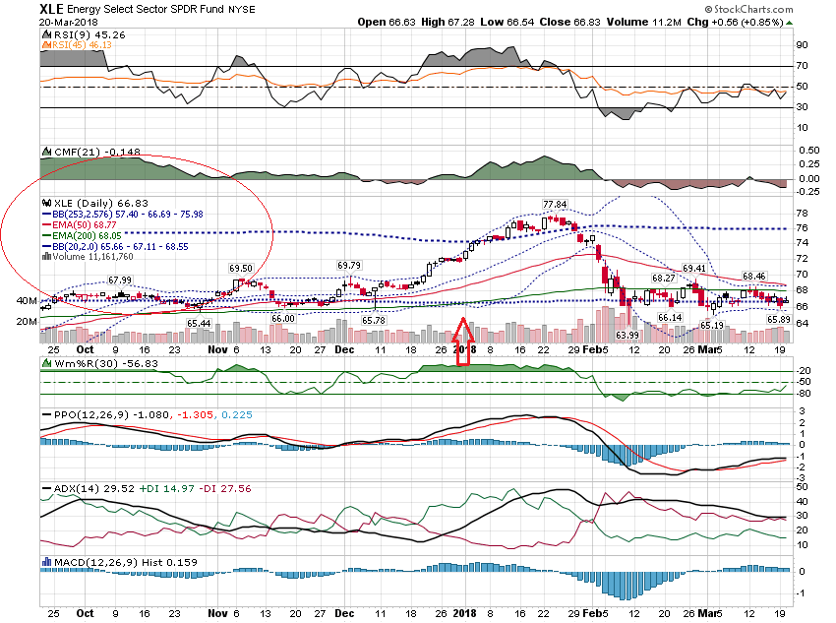

Slide 33
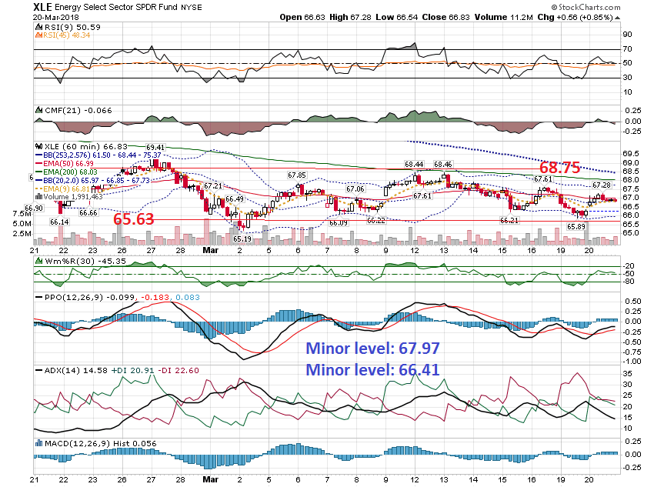

Slide 34
Crash Pattern

Slide 35
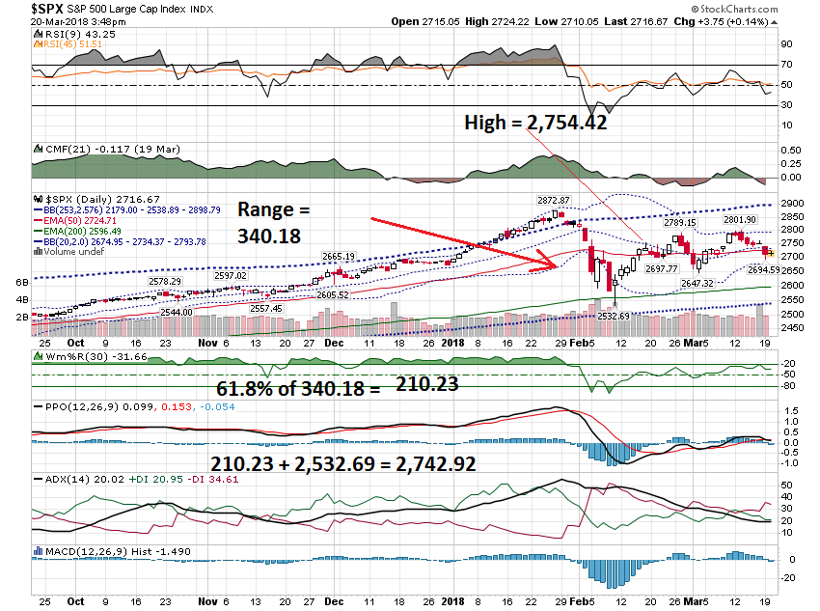

Slide 36
Hi Bill, I have attached a daily chart for KMB. The swing range has narrowed since Feb, so I am pondering starting a covered call, (cash account) and/or sell 108 call to create 105-108 call spread (margin account). This was the first trade from your bottoming scan back in October. I took profit on the first trade at the half gap of the October down-gap…. Was excited just to make a profit. Next entry was on the oversold in early January then sold at the overbought just before the late Jan dip, not quite a double. Have bought again on oversold on Feb 6 and Mar 3. CMF has tipped positive in 12 Mar, 10 min chart is uptrend from 7 Mar. The 60 min chart is overbought on 9/12 mar. Daily 200 and 253 still heading down. I am not feeling anxious... just pondering the options and would value your comment

Slide 37
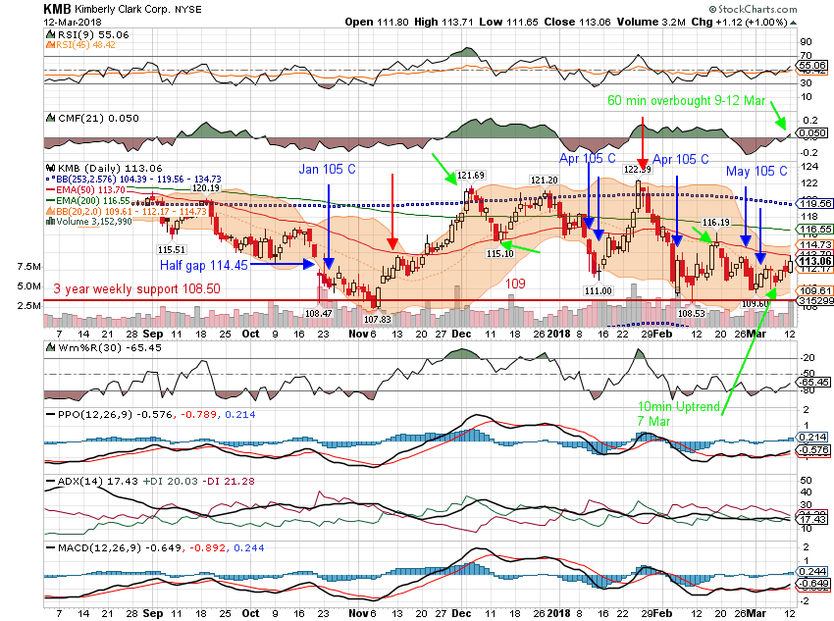

Slide 38
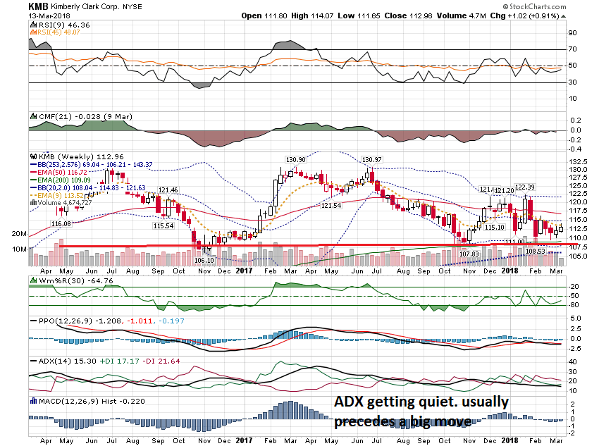

Slide 39
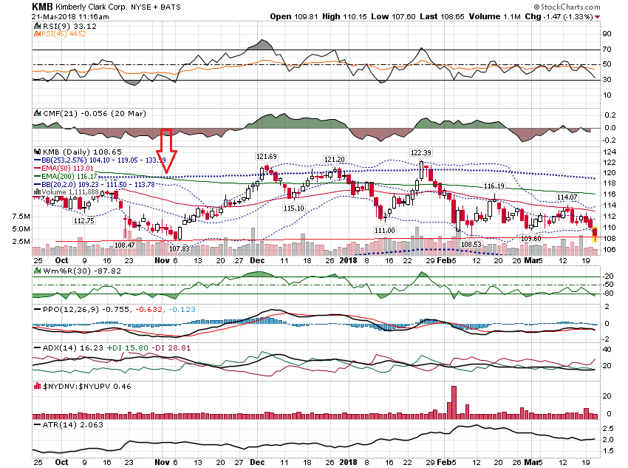

Slide 40
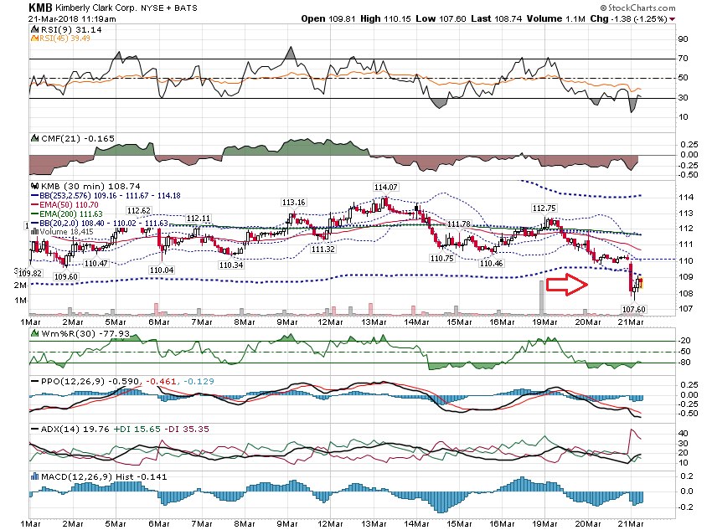

Slide 41
Thanks for watching! Bill Davis Mad Day Trader March 21, 2018 davismdt@gmail.com

