Slide 1

The Mad Hedge Fund Trader
“Tech Melt Up”
With John Thomas
from Silicon Valley, CA, March 14, 2018
www.madhedgefundtrader.com
Notes:
*

Slide 2

Co-Host Anka Metcalf www.TradeOutLoud.com
*Independent trader since 2003
*Investment banker in Europe for 10 years
*Trades stocks, ETF’s, and futures
*Is technical analysis and momentum
driven
*Uses own proprietary indicators
*Educates individuals on how to
become active day traders

Slide 3


Slide 4

Trade Alert Performance
New All Time High!!
*January 4.09% Final *July +1.95% Final
*February +1.54% Final *August +18.38% Final
*March +4.87% MTD *September +7.65% Final
*April +1.84% Final *October +1.39% Final
*May -0.45% Final *November +2.08% Final
*June +0.70% Final *December +3.76% Final
*2018 Year to Date 10.37%
compared to 2.2% for the Dow Average
*Trailing One year return +51.94%, +286.24% since inception,
*Average annualized return of 34.34%

Slide 5
Portfolio Review
20%/20% Balanced Long/Short Portfolio
with long technology weighting
Current Capital at Risk
Risk On
World is Getting Better
(AAPL) 6/$130-$140 call spread | 10.00%
(AAPL) 4/$155-$165 calls spread | 10.00%
(FB) 3/$155-$165 call spread | 10.00%
Risk Off
(FXE) 3/$120-$123 put apread | -10.00%
(FB) 3/190-$195 puts spread | -10.00%
Total Net Position | 10.00%

Slide 6
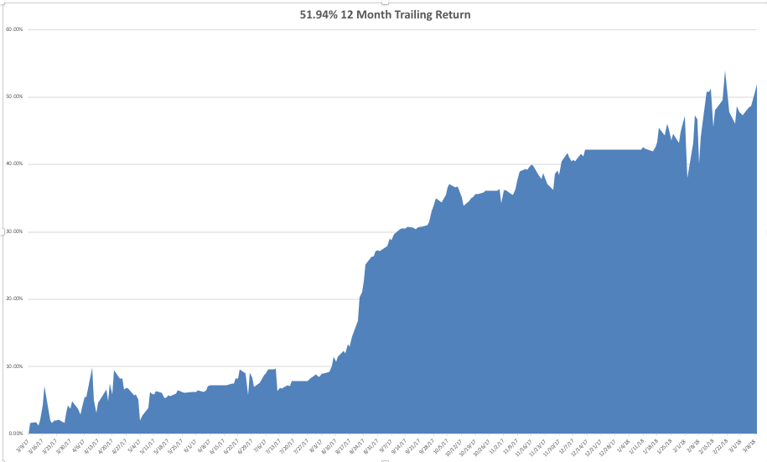
GTD Daily Audited Performance

Slide 7
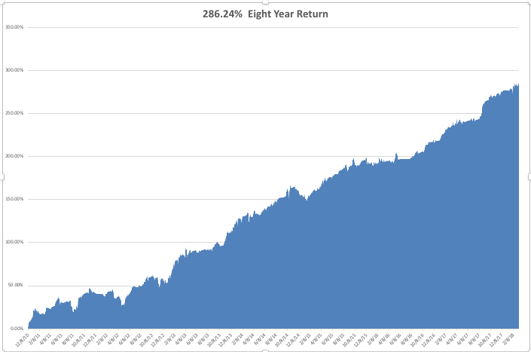
GTD Eight Year Daily Audited Performance
34.34% Average Annualized Return

Slide 8
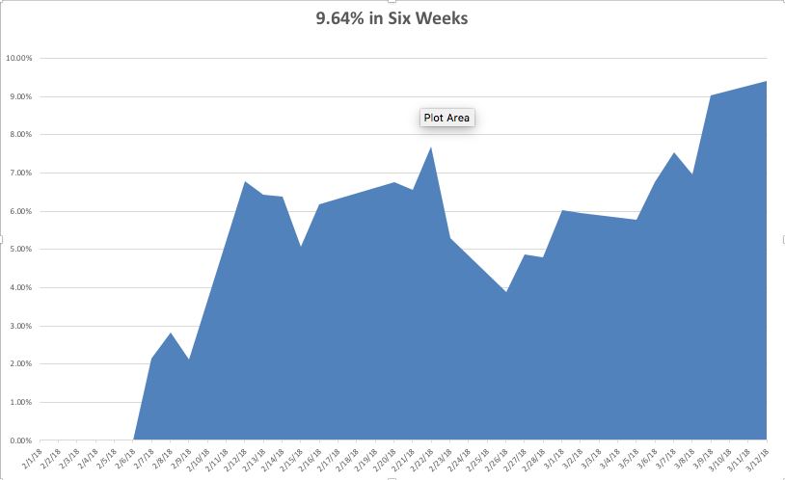
Mad Hedge Technology Letter Performance

Slide 9

The Method to My Madness
*Dumped all other positions to focus on technology equities only, was rewarded in spades
*Entry points are getting shorter as investor narrow focus to a smaller group of winning stocks
*We are now close to the same overbought condition we saw in January in tech
*Sell every bond rally….The Fed is now engaged
in major Quantitative Tightening (QT?)
in the face of exploding deficits
*Stand aside on oil, gold, foreign
currencies

Slide 10
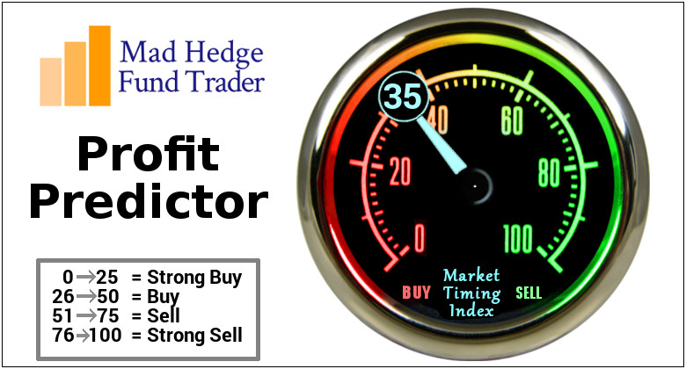
The Mad Hedge Profit Predictor
Market Timing Index
An artificial intelligence driven algorithm that analyzes 30 different economic, technical, and momentum driven indicators

Slide 11
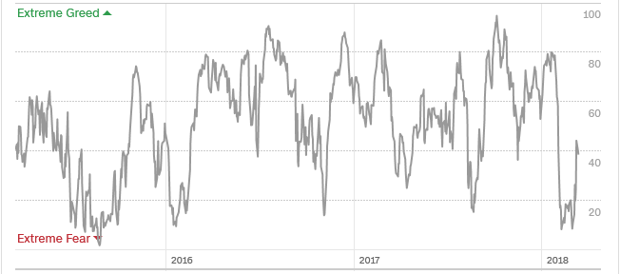
The Mad Hedge Profit Predictor
Bounce Back to Neutral

Slide 12

The Global Economy - Hotter than Hot
*February Nonfarm Payroll Report delivers a blockbuster 313,000, 100,000 more than expected with essentially zero wage growth, construction is off the charts
*Headline Unemployment Rate flat lines at a ten year low at 4.1%, U-6 at 8.2%, February CPI up 0.2%, annual rate at a low 2.2% Inflation Rate
*Second read on Q4 US GDP comes in at a lukewarm 2.5%, Fed governor Powell says “We are at or beyond full employment”
*Steel tariffs promise real damage for the
US economy, taking 0.5% off US GDP growth
PER YEAR, will bring forward a recession
and bear market, ags and aircraft now
at high risk for retaliation
*It’s back to happy days as recession
fears fade for another year

Slide 13
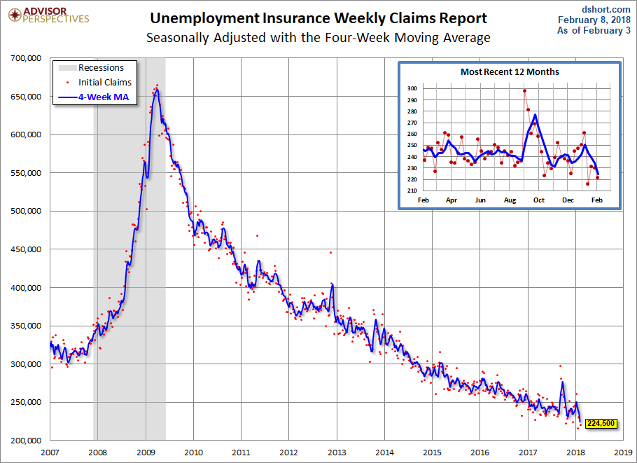
Weekly Jobless Claims –The Most Important Statistic
-7,000 to 222,000 at 49 Year Low!

Slide 14

Stocks-Narrowing Focus
*Market has shrunk to one sector only, with money pouring into tech and ignoring all else, red hot Feb Nonfarm Payroll report really through the fat on the fire
*Companies with the largest buybacks seeing the biggest gains
*Tech stocks are the new safe plays in a jittery market just coming out of a 13% correction, is also still one of the cheapest sectors
Only two more months of seasonal tailwind to go until we “Sell in May and Go away”
*Tech is draining liquidity out of all other asset classes,
including gold, oil, foreign currencies, and even
crypto currencies
*Volatility has not gone away, it’s just resting

Slide 15
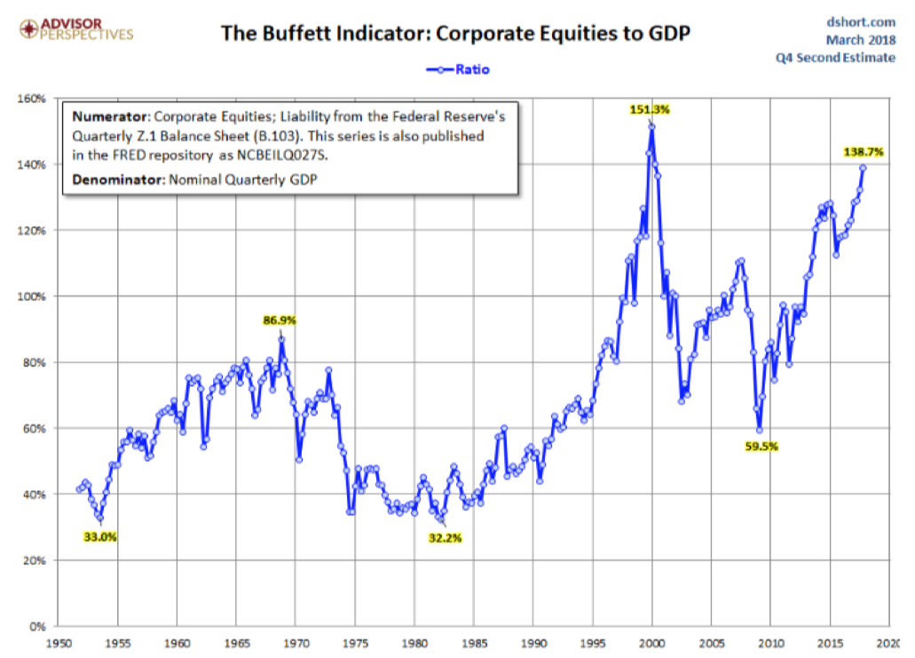

Slide 16
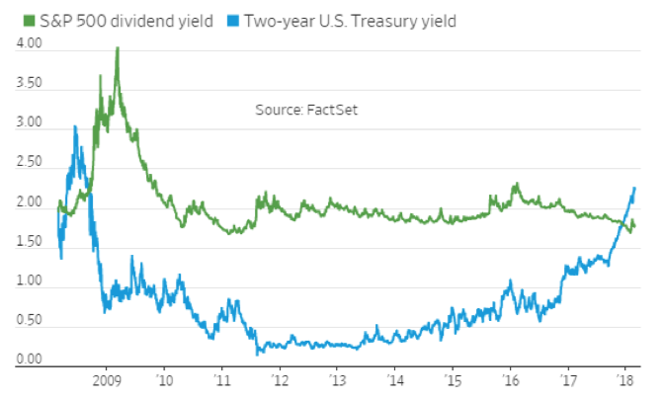
Here is the Real Problem!

Slide 17
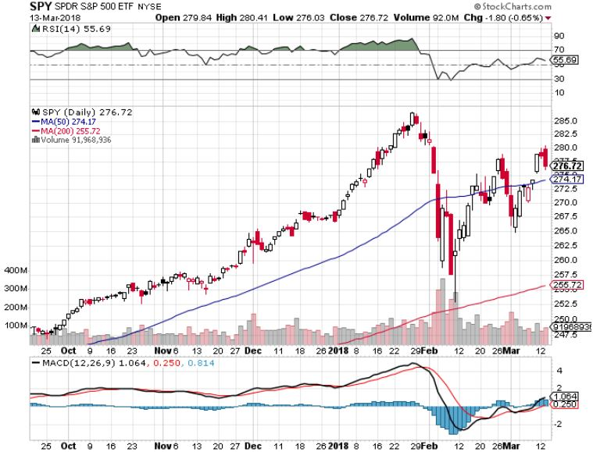
S&P 500-New Highs stopped out of Long 3/$275-$280 bear put spread

Slide 18
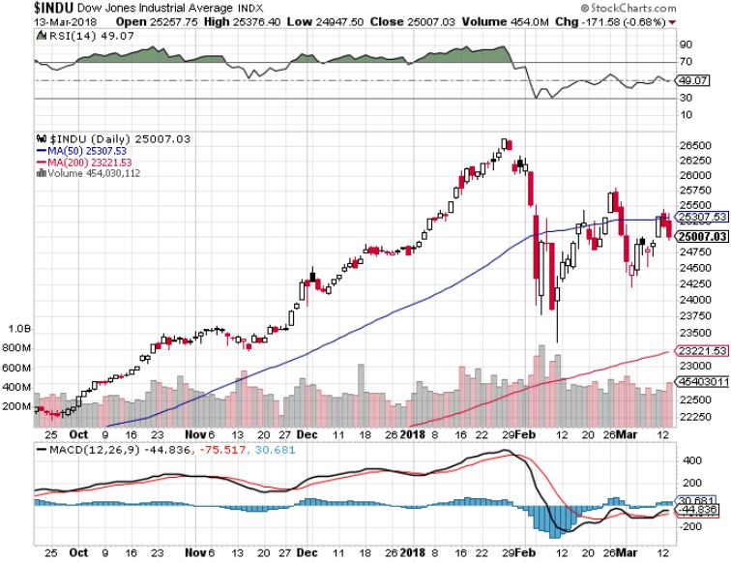
Dow Average-13.33% Correction

Slide 19
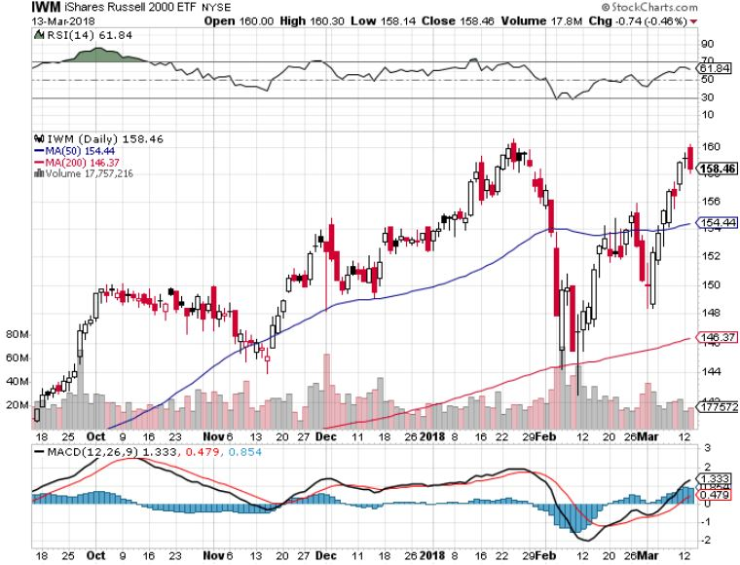
Russell 2000 (IWM)-Peaked Out stopped out of long the (IWM) 12/$152-$155 bear put spread

Slide 20
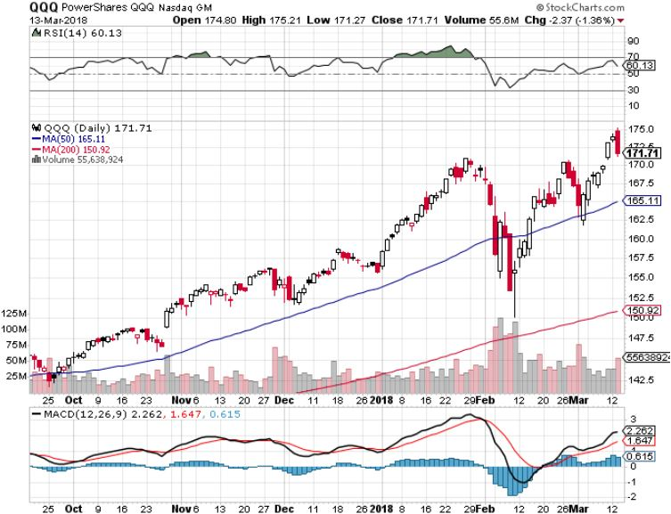
NASDAQ (QQQ)-Crushed

Slide 21
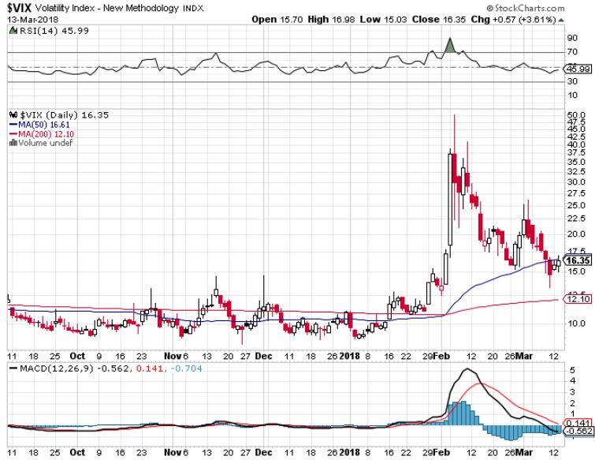
(VIX)-Crash!

Slide 22
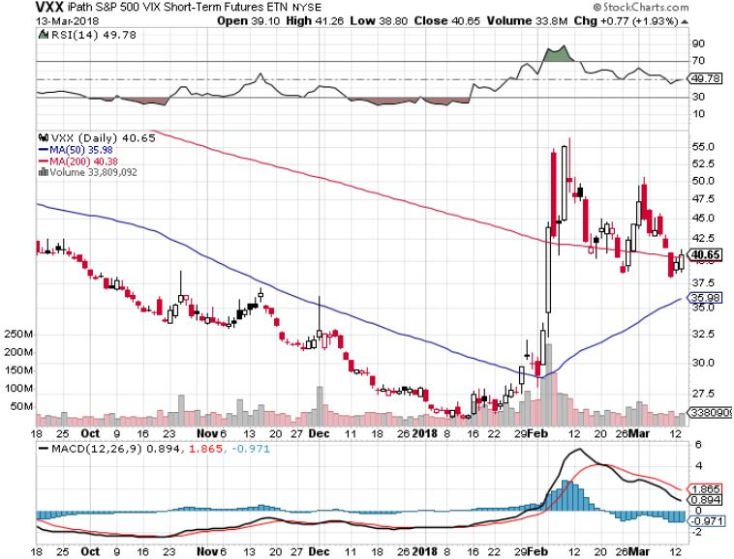
iPath S&P 500 VIX Short-Term Futures ETN (VXX) long 3/$55-$60 bear put spread-puts staying at artificially high levels took profits on $45-$60 put spread took profits on long 11/$20 calls

Slide 23
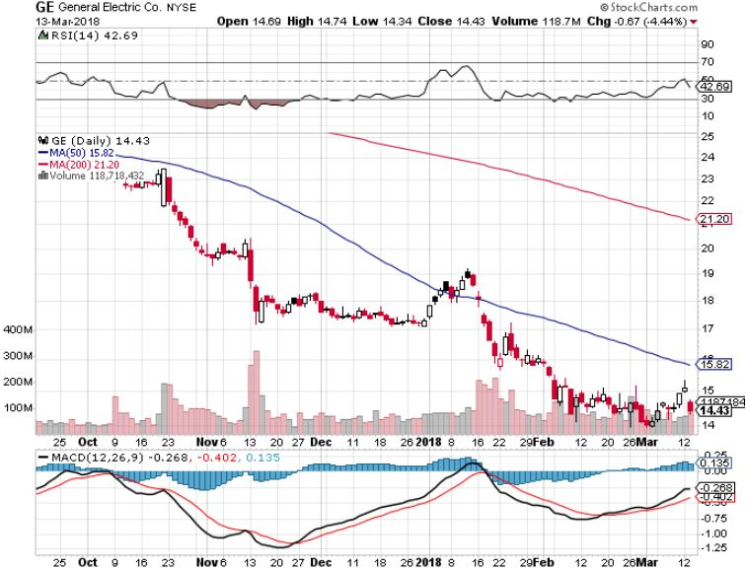
General Electric (GE)-No Recovery
Breakup Value is $15

Slide 24
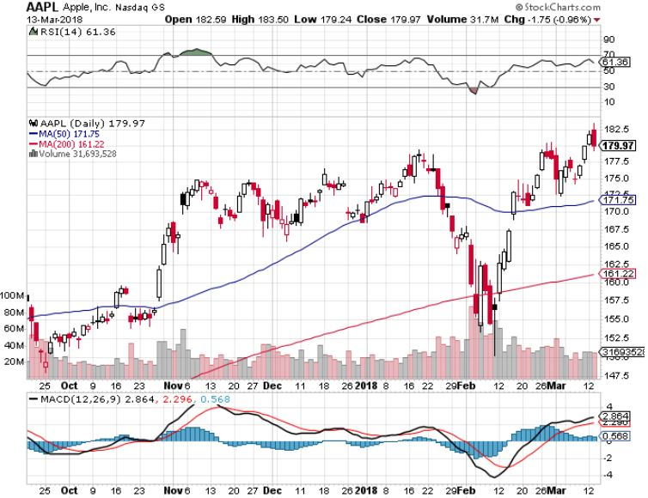
Apple (AAPL)-Waiting for Buy Backs took profits on long 3/$140-$145 calls stopped out of long 3/$170-$175 put spread long 4/$155-$165 calls spread long 6/$130-$140 calls spread

Slide 25
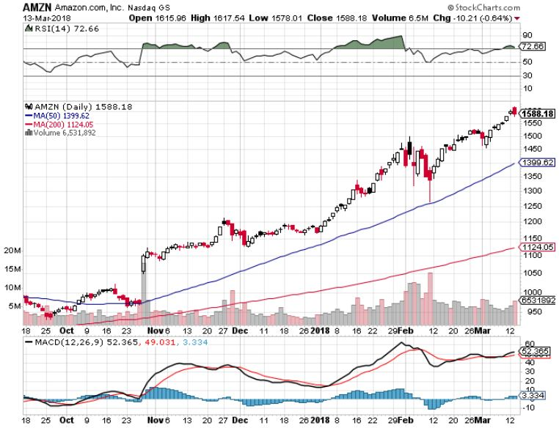
Amazon (AMZN) took profits on long 3/$1200-$1250 call spread (Tech Letter)

Slide 26
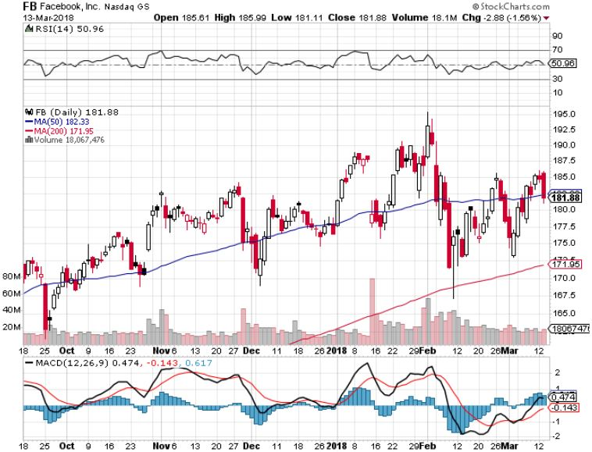
Facebook (FB)- long 3/$155-$165 bull call spread – expires in 2 days long 3/$190-$195 bear put spread - expires in 2 days

Slide 27
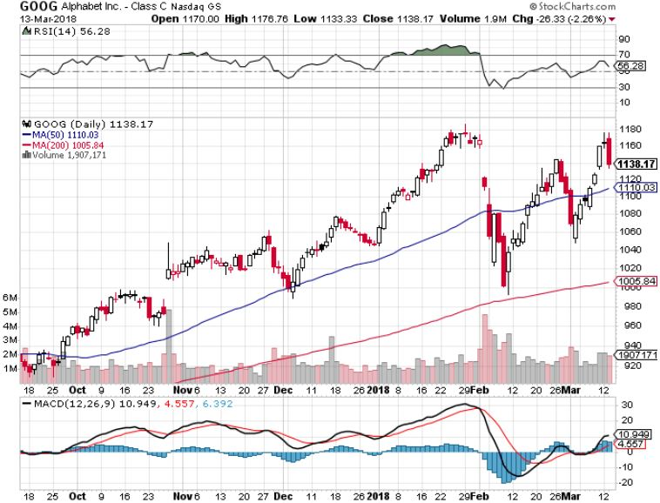
Alphabet (GOOG)-New High

Slide 28
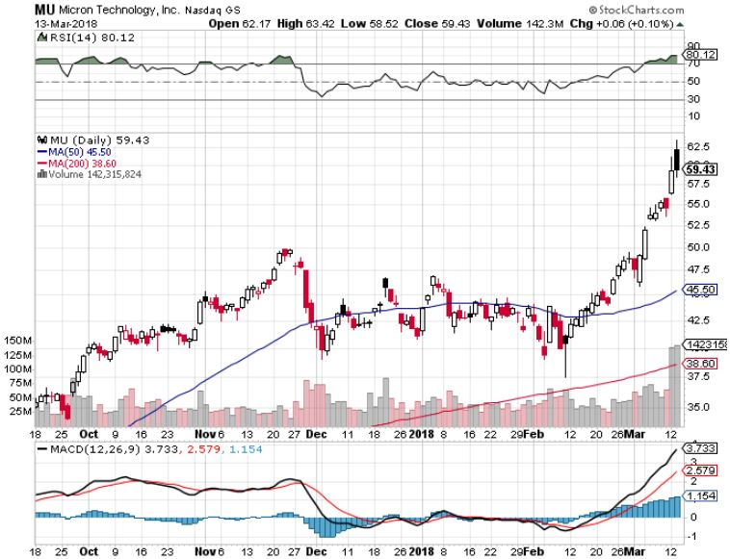
Micron Technology (MU)-The New NVIDIA took profits on long 3/$34-$37 bull call spread in Mad Hedge Technology Letter Only
54% gain since initial recommendation a month ago by tech letter

Slide 29
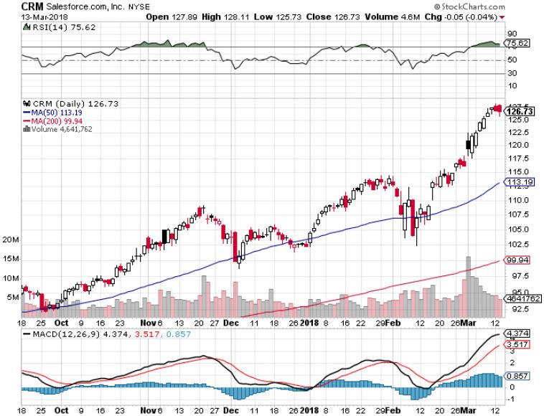
Salesforce (CRM)- took profits on long 3/$90-$95 bull call spread in Mad Hedge Technology Letter
26% gain since recommended a month ago by Tech Letter

Slide 30
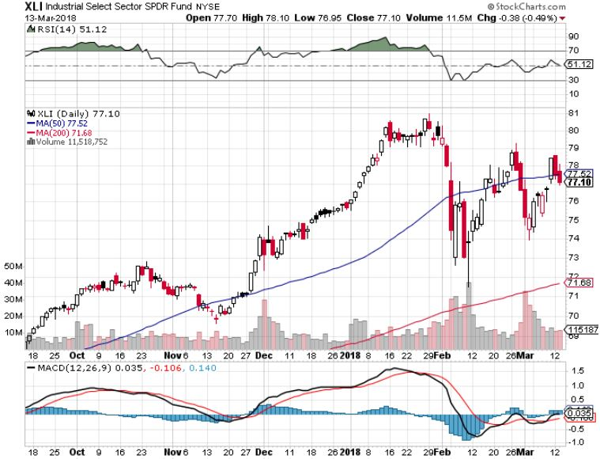
Industrials Sector SPDR (XLI)-
(GE), (MMM), (UNP), (UTX), (BA), (HON)

Slide 31
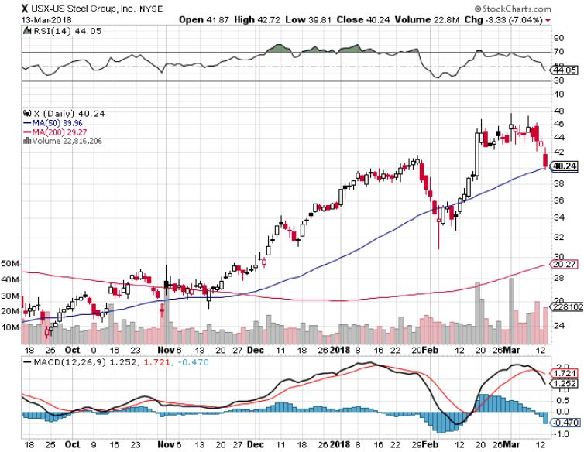
US Steel (X)- took profits on long the 9/$21-$22 vertical bull call spread

Slide 32
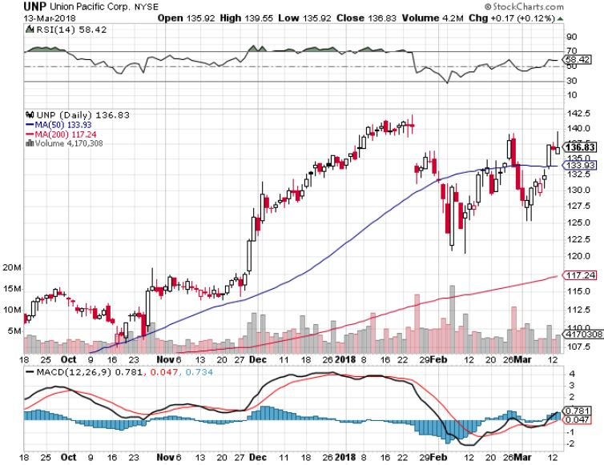
Union Pacific Railroad (UNP)- took profits on long the 9/$100-$102 vertical bull call spread

Slide 33
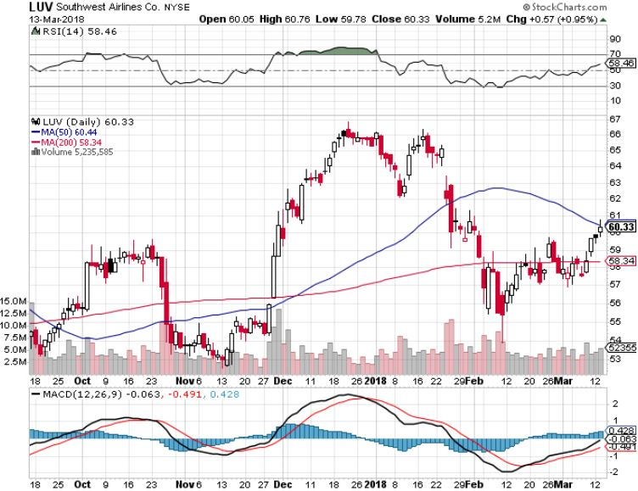
Southwest Airlines (LUV)-
Warren Buffett’s Favorite Airline

Slide 34
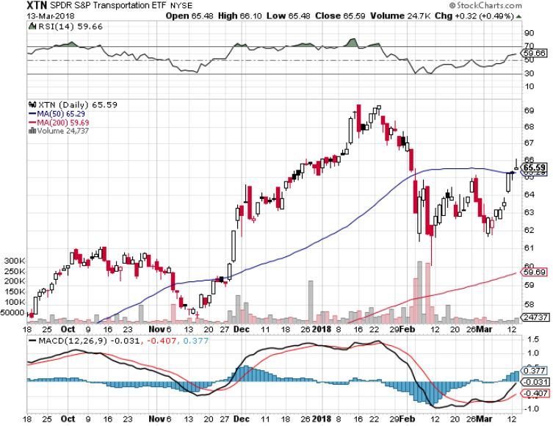
Transports Sector SPDR (XTN)-
(ALGT), (ALK), (JBLU), (LUV), (CHRW), (DAL)

Slide 35
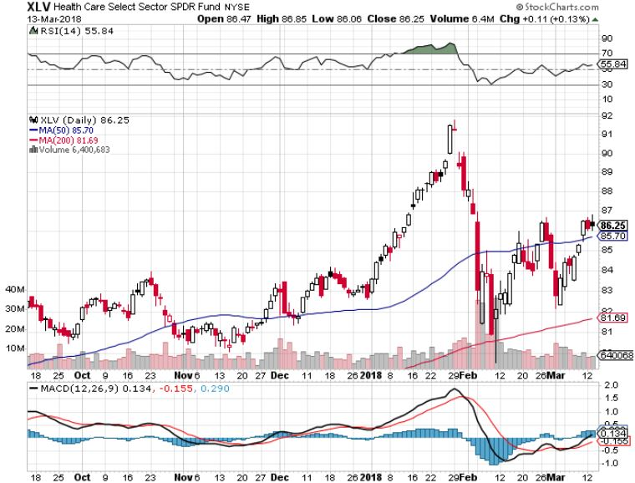
Health Care Sector (XLV), (RXL)-The New FANG?
(JNJ), (PFE), (MRK), (GILD), (ACT), (AMGN)

Slide 36
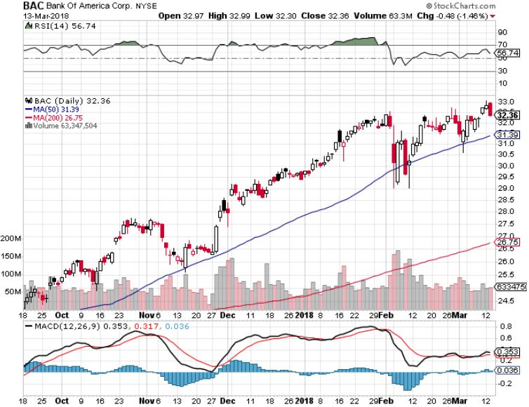
Bank of America (BAC)-New Highs
(BLK/B), (WFC), (JPM), (BAC), (C), (GS) took profits on long 12/$25.50-$27 bull call spread-expires in 7 trading days

Slide 37
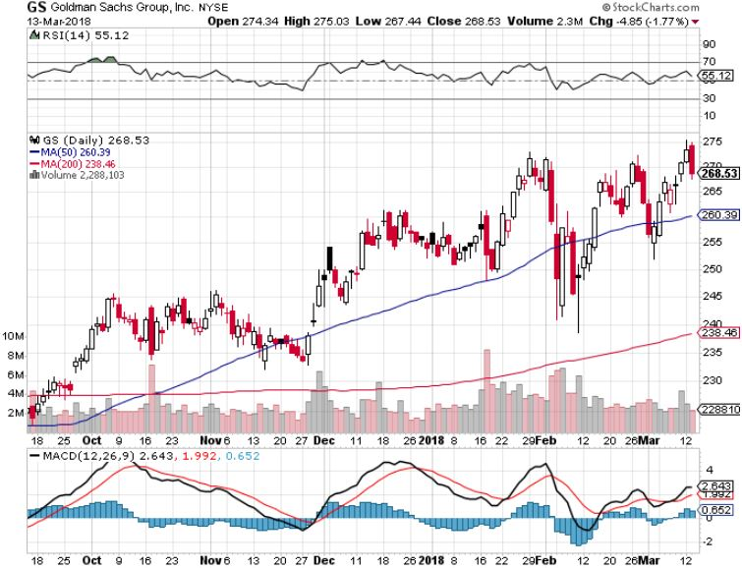
Goldman Sachs (GS)-Earnings Disappointment on bond losses stopped out of long 10/$220-$225 vertical bull call spread took profits on long 10/$227.50-$232.50 vertical bull call spread

Slide 38
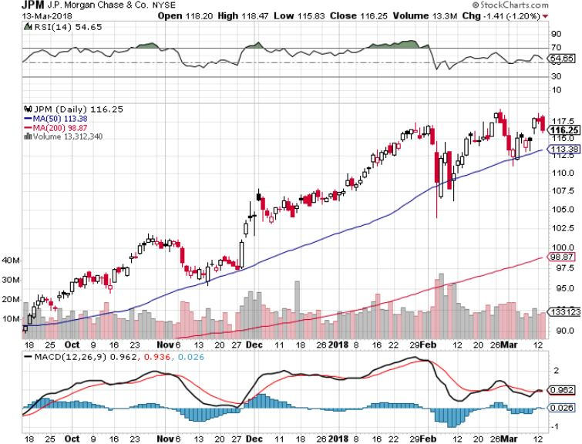
JP Morgan (JPM)- stopped out of long 2/$53-$55 call spread

Slide 39
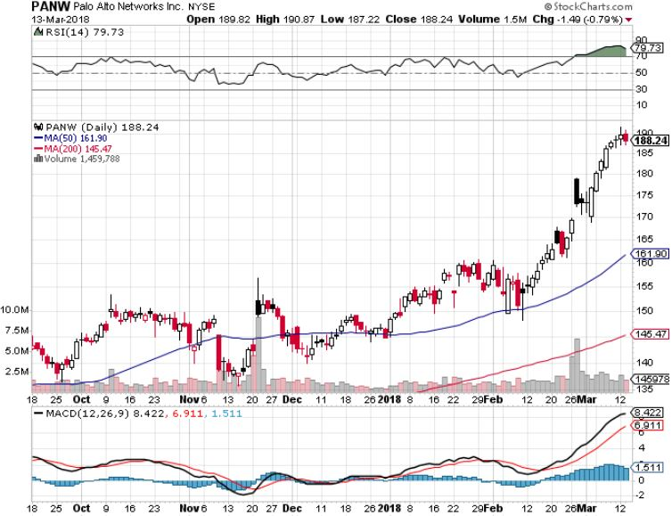
Palo Alto Networks (PANW)-

Slide 40
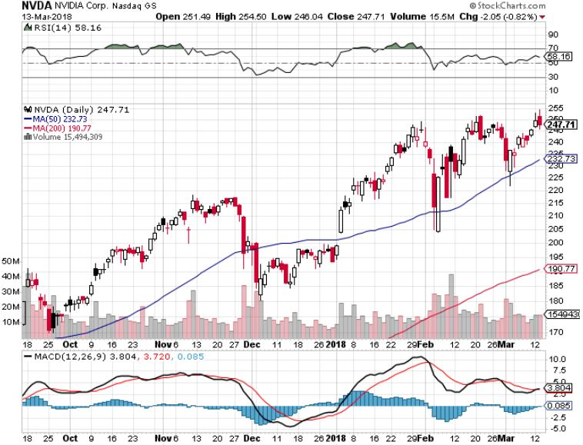
NVIDIA (NVDA)-Fabulous Earnings

Slide 41
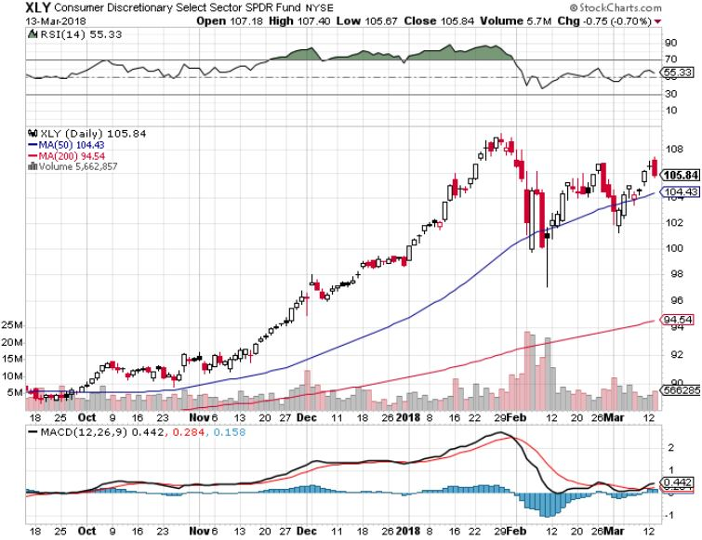
Consumer Discretionary SPDR (XLY)
(DIS), (AMZN), (HD), (CMCSA), (MCD), (SBUX)

Slide 42
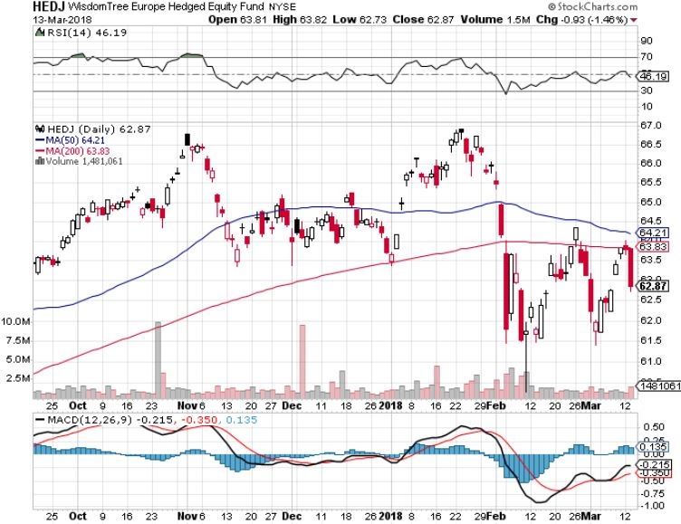
Europe Hedged Equity (HEDJ)-Global Rally

Slide 43
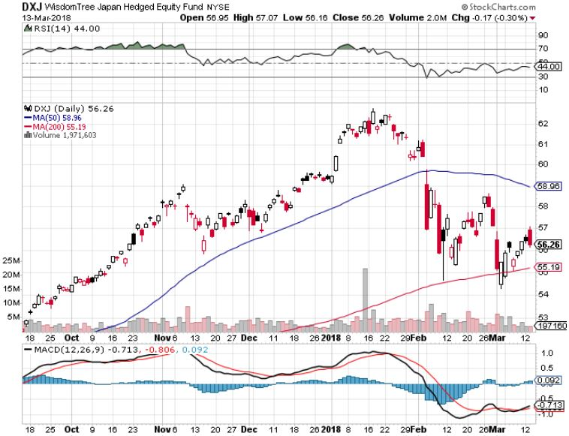
Japan (DXJ)-More Global Rally

Slide 44
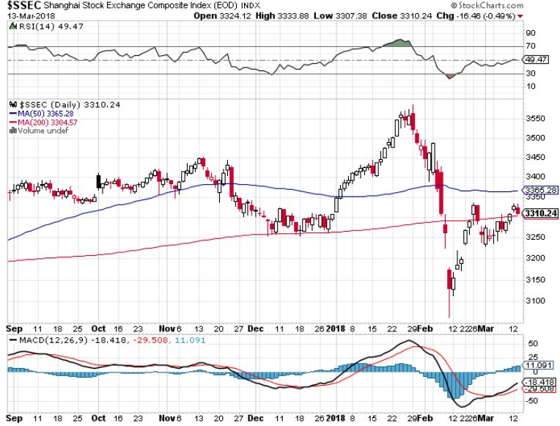
China ($SSEC)-Economic Recovery on Track

Slide 45
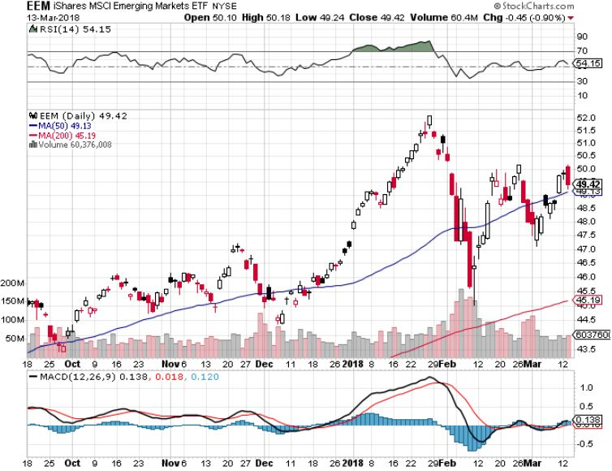
Emerging Markets (EEM)- New High

Slide 46

Bonds-Gone to Sleep
*Bond market stalls with yields at four year highs, digesting recent large falls
*February Nonfarm Payroll Report shows wage growth at near zero, meaning no inflation soon, yet bonds can only rally 10 basis points
*The easy money on the bond short has been made, I’ll cherry pick new positions from here
*Still looking for 3.25%-3.5% ten year US Treasury
yield by yearend
*Watch out for (TBT) negative cost of carry of
-6.5%/year, is only good for catching rapid price falls
*$1.2 trillion budget deficit for 2018 still provide a
terrible backdrop for bonds
*Chinese boycott of new US bond issues
makes matters worse, as does QT

Slide 47
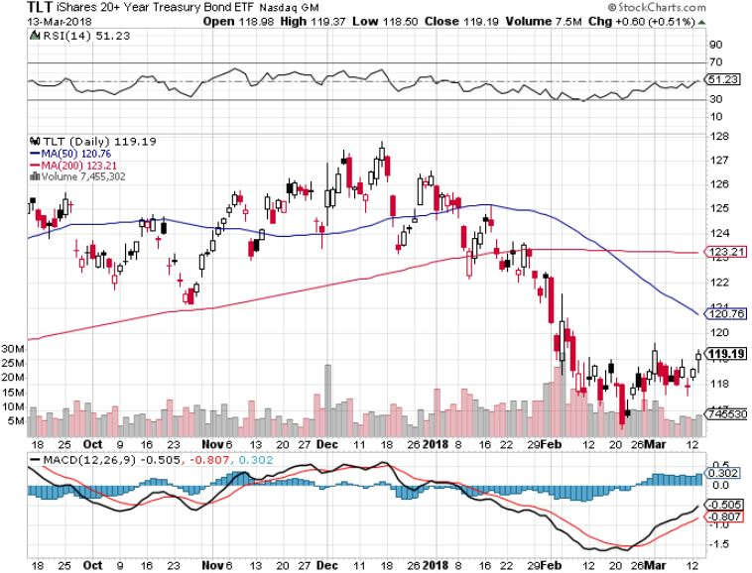
Treasury ETF (TLT) – 2.82 Topping Out
Took profits on long the (TLT) 2/$124-$127 vertical bear put spread again stopped out of long 2/$114-$117 bull call spread
Took profits on long the (TLT) 2/$124-$127 vertical bear put spread
Took profits on long the (TLT) 2/$127-$130 vertical bear put spread

Slide 48
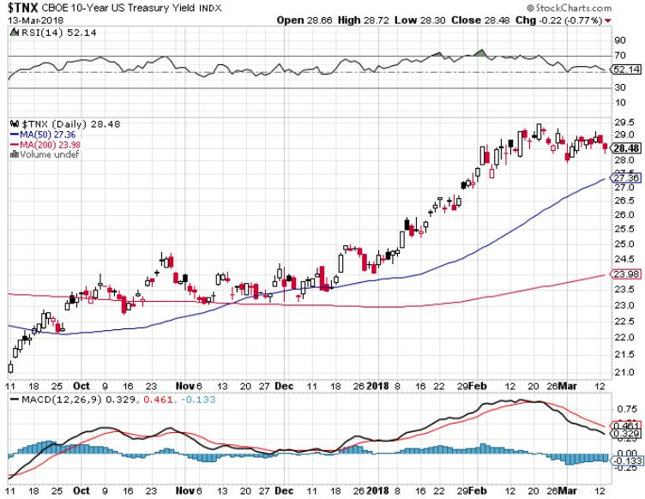
Ten Year Treasury Yield ($TNX) 2.82%
Breakdown, Now major Support

Slide 49
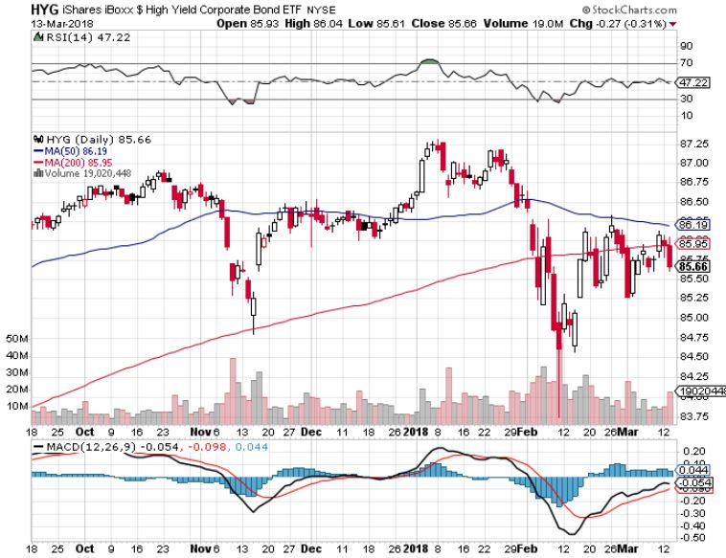
Junk Bonds (HYG) 5.39% Yield
60 basis point pop in yield on stock crash

Slide 50
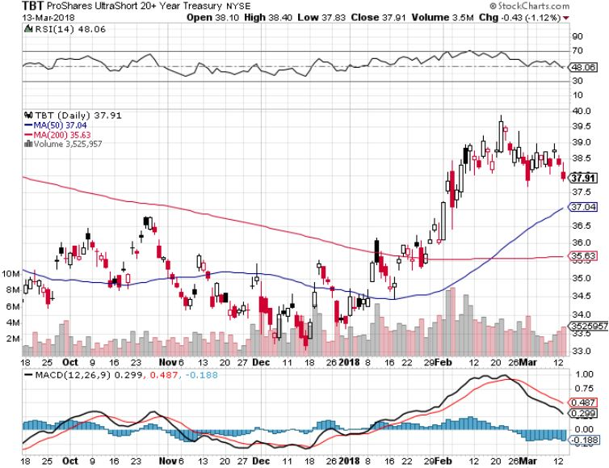
2X Short Treasuries (TBT)-Watch Out for Cost of Carry

Slide 51
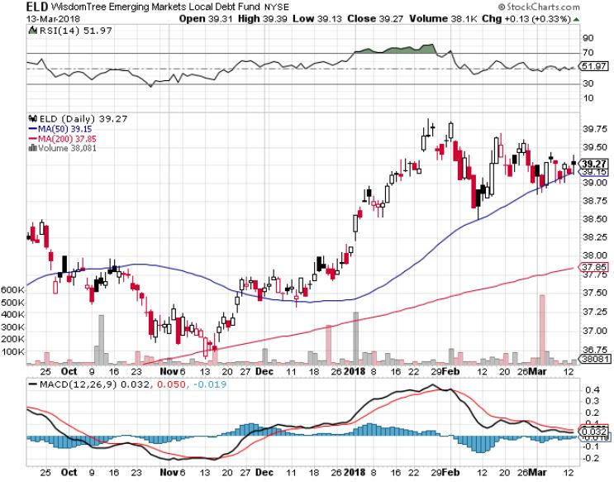
Emerging Market Debt (ELD) 5.58% Yield-

Slide 52
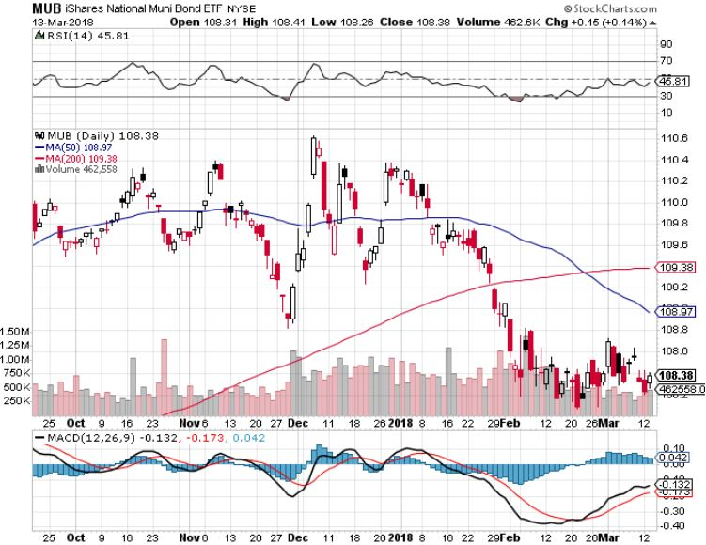
Municipal Bonds (MUB)-2.08%
Mix of AAA, AA, and A rated bonds
Huge 40 basis point yield pop on tax bill

Slide 53

Foreign Currencies- Vascillation
*ECB hints at future rate raises, but takes no immediate action, weakening the Euro (FXE)
*Bank of Japan continues QE, but with a lesser amount, supporting the yen
*Speculator Euro (FXE) position still massively long
*Market is vacillating between pro dollar rising interest rates and anti dollar exploding deficits
*Bitcoin tracks 1:1 with stocks to
the upside

Slide 54
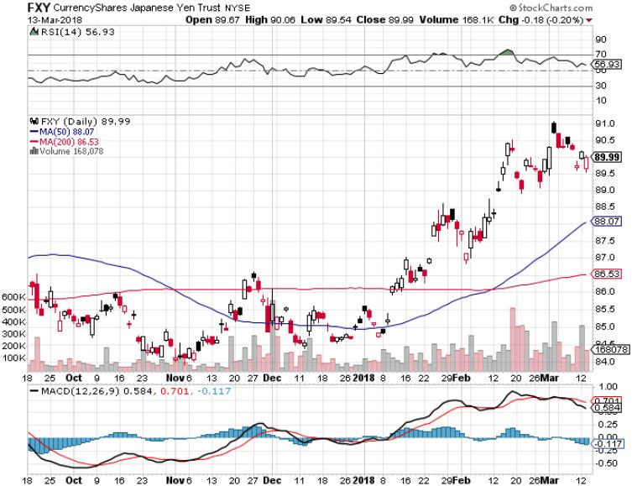
Japanese Yen (FXY), (YCS) stopped out of long (FXY) 3/$91-$93 bear put spread at cost

Slide 55
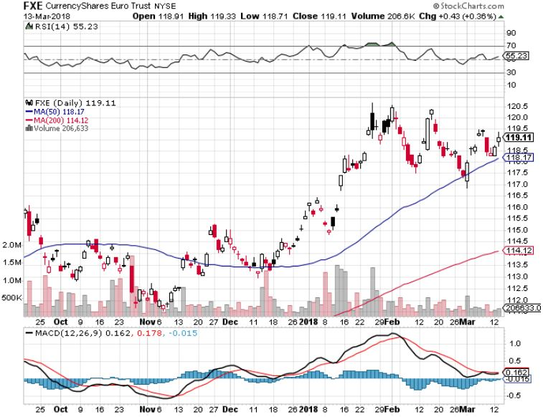
Euro ($XEU), (FXE), (EUO)- Breakout! long (FXE) 3/$120-$123 vertical bear put spread – 2 days to expiration took profits on long (FXE) 12/$116-$118 vertical bear put spread took profits on long (FXE) 12/$111-$113 vertical bull call spread

Slide 56
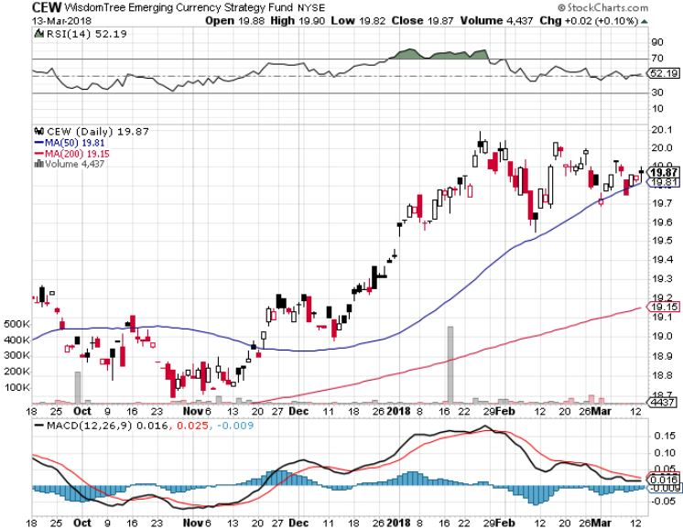
Emerging Market Currencies (CEW)

Slide 57
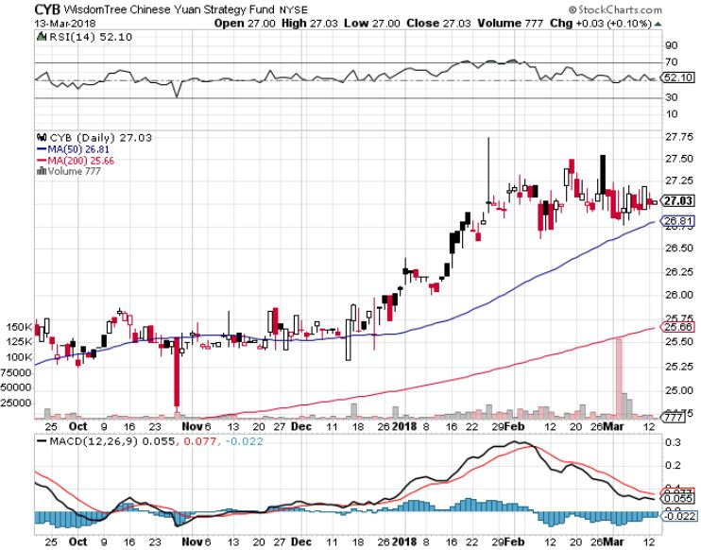
Chinese Yuan- (CYB)-Stabilizing on Government Support

Slide 58
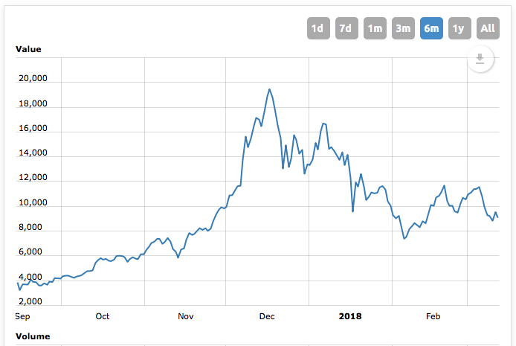
Bitcoin-Modern Day Tulips!
Now banned in China and South Korea

Slide 59
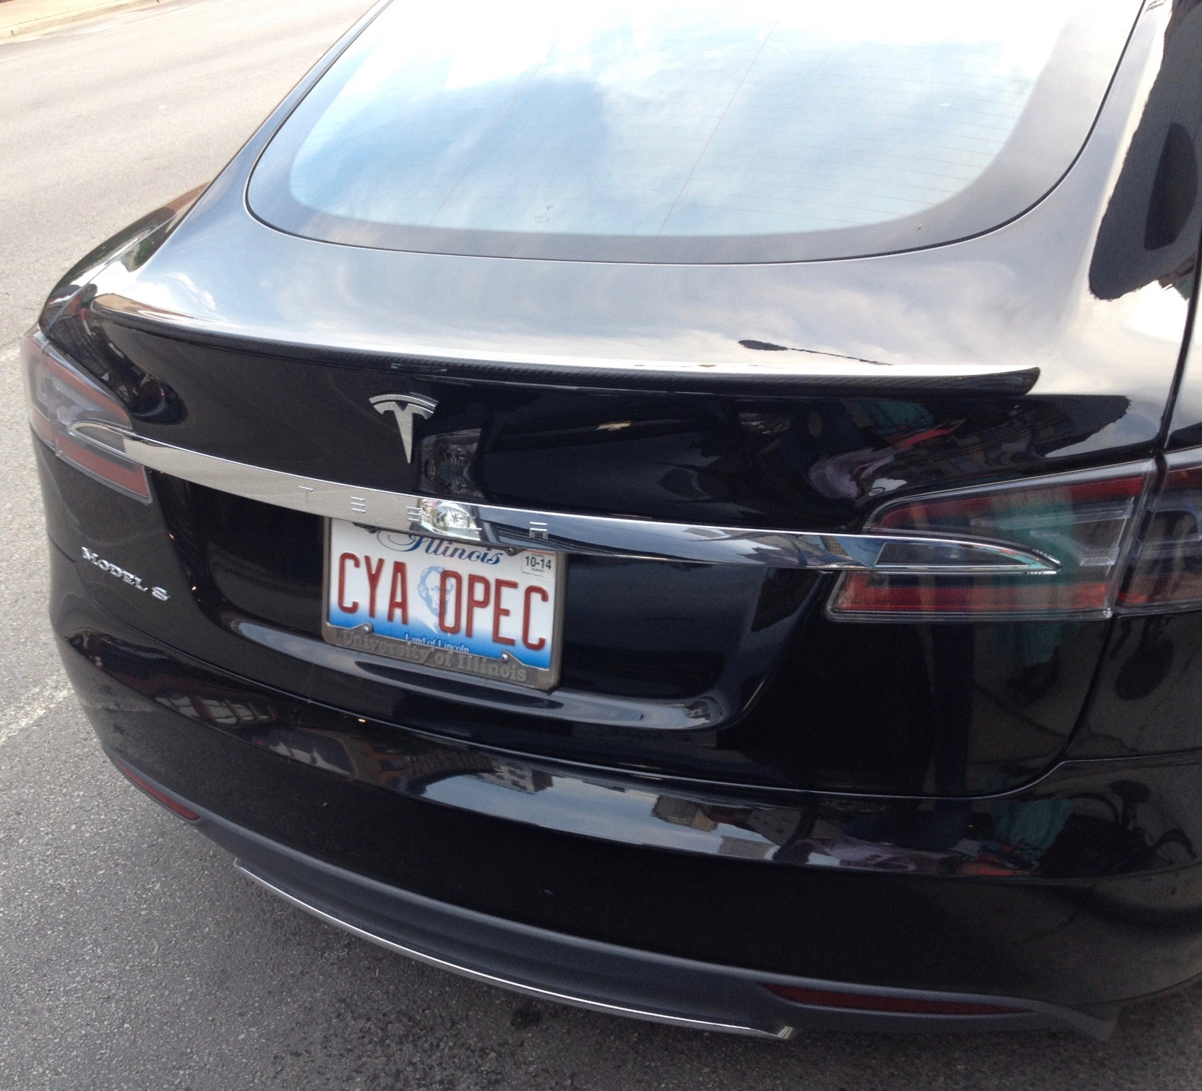
Energy-Peaked for the Year?
*Oil is increasing tracking with other asset classes, meaning that the stock market is now leading oil prices
*Exxon Q4 earnings disappointment demolishes the stock big time, 88 cents versus $1.04 expected, as one time $2.1 billion hit from tax cuts takes its toll
*Big backwardation in the futures
markets hints at more falls to come
*Fracking supply is on the rebound,
Baker Hughes US Rig Count slowing
growth, rises by only 1
*Price is falling despite big cuts in
Iran and Venezuela production

Slide 60
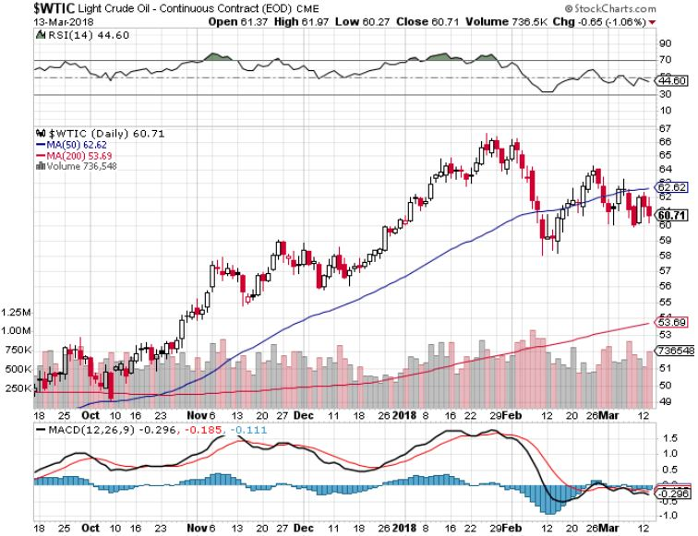
Oil- Yuck!

Slide 61

United States Oil Fund (USO)

Slide 62

Energy Select Sector SPDR (XLE)-
(XOM), (CVX), (SLB), (KMI), (EOG), (COP)

Slide 63

Alerian MLP ETF (AMLP)- Basket Approach

Slide 64

Exxon (XOM)-Earnings Dive

Slide 65

Halliburton (HAL)-

Slide 66

Natural Gas (UNG)-

Slide 67

Copper (COPX)-

Slide 68

Precious Metals-Stuck in the Mud
*Gold remains trapped in the $1,310-$1,360 range all year
*Gold backed ETF’s lose 5.1 metric tonnes in February, with all selling coming from the US, while China added
*Gary Cohen gives gold a short term boost which appears ephemeral
*Gold is seeing a sideways “time” correction prior to the next upside breakout
*Gold mining stocks perform horribly,
suggesting further gold weakness
*Buy gold and silver stocks
on the next big dip, as it is
still early days for the bull market

Slide 69

Gold is Definitely On Hold

Slide 70

Gold (GLD)-New One Year High
Stopped out of 2/$122-$125 bull call spread for small loss took profits on long (GLD) $12/$116-$119 bull call spread

Slide 71

Market Vectors Gold Miners ETF- (GDX)
Took profits on long the 9/$20.50-$21.50 bull call spread

Slide 72

Barrick Gold (ABX) stopped out of long 9/$15-16 call spread

Slide 73

Newmont Mining- (NEM)-Breakout stopped out of 2/$36-$39 bull call spread for small loss took profits on long the 9/$32-$34 bull call spread

Slide 74

Global X Silver Miners ETF- (SIL)-Breakout took profits on long the 9/$31-$33 bull call spread

Slide 75

Real Estate- Missing in Action
*Historic lack of inventory still the major factor
*January New Home Sale Listings down 10%, the sharpest drop on record
*Home prices rising twice as fast as income growth
*Rising interest rates cutting out the entry level buyer the most
*30 year fixed rate mortgage hits 4.65%,
a four year high, cutting first time home
buyers off at the knees
*S&P 500 Case-Shiller maintains
strong 6.3%, with absolute prices
hitting new all time highs,

Slide 76

December S&P7500/Case–Shiller Home Price Index
+6.2% YOY, Seattle (+12.7%), Las Vegas (+11.1%), San Francisco (+9.2%) still leaders price rises accelerating

Slide 77

Simon Property Group (SPG)-

Slide 78

US Home Construction Index (ITB)
(DHI), (LEN), (PHM), (TOL), (NVR)

Slide 79

Trade Sheet-
So What Do We Do About All This?
*Stocks- Stand aside
*Bonds-sell any and all rallies
*Commodities-buy industrials, energy
*Currencies-sell Euro and Yen-Risk On
*Precious Metals –buy dips
*Volatility-go short on runs up to $35
*Real estate-buy dips

Slide 80
Co-Host Anka Metcalf www.TradeOutLoud.com
Contact Anka at
info@tradeoutloud.com

Slide 81

Next Strategy Webinar
12:00 EST Wednesday, March 28, 2018
San Francisco, CA madhedgefundtrader.com
Good Luck and Good Trading!
Notes:
*

