Slide 1
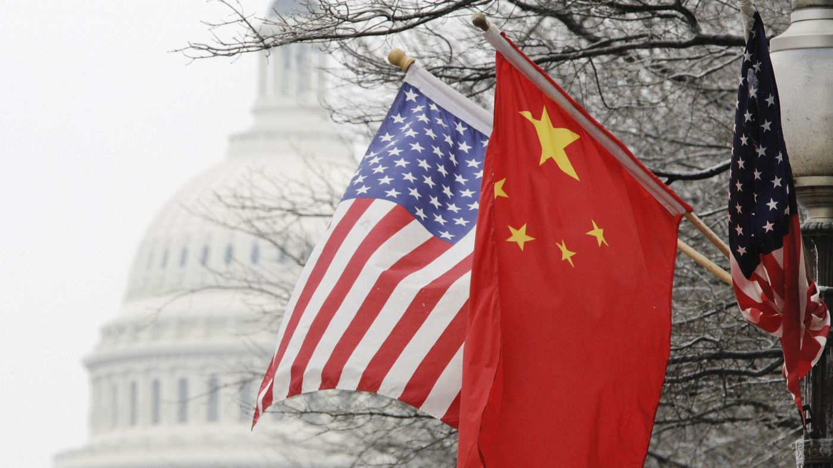
The Mad Hedge Fund Trader “Trade War”
With John Thomas from Silicon Valley, CA, March 14, 2018 www.madhedgefundtrader.com
Notes:
*

Slide 2

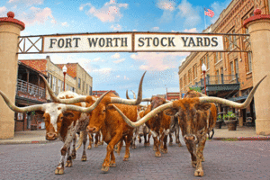
MHFT Global Strategy Luncheons Buy tickets at www.madhedgefundtrader.com
Incline Village, NV April 6
Fort Worth, TX June 11

Slide 3
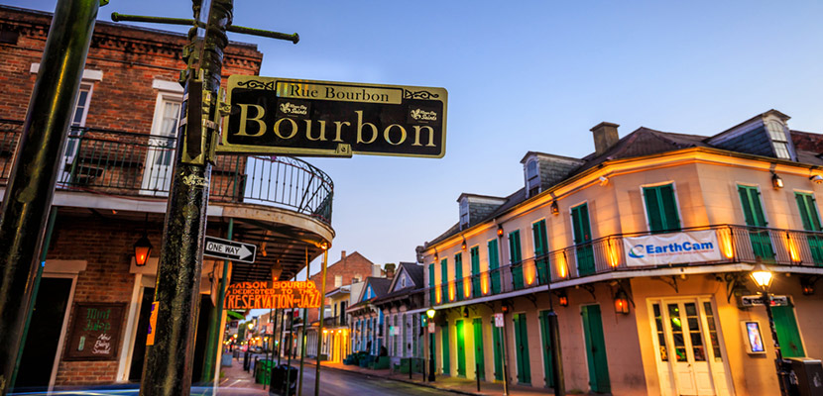
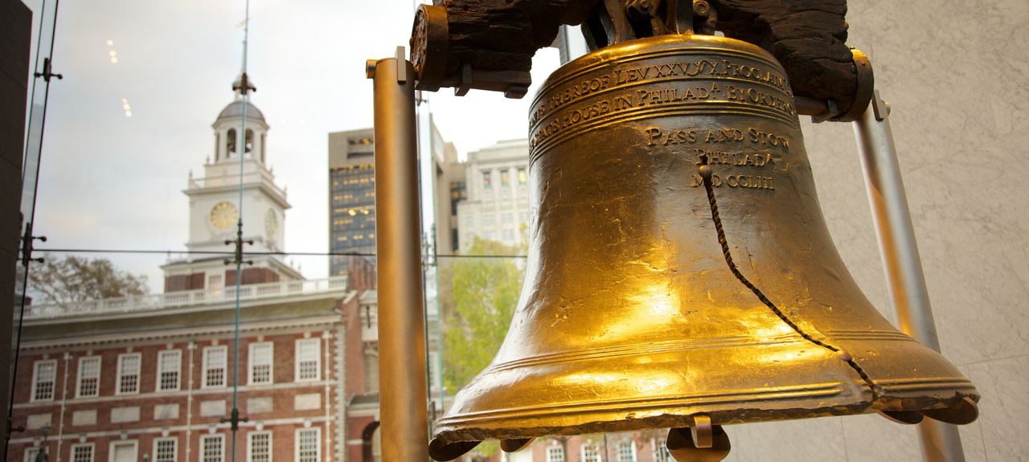
MHFT Global Strategy Luncheons Buy tickets at www.madhedgefundtrader.com
New Orleans, LA June 12
Philadelphia, PA June 13

Slide 4
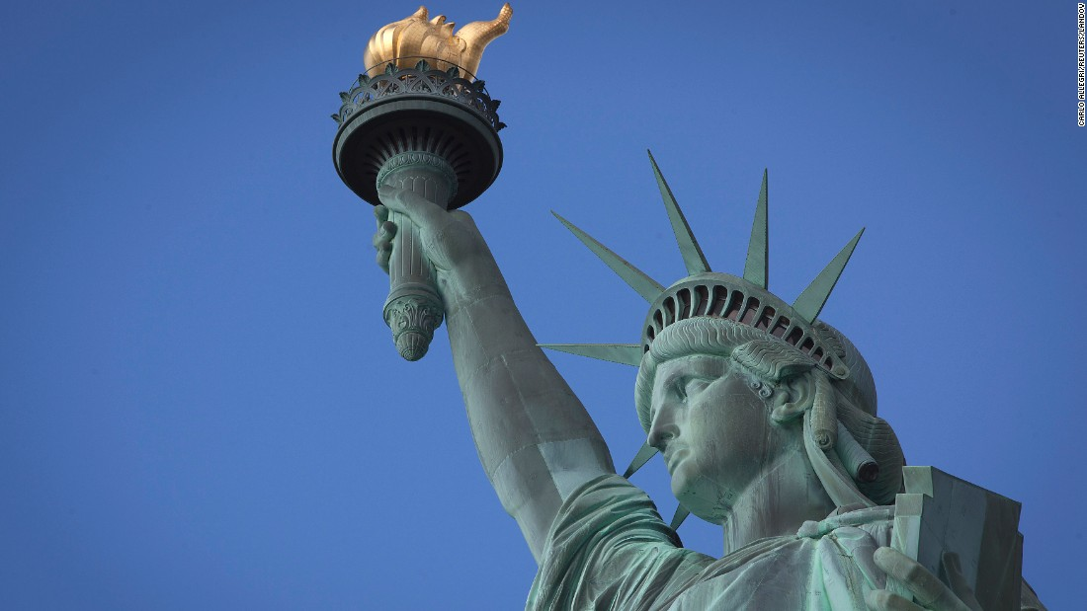
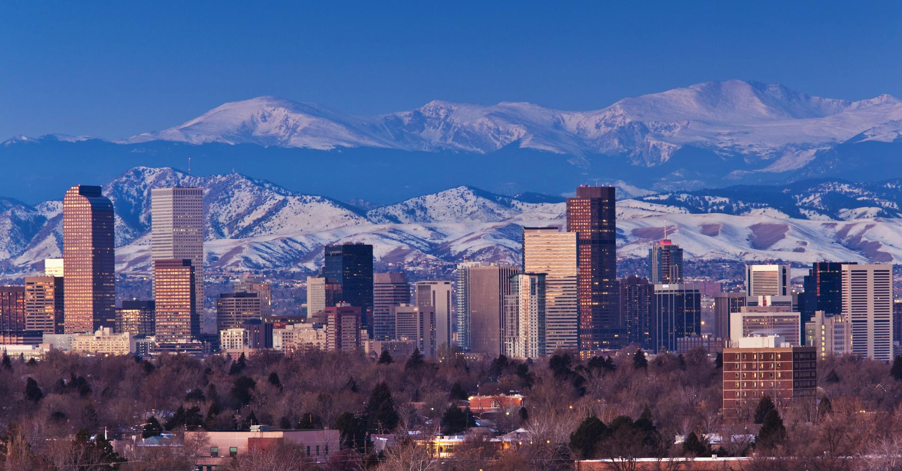
MHFT Global Strategy Luncheons Buy tickets at www.madhedgefundtrader.com
New York, NY June 14
Denver, CO June 15
Soon to be Posted: The Queen Mary II Seminar at Sea in July, Paris, France, Zermatt, Switzerland, and Geneva Switzerland

Slide 5

Trade Alert Performance New All Time High!!
*January 4.09% Final *July +1.95% Final *February +1.54% Final *August +18.38% Final *March -0.19% MTD *September +7.65% Final *April +1.84% Final *October +1.39% Final *May -0.45% Final *November +2.08% Final *June +0.70% Final *December +3.76% Final *2018 Year to Date 5.44% compared to -4.03% for the Dow Average *Trailing One year return +46.70%, +283.17% since inception, *Average annualized return of 34.00%

Slide 6
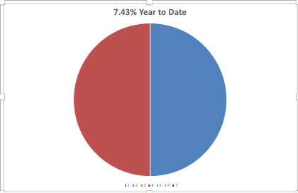
Portfolio Review 80% Cash Running Minimal Book During Extreme Volatility
Current Capital at Risk
Risk On
World is Getting Better
(AAPL) 6/$130-$140 call spread | 10.00%
(TLT) 4/$123-$126 bear put spread | 10.00%
Risk Off
Total Net Position | 20.00%

Slide 7
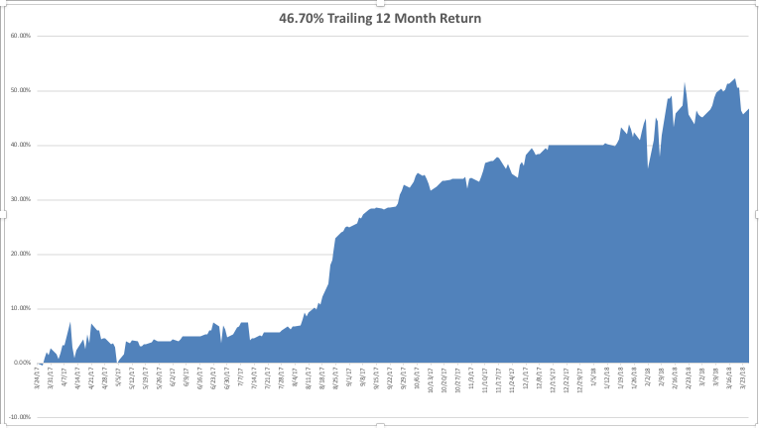
GTD Daily Audited Performance

Slide 8
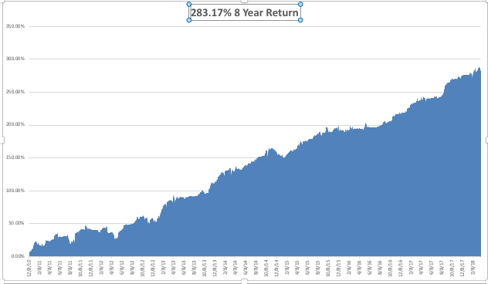
GTD Eight Year Daily Audited Performance 34.00% Average Annualized Return

Slide 9
The Bill Davis View A $1,500 Upgrade for the Mad Day Trader Service
Buys: | Entry | Target
Apple, Inc. (AAPL) | $ 156.00 | $ 175.00
Tesla, Inc. (TSLA) | $ 250.00 | $ 328.00
Palo Alto Networks (PANW) | $ 162.00 | $ 188.00
Celgene Corp (CELG) | $ 88.00 | $ 97.00
Johnson & Johnson (JNJ) | $ 125.00 | $ 142.00
Sells:
Facebook, Inc (FB) | $ 168.00 | $ 140.00
Overstock (OSTK) | $ 50.00 | $ 37.00
Federal Express (FDX) | $ 244.00 | $ 200.00
3M Company (MMM) | $ 226.00 | $ 193.00
Amgen, Inc. (AMGN) | $ 178.00 | $ 150.00

Slide 10

The Method to My Madness
*5 black swans in five days create extreme oversold conditions *Margin calls are now a bigger driver than fundamentals *If the chaos in Washington continues, volatility will increase and stocks will go lower *Sell every bond rally….The Fed is now engaged in major Quantitative Tightening (QT?) in the face of exploding deficits *Stand aside on oil, gold, foreign currencies, and commodities

Slide 11
From the Mad Hedge Department of Humility Mistakes of 2018
*Overweight equities which haven’t been working *Underweight bond shorts, which have been working *Slow to adjust to higher volatility regime, even though I predicted it

Slide 12
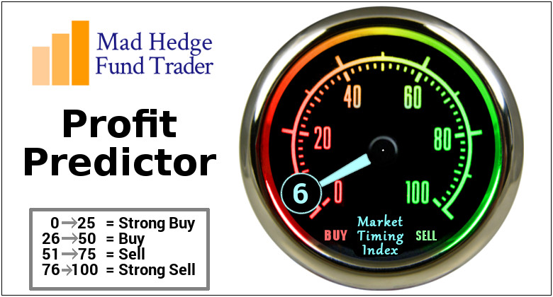
The Mad Hedge Profit Predictor Market Timing Index-All Time Low An artificial intelligence driven algorithm that analyzes 30 different economic, technical, and momentum driven indicators

Slide 13
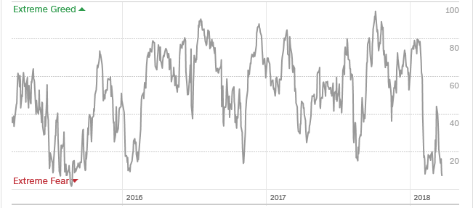
The Mad Hedge Profit Predictor Collapse Back to Extreme Fear A New 5-45 Trading Range?

Slide 14
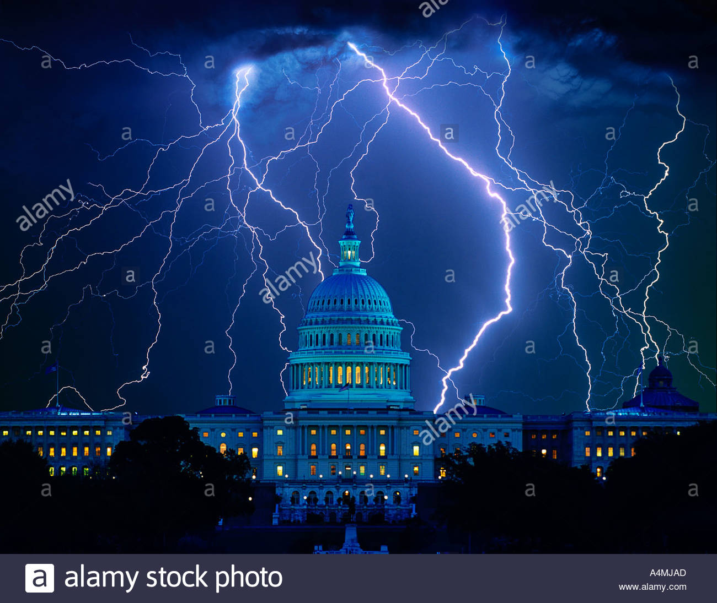
The Global Economy – At Risk from Politics
*It’s all about the trade war. Chinese response has so far been muted, but how long will that last if the US escalates, as it has promised to do so? *February Durable Goods up 3.1% vs. 1.5% est., February University of Michigan Consumer Confidence jumps from 99.9 to 102 *The only chink in the economic armor is three consecutive months of falling retail sales when we were supposed to be spending like crazy because of the tax cut *Weak global stock markets creating a negative wealth effect, bringing recession fears forward *NABE increases 2018 GDP forecast from 2.5% to 2.9%, 10 year Treasury yield to 3.6% in 2019

Slide 15
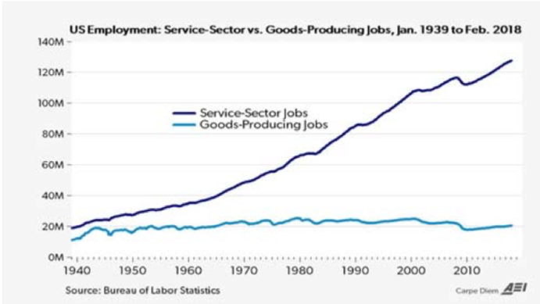
US Job Providers 130 million vs 20 million by protecting the 20 million you put a serious chunk of the 130 million at risk

Slide 16
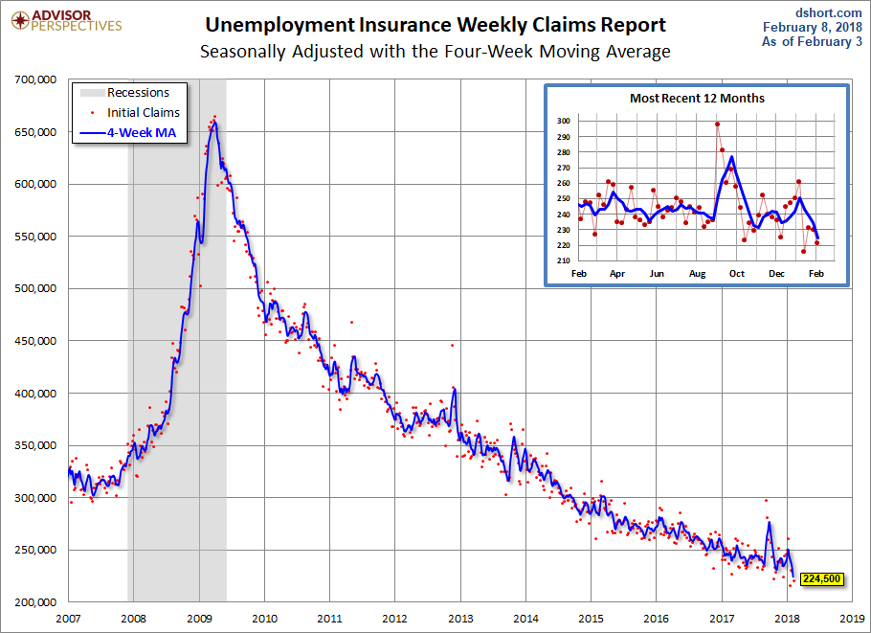
Weekly Jobless Claims –The Most Important Statistic +3,000 to 229,000 hugging 49 Year Low!

Slide 17

Stocks-Correction Time!
*Trade wars are both economy and stock market negative. We can win because our depression won’t be as bad as theirs *Trade war fears putting all global markets into severe “RISK OFF” mode *The most widely owned market leaders with the biggest gains, like tech and financials taking the biggest hits This is all happening 5 weeks ahead of the strongest earnings reporting season in history, Q1, 2018 *Are stocks setting up for a range for the rest of 2018? Only two more months of seasonal tailwind to go until we “Sell in May and Go away” Volatility spikes, but at half peak levels seen in last rout

Slide 18
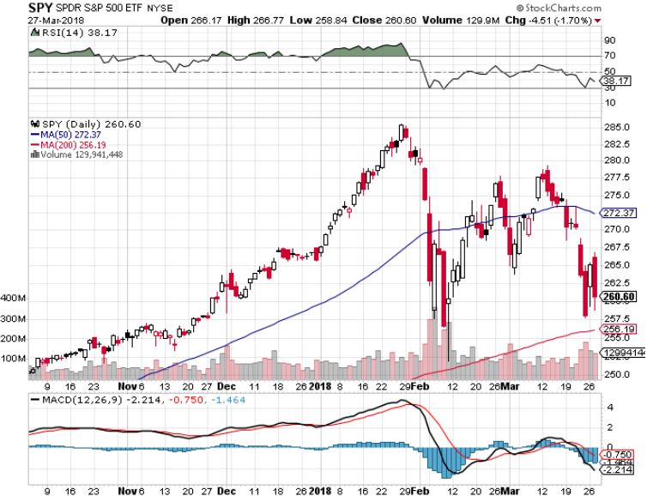
S&P 500-Moving Into a Range stopped out of Long 3/$275-$280 bear put spread

Slide 19
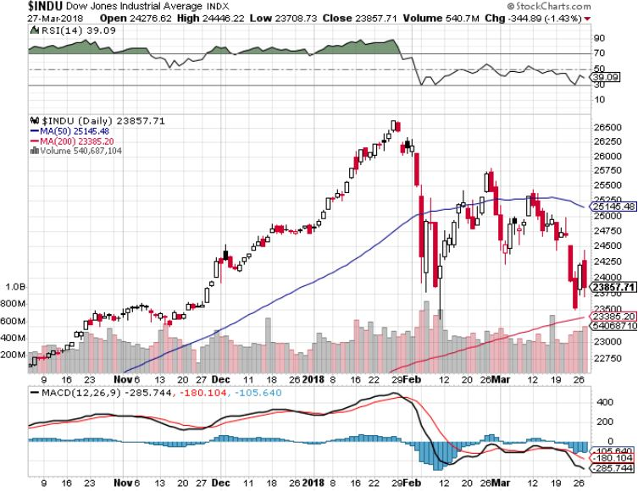
Dow Average-13.33% Correction

Slide 20
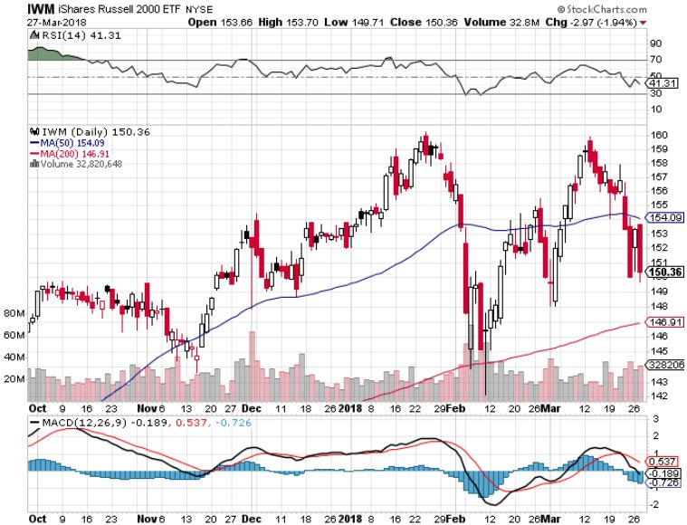
Russell 2000 (IWM)-Peaked Out stopped out of long the (IWM) 12/$152-$155 bear put spread

Slide 21
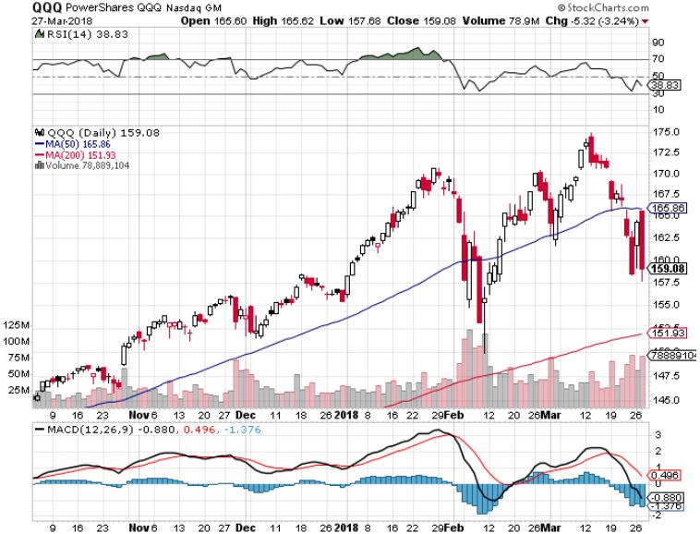
NASDAQ (QQQ)-Crushed

Slide 22
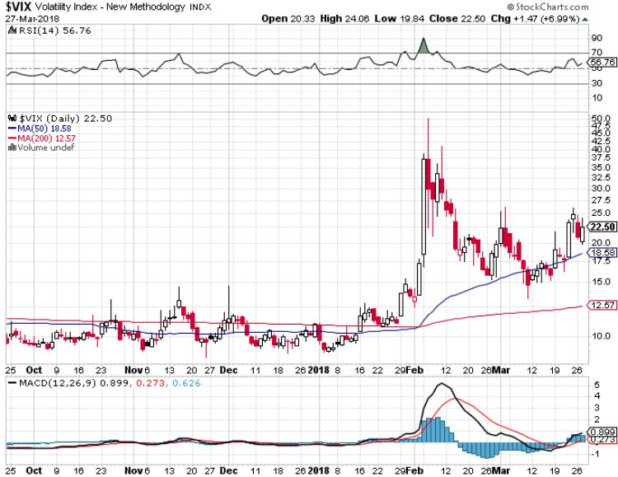
(VIX)-Spike Again!

Slide 23
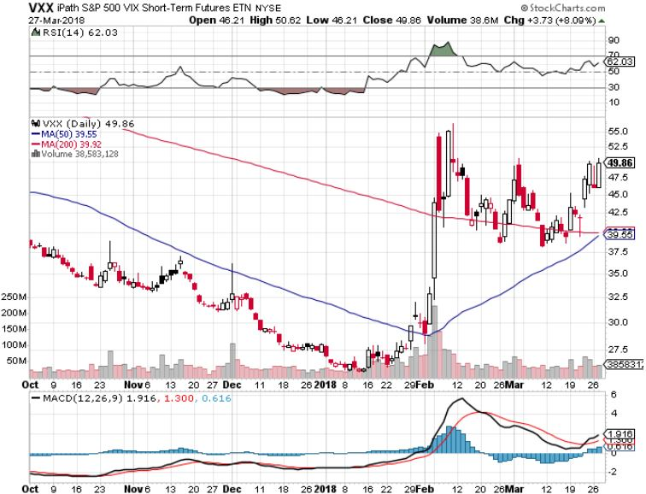
iPath S&P 500 VIX Short-Term Futures ETN (VXX) long 3/$55-$60 bear put spread-puts staying at artificially high levels took profits on $45-$60 put spread took profits on long 11/$20 calls

Slide 24
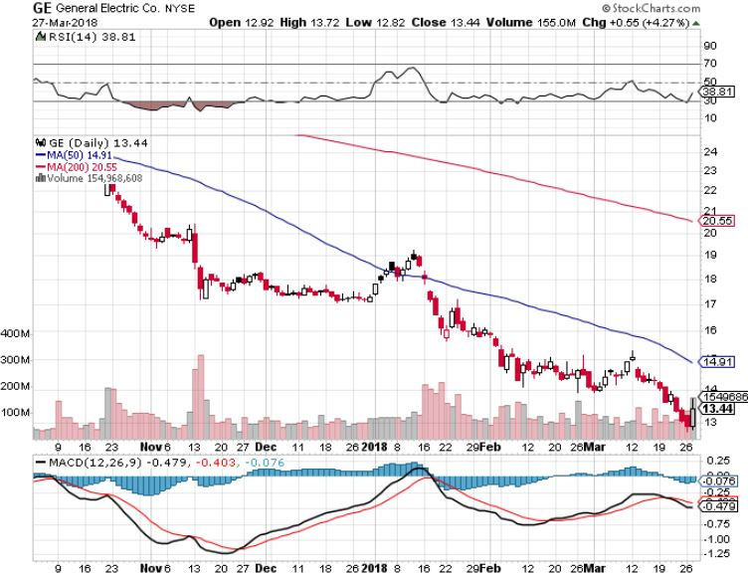
General Electric (GE)-No Recovery Breakup Value is $15

Slide 25
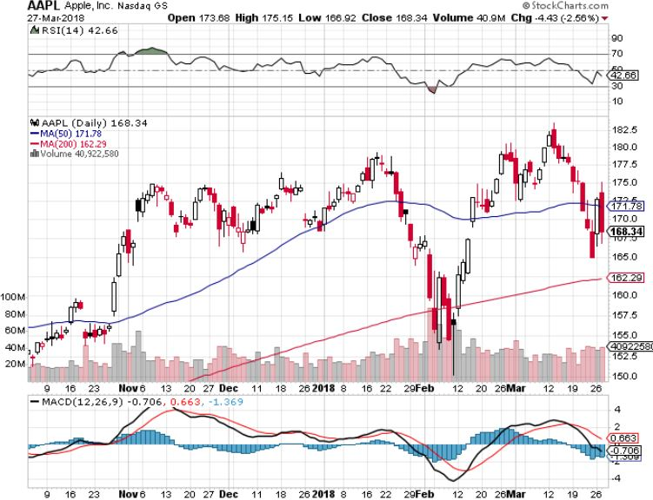
Apple (AAPL)-Waiting for Buy Backs long 3/$140-$150 calls spread took profits on long 3/$140-$145 calls stopped out of long 3/$170-$175 put spread took profits on long 4/$155-$165 calls spread

Slide 26
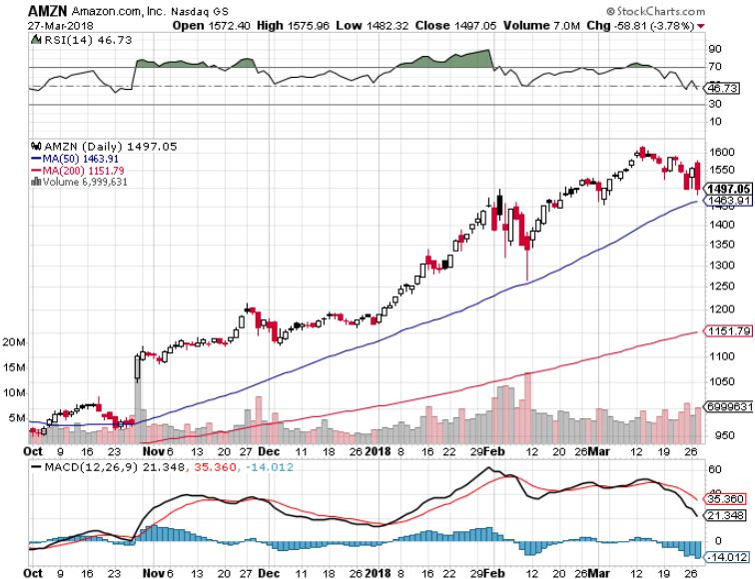
Amazon (AMZN) took profits on long 3/$1200-$1250 call spread (Tech Letter)

Slide 27
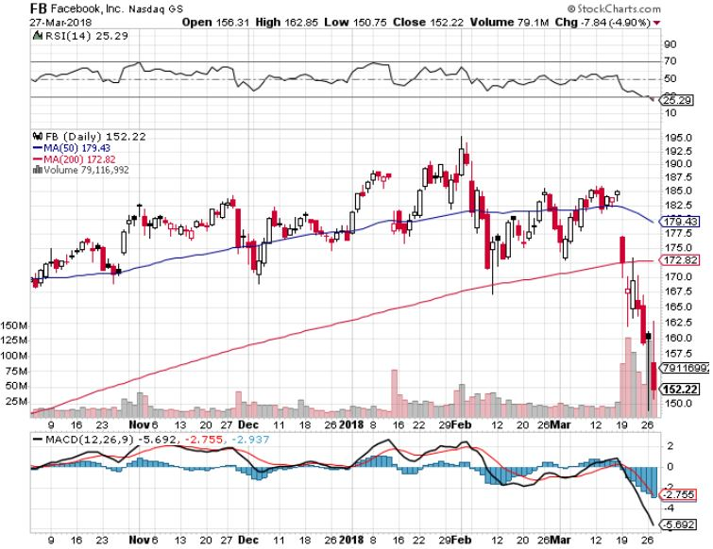
Facebook (FB)- stopped out of long 4/$150-$160 call spread took profits on long 3/$155-$165 bull call spread took profits on long 3/$190-$195 bear put spread

Slide 28
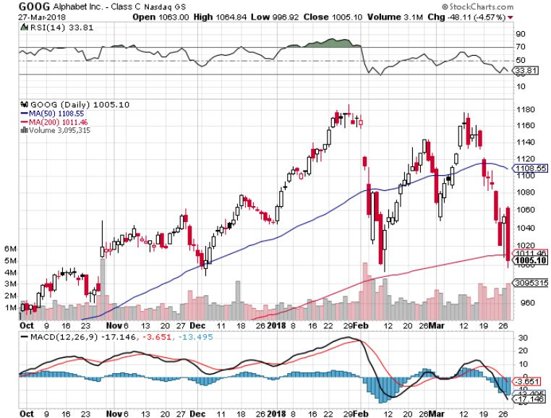
Alphabet (GOOG)-

Slide 29
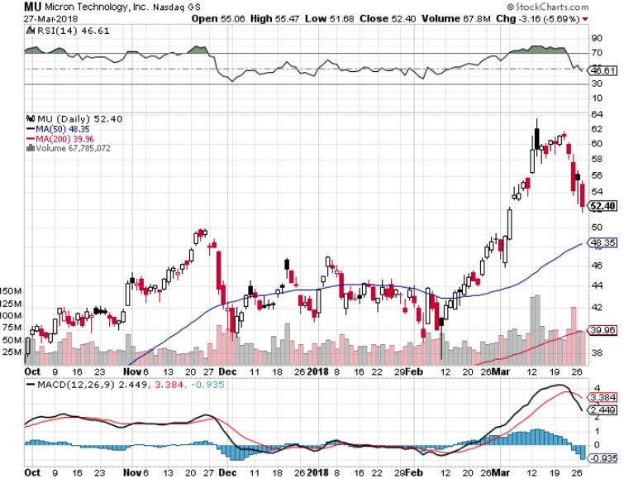
Micron Technology (MU)-Spectacular Earnings took profits on long 3/$34-$37 bull call spread in Mad Hedge Technology Letter Only 54% gain since initial recommendation a month ago by tech letter

Slide 30
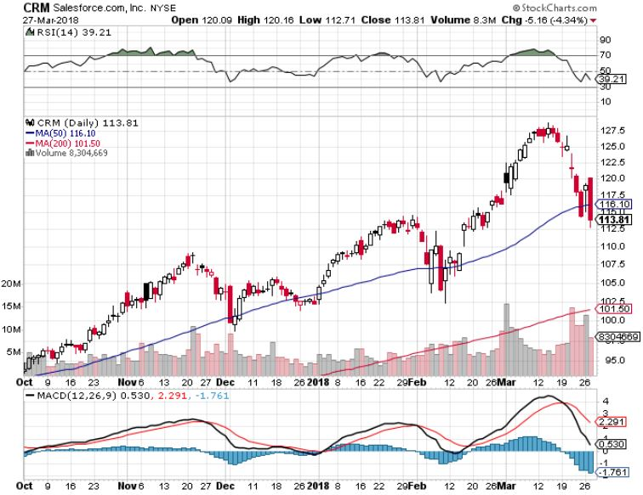
Salesforce (CRM)- took profits on long 3/$90-$95 bull call spread in Mad Hedge Technology Letter 26% gain since recommended a month ago by Tech Letter

Slide 31
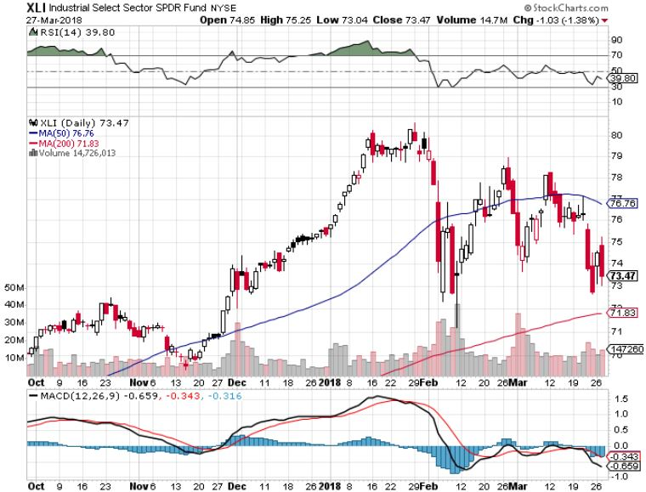
Industrials Sector SPDR (XLI)- (GE), (MMM), (UNP), (UTX), (BA), (HON)

Slide 32
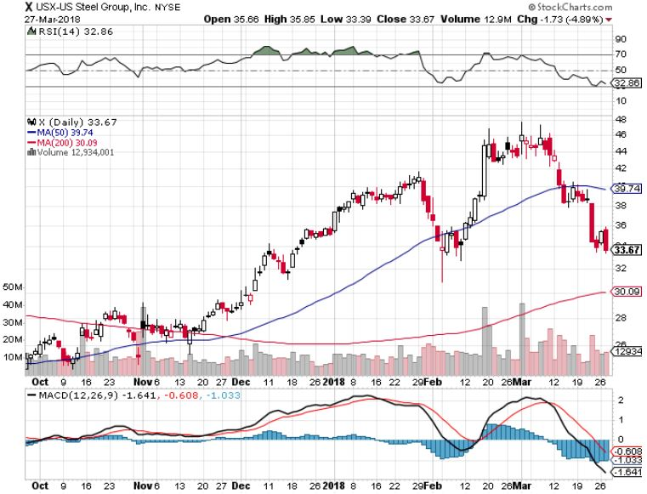
US Steel (X)- took profits on long the 9/$21-$22 vertical bull call spread

Slide 33
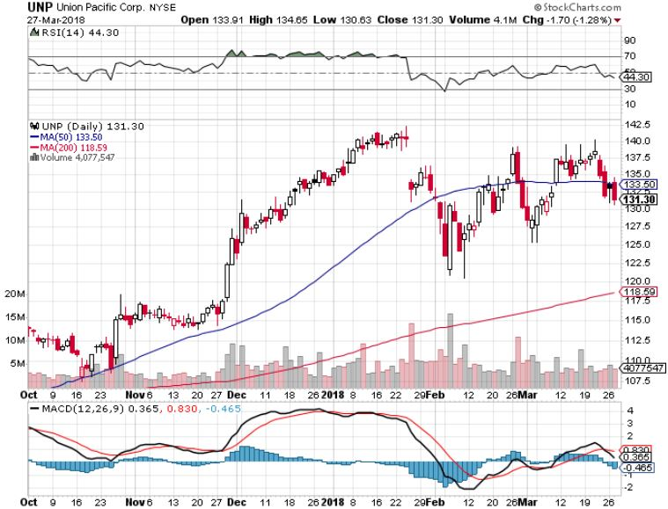
Union Pacific Railroad (UNP)- took profits on long the 9/$100-$102 vertical bull call spread

Slide 34
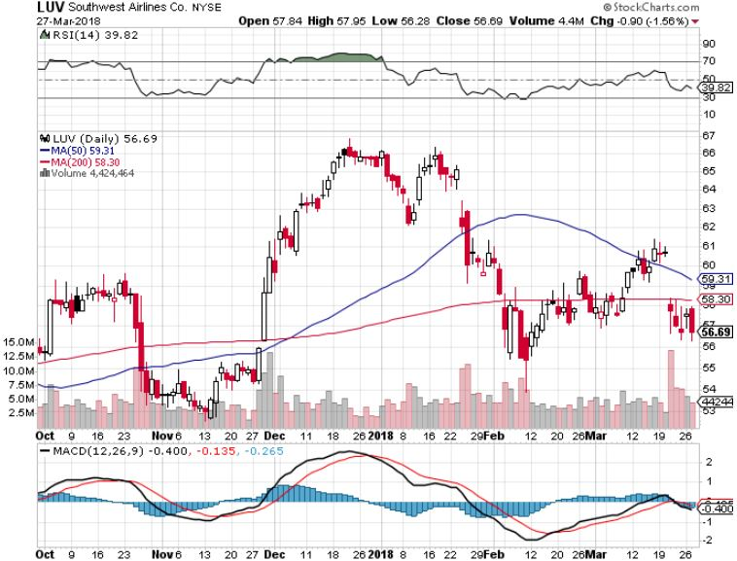
Southwest Airlines (LUV)- Warren Buffett’s Favorite Airline

Slide 35
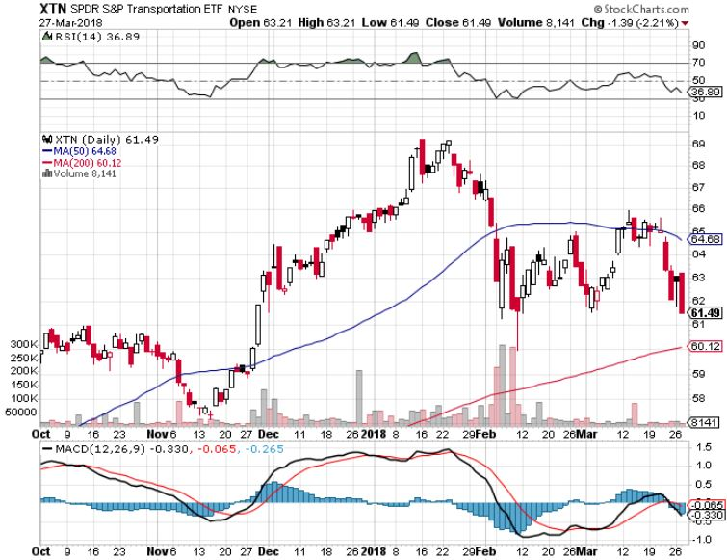
Transports Sector SPDR (XTN)- (ALGT), (ALK), (JBLU), (LUV), (CHRW), (DAL)

Slide 36
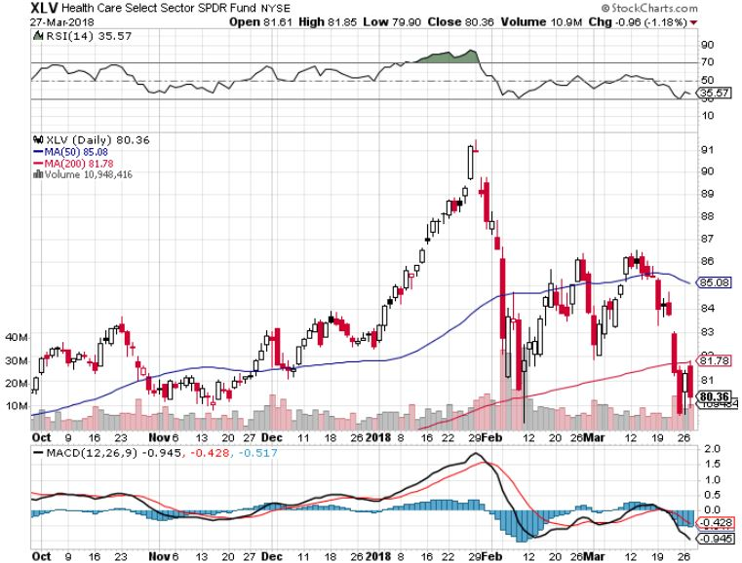
Health Care Sector (XLV), (RXL)-The New FANG? (JNJ), (PFE), (MRK), (GILD), (ACT), (AMGN)

Slide 37
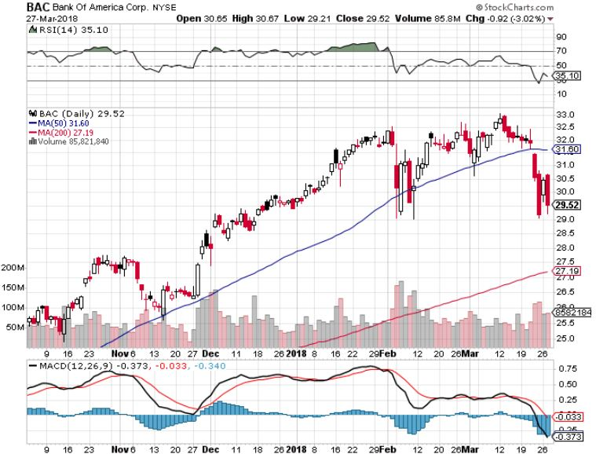
Bank of America (BAC)-New Highs (BLK/B), (WFC), (JPM), (BAC), (C), (GS) took profits on long 12/$25.50-$27 bull call spread-expires in 7 trading days

Slide 38
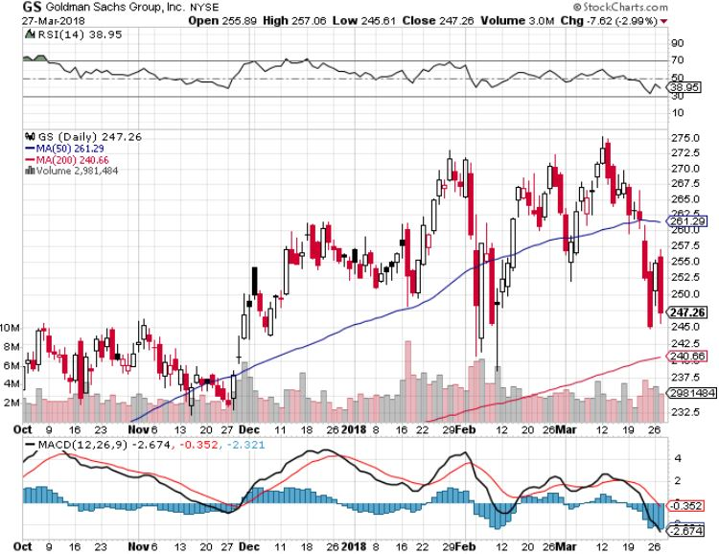
Goldman Sachs (GS)-Earnings Disappointment on bond losses stopped out of long 4/240-$245 call spread stopped out of long 10/$220-$225 vertical bull call spread took profits on long 10/$227.50-$232.50 vertical bull call spread

Slide 39
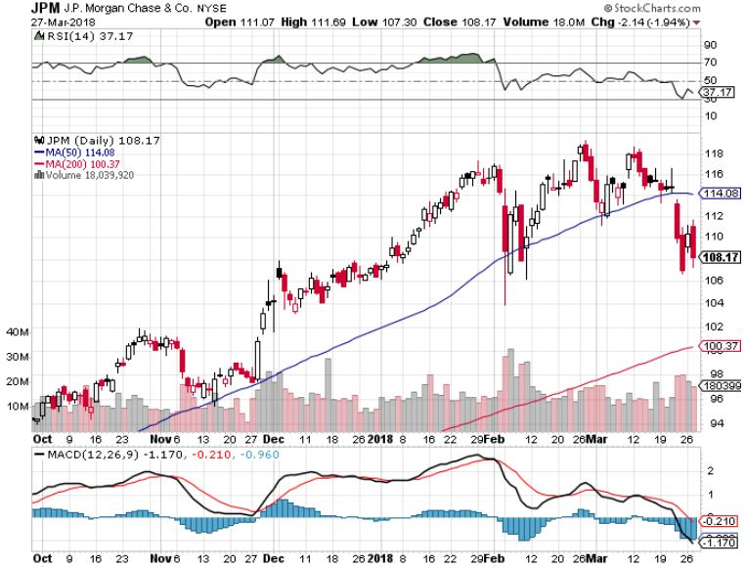
JP Morgan (JPM)-

Slide 40
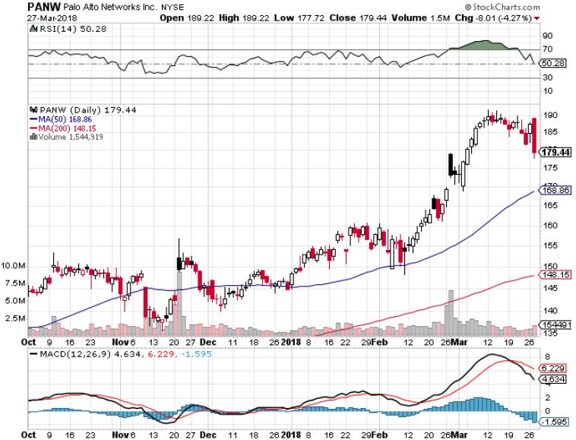
Palo Alto Networks (PANW)-

Slide 41
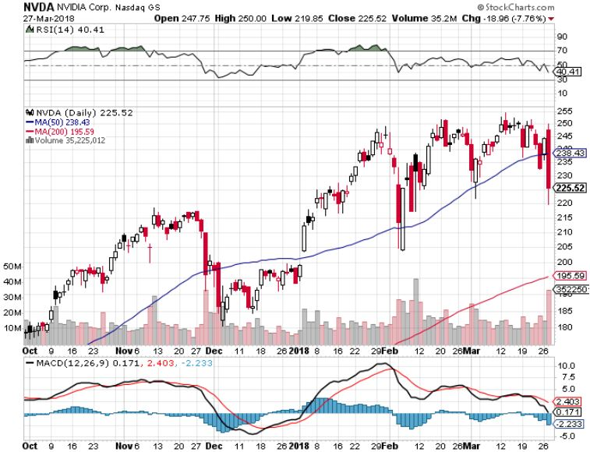
NVIDIA (NVDA)-Fabulous Earnings Autonomous Driving fears

Slide 42
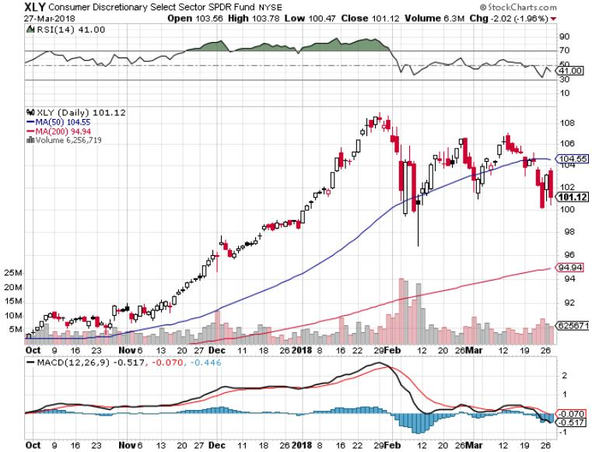
Consumer Discretionary SPDR (XLY) (DIS), (AMZN), (HD), (CMCSA), (MCD), (SBUX)

Slide 43
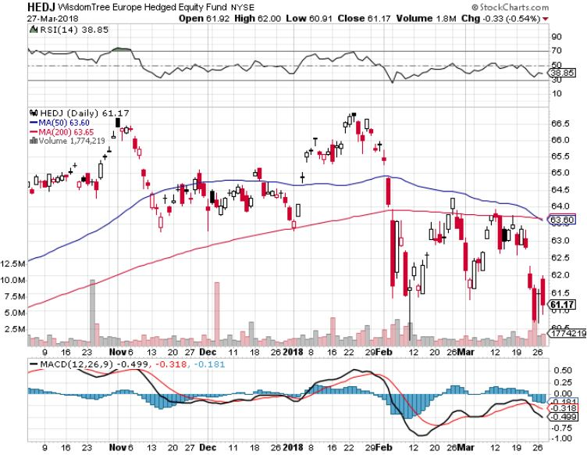
Europe Hedged Equity (HEDJ)-Global Rally

Slide 44
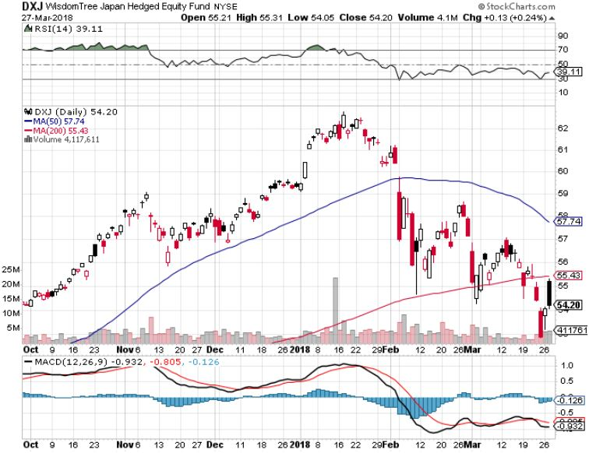
Japan (DXJ)-More Global Rally

Slide 45
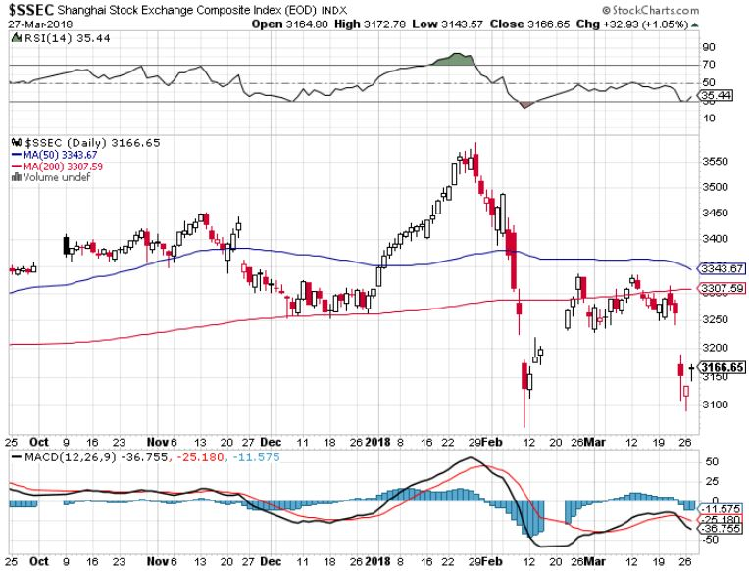
China ($SSEC)-Economic Recovery on Track

Slide 46
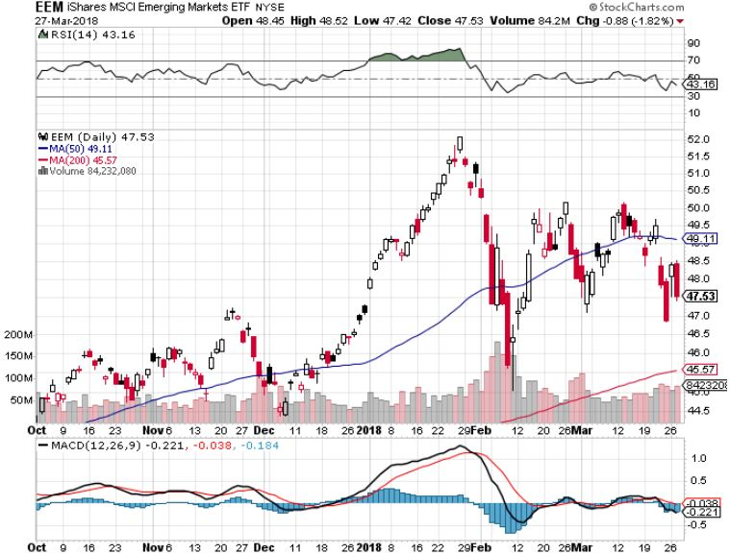
Emerging Markets (EEM)- New High

Slide 47
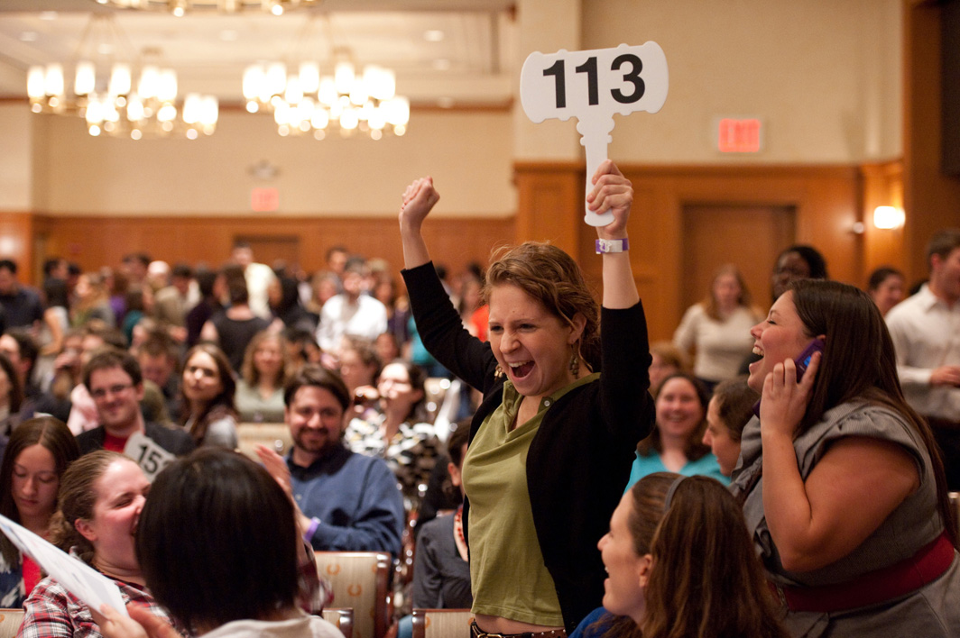
Bonds-Catching a Bid
*Fed raises interest rates by 0.25% right on schedule, new overnight range is 1.50% to 1.75% for bank funding *Bond market still stalls with yields at four year highs, digesting recent large falls *Bonds pick up flight to safety big on stock market collapse *Global liquidity is shrinking much faster overseas that it is here in the US *Still looking for 3.25%-3.5% ten year US Treasury yield by yearend *China says “everything is on the table regarding existing $1 trillion in US bond holdings

Slide 48
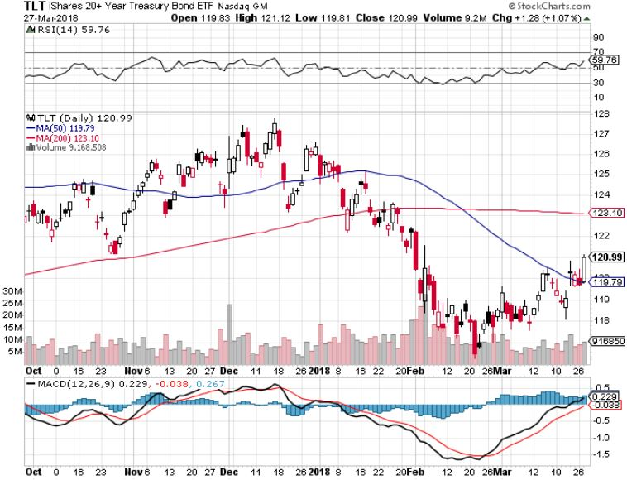
Treasury ETF (TLT) – 2.95 Topping Out long 4/$123-$126 vertical bear put spread Took profits on long the (TLT) 2/$124-$127 vertical bear put spread again stopped out of long 2/$114-$117 bull call spread Took profits on long the (TLT) 2/$124-$127 vertical bear put spread Took profits on long the (TLT) 2/$127-$130 vertical bear put spread

Slide 49
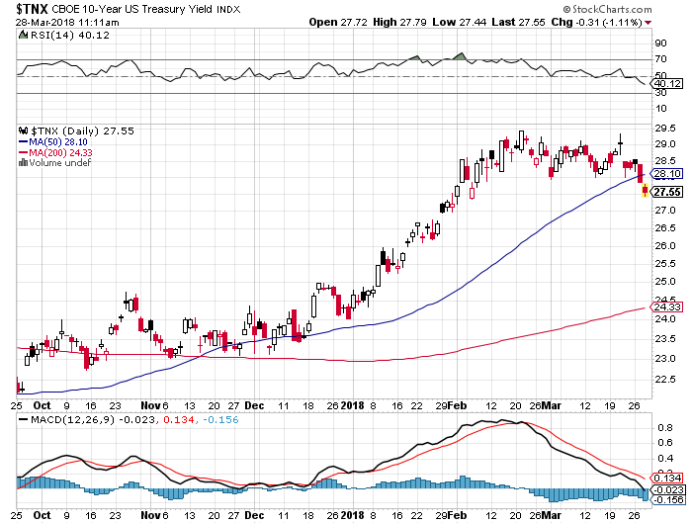
Ten Year Treasury Yield ($TNX) 2.75% Breakdown, Now major Support

Slide 50
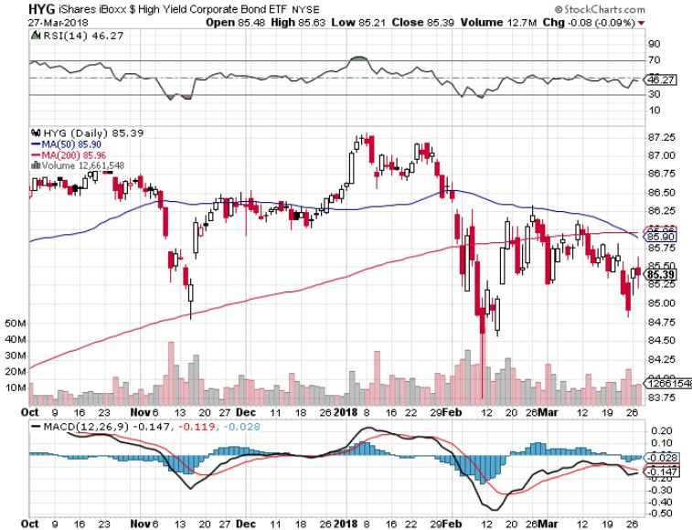
Junk Bonds (HYG) 5.39% Yield 60 basis point pop in yield on stock crash

Slide 51
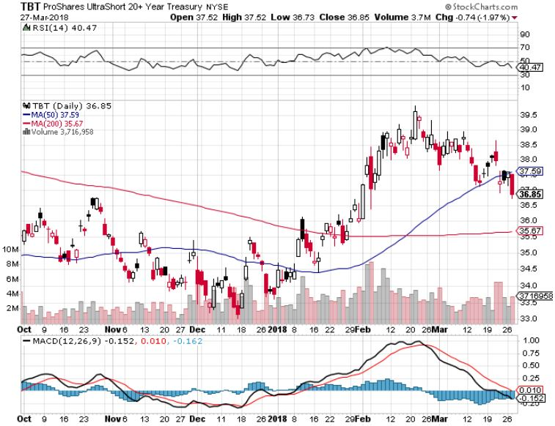
2X Short Treasuries (TBT)-

Slide 52
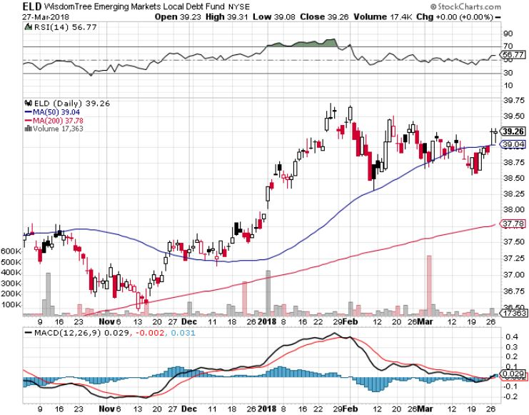
Emerging Market Debt (ELD) 5.58% Yield-

Slide 53
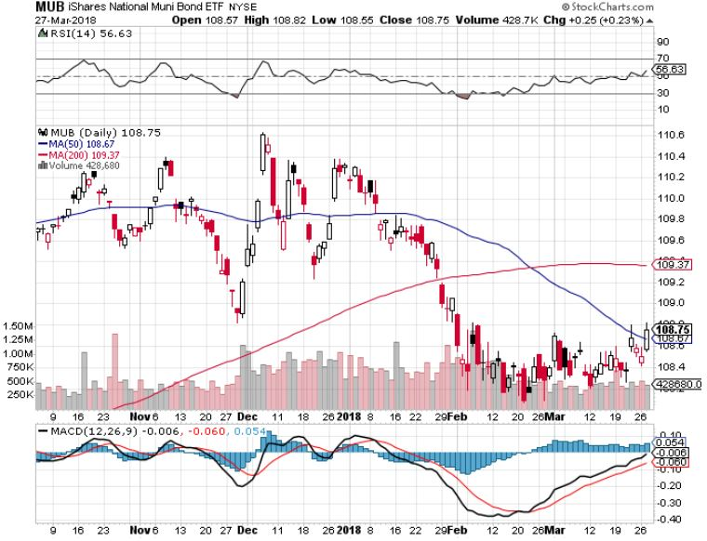
Municipal Bonds (MUB)-2.08% Mix of AAA, AA, and A rated bonds Huge 40 basis point yield pop on tax bill

Slide 54

Foreign Currencies- Dollar Dive
*US dollar is the big loser in any trade war *Risks of a weaker US economy risk sends dollar diving *Japanese yen catches a huge “carry trade” unwind bid *Bitcoin tracks 1:1 with stocks to the downside

Slide 55

Japanese Yen (FXY), (YCS) long (FXY) 3/$91-$93 bear put spread

Slide 56

Euro ($XEU), (FXE), (EUO)- Triple Top took profits on long (FXE) 3/$120-$123 vertical bear put spread took profits on long (FXE) 12/$116-$118 vertical bear put spread took profits on long (FXE) 12/$111-$113 vertical bull call spread

Slide 57

Emerging Market Currencies (CEW)

Slide 58

Chinese Yuan- (CYB)-Stabilizing on Government Support

Slide 59

Bitcoin-Modern Day Tulips! Now banned in China and South Korea, Feds closing in for the US

Slide 60

Energy-Perfect Storm in Favor
*OPEC quota compliance spikes to an amazing 138%, support oil in the face of the latest global stock market selloff, will reaming in effect until 2019 *Crude and product inventories plunge by 6.3 million barrels on US economic strength, providing further support *Saudi Arabia threat to obtain nukes if Iran does provides a geopolitical push for oil prices *Venezuela production in free fall, down from 3.5 to 1.5 million b/d in five years *Fracking supply is on the rebound, Baker Hughes US Rig Count slowing growth, rises by only 4 to 804

Slide 61

Oil-Double Top Warning?

Slide 62

United States Oil Fund (USO)

Slide 63

Energy Select Sector SPDR (XLE)-No Performance! (XOM), (CVX), (SLB), (KMI), (EOG), (COP)

Slide 64

Alerian MLP ETF (AMLP)- Basket Approach

Slide 65

Exxon (XOM)-Earnings Dive

Slide 66

Schlumberger (SLB)-

Slide 67

Halliburton (HAL)-

Slide 68

Natural Gas (UNG)-

Slide 69

Copper (COPX)-Trade War Fears

Slide 70

Precious Metals-Finally a Flight to Safety Bid
*Investors finally run to gold as a “risk off” hedge after ignoring it many times before *Gold positioning is so low that the margin call drag from the stock crash has virtually disappeared. *Gold is finally outperforming Bitcoin too *Gold mining stocks bottoming out *Buy gold and silver stocks on the next big dip, as it is still early days for the bull market

Slide 71

Gold (GLD)-New One Year High Stopped out of 2/$122-$125 bull call spread for small loss took profits on long (GLD) $12/$116-$119 bull call spread

Slide 72

Market Vectors Gold Miners ETF- (GDX) Took profits on long the 9/$20.50-$21.50 bull call spread

Slide 73

Barrick Gold (ABX) stopped out of long 9/$15-16 call spread

Slide 74

Newmont Mining- (NEM)-Breakout stopped out of 2/$36-$39 bull call spread for small loss took profits on long the 9/$32-$34 bull call spread

Slide 75

Global X Silver Miners ETF- (SIL)-Breakout took profits on long the 9/$31-$33 bull call spread

Slide 76

Real Estate- Low End Missing
*February Existing Home Sales rose 3.0% to 5.54 million units *Only 1.59 million homes for sale, the lowest in history, down -8.9% YOY *Sellers are reluctant because they don’t want to lose existing low interest rates mortgage, will increasingly become a factor *February New Home Sales down -0.6%, February Median Homes Sales $326,800, up 9.7% YOY *Builders cutting back low end home construction as lumber import duties raise costs, building high end homes only *S&P 500 Case-Shiller maintains strong 6.3%, with absolute prices hitting new all time highs

Slide 77

December S&P7500/Case–Shiller Home Price Index +6.2% YOY, Seattle (+12.7%), Las Vegas (+11.1%), San Francisco (+9.2%) still leaders price rises accelerating

Slide 78

Simon Property Group (SPG)-

Slide 79

US Home Construction Index (ITB) (DHI), (LEN), (PHM), (TOL), (NVR)

Slide 80

Trade Sheet- So What Do We Do About All This?
*Stocks- Stand aside *Bonds-sell any and all rallies *Commodities-stand aside *Currencies-stand aside *Precious Metals –buy dips *Volatility-go short on runs up to $35 *Real estate-buy dips

Slide 81

Next Strategy Webinar 12:00 EST Wednesday, April 11, 2018 San Francisco, CA madhedgefundtrader.com
Good Luck and Good Trading!
Notes:
*

