Slide 1

The Mad Hedge Fund Trader
“The Bulls Are Back!”
With John Thomas
from Silicon Valley, CA, April 11, 2018
www.madhedgefundtrader.com
Notes:
*

Slide 2
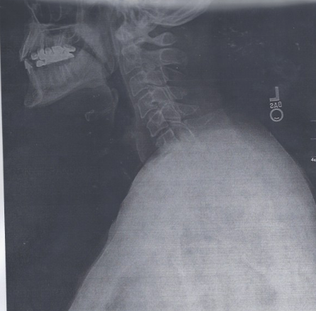

Slide 3
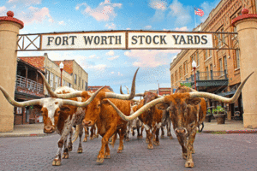
MHFT Global Strategy Luncheons
Buy tickets at www.madhedgefundtrader.com
Forth Worth, TX
June 11

Slide 4
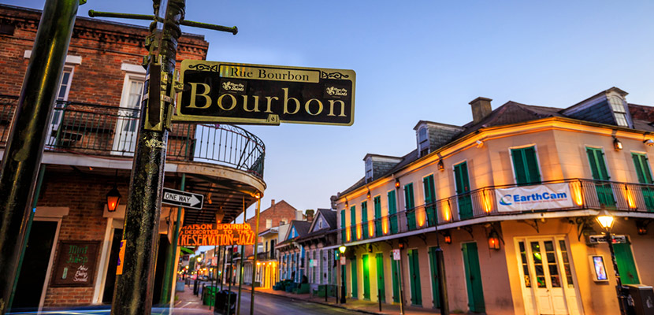
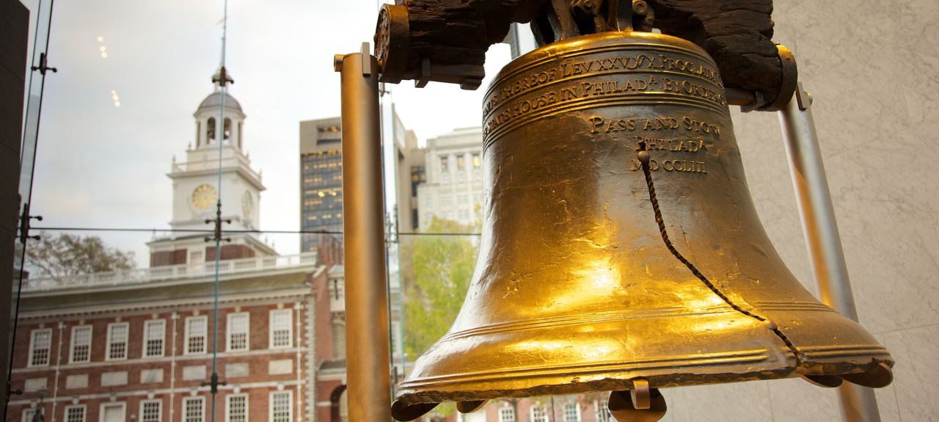
MHFT Global Strategy Luncheons
Buy tickets at www.madhedgefundtrader.com
New Orleans, LA
June 12
Philadelphia, PA
June 13

Slide 5
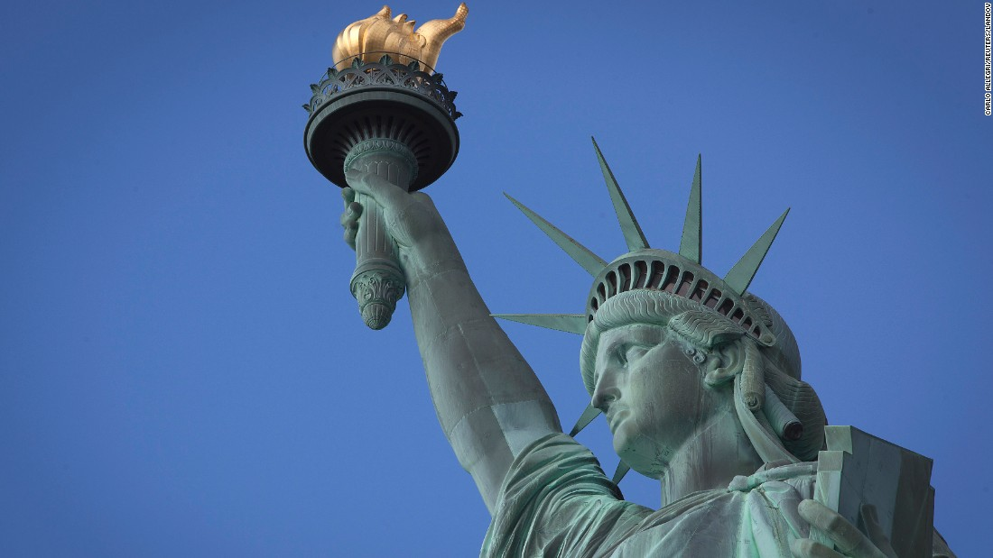
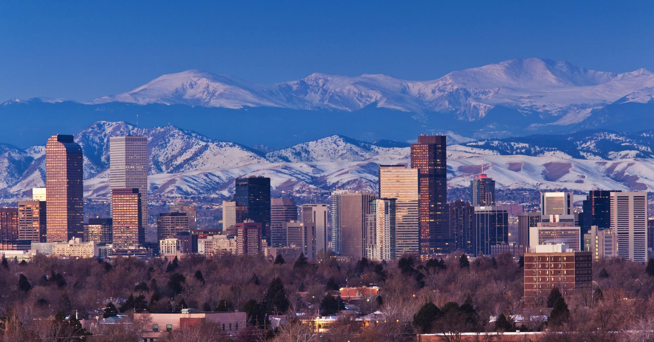
MHFT Global Strategy Luncheons
Buy tickets at www.madhedgefundtrader.com
New York, NY
June 14
Denver, CO
June 15
Soon to be Posted: The Queen Mary II Seminar at Sea in July, Paris, France, Zermatt, Switzerland, and Geneva Switzerland

Slide 6

Trade Alert Performance
New All Time High!!
*January 4.09% Final *July +1.95% Final
*February +1.54% Final *August +18.38% Final
*March +1.13% Final *September +7.65% Final
*April +3.89% MTD *October +1.39% Final
*May -0.45% Final *November +2.08% Final
*June +0.70% Final *December +3.76% Final
*2018 Year to Date 10.66%
compared to -2.37% for the Dow Average
*Trailing One year return +49.72%, +287.13% since inception,
*Average annualized return of 34.55%

Slide 7
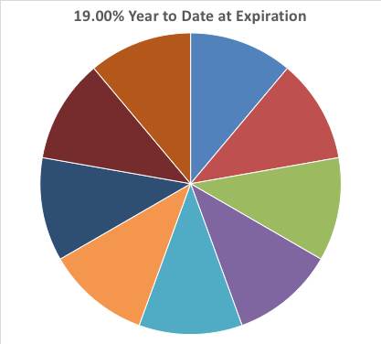
Portfolio Review
20% Cash/80% invested
Running Aggressive Book of Very Deep in the Money Call Spreads
enough to handle a 10% correction from here and still max profit,
short dated 4 of 9 positions expire in 7 trading days
Current Capital at Risk
Risk On
World is Getting Better
(AAPL) 6/$130-$140 call spread | 10.00%
(TLT) 4/$123-$126 bear put spread | 10.00%
(TLT) 5/$124-$127 put spread | 10.00%
(VXX) 4/$60-$65 call spread | 10.00%
(GOOGL) 4/$900-$930 call spread | 10.00%
(GOOGL) 6/$900-$950 call spread | 10.00%
(JPM) 4/$95-$100 call spread | 10.00%
C 6/$60-$65 call spread | 10.00%
Risk Off
(GLD) 5/$119-$122 call spread | -10.00%
Total Net Position | 70.00%

Slide 8
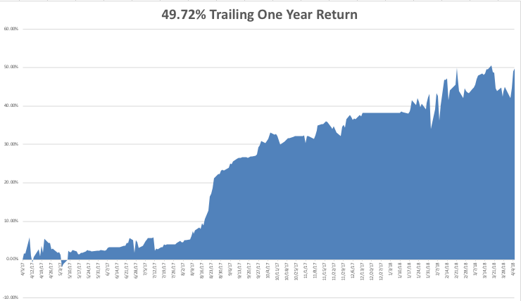
GTD Daily Audited Performance

Slide 9
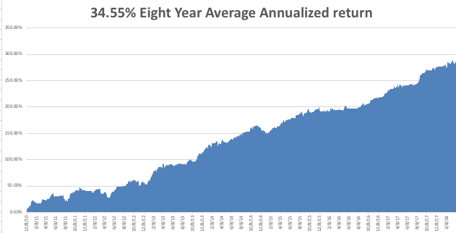
GTD Eight Year Daily Audited Performance

Slide 10

The Method to My Madness
*Eleven 2% intraday swings in 12 days create the most volatile market in history
*Washington in generating crisis faster than traders can deal with them
*Washington is playing chicken with Beijing, the loser gets a recession and a bear market
*It probably is all bluff, bringing wide trading ranges for the next 6 months, and great trading opportunities right here
*Sell every bond rally….The Fed is now engaged
in major Quantitative Tightening (QT?)
in the face of exploding deficits
*Stand aside on oil, gold, foreign
currencies, and commodities, which are all
flat lining until multiple crisis end

Slide 11
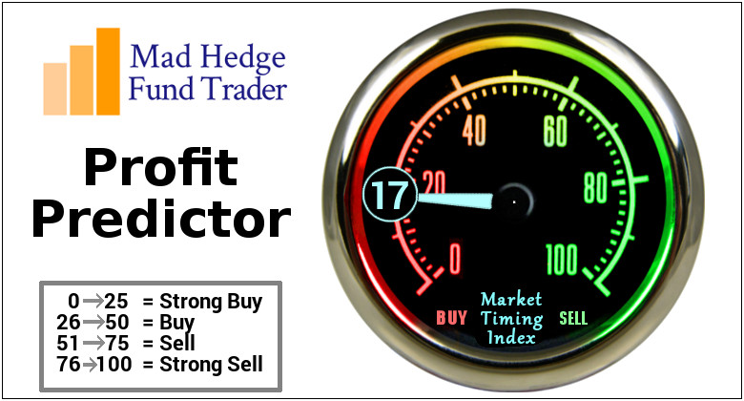
The Mad Hedge Profit Predictor
Market Timing Index-Sitting on All Time Lows
An artificial intelligence driven algorithm that analyzes 30 different economic, technical, and momentum driven indicators

Slide 12
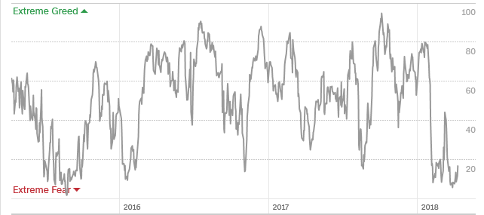
The Mad Hedge Profit Predictor
Collapse Back to Extreme Fear
A New 5-45 Trading Range?

Slide 13

The Global Economy – Slowing
*It’s all about the trade war. Chinese response has so far been muted, but how long will that last if the US escalates, as it has promised to do so?
*Final revision to Q4 GDP up 0.2% to a hot 2.9%, but is old data
*Negative data on the economy staring to pile up, with two weak Nonfarm Payroll reports in a row, 103,000 in March
Feb Dallas Fed General Business Activity Index drops from 28 to 21, March Institute of Supply Management manufacturing activity drops from 61 to 59, services down from 59 to 58
*Weak global stock markets creating a negative
wealth effect, bringing recession fears forward

Slide 14
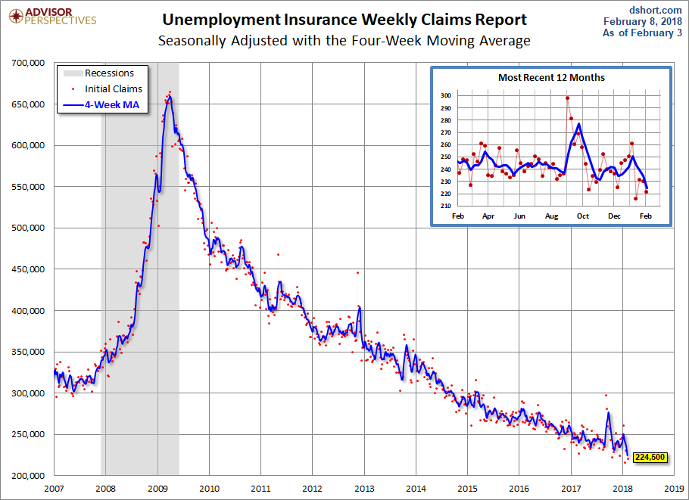
Weekly Jobless Claims –The Most Important Statistic
+24,000 to 242,000-holiday distortions

Slide 15
The Bill Davis View
A $1,500 Upgrade for the Mad Day Trader Service
Buys: | Entry | Target
Celgene Corp (CELG) | $ 88.00 | $ 97.00
Patterson Dental Co. (PDCO) | $ 22.00 | $ 30.00
Biogen Inc. (BIIB) | $ 265.00 | $ 300.00
WageWorks Inc. (WAGE) | $ 42.00 | $ 55.00
Alerian MLP (AMJ) | $ 24.00 | $ 28.00
Sells:
Facebook, Inc (FB) | $ 168.00 | $ 140.00
Scotts Co. (SMG) | $ 92.00 | $ 78.00
AGCO Corp (AGCO) | $ 66.00 | $ 58.00
Ambarella, Inc. (AMBA) | $ 50.00 | $ 42.00
Tesla Inc. (TSLA) | $ 316.00 | $ 238.00

Slide 16

Stocks- Correction Time
*So far, it’s just a normal correction. Solid economic data don’t justify a recession call
*Lead stocks down 20%-30%, how much do you want to sell in from of record earnings reports in a few weeks? No much, and none if you are a big institution
*Tech earnings looking to rise by 23.4%, Financials by 24.4%, account for 40% of the market, all stocks up by 17%
*Stocks setting up for a range for the next six months going into the November election
Only three more weeks until of seasonal headwind and “Sell in May and Go away”
Volatility spikes, but at half peak levels
seen in last rout, is in no way reflecting
the massive intraday swings
Time to start adding leveraged leaps
in the best quality tech names

Slide 17
It’s All About Buy Backs
*Corporate share buybacks are the only net buyers of stock in 2018,
individuals, institutions, and pension funds sitting on their hands
*Buy backs are up 51% this year
*Next Round of Q1 2018 earnings will announce substantial increases in buyback commitments
*Until then, companies have been sitting on their hands during the “Quiet Period” to avoid insider trading risks.
Both corrections in 2018 have coincided with “Quiet Periods” in February and April, when they end its off to the races

Slide 18
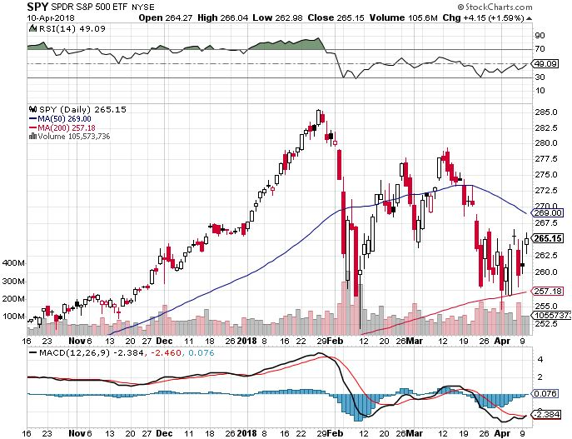
S&P 500-Moving Into a Range stopped out of Long 3/$275-$280 bear put spread

Slide 19
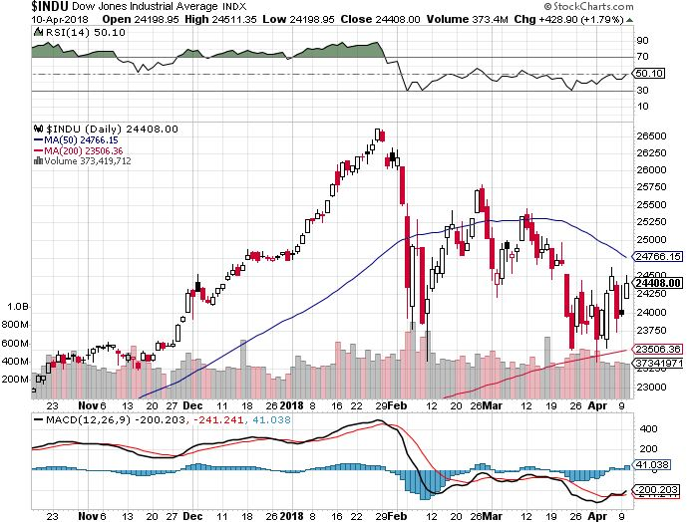
Dow Average-13.33% Correction

Slide 20
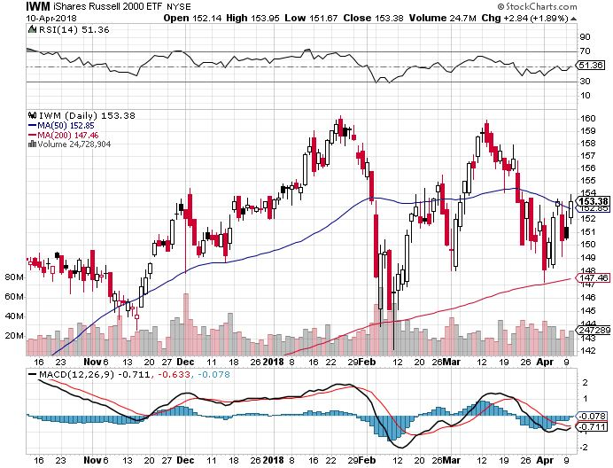
Russell 2000 (IWM)-Peaked Out stopped out of long the (IWM) 12/$152-$155 bear put spread

Slide 21
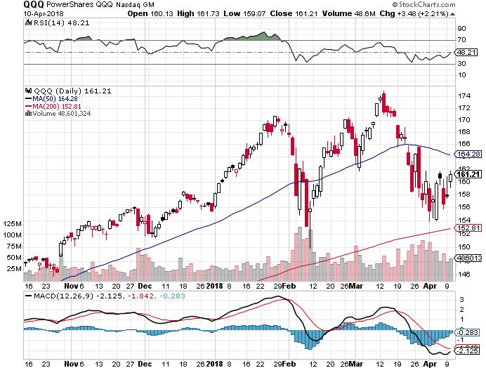
NASDAQ (QQQ)-Crushed

Slide 22
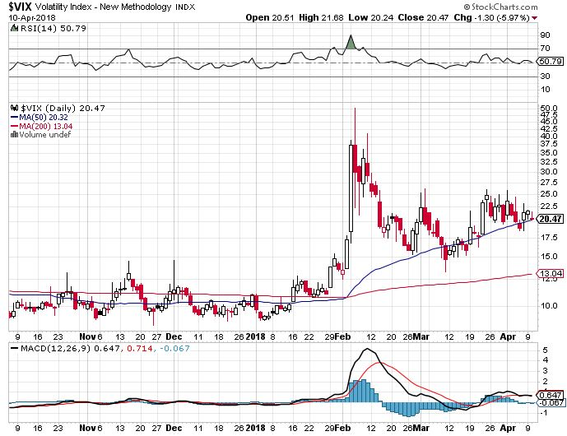
(VIX)-Spike Again!

Slide 23
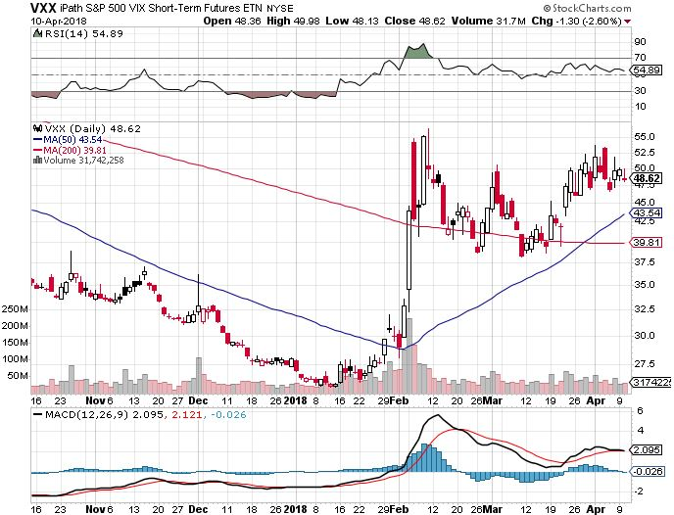
iPath S&P 500 VIX Short-Term Futures ETN (VXX) long 3/$60-$65 bear put spread – expires in 7 trading days took profits on long 3/$55-$60 bear put spread

Slide 24
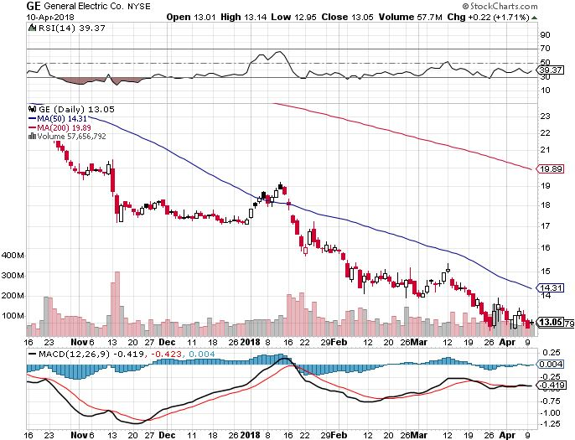
General Electric (GE)-No Recovery
Breakup Value is $15

Slide 25
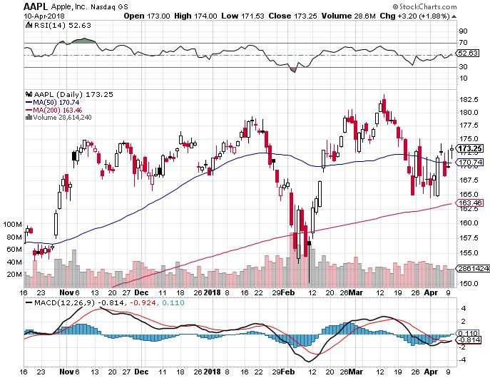
Apple (AAPL)-Waiting for Buy Backs long 3/$140-$150 calls spread took profits on long 3/$140-$145 calls stopped out of long 3/$170-$175 put spread took profits on long 4/$155-$165 calls spread

Slide 26
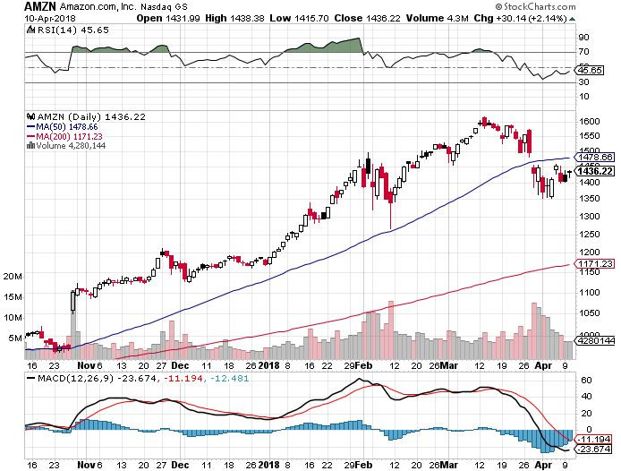
Amazon (AMZN) took profits on long 3/$1200-$1250 call spread (Tech Letter)

Slide 27
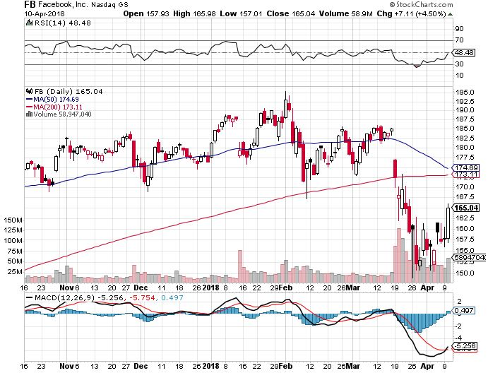
Facebook (FB)- stopped out of long 4/$150-$160 call spread took profits on long 3/$155-$165 bull call spread took profits on long 3/$190-$195 bear put spread

Slide 28
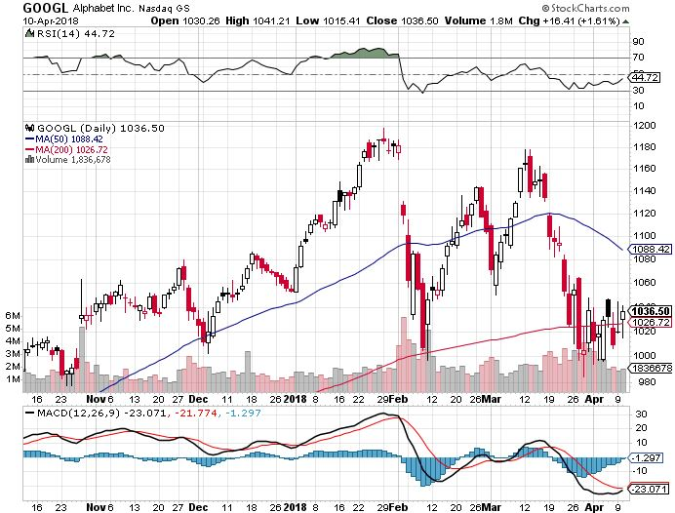
Alphabet (GOOGL)- long 4/$900-$930 call spread-Expires in 7 trading days

Slide 29
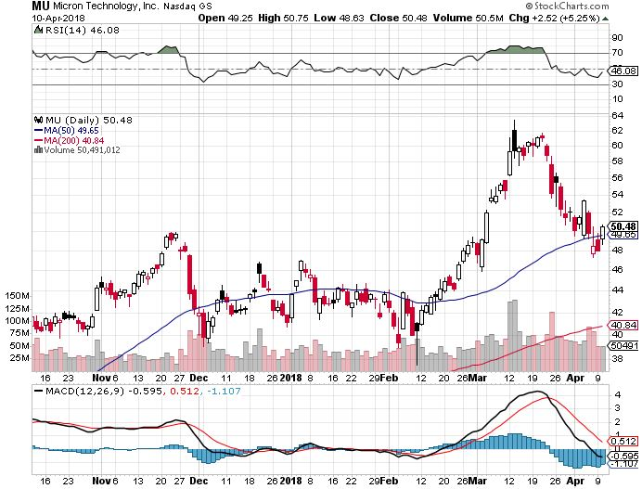
Micron Technology (MU)-Spectacular Earnings took profits on long 3/$34-$37 bull call spread in Mad Hedge Technology Letter Only
UBS bearish report decimates the entire industry

Slide 30
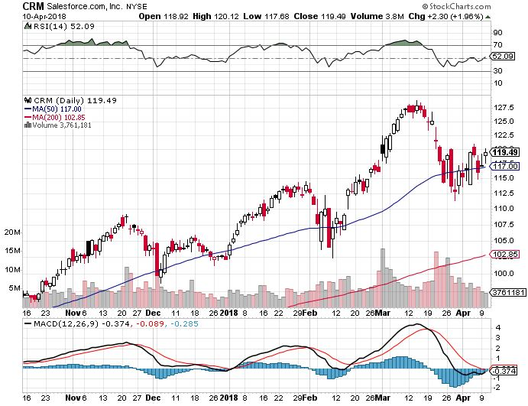
Salesforce (CRM)- long 6/$105-$110 call spread took profits on long 3/$90-$95 bull call spread in Mad Hedge Technology Letter

Slide 31
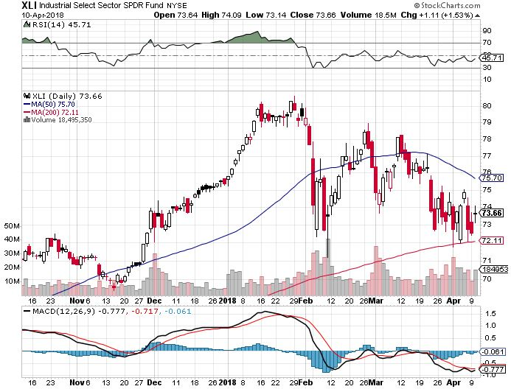
Industrials Sector SPDR (XLI)-
(GE), (MMM), (UNP), (UTX), (BA), (HON)

Slide 32
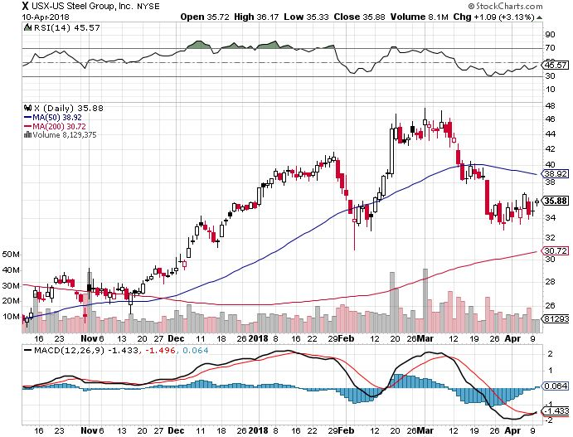
US Steel (X)- took profits on long the 9/$21-$22 vertical bull call spread

Slide 33
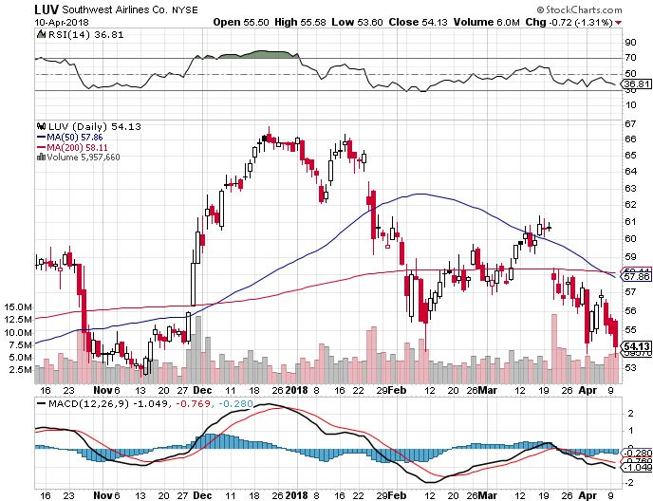
Southwest Airlines (LUV)-
Warren Buffett’s Favorite Airline

Slide 34
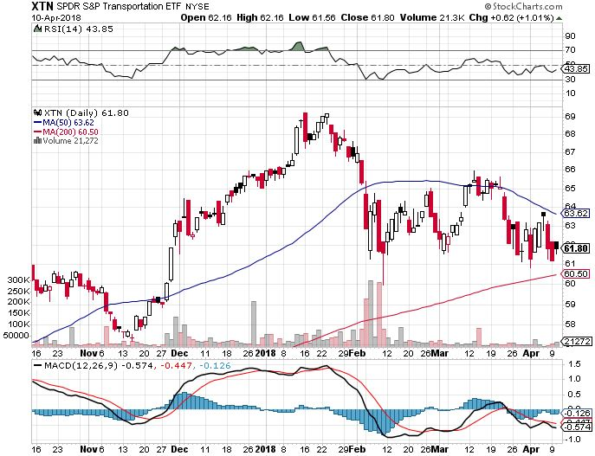
Transports Sector SPDR (XTN)-
(ALGT), (ALK), (JBLU), (LUV), (CHRW), (DAL)

Slide 35
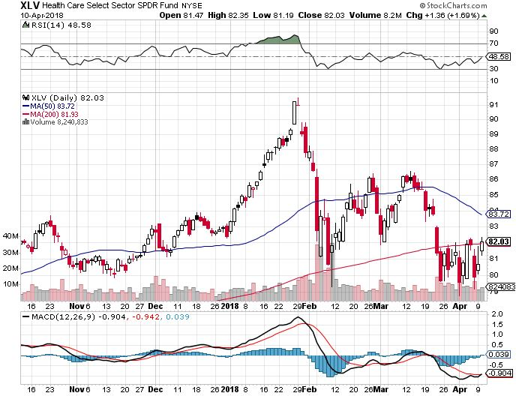
Health Care Sector (XLV), (RXL)-The New FANG?
(JNJ), (PFE), (MRK), (GILD), (ACT), (AMGN)

Slide 36
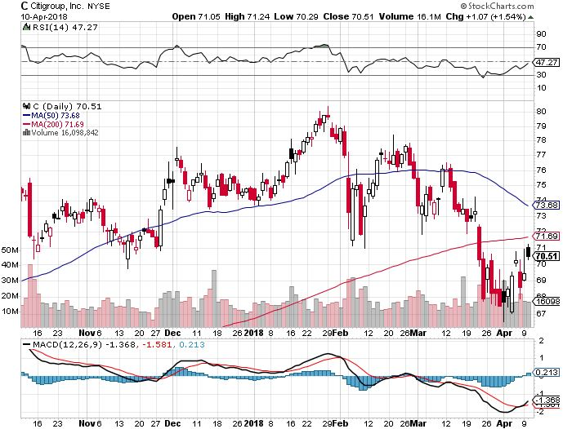
Citigroup (C)-Earnings on Friday up 25% long 6/$60-$65 bull call spread

Slide 37
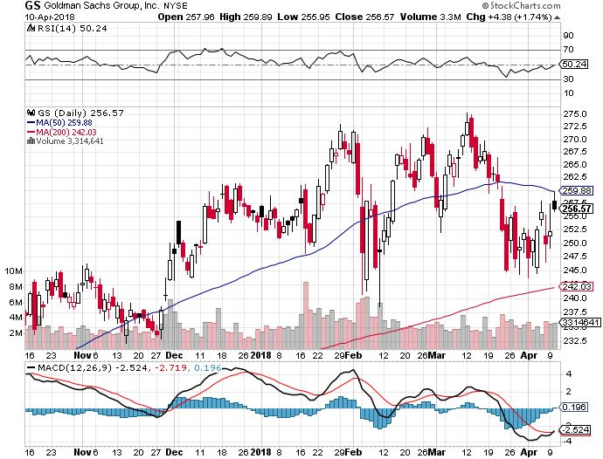
Goldman Sachs (GS)-Earnings Disappointment on bond losses stopped out of long 4/240-$245 call spread stopped out of long 10/$220-$225 vertical bull call spread took profits on long 10/$227.50-$232.50 vertical bull call spread

Slide 38
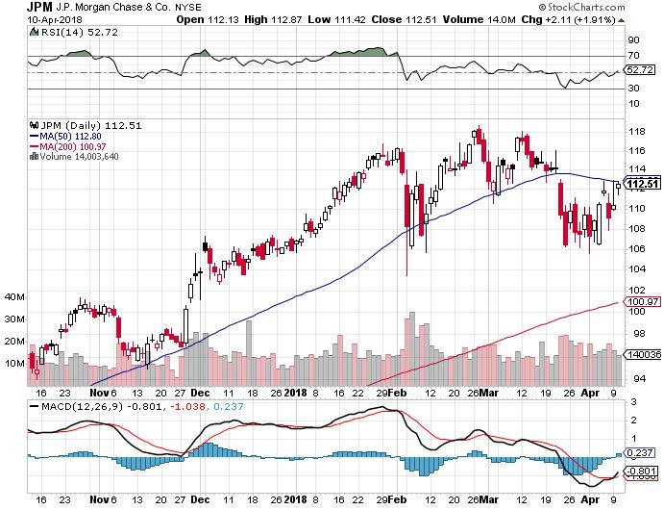
JP Morgan (JPM)- long 4/$95-$100 call spread- Expires in 7 trading days

Slide 39
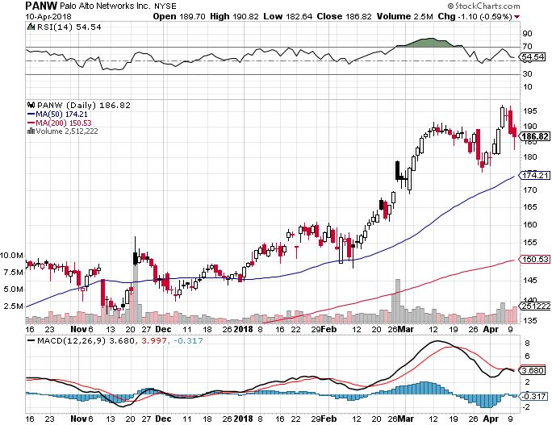
Palo Alto Networks (PANW)-

Slide 40
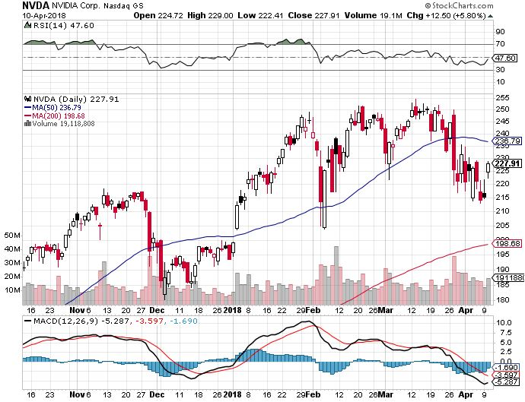
NVIDIA (NVDA)-
End of chip cycle fears

Slide 41
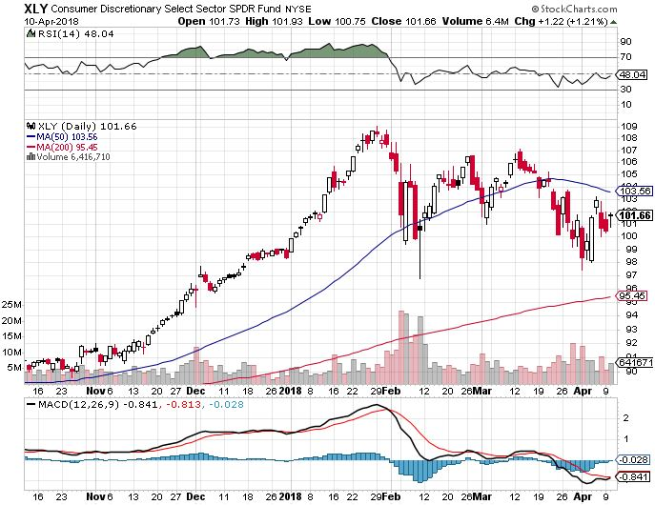
Consumer Discretionary SPDR (XLY)
(DIS), (AMZN), (HD), (CMCSA), (MCD), (SBUX)

Slide 42
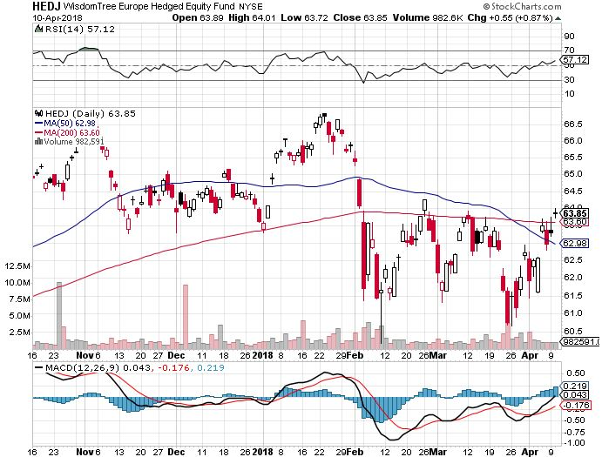
Europe Hedged Equity (HEDJ)-Global Rally

Slide 43
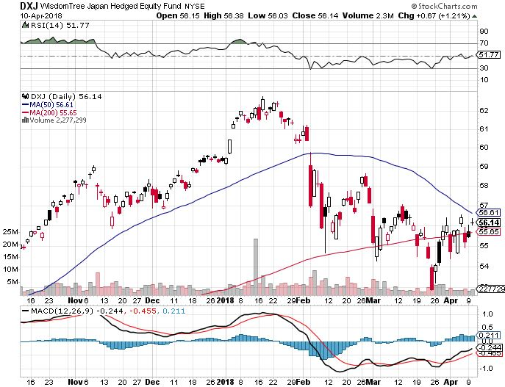
Japan (DXJ)-

Slide 44
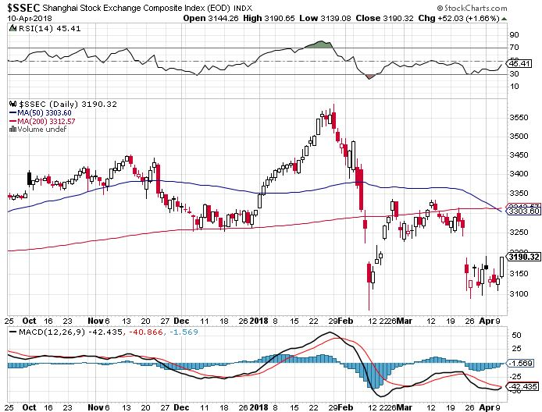
China ($SSEC)-Economic Recovery on Track

Slide 45
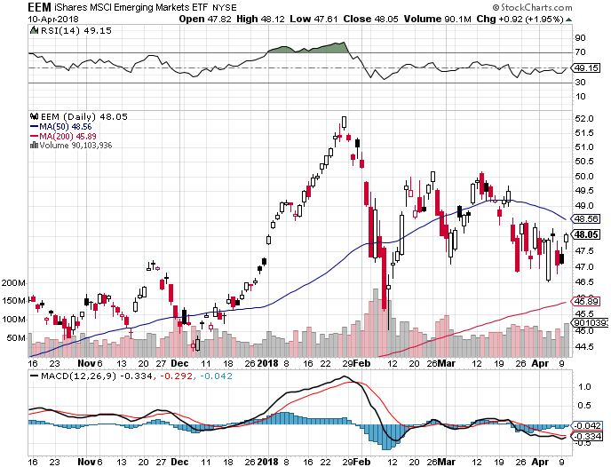
Emerging Markets (EEM)- New High

Slide 46

Bonds- Ignoring the Chaos
*Fed to raise interest rates by 0.25% again in June
*Bond market still stalls with yields at four year highs, digesting recent large falls, not reacting at all to “risk off” stock collapse
*A 10 basis point drop in yields on a 13% drop in stocks?
*Is why we’re running a double short in the (TLT)
*Global liquidity is shrinking much faster overseas that it is here in the US
*Still looking for 3.25%-3.5% ten year
US Treasury myield by yearend
*China says “everything is on the table
regarding existing $1 trillion in US bond
holdings, but bond market isn’t buying it

Slide 47
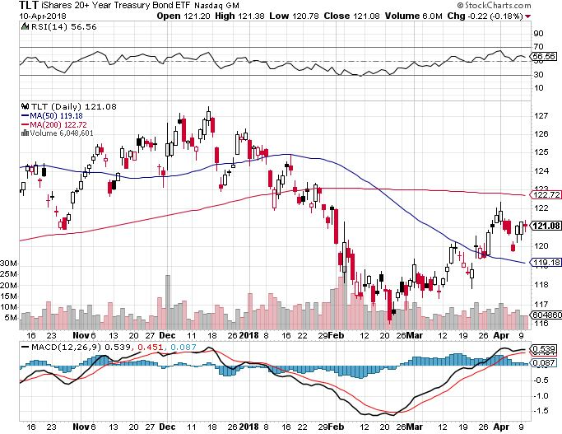
Treasury ETF (TLT) – 2.78 Bottoming Out long 5/$124-$127 vertical bear put spread long 4/$123-$126 vertical bear put spread – expires in 10 trading days
Took profits on long the (TLT) 2/$124-$127 vertical bear put spread again

Slide 48
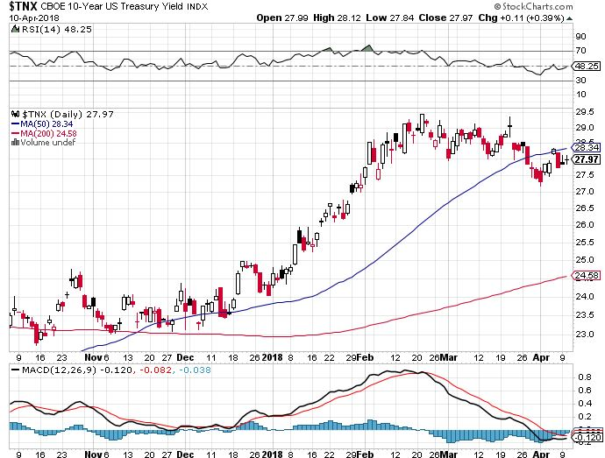
Ten Year Treasury Yield ($TNX) 2.79%
Breakdown, Now major Support

Slide 49
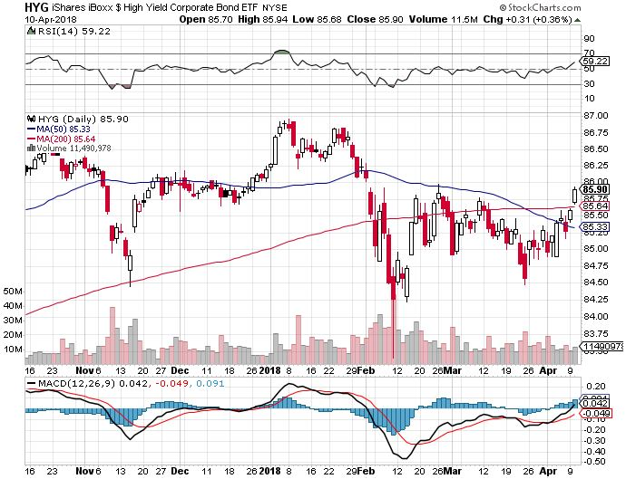
Junk Bonds (HYG) 5.39% Yield
60 basis point pop in yield on stock crash

Slide 50
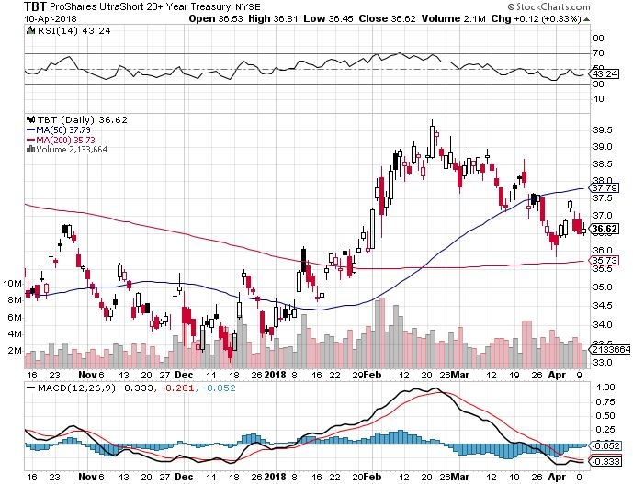
2X Short Treasuries (TBT)-

Slide 51
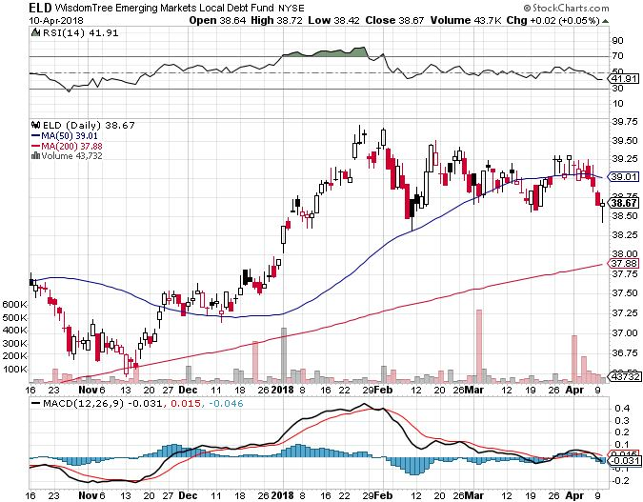
Emerging Market Debt (ELD) 5.58% Yield-

Slide 52
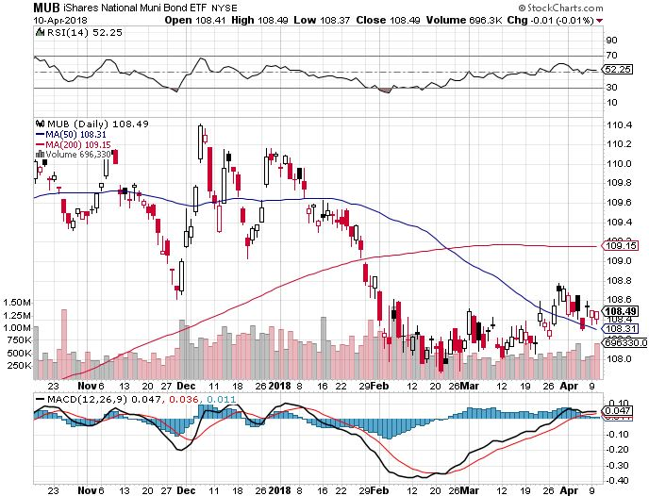
Municipal Bonds (MUB)-2.08%
Mix of AAA, AA, and A rated bonds
Huge 40 basis point yield pop on tax bill

Slide 53

Foreign Currencies- Gone to Sleep
*Chaos in stock market is sending trading capital into stock shorts and away from other asset classes
*US dollar is the big loser in any trade war
*Flat lining charts and ultra low volatility mean there are no good options trades in foreign exchange today
*25% of US corporate earnings came from a weak dollar in 2017, will reverse in 2018
*Bitcoin crashes again, some $25 billion
in capital gains due from US investors in
two weeks and they are selling bitcoin
to make the payment

Slide 54
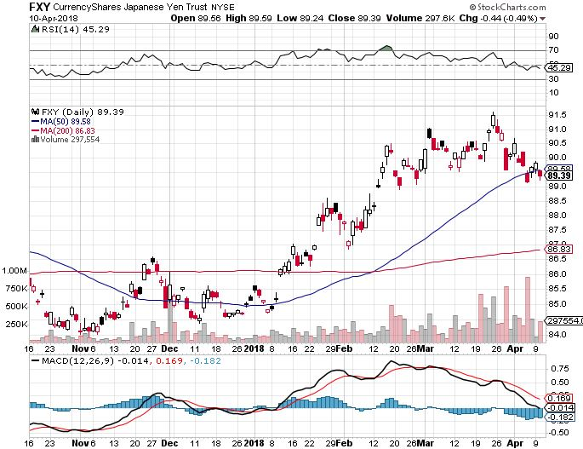
Japanese Yen (FXY), (YCS) took profits on long (FXY) 3/$91-$93 bear put spread

Slide 55
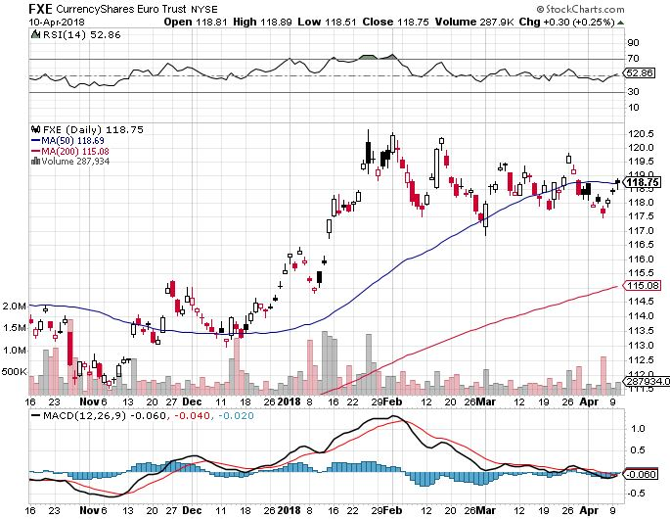
Euro ($XEU), (FXE), (EUO)- Triple Top took profits on long (FXE) 3/$120-$123 vertical bear put spread took profits on long (FXE) 12/$116-$118 vertical bear put spread took profits on long (FXE) 12/$111-$113 vertical bull call spread

Slide 56
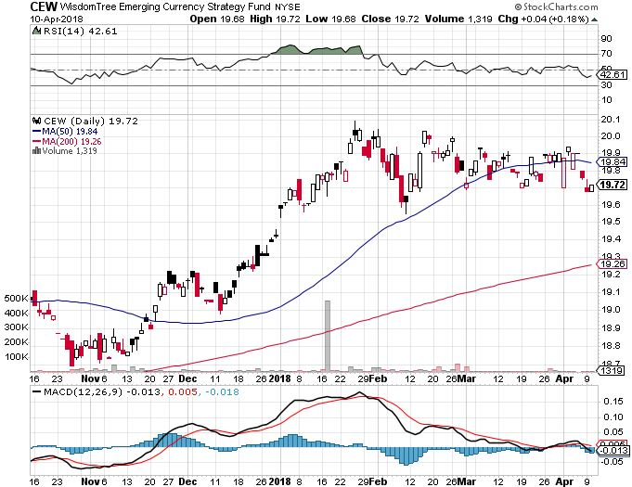
Emerging Market Currencies (CEW)

Slide 57
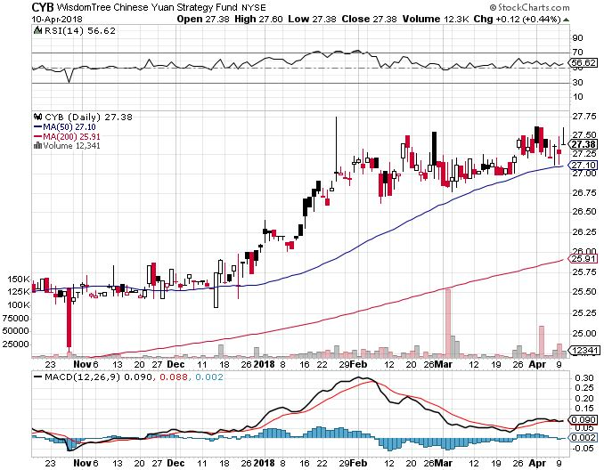
Chinese Yuan- (CYB)-Stabilizing on Government Support

Slide 58

Bitcoin-Modern Day Tulips!
Now banned in China and South Korea, Feds closing in for the US, tax overhang

Slide 59

Energy-Double Topping
*Oil charts are double topping, hinting at global economic slowdown
*China starts trading oil futures priced in renminbi as they become the world’s largest oil importer
*Bahrain discovers massive new field using fracking technology
*Small backwardation in the futures markets hints at continued price weakness
*Fracking supply is on the rebound,
Baker Hughes US Rig Count rises
sharply by 11 to 808

Slide 60

Oil-Double Top Warning?

Slide 61

United States Oil Fund (USO)

Slide 62

Energy Select Sector SPDR (XLE)-No Performance!
(XOM), (CVX), (SLB), (KMI), (EOG), (COP)

Slide 63

Alerian MLP ETF (AMLP)- Basket Approach

Slide 64

Exxon (XOM)-Earnings Dive

Slide 65

Schlumberger (SLB)-

Slide 66

Halliburton (HAL)-

Slide 67

Natural Gas (UNG)-

Slide 68

Copper (COPX)-Trade War Fears

Slide 69

Precious Metals-Syria Worries
*Sudden worries about imminent war with Syria with Russian involvement sends gold soaring
*Venezuela is almost certainly the big seller above, but they will run out of gold within a year
*Russian, Chinese, and Turkish central banks are the buyers, supporting prices
*Gold is finally outperforming Bitcoin too
*Buy gold and silver stocks
on the next big dip, as it is
still early days for the bull market

Slide 70

Gold (GLD)-Upside Breakout Imminent! long 5/$119-$122 bull call spread
Stopped out of 2/$122-$125 bull call spread for small loss took profits on long (GLD) $12/$116-$119 bull call spread

Slide 71

Market Vectors Gold Miners ETF- (GDX)
Took profits on long the 9/$20.50-$21.50 bull call spread

Slide 72

Barrick Gold (ABX) stopped out of long 9/$15-16 call spread

Slide 73

Newmont Mining- (NEM)-Breakout stopped out of 2/$36-$39 bull call spread for small loss took profits on long the 9/$32-$34 bull call spread

Slide 74

Global X Silver Miners ETF- (SIL)-Breakout took profits on long the 9/$31-$33 bull call spread

Slide 75

Real Estate- Cooling?
*February Index of Pending Home Sales rose 3.1% to 107.5
*Stock market volatility is starting to scare away homebuyers, as seen in falling mortgage applications
*National home equity hits $5.4 trillion, now 10% higher than the 2005 peak
*High end real estate starting to cool
*Subprime is making a big come back as
entry level buyers struggle to deal with
high prices
*S&P 500 Case-Shiller maintains
strong 6.3%, with absolute prices
hitting new all time highs

Slide 76

January Corelogic S&P Case Shiller Home Price Index
+6.2% YOY, Seattle (+12.7%), Las Vegas (+11.1%), San Francisco (+9.2%) still leaders price rises accelerating

Slide 77

Simon Property Group (SPG)-

Slide 78

US Home Construction Index (ITB)
(DHI), (LEN), (PHM), (TOL), (NVR)

Slide 79

Trade Sheet-
So What Do We Do About All This?
*Stocks- Trade the Range
*Bonds-sell any and all rallies
*Commodities-stand aside
*Currencies-stand aside
*Precious Metals –buy dips
*Volatility-go short on runs up to $25
*Real estate-buy dips

Slide 80

Next Strategy Webinar
12:00 EST Wednesday, April 25, 2018
San Francisco, CA
For Lunches Please Go to www.madhedgefundtrader.com and click “Store”
Good Luck and Good Trading!
Notes:
*

