Slide 1
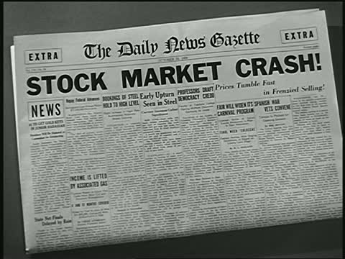
The Mad Hedge Fund Trader
“Sell the News!”
With John Thomas
from Silicon Valley, CA, April 25, 2018
www.madhedgefundtrader.com
Notes:
*

Slide 2

Special Guest Host
*Mike Pisani
*A ten year veteran options trader
*A natural swing trader
*www.smartoptiontrading.com

Slide 3
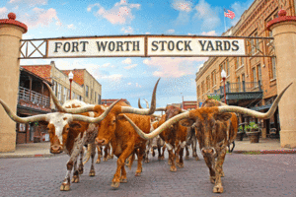
MHFT Global Strategy Luncheons
Buy tickets at www.madhedgefundtrader.com
Fort Worth, TX
June 11

Slide 4
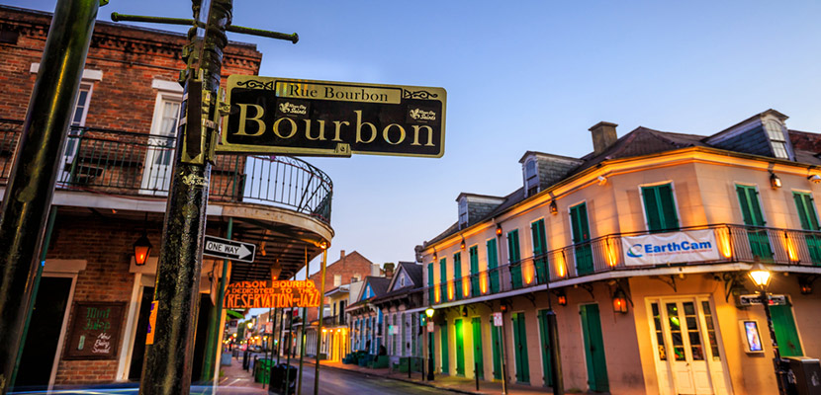
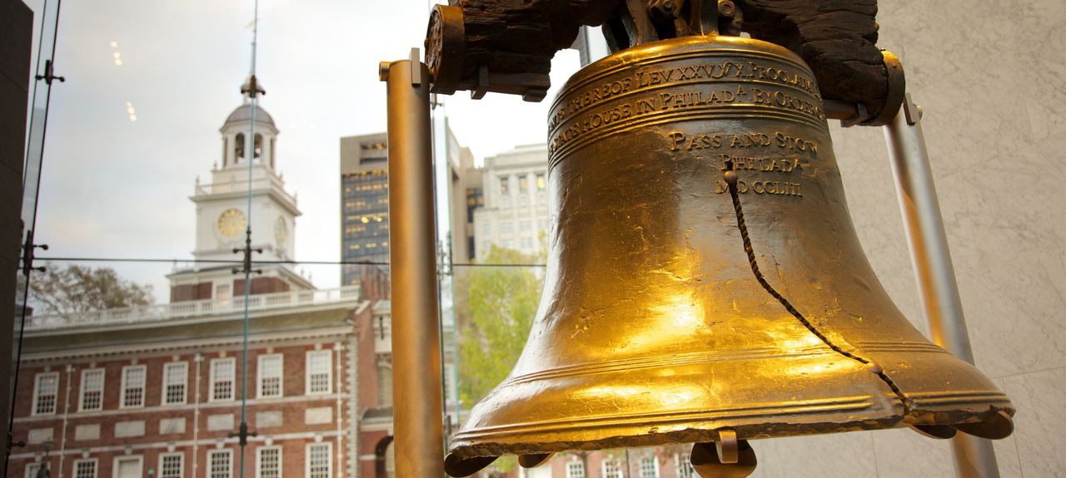
MHFT Global Strategy Luncheons
Buy tickets at www.madhedgefundtrader.com
New Orleans, LA
June 12
Philadelphia, PA
June 13

Slide 5
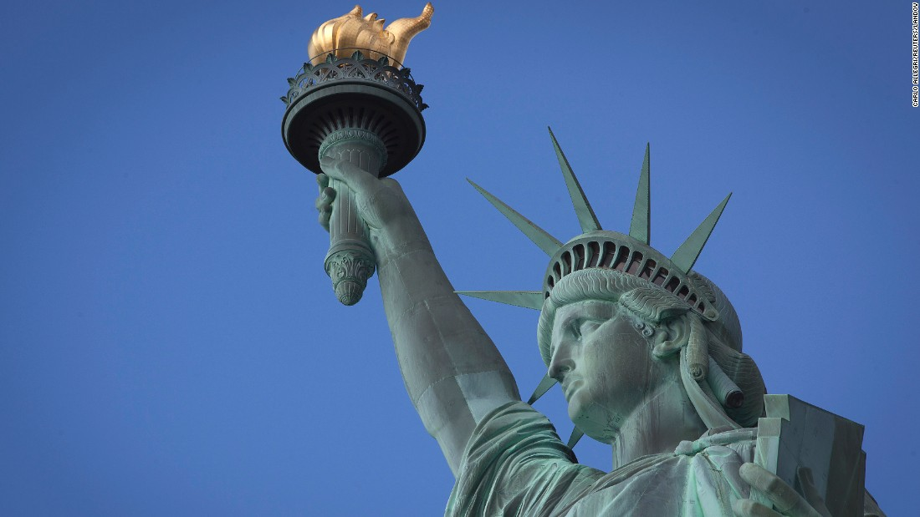
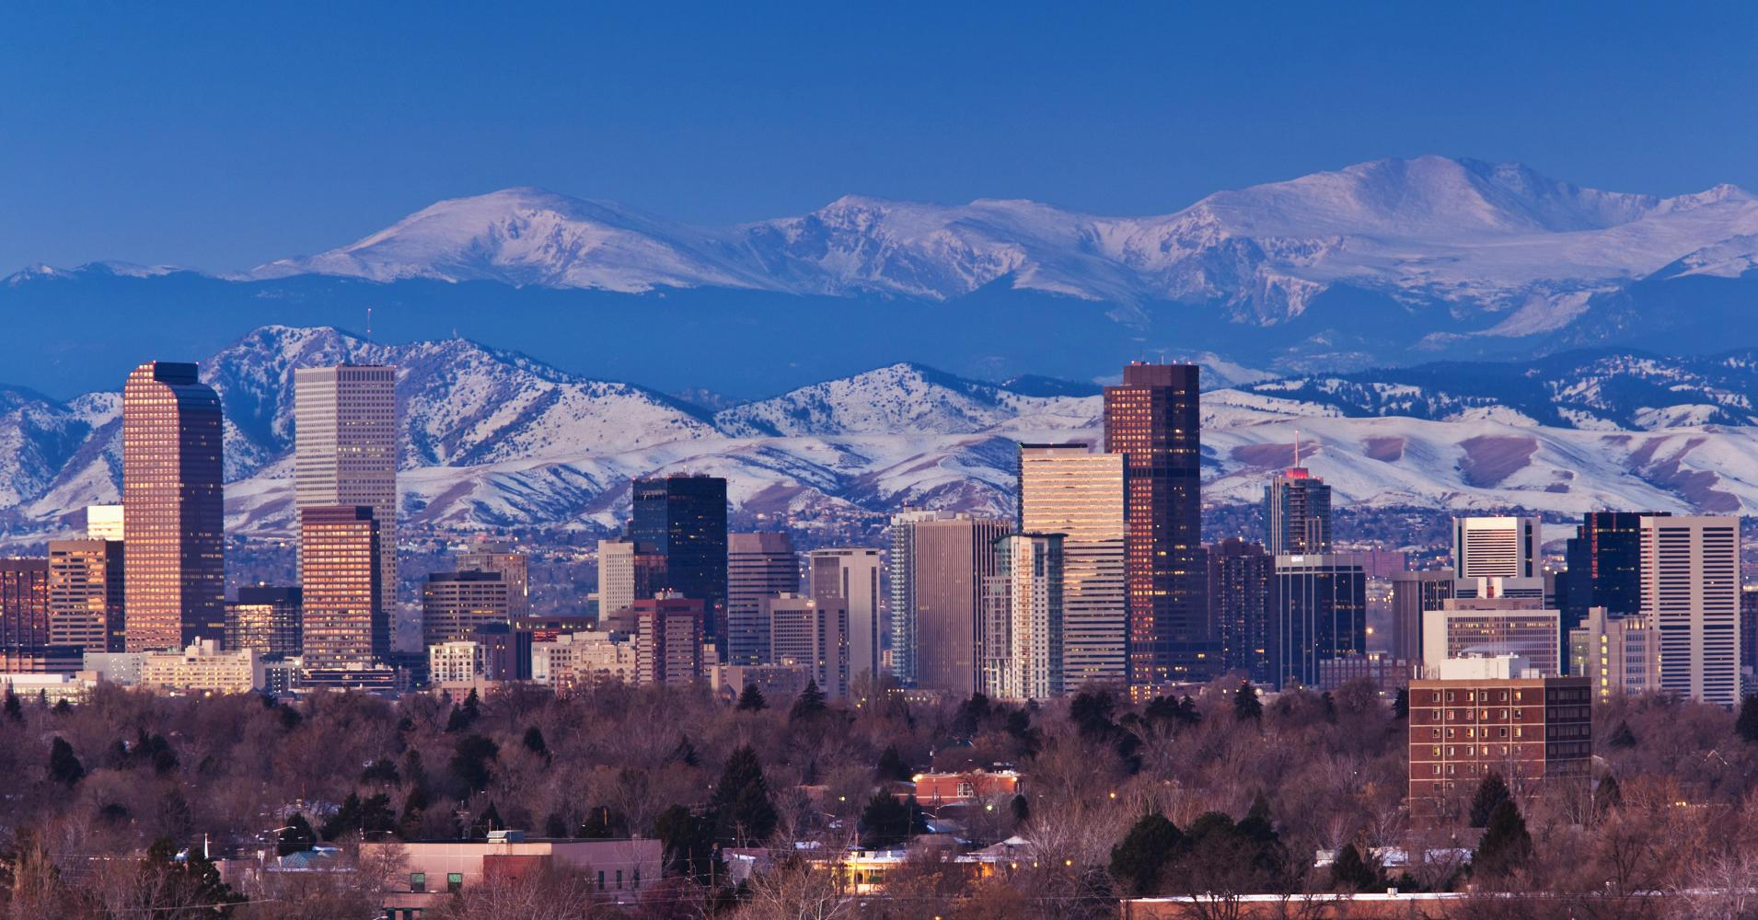
MHFT Global Strategy Luncheons
Buy tickets at www.madhedgefundtrader.com
New York, NY
June 14
Denver, CO
June 15
Soon to be Posted: The Queen Mary II Seminar at Sea in July, Paris, France, Zermatt, Switzerland, and Geneva Switzerland

Slide 6

Trade Alert Performance
New All Time High!!
*January 4.09% Final *July +1.95% Final
*February +1.54% Final *August +18.38% Final
*March +1.13% Final *September +7.65% Final
*April +12.83% MTD *October +1.39% Final
*May -0.45% Final *November +2.08% Final
*June +0.70% Final *December +3.76% Final
*2018 Year to Date 19.59%
compared to -1.27% for the Dow Average
*Trailing One year return +56.09%, +296.06% since inception,
*Average annualized return of 35.55%

Slide 7
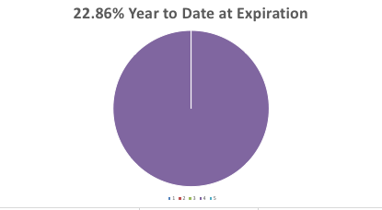
Portfolio Review
90% Cash/ 10% ”RISK OFF”
Ran to sidelines anticipating market melt down
Hedges paid off big time
Current Capital at Risk
Risk On
World is Getting Better
Risk Off
(GLD) 5/$121-$124 call spread | -10.00%
Total Net Position | -10.00%

Slide 8
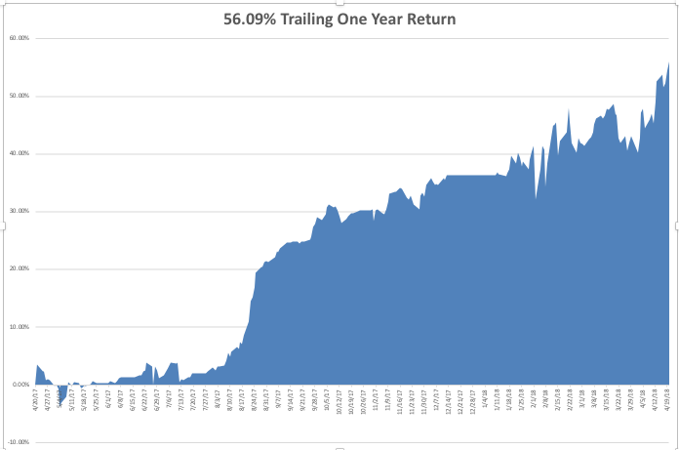
GTD Daily Audited Performance

Slide 9
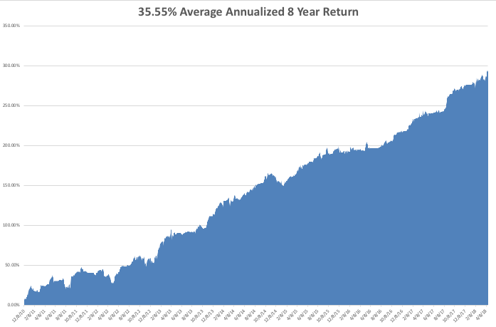
GTD Eight Year Daily Audited Performance

Slide 10
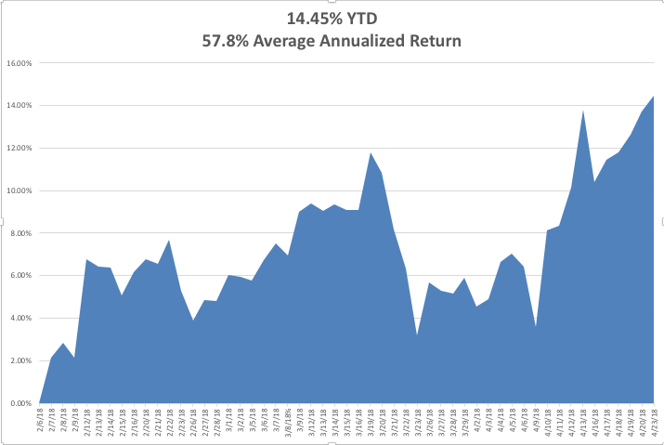
Mad Hedge Technology Letter a $2,000 a year upgrade

Slide 11

The Method to My Madness
*When market reached its first resistance point, I sold almost everything and hedged what I had left with (SPY) puts
*Added a long Volatility Position (VXX) to add spice to my performance
*Banks showed the market’s hand by selling off on good earnings, setting the pattern for every sector
*My view of wide trading ranges until the November election is vindicated
*Sell every bond rally….The Fed is now engaged
in major Quantitative Tightening (QT?)
in the face of exploding deficits
*Stand aside on oil, foreign
currencies, and commodities, which are all
flat lining until multiple crisis end

Slide 12
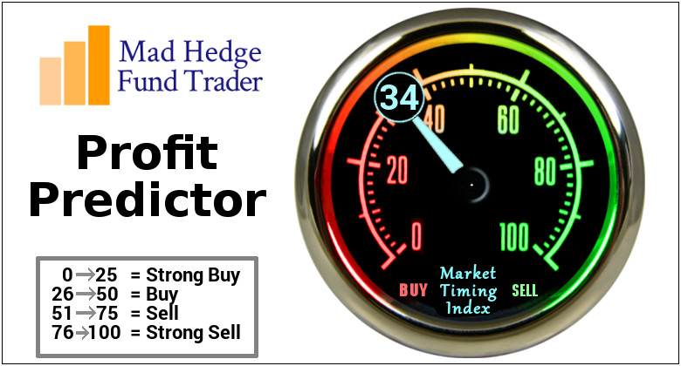
The Mad Hedge Profit Predictor
Market Timing Index-Hits Top of New Range at 42
An artificial intelligence driven algorithm that analyzes 30 different economic, technical, and momentum driven indicators

Slide 13
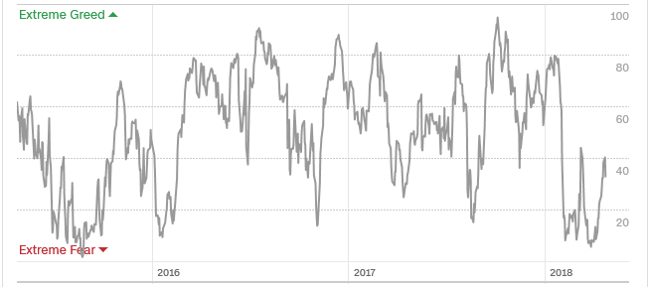
The Mad Hedge Profit Predictor
Collapse Back to Extreme Fear
A New 5-45 Trading Range?
SELL
BUY

Slide 14

The Global Economy – More Slowing
*Business Inventories rise 0.6% in March,
*March Consumer Price Index down 0.1%, so inflation is nowhere in the numbers, but anecdotal and commodity price rises show its everywhere
*IMF predicts Global Growth at a hot 3.9% for 2018 and 2019, 2.9% for the US in 2018, then growth to fall
*Europe is also slowing, with every sector if the German economy now showing negative numbers
*Weak global stock markets creating a negative
wealth effect, bringing recession fears forward

Slide 15
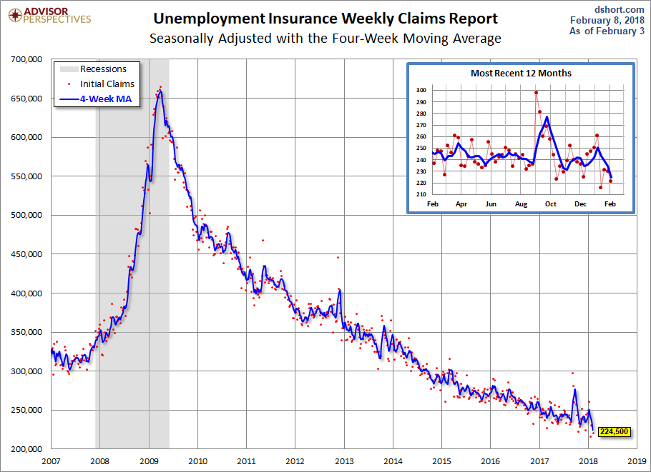
Weekly Jobless Claims –The Most Important Statistic
+1,000 to 232,000-holiday distortions

Slide 16

Stocks- Correction Time
*Stocks fail at first resistance, conforming intermediate term downtrend
*Washington chaos, trade wars, shooting wars, capping any upside moves
*Cheap valuations, specular earnings growth supporting downside
*Some 25% of US earnings came from a falling US dollar in 2017, won’t be there in 2018
*Stocks setting up for a range for the next six months going into the November election
*Only one more weeks until of seasonal
headwind and “Sell in May and Go away”
*Volatility spikes, but at half peak levels
seen in last rout, is in no way reflecting
the massive intraday swings

Slide 17
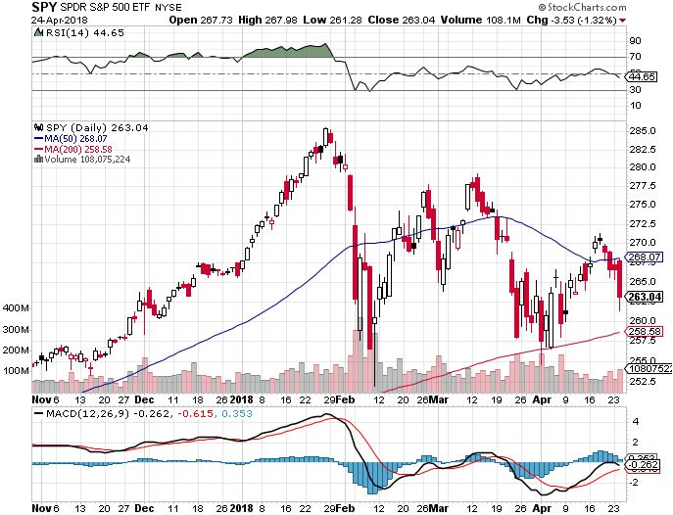
S&P 500-Moving Into a Range
200-day MA in Play took profits on long 5/$277-$280 put spread double weighting

Slide 18
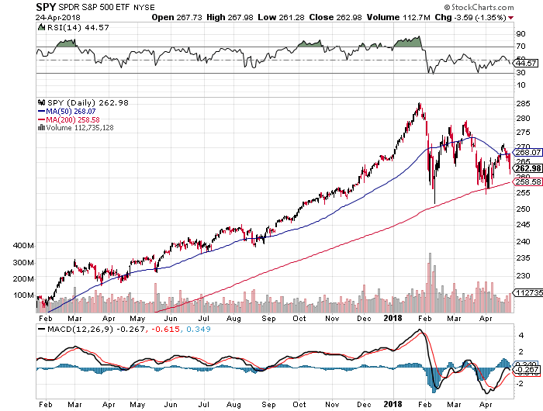
S&P 500-Moving Into a Range
200-day MA in Play, If it fails looks for $245 down another 5% and down 14% from top- PE Multiple of 15X!
Next
support

Slide 19
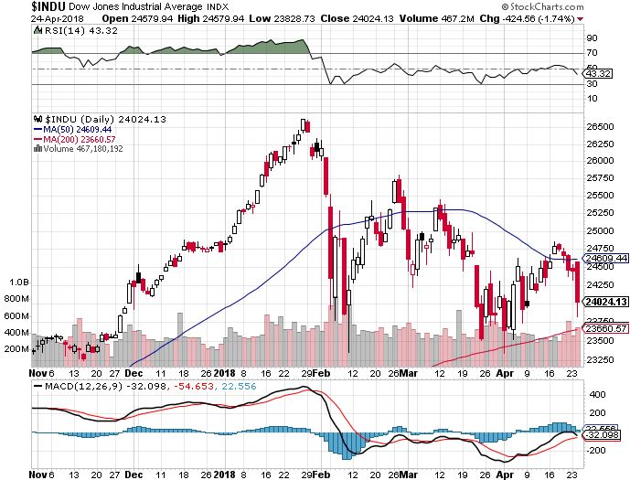
Dow Average- Downtrend

Slide 20
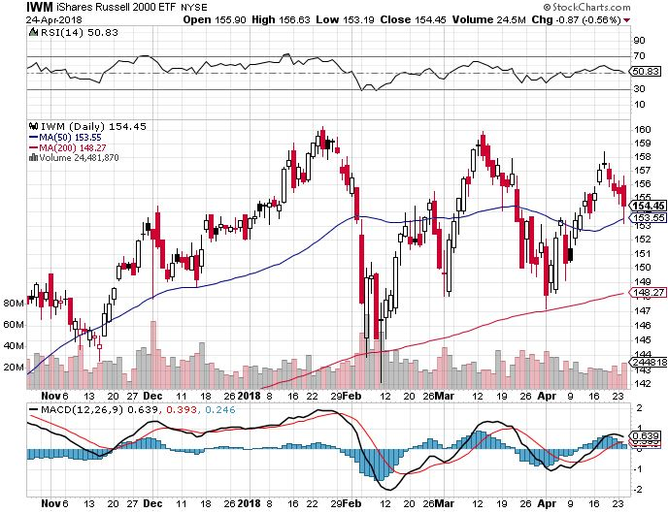
Russell 2000 (IWM)-Peaked Out stopped out of long the (IWM) 12/$152-$155 bear put spread

Slide 21
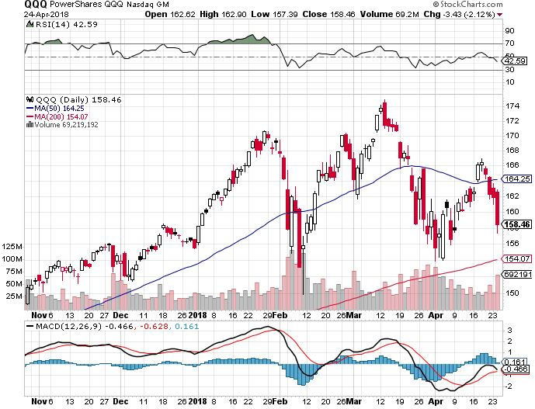
NASDAQ (QQQ)-Head & Shoulders

Slide 22
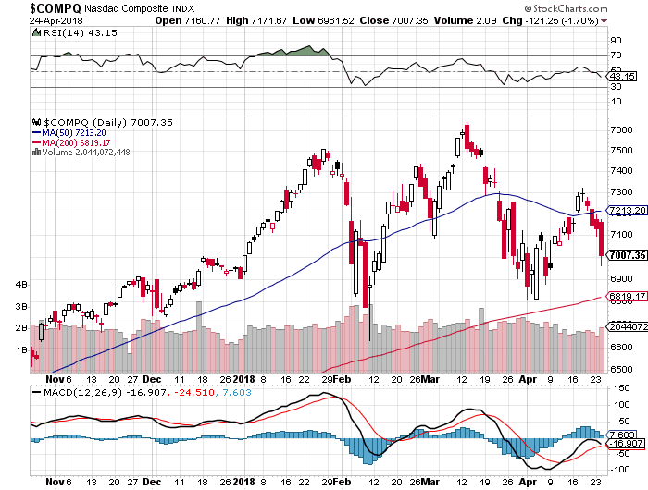
NASDAQ (QQQ)-
Settling Into a Range for the rest of 2018
Washington chaos,
Trade Wars,
Iran, NK, and Syria wars, rising oil
High earnings growth,
Good valuations,
Buybacks,
nothing else to buy

Slide 23
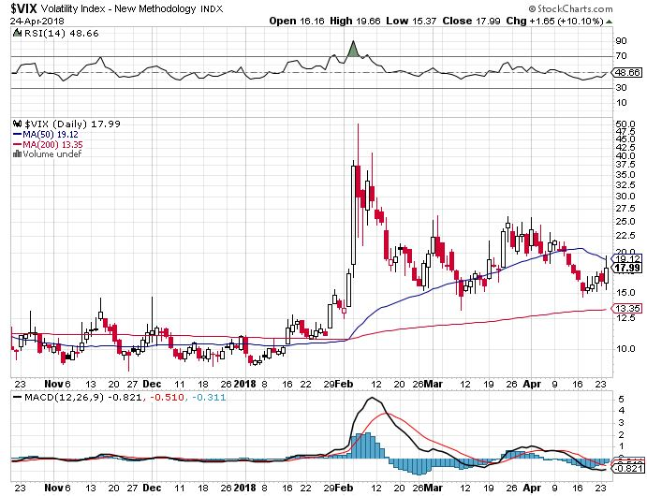
(VIX)-Spike Again!
Up 25% in one day and we were long!
This is
where it
now lives

Slide 24
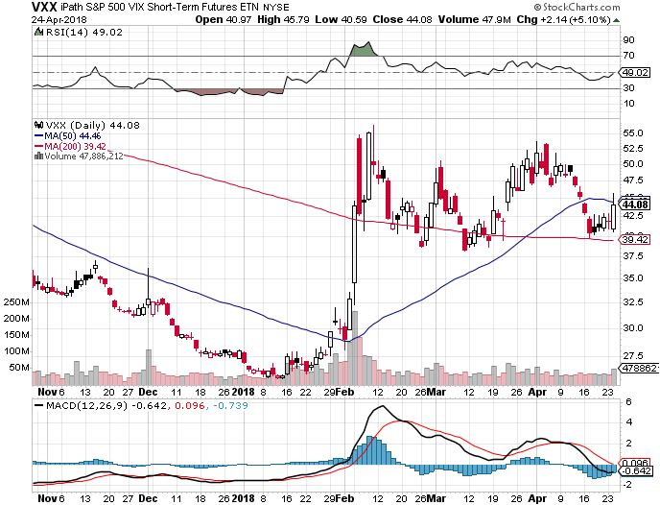
iPath S&P 500 VIX Short-Term Futures ETN (VXX) long 5/$32-$35 call spread took profits on long 3/$60-$65 bear put spread took profits on long 3/$55-$60 bear put spread

Slide 25
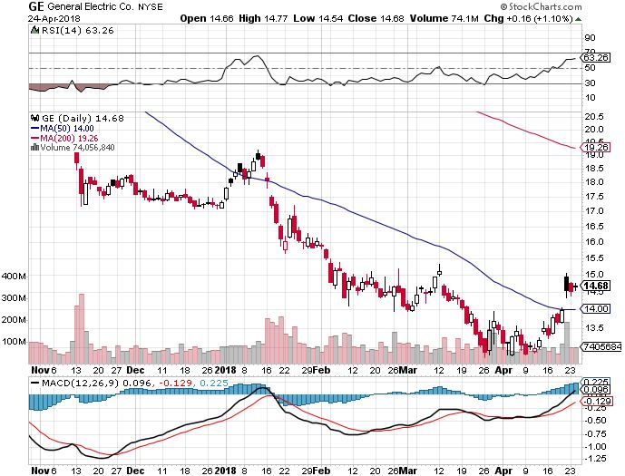
General Electric (GE)-Short Covering Rally
Breakup Value is $15

Slide 26
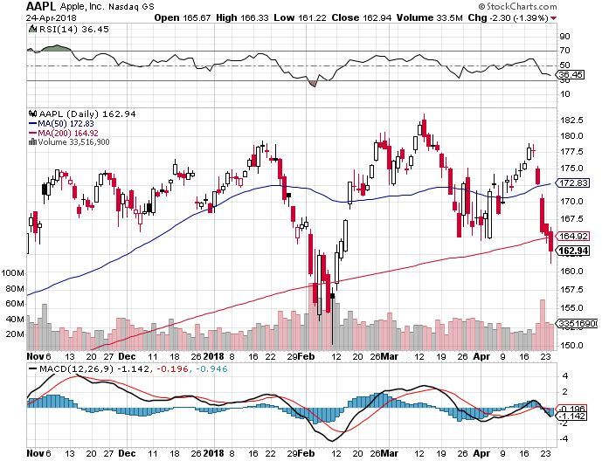
Apple (AAPL)-Waiting for Buy Backs took profits on long 3/$140-$150 calls spread took profits on long 3/$140-$145 calls took profits on long 4/$155-$165 calls spread

Slide 27
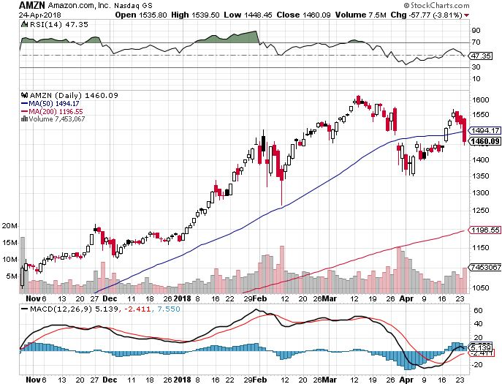
Amazon (AMZN) took profits on long 3/$1200-$1250 call spread (Tech Letter)

Slide 28
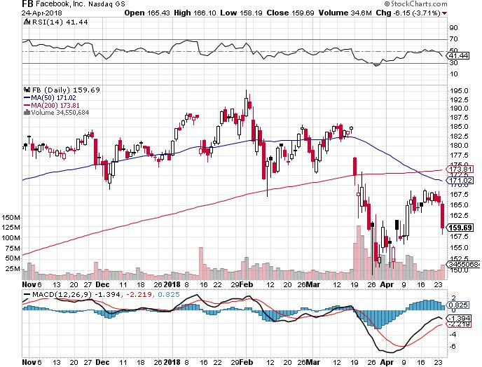
Facebook (FB)- stopped out of long 4/$150-$160 call spread took profits on long 6/$130-$140 bull call spread took profits on long 3/$155-$165 bull call spread took profits on long 3/$190-$195 bear put spread

Slide 29
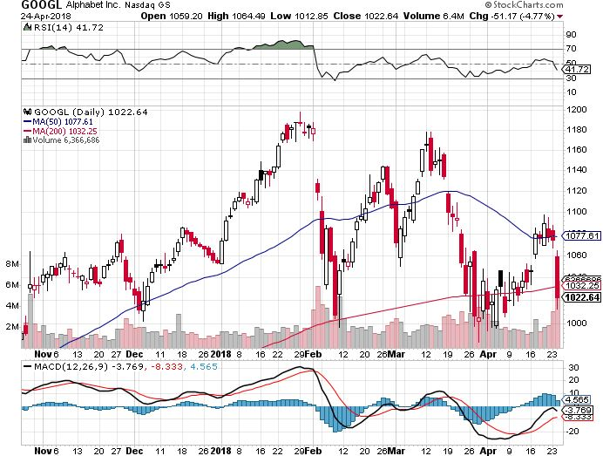
Alphabet (GOOGL)- took profits on long 4/$900-$930 call spread

Slide 30
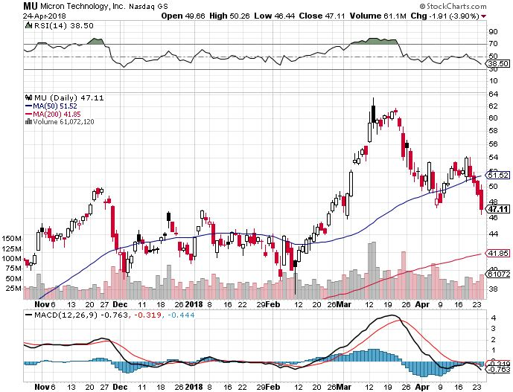
Micron Technology (MU)-Spectacular Earnings took profits on long 3/$34-$37 bull call spread in Mad Hedge Technology Letter Only
UBS bearish report decimates the entire industry

Slide 31
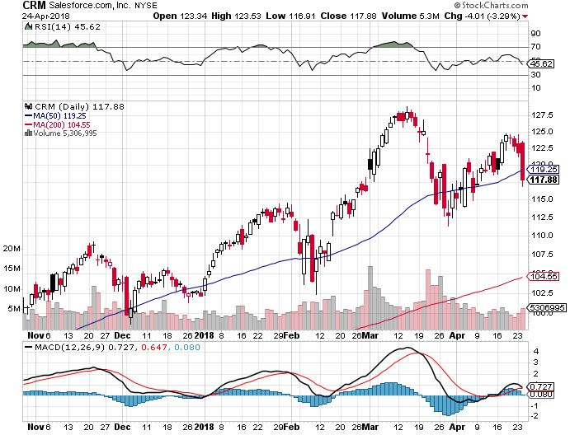
Salesforce (CRM)- took profits on long 6/$105-$110 call spread took profits on long 3/$90-$95 bull call spread in Mad Hedge Technology Letter

Slide 32
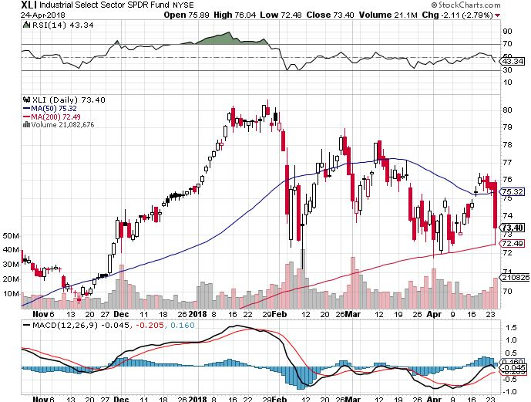
Industrials Sector SPDR (XLI)-
(GE), (MMM), (UNP), (UTX), (BA), (HON)

Slide 33
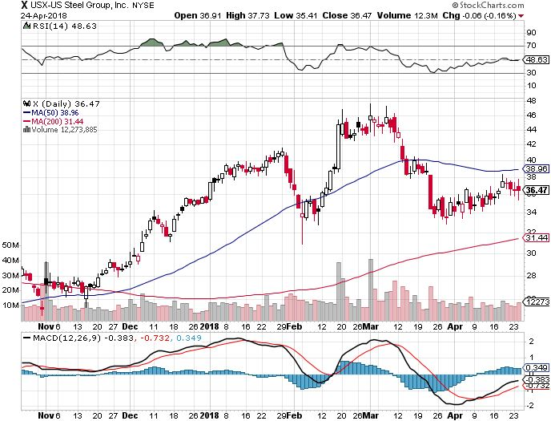
US Steel (X)- took profits on long the 9/$21-$22 vertical bull call spread

Slide 34
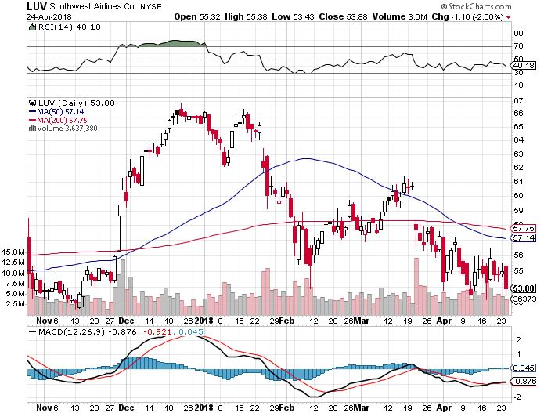
Southwest Airlines (LUV)-
Warren Buffett’s Favorite Airline

Slide 35
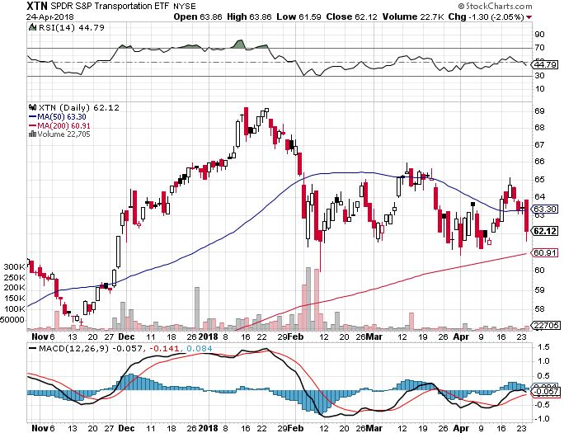
Transports Sector SPDR (XTN)-
(ALGT), (ALK), (JBLU), (LUV), (CHRW), (DAL)

Slide 36
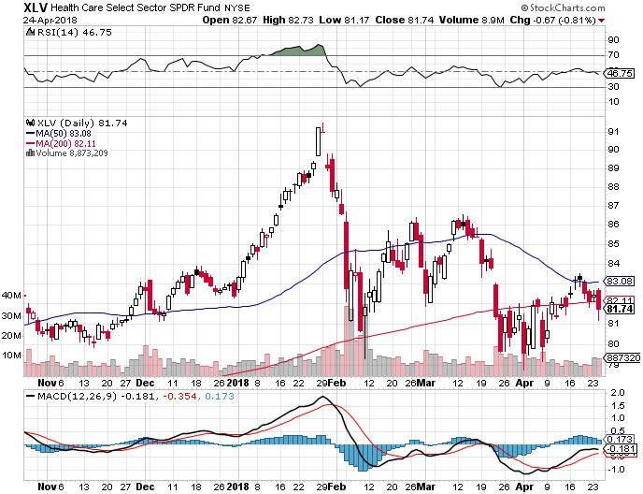
Health Care Sector (XLV), (RXL)-The New FANG?
(JNJ), (PFE), (MRK), (GILD), (ACT), (AMGN)

Slide 37
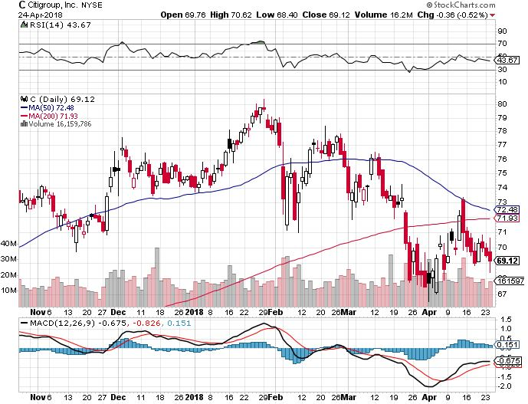
Citigroup (C)-Earnings on Friday up 25% long 6/$60-$65 bull call spread

Slide 38
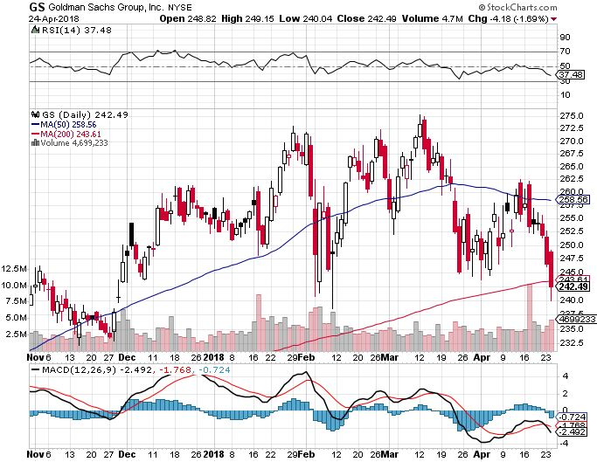
Goldman Sachs (GS)-Earnings Disappointment on bond losses stopped out of long 4/240-$245 call spread stopped out of long 10/$220-$225 vertical bull call spread took profits on long 10/$227.50-$232.50 vertical bull call spread

Slide 39
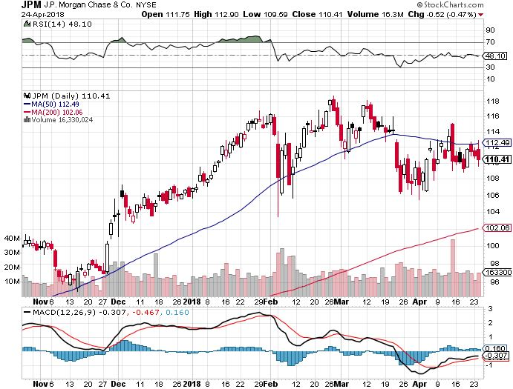
JP Morgan (JPM)- took profits on long 4/$95-$100 call spread

Slide 40
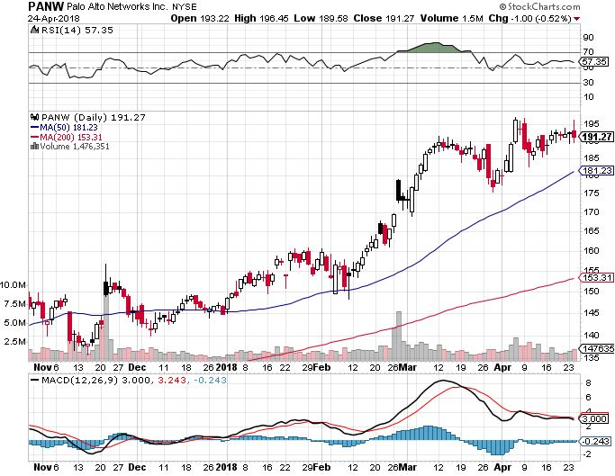
Palo Alto Networks (PANW)-

Slide 41
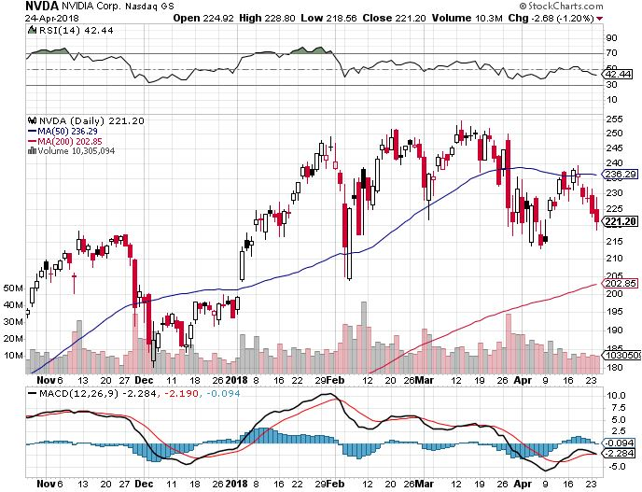
NVIDIA (NVDA)-
End of chip cycle fears

Slide 42
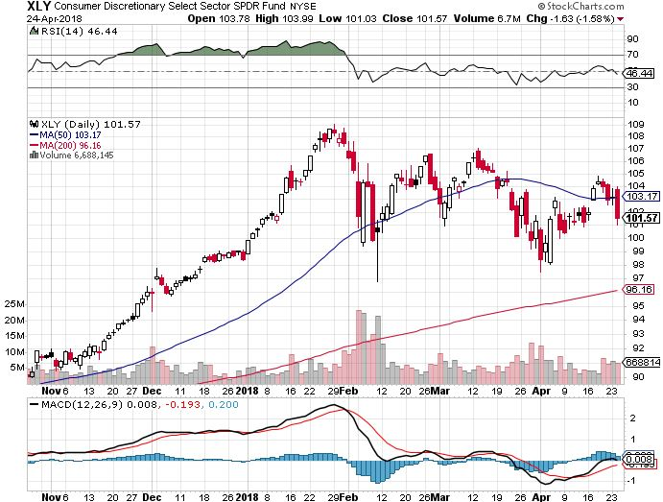
Consumer Discretionary SPDR (XLY)
(DIS), (AMZN), (HD), (CMCSA), (MCD), (SBUX)

Slide 43
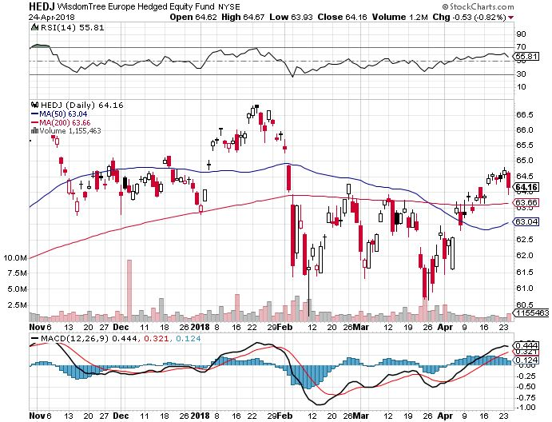
Europe Hedged Equity (HEDJ)-Global Rally

Slide 44
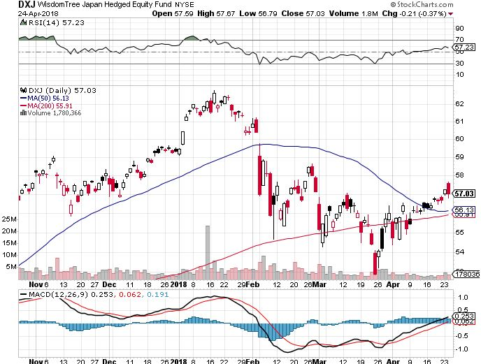
Japan (DXJ)-Falling Yen Move

Slide 45
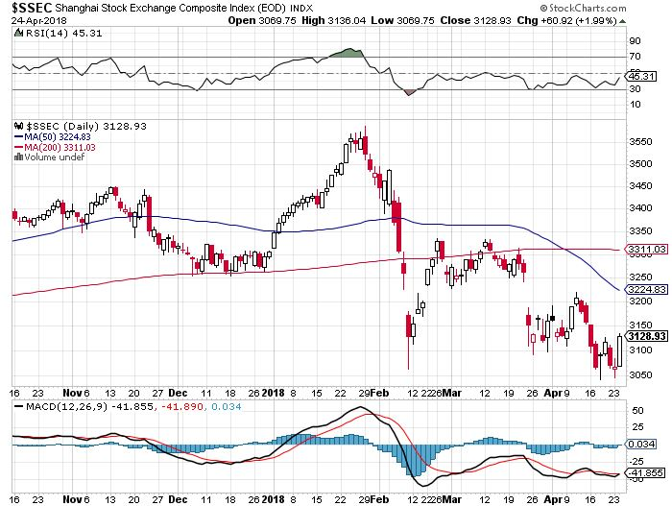
China ($SSEC)-Economic Recovery on Track

Slide 46
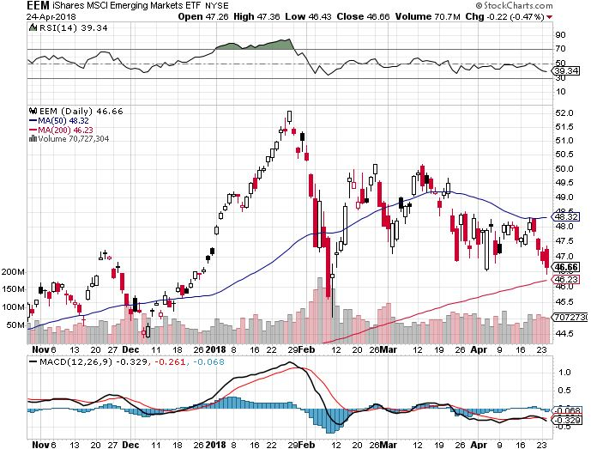
Emerging Markets (EEM)- High Beta is Fading

Slide 47

Bonds- 3% Breakout!
*Bonds hit a new 4 years low, yields a four year high at 3.01%
The next big move in yields is probably down, so avoid all rising rate plays, take profits in the (TBT)
*Fed to raise interest rates by 0.25% again in June
*Took profits on all short bond plays, nothing to
do here but wait for the next bond rally to sell into
*Global liquidity is shrinking much faster
overseas that it is here in the US
*Still looking for 3.25%-3.5% ten year
US Treasury yield by yearend
*Exploding deficit will weigh on bond for the
next decade

Slide 48
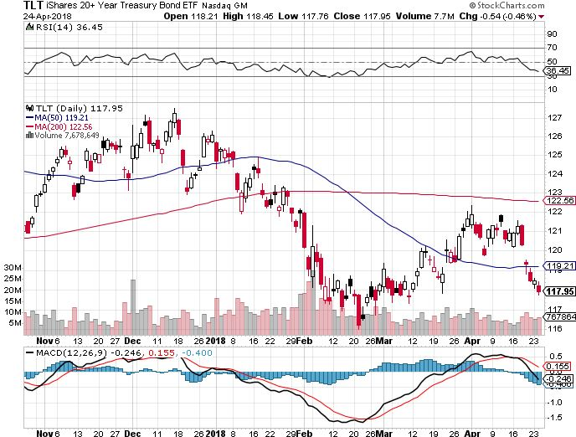
Treasury ETF (TLT) – 2.78 Bottoming Out took profits on long 5/$124-$127 vertical bear put spread took profits on long 4/$123-$126 vertical bear put spread
Took profits on long the (TLT) 2/$124-$127 vertical bear put spread again

Slide 49
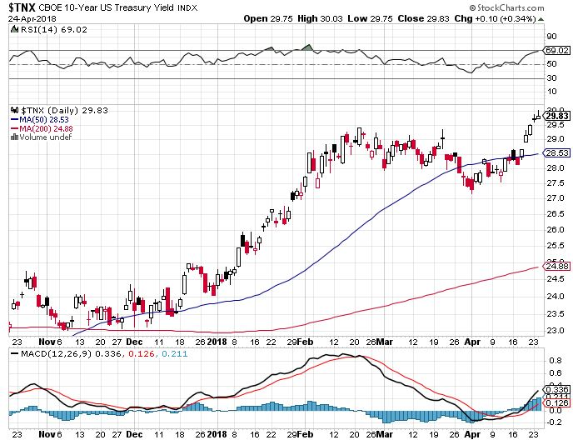
Ten Year Treasury Yield ($TNX) 2.98%
Breakdown, Now major Support

Slide 50
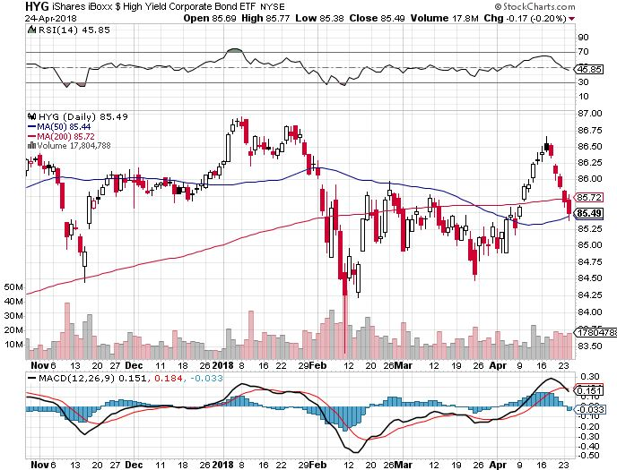
Junk Bonds (HYG) 5.51% Yield
60 basis point pop in yield on stock crash

Slide 51
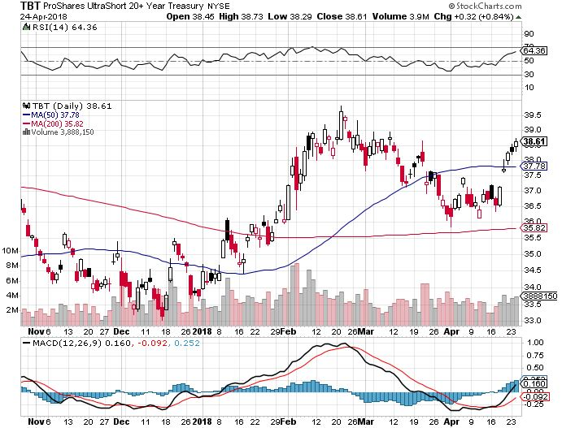
2X Short Treasuries (TBT)- Take Profits

Slide 52
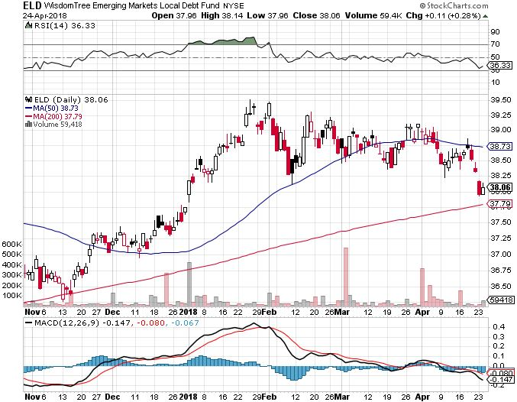
Emerging Market Debt (ELD) 5.68% Yield-

Slide 53
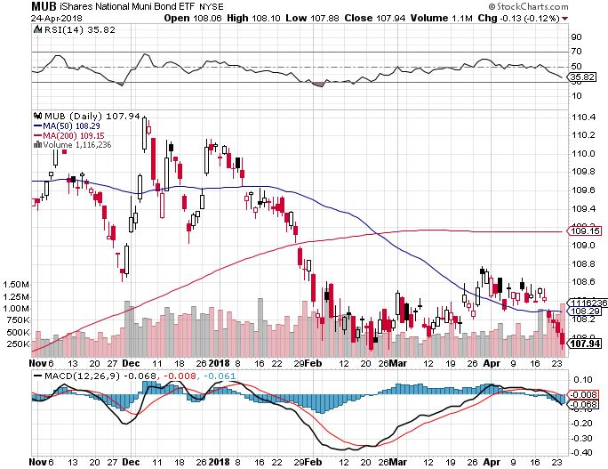
Municipal Bonds (MUB)-2.32%
Mix of AAA, AA, and A rated bonds
Huge 40 basis point yield pop on tax bill

Slide 54
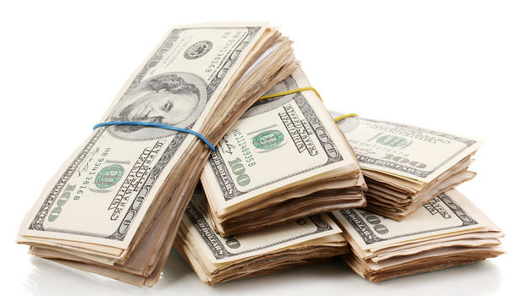
Foreign Currencies- Breakdown
*Flight to safety bid sends dollar soaring
*Euro and Japanese yen collapse to low end of ranges as hedge funds unwind short positions
*Still no trade, no volatility
*End of tax season reduces major $25 billion overhang for bitcoin, severing the ling between cryptocurrencies and stocks

Slide 55

Japanese Yen (FXY), (YCS) took profits on long (FXY) 3/$91-$93 bear put spread

Slide 56

Euro ($XEU), (FXE), (EUO)- Triple Top took profits on long (FXE) 3/$120-$123 vertical bear put spread took profits on long (FXE) 12/$116-$118 vertical bear put spread took profits on long (FXE) 12/$111-$113 vertical bull call spread

Slide 57

Australian Dollar (FXA)

Slide 58

Emerging Market Currencies (CEW)

Slide 59

Chinese Yuan- (CYB)-Stabilizing on Government Support

Slide 60

Bitcoin-Modern Day Tulips!
Now banned in China and South Korea, Feds closing in for the US, tax overhang ends

Slide 61

Energy-The Geopolitical Premium is Back!
*Continued instability in the Middle East has put a premium back into oil process for the first time in six years
*Oil supply/demand is now in balance, working off a five year glut, the next geopolitical event could send it up $10 quickly
*OPEC has cut the over supply of oil by 97% in three years, taking prices up from $25 to $$68/barrel
*Saudi Arabia now looking to extend production quotas into 2019, which have been hugely successful
*Fracking supply is on the rebound,
Baker Hughes US Rig Count rises
sharply by 5 to 1,013
*US fracking is growing so fast that
suppliers are now pipeline constrained

Slide 62

Oil-New High and Inflation Push

Slide 63

United States Oil Fund (USO)

Slide 64

Energy Select Sector SPDR (XLE)-No Performance!
(XOM), (CVX), (SLB), (KMI), (EOG), (COP)

Slide 65

Alerian MLP ETF (AMLP)- Basket Approach

Slide 66

Exxon (XOM)-Earnings Dive

Slide 67

Schlumberger (SLB)-

Slide 68

Halliburton (HAL)-

Slide 69

Natural Gas (UNG)-

Slide 70

Copper (COPX)-Trade War Fears

Slide 71

Precious Metals-The Fundamentals are Lining Up
*Gold/silver ratio now falling sharply, points to more prolonged bull market for precious metals
*India has largely been absent from the market this year, awaiting a more extreme move
*Venezuela sold $500 billion of gold in January, at that rates it runs out of gold by May next year
*General rise in all commodities providing
further support for gold, hinting at inflation
*Buy gold and silver stocks
on the next big dip, as it is
still early days for the bull market

Slide 72

Gold (GLD)-Upside Breakout Imminent! long 5/$119-$122 bull call spread
Stopped out of 2/$122-$125 bull call spread for small loss took profits on long (GLD) $12/$116-$119 bull call spread

Slide 73

Market Vectors Gold Miners ETF- (GDX)
Took profits on long the 9/$20.50-$21.50 bull call spread

Slide 74

Barrick Gold (ABX) stopped out of long 9/$15-16 call spread

Slide 75

Newmont Mining- (NEM)-Breakout stopped out of 2/$36-$39 bull call spread for small loss took profits on long the 9/$32-$34 bull call spread

Slide 76

Global X Silver Miners ETF- (SIL)-Breakout took profits on long the 9/$31-$33 bull call spread

Slide 77

Real Estate- Cooling?
*March Existing Home Sales up +1.1%, New Homes Sales up +4%, up 10.3% YOY
*73 consecutive months of price rises
*Most of the buying surge is taking place in the technology driven west
*30 year fixed mortgage approaching 5%, cooling the entry level market
*New tax bill cutting home mortgage
deduction in 2018 by 50%
*REITS crash on rising rates
*S&P 500 Case-Shiller maintains
strong 6.3%, with absolute prices
hitting new all time highs

Slide 78

February Corelogic S&P Case Shiller Home Price Index
+6.3% YOY, Seattle (+12.7%), Las Vegas (+11.6%), San Francisco (+10.1%) still leaders price rises accelerating

Slide 79

Simon Property Group (SPG)-

Slide 80

US Home Construction Index (ITB)
(DHI), (LEN), (PHM), (TOL), (NVR)

Slide 81

Trade Sheet-
So What Do We Do About All This?
*Stocks- Trade the Range
*Bonds-sell any and all rallies
*Commodities-stand aside
*Currencies-stand aside
*Precious Metals –buy dips
*Volatility-go short on runs up to $25
*Real estate-buy dips

Slide 82
Special Guest Host
*Mike Pisani
*A ten year veteran options trader
*A natural swing trader
*www.smartoptiontrading.com

Slide 83

Next Strategy Webinar
12:00 EST Wednesday, May 9, 2018
San Francisco, CA
For Lunches Please Go to www.madhedgefundtrader.com
Good Luck and Good Trading!
Notes:
*

