Slide 1
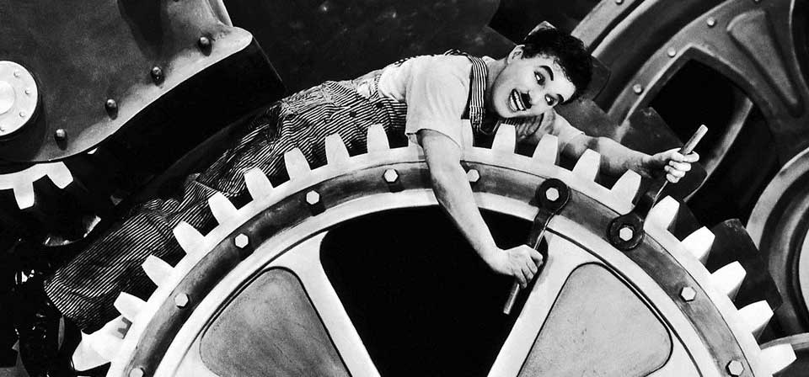
The Mad Hedge Fund Trader
“It’s Tech Time Again”
With John Thomas
from Silicon Valley, CA, June 6, 2018
www.madhedgefundtrader.com
Notes:
*

Slide 2
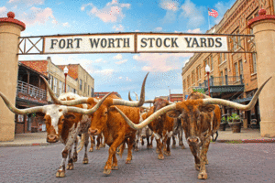
MHFT Global Strategy Luncheons
Buy tickets at www.madhedgefundtrader.com
Fort Worth, TX
June 11

Slide 3
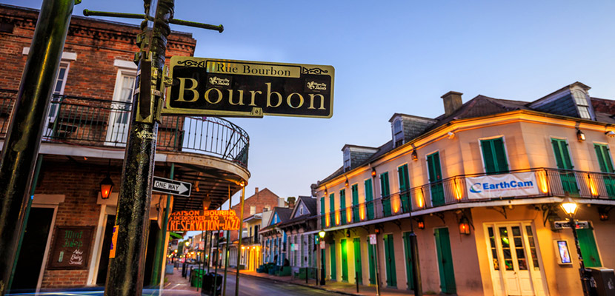
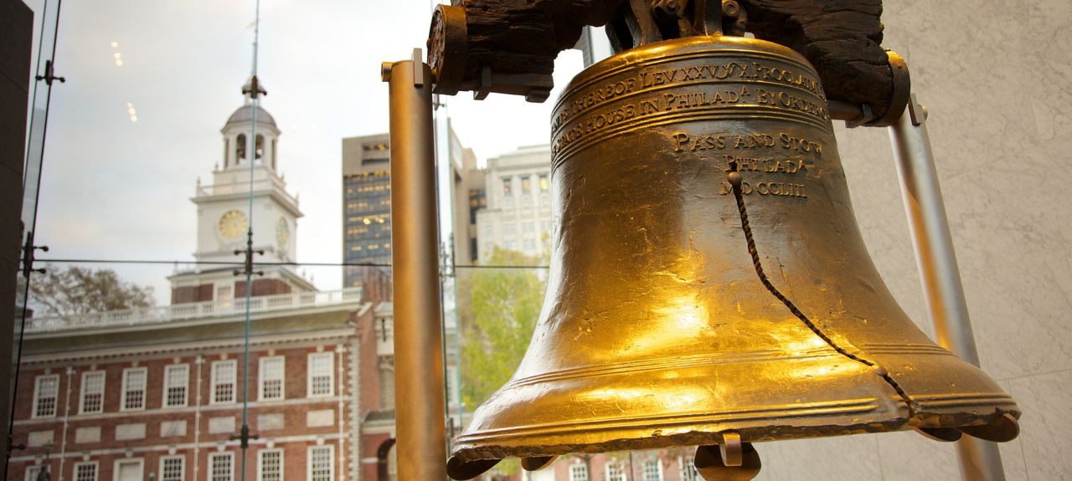
MHFT Global Strategy Luncheons
Buy tickets at www.madhedgefundtrader.com
New Orleans, LA
June 12
Philadelphia, PA
June 13

Slide 4
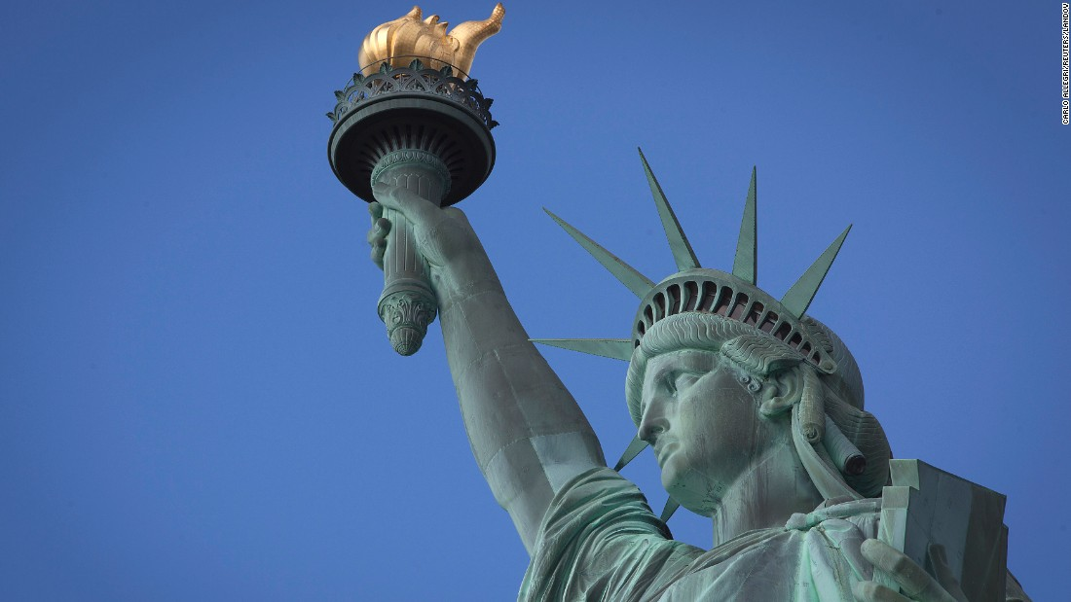
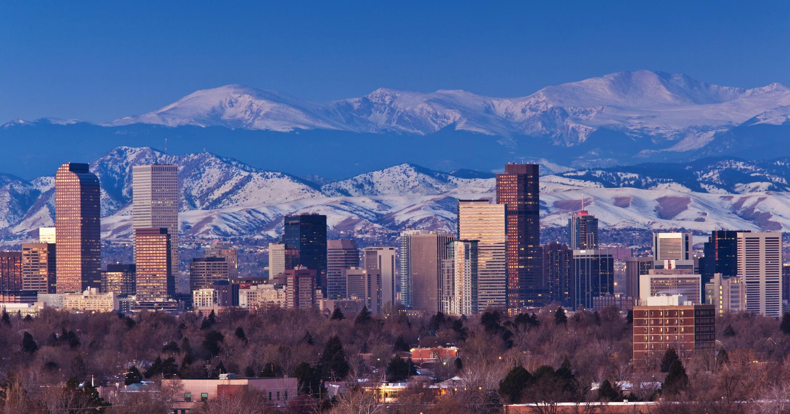
MHFT Global Strategy Luncheons
Buy tickets at www.madhedgefundtrader.com
New York, NY
June 14
Denver, CO
June 15
Soon to be Posted: Geneva Switzerland

Slide 5

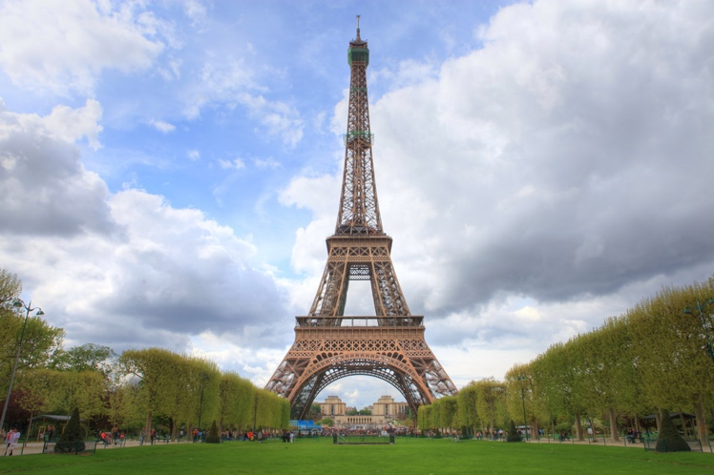
MHFT Global Strategy Luncheons
Buy tickets at www.madhedgefundtrader.com
Seminar at Sea
July 13
Paris, France
July 17

Slide 6
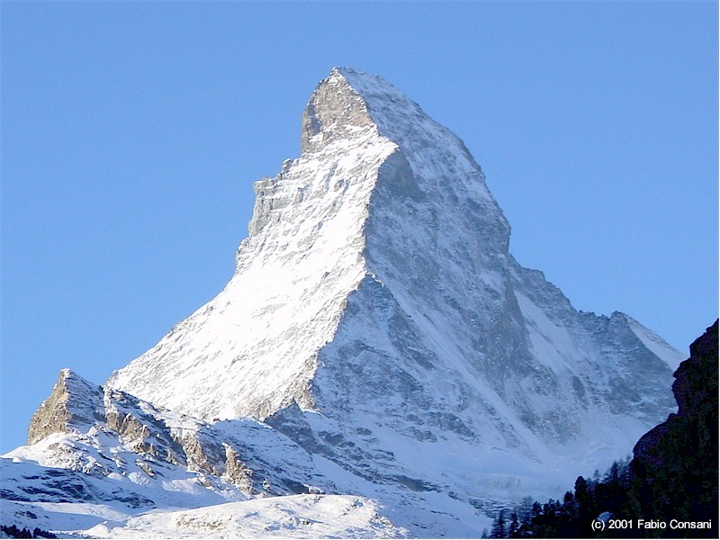

MHFT Global Strategy Luncheons
Buy tickets at www.madhedgefundtrader.com
Zermatt, Switzerland
July 27
Amsterdam, Netherlands
August 3

Slide 7

Trade Alert Performance
New All Time High!!
*January 4.09% Final *July +1.95% Final
*February +1.54% Final *August +18.38% Final
*March +1.13% Final *September +7.65% Final
*April +12.54% Final *October +1.39% Final
*May +1.07% Final *November +2.08% Final
*June +5.25% Final *December +3.76% Final
*2018 Year to Date 25.62%
compared to -0% for the Dow Average
*Trailing One year return +56.25%, +302.09% since inception,
*Average annualized return of 35.35%

Slide 8
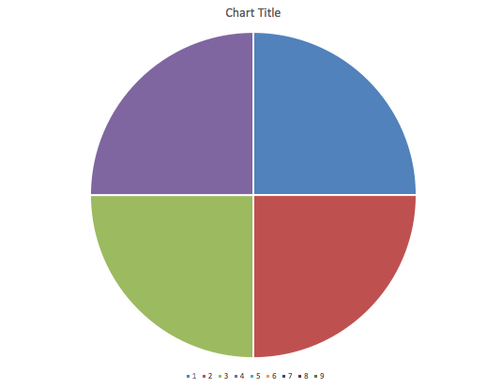
Portfolio Review
70% Cash, 30% ”RISK ON”
Play Tech upside breakout and rotation into biotech laggards
Risk On
World is Getting Better
(MSFT) 7/$90-$95 call spread | 10.00%
(AMZN) 7/$1500-1550 call spread | 10.00%
(IBB) 7/$97-$100 call spread | 10.00%
(AAPL) 7/$180-$185 call spread | 10.00%
Risk Off
No Positions | 0.00%
Total Net Position | 40.00%
Expiration P&L
28.68%

Slide 9
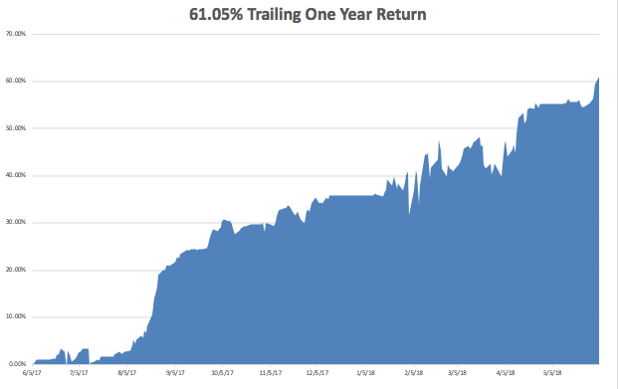
GTD Daily Audited Performance
All Time High

Slide 10
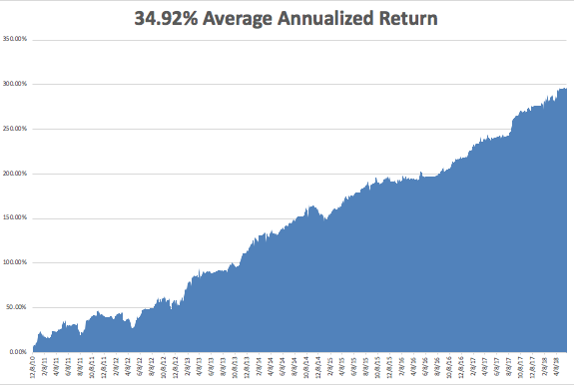
GTD 8 1/2 Year Daily Audited Performance

Slide 11
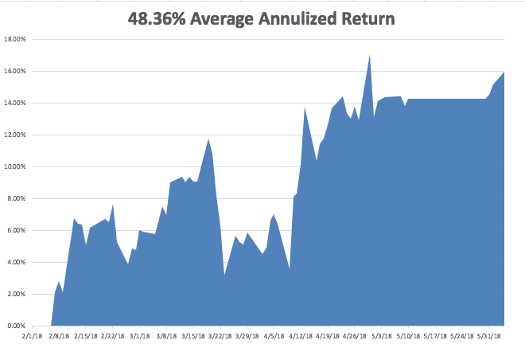
Mad Hedge Technology Letter a $2,500 a year upgrade

Slide 12

The Method to My Madness
*Tech stocks take over leadership once again and break out to new highs
*Stop out, roll down, then double up risk in bond short for huge profit as Italy crisis creates best entry point of the year for bond short
*Avoiding a dollar that is stalling out here
*Rising rates also say that precious metals and yield plays are DOA
*Start planning that vacation now, it’s
setting up to be a dreadful summer

Slide 13
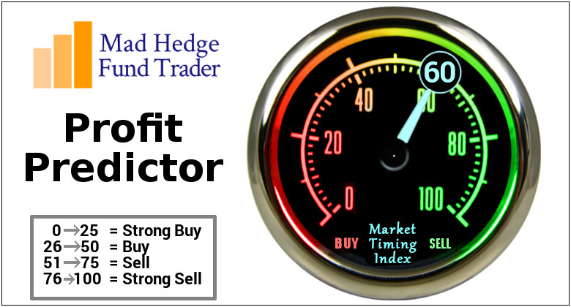
The Mad Hedge Profit Predictor
Market Timing Index-Hits Top of New Range at 60
An artificial intelligence driven algorithm that analyzes 30 different economic, technical, and momentum driven indicators

Slide 14
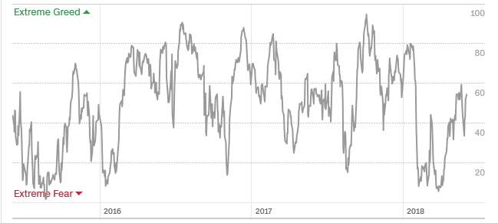
The Mad Hedge Profit Predictor
A 5 Month High
SELL
BUY

Slide 15
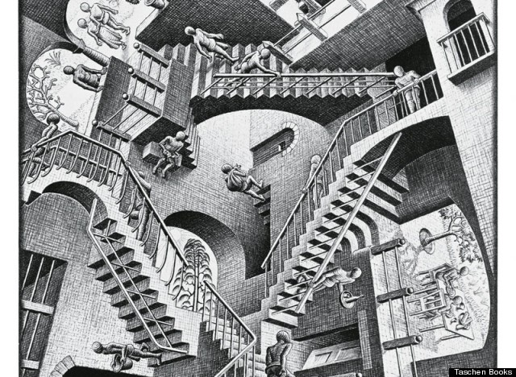
The Global Economy – Feedback Loop
*May Nonfarm Payroll Report Comes in at a hot 204,000, headline Unemployment at a two decade low at 3.8%
*April Flash PMI sharply drops from 57.8 to 56.8, is a global development, April Durable Goods down -1.7%
*Fed Beige book indicates that a June 0.25% rate hike is a sure think, but may be inclined to let economy run hot and let inflation rise above 2%
*Trade war is clearly creating a drag
on foreign economies, will feed back to US
*FOMC to raise interest rates by 25 basis
points in a two weeks

Slide 16
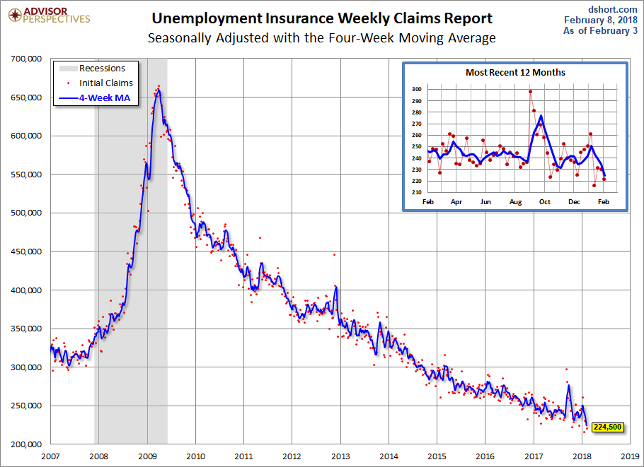
Weekly Jobless Claims –The Most Important Statistic
-13,000 to 221,000- 43 Year Low

Slide 17
The Bill Davis View
A $1,500 Upgrade for the Mad Day Trader Service
Buys: | Entry | Target
Molson Coors Brewing (TAP) | $ 59.00 | $ 75.00
Proctor & Gamble (PG) | $ 73.00 | $ 82.00
Mednax, Inc. (MD) | $ 46.00 | $ 62.00
Cirrus Logic, Inc. (CRUS) | $ 37.00 | $ 50.00
Lumber Liquidators (LL) | $ 22.00 | $ 32.00
Sells:
NetEase.com, Inc. | $ 263.00 | $ 220.00
Tesla Inc. (TSLA)-xx | $ 297.00 | $ 250.00
Oshkosh Corp (OSK)-xx | $ 76.00 | $ 68.00
Michael Kors (KORS) | $ 63.00 | $ 48.00
NXPI Semiconductor (NXPI) | $ 114.00 | $ 100.00

Slide 18

Stocks- Tech Breakout
*While domestic stocks and banks lag, technology breaks out to new highs
*No (SPY) breakout possible until we get the next batch of earnings reports in two months
*If (SPY) earnings rise to $170/share and multiples recover to 17.5 you get to 3,000 by yearend
*Stocks stuck in a range for the next five months going into the November election
*We are now in seasonal stock market headwind
*Bottom Line: Look for weakness for
the main indexes into the summer,
then a rally into yearend to new highs

Slide 19
Why Tech?
* Tech is immune to rising interest rates as they don’t borrow and have enormous cash balances, Apple alone has $270 billion
*Tech companies with massive solar arrays are net energy producers, shielding them from rising oil prices
*Tech productivity is rising faster than the inflation rate protecting them from rising prices
*While analog products grow linearly, digital ones grow exponentially
*The most profitable industries buy back the most stock. Tech will account for 70% of all share buybacks in 2018
*Tech is the most lightly regulated industry in the country because it is the newest

Slide 20
Why the Stock Market Will Peak on October 1, 2019
*Fed continues raising rates by 25 bp/quarter for 5 quarters
*That takes the overnight Fed funds rate up to a 2.75%-3.00% range by June 2019
*This will create an inverted yield curve whereby short term rates are higher than the present 2.95% ten year Treasury bond yield
*When the yield curve inverts, traders dump EVERYTHING, causing interest rates to explode, igniting a recession
*Historically, stock markets peak exactly 7.2 months before a recession, so this takes us back to March, 2019.
*This gets us to October 1, 2019 for a final stock market peak, or January 1, 2020 at the latest, in 15-18 months

Slide 21
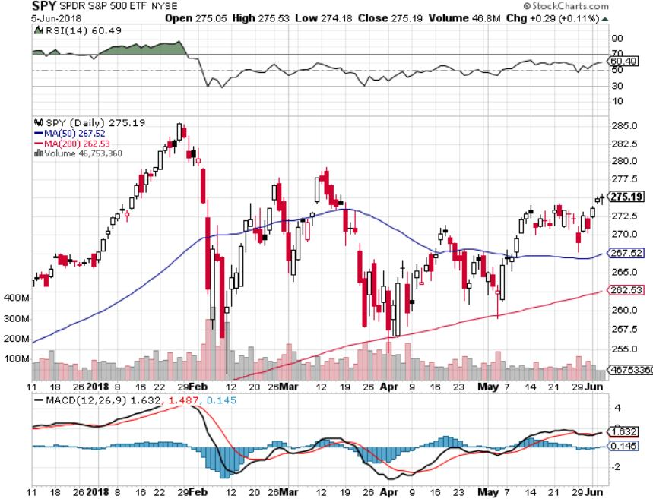
S&P 500- Stuck In a Range took profits on long 5/$277-$280 put spread double weighting
Washington chaos,
Trade Wars,
Iran, NK, and Syria wars, rising oil,
PE at 20X
Low 16X PE Multiple,
Huge Share Buybacks,
Nothing lese to buy

Slide 22
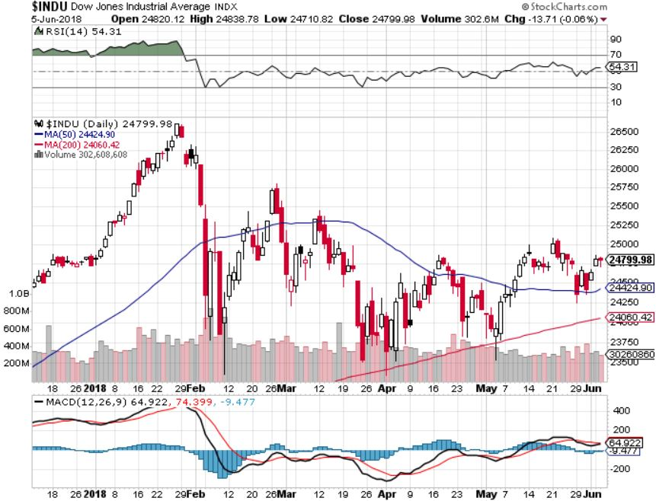
Dow Average- Downtrend

Slide 23
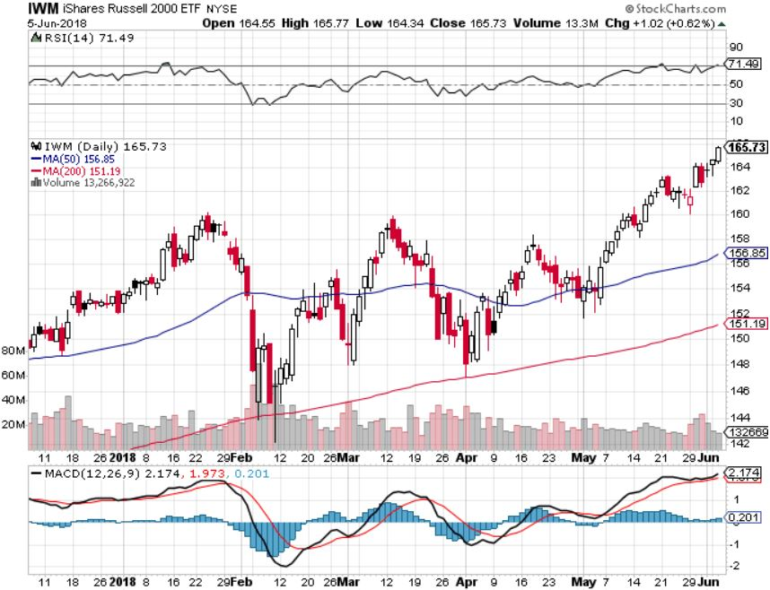
Russell 2000 (IWM)-Breakout! has become the lead index on tax breaks

Slide 24
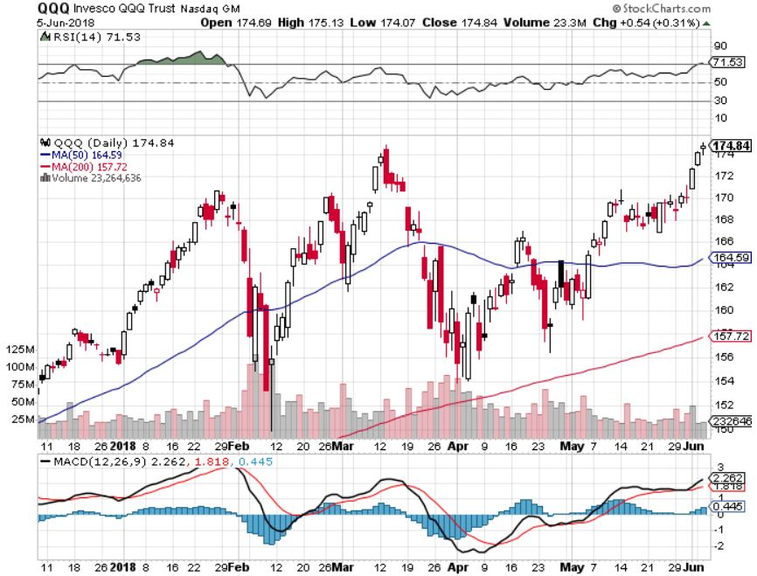
NASDAQ (QQQ)- New All Time High
High earnings growth,
Good valuations,
Buybacks,
nothing else to buy
PE at 16X

Slide 25
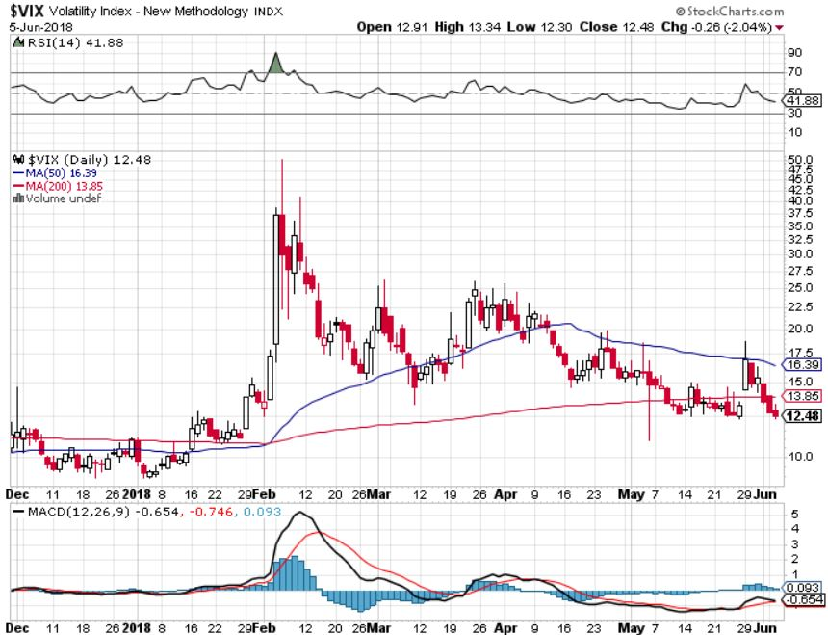
(VIX)- Gone to Sleep
This is
where it
now lives

Slide 26
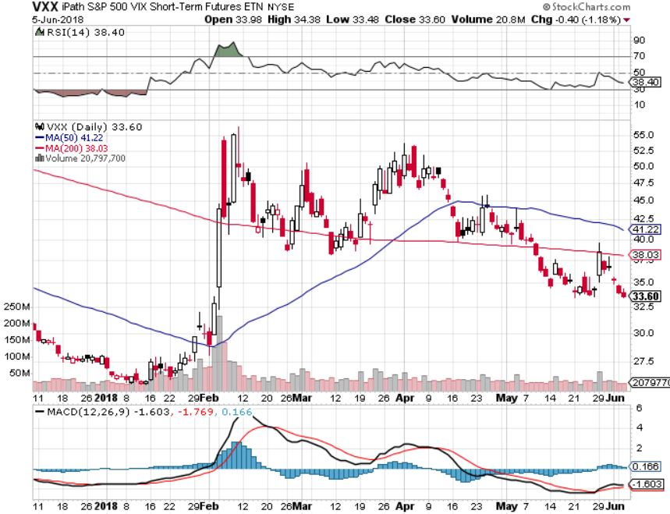
iPath S&P 500 VIX Short-Term Futures ETN (VXX) long 5/$32-$35 call spread took profits on long 3/$60-$65 bear put spread took profits on long 3/$55-$60 bear put spread

Slide 27
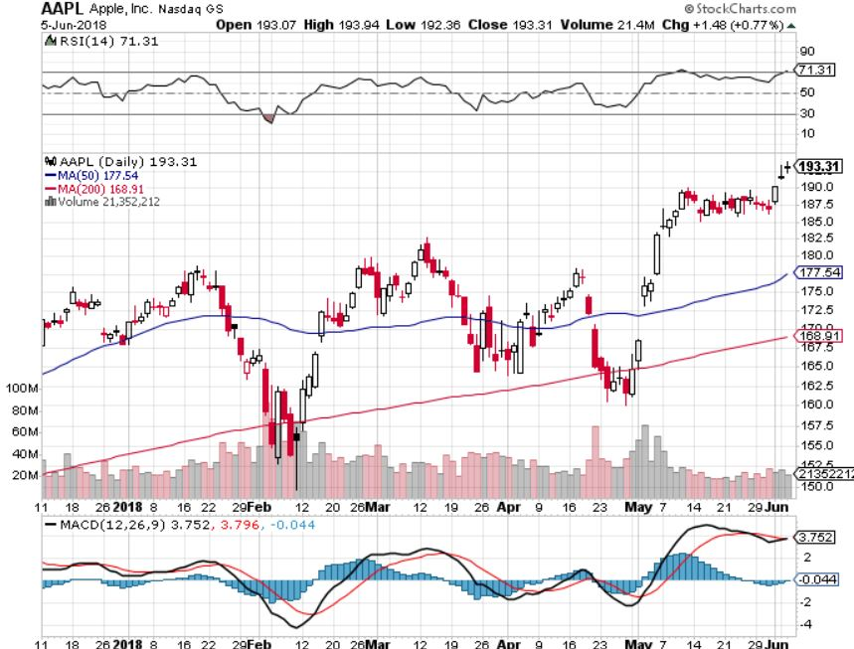
Apple (AAPL)-The Buffet Bump
Warren Buffett now owns 5% of Apple, wishes he owned the whole company long 7/$180-$185 call spread took profits on long 6/$130-$140 calls spread profits on long 3/$140-$150 calls spread

Slide 28
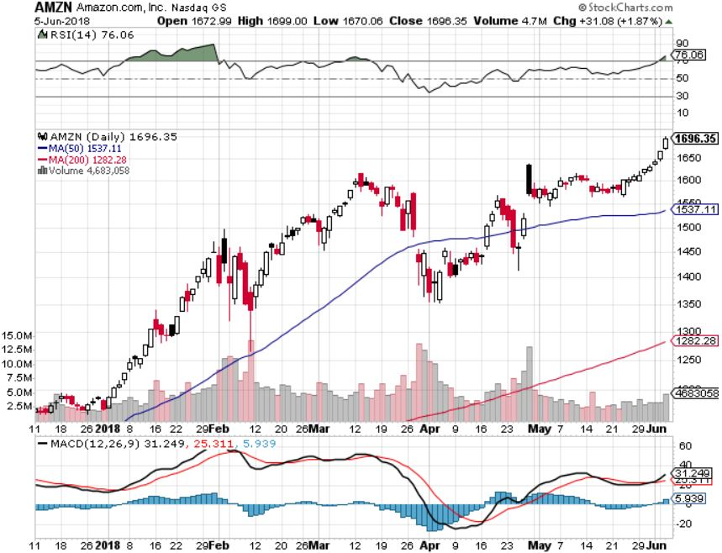
Amazon (AMZN) – Targeting $2,000 long 7/$1,500 - $1,550 call spread took profits on long 3/$1200-$1250 call spread (Tech Letter)

Slide 29
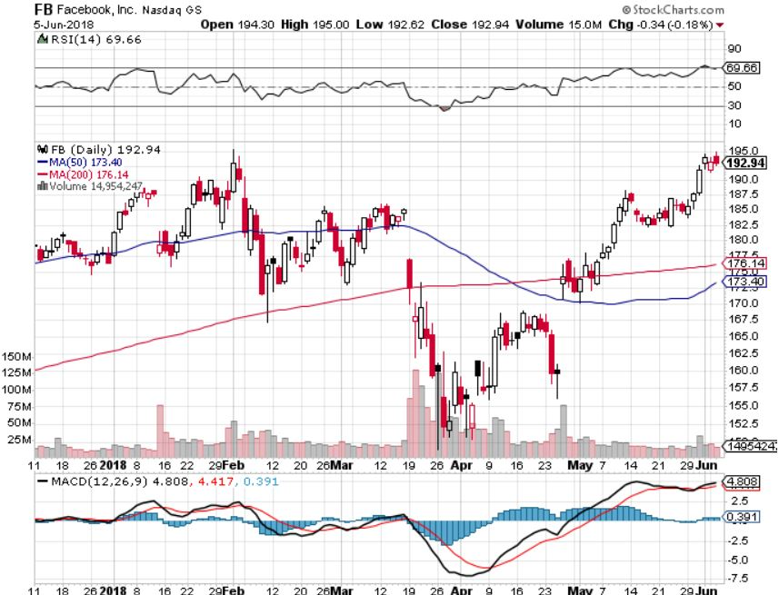
Facebook (FB)- Reality Returns stopped out of long 4/$150-$160 call spread took profits on long 6/$130-$140 bull call spread took profits on long 3/$155-$165 bull call spread took profits on long 3/$190-$195 bear put spread

Slide 30
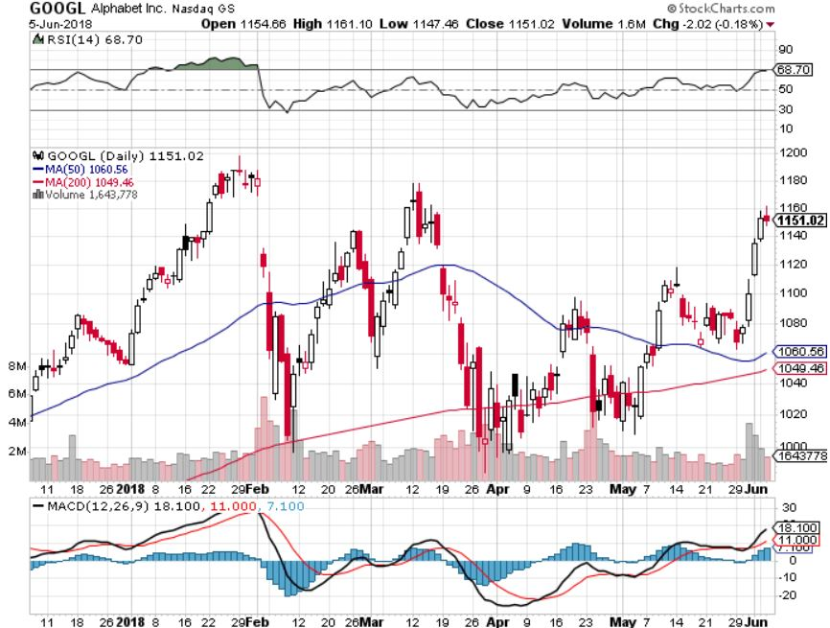
Alphabet (GOOGL)- 60 Minutes Drag took profits on long 4/$900-$930 call spread

Slide 31
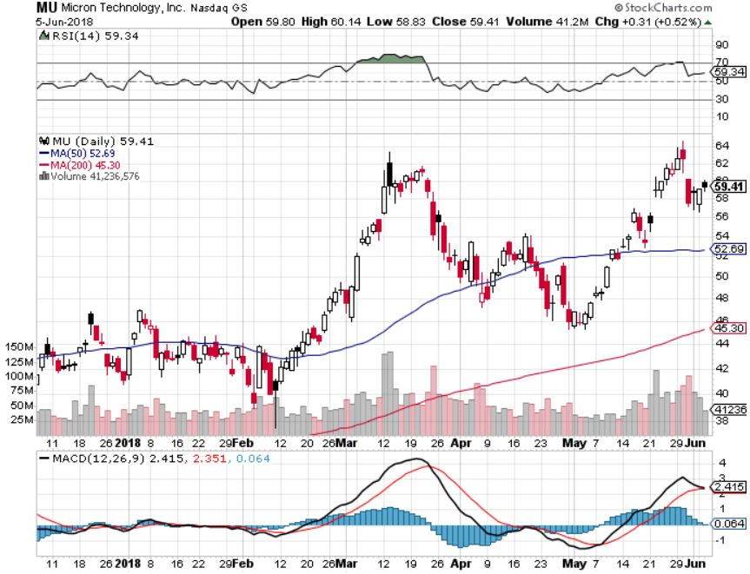
Micron Technology (MU)-Spectacular Earnings took profits on long 3/$34-$37 bull call spread in Mad Hedge Technology Letter Only
UBS bearish report totally wrong

Slide 32
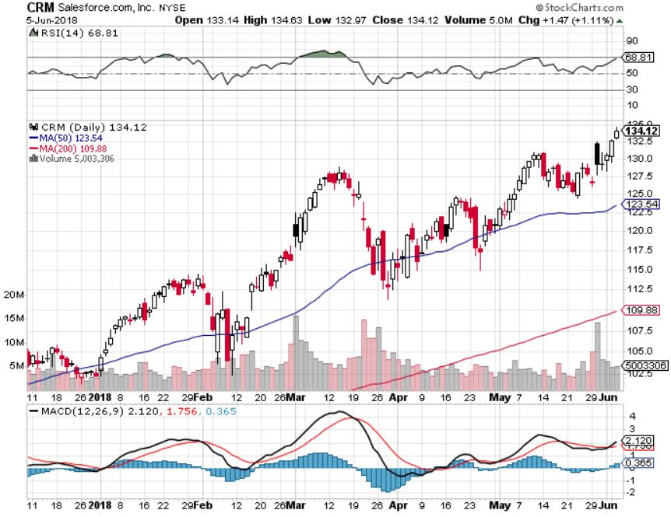
Salesforce (CRM)-New High long 6/$115-$120 call spread in Mad Tech Letter took profits on long 6/$105-$110 call spread took profits on long 3/$90-$95 bull call spread

Slide 33
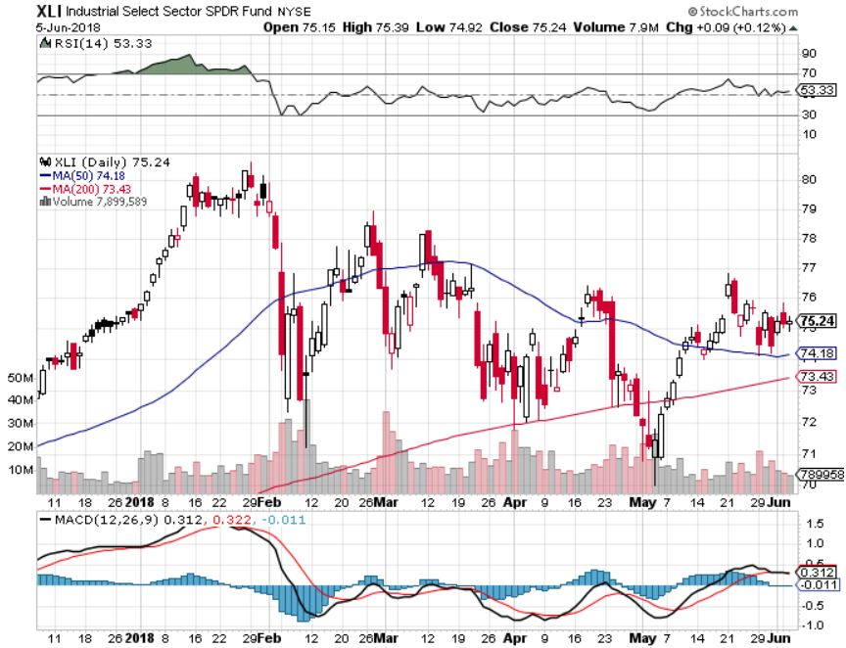
Industrials Sector SPDR (XLI)-Yuck!
(GE), (MMM), (UNP), (UTX), (BA), (HON)

Slide 34
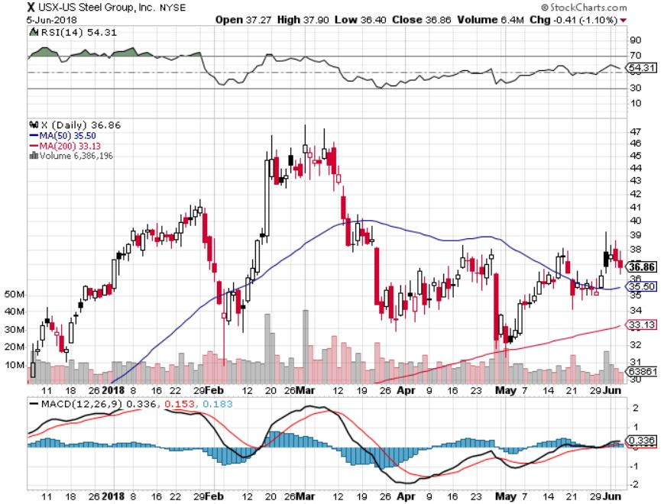
US Steel (X)-Earnings Disappointment
Import duties cause users to abandon steel took profits on long the 9/$21-$22 vertical bull call spread

Slide 35
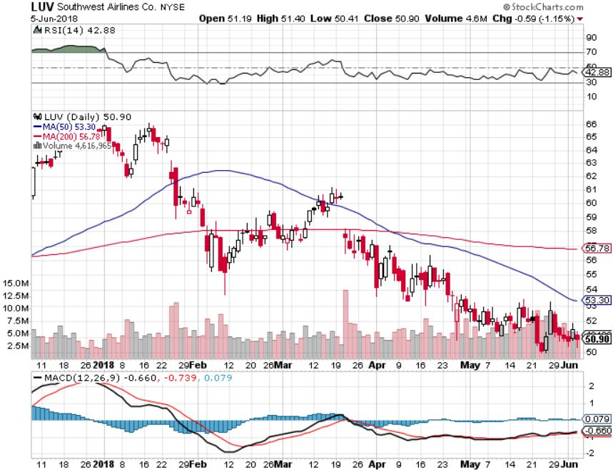
Southwest Airlines (LUV)- High Oil Prices Hurt
Warren Buffett’s Favorite Airline

Slide 36
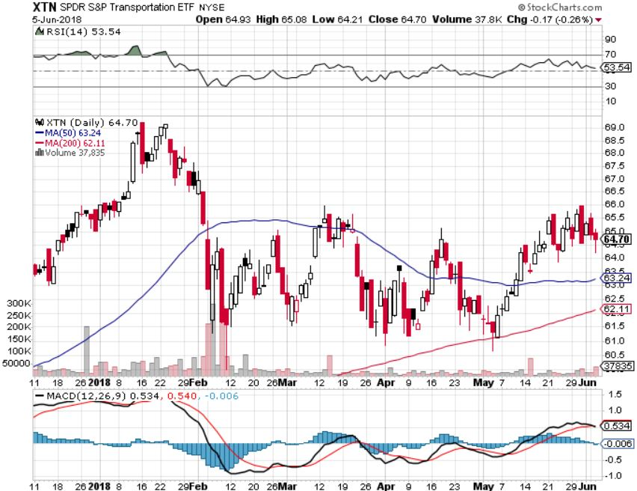
Transports Sector SPDR (XTN)-
(ALGT), (ALK), (JBLU), (LUV), (CHRW), (DAL)

Slide 37
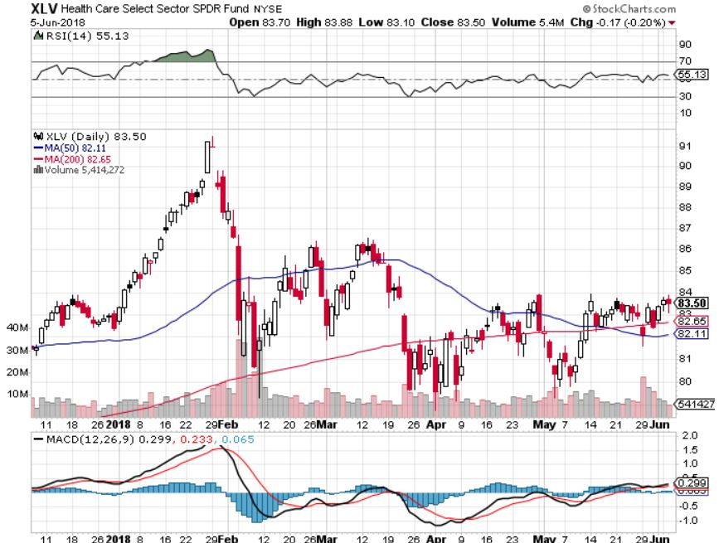
Health Care Sector (XLV), (RXL)- Breakout Attempt
(JNJ), (PFE), (MRK), (GILD), (ACT), (AMGN)

Slide 38
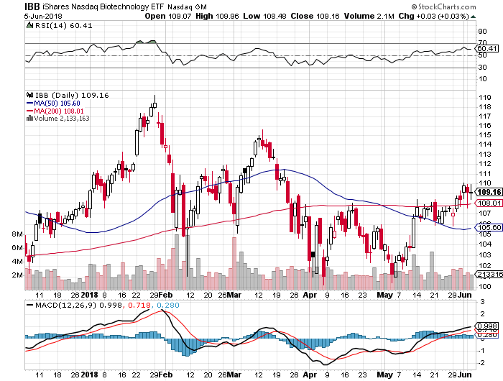
Ishares Biotechnology ETF (IBB),
(IBB), (BIIB), (AMGN), (CELG), (GILD), (VRTX) long 7/$97-$100 call spread

Slide 39
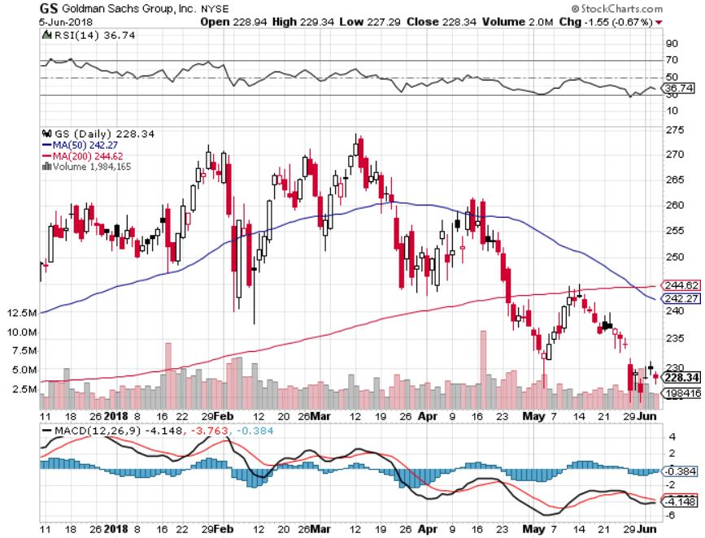
Goldman Sachs (GS)-Rising Rates Fail to Help stopped out of long 4/240-$245 call spread stopped out of long 10/$220-$225 vertical bull call spread took profits on long 10/$227.50-$232.50 vertical bull call spread

Slide 40
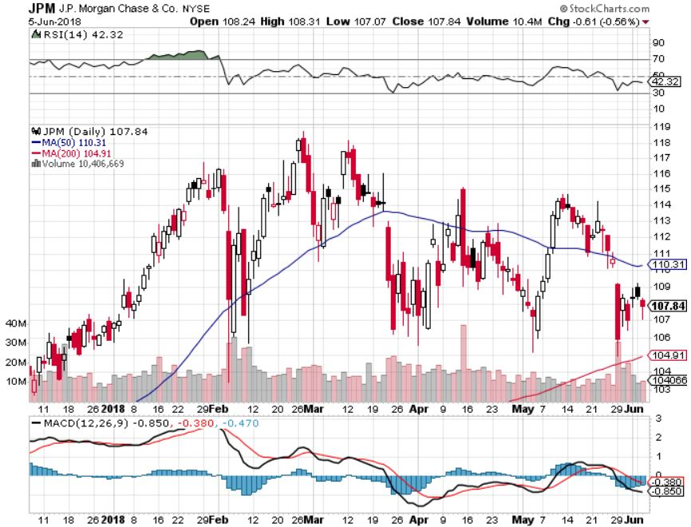
JP Morgan (JPM)- took profits on long 4/$95-$100 call spread

Slide 41
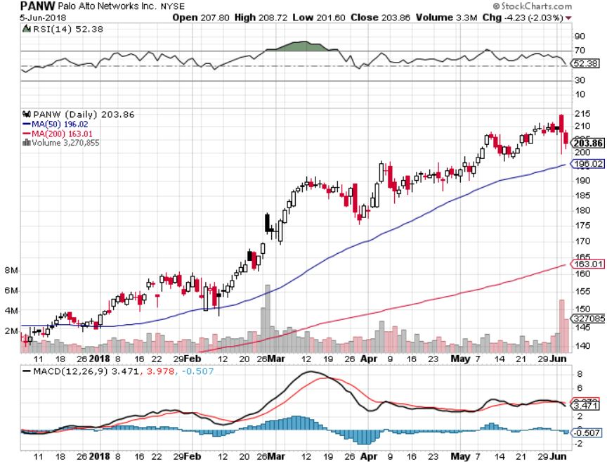
Palo Alto Networks (PANW)-New High
Hacking never goes out of fashion

Slide 42
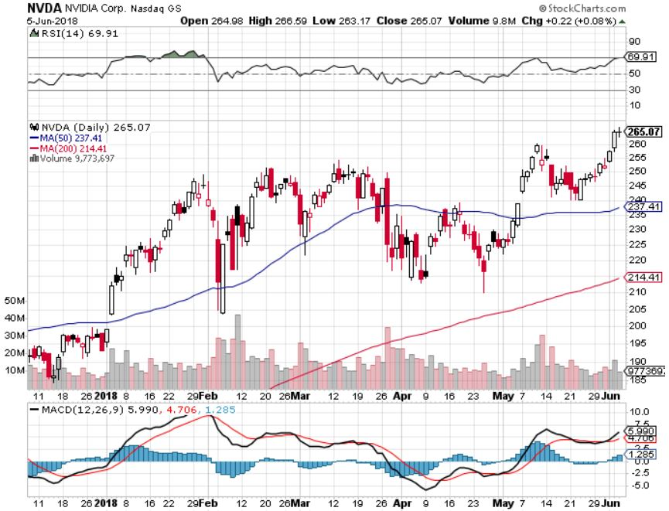
NVIDIA (NVDA)-Great Earnings

Slide 43
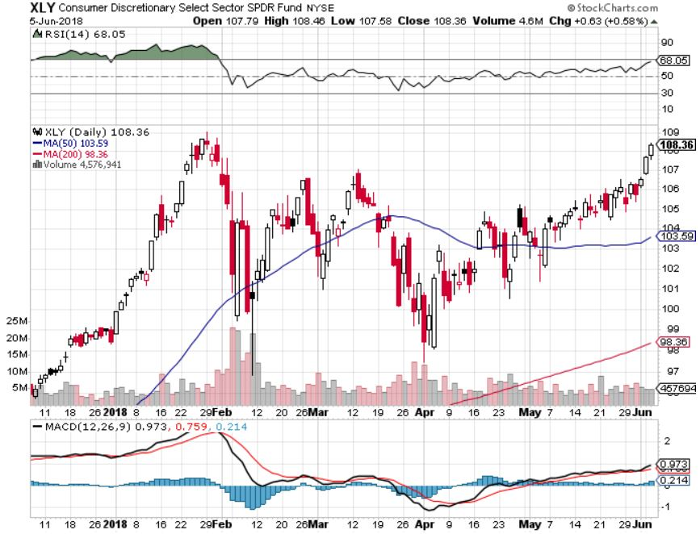
Consumer Discretionary SPDR (XLY)
(DIS), (AMZN), (HD), (CMCSA), (MCD), (SBUX)

Slide 44
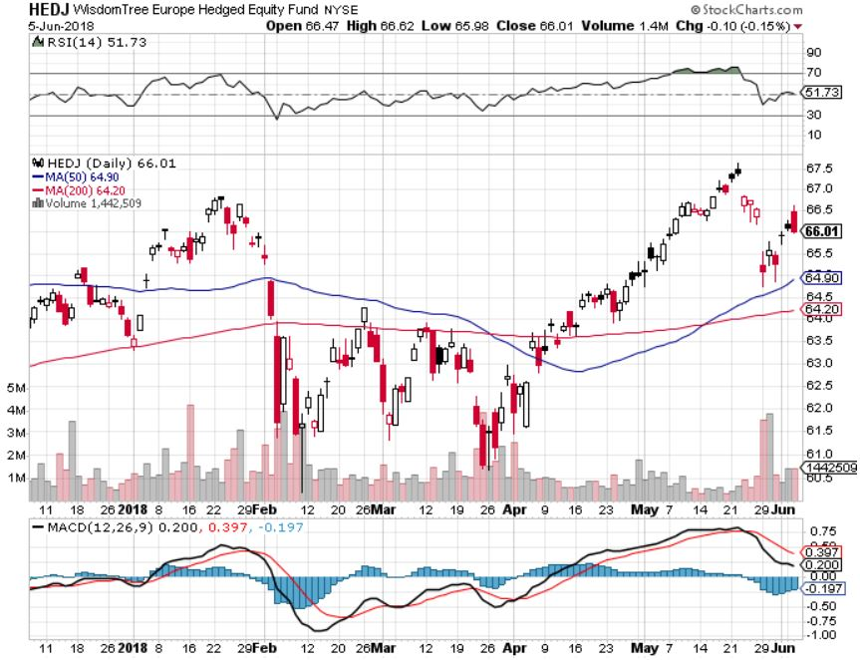
Europe Hedged Equity (HEDJ)-Euro crash

Slide 45
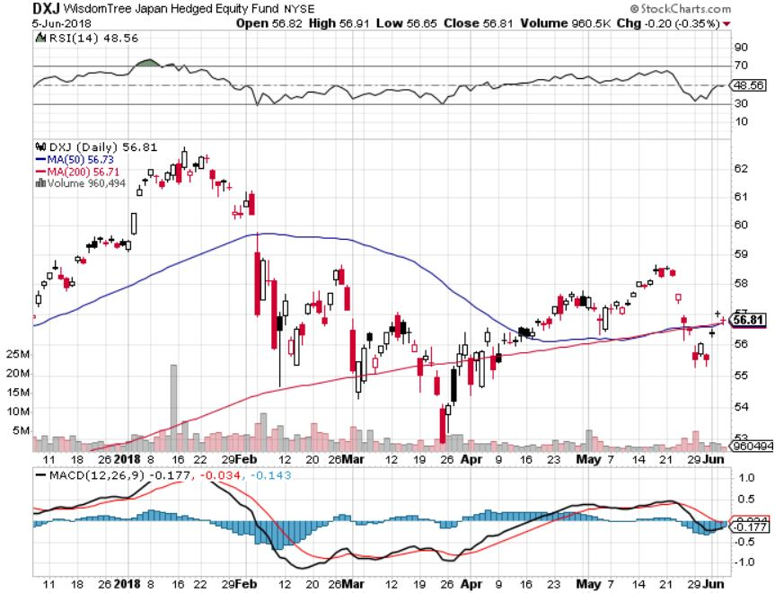
Japan (DXJ)-Falling Yen Move

Slide 46
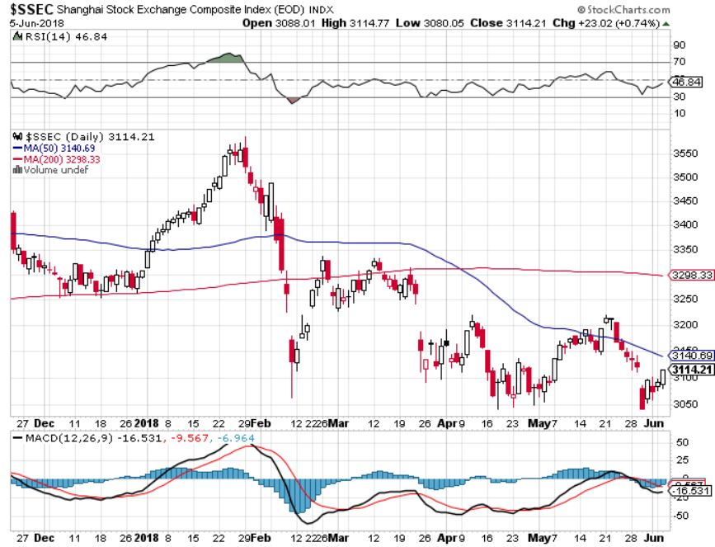
China ($SSEC)-Economic Recovery on Track

Slide 47
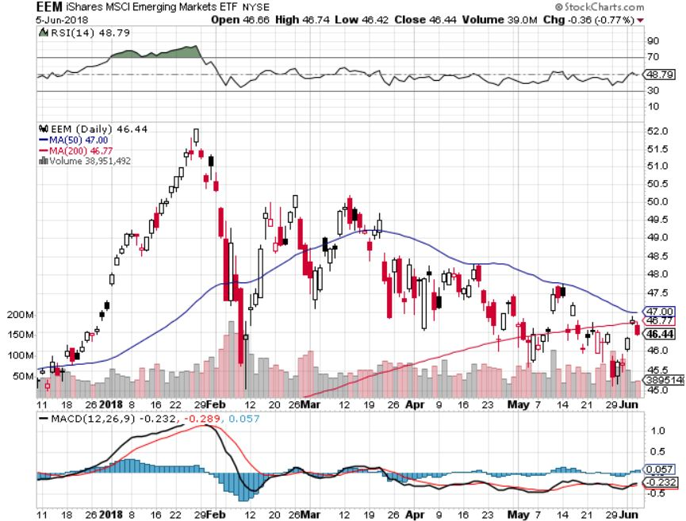
Emerging Markets (EEM)- Killed by Strong Dollar

Slide 48

Bonds- Short Squeeze!
*Italian political crisis triggers 6 1/2 point rally in bonds and a gift for new short sellers
*Eroding global economy could cause the FED to delay the June 25 basis point rate hike, causing bonds to rally
*Canada interest rate high hint that the US will remain in the same fold
*0.3% increase in Average Hourly Earnings suggests the inflation demon is back on the table
*Still looking for 3.25%-3.5% ten year
US Treasury yield by yearend, and 4% in a year
*Exploding deficits will weigh on bond for the
next decade, sell every rally across the space
*Someday there will be a big Treasury auction and
no one will show, gapping rates up 50 basis points
Bottom Line: Sell every four point rally in the (TLT)

Slide 49
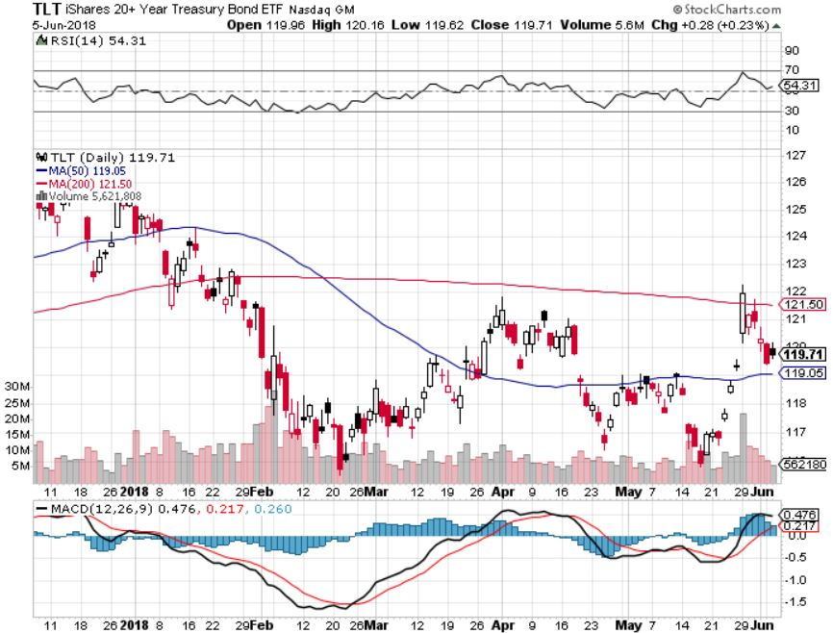
Treasury ETF (TLT) – 18 Profitable Trade Alerts in 8 Months took profits on long 5/$124-$127 vertical bear put spread took profits on long 4/$123-$126 vertical bear put spread
Took profits on long the (TLT) 2/$124-$127 vertical bear put spread again

Slide 50
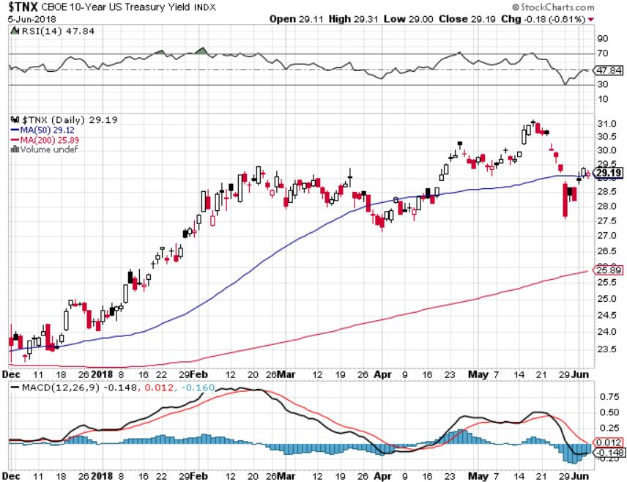
Ten Year Treasury Yield ($TNX) 3.06%
Breakdown, Now major Support

Slide 51
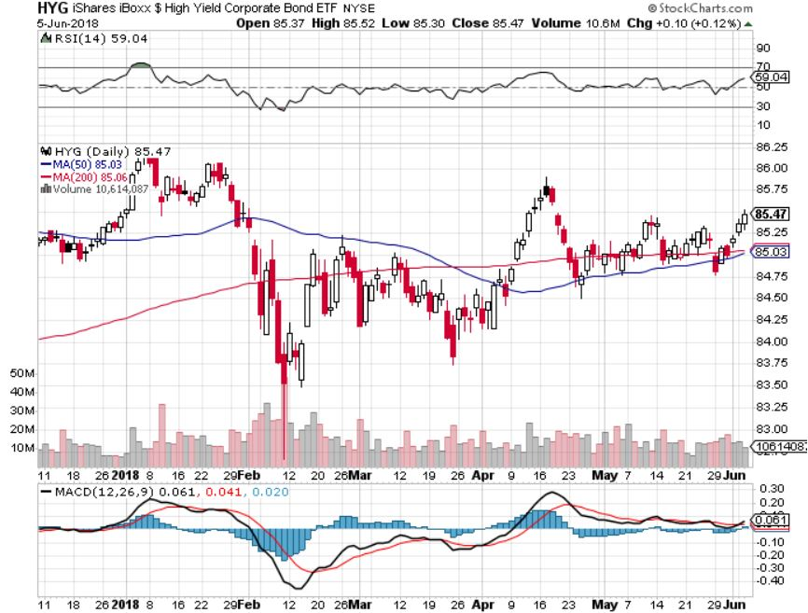
Junk Bonds (HYG) 5.47% Yield

Slide 52
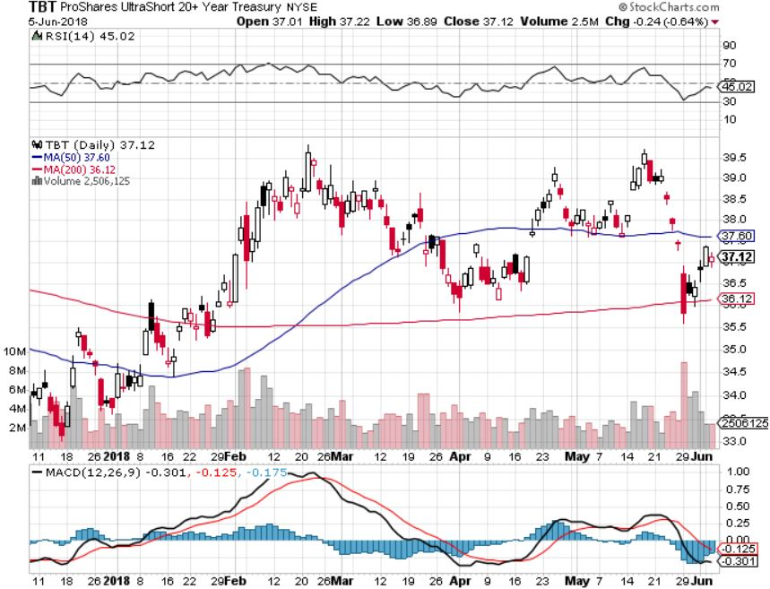
2X Short Treasuries (TBT)- Take Profits

Slide 53
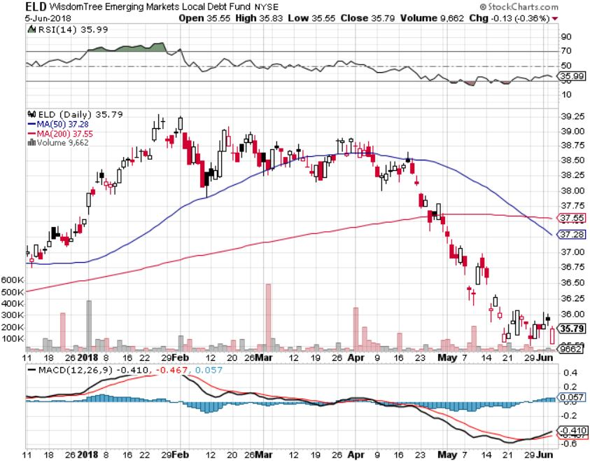
Emerging Market Debt (ELD) 5.97% Yield-

Slide 54
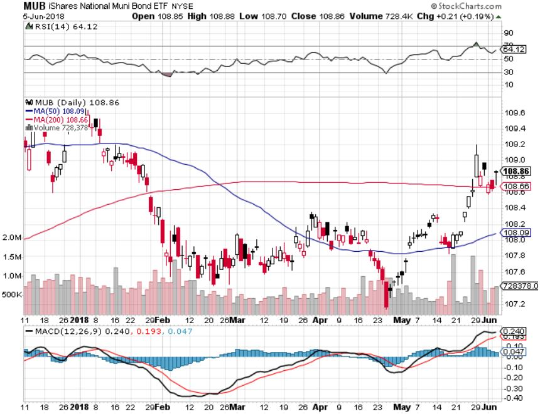
Municipal Bonds (MUB)-2.32%
Mix of AAA, AA, and A rated bonds
Huge 40 basis point yield pop on tax bill

Slide 55

Foreign Currencies-Topping Out
*Italian crisis may have put in an interim top for the US dollar
*Oil currencies of Canadian dollar (FXC), Mexican Peso, and Russian Ruble get killed on end of OPEC quotas
*A NAFTA treaty stalls creating another negative for peso and loonie
*Reserve Bank of Australia says rates are more likely up than down
*Bitcoin downtrend intact
Bottom Line: Sell rallies on any currencies

Slide 56
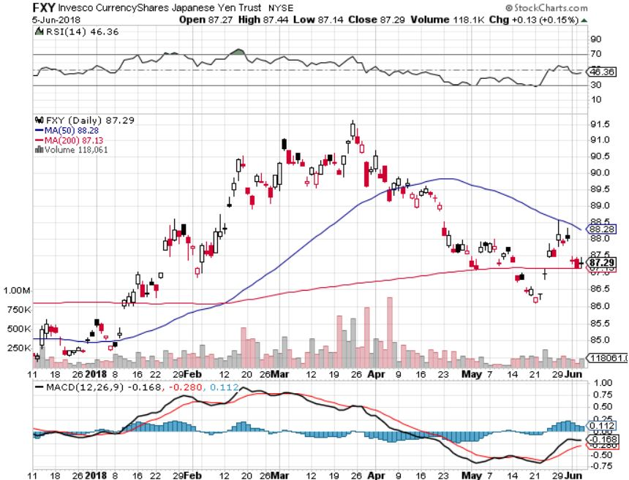
Japanese Yen (FXY), (YCS) took profits on long (FXY) 3/$91-$93 bear put spread

Slide 57

Euro ($XEU), (FXE), (EUO)- Triple Top took profits on long (FXE) 3/$120-$123 vertical bear put spread took profits on long (FXE) 12/$116-$118 vertical bear put spread took profits on long (FXE) 12/$111-$113 vertical bull call spread

Slide 58

Australian Dollar (FXA)

Slide 59

Emerging Market Currencies (CEW)

Slide 60

Chinese Yuan- (CYB)-Stabilizing on Government Support

Slide 61

Bitcoin- Downtrend Intact

Slide 62

Energy-Quota End
*Talk of ending OPEC production quotas sends oil prices into freefall, Russia agrees to join in
*Energy stocks get crushed
*New Iran Sanctions don’t kick in until November 1
*At 11 million barrels a day the US pipeline system can take anymore oil, forcing producers to truck oil to refineries, is hugely expensive
*Baker Hughes US Rig Count up 1
*Bottom Line: Oil may be peaking
here so stand aside

Slide 63

Oil-New High and Inflation Push

Slide 64

United States Oil Fund (USO)

Slide 65

Energy Select Sector SPDR (XLE)-No Performance!
(XOM), (CVX), (SLB), (KMI), (EOG), (COP)

Slide 66

Alerian MLP ETF (AMLP)- Basket Approach

Slide 67

Exxon (XOM)-Earnings Dive

Slide 68

Schlumberger (SLB)-

Slide 69

Halliburton (HAL)-

Slide 70

Natural Gas (UNG)-

Slide 71

Copper (COPX)-Trade War Fears

Slide 72

Precious Metals-Dead In the Water
*No flight to safety here
*Collapsing Euro and Japanese yen also feeding into weaker gold
*Narrow trading range is flagging
interest and shrinking volume
*Bottom Line: Buy gold and silver stocks
on the next big dip, as it is
still early days for the bull market

Slide 73

Gold (GLD)- False Breakout Generates Double Top long 5/$119-$122 bull call spread took profits on long (GLD) $12/$116-$119 bull call spread

Slide 74

Market Vectors Gold Miners ETF- (GDX)
Took profits on long the 9/$20.50-$21.50 bull call spread

Slide 75

Barrick Gold (ABX) stopped out of long 9/$15-16 call spread

Slide 76

Newmont Mining- (NEM)-Breakout stopped out of 2/$36-$39 bull call spread for small loss took profits on long the 9/$32-$34 bull call spread

Slide 77

Global X Silver Miners ETF- (SIL)- took profits on long the 9/$31-$33 bull call spread

Slide 78

Real Estate-Short Squeeze
*Pending Home Sales down -1.3%, fourth consecutive falling month, as rising mortgage rates eat into sales
*Home affordability close to all time low, especially at the entry level, so are inventories at 3.8 months
*Lack of supply still the big issue, so prices can only go up
*Median home price in San Francisco at $1,334,000 requires an annual income of $334,000 to support it
*Mortgage Applications down 2.9%
*S&P 500 Case-Shiller maintains
strong 6.5%, with absolute prices
hitting new all time highs
*Bottom Line: Buy real estate plays on dips

Slide 79

February Corelogic S&P Case Shiller Home Price Index
+6.5% YOY, Seattle (+13%), Las Vegas (+11.6%), San Francisco (+10.1%) still leaders price rises accelerating

Slide 80

Simon Property Group (SPG)-

Slide 81

US Home Construction Index (ITB)
(DHI), (LEN), (PHM), (TOL), (NVR)

Slide 82

Trade Sheet-
So What Do We Do About All This?
*Stocks-Buy tech dips
*Bonds-sell any and all rallies
*Commodities-stand aside
*Currencies-sell rallies in currencies
*Precious Metals –stand aside
*Volatility-go short on runs up to $20
*Real estate-buy dips

Slide 83

Next Strategy Webinar
12:00 EST Wednesday, June 20, 2018
San Francisco, CA
For Lunches Please Go to www.madhedgefundtrader.com and click “Store”
Good Luck and Good Trading!
Notes:
*

