Slide 1

The Mad Hedge Fund Trader
“Is the Trade War On or Off”
With John Thomas
from Silicon Valley, CA, August 22, 2018
www.madhedgefundtrader.com
Notes:
*

Slide 2

October 26-27 Lake Tahoe Conference
*Two days of informative speakers on crucial trading and investment issues
*Trade tips with the most successful Mad Hedge traders
*2 nights in the Hyatt, including all you can eat an drink
*Tickets are a bargain at
$599 to $1,799
*Buy now, upper ticket classes
sell out first

Slide 3
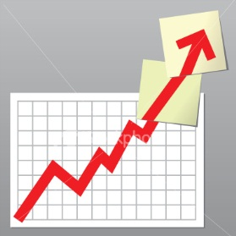
Trade Alert Performance
New All Time High!!
*January 4.09% Final *July +0% Final
*February +1.54% Final *August +0.29% MTD
*March +1.13% Final *September +7.65% Final
*April +12.54% Final *October +1.39% Final
*May +1.07% Final *November +2.08% Final
*June +4.15% Final *December +3.76% Final
*2018 Year to Date 24.52%
compared to -2% for the Dow Average
*Trailing One year return +61.12%, +302.63% since inception,
*Average annualized return of 35.60%

Slide 4
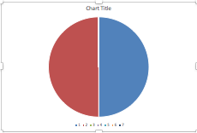
Portfolio Review
20% long laggards at top of recent range
Risk On
World is Getting Better
(DIS) 9/$105-$110 call spread | 10.00%
(TLT) 9/$123-$126 put spread | 10.00%
Risk Off
NO POSITIONS | 0.00%
Total Net Position | 20.00%
Expiration P&L
28.50%

Slide 5
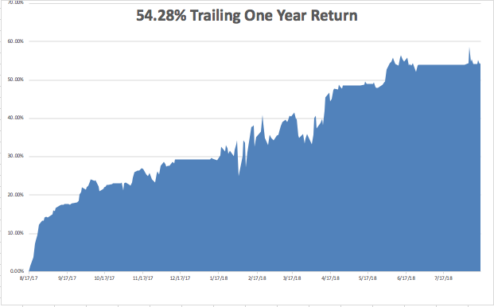
GTD Daily Audited Performance
All Time High

Slide 6
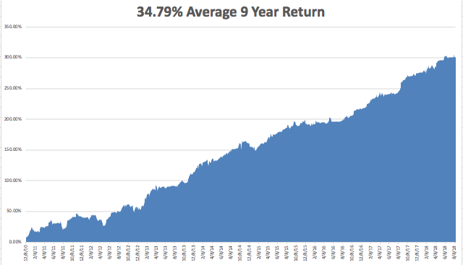
GTD 9 Year Daily Audited Performance

Slide 7
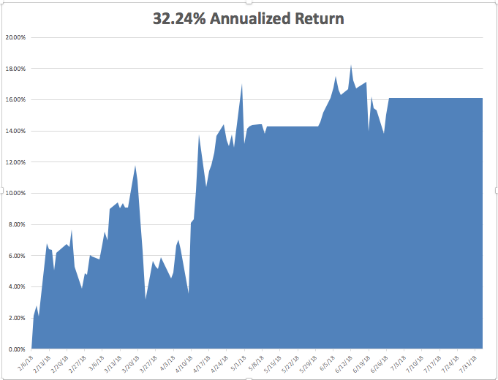
Mad Hedge Technology Letter a $2,500 a year upgrade

Slide 8

The Method to My Madness
*Markets are offering very high risks with low returns now
*Whether the trade war is on or off cannot be predicted and is not worth betting for or against
*First choice of defensive stocks does not bode well for risk taking
*Dollar hitting new high crushes all foreign currencies
*Rising rates still pushing dollar up
*Rising rates also say that precious
metals and yield plays are DOA
*Poor August liquidity is exaggerating
all stock moves

Slide 9

About That Washington Matter
*Of the top drivers of the market right now politics is number 10
*Global liquidity, exploding earnings, low interest rates, strong economy, and trade wars, and weakening foreign economies are much more important
*Net net: market doesn’t care. If stocks fall it’s because they are overbought
*Stocks still on target to bring a 10%
gain in 2018, as predicted in January
*Chance of impeachment hearings
next year has gone up to 100%
*Chance of conviction by the Senate
is zero (2/3)

Slide 10


Slide 11
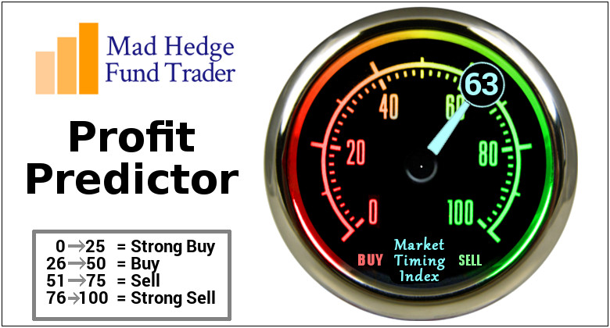
The Mad Hedge Profit Predictor
Market Timing Index-
An artificial intelligence driven algorithm that analyzes 30 different economic, technical, and momentum driven indicators

Slide 12
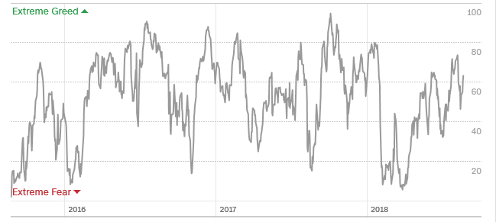
The Mad Hedge Profit Predictor
Approaching Top of 2018 Range
SELL
BUY

Slide 13

The Global Economy – Uneven
*Tax cuts and deficit spending have another 5 months to work their way through the system, after that it’s gone
*July CPI hits 2.9%, a decade high, July Retail Sales up a hot 0.5%, Small Business Optimism up +0.7 to 107.9 near an all time high
*In 9 months we have gone from global synchronized recovery to US only growth as American sucks growth from its allies
*Strong dollar is demolishing emerging markets, from China to South Africa
*Commodities will keep collapsing as long as trade war continue
*Fed 25 basis point Rate Rise to 2.0%-2.25%
a sure thing in September
*Germany comes in with a Q2 GDP of 0.5%
versus 4.1% in the US

Slide 14
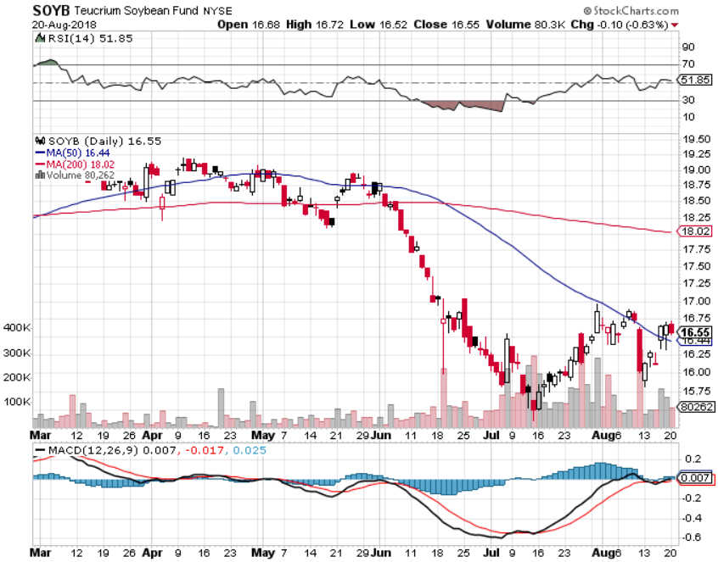
Soybeans (-20%)-Trade War Indicator

Slide 15
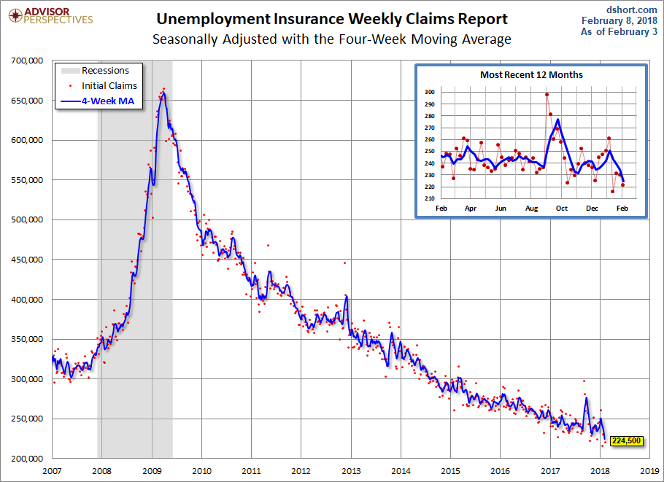
Weekly Jobless Claims –The Most Important Statistic
12,000 to 212,000- 43 Year Low

Slide 16
The Bill Davis View
A $1,500 Upgrade for the Mad Day Trader Service
Buys: | Entry | Target
Western Digital Corp (WDC) x | $ 66.00 | $ 80.00
Netflix, Inc. (NFLX) | $ 330.00 | $ 370.00
Vulcan Materials (VMC) | $ 110.00 | $ 125.00
Canada Goose Holdings (GOOS) | $ 52.00 | $ 70.00
Ferrari NV (RACE) | $ 122.00 | $ 135.00
Sells:
Jack in the Box, Inc (JACK) | $ 87.00 | $ 79.00
Alibaba Group (BABA) | $ 180.00 | $ 165.00
Gilead Sciences (GILD) | $ 75.00 | $ 62.00
Edgewell Personal Care (EPC) | $ 56.00 | $ 40.00
Perrigo Co (PRGO) | $ 78.00 | $ 67.00

Slide 17

Stocks- Peace Outbreak?
*Bank of America survey says investors most optimistic about stocks since 2015
*Last week highlighted the risk of trade peace with a 400 point up day
*However, all the buying was in defensive sectors like consumer staples
*Apple is the only tech stock that moves to new highs, is it now a ”safe” defensive stock?
*NVIDIA weak guidance confirmed the mini recession in chip stocks
*Start adding “Trade Peace” winners on dips
*Bottom Line: rotate into laggard value until
the next quarterly earnings cycle
starts in two months

Slide 18
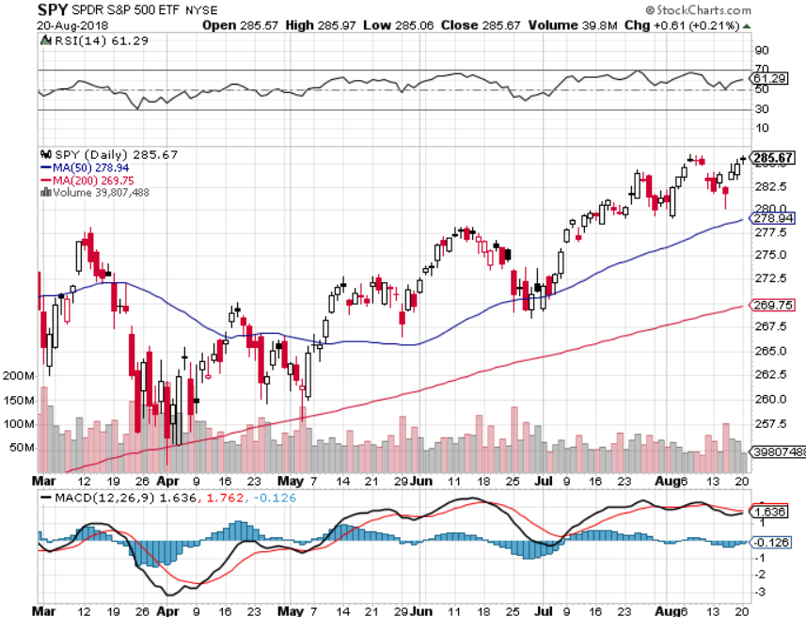
S&P 500- Top of the Range took profits on long 5/$277-$280 put spread double weighting

Slide 19
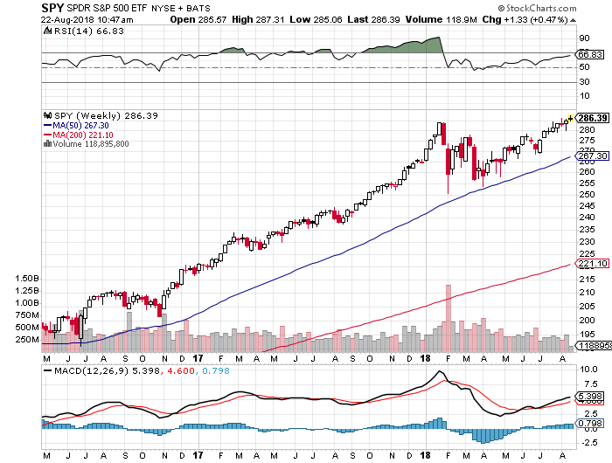
S&P 500- Double Top Risk took profits on long 5/$277-$280 put spread double weighting
8/18
Top-0%
8/17
Bottom-18%

Slide 20
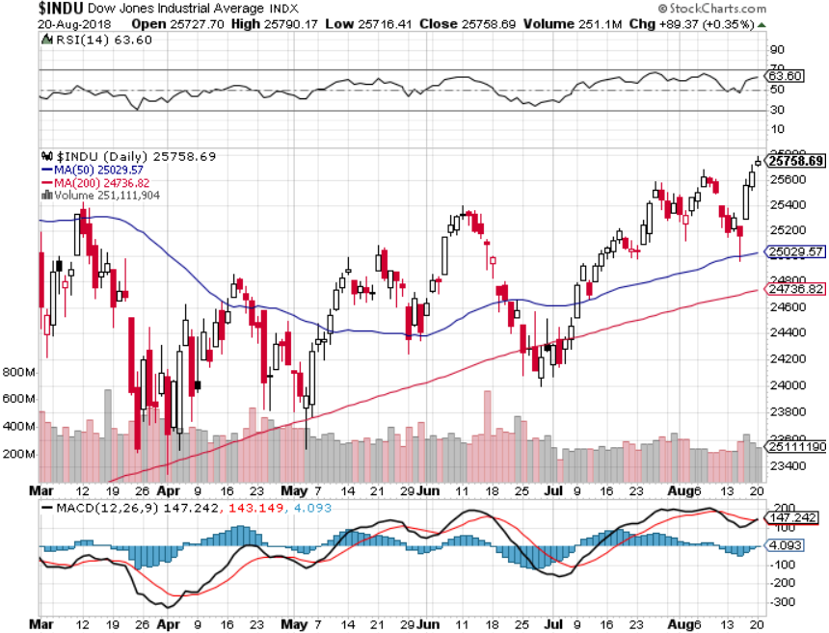
Dow Average-

Slide 21
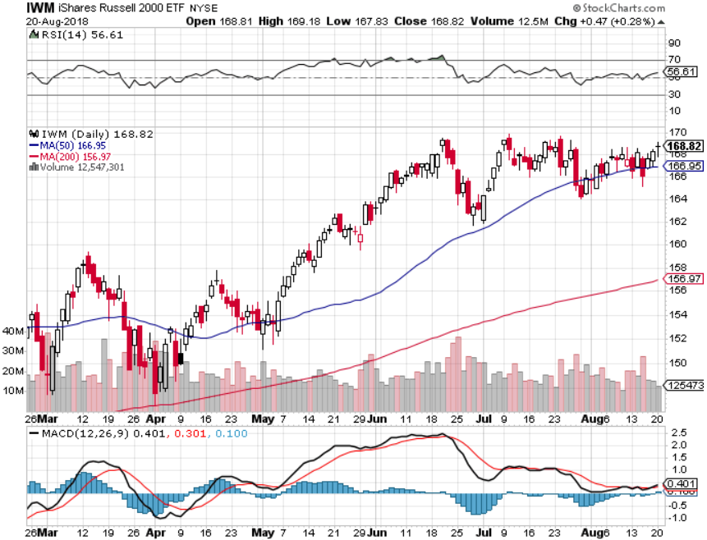
Russell 2000 (IWM)- Topping Out has become the lead index on tax breaks

Slide 22
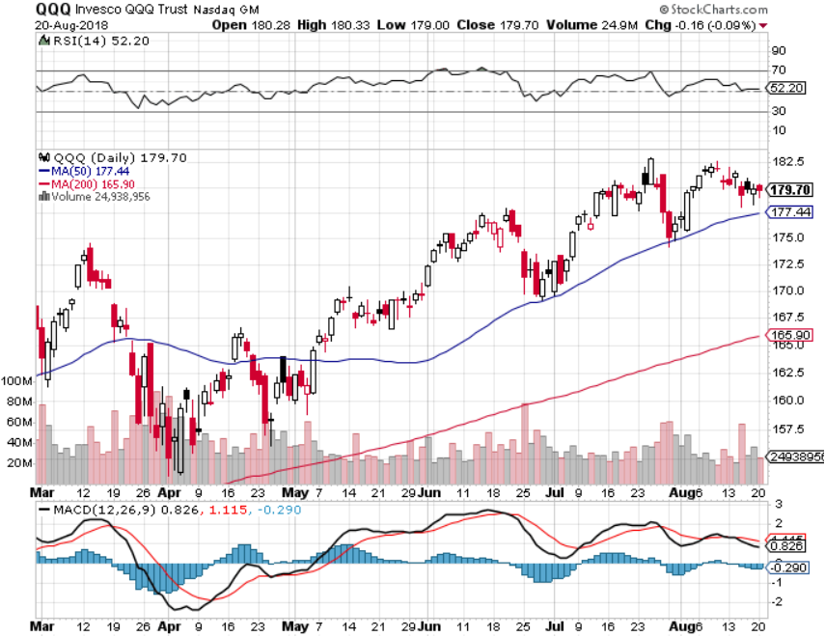
NASDAQ (QQQ)-
Settling Into a Range for the rest of 2018
High earnings growth,
Good valuations,
Buybacks,
nothing else to buy
PE at 16X

Slide 23
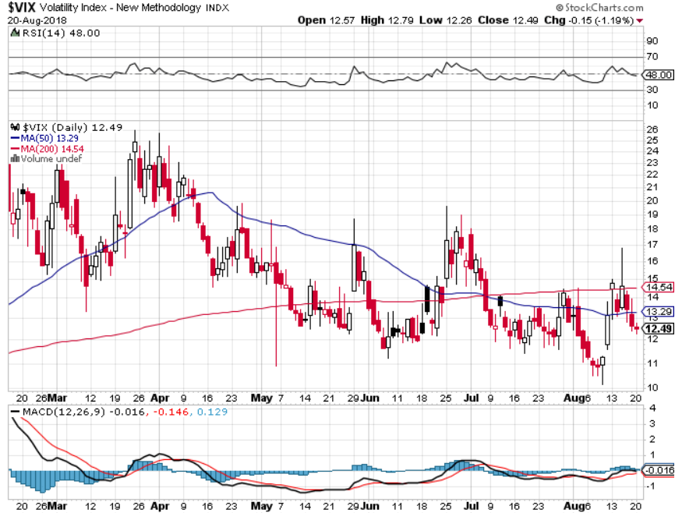
(VIX)- Spike Time

Slide 24
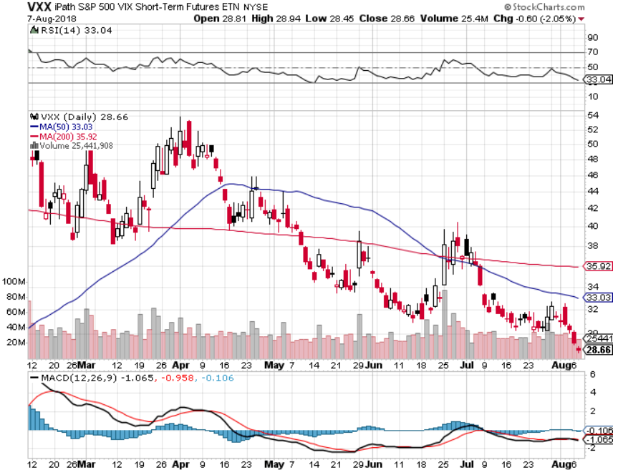
iPath S&P 500 VIX Short-Term Futures ETN (VXX) long 5/$32-$35 call spread took profits on long 3/$60-$65 bear put spread took profits on long 3/$55-$60 bear put spread

Slide 25
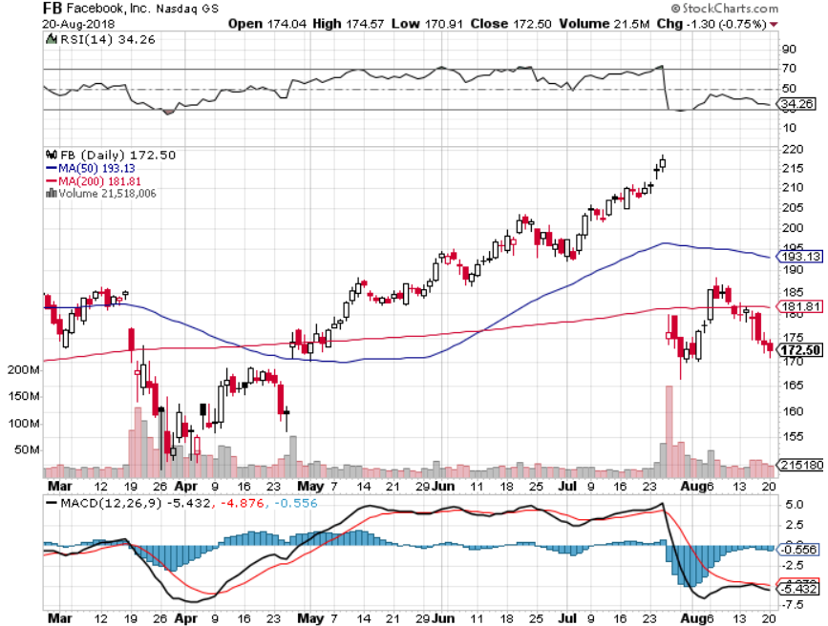
Facebook (FB)- Reality Returns stopped out of long 4/$150-$160 call spread took profits on long 6/$130-$140 bull call spread took profits on long 3/$155-$165 bull call spread took profits on long 3/$190-$195 bear put spread

Slide 26
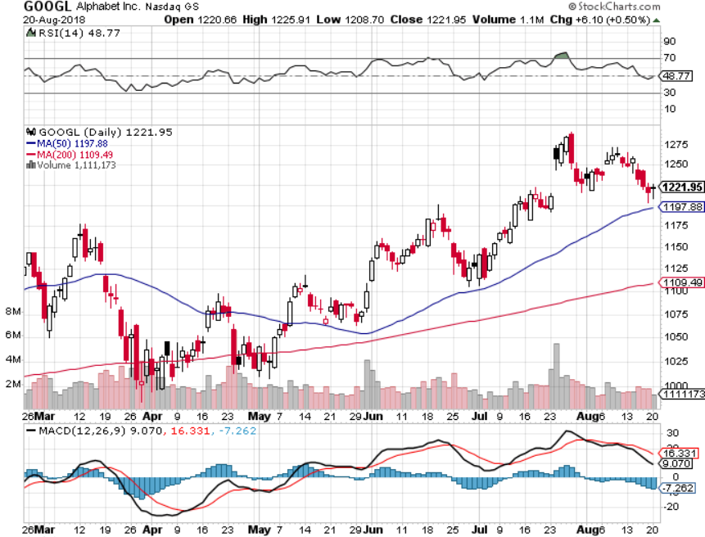
Alphabet (GOOGL)-Correction Proof took profits on long 4/$900-$930 call spread

Slide 27
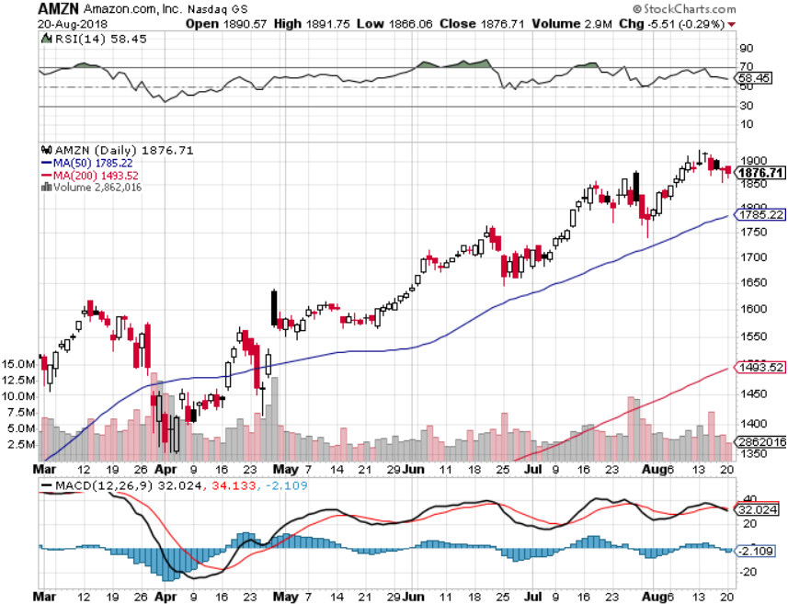
Amazon (AMZN)-Also Correction Proof

Slide 28
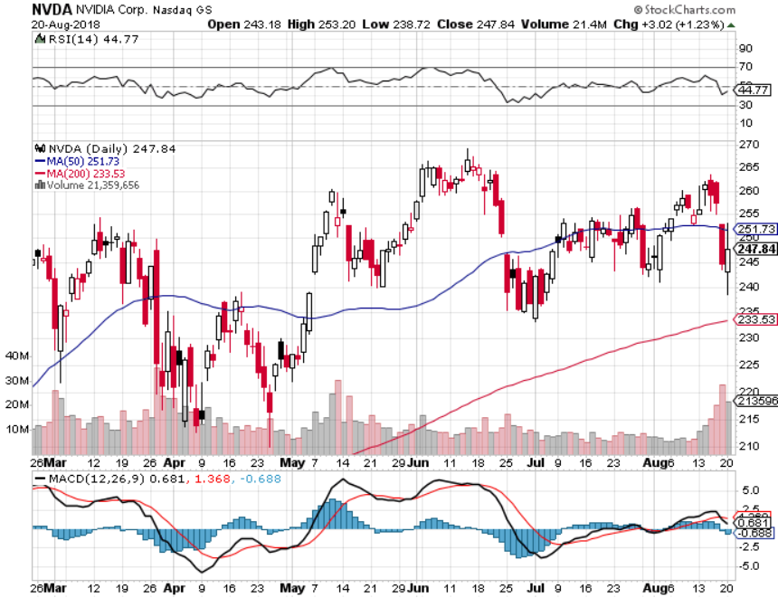
NVIDIA (NVDA)-Great Earnings but Poor Guidance
The Chip mini recession is on-Trade wars and bitcoin

Slide 29
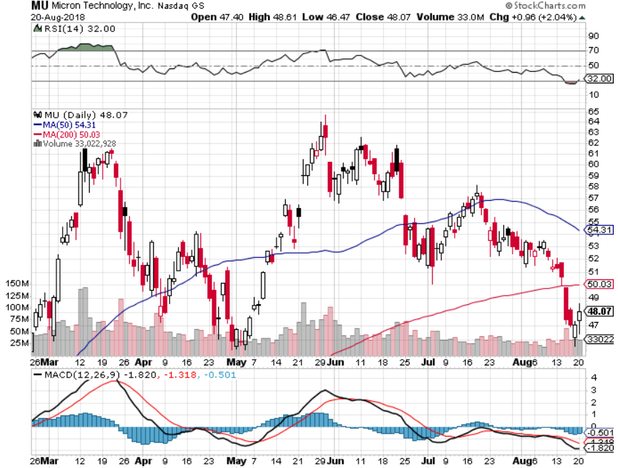
Micron Technology (MU)-Trade Wars took profits on long 3/$34-$37 bull call spread in
Mad Hedge Technology Letter Only

Slide 30
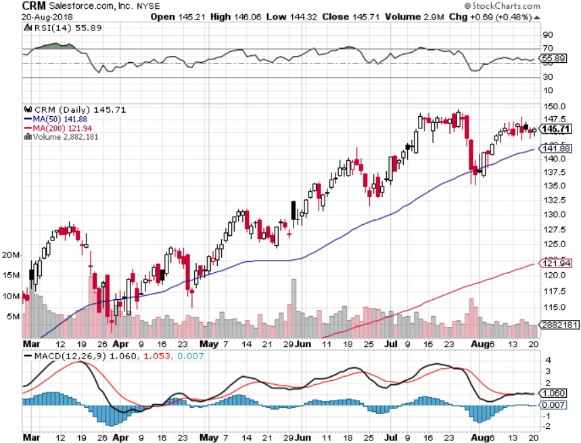
Salesforce (CRM)-Tech Correction long 7/$115-$120 call spread (tech letter) took profits on long 6/$105-$110 call spread took profits on long 3/$90-$95 bull call spread

Slide 31
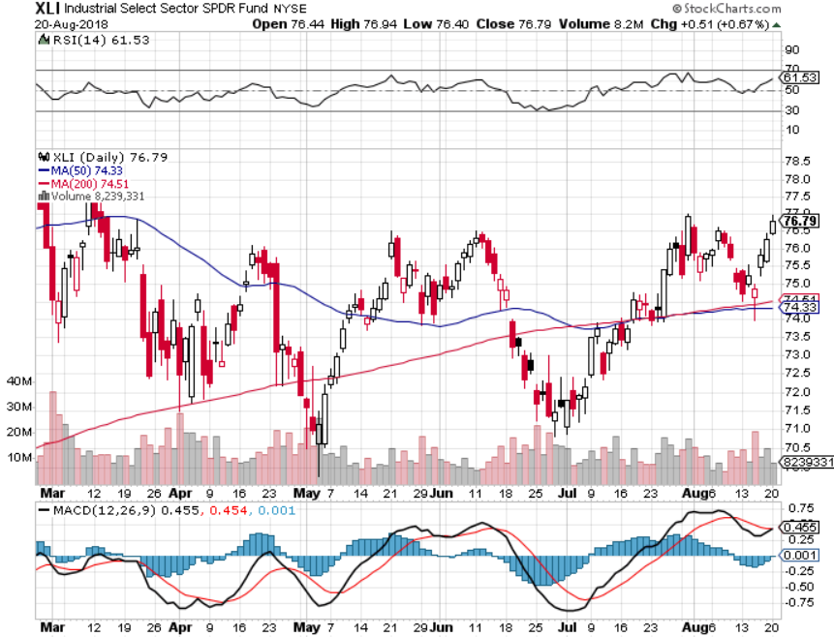
Industrials Sector SPDR (XLI)-Rotation Target
(GE), (MMM), (UNP), (UTX), (BA), (HON)

Slide 32
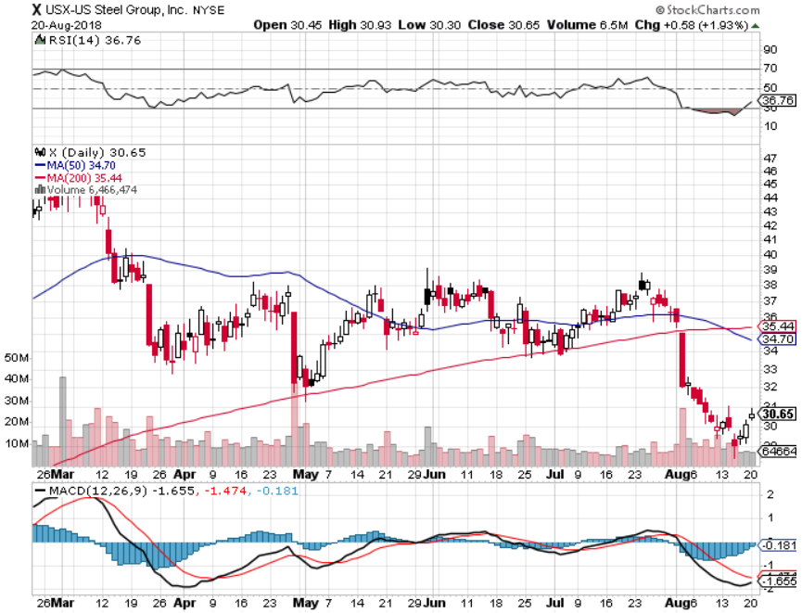
US Steel (X)-Tariffs Trouble
Import duties cause users to abandon steel took profits on long the 9/$21-$22 vertical bull call spread

Slide 33
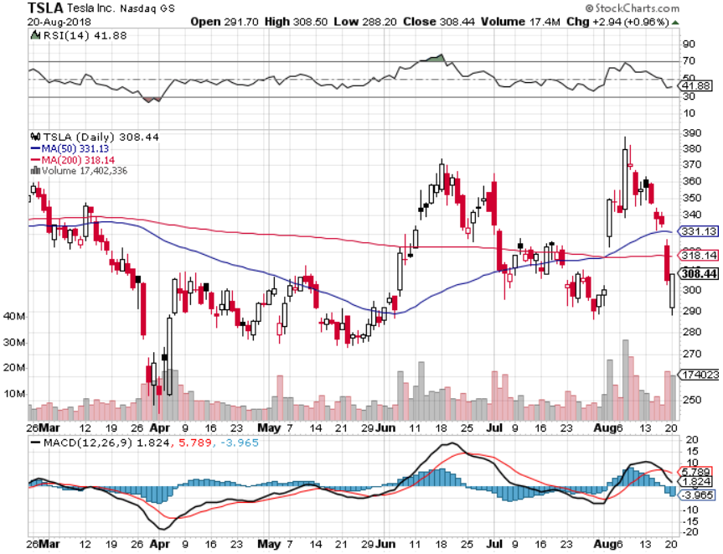
Tesla (TSLA)-Smaller Loss
Has largest short position in the market, lost$2.4 billion
Buyout attempt t $420

Slide 34
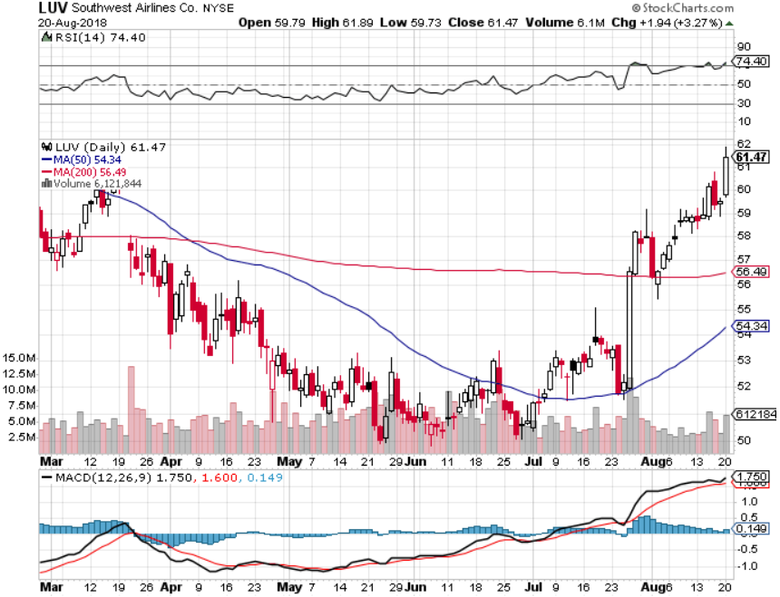
Southwest Airlines (LUV)- Earnings Pop
Warren Buffett’s Favorite Airline

Slide 35
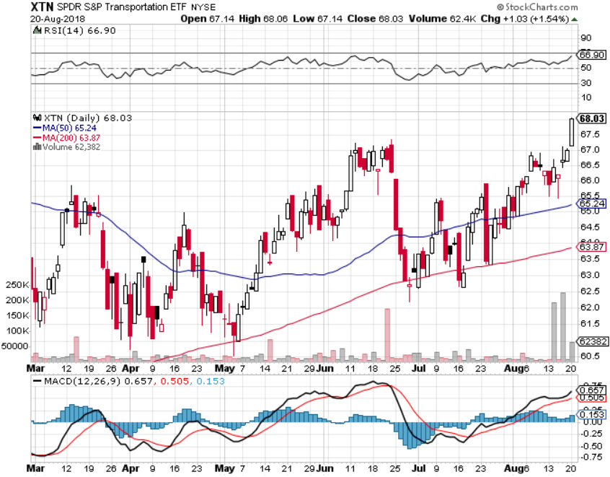
Transports Sector SPDR (XTN)-
(ALGT), (ALK), (JBLU), (LUV), (CHRW), (DAL)

Slide 36
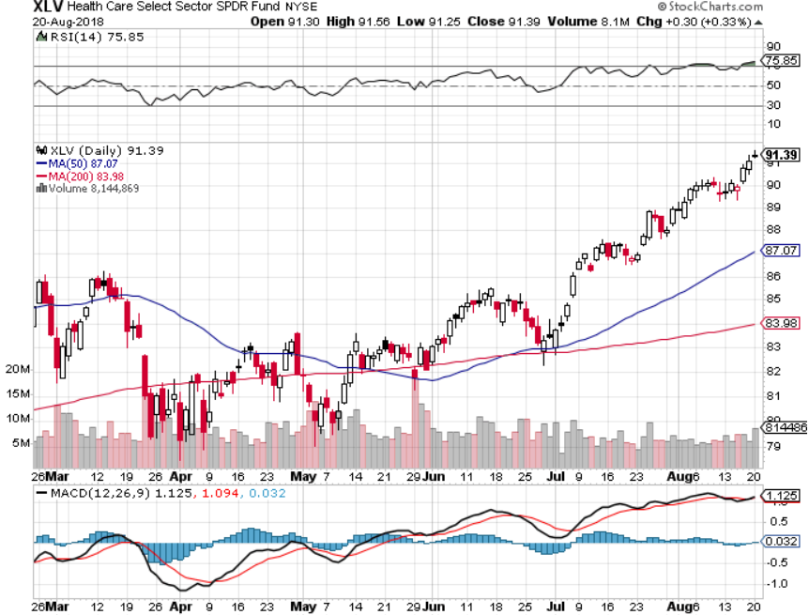
Health Care Sector (XLV), (RXL)-New Highs
(JNJ), (PFE), (MRK), (GILD), (ACT), (AMGN)

Slide 37
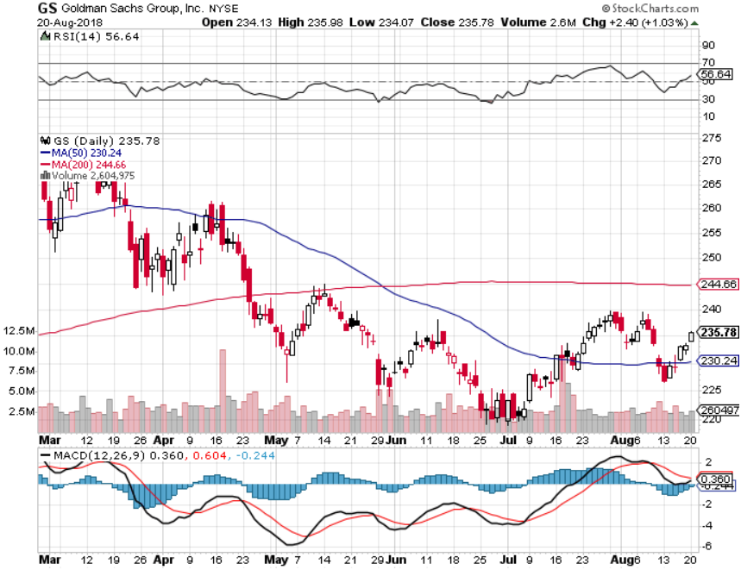
Goldman Sachs (GS)-Head and Shoulders Bottom stopped out of long 4/240-$245 call spread stopped out of long 10/$220-$225 vertical bull call spread took profits on long 10/$227.50-$232.50 vertical bull call spread

Slide 38
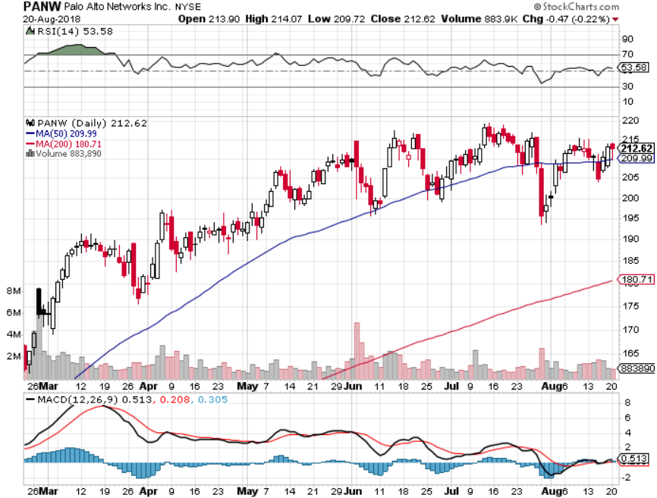
Palo Alto Networks (PANW)-
Hacking never goes out of fashion

Slide 39
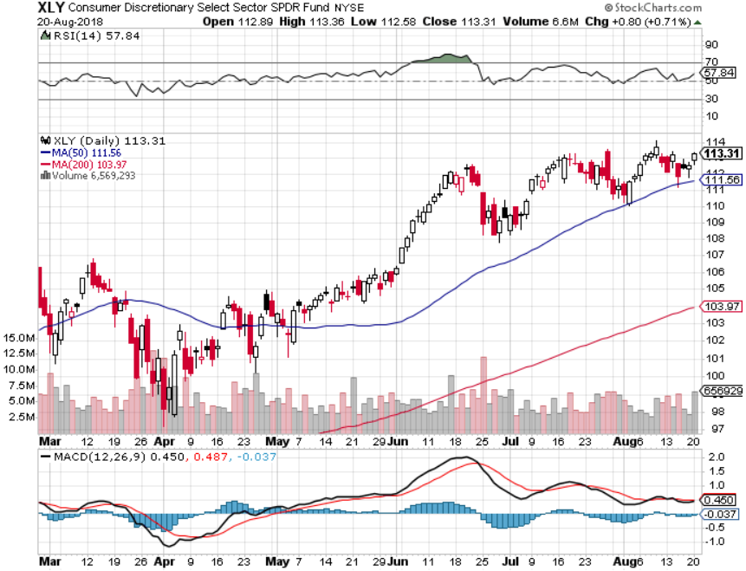
Consumer Discretionary SPDR (XLY)
(DIS), (AMZN), (HD), (CMCSA), (MCD), (SBUX)

Slide 40
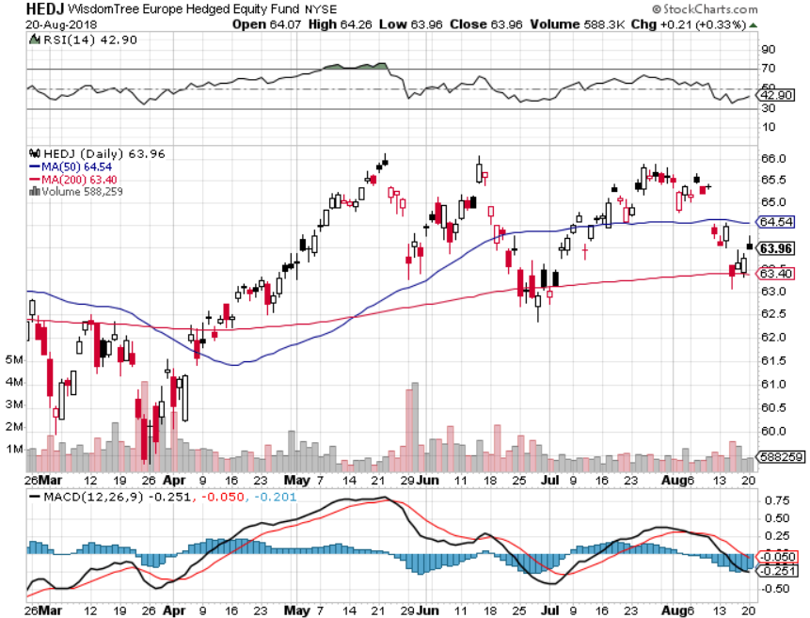
Europe Hedged Equity (HEDJ)-Triple Top

Slide 41
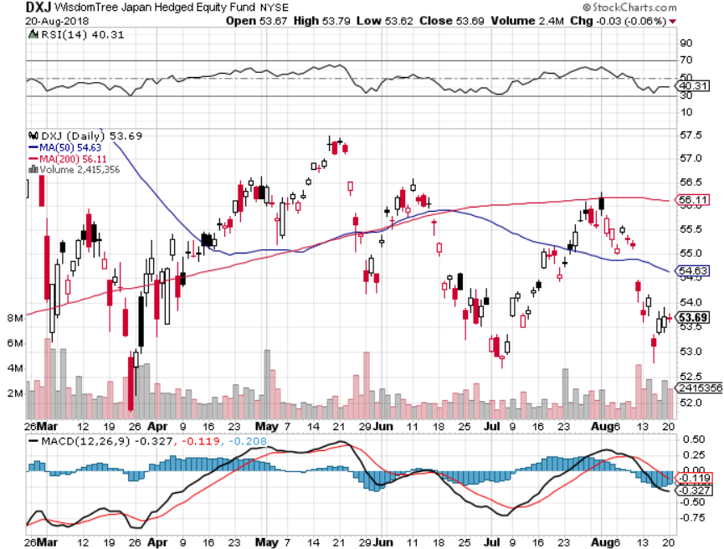
Japan (DXJ)-

Slide 42
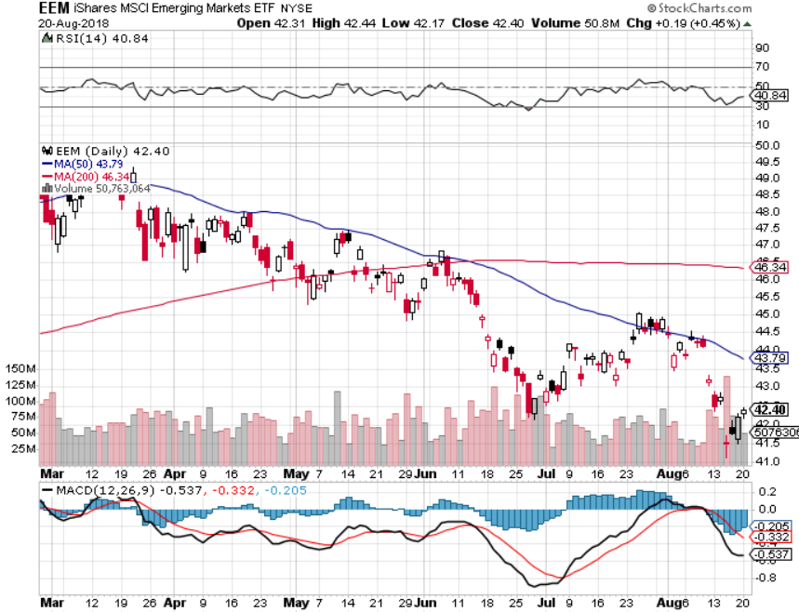
Emerging Markets (EEM)- Killed by Strong Dollar

Slide 43
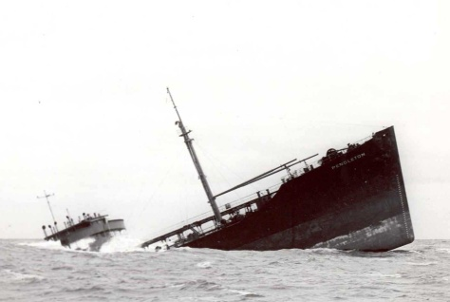
Bonds- Dead in the Water
*There has been no net movement of bond prices in two years, despite seven Fed interest rate hikes
*Huge short positions are supporting the market
*$100 billion in new Treasury bond auctions will overhang the market this week
*Massive liquidity created by global QE will drive all asset classes for years, or least prevent them from falling
*Still looking for 3.25%-3.5% ten year US Treasury yield by yearend, and 4% in a year
*Exploding deficits will weigh on
bonds for the next decade, sell every
rally across the space, up 67% YOY
Bottom Line: Sell every four point
rally in the (TLT)

Slide 44
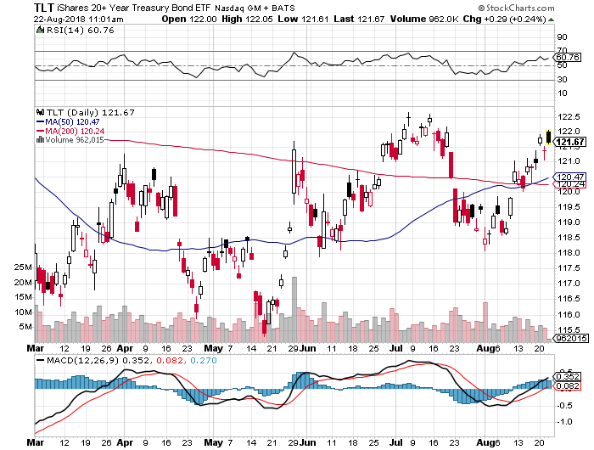
Treasury ETF (TLT) – Top of Range long the (TLT) 9/$123-$126 put spread

Slide 45
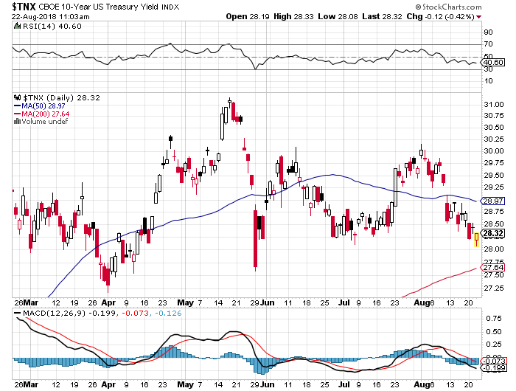
Ten Year Treasury Yield ($TNX) 2.96%
Breakdown, Now major Support

Slide 46
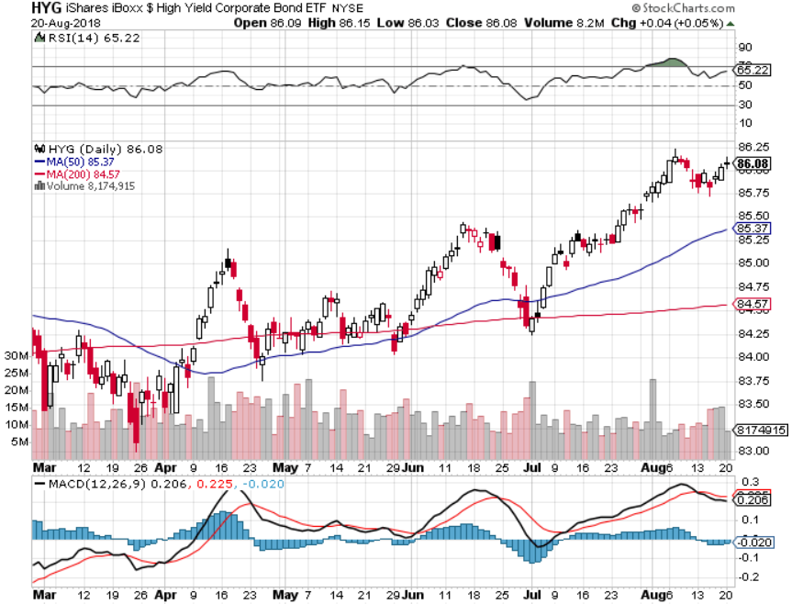
Junk Bonds (HYG) 5.78% Yield

Slide 47
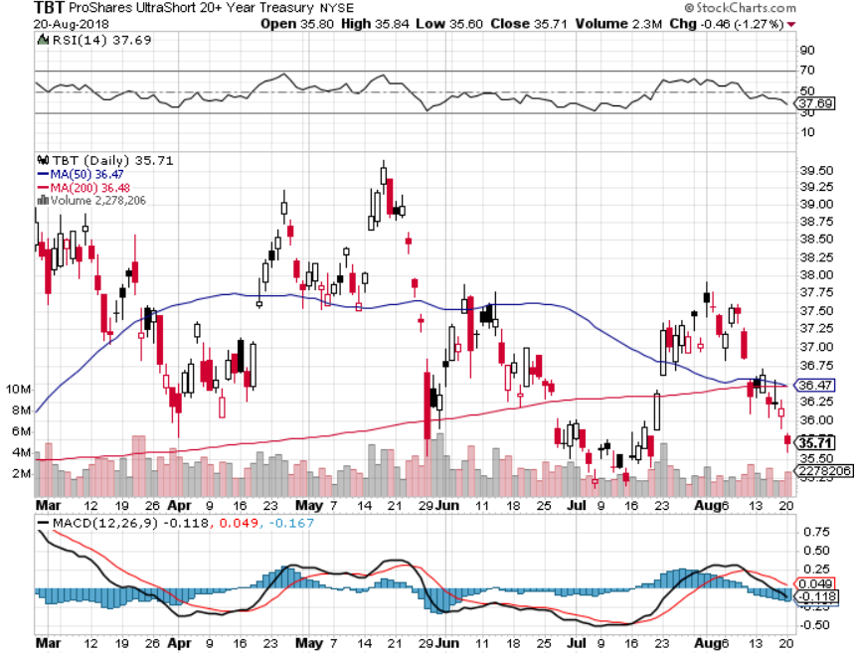
2X Short Treasuries (TBT)-Buy Territory

Slide 48
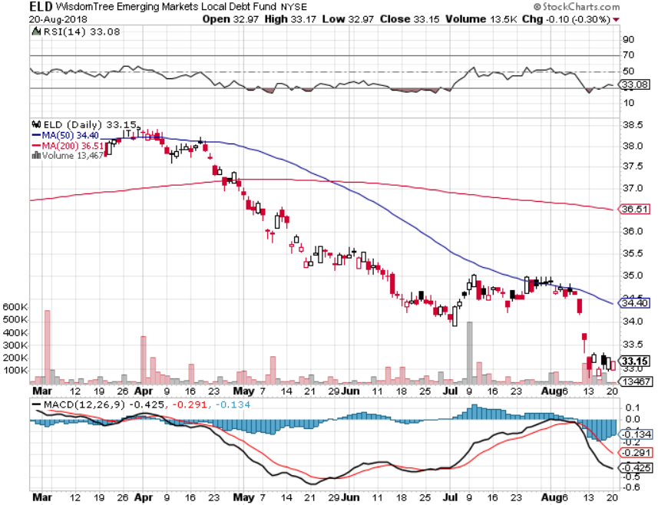
Emerging Market Debt (ELD) 5.64% Yield-

Slide 49
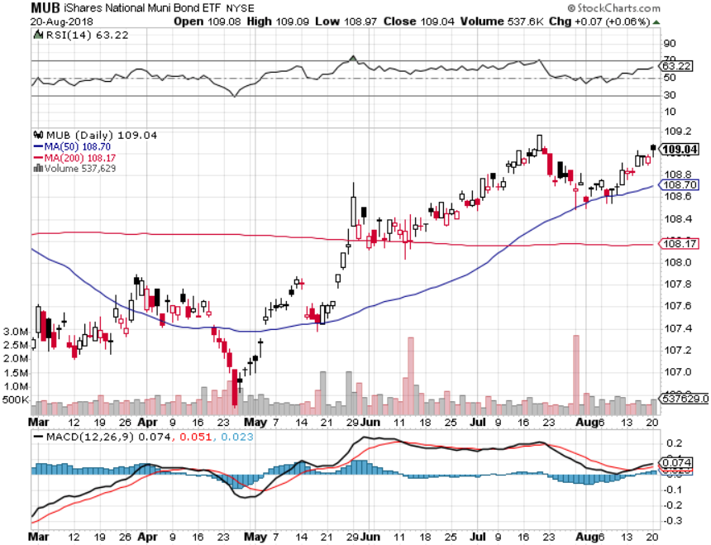
Municipal Bonds (MUB)-2.32%
Mix of AAA, AA, and A rated bonds
Huge 40 basis point yield pop on tax bill

Slide 50

Foreign Currencies- Trade Wars
*Trade war escalation crushes Turkish Lira for 20% in one day. This has led to a generalized emerging market contagion, including India and South Africa
*US trade war with China has hurt the currencies of most emerging nations, damaging their companies which borrow in dollars but increasing their export competitiveness with the US
*China is devaluing its way out of trade war damage
*Euro finally breaks one year support, taking a run at $1.00
*In the meantime, Fed is committed to
another year of rate rises
*Bitcoin struggling to hold $6,000
*Bottom Line: Sell rallies on any currencies

Slide 51
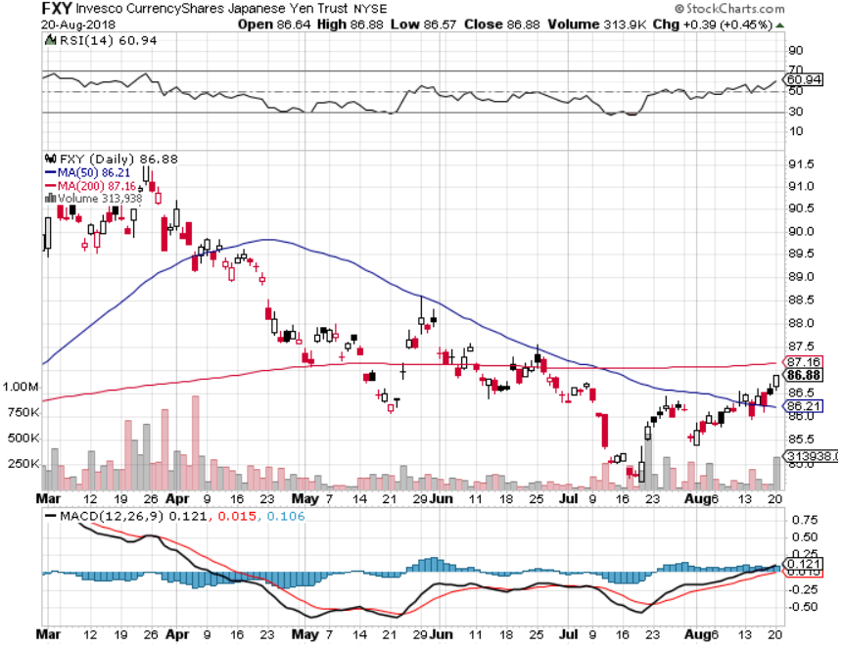
Japanese Yen (FXY), (YCS) took profits on long (FXY) 3/$91-$93 bear put spread

Slide 52
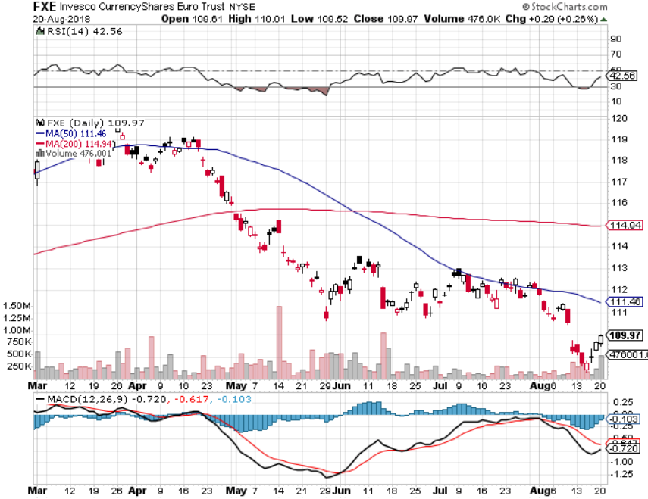
Euro ($XEU), (FXE), (EUO)- Trying to Break Down took profits on long (FXE) 3/$120-$123 vertical bear put spread took profits on long (FXE) 12/$116-$118 vertical bear put spread took profits on long (FXE) 12/$111-$113 vertical bull call spread

Slide 53
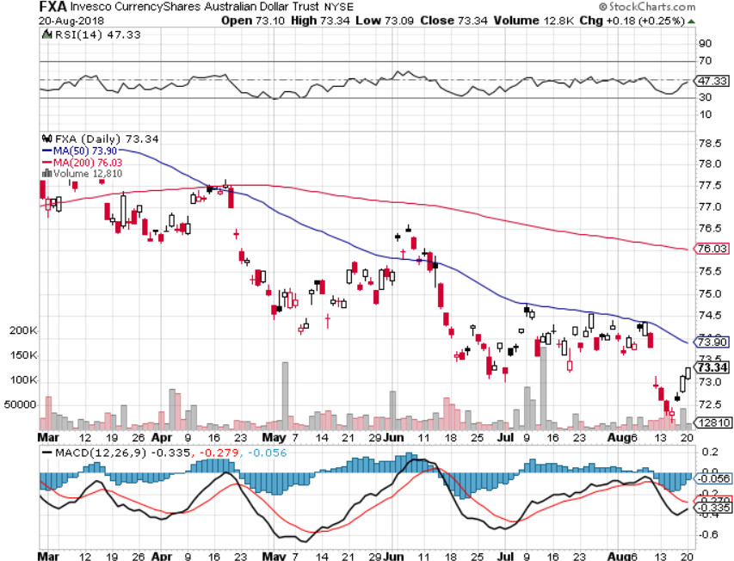
Australian Dollar (FXA)-Trade war China drag

Slide 54
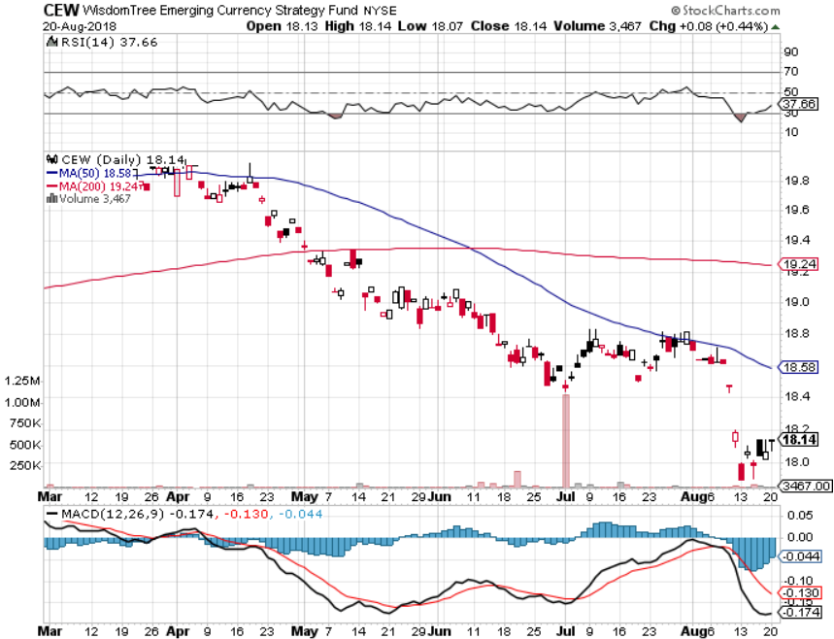
Emerging Market Currencies (CEW)

Slide 55
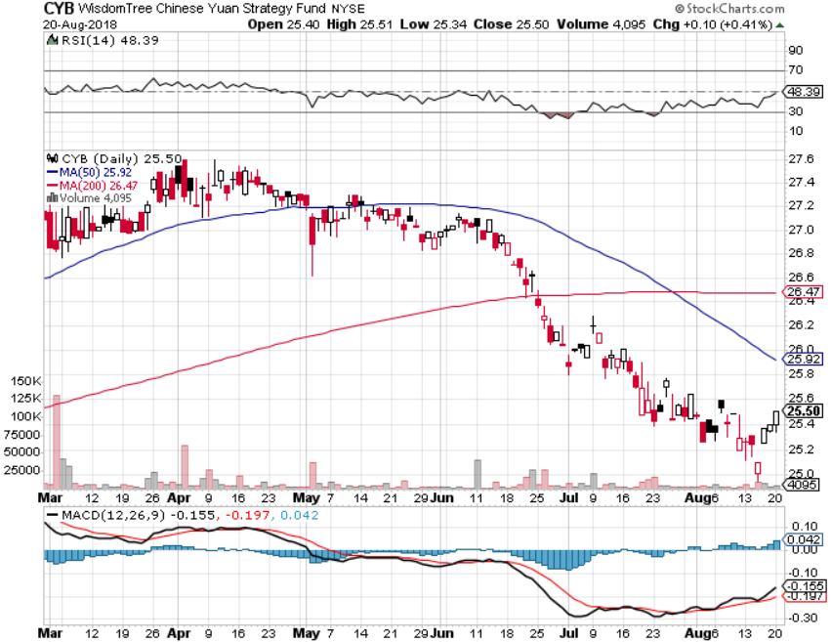
Chinese Yuan- (CYB)-Trade War Tonic

Slide 56
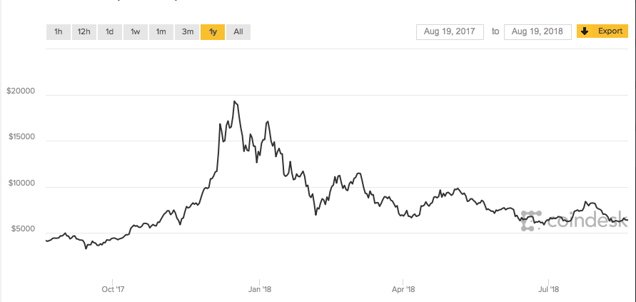
Bitcoin- Downtrend Intact

Slide 57
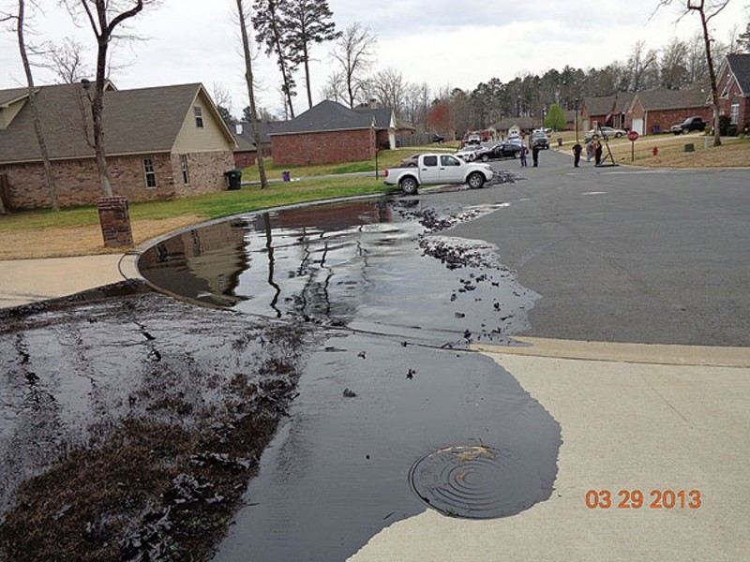
Energy – Trade War Slow Down
*Slowing global economy puts oil demand into free fall
*With peak seasonal demand behind us the outlook for oil, and oil stocks is not good
*Iran’s oil now going to China and there is nothing new the US can do about it
*Saudi Aramco deal is dead as long as oil maintains current levels
*Bottom Line: Oil may be peaking
here so stand aside

Slide 58
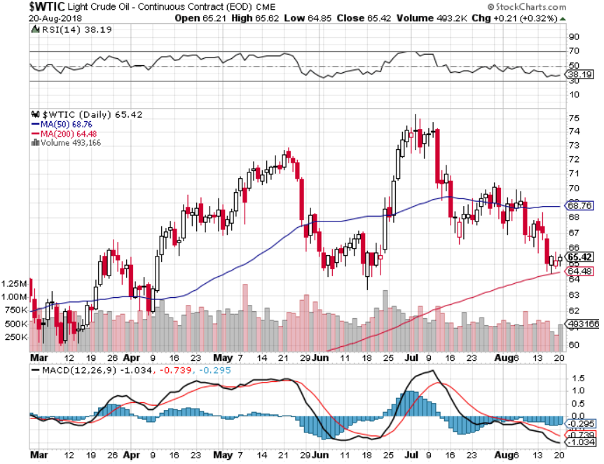
Oil-China drag

Slide 59
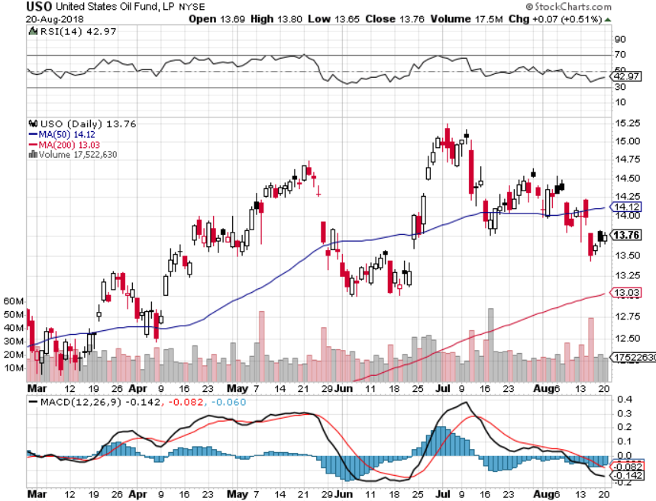
United States Oil Fund (USO)

Slide 60

Energy Select Sector SPDR (XLE)-No Performance!
(XOM), (CVX), (SLB), (KMI), (EOG), (COP)

Slide 61

Halliburton (HAL)-New Low

Slide 62

Natural Gas (UNG)-

Slide 63

Copper (COPX)-Trade War Fears

Slide 64

Precious Metals-Selling to the Rest of the World
*Rising overnight interest rates continue to crush gold, even though long rates have been stagnant
*Flight to safety bid is gone, as it is for the Japanese yen
*Russia, China, and Europe are the only gold buyers
*Venezuela is still hammering the market but only has $6 billion left to sell
*Bitcoin stealing away speculative activity,
even though it is falling faster
*Bottom Line: Stand aside

Slide 65

Gold (GLD)-No Help from Trade War
Took profits on long 5/$119-$122 bull call spread took profits on long (GLD) $12/$116-$119 bull call spread

Slide 66

Market Vectors Gold Miners ETF- (GDX) – Yikes!
Took profits on long the 9/$20.50-$21.50 bull call spread

Slide 67

Barrick Gold (ABX)

Slide 68

Newmont Mining- (NEM)-

Slide 69

Global X Silver Miners ETF- (SIL)-

Slide 70

Real Estate-Rolling Over?
*Home Affordability hits a decade low, thanks to rising prices and interest rates and soaring construction costs
*July Housing Starts up +0.9% versus 8.3% expected, tariff induced rocketing costs wipe out the profitability of new homes, New Home Sales collapse by 5.3% in June after 6.7% fall in May, new Mortgage Applications plunging, off 2% last week
*Homebuilder and construction stocks enter bear market
*14% of all June real estate listings saw price cuts, a two year high, Chinese buying of West Coast homes vaporizes
*S&P 500 Case-Shiller maintains
strong 6.5%, with absolute prices
hitting new all time highs
*Bottom Line: Stand aside

Slide 71

May Corelogic S&P Case Shiller Home Price Index
Seattle (+13.6%), Las Vegas (+12.6%) San Francisco 10.9% leaders price rises accelerating
Tradingeconomics.com

Slide 72

Simon Property Group (SPG)- Falling rates and rotation push

Slide 73

US Home Construction Index (ITB)
(DHI), (LEN), (PHM), (TOL), (NVR)

Slide 74

Trade Sheet-
So What Do We Do About All This?
*Stocks-topping out-rotate tech to value
*Bonds-sell any and all rallies
*Commodities-stand aside
*Currencies-sell rallies in currencies
*Precious Metals –stand aside
*Volatility-go short on runs up to $20
*Real estate-stand aside

Slide 75

Next Strategy Webinar
12:00 EST Wednesday, September 5,
2018 from San Francisco, CA
For Tahoe Conference
Please Go to www.madhedgefundtrader.com and click “Conferences”
Good Luck and Good Trading!
Notes:
*

