Slide 1

The Mad Hedge Fund Trader
“Struggling”
With John Thomas
from Silicon Valley, CA, September 19, 2018
www.madhedgefundtrader.com
Notes:
*

Slide 2
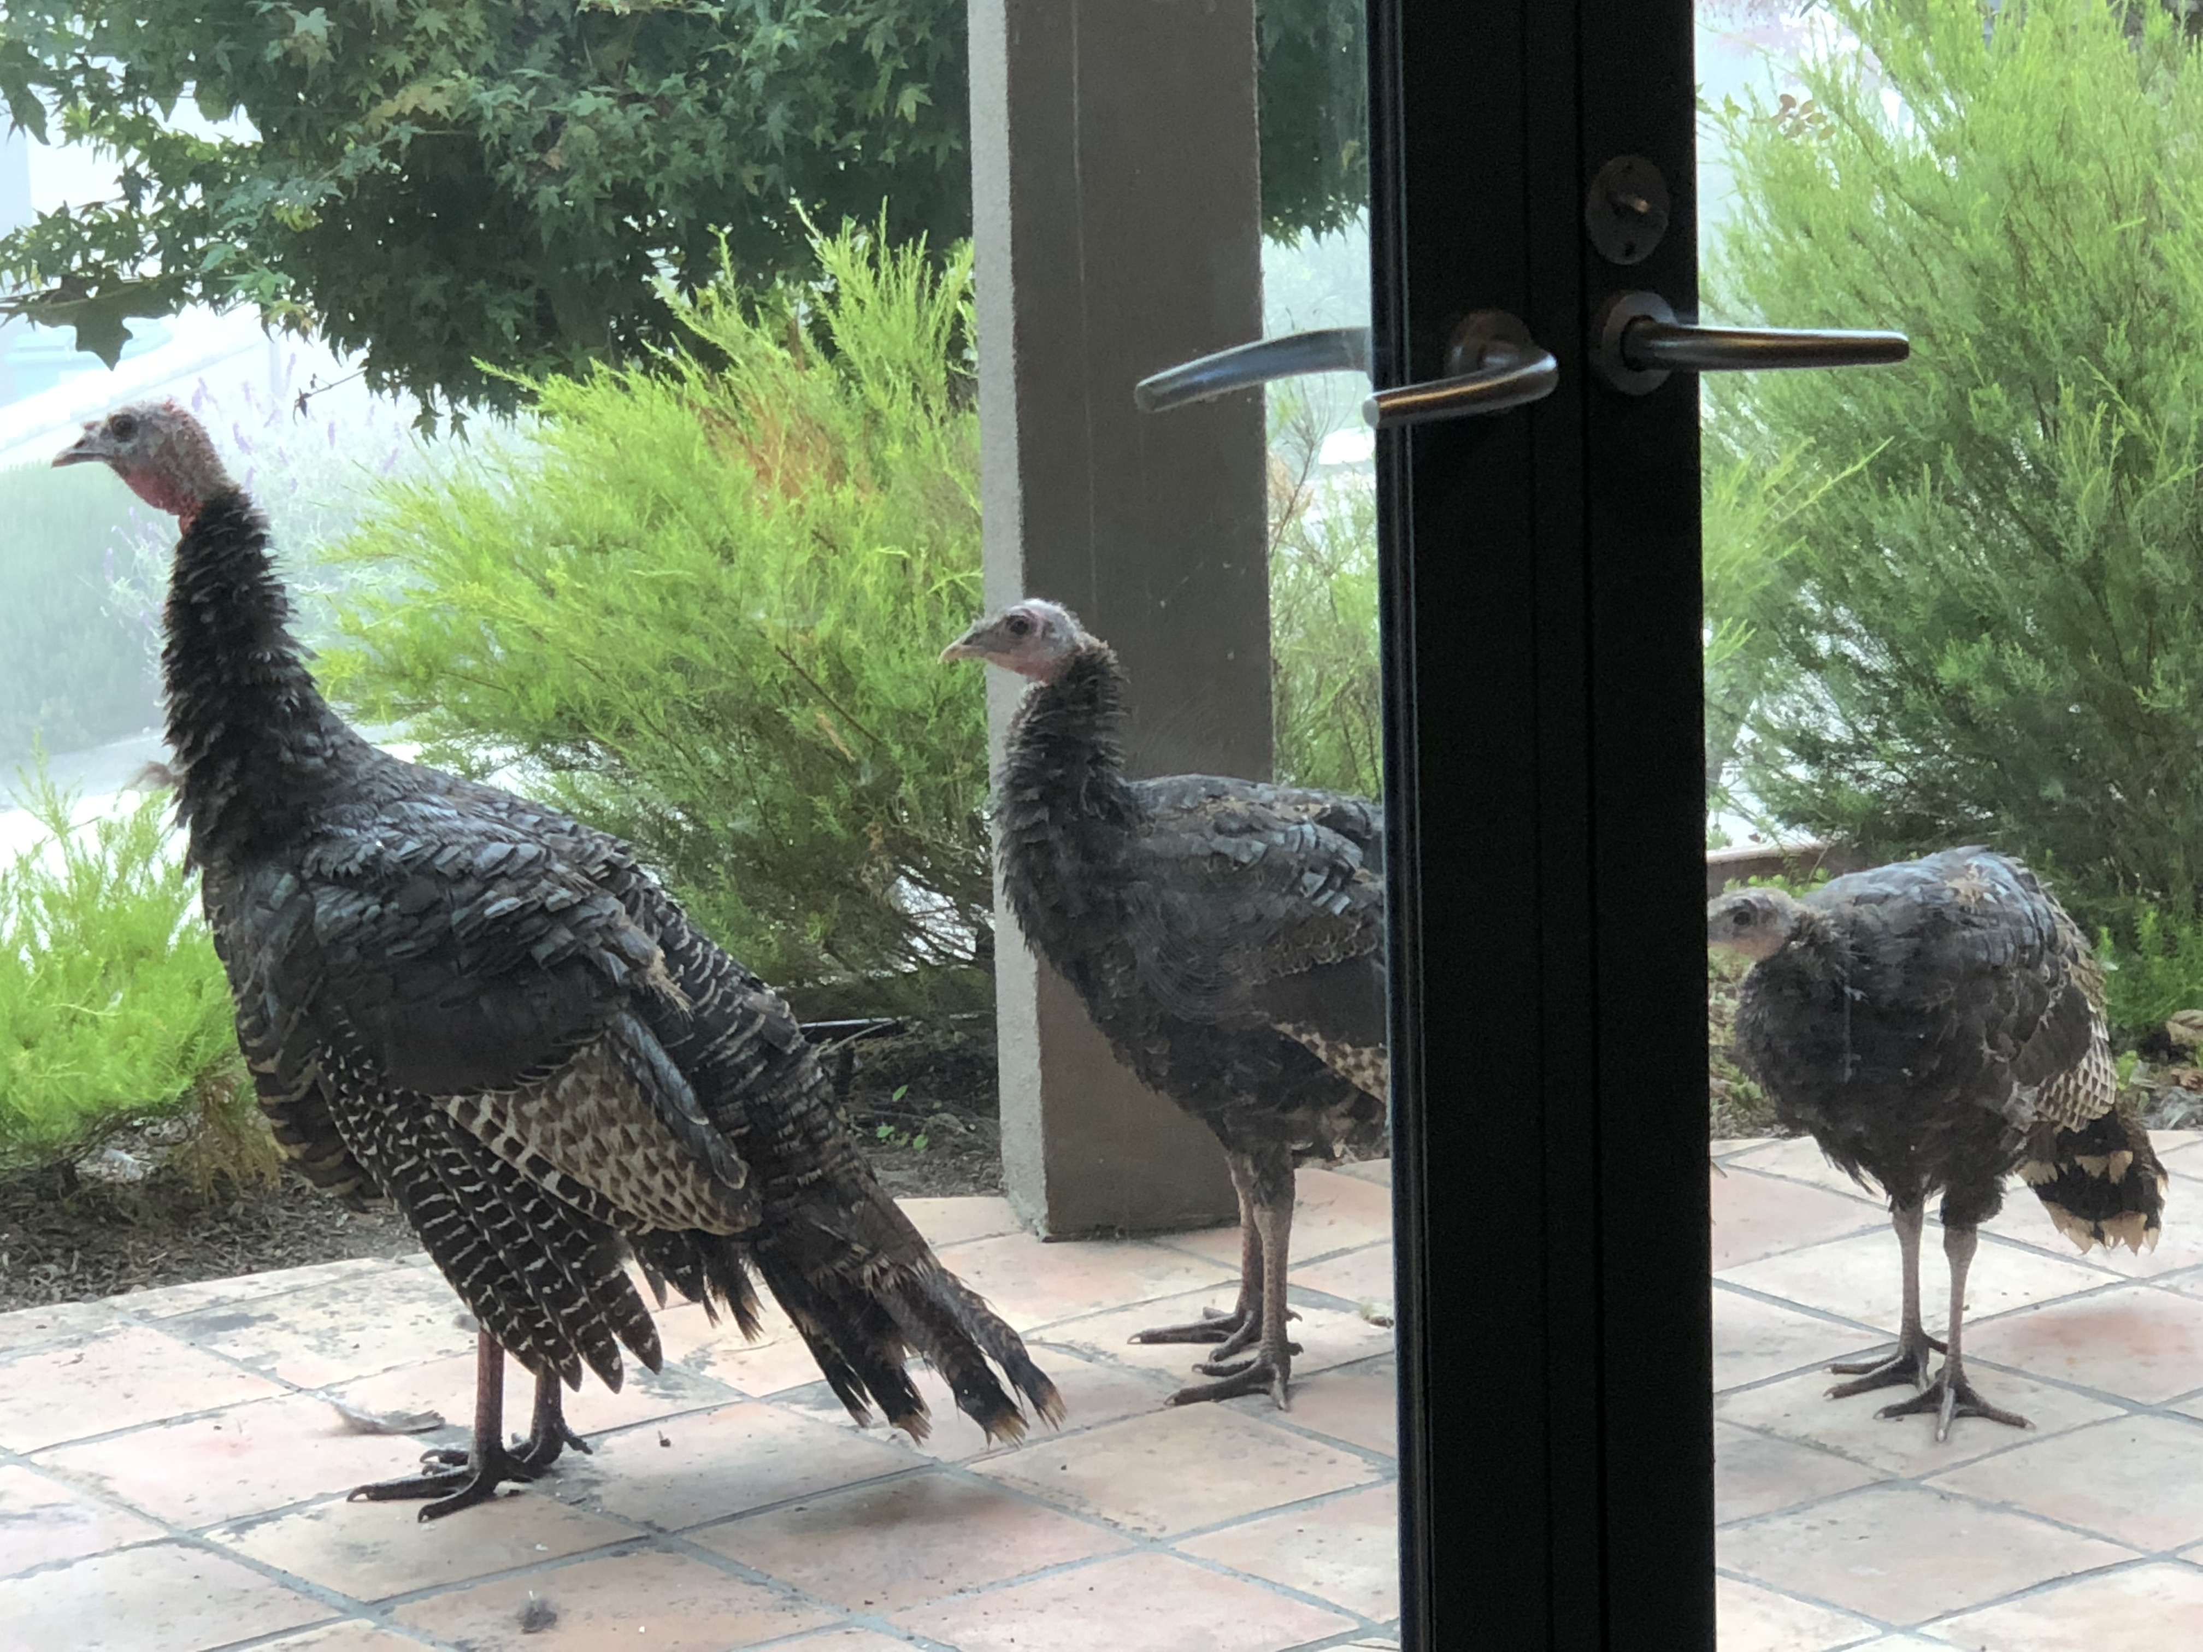

Slide 3

October 26-27 Lake Tahoe Conference
*Two days of informative speakers on crucial trading and investment issues
*Trade tips with the most successful Mad Hedge traders
*2 nights in the Hyatt, including all you can eat and drink
*Tickets are a bargain at
$599 to $1,799
*Buy now, upper ticket classes
sell out first

Slide 4

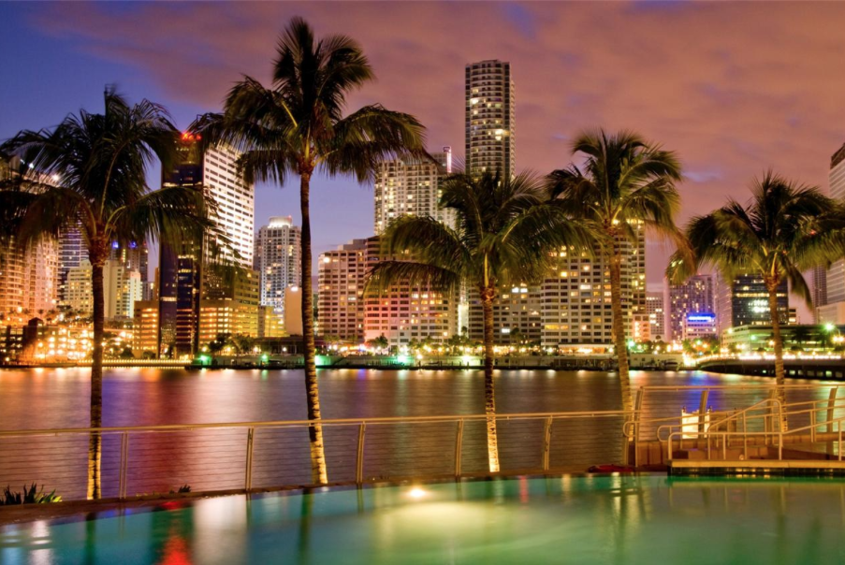
MHFT Global Strategy Luncheons
Buy tickets at www.madhedgefundtrader.com
Atlanta, GA
October 15
Miami, FL
October 16

Slide 5
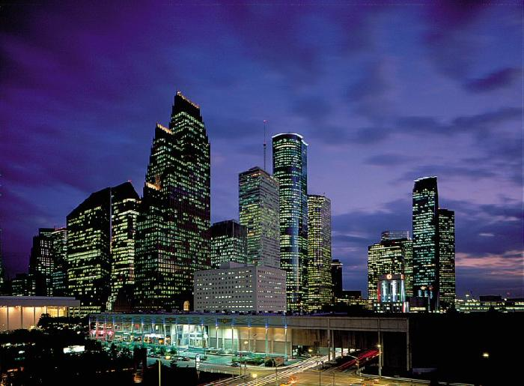
MHFT Global Strategy Luncheons
Buy tickets at www.madhedgefundtrader.com
Houston, TX
October 17

Slide 6

Trade Alert Performance
New All Time High!!
*January 4.09% Final *July +0% Final
*February +1.54% Final *August +2.19% MTD
*March +1.13% Final *September 1.96% MTD
*April +12.54% Final *October +1.39% Final
*May +1.07% Final *November +2.08% Final
*June +4.15% Final *December +3.76% Final
*2018 Year to Date 28.97%
compared to +5.7% for the Dow Average
*Trailing One year return +41.35%, +304.33% since inception,
*Average annualized return of 34.65%

Slide 7
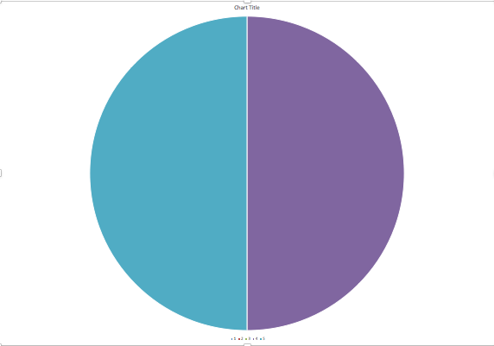
Portfolio Review
10% long tech, 10% short bonds, 10% short S&P 500
at market all time highs
Current Capital at Risk
Risk On
World is Getting Better
Risk Off
(SPY) 9/$294-$297 put spread | -10.00%
(TLT) 10/$114-$117 call spread | -10.00%
Total Net Position | -20.00%
Expiration P&L
30.49%

Slide 8
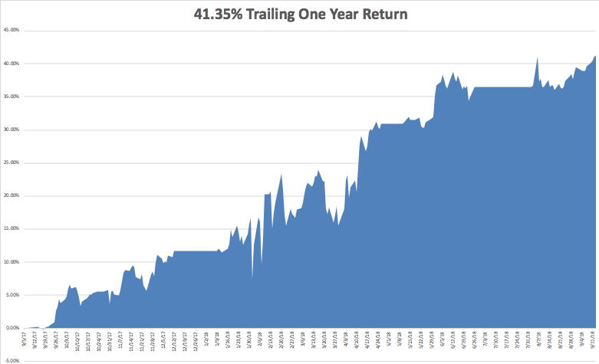
GTD Daily Audited Performance
All Time High

Slide 9
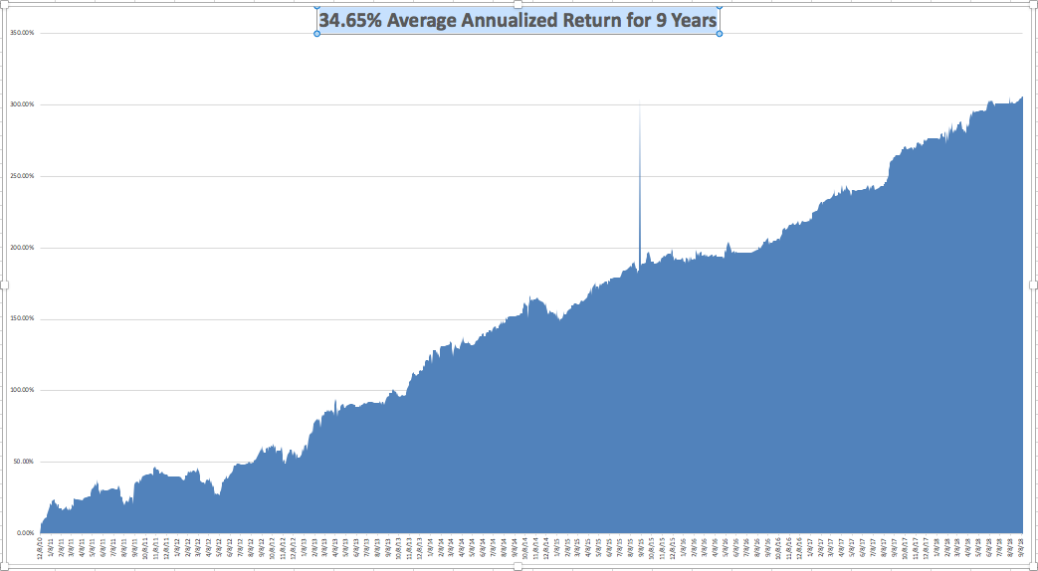
GTD 9 Year Daily Audited Performance

Slide 10
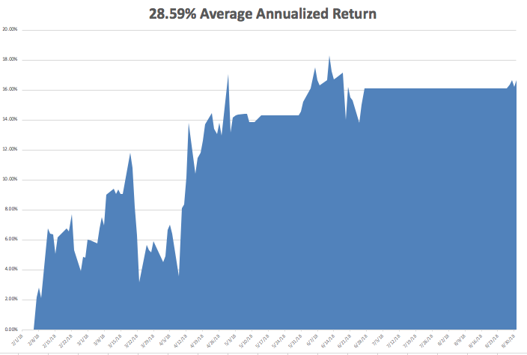
Mad Hedge Technology Letter a $2,500 a year upgrade

Slide 11

The Method to My Madness
*Markets seem immune from trade wars and rising rates. This won’t last forever
*Escalation of trade war on every front is bad for risk taking
*Big tech rolls over. For how long?
*Dollar takes a break but another leg up is in the cards
*Rising rates also say that precious
metals and yield plays are DOA
*All that said, I still expect the S&P 500
to be up 10% by the end of the year
and there is still good money to be made
*So 3% more upside in 3 months

Slide 12
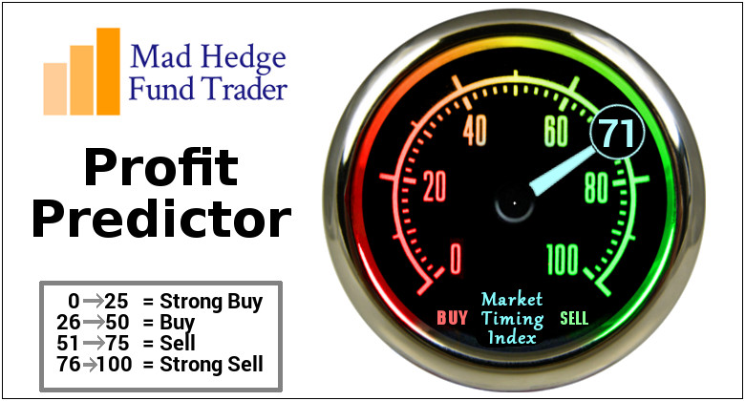
The Mad Hedge Profit Predictor
Market Timing Index-
An artificial intelligence driven algorithm that analyzes 30 different economic, technical, and momentum driven indicators

Slide 13
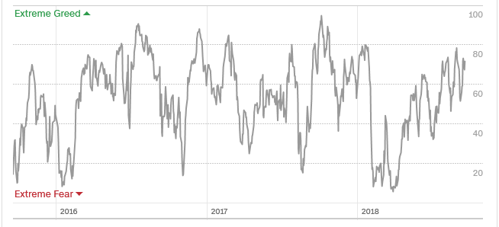
The Mad Hedge Profit Predictor
Approaching Top of 2018 Range-Risk is High
SELL
BUY

Slide 14

The Global Economy –Weakness
*Tax cuts and deficit spending have another 5 months to work their way through the US, after that, they’re gone
*US is still the sole beacon of strength in the global economy, August Industrial Production up +4.9% YOY, August Retail Sales up only 0.1%, September Consumer Sentiment from 96.2 to 100.8, August CPI 2.9% down to 2.7%
*Strong dollar take a break, lets emerging markets rally
*Commodities see a bear market rally
*Fed 25 basis point Rate Rise to 2.0%-2.25%
a sure thing on September 26
*Europe is still a disaster area, so is
China, taking big hits from the US,
Germany ZEW Index is still trending down

Slide 15
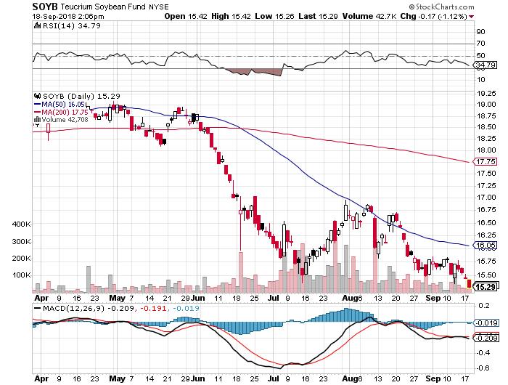
Soybeans (-20%)-Trade War Indicator
New Lows

Slide 16
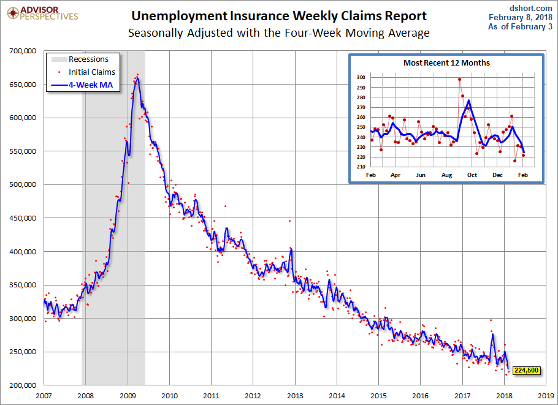
Weekly Jobless Claims –The Most Important Statistic
-1,000 to 204,000- 43 Year Low

Slide 17
The Bill Davis View
A $1,500 Upgrade for the Mad Day Trader Service
Buys: | Entry | Target
Sina.com (SINA) x | $ 65.00 | $ 75.00
Jazz Pharmaceuticals (JAZZ) | $ 160.00 | $ 180.00
Western Digital (WDC) x | $ 57.00 | $ 68.00
Boeing Co. (BA) | $ 355.00 | $ 370.00
Adobe Systems (ADBE) | $ 264.00 | $ 279.00
Sells:
Bluebird Bio (BLUE) | $ 152.00 | $ 125.00
Wynn Resorts (WYNN) | $ 138.00 | $ 110.00
Concho Resources (CXO) | $ 146.00 | $ 137.00
Cerner Corp (CERN) | $ 65.00 | $ 50.00
United Parcel Service (UPS) | $ 121.00 | $ 113.00

Slide 18

Stocks-Sideways Correction
*Stocks stocks stuck in incredible narrow range for weeks now
*No one wants to sell ahead of great October earnings
*No one wants to buy either with trade wars and horror stories coming out of Washington every day
*Daily industry rotations make this a particularly difficult market to trade
*Technology has peaked out for now
*Boring stocks making a comeback
*Bottom Line: minimize risk

Slide 19
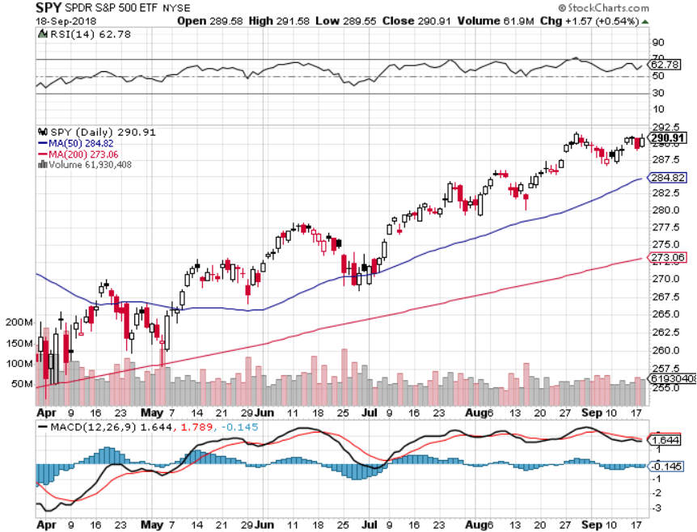
S&P 500-No Move for a Month took profits on long 5/$277-$280 put spread double weighting

Slide 20
S&P 500- Overshoot Risk took profits on long 5/$277-$280 put spread double weighting

Slide 21
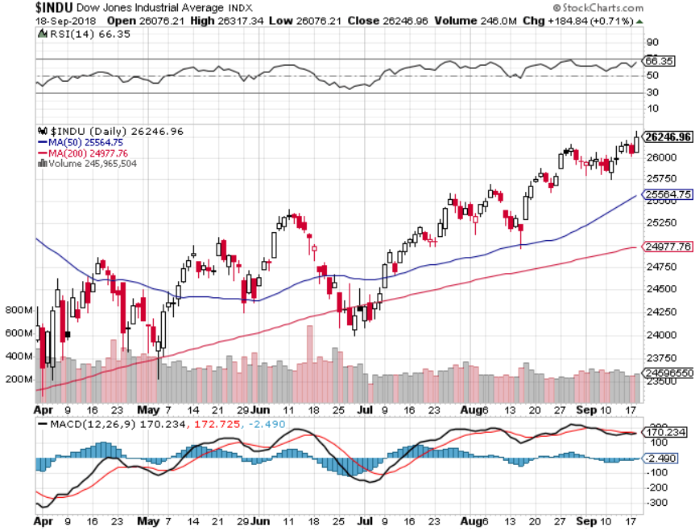
Dow Average- New High

Slide 22
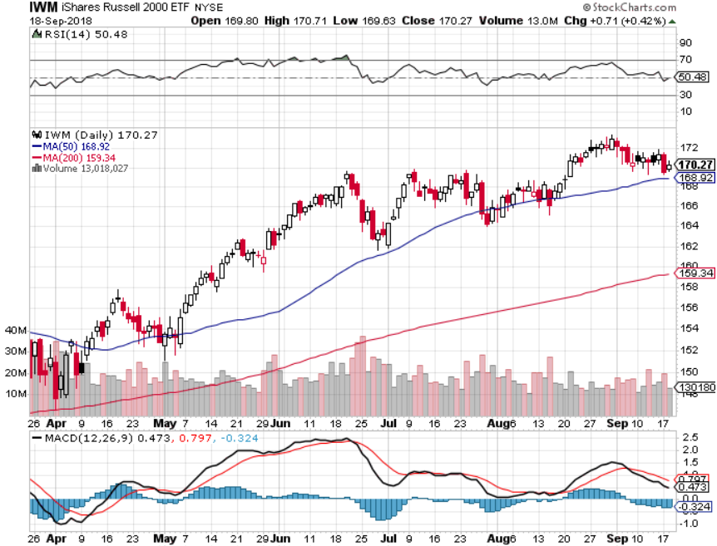
Russell 2000 (IWM)- Topping Out has become the lead index on tax breaks

Slide 23
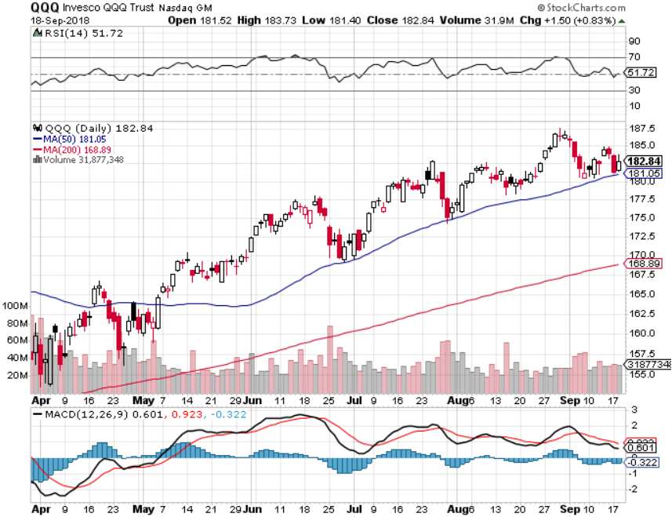
NASDAQ (QQQ)- Settling Into a Range for the rest of 2018
High earnings growth,
Good valuations,
Buybacks,
nothing else to buy
PE at 16X

Slide 24
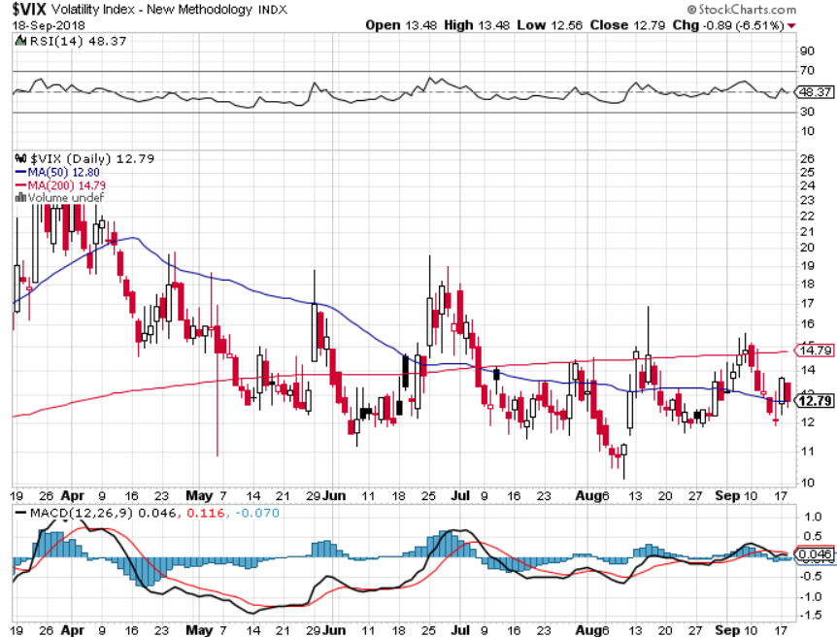
(VIX)- Spike Time

Slide 25
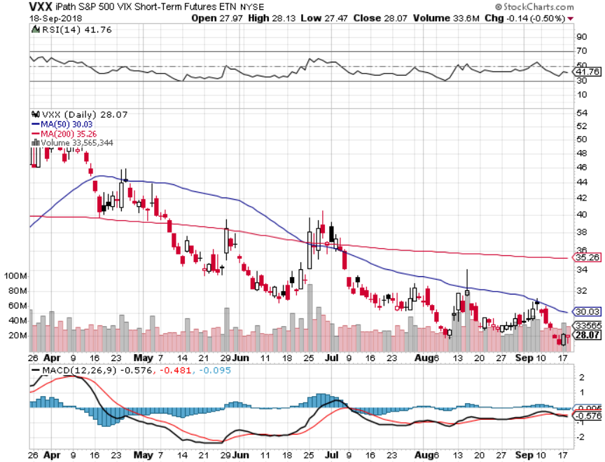
iPath S&P 500 VIX Short-Term Futures ETN (VXX) took profits on long 1/$40 calls took profits on long 3/$60-$65 bear put spread took profits on long 3/$55-$60 bear put spread

Slide 26
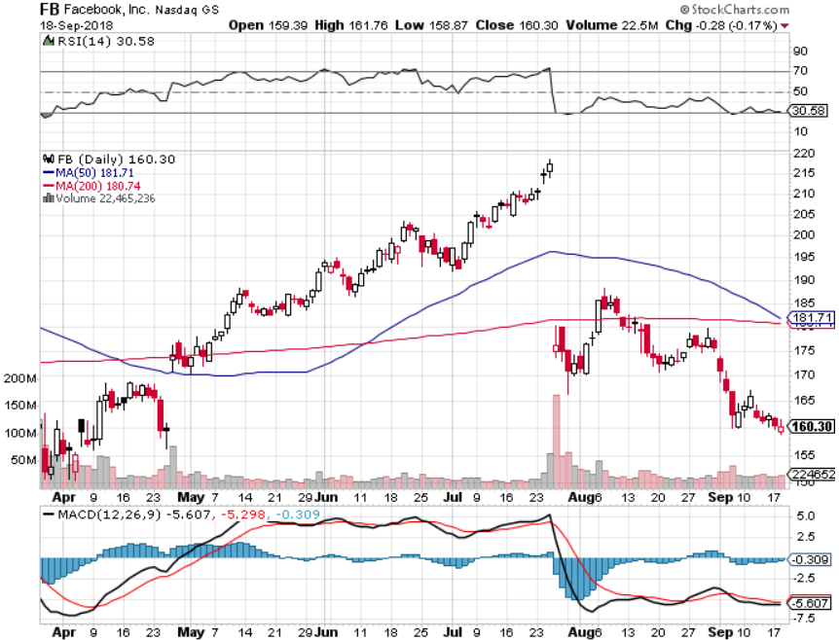
Facebook (FB)- Reality Returns stopped out of long 4/$150-$160 call spread took profits on long 6/$130-$140 bull call spread took profits on long 3/$155-$165 bull call spread took profits on long 3/$190-$195 bear put spread

Slide 27
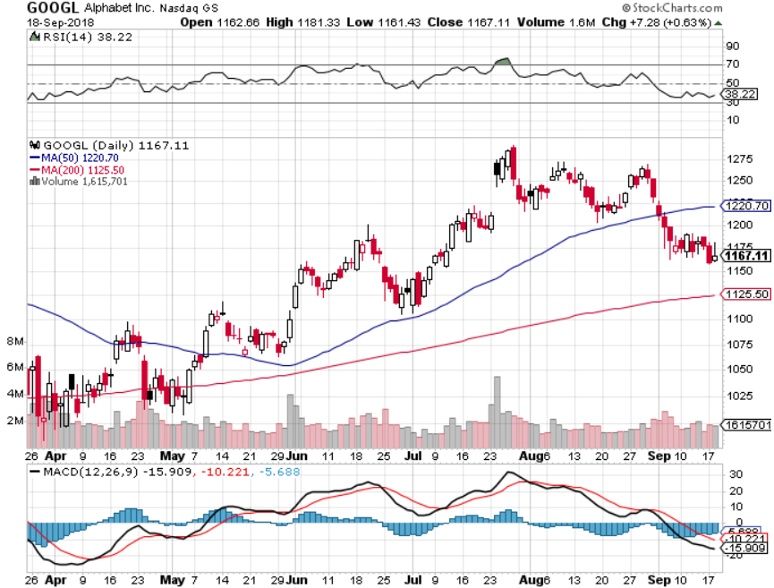
Alphabet (GOOGL)- took profits on long 4/$900-$930 call spread

Slide 28
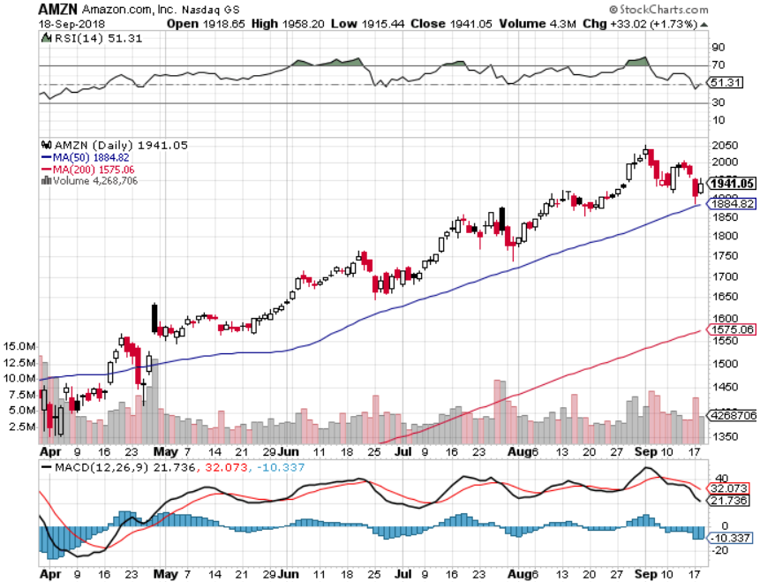
Amazon (AMZN)-Also Correction Proof
New $1 trillion company

Slide 29
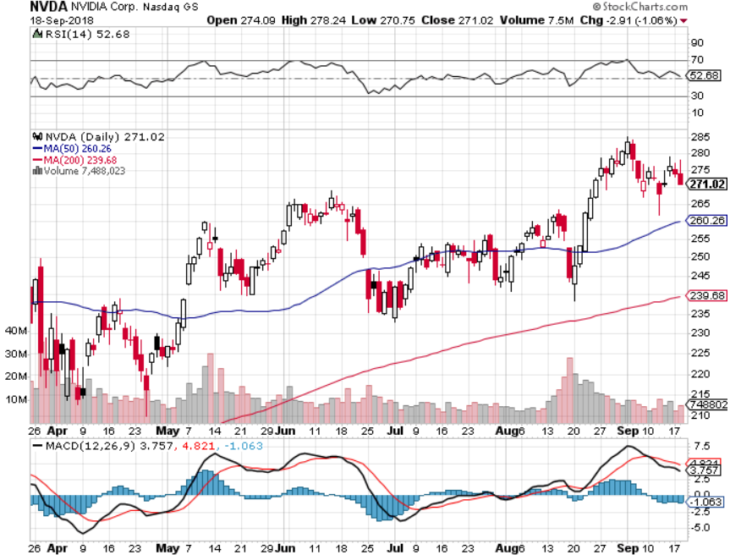
NVIDIA (NVDA)-New Highs

Slide 30
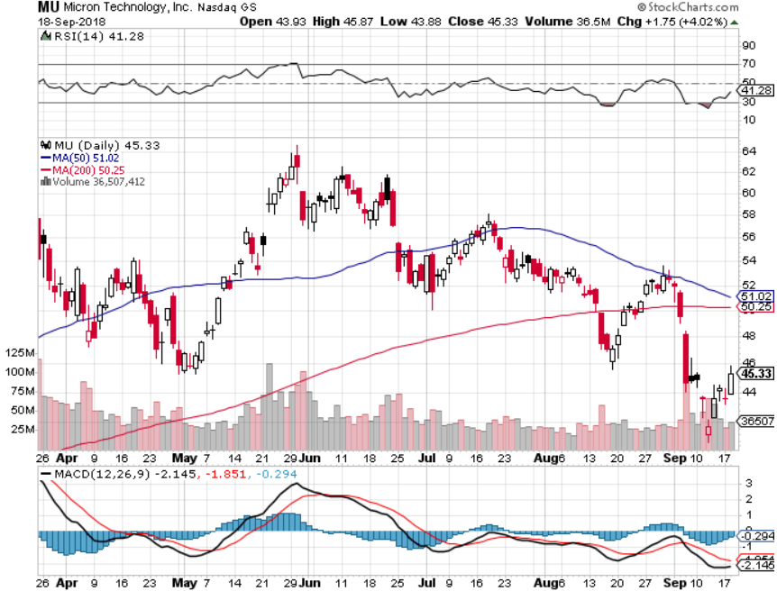
Micron Technology (MU)-Trade Wars took profits on long 3/$34-$37 bull call spread in Mad Hedge Technology Letter Only

Slide 31
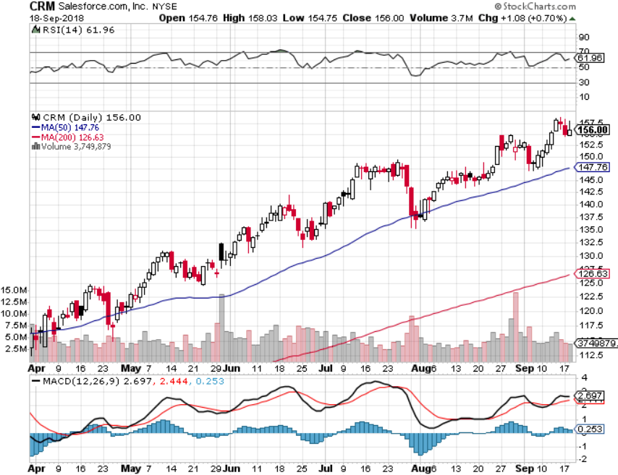
Salesforce (CRM)-New Highs took profits on long 7/$115-$120 call spread (tech letter) took profits on long 6/$105-$110 call spread took profits on long 3/$90-$95 bull call spread

Slide 32
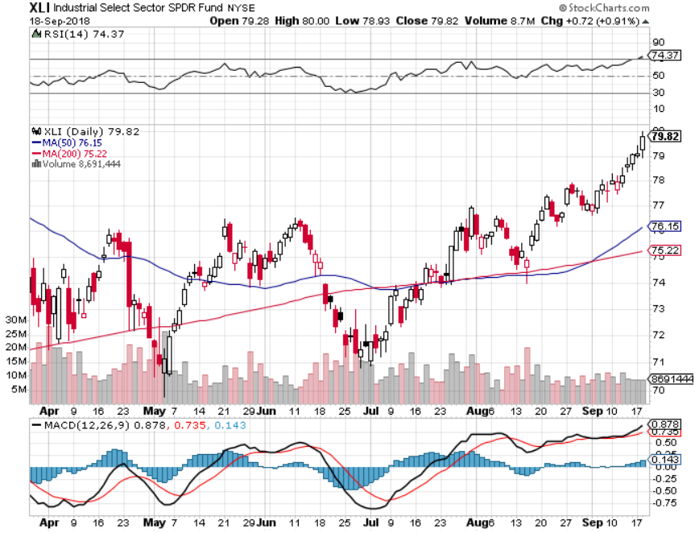
Industrials Sector SPDR (XLI)-Rotation Target
(GE), (MMM), (UNP), (UTX), (BA), (HON)

Slide 33
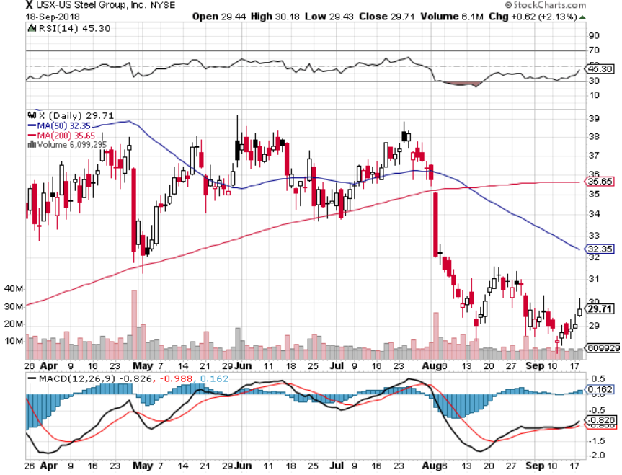
US Steel (X)-Tariffs Trouble
Import duties cause users to abandon steel took profits on long the 9/$21-$22 vertical bull call spread

Slide 34
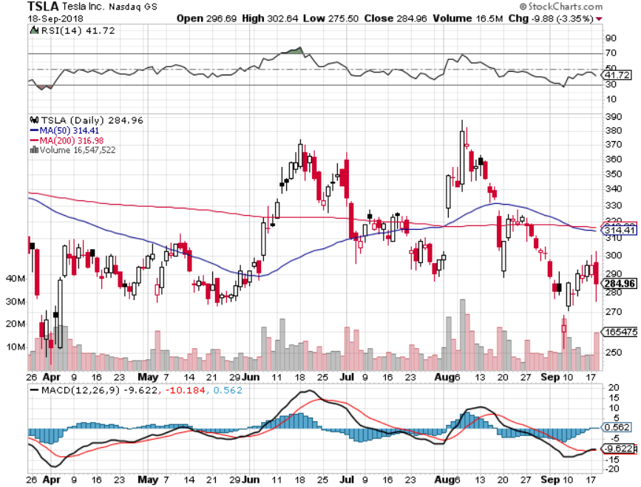
Tesla (TSLA)-
Has largest short position in the market
Buyout attempt t $420 fails

Slide 35
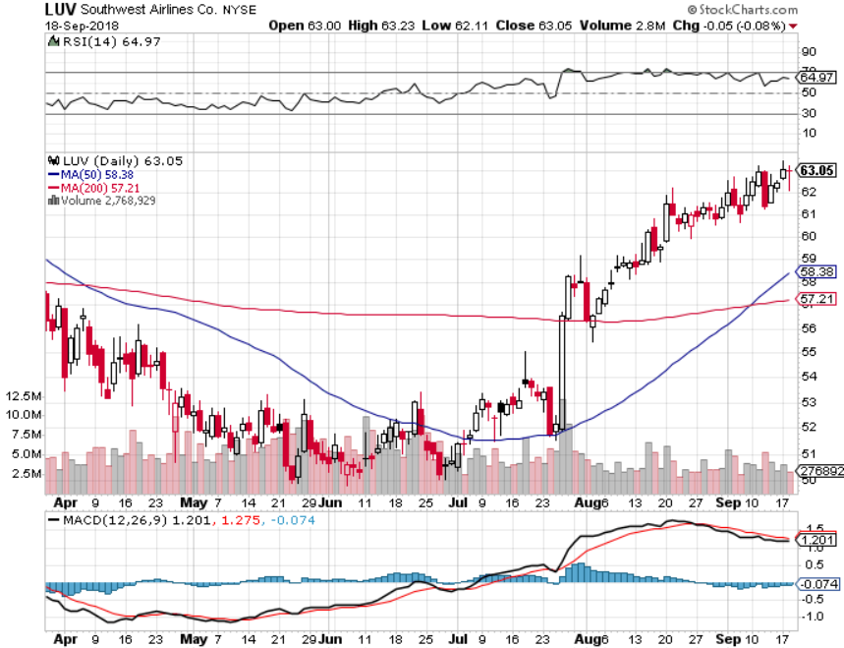
Southwest Airlines (LUV)- Earnings Pop
Warren Buffett’s Favorite Airline

Slide 36
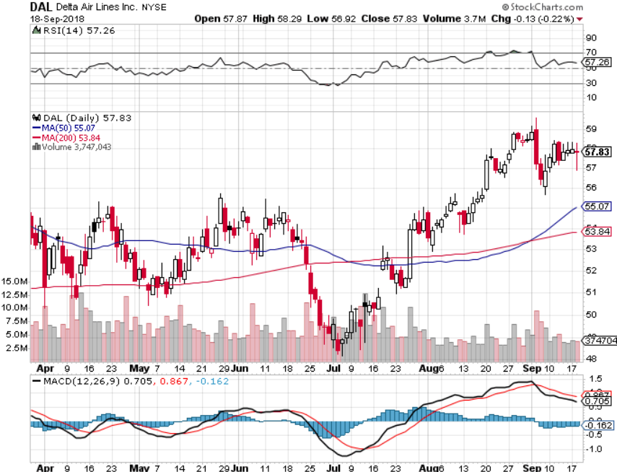
Delta Airlines (DAL)- Poisoning took profits on 3/$40-$45 call spread

Slide 37
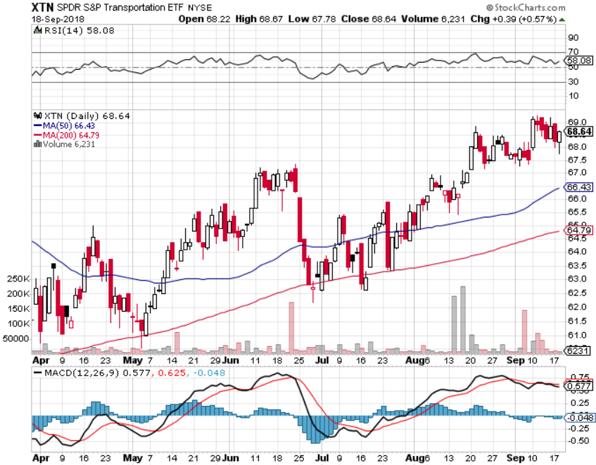
Transports Sector SPDR (XTN)-
(ALGT), (ALK), (JBLU), (LUV), (CHRW), (DAL)

Slide 38
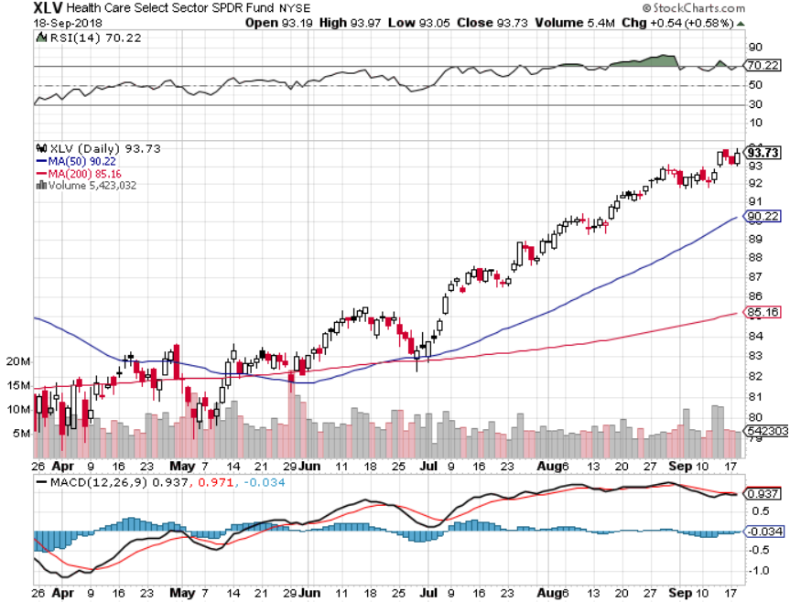
Health Care Sector (XLV), (RXL)-New Highs
(JNJ), (PFE), (MRK), (GILD), (ACT), (AMGN)

Slide 39
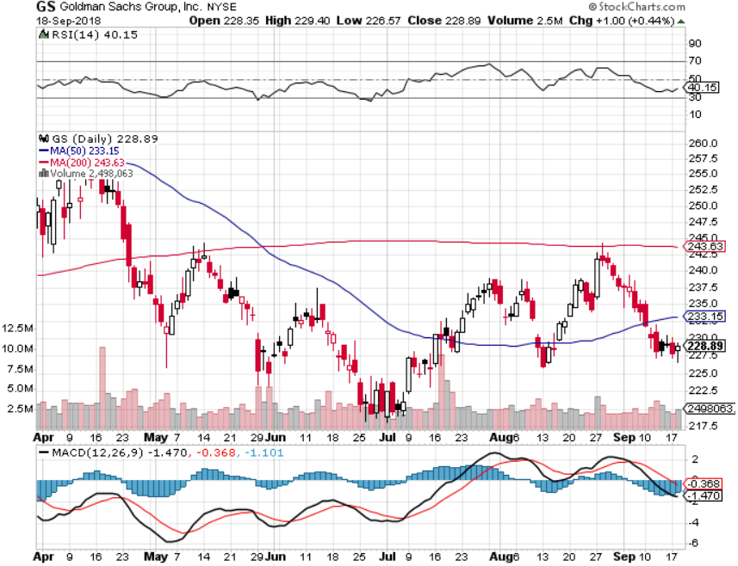
Goldman Sachs (GS)-Head and Shoulders Bottom stopped out of long 4/240-$245 call spread stopped out of long 10/$220-$225 vertical bull call spread took profits on long 10/$227.50-$232.50 vertical bull call spread

Slide 40
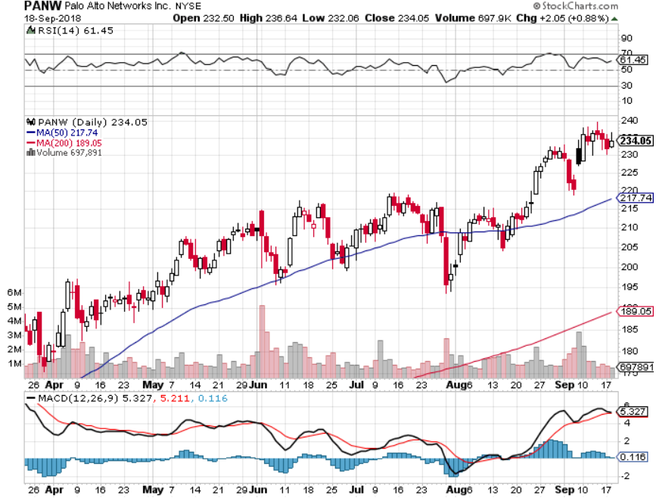
Palo Alto Networks (PANW)-
Hacking never goes out of fashion

Slide 41
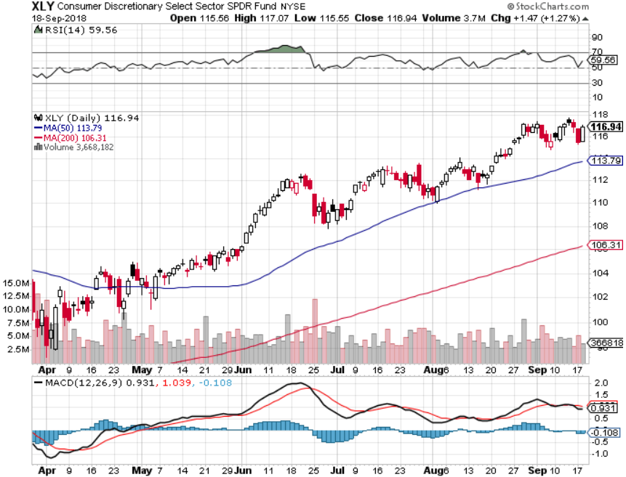
Consumer Discretionary SPDR (XLY)
(DIS), (AMZN), (HD), (CMCSA), (MCD), (SBUX)

Slide 42
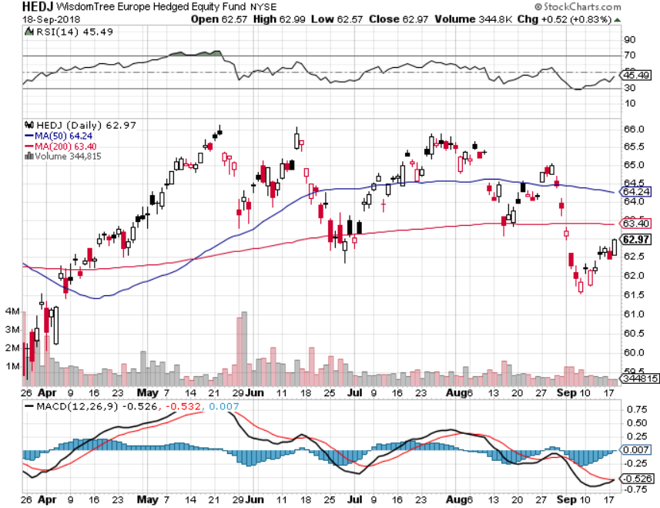
Europe Hedged Equity (HEDJ)-Quadruple top Top

Slide 43
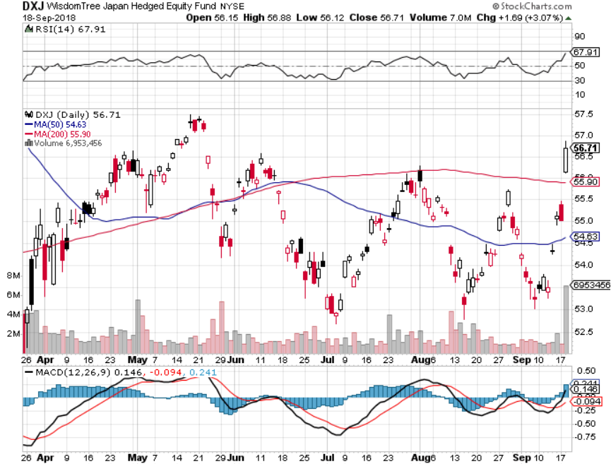
Japan (DXJ)-

Slide 44
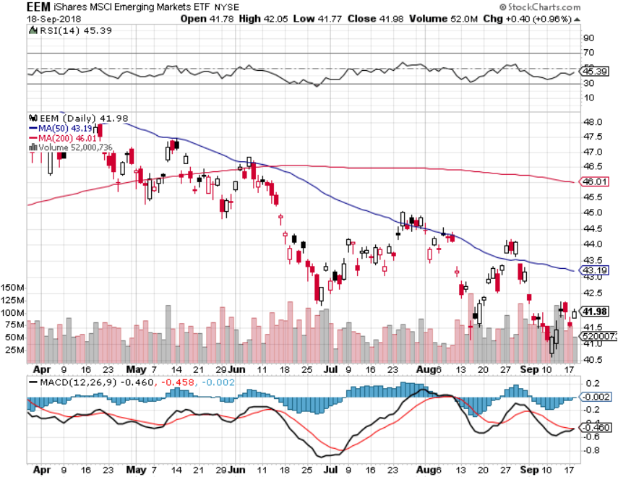
Emerging Markets (EEM)- Killed by Strong Dollar

Slide 45

Bonds-Back to the Bottom
*Bonds fall back to bottom of 2018 range, crushed by Chinese selling after latest escalation of trade war. The bad news? They have $1.1 trillion left
*Fed to raise rates 25 basis points on September 26, but won’t feed into long end
*Huge short positions are supporting the market
*Massive liquidity created by global QE will drive all asset classes for years, or least prevent them from falling
*Still looking for 3.25%-3.5% ten year US Treasury
yield by yearend, and 4% in a year
*Exploding deficits will weigh on
bonds for the next decade, sell every
rally across the space, up 67% YOY
Bottom Line: Sell every four point
rally in the (TLT)

Slide 46
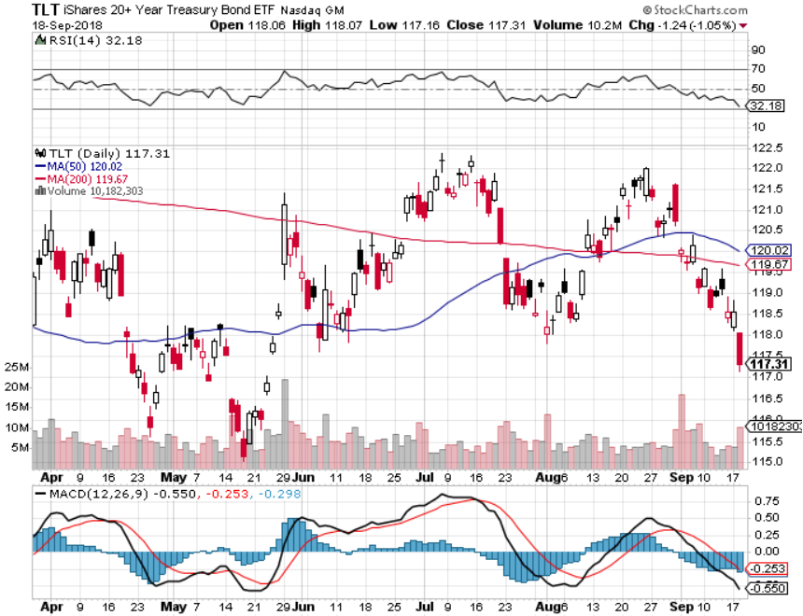
Treasury ETF (TLT) – Bottom of Range long (TLT) 10/$114-4117 call spread took profits on long (TLT) 9/$123-$126 put spread

Slide 47
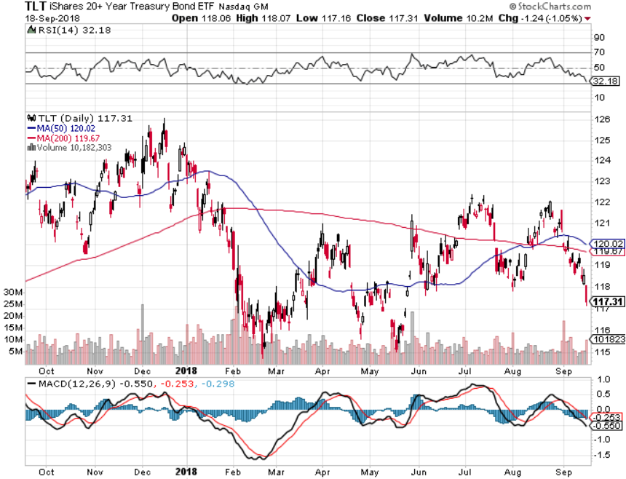
Treasury ETF (TLT) Long Term
Up 5 Points in 8 Months

Slide 48
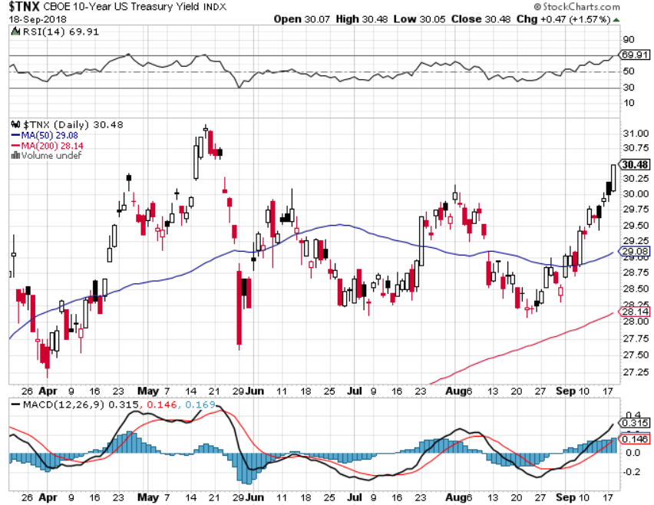
Ten Year Treasury Yield ($TNX) 2.96%
Breakdown, Now major Support

Slide 49
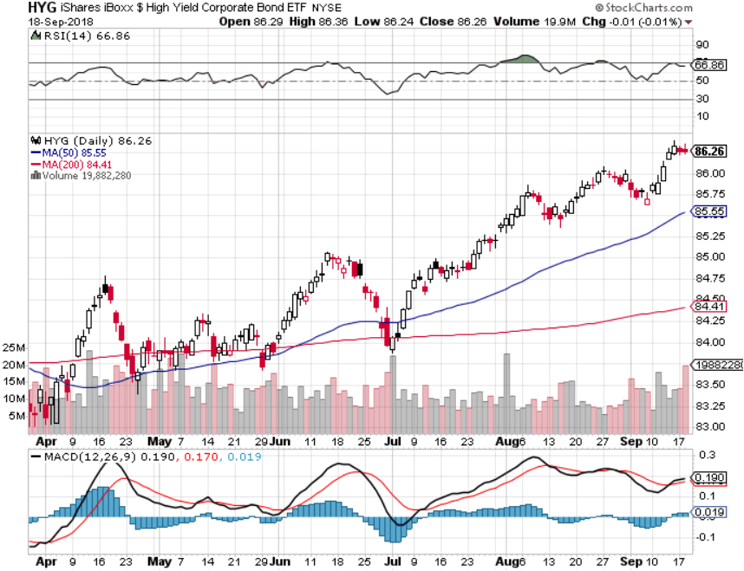
Junk Bonds (HYG) 5.78% Yield

Slide 50
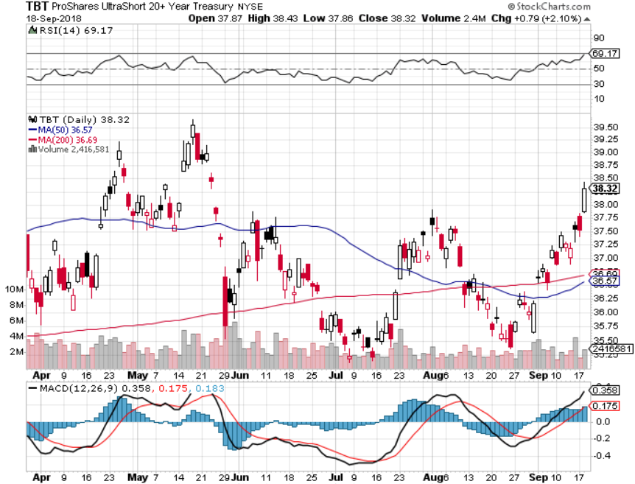
2X Short Treasuries (TBT)-Buy Territory

Slide 51
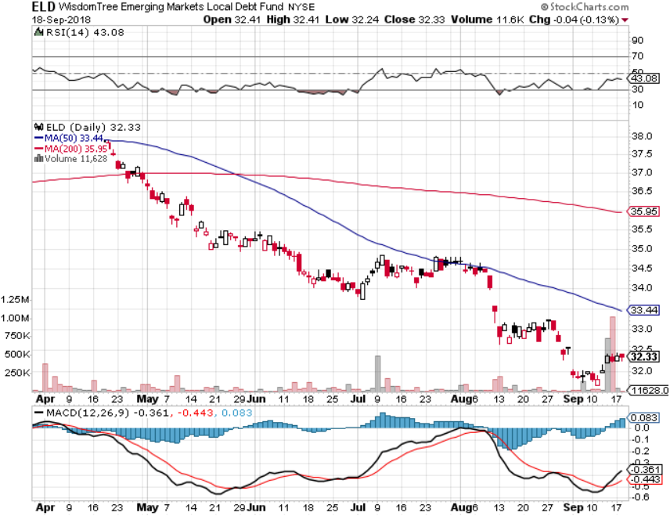
Emerging Market Debt (ELD) 5.64% Yield-

Slide 52
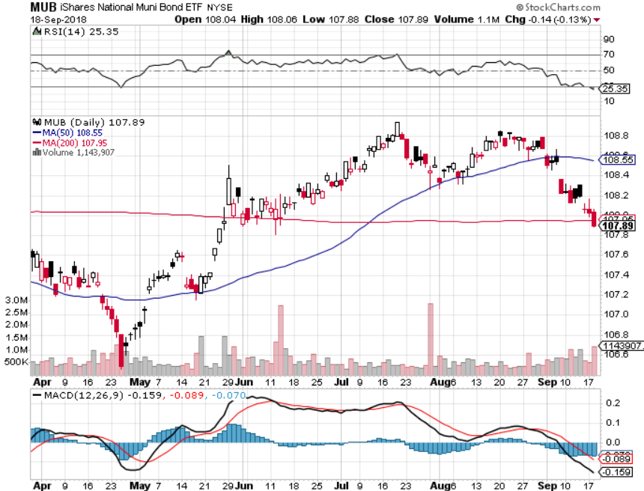
Municipal Bonds (MUB)-2.32%
Mix of AAA, AA, and A rated bonds
Huge 40 basis point yield pop on tax bill

Slide 53
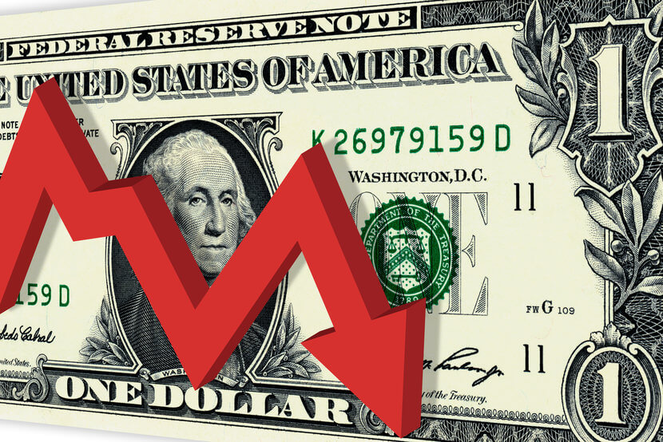
Foreign Currencies- Dollar Break
*US dollar takes a break from its relentless uptrend, a break or a reversal?
*Falling dollar going into a Fed rate rise is a classic “Buy the rumor, sell the news” move. Maybe its discounting no more rate rises for three months after next week?
*US trade war with China is escalating, dragging on the Yuan
*Is the Euro double topping here?
*In the meantime, Fed is committed to
another year of rate rises
*Bitcoin holds $6,000 again
*Bottom Line: stand aside

Slide 54
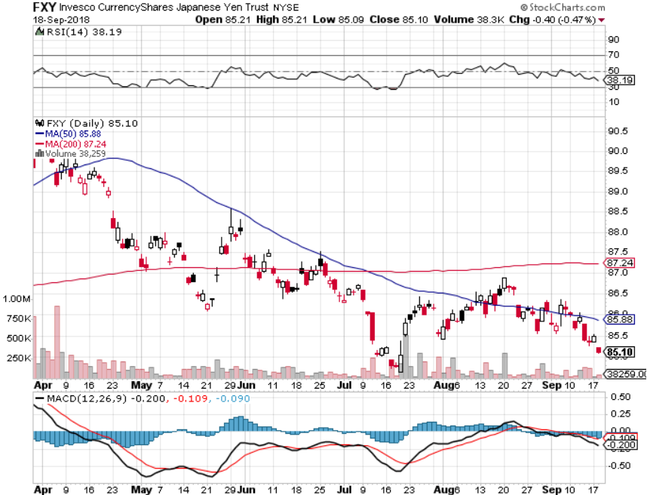
Japanese Yen (FXY), (YCS) took profits on long (FXY) 3/$91-$93 bear put spread

Slide 55
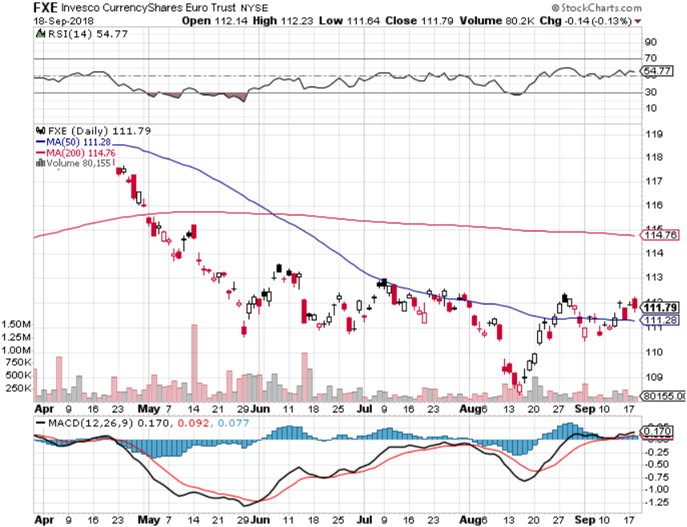
Euro ($XEU), (FXE), (EUO)- Trying to Break Down took profits on long (FXE) 3/$120-$123 vertical bear put spread

Slide 56
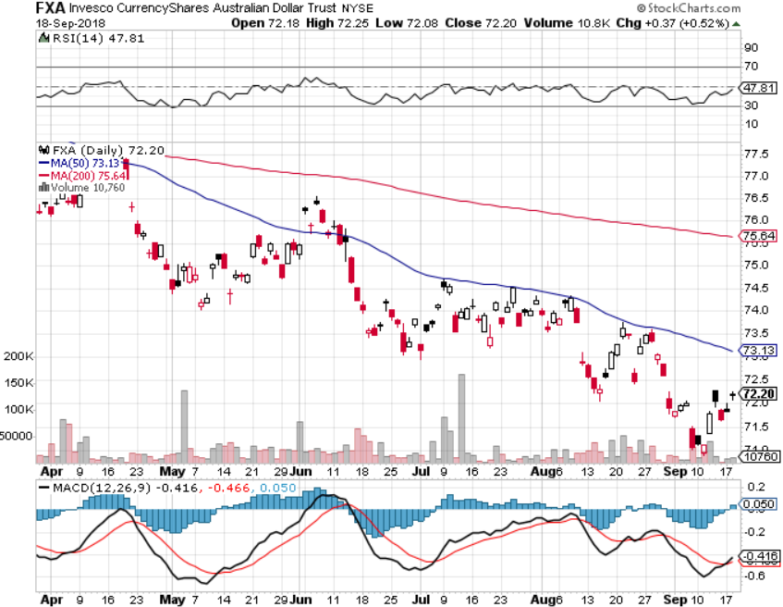
Australian Dollar (FXA)-Trade war China drag

Slide 57
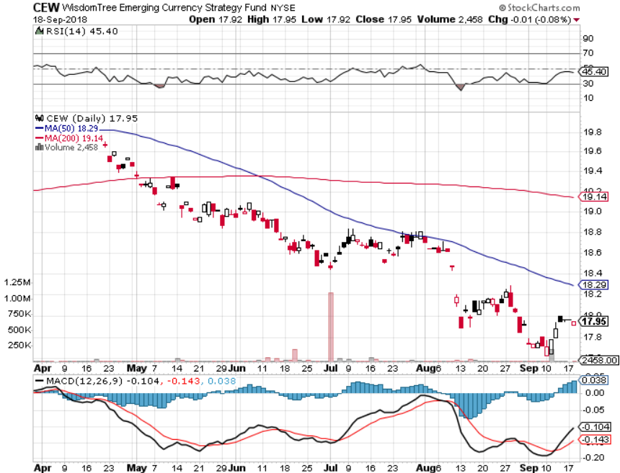
Emerging Market Currencies (CEW)

Slide 58
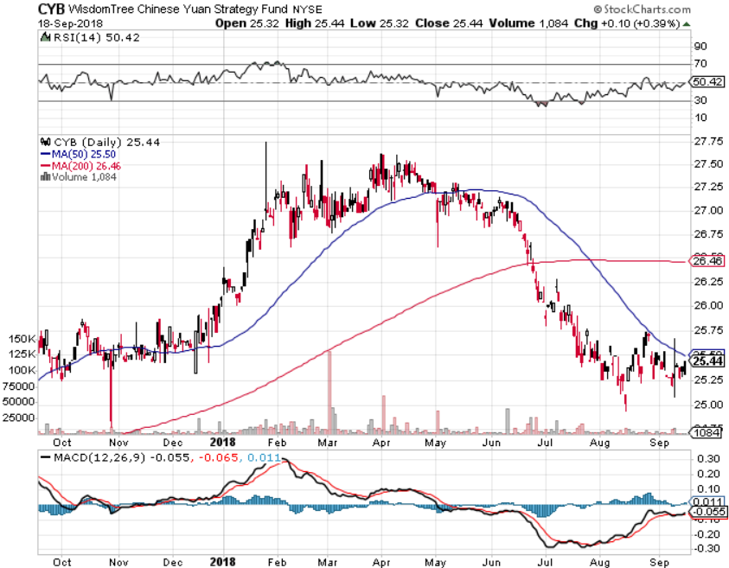
Chinese Yuan- (CYB)-Trade War Tonic

Slide 59
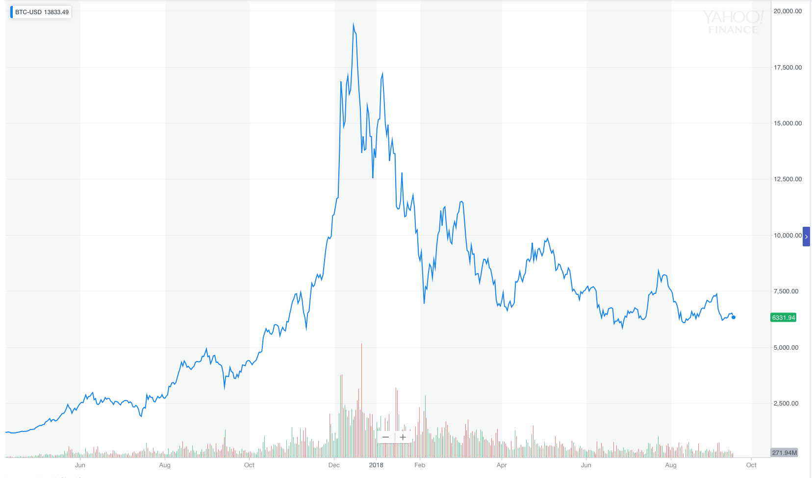
Bitcoin- Downtrend Intact

Slide 60

Energy – Stalled
*Pipeline shortage limiting US oil exports and domestic distribution
*Hurricane seasons begins with Hurricanes Gordon, then Florence, increasing oil volatility, will global warming take a toll?
*Peak demand season is behind us
*North Sea strike avoided, capping prices
*Trade wars slicing international demand
*Bottom Line: Oil may be peaking
here so stand aside

Slide 61

Oil-China drag

Slide 62

United States Oil Fund (USO)

Slide 63

Energy Select Sector SPDR (XLE)-No Performance!
(XOM), (CVX), (SLB), (KMI), (EOG), (COP)

Slide 64

Halliburton (HAL)-New Low

Slide 65

Natural Gas (UNG)-

Slide 66

Copper (COPX)-Trade War Fears

Slide 67

Precious Metals-Bottom Feeding
*The $1,170 bottom is still holding, but for how long?
*Rising overnight interest rates continue to crush gold, even though long rates have been stagnant
*Russia, China, and Europe are the only gold buyers
*Venezuela and Turkey are still hammering the market
*Gold tracking 1:1 with the Euro (FXE)
*Bitcoin also struggling at the bottom
*Bottom Line: Stand aside

Slide 68

Gold (GLD)-No Help from Trade War
Took profits on long 5/$119-$122 bull call spread took profits on long (GLD) $12/$116-$119 bull call spread

Slide 69

Gold Long Term
2017
Low

Slide 70

Market Vectors Gold Miners ETF- (GDX) – Yikes!
Took profits on long the 9/$20.50-$21.50 bull call spread

Slide 71

Barrick Gold (ABX)

Slide 72

Newmont Mining- (NEM)-

Slide 73

Real Estate-Tariff Hit
*Trumps tariffs ad $1 billion to US home construction costs
*US Home Equity hits $6 trillion, a record high, putting plenty of cash in the home ATM
*250,000 homes damaged or destroyed by Hurricane Florence, creating further supply shortages
*Millennials marrying later so the next big demographic surge is still ahead of us
*S&P 500 Case-Shiller maintains
strong 6.3%, with absolute prices
hitting new all time highs, first fall
in pace of increase in years
*Bottom Line: Stand aside

Slide 74

May Corelogic S&P Case Shiller Home Price Index
Seattle (+12.8%), Las Vegas (+10.3%) San Francisco 10.7% leaders price rises accelerating

Slide 75

Simon Property Group (SPG)-
Falling rates and rotation push

Slide 76

US Home Construction Index (ITB)
(DHI), (LEN), (PHM), (TOL), (NVR)

Slide 77

Trade Sheet-
So What Do We Do About All This?
*Stocks-stand aside
*Bonds-sell any and all rallies
*Commodities-stand aside
*Currencies-stand aside
*Precious Metals –stand aside
*Volatility-buy dips to $11
*Real estate-stand aside

Slide 78

Next Strategy Webinar
12:00 EST Wednesday, October 3,
2018 from San Francisco, CA
For Lunches and Tahoe Conference
Please Go to www.madhedgefundtrader.com and click “Store” email me at support@madhedgefundtrader.com
Good Luck and Good Trading!
Notes:
*

