Slide 1
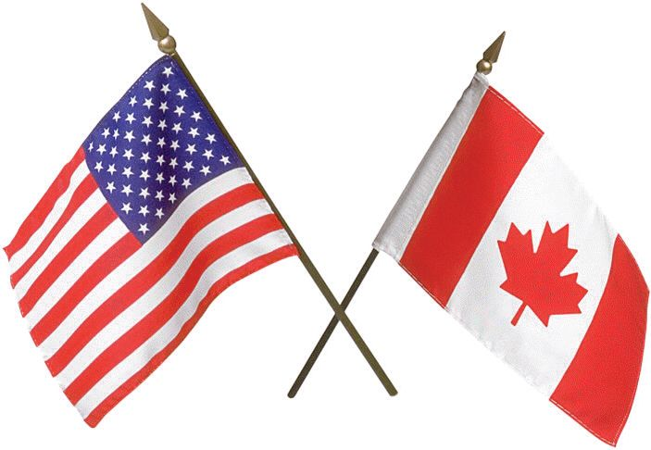
The Mad Hedge Fund Trader
“Trade Peace”
With John Thomas
from Silicon Valley, CA, October 3, 2018
www.madhedgefundtrader.com
Notes:
*

Slide 2

October 26-27 Lake Tahoe Conference
*Two days of informative speakers on crucial trading and investment issues
*Trade tips with the most successful Mad Hedge traders
*2 nights in the Hyatt, including all you can eat and drink
*Tickets are a bargain at
$599 to $1,799
*Buy now, upper ticket classes
sell out first

Slide 3

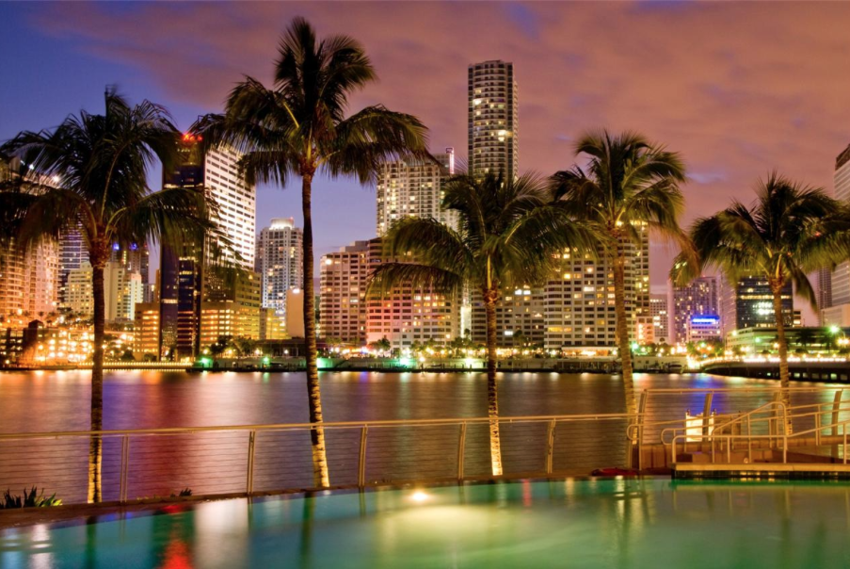
MHFT Global Strategy Luncheons
Buy tickets at www.madhedgefundtrader.com
Atlanta, GA
October 15
Miami, FL
October 16

Slide 4
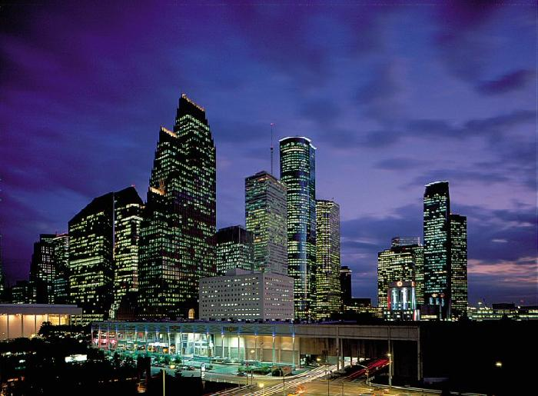
MHFT Global Strategy Luncheons
Buy tickets at www.madhedgefundtrader.com
Houston, TX
October 17

Slide 5

Trade Alert Performance
New All Time High!!
*January 4.09% Final *July +0% Final
*February +1.54% Final *August +2.19% MTD
*March +1.13% Final *September 1.38% Final
*April +12.54% Final *October +1.39% MTD
*May +1.07% Final *November +2.08% Final
*June +4.15% Final *December +3.76% Final
*2018 Year to Date 28.97%
compared to +8.0% for the Dow Average
*Trailing One year return +35.84%, +304.33% since inception,
*Average annualized return of 34.40%

Slide 6
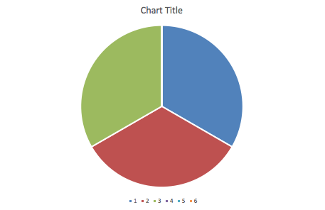
Portfolio Review
10% long tech, 10% short bonds, 10% short S&P 500
at market all time highs
Current Capital at Risk
Risk On
World is Getting Better
(AMZN) 10/$1,800-$1,900 call spread | 10.00%
(MSFT) 10/$105-$108 call spread | 10.00%
(TLT) 10/$118-$121 put spread | 10.00%
Risk Off
no positions | 0.00%
Total Net Position | 30.00%
Expiration P&L
30.13%

Slide 7
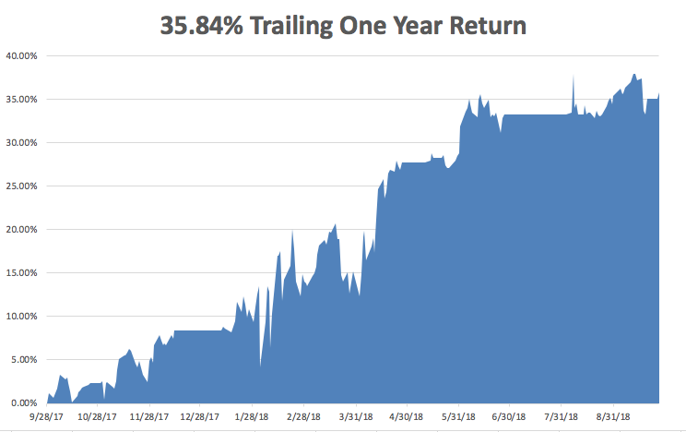
GTD Daily Audited Performance
All Time High

Slide 8
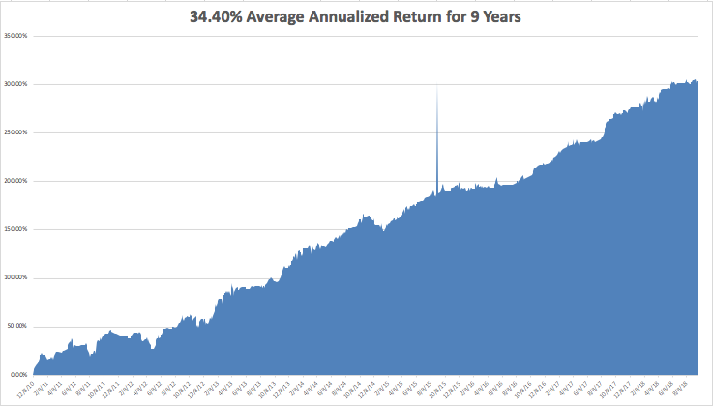
GTD 9 Year Daily Audited Performance

Slide 9
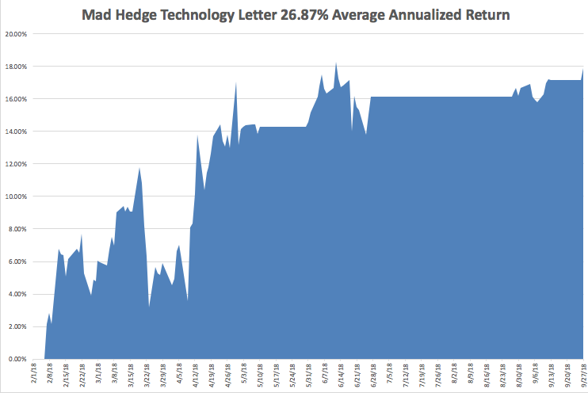
Mad Hedge Technology Letter a $2,500 a year upgrade

Slide 10

The Method to My Madness
*NAFTA 2.0 is a total sham. It why markets gave up gains the next day. Peace with 163 million, still at war with 1.2 billion, or 88%
*Economic data shifting from great to mixed
*Big tech rolls over. For how long?
*US Dollar back on the bid
*Amazon wage rise puts new life
in precious metals
*All that said, I still expect the S&P 500
to be up 10% by the end of the year
and there is still good money to be made
*So 3% more upside in 3 months

Slide 11
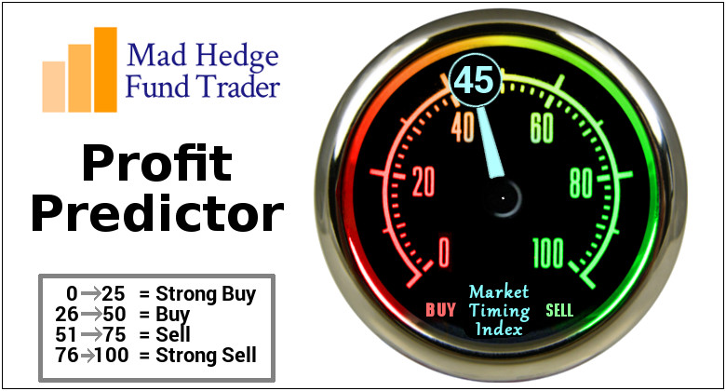
The Mad Hedge Profit Predictor
Market Timing Index-
An artificial intelligence driven algorithm that analyzes 30 different economic, technical, and momentum driven indicators

Slide 12
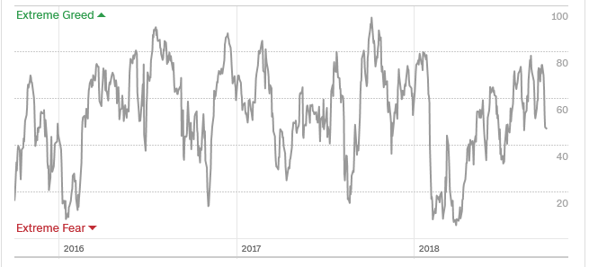
The Mad Hedge Profit Predictor
Risk is Neutral
SELL
BUY

Slide 13

The Global Economy –Out of Balance
*The US centric economy is not sustainable, it’s just a matter of time before weakness abroad comes home to roost
* We could be moving from universally good to choppy as tax cut effects wear off. Core capital goods were off, weekly jobless claims pop 13,000 to 214,000, and the trade deficit explodes to $75 billion. However, Q2 GDP holds at 4.2%.
* US September Auto Sales Seen Down 6%. Another nail in the auto industry coffin. If you can’t sell a car now in this red hot economy, when will you?
*Strong dollar is back, now digesting the latest rate rise
*Commodities see a bear market rally, but China
is still the problem
*Next Fed 25 basis point rate rise December 19

Slide 14
NAFTA 2.0
This is what all the trouble was about
*Cars made in Mexico have US content raised from 62.5% to75% to be tariff free
*45% of Mexican cars must be made by workers earnings $16/hour
*Canada no longer a national security threat
*US gets 3.6% of Canadian dairy market
*Duty free limit for American’s going to Canada raised from $20 to $115
*Duty free limit for American’s going to Mexico raised from $50 to $100
*Name to chance from NAFTA to USMCA
*Bottom line: no net change on any economy

Slide 15
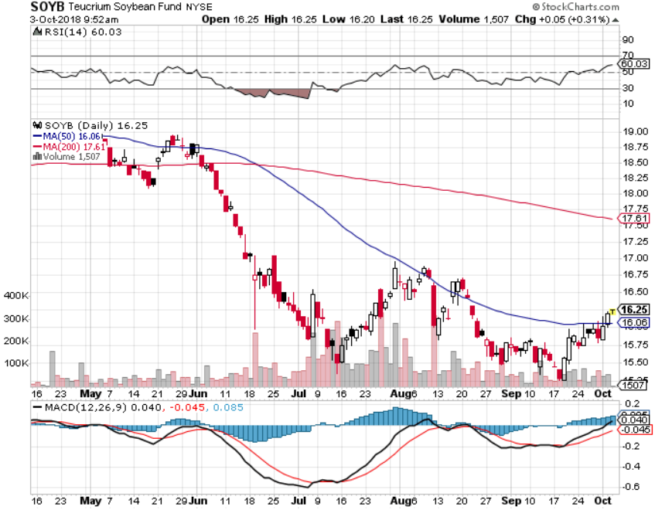
Soybeans (-20%)-Trade War Indicator
Brazil signs the biggest contract in history, 12-14 tonnes
China Cancels Trade Talks, NAFTA deal creates short term boost

Slide 16
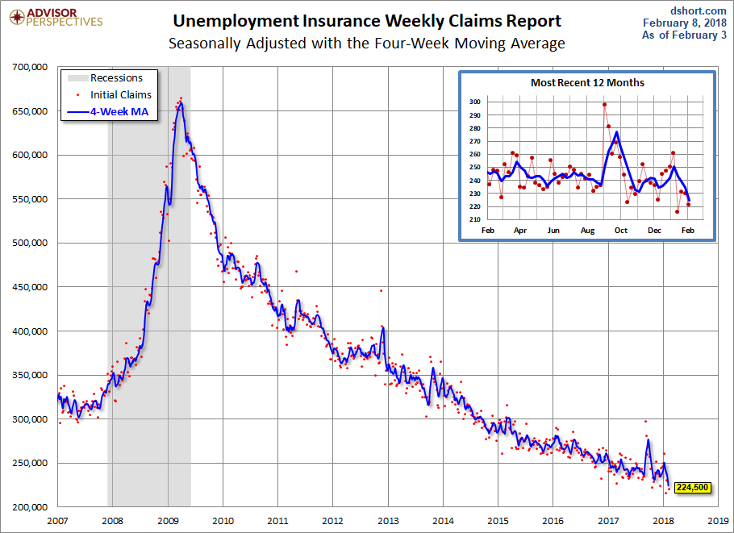
Weekly Jobless Claims –The Most Important Statistic
+4,000 to 214,000

Slide 17
The Bill Davis View
A $1,500 Upgrade for the Mad Day Trader Service
Buys: | Entry | Target
CBOE Holdings (CBOE) | $ 98.00 | $ 75.00
Western Digital (WDC) x | $ 54.00 | $ 61.00
Welltower Inc. (WELL) | $ 60.00 | $ 70.00
Kronos Worldwide (KRO) | $ 17.00 | $ 23.00
Fleetcore Technol. (FLT) | $ 221.00 | $ 232.00
Sells:
Bluebird Bio (BLUE) x | $ 145.00 | $ 125.00
Mahattan Associates (MANH) | $ 55.00 | $ 47.00
Chubb Ltd, (CB) | $ 136.00 | $ 125.00
Dicks Sporting Goods (DKS) | $ 36.00 | $ 28.00
Goldman Sacks (GS) | $ 230.00 | $ 220.00

Slide 18

Stocks-Sideways Correction
*If all tariffs are implemented it will cut S&P 500 2019 earnings by $10, creating YOY losses for the first time since 2009. China is the big story
*NAFTA resurrection is a positive, but is only 12% of the problem, and 5% if you include Europe
*Share Buy Backs Are Booming, hitting $189 billion in Q2, up 60% YOY, the most in history
*Multinationals have been slow to repatriate foreign funds, so there is a lot more more still abroad to buy back stocks
*Number of shares falling on down days greatly
exceeds rising ones
*Bottom Line: keep small longs in tech and
trade peace stocks

Slide 19
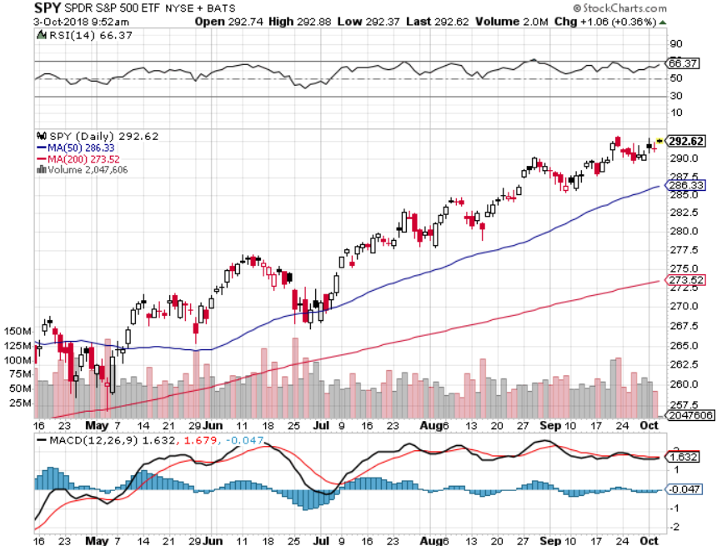
S&P 500-New High took profits on long 5/$277-$280 put spread double weighting

Slide 20
S&P 500- Overshoot Risk took profits on long 5/$277-$280 put spread double weighting

Slide 21
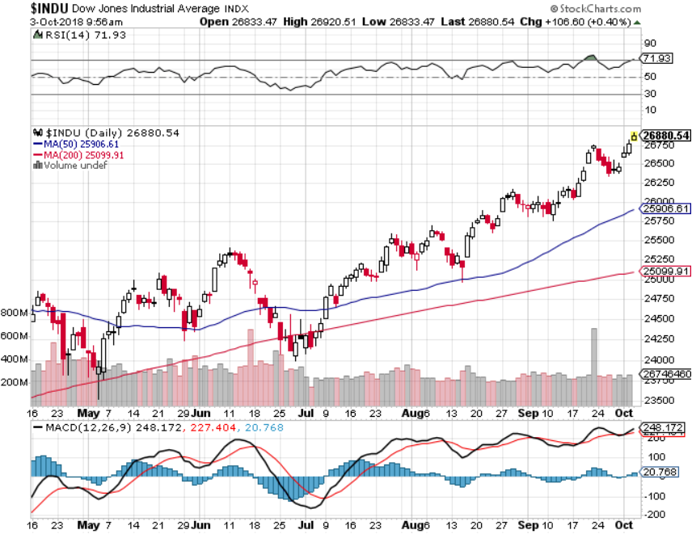
Dow Average- New High

Slide 22
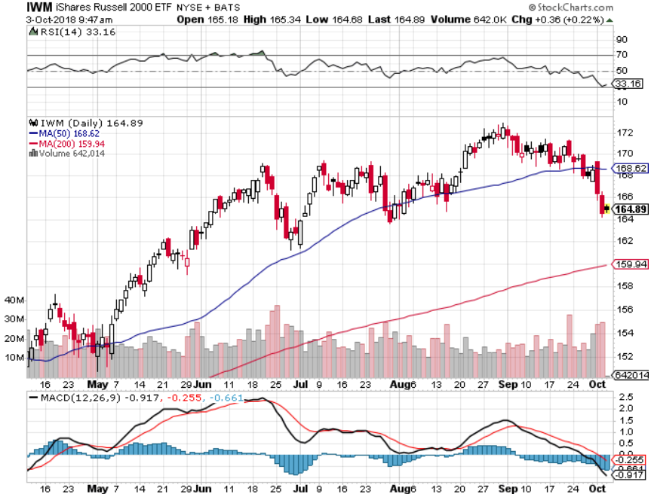
Russell 2000 (IWM)- Topping Out has become the lead index on tax breaks

Slide 23
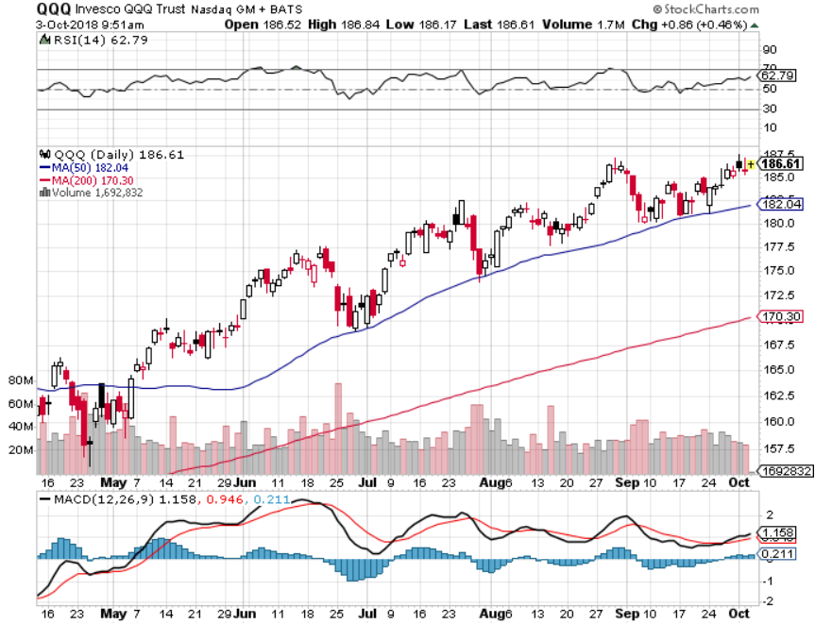
NASDAQ (QQQ)- Settling Into a Range for the rest of 2018

Slide 24
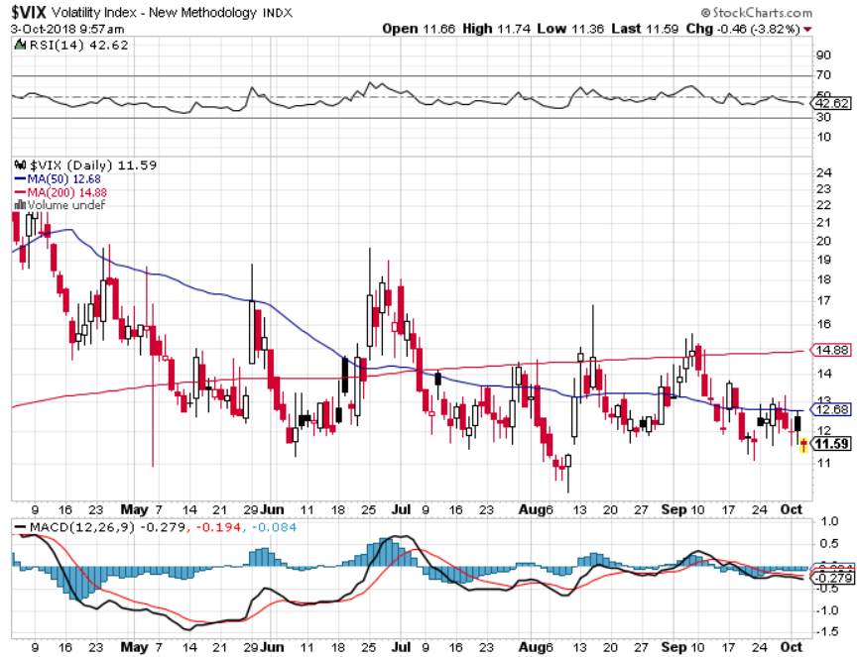
(VIX)- Spike Time

Slide 25
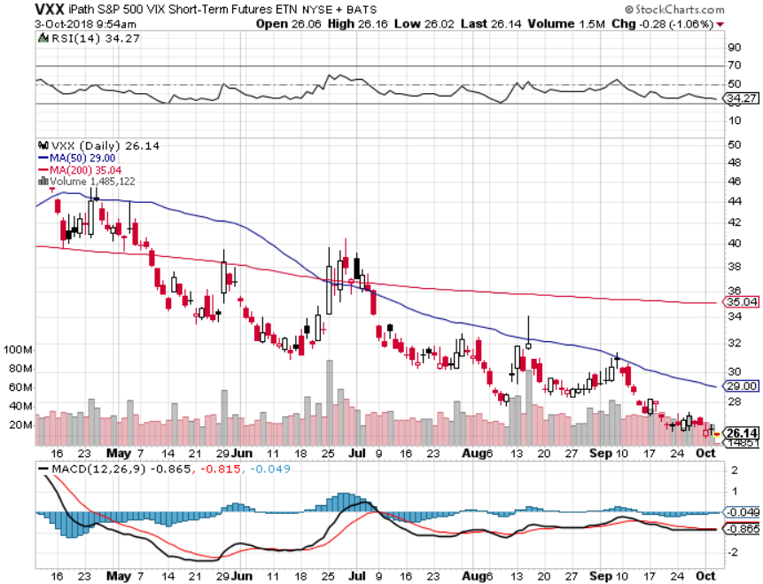
iPath S&P 500 VIX Short-Term Futures ETN (VXX) took profits on long 1/$40 calls took profits on long 3/$60-$65 bear put spread took profits on long 3/$55-$60 bear put spread

Slide 26
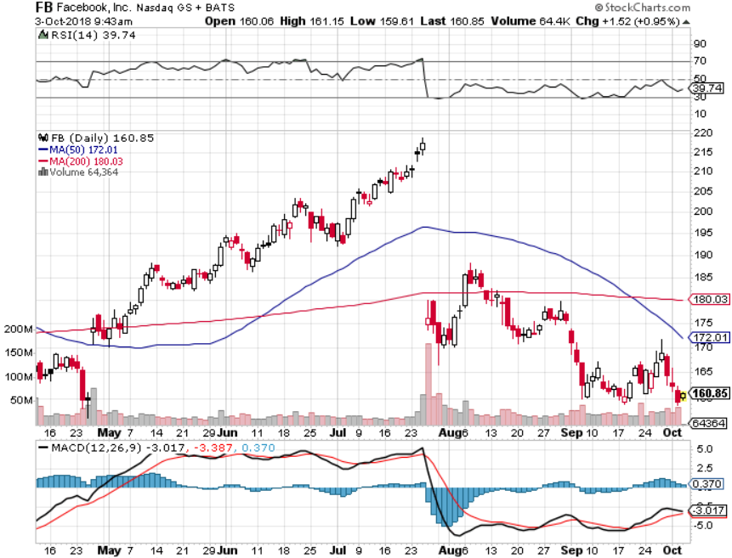
Facebook (FB)- Reality Returns stopped out of long 4/$150-$160 call spread took profits on long 6/$130-$140 bull call spread took profits on long 3/$155-$165 bull call spread took profits on long 3/$190-$195 bear put spread

Slide 27
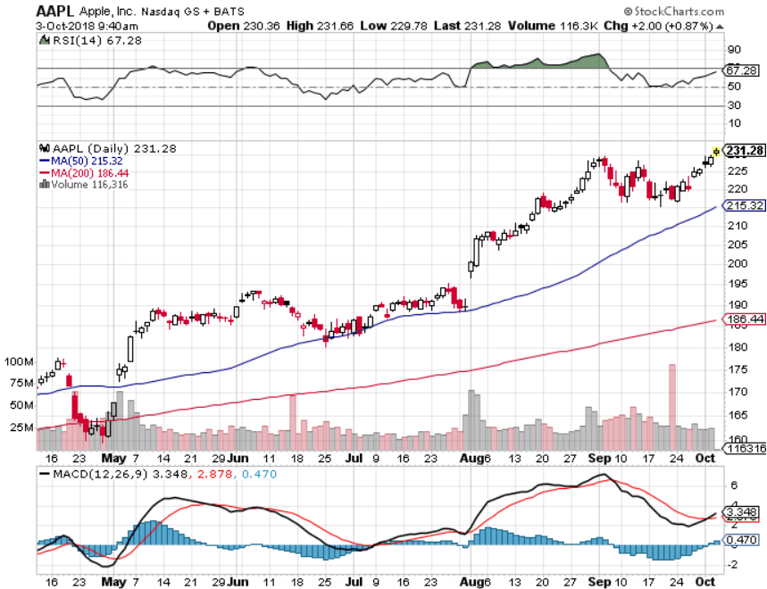
Apple (AAPL)-
JP Morgan Goes Apple Picking, with an initial target of $272.

Slide 28
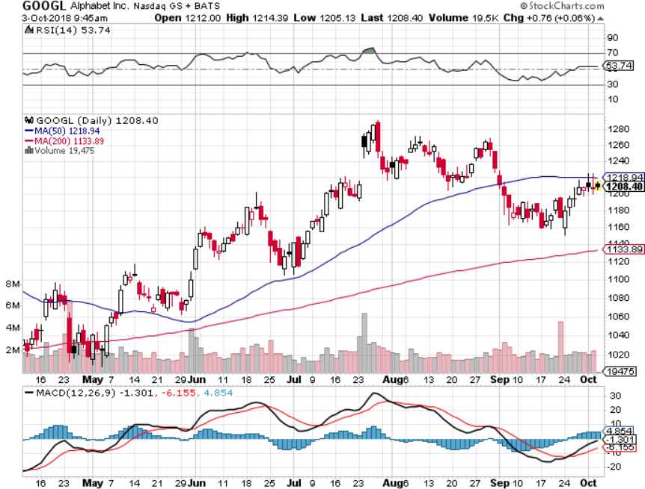
Alphabet (GOOGL)- took profits on long 4/$900-$930 call spread

Slide 29
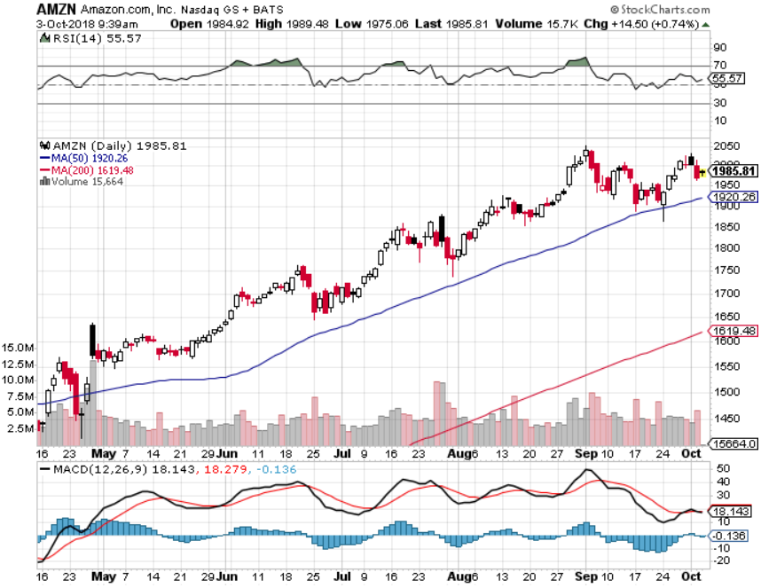
Amazon (AMZN)-Also Correction Proof
New $1 trillion company

Slide 30
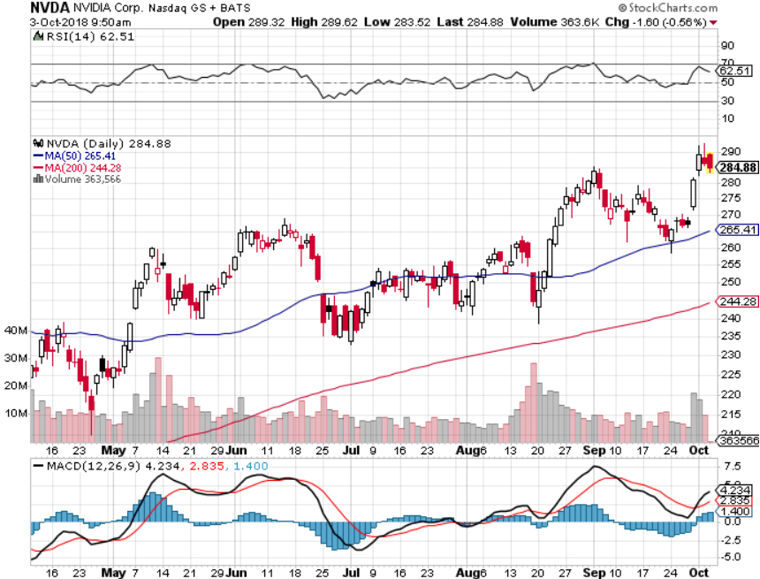
NVIDIA (NVDA)-New Highs

Slide 31
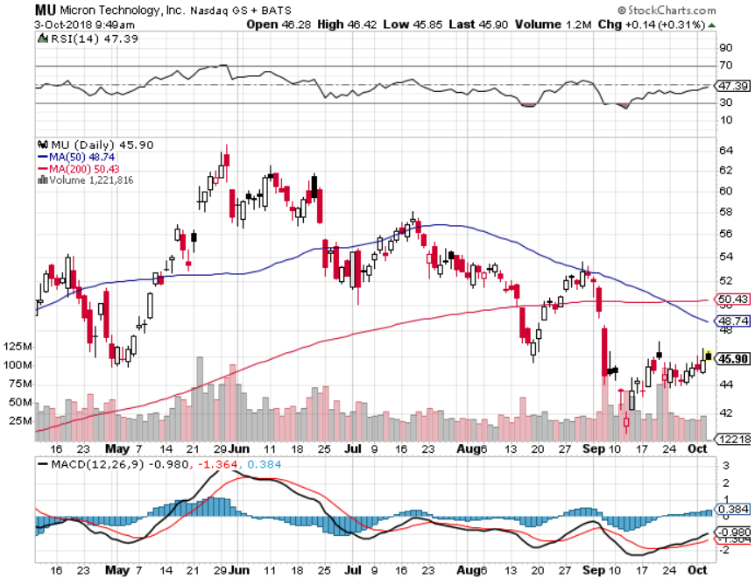
Micron Technology (MU)-Trade Wars took profits on long 3/$34-$37 bull call spread in Mad Hedge Technology Letter Only

Slide 32
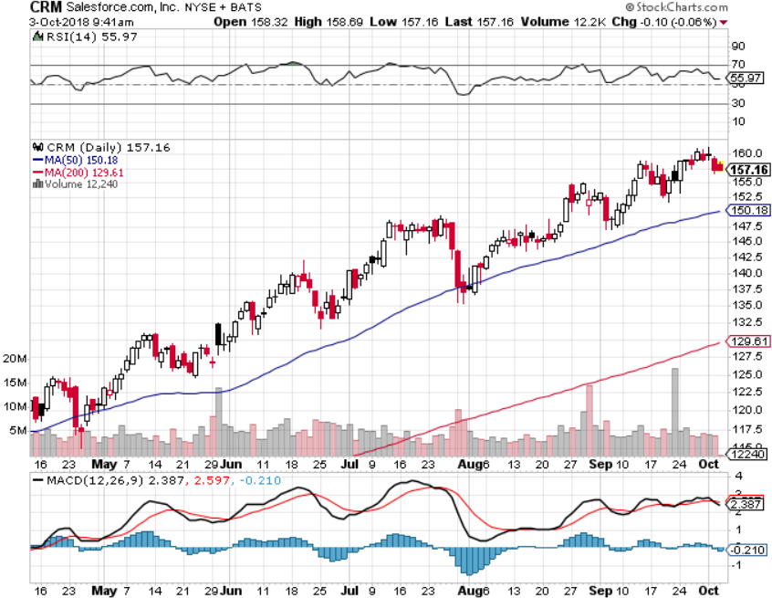
Salesforce (CRM)-New Highs took profits on long 7/$115-$120 call spread (tech letter) took profits on long 6/$105-$110 call spread took profits on long 3/$90-$95 bull call spread

Slide 33
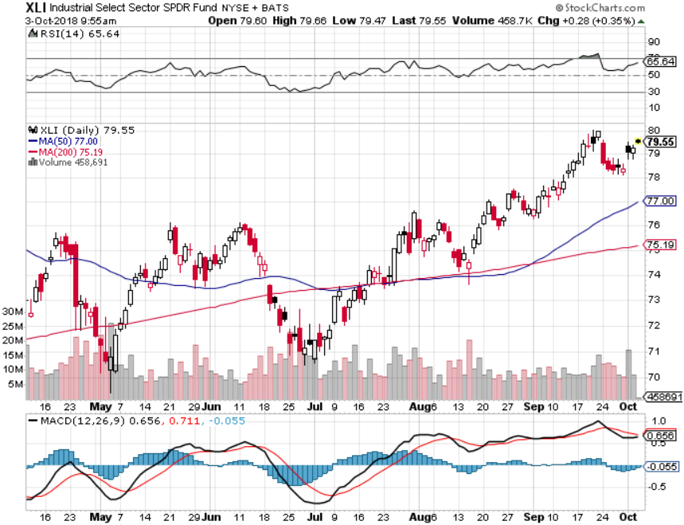
Industrials Sector SPDR (XLI)-Rotation Target
(GE), (MMM), (UNP), (UTX), (BA), (HON)

Slide 34
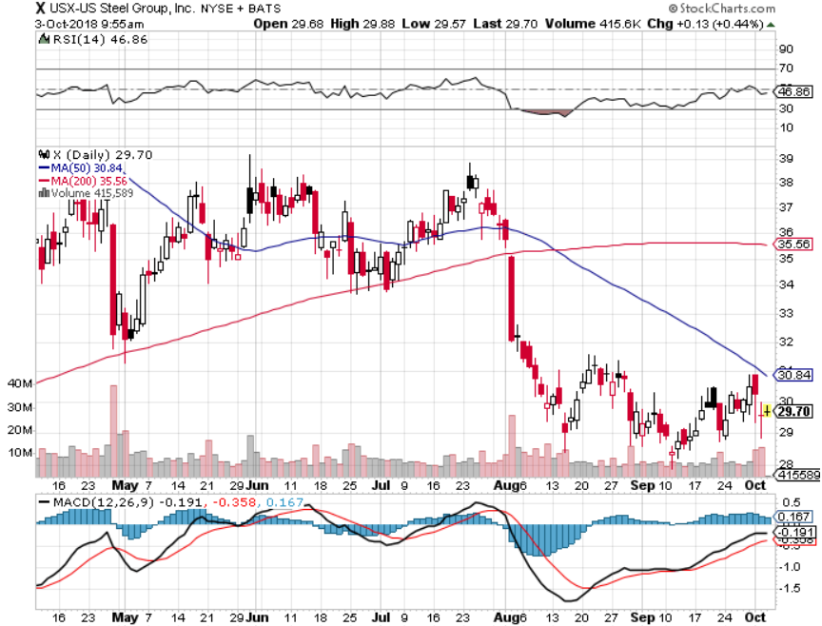
US Steel (X)-Tariffs Trouble
Import duties cause users to abandon steel took profits on long the 9/$21-$22 vertical bull call spread

Slide 35
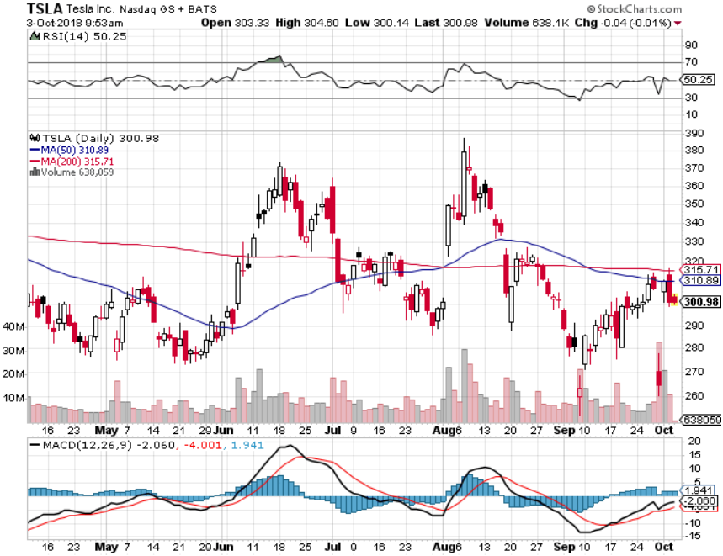
Tesla (TSLA)-
Has largest short position in the market
Buyout attempt t $420 fails

Slide 36
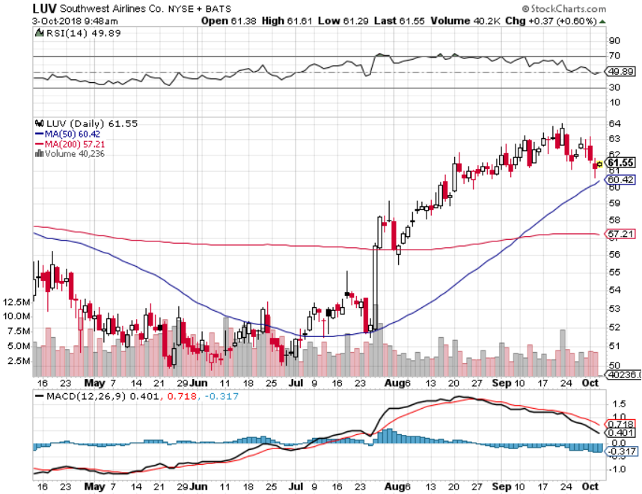
Southwest Airlines (LUV)- Earnings Pop
Warren Buffett’s Favorite Airline

Slide 37
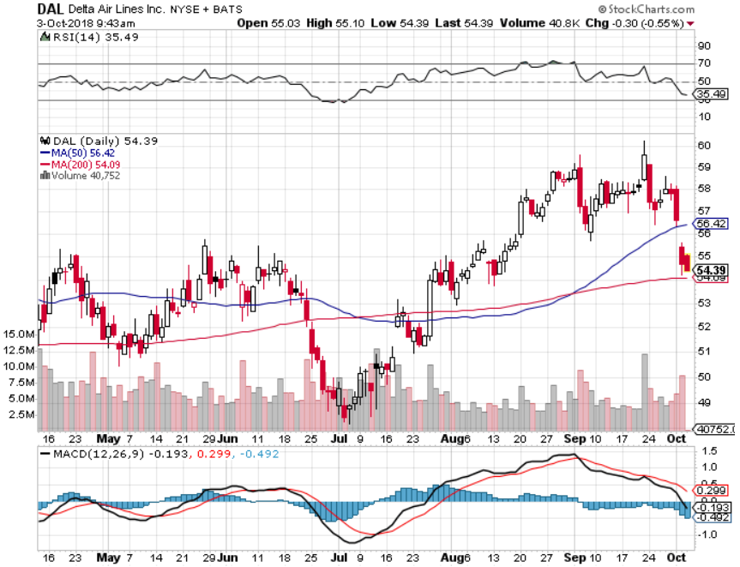
Delta Airlines (DAL)- Poisoning took profits on 3/$40-$45 call spread

Slide 38
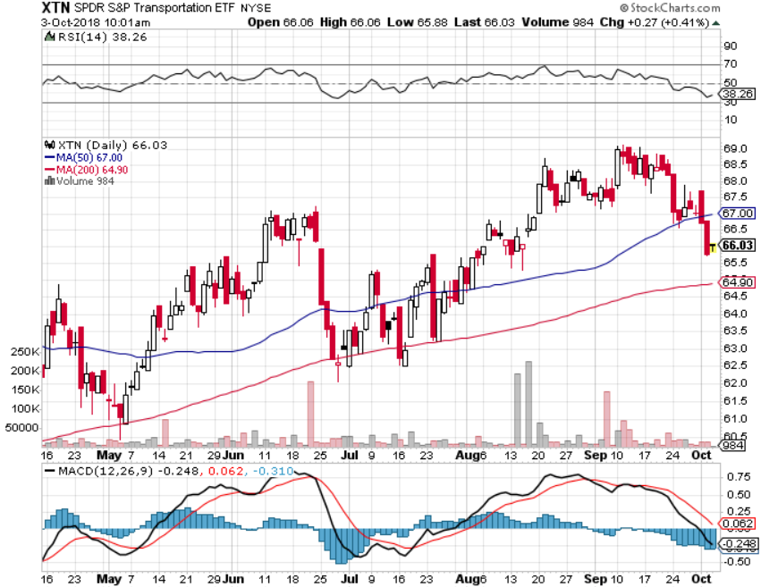
Transports Sector SPDR (XTN)-
(ALGT), (ALK), (JBLU), (LUV), (CHRW), (DAL)

Slide 39
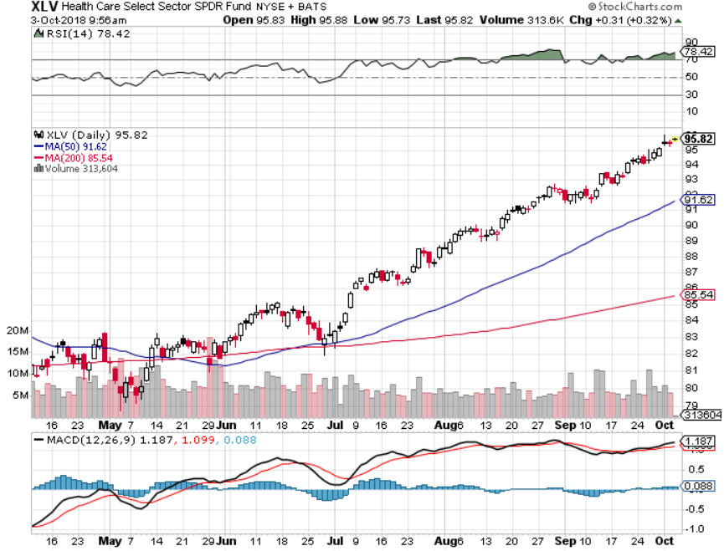
Health Care Sector (XLV), (RXL)-New Highs
(JNJ), (PFE), (MRK), (GILD), (ACT), (AMGN)

Slide 40
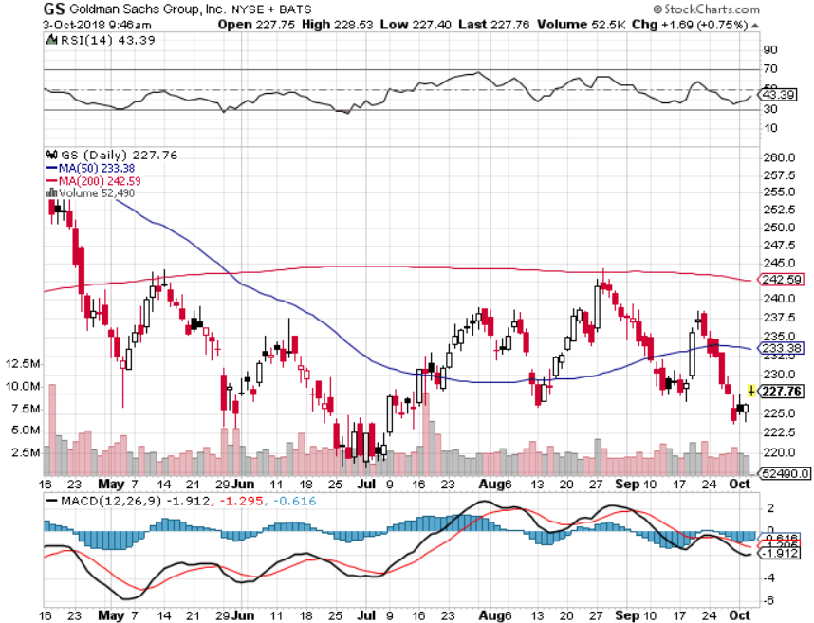
Goldman Sachs (GS)-Head and Shoulders Bottom stopped out of long 4/240-$245 call spread stopped out of long 10/$220-$225 vertical bull call spread took profits on long 10/$227.50-$232.50 vertical bull call spread

Slide 41
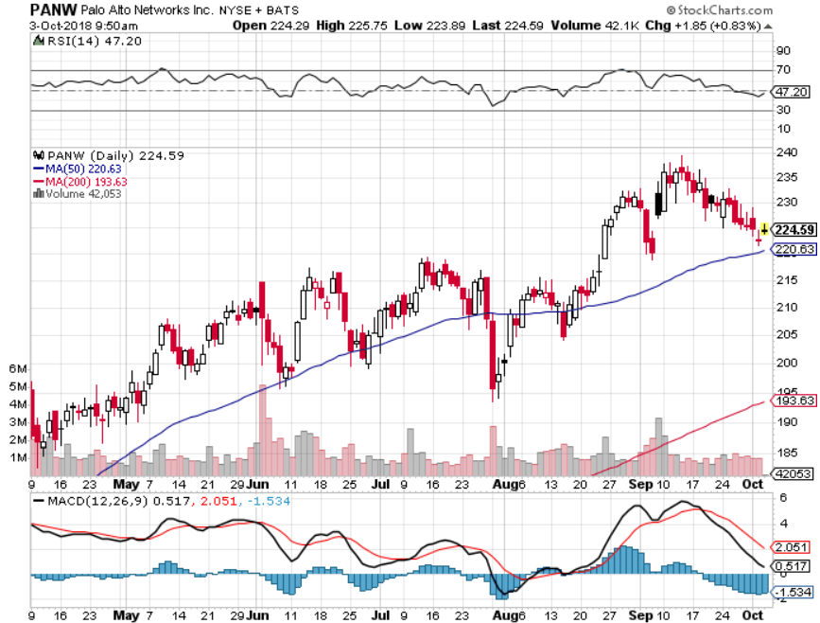
Palo Alto Networks (PANW)-
Hacking never goes out of fashion

Slide 42
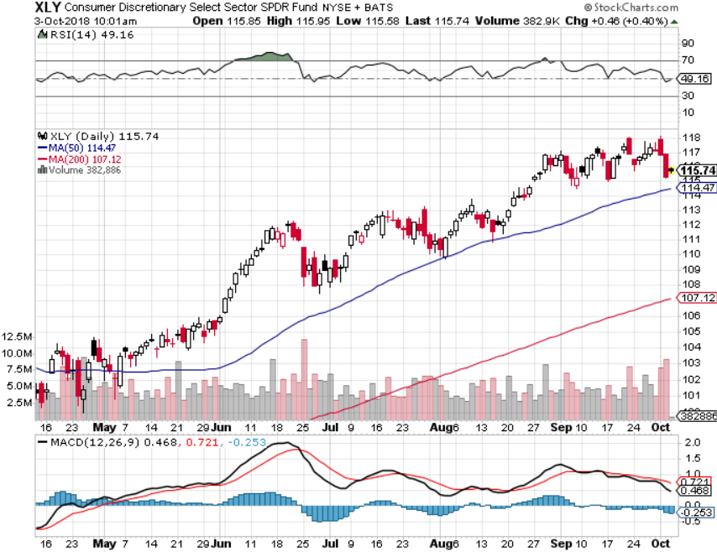
Consumer Discretionary SPDR (XLY)
(DIS), (AMZN), (HD), (CMCSA), (MCD), (SBUX)

Slide 43
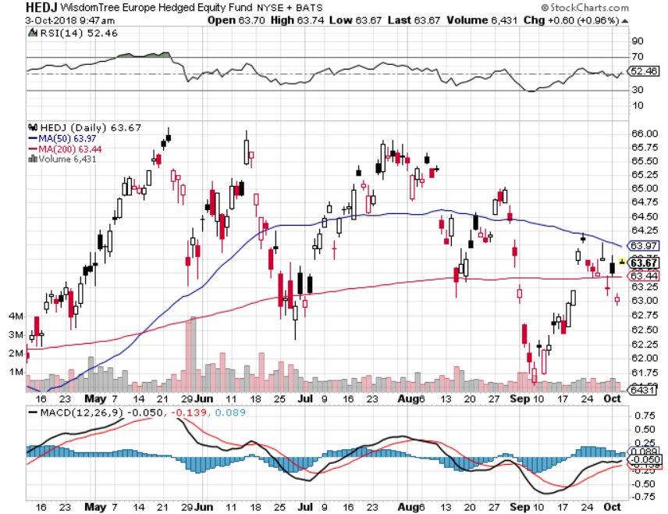
Europe Hedged Equity (HEDJ)-Quadruple top Top

Slide 44
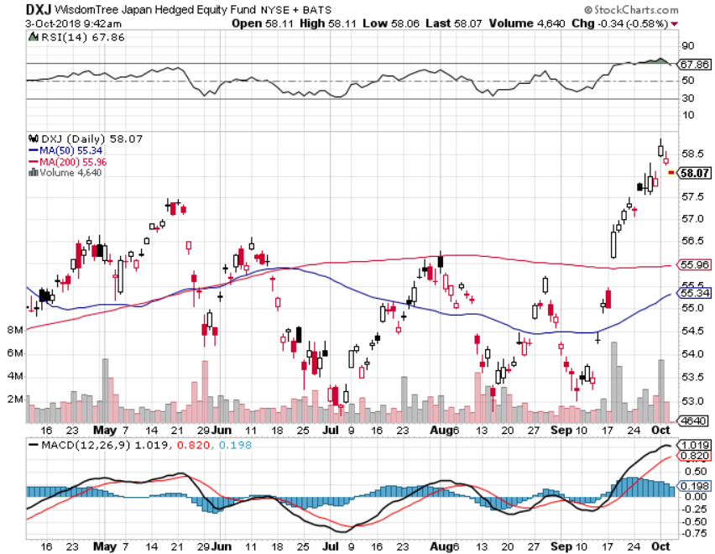
Japan (DXJ)-

Slide 45
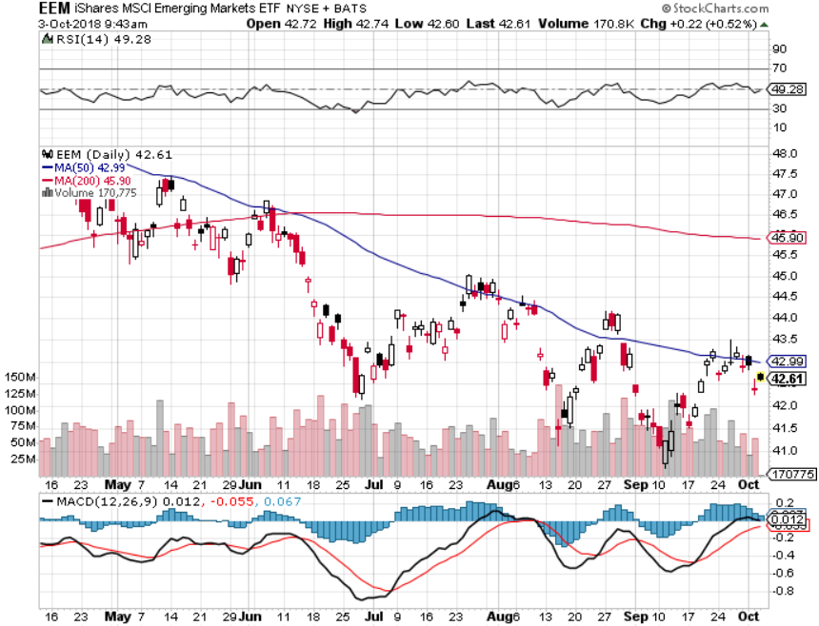
Emerging Markets (EEM)- Killed by Strong Dollar

Slide 46

Bonds-Bottom Fishing
*Bonds fall back to bottom of 2018 range, breakdown could be imminent
*Three More Fed Rate Hikes In 2019, after a coming December hike, which will take overnight rates up to 3.00-3.25%.
*Interest Payments to Become the Largest Government Expense Within a Decade, at $900 billion far outpacing the defense budget by 2028
*Massive liquidity created by global QE will drive all asset classes for years, or least prevent them from falling
*Still looking for 3.25% ten year US Treasury
yield by yearend, and 4% in a year
*Exploding deficits will weigh on
bonds for the next decade, sell every
rally across the space, up 67% YOY
Bottom Line: Sell every four point
rally in the (TLT)

Slide 47
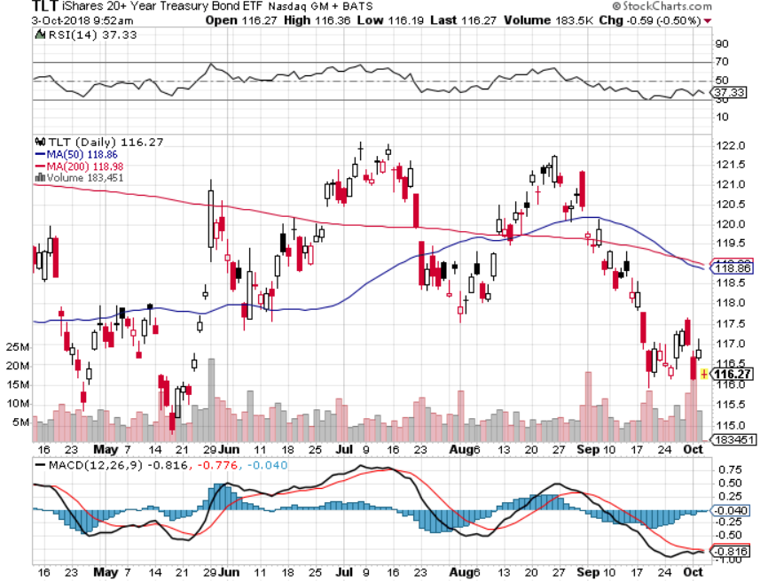
Treasury ETF (TLT) – Bottom of Range long (TLT) 10/$114-4117 call spread took profits on long (TLT) 9/$123-$126 put spread

Slide 48
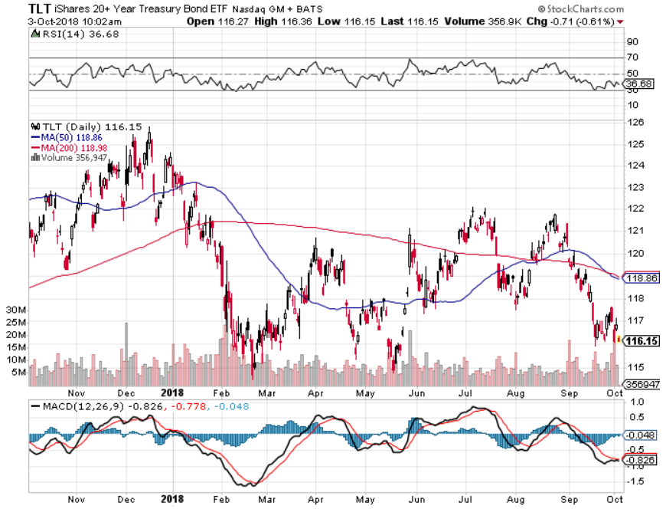
Treasury ETF (TLT) Long Term
Up 5 Points in 8 Months

Slide 49
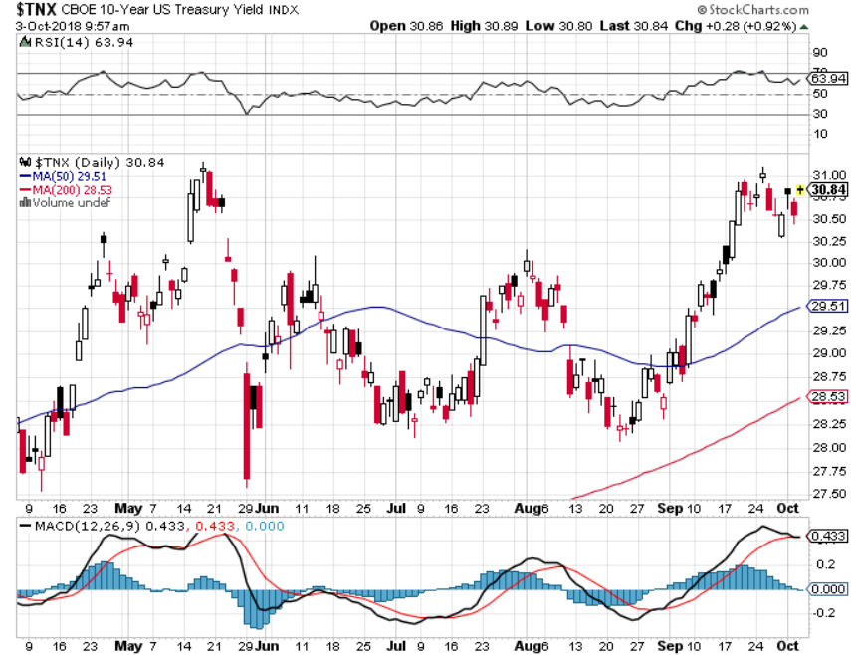
Ten Year Treasury Yield ($TNX) 2.96%
Breakdown, Now major Support

Slide 50
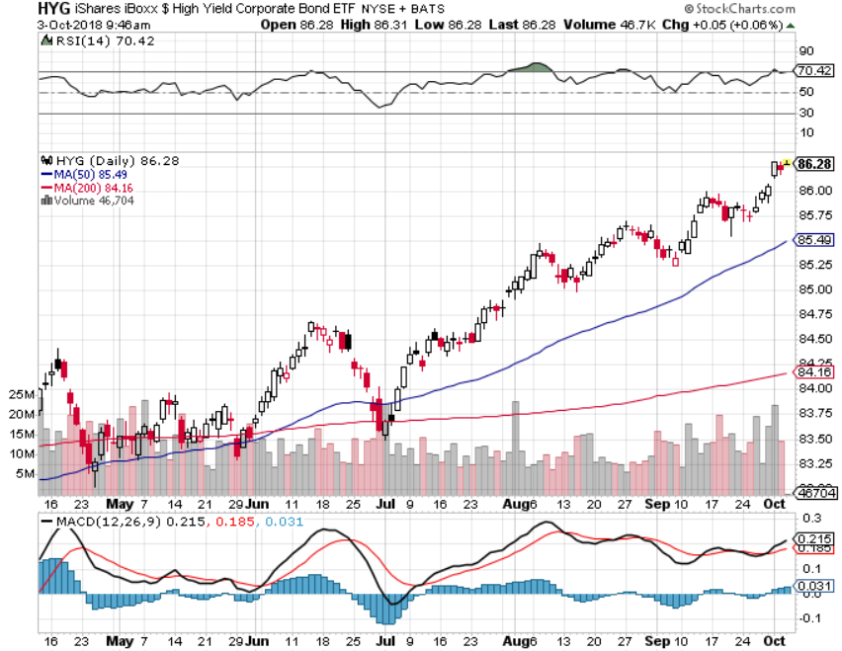
Junk Bonds (HYG) 5.78% Yield

Slide 51
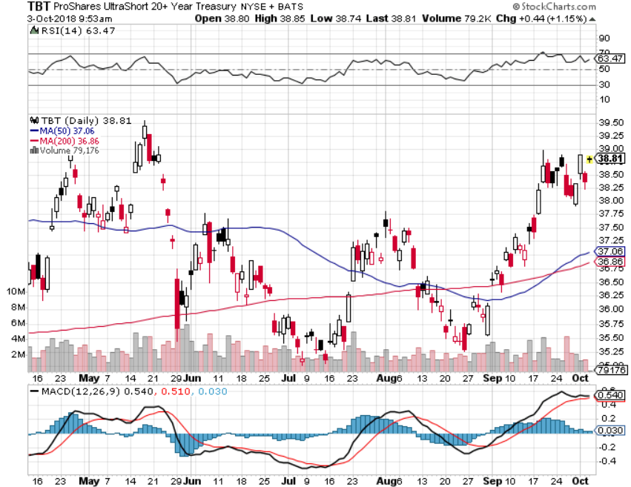
2X Short Treasuries (TBT)-Buy Territory

Slide 52
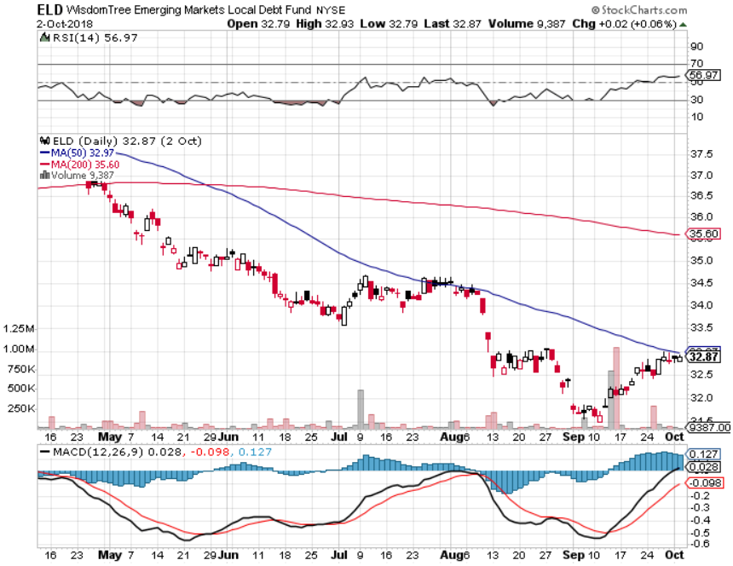
Emerging Market Debt (ELD) 5.64% Yield-

Slide 53
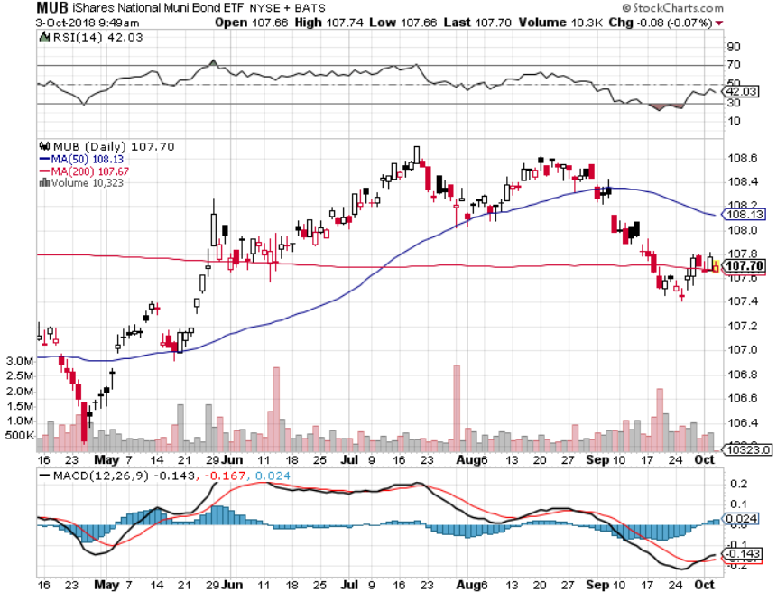
Municipal Bonds (MUB)-2.32%
Mix of AAA, AA, and A rated bonds
Huge 40 basis point yield pop on tax bill

Slide 54
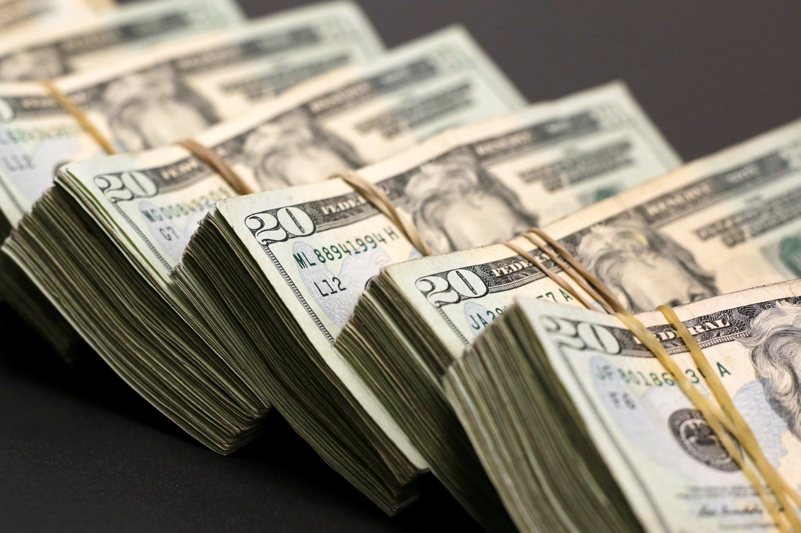
Foreign Currencies- Dollar Rebound
*Fed interest rate rise gives the US dollar a second lease on life
*Euro (FXE) takes it on the chin on the announcement, double tops
*Chinese Yuan sitting on the bottom, it could be a long visit
*In the meantime, Fed is committed to
another year of rate rises
*Bitcoin still holding $6,000
*Bottom Line: stand aside

Slide 55
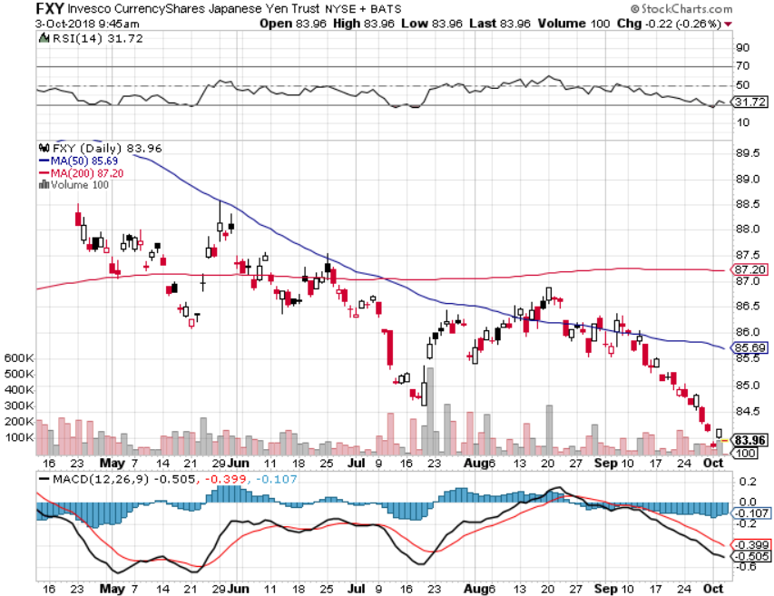
Japanese Yen (FXY), (YCS) took profits on long (FXY) 3/$91-$93 bear put spread

Slide 56
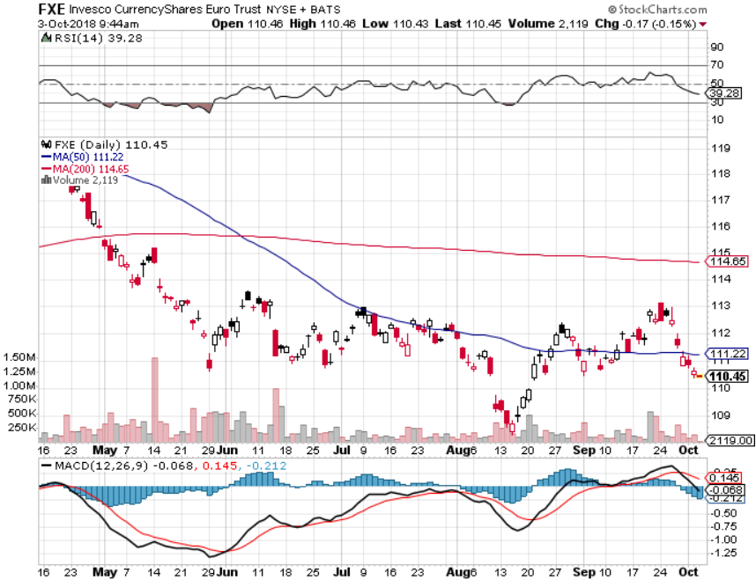
Euro ($XEU), (FXE), (EUO)- Trying to Break Down took profits on long (FXE) 3/$120-$123 vertical bear put spread

Slide 57
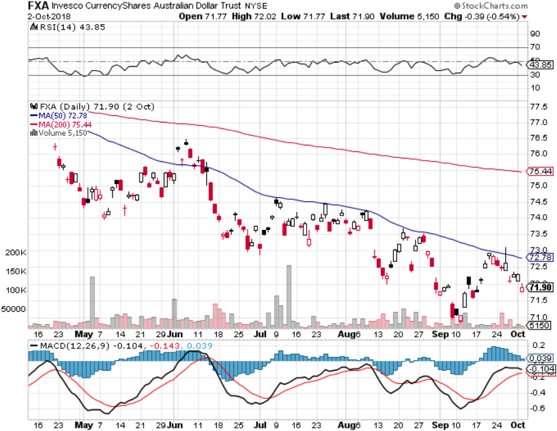
Australian Dollar (FXA)-Trade war China drag

Slide 58
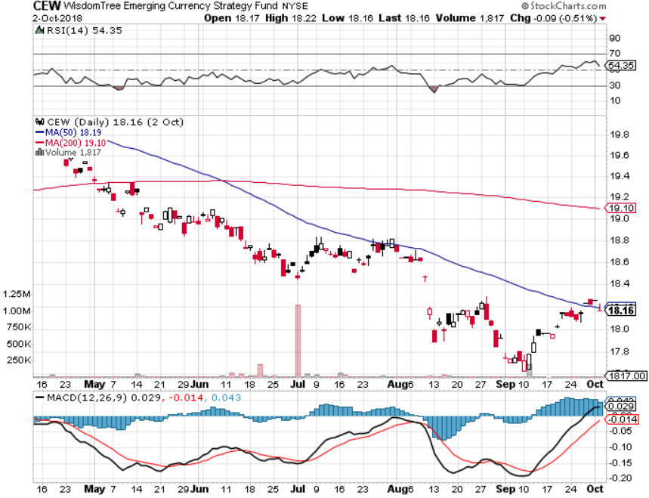
Emerging Market Currencies (CEW)

Slide 59
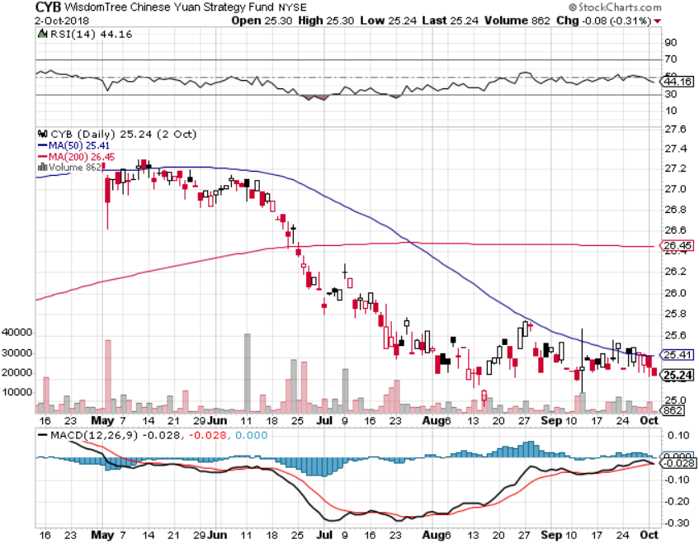
Chinese Yuan- (CYB)-Trade War Tonic

Slide 60

Bitcoin- Downtrend Intact

Slide 61

Energy – Geopolitics Are Back
*Brent crude tops $80, a four year high, Iran sanctions causing oil shortages in Europe
*Russia and Saudi Arabia refusing to increase production to cap rising prices
*Futures market backwardation is very bullish for prices
*Iran threatening to close the Straits of Hormuz, as they have done for 50 years.
*Copper Hits a Two Month High. With biggest
one day gain in 5 years. Is the bear market
in commodities finally over
*China oil usage up a hug 9.1% in August
*Bottom Line: stand aside

Slide 62

Oil-China drag

Slide 63

United States Oil Fund (USO)

Slide 64

Energy Select Sector SPDR (XLE)-No Performance!
(XOM), (CVX), (SLB), (KMI), (EOG), (COP)

Slide 65

Halliburton (HAL)-New Low

Slide 66

Natural Gas (UNG)-

Slide 67

Copper (COPX)-Trade War Fears

Slide 68

Precious Metals-Bottom Feeding
*Amazon wage hike to $15/hours is a major signal that inflation is coming
*Barrick Gold (ABX) Buys Randgold (GOLD), chairman buys $25 million worth of stock
*Is Palladium a preview of great things to come?
*Gold/silver ration plunges, is usually gold positive
*Bitcoin also struggling at the bottom
*Bottom Line: get ready t buy the dip

Slide 69

Gold (GLD)-No Help from Trade War
Took profits on long 5/$119-$122 bull call spread took profits on long (GLD) $12/$116-$119 bull call spread

Slide 70

Gold Long Term
2017
Low

Slide 71

Market Vectors Gold Miners ETF- (GDX) – Yikes!
Took profits on long the 9/$20.50-$21.50 bull call spread

Slide 72

Barrick Gold (ABX)

Slide 73

Newmont Mining- (NEM)-

Slide 74

Palladium - (PALL)-

Slide 75

Real Estate-Rolling Over
*August New Home Sales up 3.5%, Pending Homes Sales down -1.8%,
Inventories up 6.1%, a one year high
*August Housing Starts up 9.2% to 1.28 million units
*30 year fixed rate home mortgage hits 4.95%, a seven year high
*”FOR SALE” sign popping up across the country
*S&P 500 Case-Shiller drops to 5.9%,
with absolute prices
hitting new all time highs, first fall
in pace of increase in years
*Bottom Line: Stand aside

Slide 76

July Corelogic S&P Case Shiller Home Price Index
Seattle (+12.8%), Las Vegas (+10.3%) San Francisco 10.7% leaders price rises accelerating
Tradingeconomics.com

Slide 77

Simon Property Group (SPG)-

Slide 78

US Home Construction Index (ITB)
(DHI), (LEN), (PHM), (TOL), (NVR)

Slide 79

Trade Sheet-
So What Do We Do About All This?
*Stocks-buy dips
*Bonds-sell any and all rallies
*Commodities-stand aside
*Currencies-stand aside
*Precious Metals –buy dips
*Volatility-buy dips to $11
*Real estate-stand aside

Slide 80

Next Strategy Webinar
12:00 EST Wednesday, October 31,
2018 from San Francisco, CA
For Lunches and Tahoe Conference
Please Go to www.madhedgefundtrader.com and click “Store” email me at support@madhedgefundtrader.com
Good Luck and Good Trading!
Notes:
*

