Slide 1

The Mad Hedge Fund Trader “The Bottom is In”
With John Thomas from Silicon Valley, CA, October 31, 2018 www.madhedgefundtrader.com
Notes:
*

Slide 2

Trade Alert Performance Yesterday
*January 4.09% Final *July +0% Final *February +1.54% Final *August +2.19% MTD *March +1.13% Final *September 1.38% Final *April +12.54% Final *October +9.65% MTD *May +1.07% Final *November +2.08% Final *June +4.15% Final *December +3.76% Final *2018 Year to Date 18.74% compared to -2.0% for the Dow Average *Trailing One year return +30.68%, +295.21% since inception, *Average annualized return of 34.40%

Slide 3
Trade Alert Performance Today-New All-Time High Hanging tough and beating the market
*January 4.09% Final *July +0% Final *February +1.54% Final *August +2.19% MTD *March +1.13% Final *September 1.38% Final *April +12.54% Final *October +1.37% MTD *May +1.07% Final *November +2.08% Final *June +4.15% Final *December +3.76% Final *2018 Year to Date 29.76% compared to 1.2% for the Dow Average *Trailing One year return +30.68%, +306.23% since inception, *Average annualized return of 34.40%

Slide 4
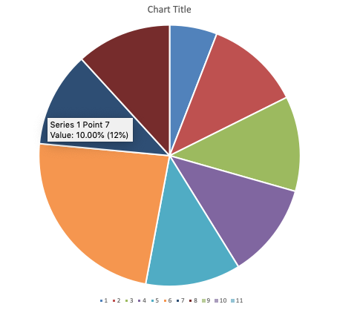
Portfolio Review 50% long stocks, 20% short bonds, 5% short Volatility aggressive bet the ranch long after a decade correction
Current Capital at Risk
Risk On
World is Getting Better
(VXX) 1/$20 puts | 5.00%
(SPY) 11/$250-$260 call spread | 10.00%
(AMZN) 11/$1550-$160 call spread | 10.00%
(CRM) 11/$120-$125 call spread | 10.00%
(TLT) 11/$117-$120 put spread | 10.00%
(AMZN) 11/$1350-$1400 call spread | 20.00%
(TLT) 11/$116-$119 put spread | 10.00%
(IWM) 11/$135-$140 call spread | 10.00%
Risk Off
Total Net Position | 85.00%
Expiration P&L 40.80%

Slide 5
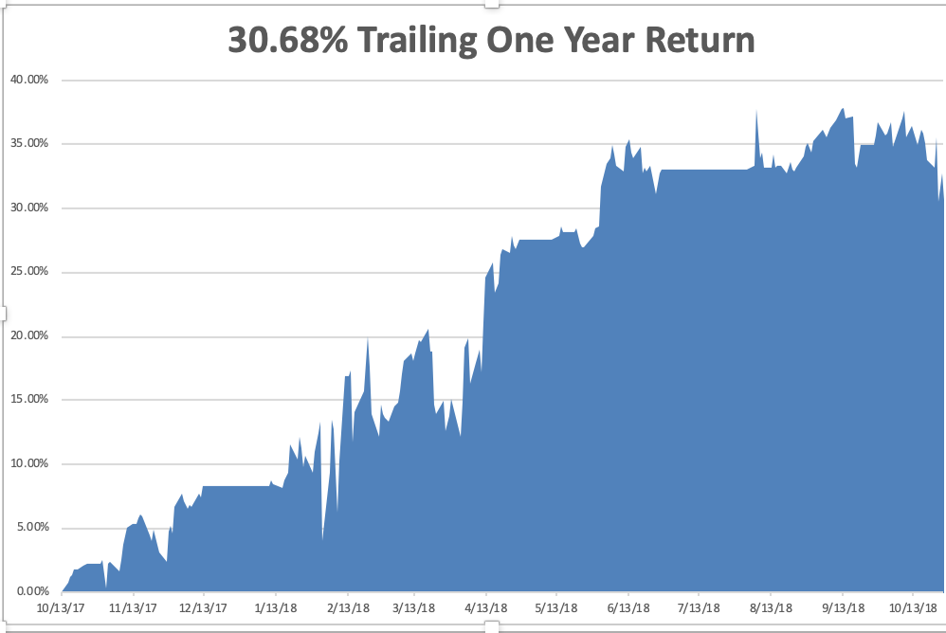
GTD Daily Audited Performance All Time High

Slide 6
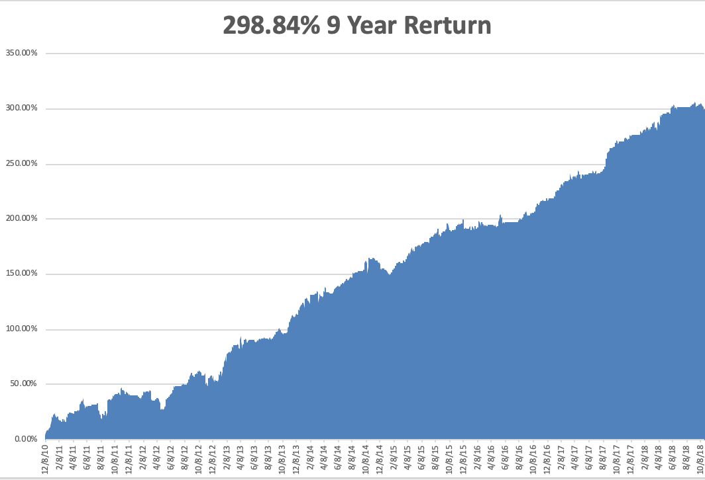
GTD 9 Year Daily Audited Performance

Slide 7
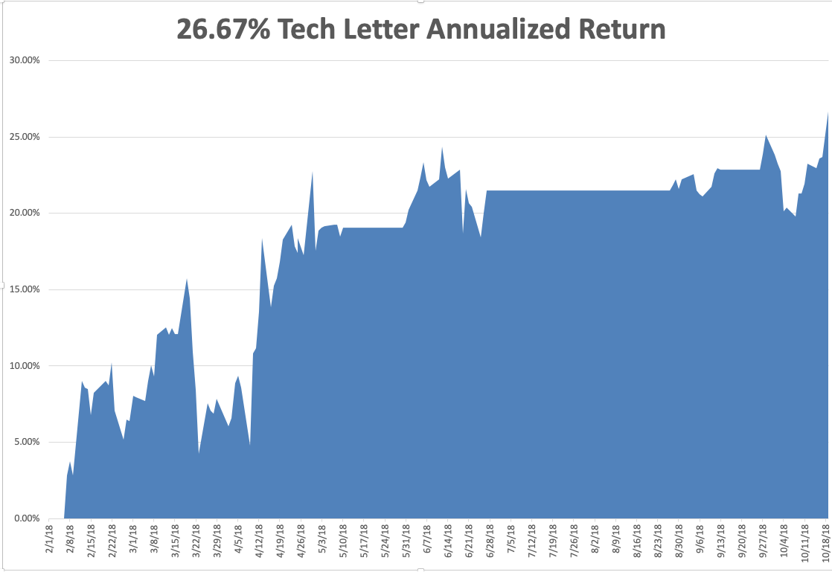
Mad Hedge Technology Letter a $2,500 a year upgrade

Slide 8

The Method to My Madness
*Trade war, rate fears, and rich valuations triggered the worst technology selloff in a decade *We went from 90% cash to 15 cash by month end *Bonds barely moved and are a screaming sell *US Dollar back on the bid *Oil crashes on recession fears *All that said, I still expect the S&P 500 to be up 10% by the end of the year and there is still good money to be made

Slide 9
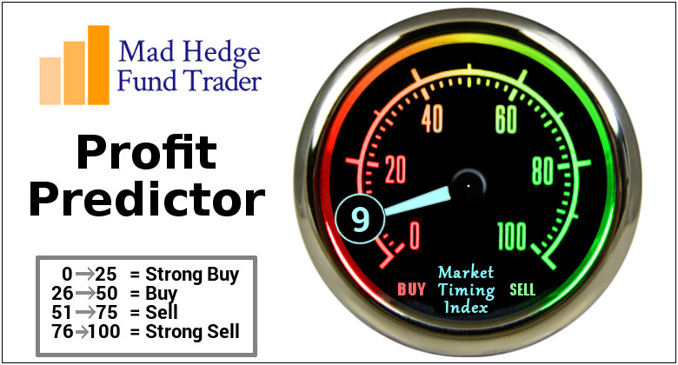
The Mad Hedge Profit Predictor Market Timing Index- An artificial intelligence driven algorithm that analyzes 30 different economic, technical, and momentum driven indicators

Slide 10
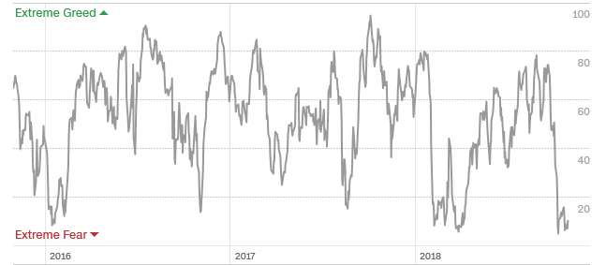
The Mad Hedge Profit Predictor Best ”BUY” Entry Point in 3 Years
SELL
BUY

Slide 11

The Global Economy –Global weakening
*Q3 GDP comes drops from 4.2% to 3.5%, is the peak in? *Maybe half of Q3 GDP came from acceleration of Chinese imports to bear the trade tariffs, the rest was all inventory building, creating a possible vacuum for Q4 and Q!. All future growth may have been sucked forward *Chinese economy is rolling over thanks to the trade war, killing off our biggest customer *Strong dollar is back, crushing foreign earnings *Europe is looking terrible, economy hits a four year low *Next Fed 25 basis point rate rise December 19

Slide 12
Soybeans (-20%)-Trade War Indicator Bouncing alone the bottom

Slide 13
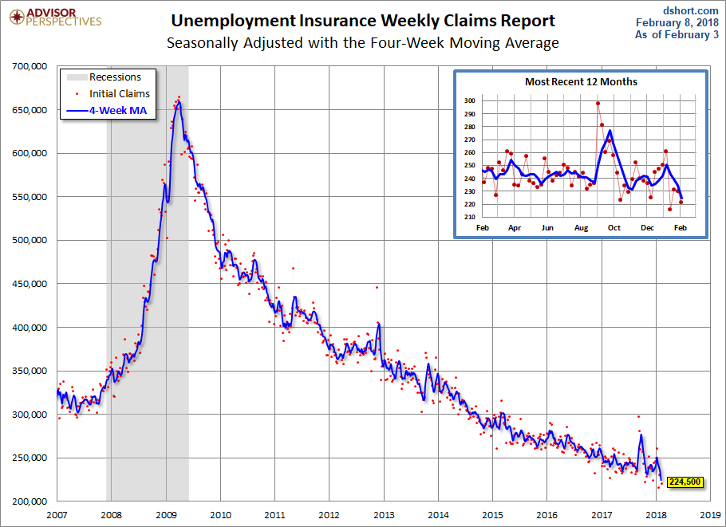
Weekly Jobless Claims –The Most Important Statistic +5,000 to 215,000

Slide 14
The Bill Davis View A $1,500 Upgrade for the Mad Day Trader Service
Buys: | Entry | Target
Western Digital (WDC) x | $ 43.00 | $ 53.00
MSC Industrial (MSM) | $ 78.00 | $ 92.00
Align Technology,Inc (ALGN) | $ 226.00 | $ 260.00
Wabtec(WAB) | $ 87.00 | $ 97.00
Beckton Dickinson (BDX) | $ 232.00 | $ 253.00
Sells:
Air Products (APD) | $ 160.00 | $ 148.00
Jack in the Box (JACK) | $ 87.00 | $ 62.00
JM Smucker (SJM) | $ 113.00 | $ 95.00
Kimberly Clark (KMB) | $ 107.00 | $ 98.00
Celgene (CELG) | $ 77.00 | $ 65.00

Slide 15

Stocks – Reality Check
*Worst tech selloff in a decade pummels market *Earnings made no difference, all stocks were sold off on earnings *$200 in Share Buy Backs have to be put into the market by yearend *Midterm election result on November 7 will remove a huge amount of uncertainty, markets ALWAYS rally in the quarter afterwards *Bear markets never start with zero real interest rates (3.10% inflation rate – 3.1% ten year Treasury yield = zero) *Bottom Line: its bet the ranch time on tech longs *Throw all fundamentals out the window and buy the stocks that have gone down the most

Slide 16
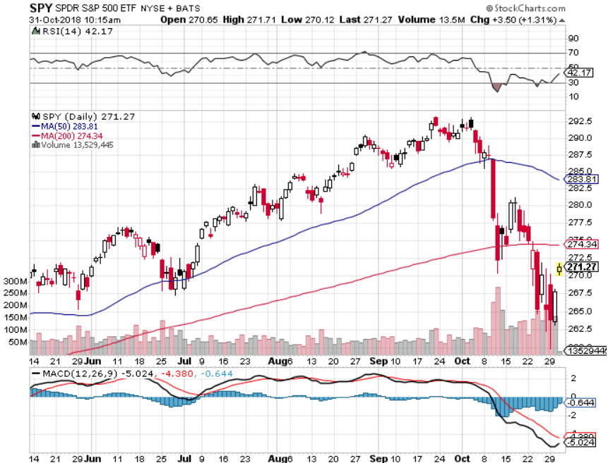
S&P 500- long 11/$250-$260 call spread-expires in 12 trading days

Slide 17
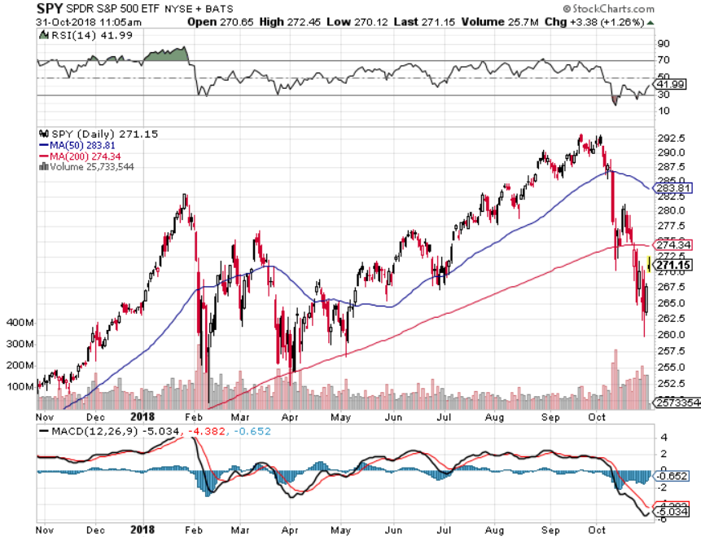
S&P 500-

Slide 18
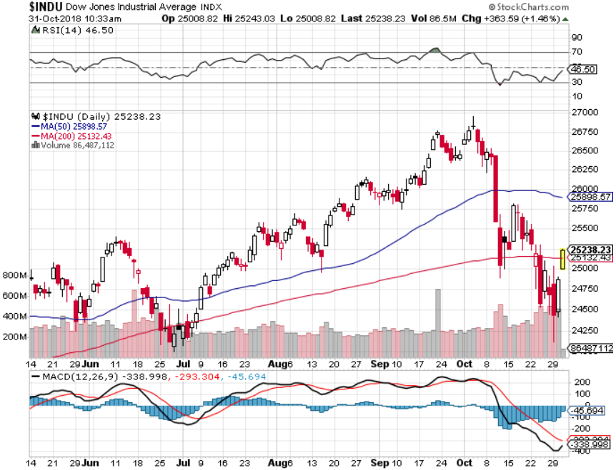
Dow Average-

Slide 19
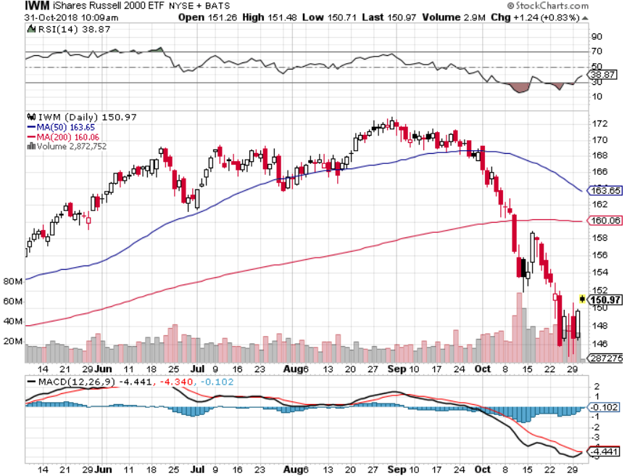
Russell 2000 (IWM)- long 11/$135-$140 call spread - expires in 12 trading days

Slide 20
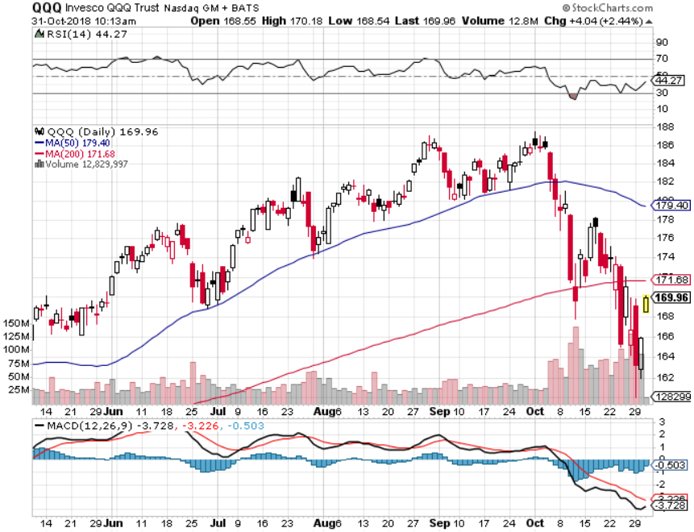
NASDAQ (QQQ)-

Slide 21
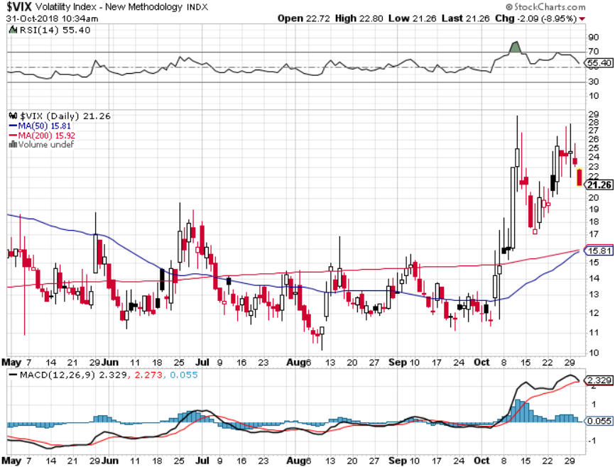
(VIX)- Spike Time

Slide 22
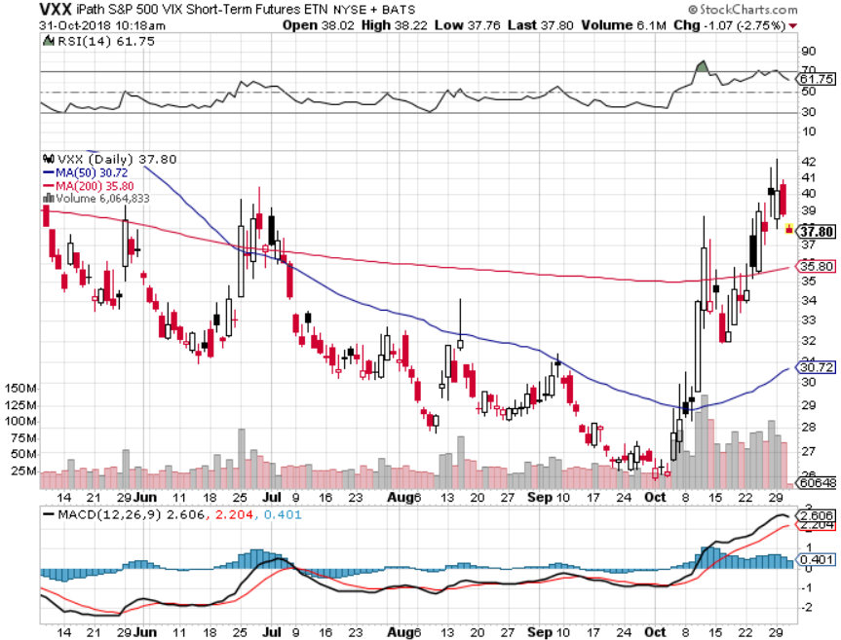
iPath S&P 500 VIX Short-Term Futures ETN (VXX) took profits on long 1/$40 calls took profits on long 3/$60-$65 bear put spread took profits on long 3/$55-$60 bear put spread long 1/$20 puts outright

Slide 23
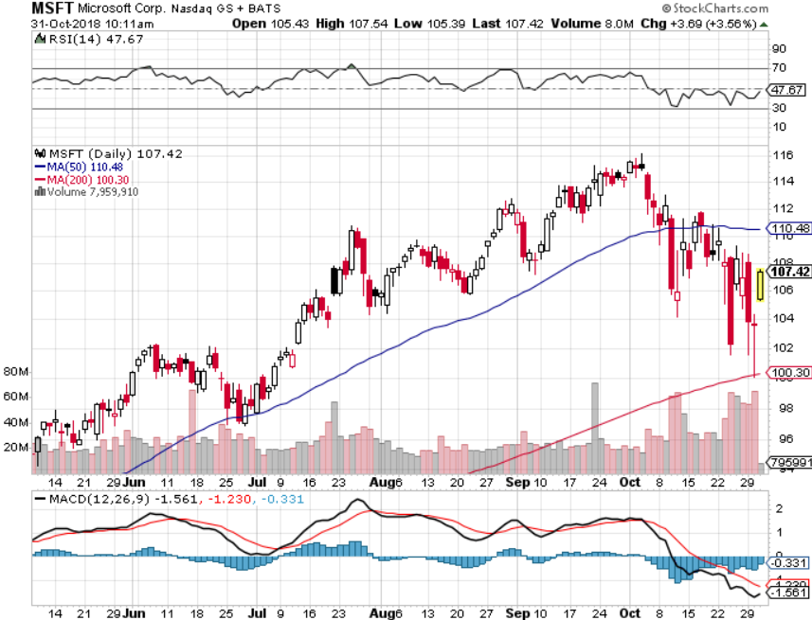
Microsoft (MSFT)- Earnings beat long 11/$90-$95 call spread-expires in 12 trading days

Slide 24
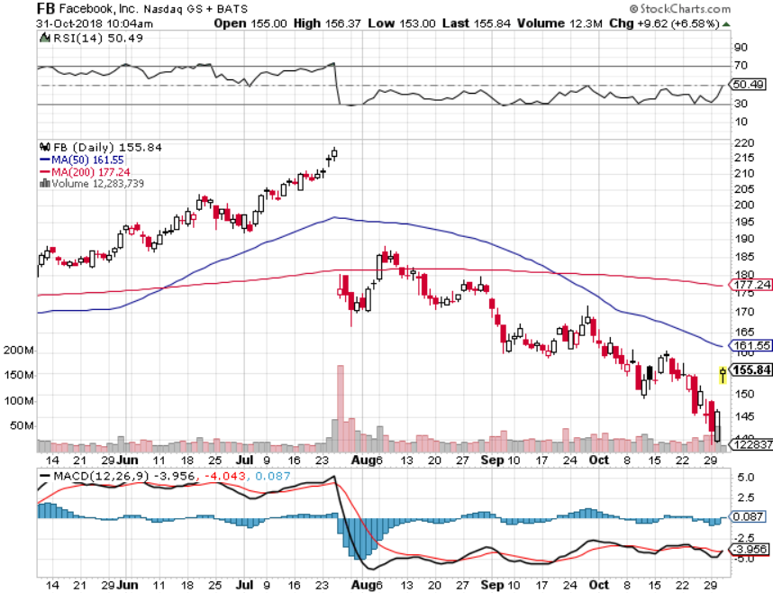
Facebook (FB)- Earnings beat stopped out of long 4/$150-$160 call spread took profits on long 6/$130-$140 bull call spread took profits on long 3/$155-$165 bull call spread took profits on long 3/$190-$195 bear put spread

Slide 25
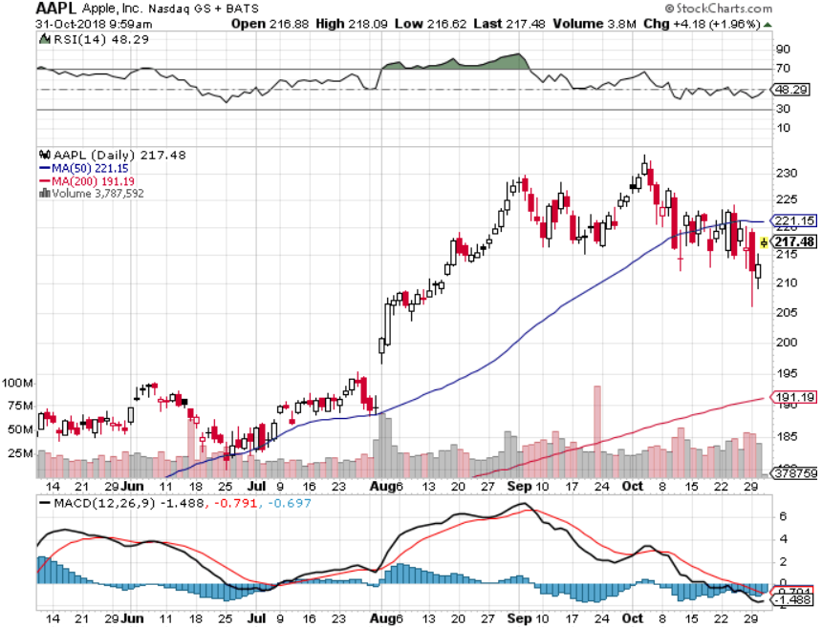
Apple (AAPL)- took profits on 11/$180-$190 call spread

Slide 26
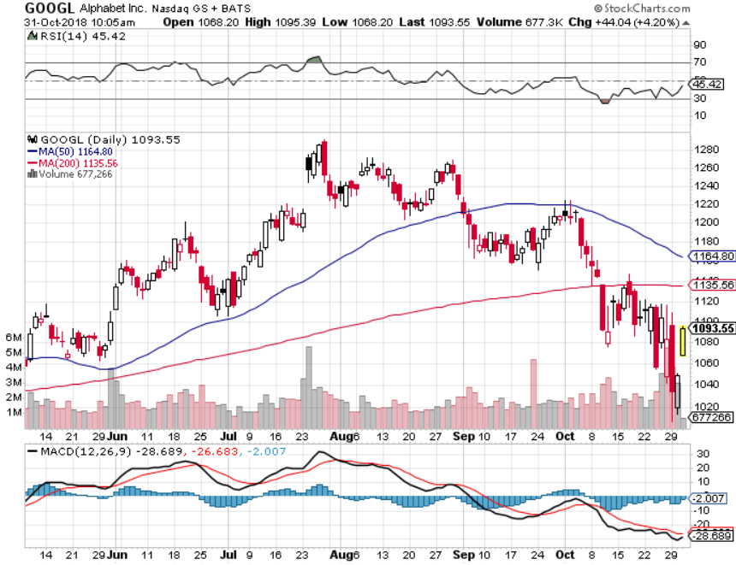
Alphabet (GOOGL)-

Slide 27
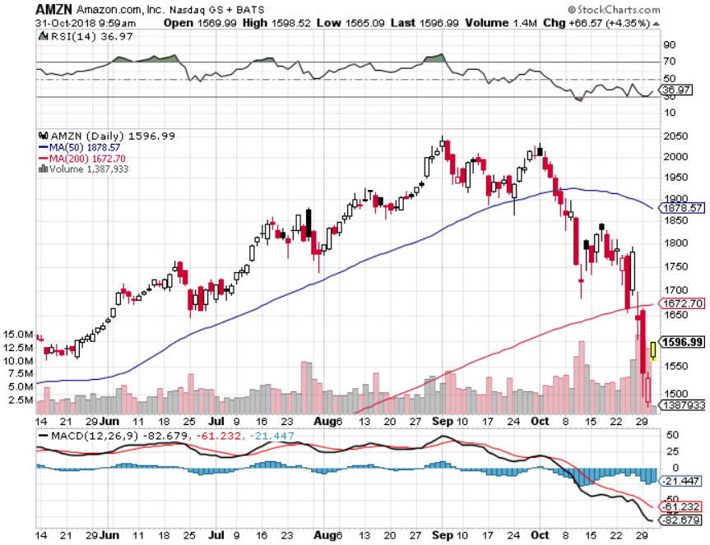
Amazon (AMZN)-Screaming BUY no China business long 11/$1,550-$1,600 call spread long 11/$1,500-$1,400 call spread

Slide 28
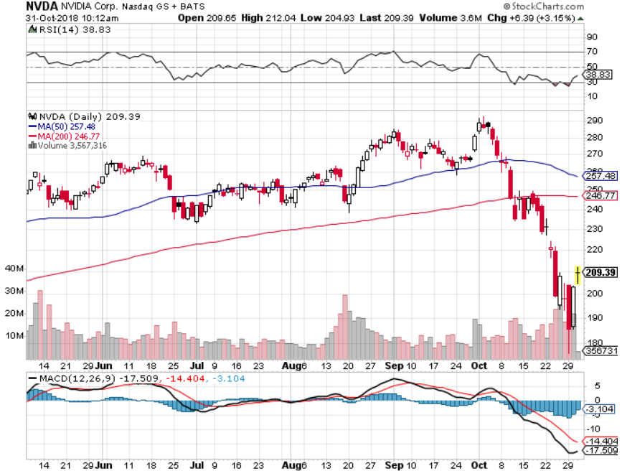
NVIDIA (NVDA)-

Slide 29
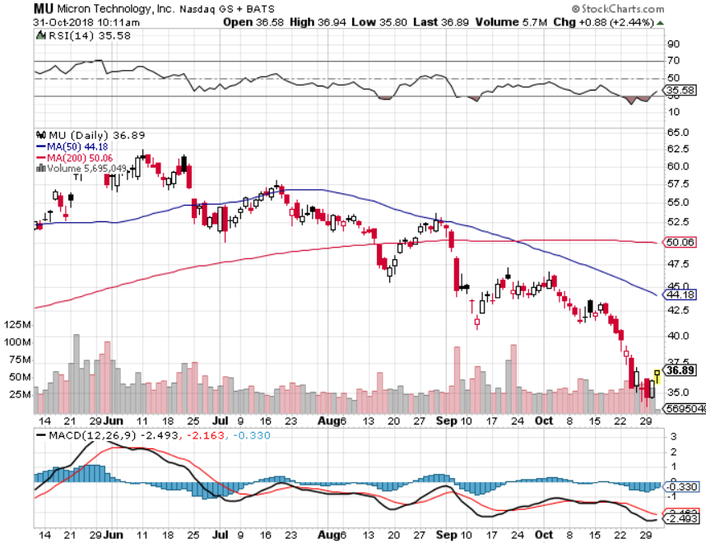
Micron Technology (MU)-Trade Wars

Slide 30
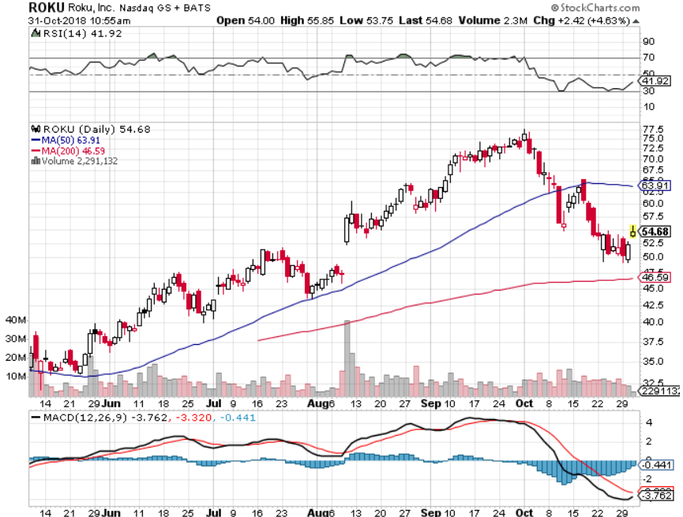
Roku (ROKU)- long 11/$40-$45 call spread expires in 12 days (TECH LETTER ONLY)

Slide 31
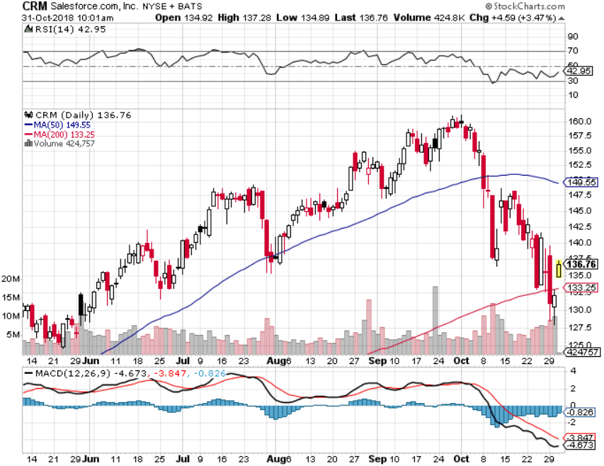
Salesforce (CRM)-New Highs long 11/$120-$125 call spread-expires in 12 days (TECH LETTER ONLY)

Slide 32
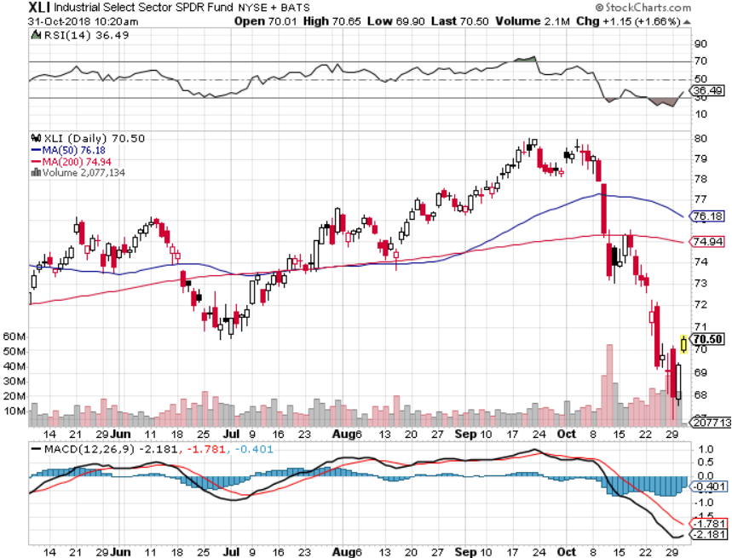
Industrials Sector SPDR (XLI)-Rotation Target (GE), (MMM), (UNP), (UTX), (BA), (HON)

Slide 33
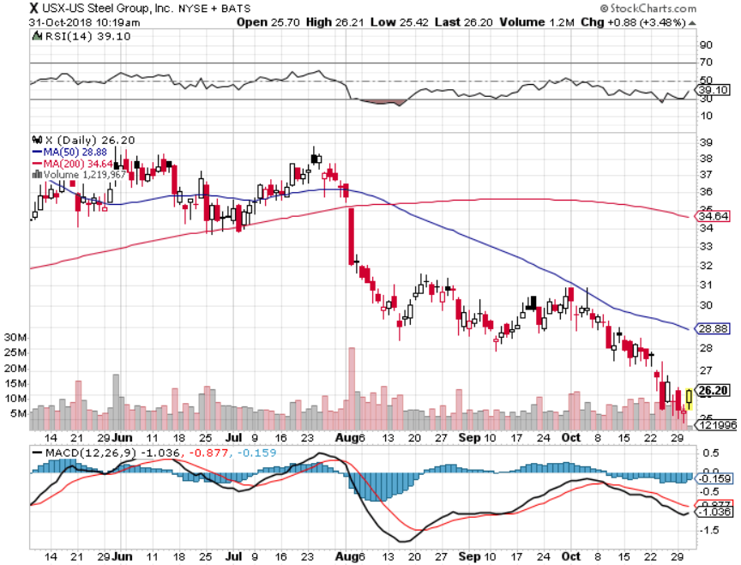
US Steel (X)-Tariffs Trouble Import duties cause users to abandon steel took profits on long the 9/$21-$22 vertical bull call spread

Slide 34
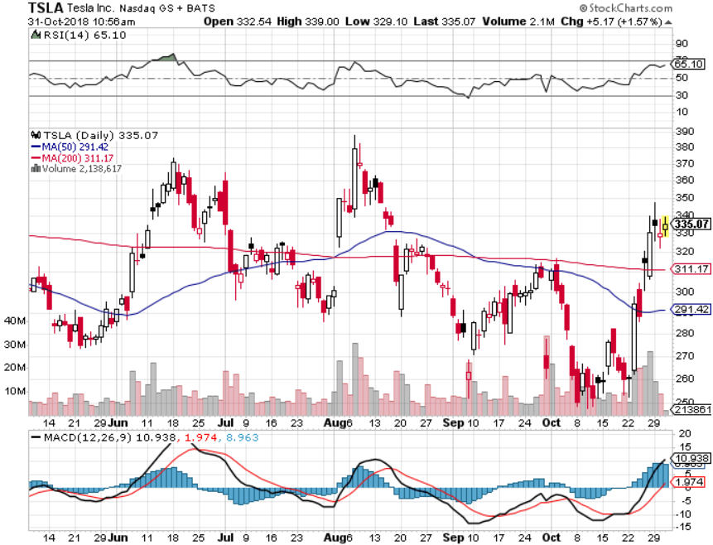
Tesla (TSLA)- Rising share price on successful Tesla 3 deliveries largest outside shareholder says they want more stock

Slide 35
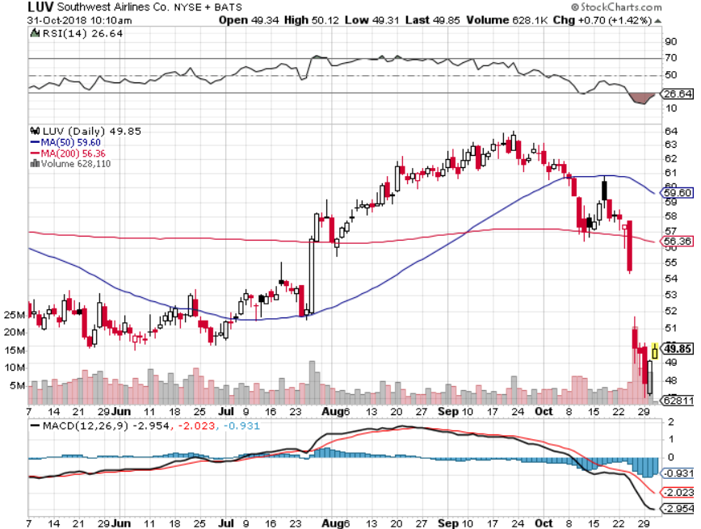
Southwest Airlines (LUV)- Earnings Pop Warren Buffett’s Favorite Airline

Slide 36
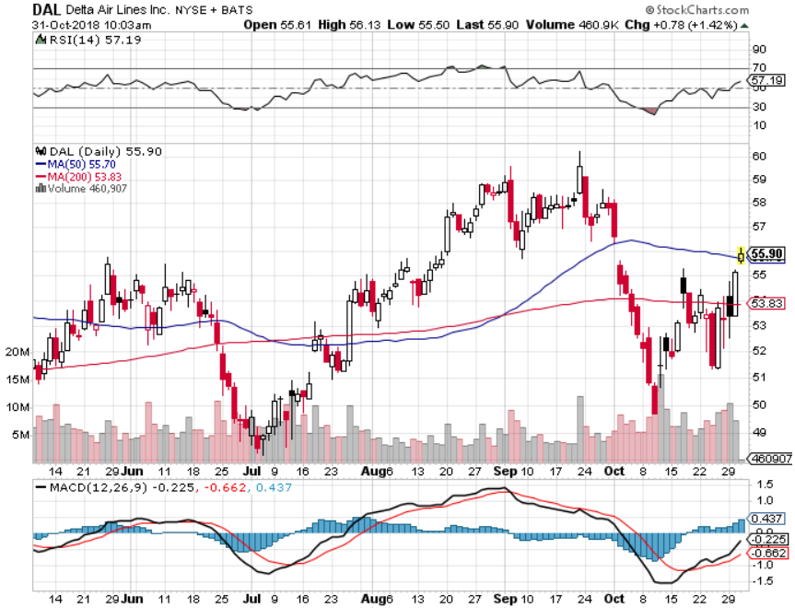
Delta Airlines (DAL)- Poisoning took profits on 3/$40-$45 call spread

Slide 37
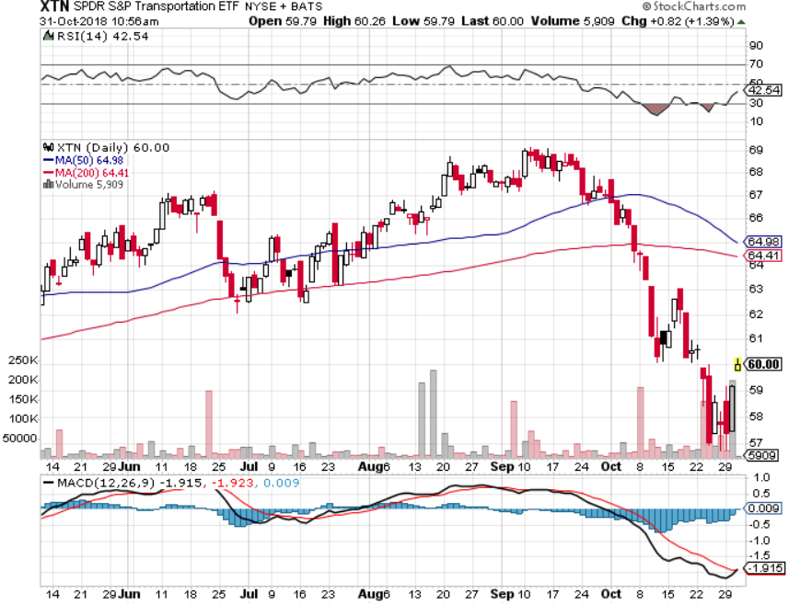
Transports Sector SPDR (XTN)- (ALGT), (ALK), (JBLU), (LUV), (CHRW), (DAL)

Slide 38
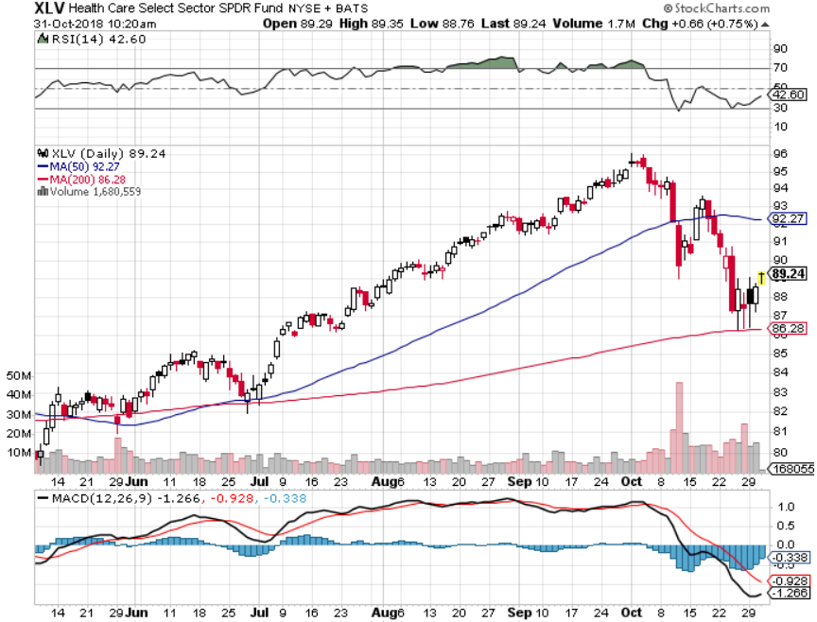
Health Care Sector (XLV), (RXL)-New Highs (JNJ), (PFE), (MRK), (GILD), (ACT), (AMGN)

Slide 39
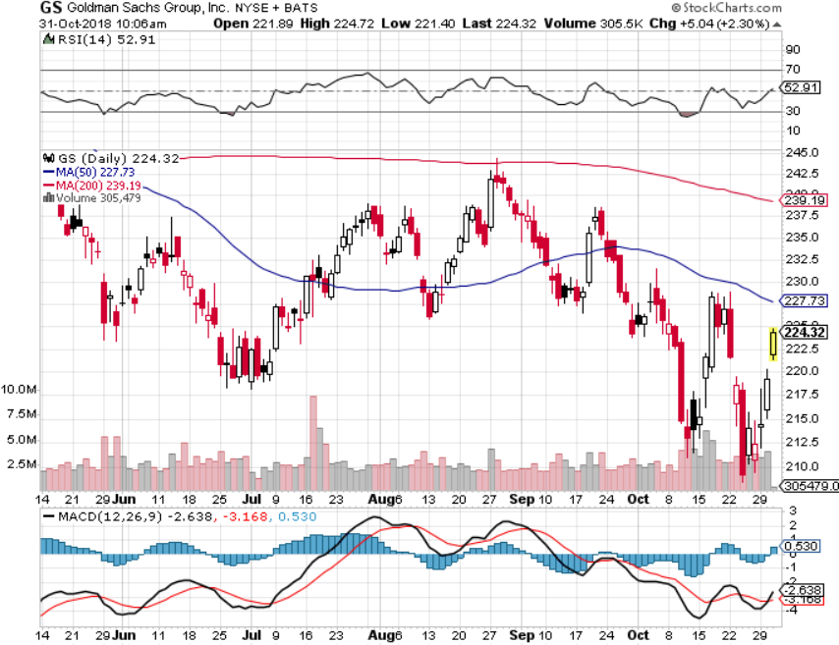
Goldman Sachs (GS)-The Next Buggy Whip maker stopped out of long 4/240-$245 call spread stopped out of long 10/$220-$225 vertical bull call spread took profits on long 10/$227.50-$232.50 vertical bull call spread

Slide 40
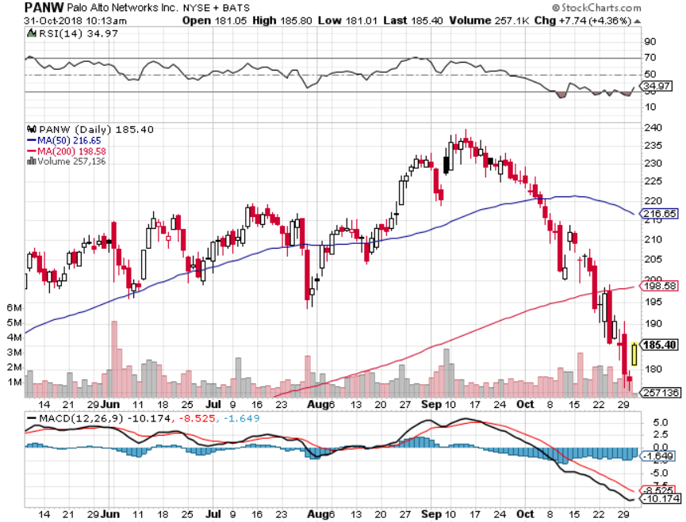
Palo Alto Networks (PANW)- Hacking never goes out of fashion

Slide 41
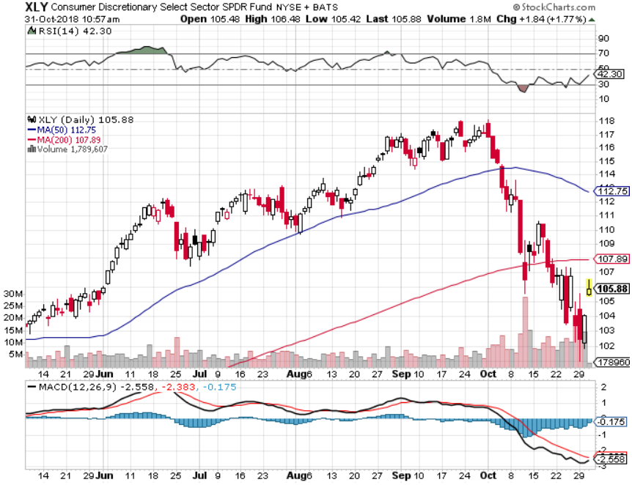
Consumer Discretionary SPDR (XLY) (DIS), (AMZN), (HD), (CMCSA), (MCD), (SBUX)

Slide 42
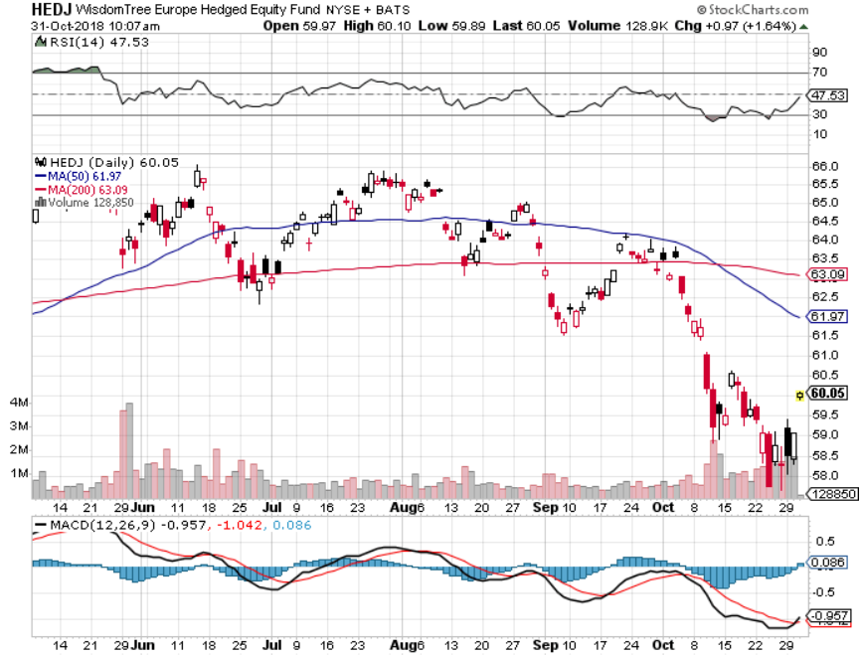
Europe Hedged Equity (HEDJ)-Quadruple top Top

Slide 43
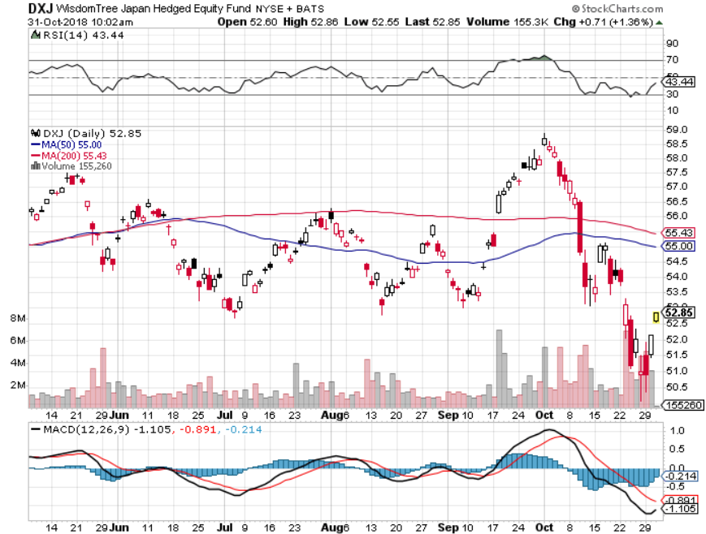
Japan (DXJ)-

Slide 44
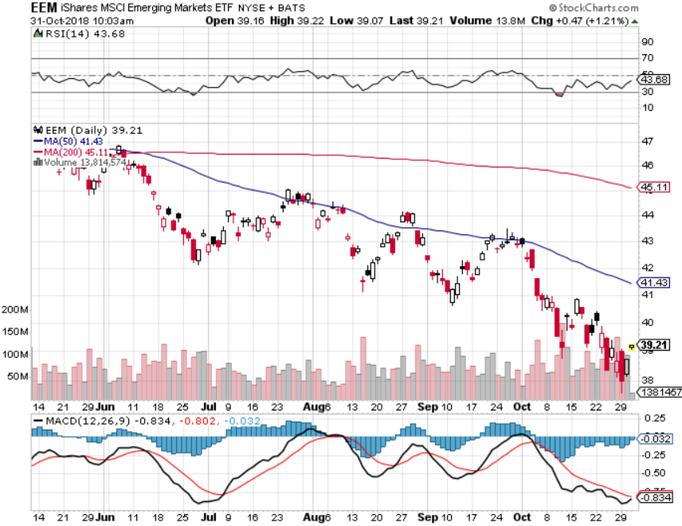
Emerging Markets (EEM)- Killed by Strong Dollar

Slide 45
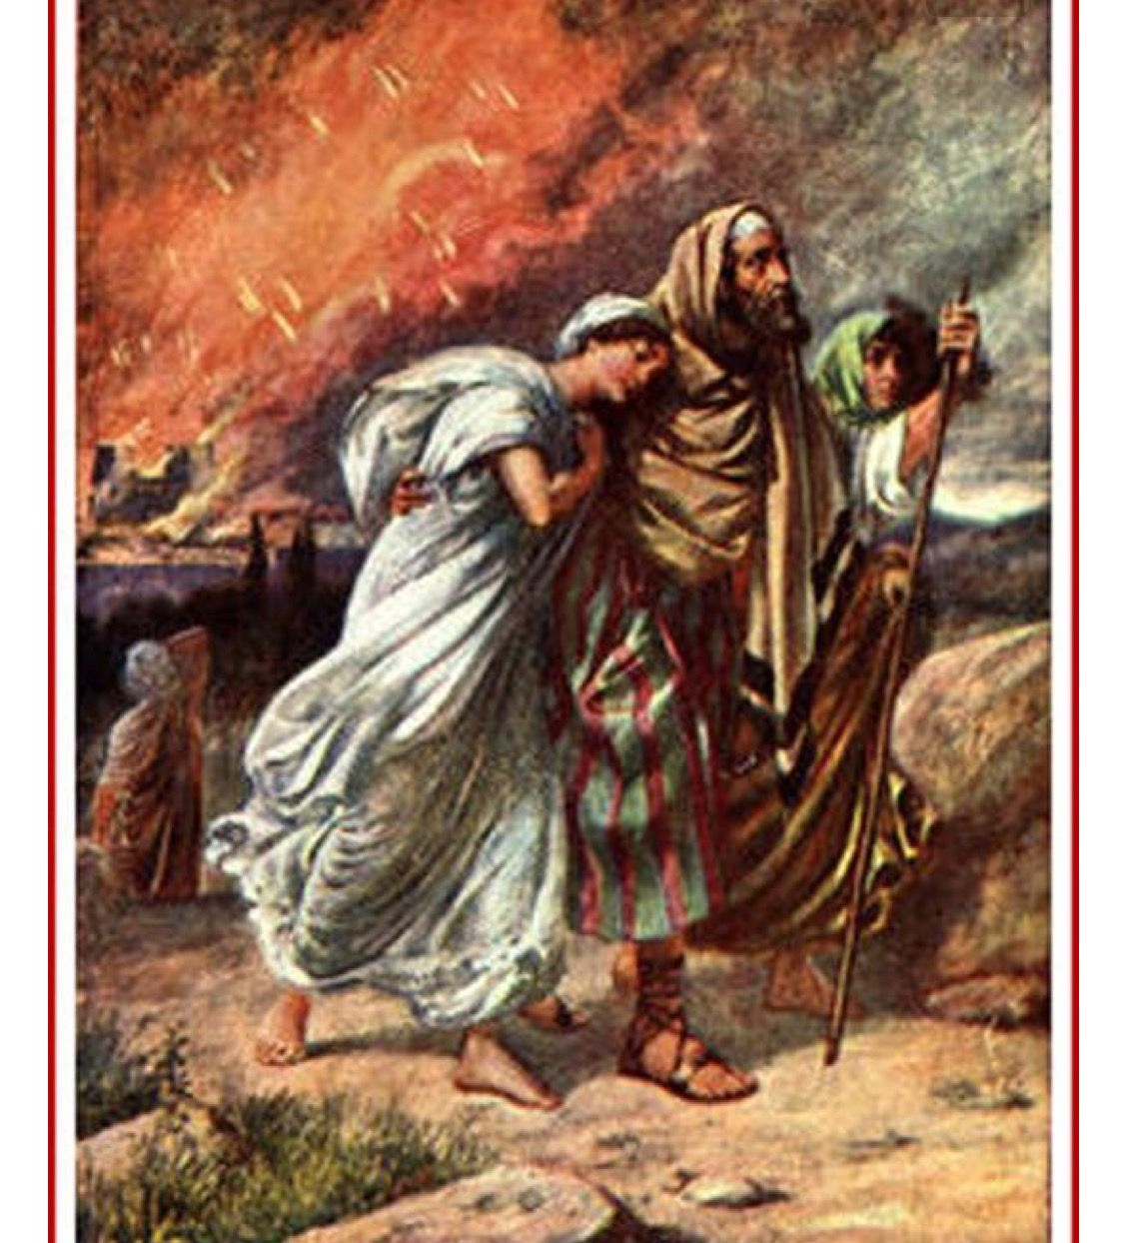
Bonds – Flight to Safety
*Huge global “RISK OFF” creates flight to safety bid that takes yields down 18 basis points to a 3.07% low *Three More Fed Rate Hikes In 2019, after a coming December hike, which will take overnight rates up to 3.00-3.25%.
*Interest Payments to Become the Largest Government Expense Within a Decade, at $900 billion far outpacing the defense budget by 2028 *Still looking for 3.25% ten year US Treasury yield by yearend, and 4% in a year *Exploding deficits will weigh on bonds for the next decade, sell every rally across the space, up 100% IN TWO YEARS! Bottom Line: Sell every four point rally in the (TLT)

Slide 46
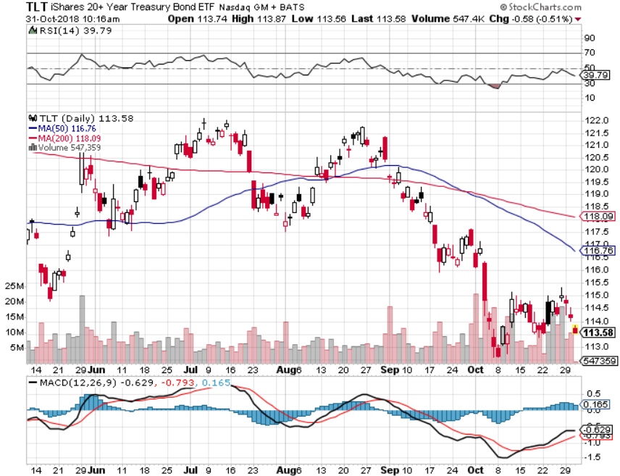
Treasury ETF (TLT) – Bottom of Range took profits on long (TLT) 10/$114-117 call spread took profits on long (TLT) 9/$123-$126 put spread long 11/$116-$119 call spread-expires in 12 trading days long 11/$117-$120 call spread-expires in 12 trading days

Slide 47
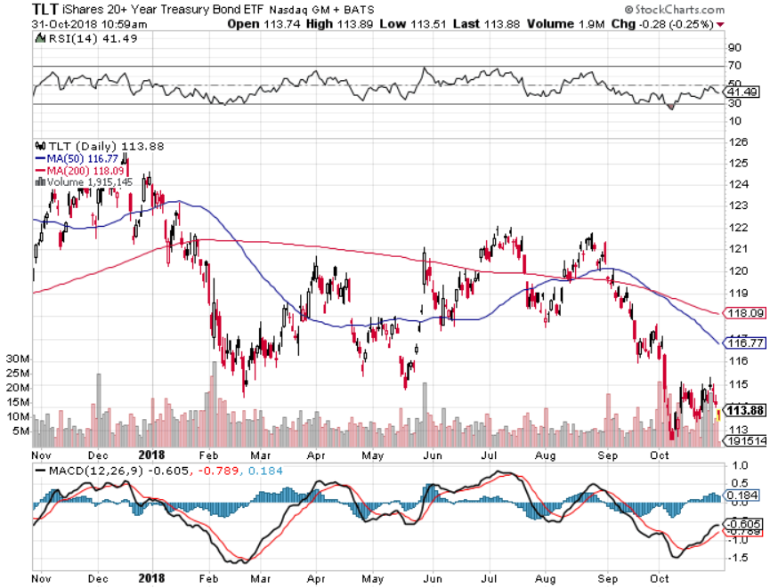
Treasury ETF (TLT) Long Term Up 5 Points in 8 Months

Slide 48
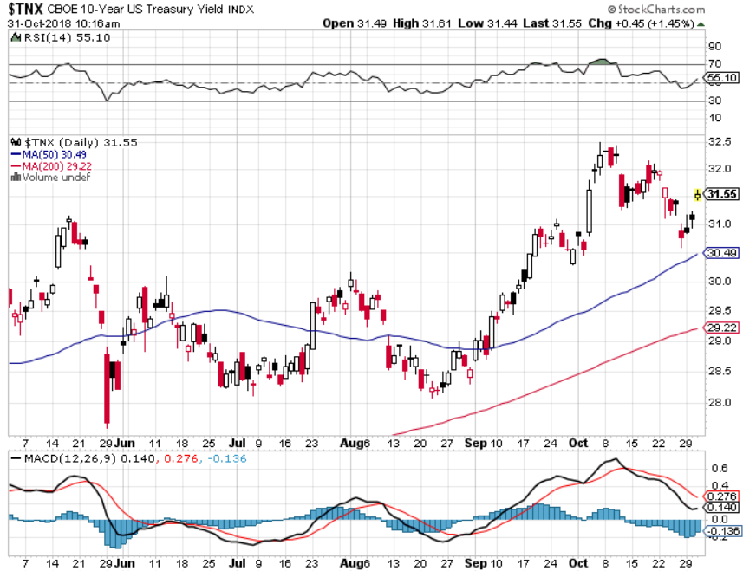
Ten Year Treasury Yield ($TNX) 3.10% Breakdown, Now major Support

Slide 49
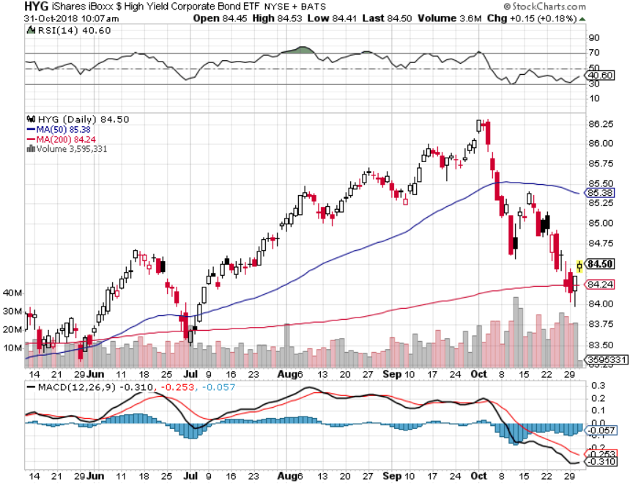
Junk Bonds (HYG) 5.78% Yield

Slide 50
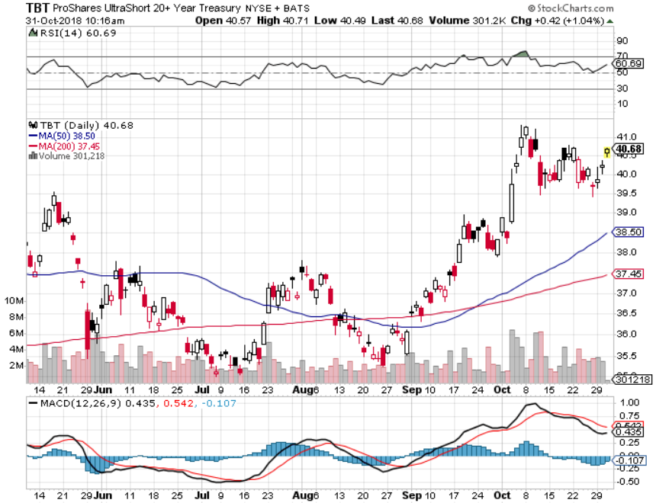
2X Short Treasuries (TBT)-Buy Territory

Slide 51
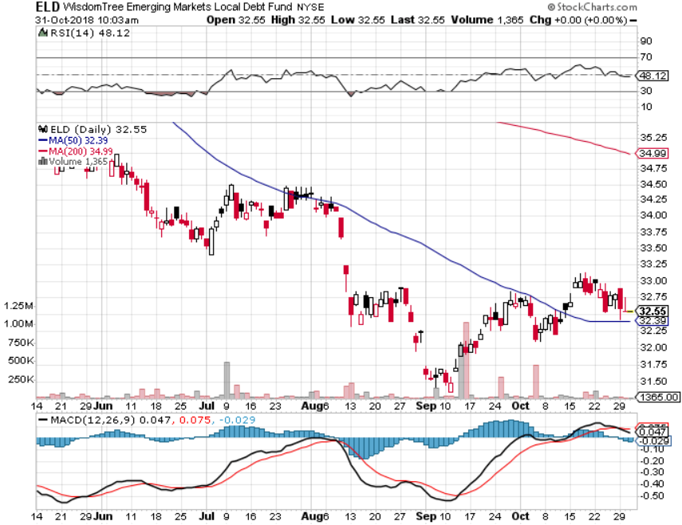
Emerging Market Debt (ELD) 5.64% Yield-

Slide 52
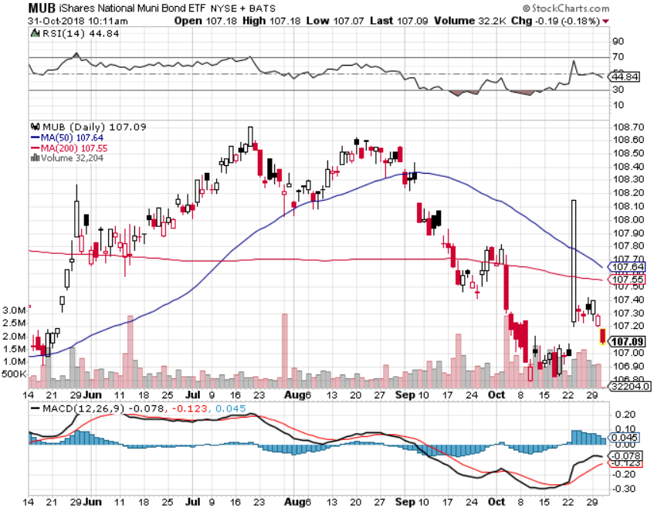
Municipal Bonds (MUB)-2.32% Mix of AAA, AA, and A rated bonds Huge 40 basis point yield pop on tax bill

Slide 53
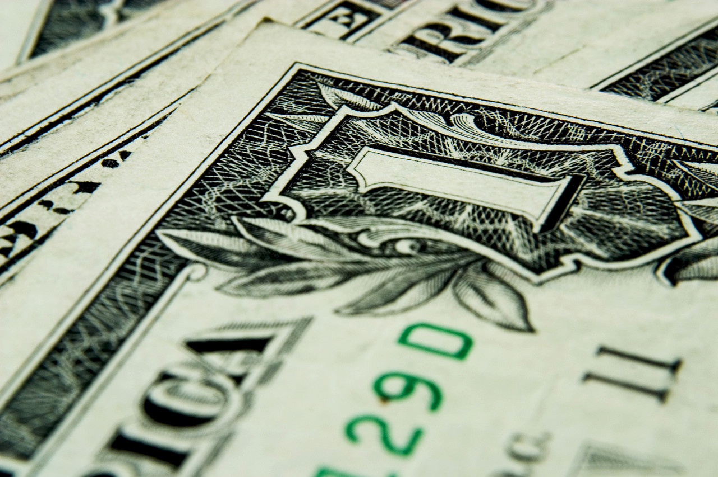
Foreign Currencies – New Dollar Life
*Rising rates give new life to the US dollar *Euro (FXE) gets crushed on Germany’s Angela Merkel’s party resignation. Is political instability coming to Germany? *Chinese Yuan hits a ten year low on trade war *In the meantime, Fed is committed to another year of rate rises, guaranteeing further dollar strength *Bitcoin still holding $6,000 *Bottom Line: stand aside

Slide 54
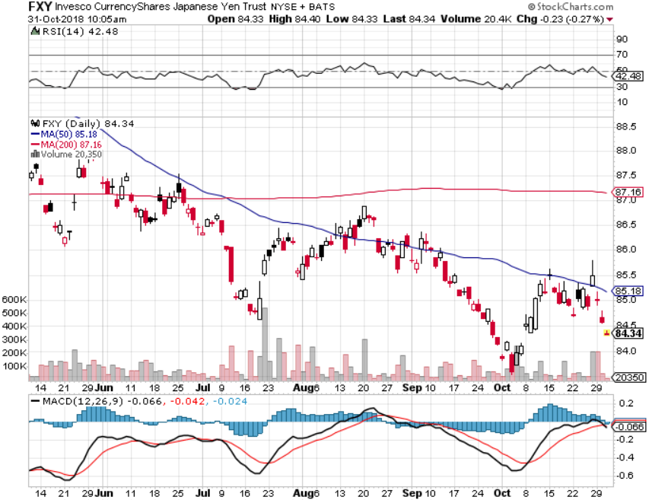
Japanese Yen (FXY), (YCS) took profits on long (FXY) 3/$91-$93 bear put spread

Slide 55
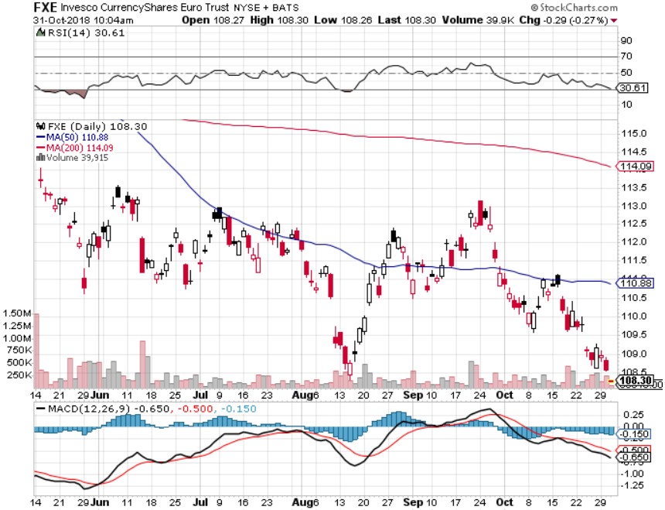
Euro ($XEU), (FXE), (EUO)- Trying to Break Down

Slide 56
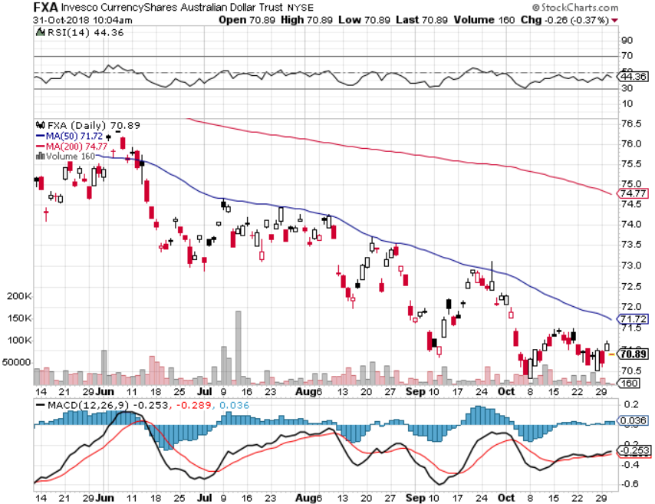
Australian Dollar (FXA)-Trade war China drag

Slide 57
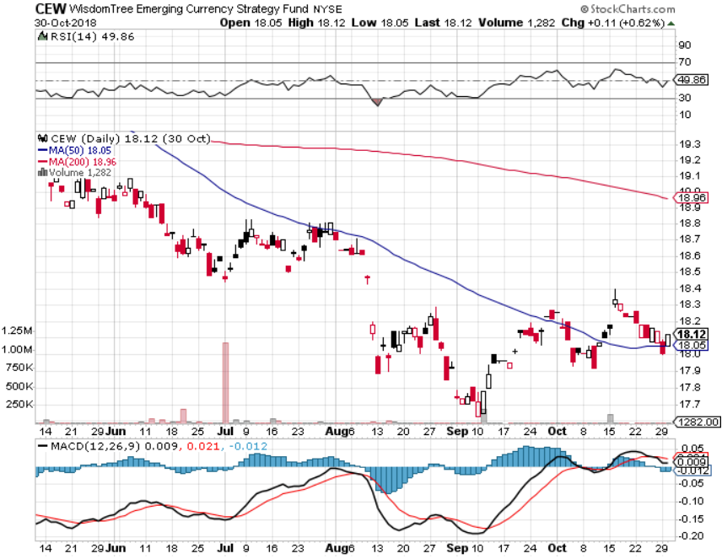
Emerging Market Currencies (CEW)

Slide 58
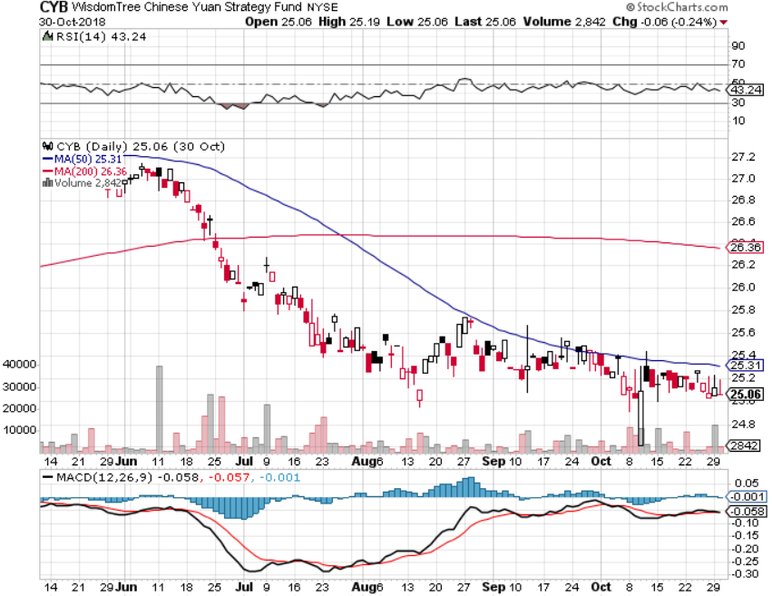
Chinese Yuan- (CYB)-Trade War Tonic

Slide 59

Bitcoin- Downtrend Intact

Slide 60
Energy – Selloff
*Oil gets crushed on recession fears *Even Iran sanctions and Saudi crisis aren’t helping *US still infrastructure constrained on production expansion *Copper bouncing along two year lows *Futures have gone from backwardation contango for the first time in a year, which is hugely price negative *Bottom Line: stand aside

Slide 61

Oil-China drag

Slide 62

United States Oil Fund (USO)

Slide 63

Energy Select Sector SPDR (XLE)-No Performance! (XOM), (CVX), (SLB), (KMI), (EOG), (COP)

Slide 64

Halliburton (HAL)-New Low

Slide 65

Natural Gas (UNG)-

Slide 66

Copper (COPX)-Trade War Fears

Slide 67

Precious Metals – Back to Sleep
*Gold gets a slight flight to safety bid and then stalls *Central banks have become the principal buyers of gold in 2018, some 264 metric tonnes, and that is increasing *Russia and Turkey have been dominating, with Poland joining the fray *Bitcoin also struggling at the bottom *Bottom Line: get ready to buy the next big dip

Slide 68

Gold (GLD)-No Help from Trade War Took profits on long 5/$119-$122 bull call spread took profits on long (GLD) $12/$116-$119 bull call spread

Slide 69

Market Vectors Gold Miners ETF- (GDX) – Yikes! Took profits on long the 9/$20.50-$21.50 bull call spread

Slide 70

Barrick Gold (ABX)

Slide 71

Newmont Mining- (NEM)-

Slide 72

Palladium - (PALL)-

Slide 73
Real Estate -Horrible
*September Pending Home Sales up 0.55%, New Home Sales down 5.5%, 13% YOY, September Existing Home Sales down -3.4% *High rates pricing buyers out of the market *Mortgage application falling off a cliff *”FOR SALE” sign popping up across the country *S&P 500 Case-Shiller drops to 5.7%, annual gain, the lowest in a year *Bottom Line: Stand aside

Slide 74

July Corelogic S&P Case Shiller Home Price Index Las Vegas, Seattle, and San Francisco showing biggest gains

Slide 75

Simon Property Group (SPG)-

Slide 76

US Home Construction Index (ITB) (DHI), (LEN), (PHM), (TOL), (NVR)

Slide 77

Trade Sheet- So What Do We Do About All This?
*Stocks-buy dips *Bonds-sell any and all rallies *Commodities-stand aside *Currencies-stand aside *Precious Metals –buy dips *Volatility-buy dips to $11 *Real estate-stand aside

Slide 78

Next Strategy Webinar 12:00 EST Wednesday, November 14, 2018 from San Francisco, CA www.madhedgefundtrader.com email me at support@madhedgefundtrader.com
Good Luck and Good Trading!
Notes:
*

