Slide 1
The Mad Hedge Fund Trader
“Crunch Time”
With John Thomas
from Incline Village, NV, November 28, 2018
www.madhedgefundtrader.com
Notes:
*

Slide 2

Trade Alert Performance
Today-New All-Time High
Hanging tough and beating the market
*January 4.09% Final *July +0% Final
*February +1.54% Final *August +2.19% MTD
*March +1.13% Final *September 1.38% Final
*April +12.54% Final *October +1.37% Final
*May +1.07% Final *November -2.56% MTD
*June +4.15% Final *December +3.76% Final
*2018 Year to Date 25.92%
compared to 0% for the Dow Average
*Trailing One year return +31.71%, +302.39% since inception,
*Average annualized return of 33.57%

Slide 3
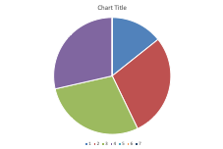
Portfolio Review
50% long stocks, 20% short bonds, 5% short Volatility
aggressive bet the ranch long after a decade correction
Risk On
World is Getting Better
(VXX) 1/$20 puts | 5.00%
(TLT) 12/$116-$119 bear put spread | 10.00%
(AAPL) 12/$160-$170 call spread | 10.00%
(TLT) 12/$117-$120bear put spread | 10.00%
Risk Off
(TSLA) 12/$400-$430 put spread | -10.00%
Total Net Position | 25.00%
Expiration P&L
32.22%

Slide 4
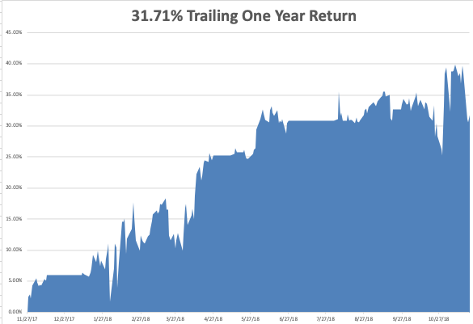
GTD Daily Audited Performance
All Time High

Slide 5
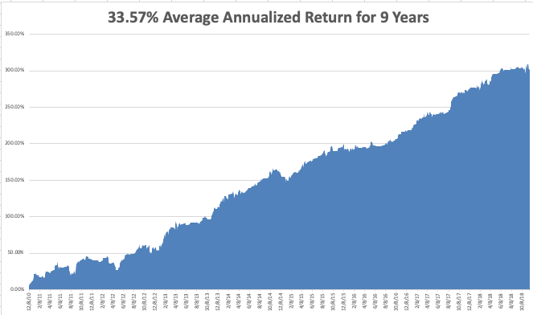
GTD 9 Year Daily Audited Performance

Slide 6

The Method to My Madness
*Trade wars, strong dollar, and rising interest rates are weighing heavily on the market
*Political instability in Washington is crushing confidence
*Stocks have given up half of a decade
long increase in valuations in 7 weeks,
cratering from 20X to 14.9X against a 9.5X
*Bonds barely moved and are a
screaming sell
*Oil crash creates a $200 billion stimulus
for the US economy
*All that said, I still expect the S&P 500
to be up 10% by the end of the year
and there is still good money to be made

Slide 7
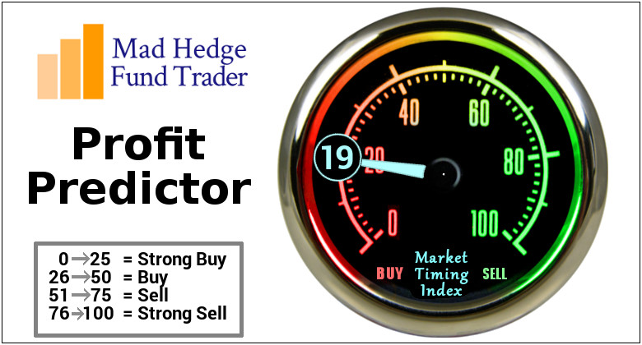
The Mad Hedge Profit Predictor
Market Timing Index-
An artificial intelligence driven algorithm that analyzes 30 different economic, technical, and momentum driven indicators

Slide 8
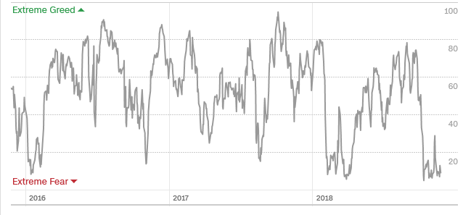
The Mad Hedge Profit Predictor
Best ”BUY” Entry Point in 3 Years
SELL
BUY

Slide 9
The Global Economy –Recession Fears
*Global economy moving from Synchronized Recover to US Only to Global Recession
*The US Data is suddenly turning weak, October Durable Goods falls 4.4%, October Consumer Confidence falls from 98.6 to 97.5, Residential Real Estate is a disaster
*Oil price crash is emerging as a major new economic stimulus, but is crushing the energy industry
*Dollar remains strong , dragging on US exports
*Europe is in free fall
*Next Fed 25 basis point rate rise
December 19

Slide 10
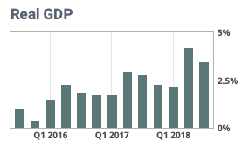

Slide 11
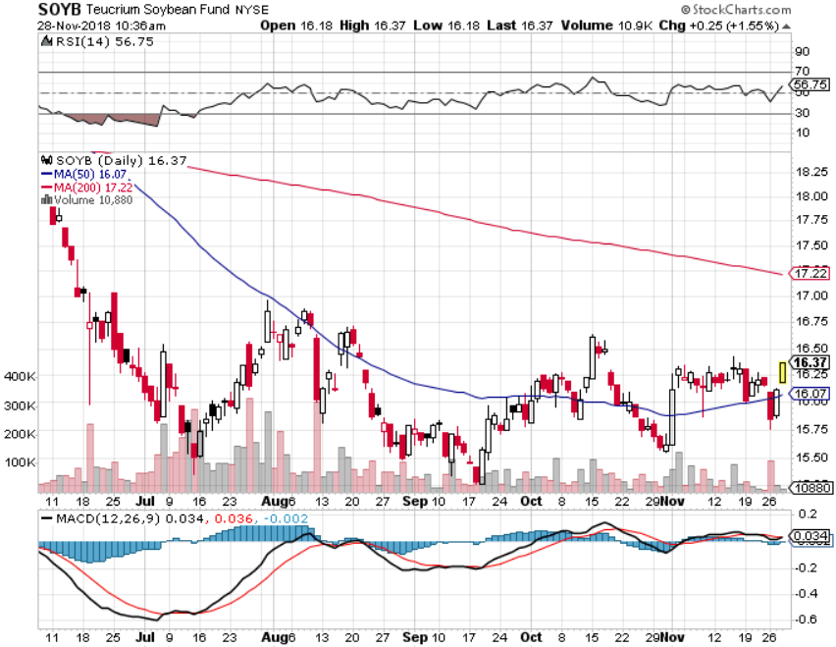
Soybeans (-20%)-Trade War Indicator
Bouncing alone the bottom and Hoping for Buenos Aires

Slide 12
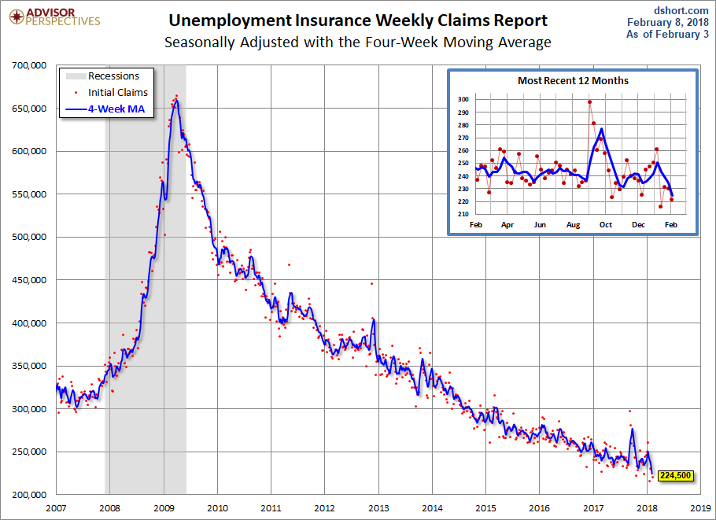
Weekly Jobless Claims –The Most Important Statistic
+3,000 to 224,000, 4 ½ MONTH HIGH

Slide 13
The Bill Davis View
A $1,500 Upgrade for the Mad Day Trader Service
Buys: | Entry | Target
DaVita Inc. (DVA) | $ 60.00 | $ 72.00
Las Vegas Sands (LVS) | $ 52.00 | $ 65.00
Weyerhaeuset Co. (WY) | $ 27.00 | $ 34.00
Qualcomm Inc. (QCOM) | $ 56.00 | $ 65.00
Stericycle, Inc. (SRCL) | $ 45.00 | $ 62.00
Sells:
Air Products (APD) x | $ 161.00 | $ 148.00
Jack in the Box (JACK) x | $ 87.00 | $ 62.00
Sherwin Williams Co (SHW) | $ 410.00 | $ 350.00
Honeywell Intl (HON) | $ 145.00 | $ 120.00
Wex Inc. (WEX) | $ 155.00 | $ 145.00

Slide 14
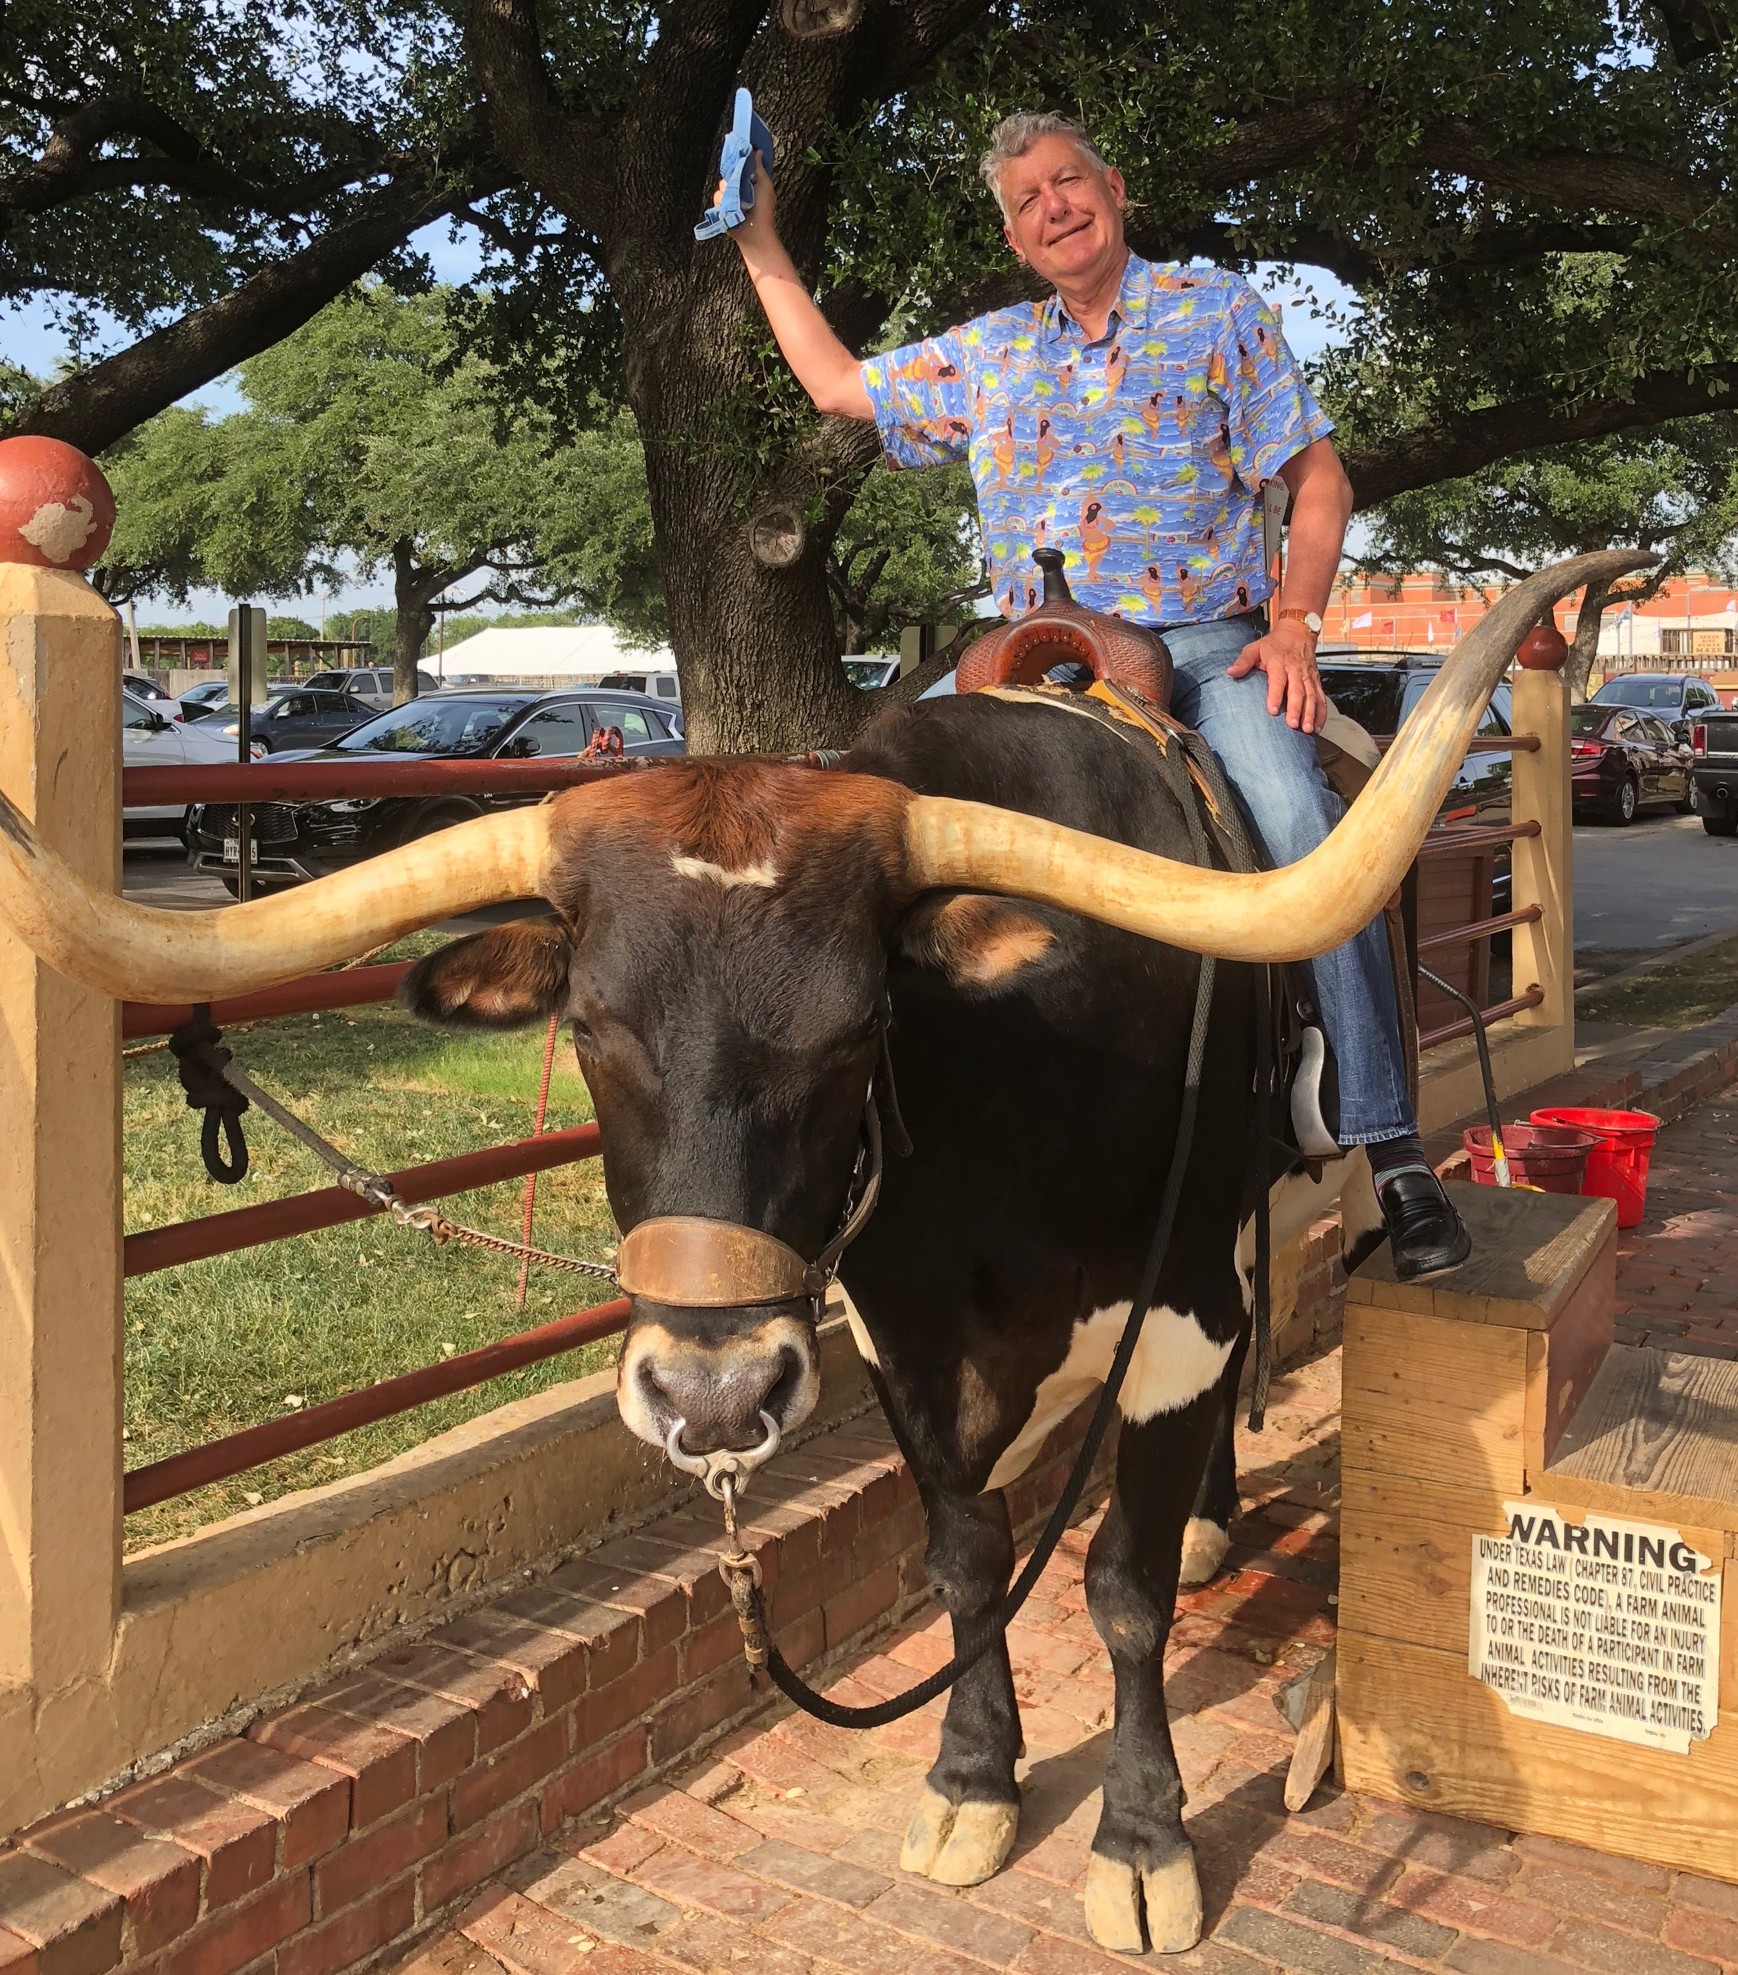
Stocks – The Bull Market Lives
*Sharpest tech selloff in 18 year gives up 2018 gains
*Tech is now selling at a cheaper earnings multiple than toilet paper, despite a tenfold greater growth rate
*Institutional selling is almost nil, individuals are selling when they don’t know what they own
*Share Buy Backs are about to become much more aggressive
*Bear markets never start with zero real interest rates
(3.10% inflation rate – 3.1% ten year Treasury yield = zero)
*Bottom Line: its bet the ranch time on tech longs

Slide 15
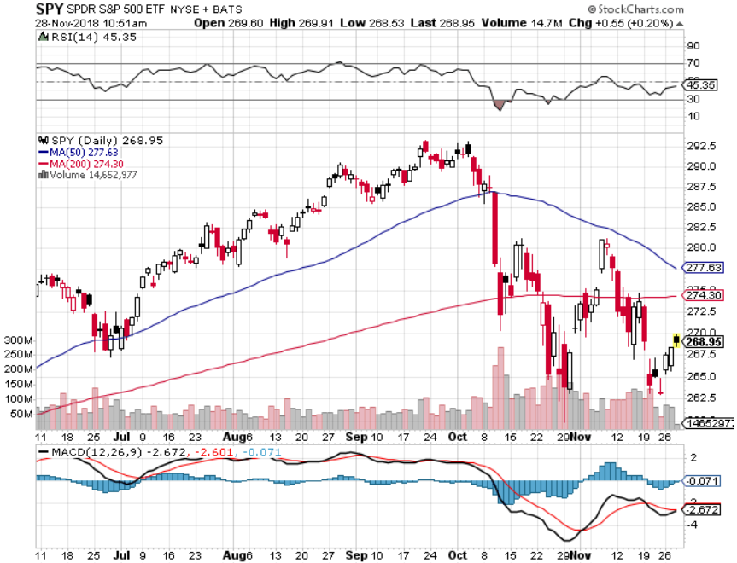
S&P 500- took profits on long 11/$250-$260 call spread-expires in 12 trading days

Slide 16
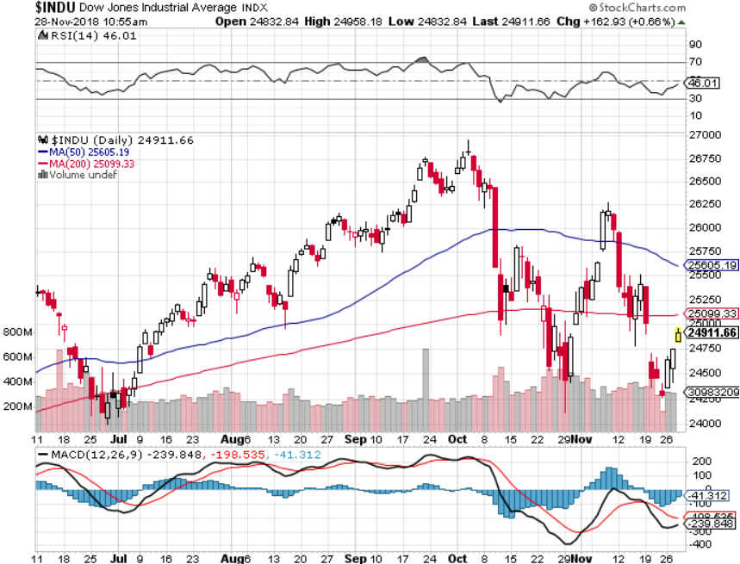
Dow Average-

Slide 17
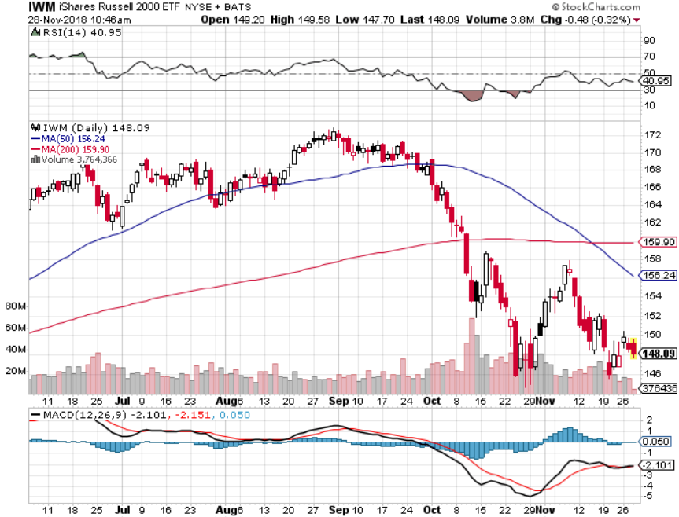
Russell 2000 (IWM)- took profits on long 11/$135-$140 call spread - expires in 12 trading days

Slide 18
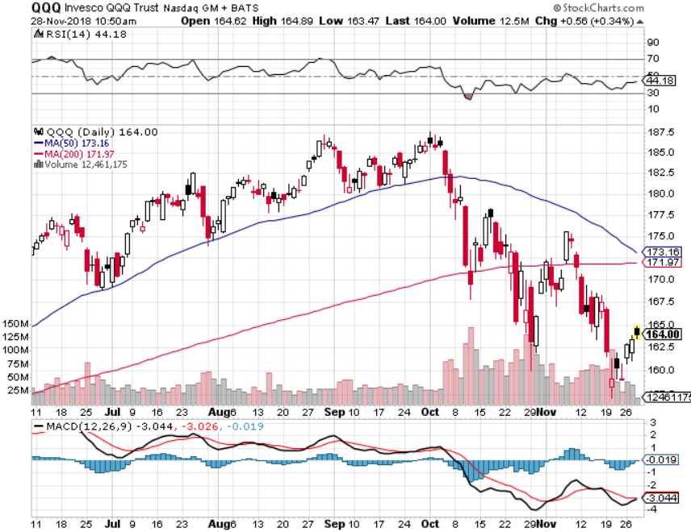
NASDAQ (QQQ)

Slide 19
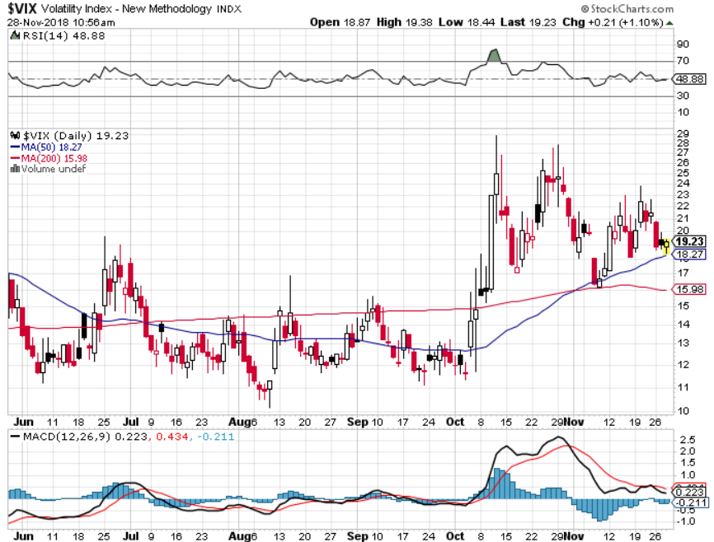
(VIX)- Levitating at a High Level

Slide 20
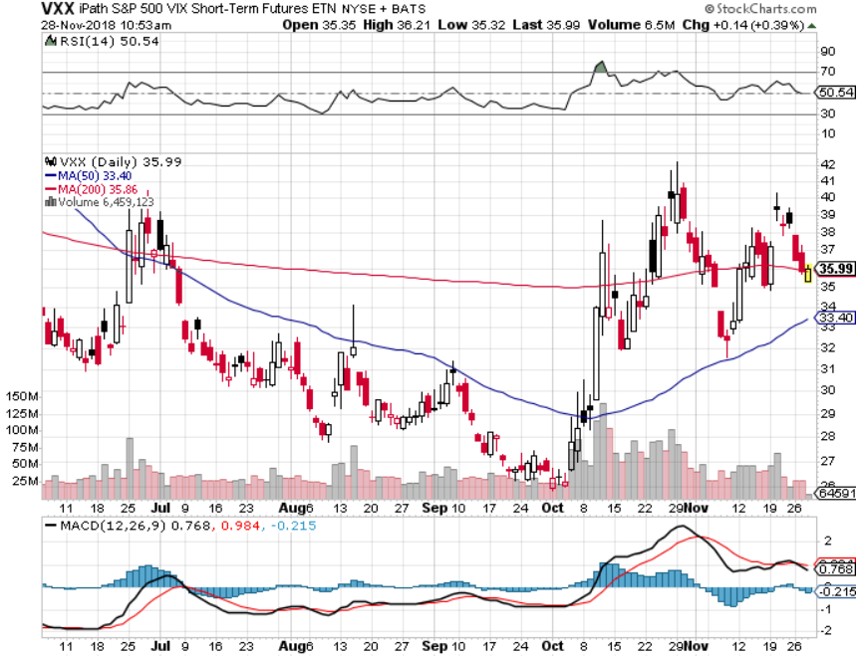
iPath S&P 500 VIX Short-Term Futures ETN (VXX) took profits on long 1/$40 calls took profits on long 3/$60-$65 bear put spread took profits on long 3/$55-$60 bear put spread long 1/$20 puts outright

Slide 21
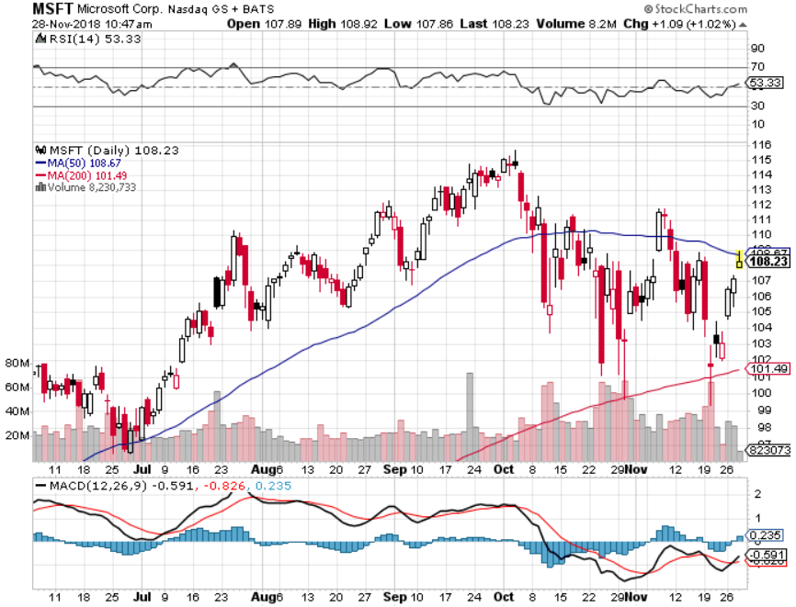
Microsoft (MSFT)- Earnings beat took profits on long 11/$90-$95 call spread

Slide 22
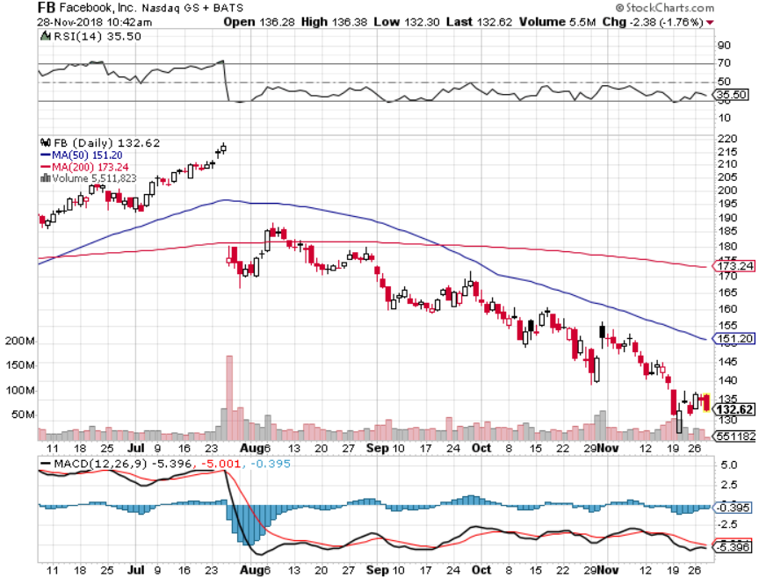
Facebook (FB)- Earnings beat stopped out of long 4/$150-$160 call spread took profits on long 6/$130-$140 bull call spread took profits on long 3/$155-$165 bull call spread took profits on long 3/$190-$195 bear put spread

Slide 23
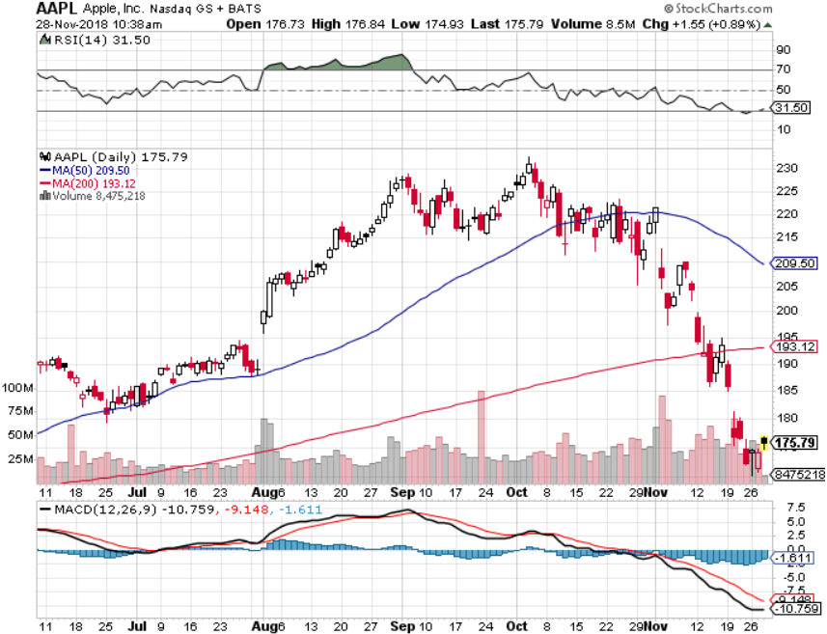
Apple (AAPL)- long 12/$160-$170 call spread took profits on long 11/$180-$190 call spread

Slide 24
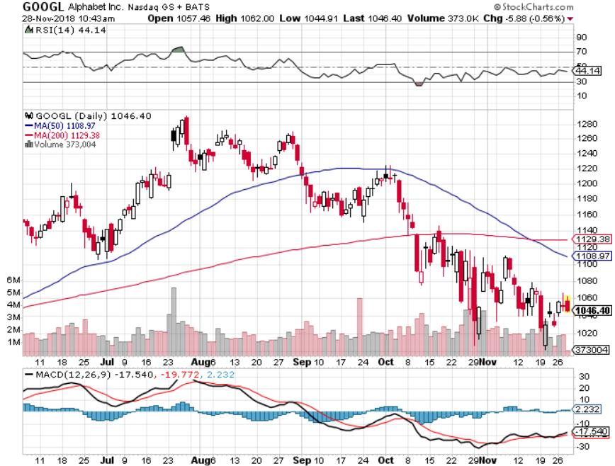
Alphabet (GOOGL)-

Slide 25
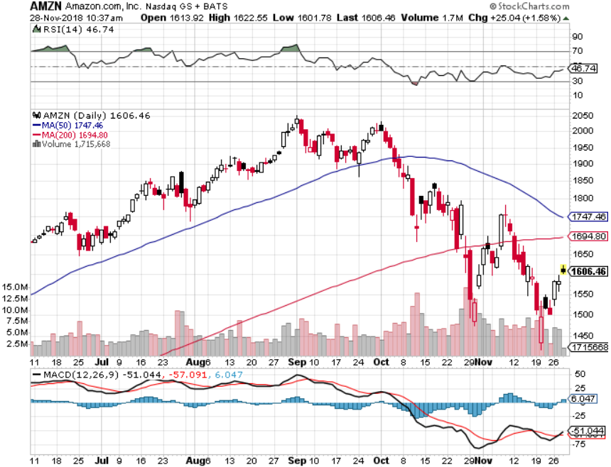
Amazon (AMZN)-Screaming BUY no China business stopped out of long 11/$1,550-$1,600 call spread took profits on long 11/$1,500-$1,400 call spread stopped out of long 11/$1,450- $1,500 call spread

Slide 26
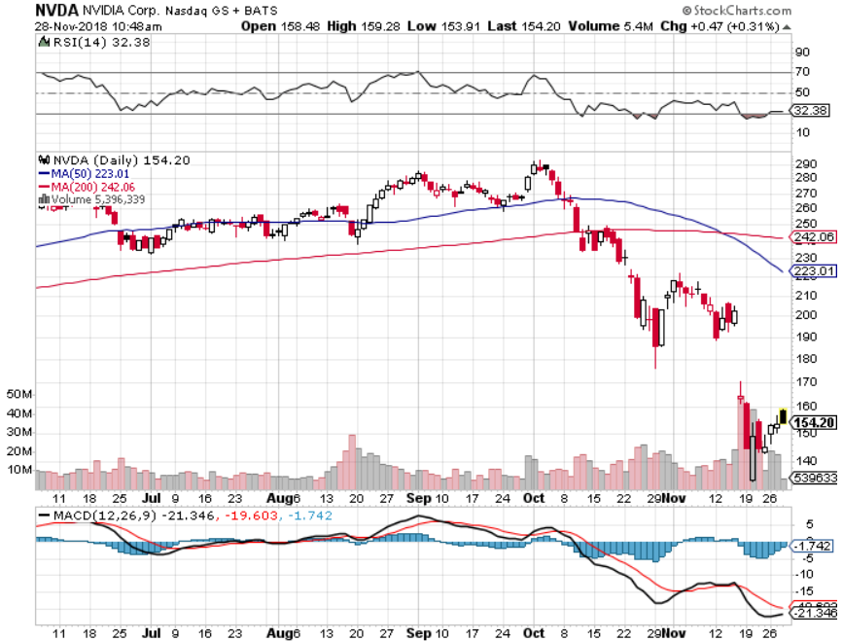
NVIDIA (NVDA)- stopped out of long 12/$130-$140 call spread

Slide 27
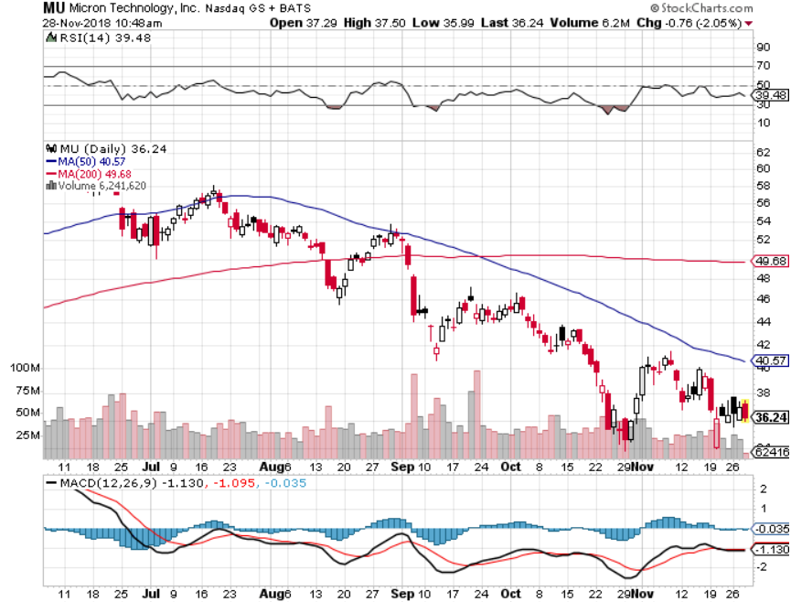
Micron Technology (MU)-Trade Wars

Slide 28
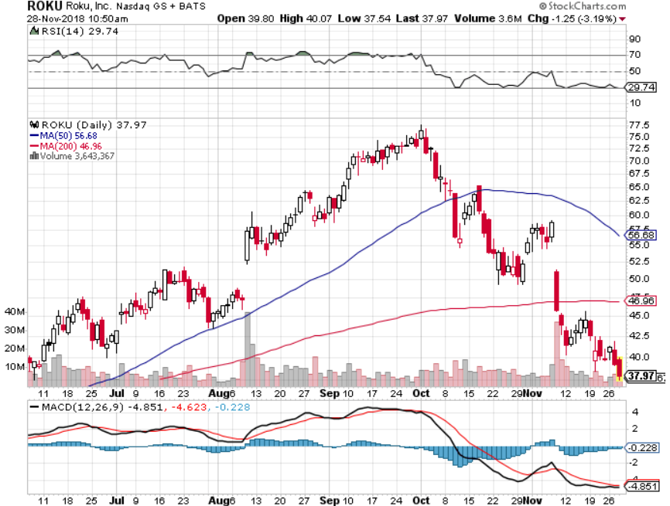
Roku (ROKU)-Apple Enters Their Space took profits on long 11/$40-$45 call spread (TECH LETTER ONLY) long 12/$30-$35 call spread

Slide 29
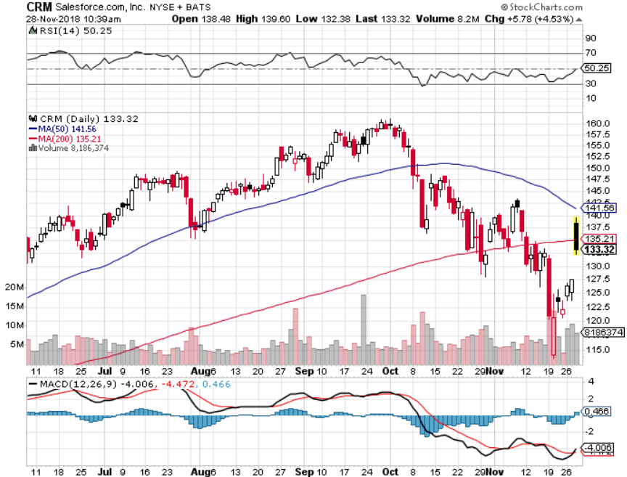
Salesforce (CRM)-Great Earnings-New Highs long 11/$105-$110 call spread took profits on long 11/$120-$125 call spread (TECH LETTER ONLY)

Slide 30
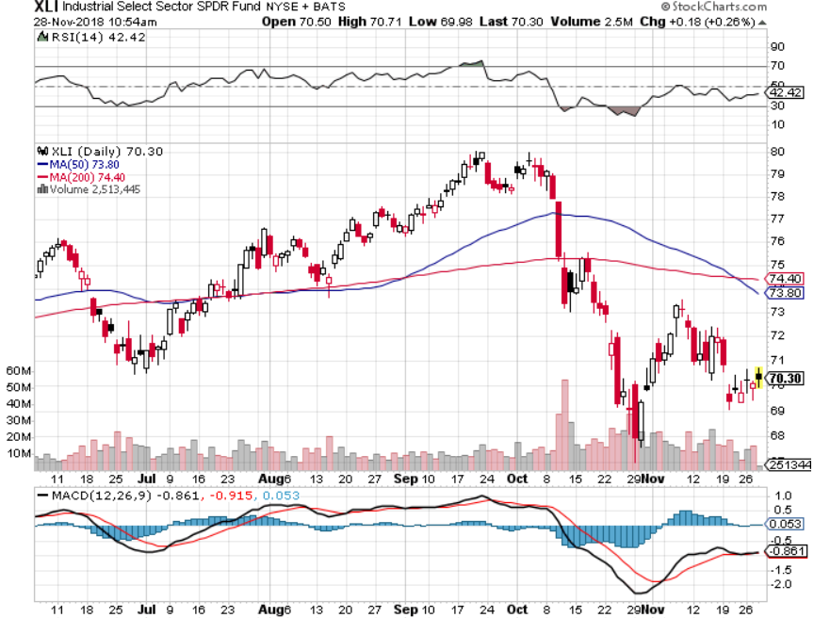
Industrials Sector SPDR (XLI)-No Support
(GE), (MMM), (UNP), (UTX), (BA), (HON)

Slide 31
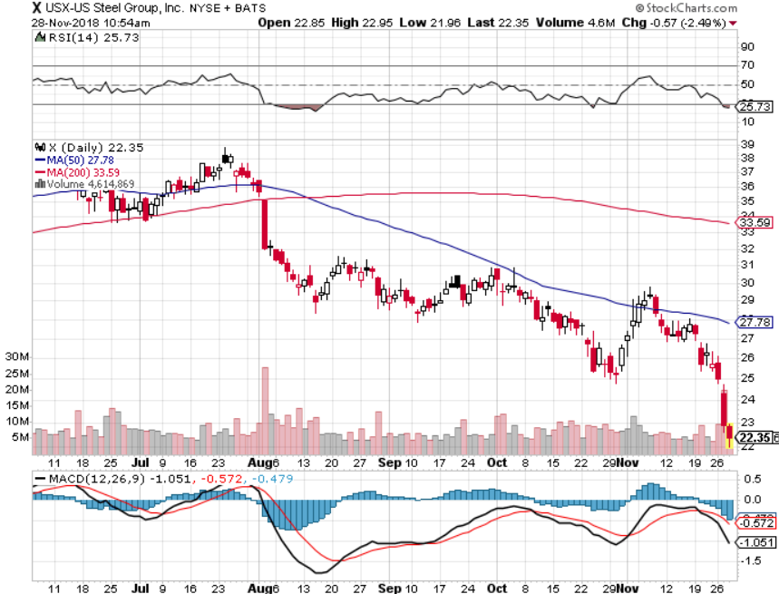
US Steel (X)-Tariffs Trouble
Import duties cause users to abandon steel
Unwound the entire Trump trade

Slide 32
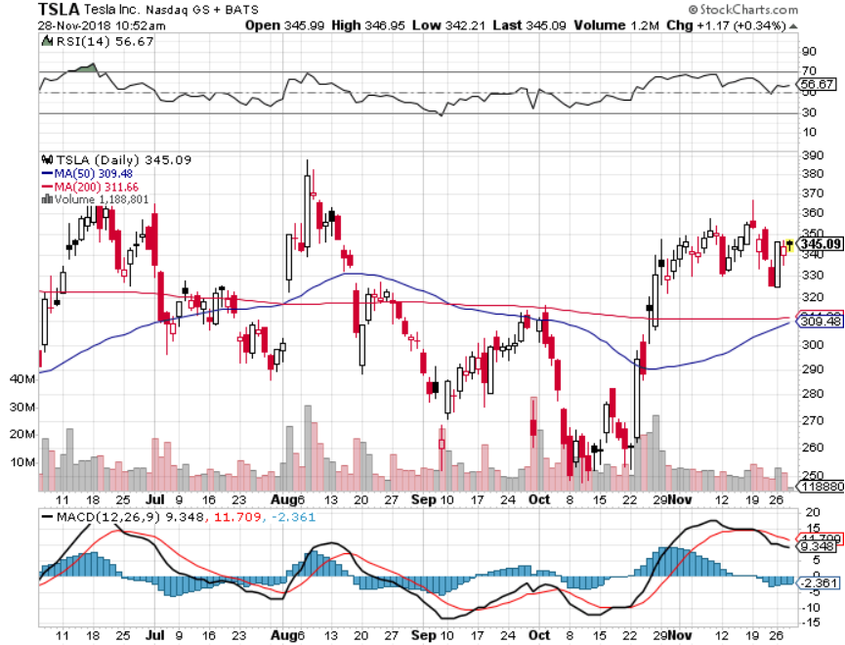
Tesla (TSLA)-
Rising share price on successful Tesla 3 deliveries largest outside shareholder says they want more stock long 12/$400-$430 bear put spread

Slide 33
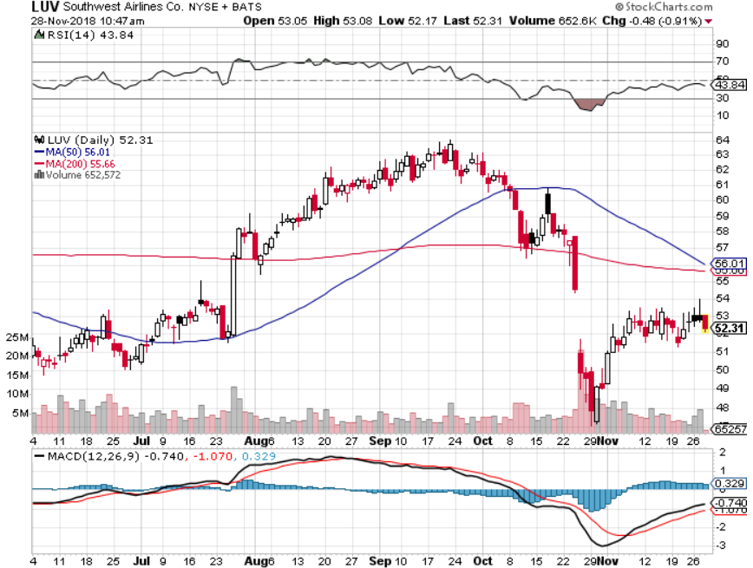
Southwest Airlines (LUV)-No oil help
Warren Buffett’s Favorite Airline

Slide 34
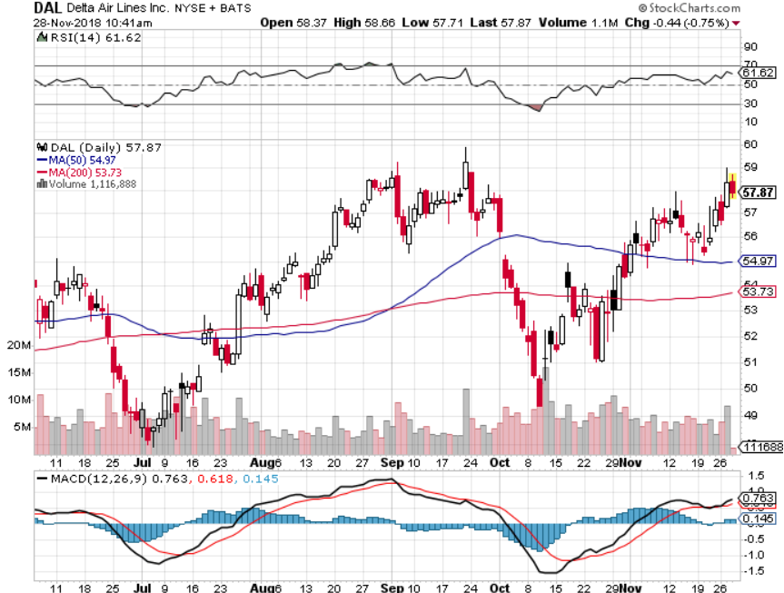
Delta Airlines (DAL) took profits on 3/$40-$45 call spread

Slide 35
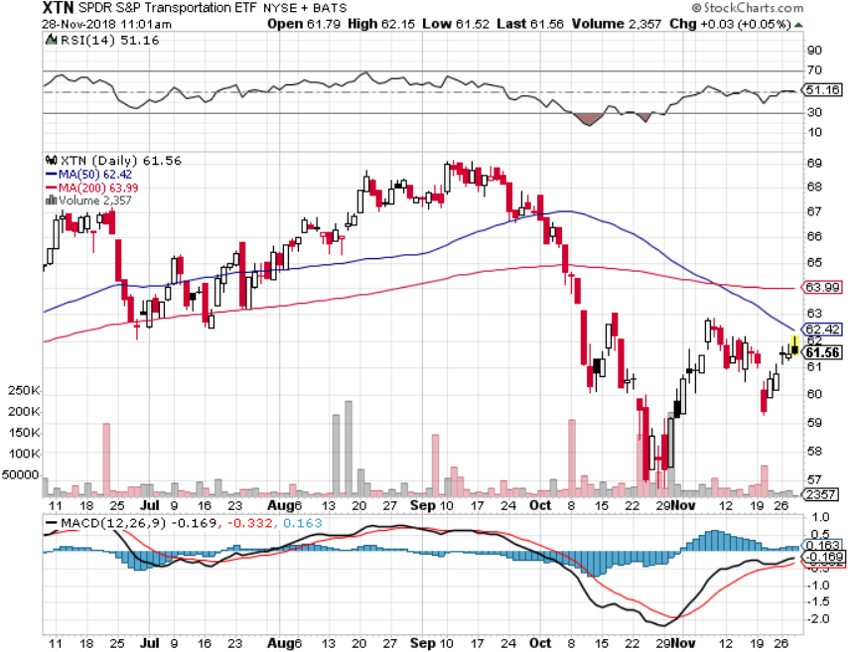
Transports Sector SPDR (XTN)-
(ALGT), (ALK), (JBLU), (LUV), (CHRW), (DAL)

Slide 36
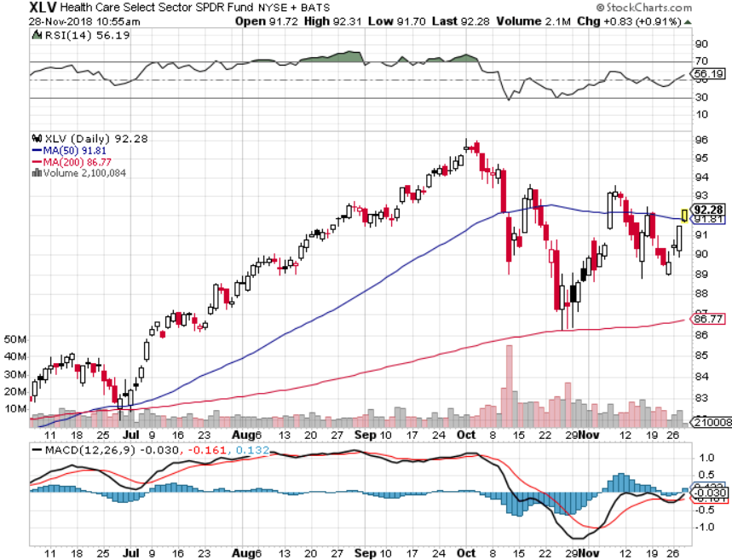
Health Care Sector (XLV), (RXL)-New Highs
(JNJ), (PFE), (MRK), (GILD), (ACT), (AMGN)

Slide 37
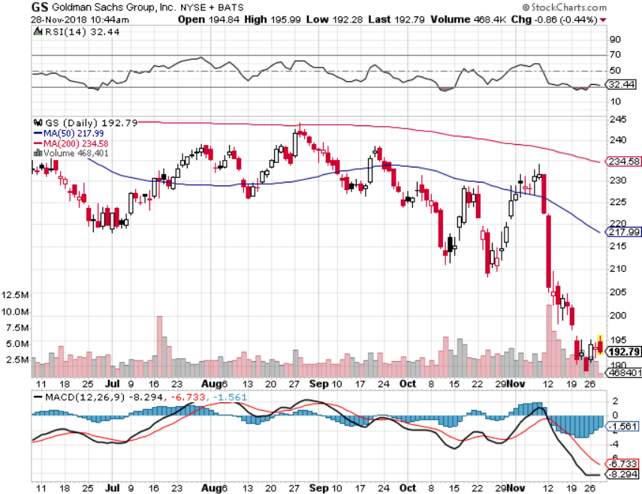
Goldman Sachs (GS)-The Next Buggy Whip maker stopped out of long 4/240-$245 call spread stopped out of long 10/$220-$225 vertical bull call spread took profits on long 10/$227.50-$232.50 vertical bull call spread

Slide 38
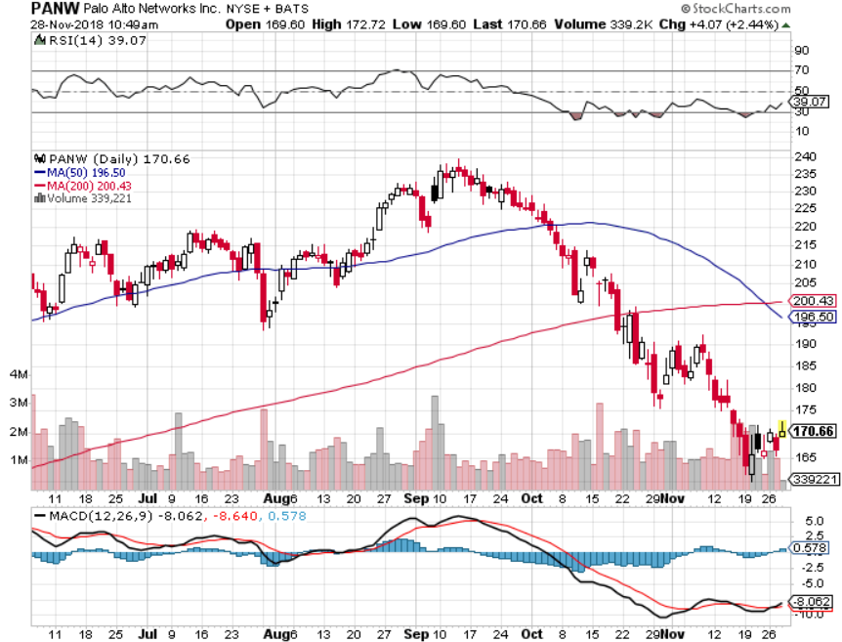
Palo Alto Networks (PANW)-
Hacking never goes out of fashion

Slide 39
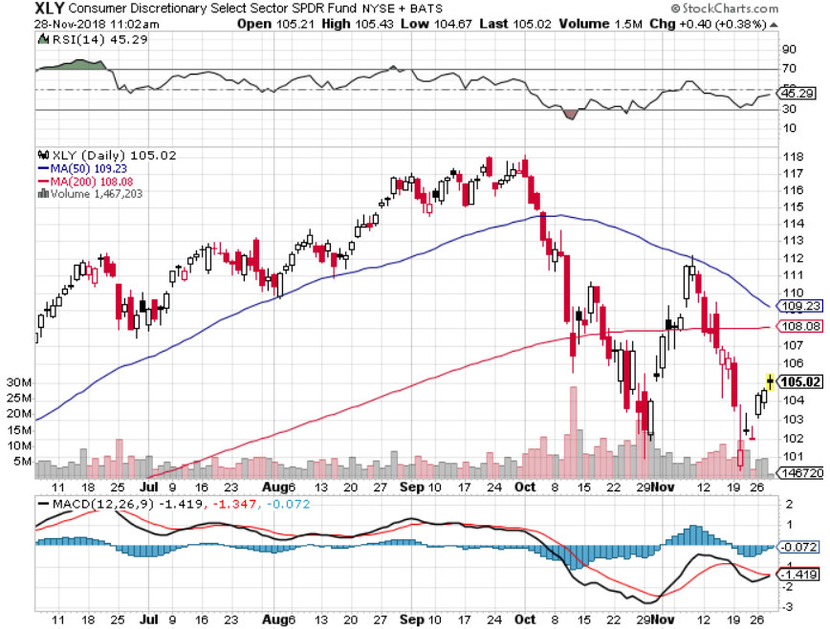
Consumer Discretionary SPDR (XLY)
(DIS), (AMZN), (HD), (CMCSA), (MCD), (SBUX)

Slide 40
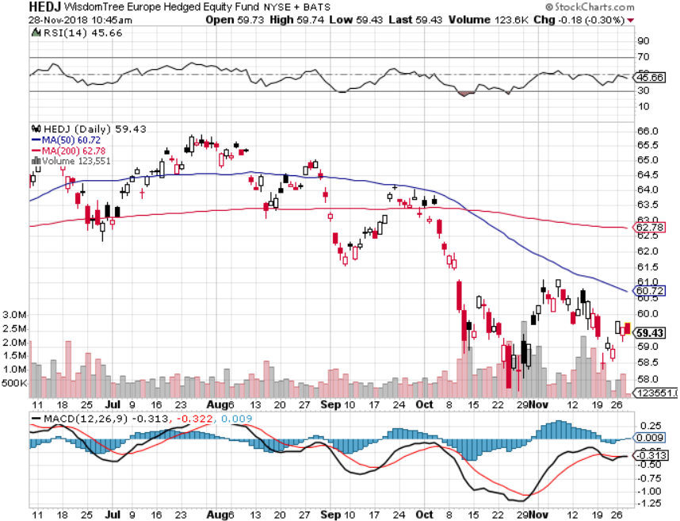
Europe Hedged Equity (HEDJ)-Quadruple top Top

Slide 41
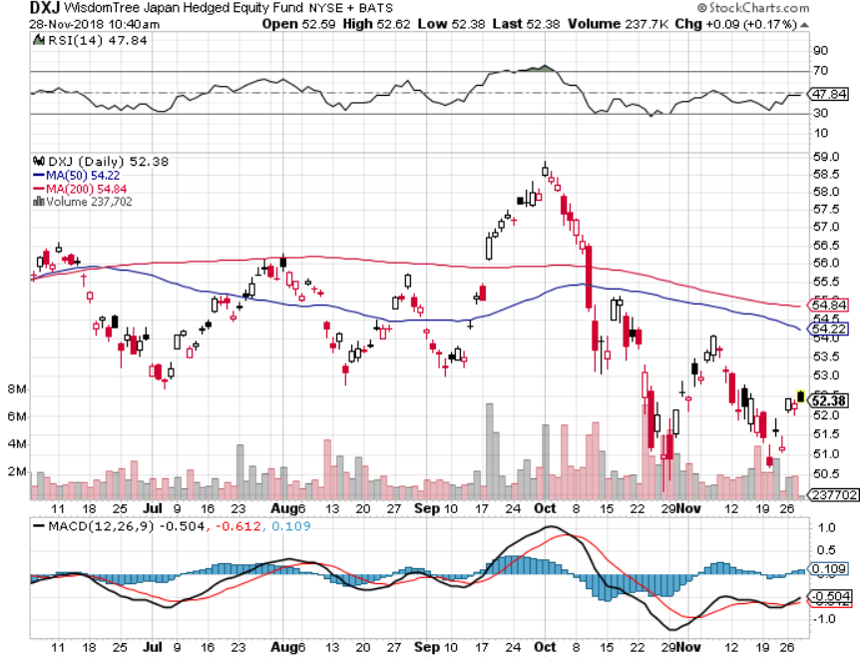
Japan (DXJ)-

Slide 42
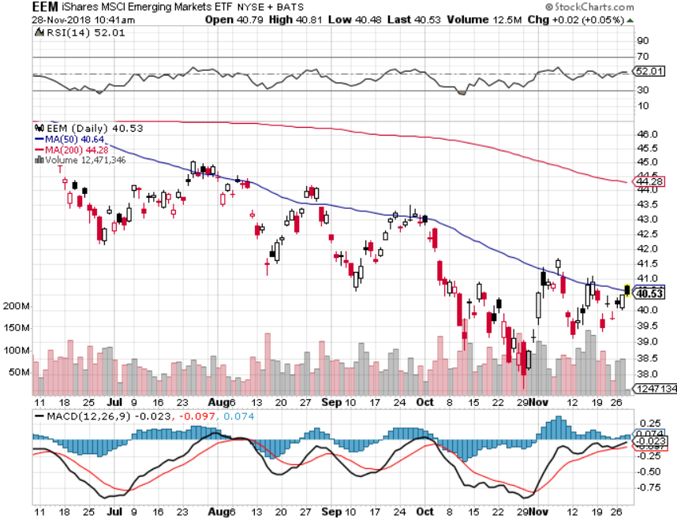
Emerging Markets (EEM)- Killed by Strong Dollar

Slide 43
Bonds-Dead Can Bounce
*Huge global “RISK OFF” creates flight to safety bid that takes yields down 18 basis points to a 3.04% low
*Three More Fed Rate Hikes In 2019, after a coming December hike, which will take overnight rates up to 3.00-3.25%.
*Interest Payments to Become the Largest Government Expense Within a Decade, at $900 billion far outpacing the defense budget by 2028
*Still looking for 3.25% ten year US Treasury
yield by yearend, and 4% in a year
*Exploding deficits will weigh on
bonds for the next decade, sell every
rally across the space, up 100%
IN TWO YEARS!
Bottom Line: Sell every four point
rally in the (TLT)

Slide 44
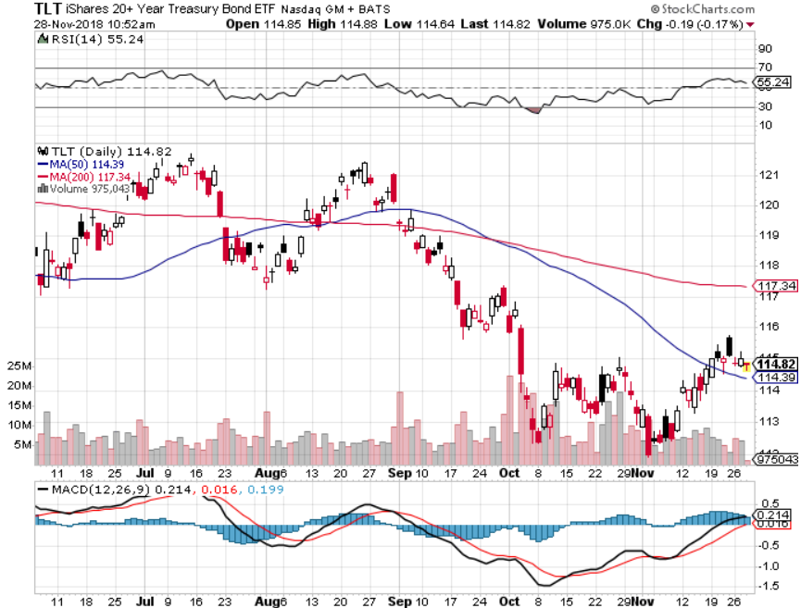
Treasury ETF (TLT) – Bottom of Range took profits on long (TLT) 10/$114-117 call spread took profits on long (TLT) 9/$123-$126 put spread took profits on long 11/$116-$119 call spread took profits on long 11/$117-$120 call spread long 12/$116-$119 call spread long 12/$117-$120 call spread

Slide 45
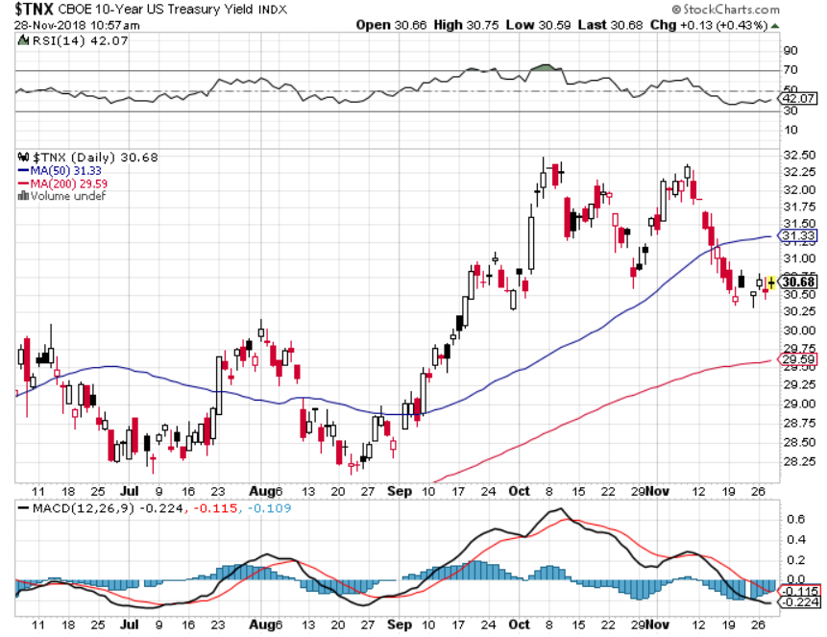
Ten Year Treasury Yield ($TNX) 3.05%
Breakdown, Now major Support

Slide 46
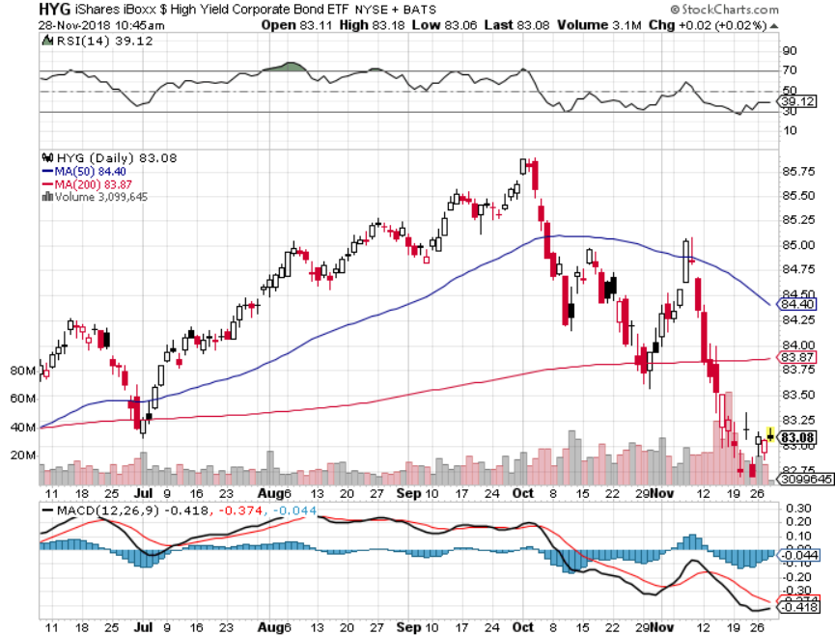
Junk Bonds (HYG) 5.96% Yield

Slide 47
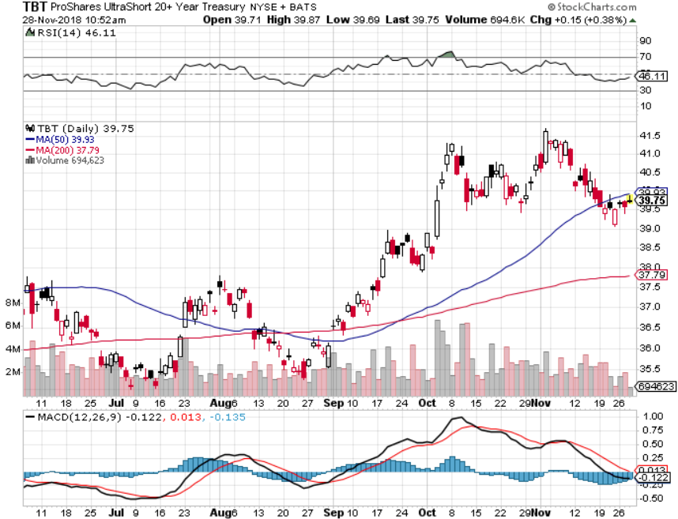
2X Short Treasuries (TBT)-Buy Territory

Slide 48
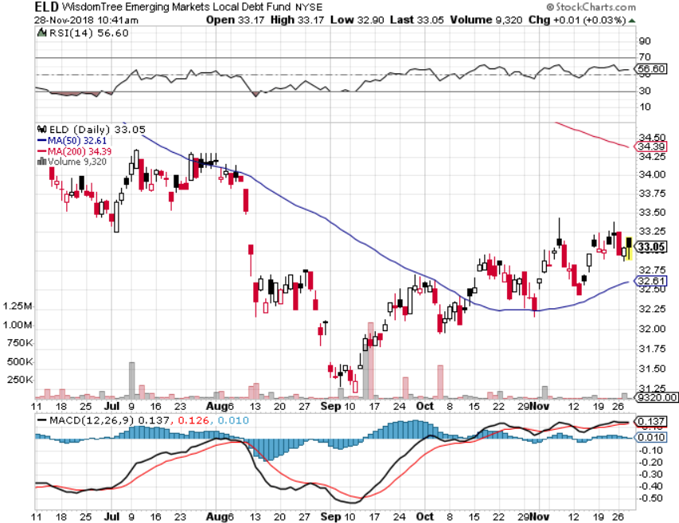
Emerging Market Debt (ELD) 6.07% Yield-

Slide 49
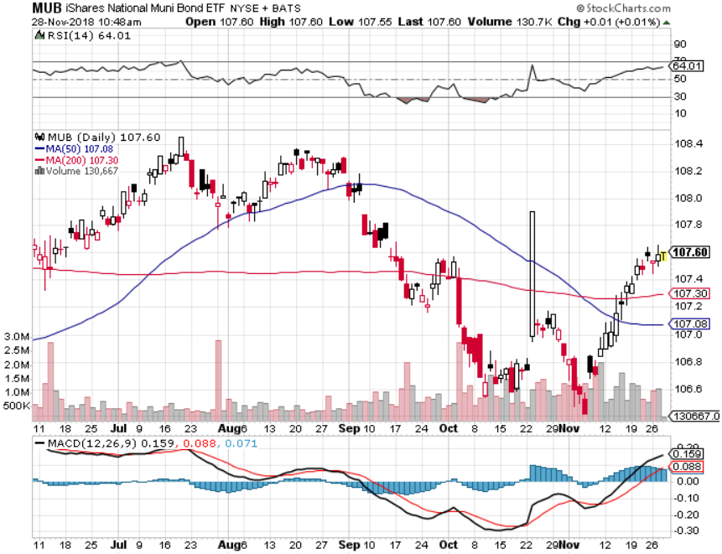
Municipal Bonds (MUB)-2.83%
Mix of AAA, AA, and A rated bonds

Slide 50
Foreign Currencies – New Dollar Life
*Rising rates still boosting the US dollar
*Euro (FXE) gets crushed on weakening economy
*Chinese Yuan sitting at 10 year low
*In the meantime, Fed is committed to another year of rate rises, guaranteeing further dollar strength
*Bitcoin crashes to $3,500, down 82.5% in a year,
the Ponzi Scheme collapses
*Bottom Line: stand aside

Slide 51
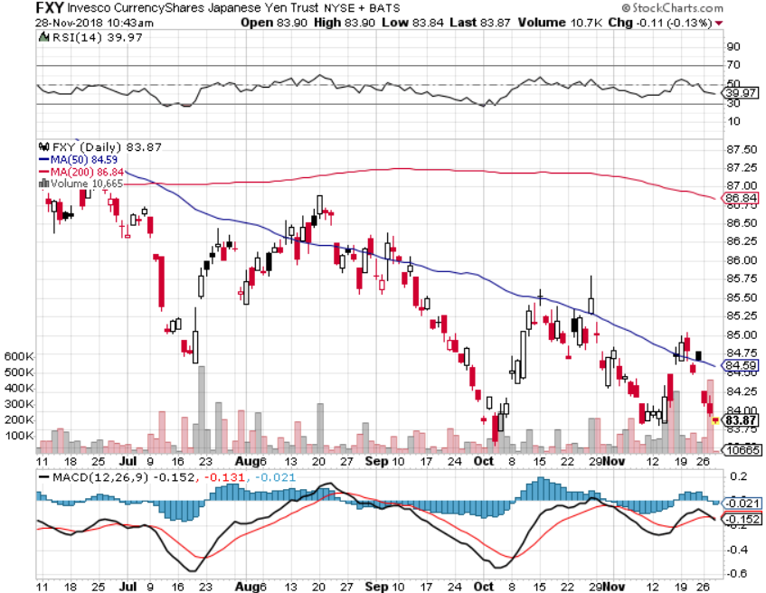
Japanese Yen (FXY), (YCS) took profits on long (FXY) 3/$91-$93 bear put spread

Slide 52
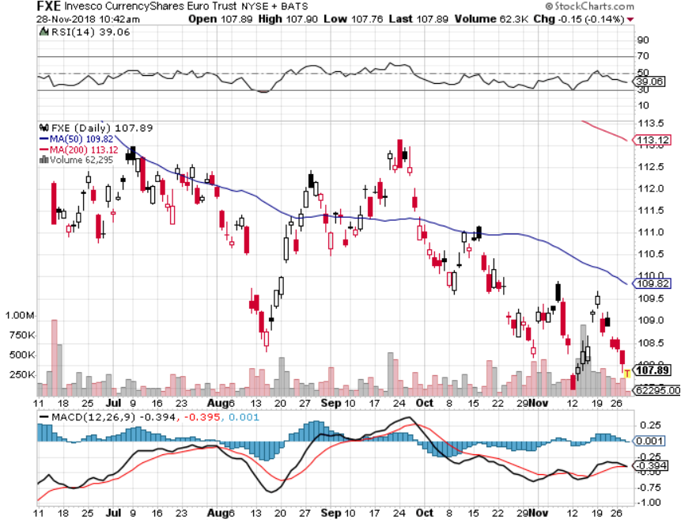
Euro ($XEU), (FXE), (EUO)- Trying to Break Down

Slide 53
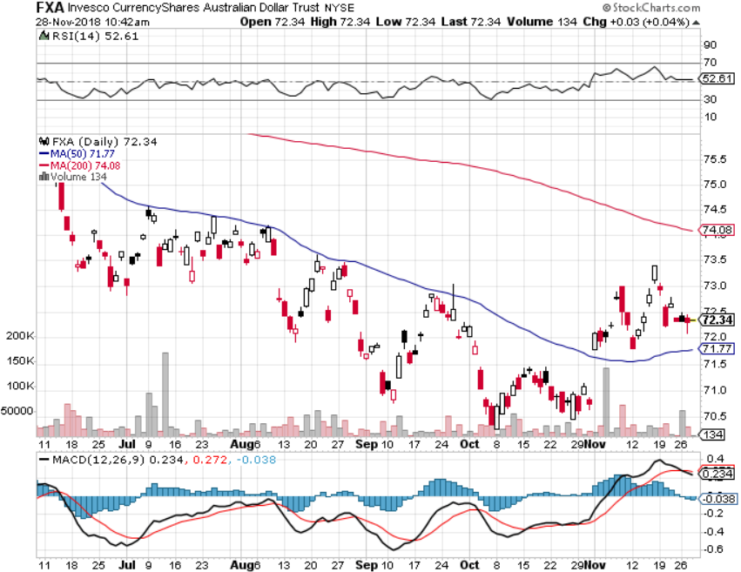
Australian Dollar (FXA)-Trade war China drag

Slide 54
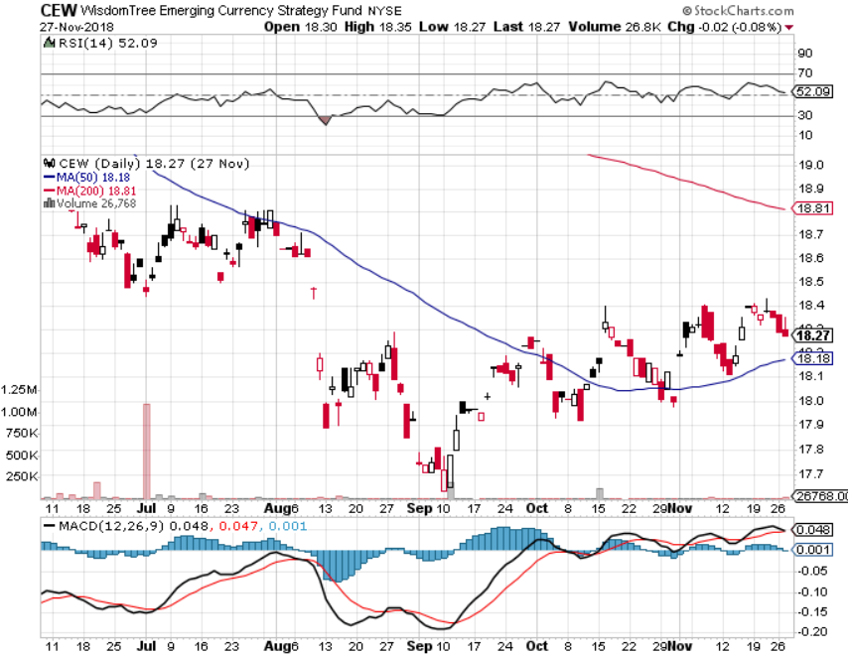
Emerging Market Currencies (CEW)

Slide 55
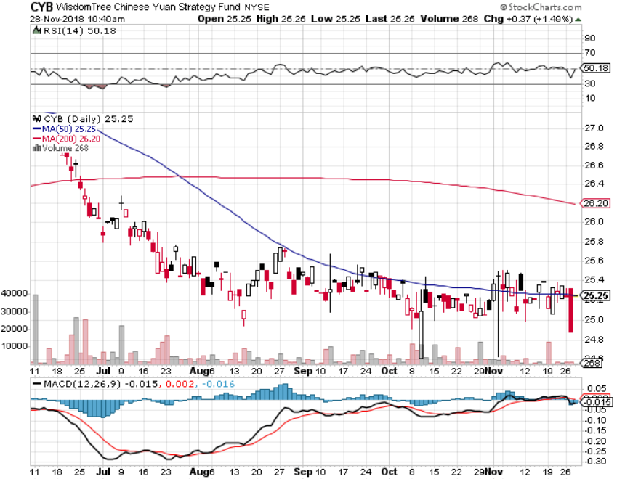
Chinese Yuan- (CYB)-Trade War Tonic

Slide 56
Energy – Crash!
*Oil gets crushed on recession fears, down 35% in 7 weeks
*Iran ended up selling its oil to China so no global shortage
*Khashoggi killing ties Saudi Arabia’s hands, keeping them in over production, and cutting their oil revenues by %95 billion
*US still infrastructure constrained on production expansion
*Copper bouncing along two year lows
*Futures have gone from backwardation
to contango for the first time in a year,
which is hugely price negative
*Bottom Line: stand aside

Slide 57
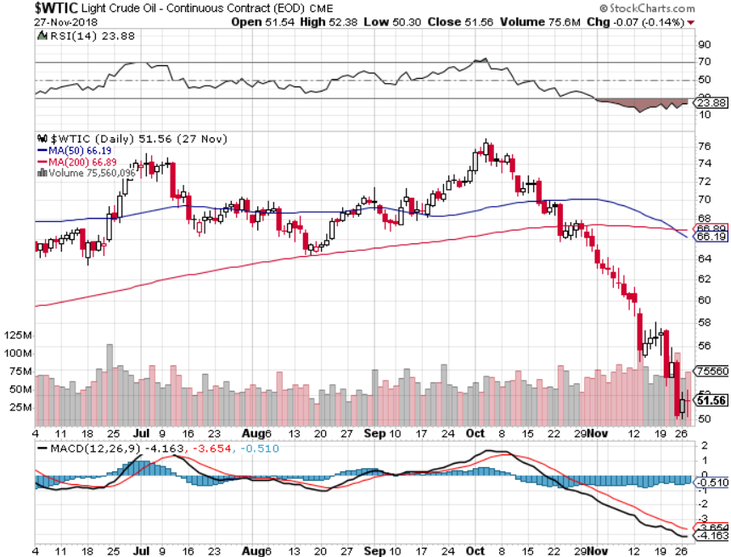
Oil-More Recession Fears

Slide 58
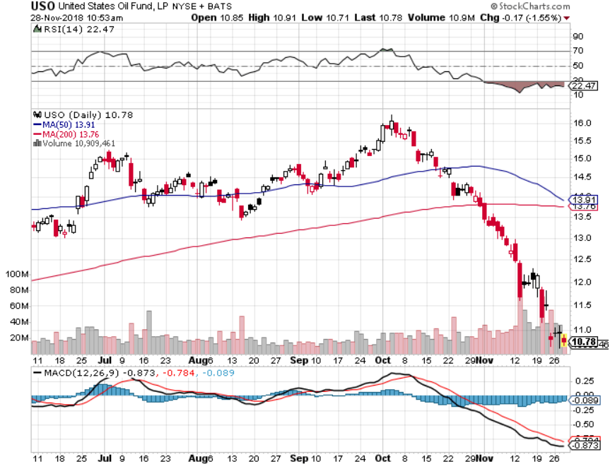
United States Oil Fund (USO)

Slide 59

Energy Select Sector SPDR (XLE)-No Performance!
(XOM), (CVX), (SLB), (KMI), (EOG), (COP)

Slide 60

Halliburton (HAL)-New Low

Slide 61

Natural Gas (UNG)-
Major Hedge Fund Blow Up

Slide 62

Copper (COPX)-One Year Downtrend
Trade War Fears Crush

Slide 63
Precious Metals – Nowheresville
*Gold gets a slight flight to safety bid and then stalls
*Central banks have become the principal buyers of gold in 2018, some 264 metric tonnes, and that is increasing
*Russia and Turkey have been dominating, with Poland joining the fray
*Bottom Line: get ready to buy the
next big dip

Slide 64

Gold (GLD)-No Help from Trade War
Took profits on long 5/$119-$122 bull call spread took profits on long (GLD) $12/$116-$119 bull call spread

Slide 65

Market Vectors Gold Miners ETF- (GDX) – Yikes!
Took profits on long the 9/$20.50-$21.50 bull call spread

Slide 66

Barrick Gold (ABX)

Slide 67

Newmont Mining- (NEM)-

Slide 68

Palladium - (PALL)-

Slide 69
Real Estate –The Recession is On
*October Existing Home Sales up 1.4%, New Home Sales down 8.9% and off 12% YOY, inventories at 9 year high!
*Median Home Price rises 3.8%, slowest gain in a year
*Inventories rise to 4.3 months
*Homebuilder Confidence hits a 5 year low
*S&P 500 Case-Shiller drops to 5.5%,
annual gain, the lowest in a 18 months
*However, 30 year fixed rate loan drop
to 4.70% steepest drop in 5 years off
the back of bond market rally
*Bottom Line: Stand aside

Slide 70

July Corelogic S&P Case Shiller Home Price Index
Las Vegas, Seattle, and San Francisco showing biggest gains

Slide 71

Simon Property Group (SPG)-

Slide 72

US Home Construction Index (ITB)
(DHI), (LEN), (PHM), (TOL), (NVR)

Slide 73

Trade Sheet-
So What Do We Do About All This?
*Stocks-buy dips
*Bonds-sell any and all rallies
*Commodities-stand aside
*Currencies-stand aside
*Precious Metals –buy dips
*Volatility-buy dips to $12
*Real estate-stand aside

Slide 74

Next Strategy Webinar
12:00 EST Wednesday, December 12,
2018 from San Francisco, CA www.madhedgefundtrader.com email me at support@madhedgefundtrader.com
Good Luck and Good Trading!
Notes:
*

