Slide 1

The Mad Hedge Fund Trader
“Searching for a Bottom”
With John Thomas
from Incline Village, NV, December 12, 2018
www.madhedgefundtrader.com
Notes:
*

Slide 2
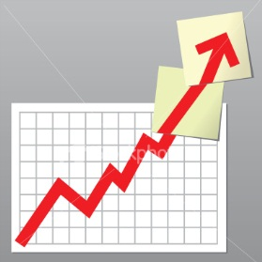
Trade Alert Performance
Today-New All-Time High
Hanging tough and beating the market
*January 4.09% Final *July +0% Final
*February +1.54% Final *August +2.19% MTD
*March +1.13% Final *September 1.38% Final
*April +12.54% Final *October +1.37% Final
*May +1.07% Final *November -1.83% Final
*June +4.15% Final *December -0.02% MTD
*2018 Year to Date 27.73%
compared to -0.6% for the Dow Average
*Trailing One year return +30.17%, +304.20% since inception,
*Average annualized return of 33.87%

Slide 3
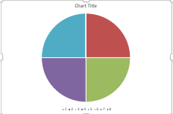
Portfolio Review
50% long stocks, 20% short bonds, 5% short Volatility
aggressive bet the ranch long after a decade correction
Risk On
World is Getting Better
(TLT) 12/$121-$124 bear put spread | 10.00%
(SPY) 12/$240-$250 call spread | 10.00%
(MSFT) 12/$95-$100 call spread | 10.00%
(IWM) 12/$$130-$140 calls spread | 10.00%
Risk Off
(TSLA) 12/$400-$430 put spread | -10.00%
Total Net Position | 30.00%
Expiration P&L
31.42%

Slide 4
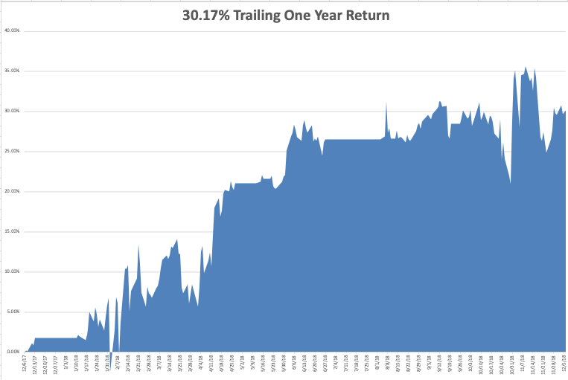
GTD Daily Audited Performance

Slide 5
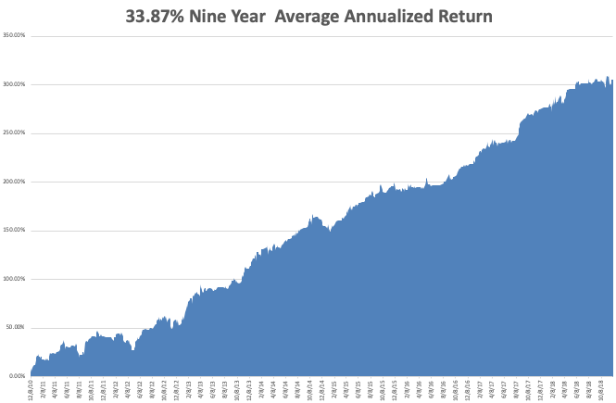
GTD 9 Year Daily Audited Performance

Slide 6

The Method to My Madness
*G-20 disaster weighs heavily on the global economy and on the markets
*Markets remain the most oversold history
*Huge bond market rally acts as a major market stimulus
*Softening Fed rate stance could be capping the US dollar, a major drag on US earnings
*So does the Oil crash, which created a $200 billion stimulus for the US economy
*Washington is emerging as a major threat to
the market after ignoring it for years
*All that said, I still expect the S&P 500
to be up 5% by the end of the year
and there is still good money to be made

Slide 7
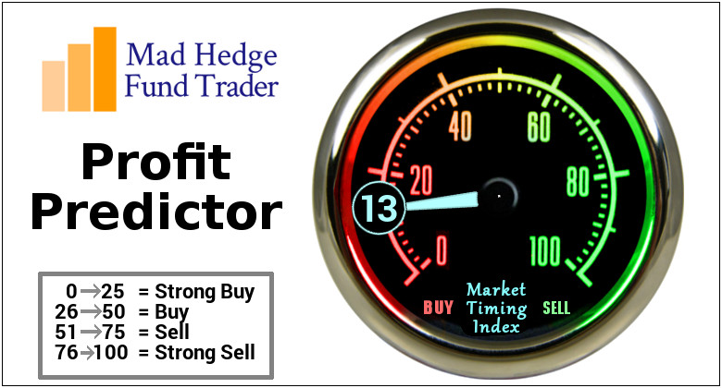
The Mad Hedge Profit Predictor
Market Timing Index-
An artificial intelligence driven algorithm that analyzes 30 different economic, technical, and momentum driven indicators

Slide 8
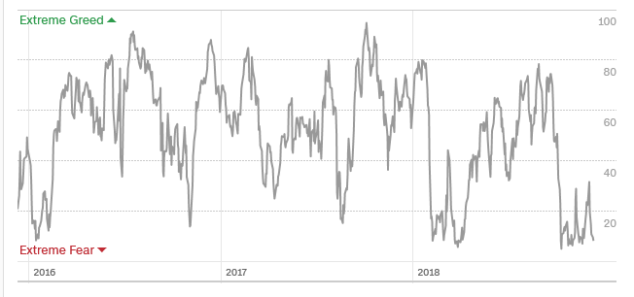
The Mad Hedge Profit Predictor
Best ”BUY” Entry Point in 3 Years
SELL
BUY

Slide 9
The Global Economy –Confusion
*US economic data moving from uniformly strong to mixed, Weekly Jobless Claims hit a six month high
*Two months of weak nonfarm payroll data signals another nail in the bull market’s coffin, but it will take at least another 6 months to bury it
*G-20 disaster weighs heavily on the global economy and on the markets
*Oil price crash is emerging as a major new economic stimulus, but is crushing the energy industry
*Peaking dollar could boost non-dollar plays, like emerging markets (EEM) and the currencies (FXE) and (FXY)
*Europe is in free fall
*Next Fed 25 basis point rate rise
December 19

Slide 10
Soybeans (-20%)-Trade War Indicator
Price Action Suggests that the China Trade Talks are Going Better than people realize

Slide 11
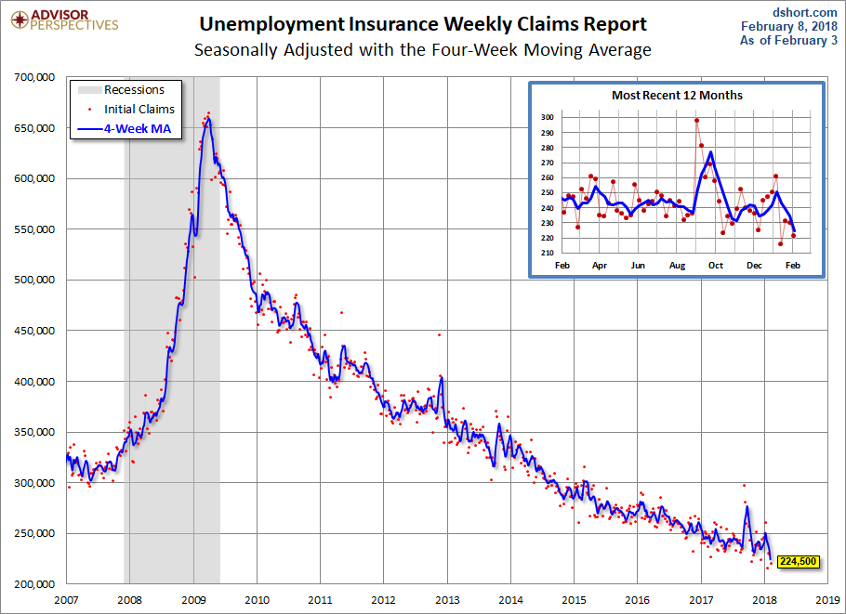
Weekly Jobless Claims –The Most Important Statistic
+10,000 to 234,000, 6 MONTH HIGH

Slide 12
The Bill Davis View
A $1,500 Upgrade for the Mad Day Trader Service
Buys: | Entry | Target
Apple (AAPL) | $ 162.00 | $ 175.00
Exxon Mobil (XOM) | $ 75.00 | $ 81.00
Imax Corp (IMAX) | $ 18.00 | $ 22.00
Elli Mae (ELLI) | $ 61.00 | $ 80.00
Nvidia Corp (NVDA) | $ 156.00 | $ 180.00
Sells:
General Dynamics (GD) | $ 178.00 | $ 166.00
Dollar General (DG) | $ 109.00 | $ 100.00
FedEx Corp (FDX) | $ 210.00 | $ 185.00
Martin Marietta (MLM) | $ 185.00 | $ 172.00
Concho Resources (CXO) | $ 125.00 | $ 110.00

Slide 13
Stocks – Self Doubts
*The tech meltdown continues, now led by Apple, off 30% in ten weeks, which the algorithms are clearly targeting
*50% of S&P 500 stocks now in bear markets at down 20%
*Banks hot new two year lows, giving up the entire Trump bump
*Share Buy Backs are still there, but are getting overwhelmed by algos
*Bear markets never start with zero real interest rates
(3.10% inflation rate – 3.1% ten year Treasury yield = zero)
*Bottom Line: its bet the ranch time on tech longs,
but stay away from those with big China exposure,
like Apple

Slide 14
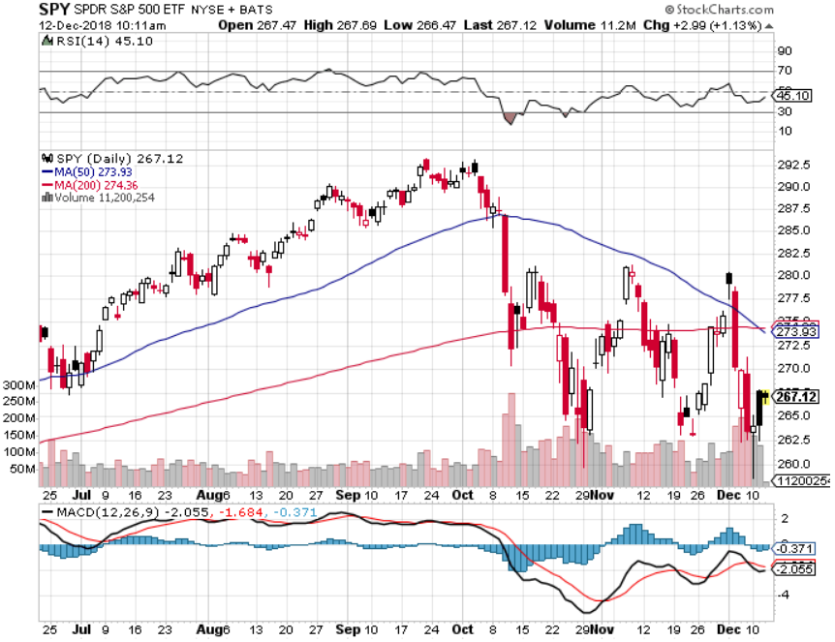
S&P 500- long 12/$250-$260 call spread-expires in 12 trading days took profits on long 11/$250-$260 call spread

Slide 15
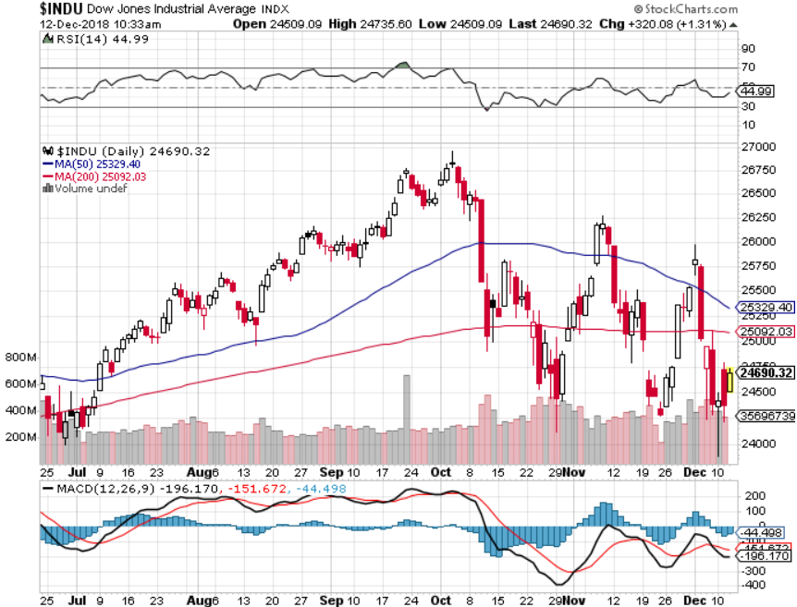
Dow Average-

Slide 16
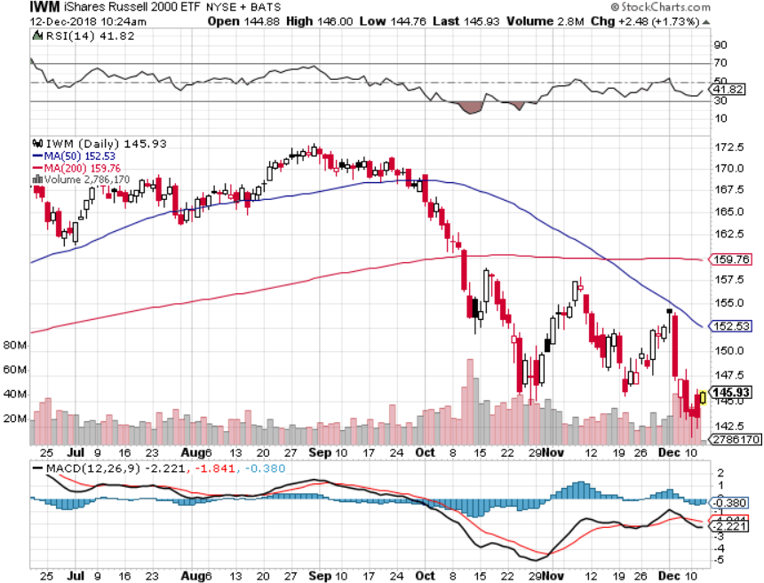
Russell 2000 (IWM)- long 11/$135-$140 call spread - expires in 12 trading days took profits on long 11/$135-$140 call spread

Slide 17
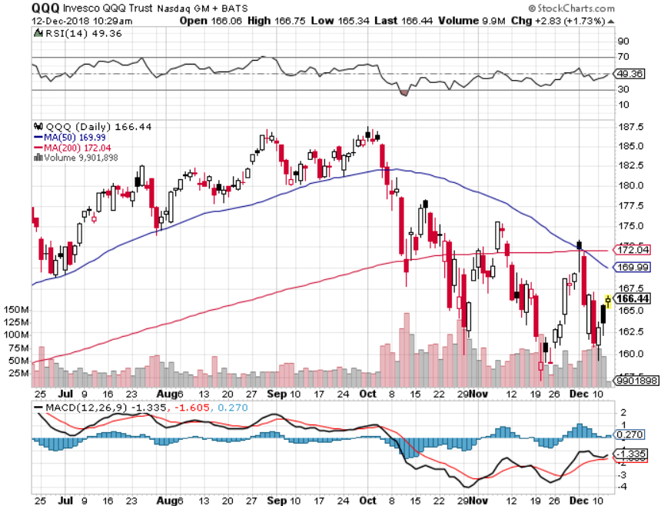
NASDAQ (QQQ)

Slide 18
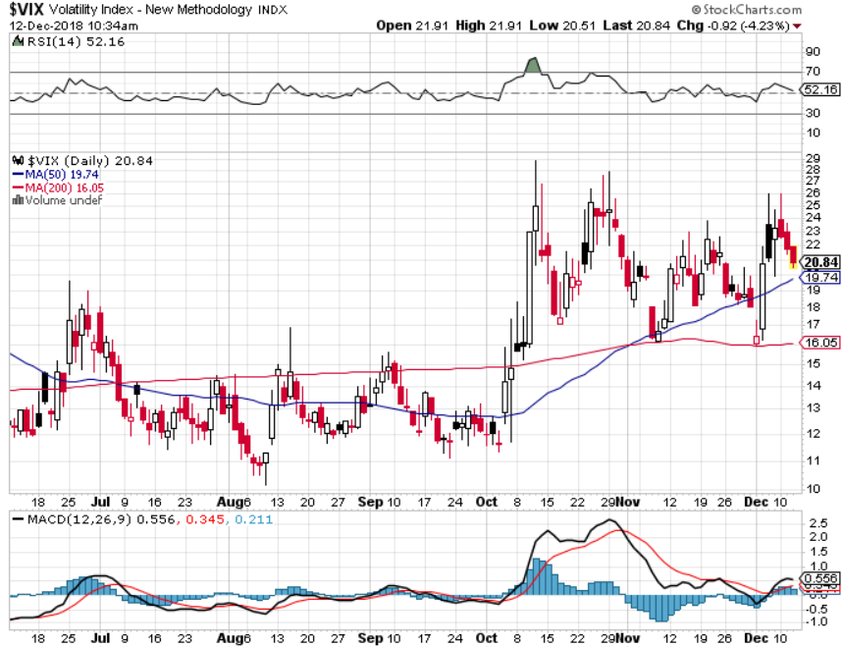
(VIX)- Levitating at a High Level

Slide 19
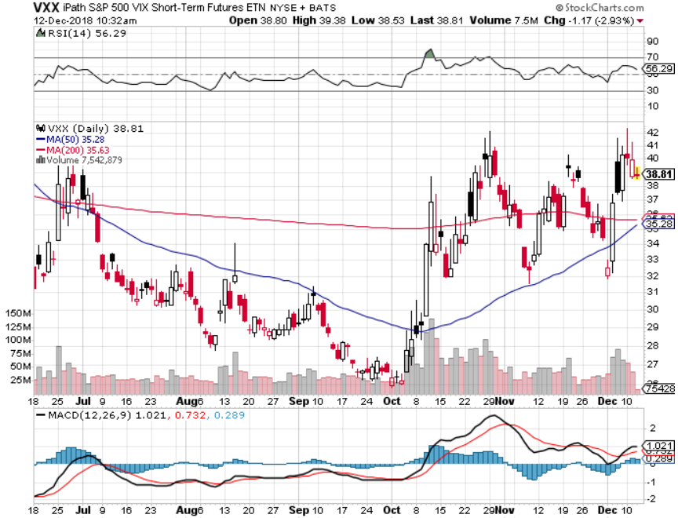
iPath S&P 500 VIX Short-Term Futures ETN (VXX) took profits on long 1/$40 calls took profits on long 3/$60-$65 bear put spread took profits on long 3/$55-$60 bear put spread stopped out of long 1/$20 puts outright

Slide 20
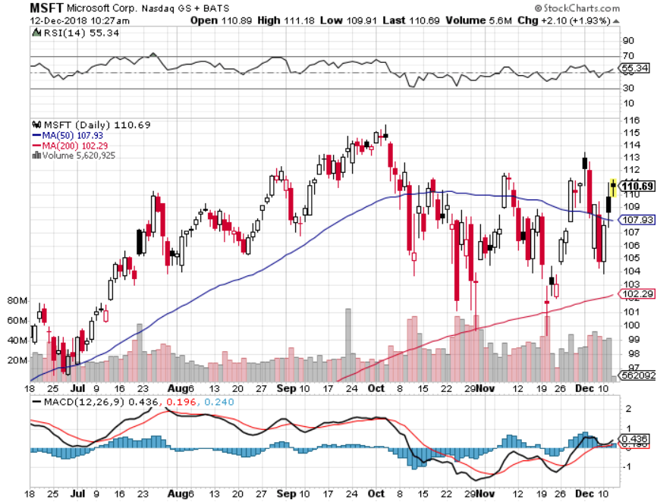
Microsoft (MSFT)- Earnings beat long 12/$95-$100 call spread-expires in 12 days took profits on long 11/$90-$95 call spread

Slide 21
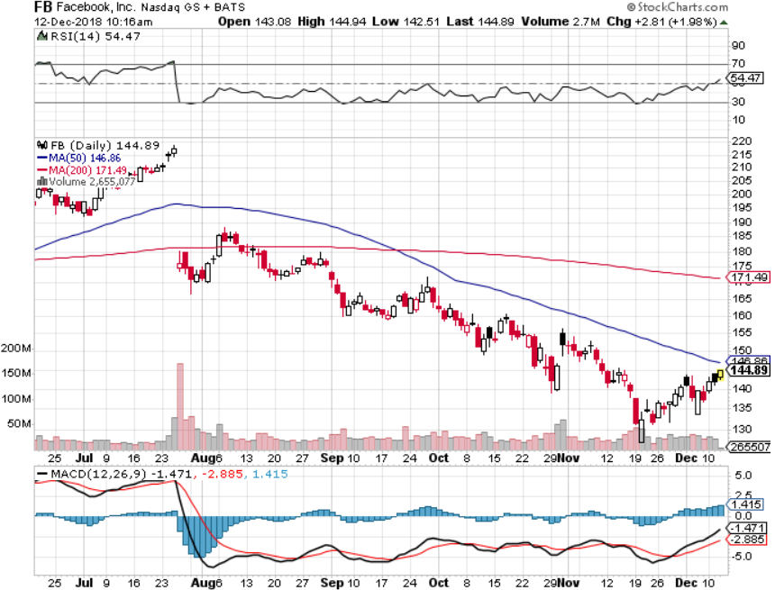
Facebook (FB)- Earnings beat stopped out of long 4/$150-$160 call spread took profits on long 6/$130-$140 bull call spread took profits on long 3/$155-$165 bull call spread took profits on long 3/$190-$195 bear put spread

Slide 22
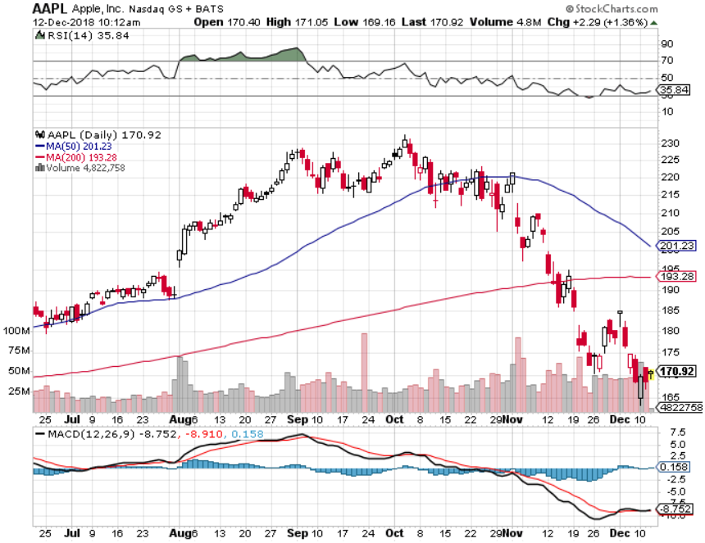
Apple (AAPL)- stopped out of long 12/$160-$170 call spread took profits on long 11/$180-$190 call spread

Slide 23
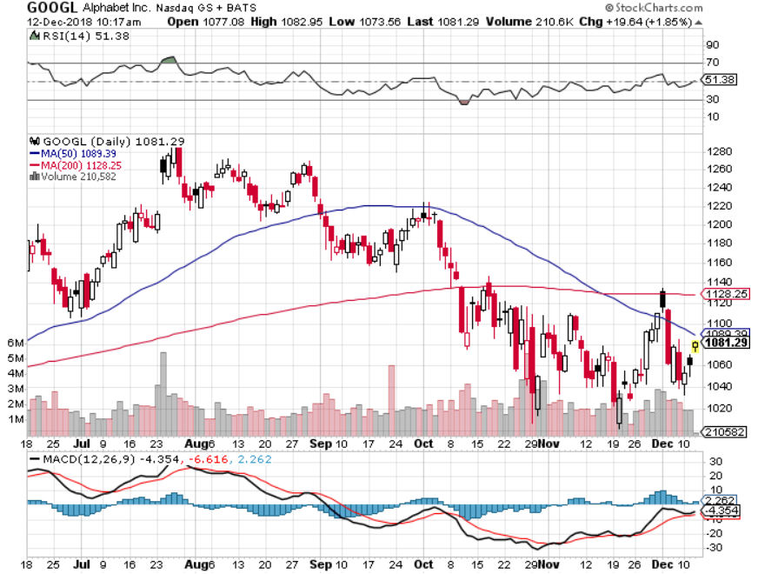
Alphabet (GOOGL)-

Slide 24
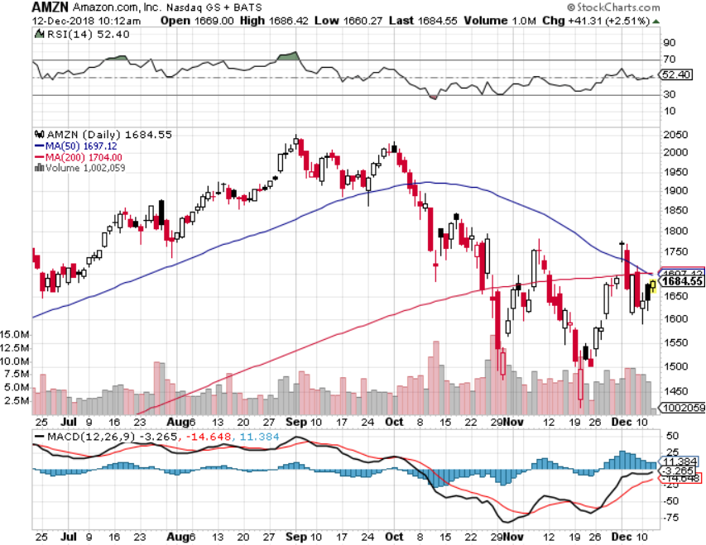
Amazon (AMZN)-Screaming BUY no China business stopped out of long 11/$1,550-$1,600 call spread took profits on long 11/$1,500-$1,400 call spread stopped out of long 11/$1,450- $1,500 call spread

Slide 25
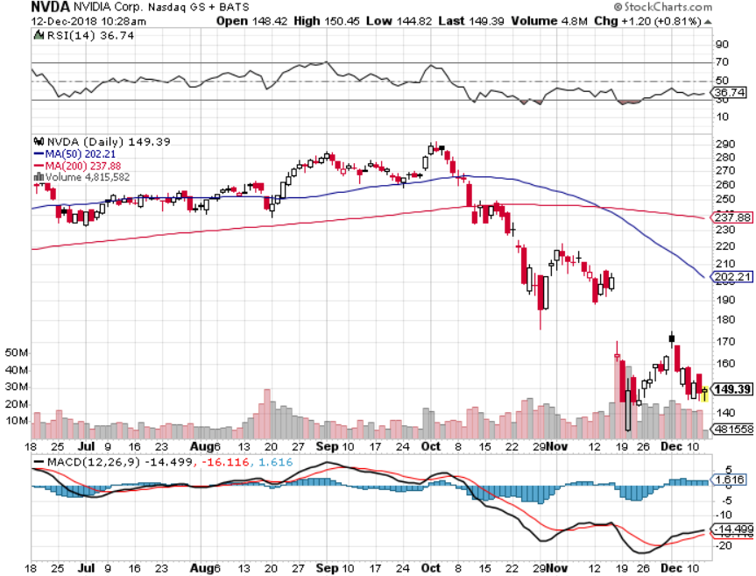
NVIDIA (NVDA)-

Slide 26
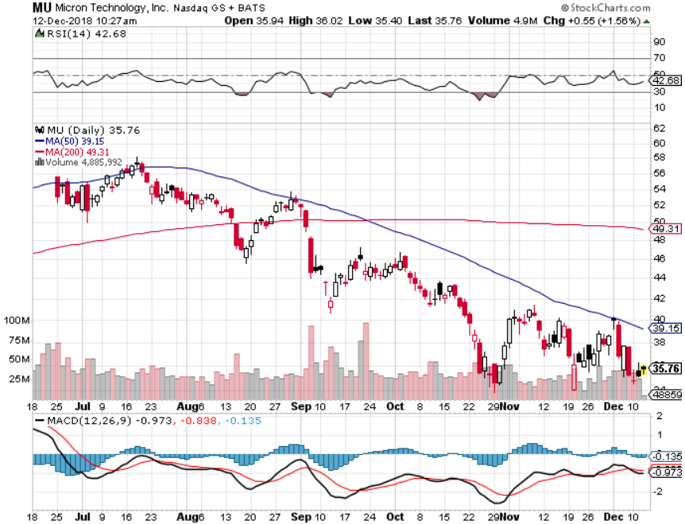
Micron Technology (MU)-Trade Wars

Slide 27
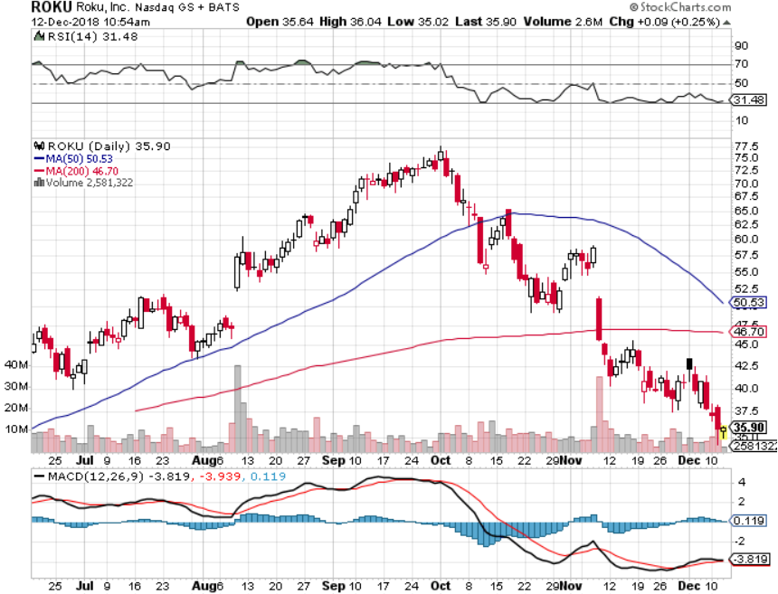
Roku (ROKU)-Apple Enters Their Space took profits on long 11/$40-$45 call spread (TECH LETTER ONLY) long 12/$30-$35 call spread-expires in 12 days

Slide 28
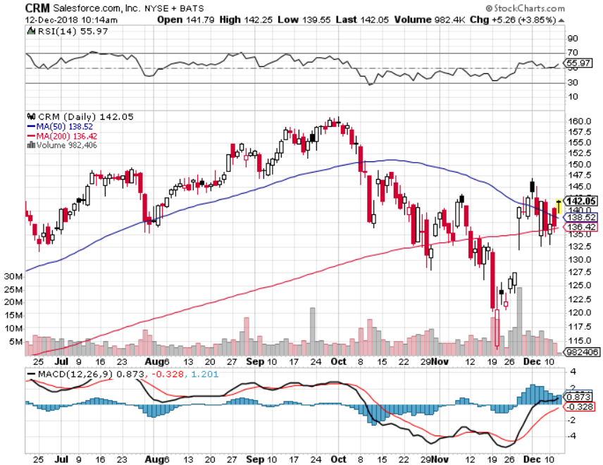
Salesforce (CRM)-Great Earnings-New Highs took profits on long 11/$105-$110 call spread took profits on long 11/$120-$125 call spread (TECH LETTER ONLY)

Slide 29
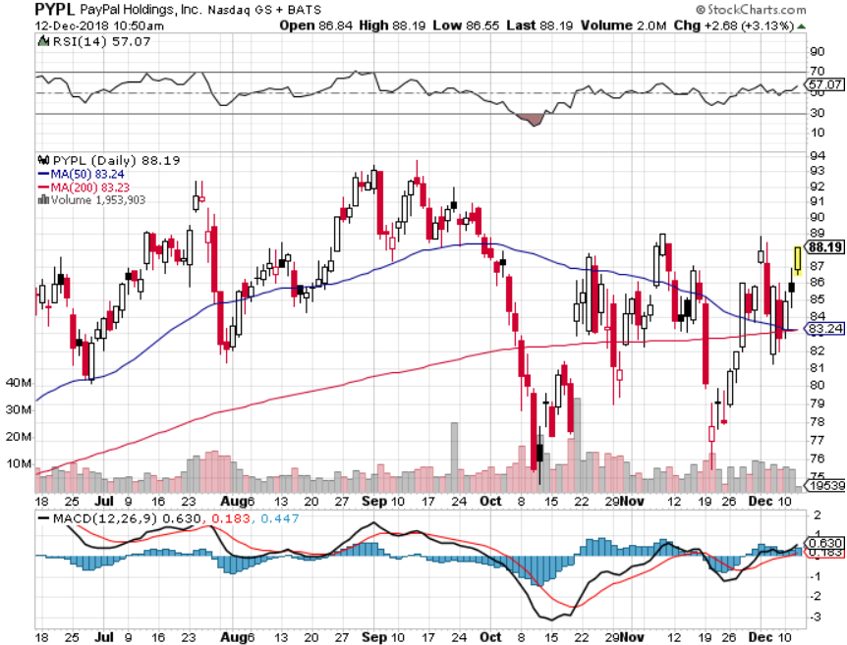
PayPal (PYPL)- long 11/$72-$77 call spread (TECH LETTER ONLY)

Slide 30
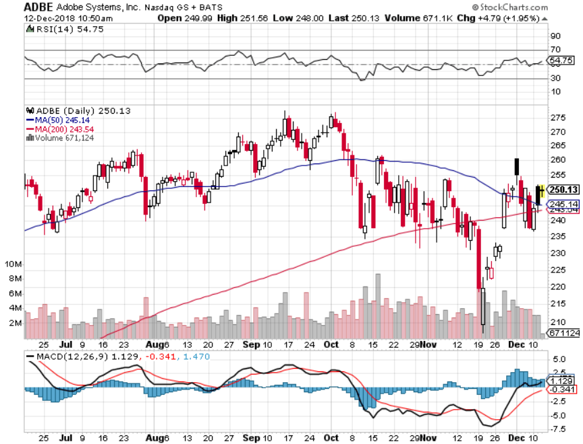
Adobe (ADBE)-
The Quality Non-China tech play

Slide 31
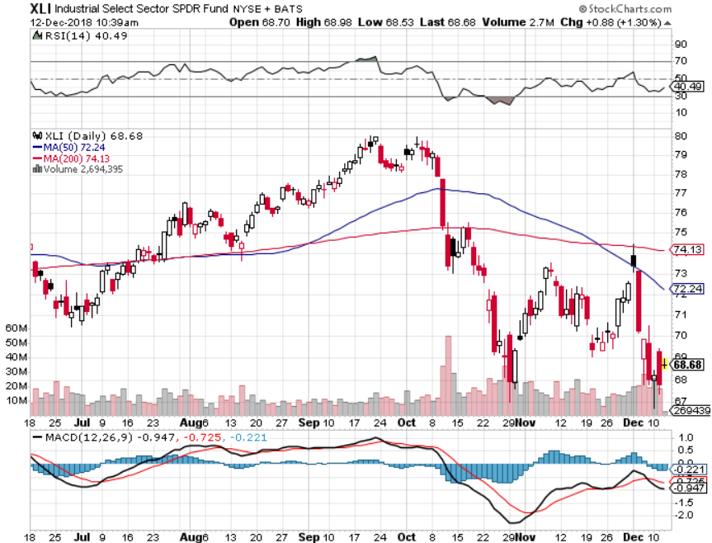
Industrials Sector SPDR (XLI)-No Support
(GE), (MMM), (UNP), (UTX), (BA), (HON)

Slide 32
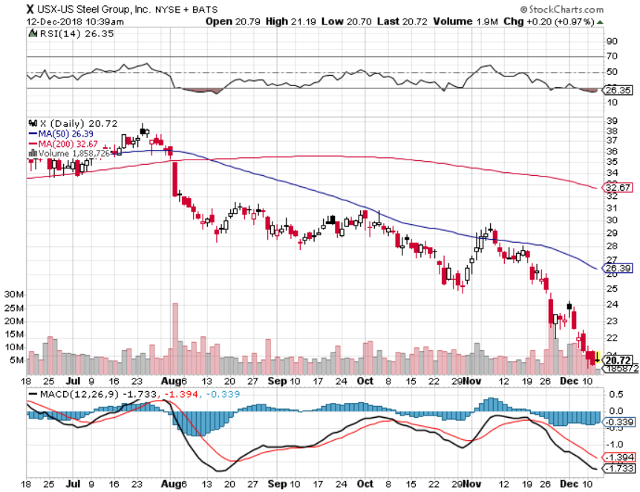
US Steel (X)-Tariffs Trouble
Import duties cause users to abandon steel
Unwound the entire Trump trade

Slide 33
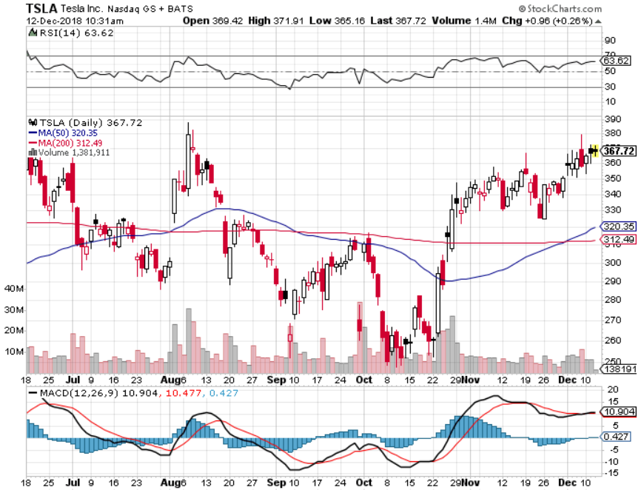
Tesla (TSLA)-
Rising share price on successful Tesla 3 deliveries largest outside shareholder says they want more stock long 12/$400-$430 bear put spread

Slide 34
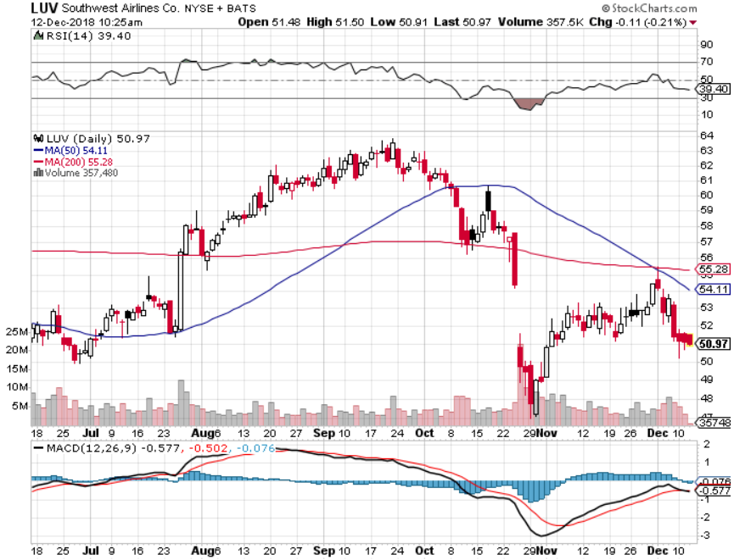
Southwest Airlines (LUV)-No oil help
Warren Buffett’s Favorite Airline

Slide 35
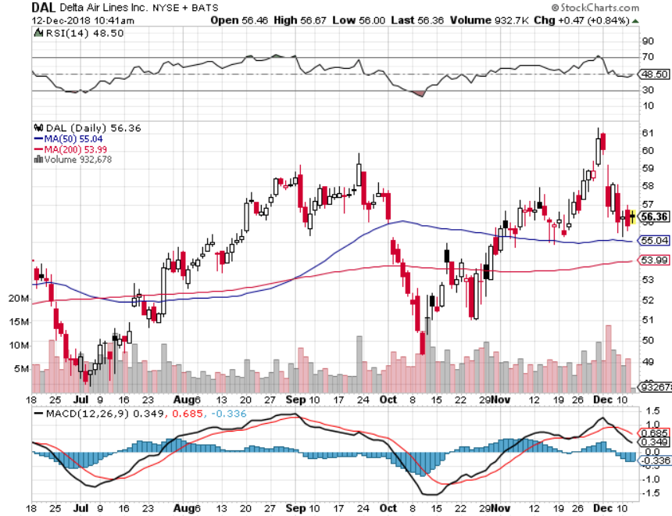
Delta Airlines (DAL) took profits on 3/$40-$45 call spread

Slide 36
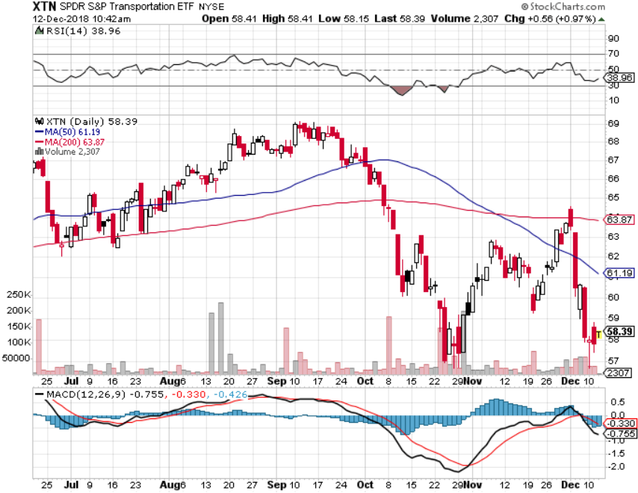
Transports Sector SPDR (XTN)-
(ALGT), (ALK), (JBLU), (LUV), (CHRW), (DAL)

Slide 37
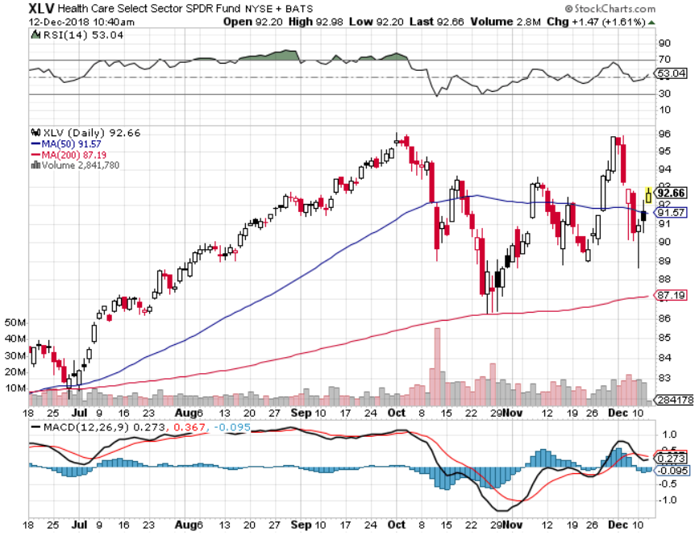
Health Care Sector (XLV), (RXL)-New Highs
(JNJ), (PFE), (MRK), (GILD), (ACT), (AMGN)

Slide 38
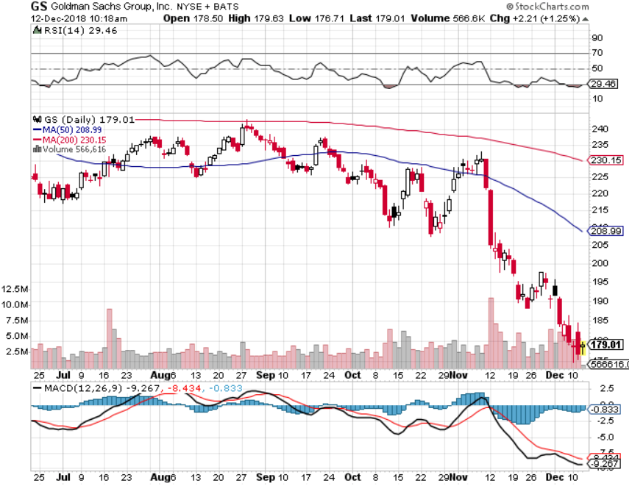
Goldman Sachs (GS)-The Next Buggy Whip maker took profits on long 10/$227.50-$232.50 vertical bull call spread

Slide 39
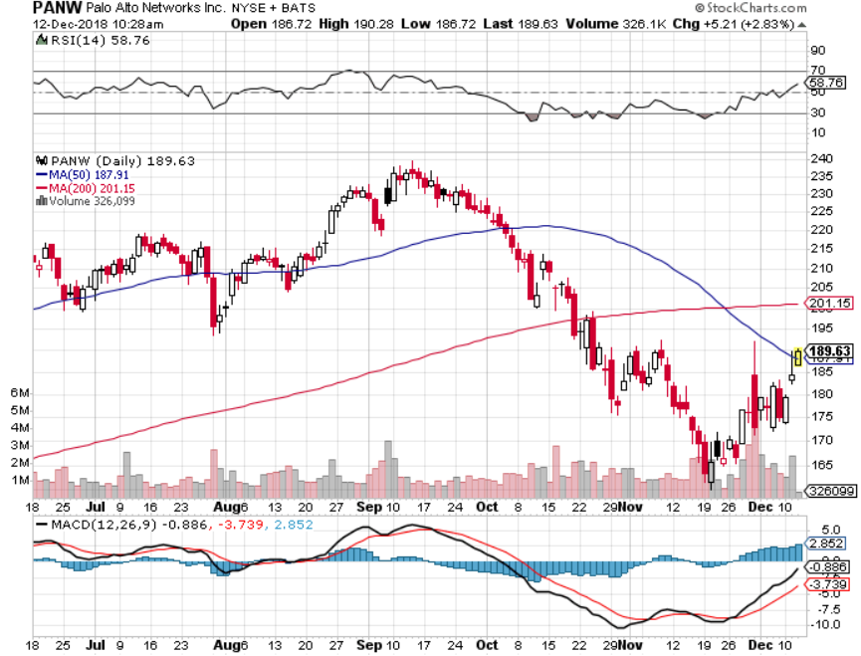
Palo Alto Networks (PANW)-
Hacking never goes out of fashion

Slide 40
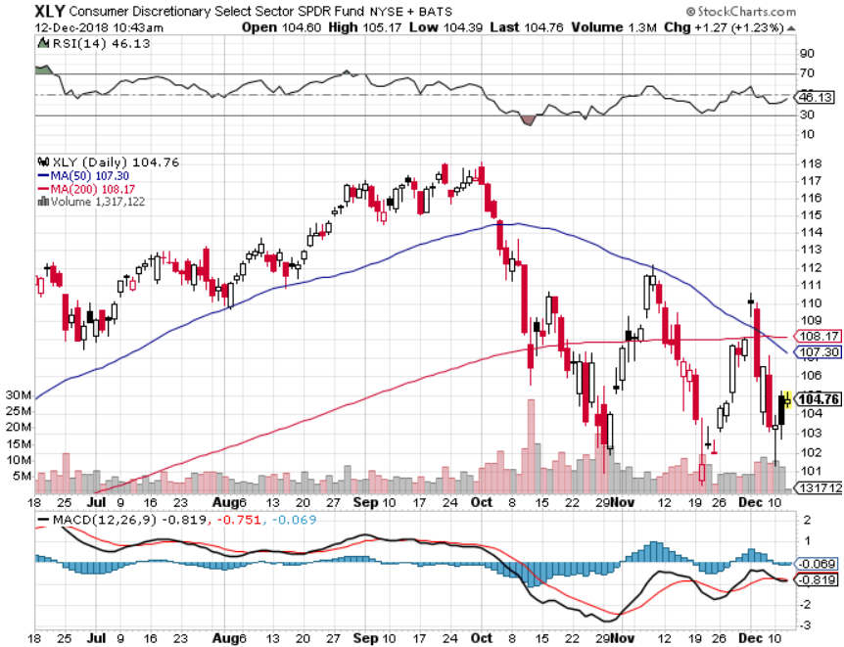
Consumer Discretionary SPDR (XLY)
(DIS), (AMZN), (HD), (CMCSA), (MCD), (SBUX)

Slide 41
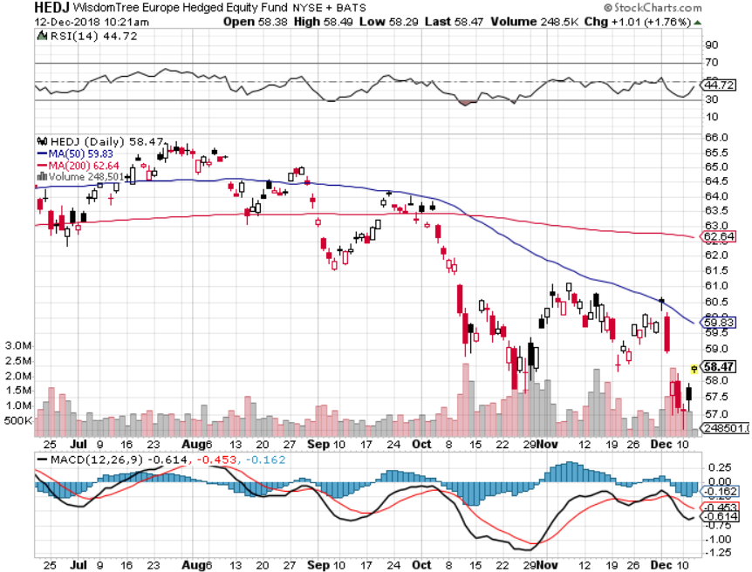
Europe Hedged Equity (HEDJ)-Quadruple top Top

Slide 42
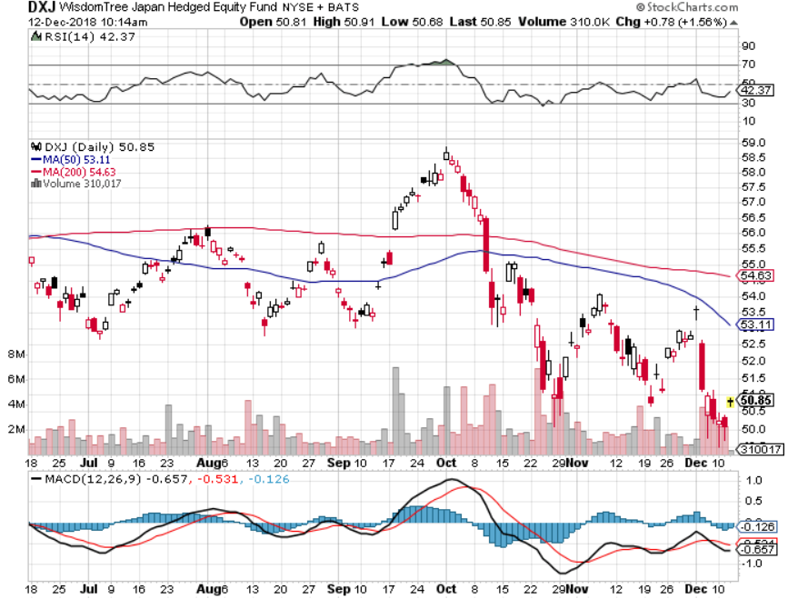
Japan (DXJ)-

Slide 43
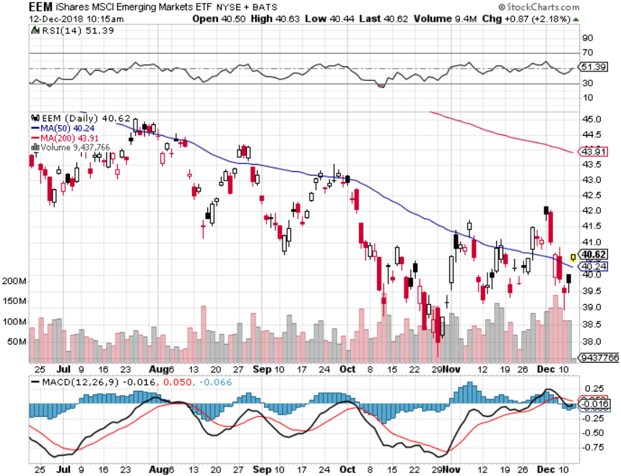
Emerging Markets (EEM)- Killed by Strong Dollar

Slide 44
Bonds-Dead Can Bounce
*Huge global “RISK OFF” creates flight to safety bid that takes yields down 55 basis points to a 2.80% low
*The ”One and Done” theory is taking over to spur the rally, which calls for one more rate hike in December and then no more
*What is most likely is a rate hike in December and then a six month pause
*Now looking for only a 3.00% ten year US Treasury
yield by yearend, and 4% in a year
*Exploding deficits will weigh on
bonds for the next decade, sell every
rally across the space, up 100%
IN TWO YEARS!
Bottom Line: Sell every four point
rally in the (TLT)

Slide 45
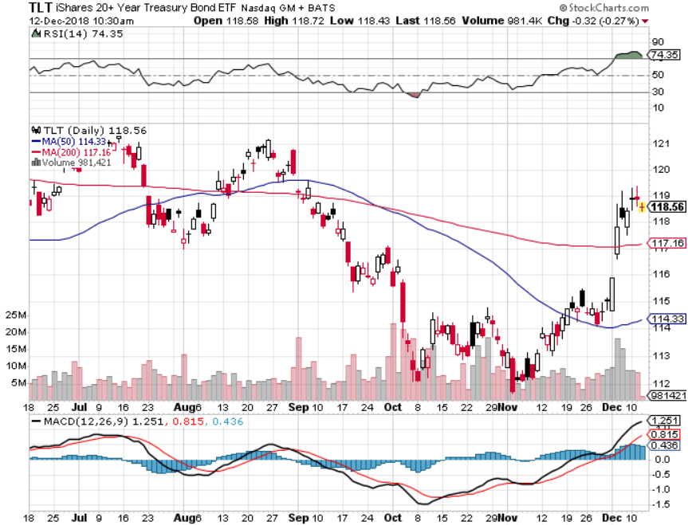
Treasury ETF (TLT) – Bottom of Range long 12/$121-$124 call spread took profits on long (TLT) 10/$114-117 call spread took profits on long (TLT) 9/$123-$126 put spread took profits on long 11/$116-$119 call spread took profits on long 11/$117-$120 call spread took profits on long 12/$116-$119 call spread took profits on long 12/$117-$120 call spread

Slide 46
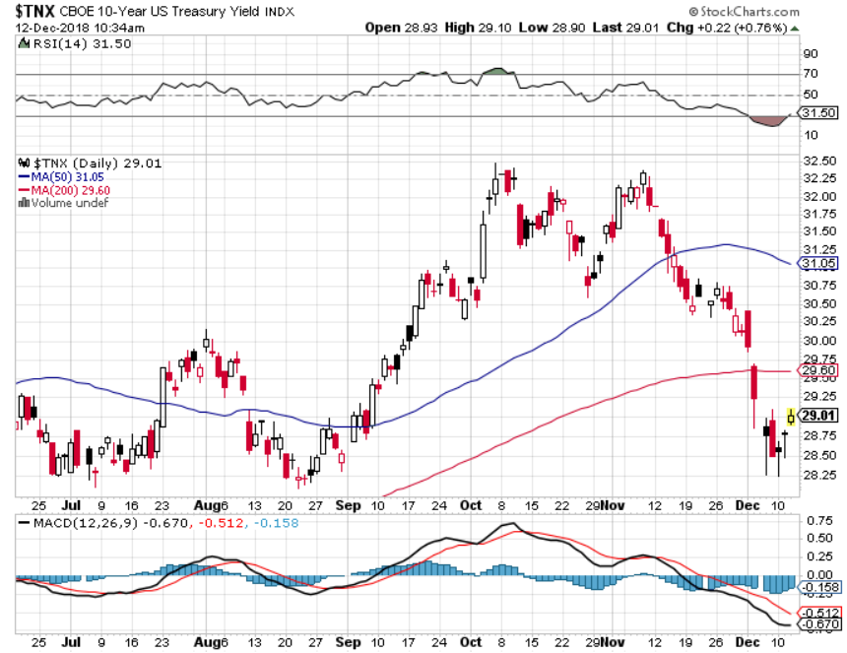
Ten Year Treasury Yield ($TNX) 3.05%
Breakdown, Now major Support

Slide 47
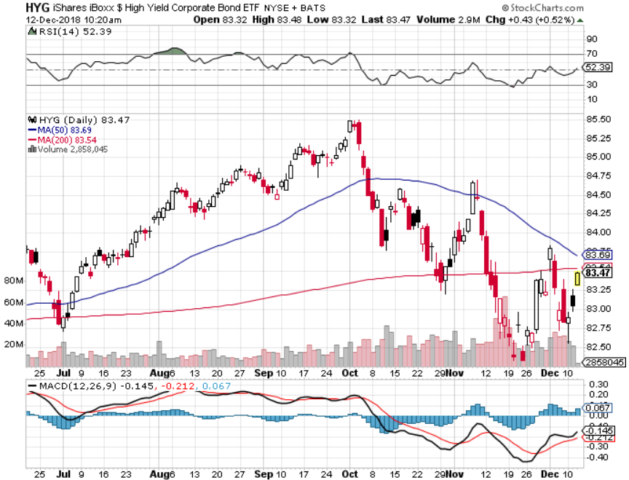
Junk Bonds (HYG) 5.96% Yield

Slide 48
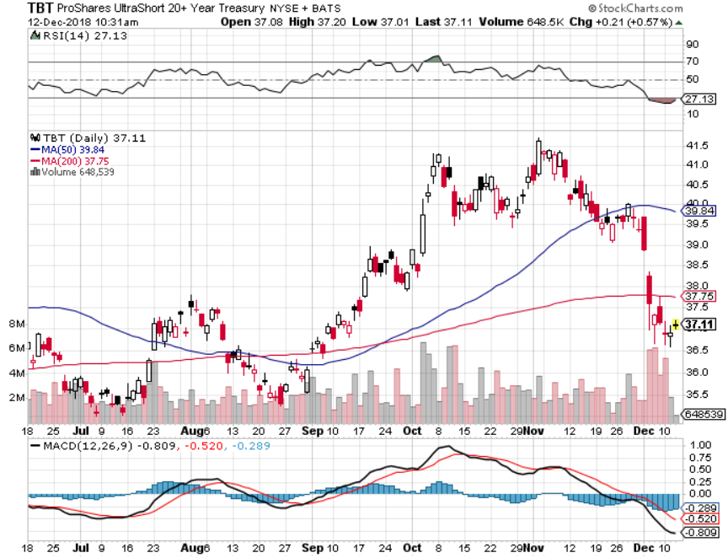
2X Short Treasuries (TBT)-Strong Buy Territory

Slide 49
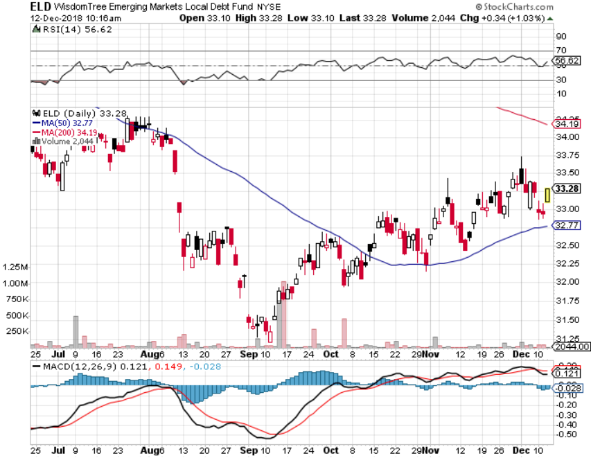
Emerging Market Debt (ELD) 6.07% Yield-

Slide 50
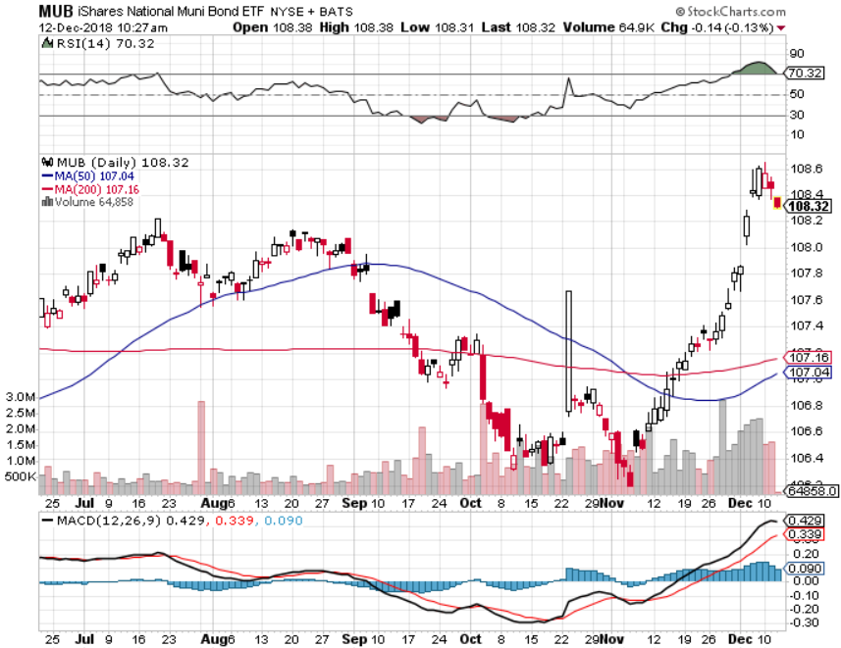
Municipal Bonds (MUB)-2.83%
Mix of AAA, AA, and A rated bonds

Slide 51
Foreign Currencies – Topping Dollar
*Slowing pace of US interest rate rises mean that the dollar may be topping here
*Euro (FXE)and Japanese yen (FXY) could be putting in a bottom here
*Chinese Yuan sitting at 10 year low, but starting to trend up on trade hopes
*British pound rallies strong in the imminent collapse of the British government and the end of Brexit keep the UK in the EC.
*Bitcoin crashes to $3,600, down 82.5% in a year,
the Ponzi Scheme collapses
*Bottom Line: stand aside

Slide 52
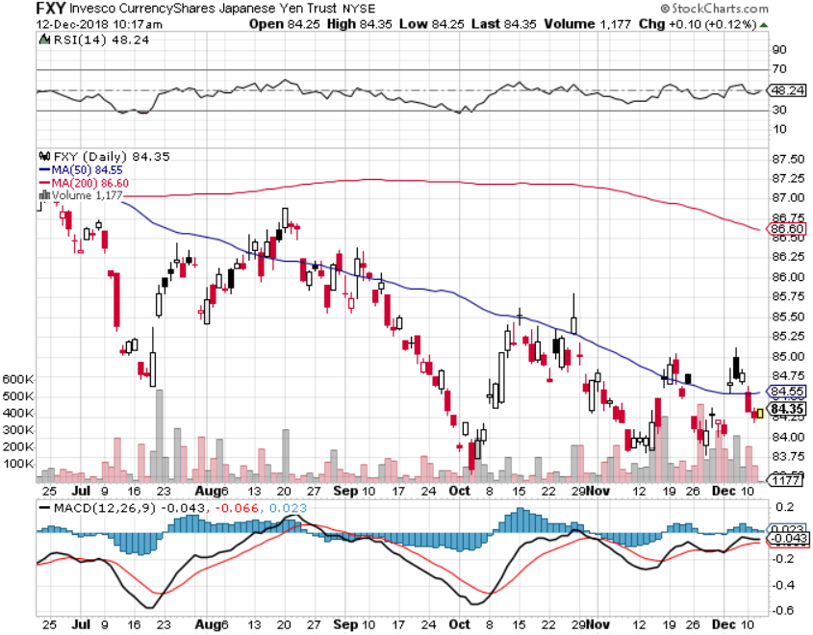
Japanese Yen (FXY), (YCS) took profits on long (FXY) 3/$91-$93 bear put spread

Slide 53
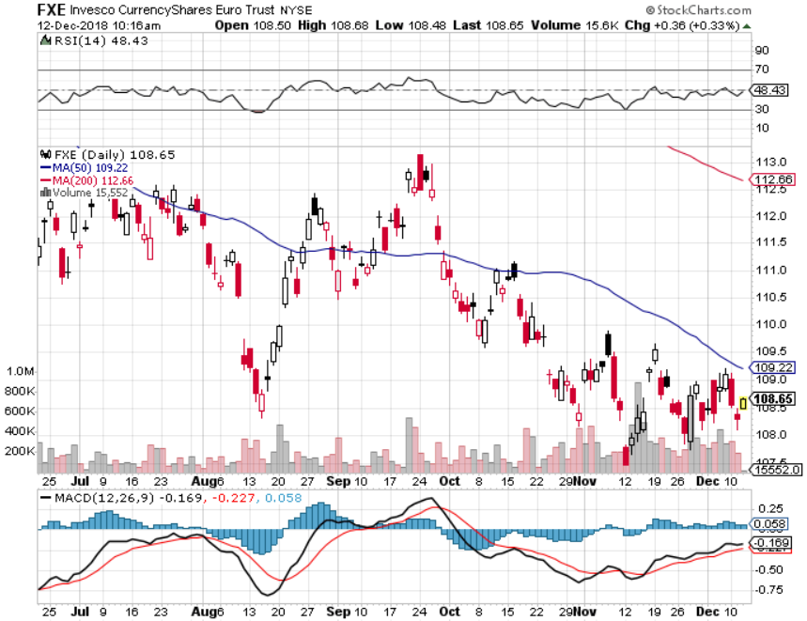
Euro ($XEU), (FXE), (EUO)- Trying to Break Upwards

Slide 54
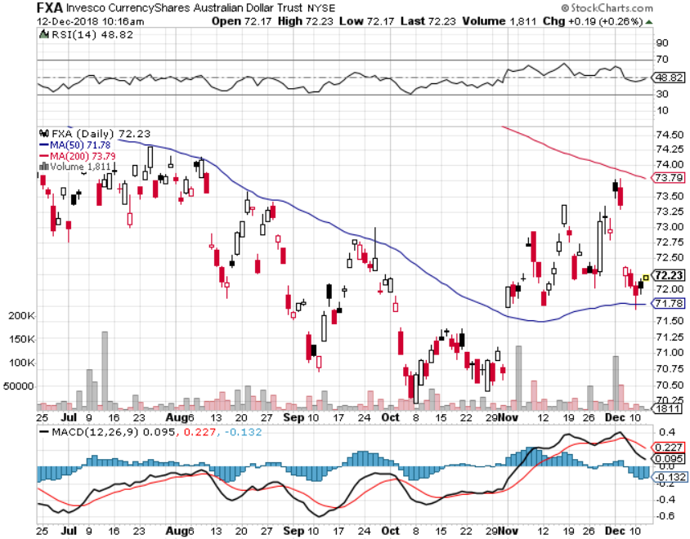
Australian Dollar (FXA)-Trade hopes

Slide 55
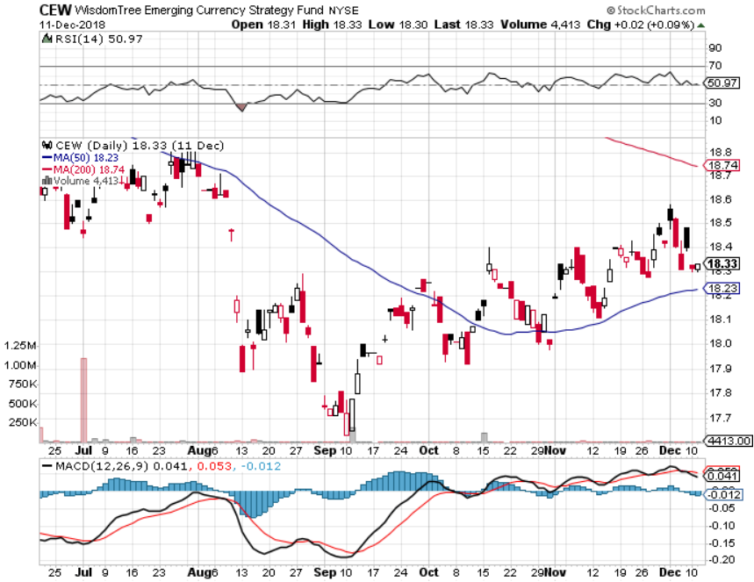
Emerging Market Currencies (CEW)-Head and Shoulders

Slide 56
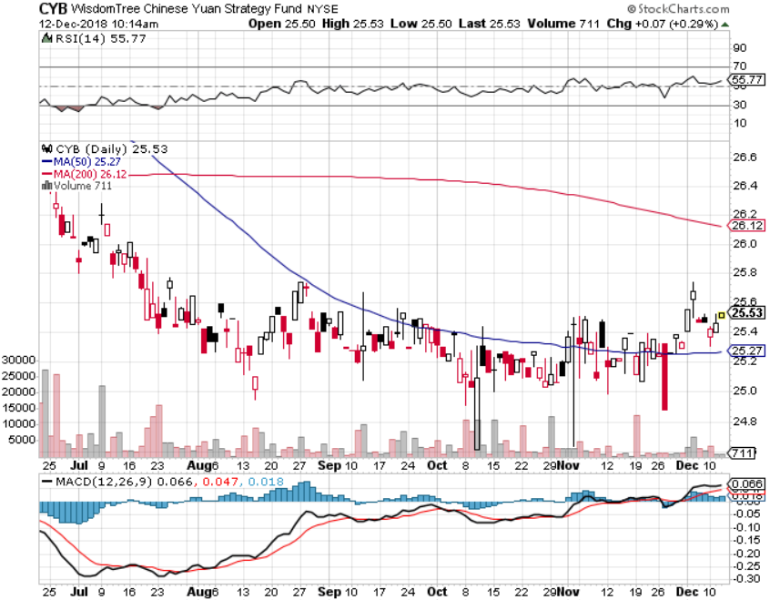
Chinese Yuan- (CYB)-Trade War Tonic

Slide 57
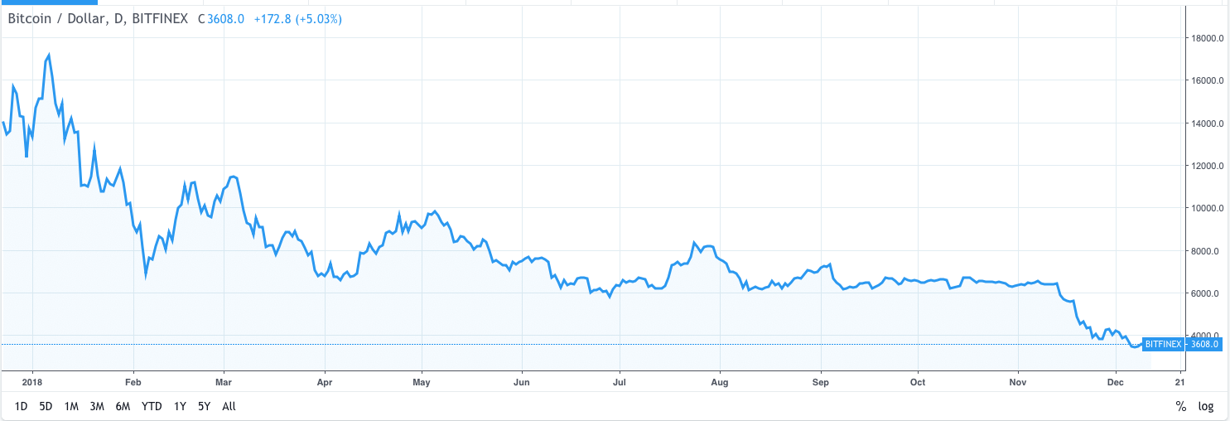
Bitcoin- Disaster!
Dow 82% in a Year!

Slide 58
Energy – Crash!
*Oil gets crushed on recession fears, down 35% in 7 weeks
*Iran ended up selling its oil to China so no global shortage
*Prices are struggling to put in a bottom here, but the stocks aren’t buying it
*If there is no imminent recession the entire sector is now a screaming buy
*Copper bouncing along two year lows
*Futures have gone from backwardation
to contango for the first time in a year,
which is hugely price negative
*Bottom Line: BUY

Slide 59
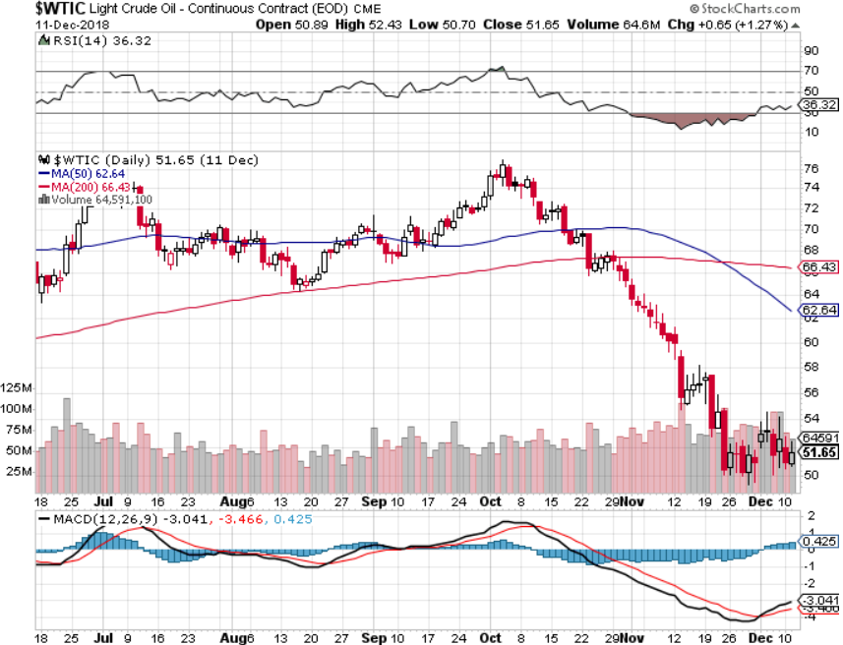
Oil-More Recession Fears

Slide 60

United States Oil Fund (USO)

Slide 61

Energy Select Sector SPDR (XLE)-No Performance!
(XOM), (CVX), (SLB), (KMI), (EOG), (COP)

Slide 62

Halliburton (HAL)-New Low

Slide 63

Natural Gas (UNG)-
Major Hedge Fund Blow Up

Slide 64

Copper (COPX)-One Year Downtrend
Trade War Fears Crush

Slide 65
Precious Metals – Breakout
*Gold finally gets a decent flight to safety bid of of extreme fear in the stock market, taking it to a multi month high
*Bond rally that has lowered ten year US Treasury yields by 55 basis points has been another huge help
*Precious metals hate rising rates and love falling ones because of fading yield competition
*Bottom Line: get ready to buy the
next big dip

Slide 66

Gold (GLD)-No Help from Trade War
Took profits on long 5/$119-$122 bull call spread took profits on long (GLD) $12/$116-$119 bull call spread

Slide 67

Market Vectors Gold Miners ETF- (GDX) – Yikes!
Took profits on long the 9/$20.50-$21.50 bull call spread

Slide 68

Barrick Gold (ABX)

Slide 69

Newmont Mining- (NEM)-

Slide 70

Palladium - (PALL)-

Slide 71
Real Estate –A World of Hurt
*Bond rally has triggered a dramatic dip in 30 year fixed rate mortgage rates down to 4.7%, spurring a round of refi activity
*Mortgage applications jump 1.6%
*Home price appreciation hits a two year low
*89% of Millennials still plan to become homeowners
*Toll Brothers (TOL) sales hit a four year low
*S&P 500 Case-Shiller drops to 5.5%,
annual gain, the lowest in a 18 months
*Bottom Line: Stand aside

Slide 72

July Corelogic S&P Case Shiller Home Price Index
Las Vegas, Seattle, and San Francisco showing biggest gains

Slide 73

Simon Property Group (SPG)-

Slide 74

US Home Construction Index (ITB)
(DHI), (LEN), (PHM), (TOL), (NVR)

Slide 75

Trade Sheet-
So What Do We Do About All This?
*Stocks-buy dips
*Bonds-sell any and all rallies
*Commodities-stand aside
*Currencies-stand aside
*Precious Metals –buy dips
*Oil – Buy dips
*Volatility-buy dips to $12
*Real estate-stand aside

Slide 76

Next Strategy Webinar
12:00 EST Wednesday, January 9,
2019 from San Francisco, CA www.madhedgefundtrader.com email me at support@madhedgefundtrader.com
Good Luck and Good Trading!
Notes:
*

