Slide 1
The Mad Hedge Fund Trader “The Bottom is In”
With John Thomas from Silicon Valley, CA, January 9, 2019 www.madhedgefundtrader.com
Notes:
*

Slide 2
Trade Alert Performance Off to the Races
*January 5.73% MTD *July +0.0% Final *February +1.54% Final *August +2.19% MTD *March +1.13% Final *September 1.38% Final *April +12.54% Final *October +1.37% Final *May +1.07% Final *November -2.56% Final *June +4.15% Final *December -4.13% Final *2019 Year to Date 5.73% compared to +3.4% for the Dow Average *Trailing One year return +29.92%, +306.60% since inception, *Average annualized return of 33.74%

Slide 3
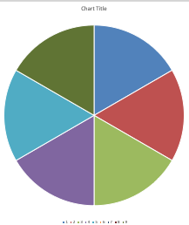
Portfolio Review aggressive bet the ranch long after a once a decade correction
Risk On
World is Getting Better
(TLT) 1/$124-$127 put spread | 10.00%
(TLT) 2/$125-$128 put spread | 10.00%
(AMZN) 2/$1200-$1300 call spread | 10.00%
(MSFT) 2/$85-$90 call spread | 10.00%
(CRM) 2/$105-$115 call spread | 10.00%
Risk Off
(AAPL) 2/$165-$175 put spread | -10.00%
(FXE) 2/$105-$108 call spread | -10.00%
Total Net Position | 30.00%
Expiration P&L 11.24%

Slide 4
My Short List of Possible Trades
BUY Home Depot (HD) Emerging Markets (EEM) Boeing Aircraft (HD) Freeport McMoRan (FCX) Walt Disney (DIS) Visa (V) eBay (EBAY) Occidental Petroleum (OXY) Sell S&P 500 (SPY) over $270

Slide 5
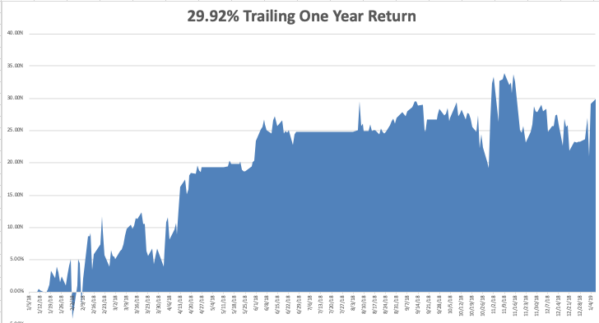
GTD Daily Audited Performance

Slide 6
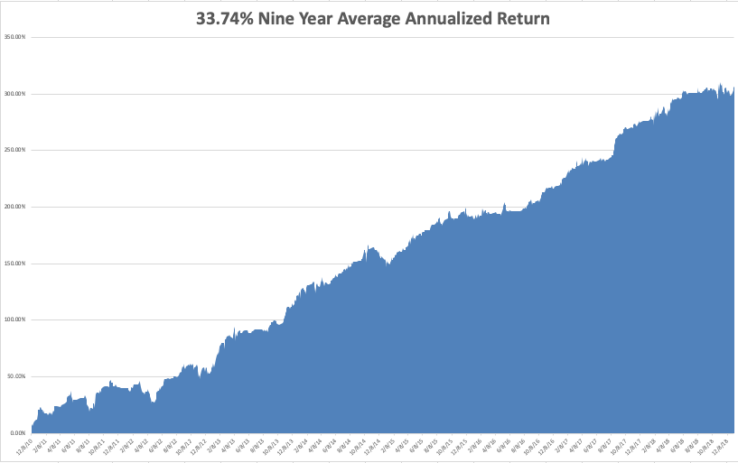
GTD 9 Year Daily Audited Performance

Slide 7
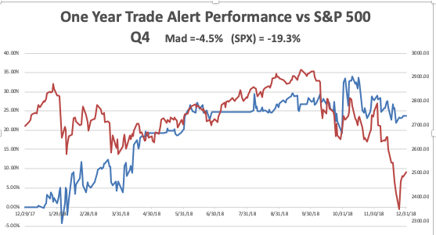

Slide 8
The Method to My Madness
*The bottom is in for stocks for a trade, but a big one *Markets were the most oversold history *Bonds have peaked and interest have bottomed for 2019 *Fed has turned from hawkish to dovish, a huge risk positive and dollar negative *So does the Oil crash, which created a $200 billion stimulus for the US economy and a trillion for the world *Washington is emerging as a major threat to the market after ignoring it for years *All that said, I still expect the S&P 500 to be down 5% by the end of the year but there is still good money to be made

Slide 9
The Five Surprises of 2019
*The government shutdown ends quickly *The Chinese trade war ends *The House makes no moves to impeach the president, focusing on domestic issues instead *Britain votes to rejoin Europe *The Mueller investigation concludes that Trump has an unpaid parking ticket in Queens from 1974 and that’s it *All of the above are hugely risk positive

Slide 10
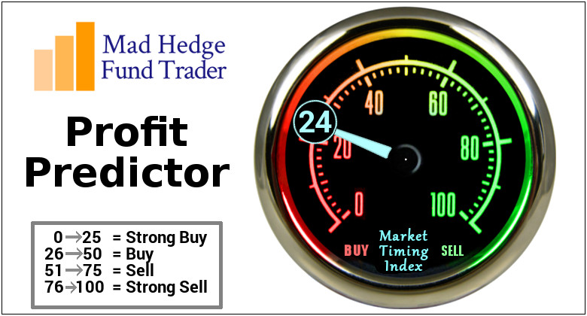
The Mad Hedge Profit Predictor Market Timing Index- An artificial intelligence driven algorithm that analyzes 30 different economic, technical, and momentum driven indicators

Slide 11
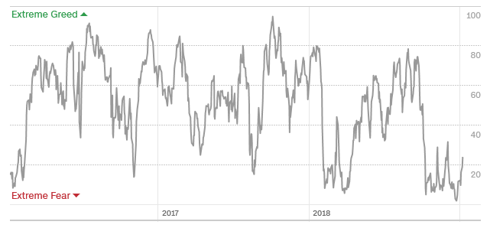
The Mad Hedge Profit Predictor Best ”BUY” Entry Point in 3 Years
SELL
BUY

Slide 12
The Global Economy – Slowing
*New hints from the Fed that rates won’t rise this year are hugely positive for the global economy, China stimulates with a major bank reserve easing *December nonfarm Payroll Report at a blockbuster 312,000 shows that the US economy is alive and well *However, trade war induced slowdowns in China and Europe are starting to drag on the US *Government shit down is costing 5 basis points a week in GDP growth, 20 weeks cuts growth by a full 1% *Newly weakened dollar will boost non-dollar plays, like emerging markets (EEM) and the currencies (FXE) and (FXY), and oil (USO) *Europe is still terrible

Slide 13
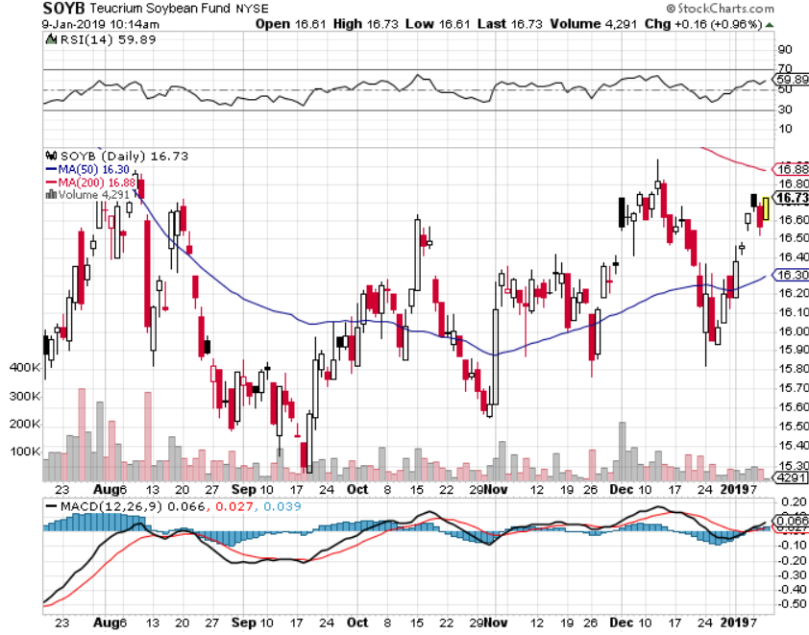
Soybeans (-20%)-Trade War Indicator Price Action Suggests that the China Trade Talks are Going Better than people realize

Slide 14
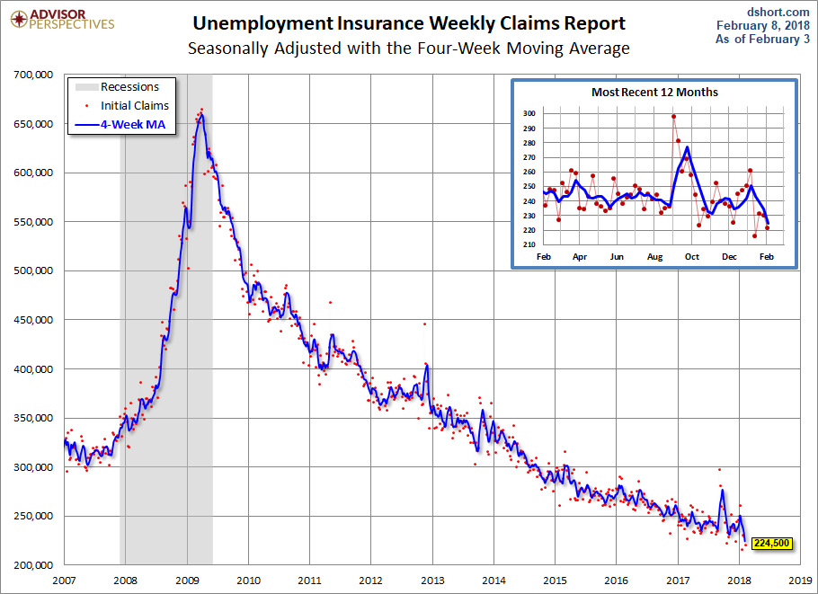
Weekly Jobless Claims –The Most Important Statistic +10,000 to 231,000, NEAR 6 MONTH HIGH

Slide 15
The Bill Davis View A $1,500 Upgrade for the Mad Day Trader Service
Buys: | Entry | Target
Apple (AAPL) | $ 150.00 | $ 188.00
United Technologies (UTX) | $ 109.00 | $ 120.00
Federal Express (FDX) | $ 178.00 | $ 195.00
Raytheon (RTN) | $ 155.00 | $ 175.00
Core Laboratories (CLB) | $ 66.00 | $ 87.00
Sells:
Becton Dickinson (BDX) | $ 235.00 | $ 208.00
Cigna Corp (CI) | $ 185.00 | $ 165.00
Edwards Lifesciences (EW) | $ 153.00 | $ 135.00
Zebra Technologies (ZBRA) | $ 160.00 | $ 137.00
Gartner Group (IT) | $ 132.00 | $ 120.00

Slide 16
Stocks – The Bottom is In
*The Christmas Eve massacre was the bottom in this cycle at (SPY) 2,340 *PE multiple of 14X was the loan in the sand, down from 20X *The rally from here will last one to three months, but strength could end at any time with a single presidential tweet *Another $1 trillion in new share buybacks kicks in, corporations will be the biggest buyers of stock in 2019 for the second year in a row *Tech will lead to the upside as the sold off the most and have the cash to bid their shares back up *Value names will start to perform as recession fears rise *Bottom Line: its bet the ranch time on tech longs, but stay away from those with big China exposure, like Apple, and weak dollar plays like energy, and emerging markets

Slide 17
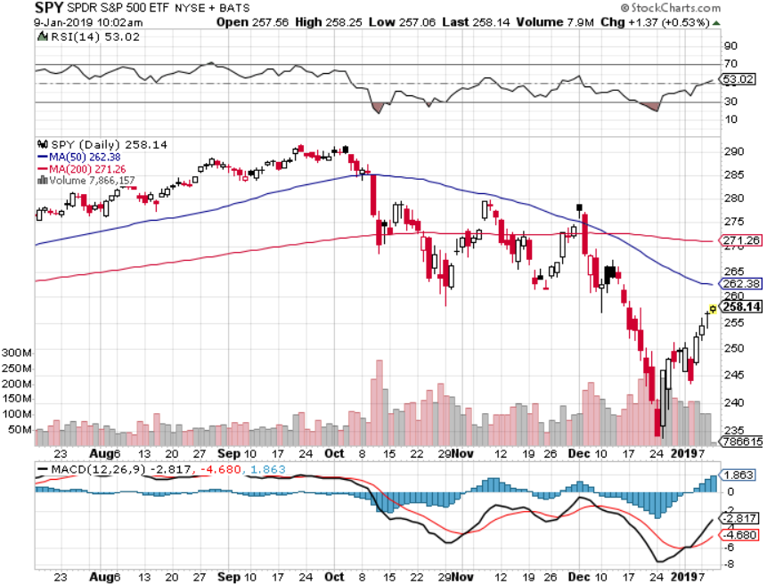
S&P 500-

Slide 18
S&P 500-Watch Out for the Head & Shoulders Set Up! You absolute want to sell short the next run at the highs….but it may be six months off
May 2019
GO Short $280

Slide 19
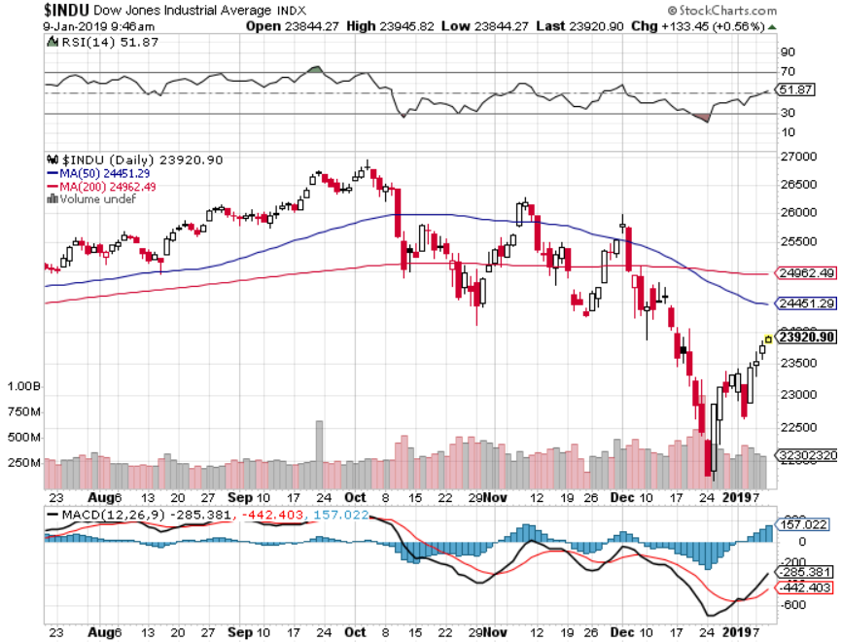
Dow Average-

Slide 20
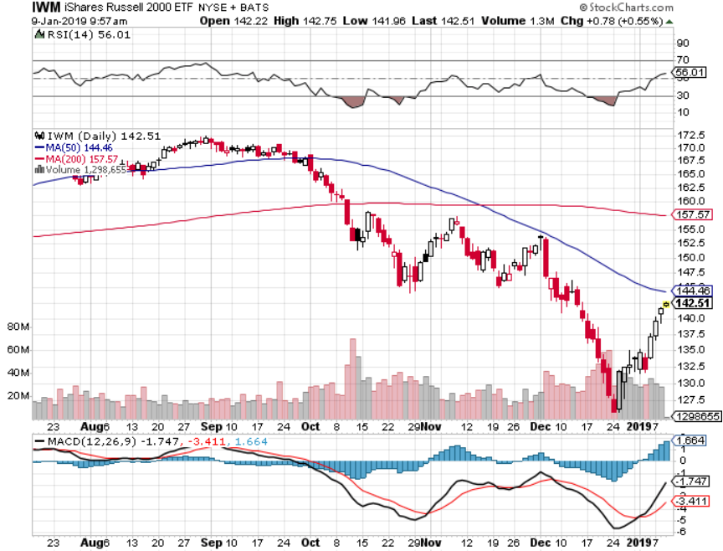
Russell 2000 (IWM)-

Slide 21
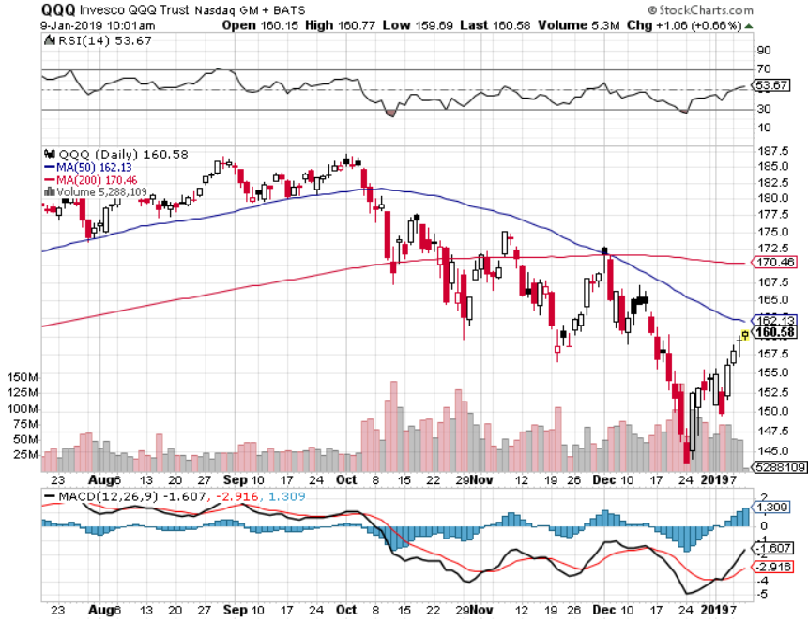
NASDAQ (QQQ)

Slide 22
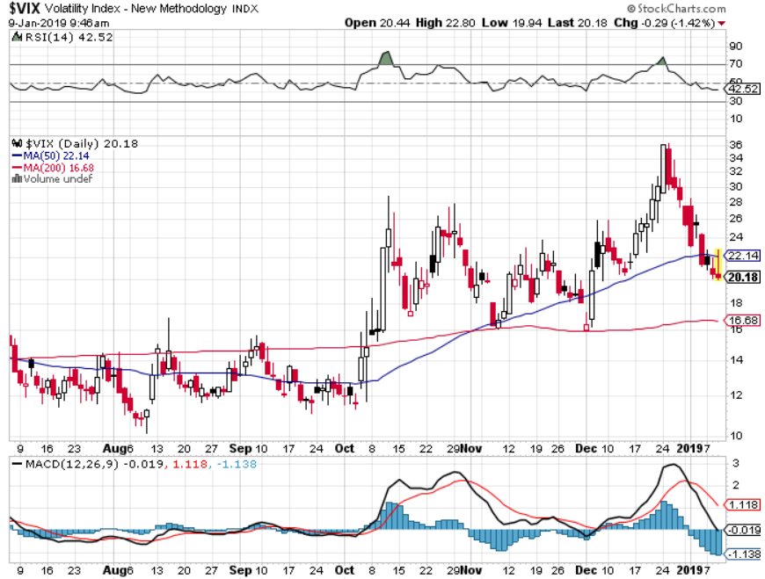
(VIX)- Levitating at a High Level

Slide 23
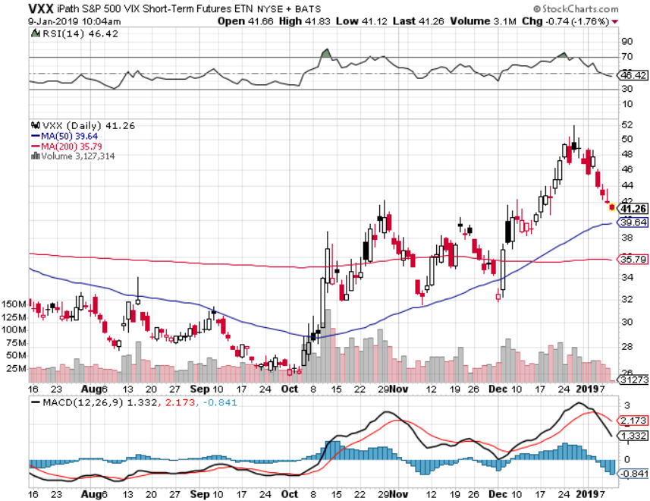
iPath S&P 500 VIX Short-Term Futures ETN (VXX)

Slide 24
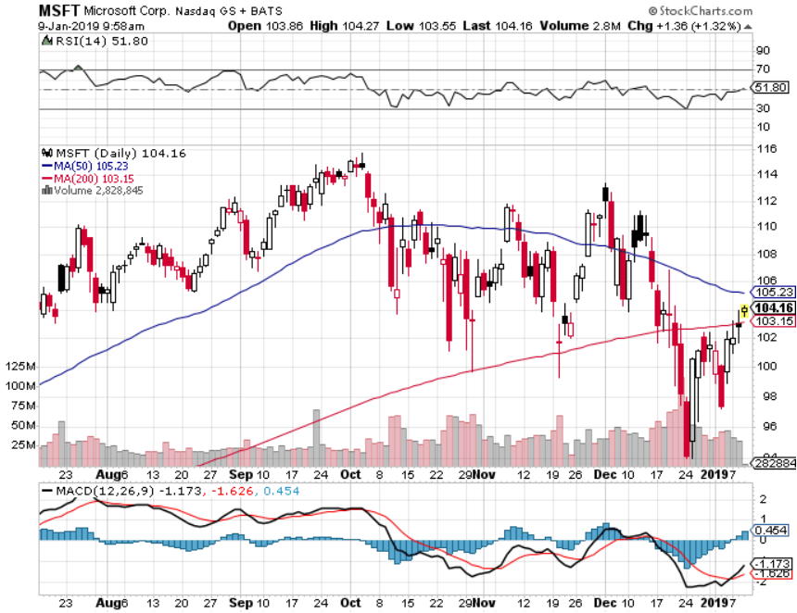
Microsoft (MSFT)- Earnings beat long 2/$85-$90 call spread

Slide 25
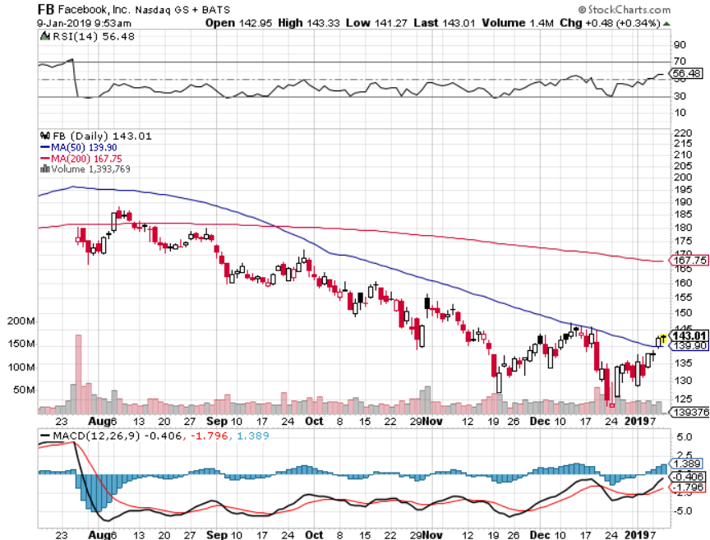
Facebook (FB)- Struggling

Slide 26
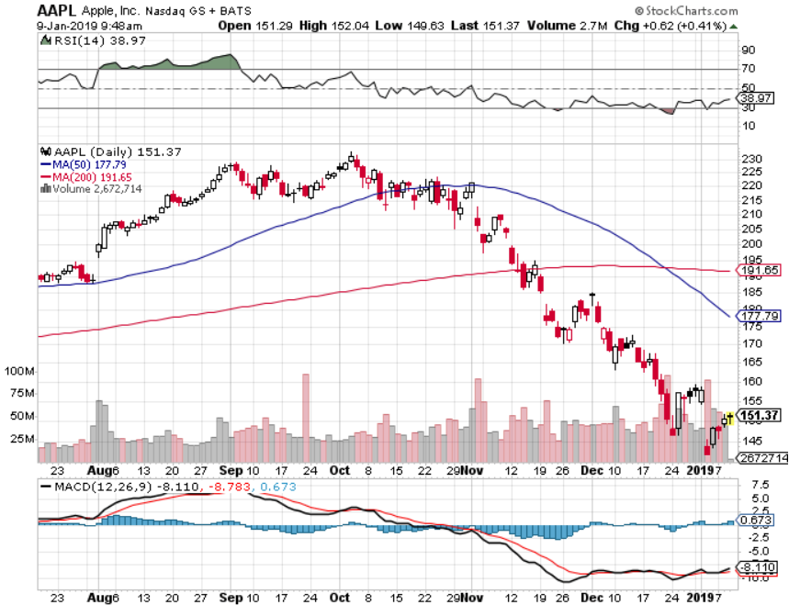
Apple (AAPL)- In the Dog House long 11/$165-$175 bear put spread

Slide 27
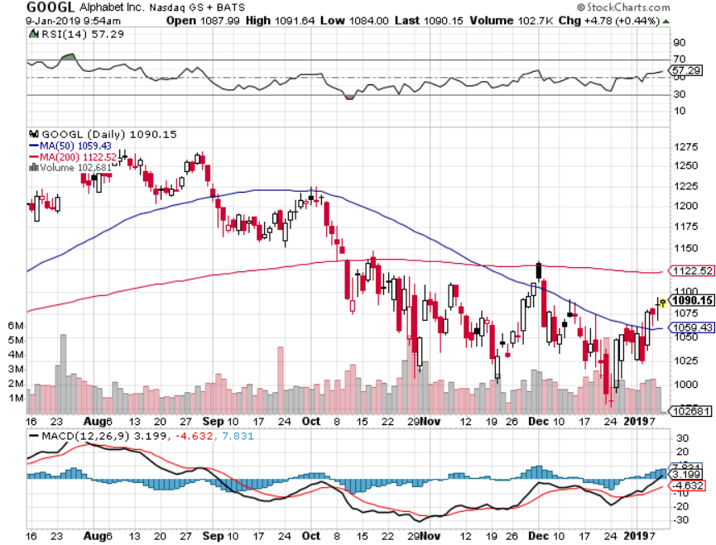
Alphabet (GOOGL)-

Slide 28
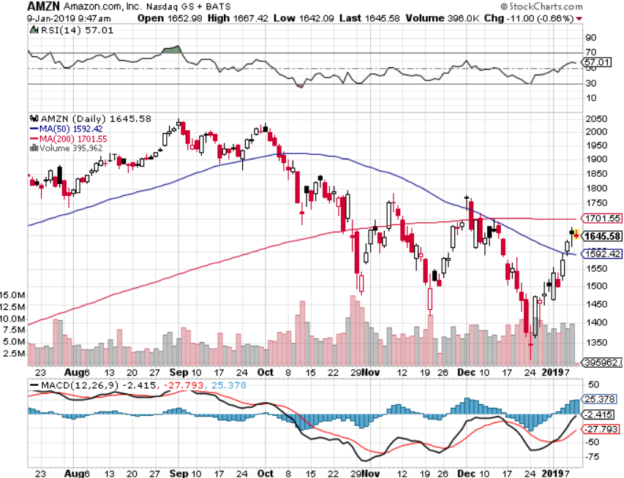
Amazon (AMZN)-Screaming BUY no China business long 2/$1,200-$1,300 call spread

Slide 29
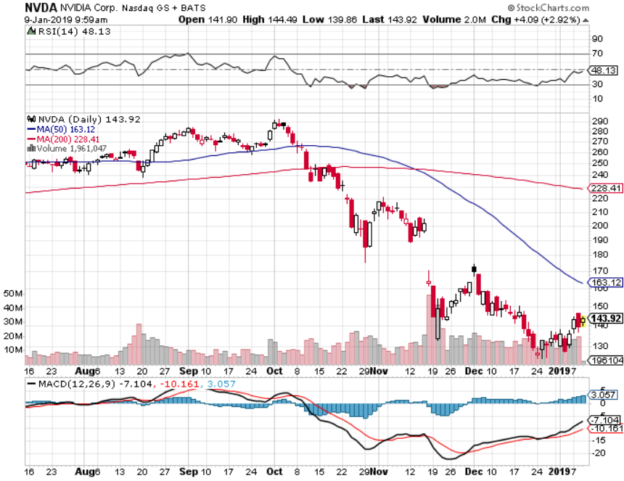
NVIDIA (NVDA)- The High Betas are Bouncing Hard

Slide 30
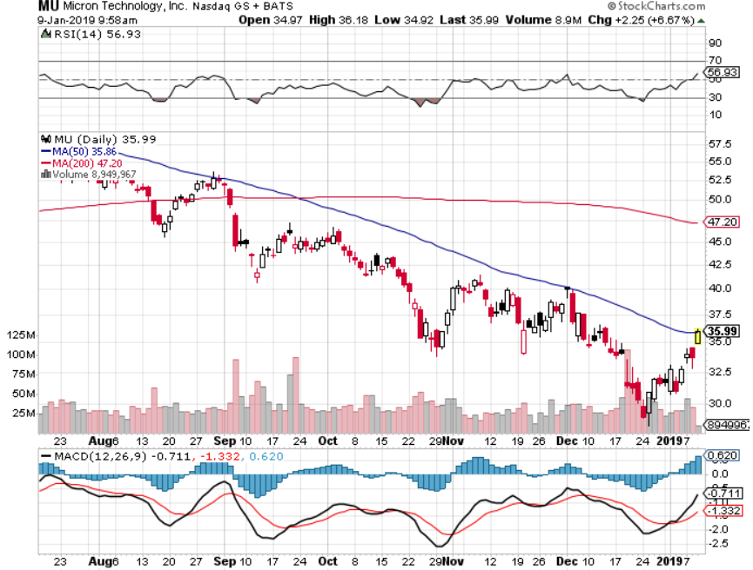
Micron Technology (MU)-Trade Wars

Slide 31
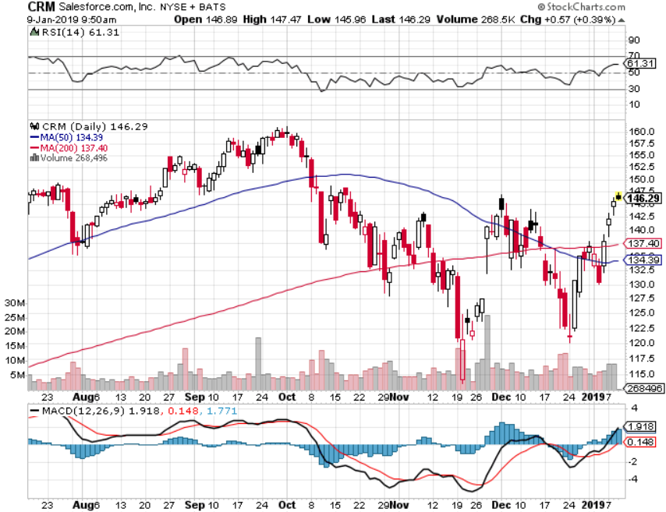
Salesforce (CRM)-Great Earnings-New Highs long 2/$105-$115 call spread

Slide 32
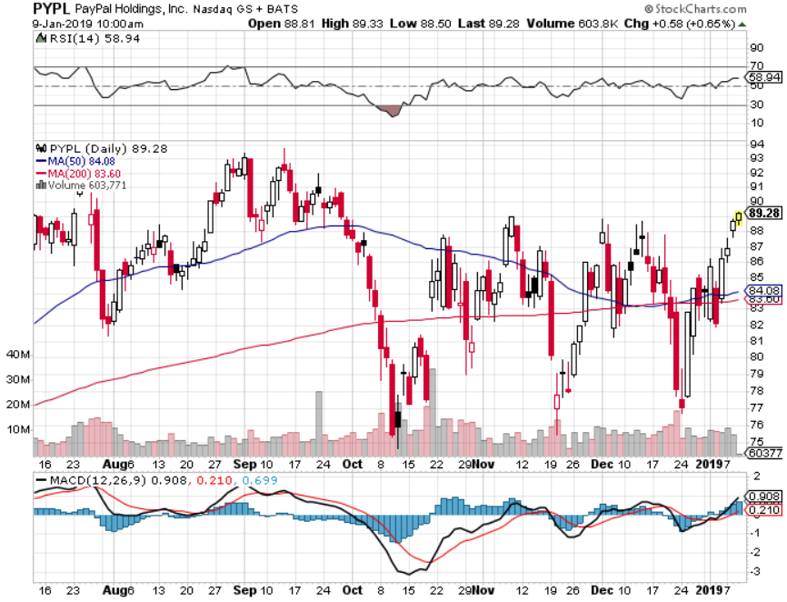
PayPal (PYPL)-

Slide 33
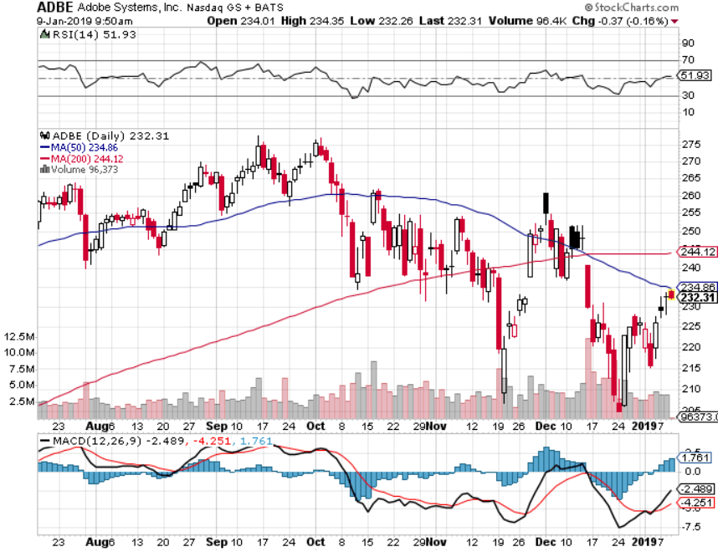
Adobe (ADBE)- The Quality Non-China tech play

Slide 34
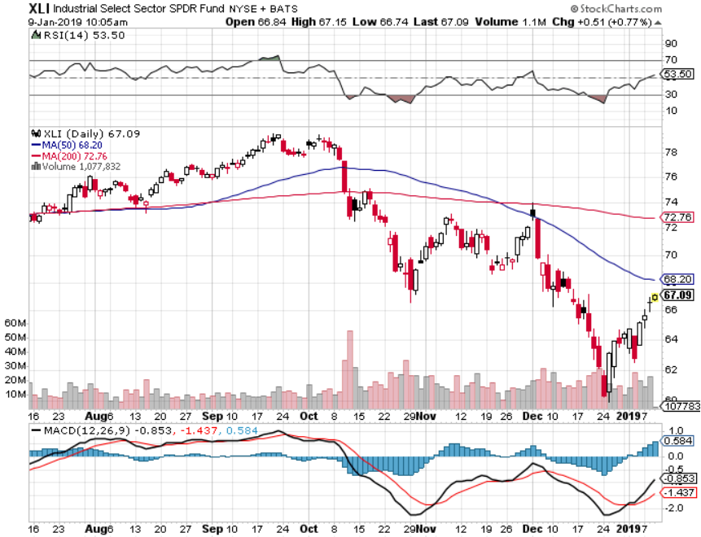
Industrials Sector SPDR (XLI)-No Support (GE), (MMM), (UNP), (UTX), (BA), (HON)

Slide 35
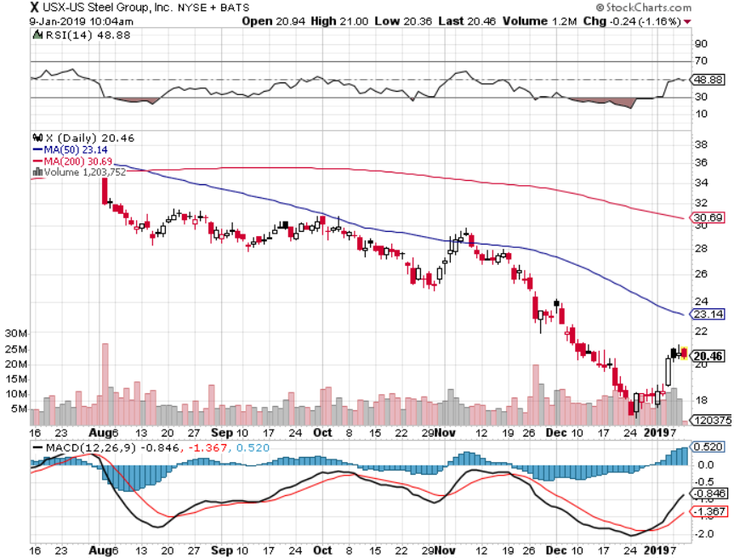
US Steel (X)-Tariffs Trouble Import duties cause users to abandon steel Unwound the entire Trump trade

Slide 36
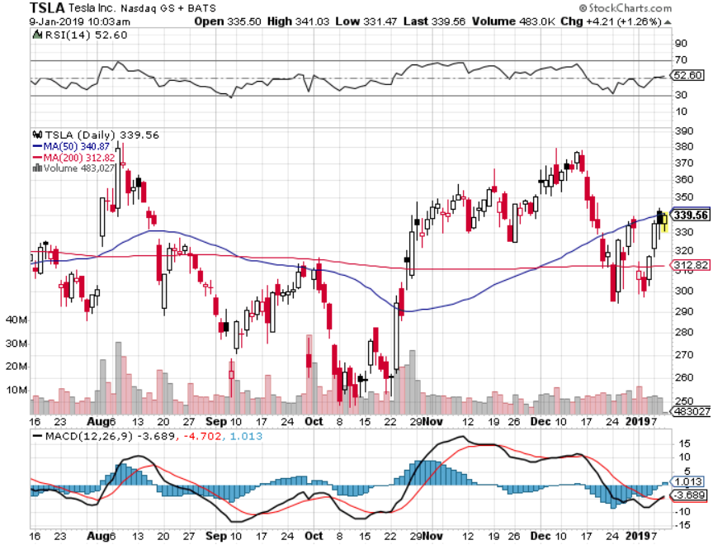
Tesla (TSLA)- Rising share price on successful Tesla 3 deliveries WHICH HIT 7,000 A WEEK

Slide 37
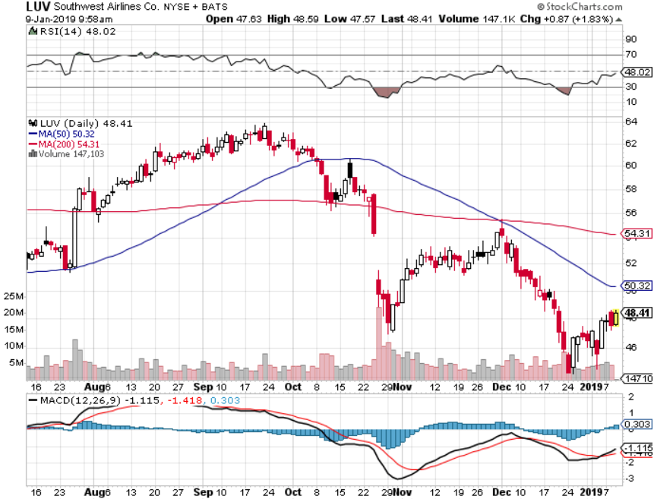
Southwest Airlines (LUV)-No oil help Warren Buffett’s Favorite Airline

Slide 38
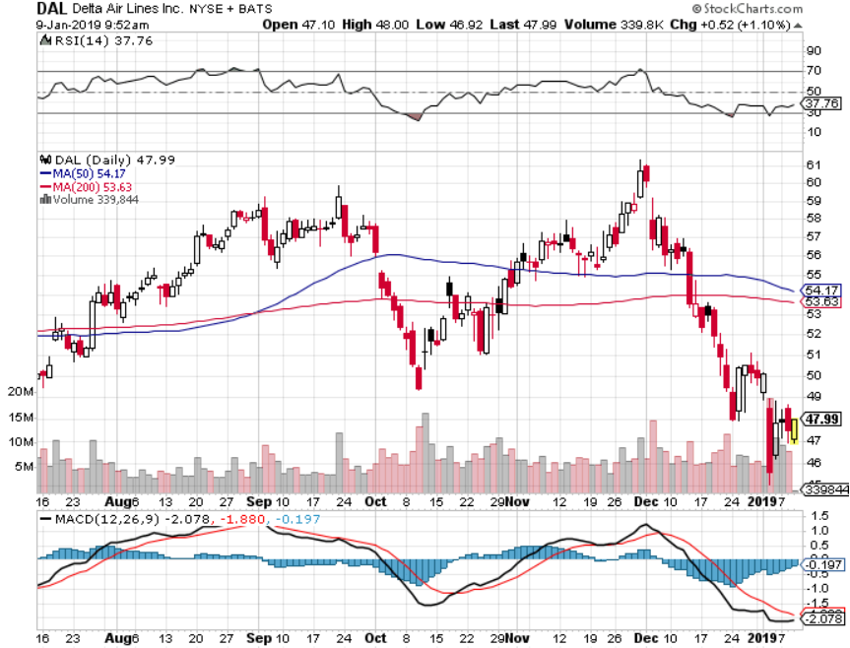
Delta Airlines (DAL)

Slide 39
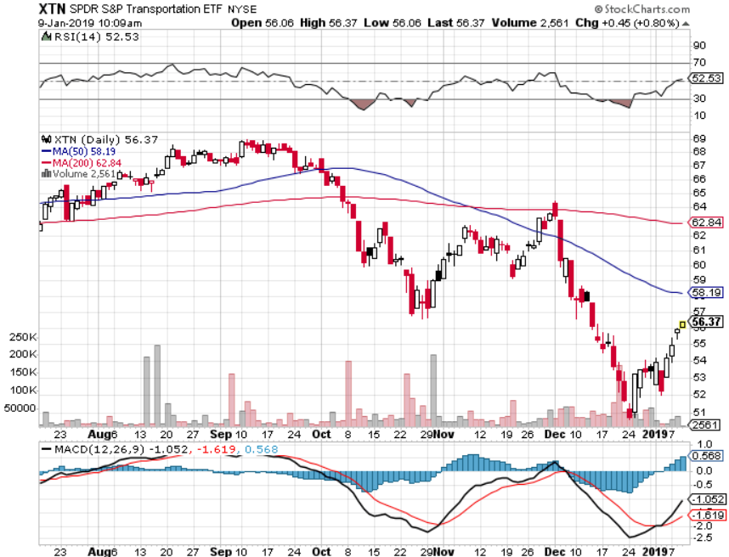
Transports Sector SPDR (XTN)- (ALGT), (ALK), (JBLU), (LUV), (CHRW), (DAL)

Slide 40
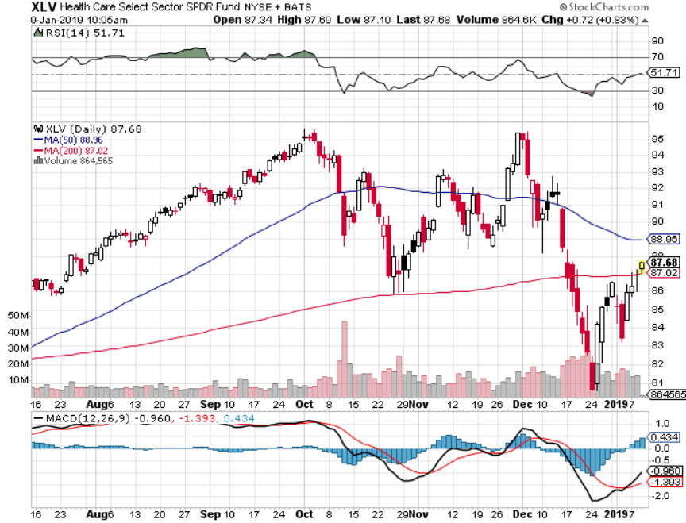
Health Care Sector (XLV), (RXL)-New Highs (JNJ), (PFE), (MRK), (GILD), (ACT), (AMGN)

Slide 41
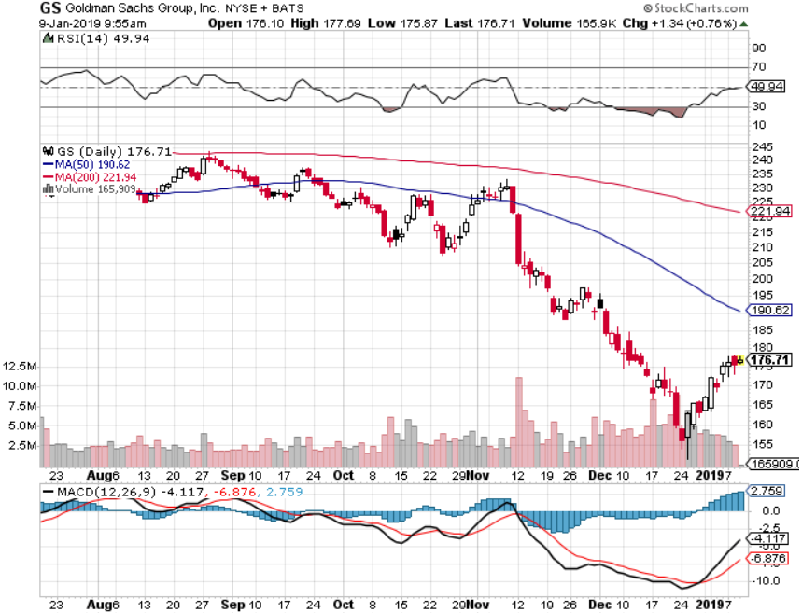
Goldman Sachs (GS)-The Next Buggy Whip maker

Slide 42
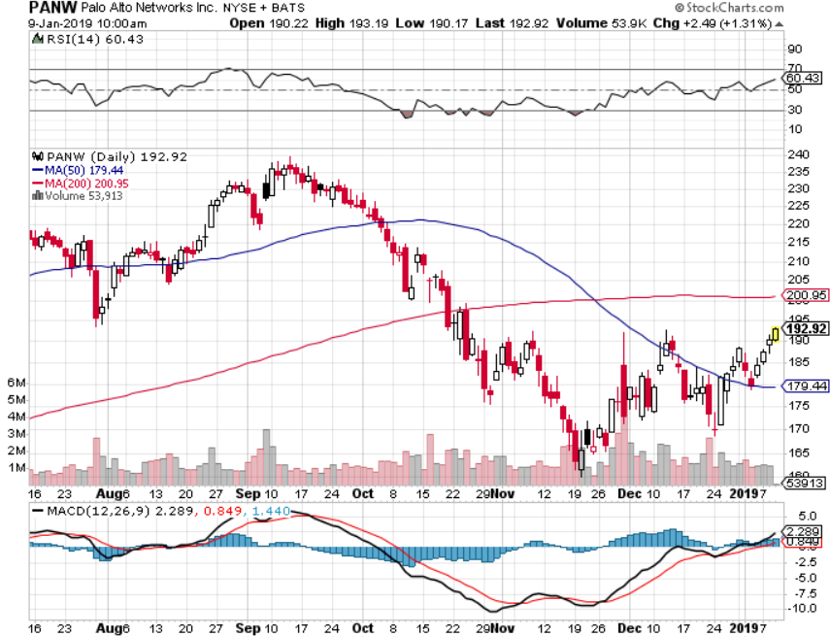
Palo Alto Networks (PANW)- Hacking never goes out of fashion

Slide 43
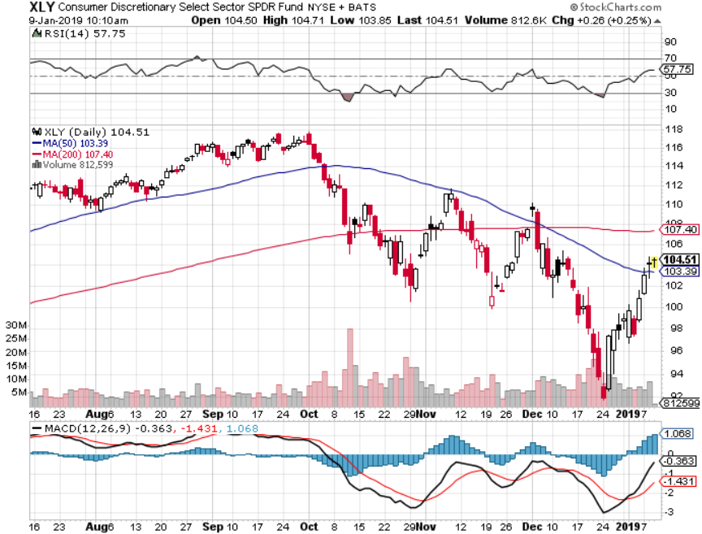
Consumer Discretionary SPDR (XLY) (DIS), (AMZN), (HD), (CMCSA), (MCD), (SBUX)

Slide 44
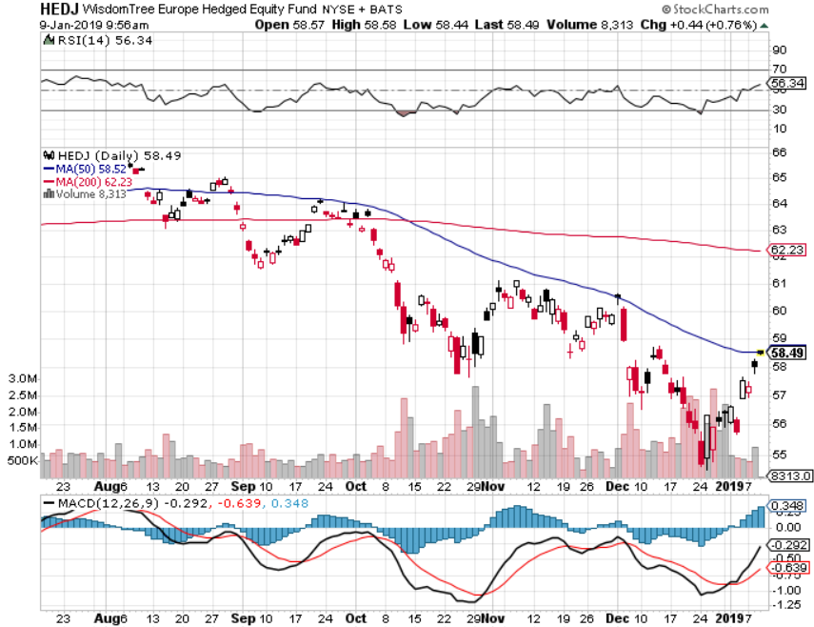
Europe Hedged Equity (HEDJ)-Quadruple top Top

Slide 45
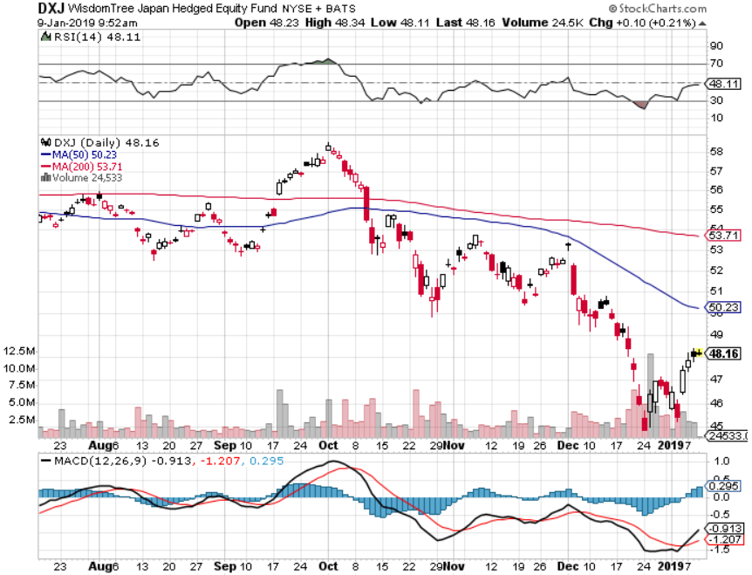
Japan (DXJ)-

Slide 46
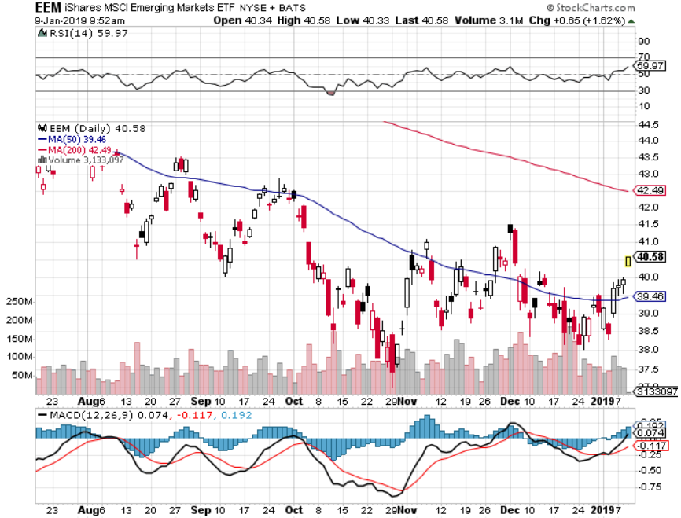
Emerging Markets (EEM)- Time to Buy on Weak Dollar

Slide 47
Bonds-Rolling Over
*Fed switch from hawk to dove reignites the bear market for bonds *Going from 3 Fed rate hikes in 2019 to possibly none in one minute *Still looking for 3.50% ten year US Treasury in a year, but what if the peak in this cycle is already in at 3.25%? *Total government issuance plus the Fed’s quantitative tightening totals $1.8 trillion in 2018, and there’s no way the bond market can handle this *Exploding deficits will weigh on bonds for the next decade, sell every rally across the space Bottom Line: Sell every four point rally in the (TLT)

Slide 48
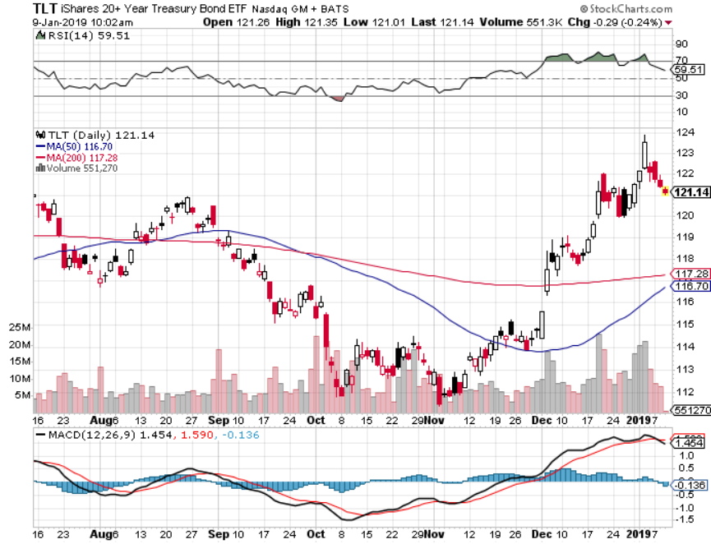
Treasury ETF (TLT) – Bottom of Range long 1/$124-$127 call spread-expires in 7 trading days long 2/$125-$128 call spread

Slide 49
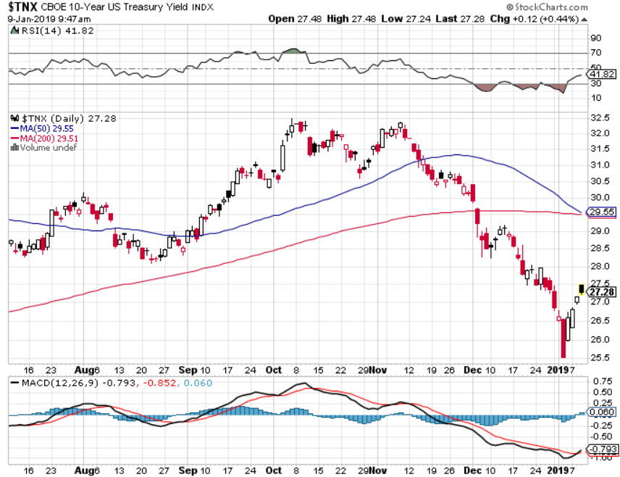
Ten Year Treasury Yield ($TNX) 2.69% Breakdown, Now major Support

Slide 50
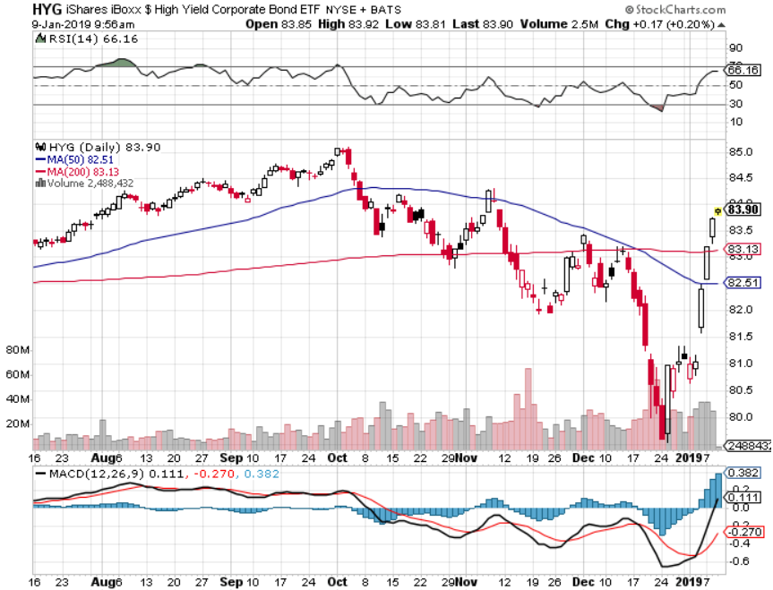
Junk Bonds (HYG) 5.60% Yield

Slide 51
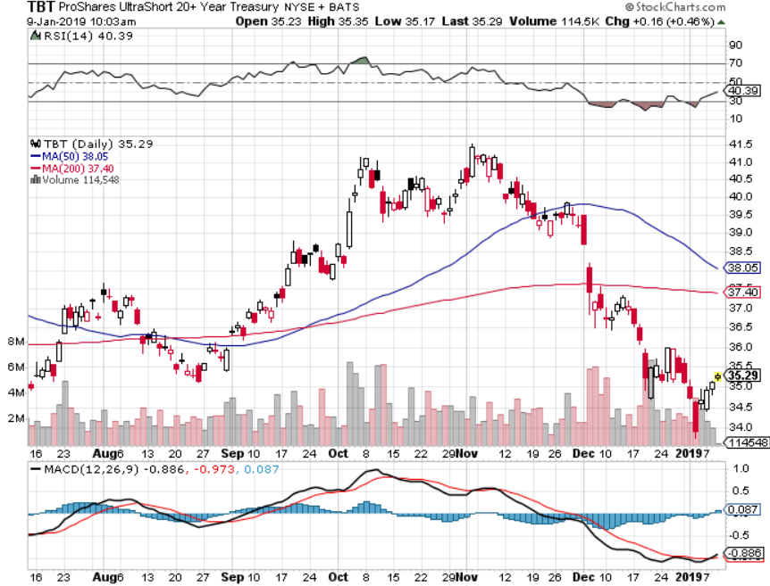
2X Short Treasuries (TBT)-Buy Territory

Slide 52
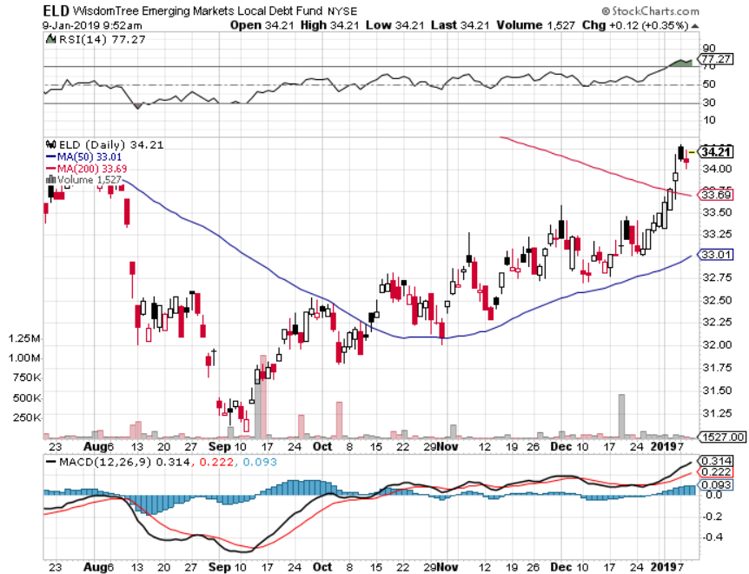
Emerging Market Debt (ELD) 6.02% Yield-

Slide 53
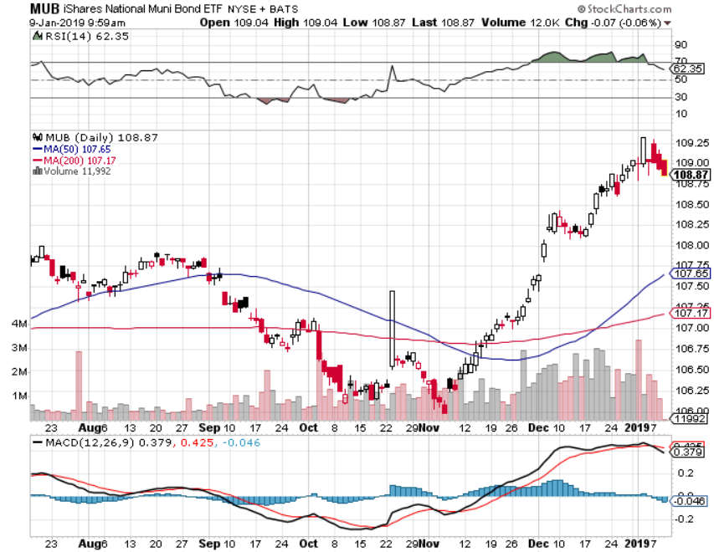
Municipal Bonds (MUB)-2.52% Mix of AAA, AA, and A rated bonds

Slide 54
Foreign Currencies – Fed Flip Flop
*Fed flip flop on interest rate outlook totally reverses the currency picture *Look for 3-6 months of dollar weakness and currency strength as a result *British pound is hanging on a thread depending on the Brexit outcome *Even a damaged Chinese yuan is starting to rally *Bitcoin at $3,984 is dead in the water *Bottom Line: sell dollars, buy the Euro (FXE)

Slide 55
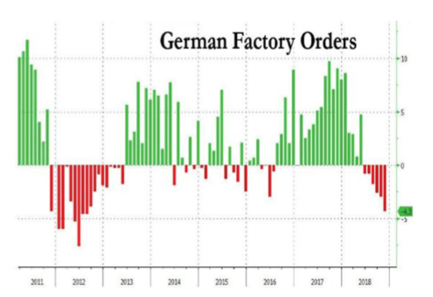

Slide 56
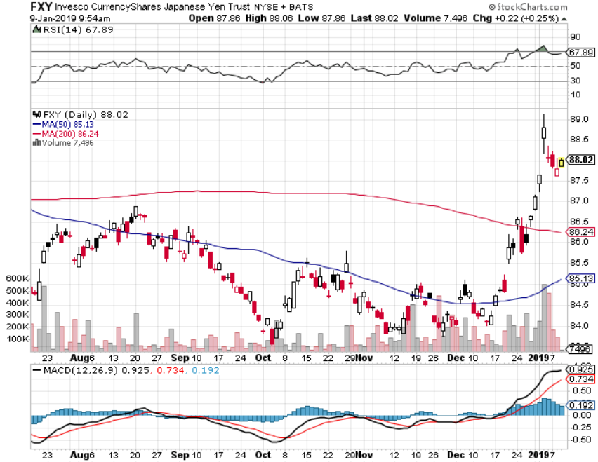
Japanese Yen (FXY), (YCS)

Slide 57
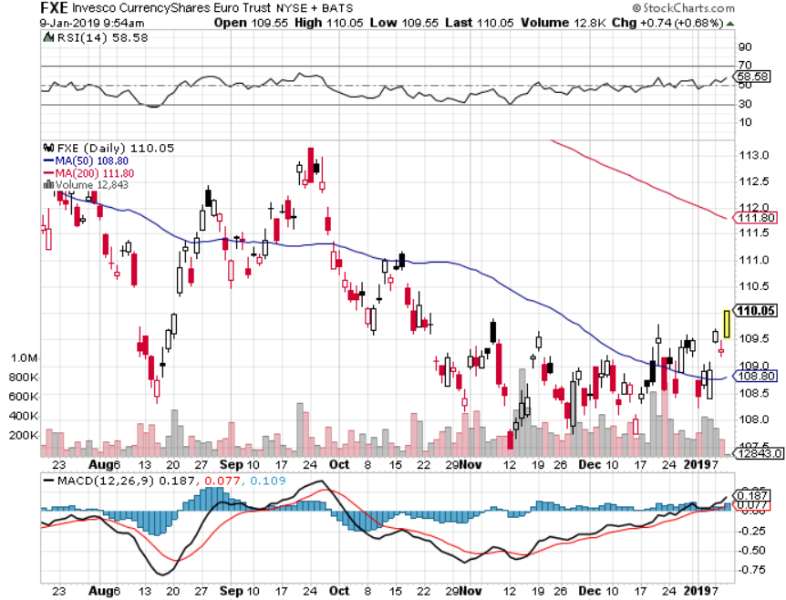
Euro ($XEU), (FXE), (EUO)- Trying to Break Down long 2/$105-$108 call spread

Slide 58
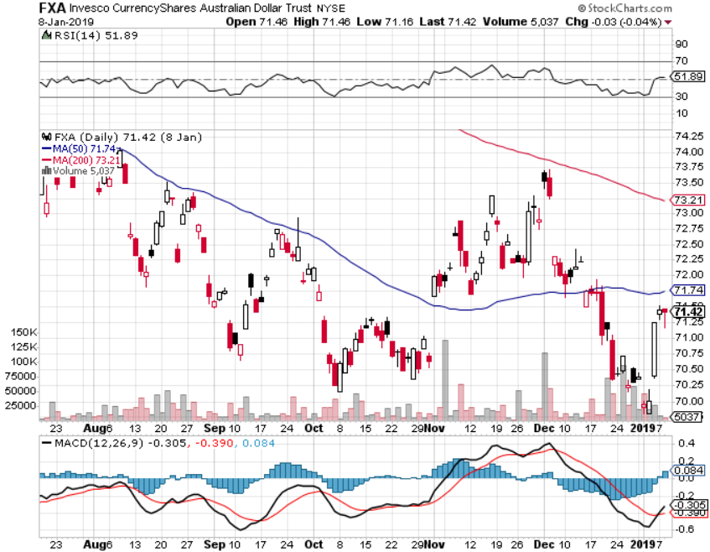
Australian Dollar (FXA)-

Slide 59
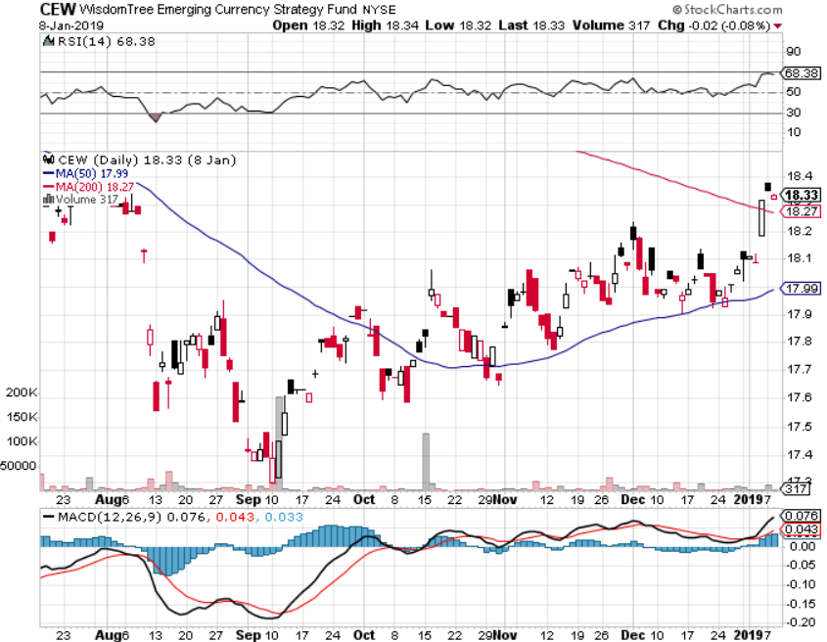
Emerging Market Currencies (CEW)

Slide 60
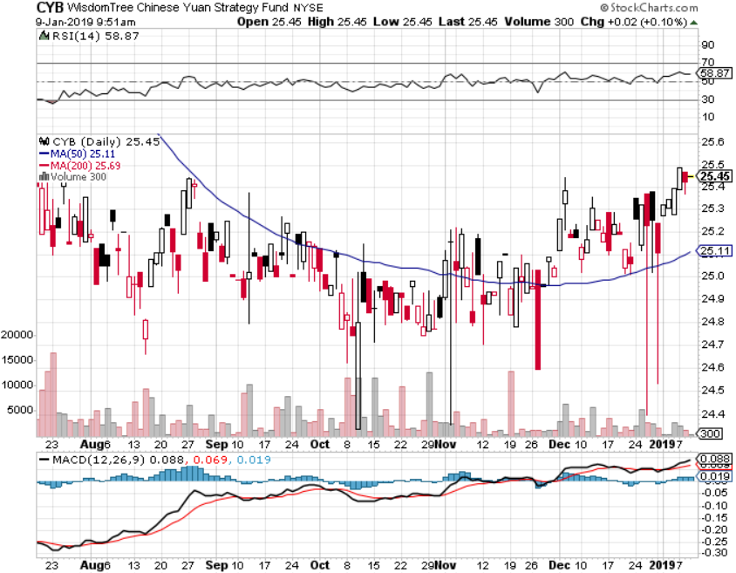
Chinese Yuan- (CYB)-

Slide 61
Bitcoin- Going Nowhere should be called “bombcoin”

Slide 62
Energy – Finding a Bottom
*Saudi production cut puts a floor under crude, triggering a 20% rally, look for 40% before it’s all over *Weak dollar is providing a bid for the entire commodity complex, including oil *US still infrastructure constrained on production expansion *Copper bouncing along two year lows *Bottom Line: Buy the dips

Slide 63
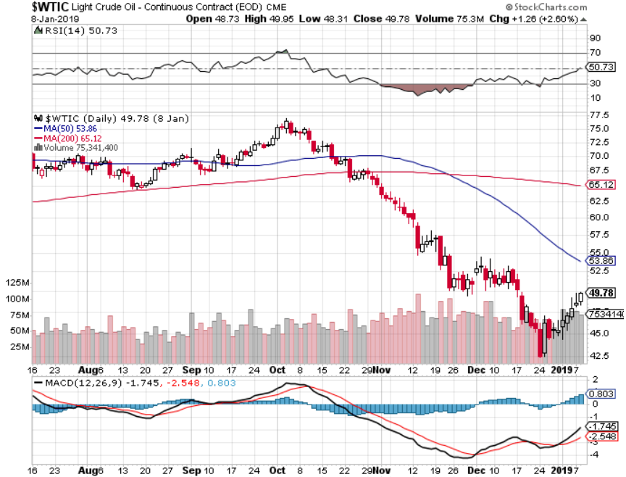
Oil-Bouncing

Slide 64
United States Oil Fund (USO)

Slide 65
Energy Select Sector SPDR (XLE)-No Performance! (XOM), (CVX), (SLB), (KMI), (EOG), (COP)

Slide 66
Halliburton (HAL)-

Slide 67
Natural Gas (UNG)- Major Hedge Fund Blow Up

Slide 68
Copper (COPX)-Flatlining on the bottom Trade War Fears Crush

Slide 69
Precious Metals – The Rally fades
*Flight to safety bid generated by stock market crash gives gold a three month rally *However, we only got only 10% on the move from the august bottom, barely proving its worth as a hedge *3% rise in gold ETF flows, North America and Asia are sellers, Europe is a buyer *The real move for gold won’t begin until we get true inflation, which won’t appear until later this year *Bottom Line: take profit for now, get out of the way for a 1-3 month “RISK ON” rally

Slide 71
Gold (GLD)-No Help from Trade War

Slide 72
Market Vectors Gold Miners ETF- (GDX) – Yikes!

Slide 73
Barrick Gold (ABX)

Slide 74
Newmont Mining- (NEM)-

Slide 75
Palladium - (PALL)-

Slide 76
Real Estate –The Recession Deepens
*The government shut down is creating major problems for the real estate market *With the IRS closed tax transcripts are unobtainable, required for all loan closings and loan resale *September S&P 500 Case-Shiller drops to 5.5%, annual gain, the lowest gain in two years *However, 30 year fixed rate loan drop to 4.40%, the steepest fall in 5 years off the back of bond market rally, is giving affordability a major boost *Bottom Line: Stand aside

Slide 77
September Corelogic S&P Case Shiller Home Price Index Las Vegas, Seattle, and San Francisco still showing biggest gains
Tradingeconomics.com

Slide 78
Simon Property Group (SPG)-

Slide 79
US Home Construction Index (ITB) (DHI), (LEN), (PHM), (TOL), (NVR)

Slide 80
Trade Sheet- So What Do We Do About All This?
*Stocks-buy dips *Bonds-sell any and all rallies *Commodities-buy dips *Currencies-buy dips *Precious Metals – stand aside *Volatility-buy dips to $15 *Real estate-stand aside

Slide 81
Next Strategy Webinar 12:00 EST Wednesday, January 23, 2019 from San Francisco, CA www.madhedgefundtrader.com email me at support@madhedgefundtrader.com
Good Luck and Good Trading!
Notes:
*

