Slide 1

The Mad Hedge Fund Trader
“Are We There Yet?”
With John Thomas
from Silicon Valley, CA, January 23, 2019
www.madhedgefundtrader.com
Notes:
*

Slide 2

Trade Alert Performance
Off to the Races
*January 6.24% MTD *July +0.0% Final
*February +1.54% Final *August +2.19% MTD
*March +1.13% Final *September 1.38% Final
*April +12.54% Final *October +1.37% Final
*May +1.07% Final *November -2.56% Final
*June +4.15% Final *December -4.13% Final
*2019 Year to Date 6.24%
compared to +3.4% for the Dow Average
*Trailing One year return +27.61%, +307.14% since inception,
*Average annualized return of 33.40%

Slide 3
Portfolio Review
aggressive bet the ranch long after a once a decade correction
Expiration P&L
11.24%

Slide 4

My Short List of Possible Trades
BUY
Home Depot (HD)
Emerging Markets (EEM)
Boeing Aircraft (HD)
Freeport McMoRan (FCX)
Walt Disney (DIS)
Visa (V)
eBay (EBAY)
Occidental Petroleum (OXY)
Sell
S&P 500 (SPY) over $270

Slide 5
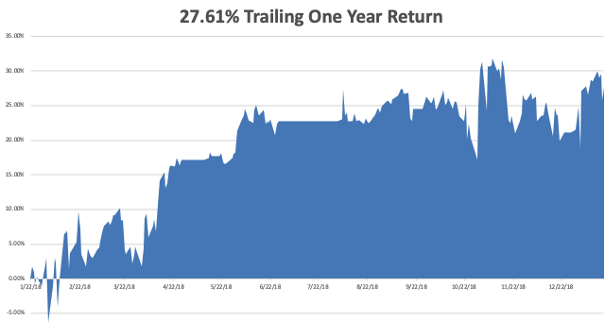
GTD Daily Audited Performance

Slide 6
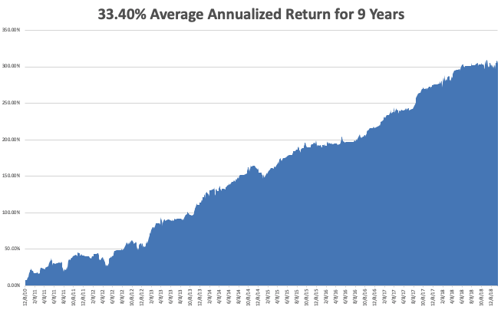
GTD 9 Year Daily Audited Performance

Slide 7

The Method to My Madness
*The bottom is in for stocks for a trade, but are we in for a failed rally or new highs?
*Markets have seen the best January in 30 years
*Bonds have peaked and interest have bottomed for 2019, yield up 30 BP in 2019
*Fed has turned from hawkish to dovish, a huge risk positive and dollar negative
*Oil crash is over
*China is now the big unknown, can it recover
from a death spiral?
*All that said, I still expect the S&P 500
to be down 5% by the end of the year
but there is still good money to be made

Slide 8
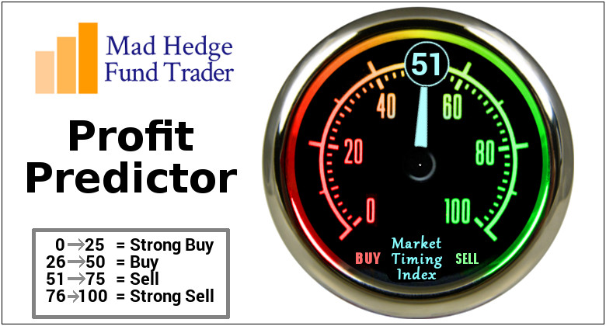
The Mad Hedge Profit Predictor
Market Timing Index-
An artificial intelligence driven algorithm that analyzes 30 different economic, technical, and momentum driven indicators

Slide 9
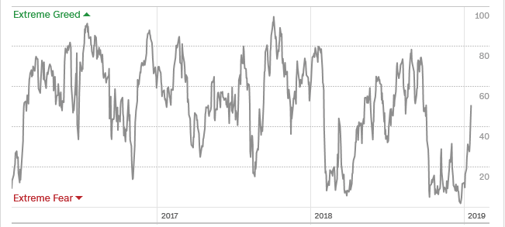
The Mad Hedge Profit Predictor
A 3 Month High
SELL
BUY

Slide 10
The Global Economy – Unstable
*Government shut down slowing the economy by 0.13% a week, and the bill is 52 basis points off 2019 growth so far, and may lose another 50 bp before it is over and the economy restarts. Empire State Manufacturing Index plunges by 8 to a two year low, December Producer Price Index down by 0.2%
*China cuts bank reserve requirements and tax in a massive effort to float the economy
*However, trade war induced slowdowns in China and Europe are starting to drag on the US
*Lower interest rates everywhere is so far showing
no positive effect
*Newly weakened dollar will boost non-dollar plays,
like emerging markets (EEM) and the currencies
(FXE) and (FXY), and oil (USO)
*Watch out for terrible data coming out of
Europe and China in February

Slide 11
Soybeans (-20%)-Trade War Indicator
Price Action Suggests that the China Trade Talks are Going Better than people realize

Slide 12
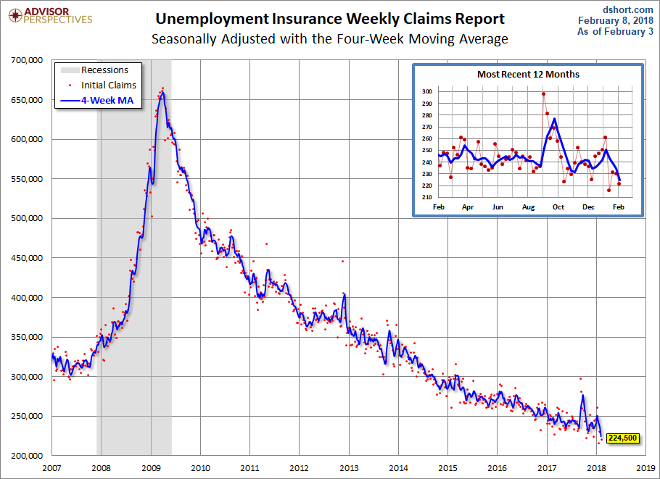
Weekly Jobless Claims –The Most Important Statistic
-3,000 to 213,000,

Slide 13
The Bill Davis View
A $1,500 Upgrade for the Mad Day Trader Service
Buys: | Entry | Target
Johnson & Johnson (JNJ) | $ 128.00 | $ 145.00
Jazz Pharmeceuticals (JAZZ) | $ 131.00 | $ 155.00
AmerisourceBergen (ABC) | $ 75.00 | $ 87.00
United Continental (UAL) | $ 82.00 | $ 95.00
Exxon Mobil (XOM) | $ 72.00 | $ 84.00
Sells:
Tesla Inc. (TSLA) | $ 309.00 | $ 250.00
F5 Networks (FFIV) | $ 167.00 | $ 150.00
Qualcomm Inc. (QCOM) | $ 60.00 | $ 50.00
Netflix Inc. (NFLX) | $ 345.00 | $ 270.00
Alibaba Group (BABA) | $ 174.00 | $ 130.00

Slide 14
Stocks – Back to the Middle of the Range
*The Christmas Eve massacre was the bottom in this cycle at (SPY) 2,340, Dow 21,600
*PE multiples have popped from 14X to 17X, back to the middle of the range
*Trade war settlement and end of government shut down could be a threat to the market on a “buy the rumor, sell the news”
*Another $1 trillion in new share buybacks kicks in, corporations will be the biggest buyers of stock in 2019 for the second year in a row
*Tech will continue lead to the upside as the sold
off the most and have the cash to bid
their shares back up
*Value names will start to perform
as recession fears rise
*Bottom Line: its bet the ranch time on tech longs,
but stay away from those with big China exposure,
like Apple, and weak dollar plays like energy, and
emerging markets

Slide 15
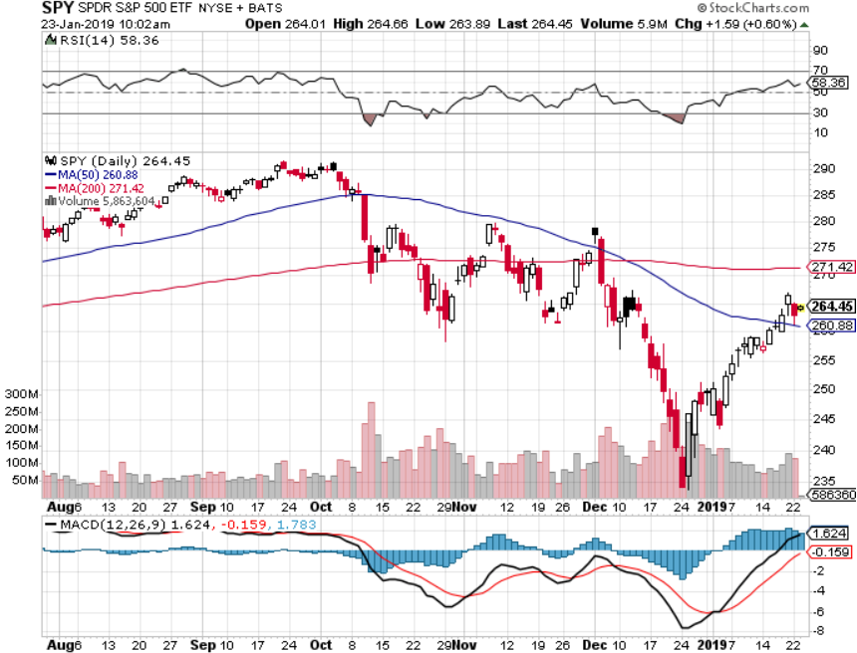
S&P 500- long 2/$270-$275 bear put spread

Slide 16
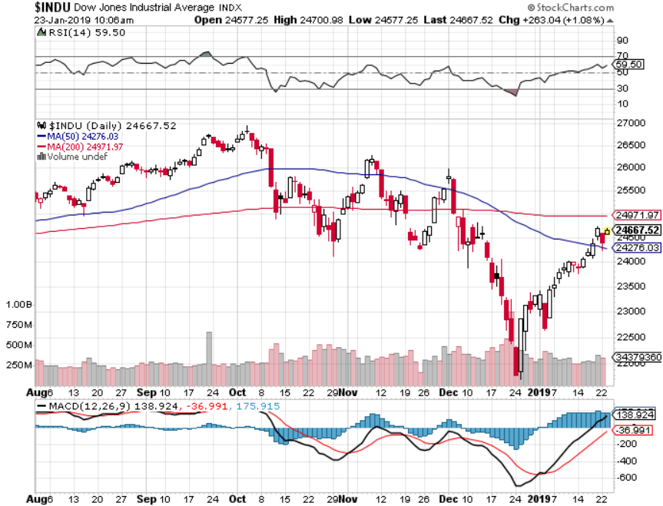
Dow Average-

Slide 17
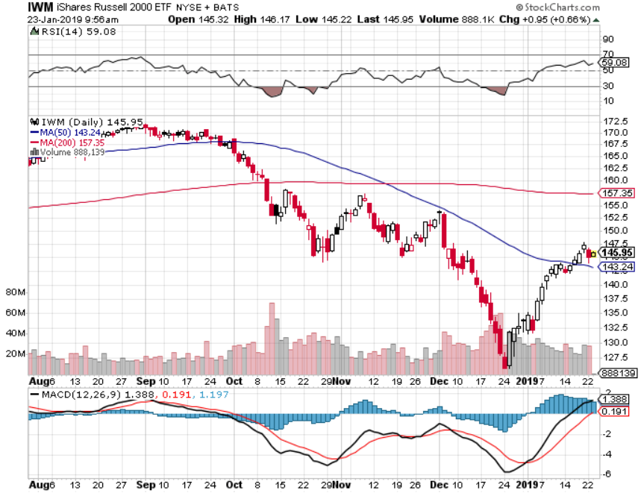
Russell 2000 (IWM)-

Slide 18
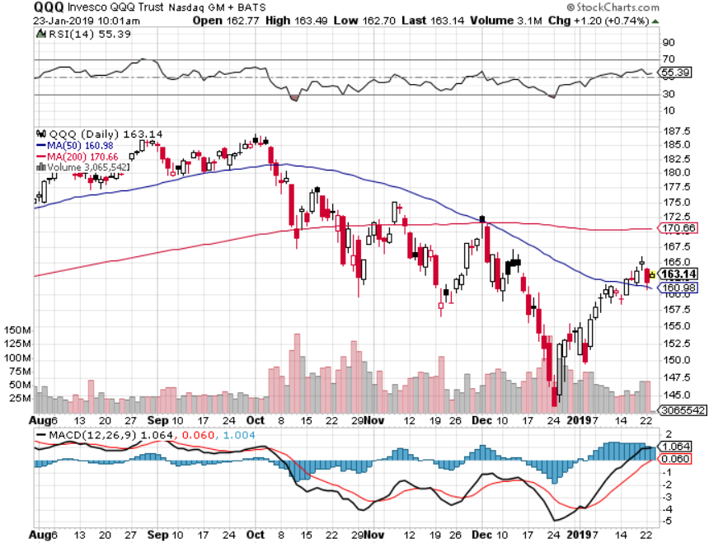
NASDAQ (QQQ)

Slide 19
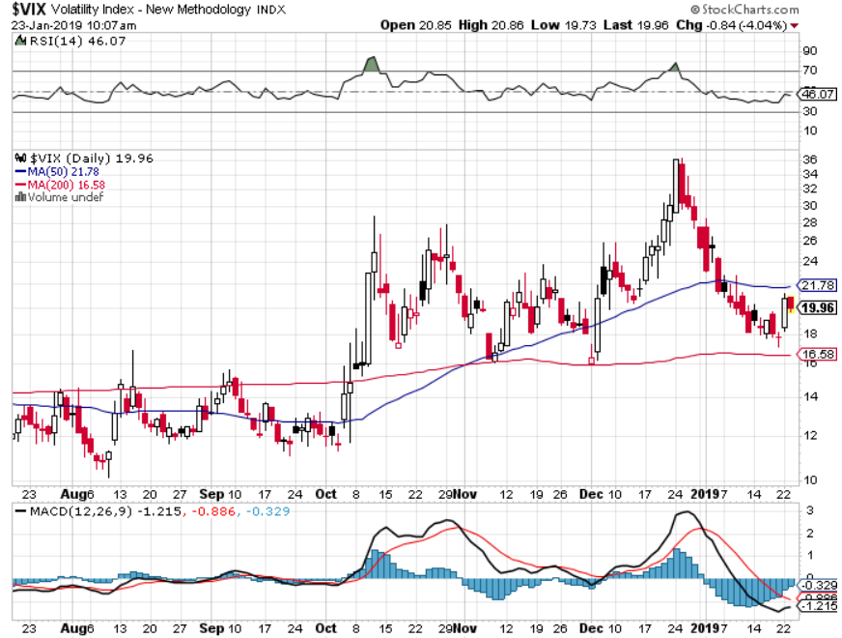
(VIX)- Probing Lows

Slide 20
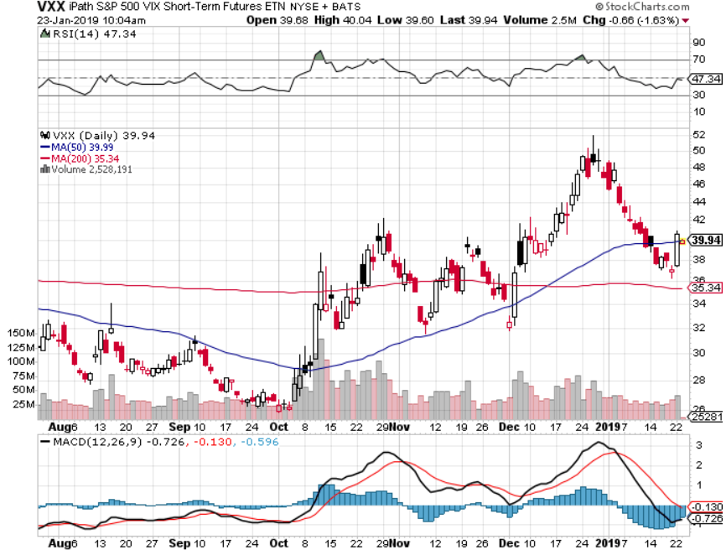
iPath S&P 500 VIX Short-Term Futures ETN (VXX)

Slide 21
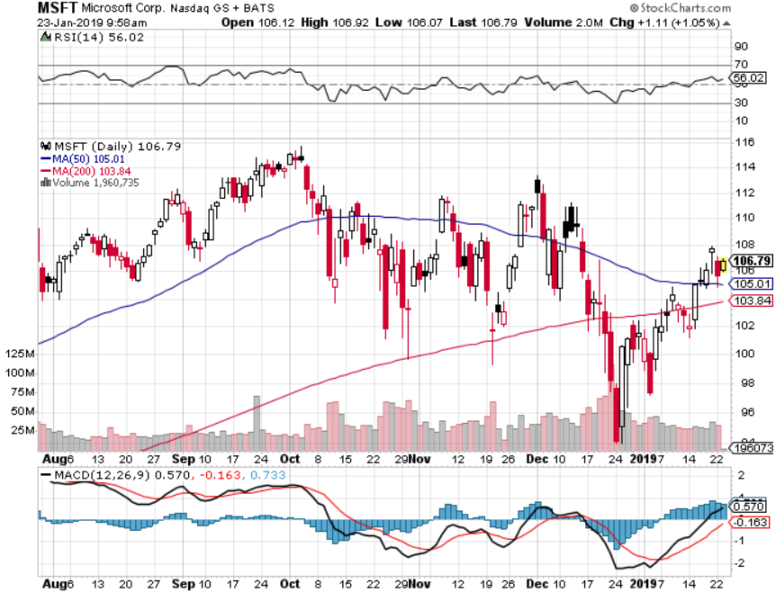
Microsoft (MSFT)- Earnings beat long 2/$85-$90 call spread

Slide 22
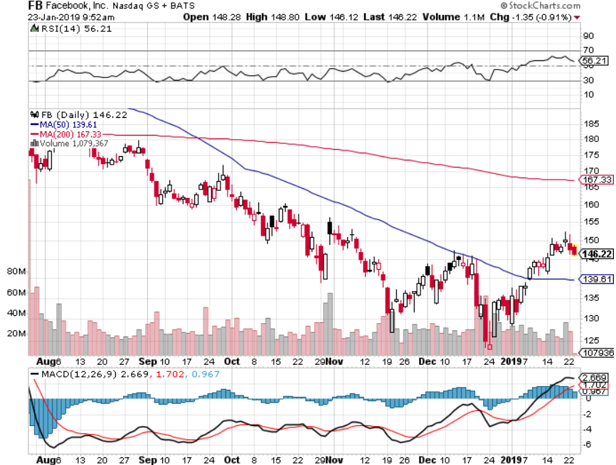
Facebook (FB)- Struggling

Slide 23
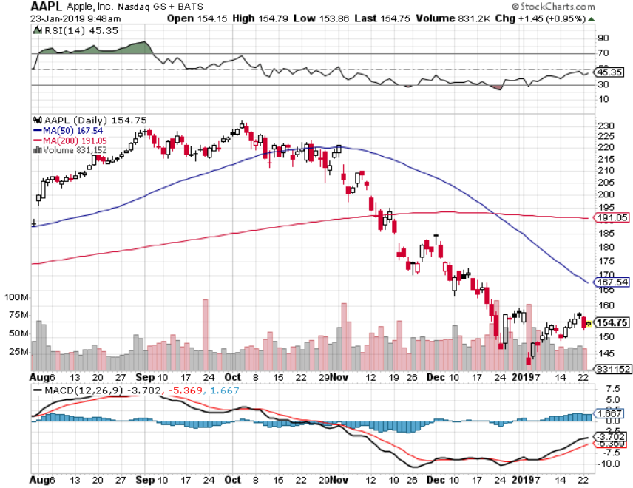
Apple (AAPL)- Underperforming
Earnings Out Jan 29 long 11/$165-$175 bear put spread

Slide 24
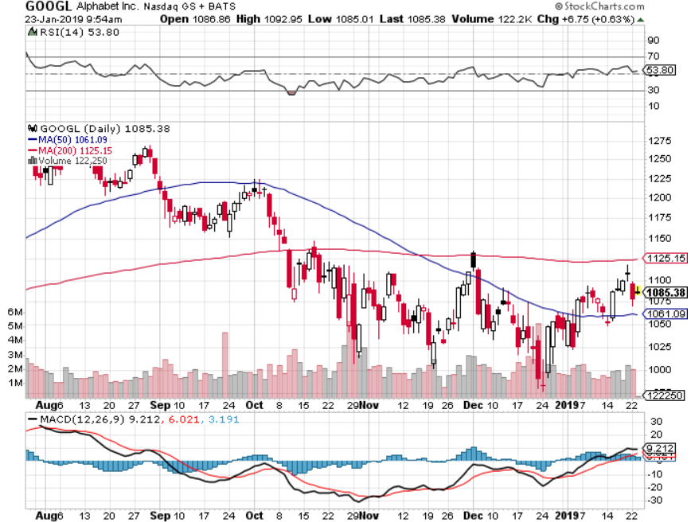
Alphabet (GOOGL)-

Slide 25
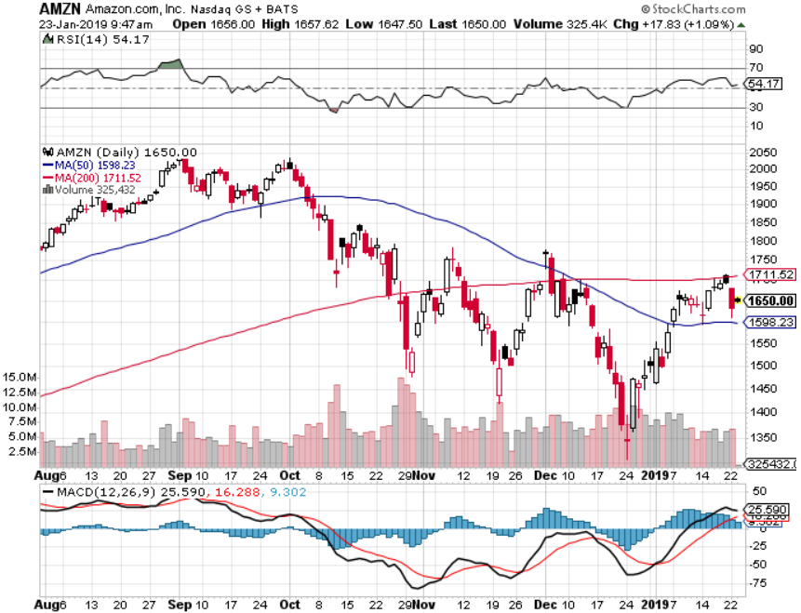
Amazon (AMZN)-Back to Top of Range no China business took profits on long 2/$1,200-$1,300 call spread

Slide 26
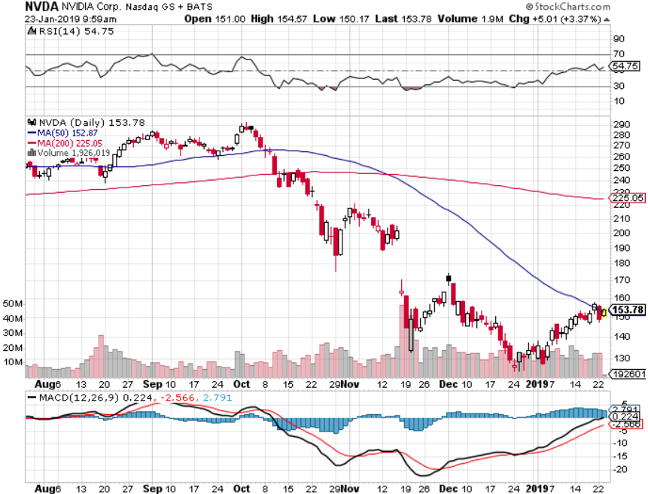
NVIDIA (NVDA)- The High Betas are Bouncing Hard

Slide 27
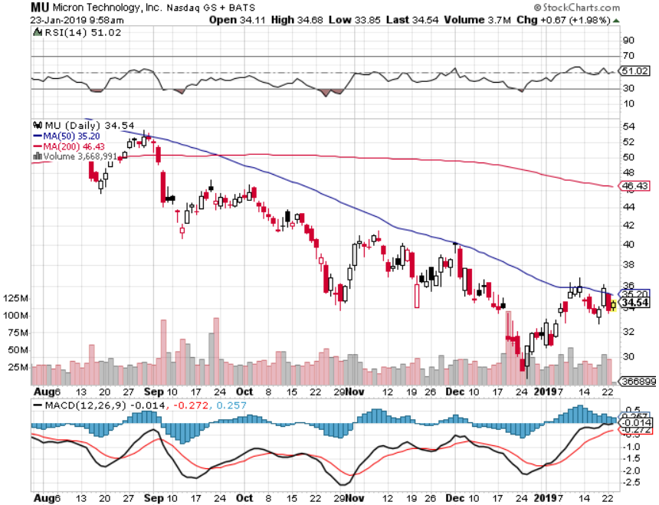
Micron Technology (MU)-Trade Wars

Slide 28
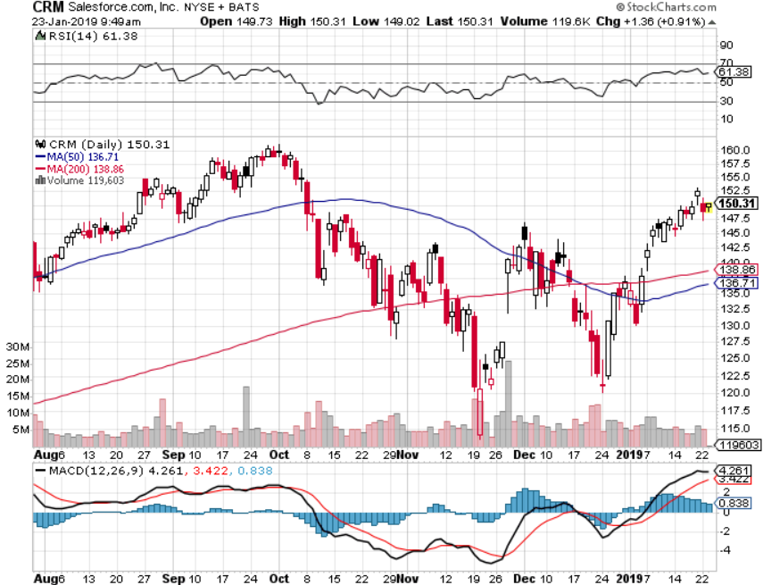
Salesforce (CRM)-Great Earnings-New Highs took profits on long 2/$105-$115 call spread

Slide 29
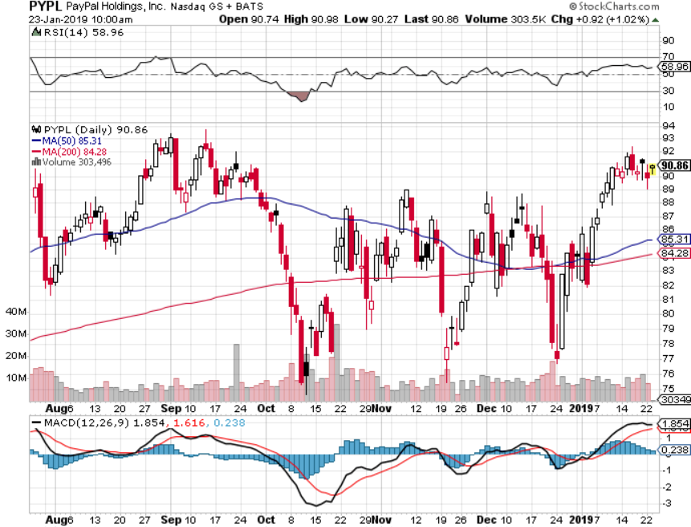
PayPal (PYPL)-

Slide 30
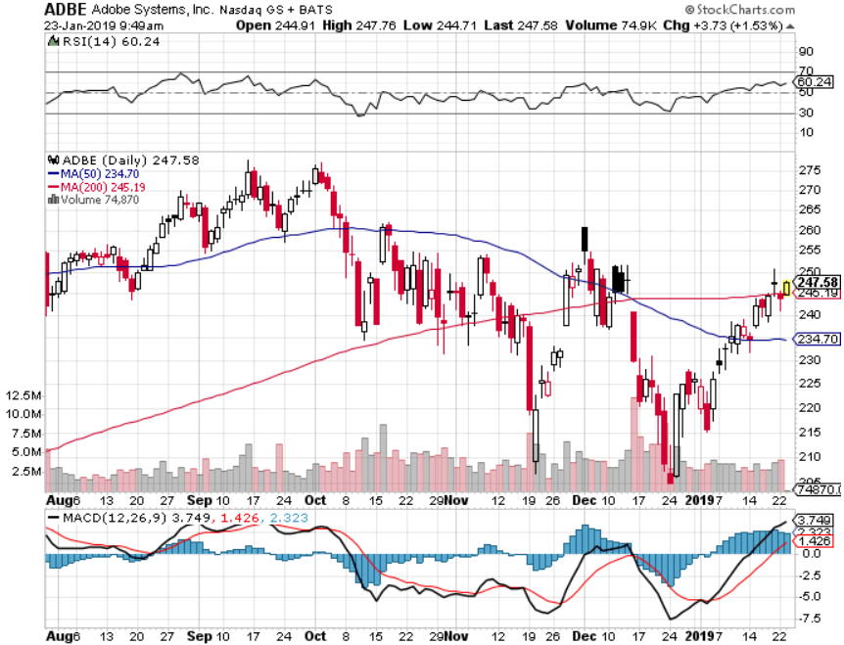
Adobe (ADBE)-
The Quality Non-China tech play

Slide 31
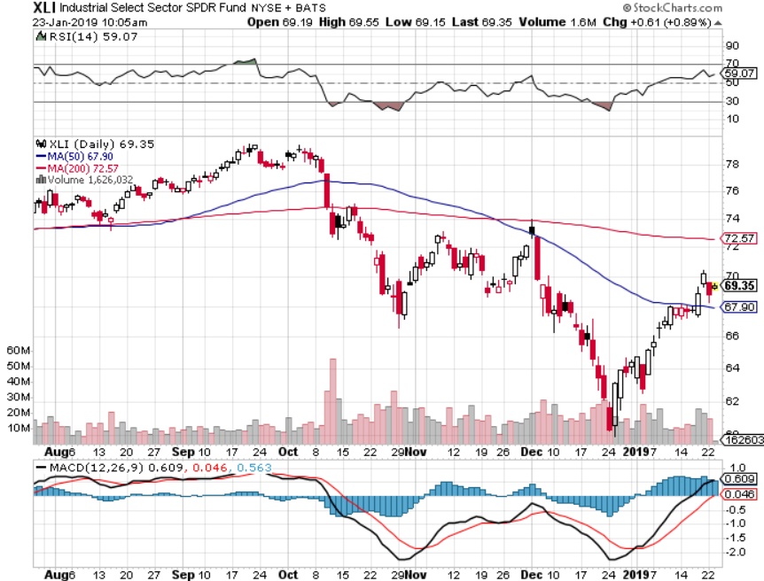
Industrials Sector SPDR (XLI)-No Support
(GE), (MMM), (UNP), (UTX), (BA), (HON)

Slide 32
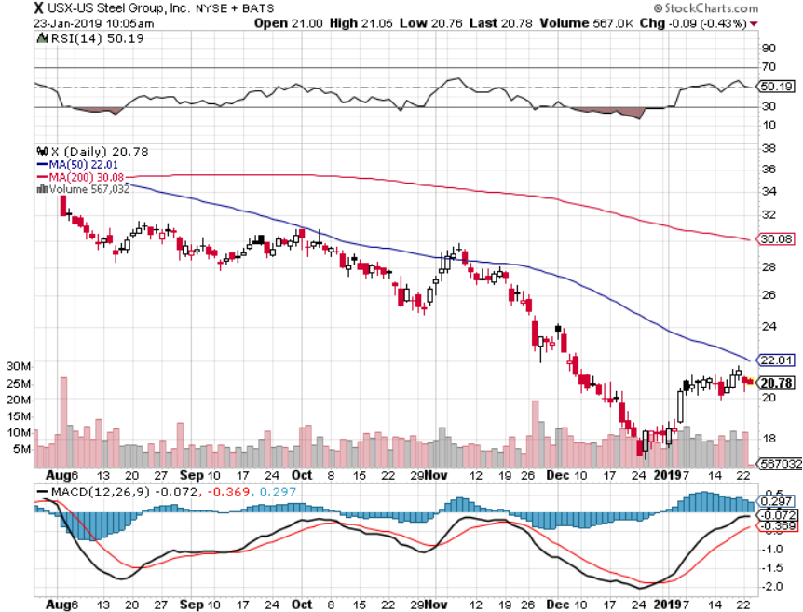
US Steel (X)-Tariffs Trouble
Import duties cause users to abandon steel
Unwound the entire Trump trade

Slide 33
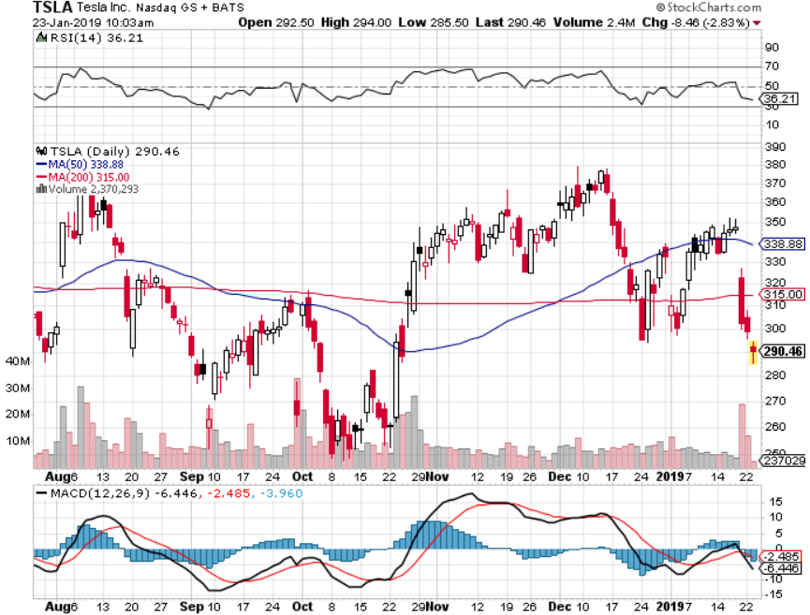
Tesla (TSLA)-
Cut 7% of Work Force, China airbag recall

Slide 34
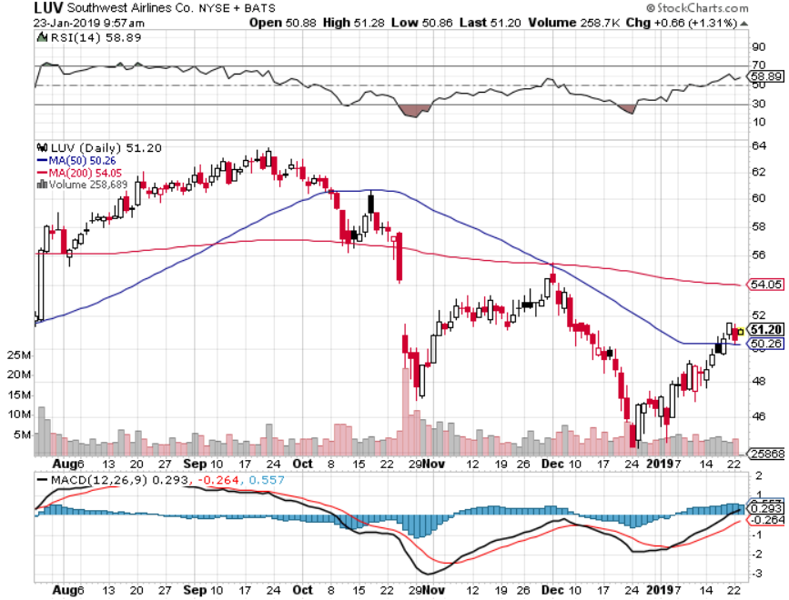
Southwest Airlines (LUV)-No oil help
Warren Buffett’s Favorite Airline

Slide 35
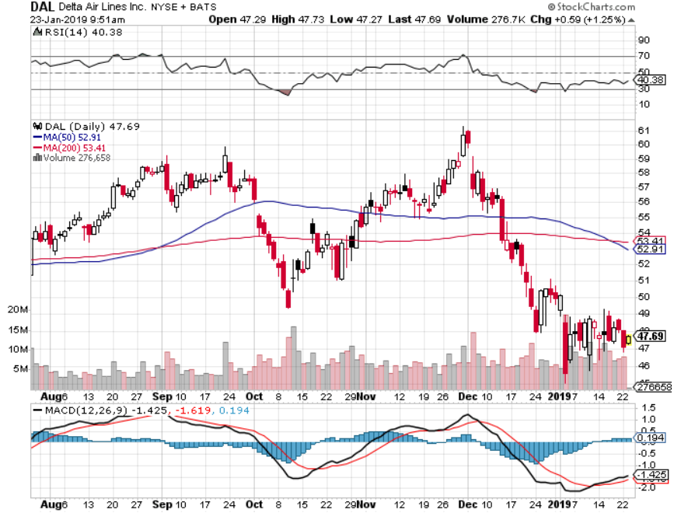
Delta Airlines (DAL)

Slide 36
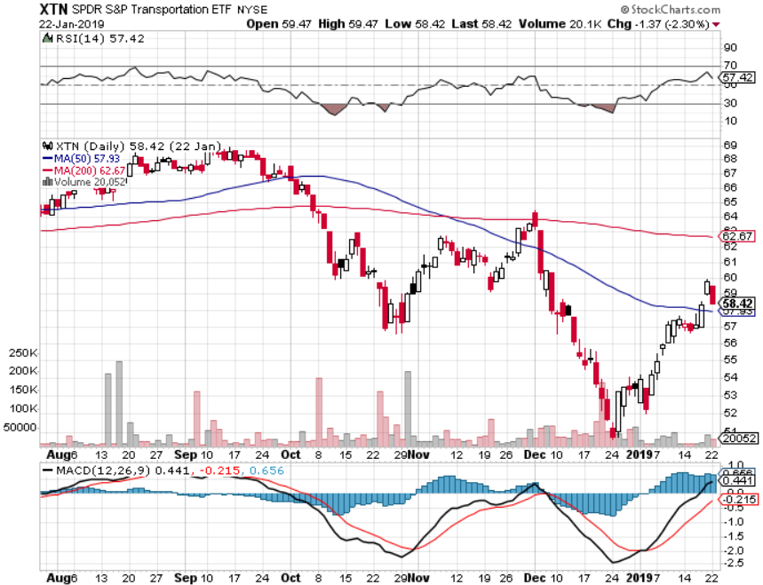
Transports Sector SPDR (XTN)-
(ALGT), (ALK), (JBLU), (LUV), (CHRW), (DAL)

Slide 37
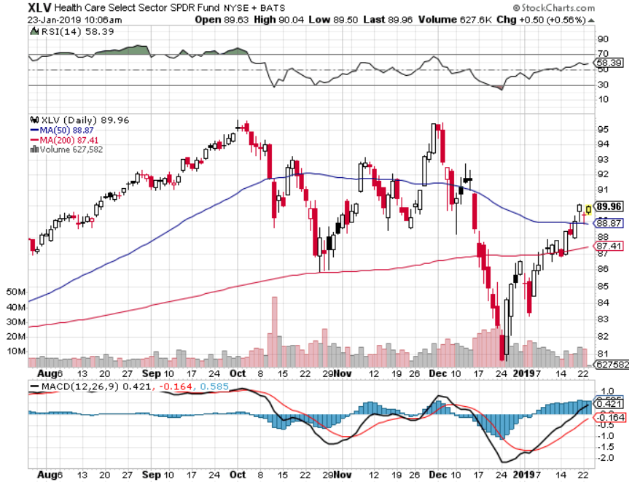
Health Care Sector (XLV), (RXL)-New Highs
(JNJ), (PFE), (MRK), (GILD), (ACT), (AMGN)

Slide 38
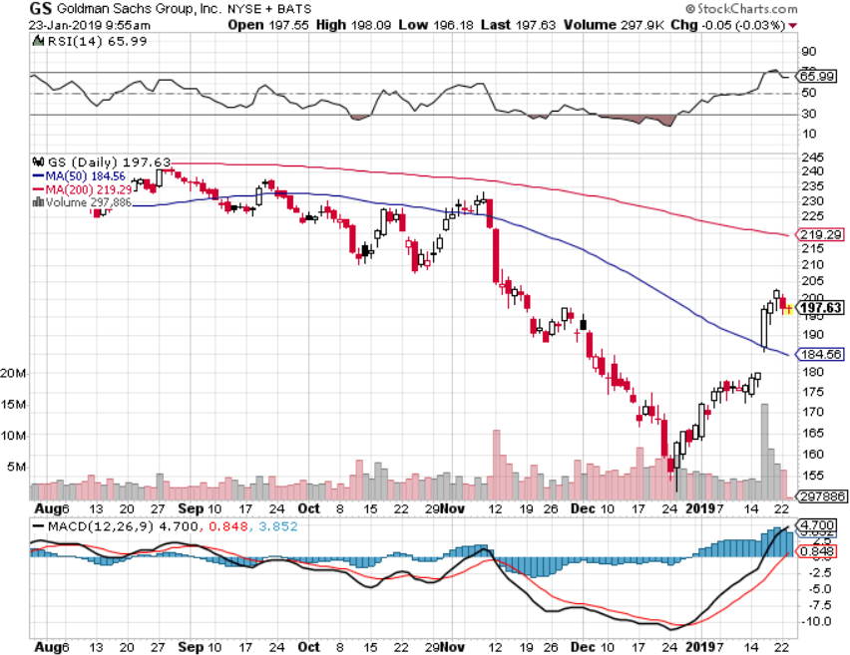
Goldman Sachs (GS)-The Next Buggy Whip maker

Slide 39
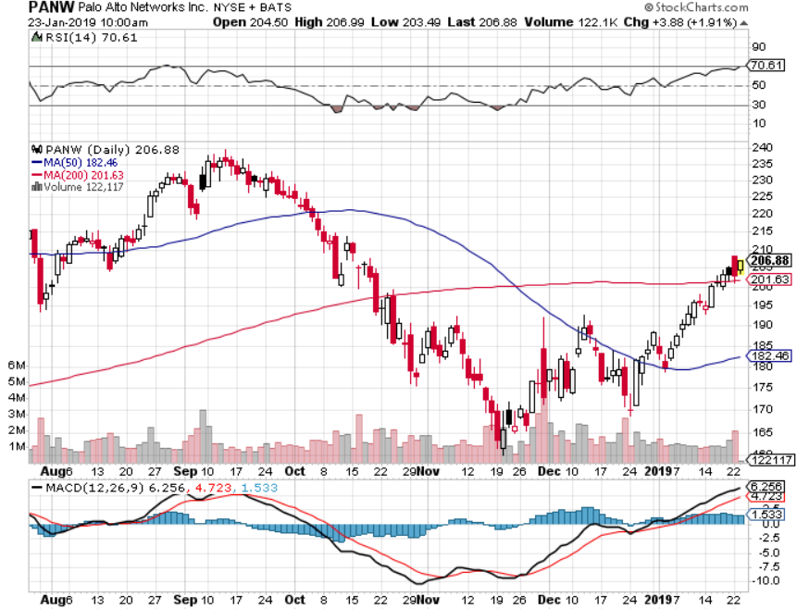
Palo Alto Networks (PANW)-
Hacking never goes out of fashion

Slide 40
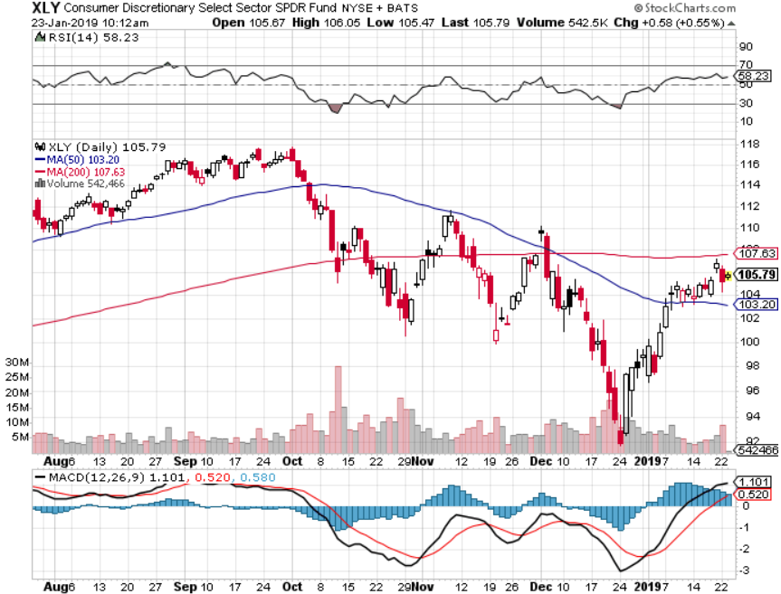
Consumer Discretionary SPDR (XLY)
(DIS), (AMZN), (HD), (CMCSA), (MCD), (SBUX)

Slide 41
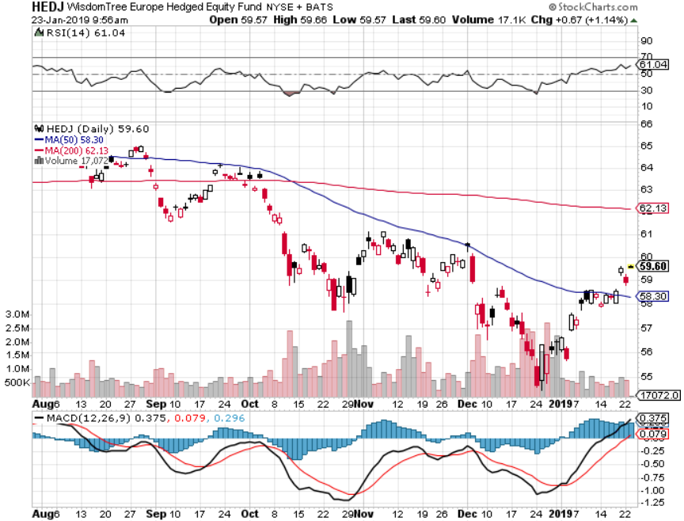
Europe Hedged Equity (HEDJ)-Quadruple top Top

Slide 42
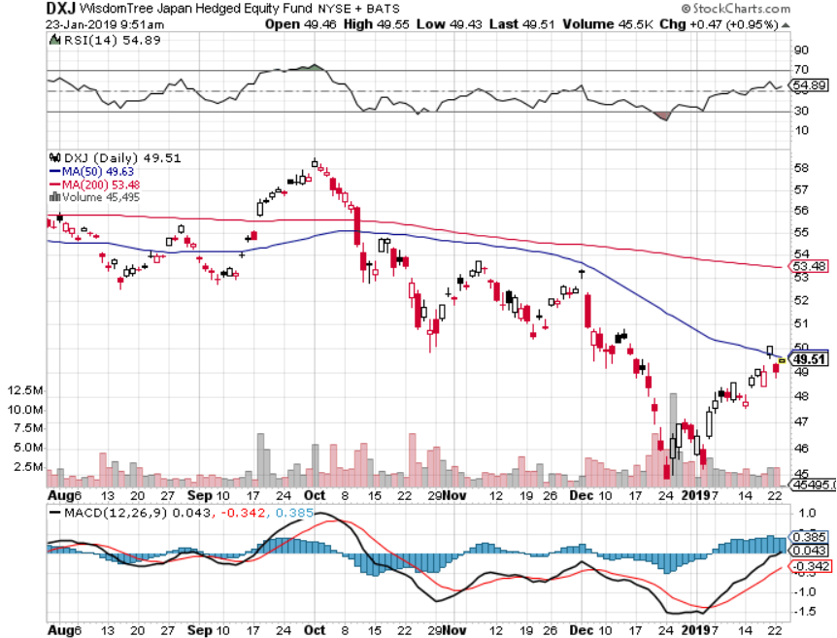
Japan (DXJ)-

Slide 43
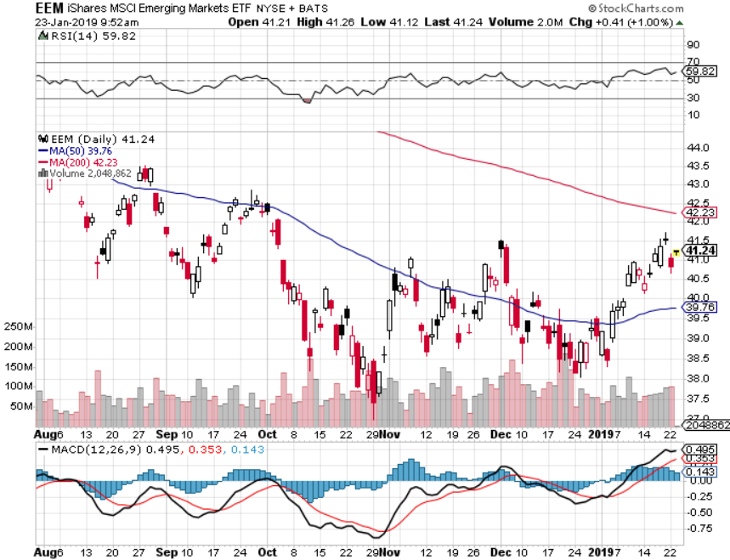
Emerging Markets (EEM)- Time to Buy on Weak Dollar

Slide 44
Bonds- It’s All About Jay
*Fed switch from hawk to dove reignites the bear market for bonds
*Going from 3 Fed rate hikes in 2019 to possibly none in one minute
*Bond yields recover from 2.55% to 2.85%
*Still looking for 3.50% ten year US Treasury in a year, but what if the peak in this cycle is already in at 3.25%?
*Total government issuance plus the Fed’s quantitative tightening totals $1.8 trillion in 2018, and there’s no way the bond market can handle this
*Exploding deficits will weigh on
bonds for the next decade, sell every
rally across the space
Bottom Line: Sell every four point
rally in the (TLT)

Slide 45
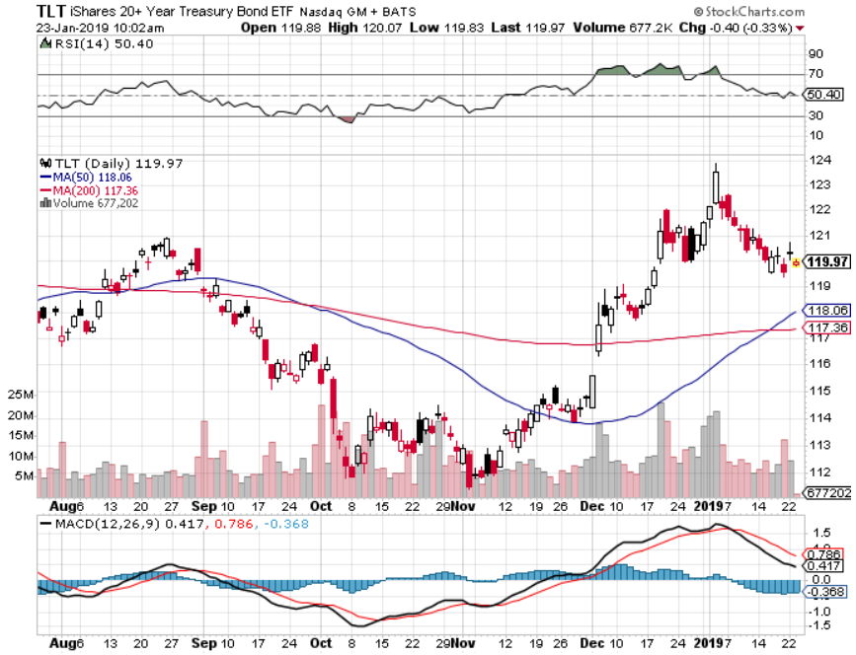
Treasury ETF (TLT) – Bottom of Range took profits on long 1/$124-$127 call spread long 2/$125-$128 call spread

Slide 46
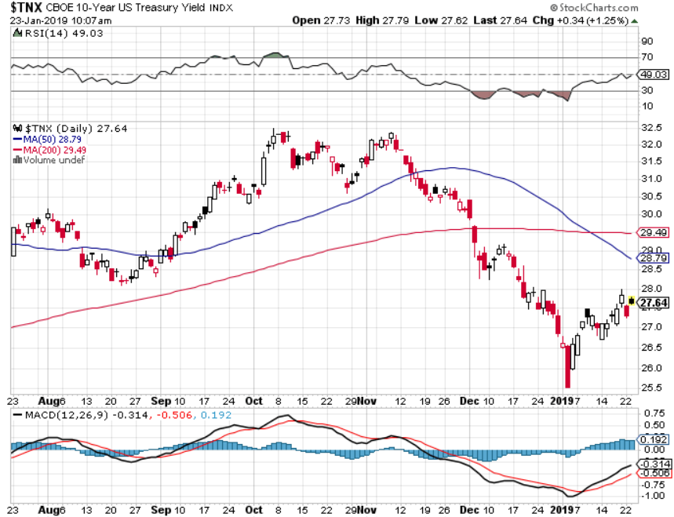
Ten Year Treasury Yield ($TNX) 2.85%
Breakdown, Now major Support

Slide 47
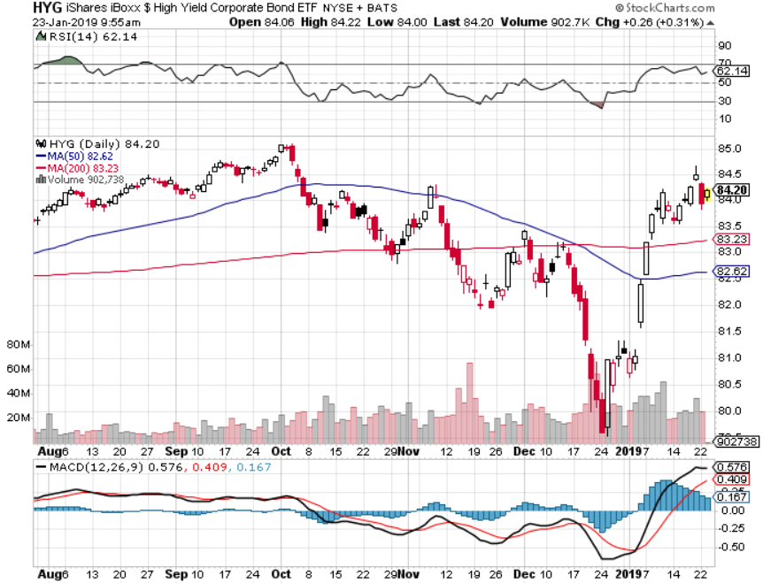
Junk Bonds (HYG) 5.60% Yield

Slide 48
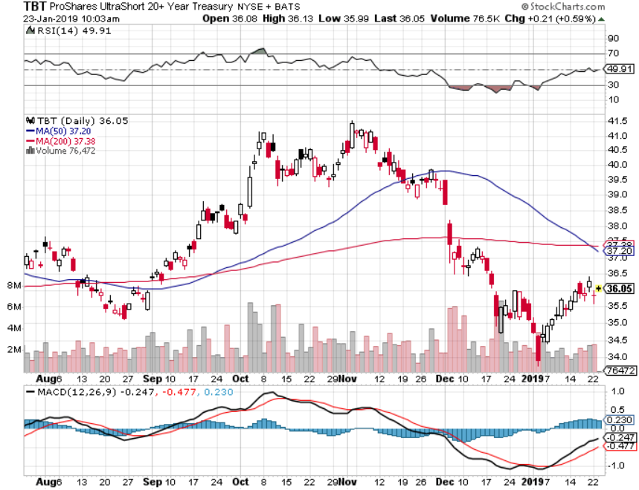
2X Short Treasuries (TBT)-Buy Territory

Slide 49
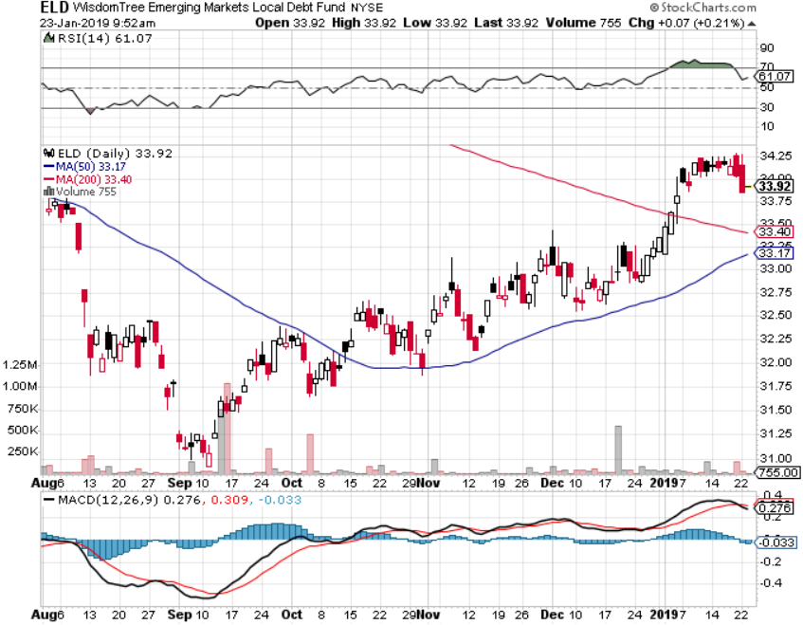
Emerging Market Debt (ELD) 6.02% Yield-

Slide 50
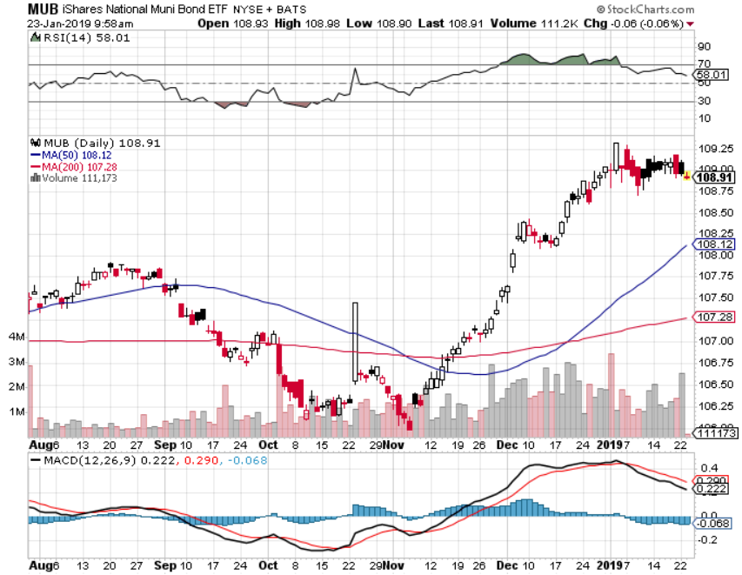
Municipal Bonds (MUB)-2.52%
Mix of AAA, AA, and A rated bonds

Slide 51
Foreign Currencies – Dollar Rally
*Big “RISK ON” move in equities trigger interest rates rise and dollar rally, but it won’t last with inactive Fed
*RISK is now a bigger driver of currencies than interest rates
*British pound stages huge 5 cent rally on Brexit fail
*Massive Chinese economic stimulus drives Yuan higher
*Bitcoin at $3,500 is dead money
*Bottom Line: sell dollars, buy the Euro (FXE)

Slide 52
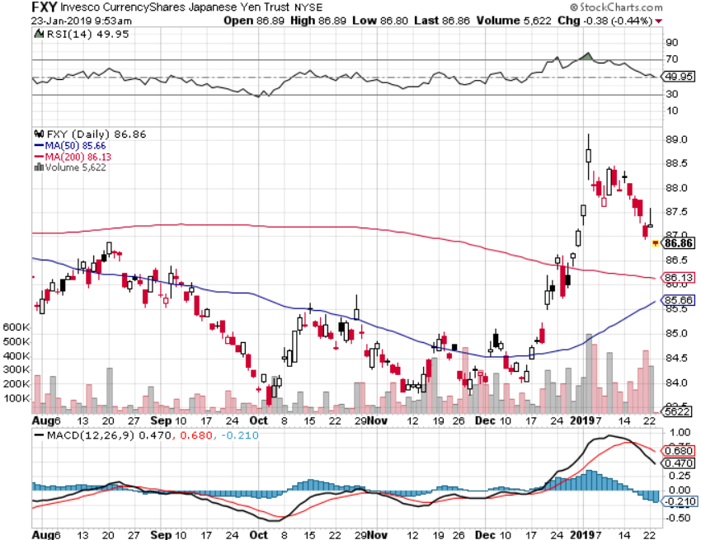
Japanese Yen (FXY), (YCS)

Slide 53
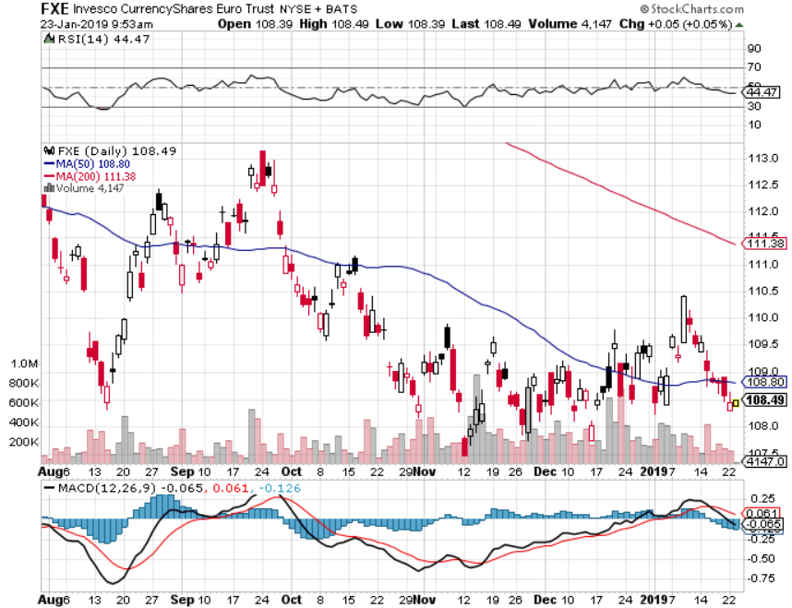
Euro ($XEU), (FXE), (EUO)- Trying to Break Down long 2/$105-$108 call spread

Slide 54
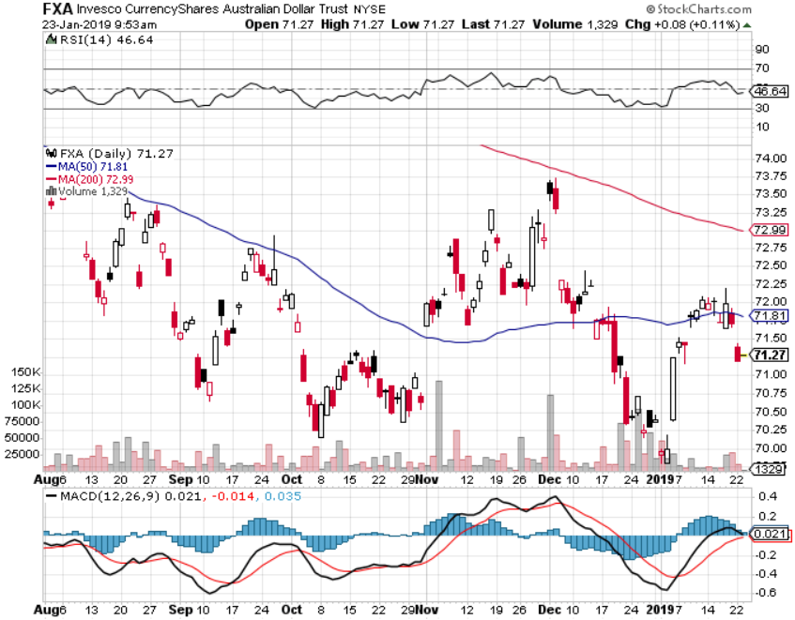
Australian Dollar (FXA)-

Slide 55
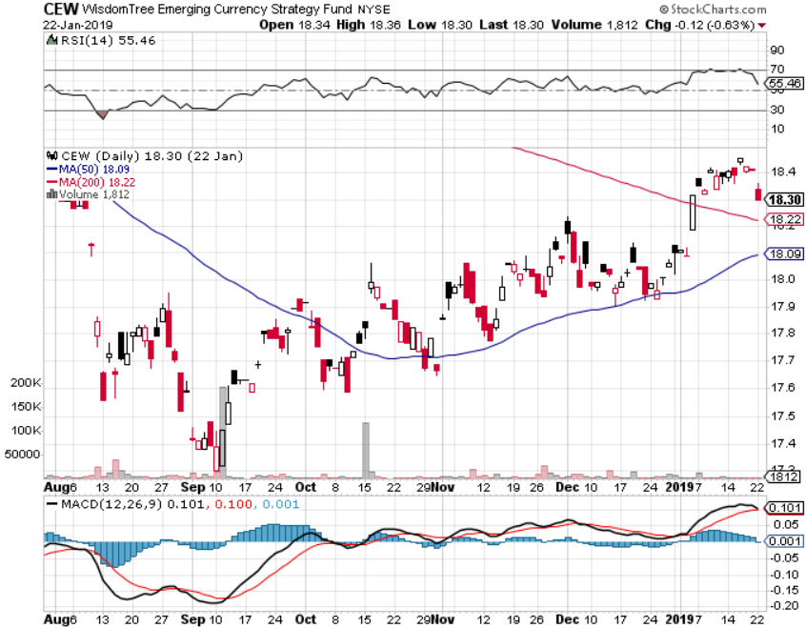
Emerging Market Currencies (CEW)

Slide 56
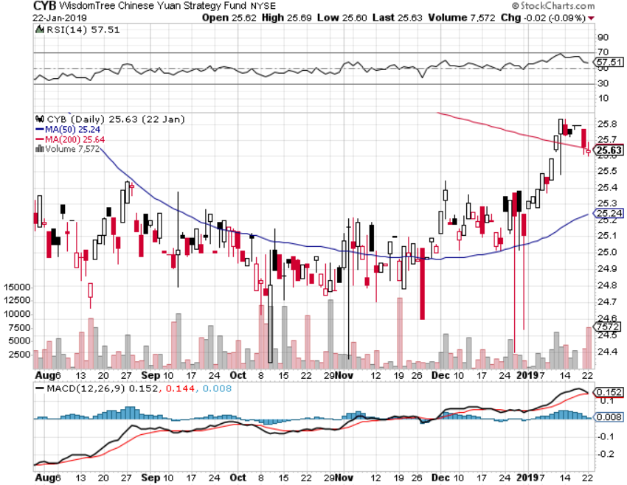
Chinese Yuan- (CYB)-

Slide 57
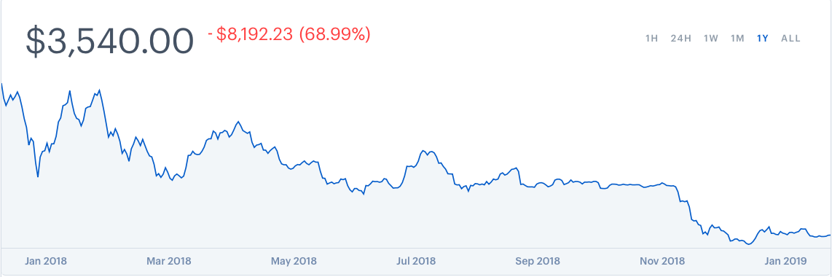
Bitcoin- Dead Money

Slide 58
Energy – Rally Time
*Saudi production cut of 500,000 barrels/day keeps the oil rally going
*String stocks pulling up oil and strong oil pulling up stocks, it’s a mutual admiration society
*Weak dollar is providing a bid for the entire commodity complex, including oil
*Chinese economic stimulus, the largest marginal new buyer of crude is another positive
*Copper bouncing along two
year lows
*Bottom Line: Buy the dips

Slide 59
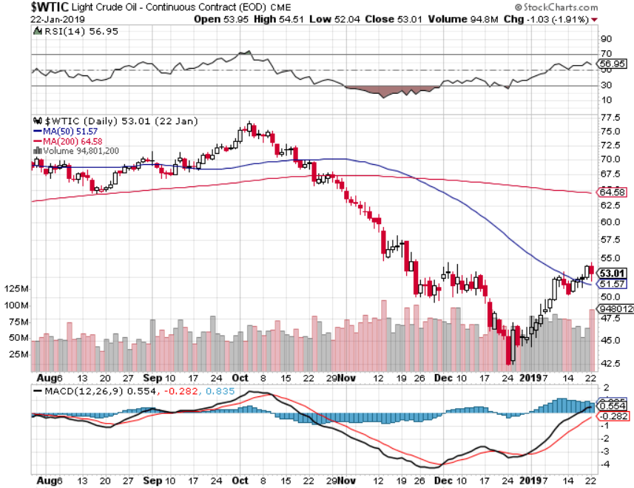
Oil-Bouncing

Slide 60
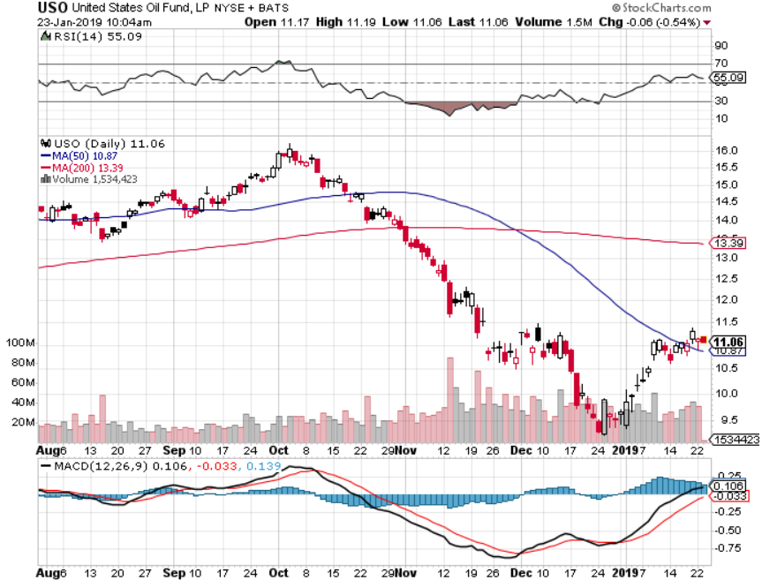
United States Oil Fund (USO)

Slide 61
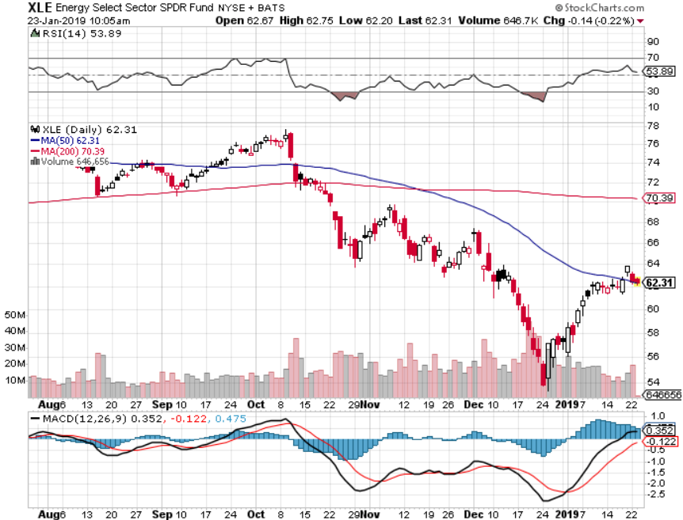
Energy Select Sector SPDR (XLE)-No Performance!
(XOM), (CVX), (SLB), (KMI), (EOG), (COP)

Slide 62
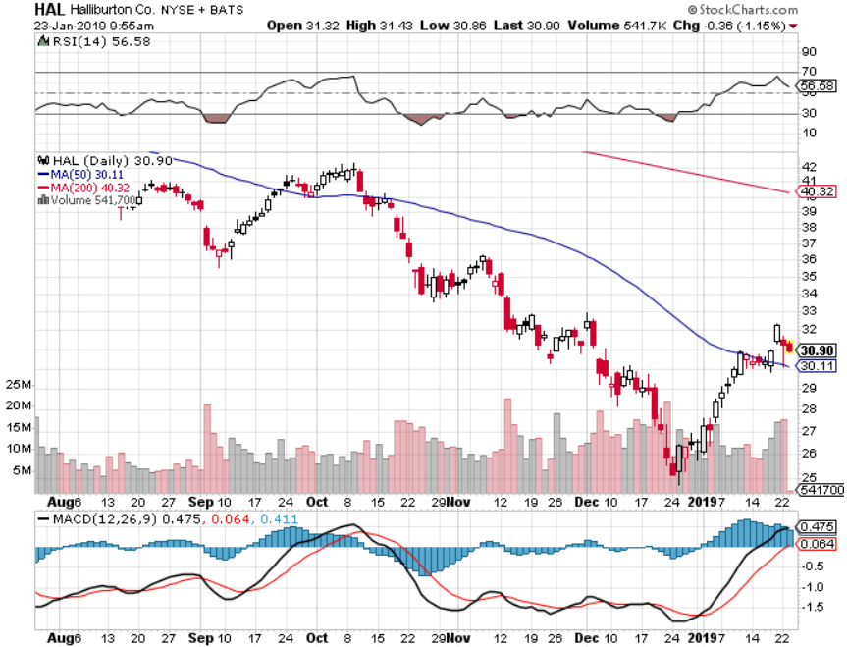
Halliburton (HAL)-

Slide 63

Natural Gas (UNG)-
Major Hedge Fund Blow Up

Slide 64

Copper (COPX)-Flatlining on the bottom
Trade War Fears Crush

Slide 65
Precious Metals – The Rally fades
*Monster stock rally knocks the wind out of gold, which will take a break as long as interest rates are rising and the dollar is strong
*However, the $10 billion takeover of Goldcorp by Newmont Mining (NEM) means a larger bull move is shaping up
*The real move for gold won’t begin
until we get true inflation, which won’t
appear until later this year
*Bottom Line: take profit for now,
get out of the way for a 1-3 month
“RISK ON” rally

Slide 66

Gold (GLD)-No Help from Trade War

Slide 67

Market Vectors Gold Miners ETF- (GDX) – Yikes!

Slide 68

Barrick Gold (ABX)

Slide 69

Newmont Mining- (NEM)-

Slide 70

Palladium - (PALL)-

Slide 71
Real Estate – A Pulse Returns
*Dramatic decline in 30 year mortgage interest rates, from 3.10% to 2.40%, brings a pulse back to a dead real estate market
*Affordability gets a big boost, with falling rates and prices
*Government shut down is still interfering with the closing process on a widespread scale, putting 500,000 home mortgages at risk
*December Existing Home Sales down 6.4% to annualized 4.99 million, down 10% YOY, prices up 2.9% YOY, smallest gain in 6 years
*September S&P 500 Case-Shiller drops to 5.1%,
annual gain, the lowest gain in four years
*Single family rent prices gaining only
2.9% YOY
*Bottom Line: Stand aside for a trade
but buy for long term investment

Slide 72

October Corelogic S&P Case Shiller Home Price Index
Las Vegas, Seattle, and San Francisco still showing biggest gains
Tradingeconomics.com

Slide 73

Simon Property Group (SPG)-

Slide 74

US Home Construction Index (ITB)
(DHI), (LEN), (PHM), (TOL), (NVR)

Slide 75

Trade Sheet-
So What Do We Do About All This?
*Stocks-buy dips
*Bonds-sell any and all rallies
*Commodities-buy dips
*Currencies-buy dips
*Precious Metals – stand aside
*Volatility-buy dips to $15
*Real estate-stand aside

Slide 76

Next Strategy Webinar
12:00 EST Wednesday, February 6,
2019 from San Francisco, CA www.madhedgefundtrader.com email me at support@madhedgefundtrader.com
Good Luck and Good Trading!
Notes:
*

