Slide 1
The Mad Hedge Fund Trader “Entering the Minefield”
With John Thomas from Silicon Valley, CA, February 6, 2019 www.madhedgefundtrader.com
Notes:
*

Slide 3
Trade Alert Performance New All Time High
*January 9.49% Final *July +0.0% Final *February -2.02% MTD *August +2.19% MTD *March +1.13% Final *September 1.38% Final *April +12.54% Final *October +1.37% Final *May +1.07% Final *November -2.56% Final *June +4.15% Final *December -4.13% Final *2019 Year to Date 9.49% compared to +8.70% for the Dow Average *Trailing One year return +29.24%, +309.45% since inception, *Average annualized return of 33.76%

Slide 4
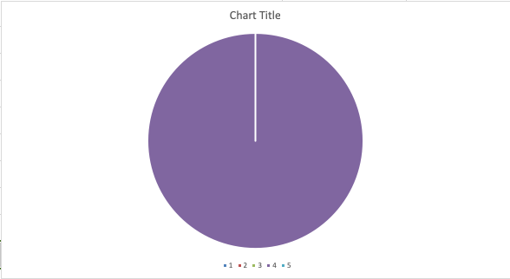
Portfolio Review running small short after great market run
Current Capital at Risk
Risk On
World is Getting Better
NO POSITIONS
Risk Off
(TLT) 2/$124-$126 put spread | -10.00%
Total Net Position | -10.00%
Expiration P&L 7.63%

Slide 5
My Short List of Possible Trades
BUY Home Depot (HD) Emerging Markets (EEM) Boeing Aircraft (HD) Freeport McMoRan (FCX) Walt Disney (DIS) Visa (V) eBay (EBAY) Occidental Petroleum (OXY) Sell S&P 500 (SPY) over $280

Slide 6
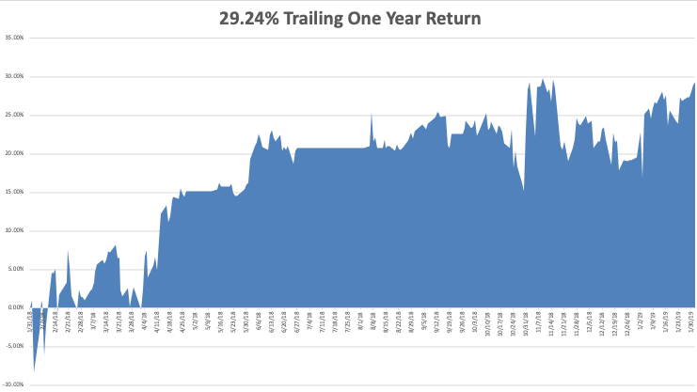
GTD Daily Audited Performance

Slide 7
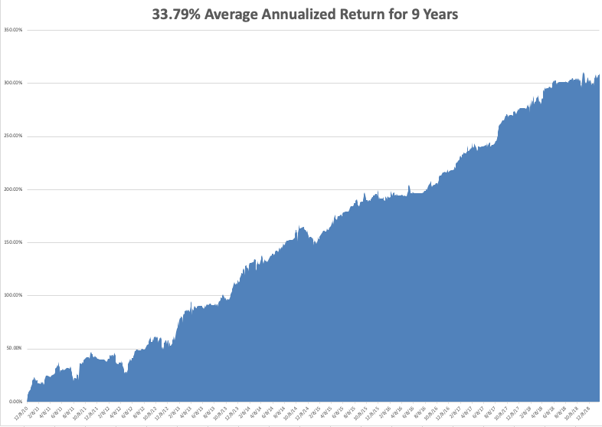
GTD 9 Year Daily Audited Performance

Slide 8
The Method to My Madness
*Only one big positive left: resolution of the China trade war. Once that’s done there is nothing left to support the market buy corporate buybacks for the rest of 2019 *Falling earnings are the biggest market challenge for 2019 *Head and shoulders top for the bond market? *Fed keeps pounding away with a dovish message, but for how long? *Oil remains strong on Venezuela collapse *Europe is falling to pieces *Interest in gold is booming

Slide 9
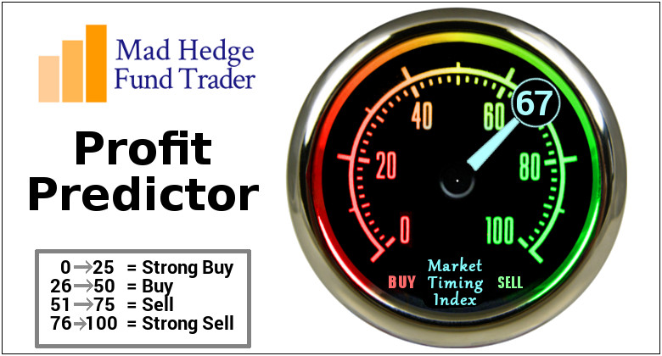
The Mad Hedge Profit Predictor Market Timing Index- An artificial intelligence driven algorithm that analyzes 30 different economic, technical, and momentum driven indicators

Slide 10
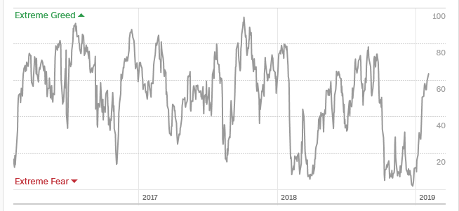
The Mad Hedge Profit Predictor A 5 Month High-Not “BUY” Territory
SELL
BUY

Slide 11
The Global Economy – Unstable
*Government shut down will most certainly deliver a negative Q1 for the economy, a second one will bring a recession. Private sector took the biggest hit as government employees eventually will get paid. *304,000 January Nonfarm Payroll Report, shows the economy still lives, but against mixed data. Factory Orders down 0.6% in November because no one want to buy stuff ahead of a recession, January Consumer Sentiment collapses, from 98.3 to 91.2 *German GDP will come in under 1.5% in 2019, with risks to downside *China cuts bank reserve requirements and tax in a massive effort to float the economy *Trade war induced slowdowns in China and Europe are starting to drag on the US *Newly weakened dollar will boost non-dollar plays, like emerging markets (EEM) and the currencies (FXE) and (FXY), and oil (USO)

Slide 12
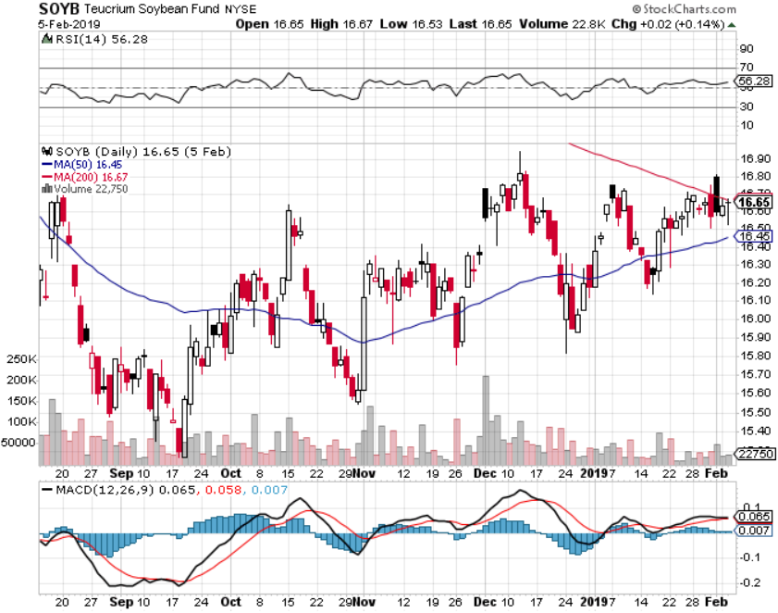
Soybeans (-20%)-Trade War Indicator Price Action Suggests that the China Trade Talks are Going Better than people realize

Slide 13
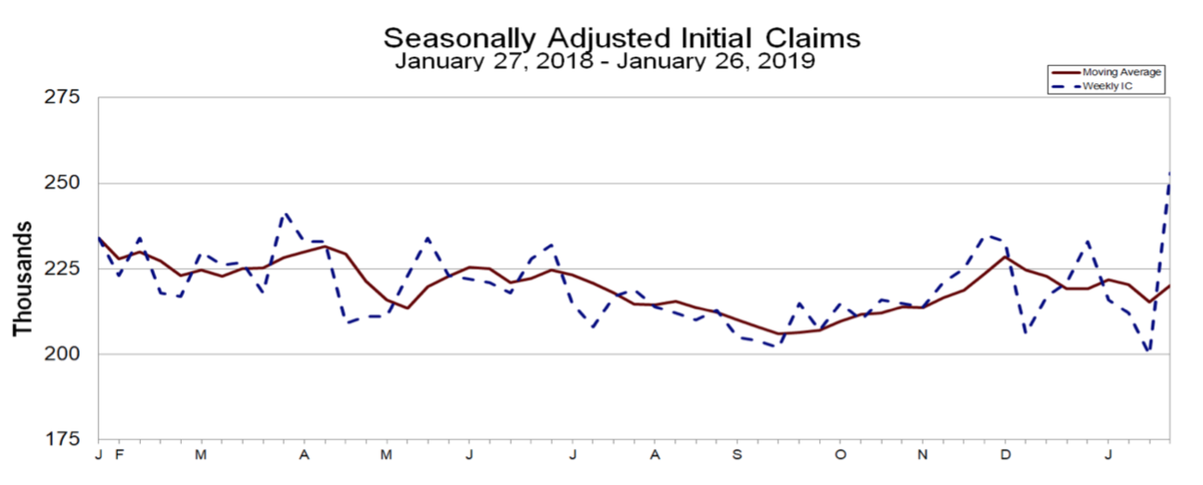
Weekly Jobless Claims –The Most Important Statistic +53,000 to 253,000
YIKES!

Slide 14
The Bill Davis View A $1,500 Upgrade for the Mad Day Trader Service
Buys: | Entry | Target
Jazz Pharmeceuticals (JAZZ) | $ 128.00 | $ 150.00
Facebook (FB) | $ 160.00 | $ 190.00
Eaton Corp (ETN) | $ 74.00 | $ 85.00
Quest Diagnostics (DGX) | $ 85.00 | $ 100.00
Bottomline Technologies (EPAY) | $ 45.00 | $ 55.00
Sells:
F5 Networks (FFIV) | $ 167.00 | $ 150.00
Tupperware (TUP) | $ 32.00 | $ 24.00
Alibaba Group (BABA) | $ 162.00 | $ 135.00
Electronic Arts (EA) | $ 90.00 | $ 75.00
Church & Dwight (CHD) | $ 66.00 | $ 56.00

Slide 16
Stocks – Entering Danger Territory
*Q4 earnings were mixed, but forward guidance is weak, and investors won’t pay up for falling earnings and an unstable political environment *Puts a revisit of the Christmas Eve lows back on the table *Trade war settlement could be a threat to the market on a “buy the rumor, sell the news”, the last positive to drive stocks upward *Another $1 trillion in new share buybacks kicks in, corporations will be the biggest buyers of stock in 2019 for the second year in a row *Tech is starting to fade, to be replaced by high quality value and health care stocks *During 2008-2018, 53% of profits went to buybacks, 30% to dividends, and 17% for capital spending *Bottom Line: its bet the ranch time on tech longs, but stay away from those with big China exposure, like Apple, and weak dollar plays like energy, and emerging markets

Slide 17
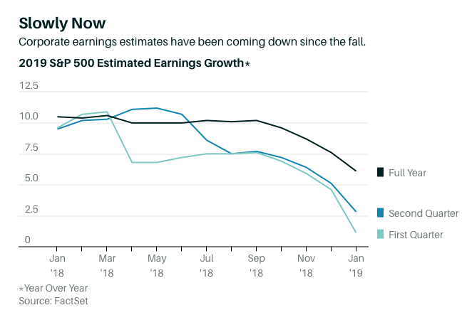

Slide 18
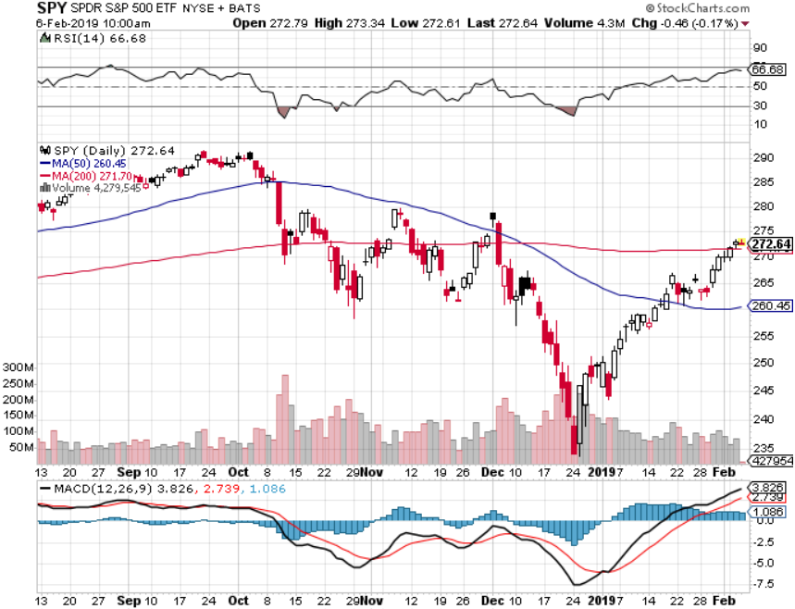
S&P 500- took profits on long 2/$270-$275 bear put spread

Slide 19
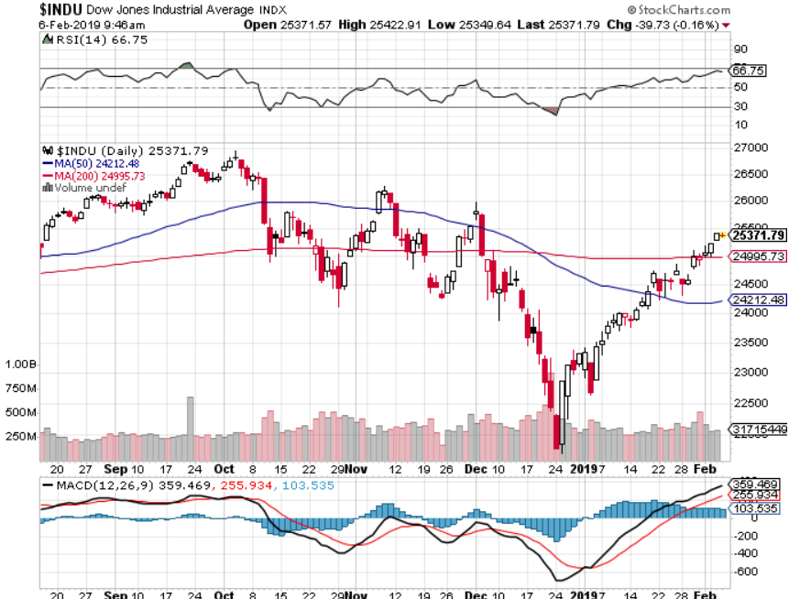
Dow Average- up 4,000 points in six weeks, 1,500 to go

Slide 20
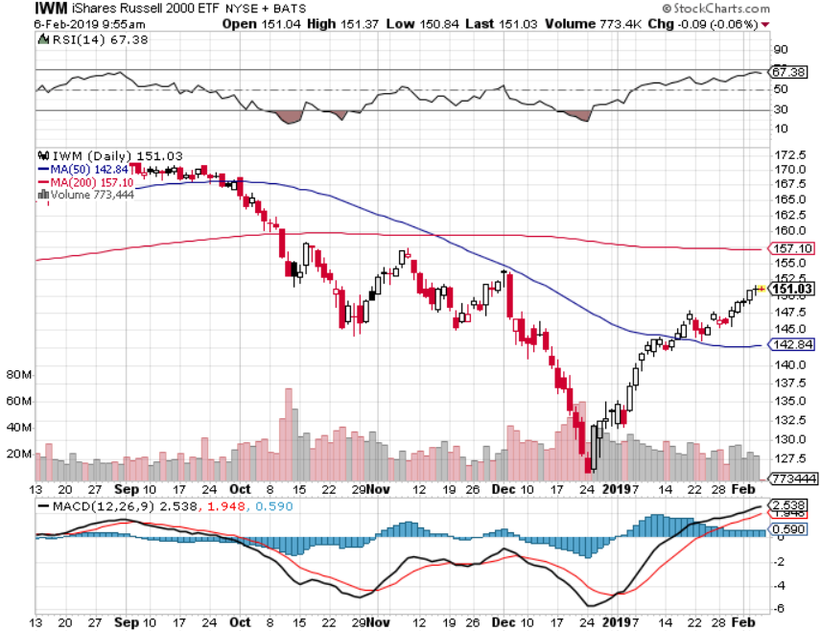
Russell 2000 (IWM)-

Slide 21
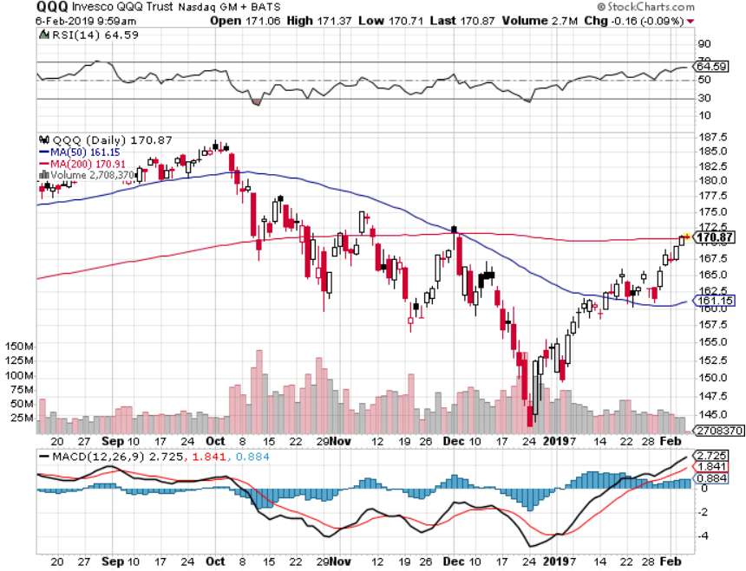
NASDAQ (QQQ)

Slide 22
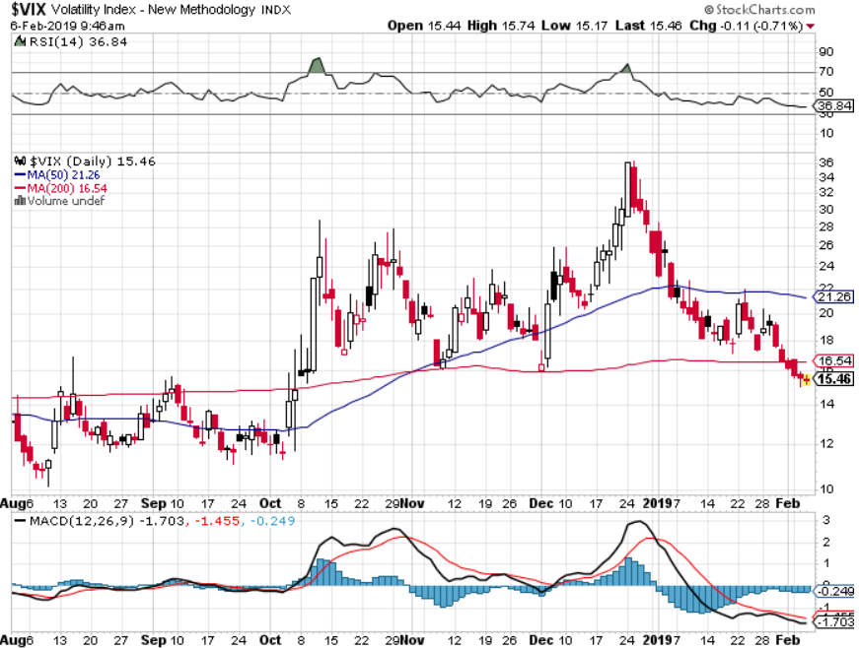
(VIX)- Probing Lows

Slide 23
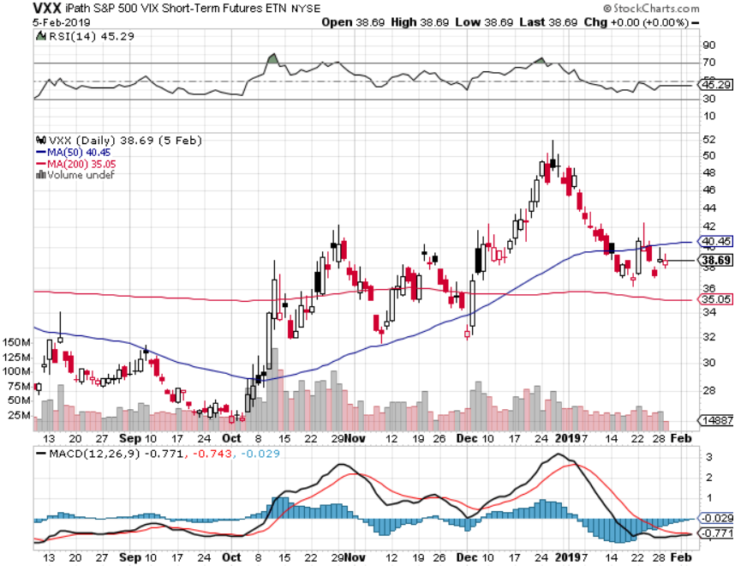
iPath S&P 500 VIX Short-Term Futures ETN (VXX)

Slide 24
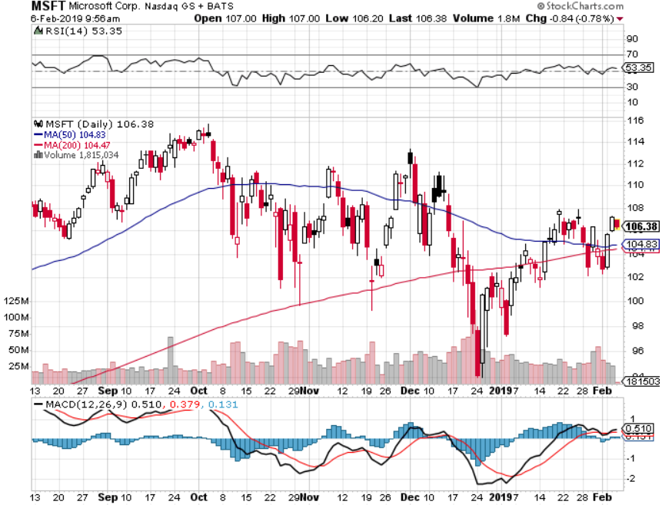
Microsoft (MSFT)- Earnings beat took profits on long 1/$85-$90 call spread took profits on long 2/$90-$95 call spread

Slide 25
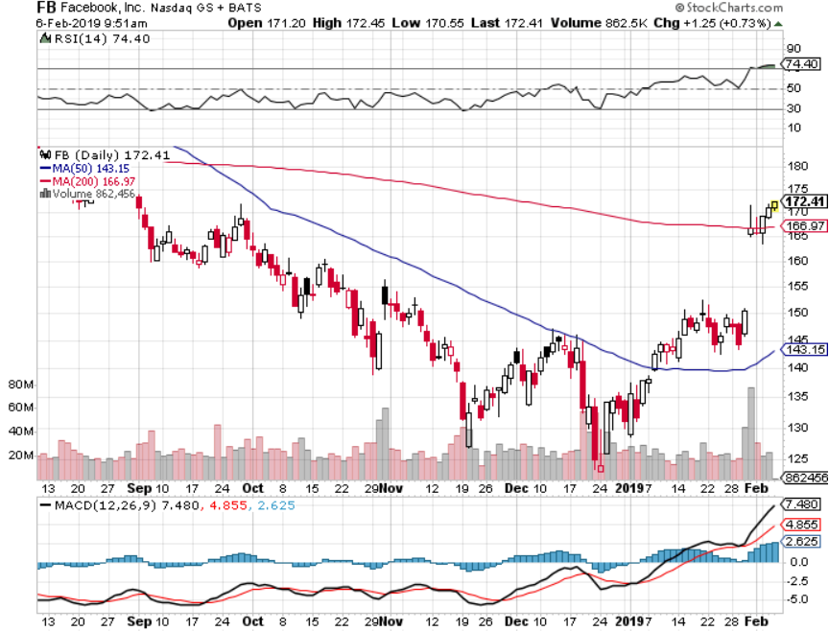
Facebook (FB)- Big earnings surprise

Slide 26
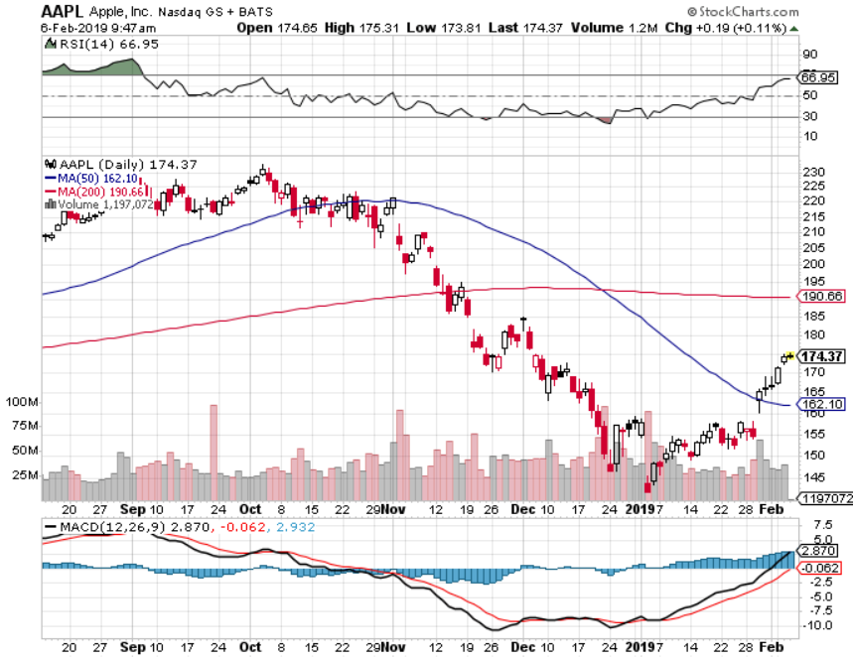
Apple (AAPL)- Apple is buying Earnings mixed stopped out of long 11/$175-$180 bear put spread took profits on long 11/$165-$175 bear put spread

Slide 27
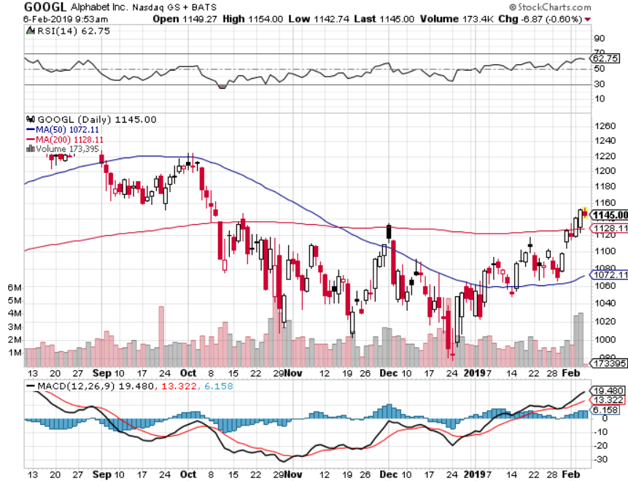
Alphabet (GOOGL)-Earnings are OK

Slide 28
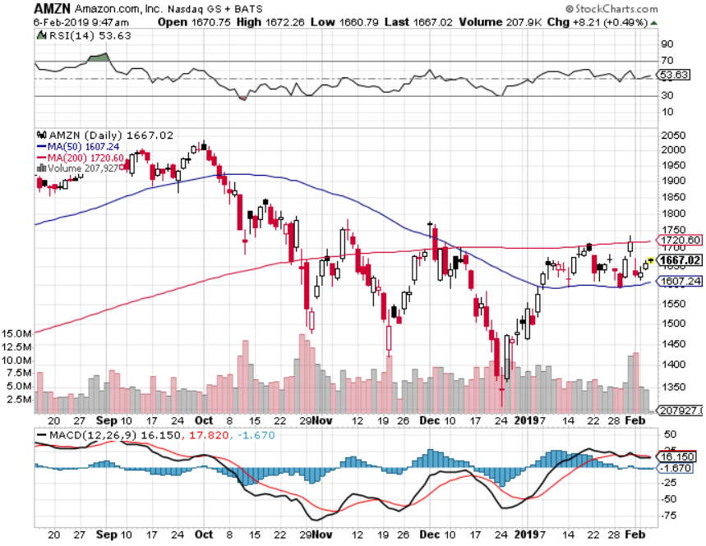
Amazon (AMZN)-Back to Top of Range selloff on great earnings augurs poorly for tech took profits on long 2/$1,200-$1,300 call spread

Slide 29
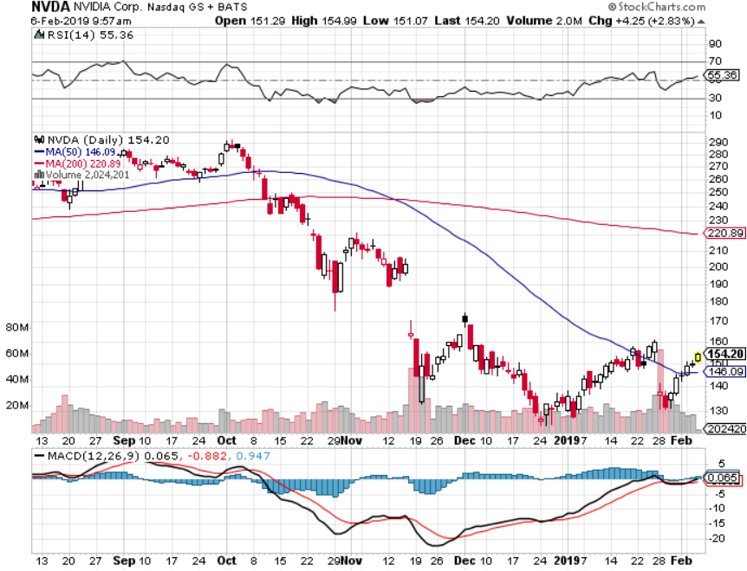
NVIDIA (NVDA)-

Slide 30
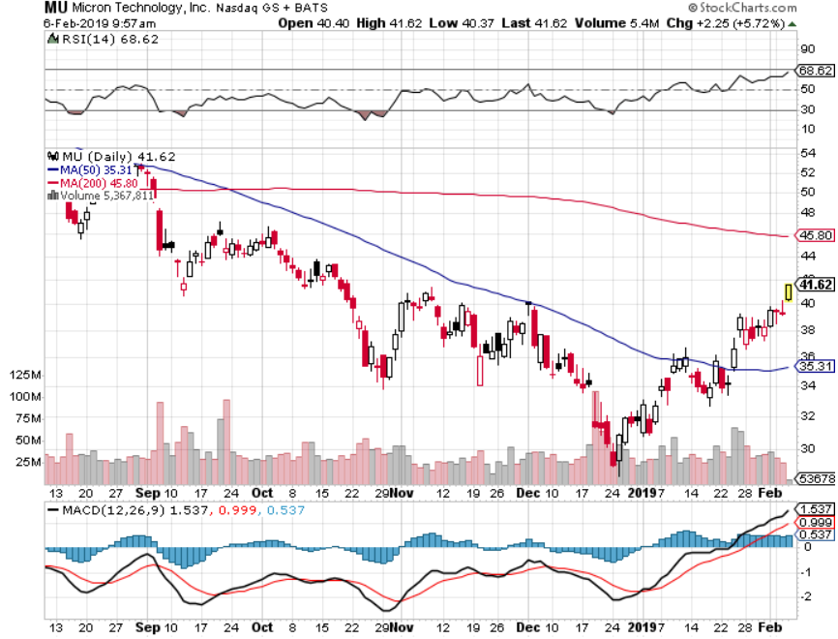
Micron Technology (MU)-Trade Wars

Slide 31
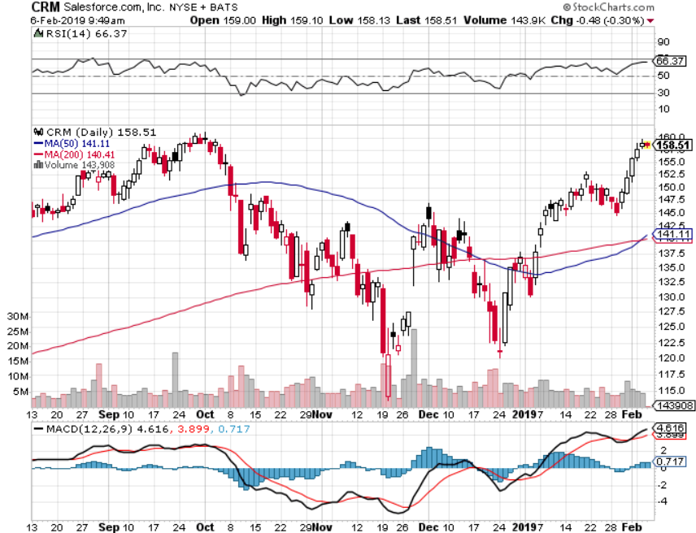
Salesforce (CRM)-Great Earnings-New Highs took profits on long 2/$105-$115 call spread

Slide 32
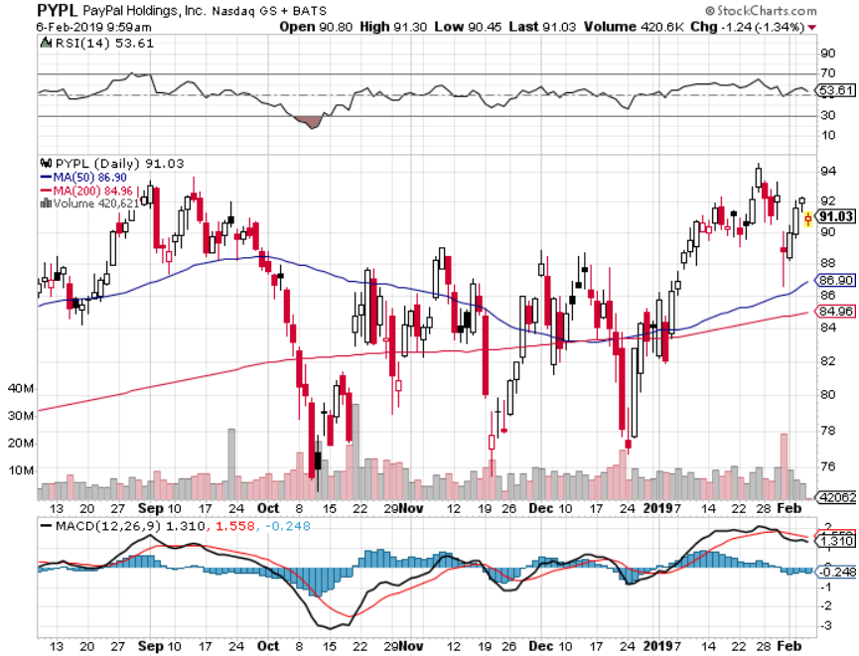
PayPal (PYPL)-

Slide 33
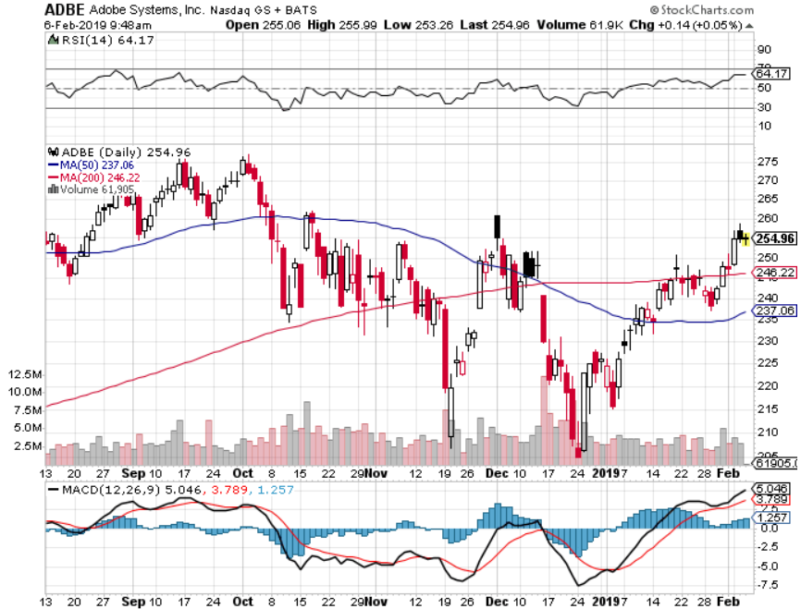
Adobe (ADBE)- The Quality Non-China tech play

Slide 34
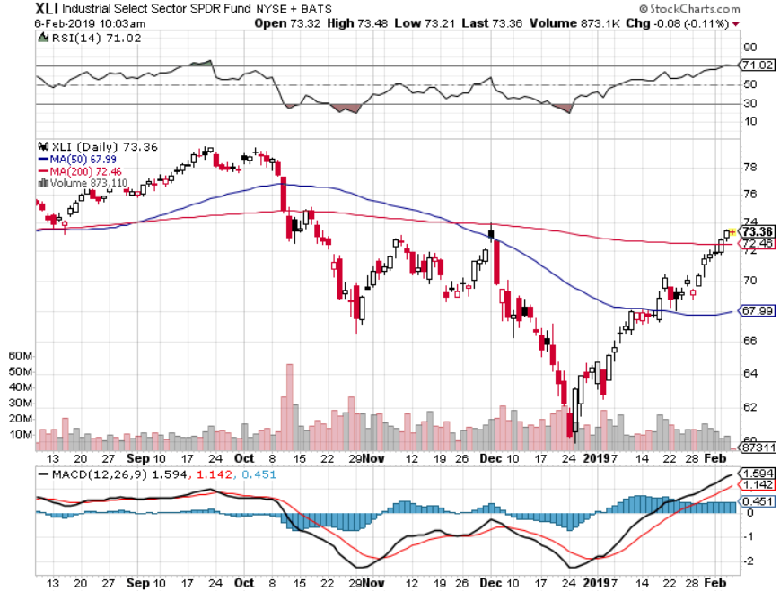
Industrials Sector SPDR (XLI)-No Support (GE), (MMM), (UNP), (UTX), (BA), (HON)

Slide 35
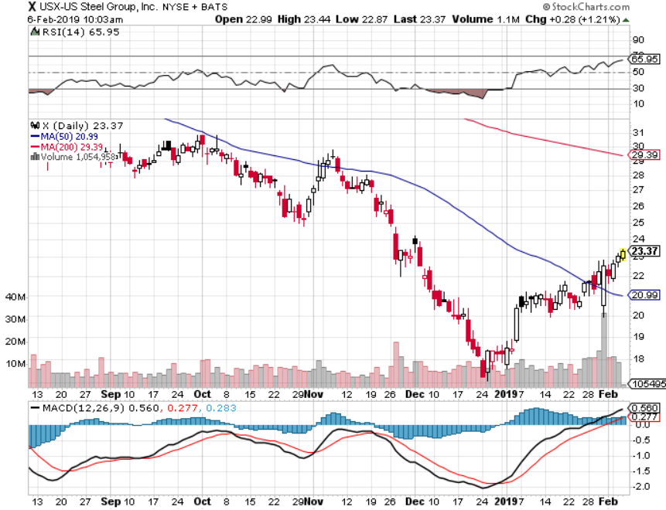
US Steel (X)-Tariffs Trouble Import duties cause users to abandon steel Unwound the entire Trump trade

Slide 36
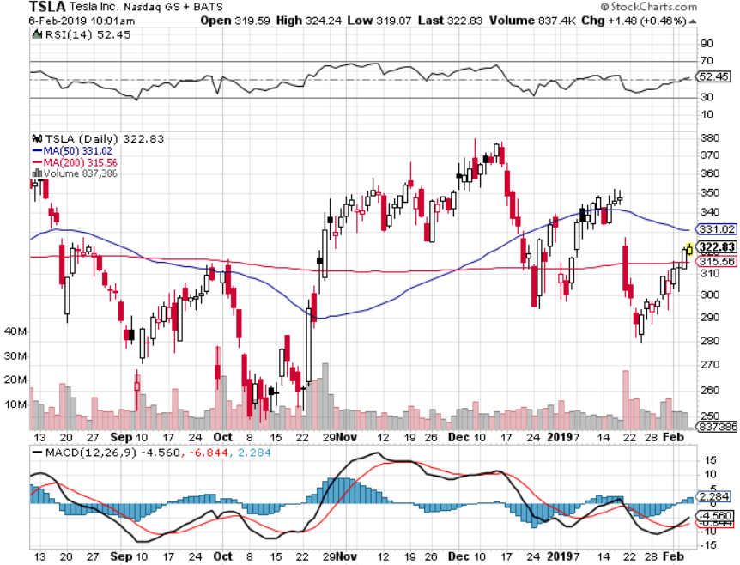
Tesla (TSLA)-Second Quarter of Earnings Cut 7% of Work Force, China airbag recall

Slide 37
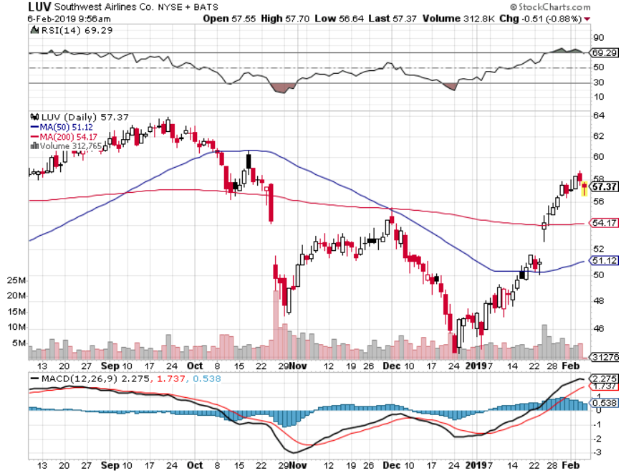
Southwest Airlines (LUV)- Warren Buffett’s Favorite Airline

Slide 38
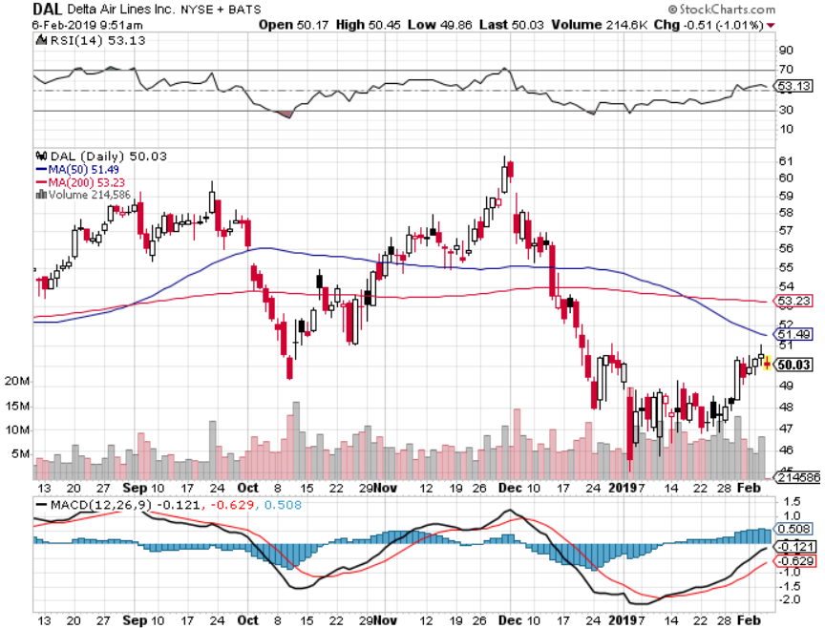
Delta Airlines (DAL)

Slide 39
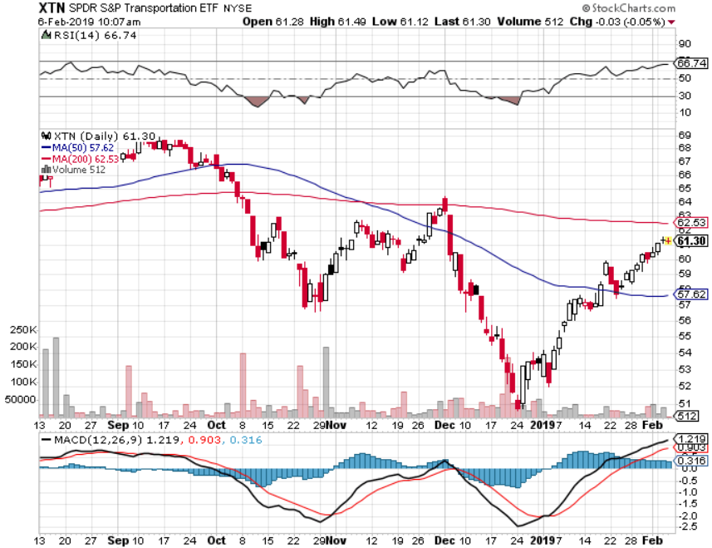
Transports Sector SPDR (XTN)- (ALGT), (ALK), (JBLU), (LUV), (CHRW), (DAL)

Slide 40
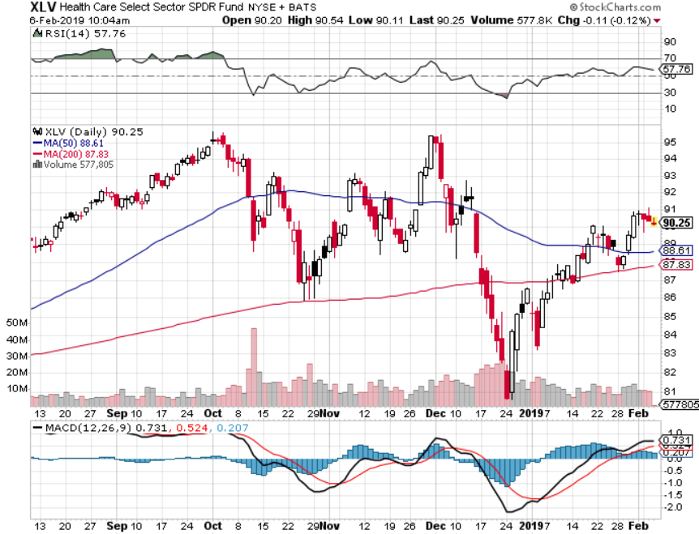
Health Care Sector (XLV), (RXL)-New Highs (JNJ), (PFE), (MRK), (GILD), (ACT), (AMGN)

Slide 41
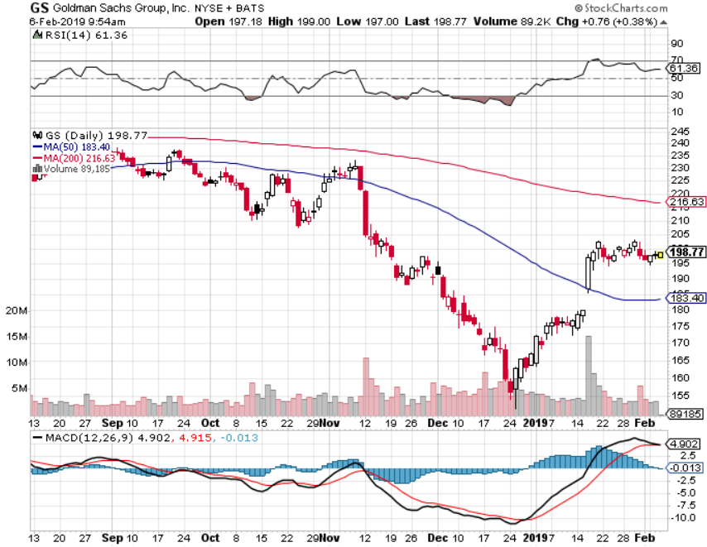
Goldman Sachs (GS)-The Next Buggy Whip maker

Slide 42
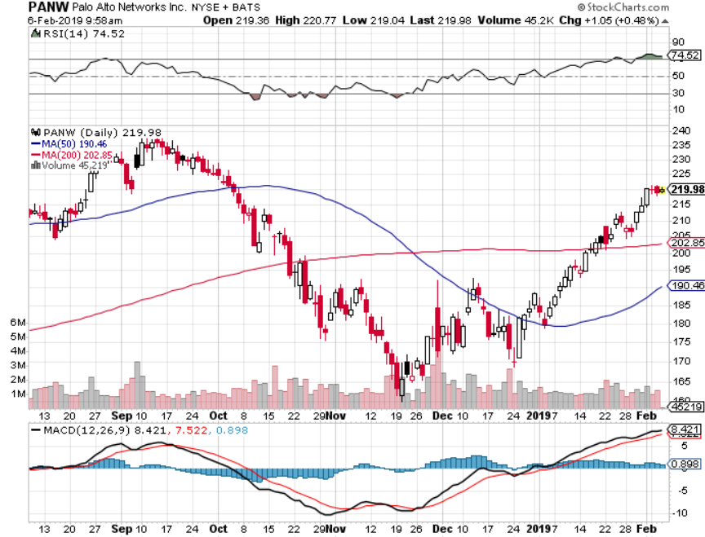
Palo Alto Networks (PANW)- Hacking never goes out of fashion

Slide 43
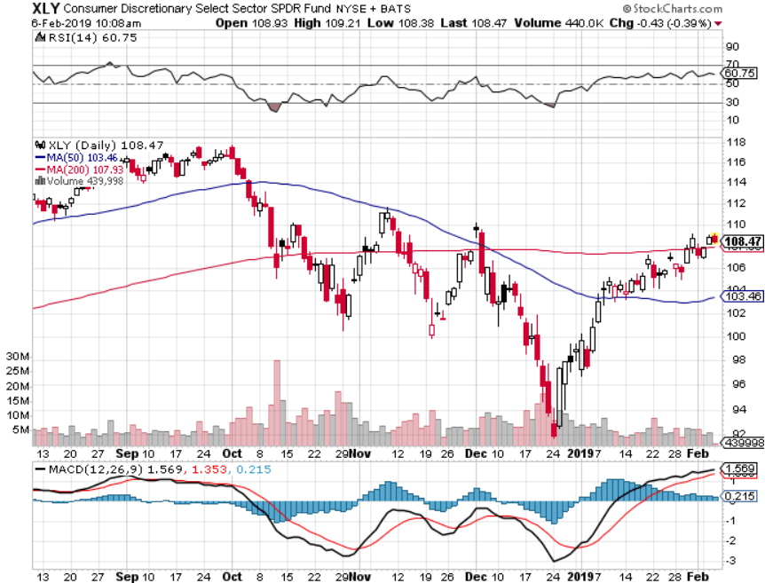
Consumer Discretionary SPDR (XLY) (DIS), (AMZN), (HD), (CMCSA), (MCD), (SBUX)

Slide 44
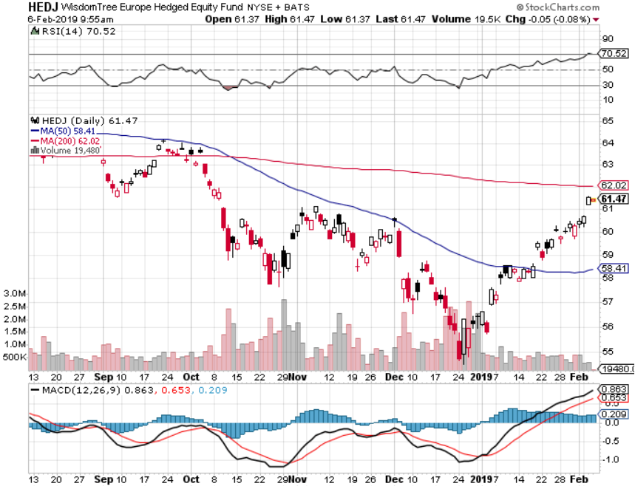
Europe Hedged Equity (HEDJ)-

Slide 45
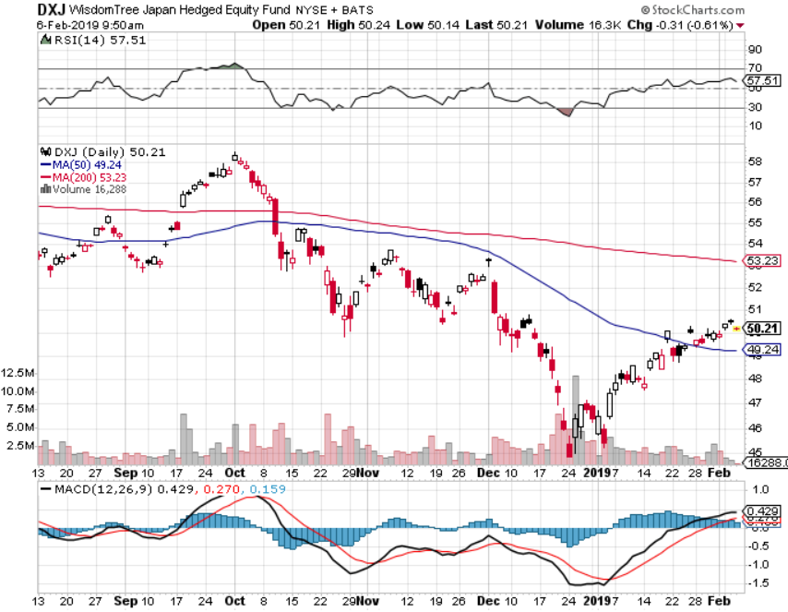
Japan (DXJ)-

Slide 46
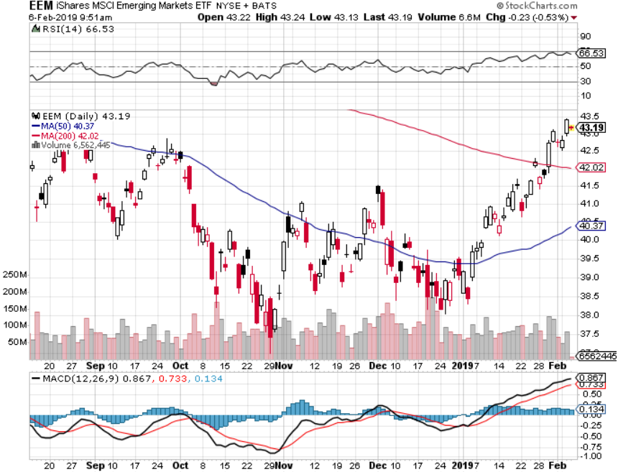
Emerging Markets (EEM)- Time to Buy on Weak Dollar

Slide 47
Bonds- The Head and Shoulders is In
*Hot January Nonfarm Payroll report, at 304,000, knocks the wind out of bonds *How long will the Fed’s dovish posture will last? *Still looking for 3.50% ten year US Treasury in a year, but what if the peak in this cycle is already in at 3.25%? *Total government issuance plus the Fed’s quantitative tightening totals $1.8 trillion in 2018, and there’s no way the bond market can handle this *Exploding deficits will weigh on bonds for the next decade, sell every rally across the space Bottom Line: Sell every four point rally in the (TLT), but this time, I settled for three

Slide 48
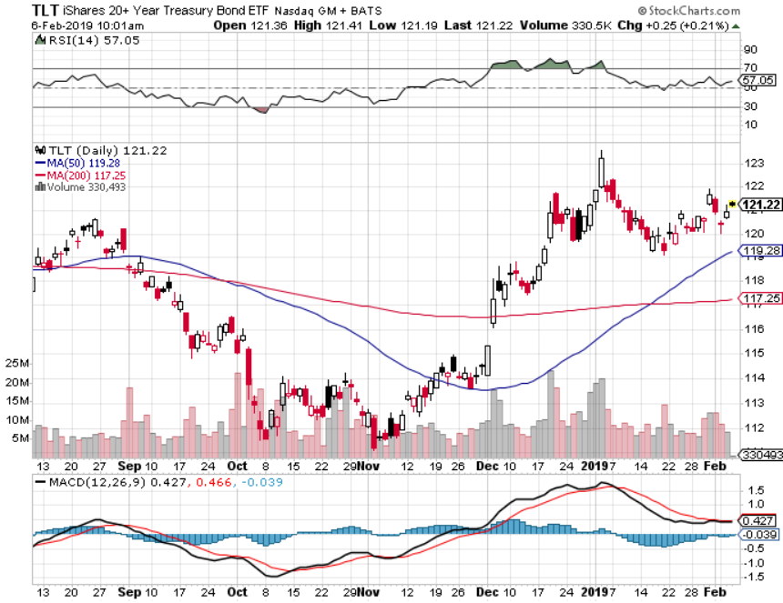
Treasury ETF (TLT) – Head and Shoulders Top reentered long 2/$125-$128 call spread took profits on long 1/$124-$127 call spread took profits on long 2/$125-$128 call spread

Slide 49
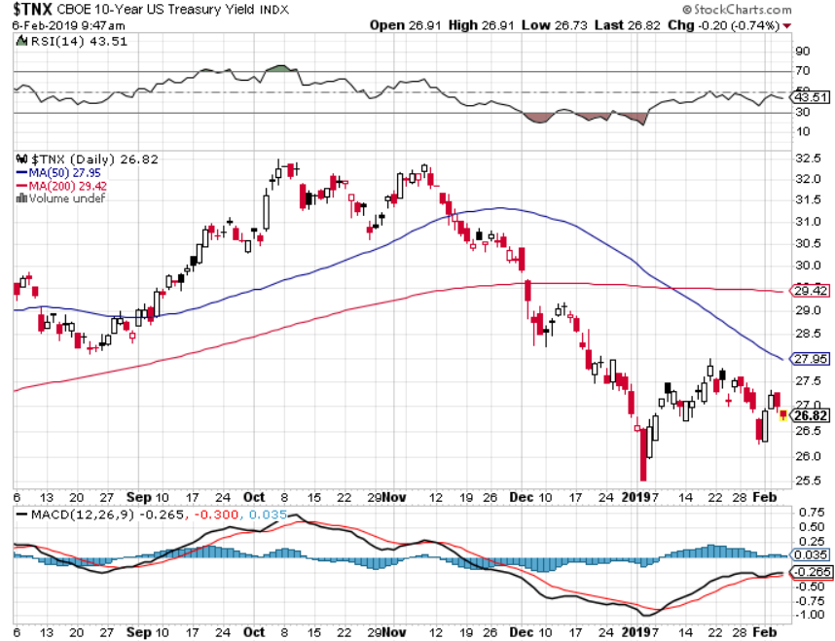
Ten Year Treasury Yield ($TNX) 2.68% Breakdown, Now major Support

Slide 50
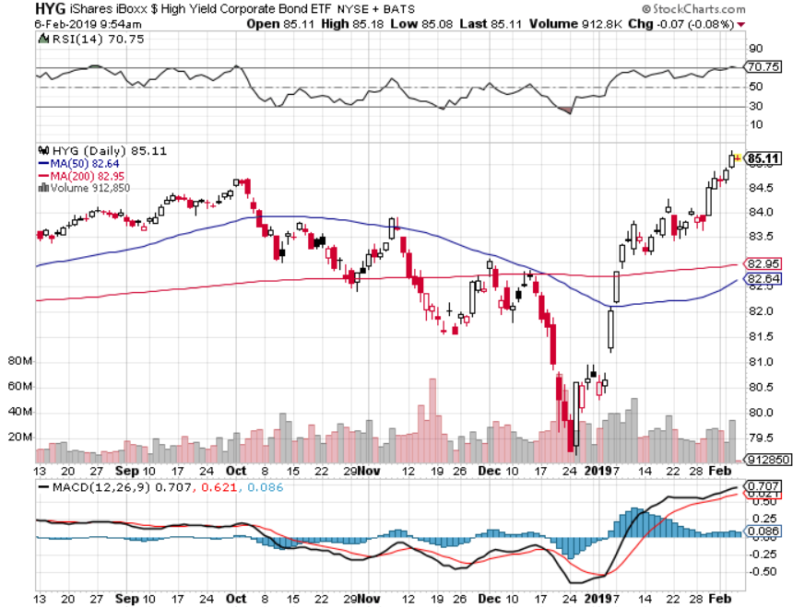
Junk Bonds (HYG) 5.60% Yield

Slide 51
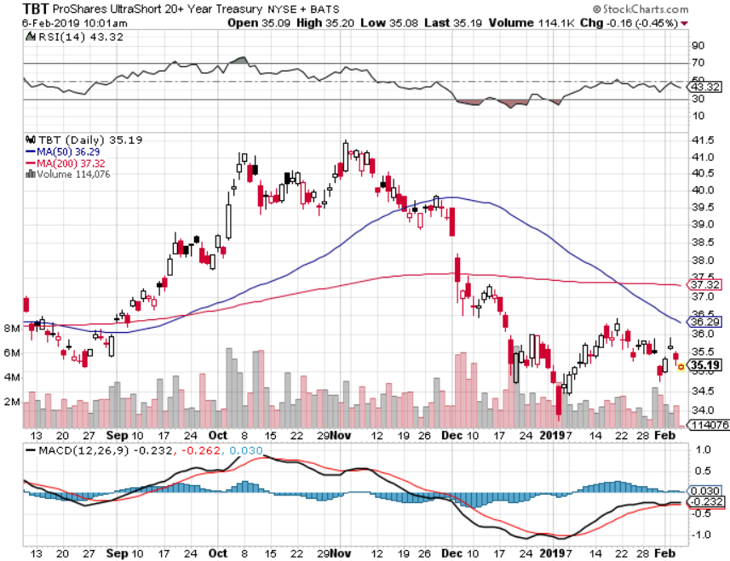
2X Short Treasuries (TBT)-Buy Territory

Slide 52
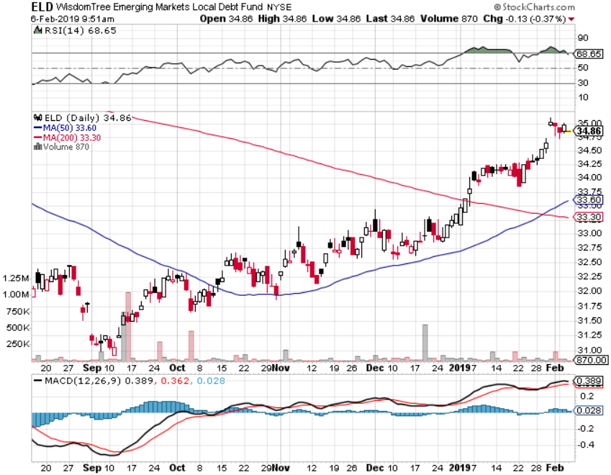
Emerging Market Debt (ELD) 6.02% Yield-

Slide 53
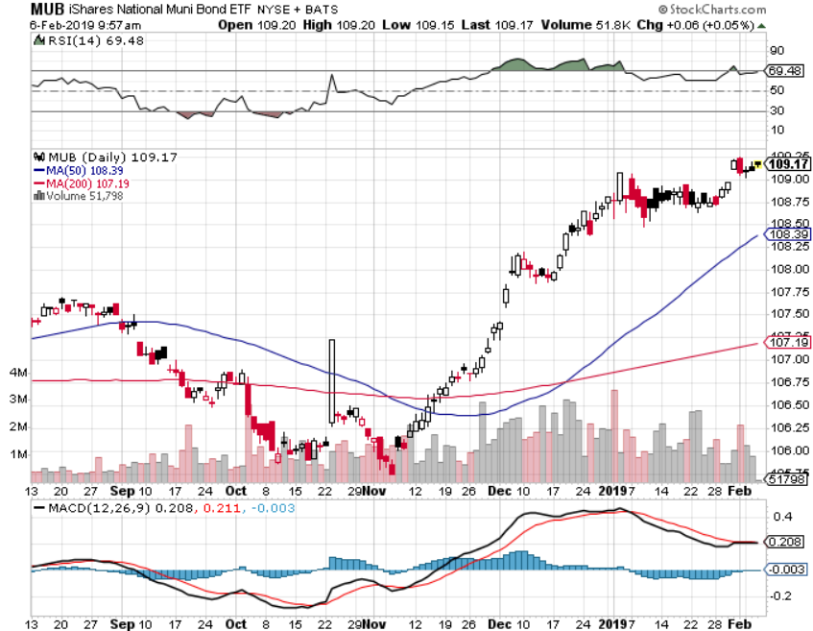
Municipal Bonds (MUB)-2.52% Mix of AAA, AA, and A rated bonds

Slide 54
Foreign Currencies – Sagging Dollar
*Continued Fed dovish drags heavily on the dollar *Is a big positive for weak dollar plays like Gold (GLD) and Emerging markets (EEM) *British pound stages another huge rally on Brexit fail *Massive Chinese economic stimulus drives Yuan higher *Bitcoin hits new low at $3,400 *Bottom Line: sell dollars, buy the Euro (FXE)

Slide 55
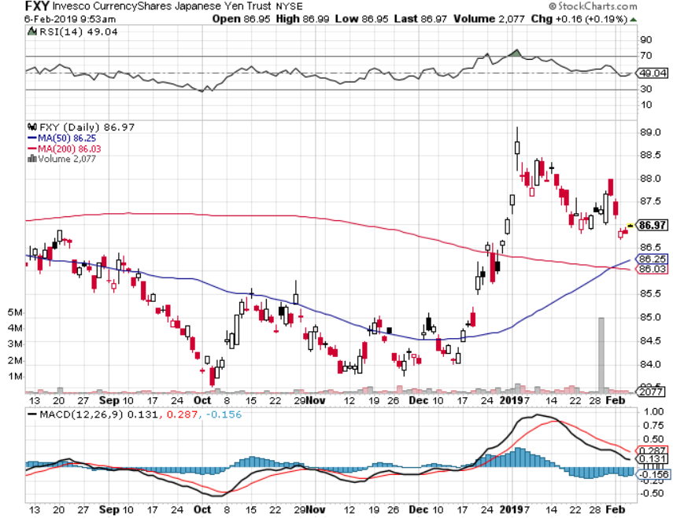
Japanese Yen (FXY), (YCS)

Slide 56
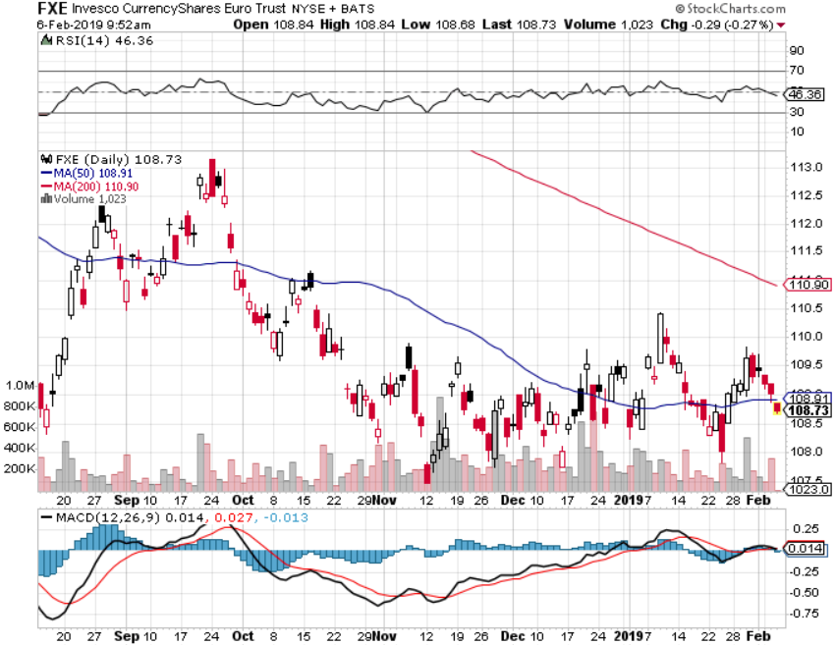
Euro ($XEU), (FXE), (EUO)- Trying to Break Down long 2/$105-$108 call spread

Slide 57
Australian Dollar (FXA)-

Slide 58
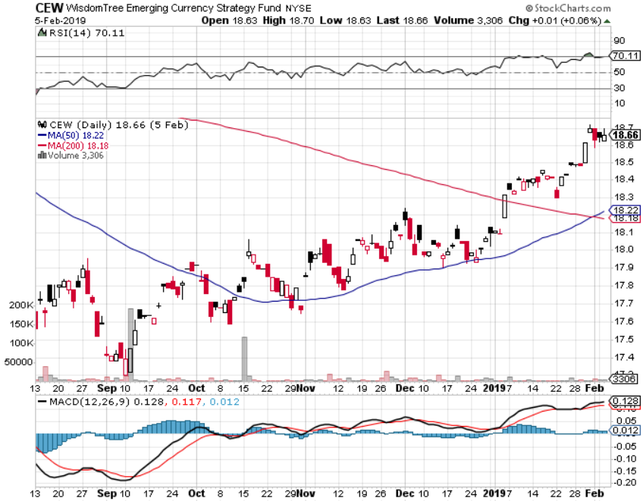
Emerging Market Currencies (CEW)

Slide 59
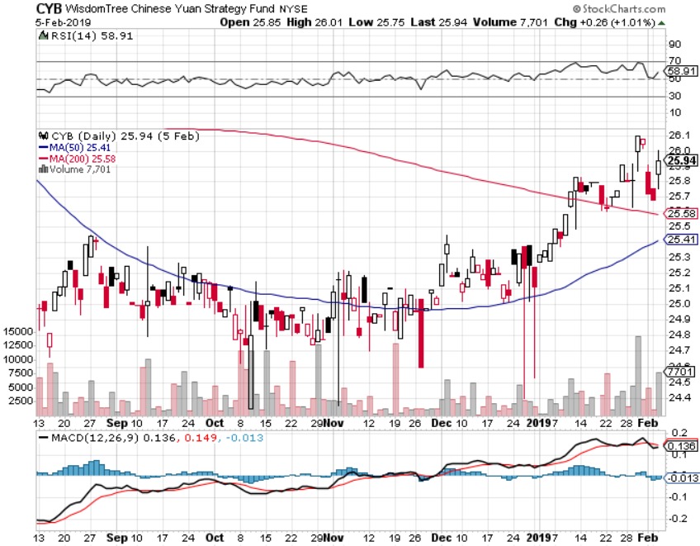
Chinese Yuan- (CYB)-

Slide 60
Bitcoin- New Low

Slide 61
Energy – It’s All About Venezuela
*Boycott of Venezuelan oil drives prices higher, helped by a severe polar vortex, minus 55 degrees in Chicago *Saudis trying to engineer production cutbacks to keep price rises going *Weak dollar is providing a bid for the entire commodity complex, including oil *Chinese economic stimulus, the largest marginal new buyer of crude is another positive *Copper upside breakout in progress in coming China trade deal *Bottom Line: Buy the dips

Slide 62
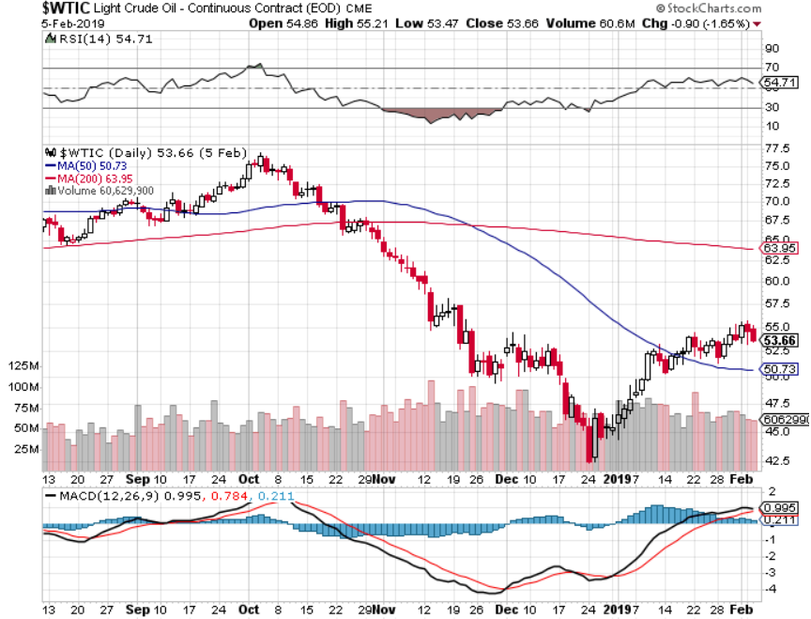
Oil-Bouncing

Slide 63
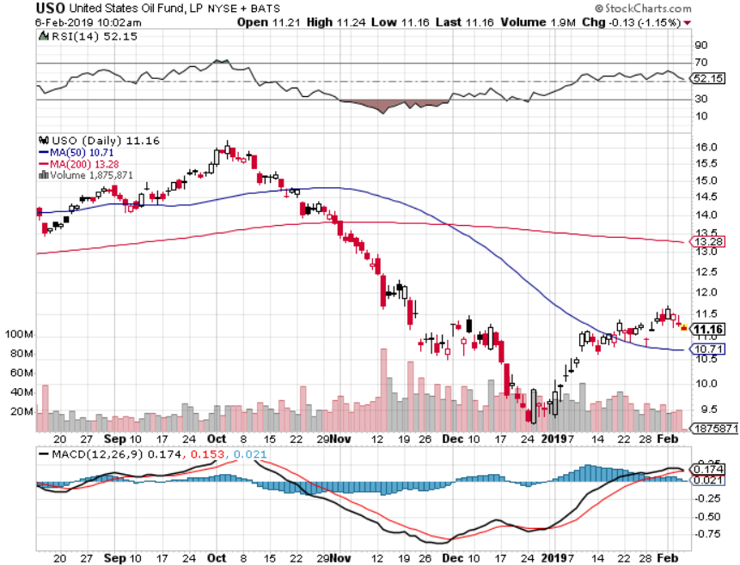
United States Oil Fund (USO)

Slide 64
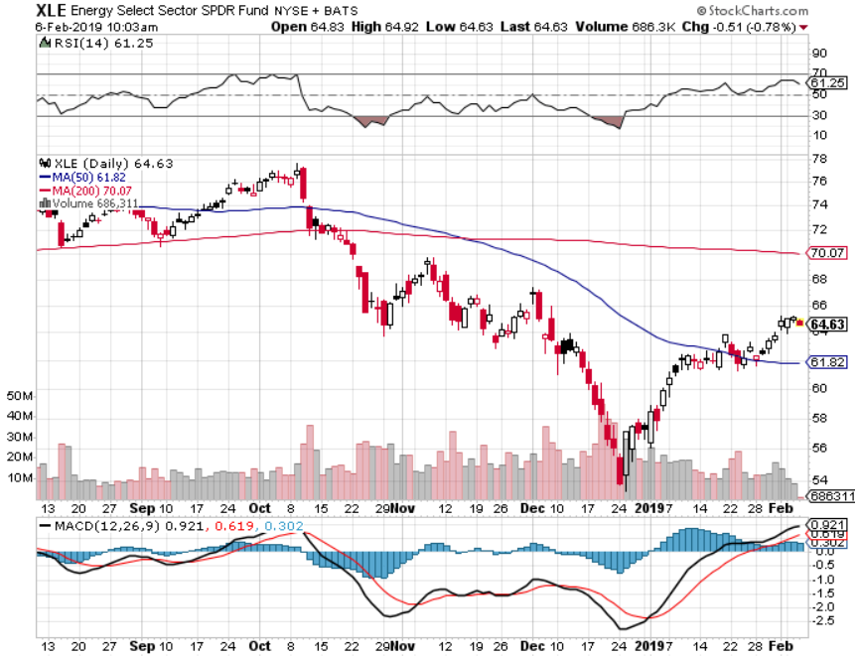
Energy Select Sector SPDR (XLE)-No Performance! (XOM), (CVX), (SLB), (KMI), (EOG), (COP)

Slide 65
Halliburton (HAL)-

Slide 66
Natural Gas (UNG)- Major Hedge Fund Blow Up Polar Vortex Doesn’t Help

Slide 67
Copper (COPX)- Upside breakout Trade War Deal Coming

Slide 68
Precious Metals – Flavor of the Month
*Hedging demand is driving gold bigtime, new one year highs *Dovish Fed is a big help *Venezuela ships 20 metric tonnes of gold to Russia, removing the major seller from the market *The real move for gold won’t begin until we get true inflation, which won’t appear until later this year *Buy Dips

Slide 69
Gold (GLD)-No Help from Trade War

Slide 70
Market Vectors Gold Miners ETF- (GDX) – Yikes!

Slide 71
Barrick Gold (ABX)

Slide 72
Newmont Mining- (NEM)-

Slide 73
Palladium - (PALL)-

Slide 74
Real Estate – Horrible Numbers
*Stock market crash still feeding into weak housing numbers, government shutdown will hit next month *December Pending Homes Sales down 2.2%, 9.8% YOY, sharpest drop in four years, with biggest falls in the west *Government shut down is still interfering with the closing process on a widespread scale, putting 500,000 home mortgages at risk *November S&P 500 Case-Shiller drops to 5.2%, annual gain, the lowest gain in four years *Bottom Line: Stand aside for a trade but buy for long term investment

Slide 75
October Corelogic S&P Case Shiller Home Price Index Las Vegas, Seattle, and San Francisco still showing biggest gains
Tradingeconomics.com

Slide 76
Simon Property Group (SPG)-

Slide 77
US Home Construction Index (ITB) (DHI), (LEN), (PHM), (TOL), (NVR)

Slide 78
Trade Sheet- So What Do We Do About All This?
*Stocks-don’t chase *Bonds-sell any and all rallies *Commodities-buy dips *Currencies-buy dips *Precious Metals – buy dips *Volatility-buy dips to $17 *Real estate-stand aside

Slide 79
Next Strategy Webinar 12:00 EST Wednesday, February 20, 2019 from San Francisco, CA www.madhedgefundtrader.com email me at support@madhedgefundtrader.com
Good Luck and Good Trading!
Notes:
*

