Slide 1
The Mad Hedge Fund Trader
“The Recession Has Begun”
With John Thomas
from Silicon Valley, CA, March 6, 2019
www.madhedgefundtrader.com
Notes:
*

Slide 2

Trade Alert Performance
New All-Time High
Hanging tough and beating the market
*January 9.49% Final *July +0.0% Final
*February +4.64% Final *August +2.19% MTD
*March -1.14% Final *September 1.38% Final
*April +12.54% Final *October +1.37% Final
*May +1.07% Final *November -1.83% Final
*June +4.15% Final *December -4.13% Final
*2019 Year to Date +13.64%
compared to +11.2% for the Dow Average
*Trailing One year return +32.90%, +312.93% since inception,
*Average annualized return of 34.12% for 9 years

Slide 3
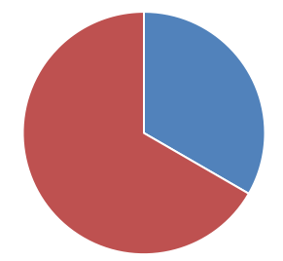
Portfolio Review
running small short after great market run
Current Capital at Risk
Risk On
World is Getting Better
(TLT) 3/$124-$126 put spread | 10.00%
(FCX) 4/$$10-$11 call spread | 20.00%
Risk Off
Total Net Position | 30.00%
Expiration P&L
14.40%

Slide 4
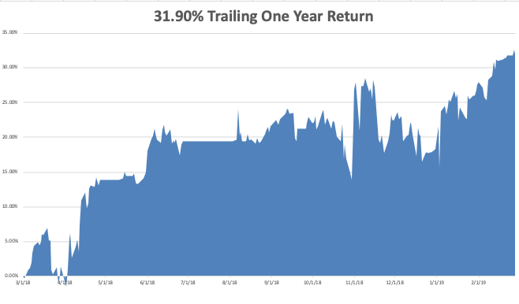
GTD Daily Audited Performance

Slide 5
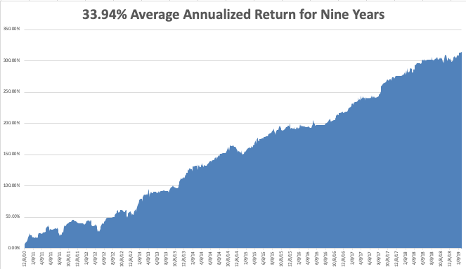
GTD 9 Year Daily Audited Performance

Slide 6

The Method to My Madness
*GDP Upside surprise triggers bond crash, but also selloffs in commodities and oil, but is not sustainable until Fed raises interest rates
*China deal could trigger the biggest “Sell the news” collapse in the US of all time
*No earnings growth is the biggest market challenge for 2019, shrinking multiples are next
*Oil remains strong on Venezuela collapse, inventory shortfall, and
China stimulus
*With much more stimulus than the US, China
could outperform the US in 2019

Slide 7
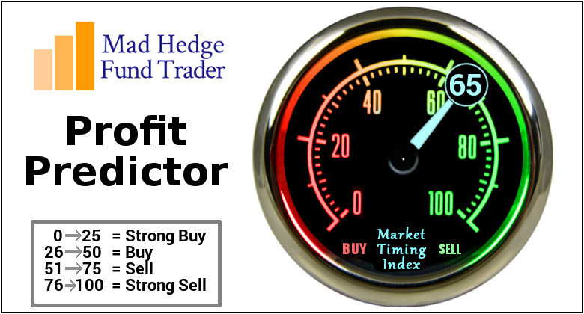
The Mad Hedge Profit Predictor
Market Timing Index-
An artificial intelligence driven algorithm that analyzes 30 different economic, technical, and momentum driven indicators

Slide 8
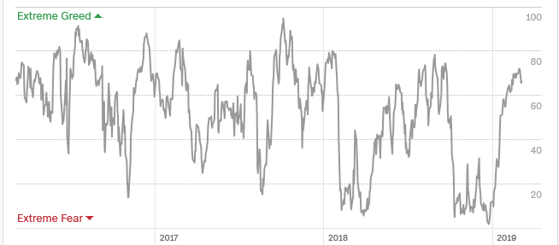
The Mad Hedge Profit Predictor
SELL
BUY

Slide 9
The Global Economy – Weak
*Economic data flow is almost all terrible, issuing a loud recession waning, Wholesale Inventories rose sharply, up 1.1%, Factory Orders came in incredibly weak, at 0.1% in December, when 0.6% was expected, December Construction Orders down 0.6%
*Ag crisis spreads, with 19.4% of Farm Service loans delinquent, vuctims of trade war
*Bonds see their worst week in five months, driving the ten year rate up to 2.77%
*Gold takes a break providing an entry point as a dollar rally puts inflation fears on hold
*As European economy tips into recession they may be about to return to QE, taking rates back to negative numbers
*Weakened dollar will boost non-dollar plays,
like emerging markets (EEM) and the currencies
(FXE) and (FXA), and oil (USO)

Slide 10
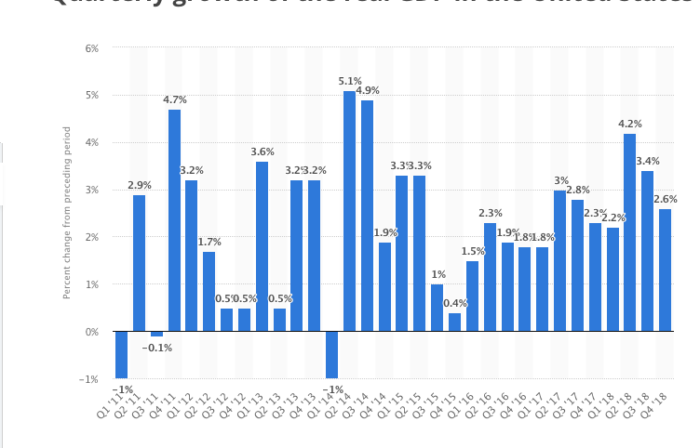
Growth Recession
Q1 2019

Slide 11
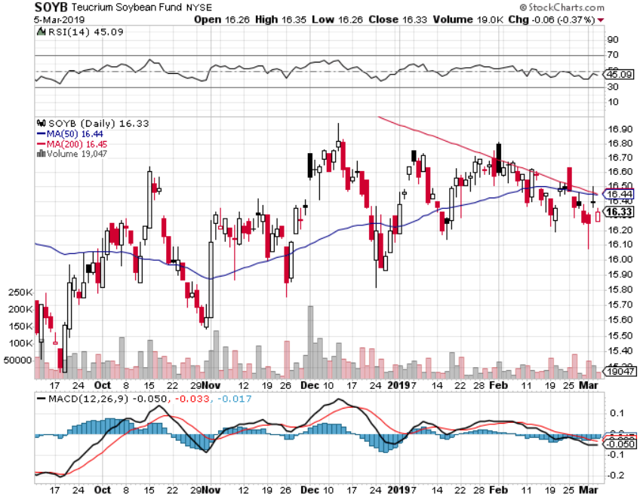
Soybeans (-20%)-Trade War Indicator rolling over price action hits on a big “Sell the news” on China trade deal

Slide 12
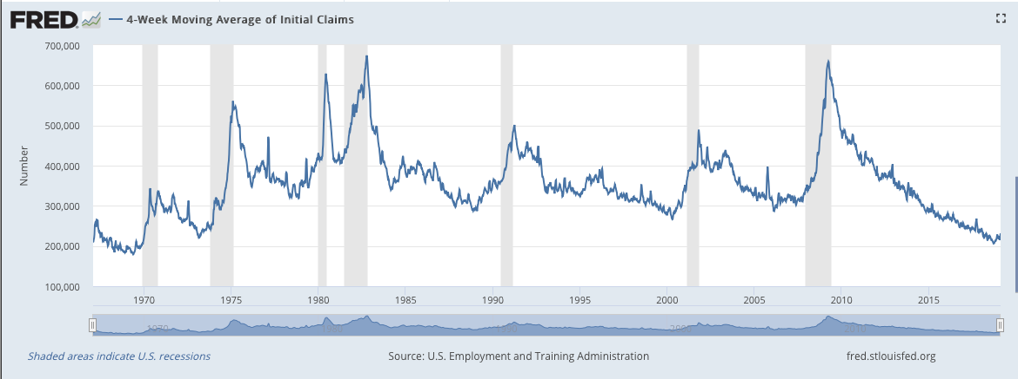
Weekly Jobless Claims –The Most Important Statistic
-33,000 to 213,000

Slide 13
The Bill Davis View
A $1,500 Upgrade for the Mad Day Trader Service
Buys: | Entry | Target
Quest Diagnostics (DGX)-X | $ 85.00 | $ 100.00
3M Co. (MMM)-X | $ 200.00 | $ 215.00
CenturyLink, Inc. (CTL) | $ 12.00 | $ 17.00
Core Laboratories (CLB) | $ 67.00 | $ 86.00
McDonalds Corp (MCD) | $ 178.00 | $ 188.00
Sells:
F5 Networks, Inc. (FFIV) | $ 167.00 | $ 155.00
FleetCor Technologies Inc. (FLT) | $ 230.00 | $ 205.00
Global Payments, Inc. (GPN) | $ 133.00 | $ 118.00
Baxter Intl Inc. (BAX) | $ 75.00 | $ 68.00
Graco, Inc. (GGG) | $ 50.00 | $ 37.00

Slide 14
Stocks – Nosebleed Territory
*Best start to a year since 1987
*Earnings multiple just jumped from 14X to 18X without the growth to support it creates a very high risk market
*Analysts are now looking for negative earnings growth in 2019
*Trade war settlement is 95% in the market, if it doesn’t happen the market will back that 95% out very quickly
*Main indexes offer 5% of upside versus
20% downside risk
*Tech is starting to fade, to be replaced by
weak dollar plays like emerging markets, gold,
commodities, and energy
*Bottom Line: its bet the ranch time on tech longs,
but stay away from those with big China exposure,
like Apple, and weak dollar plays like energy, and
emerging markets

Slide 15
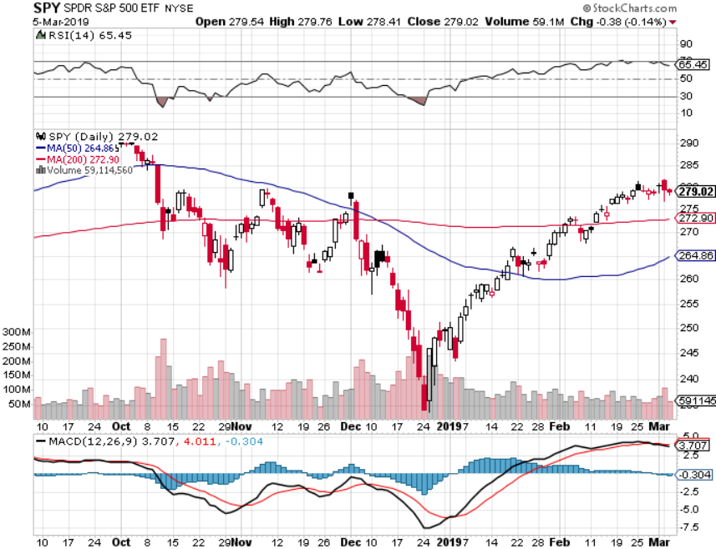
S&P 500- took profits on long 2/$270-$275 bear put spread

Slide 16
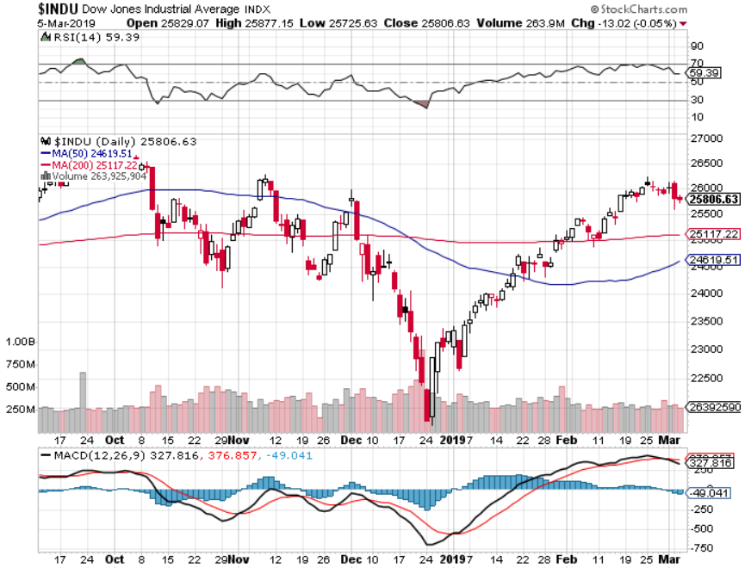
Dow Average-

Slide 17
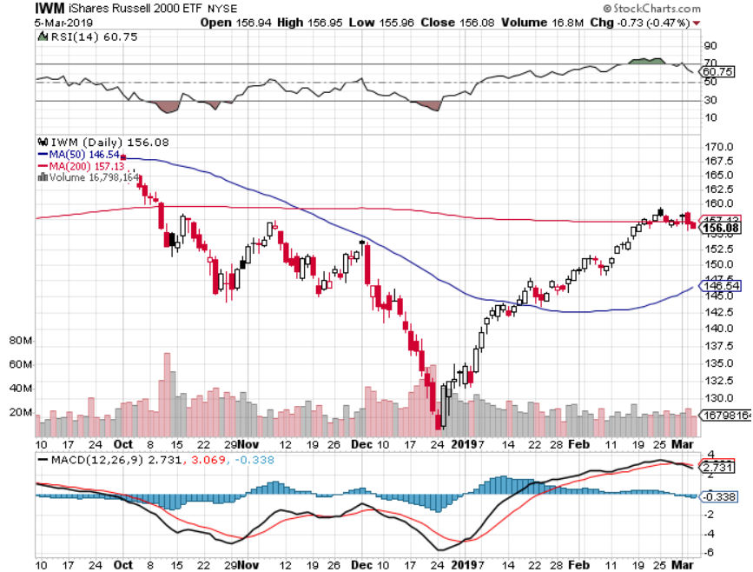
Russell 2000 (IWM)-

Slide 18
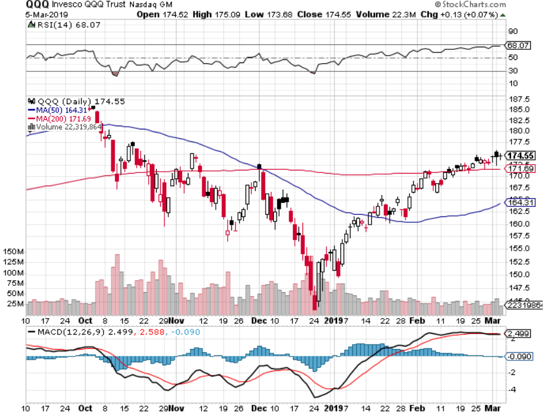
NASDAQ (QQQ)

Slide 19
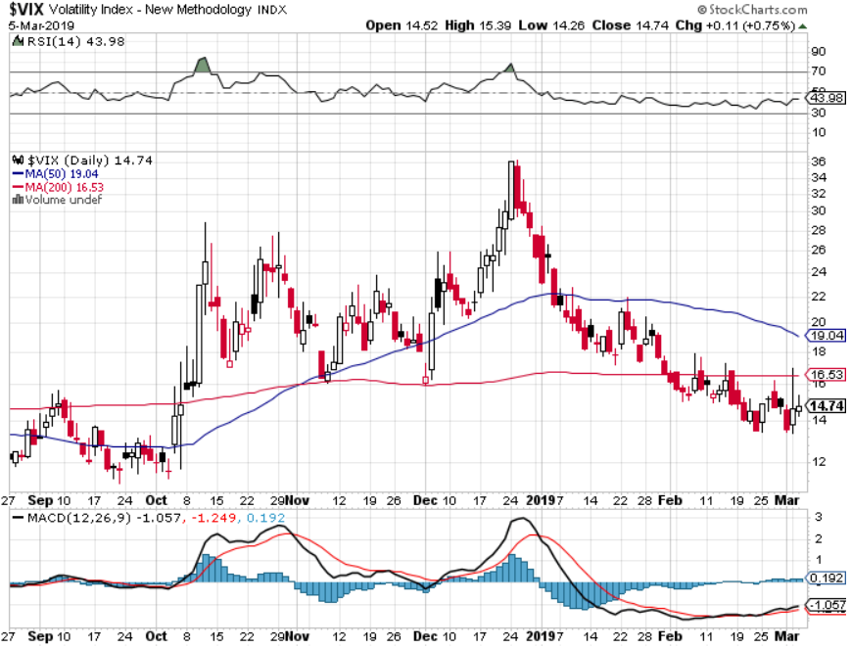
(VIX)- Probing Lows

Slide 20
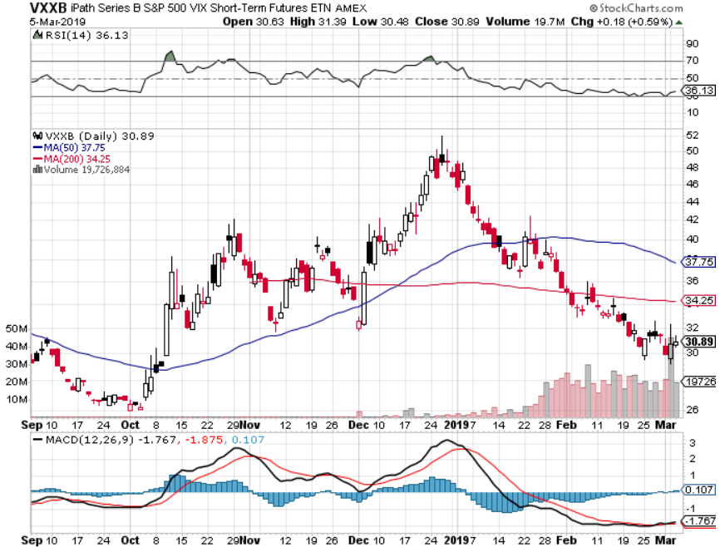
iPath S&P 500 VIX Short-Term Futures ETN (VXX)

Slide 21
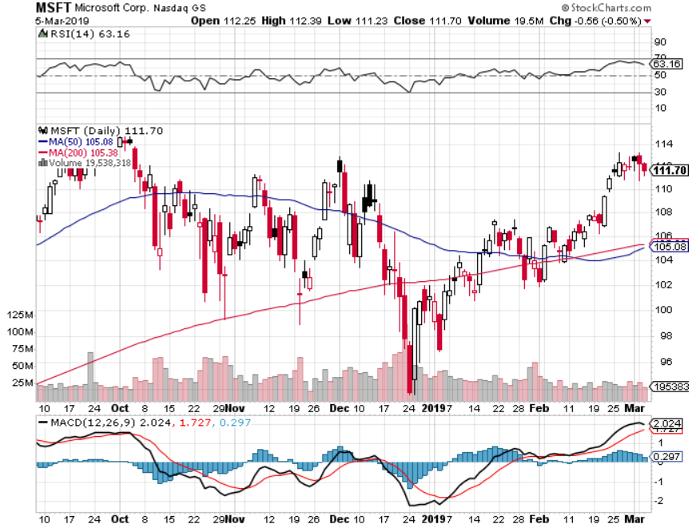
Microsoft (MSFT)- Earnings beat took profits on long 2/$85-$90 call spread

Slide 22
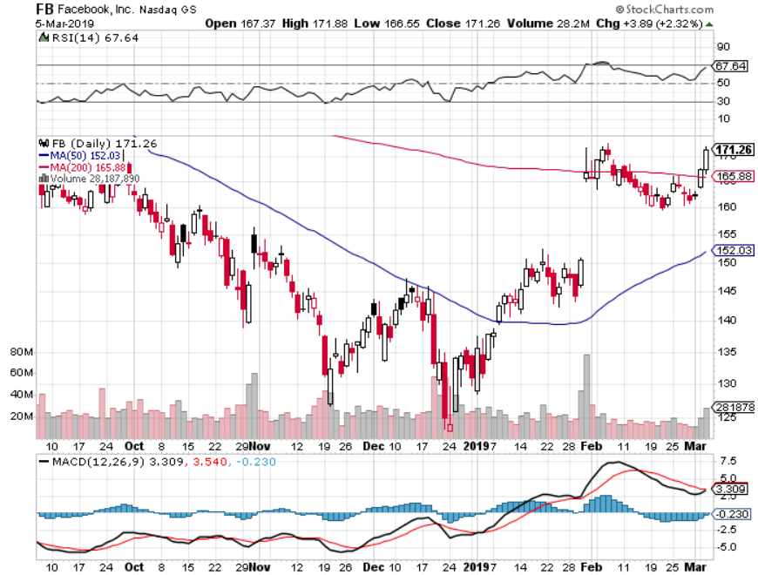
Facebook (FB)- Struggling

Slide 23
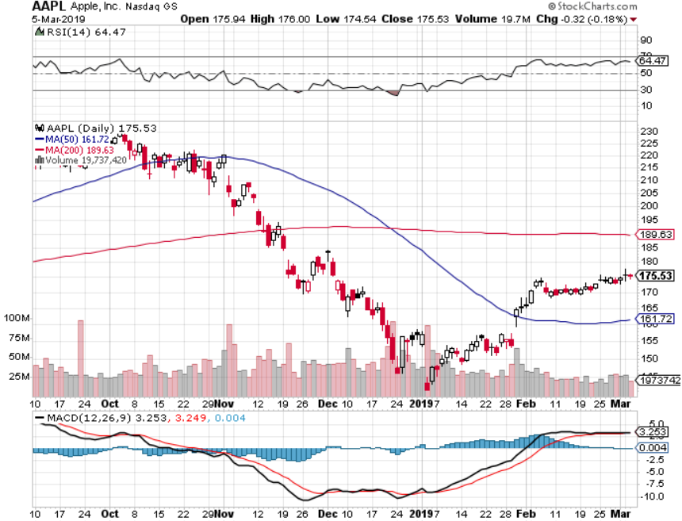
Apple (AAPL)- Underperforming
Earnings mixed long 3/$180-$185 bear put spread – 7 days to expiration- Tech Letter stopped out of long 11/$175-$180 bear put spread took profits on long 11/$165-$175 bear put spread

Slide 24
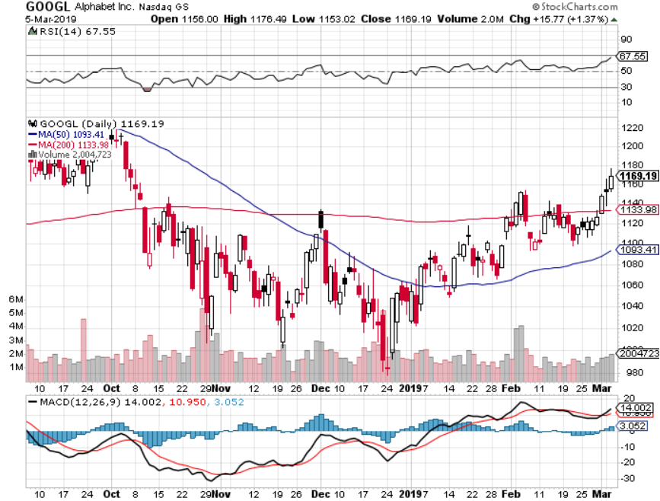
Alphabet (GOOGL)-

Slide 25
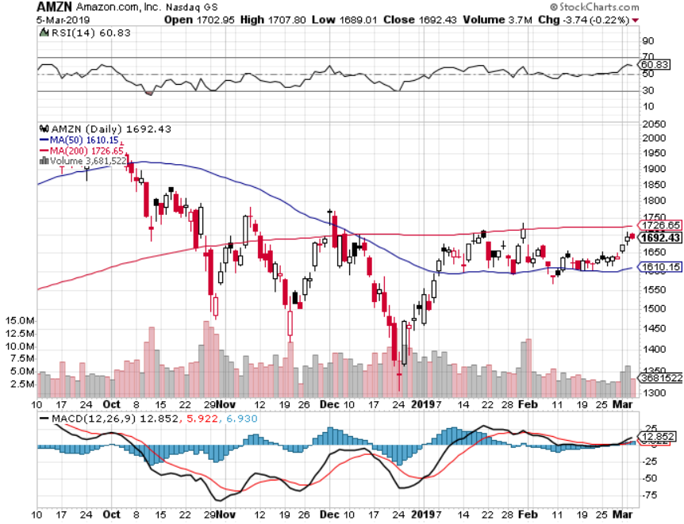
Amazon (AMZN)-Back to Top of Range
Cancelled NY HQ2 to duck coming recession took profits on long 2/$1,200-$1,300 call spread

Slide 26
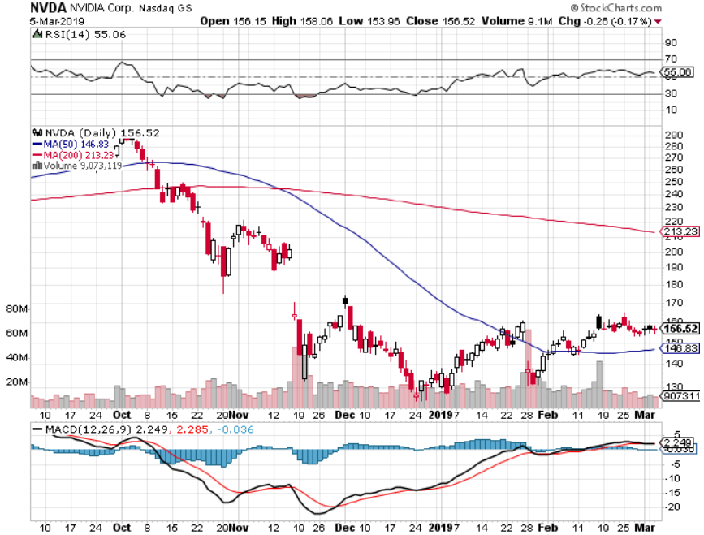
NVIDIA (NVDA)- earnings beat

Slide 27
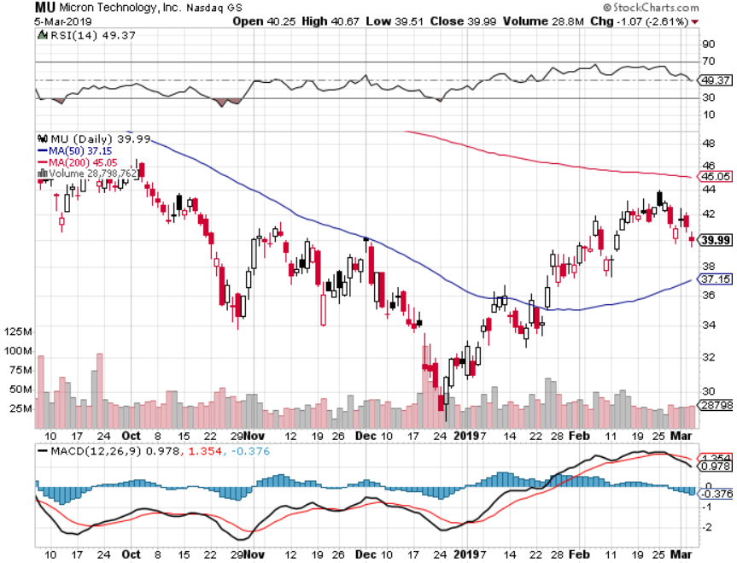
Micron Technology (MU)-

Slide 28
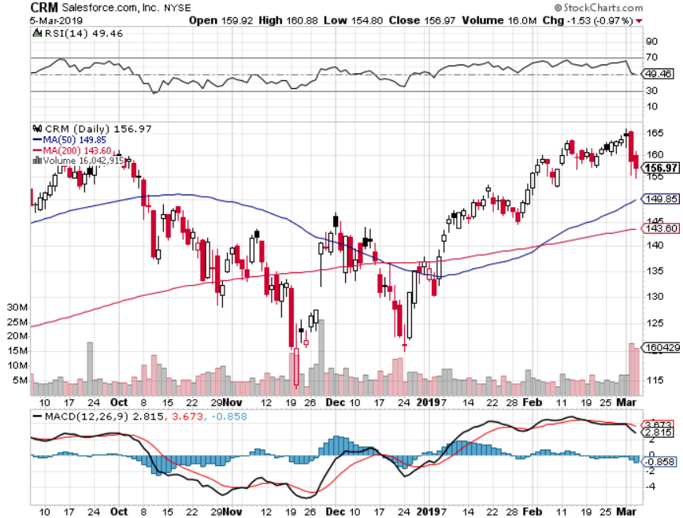
Salesforce (CRM)-Great Earnings-Poor Guidance took profits on long 2/$105-$115 call spread

Slide 29
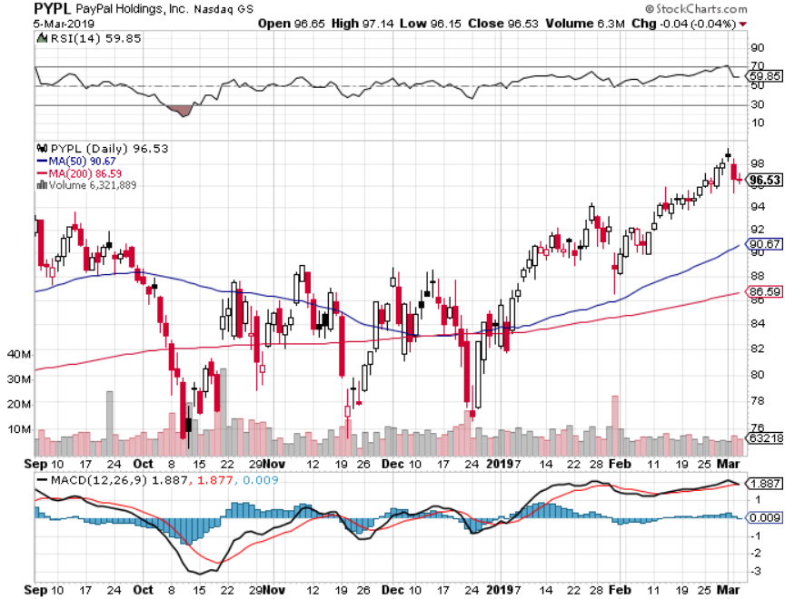
PayPal (PYPL)-

Slide 30
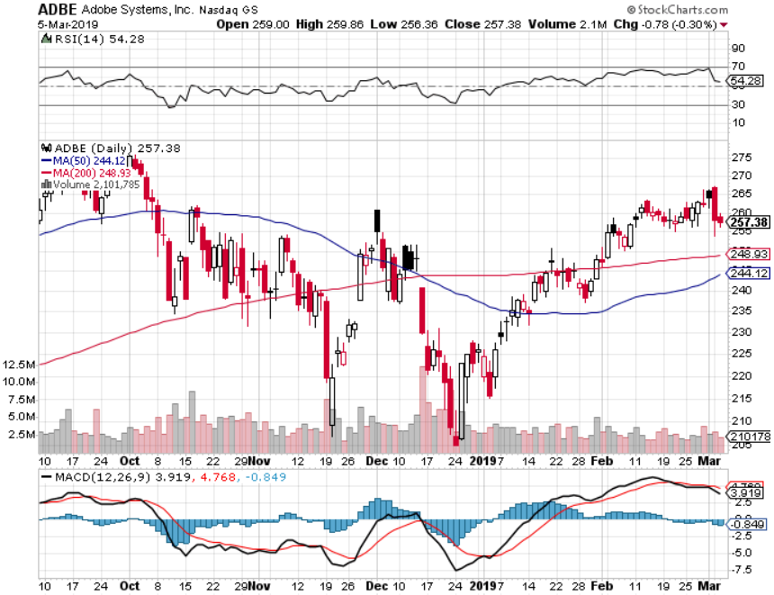
Adobe (ADBE)-
The Quality Non-China tech play

Slide 31
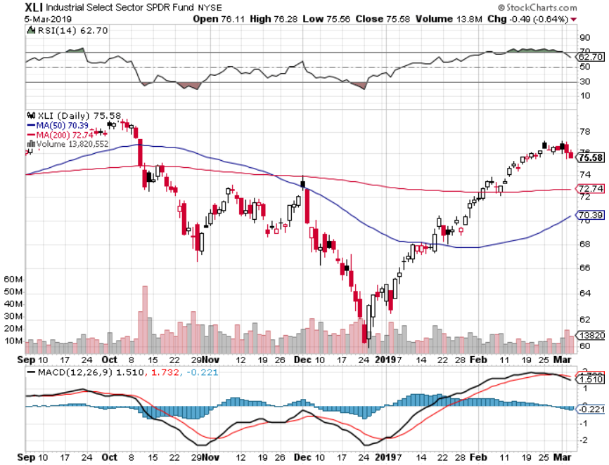
Industrials Sector SPDR (XLI)-
(GE), (MMM), (UNP), (UTX), (BA), (HON)

Slide 32
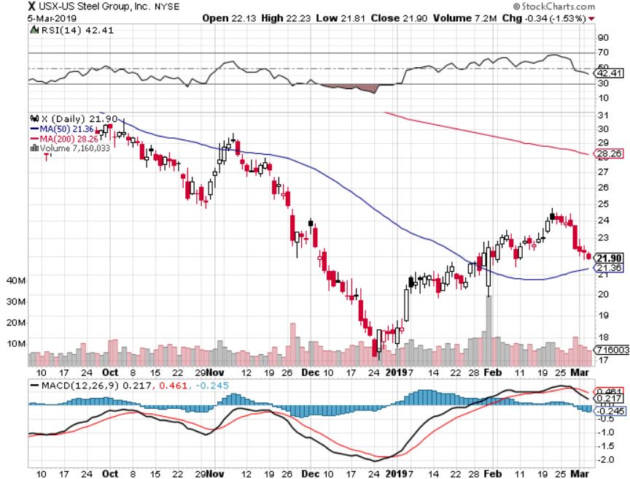
US Steel (X)-Tariffs Trouble
Import duties cause users to abandon steel
Unwound the entire Trump trade

Slide 33
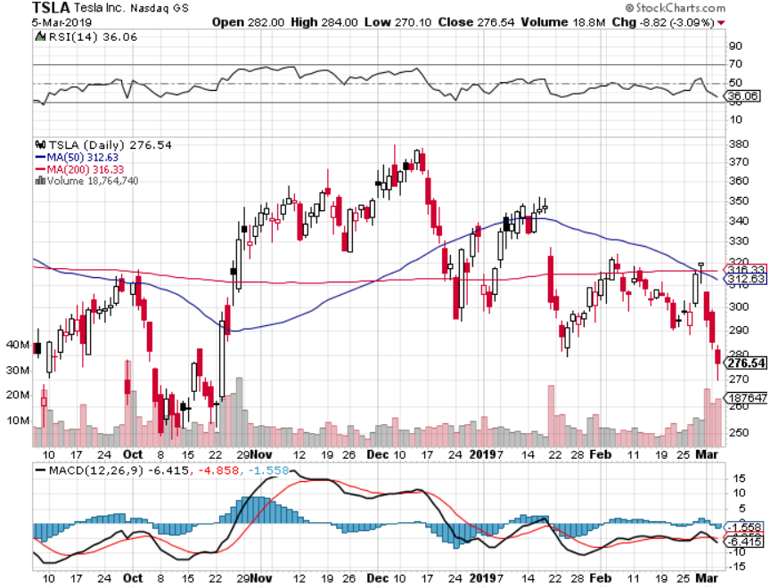
Tesla (TSLA)-Second Quarter of Earnings
Cut price of tesla 3 to $35,000, the Model Y is Out

Slide 34
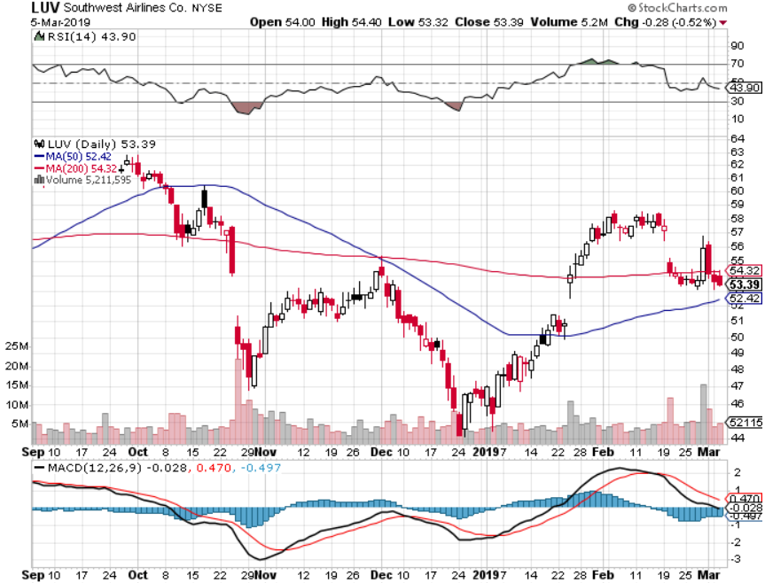
Southwest Airlines (LUV)-No oil help
Warren Buffett’s Favorite Airline

Slide 35
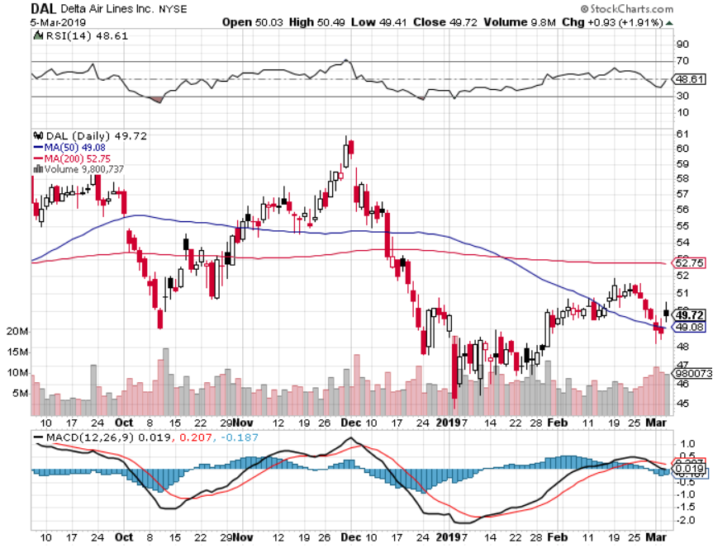
Delta Airlines (DAL)

Slide 36
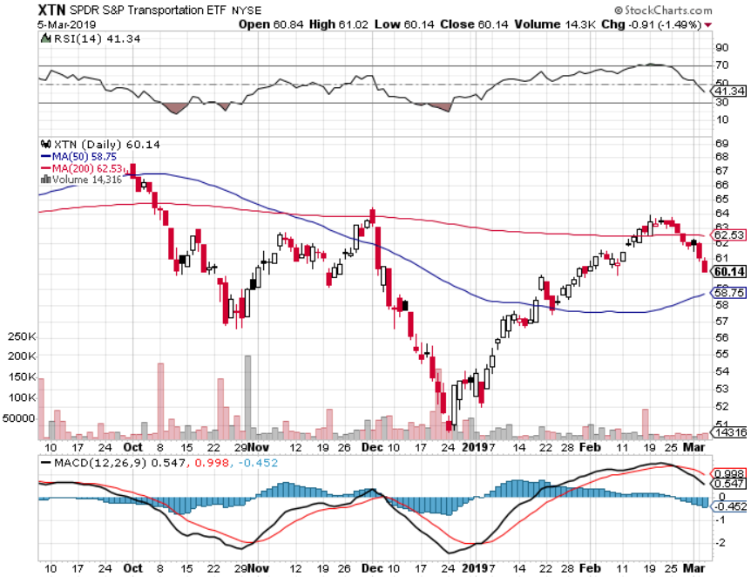
Transports Sector SPDR (XTN)-
(ALGT), (ALK), (JBLU), (LUV), (CHRW), (DAL)

Slide 37
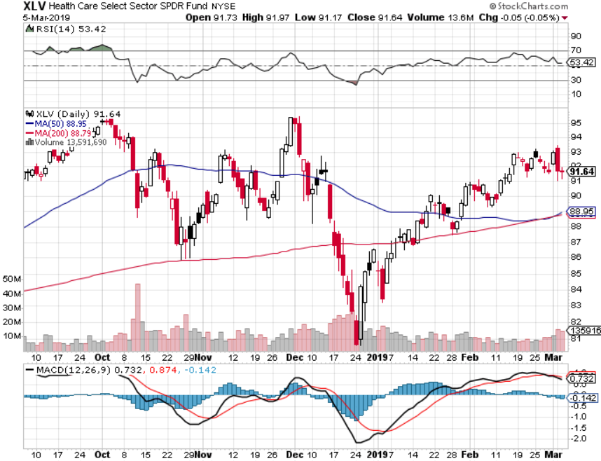
Health Care Sector (XLV), (RXL)-New Highs
(JNJ), (PFE), (MRK), (GILD), (ACT), (AMGN)

Slide 38
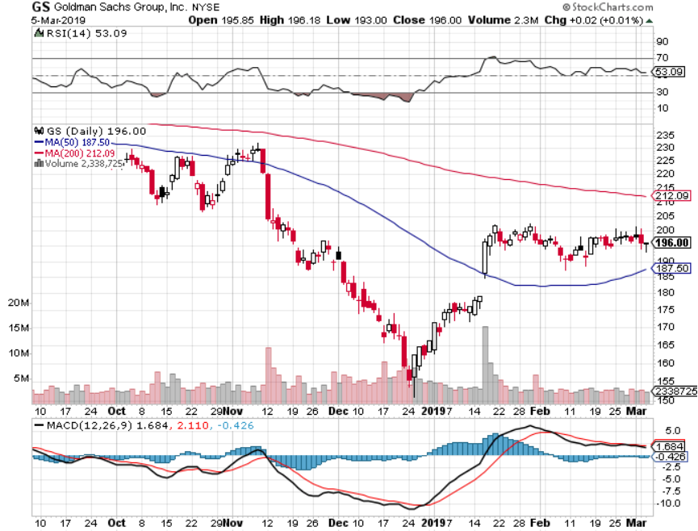
Goldman Sachs (GS)-The Next Buggy Whip maker

Slide 39
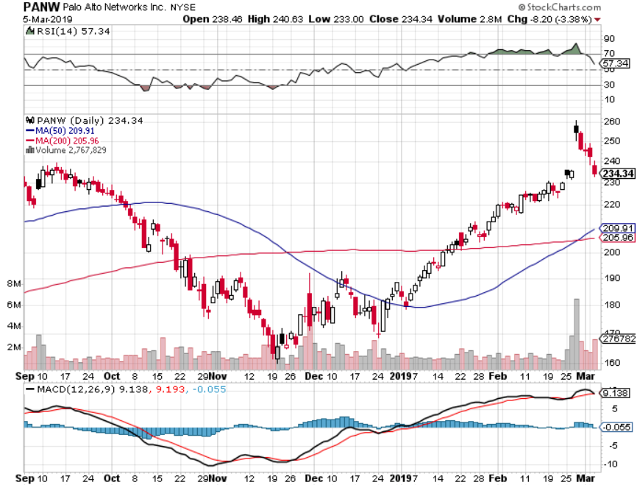
Palo Alto Networks (PANW)-
Hacking never goes out of fashion

Slide 40
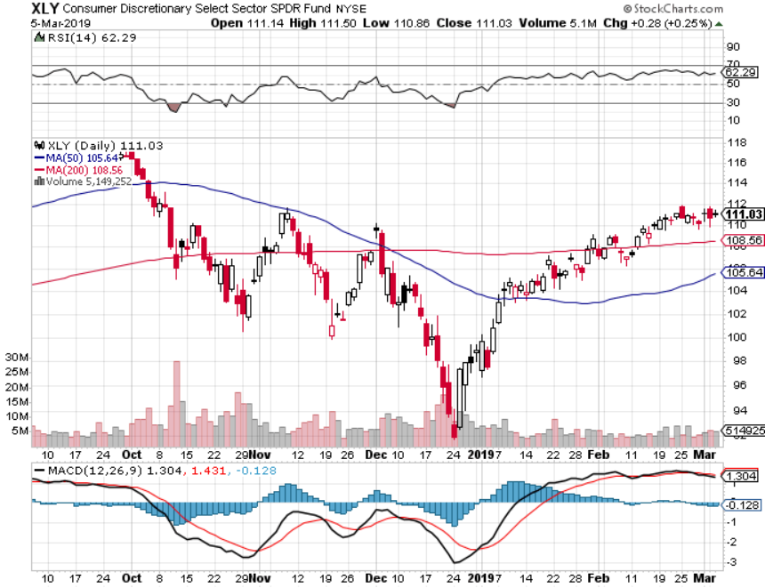
Consumer Discretionary SPDR (XLY)
(DIS), (AMZN), (HD), (CMCSA), (MCD), (SBUX)

Slide 41
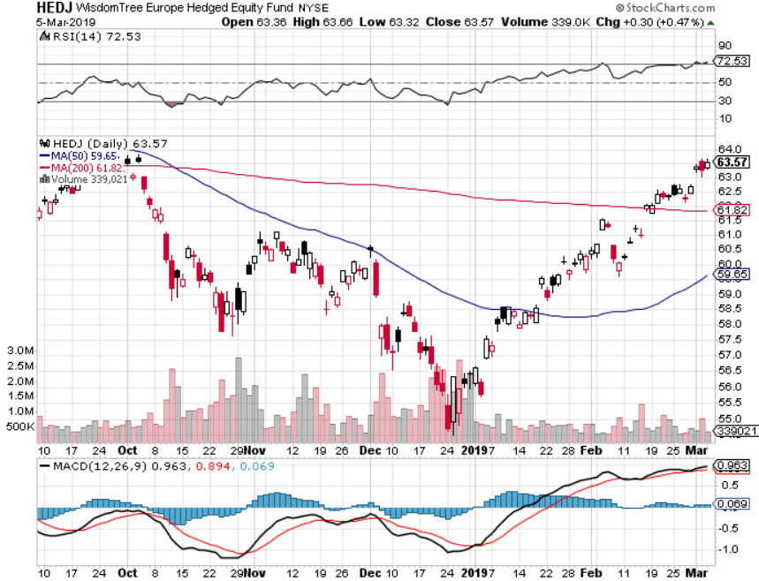
Europe Hedged Equity (HEDJ)-Quadruple top Top

Slide 42
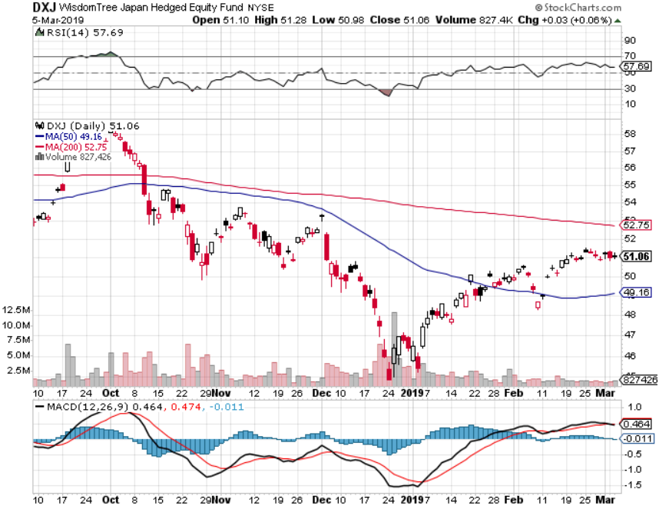
Japan (DXJ)-

Slide 43
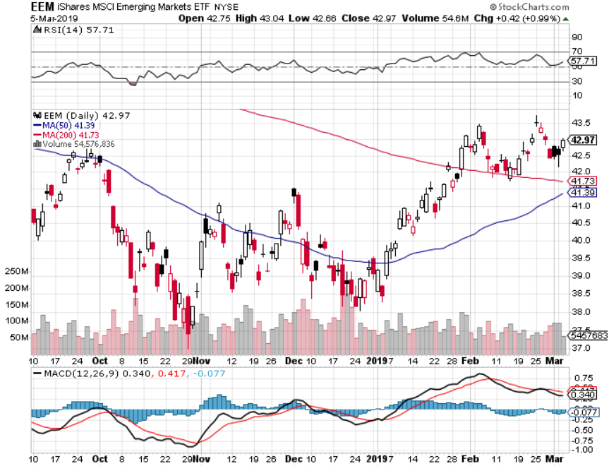
Emerging Markets (EEM)- Time to Buy on Weak Dollar

Slide 44
Bonds – Breakdown!
*Worst week in five months takes (TLT) down 3 points
*Jay Powell reiterates Fed’s dovish posture
*Massing government auctions is crowing our huge private borrowing
*Still looking for 3.50% ten year US Treasury in a year, but what if the peak in this cycle is already in at 3.25%?
*Exploding deficits will weigh on
bonds for the next decade, sell every
rally across the space
Bottom Line: Sell every four point
rally in the (TLT), but this time,
I settled for three

Slide 45
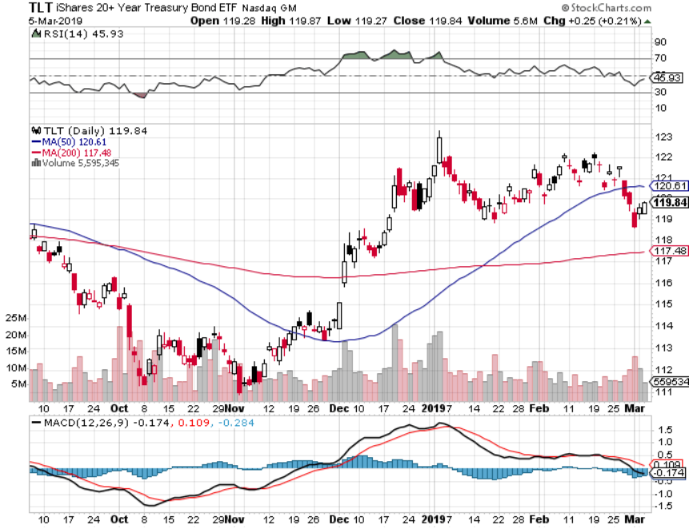
Treasury ETF (TLT) – Bottom of Range long 3/$124-$126 put spread- Expires in 7 days
Expiration of long 2/$124-$126 put spread at maximum profit point took profits on long 2/$125-$128 call spread again took profits on long 1/$124-$127 call spread took profits on long 2/$125-$128 call spread

Slide 46
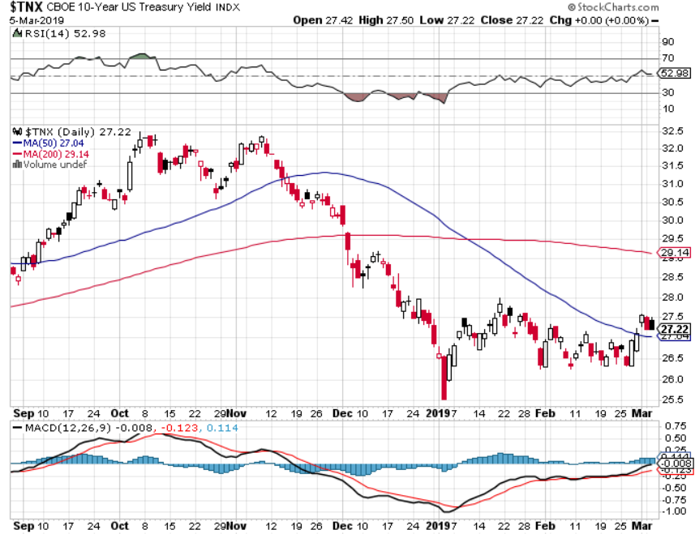
Ten Year Treasury Yield ($TNX) 2.72%
Breakdown

Slide 47
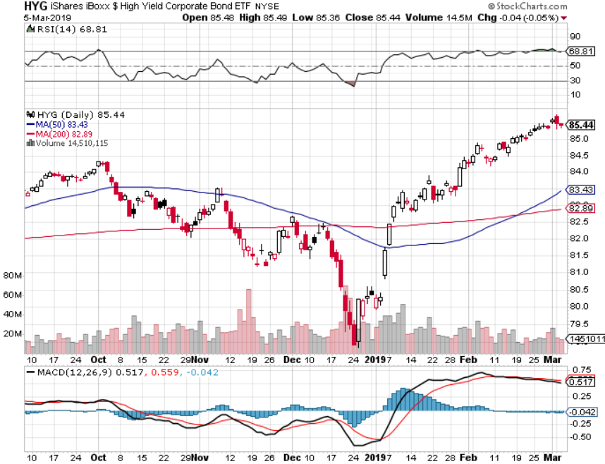
Junk Bonds (HYG) 5.60% Yield

Slide 48
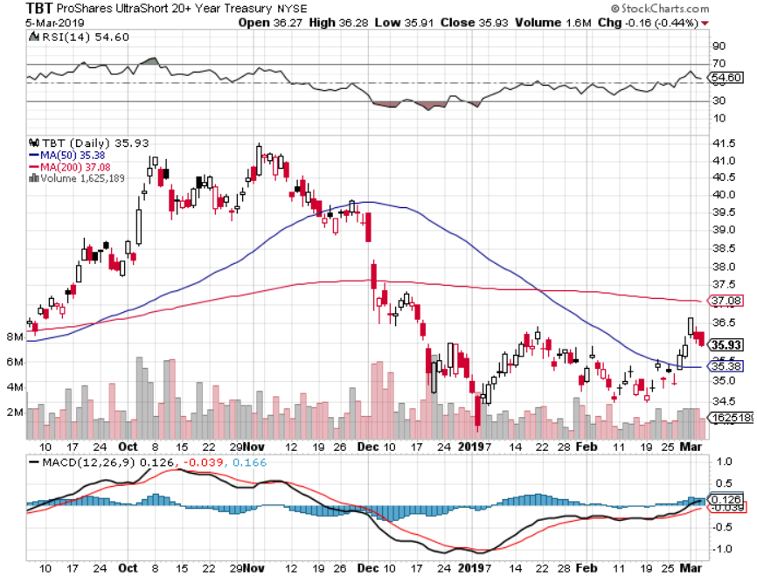
2X Short Treasuries (TBT)-Buy Territory

Slide 49
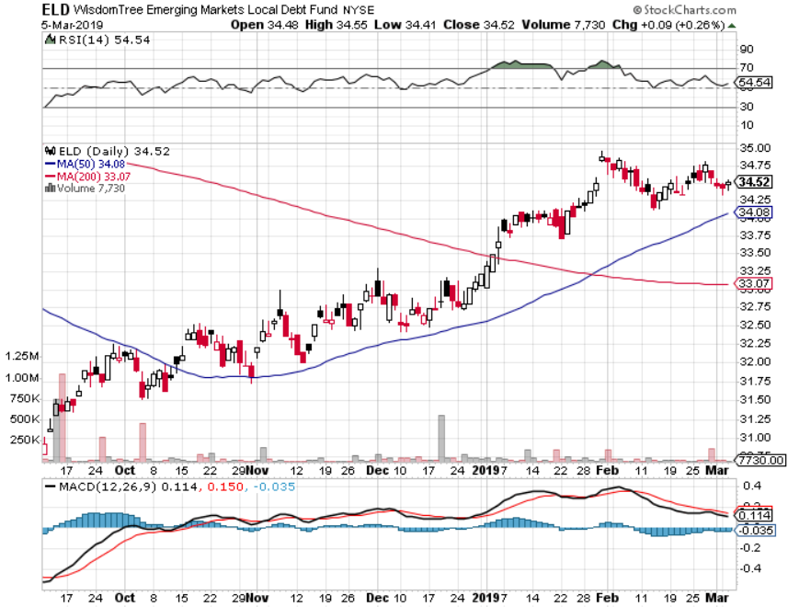
Emerging Market Debt (ELD) 6.02% Yield-

Slide 50
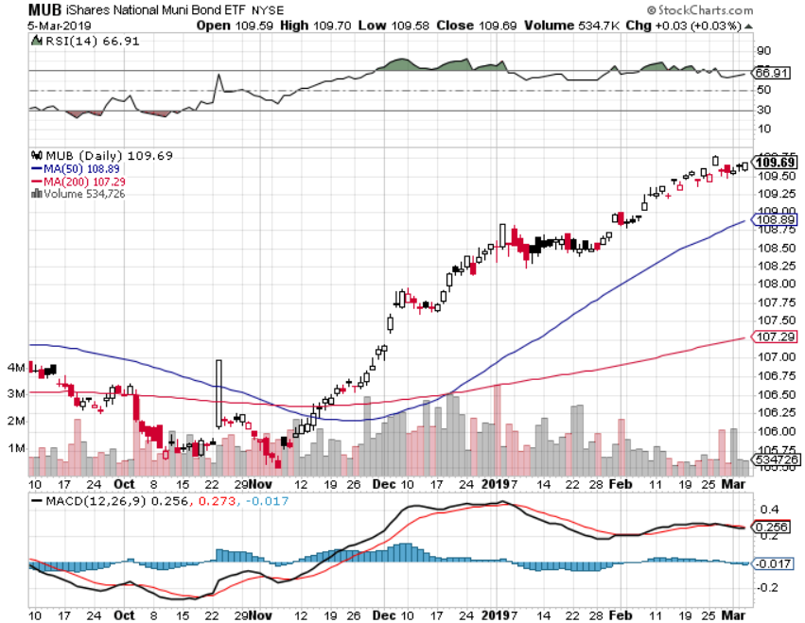
Municipal Bonds (MUB)-2.52%
Mix of AAA, AA, and A rated bonds

Slide 51
Foreign Currencies – Dollar Pop
*Continued Fed dovish drags heavily on the dollar, however, bond market collapse gave it a nice one day pop
*Is a big positive for weak dollar plays like Gold (GLD) and Emerging markets (EEM)
*British pound stages another huge rally on Brexit fail
*Massive Chinese economic stimulus drives Yuan higher
*Bitcoin hits new low at $3,400
*Bottom Line: sell dollars, buy the Euro (FXE)

Slide 52
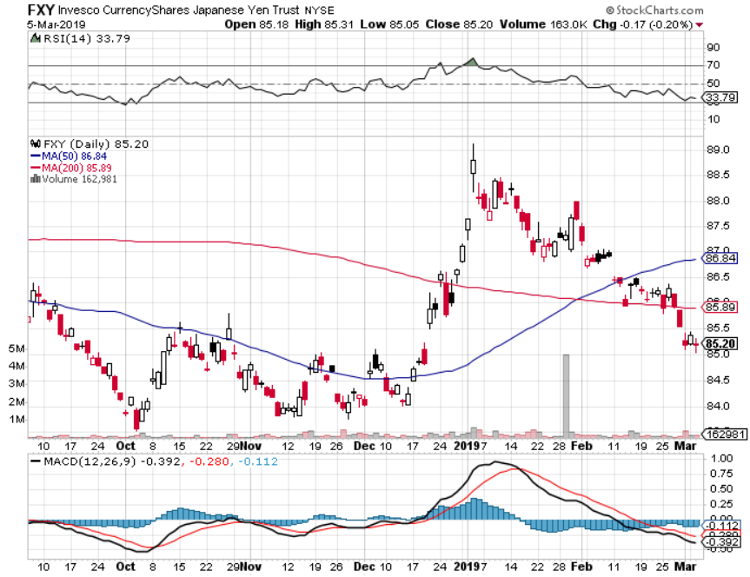
Japanese Yen (FXY), (YCS)

Slide 53
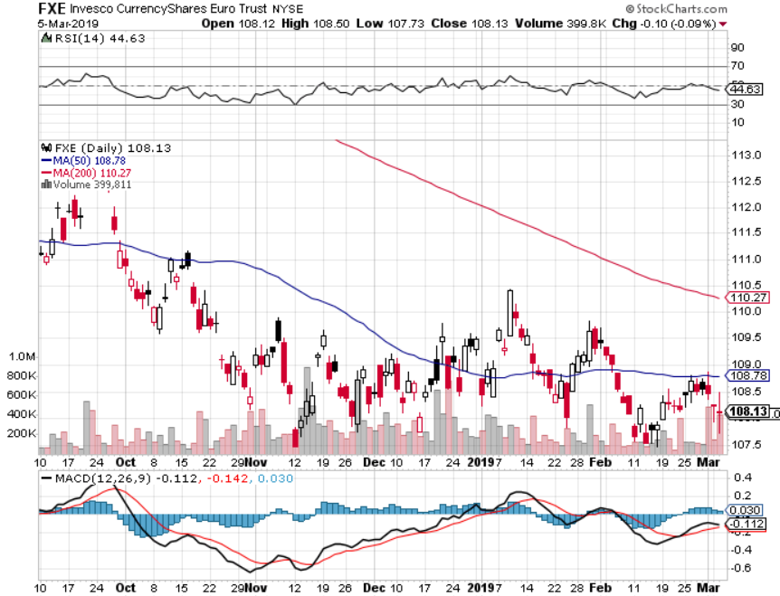
Euro ($XEU), (FXE), (EUO)- Trying to Break Down long 2/$105-$108 call spread

Slide 54
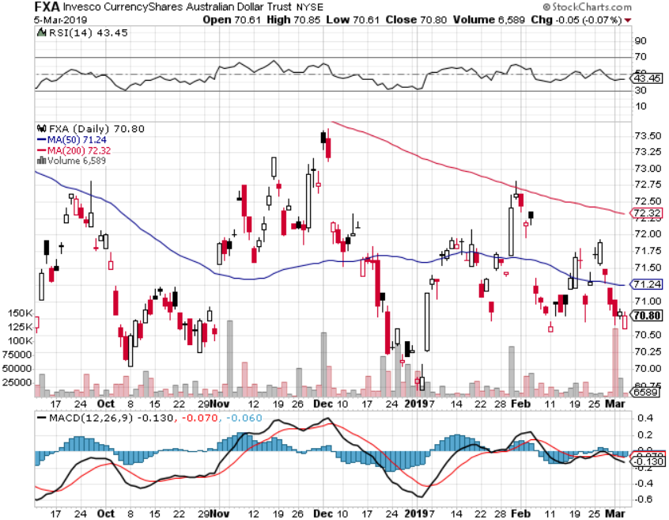
Australian Dollar (FXA)-

Slide 55
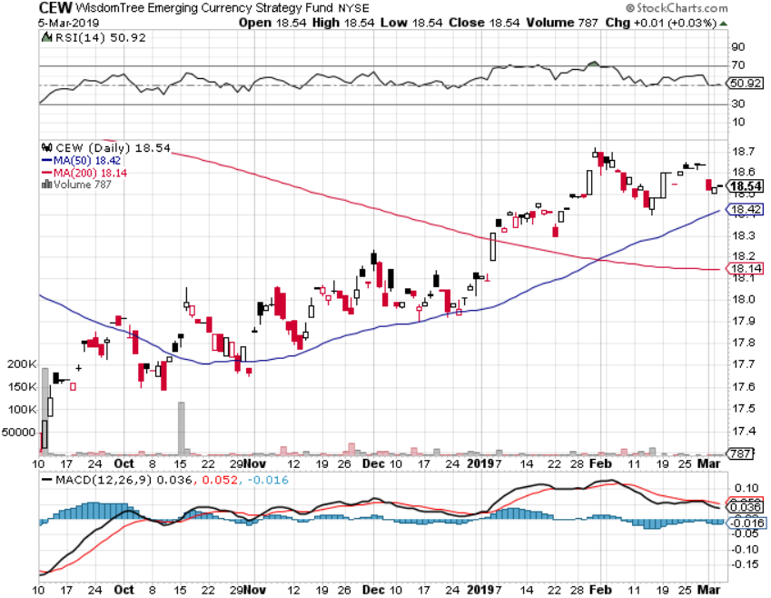
Emerging Market Currencies (CEW)

Slide 56
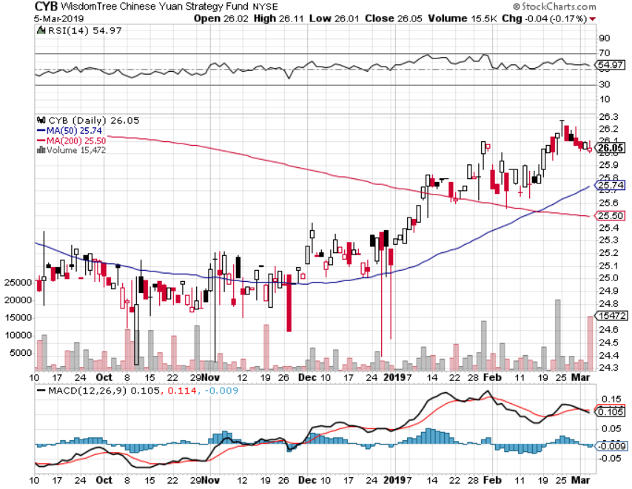
Chinese Yuan- (CYB)-

Slide 57
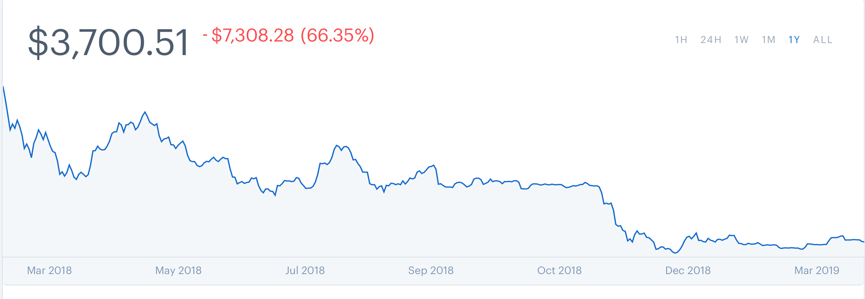
Bitcoin- 10% Rally
Venezuela collapse is creating demand

Slide 58
Energy – US in No. 1
*US oil production hits new record of 12.1 million b/d
*Weak dollar is providing a bid for the entire commodity complex, including oil
*Venezuelan production going to zero
*Libya is coming back on line with 300,000 barrels a day in production
*Massive draw down in inventories boosts prices
*Recovering China economy is
another major positive
*Bottom Line: Buy the dips

Slide 59
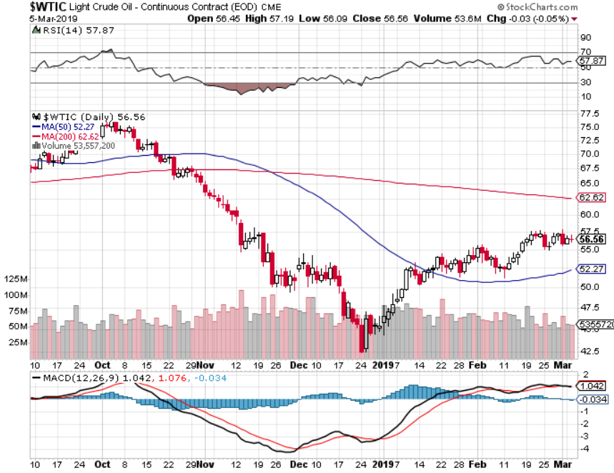
Oil-Bouncing

Slide 60

United States Oil Fund (USO)

Slide 61

Energy Select Sector SPDR (XLE)-No Performance!
(XOM), (CVX), (SLB), (KMI), (EOG), (COP)

Slide 62

Halliburton (HAL)-

Slide 63

Natural Gas (UNG)-
Major Hedge Fund Blow Up

Slide 64

Copper (COPX)- Upside breakout
Trade War Deal Coming

Slide 65
Precious Metals – Punch in the Nose
*New one year highs as equity traders diversify into gold
*Dovish Fed is a big help
*However, upside surprise in Q4 GDP, from 2.2% to 2.6% annualized, triggers bout of short term profit taking
However, the long term trend is intact until the Fed starts raising rates again.
*The real move for gold won’t begin
until we get true inflation, which won’t
appear until later this year
*Buy Dips

Slide 66

Gold (GLD)- The flight to safety bid is coming
Stopped out of 3/$119-$122 vertical bull call spread

Slide 67

Market Vectors Gold Miners ETF- (GDX) – Yikes!

Slide 68

Barrick Gold (GOLD)

Slide 69

Newmont Mining- (NEM)-

Slide 70

Palladium - (PALL)-

Slide 71

Real Estate – In the Toilet
*Listings skyrocket 6% and speculators rush to get out of the market, with 73,000 new homes on the market
*Luxury end of the market has basically shut down due to huge oversupply
*January Pending Home Sales jump a surprise 4.6%, but Existing Home Sales down 8%, New Home Sales up 3.6%
*30 year fixed rate loan drops to 4.43%
*December S&P 500 Case-Shiller drops to 4.2%,
annual gain, the lowest gain in 3 ½ years
*Bottom Line: Stand aside for a trade
but buy for long term investment

Slide 72

December Corelogic S&P Case Shiller Home Price Index
Las Vegas (11.4%), Phoenix (8%), and Atlanta (5.9%) showing biggest gains
Tradingeconomics.com

Slide 73

Simon Property Group (SPG)-

Slide 74

US Home Construction Index (ITB)
(DHI), (LEN), (PHM), (TOL), (NVR)

Slide 75

Trade Sheet-
So What Do We Do About All This?
*Stocks-don’t chase
*Bonds-sell any and all rallies
*Commodities-buy dips
*Currencies-buy dips
*Precious Metals – buy dips
*Volatility-buy dips to $12
*Real estate-stand aside

Slide 76

Next Strategy Webinar
12:00 EST Wednesday, March 20,
2019 from San Francisco, CA www.madhedgefundtrader.com email me at support@madhedgefundtrader.com
Good Luck and Good Trading!
Notes:
*

