Slide 1
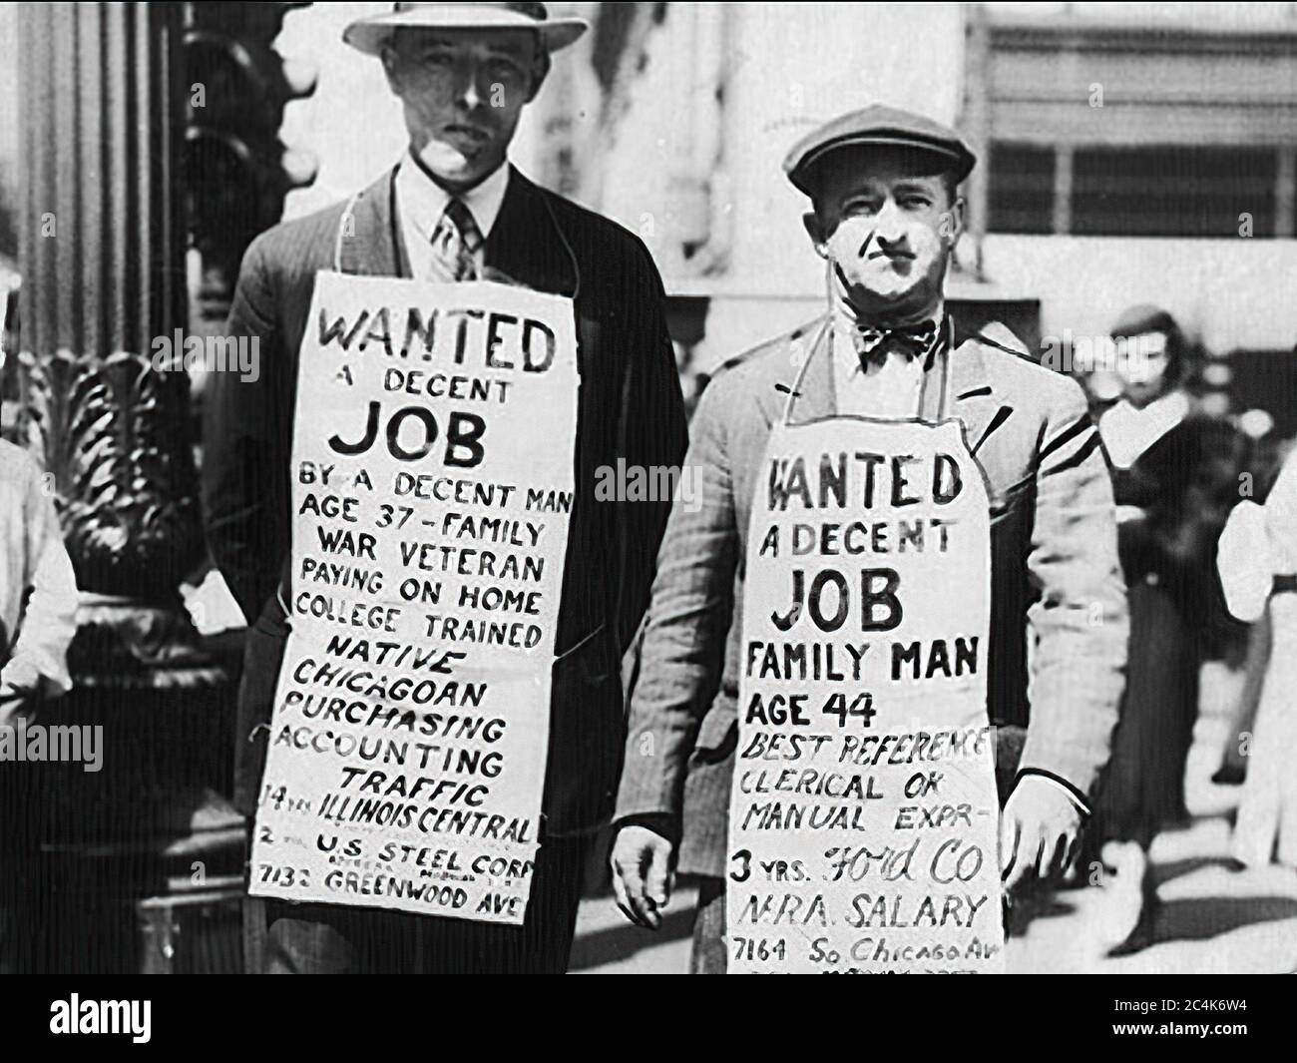
The Mad Hedge Fund Trader “The Special Recession Issue”
With John Thomas Incline Village, NV April 30, 2025 www.madhedgefundtrader.com
Notes:
*

Slide 2
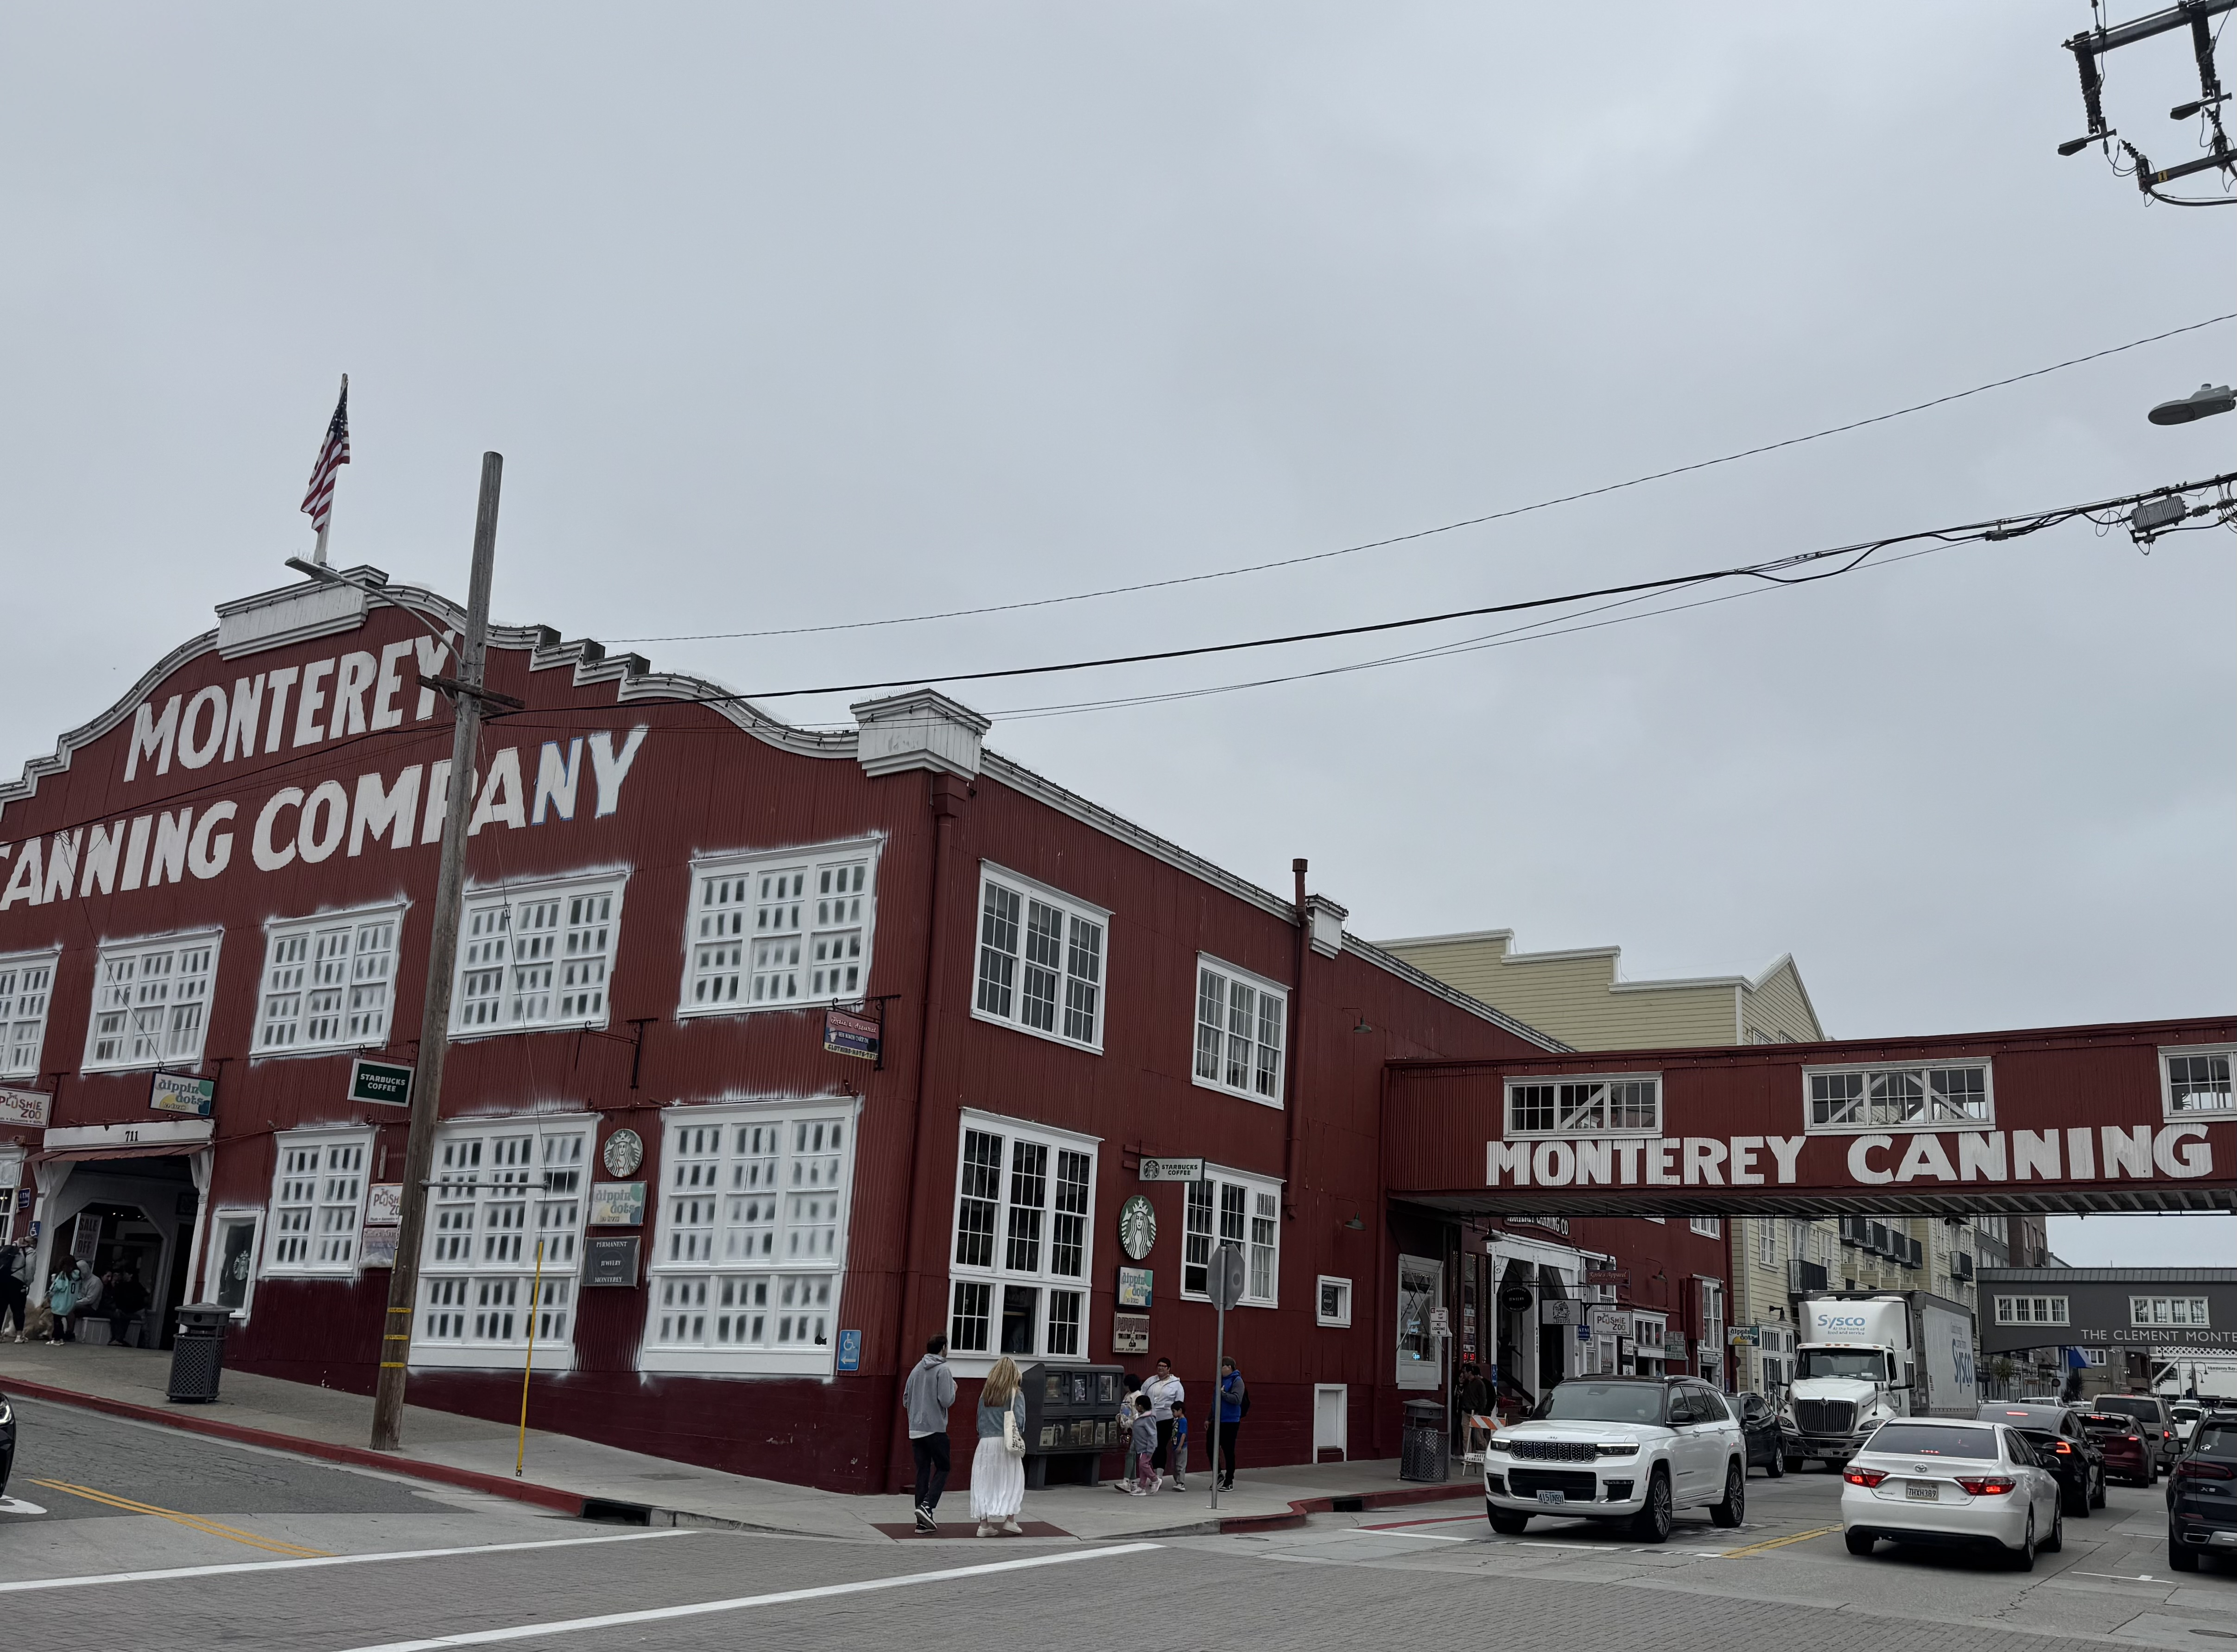

Slide 3
Trade Alert Performance New All-Time Highs!
*January +5.80% Final *July +10.92% Final *February +3.66% Final. *August +3.74% Final *March +4.36% Final *September +10.28% Final *April +12.69% MTD *October +7.59% Final *May +3.74% Final *November +18.96 Final *June +1.94% Final *December +3.26% Final *2025 Year To Date +26.52% +776.03% since inception *Versus 84.63% for all of 2022 *Versus 79.79% for all of 2023 *Versus 75.29% for all of 2024

Slide 4
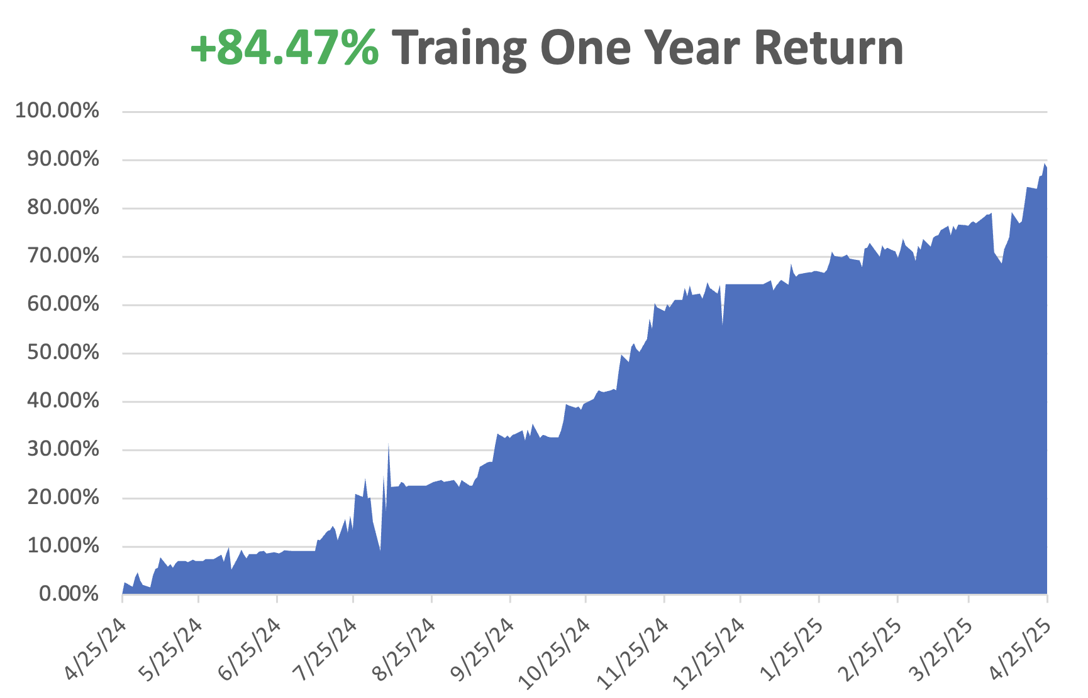

Slide 5
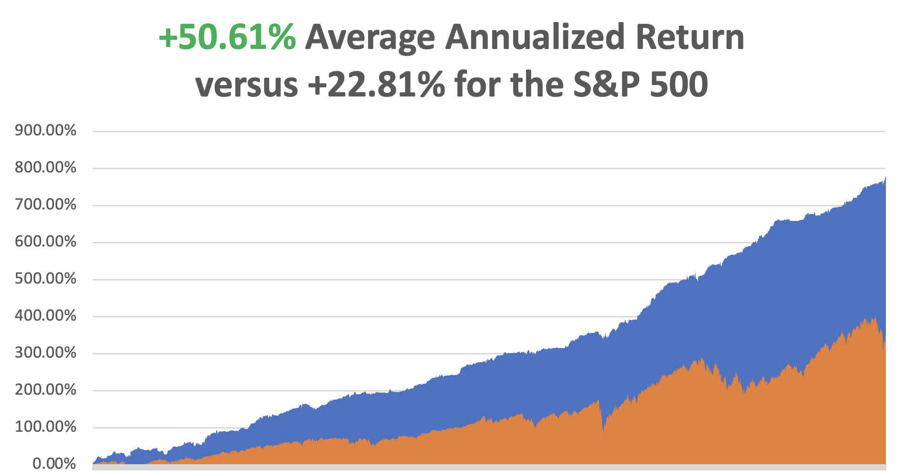

Slide 7
The Method to My Madness
*Market looks through to a trade war solution….for a week *Bonds stabilize after Trump back off Powell firing *Markets have entered wide trading range with much volatility *Economic data remains consistently weak capping any upside in stocks *Recession call is still on with China in no hurry to negotiate *US Dollar hits three-year lows on “Sell America” trade *Oil bounces on Iran war risks *Gold remains golden at new all-time highs, silver ready to play catch-up

Slide 8
The Global Economy – Universally Bad
*Negative 0.3%GDP growth, 4.3% March inflation rate Point to Stagflation *Jay Powell Hints at No Rate Cuts This Year *Consumer Confidence Dives on Tariff Fears from 57.0 to March to 52.2 in April *IMF Cuts US GDP forecast for 2025 from 2.8% to 1.8%, *Leading Economic Indicators Plunge, down 0.7%, to 100.5 *Europe Lowers Interest Rates, down 0.25% to 2.25% *Unemployment Fears Hit Five Year High *US Inflation Expectations Hits 44 Year High

Slide 9
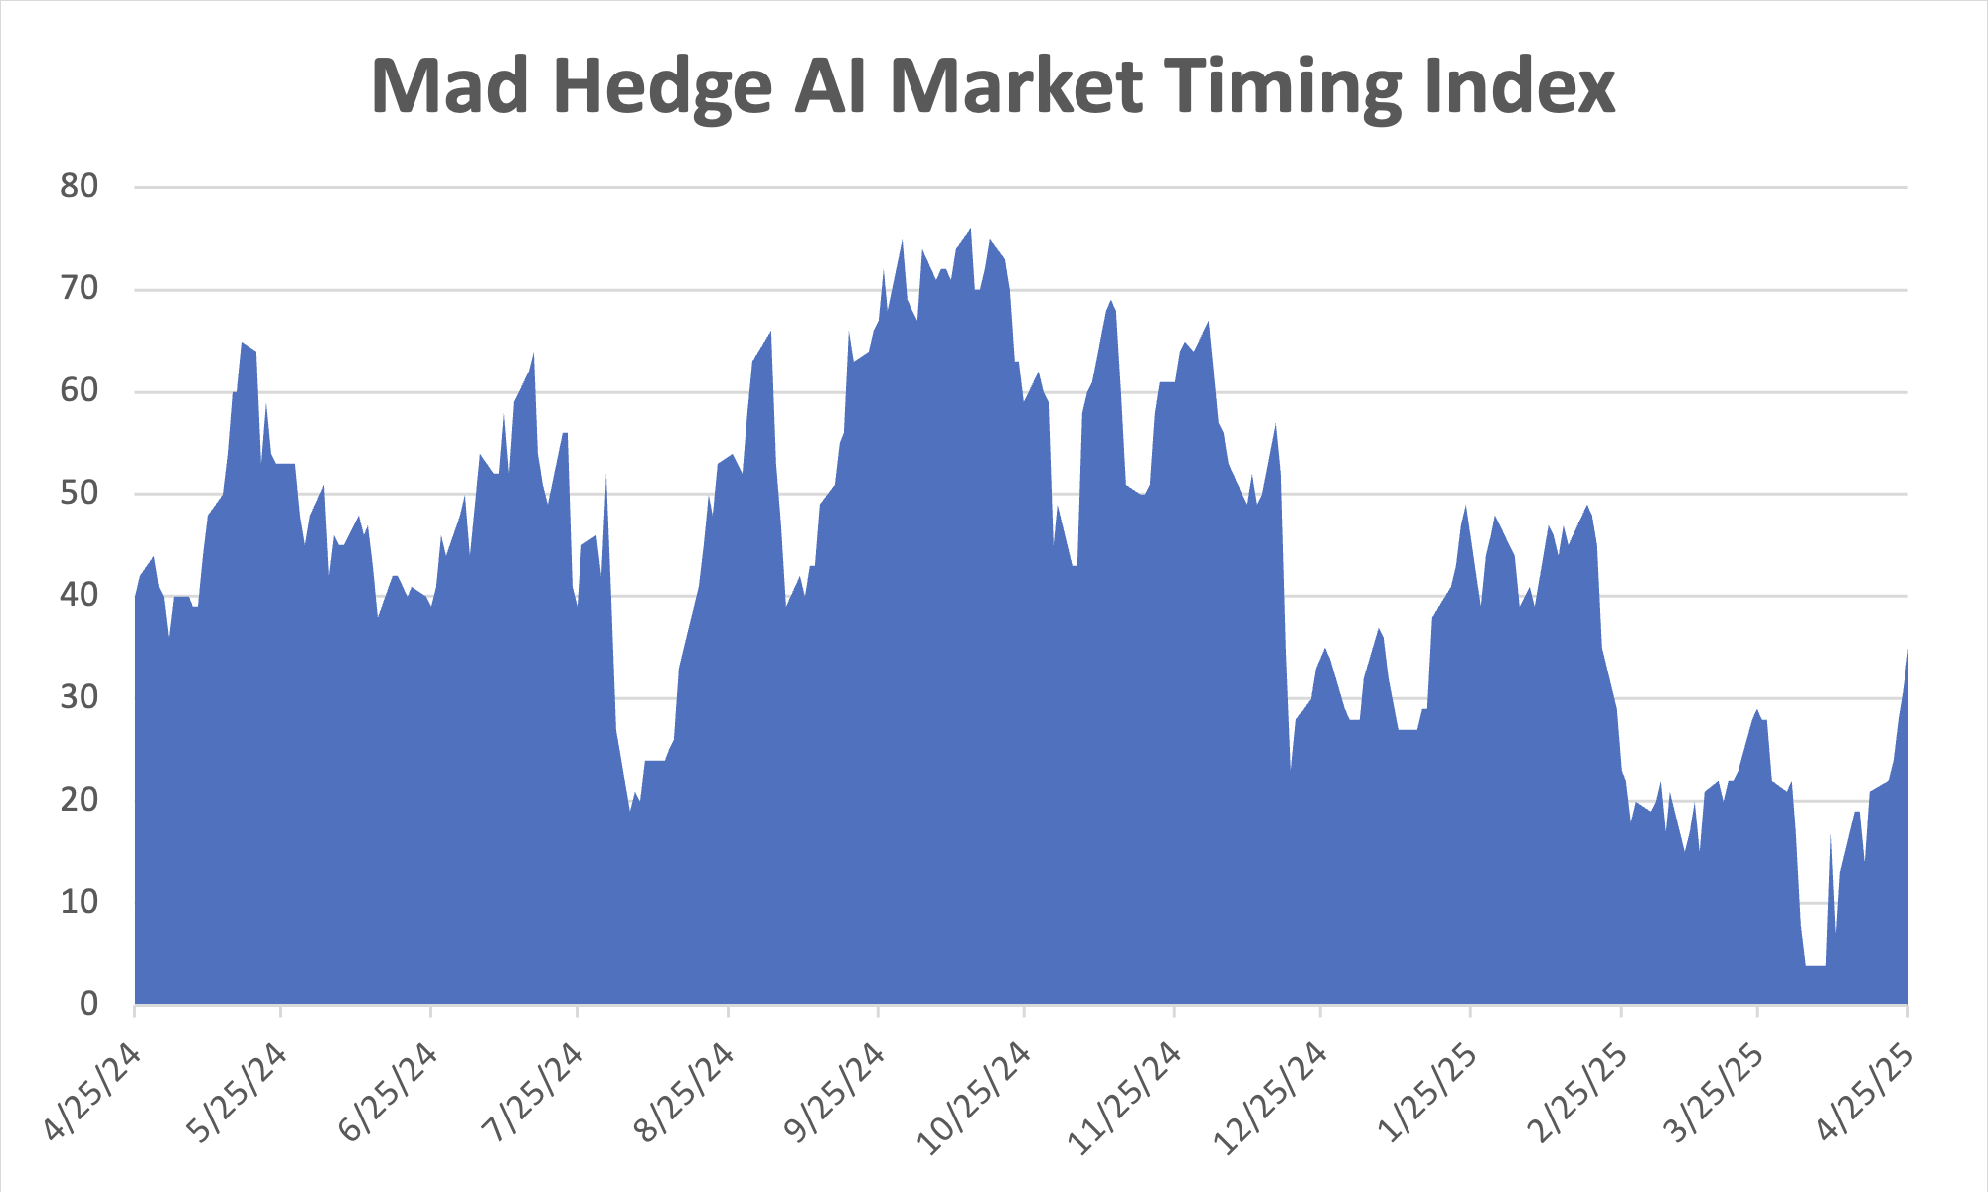
The Mad Hedge Profit Predictor Market Timing Index – New Range? An artificial intelligence driven algorithm that analyzes 30 different economic, technical, and momentum driven indicators
SELL
BUY

Slide 10
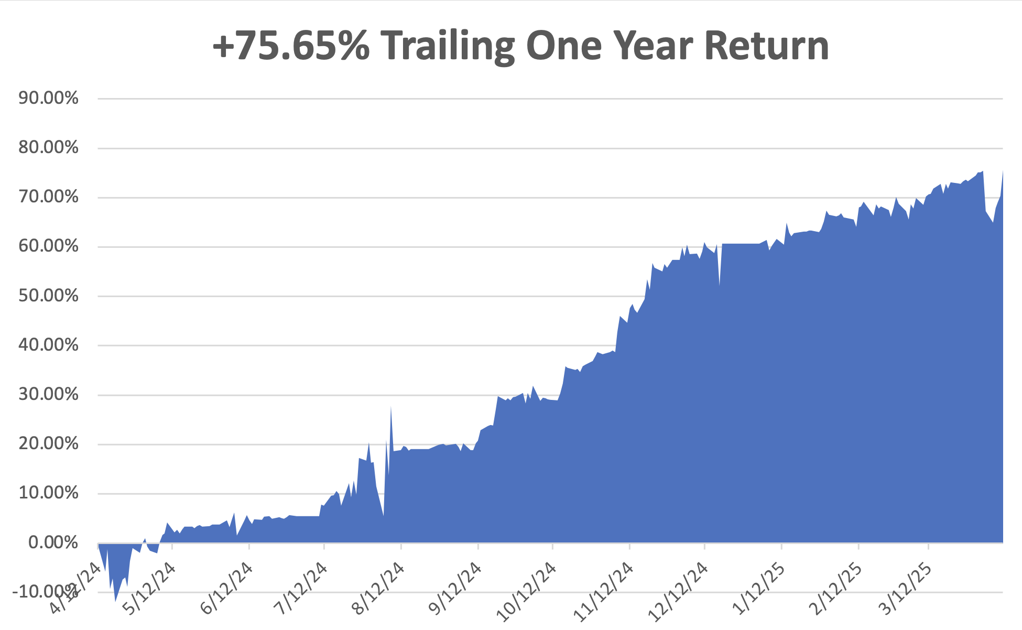

Slide 11
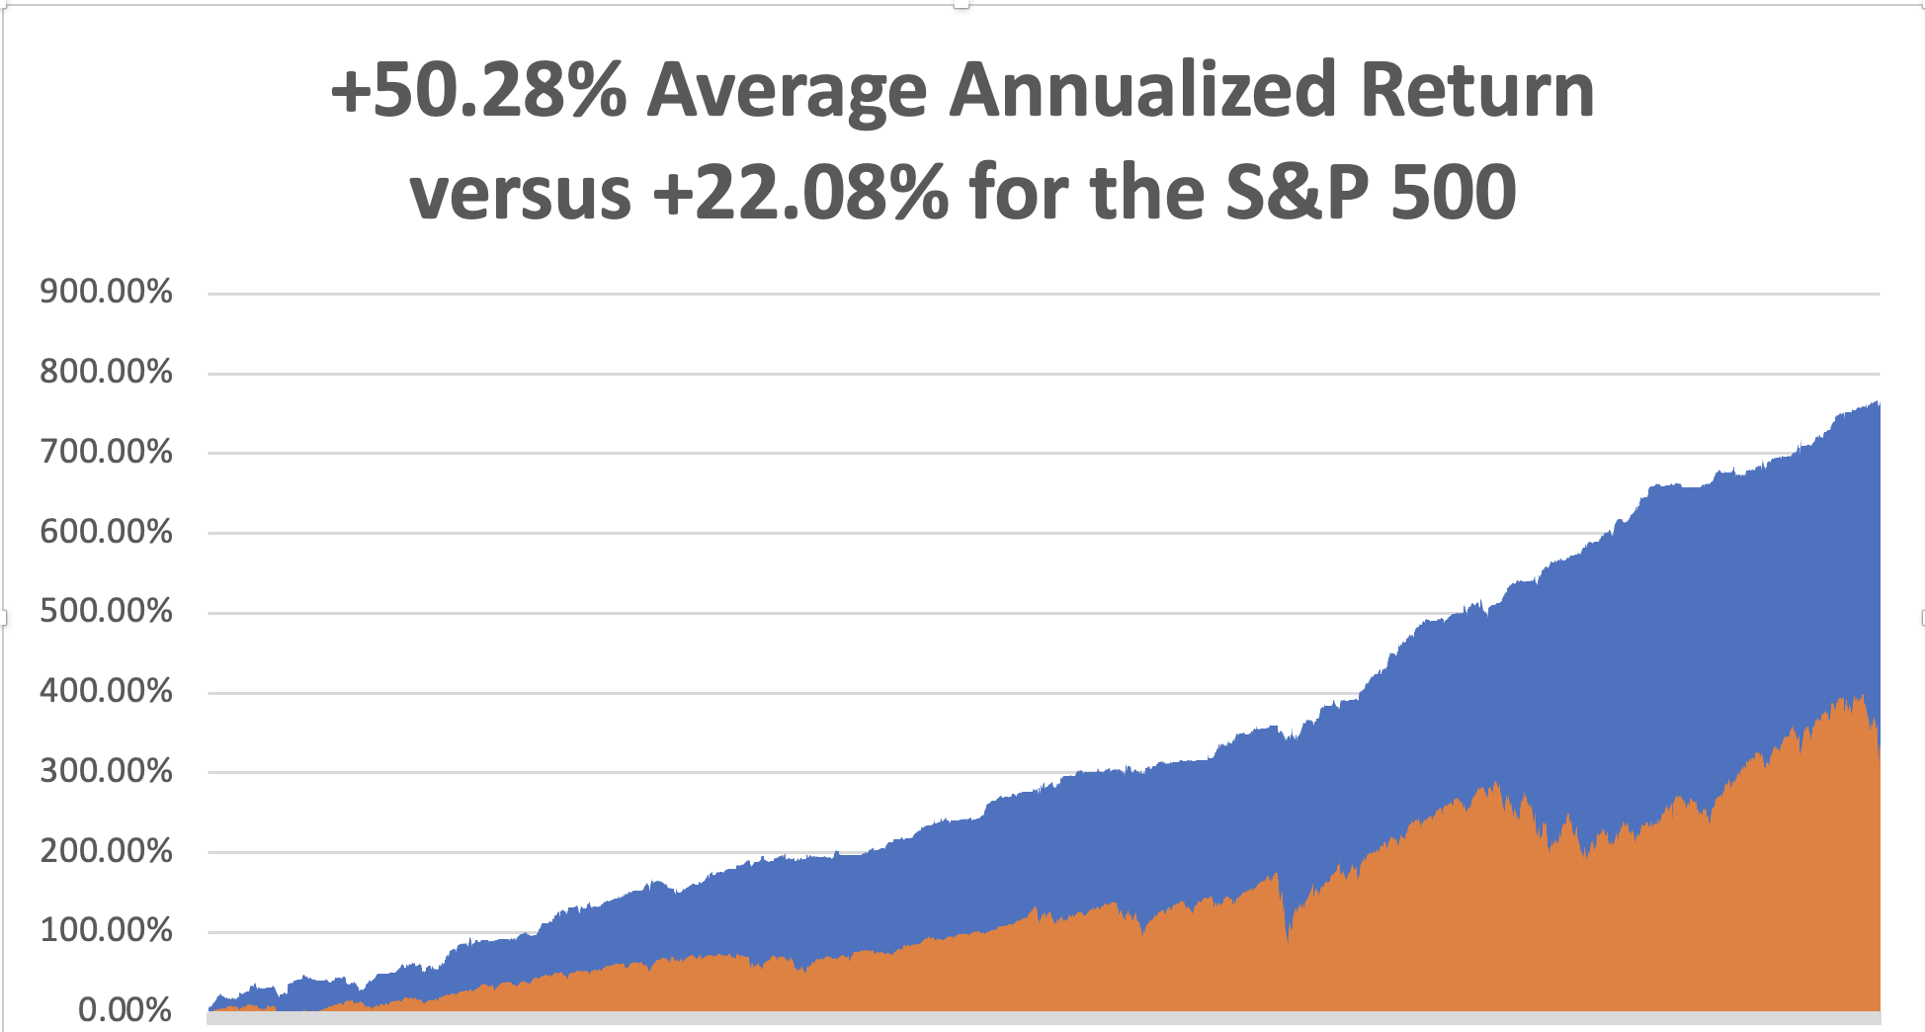

Slide 12
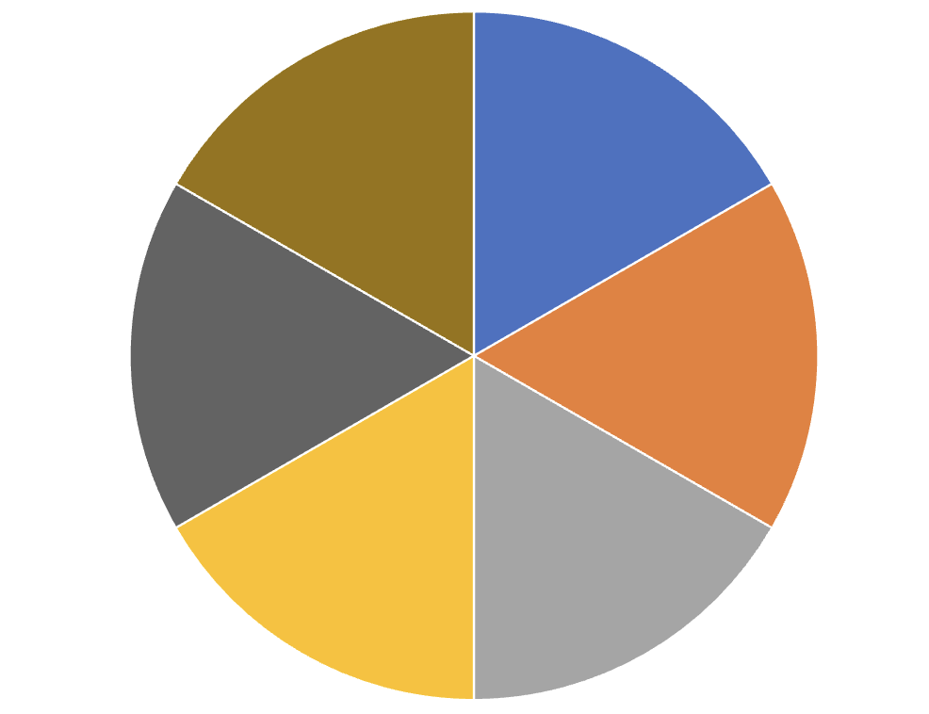
Portfolio Review – Big Bet We Don’t Go to New Highs by April 17 30% risk on, 0% risk off, 70% cash
Portfolio Review – Big Bet We Don’t Go to New Highs by April 17 30% risk on, 0% risk off, 70% cash
Risk On
(MSTR) 5/$220-$230 call spread | 10.00%
(MSTR) 5/$250-$260 call spread | 10.00%
(NFLX) 5/$850-$850 call spread | 10.00%
(JPM) 5/$190-$200 call spread | 10.00%
Risk Off
(SPY) 5/$570-$580 put spread | -10.00%
(GLD) 5/$275-$285 call spread | -10.00%
Total Net Position | 20.00%
Total Gross Position | 60.00%
Expiration Value +15.29%

Slide 13
The Method to My Madness
*Market looks through to a trade war solution….for a week *Bonds stabilize after Trump back off Powell firing *Markets have entered wide trading range with much volatility *Economic data remains consistently weak capping any upside in stocks *Recession call is still on with China in no hurry to negotiate *US Dollar hits three-year lows on “Sell America” trade *Oil bounces on Iran war risks *Gold remains golden at new all-time highs, silver ready to play catch-up

Slide 14
The Global Economy – Universally Bad
*Fed Beige Books Points to Stagflation *Jay Powell Hints at No Rate Cuts This Year *Consumer Confidence Dives on Tariff Fears from 57.0 to March to 52.2 in April *IMF Cuts US GDP forecast for 2025 from 2.8% to 1.8%, *Leading Economic Indicators Plunge, down 0.7%, to 100.5 *Europe Lowers Interest Rates, down 0.25% to 2.25% *Unemployment Fears Hit Five Year High *US Inflation Expectations Hits 44 Year High

Slide 15
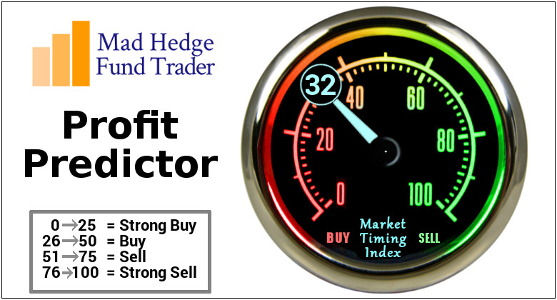

Slide 16
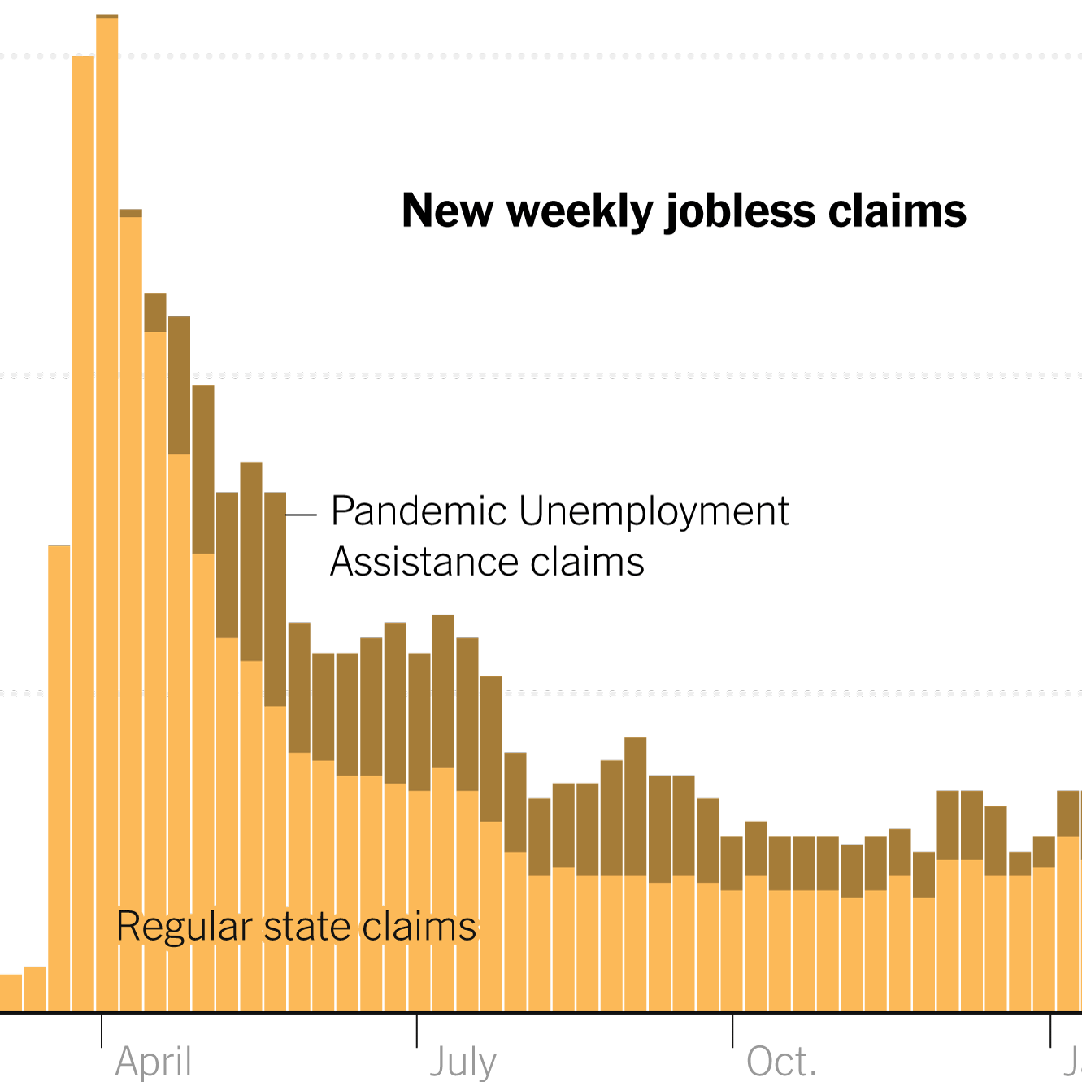
Weekly Jobless Claims – 4 Month Low +6,000 to 222,000

Slide 18
Stocks – Roller Coaster
*Stock Market Suffers Worst Start to a Year in History, but are still expensive *Morgan Stanely Marks Down (SPX) Earnings, from $270 to $257 per share *The Volatility Index ($VIX) Spikes to $54, then $54 *All Capital Gains of the Last 13 months wiped out at market lows *Chaos reigns supreme, with the (SPX) dropping 20% at the lows *Hedge Funds are Still Dumping Technology Stocks, as they still command big premiums to the main market *Tech leads the downturn on every selloff *All long-term technical indicators have rolled over, meaning that the bear market could continue until summer at the eeliest and next year at the latest *2025 will be a down year for stocks

Slide 19
The Ultimate Hedge – Defensive stocks only go down at a slower rate 90 - day US Treasury Bills (Warren Buffet owns $300 billion)
*Government Guaranteed principal *Endless liquidity, trade like water *100% collateral value for margin *Lock in guaranteed income *Can be sold at any time to earn full interest *Will survive any bear market *Ask your broker how to buy

Slide 20
TRADE THE BOTTOM OF A NEW LOW RANGE -10% - 18% FROM THE TOP OR (SPX) 5,000 TO 5,500

Slide 21
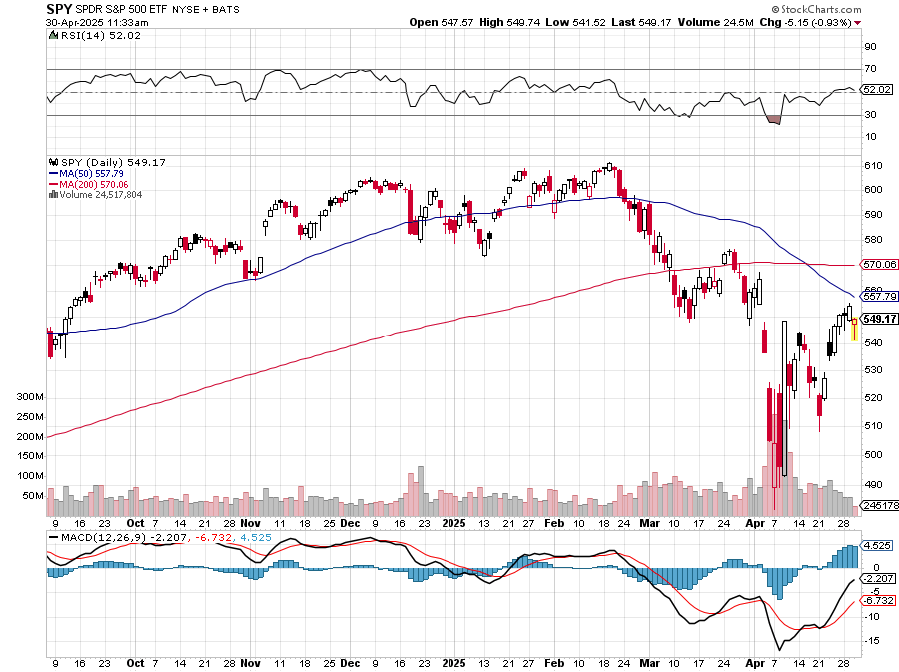
S&P 500 – Downside Targets – down -10.3% on year long 5/$570-$580 put spread-expires in 12 trading days
$560 -8.6% 1st resistance
$485 -20.9% 1st support

Slide 22
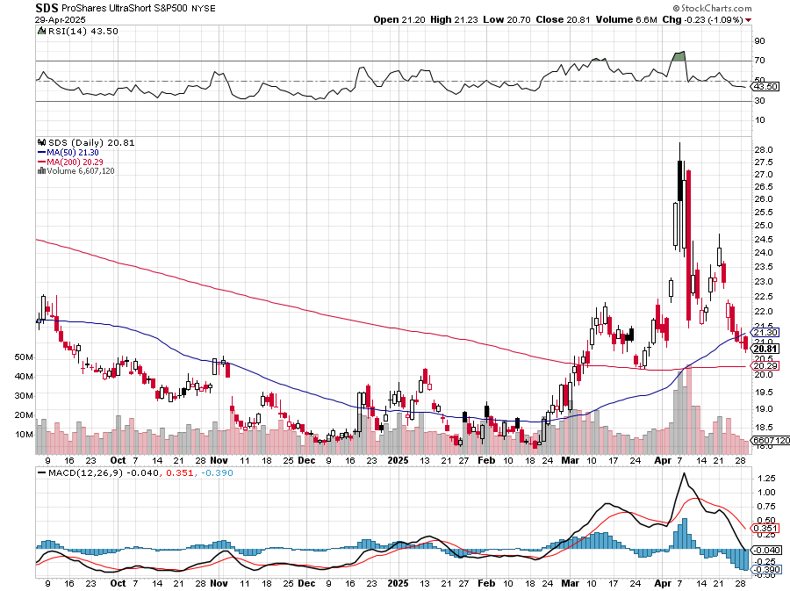
ProShares -2X Short S&P 500 (SDS) - a great 2X hedge for falling long stocks Long 3/$38-$41 call spread – expires in 2 days, long $40-$43 calls prad – expires in 21 days up 40%

Slide 23
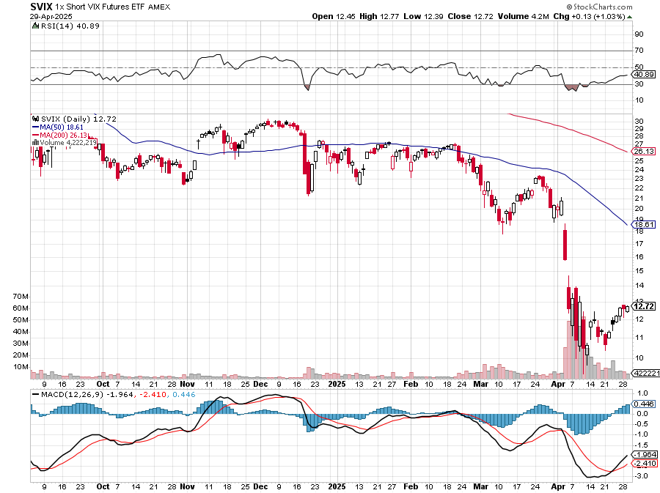
(VIX) – Volatility Index Hits Four Year High at $65, the most since the 2020 pandemic. That implies a 2% move in the S&P 500 (SPX) every day for the next 30 days

Slide 24
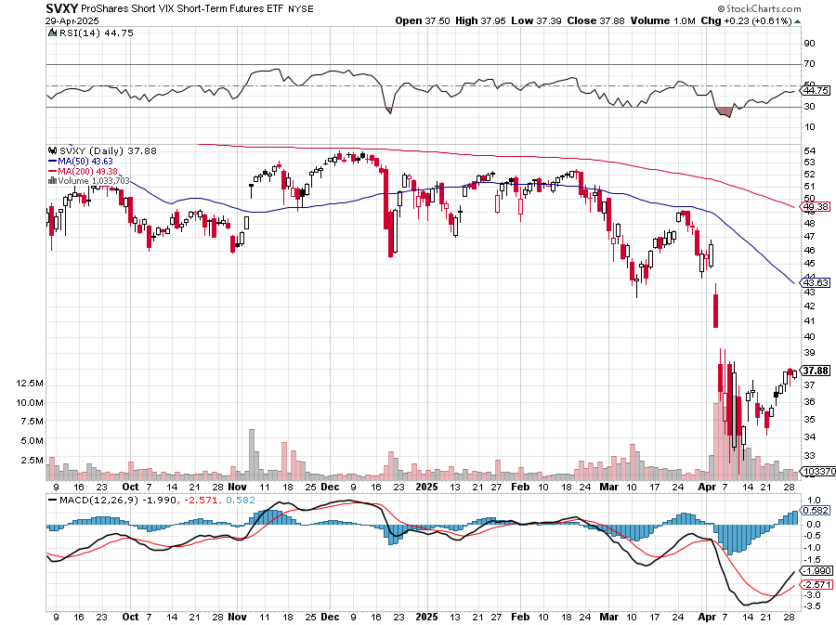
(SVXY) –Short Volatility ETF bought at $36.31 - $32.74 = $3.57

Slide 25
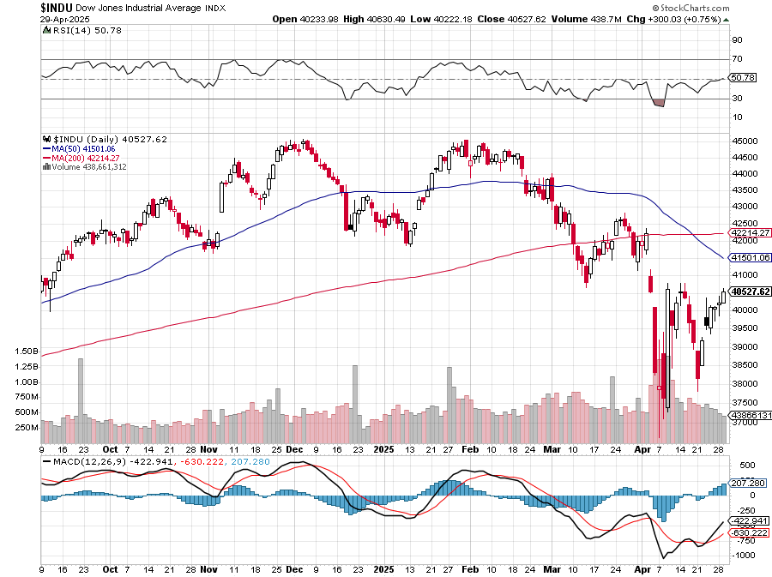
Dow Average ($INDU)-

Slide 26
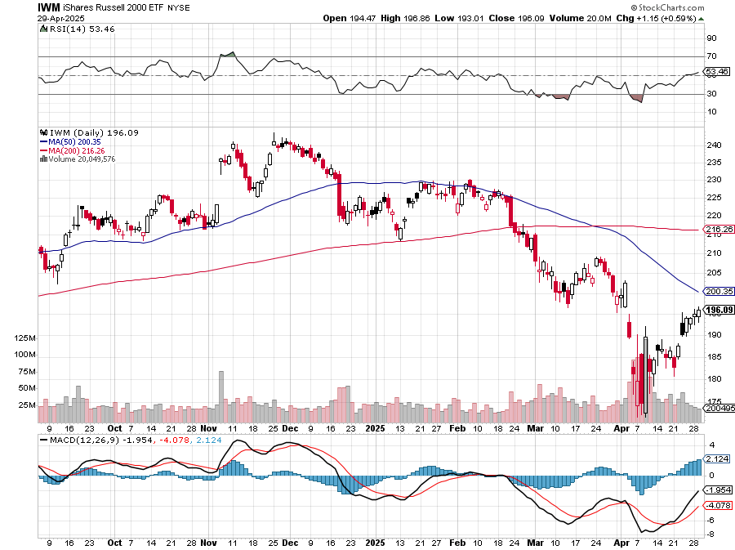
Russell 2000 (IWM)- took profits on Long 10/$137-$142 vertical bull call spread took profits on Long 10/$153-$156 vertical bear put spread

Slide 27
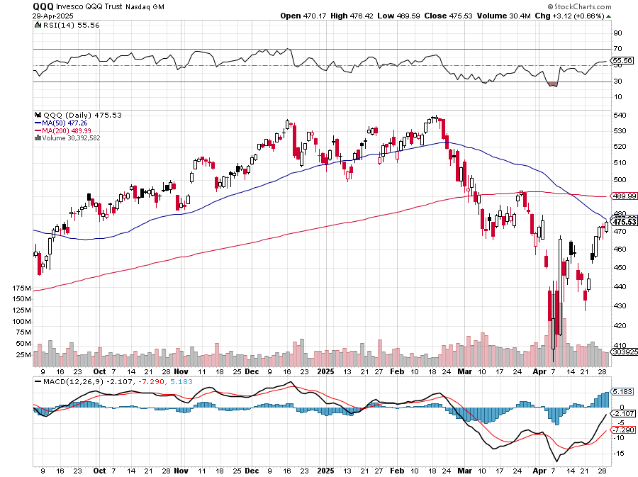
NASDAQ (QQQ) – Down 15% took profits on Long 5/$335-$345 put spread took profits on long (QQQ) 1/$290-$300 put spread, took profits on long (QQQ) 4/$330-$335 put spread took profits on long (QQQ) 3/$340-$345 put spread, covered long (QQQ) $325-$330 put spread

Slide 28
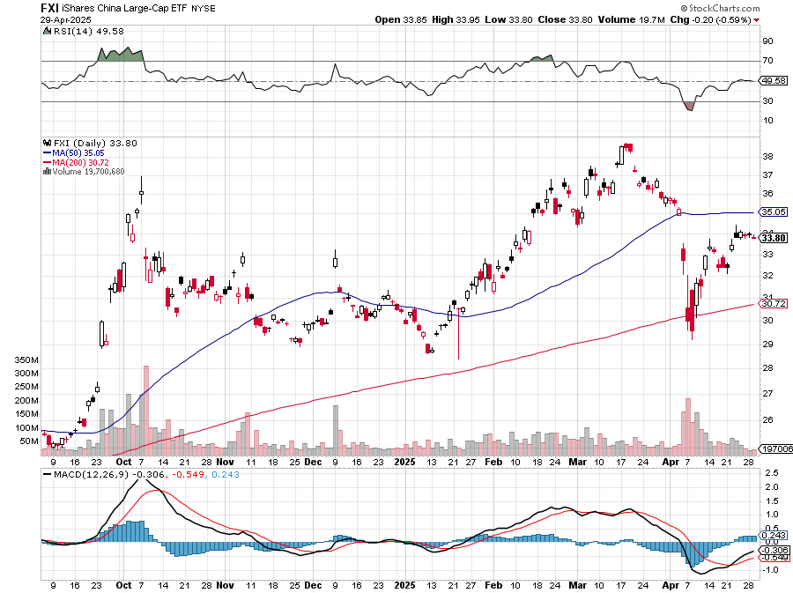
China (FXI) + 36%

Slide 29
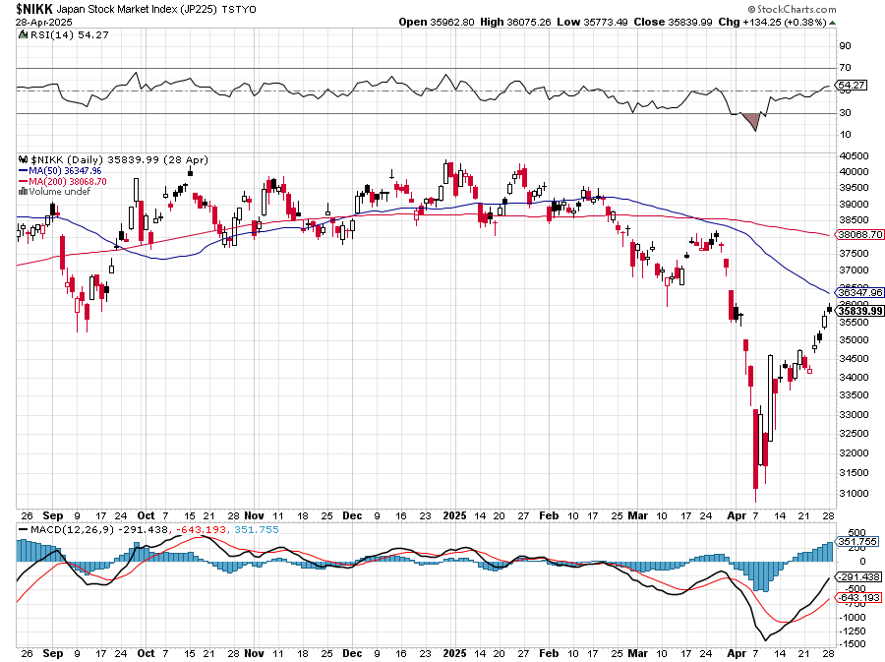
Japan ($NIKK) – down 10%

Slide 30
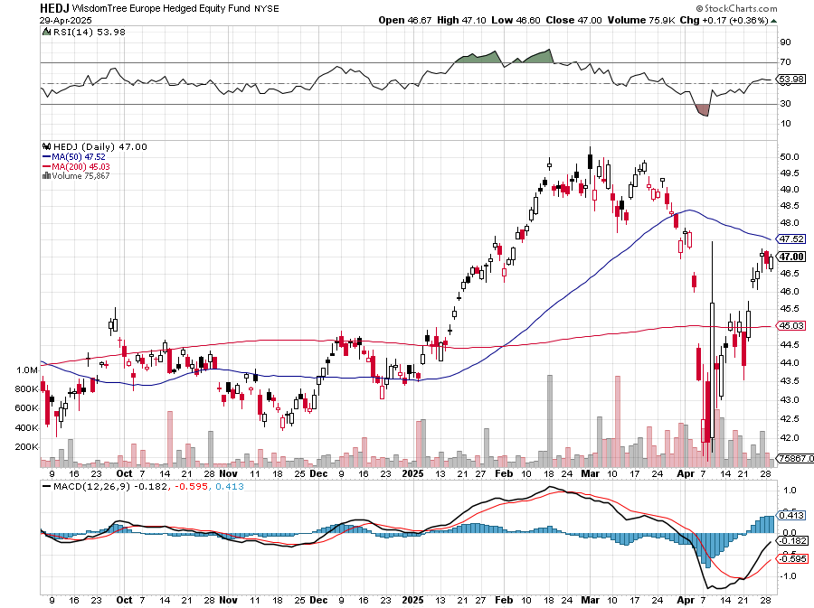
Europe Hedged Equity (HEDJ)- +19%

Slide 31
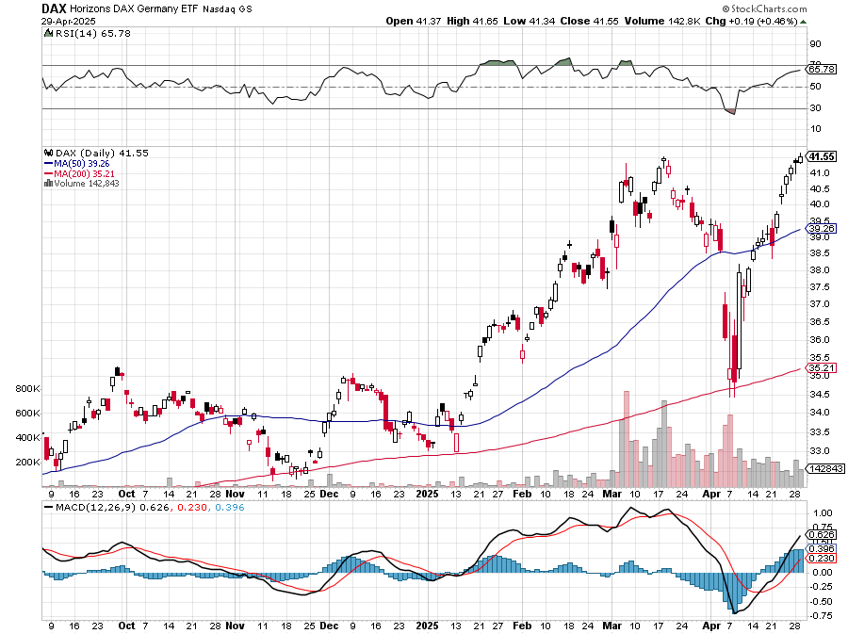
German Dax (DAX)- +30%

Slide 32
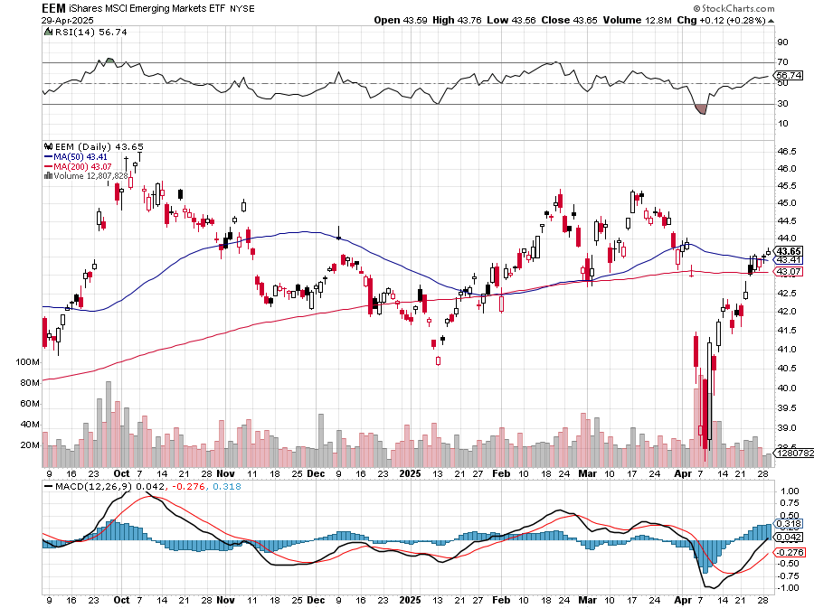
Emerging Markets (EEM) - +8% Weak Dollar, Long Recovery Play

Slide 33
THE MAD HEDGE FUND TRADER
The Barbell Portfolio
*75% Big Tech – 2% of US workforce, 25% of market cap and 25% of US earnings 25% Domestic Recovery, including: Railroads, airlines, cruise lines, Couriers, steel companies Banks, commodities Construction Credit Card Companies Hotels, casinos Online Ticket Sales

Slide 34
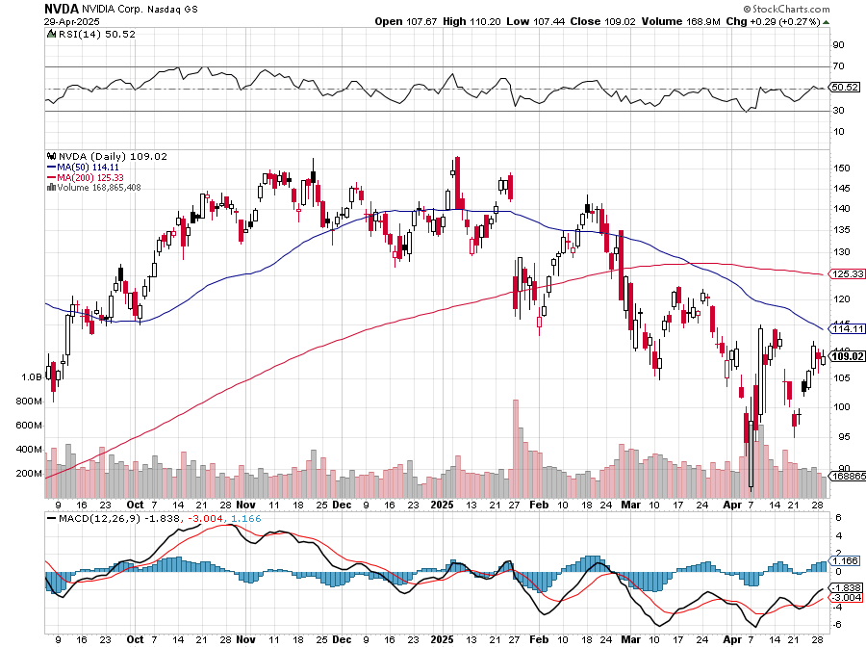
NVIDIA (NVDA) – Blackwell Chips @ $70,000 each Nvidia Tanks Again, as the incoming government plans new China export restrictions on the company took profits on long 5/$70-$75 call spread took profits on long 3/$88-$90 call spread, took profits on long 4/$140-$145 puts spread took profits on Long 2/$90-$95 call spread, took profits on Long 12/$117-$120 call spread

Slide 35
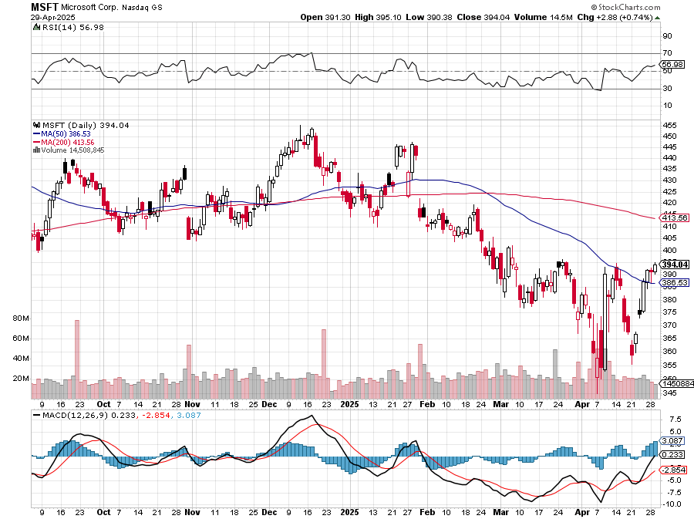
Microsoft (MSFT)-Microsoft Bombs, Microsoft Blows Up on Cloud Guidance took profits on long 5/$430-$440 put spread Took profits on long 2/$330-$340 call spread, took profits on long 12/$320-$330 call spread took profits on long 9/$235-$245 call spread, took profits on long 7/$220-$210 call spread,

Slide 36
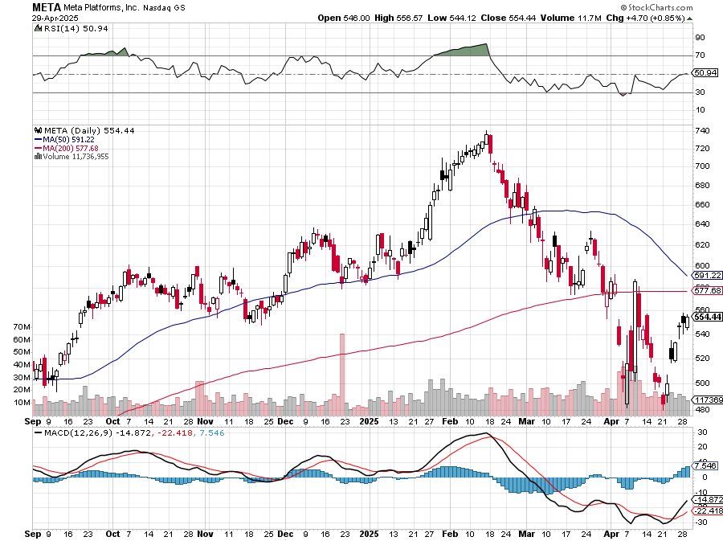
Meta (META) Meta Beats, on improving ad sales, a preeminent AI user took profits on Long 8/$420-$430 call spread took profits on Long 5/$360-$370 vertical bull call spread, took profits on Long 9/$290-$300 vertical bear put spread, stopped out of Long 9/$190-$200 vertical bear put spread

Slide 37
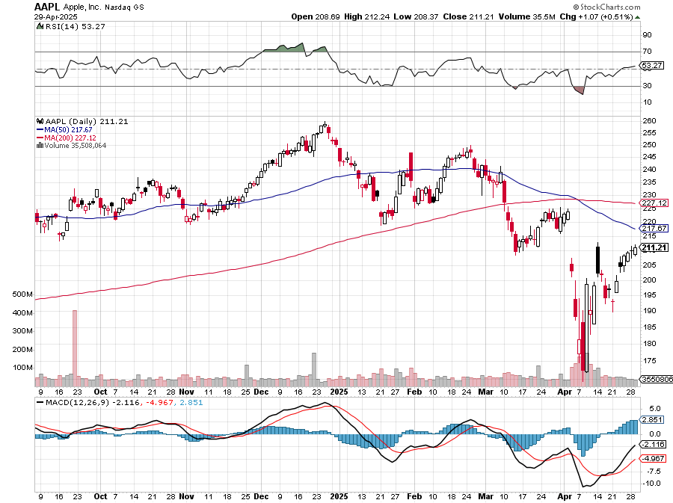
Apple (AAPL) Rally on exemption took profits on Long 5/$225-$235 vertical bear put spread, took profits on Long 8/$160-$170 call spread took profits on Long 6/$200-$210 bear put spread,

Slide 38
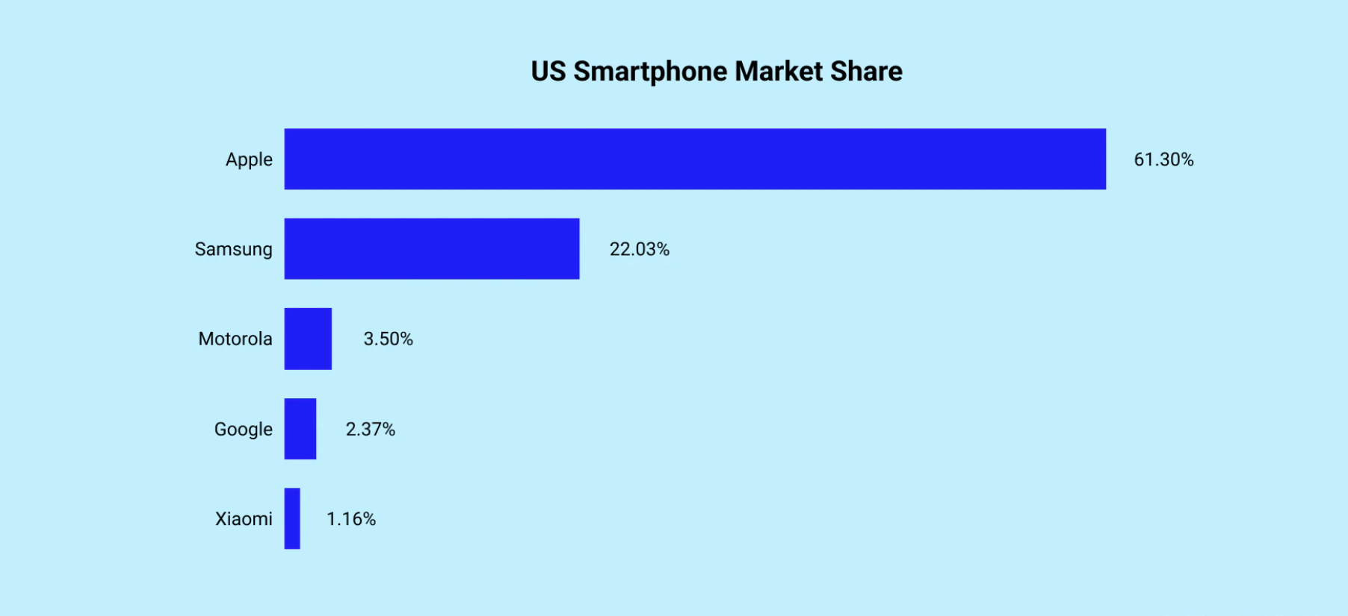

Slide 39
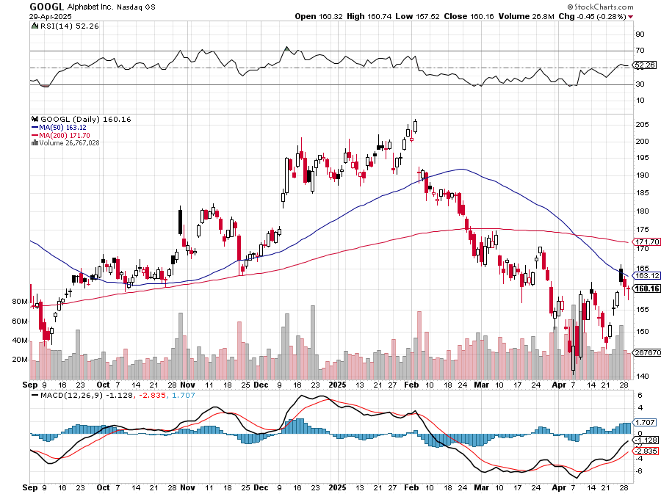
Alphabet (GOOGL) – Breakup Target Trump Administration to Pursue Alphabet Breakup, Alphabet’s Waymo Expands to Washington DC took profits on long 12/$110-$120 call spread took profits on long 12/$1,200-$1,230 bull call spread, took profits on long 9/$1,030-$1,080 vertical bull call spread

Slide 40
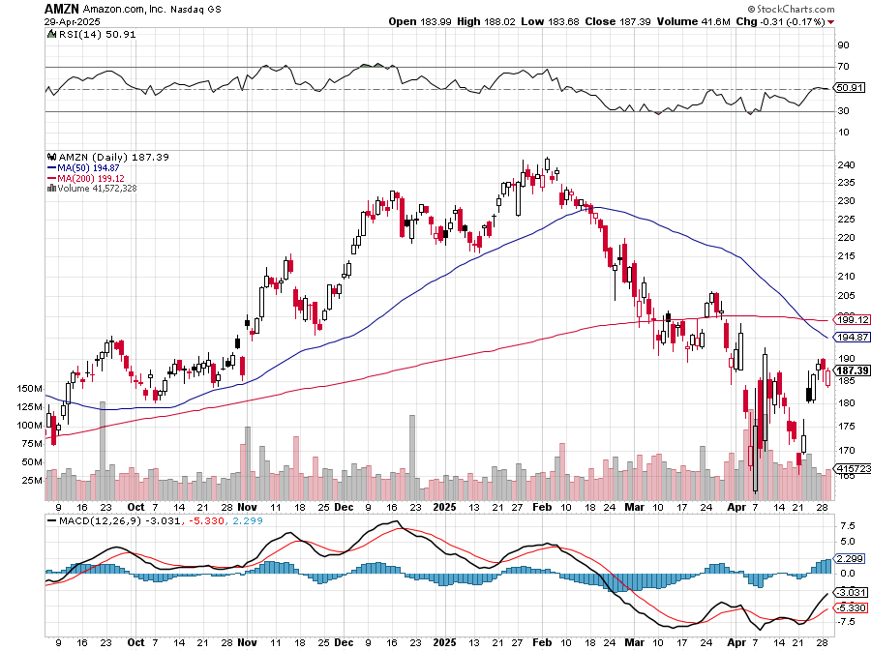
Amazon (AMZN) – Antirust Target took profits on long 3/$155-$160 bull call spread , took profits on long 2/$130-$135 bull call spread

Slide 41
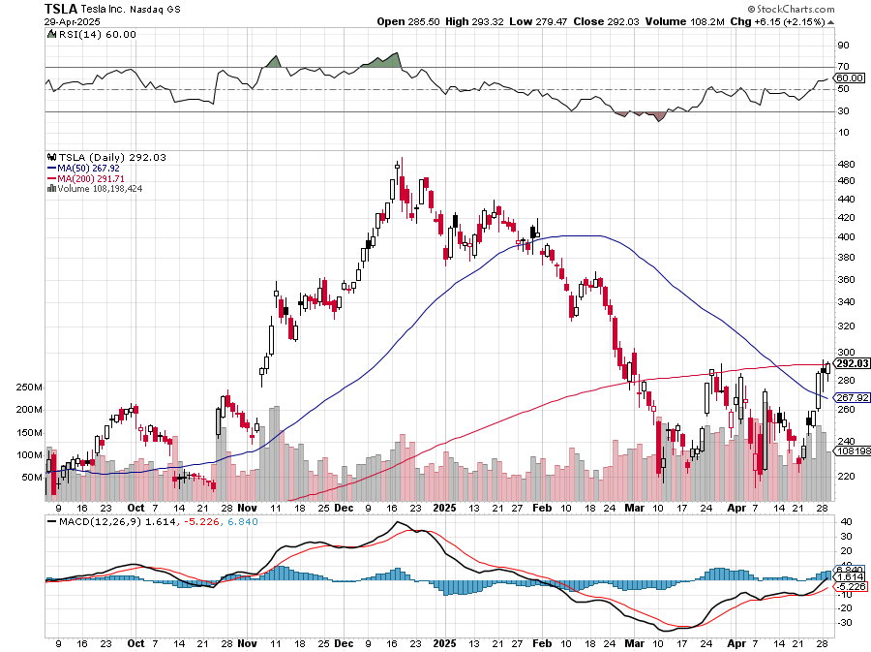
Tesla (TSLA) – Global Brand Destroyed Tesla Sales Fall of a Cliff, down 13% on the quarter took profits on long 4/160-$170 call spread stopped out of long $310-$320 put spread at cost, took profits on long 3/$350-$360 put spread, stopped out of 3/$210-$220 call spread, profits on long 2/$300-$310 call spread, took profits on long 2/$300-$310 call spread,

Slide 42
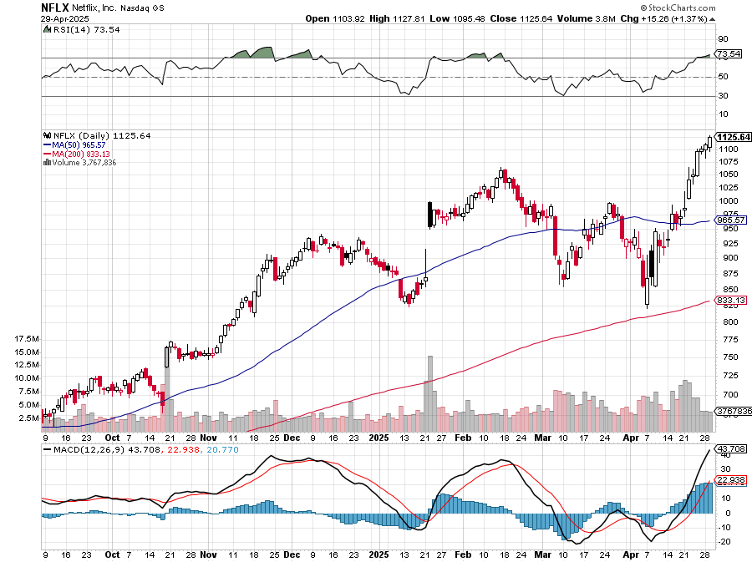
Netflix (NFLX) – Netflix Earnings Rocket, on the back of 19 million new subscriber took profits on long 4/800-$810 call spread

Slide 43
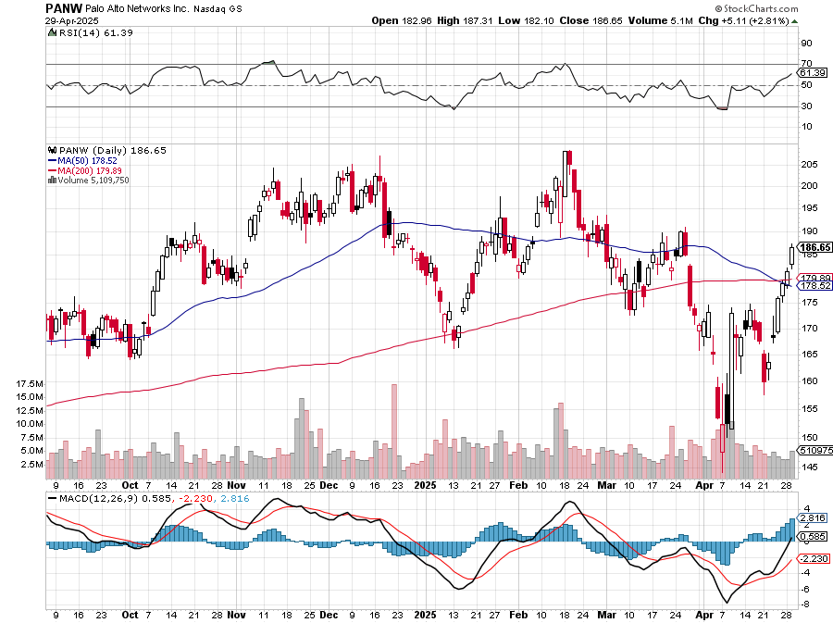
Palo Alto Networks (PANW)- Hacking never goes out of fashion Palo Alto Announced\s 2:1 Split took profits on long 2/$260-$270 call spread, took profits on long 10/$130-$140 call spread

Slide 44
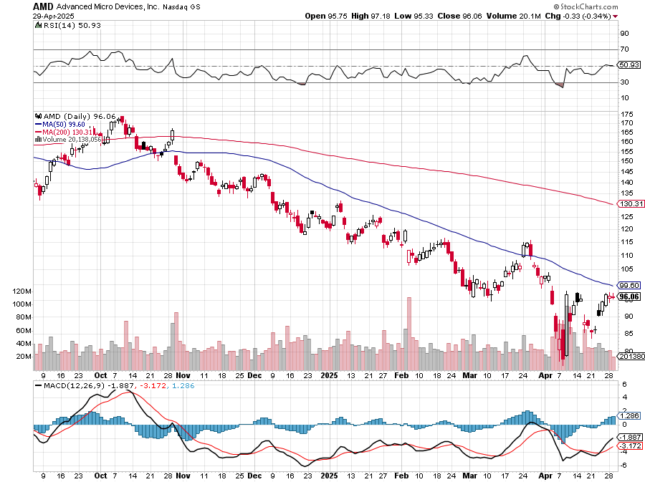
Advanced Micro Devices (AMD)- Recession fears programable logic devices took profits on long 2/$75-$80 call spread

Slide 45
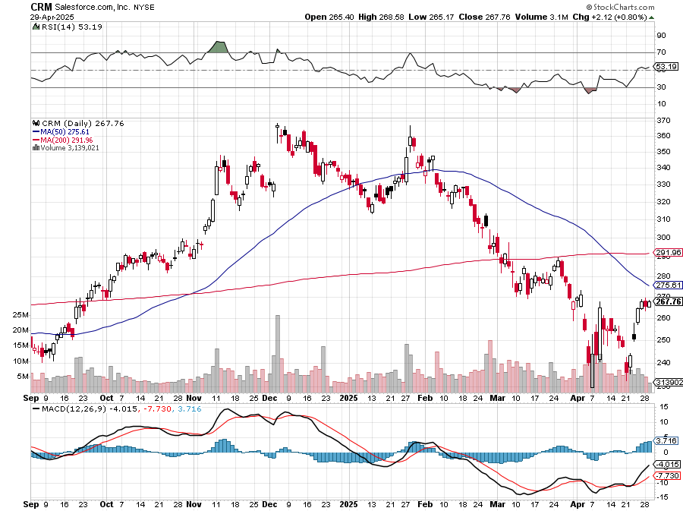
Salesforce (CRM)- Massive Online Migration took profits on long 12/$185-$195 call spread, took profits on long 9/$125-$130 vertical bull call spread took profits on long 8/$125-$130 vertical bull call spread

Slide 46
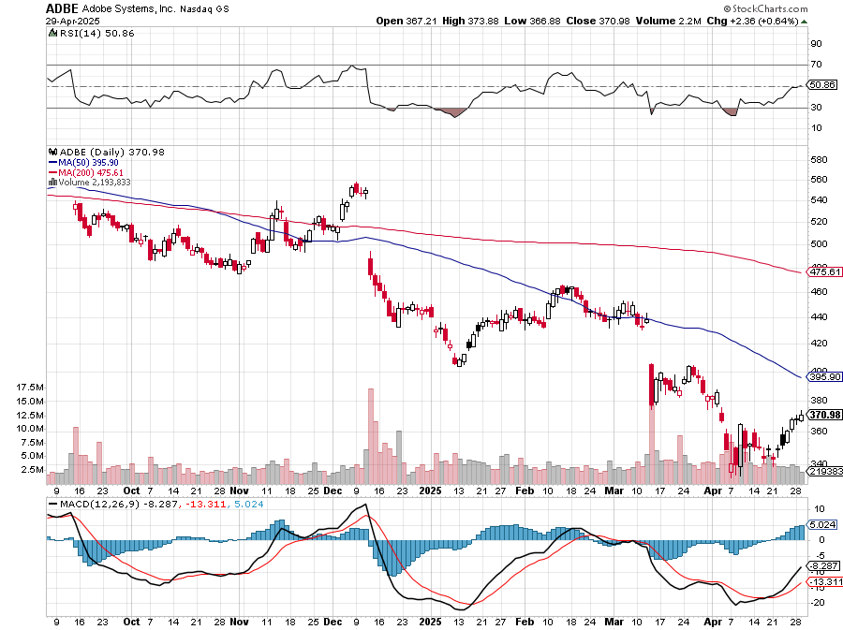
Adobe (ADBE)- Cloud play The Quality Non-China tech play

Slide 47
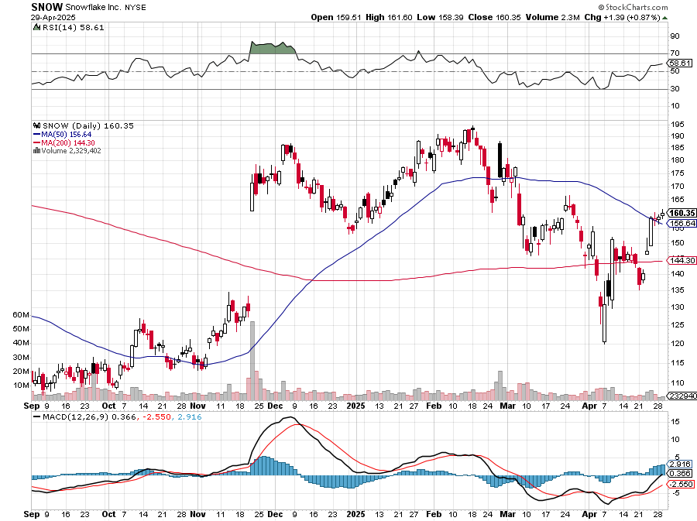
Snowflake (SNOW)- Blockbuster AI Earnings stopped out of long 4/$150-$255 call spread, took profits on long 12/$135-$140 call spread

Slide 48
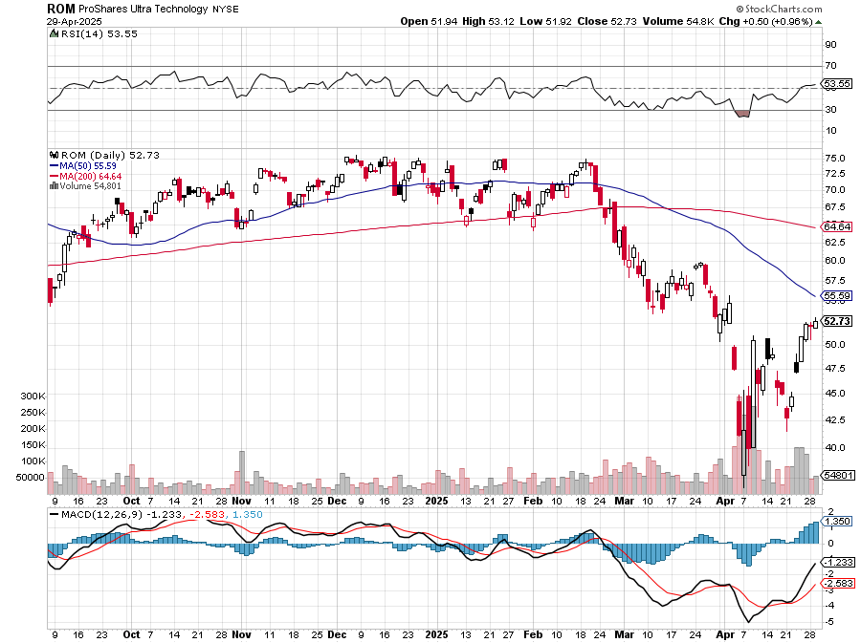
ProShares Ultra Technology ETF (ROM) – 2X Long Technology ETF took profits on long 10/$62-65 call spread

Slide 49
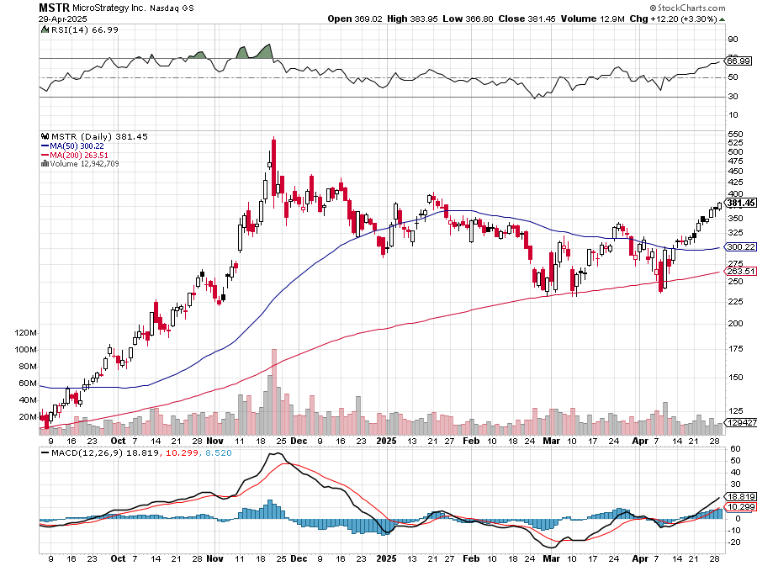
MicroStrategy (MSTR) – Long Bitcoin Play MicroStrategy Issues 10% Yielding Preferred Stock long 5/$400-$410 put spread, took profits on long 4/$340-$350 put spread

Slide 50
The Second Half of the Barbell
*Bets on a domestic recovery in 2022 Q4 *Upside potential in 2024 far greater than tech *Some of these have not moved for 5 or 10 years *Focuses on economically sensitive cyclical industries *Makes a great counterweight to high-growth technology *We could spend all of next ten years rotating between the two groups

Slide 51
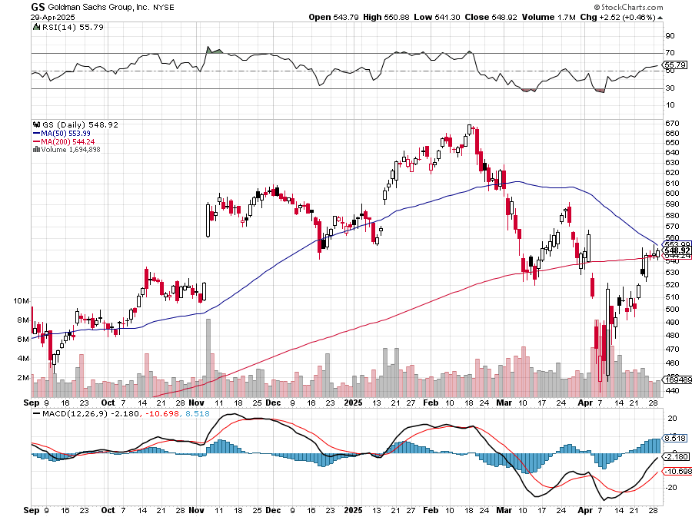
Goldman Sachs (GS) – Goldman Sachs Beats, with Revenues of $12.73 billion vs. $12.46 billion estimate stopped out of 3/$380-$390 call spread, profits on long 12/$330-$350 call spread, took profits on long 11/$330-$350 call spread

Slide 52
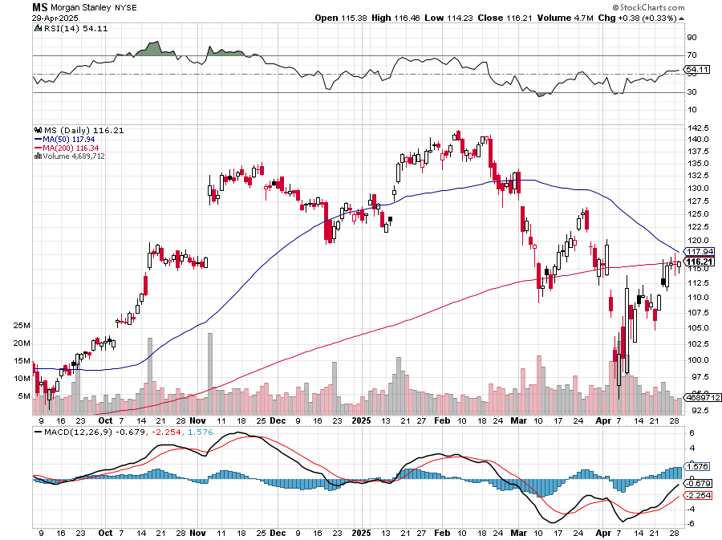
Morgan Stanley (MS) Morgan Stanley Doubles Profits took profits on long $12/210-$220 call spread, Took profits on long $195-$205 call spread, took profits on long 4/$65-$70 call spread

Slide 53
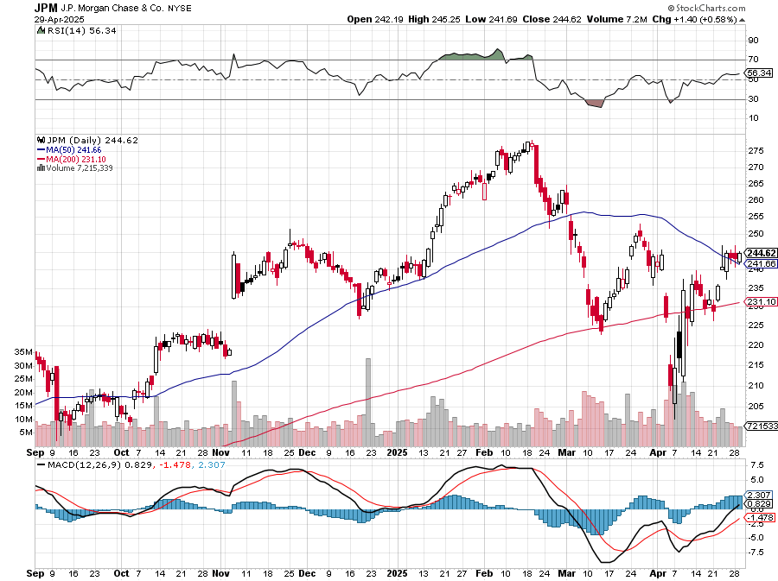
JP Morgan Chase (JPM) – Jamie Diamond Sells 30% of JP Morgan Stock stopped out of 3/$235-$245 calls spread, profits on long 12/$210-$220 call spread, took profits on long 11/$195-$205 call spread, took profits on 4/$215-225 put spread, took profits on long 4/$105-$115 call spread

Slide 54
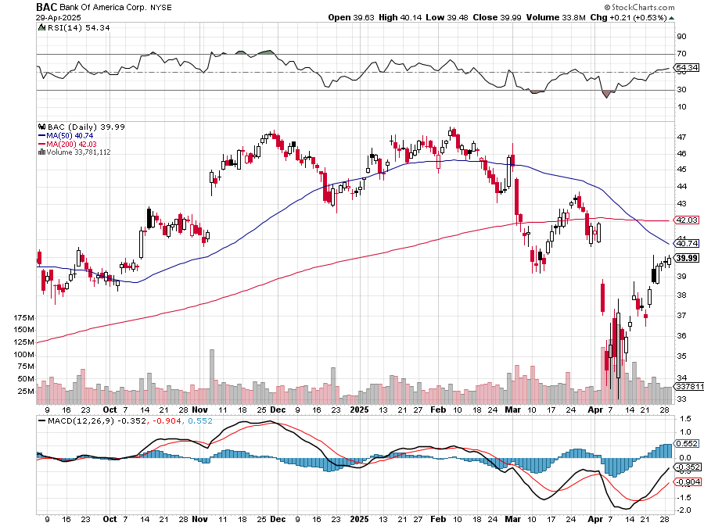
Bank of America (BAC) – Deregulation play took profits on long long 12/$41-$44 call spread, took profits on long 4/$20-$23 call spread

Slide 55
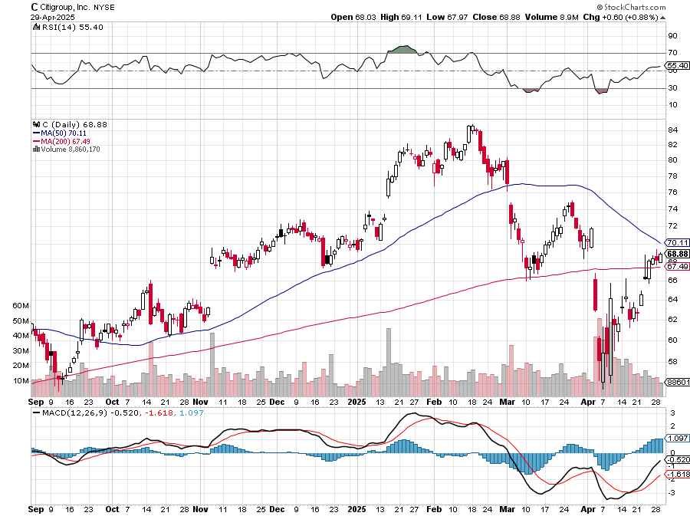
Citigroup (C) – took profits on long long 12/$60-$65 call spread , took profits on long 4/$30-$35 call spread

Slide 56
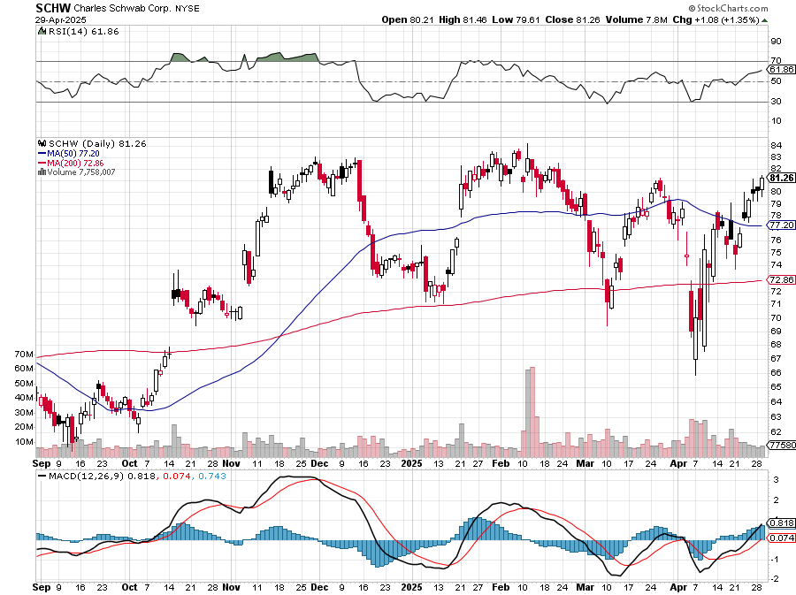
Charles Schwab (SCHW) – LEAPS expire at Max profit took profits on long 4/$30-$35 call spread

Slide 57
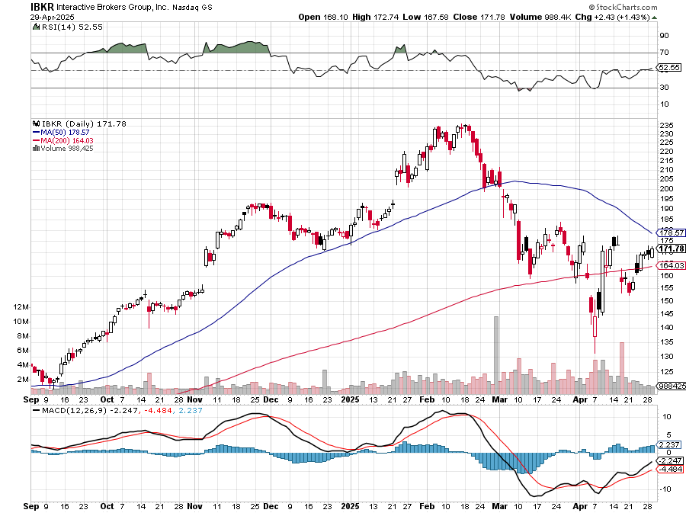
Interactive Brokers (IBKR) – LEAPS expired at Max Profit stopped out of long 3/$160-$170 call spread, out of long 8/$110-$115 call spread , took profits on long 4/$60-$65 call spread

Slide 58
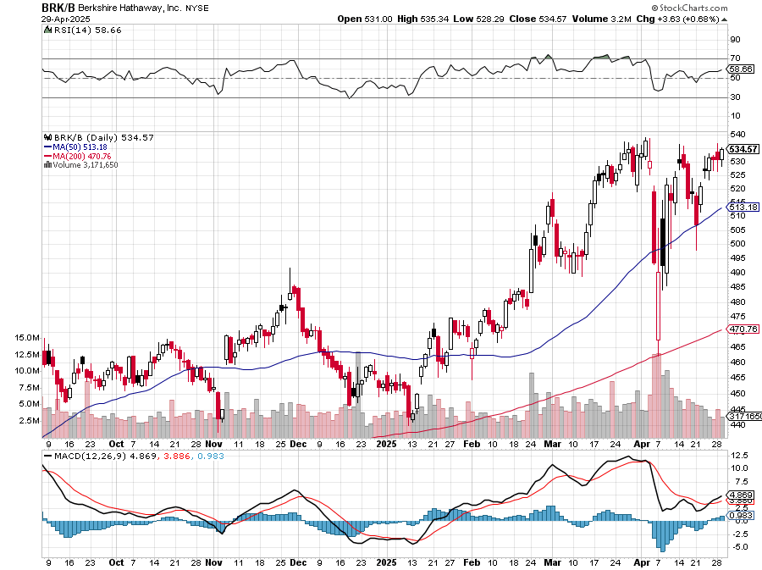
Berkshire Hathaway (BRKB)- Ultimate defensive stock Berkshire Hathaway Builds Record Cash, at $334 billion – Is the new T Bill proxy stopped out of long 12/$405-$415 call spread, took profits on long 12/$320-$330 call spread took profits on long 4/$260-$270 call spread, took profits on long 1/$290-$300 call spread

Slide 59
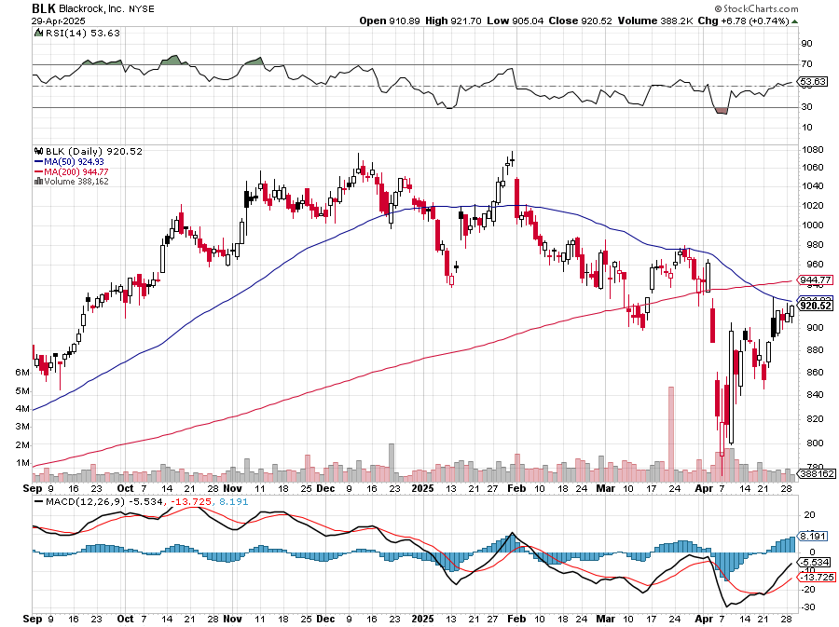
Blackrock (BLK)-Asset Collection Boom took profits on long 12/$850-$860 call spread took profits on long 3/$770-$790 call spread, took profits on long 3/$310-$340 call spread

Slide 60
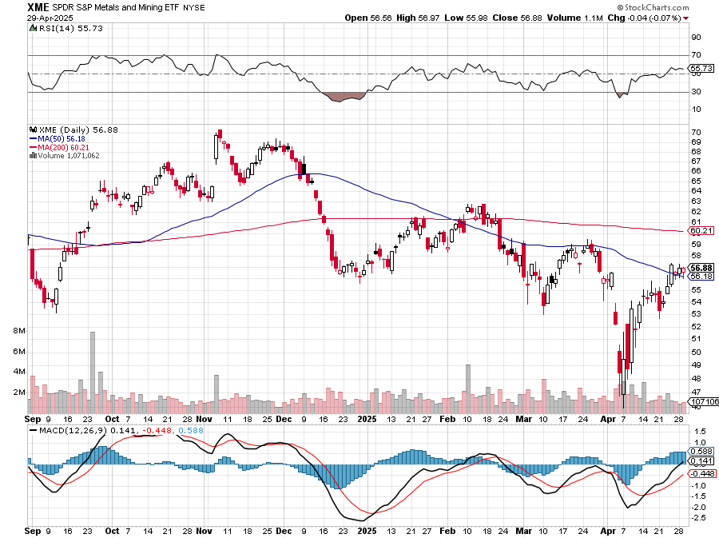
SPDR Metals & Mining ETF (XME) – long 2/$28-$30 call spread

Slide 61
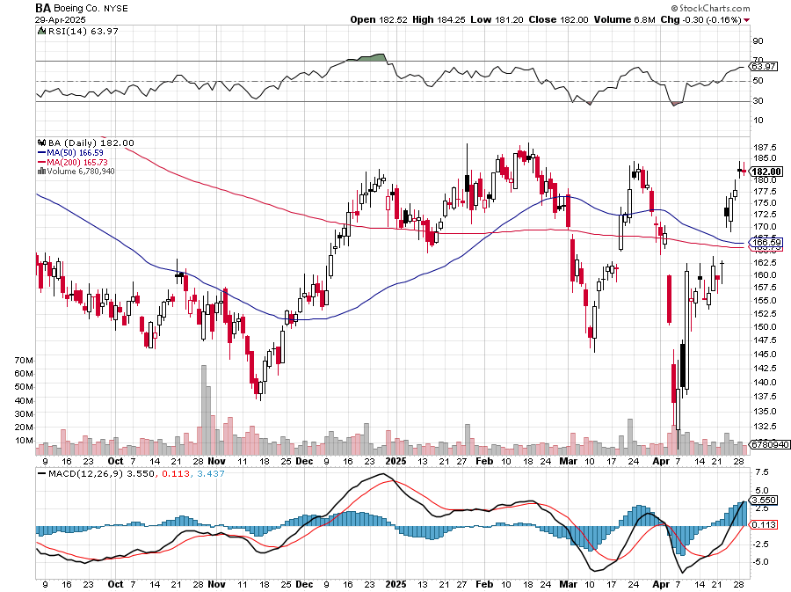
Boeing (BA) – Q3 $6 Billion Loss –b Strike Continues Boeing Beats Lockheed for Next Gen Fighter Contract, for the F-47 “il pesce marcisce dalla testa”

Slide 62
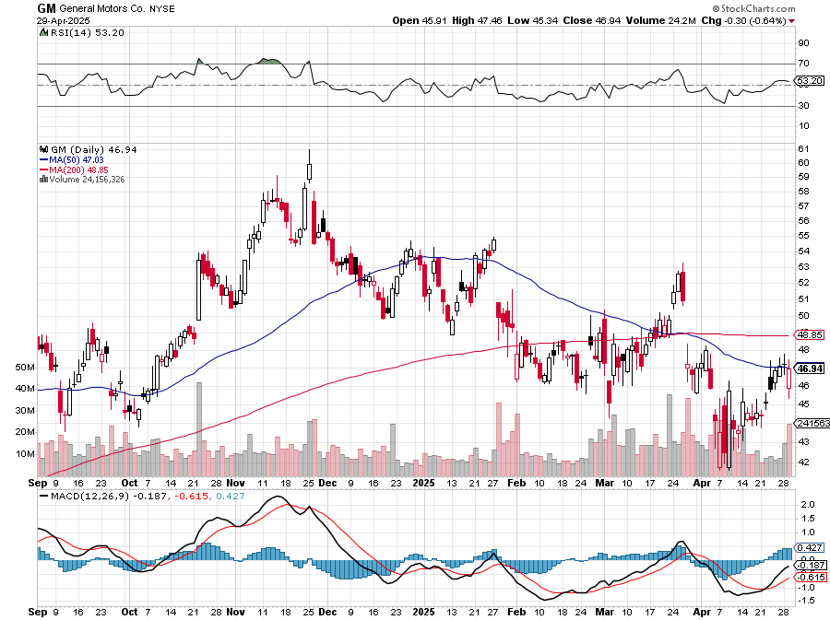
General Motors (GM) – Worst Off Trade War Victim stopped out of long 4/$52.50-$57.50 put spread at cost, long 3/$53-$56 put spread

Slide 63
Package Delivery- United Parcel Service (UPS) – strike averted took profits on long 11/$130-$140 call spread

Slide 64
Caterpillar (CAT)- Ag + Infrastructure + Housing stopped out of long 8/$310-$320 call spread, took profits on long 12/$220-$230 calls spread took profits on long 12/$145-$150 call spread, took profits on long 11/$125-$135 call spread

Slide 65
Deere & Co. (DE)- Ag + Infrastructure + Housing took profits on long 8/$330-$340 put spread stopped out of long 8/$330-$340 calls spread

Slide 66
Freeport McMoRan - (FCX)- Coming Copper Crisis Freeport McMoRan Beats, helped by higher production and easing costs took profits on long 4/$37-$40 call spread, took profits on long 5/$42-$45 call spread, stopped out of long $48-$51 put spread, profits on long 6/$32-$35 call spread took profits on long 4/$30-$33 call spread, took profits on long 10/$20-$23 call spread

Slide 67
Walt Disney (DIS) -Disney Beats Disney Dives on Earnings Bust, although streaming broke even versus an expected loss

Slide 68
Industrials Sector SPDR (XLI)- (GE), (MMM), (UNP), (UTX), (BA), (HON)

Slide 69
Union Pacific RR (UNP)- Big Stuff to Ship took profits on long 5/$200-$210 call spread took profits on 11/$150-$160 call spread

Slide 70
Walmart (WMT) – The New AI Stock took profit on Long 11/$125-$130 bear put spread, took profit on Long 10/$119-$121 bear put spread took profits on Long 8/$114-$117 bear put spread

Slide 71
Costco (COST) – Permanent Compounder took profits on long 4/$840-$850 call spread

Slide 72
Delta Airlines (DAL) – Recession Warning-Travel Collapse The Non-Boeing Airline – uses Airbuses

Slide 73
Transports Sector SPDR (XTN)- Worst Hit Sector (ALGT), (ALK), (JBLU), (LUV), (CHRW), (DAL)

Slide 74
Health Care Sector (XLV) – Defensive Play and Cheap (JNJ), (PFE), (MRK), (GILD), (ACT), (AMGN)

Slide 75
Amgen (AMGN) took profits on long 11/$185-$200 bull call spread

Slide 76
Visa (V) – Inflation boost Justice Hits Visa (V) with Antitrust Suit, with a 47% market share took profits on long 2/$240-$250 bull call spread took profits on long 10/$160-$170 bull call spread, took profits on long 6/$150-$160 bull call spread

Slide 77
Consumer Discretionary SPDR (XLY) (DIS), (AMZN), (HD), (CMCSA), (MCD), (SBUX)

Slide 79
Bonds – Stabilizing
*Foreign Central Banks Selling US Treasury Bonds, and buying Treasury bills *Treasury discussed banning sales of bonds by foreign investors or hitting t-bills with withholding taxes *With Bonds suffering their worst selloff in 25 years no one is rushing back in *Continuing collapse of the US dollar is scaring away bond investors *Bond Credit Quality is Crashing, as recessions lead to more defaults *Avoid (TLT), (JNK), (NLY), (SLRN) and REITS

Slide 80
Treasury ETF (TLT) – took profits on long 4/$84-$87 call spread stopped out of long 1/$82-$85 call spread, took profits on long 10/$103-$106 put spread took profits on long 6/$$94-$97 put spread, took profits on long 5/$82-$85 calls spread

Slide 81
Ten Year Treasury Yield ($TNX) – 4.15%

Slide 82
Junk Bonds (JNK) 6.54% Yield

Slide 83
Municipal Bonds (MUB) 4.21% Yield-

Slide 84
Emerging Market Debt (ELD) 5.62% Yield-

Slide 85
2X Short Treasuries (TBT)-Out of Favor

Slide 86
Anally Capital Management (NLY) – Leveraged REIT Play Yield 13.25% took profits on long 12/$15-$16 call spread

Slide 87
Acelryn (SLRN) – Double B Bond Fund took profits on long 12/$15-$16 call spread

Slide 89
Foreign Currencies –
*US Dollar Hits Three Year Low, as the flight from America trade accelerates *Rising rates didn’t provide any help, meaning the weakness is structural *15 years of long dollar positions are unwinding *The Trump economy is forcing investors to flee all US assets, including stocks and currency *Massive cash flight is running away from the US and into Europe and China *Buy (FXA), (FXE), (FXB), (FXC), and (FXY)

Slide 90
THE MAD HEDGE FUND TRADER
Australian Dollar (FXA) - Major Long-Term Bottom is In Targeting Parity – A call option on a global synchronized recovery

Slide 91
Japanese Yen (FXY)

Slide 92
Euro (FXE)-

Slide 93
British Pound (FXB)-

Slide 94
Emerging Market Currencies (CEW)

Slide 96
Energy & Commodities – Crash!
*Oil Crashes, down an amazing $13, or down 18% in a week, from $72 to $59 *High dividend paying (XOM) has collapsed by 18% *It is the sharpest fall in Texas tea prices since the 1991 Gulf War *Recession fears are running rampant, and no one wants to pay for storage until a recovery which may be years off. *Sell all energy rallies *A global recession is looming large *Avoid all energy plays like the plague

Slide 97
Oil-($WTIC)

Slide 98
United States Oil Fund (USO)

Slide 99
Energy Select Sector SPDR (XLE)-No Performance! (XOM), (CVX), (SLB), (KMI), (EOG), (COP)

Slide 100
ExxonMobil (XOM)- Exxon Moves Big into Lithium, with the construction of a major mining operation in Arkansas took profits on Long 4/$100-$105 call spread, took profits on long 12/$120-$125 put spread

Slide 101
Occidental Petroleum (OXY)- Buffet’s a Buyer took profits on long 4/$59-$62 call spread took profits on long 2/$55-$60 call spread, took profits on long 12/$77.50-$82.50 put spread

Slide 102
Natural Gas (UNG) – Free Fall on Warm Winter took profits on Long January 2025 $7-8 Call Spread LEAPS

Slide 103
Cameco (CCJ) – Global Uranium Renaissance Microsoft to Reopen Three Mile Island to power AI data centers took profits on long 12/$41-$44 call spread, took profits on long 12/$35-$38 call spread, took profits on long 5/$20-$23 bull call spread

Slide 104
Vistra Corp. (VST) – Global Uranium Renaissance took profits on long 2/$100-$110 call spread

Slide 106
Precious Metals – Taking a Break
*JP Morgan Targets Gold at $4,000 in Q2, as the “Sell America” trade gathers steam *Gold Tops $3,424, the 1980 inflation adjusted all-time high *Interest rates seem to be no longer a factor in the gold trading, losing the opportunity cost *Gold sees first $100 up day in history *Natural profit taking takes gold back 5% *Central bank buying and Chinese savings demand continues unabated with China devaluing its currency *Keep buying all (GLD) metal dips.

Slide 107
THE MAD HEDGE FUND TRADER
Gold (GLD)-A New Leg took profits on Long 10/$230-$235 call spread took profits on Long 10/$220-$225 call spread, took profits on Long 8/$210-215 call spread, took profits on Long 7/$200-205 call spread, Long 6/$207.5-$212.5 call spread took profits on Long 4/$194-$197 call spread, took profits on long 5/$165-$170 bull call spread
$5,000 in 2028 +66%
BUY

Slide 108
Gold (GLD) –Falling Rate took profits on Long 10/$230-$235 call spread took profits on Long 10/$220-$225 call spread, took profits on Long 8/$210-215 call spread, took profits on Long 7/$200-205 call spread, Long 6/$207.5-$212.5 call spread took profits on Long 4/$194-$197 call spread, took profits on long 5/$165-$170 bull call spread

Slide 109
Market Vectors Gold Miners ETF- (GDX) – took profit on long 6/$207.50-$212.50 call spread, took profit on long 7/$200-$205 call spread

Slide 110
Barrick Gold (GOLD) took profit on long 1/$15.50-$16.50 call spread

Slide 111
Newmont Mining- (NEM)- Sometimes you Just Get Lucky took profits on long 10/$47-$50 call spread, took profits on long $55-60 call spread

Slide 112
THE MAD HEDGE FUND TRADER
iShares Silver Trust (SLV) - The Better Play Industrial demand, solar panels, electric cars
2025 Target $50 +50%
BUY

Slide 113
Silver Miners - (SIL)-

Slide 114
Wheaton Precious Metals - (WPM)- LEAPS Approaching Max Profit took profits on long 4/$39-$42 call spread , took profits on long 1/$36-$39 call spread

Slide 115
Platinum- (PPLT)- 556,000-ounce shortage this year took profits on long 1/$36-$39 call spread

Slide 117
Real Estate – Gone Quiet
*New Home Sales Jump, in March. The median price of a new home sold is down 7.5% YOY thanks to greater demand for lower priced homes. Interest rates delivered a short-term dip in March which they gave back in April *Existing Homes Sales Hit 16 Year Low *Sales of previously owned US homes fell 5.9% in March to an annualized rate of 4.02 million, the weakest March since 2009 *The median sales price increased 2.7% from a year ago to $403,700, a record for the month of March and extending a run of year-over-year price gains dating back to mid-202 *Weekly mortgage demand has plunged 13%

Slide 118
S&P Case Shiller Slows S&P Case Shiller Rises to +4.1% YOY in January, with its National Home Price Index New York gained +7.7%, Chicago +7.0%, and Cleveland +6.8%. Tampa was down -1.4%

Slide 119
Crown Castle International (CCI) – 6.62% yielding 5G cell phone tower REIT Eliot Management Pushes up stock with activist bid took profits on Long 8/$90-$95 call spread,

Slide 120
US Home Construction Index (ITB) (DHI), (LEN), (PHM), (TOL), (NVR)

Slide 121
DH Horton (DHI) Horton Bombs, with the stock dropping some 11% in Tuesday morning trading after the U.S.'s largest homebuilder issued its fiscal 2025 guidance took profits on long 11/$165-$175

Slide 124
Trade Sheet- The Recession Trade So What Do We Do About All This?
*Stocks –sell rallies *Bonds – stand aside *Commodities - stand aside *Currencies – buy dips *Precious Metals – buy dips *Energy – stand aside *Volatility – sell over $50 *Real estate – stand aside

Slide 125
Next Strategy Webinar 12:00 EST Wednesday, May 14, 2025 from Incline Village, NV email me questions at support@madhedgefundtrader.com
Good Luck and Good Trading!
Notes:
*

