Slide 1
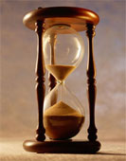
Please Stand By for John Thomas Wednesday, May 1, 2013, San Francisco, CA Global Trading Dispatch
The Webinar will begin at 12:00 pm EST

Slide 2
The Mad Hedge Fund Trader “Nothing to Do”
Diary of a Mad Hedge Fund Trader San Francisco, CA, May 1, 2013 www.madhedgefundtrader.com

Slide 3
MHFT Global Strategy Luncheons Buy tickets at www.madhedgefundtrader.com 2013 Schedule-Updated
May 8 Las Vegas July 2 New York July 8 London, England July 12 Amsterdam, Neth. July 16 Berlin, Germany July 18 Frankfurt, Germany July 25 Portofino, Italy August 1 Mykonos, Greece August 9 Zermatt, Switzerland

Slide 4
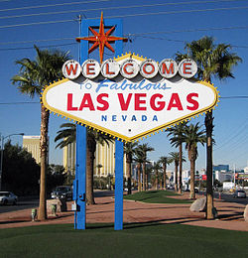
MHFT Global Strategy Luncheons Buy tickets at www.madhedgefundtrader.com
Las Vegas May 8
New York July 2

Slide 5
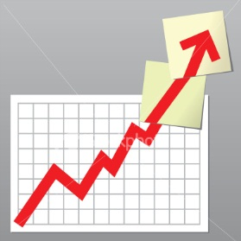
Trade Alert Performance Beating the Entire Market
*January +16.75% Dow +6.9% (2.4X) February +10.13% Dow +0.57% (18X) March +4.28% Dow +3.7% April + 4.91% Dow +1.8% *2013 YTD +36.07%, compared to 13% for the Dow, beating it by 23%, 3X *First 120 weeks of Trading +91.1% *Versus +21% for the Dow Average A 70.1% outperformance of the index, a 4.3X
133 out of 185 closed trades profitable 71.9% success rate on closed trades

Slide 6
Portfolio Review-Running small net long Volatility collapse causing options premiums to shrink, increasing risk and reducing returns of option spread strategy wait for May to show its hand
Mad Hedge Fund Trader
Trading Book
Asset Class Breakdown
Risk Adjusted Basis
current capital at risk
Risk On
(SPY) 5/$143-$148 call spread | 20.00%
(AAPL) 6/$380-$410 call spread | 10.00%
Risk Off
total net position | 30.00%

Slide 7
Performance Year to Date- +36.07%

Slide 8
Performance Since Inception +36.4% Average Annualized Return

Slide 9
Strategy- Tons of Negatives
*Almost all macro data has turned negative *Economic Growth is weak at 2.5% *Q2 growth is decelerating *Corporate earnings growth is weak *Bonds are going up with stocks *Volume spikes on down days *Buying focused on defensives *Buying in a narrowing number of names *Top of 13 year channel *Commodities are crashing everywhere *Eve of seasonal weakness for 6 months *Tax rise and sequester licking in

Slide 10
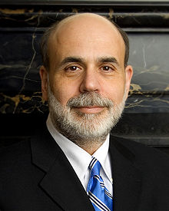
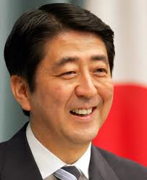
Strategy- Two Big Positives
Ben Bernanke $85 bill/month
Shinzo Abe $85 bill/month

Slide 11
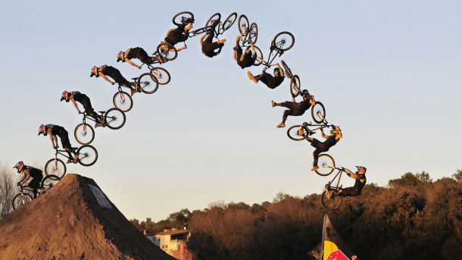
Reality Hits the Economy suddenly the data has flipped from mostly positive to mostly negative
*Q1 GPD 2.5% vs 3.0% expected, European, Chinese, and German PMI’s still weak *March consumer spending a weak 0.2%, April ADP a weak 119,000 *China 7.7% Q1 GDP *March headline CPI -0.2% 1.5% YOY *March retail sales -0.4% *March Producer Price Index -0.6% *Chicago PMI 49.0

Slide 12
Weekly Jobless Claims -16,000 jump to 339,000 is just weekly noise Downtrend still in place

Slide 13
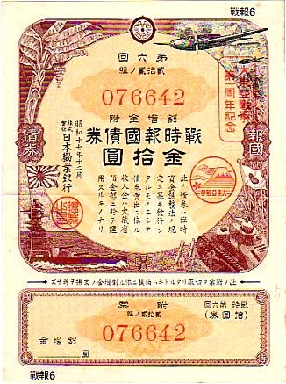
Bonds-Return to Safety
*Flood of Japanese buying hitting the market *Is turning US Treasuries into JGB’s, which yield 0.60% *Hedge fund longs close to record highs *Longer term 10 year Treasury range 1.70%-2.50% is broken *I bailed on my (TBT) at cost *Stand aside until sanity returns

Slide 14
(TLT)

Slide 15
Short Treasuries (TBT) Bailed on long position at cost

Slide 16
Municipal Bonds (MUB)-2.84% yield, Mix of AAA, AA, and A rated bonds

Slide 17
(JNK)-6.64% Yield

Slide 18
Stocks-Risk is Rising
*No 5% pullback for 6 months only 3 times in history *Buy the dip crowd still sitting under the market *75% of companies beating very low forecasts on no revenue growth *Top of 13 year channel is extremely high risk *Potential returns are now very low *Only buy deep laggards, like technology or commodities, balance with shorts

Slide 19
Dow Average

Slide 20
(SPY)- Long 5/$143-$148 call spread

Slide 21
(SPX)-The 30,000 view Expect a long churn at the triple top
Fail Here

Slide 22
(QQQ)-Top of the Up Channel Has the Rotation Started?

Slide 23
(VIX)-Dieing a Slow Death

Slide 24
(AAPL)- The Bottom is In 50 day moving average in play for an upside breakout long the 6/$380-$410 call spread

Slide 25
Google (GOOG)

Slide 26
Russell 2000 (IWM) Target the 5/$96-$99 bear put spread

Slide 27
(IWM)

Slide 28
Shanghai-Still Trending Down

Slide 29
(DXJ)--Nikkei with hedged yen

Slide 30
Microsoft-Stock of the Week, Old Tech is Back!

Slide 31
(INTC)

Slide 32
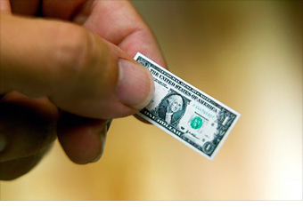
Dollar Rally Stalls
*Golden week holidays trigger profit taking on Yen shorts *Japanese profit taking on foreign assets has put a floor under the yen at 100. (a sudden 25% gain on $2 trillion in assets) *An entry point for those who missed *Imminent interest rates cut in Europe cuts the knees out from Euro *Week US economic data feeding into weak dollar

Slide 33
Long Dollar Basket (UUP)

Slide 34
Euro (FXE)

Slide 35
Australian Dollar (FXA) Commodity Collapse Means dump Aussie

Slide 36
Japanese Yen (FXY)- Aim for the 6/$103-$106 in-the-money bear put spread

Slide 37
(YCS)-200% short yen ETF

Slide 38
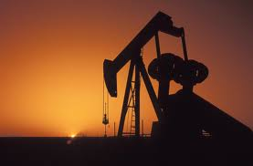
Energy-Taking the Heat
*Is feeling the global economic slowdown more than stocks *Ranges too narrow to trade *Has become a professional only market *Weak global growth holding it back *Gasoline may fall going into summer *Natgas gets a second wind on late winter storms

Slide 39
Crude

Slide 40
(USO)

Slide 41
Natural Gas-Boost from late winter storm

Slide 42
Copper- China drag still hurts a new type of Chinese GDP

Slide 43
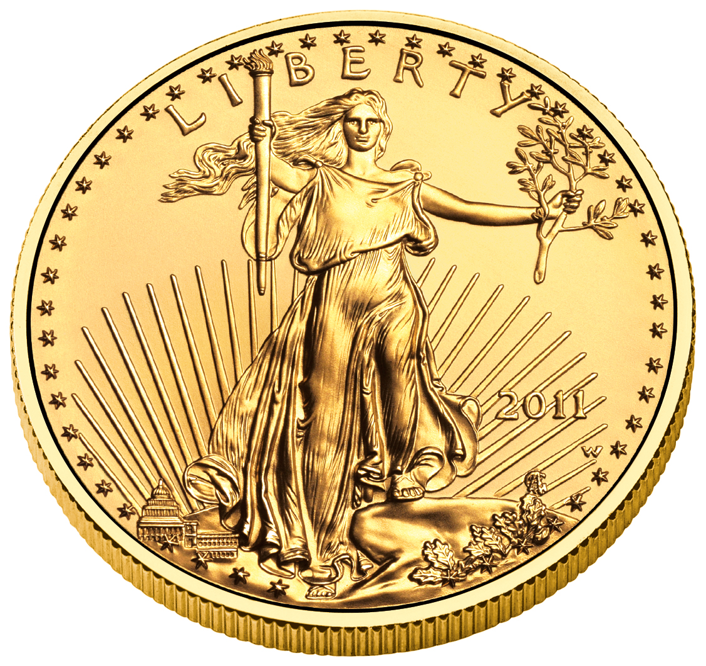
Precious Metals- Sell the short covering bounce to $1,500 Buy the (GLD) 6/$150-$155 put spread
*Huge short covering rally hits *Goldman Sachs covers its short
*Margin calls are done *Huge physical buying is meeting massive paper selling *Hedge fund redemptions still pressuring *There are no value players in gold no interest payment, no dividend *US mint runs out of gold Eagles

Slide 44
Gold-The dead cat bounce Target the 6/$150-$155 in-the-money bear put spread

Slide 45
Silver (SLV)

Slide 46
(Platinum) (PPLT) South African strike can’t get rally going

Slide 47
Palladium (PALL)

Slide 48
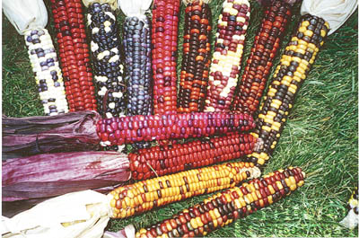
The Ags-The Bottom May be In
*Cold weather, heavy rains and snow delaying spring planting *Latest start to planting season in many years *Only 5% of corn crop has been planted, vs. 49% a year ago only the long term average of 31% *More planting is being diverted from corn to soybeans *We may has seen the bottom in for the ags *The set up for the summer global warming trade may be here

Slide 49
(CORN)

Slide 50
DB Commodities Index ETF (DBC)

Slide 51
Real Estate-Pause Continues
*March new home sales +1.5% *February Case-Shiller YOY 8.1% to 9.3% best in 7 years *March pending home sales a weak 1.5% 7% YOY *March existing home sales -0.6% *Medium home price +11.9% YOY under $100k -16% over $500k +25% *Inventories -17% YOY to 4.7 months *10 million home still underwater (22%) 11 million less than 20% equity, so trade up market is dead

Slide 52
February S&P Case Shiller

Slide 53
(ITB)-US Home Construction Dow Sub index

Slide 54
Trade Sheet-No Change “RISK ON” Good Until Proven Guilty
*Stocks- buy the 2.5% dips *Bonds- stand aside on Japanese buying *Commodities-stand aside until global sell off ends *Currencies- sell yen on any rallies, too late on Euro *Precious Metals –sell the big rallies *Volatility-stand aside, will bounce along bottom *The Ags –wait for crash to work its way through *Real estate- too late to touch

Slide 55
To buy strategy luncheon tickets Please Go to www.madhedgefundtrader.com Next Strategy Webinar Wednesday, May 1, 2013
Good Luck and Good Trading!

