Slide 1
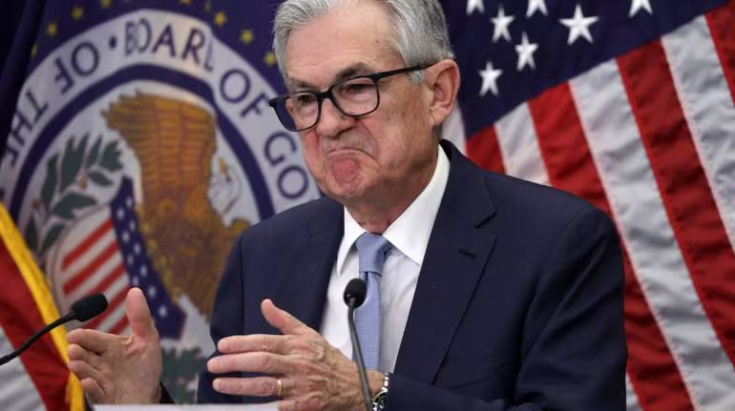
The Mad Hedge Fund Trader “The Fed Wins”
With John Thomas Silicon Valley, CA December 13, 2023 www.madhedgefundtrader.com
Notes:
*

Slide 3
Trade Alert Performance Beating 2022 – Best in 15 years 60 out of 66 trade alerts profitable – No losers since August 4
*January +22.35% Final *July +0.44% Final *February +3.41% Final *August -4.70% Final *March +20.85% Final *September +00% Final *April +15.13% Final *October -5.37% MTD *May +0.30%% Final *November +15.37 Final *June +3.01% Final *December -2.85% Final *2023 Year to Date +78.86%, versus +21.05% for the S&P 500 and +676.05% since inception *Versus 84.63% for all of 2022 *Average annualized return of +52.00% for 15 years

Slide 4
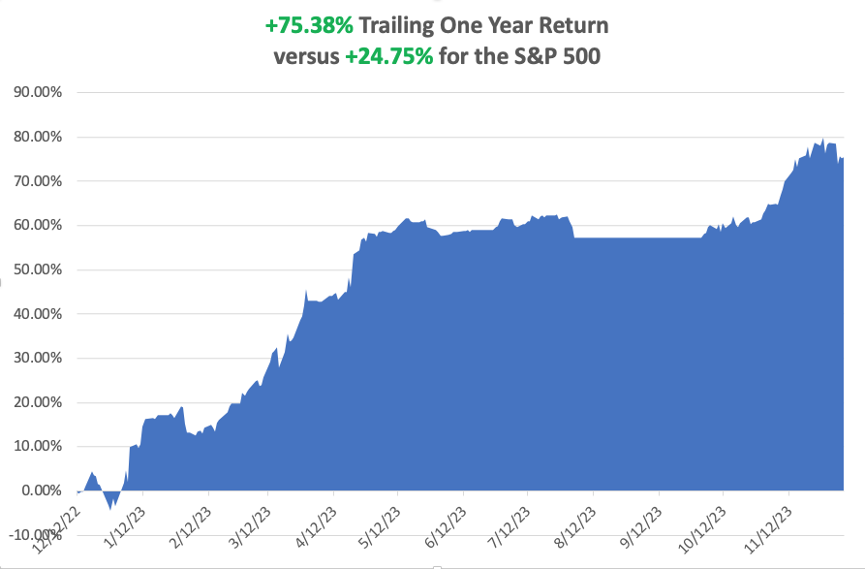

Slide 5
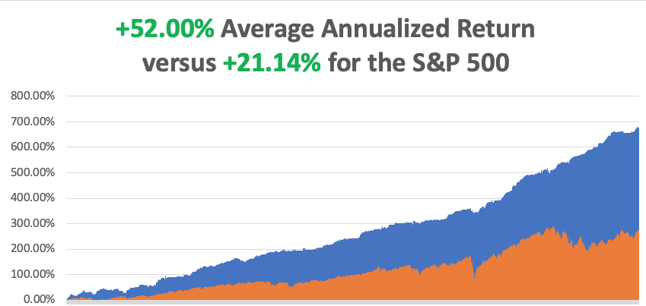

Slide 6
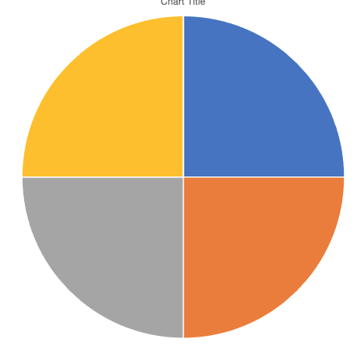
Portfolio Review – Big Tech Bet 90% Long, 10% Short, 0% cash
POSITIONS
Expiration Value +79.34%
Current Capital at Risk
Risk On
(NLY) 12/$15-$16 call spread | 10.00%
(BRK/B) 12/$320-$330 call spread | 10.00%
(GOOGL) 12/$110-$120 call spread | 10.00%
(CAT) 12/$220-$230 call spread | 10.00%
Risk Off
NO POSITIONS | 0.00%
Total Net Position | 40.00%
Total Aggregate Position | 40.00%

Slide 7
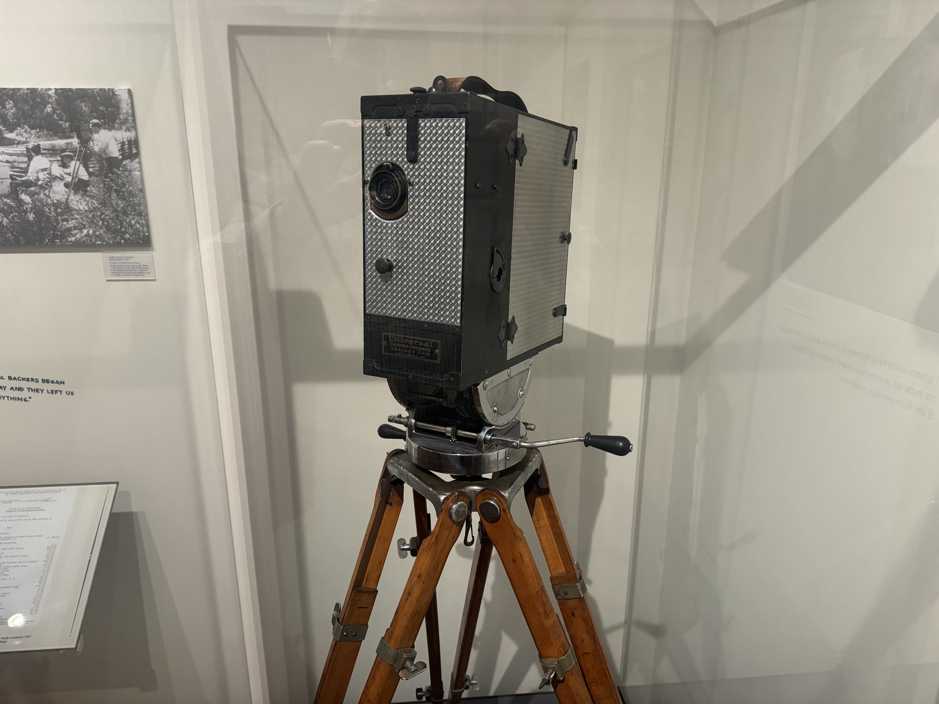

Slide 8
The Method to My Madness
*Fed is done raising interest rates, markets are now discounting first cut in as early as March *All interest rate plays go wild, including bonds, REIT’s, precious metals, and financials *The yearend rally is on, but what happens in January? *All economic data is globally slowing *Oil prices and commodities are now trading as one, selling off on slowing economy *The tech bull market is back and will continue for years *Time to go aggressively long on stocks and bonds *Commodities and industrials are a second half play

Slide 9
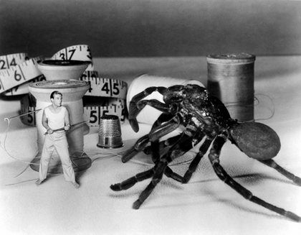
The Global Economy – Shrinking
*Nonfarm Payroll Comes in Soft, in November at 199,000. The headline Unemployment Rate fell to 3.7%, near a 50-year low *US GDP Revised Up to a Blistering 5.2% *S&P Global Services PMI Comes in Flat, at 50.8, but still above the boom/bust level. It’s the 11th consecutive month over 50 in expansion territory *Fed’s Favorite Inflation Gauge Rises a Modest 0.2%, and 3.5% on a YOY basis, a new cycle low *ISM Services came in at 52.7 versus and estimated 52.4. No recession here, nor super-heated economy. Another Fed friendly number. *China Moves to Further Stimulate Economy, after many failed efforts, this time through reduced reserve requirements

Slide 10
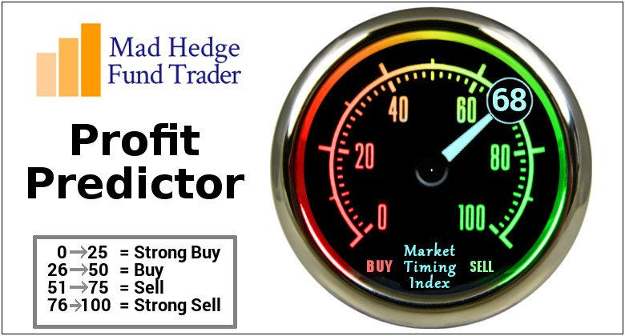
The Mad Hedge Profit Predictor Market Timing Index – Drops Below 50, for the first time since April An artificial intelligence driven algorithm that analyzes 30 different economic, technical, and momentum driven indicators

Slide 11
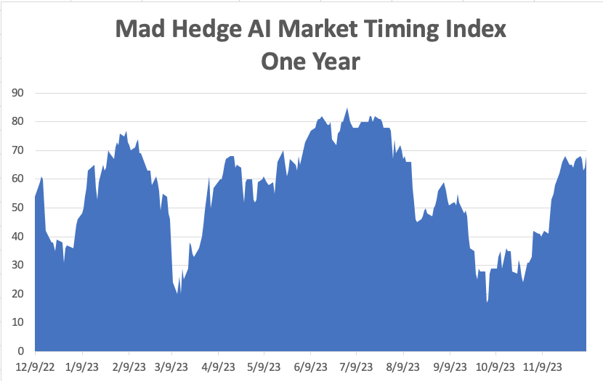
Buy Territory!! – Approaching Overbought
SELL
BUY

Slide 12
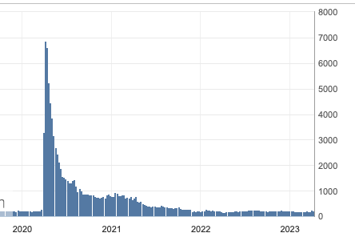
Weekly Jobless Claims – Falling 224,000 – -24,000

Slide 13
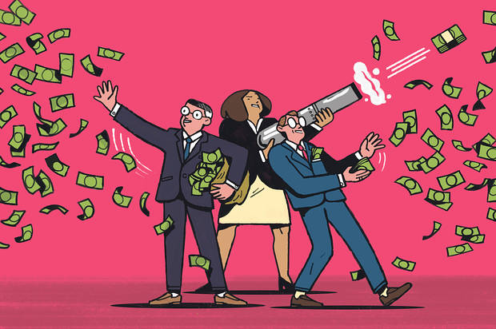
Stocks – Buy Back Boom
*Yearend rally started October 26, happened in November, now losing momentum *Santa Came Early this Year, clearly confusing Thanksgiving with Christmas *70% of corporate profits went into stock buy backs this year *Alaska Air Buys Hawaiian, for $1.9 Billion in a big overpay. (ALK) dropped 15% of the news. *Uber Enters S&P 500, on December 18, taking the stock up 10% on the news. *IBM Announces New Quantum Computing Chip *Snowflake Delivers a Big Beat, taking the stock up 10% in hours *Berkshire Hathaway Fails to Fall on Munger Death.

Slide 14
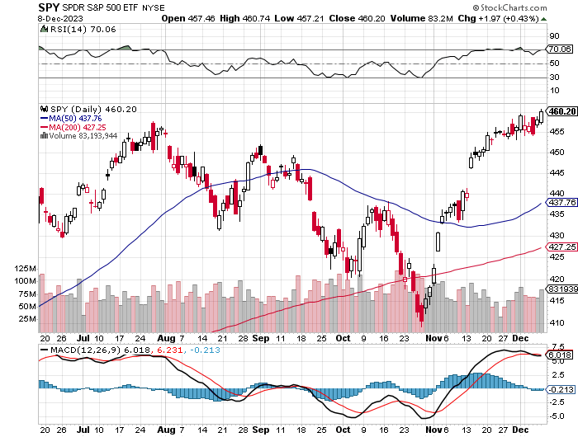
S&P 500 – New High took profits on long 5/$420-$430 put spread, took profits on long 1/$420-$430 put spread, took profits on long 11/$420-$430 put spread
Yearend Target $480
$445 -3.20% 1st support

Slide 15
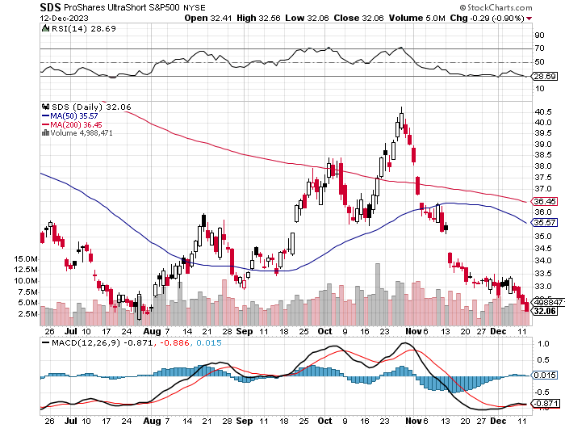
ProShares Ultra Short S&P 500 (SDS)- a great hedge for long stocks and bonds long 2X position has a hedge against longs and bond shorts

Slide 16
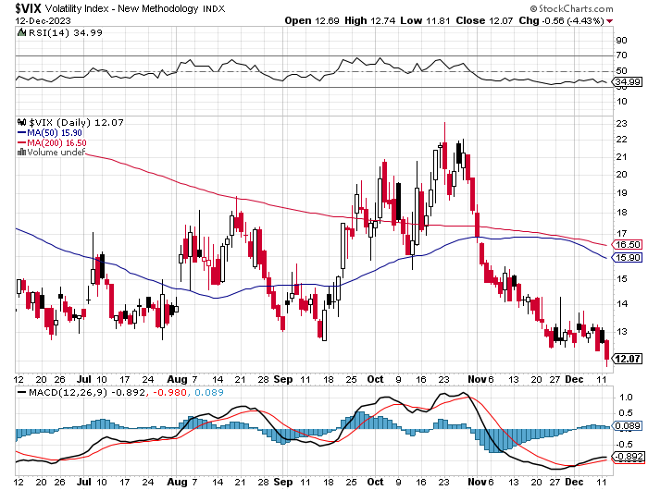
(VIX) – Bargain of the Century

Slide 17
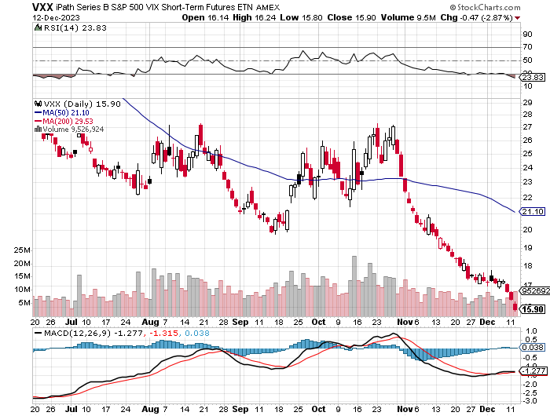
(VXX)-

Slide 18
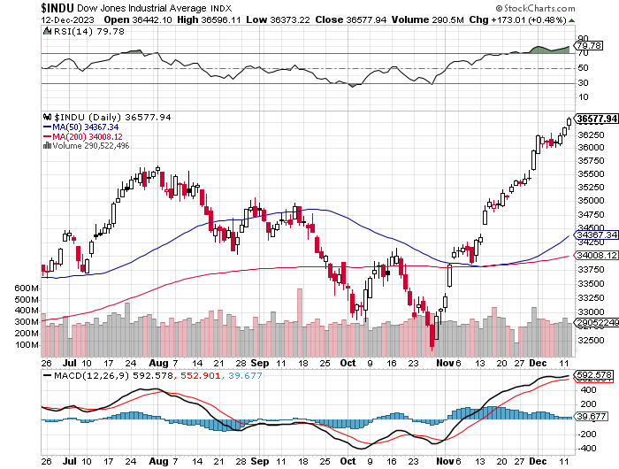
Dow Average ($INDU)-

Slide 19
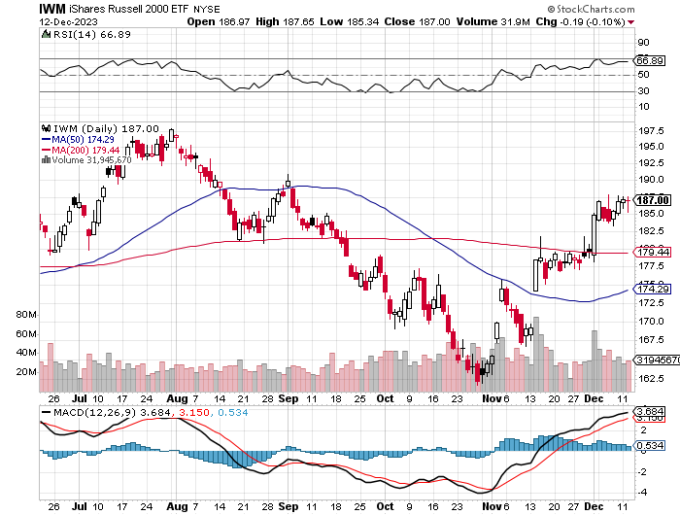
Russell 2000 (IWM)- took profits on Long 10/$137-$142 vertical bull call spread took profits on Long 10/$153-$156 vertical bear put spread

Slide 20
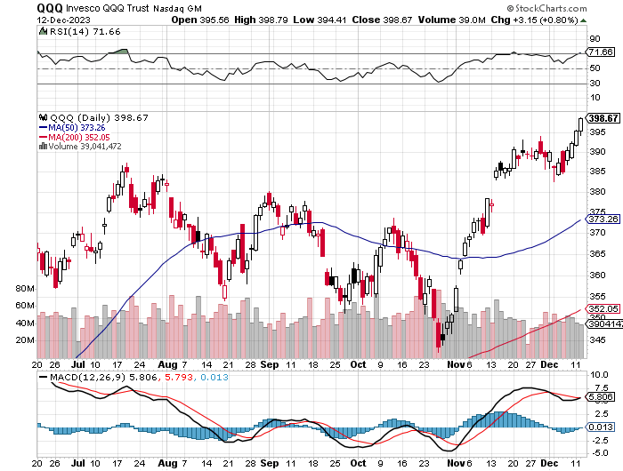
NASDAQ (QQQ) – took profits on Long 5/$335-$345 put spread took profits on long (QQQ) 1/$290-$300 put spread, took profits on long (QQQ) 4/$330-$335 put spread took profits on long (QQQ) 3/$340-$345 put spread, covered long (QQQ) $325-$330 put spread

Slide 22
THE MAD HEDGE FUND TRADER
The Barbell Portfolio
*75% Big Tech – 2% of US workforce, 25% of market cap and 25% of US earnings 25% Domestic Recovery, including: Railroads, airlines, cruise lines, Couriers, steel companies Banks, commodities Construction Credit Card Companies Hotels, casinos Online Ticket Sales

Slide 23
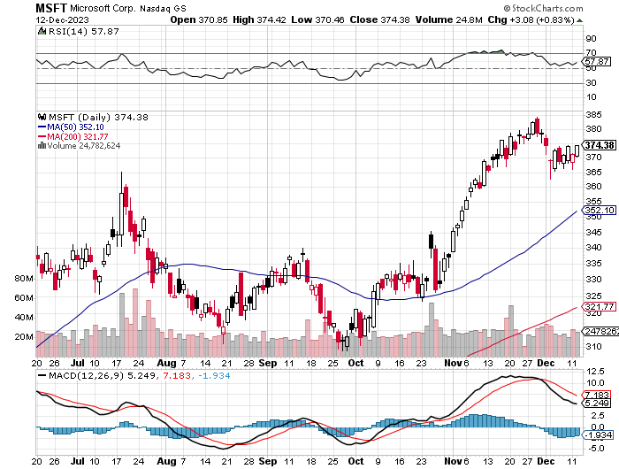
Microsoft (MSFT)- Earnings Beat The AI Wars Continue, with the entire Open AI staff going to Microsoft (MSFT) took profits on long 12/$320-$330 call spread took profits on long 9/$235-$245 call spread, took profits on long 7/$220-$210 call spread, took profits on long 6/$220-$230 call spread, took profits on long 2/$200-$210 bear put spread

Slide 24
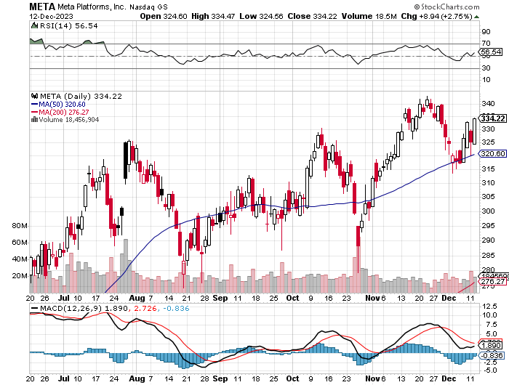
Meta (META)- Soars an Incredible 20% took profits on Long 9/$290-$300 vertical bear put spread stopped out of Long 9/$190-$200 vertical bear put spread

Slide 25
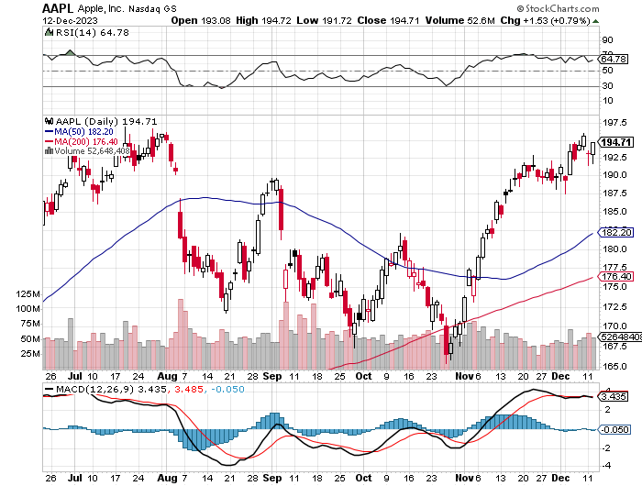
Apple (AAPL) Apple Upgrades New iPhone 15, to deal with overheating from third party gaming took profits on long 1/$145-$155 put spread, Took profits on long 10/$165-$175 put spread took profits on long 6/$155-$165 put spread, stopped out of long 6/$125-135 call spread, took profits on long 6/$110-$120 call spread, took profits on long 2/$180-$190 put spread

Slide 27
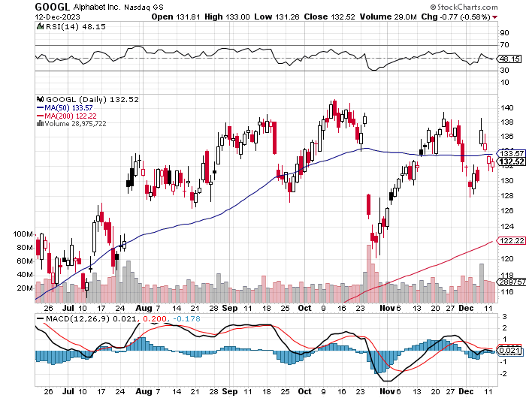
Alphabet (GOOGL) – Google Ramps Up AI Effort Alphabet Unveils New Gemini AI Model long 12/$110-$120 call spread – expires in 2 trading days took profits on long 12/$1,200-$1,230 bull call spread, took profits on long 9/$1,030-$1,080 vertical bull call spread

Slide 28
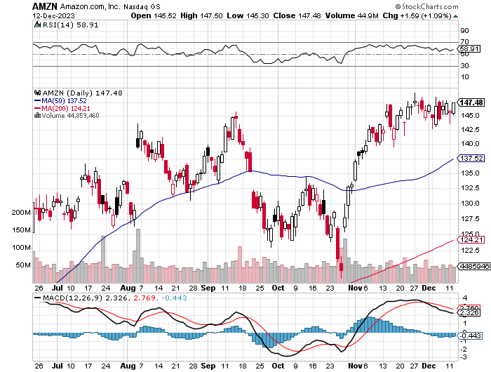
Amazon (AMZN) – Jeff Bezos Sells Amazon, some 1.673 million shares worth $244 million. He still has 988 million shares left worth $144 billion took profits on long 2/$3,400-$3,500 bear put spread took profits on long 9/$2,800-$2,900 bull call spread

Slide 29
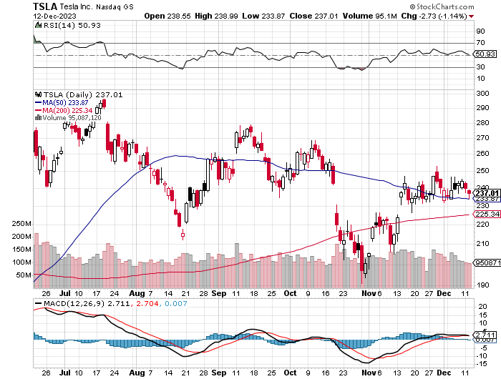
Tesla (TSLA) – The Price War Continues Tesla China Sales Drop 17.8%, in November, the sharpest drop in a year New Cybertruck resales banned for one year took profits on long 10/$200-$210 call spread took profits on long 6/$120-$130 call spread, stopped out of long 6/$210-$220 put spread took profits on long 5/$110-$120 call spread, took profits on long 5/$220-$230 put spread

Slide 30
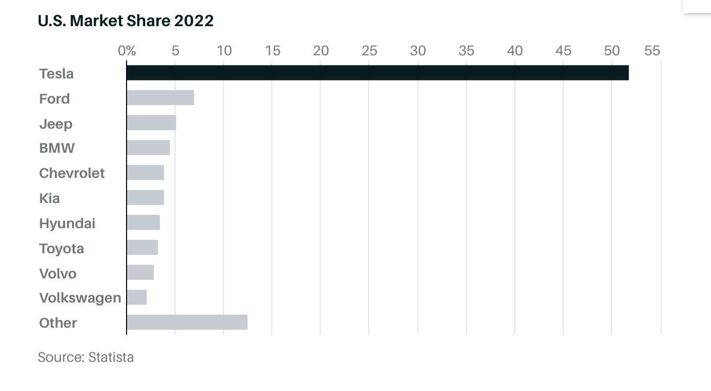

Slide 31
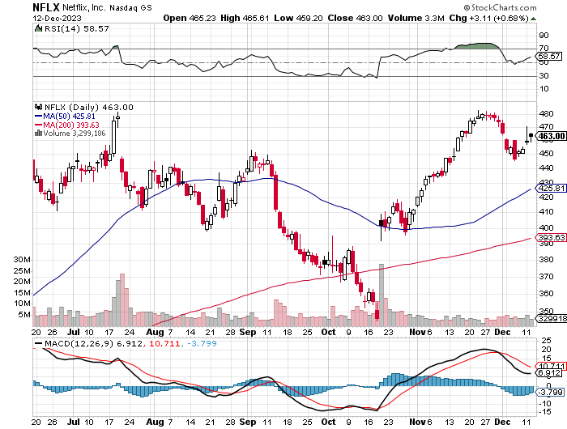
Netflix (NFLX) – Netflix subscribers beat - Netflix Password Sharing Crackdown Goes Global

Slide 32
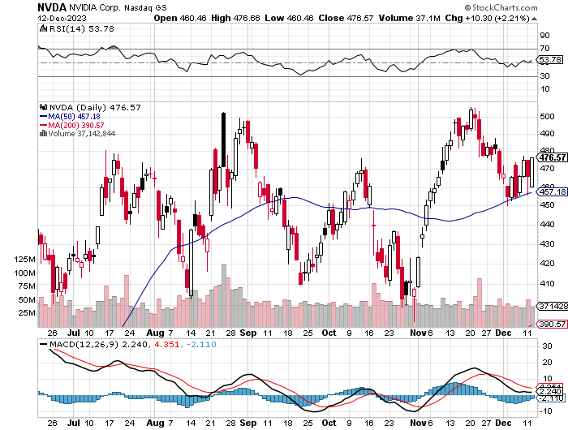
NVIDIA (NVDA) – Blowout Profits – NVIDIA Beats, with a profit triple, but that stock sells off 6% on the news It was a classic buy the rumor, sell the news move NVIDIA is Designing Dumbed Down Chips for China, to bypass government sanctions took profits on long 10/$370-$380 call spread – took profits on long 11/$370-$380 call spread took profits on long 3/$260-$270 put spread, took profits on long 10/$95-$100 call spread took profits on long 7/$120-$130 call spread, took profits on long 6/$120-$130 call spread

Slide 33
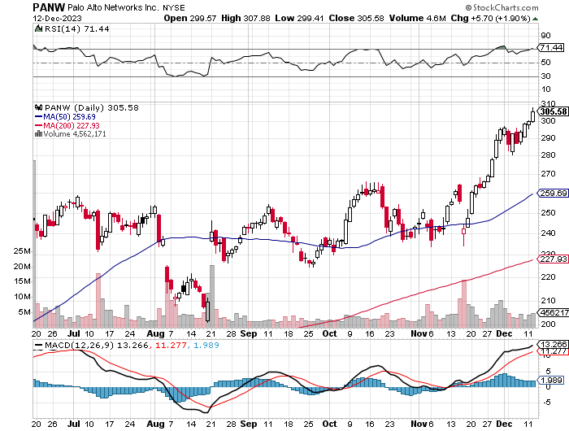
Palo Alto Networks (PANW)- Hacking never goes out of fashion Palo Alto Networks Dives on Weak Guidance, even though reported earnings were great took profits on long 10/$130-$140 call spread

Slide 34
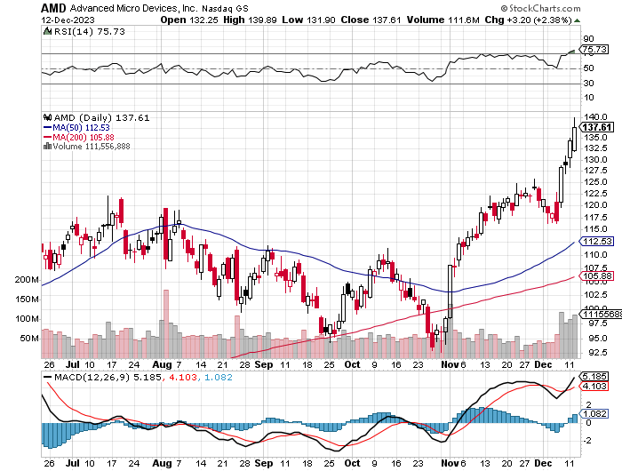
Advanced Micro Devices (AMD)- Recession fears programable logic devices took profits on long 2/$75-$80 call spread

Slide 35
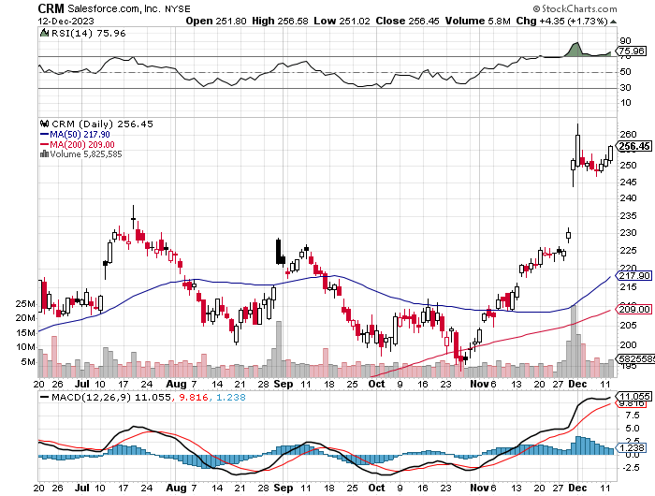
Salesforce (CRM)- Massive Online Migration Salesforce Soars 16%, on better-than-expected guidance took profits on long 12/$185-$195 call spread took profits on long 9/$125-$130 vertical bull call spread took profits on long 8/$125-$130 vertical bull call spread

Slide 36
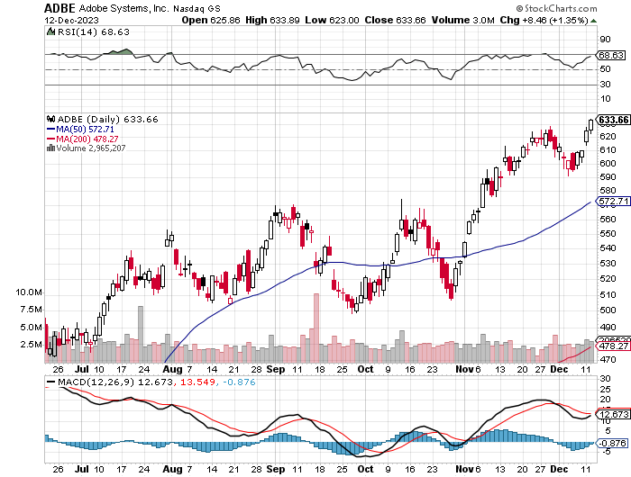
Adobe (ADBE)- Cloud play The Quality Non-China tech play

Slide 37
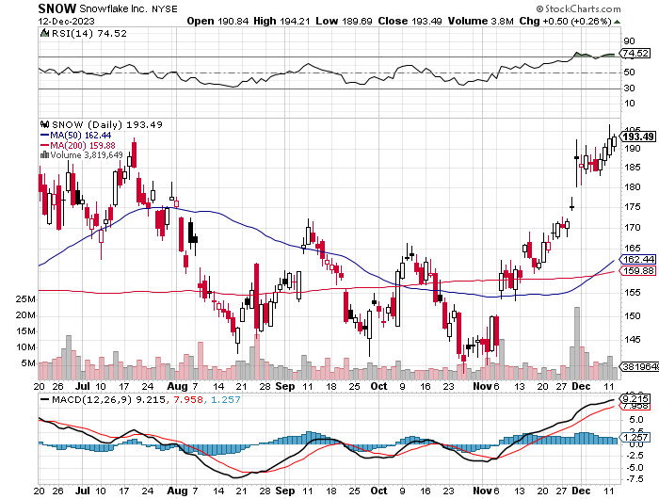
Snowflake (SNOW)- Blockbuster AI Earnings took profits on long 12/$135-$140 call spread

Slide 38
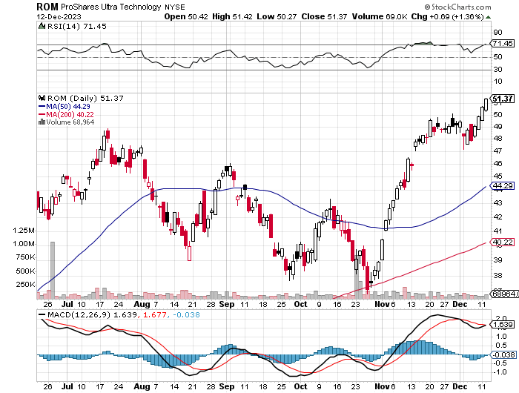
ProShares Ultra Technology ETF (ROM) – 2X Long Technology ETF took profits on long 10/$62-65 call spread

Slide 40
The Second Half of the Barbell
*Bets on a domestic recovery in 2022 Q4 *Upside potential in 2024 far greater than tech *Some of these have not moved for 5 or 10 years *Focuses on economically sensitive cyclical industries *Makes a great counterweight to high-growth technology *We could spend all of next ten years rotating between the two groups

Slide 41
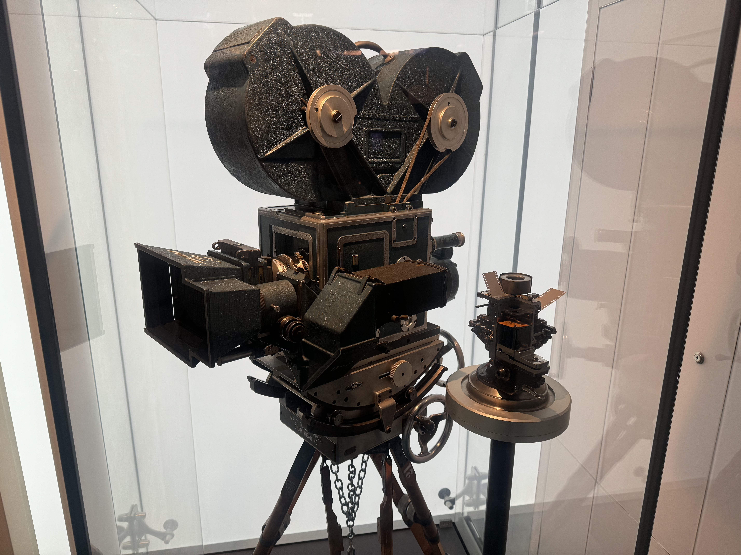

Slide 42
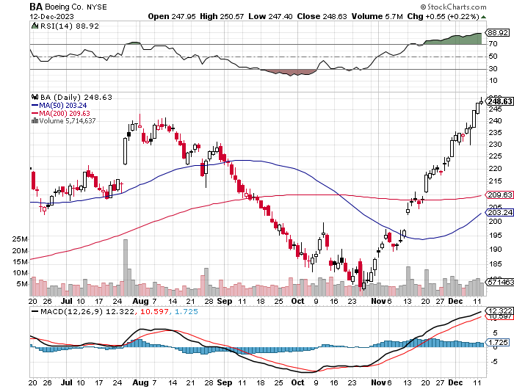
Boeing (BA) – Boeing's single-aisle deliveries up to 351 units for the year so far took profits on long 5/$17-$175 call spread

Slide 43
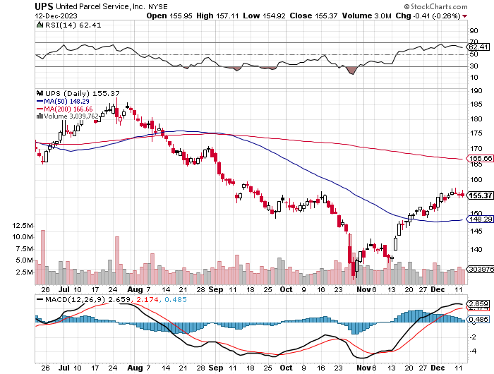
Package Delivery- United Parcel Service (UPS) – strike averted took profits on long 11/$130-$140 call spread

Slide 44
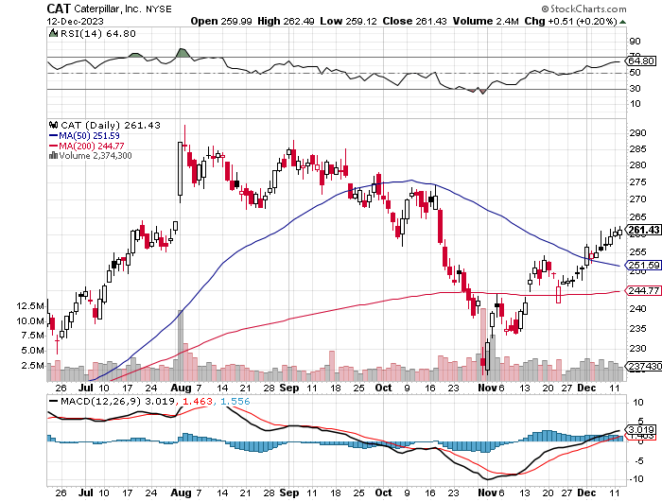
Caterpillar (CAT)- Ag + Infrastructure + Housing long 12/$220-$230 calls – expires in 2 trading days took profits on long 12/$145-$150 call spread took profits on long 11/$125-$135 call spread

Slide 45
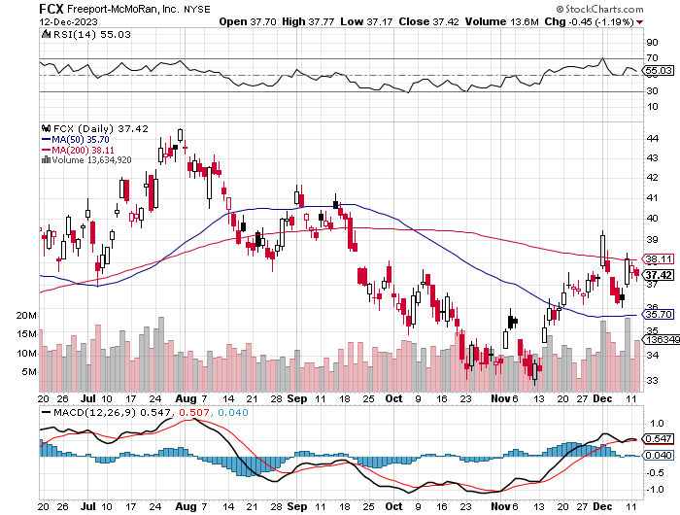
Freeport McMoRan - (FCX)- Coming Copper Crisis took profits on long 6/$32-$35 call spread took profits on long 4/$30-$33 call spread, took profits on long 10/$20-$23 call spread

Slide 46
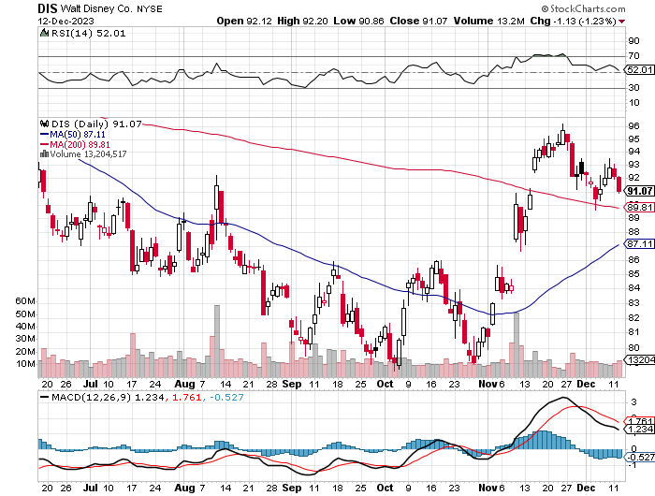
Walt Disney (DIS) -Disney Beats The big profit boost came from the parks

Slide 47
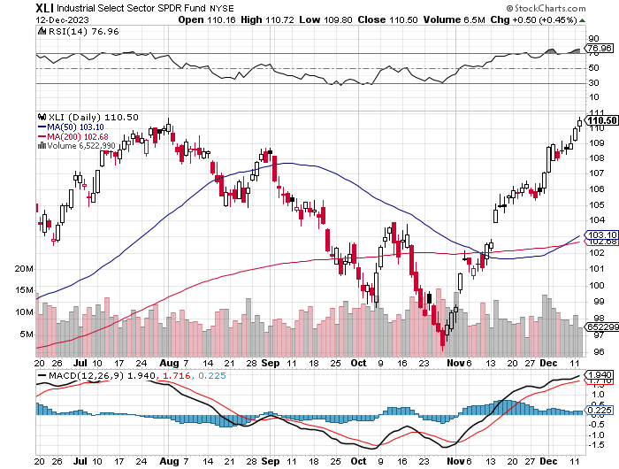
Industrials Sector SPDR (XLI)- (GE), (MMM), (UNP), (UTX), (BA), (HON)

Slide 48
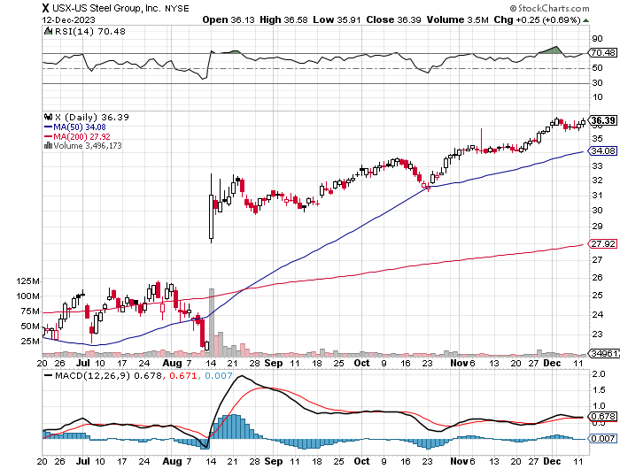
US Steel (X) – Commodity Boom and commodity Bidding war breaks out with 5 buyers, taking stock up 50% and LEAPS up 101%

Slide 49
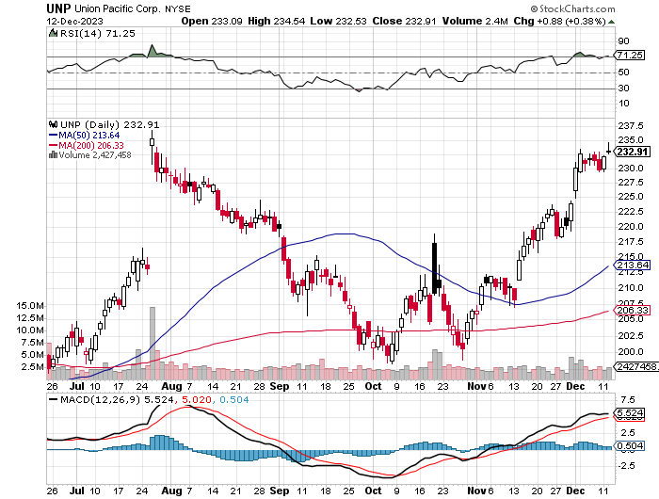
Union Pacific RR (UNP)- Big Stuff to Ship took profits on long 5/$200-$210 call spread took profits on 11/$150-$160 call spread

Slide 50
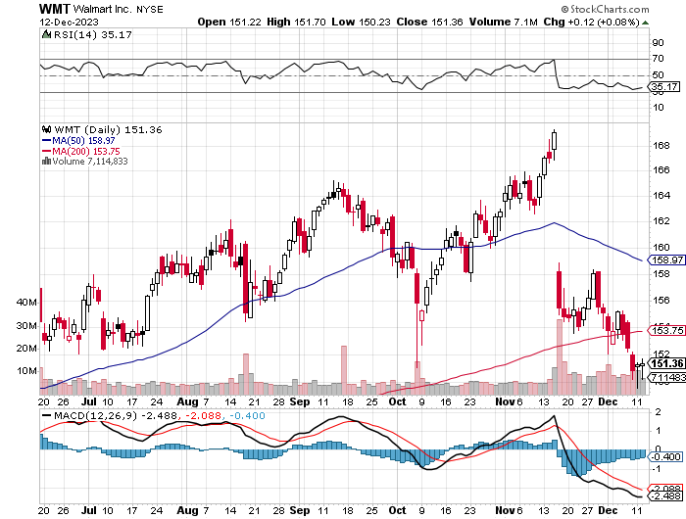
Wal-Mart (WMT)- took profit on Long 11/$125-$130 bear put spread took profit on Long 10/$119-$121 bear put spread took profits on Long 8/$114-$117 bear put spread

Slide 51
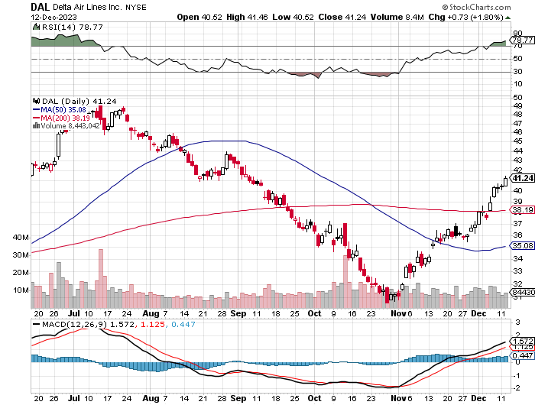
Delta Airlines (DAL) – Travel is Back! Delta Posts Strong Earnings on Robust international travel

Slide 52
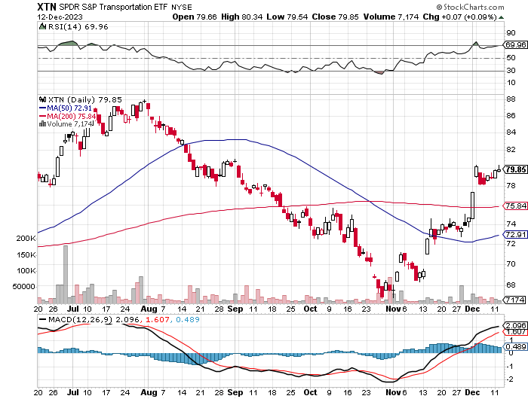
Transports Sector SPDR (XTN)- Worst Hit Sector (ALGT), (ALK), (JBLU), (LUV), (CHRW), (DAL)

Slide 53
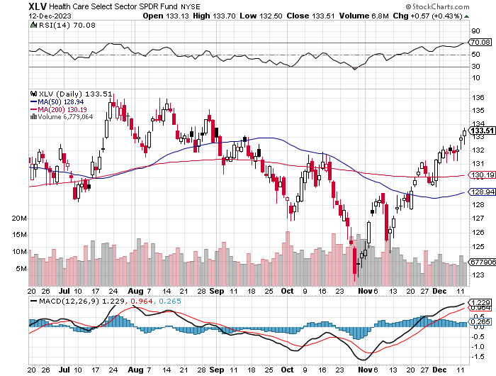
Health Care Sector (XLV) (JNJ), (PFE), (MRK), (GILD), (ACT), (AMGN)

Slide 54
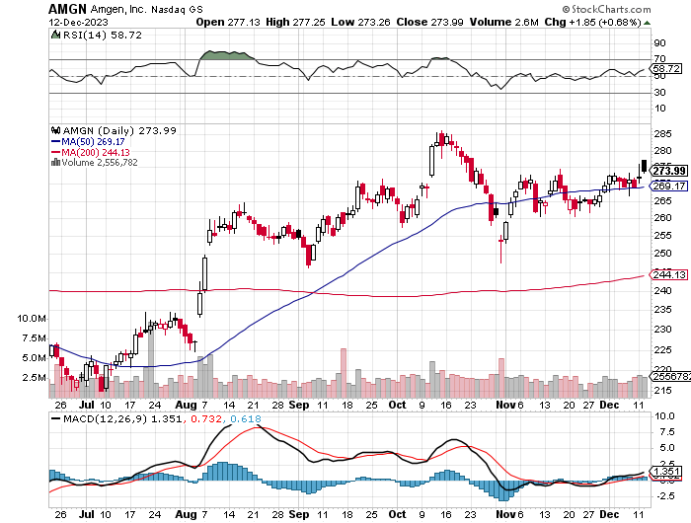
Amgen (AMGN) took profits on long 11/$185-$200 bull call spread

Slide 55
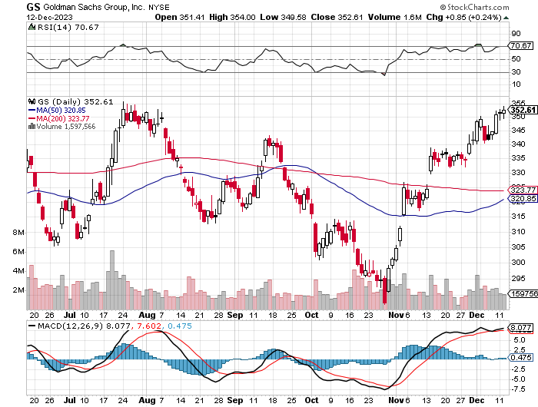
Goldman Sachs (GS) – Earnings Down but Less than Expected took profits 12/$330-$350 call spread took profits 11/$330-$350 call spread stop loss on long 11/$385-$395 call spreads

Slide 56
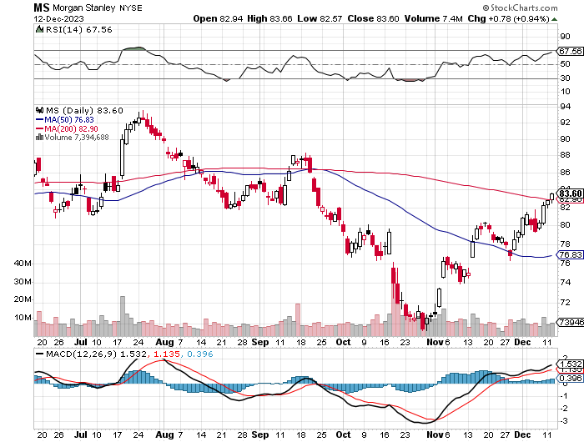
Morgan Stanley (MS) – Highest Capital ratio net of mark to market CEO to Step Down in a Year took profits on long 4/$65-$70 call spread

Slide 57
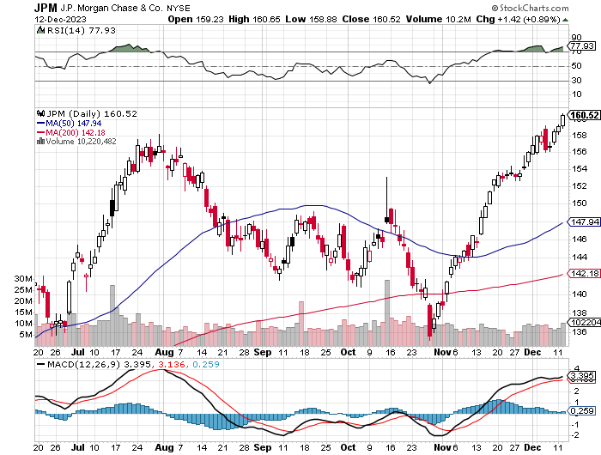
JP Morgan Chase (JPM) – Monster Earnings Surprise took profits on long 4/$105-$115 call spread

Slide 58
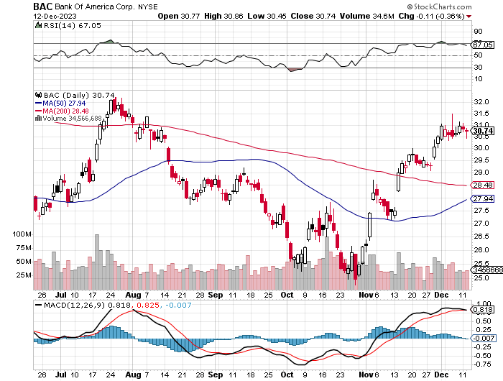
Bank of America (BAC) – Bank of America Rips, on a great earnings report took profits on long 4/$20-$23 call spread

Slide 59
Citigroup (C) – took profits on long 4/$30-$35 call spread

Slide 60
Charles Schwab (SCHW) – LEAPS up 67% in three months took profits on long 4/$30-$35 call spread

Slide 61
Interactive Brokers (IBKR) – Best Risk Control took profits on long 4/$60-$65 call spread

Slide 62
SPDR Metals & Mining ETF (XME) – long 2/$28-$30 call spread

Slide 63
Blackrock (BLK)-Asset Collection Boom took profits on long 3/$770-$790 call spread took profits on long 3/$310-$340 call spread

Slide 64
Visa (V) – Inflation boost Transaction grew by an inflationary 10% back to pre-pandemic levels took profits on long 10/$160-$170 bull call spread took profits on long 6/$150-$160 bull call spread

Slide 65
Consumer Discretionary SPDR (XLY) (DIS), (AMZN), (HD), (CMCSA), (MCD), (SBUX)

Slide 66
Berkshire Hathaway (BRKB)- Natural Barbell Berkshire Hathaway Knocks it Out of the Park, with a 41% gain in operating earnings long 12/$320-$330 call spread – expires in 2 trading days took profits on long 4/$260-$270 call spread, took profits on long 1/$290-$300 call spread took profits on long 10/$220-$230 call spread, took profits on long 7/$220-$230 call spread took profits on long 7/$220-$230 call spread, took profits on long 6/$260-$270 call spread

Slide 67
Europe Hedged Equity (HEDJ)-

Slide 68
Japan (DXJ)-

Slide 69
Emerging Markets (EEM) - Pro trade, Weak Dollar, Long Recovery Play

Slide 71
Bonds – Blowout Top
*Panic Buying Drives Treasury Yields to 4.13%, down nearly a full percentage point in little more than a month on weakening economic data *US Government to Finance Million Dollar Mortgage, through its Fannie Mae and Freddie Mac finance agencies *Fed to Cut Interest Rates as Early as March, or so says the futures market, which gives this a 40% probability *Crown Castle International Catches Activist Bid, from Elliot Management *Junk bond ETF’s (JNK) and (HYG) are holding up extremely well with a 8.74% yield and 18 month high *Buy (TLT) on the dip.

Slide 72
Treasury ETF (TLT) – On Fire long 12/$95-$98 put spread – expires in 12 trading days took profits on long 12/$79-$82 call spread, took profits on long 11/$76-79 call spread, took profits on long 10/$89-92 put spread, took profits on long 5/$98-$101 call spread took profits on long 5/$97-$100 call spread, long 2/$98-$101 call spread, took profits on long 4/$96-$99 call spread

Slide 73
Ten Year Treasury Yield ($TNX) – 4.24%

Slide 74
Junk Bonds (JNK) 8.18% Yield

Slide 75
Municipal Bonds (MUB) 3.79% Yield-

Slide 76
Emerging Market Debt (ELD) 6.69% Yield-

Slide 77
2X Short Treasuries (TBT)-Out of Favor

Slide 78
Anally Capital Management (NLY) – Leveraged REIT Play long 12/$15-$16 call spread – expires in 2 trading days

Slide 80
Foreign Currencies – Massive Yen Reversal
*Massive short cover hits Japanese yen, taking it up 10% in days *The prospect of falling US interest rates adds fuel to the fire *Buy (FXY) on dips *Bank of Japan Eases Grip on Bond Yields, ending its unlimited buying operation to keep interest rates down *Japan is the last country to allow rates to rise *Expect the Japanese yen to take off like a rocket. *Dollar weekending on “high for shorter” *Collapse of dollar is now a 2024 story

Slide 81
THE MAD HEDGE FUND TRADER
Australian Dollar (FXA) - Major Long-Term Bottom is In Targeting Parity – A call option on a global synchronized recovery
1:1
BUY

Slide 82
Japanese Yen (FXY)

Slide 83
Euro (FXE)-
2023 Target 25%

Slide 84
British Pound (FXB)-
2023 Target 15%

Slide 85
Emerging Market Currencies (CEW)
2023 Target 40%

Slide 86
Energy & Commodities – New Lows
*Exploding Sales of EV’s Are Ringing the Bell for Oil, leading forecasters to speed their projections for when global oil use will peak, as public subsidies and improved technology help consumers overcome the sometimes eye-popping sticker prices for battery-powered cars *Oil Crashes, from $96 down to $68 in less than six months, as fears of a global economic slowdown continue *US Gasoline Prices Hit Three Year Low, on recession fears and replacement concerns by EV’s *Energy stocks are tracking the downside tic for tic, pulling down all other commodities *There is a “BUY” setting up here when the global economy reaccelerates on a lower interest rates world. Watch (XOM) and (OXY). *Warm weather is capping rallies in natural gas (UNG)

Slide 87
Oil-($WTIC)

Slide 88
United States Oil Fund (USO)

Slide 89
Energy Select Sector SPDR (XLE)-No Performance! (XOM), (CVX), (SLB), (KMI), (EOG), (COP)

Slide 90
ExxonMobile (XOM)- Exxon Moves Big into Lithium, with the construction of a major mining operation in Arkansas stopped out of Long 12/$97-$100 call spread took profits on long 12/$120-$125 put spread

Slide 91
Occidental Petroleum (OXY)- Buffet’s a Buyer took profits on long 2/$55-$60 call spread took profits on long 12/$77.50-$82.50 put spread

Slide 92
Natural Gas (UNG) – Free Fall on Warm Winter Long January 2025 $14 - $15 Call Spread LEAPS

Slide 93
Freeport McMoRan (FCX) - Codelco Sees Profit Slump, the world’s largest copper producer based in Chile

Slide 94
Cameco (CCJ) – Global Uranium Renaissance long 12/$35-$38 call spread – expires in 12 trading days profits on long 5/$20-$23 bull call spread

Slide 96
Precious Metals – A New 10 Year Bull Market
*Gold Hits new all-time High, and another falling interest rate play. *Sharp drop in interest is very positive for gold *Investors are picking up gold as a hedge for 2024 volatility *Gold headed for $3,000 by 2025, but back off first from new all-time highs *The new drivers are soon to fall interest rates and the demise of crypto *Silver is the better play with a higher beta *Russia and China are also stockpiling gold to sidestep international sanctions

Slide 97
Gold (GLD) - Deflation call took profits on long 5/$165-$170 bull call spread

Slide 98
Market Vectors Gold Miners ETF- (GDX) –

Slide 99
Barrick Gold (GOLD) took profit on long 1/$15.50-$16.50 call spread

Slide 100
Newmont Mining- (NEM)- took profits on long $55-60 call spread

Slide 101
Silver- (SLV)- took profits on long 11/$19-$20 call spread

Slide 102
Silver Miners - (SIL)-

Slide 103
Wheaton Precious Metals - (WPM)- took profits on long 1/$36-$39 call spread

Slide 104
Platinum- (PPLT)- 556,000-ounce shortage this year took profits on long 1/$36-$39 call spread

Slide 106
Real Estate – The Bull is Back
*Refi Demand Rockets, as interest rates plunge to four-month lows *The rate for the popular 30-year mortgage fell back toward 7% after hitting 8% earlier this fall *Applications to refinance a home loan Index increased 14% from the previous week and were 10% higher than the same week one year ago *Zombie Malls are a New Term You Should Get Used to. People are just not coming back to work *It’s worst in San Francisco where tech discovered the wonders of cost cutting, taking the office vacancy rate up to 35%. *Pending Home Sales Collapse, dropping to the lowest level since the National Association of Realtors began tracking them in 2001. *Tight supply and still-strong demand have kept pressure on home prices, which not only continue to hit new highs. S&P Case Shiller Hits New Highs, 3.9% higher in September

Slide 107
S&P Case Shiller Plunges S&P Case Shiller Rises to +3.90% in September, with its National Home Price Index Detroit gained +6.7%, San Diego +6.5%, and New York +6.2%.

Slide 108
Crown Castle International (CCI) – 6.26% yielding cell phone tower REIT Eliot Management Pushes up stock with activist bid

Slide 109
US Home Construction Index (ITB) (DHI), (LEN), (PHM), (TOL), (NVR)

Slide 111
Trade Sheet- So What Do We Do About All This?
*Stocks – buy any dips *Bonds – buy dips *Commodities-buy dips *Currencies- sell dollar rallies, buy currencies *Precious Metals – buy dips *Energy – buy dips *Volatility - buy $12 *Real estate – buy dips

Slide 112
Next Strategy Webinar 12:00 EST Wednesday, January 10 from Silicon Valley email me questions at support@madhedgefundtrader.com
Good Luck and Good Trading!
Notes:
*

