Slide 1

The Mad Hedge Fund Trader
“The Melt Up Market”
With John Thomas
Lake Tahoe, NV September 25, 2024
www.madhedgefundtrader.com
Notes:
*

Slide 2
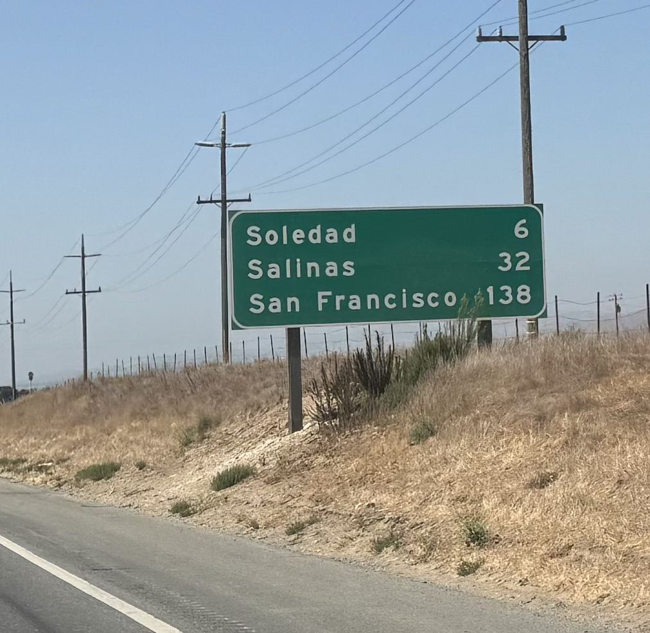

Slide 3

Trade Alert Performance
New All-Time Highs!
*January -4.28% Final *July +10.92% Final
*February +7.42% Final *August +3.74% Final
*March +6.23% Final *September +9.67% MTD
*April +5.24% Final *October -5.37% Final
*May +3.74% Final *November +15.37 Final
*June +1.94% Final *December -2.27% Final
*2024 YTD +44.36%, versus +19% for the S&P 500 and
+720.99% since inception
*Versus 84.63% for all of 2022
*Versus 79.79% for all of 2023
*Average annualized return of +51.62% for 16 years

Slide 4
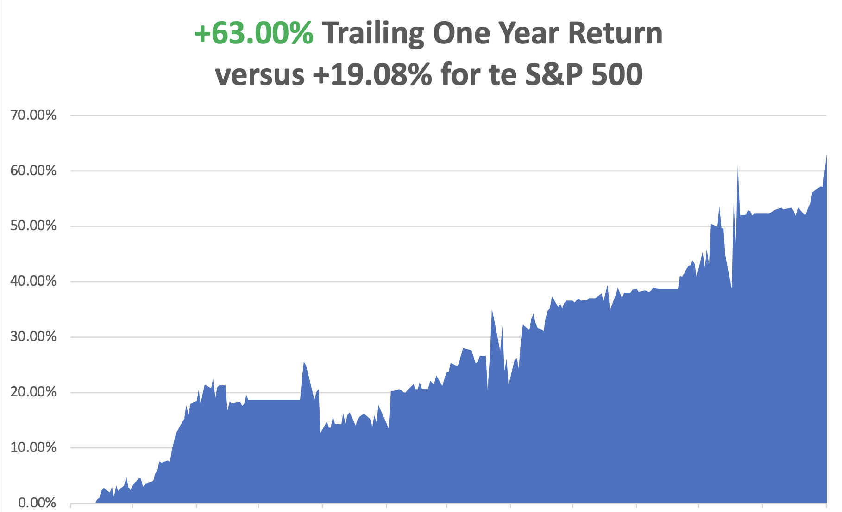

Slide 5
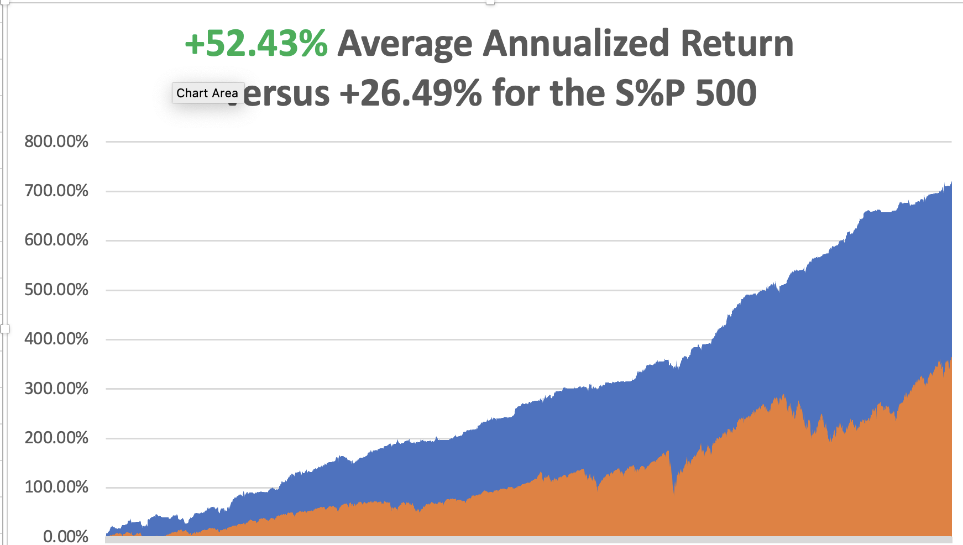

Slide 6
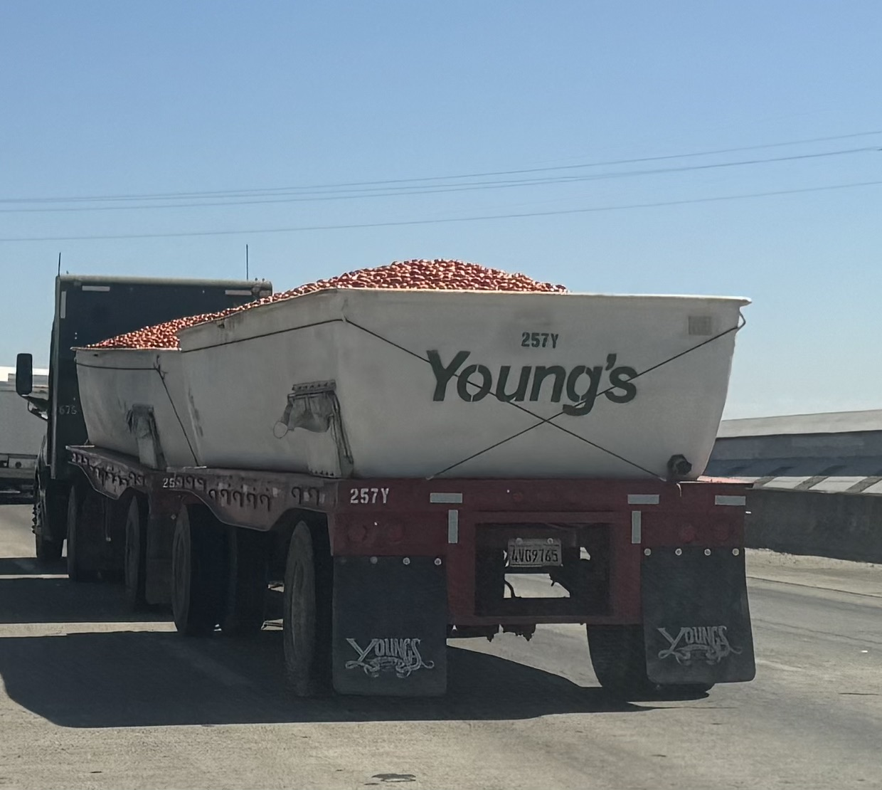

Slide 7
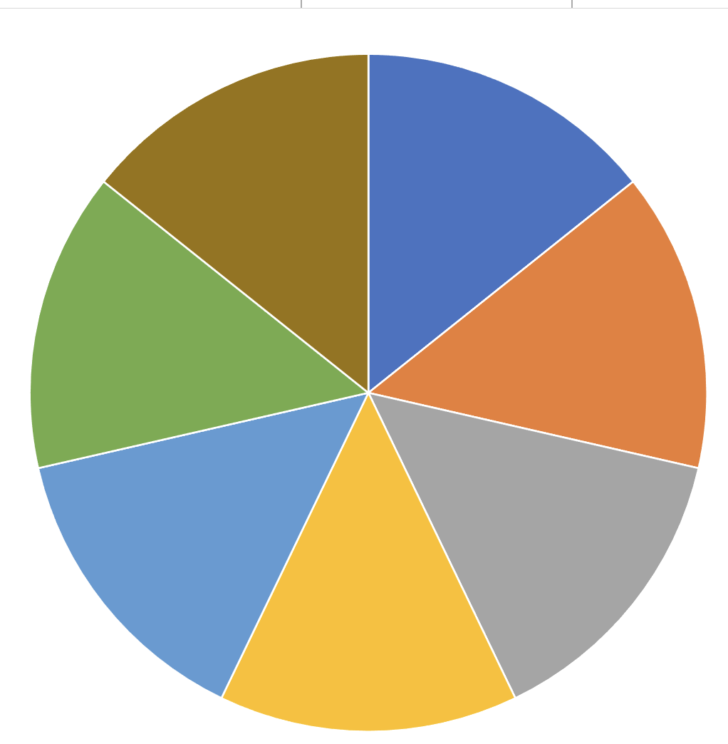
Portfolio Review – Aggressively Long
60% risk on, long, 10% risk off, 30% cash
Risk On
(GLD) 10/$220-$225 call spread | 10.00%
(CCJ) 10/$33-$36 call spread | 10.00%
(NEM) 10/$47-$50 call spread | 10.00%
(TSLA) 10/$180-$190 call spread | 10.00%
(DHI) 10/$165-$175 call spread | 10.00%
(TLT) 10/$93-$96 call spread | 10.00%
Risk Off
(TLT) 10/$103-$106 put spread | -10.00%
Total Net Position | 50.00%
Total Aggregate Position | 70.00%
Expiration Value
+50.08%

Slide 8

The Method to My Madness
*Presidential debate and surprise monster 50 basis point rate cut trigger massive “risk on” move in all asset classes
*All interest rate plays deliver massive upside moves
*We are unlikely to see a more than 5% drop in indexes for the rest of 2024
*US Dollar gets is trash and could stay weak for years
*Technology stocks will recover after a much-needed correction
*Energy gets dumped on slowdown fears
*Buy stocks and bonds on dips, but now it’s ALL sectors

Slide 9
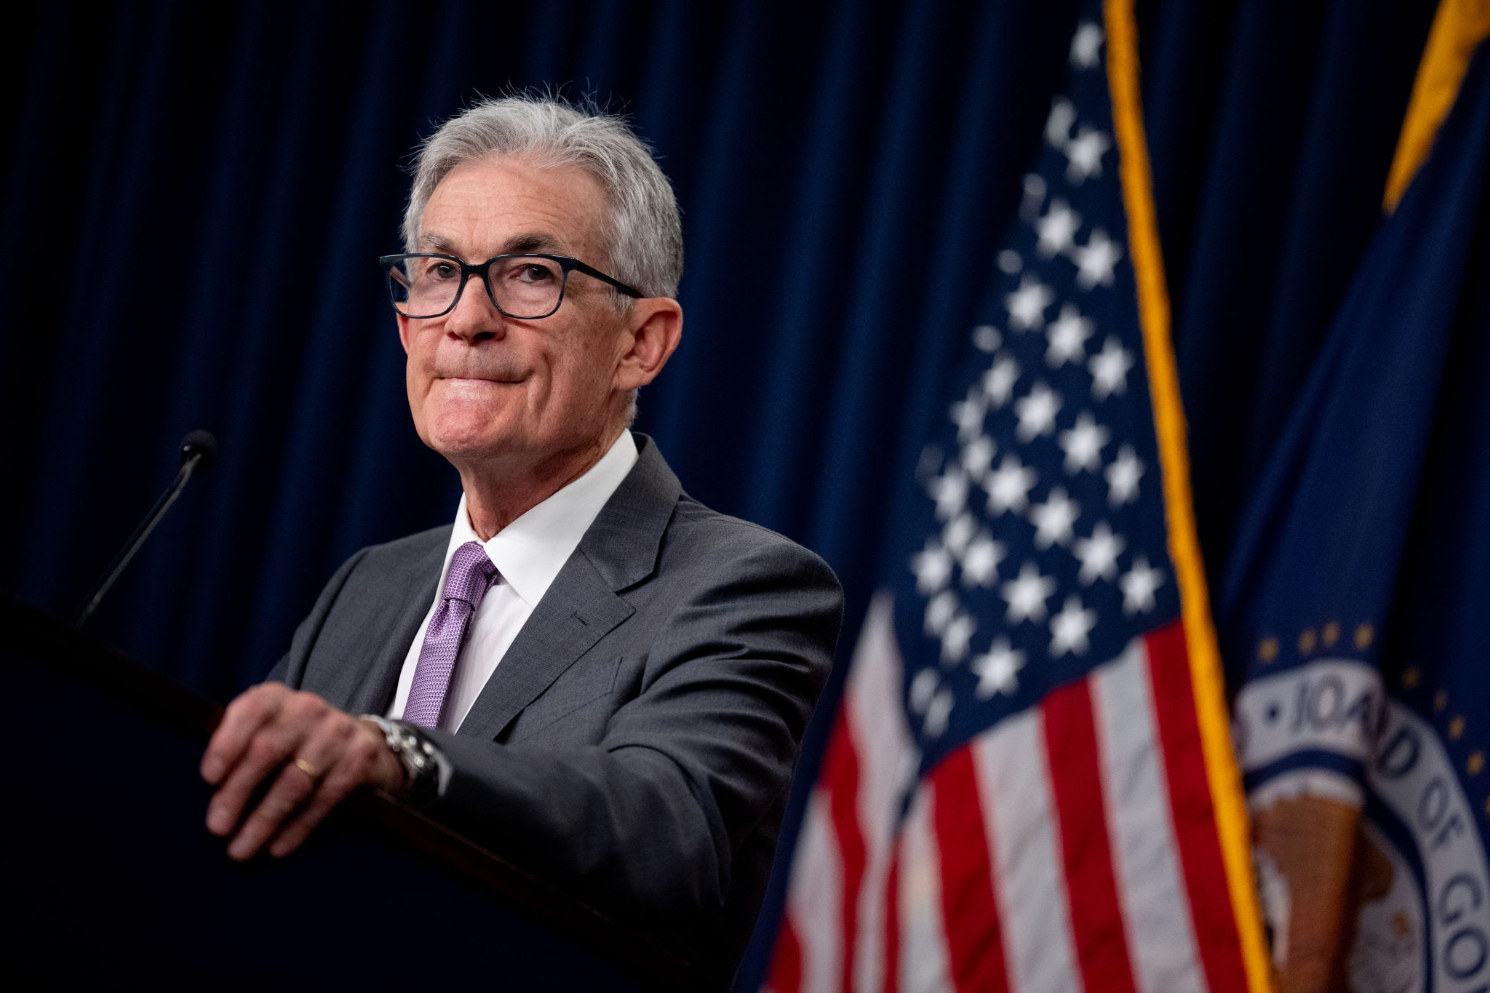
The Global Economy – Panic Cut
*Fed Shocks Market with a 50 Basis Point Rate Cut
*Inflation is Running Slower than Expected, at a 1.8% annualized rate for the last four months
Consumer Sentiment Rises, to the highest level in four months according to the University of Michigan,
*US retail sales unexpectedly rose in August, supported by online purchases
*US Household Wealth Hits New All-Time High, or the value of American home equity at $163.8 trillion
*Foreign Direct Investment into China Collapses, down 31.5% in the
first eight months of 2024
*Foreign Investors Pour $31 Billion into Emerging Markets in August
*US Import Prices are in Free Fall

Slide 10
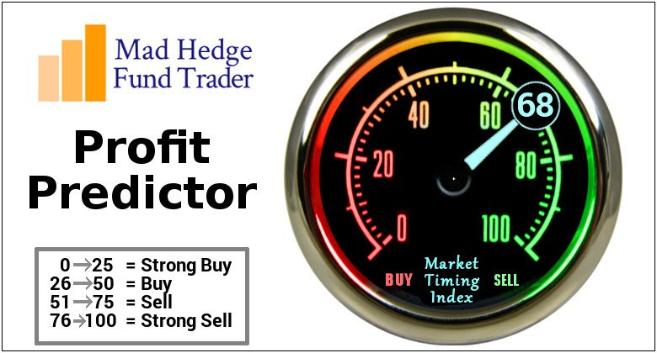
The Mad Hedge Profit Predictor
Market Timing Index – DO NOTHING Territory
An artificial intelligence driven algorithm that analyzes 30 different economic, technical, and momentum driven indicators

Slide 11
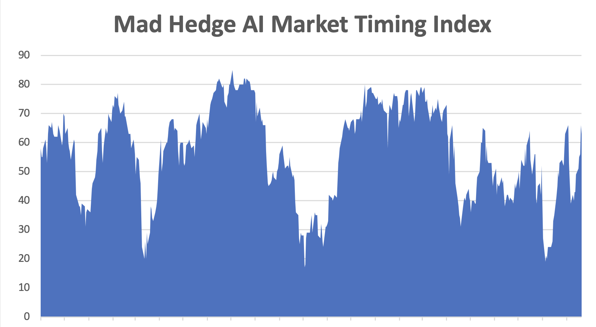
Neutral Territory
SELL
NOW
BUY

Slide 12
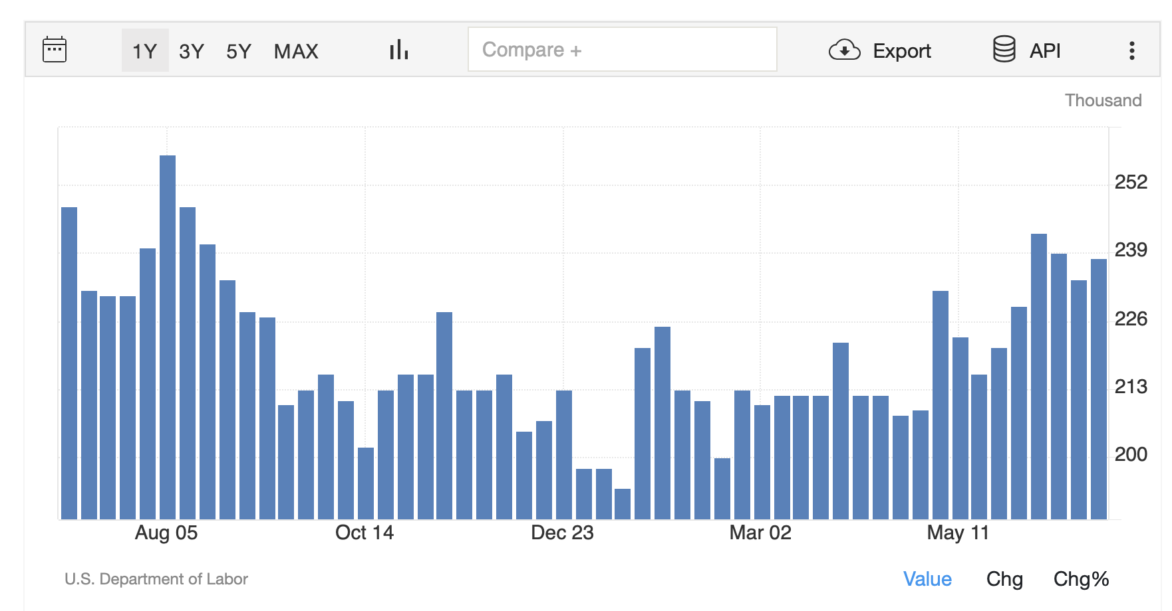
Weekly Jobless Claims – Falling
219,000 -10,000 – a 4 Month Low

Slide 13


Slide 14

Stocks – New Lease on Life
  *Market Scores Biggest Turnaround in Two Years, now that the presidential debate is history, scoring an amazing 900-point intraday swing
  *Solar Stocks get Harris Bump
  *FedEx (FDX) Gets Crushed 10%, on disappointing earnings and guidance
  *Intel (INTC) Cuts Amazon Deal, to supply the online marketing behemoth with a steady supply of high-end chips
  *Charles Schwab (SCHW) Pops 5%, after the brokerage firm reported steady
  growth in net new assets
  *Wells Fargo (WFC) Gets Hit with Another Regulatory Action for failure
  to control money laundering
  *Palantir (PLTR), Dell (DELL), and Erie Indemnity (ERIE) to Join S&P 500

Slide 15
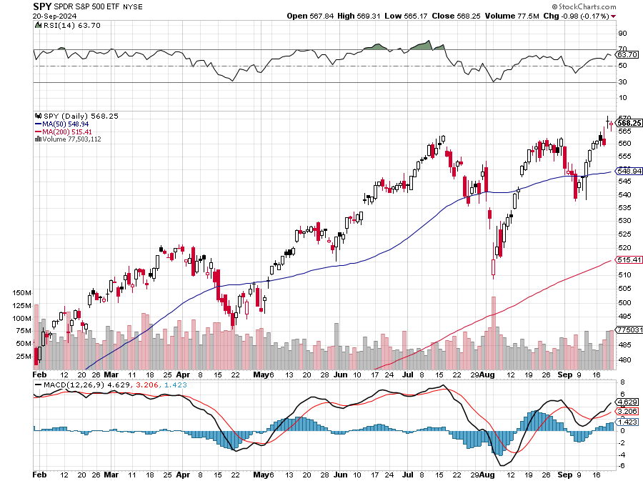
S&P 500 – Double Top Risk
Yearend
Target
$600 +25%
$510
-9.7%
1st support
$493
-12.7%
1st support

Slide 16
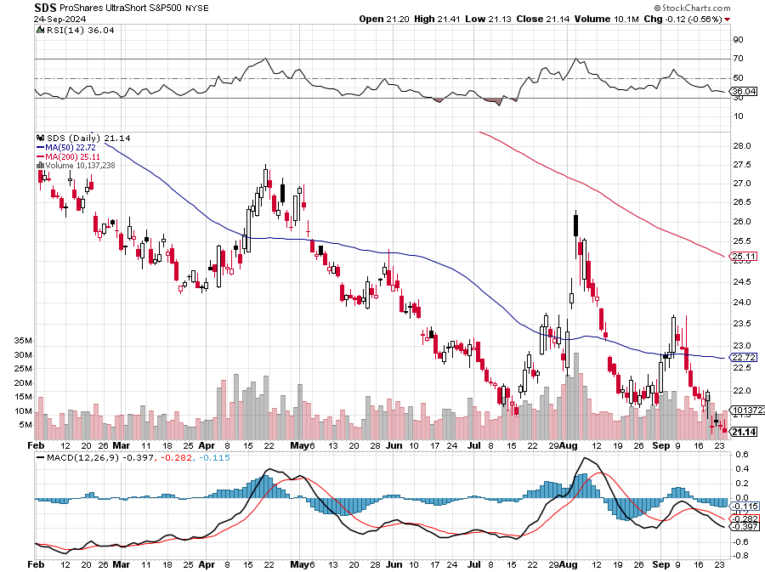
ProShares Ultra Short S&P 500 (SDS)- a great hedge for long stocks and bonds long 2X position has a hedge against longs and bond shorts

Slide 17
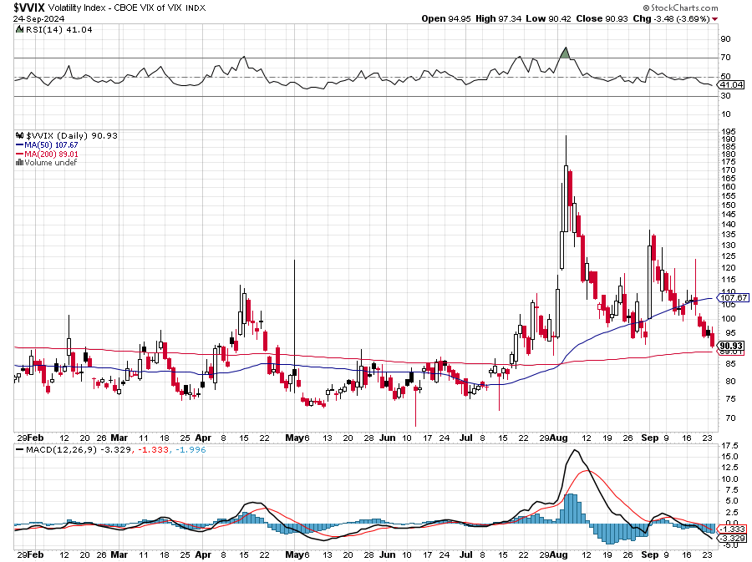
(VIX) – Rare Spike
Volatility Index Hits Four Year High at $65, the most since the 2020 pandemic. That implies a 2% move in the S&P 500 (SPX) every day for the next 30 days

Slide 18
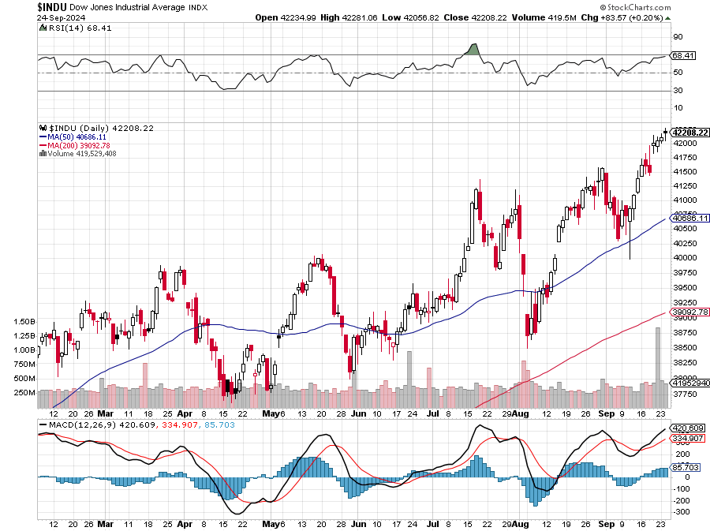
Dow Average ($INDU)-

Slide 19
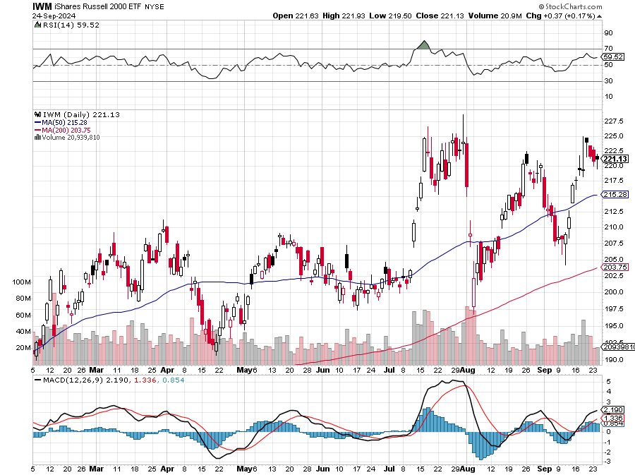
Russell 2000 (IWM)- took profits on Long 10/$137-$142 vertical bull call spread took profits on Long 10/$153-$156 vertical bear put spread

Slide 20
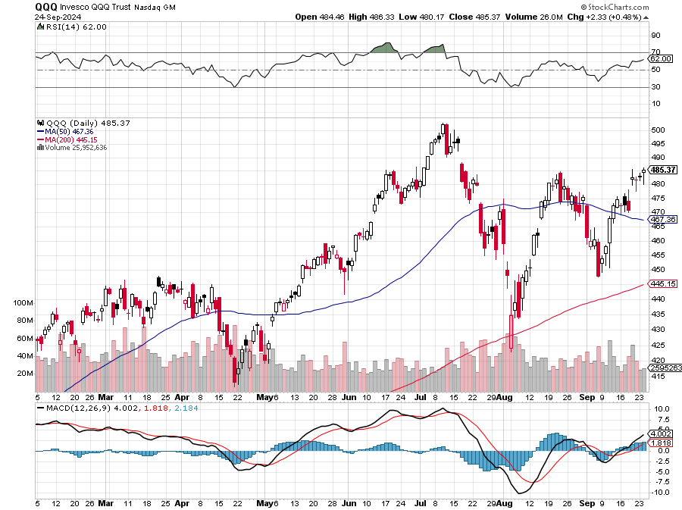
NASDAQ (QQQ) – took profits on Long 5/$335-$345 put spread took profits on long (QQQ) 1/$290-$300 put spread, took profits on long (QQQ) 4/$330-$335 put spread took profits on long (QQQ) 3/$340-$345 put spread, covered long (QQQ) $325-$330 put spread

Slide 21
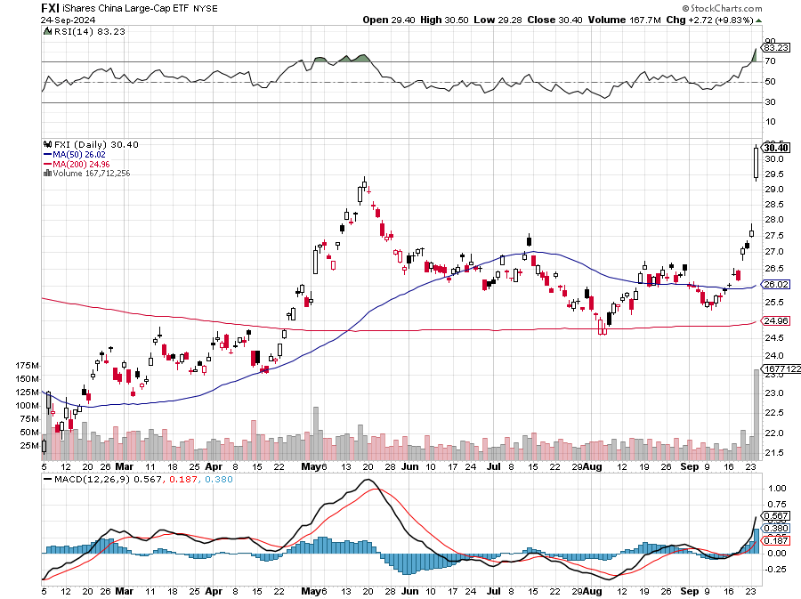
China (FXI)

Slide 22
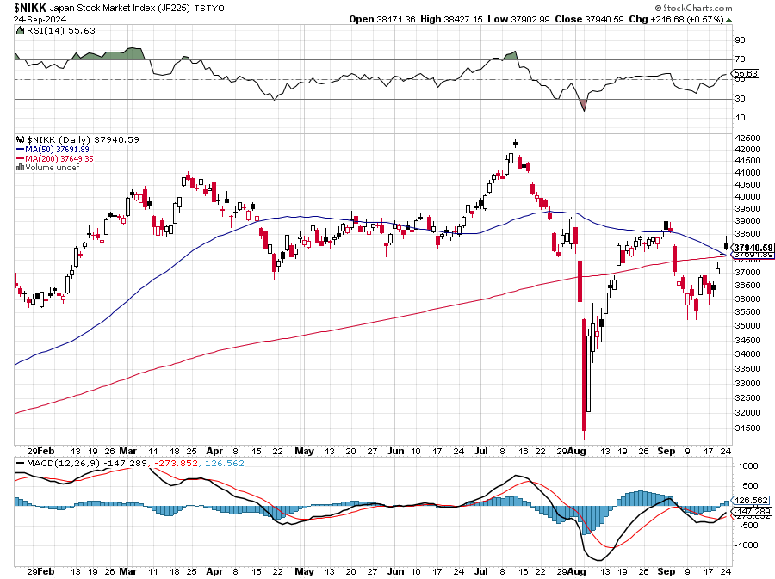
Japan ($NIKK)
THE BIG STORY THIS WEEK

Slide 23
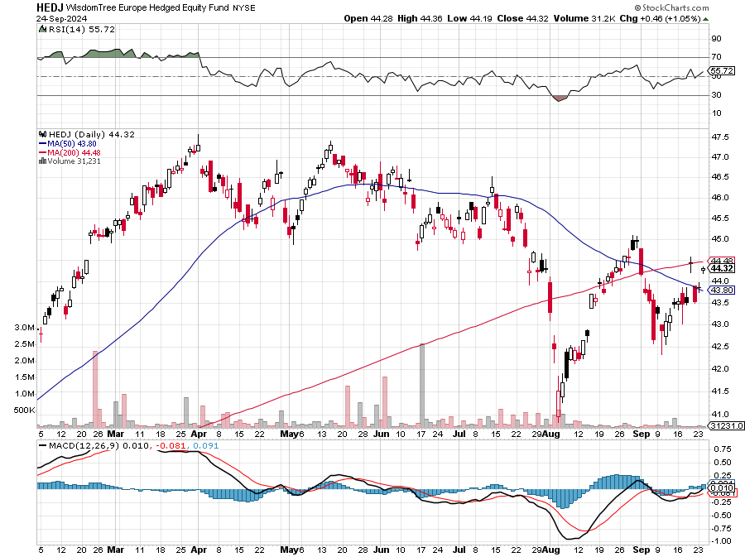
Europe Hedged Equity (HEDJ)-

Slide 24
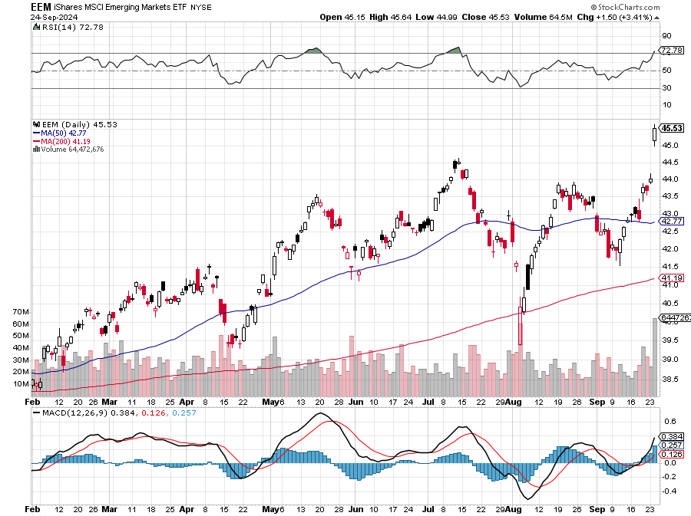
Emerging Markets (EEM) - Pro trade, Weak Dollar, Long Recovery Play
Traders are Lining up for a Big Emerging Market Bet. Falling US interest rates will bring a weak US dollar and runaway bull markets in most emerging markets, which have remained unchanged for more than a decade

Slide 25
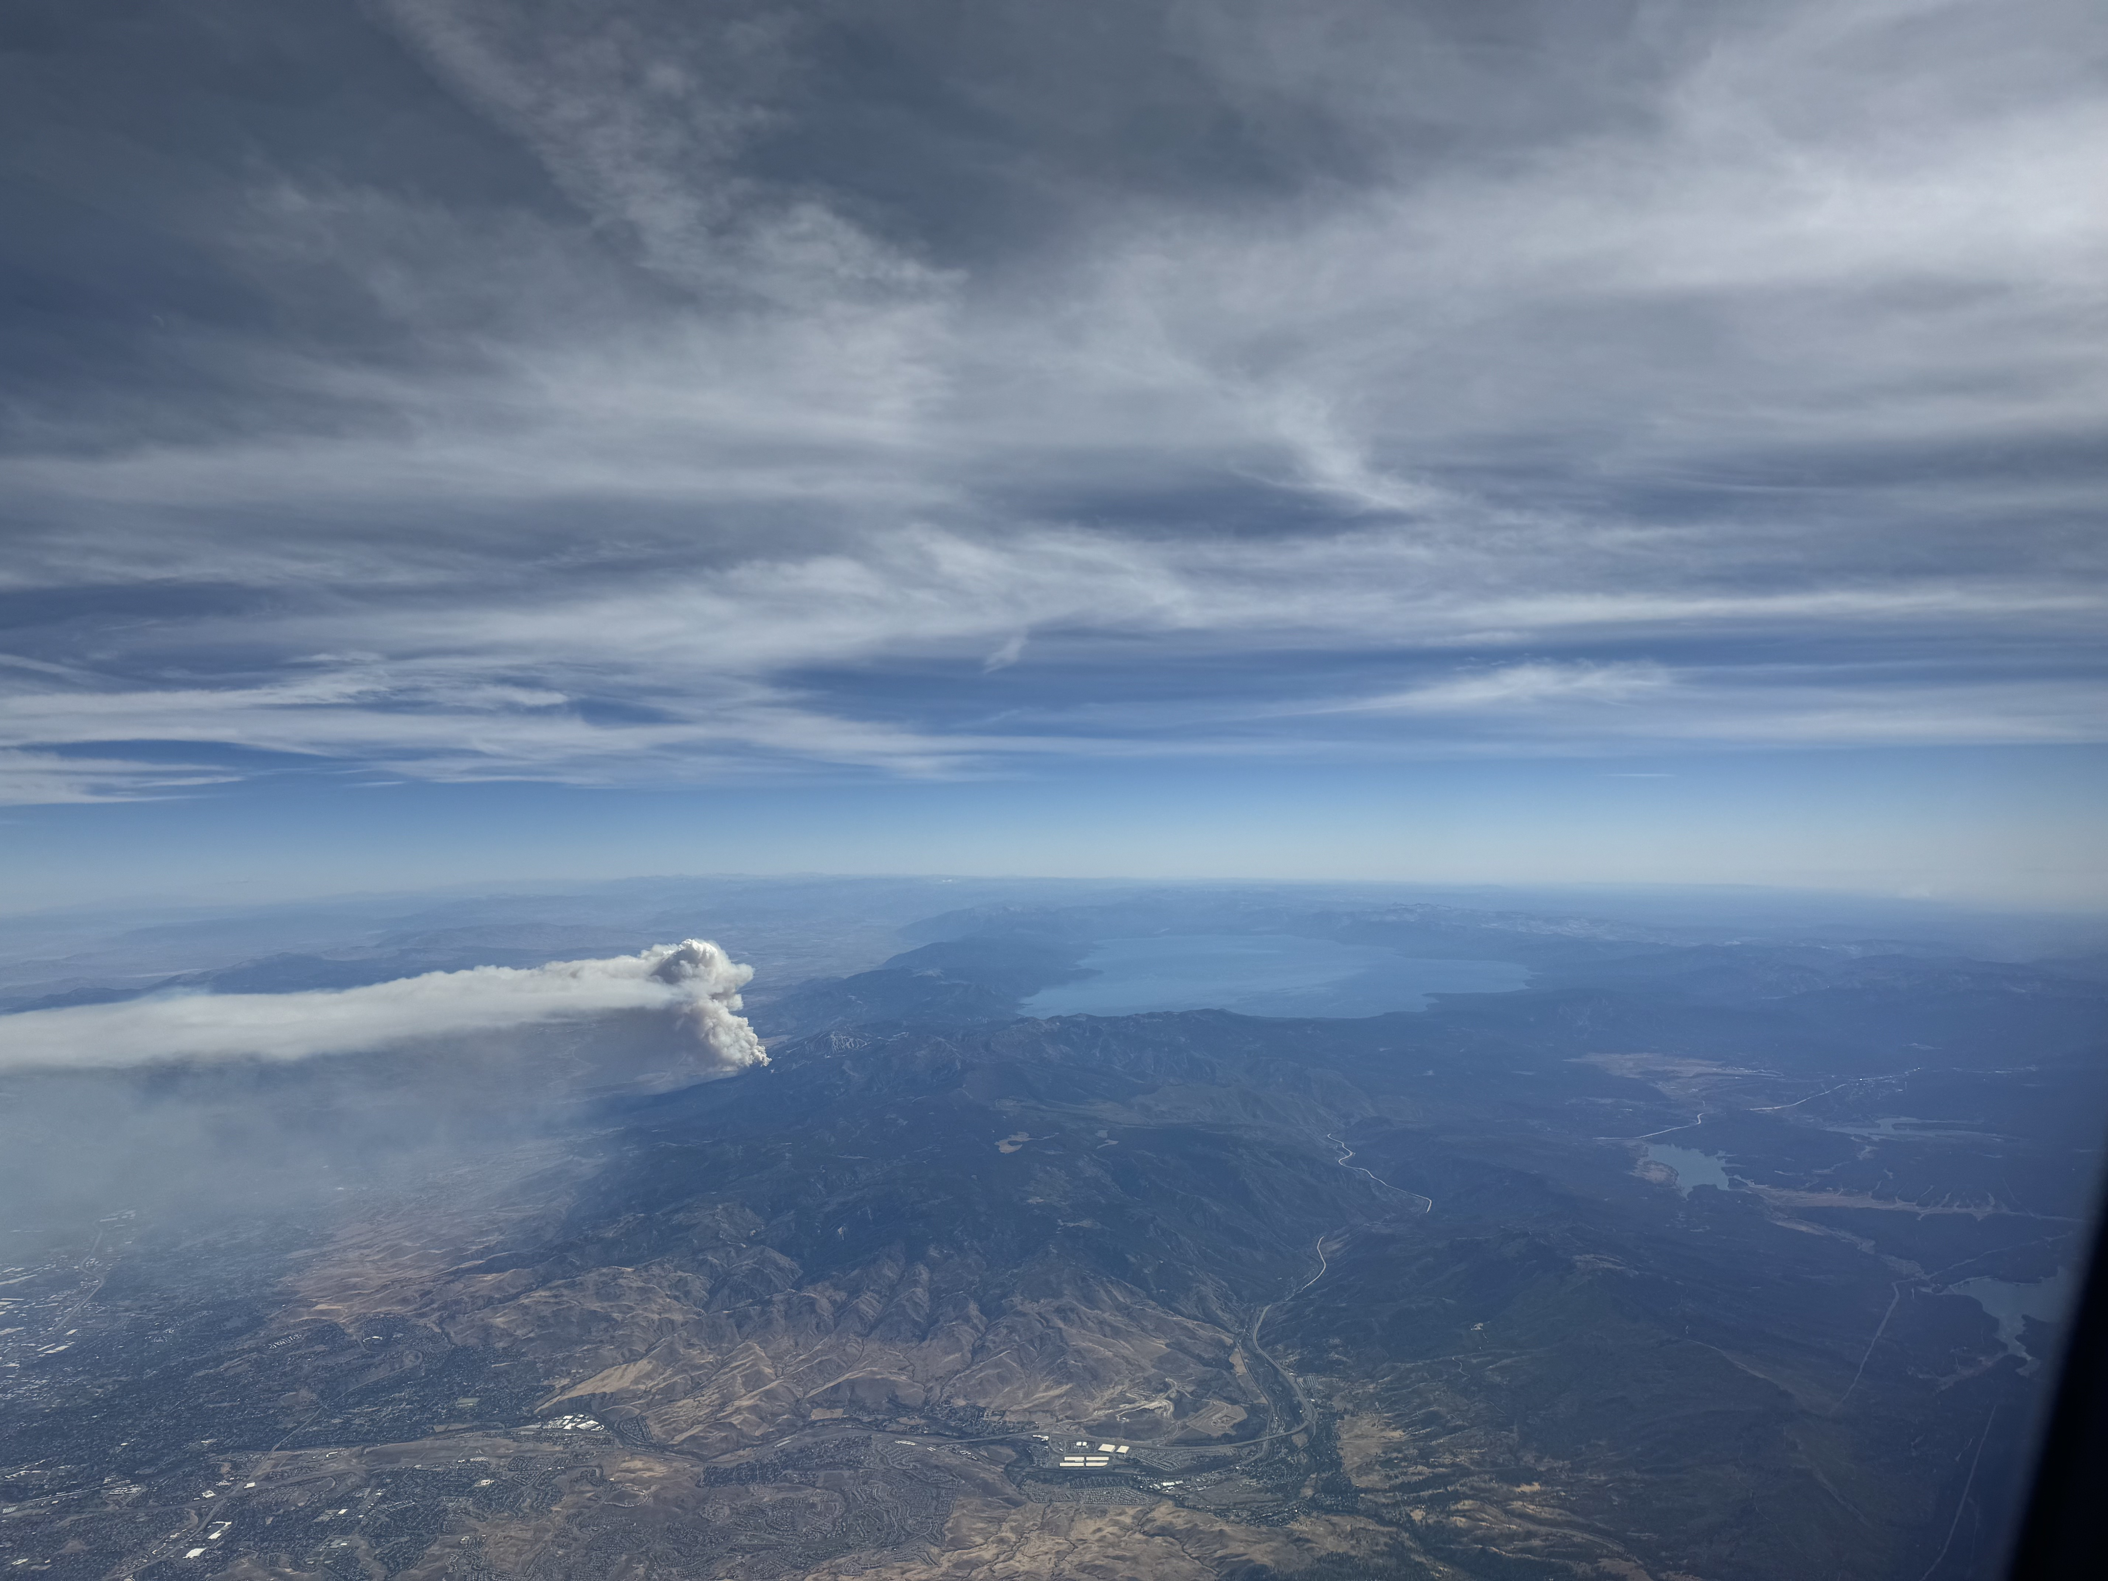

Slide 26



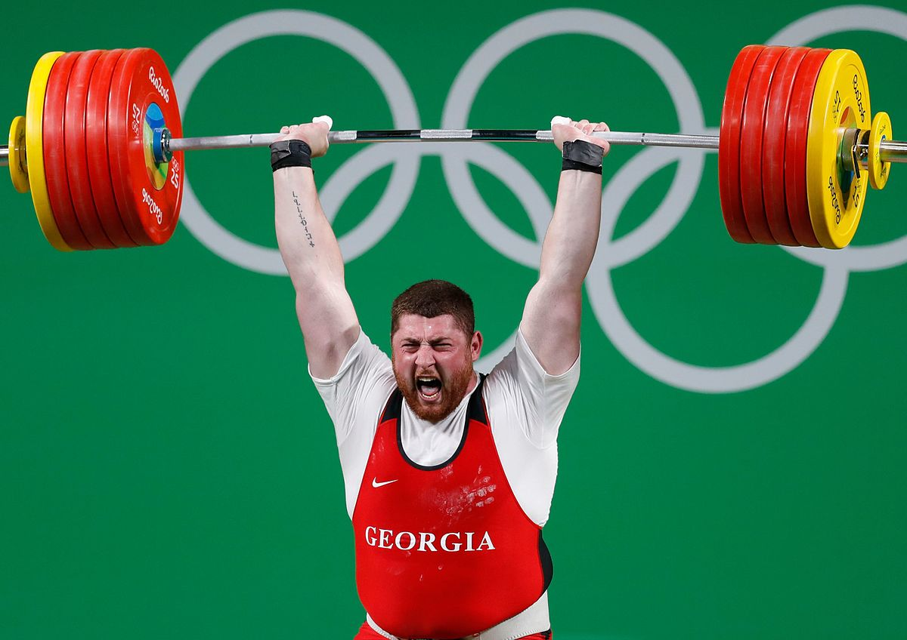
THE MAD HEDGE FUND TRADER
The Barbell Portfolio
*75% Big Tech – 2% of US workforce, 25% of market cap and 25% of US earnings
25% Domestic Recovery, including:
Railroads, airlines, cruise lines,
Couriers, steel companies
Banks, commodities
Construction
Credit Card Companies
Hotels, casinos
Online Ticket Sales

Slide 27
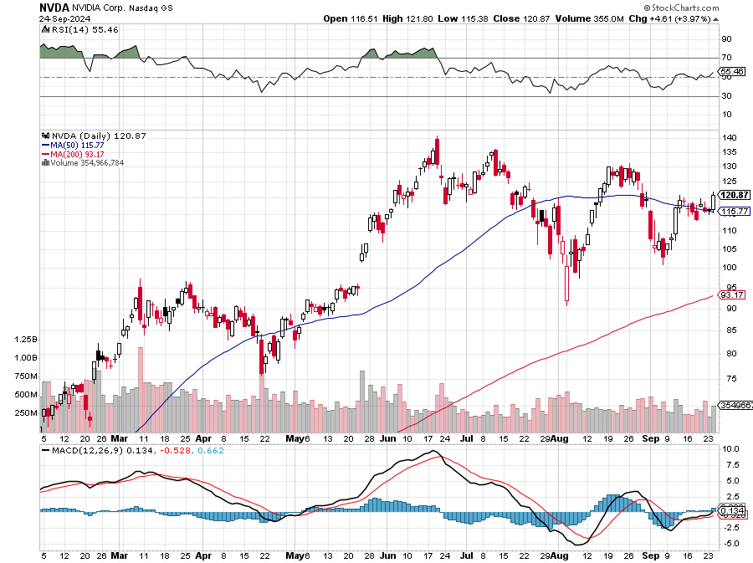
NVIDIA (NVDA) – Blowout Top is In
No Subpoena’s Here Says NVIDIA, refuting yesterday’s rumors that it was the target of an antitrust action took profits on long 8/70-$73 call spread took profits on long 8/137-$140 put spread, took profits on long 8/85-$ call spread took profits on long 5/155-$160 put spread, took profits on long 5/98-$99 put spread

Slide 28
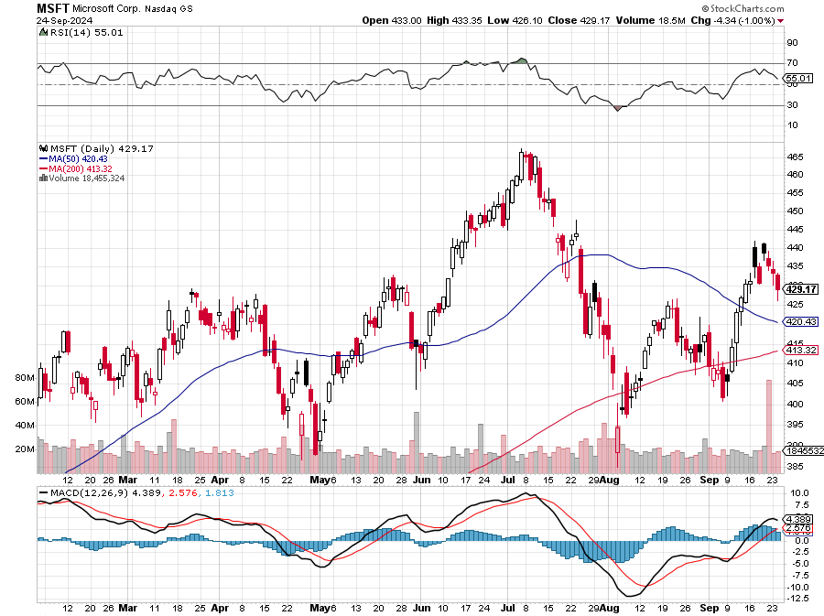
Microsoft (MSFT)-Microsoft Bombs, with an earnings and revenue beat, but with a slight shortfall in their Azure cloud business took profits on long 5/$430-$440 put spread
Took profits on long 2/$330-$340 call spread, took profits on long 12/$320-$330 call spread took profits on long 9/$235-$245 call spread, took profits on long 7/$220-$210 call spread, took profits on long 6/$220-$230 call spread, took profits on long 2/$200-$210 bear put spread

Slide 29
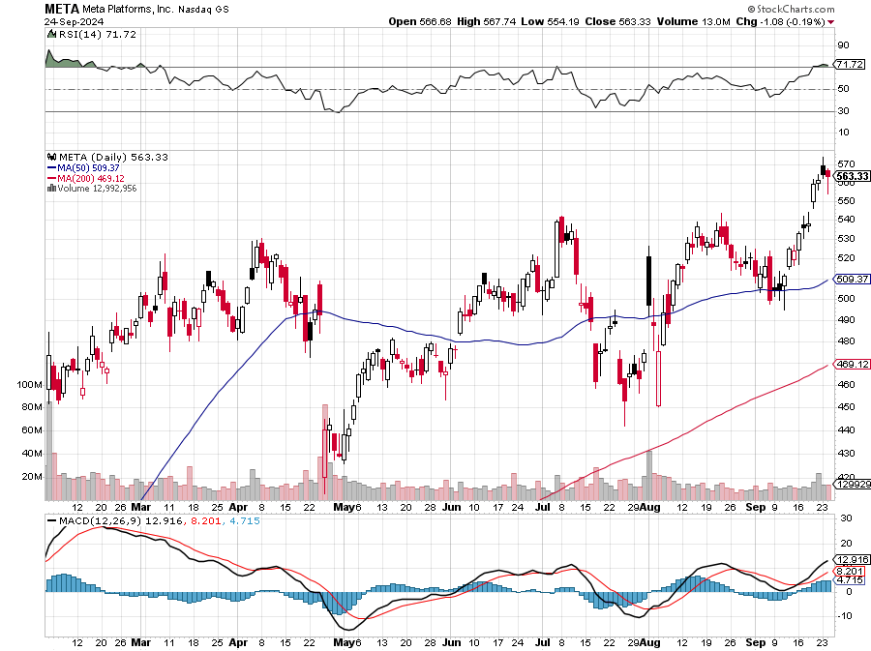
Meta (META)
Meta Beats, as advertising revenue kicks in big time took profits on Long 8/$420-$430 call spread took profits on Long 5/$360-$370 vertical bull call spread, took profits on Long 9/$290-$300 vertical bear put spread, stopped out of Long 9/$190-$200 vertical bear put spread

Slide 30
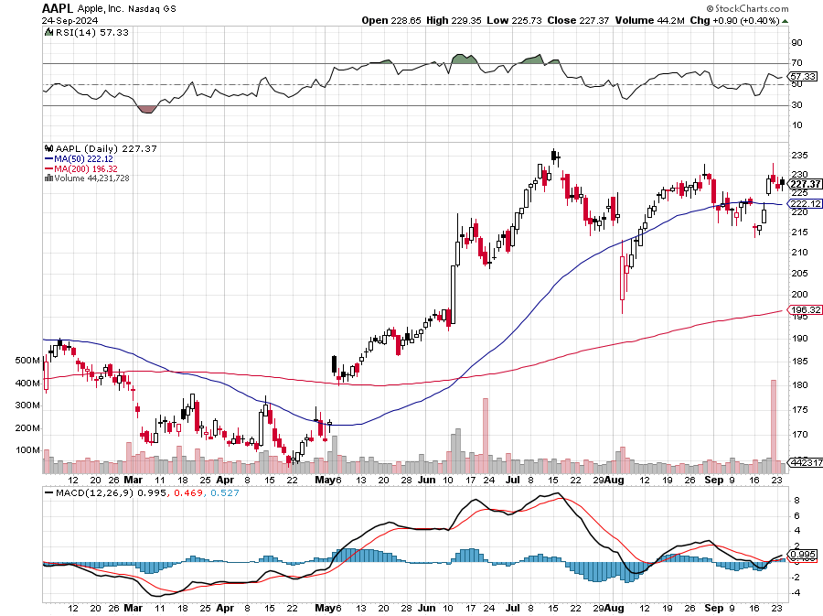
Apple (AAPL)
16 Sales Expected to Bomb took profits on Long 5/$225-$235 vertical bear put spread, took profits on Long 8/$160-$170 call spread took profits on Long 6/$200-$210 bear put spread, stopped out of Long 5/$185-$195 vertical bear put spread took profits on long 1/$145-$155 put spread, Took profits on long 10/$165-$175 put spread

Slide 31
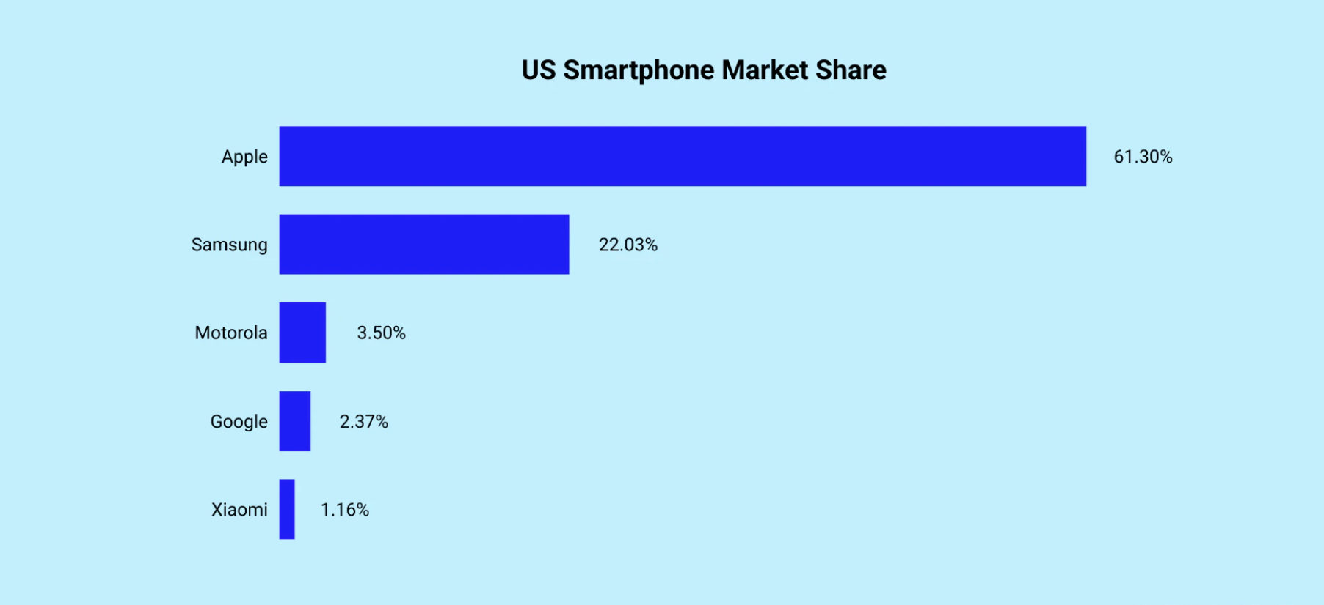

Slide 32
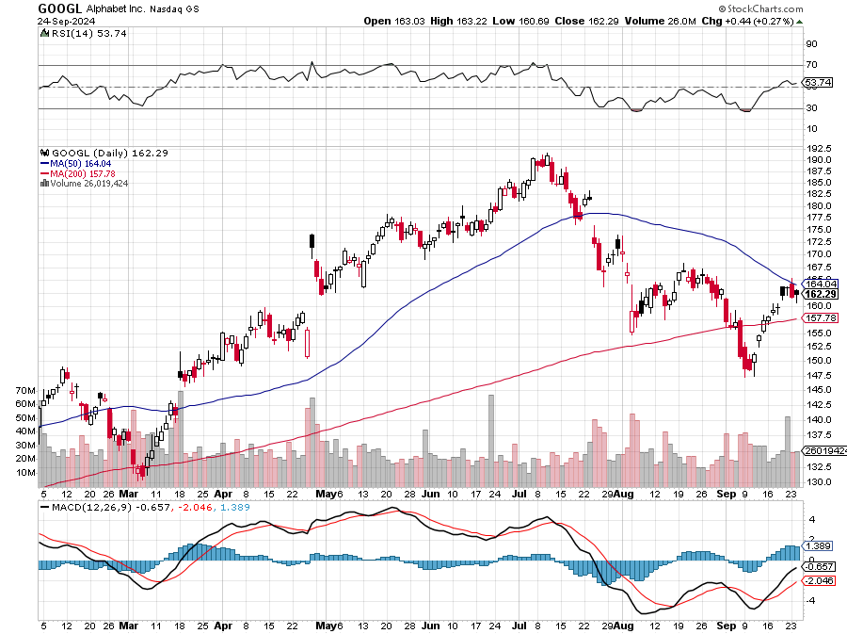
Alphabet (GOOGL) – Back in Play
Google Gets Hit with an Antitrust Suit took profits on long 12/$110-$120 call spread took profits on long 12/$1,200-$1,230 bull call spread, took profits on long 9/$1,030-$1,080 vertical bull call spread

Slide 33
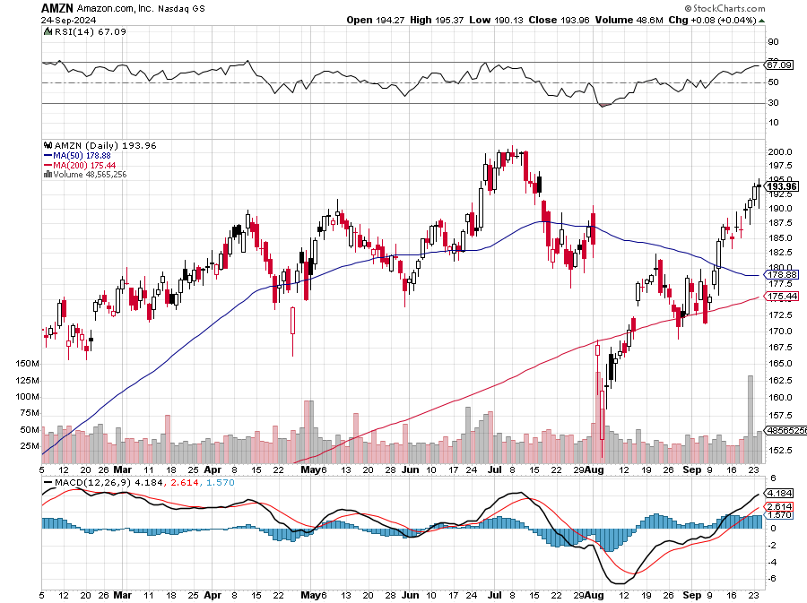
Amazon (AMZN) – Best Value AI Play
Amazon Puts AI to Work, using it to plan new delivery routes which save time and millions of gallons of gasoline
Stopped out of long 3/$150-$160 bull call spread, took profits on long 3/$155-$160 bull call spread , took profits on long 2/$130-$135 bull call spread

Slide 34
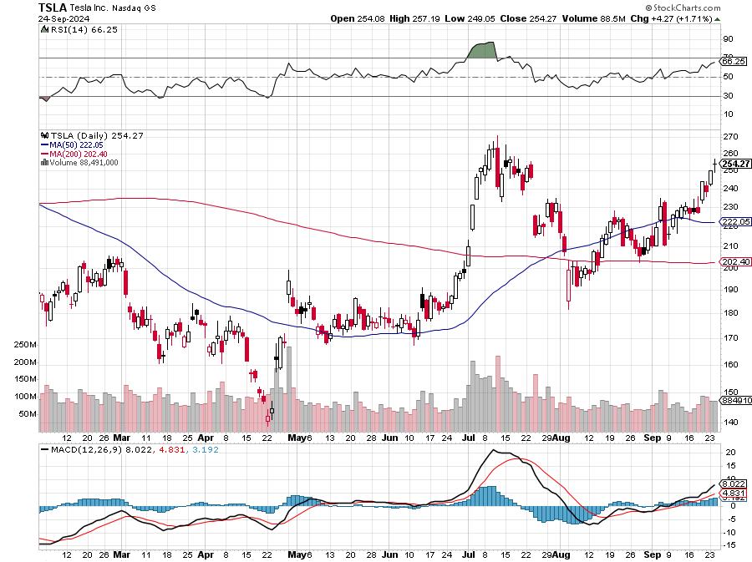
Tesla (TSLA) – Tesla sold about 304,000 cars in the first half of the year to Americans
down about 10% from a year ago.
Long 10/$180-$190 call spread, stopped out of long 9/$250-$260 put spread
Took profits on long 8/$245-$255 put spread, Took profits on long 8/$150-$160 call spread,
Took profits on long 6/$310-$320 put spread, Stopped out of long 4/$140-4150 call spread,

Slide 35
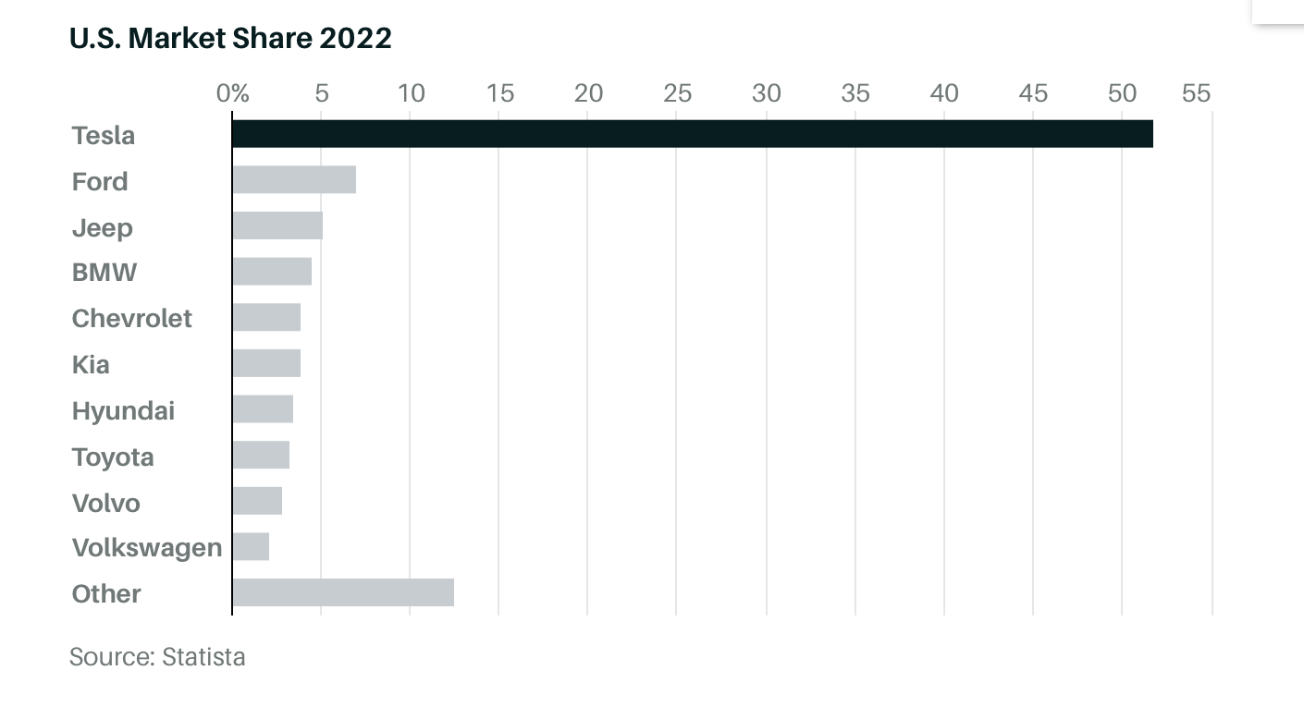

Slide 36
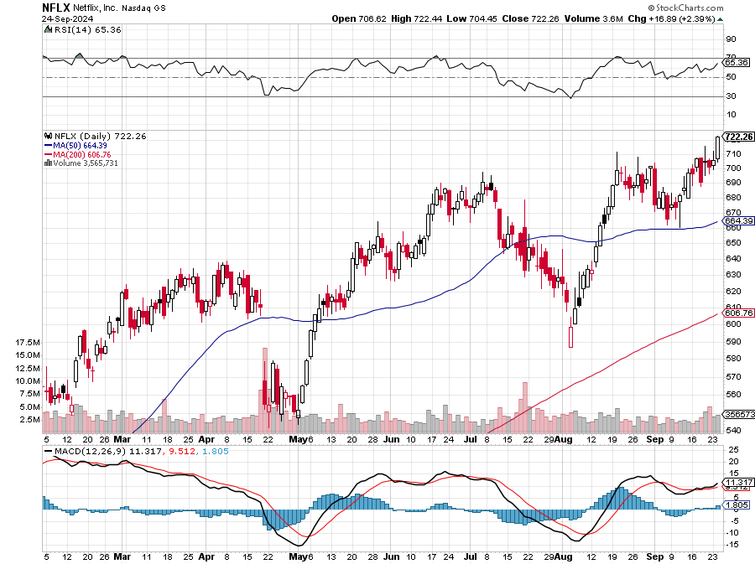
Netflix (NFLX) –
Netflix to Stream NFL Games from Christmas, creating another huge revenue stream for the dominant player in the sector

Slide 37
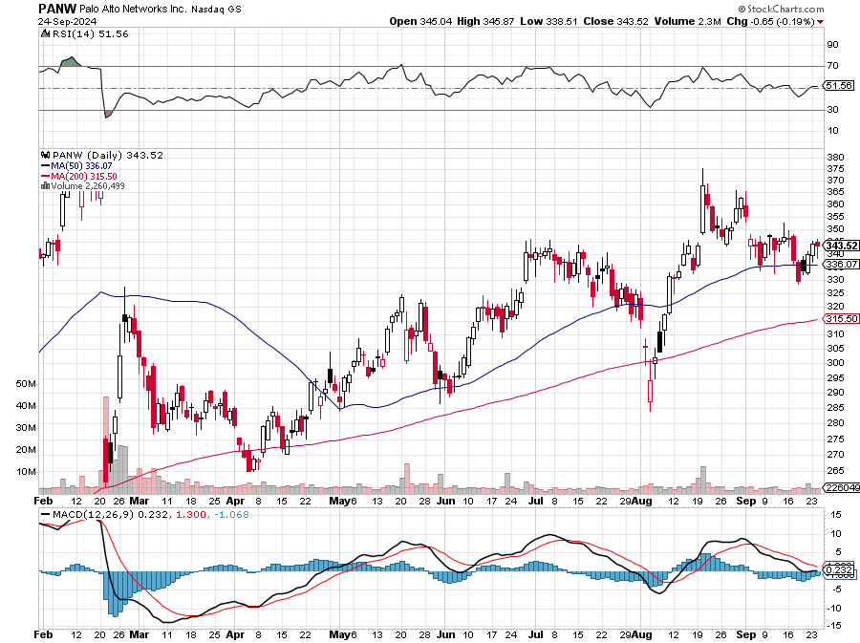
Palo Alto Networks (PANW)- Hacking never goes out of fashion
Palo Alto Networks Disappoints took profits on long 2/$260-$270 call spread, took profits on long 10/$130-$140 call spread

Slide 38
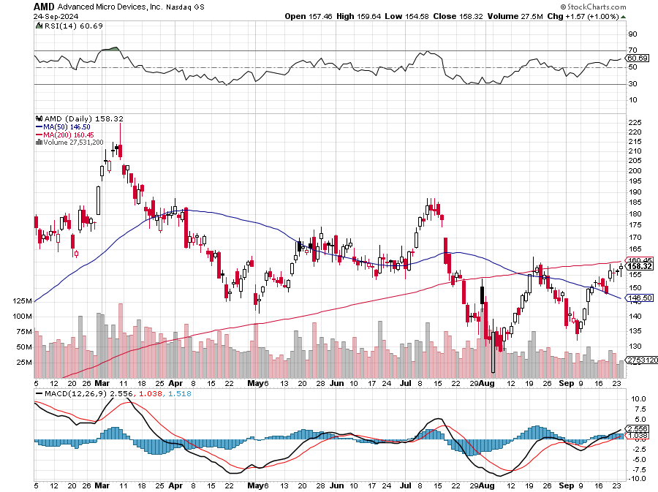
Advanced Micro Devices (AMD)- Recession fears programable logic devices took profits on long 2/$75-$80 call spread

Slide 39
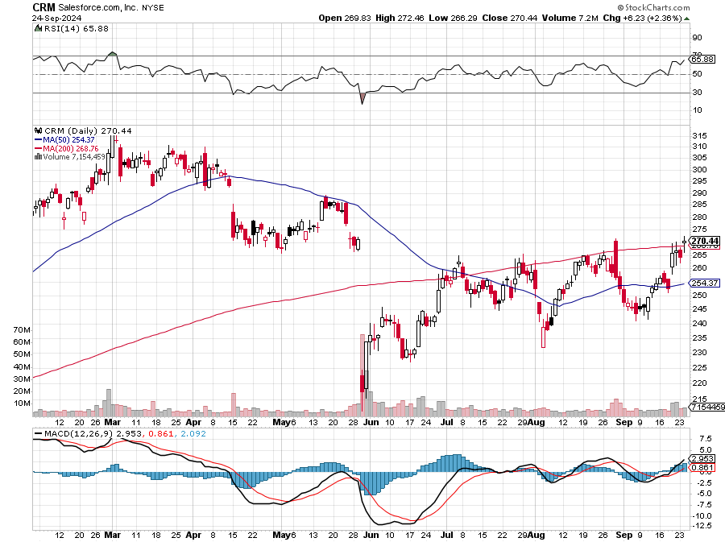
Salesforce (CRM)- Massive Online Migration
Salesforce Soars 16%, on better-than-expected guidance took profits on long 12/$185-$195 call spread took profits on long 9/$125-$130 vertical bull call spread took profits on long 8/$125-$130 vertical bull call spread

Slide 40
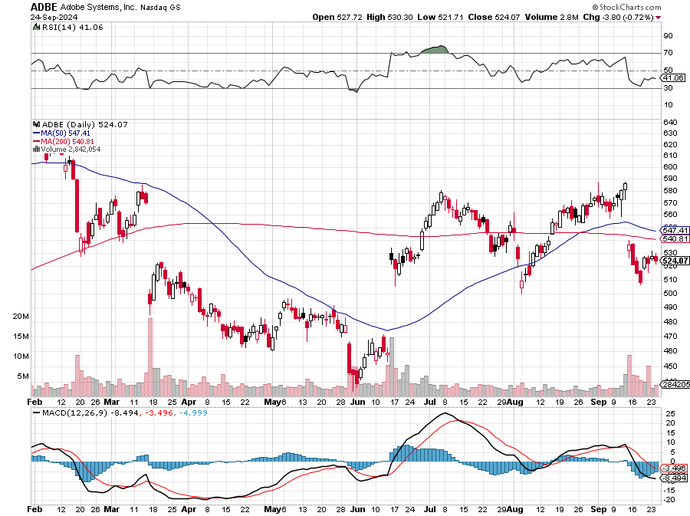
Adobe (ADBE)- Cloud play
The Quality Non-China tech play

Slide 41
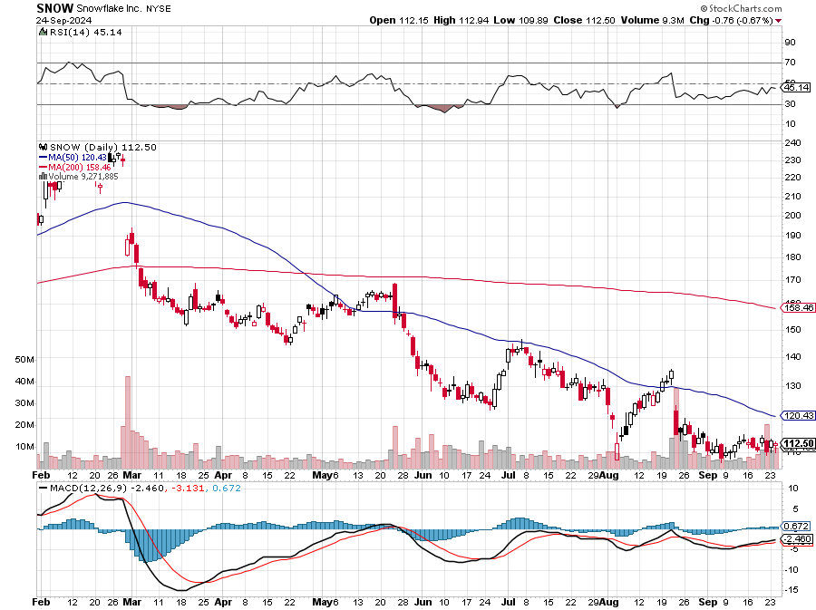
Snowflake (SNOW)- Blockbuster AI Earnings
Snowflake Crashes, down 20%, on weak guidance. CEO Frank Slootman is retiring stopped out of long 4/$150-$255 call spread, took profits on long 12/$135-$140 call spread

Slide 42
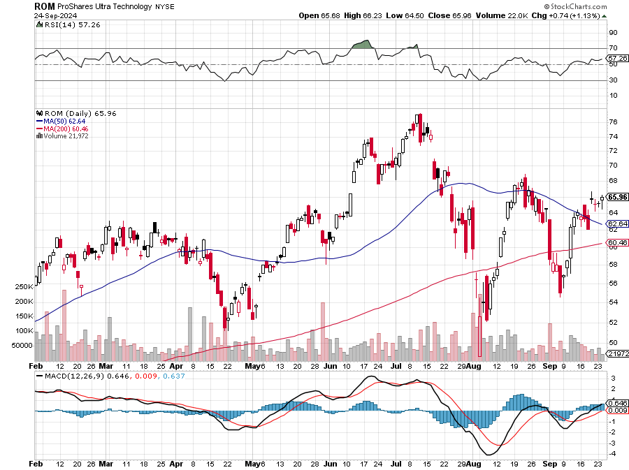
ProShares Ultra Technology ETF (ROM) – 2X Long Technology ETF took profits on long 10/$62-65 call spread

Slide 43
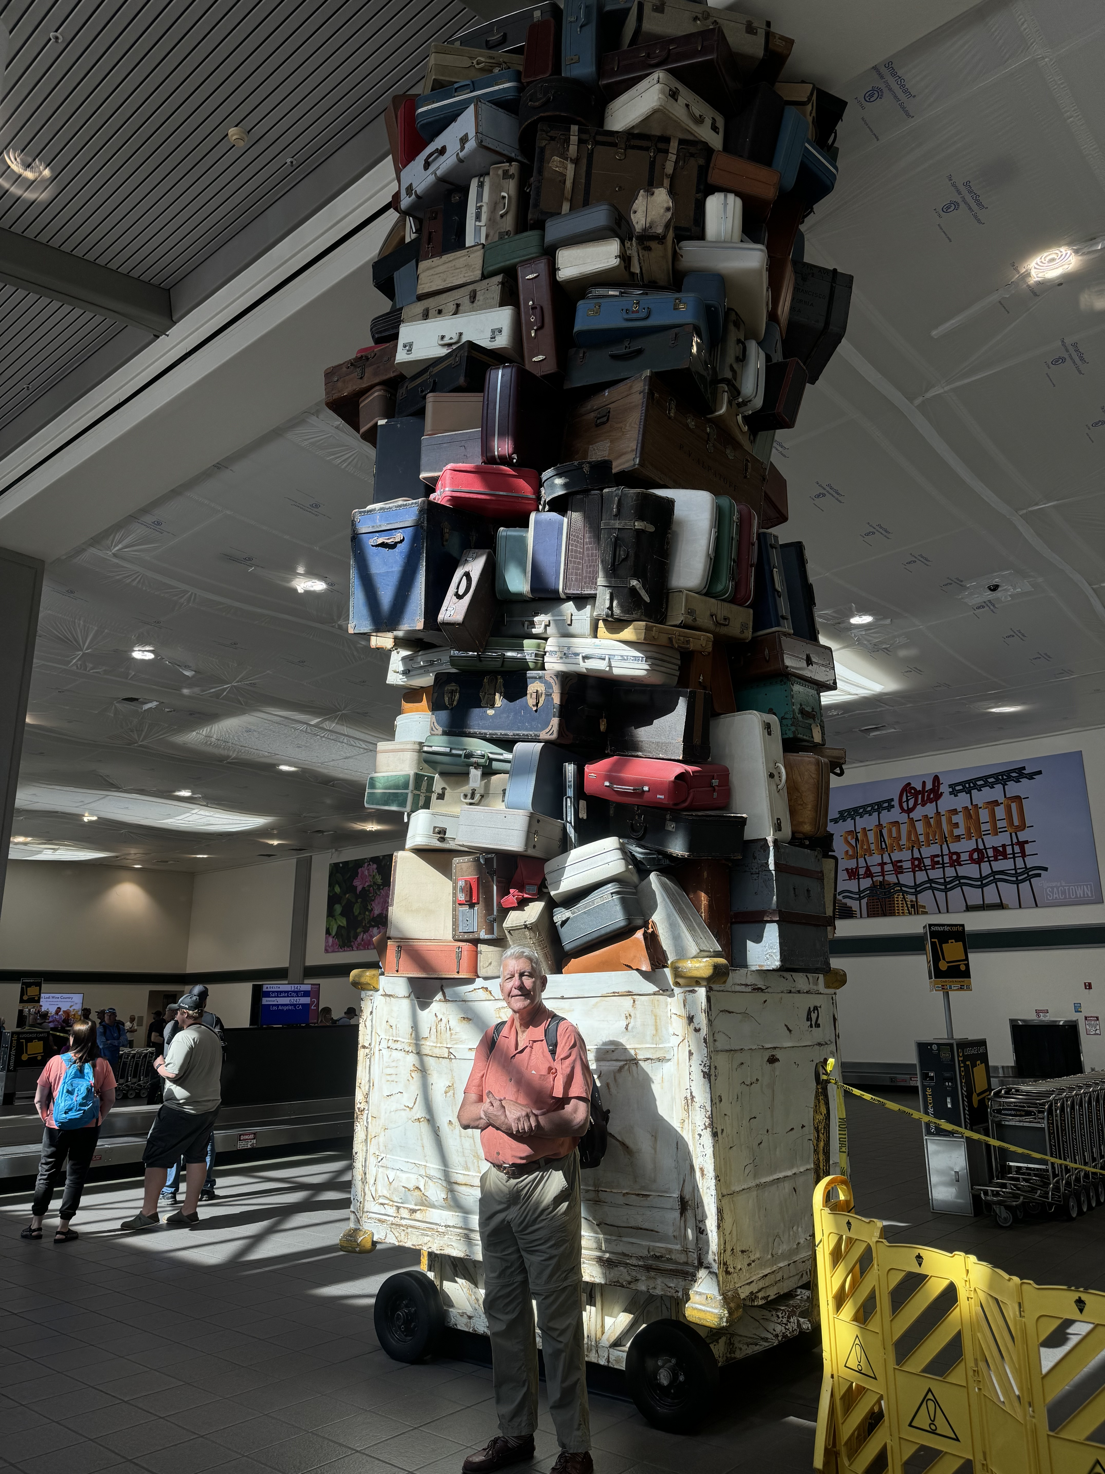

Slide 44
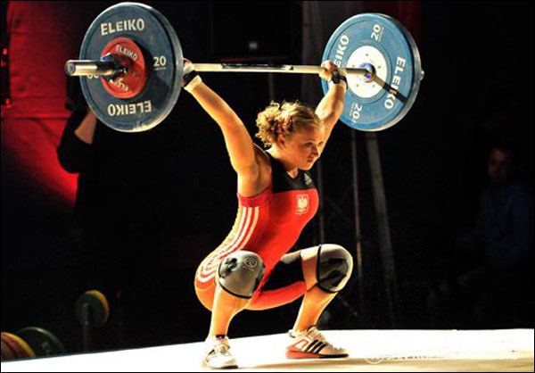
The Second Half of the Barbell
*Bets on a domestic recovery in 2022 Q4
*Upside potential in 2024 far greater than tech
*Some of these have not moved for 5 or 10 years
*Focuses on economically sensitive cyclical industries
*Makes a great counterweight to
high-growth technology
*We could spend all of next ten years rotating
between the two groups

Slide 45
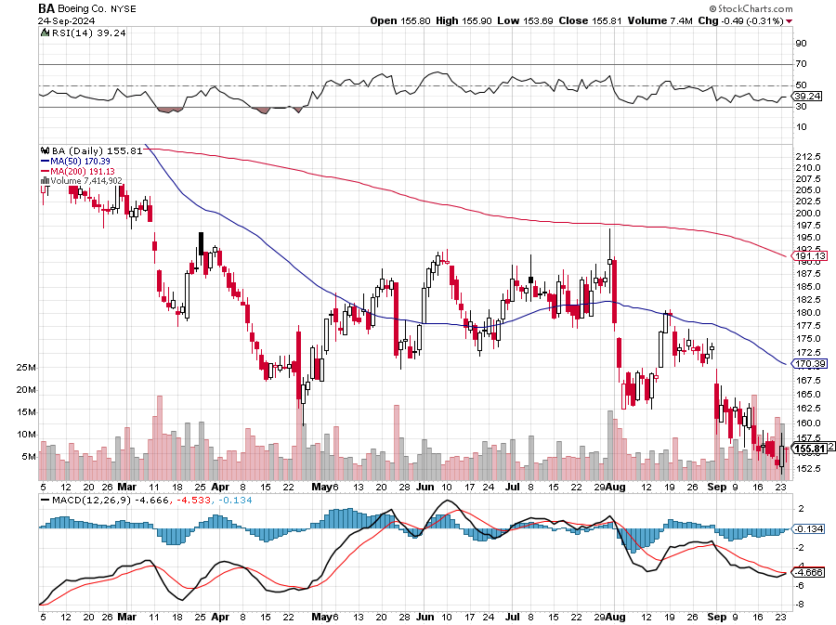
Boeing (BA) –
Boeing Battles Fake Part Supplies, originating in China, in a desperate effort to lift flagging quality
“il pesce marcisce dalla testa” stopped out of long 2/$190-$200 call spread, took profits on long 5/$17-$175 call spread

Slide 46
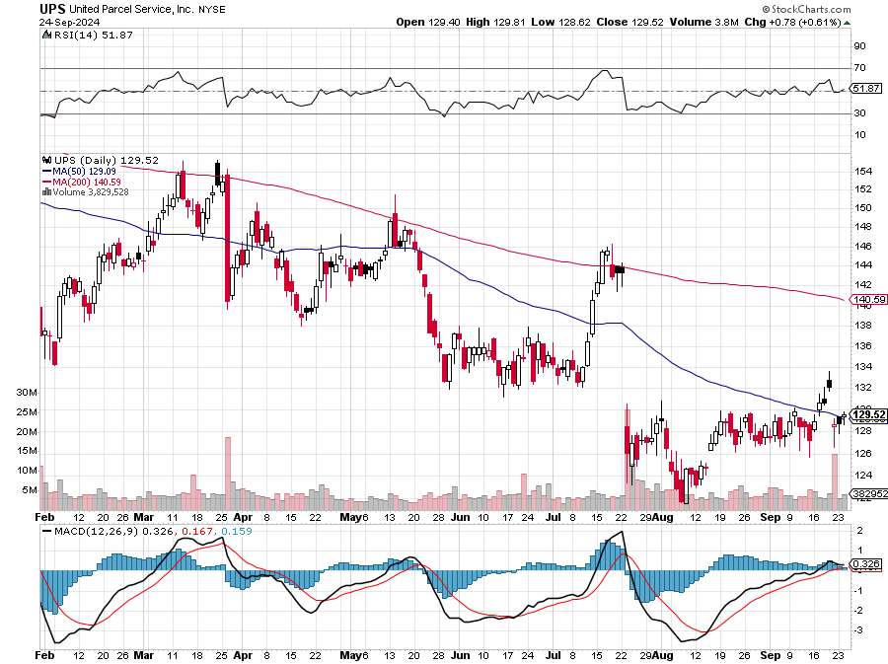
Package Delivery- United Parcel Service (UPS) – strike averted took profits on long 11/$130-$140 call spread

Slide 47
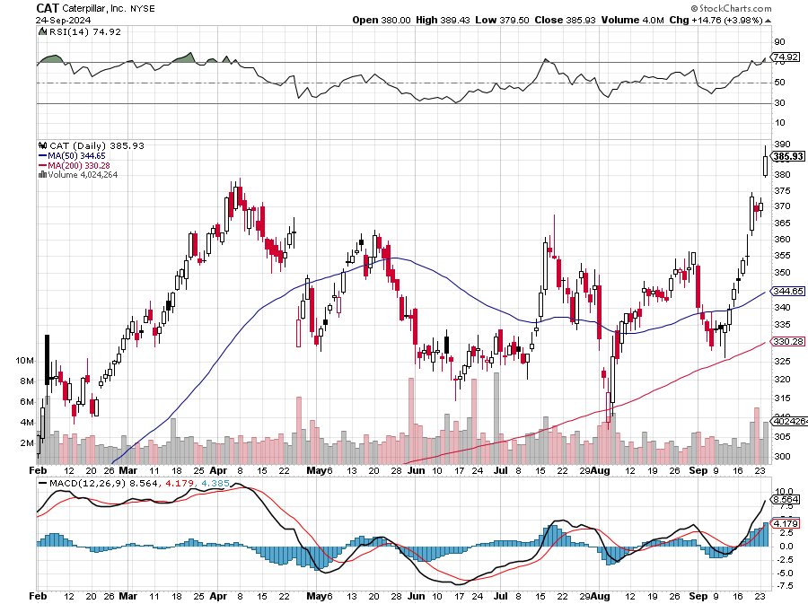
Caterpillar (CAT)- Ag + Infrastructure + Housing stopped out of long 8/$310-$320 call spread, took profits on long 12/$220-$230 calls spread took profits on long 12/$145-$150 call spread, took profits on long 11/$125-$135 call spread

Slide 48
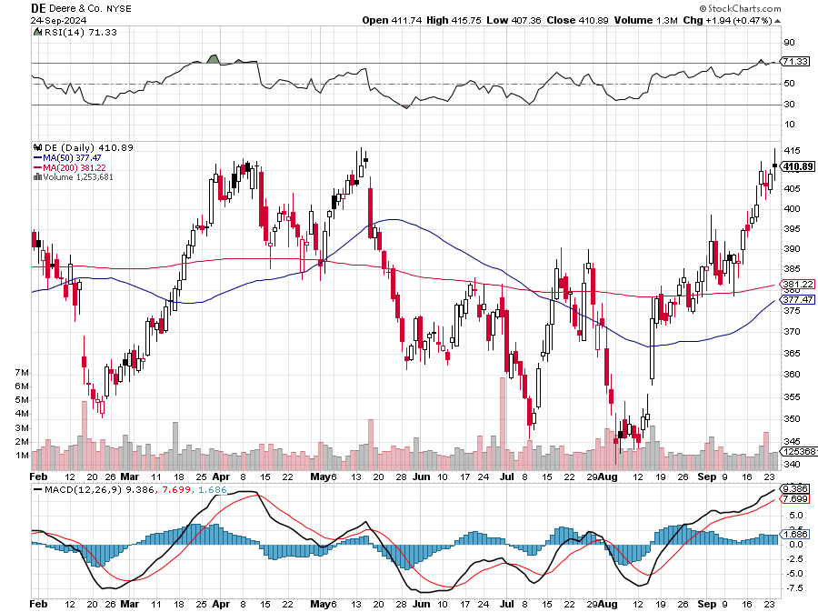
Deere & Co. (DE)- Ag + Infrastructure + Housing took profits on long 8/$330-$340 put spread stopped out of long 8/$330-$340 calls spread

Slide 49
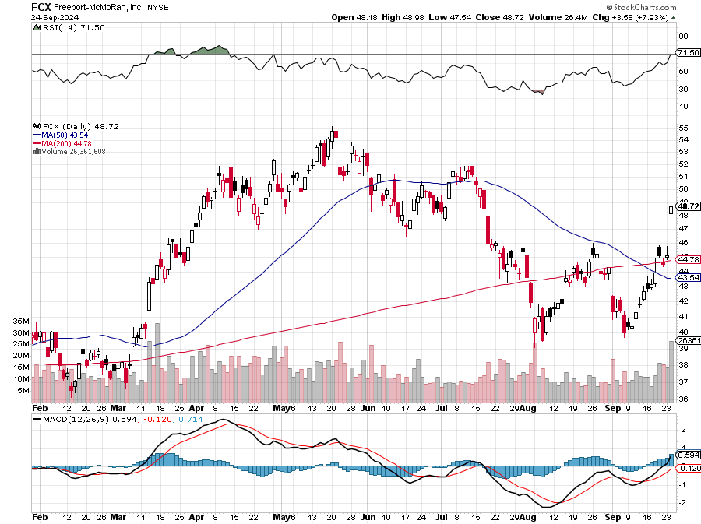
Freeport McMoRan - (FCX)- Coming Copper Crisis
Freeport McMoRan Beats, helped by higher production and easing costs took profits on long 4/$37-$40 call spread, took profits on long 5/$42-$45 call spread, stopped out of long $48-$51 put spread, profits on long 6/$32-$35 call spread took profits on long 4/$30-$33 call spread, took profits on long 10/$20-$23 call spread

Slide 50
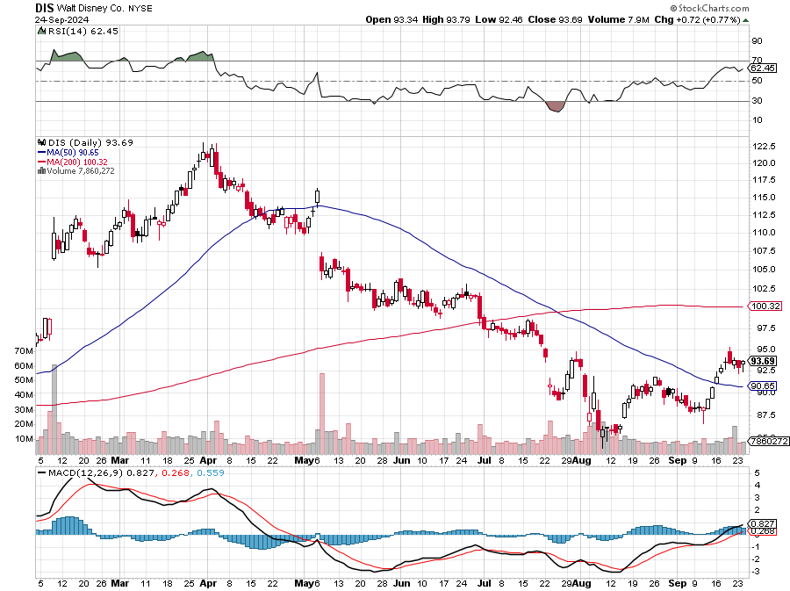
Walt Disney (DIS) -Disney Beats
Disney Dives on Earnings Bust, although streaming broke even versus an expected loss

Slide 51
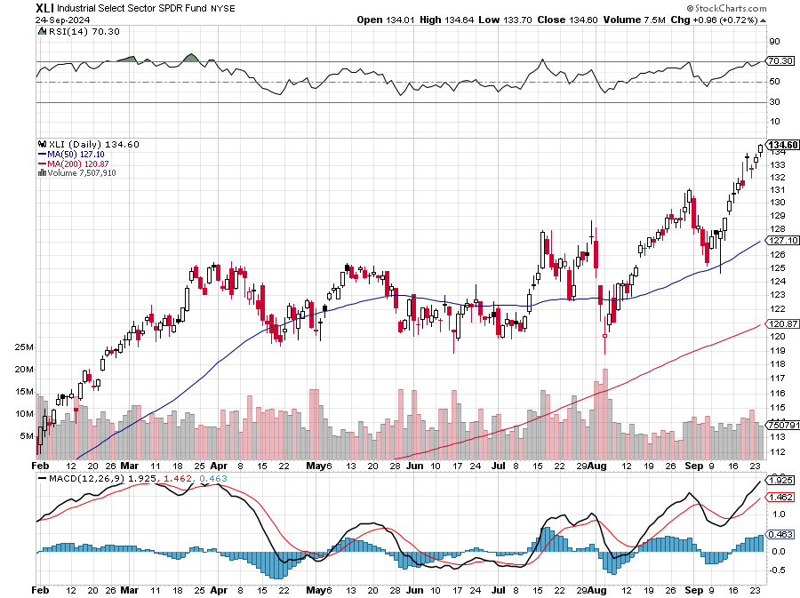
Industrials Sector SPDR (XLI)-
(GE), (MMM), (UNP), (UTX), (BA), (HON)

Slide 52
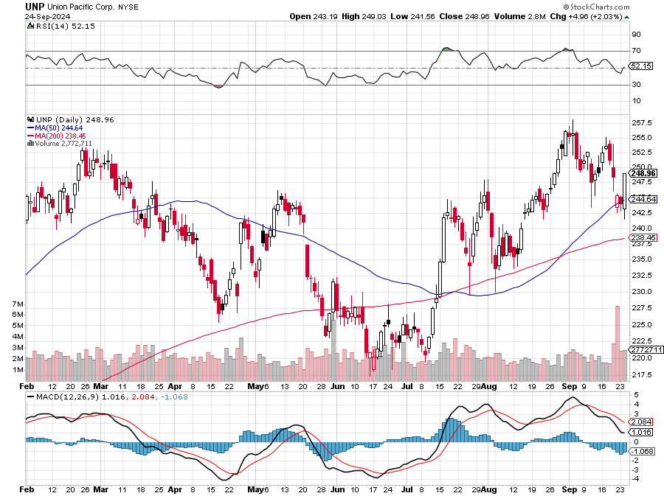
Union Pacific RR (UNP)- Big Stuff to Ship took profits on long 5/$200-$210 call spread took profits on 11/$150-$160 call spread

Slide 53
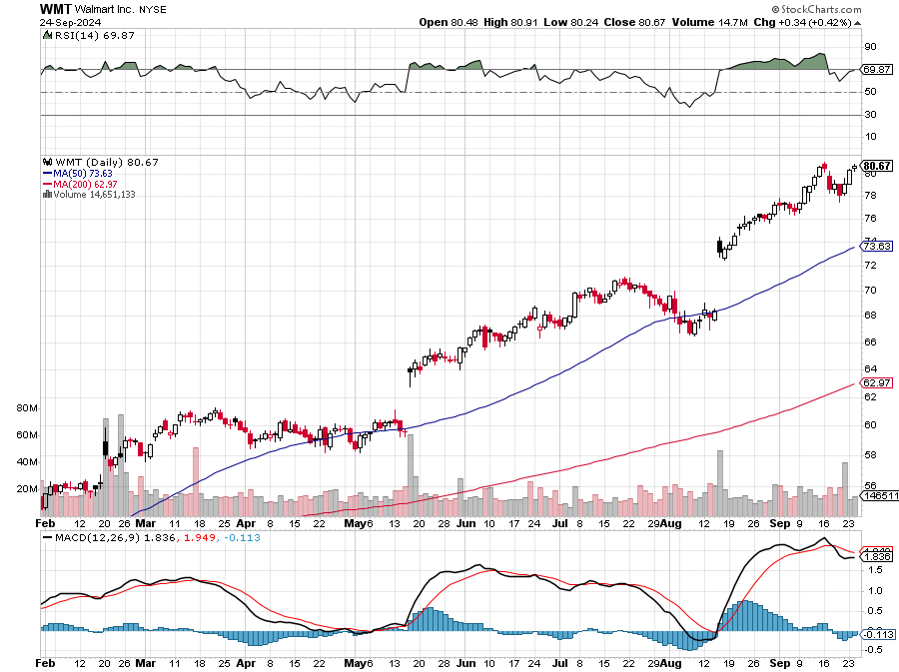
Wal-Mart (WMT)- took profit on Long 11/$125-$130 bear put spread took profit on Long 10/$119-$121 bear put spread took profits on Long 8/$114-$117 bear put spread

Slide 54
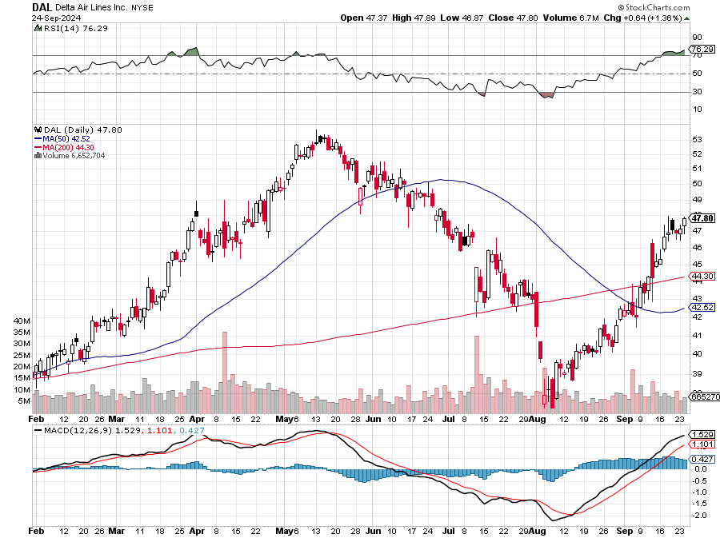
Delta Airlines (DAL) – Travel is Back!
The Non-Boeing Airline – uses Airbuses stopped out of long 2/$35-$38 call spread

Slide 55
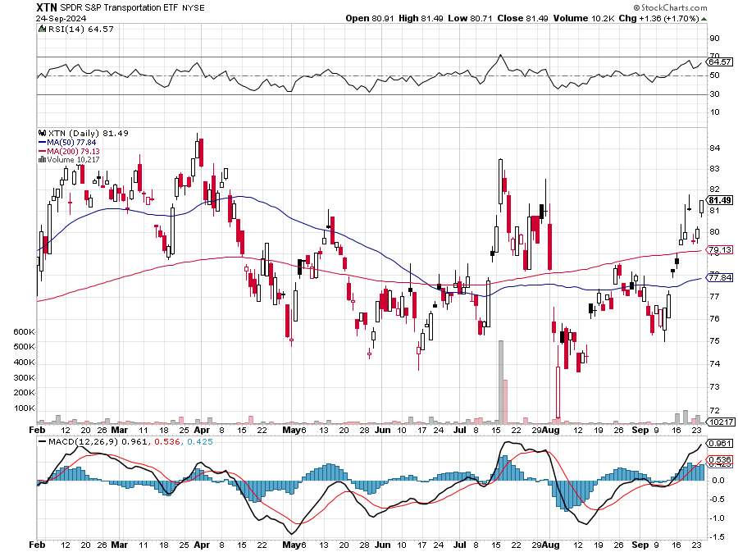
Transports Sector SPDR (XTN)- Worst Hit Sector
(ALGT), (ALK), (JBLU), (LUV), (CHRW), (DAL)

Slide 56

Health Care Sector (XLV)
(JNJ), (PFE), (MRK), (GILD), (ACT), (AMGN)

Slide 57

Amgen (AMGN) took profits on long 11/$185-$200 bull call spread

Slide 58

Goldman Sachs (GS) –
Goldman Sachs Beats, with Revenues of $12.73 billion vs. $12.46 billion estimate took profits 12/$330-$350 call spread took profits 11/$330-$350 call spread stop loss on long 11/$385-$395 call spreads

Slide 59

Morgan Stanley (MS)
Morgan Stanley Beats, with Revenues in at $15.02 billion vs. $14.3 billion estimate took profits on long 4/$65-$70 call spread

Slide 60

JP Morgan Chase (JPM) –
JP Morgan Misses on Earnings, tanking the shares by $10 took profits on 4/$215-225 put spread, took profits on 4/$190-$195 call spread , took profits on long 4/$105-$115 call spread

Slide 61

Bank of America (BAC) – Buffet Hammers (BAC) for a 9th Straight Days, taking profits from a much lower level. took profits on long 4/$20-$23 call spread

Slide 62

Citigroup (C) – took profits on long 4/$30-$35 call spread

Slide 63

Charles Schwab (SCHW) – LEAPS expire at Max profit took profits on long 4/$30-$35 call spread

Slide 64

Interactive Brokers (IBKR) – LEAPS expired at Max Profit stopped out of long 8/$110-$115 call spread , took profits on long 4/$60-$65 call spread

Slide 65

SPDR Metals & Mining ETF (XME) – long 2/$28-$30 call spread

Slide 66

Blackrock (BLK)-Asset Collection Boom took profits on long 3/$770-$790 call spread took profits on long 3/$310-$340 call spread

Slide 67

Visa (V) – Inflation boost
Antitrust woes with 47% marker share took profits on long 2/$240-$250 bull call spread took profits on long 10/$160-$170 bull call spread, took profits on long 6/$150-$160 bull call spread

Slide 68

Consumer Discretionary SPDR (XLY)
(DIS), (AMZN), (HD), (CMCSA), (MCD), (SBUX)

Slide 69

Berkshire Hathaway (BRKB)- Natural Barbell
Berkshire Hathaway Cash Approaches $300 Billion stopped out of long 12/$405-$415 call spread, took profits on long 12/$320-$330 call spread took profits on long 4/$260-$270 call spread, took profits on long 1/$290-$300 call spread

Slide 70


Slide 71

Bonds – Exhaustion
*Another Government Shutdown is in the Works in 5 days, with the house unable to pass a spending bill with only a four-seat majority
*Interest Payments on National Debt Top $1 Trillion per year
*The jump in debt service costs came as the U.S. budget deficit surged in August, edging closer to $2 trillion for the full year
*I bet the Treasury really wants to see the Fed cut interest rates more
*The Yield Curve has De-Inverted, meaning that short term interest
rates have fallen below long-term ones
*Yield Chasers Post Record Demand for Junk Bonds
*Buy (TLT), (JNK), (NLY), (SLRN) and REITS on dips

Slide 72

Treasury ETF (TLT) – long 10/$103-$106 put spread took profits on long 6/$$94-$97 put spread, took profits on long 5/$82-$85 calls spread took profits on long 4/$87-$90 call spread took profits on long 2/$90-$93 call spread,

Slide 73

Ten Year Treasury Yield ($TNX) – 3.75%

Slide 74

Junk Bonds (JNK) 7.47% Yield

Slide 75

Municipal Bonds (MUB) 3.38% Yield-

Slide 76

Emerging Market Debt (ELD) 6.56% Yield-

Slide 77

2X Short Treasuries (TBT)-Out of Favor

Slide 78

Anally Capital Management (NLY) – Leveraged REIT Play
Yield 14.10% took profits on long 12/$15-$16 call spread

Slide 79

Acelryn (SLRN) – Double B Bond Fund
Yield 8.8% took profits on long 12/$15-$16 call spread

Slide 80


Slide 81

Foreign Currencies – Dollar Puke Out
*Dollar Hits Seven Month Low, as US interest rate cuts loom. It could be a decade long move.
*The Yen Carry Trade is Back, with hedge funds piling back into positions they baled on only two weeks ago
*It’s just a matter of math, now that the Bank of Japan has given up on raising interest rates anytime soon
*What this means is more leverage, risk, and volatility
for global financial markets. I love it!
*The prospect of falling interest rates means that
the greenback is toast
*Buy (FXA), (FXE), (FXB), (FXC).

Slide 82

THE MAD HEDGE FUND TRADER
Australian Dollar (FXA) - Major Long-Term Bottom is In Targeting Parity – A call option on a global synchronized recovery
1:1
BUY

Slide 83

Japanese Yen (FXY)

Slide 84

Euro (FXE)-
2023
Target
25%

Slide 85

British Pound (FXB)-
2023
Target
15%

Slide 86


Emerging Market Currencies (CEW)
2023
Target
40%

Slide 87


Slide 88

Energy & Commodities – A Big Move Towards Nuclear Renaissance
*My Cameco (CCJ) trade alert came through in a week, immediately tacking on 20%.
*While advanced nuclear power plant design and fuels (low enriched uranium oxide with an M5TM zirconium-based cladding) have been around for years
*Microsoft (MSFT) announced the reopening of Three Mile Island, the site of the worst nuclear accident in US history in 1979.
*Microsoft will purchase the carbon-free energy produced from it to
power its data centers to support artificial intelligence.
*12 U.S. nuclear power reactors have permanently closed since 2012.
Another seven U.S. reactor retirements have been announced through
2025, with total generating capacity of 7,109 MW (equal to roughly 7%
of U.S. nuclear capacity).

Slide 89

Cameco (CCJ) – Global Uranium Renaissance
Microsoft to Reopen Three Mile Island to power AI data centers long 10/$33-$36 call spread took profits on long 12/$35-$38 call spread, took profits on long 5/$20-$23 bull call spread

Slide 90

Oil-($WTIC)

Slide 91

United States Oil Fund (USO)

Slide 92

Energy Select Sector SPDR (XLE)-No Performance!
(XOM), (CVX), (SLB), (KMI), (EOG), (COP)

Slide 93

ExxonMobile (XOM)-
Exxon Moves Big into Lithium, with the construction of a major mining operation in Arkansas took profits on Long 4/$100-$105 call spread, took profits on long 12/$120-$125 put spread

Slide 94

Occidental Petroleum (OXY)- Buffet’s a Buyer took profits on long 4/$59-$62 call spread took profits on long 2/$55-$60 call spread, took profits on long 12/$77.50-$82.50 put spread

Slide 95

Natural Gas (UNG) – Free Fall on Warm Winter took profits on Long January 2025 $7-8 Call Spread LEAPS

Slide 96


Slide 97

Precious Metals – New Highs
*Gold Hits New High, at $2,650 an ounce, as hedge funds pour in
*Seasonals for the barbarous relic are now the most positive of the year
*Look for $3,000 an ounce by next year
*Notice how (GLD) gaps higher every morning, signifying that the bulk of
buying is coming from Asia. Buy (GLD) on dips.
*The next Problem? What to do when gold hits $3,000
*Most likely, it keeps going up, as the Chinese have no where
else to save
Buy (GLD), (SLV), (AGQ), and (WPM) on dips

Slide 98

Gold (GLD) – China and Millennial call
Long 10/$220-$225 call spread, took profits on Long 8/$210-215 call spread, took profits on Long 7/$200-205 call spread, Long 6/$207.5-$212.5 call spread took profits on Long 4/$194-$197 call spread, took profits on long 5/$165-$170 bull call spread

Slide 99

Market Vectors Gold Miners ETF- (GDX) – took profit on long 6/$207.50-$212.50 call spread, took profit on long 7/$200-$205 call spread

Slide 100

Barrick Gold (GOLD) took profit on long 1/$15.50-$16.50 call spread

Slide 101

Newmont Mining- (NEM)- long 10/$47-$50 call spread, took profits on long $55-60 call spread

Slide 102

Silver- (SLV)- stopped out of long 6/$23-$25 call spread, took profits on long 11/$19-$20 call spread

Slide 103

2X ProShares Ultra Silver- (AGQ)-

Slide 104

Silver Miners - (SIL)-

Slide 105

Wheaton Precious Metals - (WPM)- LEAPS Approaching Max Profit took profits on long 4/$39-$42 call spread , took profits on long 1/$36-$39 call spread

Slide 106

Platinum- (PPLT)- 556,000-ounce shortage this year took profits on long 1/$36-$39 call spread

Slide 107

Real Estate – Rate Shock
*Existing Home Sales Drop 4.2%, in August to a seasonally adjusted annualized rate of 3.86 million unit
*There were 1.35 million units for sale at the end of August
*That’s up 0.7% from July and up 22.7% year over year
*Median price of an existing home sold in August was $416,700, up 3.1% from August 2023, a new all-time high
*Real estate should pick up once lower interest rates feed through
*US Homebuilder Sentiment Rises, in the wake of the massive
drop in mortgage rates in recent months
*The NAHB/Wells Fargo Housing Market Index of builder confidence
rose to 41 this month from 39 in August
* Buy (DHI), (LEN), (PHM), and (KBH) on dips.

Slide 108

S&P Case Shiller Turns Hot
S&P Case Shiller Rises to +6.3% YOY in May, with its National Home Price Index
San Diego gained +11.4%, Chicago +8.9%, and Detroit +8.9%.

Slide 109

Crown Castle International (CCI) – 6.62% yielding 5G cell phone tower REIT
Eliot Management Pushes up stock with activist bid
Long 8/$90-$95 call spread,

Slide 110

US Home Construction Index (ITB)
(DHI), (LEN), (PHM), (TOL), (NVR)

Slide 111

DH Horton (DHI)
Blowout Earnings Report long 10/$165-$175

Slide 112



Slide 113

Trade Sheet-
So What Do We Do About All This?
*Stocks – buy the next big dip
*Bonds – buy dips
*Commodities-stand aside
*Currencies- sell dollar rallies, buy currencies
*Precious Metals – buy dips
*Energy – avoid
*Volatility – sell over $30
*Real estate – buy dips

Slide 114


Slide 115

Next Strategy Webinar
12:00 EST Wednesday, October 9 from Lake Tahoe, Nevada email me questions at support@madhedgefundtrader.com
Good Luck and Good Trading!
Notes:
*

Slide 116


