Slide 1
Please Stand By for John Thomas Wednesday, November 9, 2011 Trade Alert Service
The Webinar will begin at 12:00 pm EST

Slide 2
The Mad Hedge Fund Trader Watch Out for the Upside Surprise
Diary of a Mad Hedge Fund Trader November 9, 2011 www.madhedgefundtrader.com

Slide 3
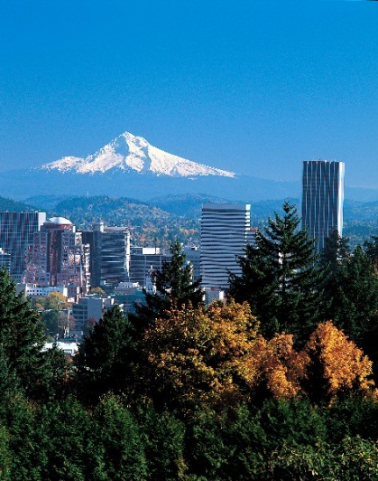
MHFT Global Strategy Luncheons Buy tickets at www.madhedgefundtrader.com
Portland, Oregon November 25, 2011
Orlando, Florida November 10, 2011

Slide 4
MHFT Global Strategy Luncheons Buy tickets at www.madhedgefundtrader.com
Chicago December 26, 2011
New Lunch!

Slide 5
Trade Alert Performance Tuesday Figures
*October +3.15% *First 48 weeks of Trading + 47.17% *Versus +8% for the S&P500 since December, 2010 a 36.8% outperformance of the index
46 out of 55 closed trades profitable 84% success rate

Slide 6
Portfolio Review Trade or Die
Mad Hedge Fund Trader
Trading Book
Asset Class Breakdown
Risk Adjusted Basis
current capital at risk
Risk On
bonds (TBT) | 13.60%
equity | 2.50%
silver (SLV) | 5.00%
Risk Off
total | 21.10%
*

Slide 7
The Economy
*The economic data is mostly positive *Weekly jobless claims down to 397,000, under 400,000 is key *Government and private job offerings at 3.35 million, a 3 year high *Purchasing managers index improving *Companies are knocking the cover off the ball on earnings-17% *Q3 GDP at 2.5%, better than expected *Crash absence is a boost to managers *All consistent with a low 2.0% GDP growth rate

Slide 8
The Three Black Swans Surprises not discounted by the market
*ECB cuts interest rate, Trichet retirement paves the way for Draghi action, there’s a new fire chief in town *Supercommittee Surprise compromise $4 trillion compromise from last summer is revived, Dow rallies 1,000 points by year end *China cuts interest rates declares victory on inflation, says risks to economy are now on the downside, its off to the races for emerging markets

Slide 9
Bonds
*Are not buying this rally at all *Yields hovering at 60 year lows *Junk bond stabilizing after massive rally *Who is telling the truth, bonds or equities? *Answer: Short term = equities, long term = bonds

Slide 10
(TLT)

Slide 11
(TBT)

Slide 12
(JNK)

Slide 13
Stocks
*Watch out for the upside surprise *Corporate earnings expected at 13% came in at 17% *Same girls invited to the ball, energy, commodities, coal, miners, rails, precious metals *Stocks could rally until year end *My primary (SPX) 1,275 target has been hit *(SPX) secondary 1,350 target

Slide 14
(SPX)

Slide 15
Russell 2000 (IWM)

Slide 16
Financials (XLF)

Slide 17
Caterpillar (CAT)

Slide 18
Freeport McMoRan (FCX)

Slide 19
(VIX)

Slide 20
The Dollar
*”RISK ON” means a weak dollar *Relief rally in the euro over sovereign debt progress short term, lower euro long term, sell at $1.40 *Euro has become everyone’s favorite target *Yen looks to strengthen, not follow through from the Bank of Japan with intervention efforts *Australian dollar is churning

Slide 21
(UUP)

Slide 22
(FXE)

Slide 23
Another Euro Chart

Slide 24
Australian Dollar (FXA)

Slide 25
(YCS)

Slide 26
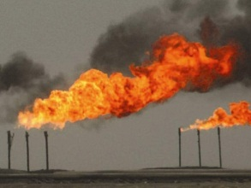
Energy
*Still giving great market direction *For now that means up *Crude takes a run at $100 *Iran noise is stepping up the volume *Coal breaking out to new highs *Natural gas still dead as a doorknob

Slide 27
Crude

Slide 28
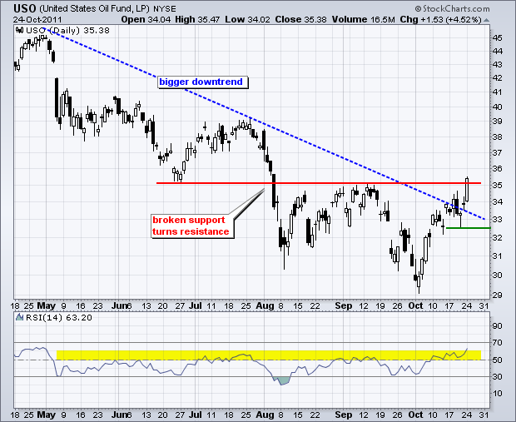
OIL

Slide 29
Natural Gas

Slide 30
Alpha Natural Resources (ANR)

Slide 31
Copper

Slide 32
Precious Metals
*Resolution of European sovereign debt crisis will trigger panic buying of all precious metals *Result ion means a TARP and a quantitative easing *Chinese central bank sitting on the bid *Gold leading the charge *Technical picture looks good *Gold has turned into paper, so ‘RISK ON” means buy precious metals

Slide 33
Gold

Slide 34
Silver

Slide 35
(Platinum)

Slide 36
Palladium

Slide 37
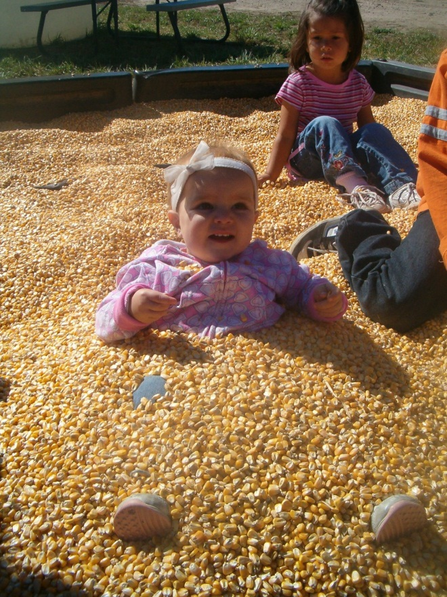
The Ags
*Overshadowed by financial assets *Improving weather in the US is offset by rising supply in Russia *No clear trend

Slide 38
(CORN)

Slide 39
(DBA)

Slide 40
Real Estate September

Slide 41
Trade Sheet The bottom line: Trade or die
*Stocks-run longs for a breakout *Bonds- stand aside, wait for 2.6% yield to sell TBT to rally *Commodities- stand aside, wait for a dip *Currencies-get ready to sell Euro rallies higher, $1.40 *Precious Metals-buy silver, gold has run too far *Volatility-stand aside *The ags – stand aside *Real estate-bouncing along a bottom Next Webinar is on Wednesday, November 30

Slide 42
To access my research data base or buy strategy luncheon tickets Please Go to www.madhedgefundtrader.cpm

