Slide 1
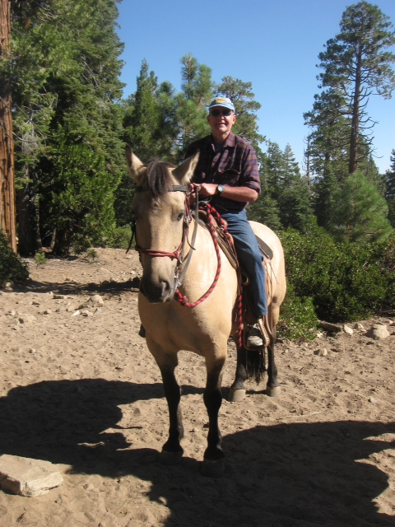
The Mad Hedge Fund Trader
“Back in the Saddle”
San Francisco, CA
August 28, 2013
www.madhedgefundtrader.com

Slide 2

Trade Alert Performance
Staying On Top
*2013 YTD +34.8%, compared to 11.7%
for the Dow, beating it by 23.1%
*August -1.77%
*First 141 weeks of Trading +89.9%
*Versus +21% for the Dow Average
A 66% outperformance of the index
138 out of 194 closed trades profitable
71.1% success rate on closed trades

Slide 3
Portfolio Review-Running small net long
Market Risk is Now -High-keep positions small
current capital at risk
Risk On
(FXE) 9/$133-$135 put spread | 10.00%
(FXY) 9/$103-$106 put Spread | 10.00%
Risk Off
(USO) 9/$39-$40 put spread | -10.00%
total net position | 10.00%

Slide 4
Performance Year to Date +37.08%
Taking another run at 40%

Slide 5
Performance Since Inception
+35.7% Average Annualized Return

Slide 6
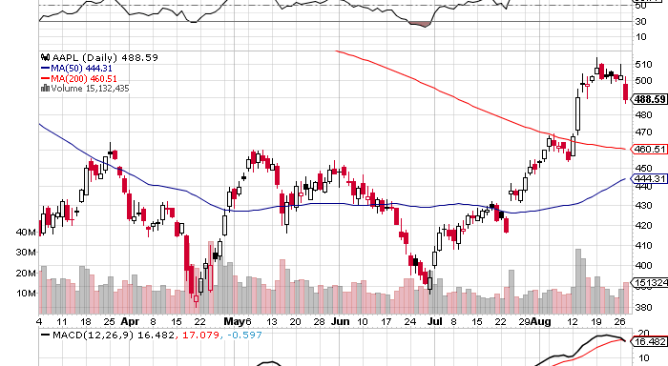
What I Missed This Summer (AAPL)

Slide 7
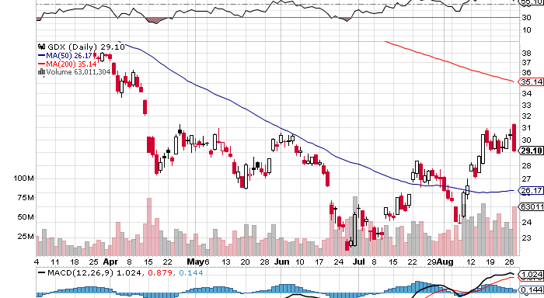
What I missed this summer (GDX)

Slide 8
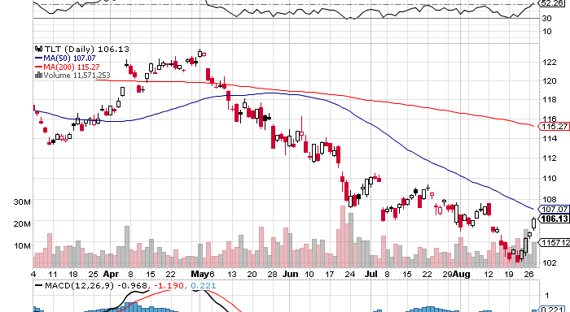
What I Missed This Summer (TLT)

Slide 9

Strategy Outlook-Will Syria Kill the Taper?
*Buyable dip setting up in all risk assets
*May match may correction of 7.5%
*Fed won’t taper in September when we are losing housing,
one of three les supporting the economy.
*Syria is creating an opportunity, any military
actions will be limited and brief
*Debt ceiling crisis in October, Obama won’t cave,
could lead to Sequester II and another 1% off GDP in 2014, maintaining 2% annual growth rate
*Generational BUY setting up for emerging markets at 1.6X book, versus 2.4X book for the US

Slide 10

The Jim Parker View
The Mad Day Trader-On sale for a $1,000 upgrade
Summer market still prevails
Technical Set Up of the week
*Buy –(SPX) will grind up through the end of September
Technical's have gold (GLD) peaking on Thursday
All momentum is in (TSLA), (GOOG), (NFLX), (AAPL)
*Sell Short
Sell (FXE), (FXY) on rallies

Slide 11

The Economy-More Slow Motion
*German July business confidence 106.2 to 107.5
*New housing starts falling off a cliff
*September 5 nonfarm payroll will
determine Fed taper decision
*Weak emerging markets show they
will get hit more by tapering an US
*July durable goods down -7.3% creates
another shock

Slide 12
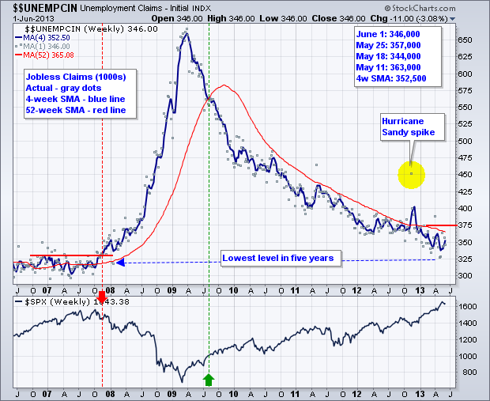
Weekly Jobless Claims
+ jump to 13,000 to 336,000 Downtrend still in place

Slide 13

Bonds-Taking it on the nose
*Is $85 billion a month in Fed bond buying about to disappear?
Probably not
*Bond long setting up here, buy (TLT) as close to a 3.0% yield as you can get
*Detroit default weighing heavily on
muni bonds nationally on attempt
to break liens and covenants
*Foreign sovereign bond funds
getting crushed

Slide 14
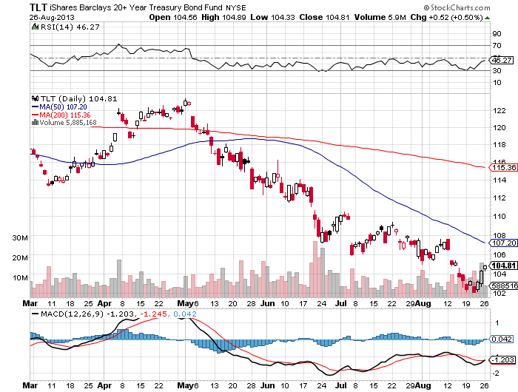
Ten Year Treasuries (TLT)

Slide 15
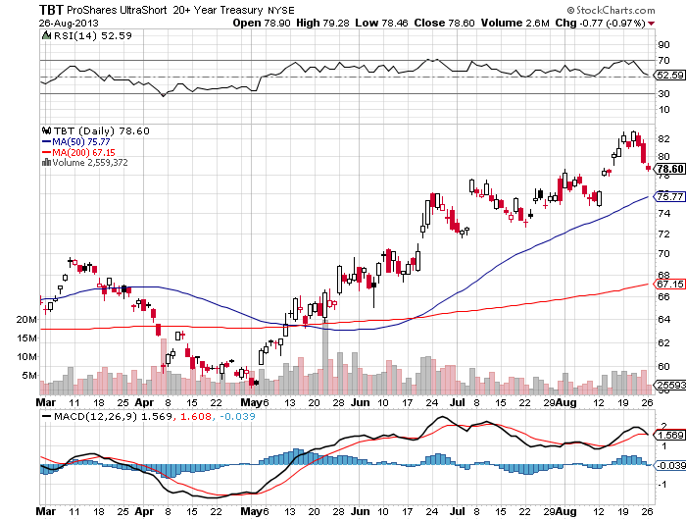
2X Short Treasuries (TBT)

Slide 16
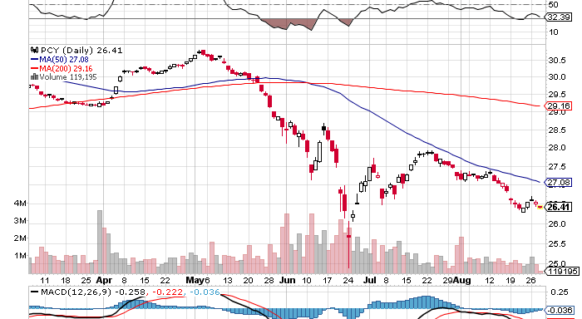
Emerging Market Sovereign Debt (PCY) 4.9% Yield

Slide 17
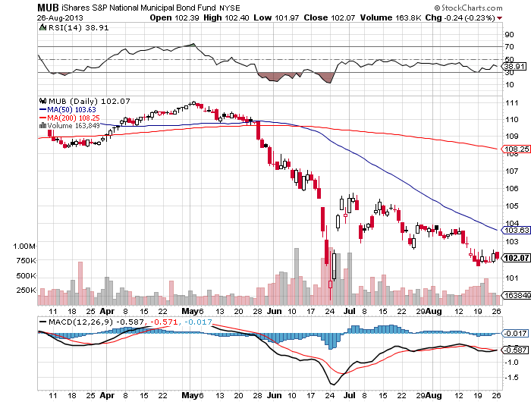
Municipal Bonds (MUB)-3% yield,
Mix of AAA, AA, and A rated bonds

Slide 18
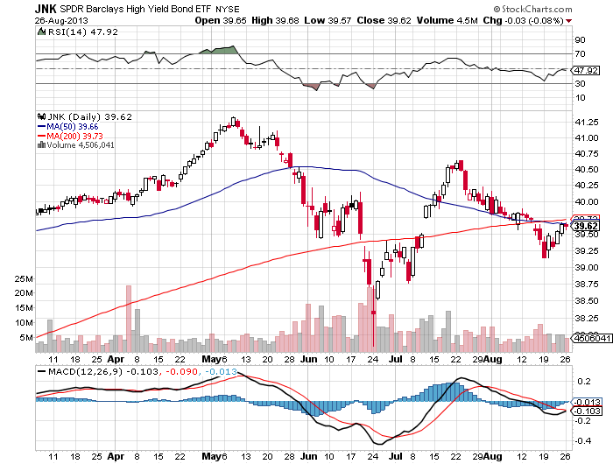
(JNK)-Cruising for a bruising

Slide 19

S&P 500 (SPX)-Searching for a bottom
*August has been the worst since May, 2012, $14 billion out of equity funds
*Market is discounting a 50% taper in September and 50% in December, but may not come until 2014
*Syria will be brief and is creating a great entry point for equities.
*Wall of money is still out there
*Customer cash holdings at all time highs
*October debt ceiling crisis may create
secondary low, then year end rally to new highs
*Buy every 7%-10% dip

Slide 20
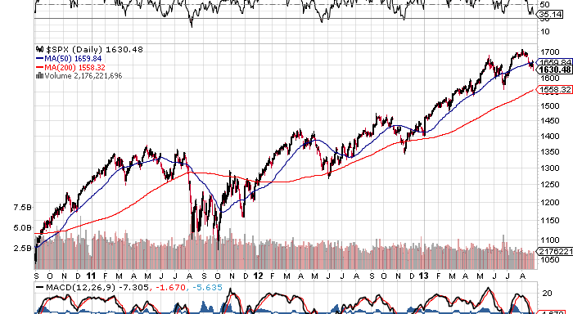
(SPX)-The 30,000 view
We got the six month churn that I expected
Fail
Here

Slide 21
S&P 500 (SPX)-Searching for a bottom
*August has been the worst since May, 2012, $14 billion out of equity funds
*Market is discounting a 50% taper in September and 50% in December, but may not come until 2014
*Syria will be brief and is creating a great entry point for equities.
*Wall of money is still out there
*Customer cash holdings at all time highs
*October debt ceiling crisis may create
secondary low, then year end rally to new highs
*Buy every 7%-10% dip

Slide 22
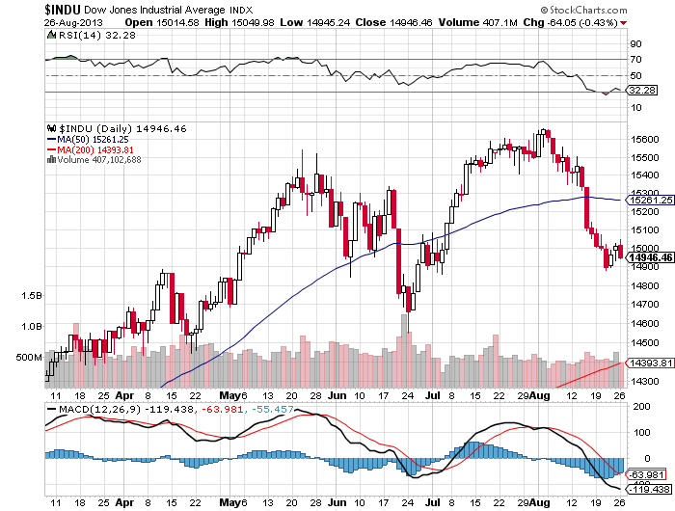
Dow Average (INDU)

Slide 23
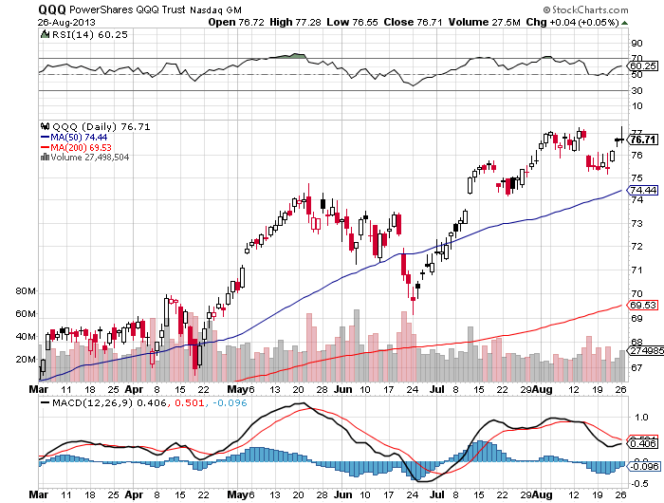
NASDAQ (QQQ)

Slide 24
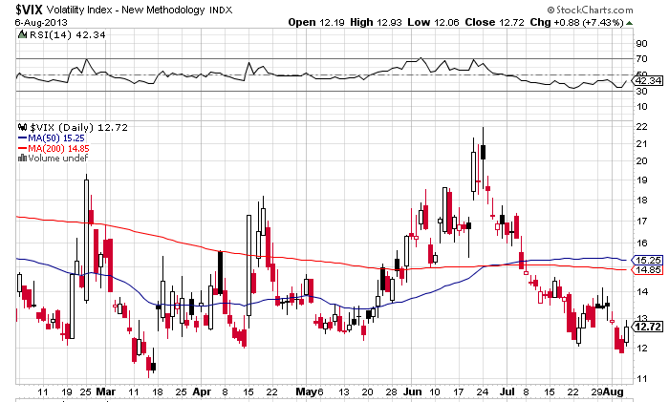
(VIX)-Back to the Graveyard
The spike for the year is in

Slide 25
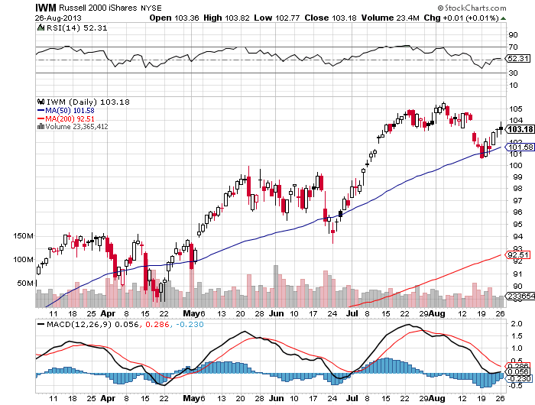
Russell 2000 (IWM)-Leads the Upturn

Slide 26

Apple (AAPL)-Off to the races

Slide 27
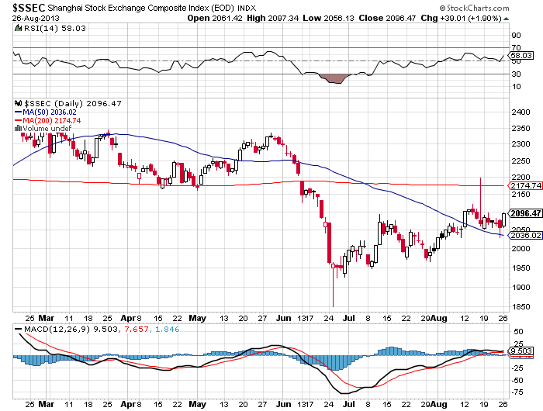
Shanghai-Barely a pulse

Slide 28
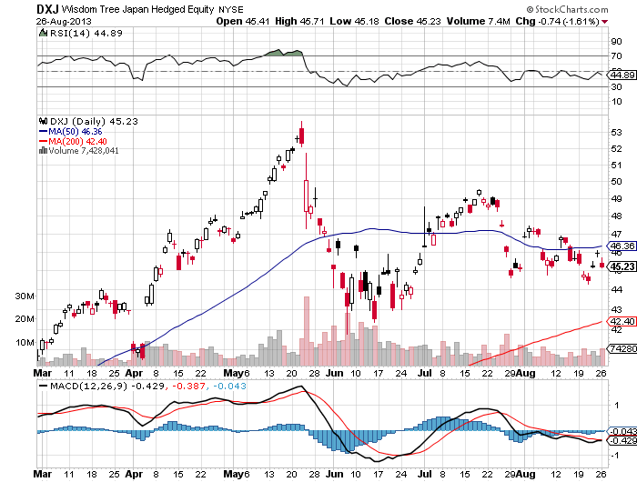
(DXJ)-the only way to play Japan
-Nikkei with hedged yen

Slide 29
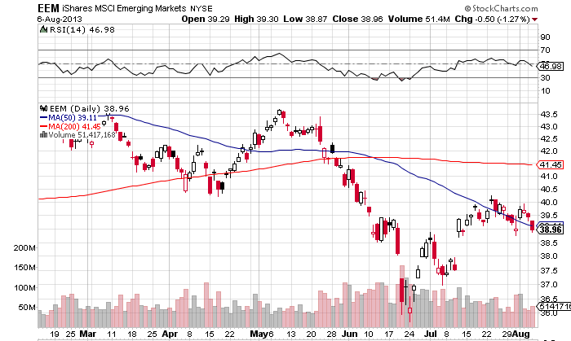
Emerging Markets-Dragged Down by Strong dollar and weak China and commodities

Slide 30
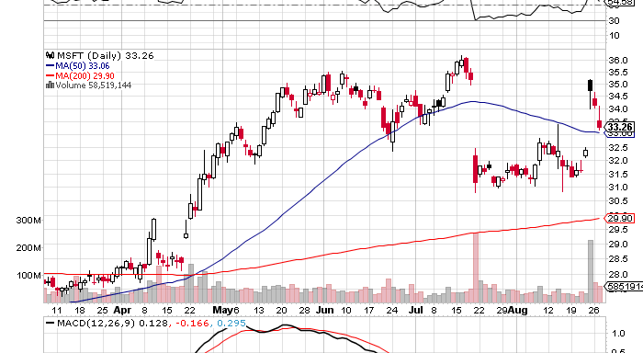
Stock of the Week-(MSFT)
CEO Steve Balmer gets $847 million boost on retirement announcement

Slide 31
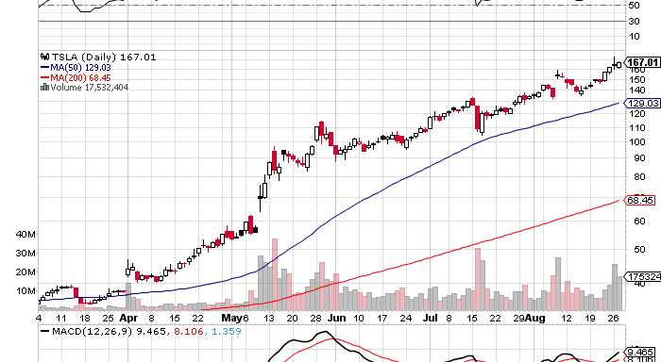
Another Stock of the Week-(TSLA) redefining momentum

Slide 32

Dollar-Probing Lows for the Year
*RISK OFF send dollar to the dumps
*A hold here could start the beginning of a multi month dollar rally
*Is creating another window to sell short the yen and the Euro
*Big positioning now is in the emerging
markets, Rupee and the Real
*Commodity rally is giving a boost to Ausie

Slide 33
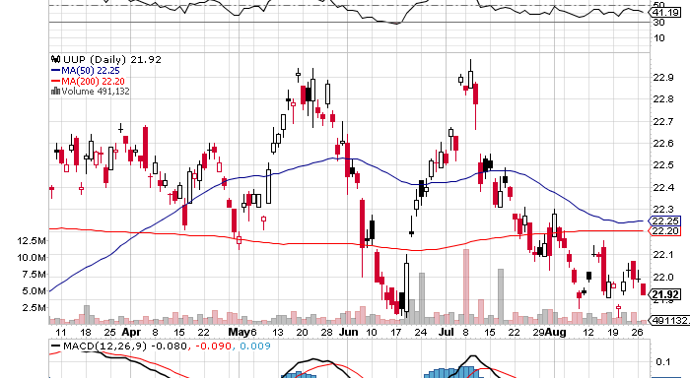
Long Dollar Basket (UUP)-
Bottom end of the range

Slide 34
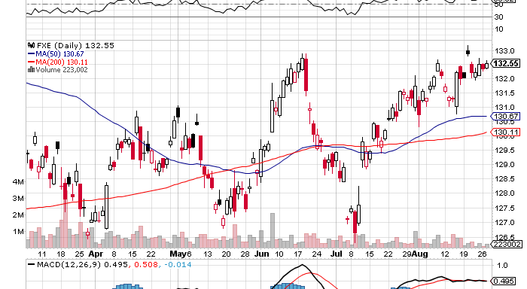
Euro (FXE)-Top end of Range, shorting territory long the $34-$36 bear put spread

Slide 35
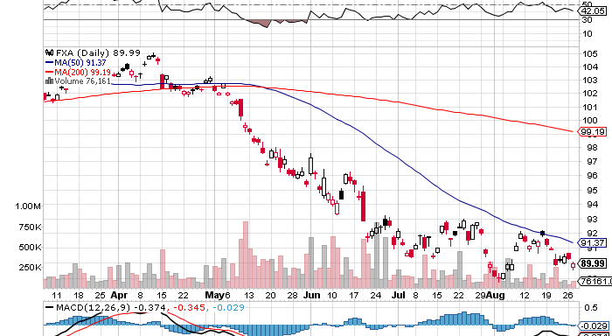
Australian Dollar (FXA)

Slide 36
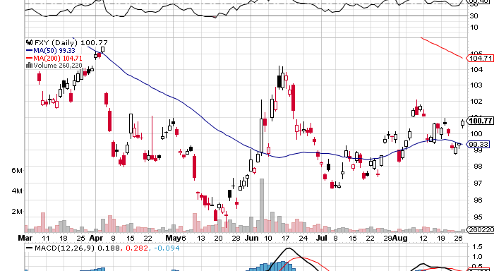
Japanese Yen (FXY)-Still stalled at ¥100 long the $103-$106 bear put spread

Slide 37
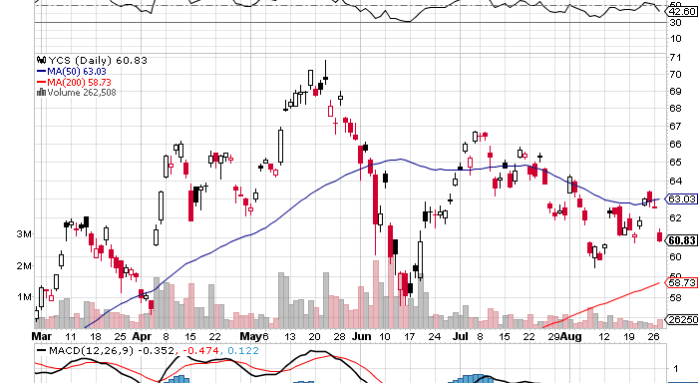
(YCS)-For Non Options Players
200% Short Yen ETF-head and shoulders top risk

Slide 38
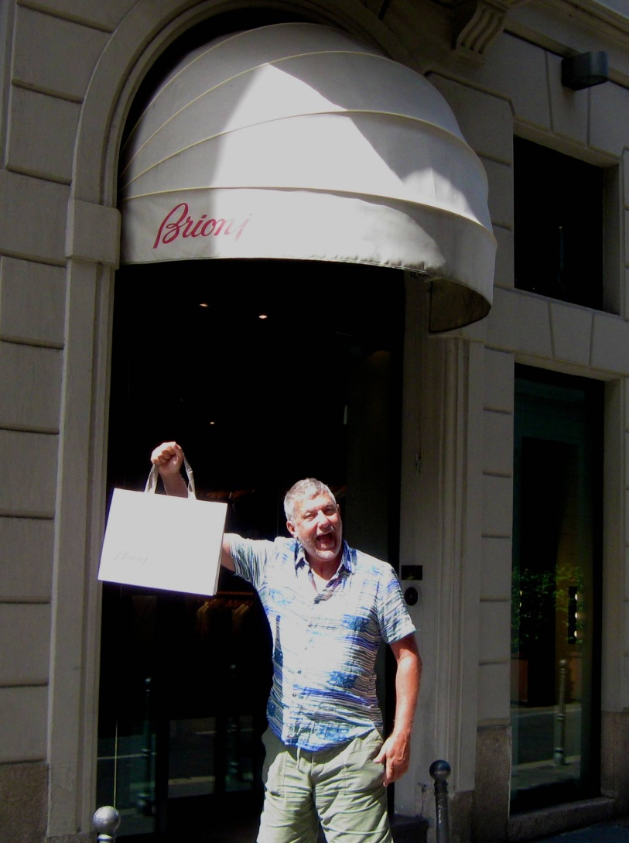
Hello from Milan, Italy

Slide 39

Energy-Sell the Breakout, it can’t last
*Oil has been over $100/barrel since July 4
*Wall Street is long 1.9 million contracts in wake of Egypt and Syria Crisis,
about a 4 month refinery supply, vastly overextended
*This long has pushed cruse to to a $20 premium to actual supply and demand
*Risk of a $20 gap down is high
*Strongest driving season in
31 years ending
*Only Syria is levitating these prices
*Obama will move slowly in response
*Net imports down from 60% to 35.9%
since 2005

Slide 40
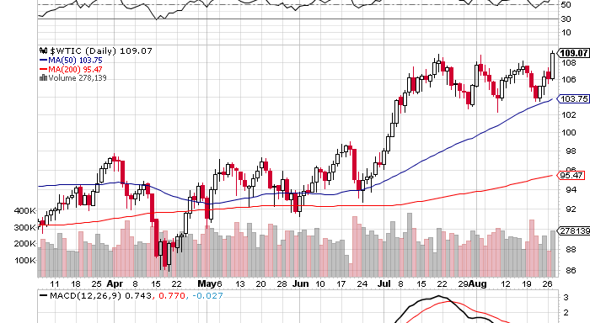
Crude-Sell the Rallies on 2 ½ year high

Slide 41
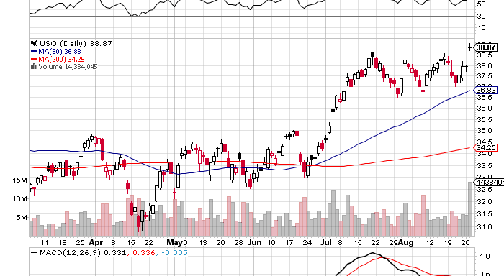
(USO) long the September $39-$42 bear put spread

Slide 42
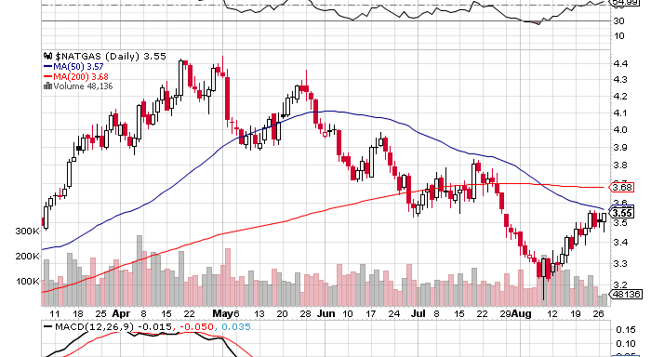
Natural Gas-Recovering from a Cool summer more supply is on the way

Slide 43
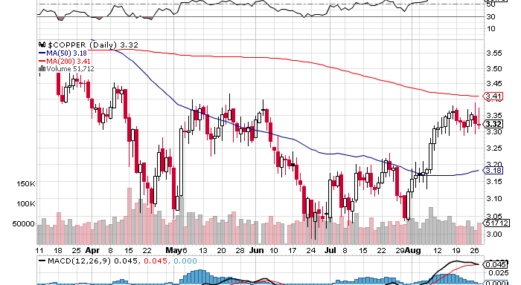
Copper (CU)-trying to bottom rally off of weak dollar

Slide 44

Hello From Wales

Slide 45

Gold-Finally, A “Flight to Safety” Asset Again
*Syria triggers a $30 rally and a two month rally
*Low for the year put in when
mining companies renewed hedging
*Buy the miners (GDX) on dips,
trend has more to run
*Breakeven cost for miners now
goes all the way up to $1,300

Slide 46
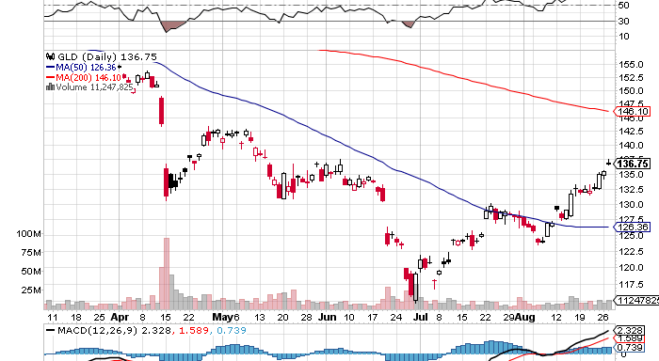
Gold (GLD)

Slide 47
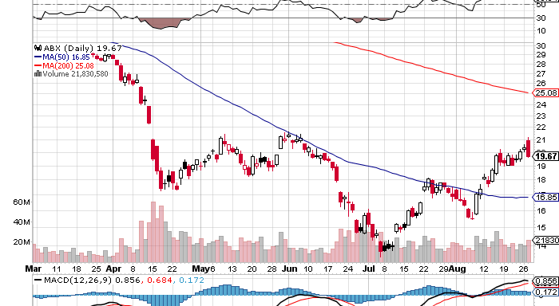
Barrack Gold (ABX)-weekly
10% rise in gold creates 50% rise in stock

Slide 48
Market Vectors Gold Miners ETF- (GDX)

Slide 49
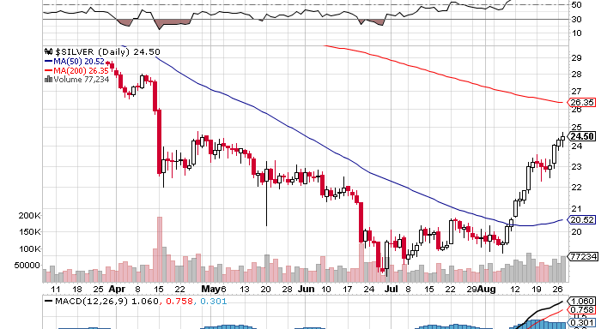
Silver

Slide 50
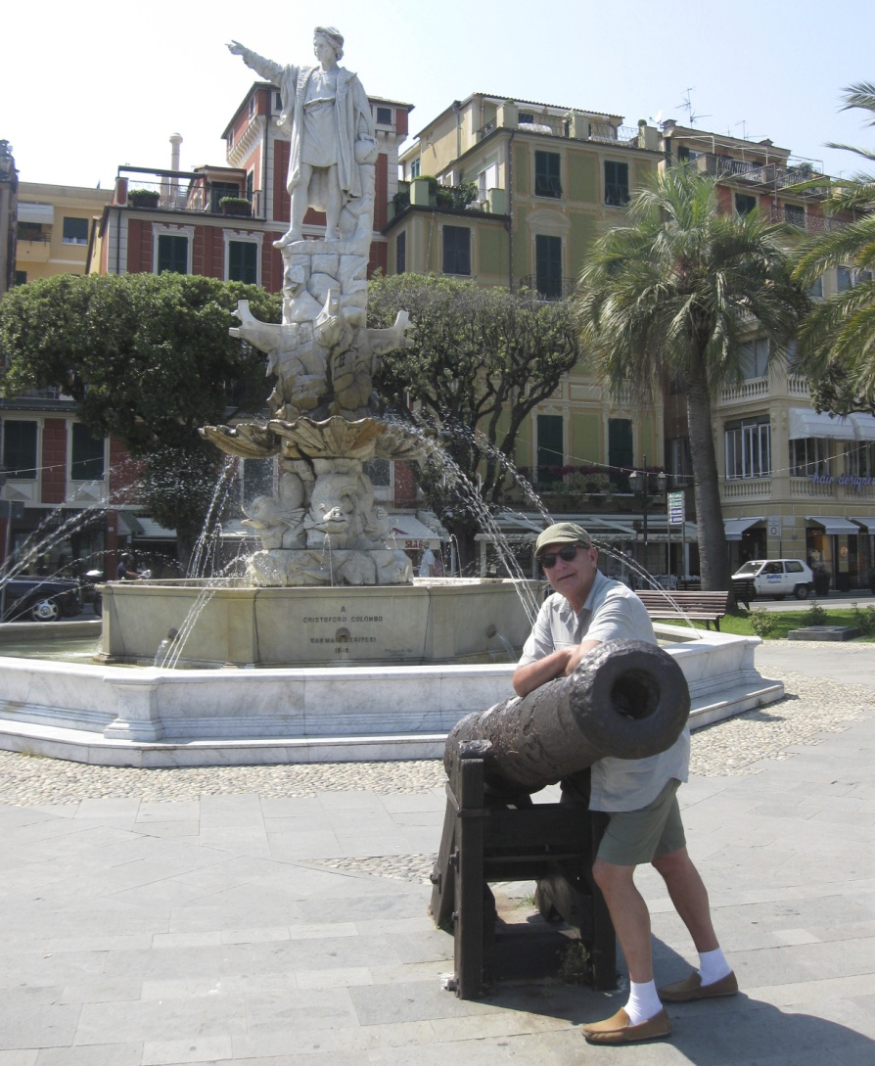
Greetings From Genoa, Italy

Slide 51
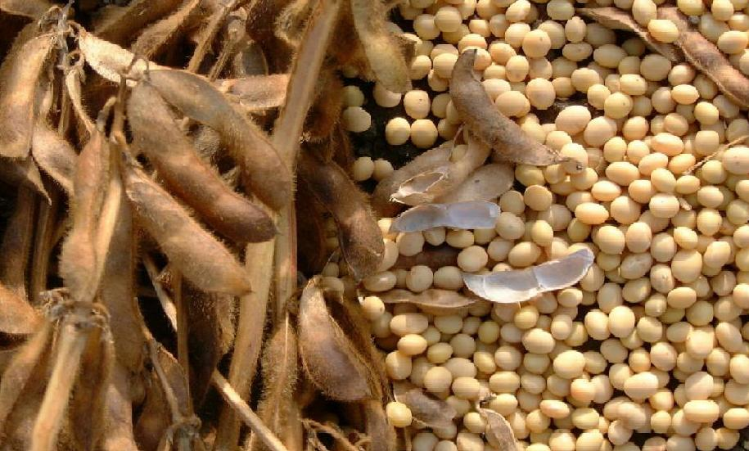
Agriculture-Break Down to New Lows
*Negative USDA crop report finally gives corn a bounce, high end yield and crop estimates getting pared back
*High midwest temperatures suddenly cut back yields
*Still setting up for the biggest grain crop of all time
*Soybean market suddenly
has become tight

Slide 52
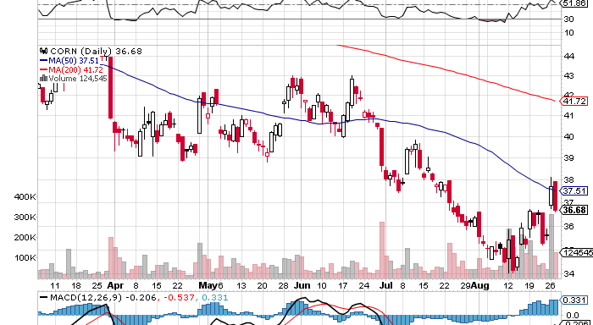
(CORN)-still trying to bottom

Slide 53
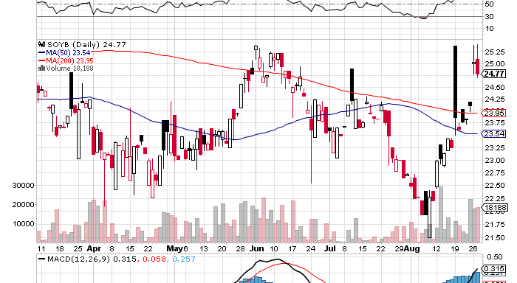
Soybeans (SOYB)-lookout below

Slide 54
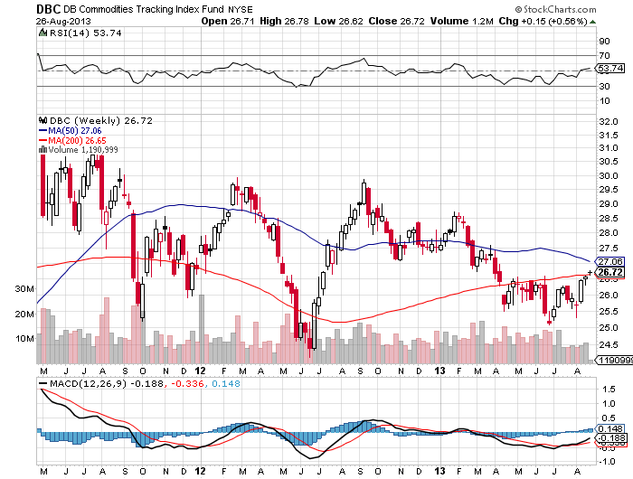
DB Commodities Index ETF (DBC)
More new lows

Slide 55
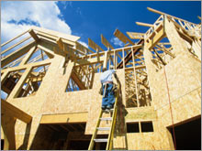
Real Estate-the shaky leg in the economy
* June Case Shiller
Up 12.1% YOY, but gains slowing
*July Single family homes plunge
*30 year mortgage up 25% in three months
*Weakness may kill fed taper

Slide 56
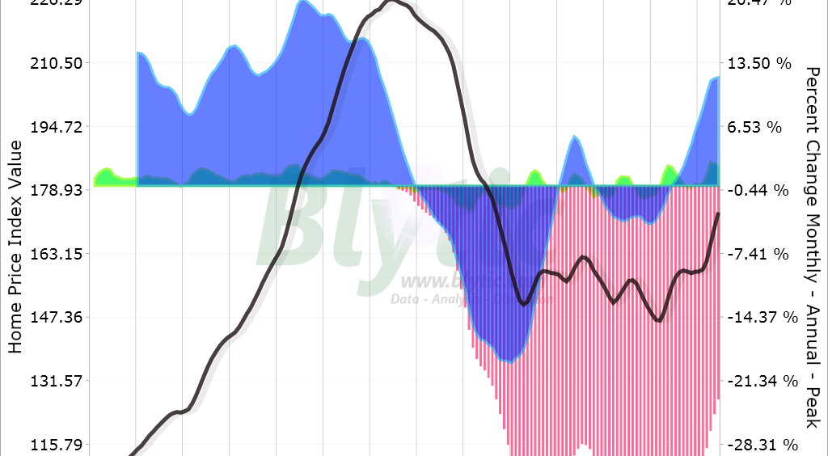
May S&P/Case–Shiller Home Price Index

Slide 57
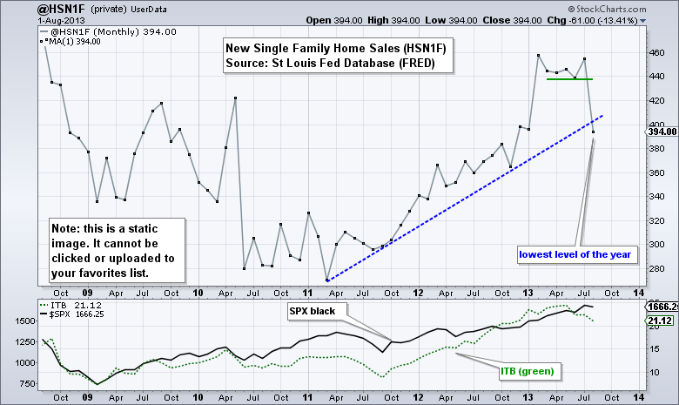
New Single Family Home Sales

Slide 58
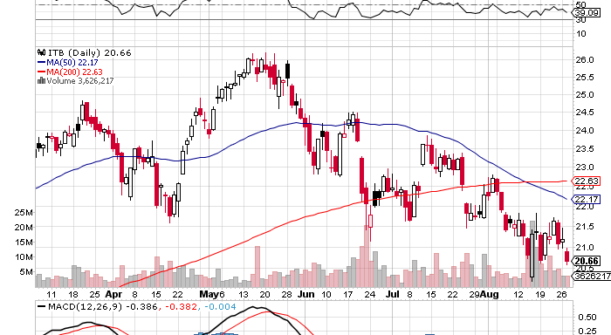
(ITB)-US Home Construction Dow Sub index

Slide 59

Hello from the Matterhorn Summit

Slide 60

Trade Sheet-No Change
“RISK ON” Good Until Proven Guilty
*Stocks- buy the big dips coming, running to a new yearend high
*Bonds- close to buying here for 50 bp rally
*Commodities-watch the dollar
*Currencies- sell yen, euro, and Aussie on any rallies
*Precious Metals –buy $50 dips, buy (GDX)
*Volatility-stand aside, will bounce along bottom
*The Ags –wait for bottom to prove itself
*Real estate- no trade

Slide 61
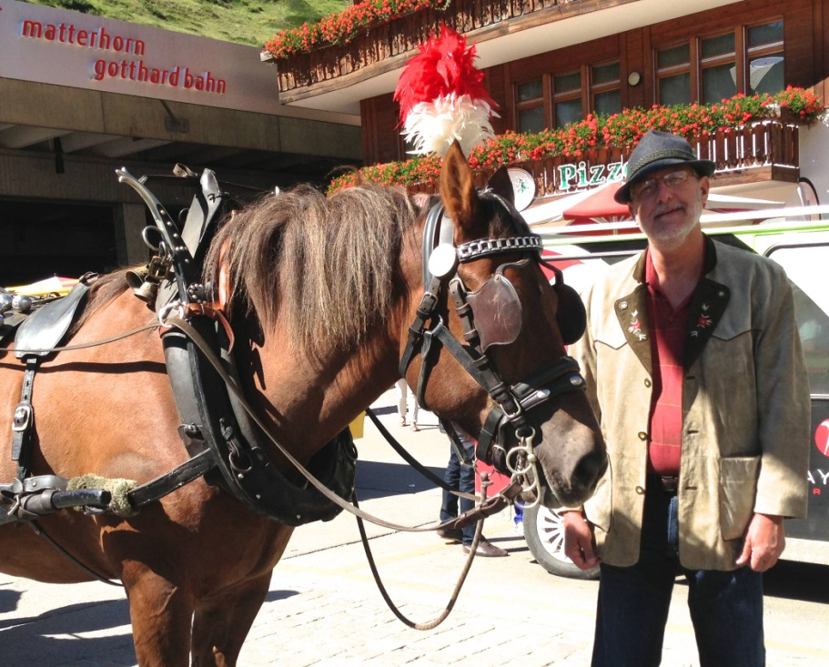
To buy strategy luncheon tickets Please Go to www.madhedgefundtrader.com
Next Strategy Webinar
12:00 EST Wednesday, September 11, 2013
Live from San Francisco
Good Luck and Good Trading!

