Slide 1
Mad Day Trader
Bill Davis
Webinar – June 24, 2015

Slide 2
Today, I want to continue the discussion of the extreme Bollinger Band Settings and using the VIX to read the markets.

Slide 3
The question was raised last week if the VIX led the markets or if the price action does. I said I would share a chart of major turning points on both the VIX & the S & P.

Slide 4
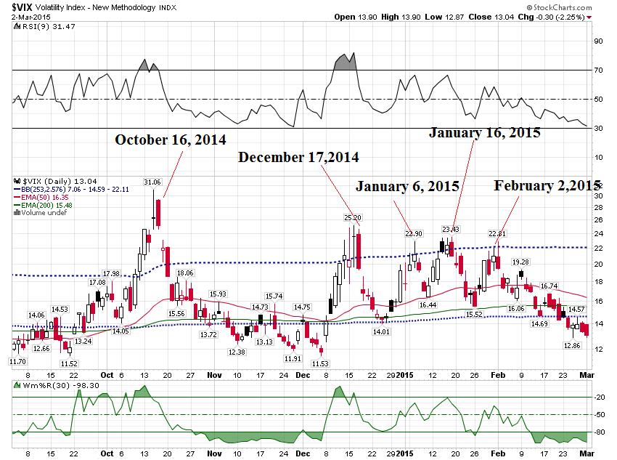

Slide 5
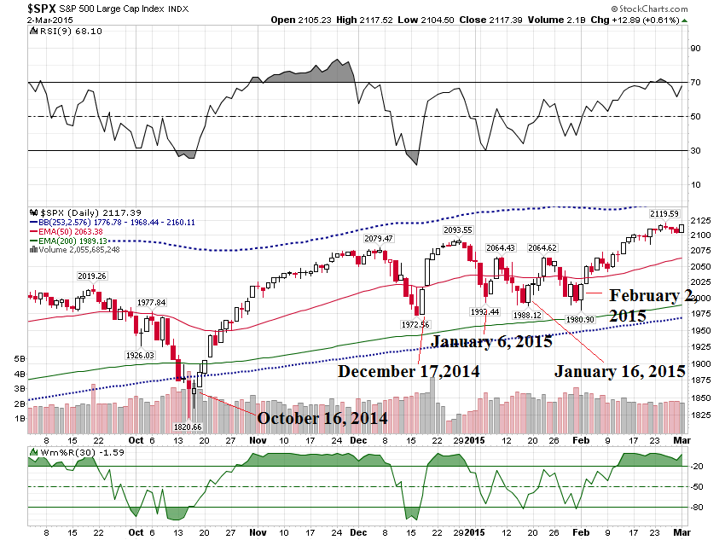

Slide 6
Short Term Moves with the VIX – FOMC Day

Slide 7
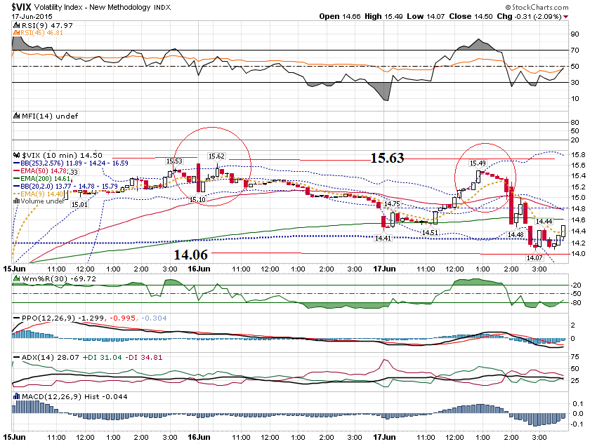

Slide 8
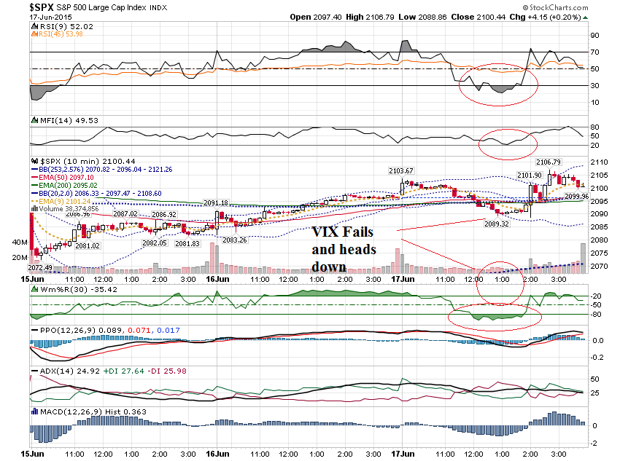

Slide 9
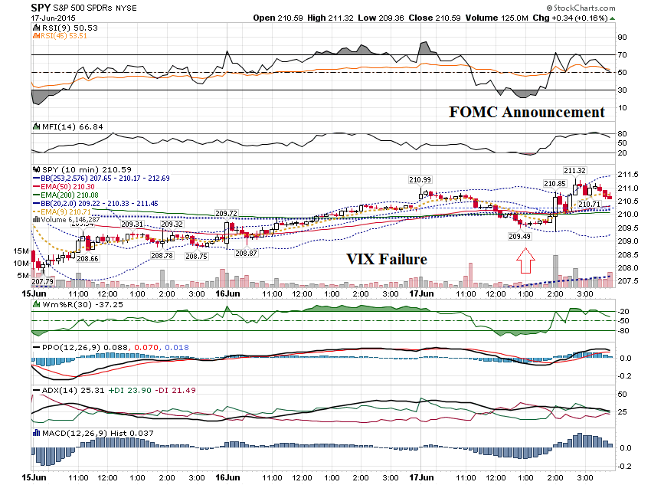

Slide 10
SPY $209.50 Weekly Call Prev Close: 1.66 Open: 1.71 Bid: 1.32 Ask: 1.42 Strike: 209.50 Expire Date: 19-Jun-15 Day's Range: 0.85 - 2.00 Contract Range: N/A - N/A Volume: 4,734 Open Interest: 16,862 About $1.20 before the announcement

Slide 11
SPY $210 Weekly Call Prev Close: 1.35 Open: 1.41 Bid: 0.96 Ask: 1.02 Strike: 210.00 Expire Date: 19-Jun-15 Day's Range: 0.74 - 1.70 Contract Range: N/A - N/A Volume: 70,521 Open Interest: 106,494 About $.90 before announcement and hit $1.65

Slide 12
We can even scope down to a shorter term intra day chart to help with entries.

Slide 13
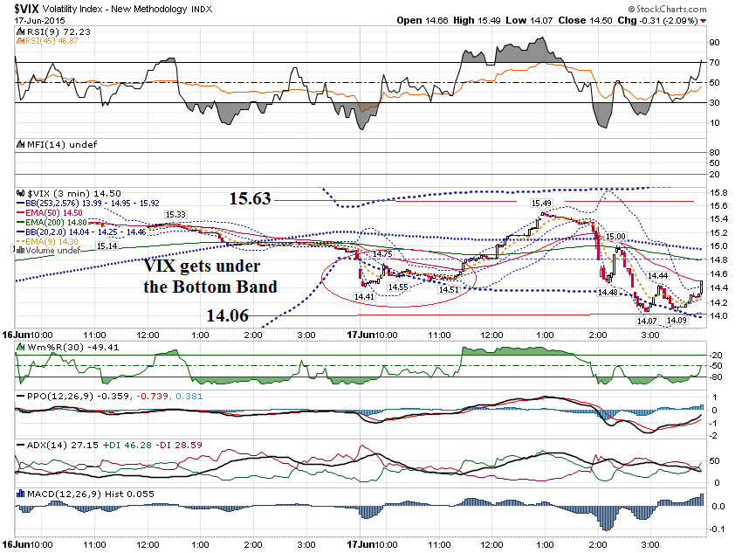

Slide 14
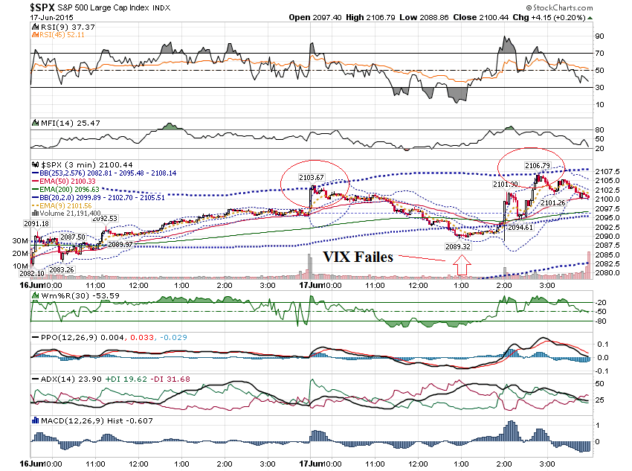

Slide 15
Extreme Bollinger Band Pattern

Slide 16
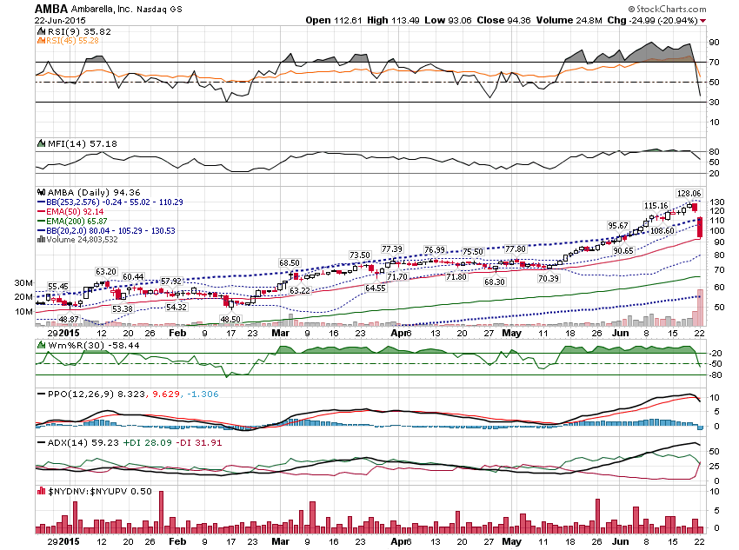

Slide 17
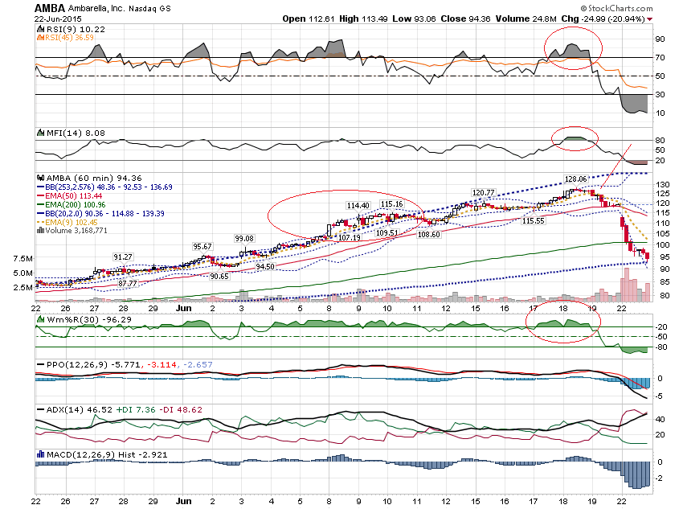

Slide 18
AMBA $128 Weekly Put Prev Close: 9.80 Open: 6.99 Bid: 32.60 Ask: 34.30 Strike: 128.00 Expire Date: 26-Jun-15 Day's Range: 6.99 - 9.80 Contract Range: N/A - N/A Volume: 22 Open Interest: 22

Slide 19
AMBA $115 Weekly Put Prev Close: 2.26 Open: 5.10 Bid: 20.40 Ask: 21.50 Strike: 115.00 Expire Date: 26-Jun-15 Day's Range: 4.30 - 21.80 Contract Range: N/A - N/A Volume: 698 Open Interest: 1,080

Slide 20
Friday Trading

Slide 21
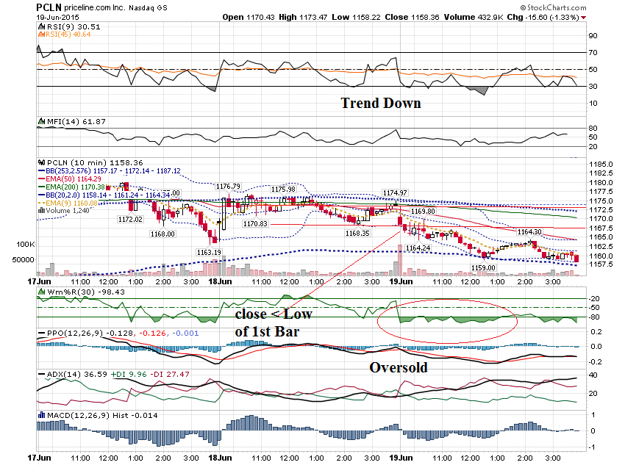

Slide 22
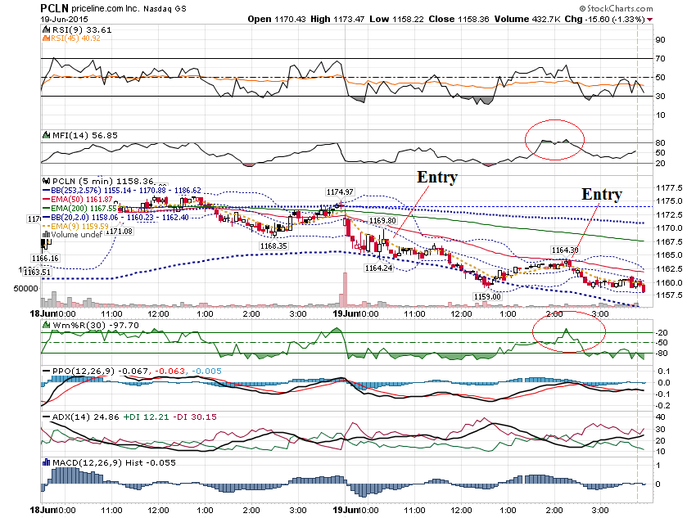

Slide 23
PCLN $1165 put Prev Close: 1.66 Open: 1.19 Bid: 5.00 Ask: 5.90 Strike: 1,165.00 Expire Date: 19-Jun-15 Day's Range: 1.05 - 6.00 Contract Range: N/A - N/A Volume: 1,257 Open Interest: 846

Slide 24
Earnings Announcement Before the Market on a Friday

Slide 25
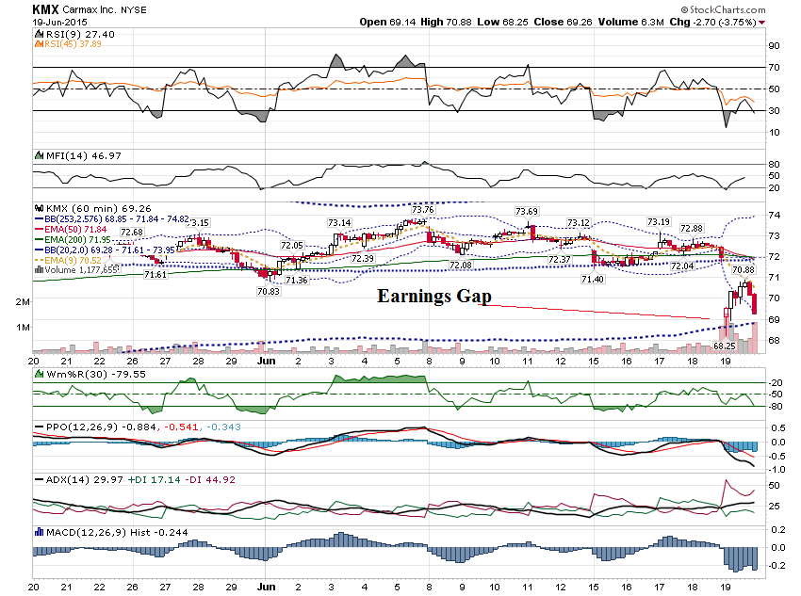

Slide 26
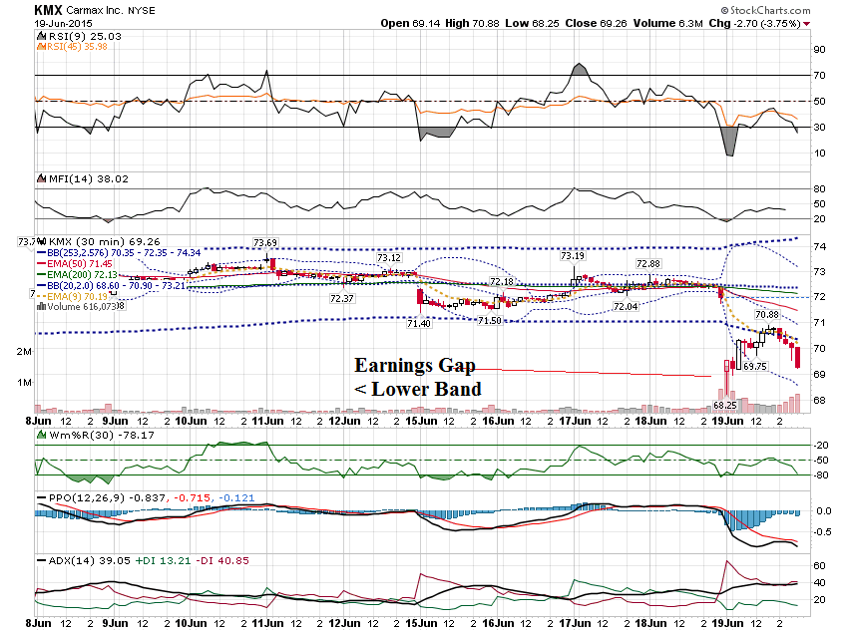

Slide 27
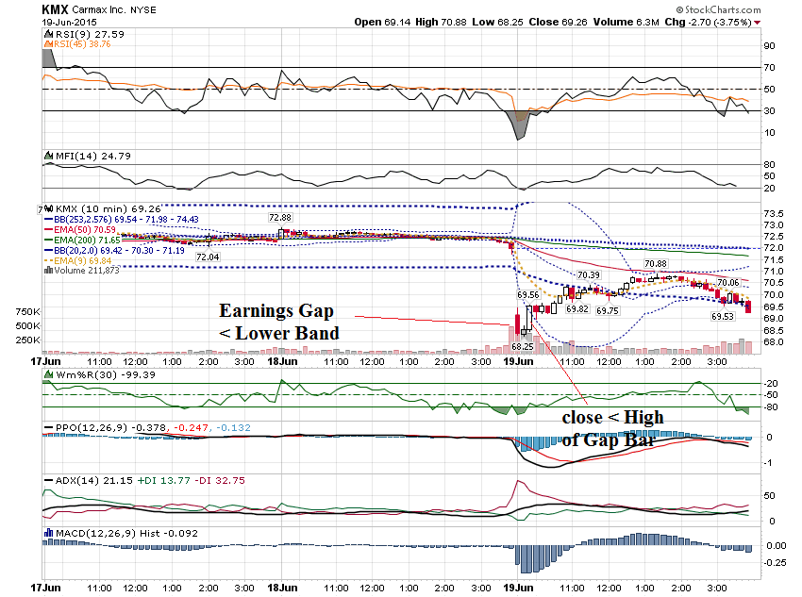

Slide 28
KMX $70 Call Prev Close: 3.30 Open: 0.20 Bid: N/A Ask: 0.15 Strike: 70.00 Expire Date: 19-Jun-15 Day's Range: 0.05 - 0.82 Contract Range: N/A - N/A Volume: 834 Open Interest: 866

Slide 29
Friday Example - CMG

Slide 30
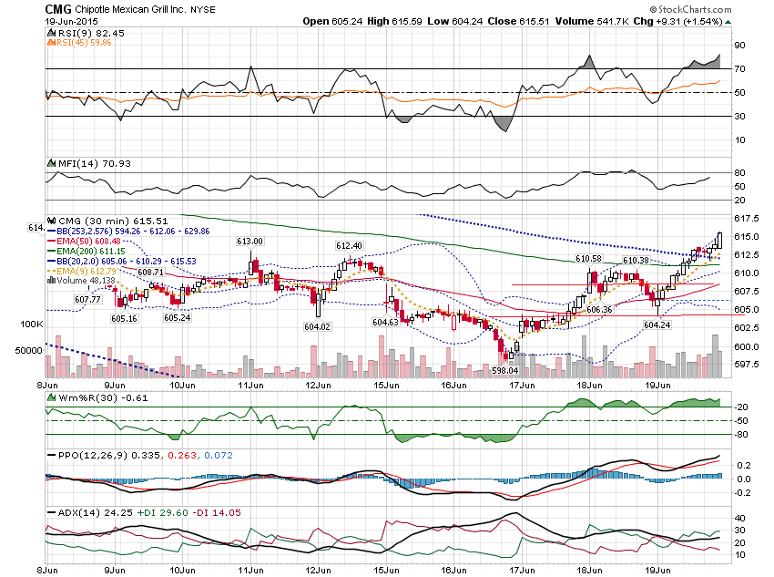

Slide 31
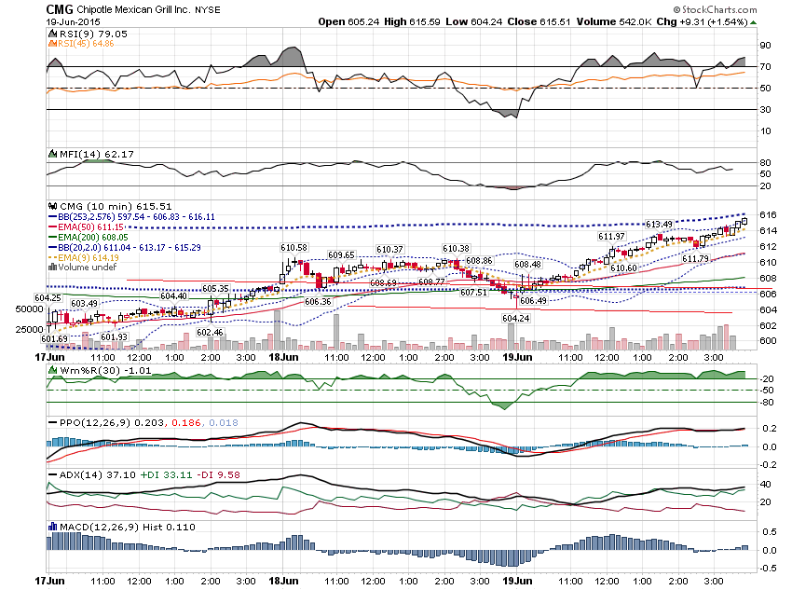

Slide 32
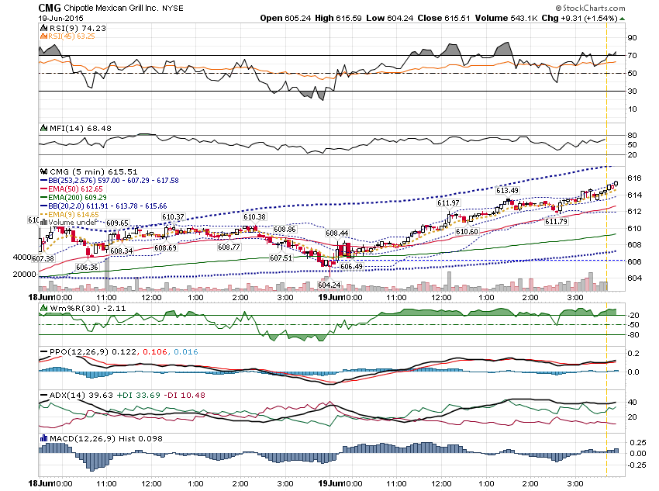

Slide 33
CMG $605 Weekly Call Prev Close: 2.42 Open: 1.45 Bid: 9.40 Ask: 10.10 Strike: 605.00 Expire Date: 19-Jun-15 Day's Range: 1.45 - 9.30 Contract Range: N/A - N/A Volume: 213 Open Interest: 306

Slide 34
CMG $607.50 Call Prev Close: 1.25 Open: 0.74 Bid: 7.20 Ask: 7.90 Strike: 607.50 Expire Date: 19-Jun-15 Day's Range: 0.74 - 7.00 Contract Range: N/A - N/A Volume: 343

Slide 35
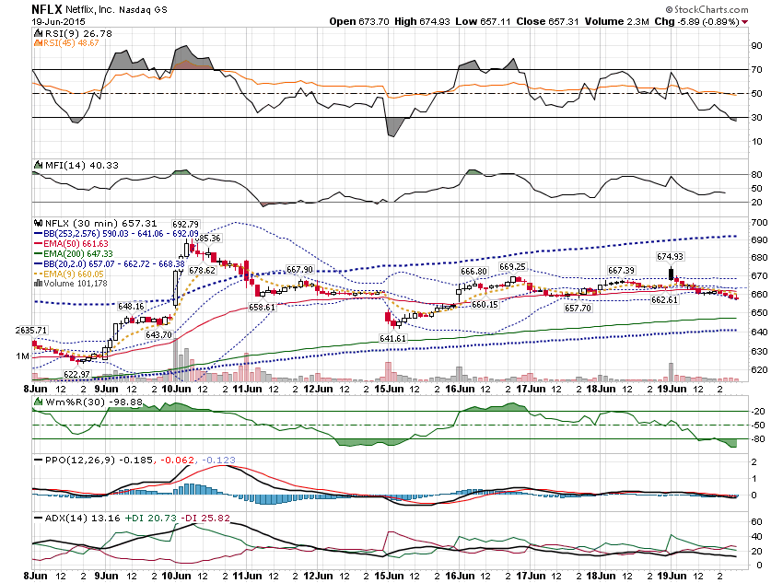

Slide 36
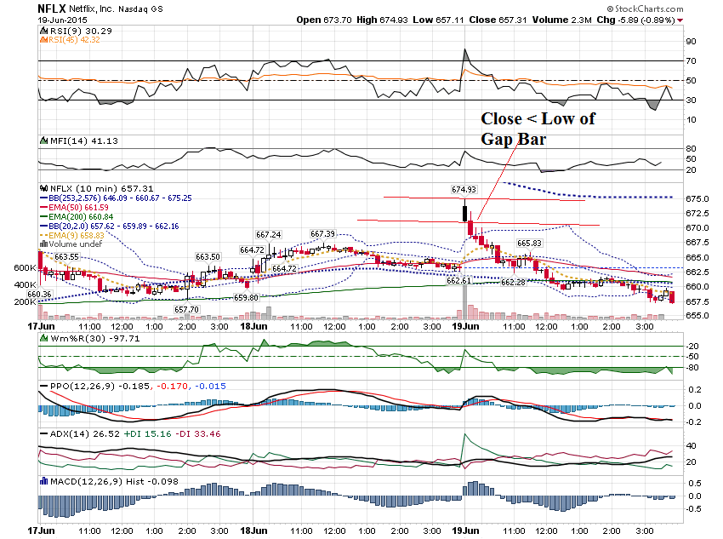

Slide 37
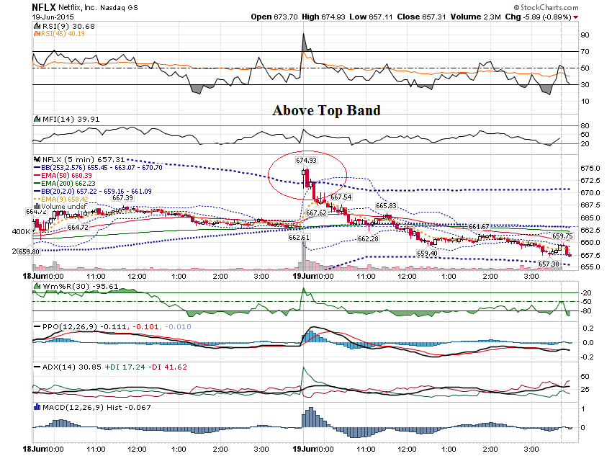

Slide 38
100 to 1 Overnight Return

Slide 39
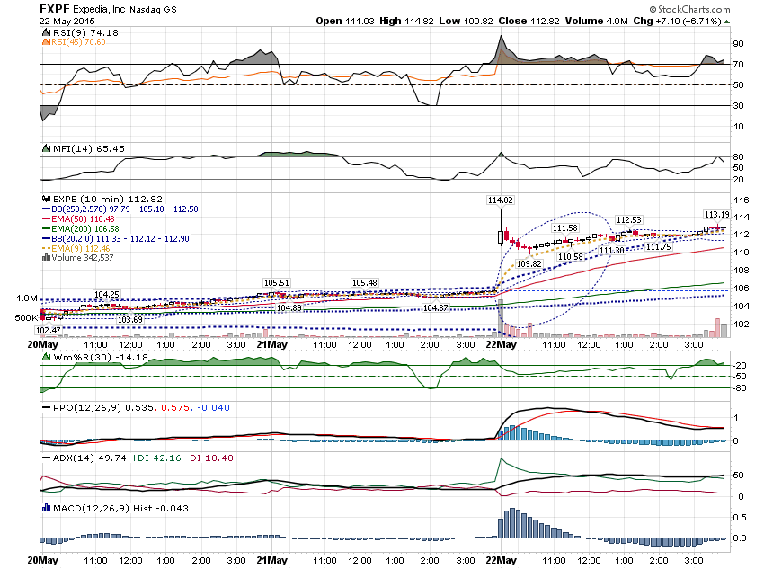

Slide 40
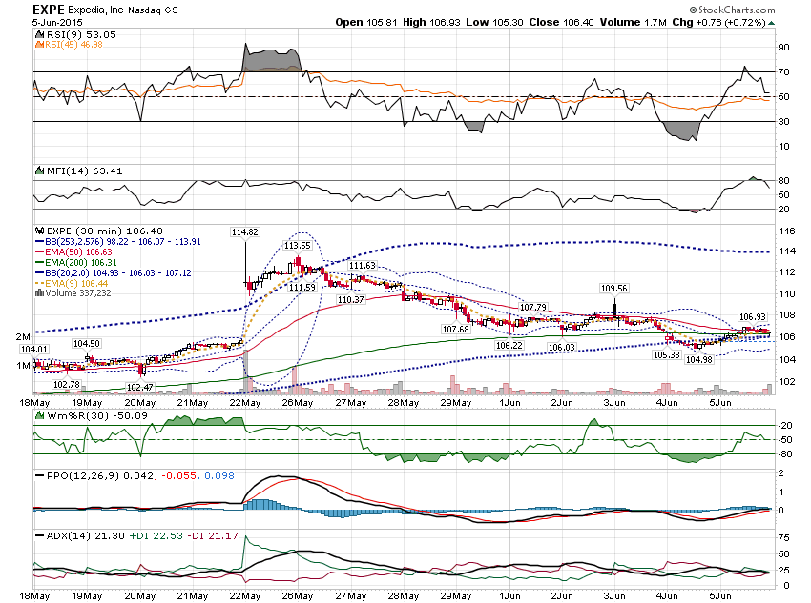

Slide 41
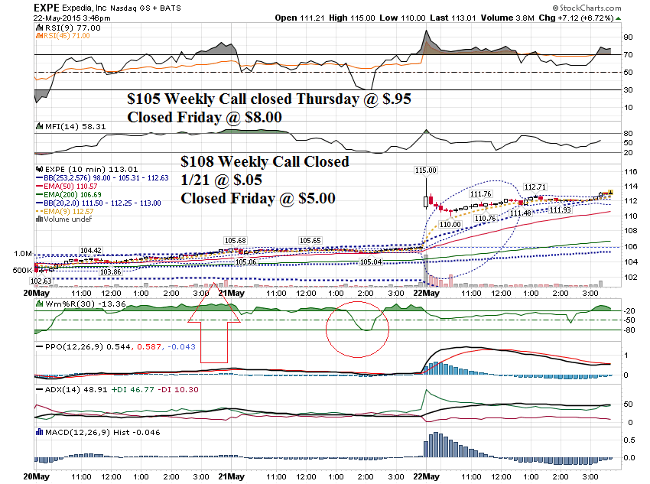

Slide 42
Thanks for watching! Bill Davis Mad Day Trader June 24, 2015 davismdt@gmail.com

