Slide 1

The Mad Hedge Fund Trader
“Switching From Growth to Value”
With John Thomas
from Incline Village, NV, October 21, 2015
www.madhedgefundtrader.com
Notes:
*

Slide 2

Trade Alert Performance
*January +0.53% Final *July +6.42% Final
*February +7.73% Final *August +1.27% Final
*March +3.00% Final *September +11.99% Final
*April +6.62% Final *October MTD -7.14%
*May +5.15% Final
*June +3.68% Final
*2015 Year to Date +37.08%
compared to -3.4% for the Dow Average
*Trailing 1 year return +32.41%, +188.62% since inception,
*Average annualized return of 35.81%

Slide 3
MHFT Global Strategy Luncheons
Buy tickets at www.madhedgefundtrader.com
Incline Village
Nevada
October 23, 2015

Slide 4
MHFT Global Strategy Luncheons
Buy tickets at www.madhedgefundtrader.com
San Francisco, CA
October 30, 2015

Slide 5
Portfolio Review
Staying very small and very nimble
Mad Hedge Fund Trader
Model Trading Book
Asset Class Breakdown
Risk Adjusted Basis
current capital at risk
Risk On
World is Getting Better
(TLT) 11/$128-$133 put spread | 10.00%
Risk Off
World is Getting Worse
None
total net position | 10.00%
Expiration P&L
37.71% YTD

Slide 6
Paid Subscriber Trailing 12 Month
Audited Return +34.41%

Slide 7
58 Months Since Inception
Daily Audited Performance
Averaged annualized return +39.32%

Slide 8
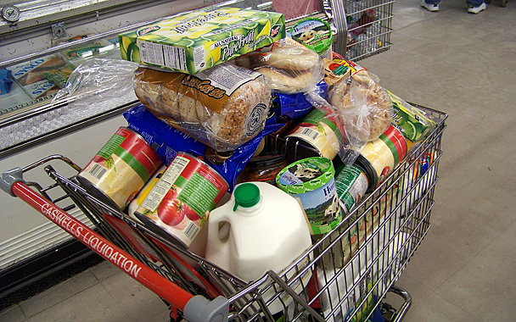
10 Stocks to Buy at the Bottom
Lennar Homes (LEN) $53.45
Home Depot (HD) $116.16
Walt Disney (DIS) $98.84
General Motors (GM) $29.60
Tesla (TSLA) $230.77
Apple (AAPL) $105.76
Solar City (SCTY) $40.99
Gilead Sciences (GILD) $105.33
Wisdom Tree Japan Hedged Equity (DXJ) $52.01
Wisdom Tree Europe Hedged Equity (HEDJ) $56.95

Slide 9

Strategy Outlook-Setting Up the “BUY”
*Sudden spate of weak data his the US, triggering bond rally and dollar weakness
*The bottom in stocks may be in, but expect a retest, and another flash crash, thanks to structurally poor liquidity
*Looming November budget crisis may bring
another government shut down amidst Republican
Chaos and a round of profit taking on recent gains
*Oil trapped in wide $44-$48 range, entering seasonal
weakness
*Delayed interest rate rise weakens dollar extends
gold rally
*Ags clearly discounting major damage from
an el nino winter

Slide 10
The Bill Davis View
Picks of the Week
Buys:
Amazon.com (AMZN) $550 Target to $586
Expedia, Inc (EXPE) $121 Target to $133
Nike, Inc. (NKE) $130 Target to $136
Tesoro Petroleum (TSO) $98 Target to $107
Adobe Systems (ADBE) $84 Target to $90
Salesforce.Com (CRM) $74 Target to $80
Starbucks Corp (SBUX) $57 Target to $62
Facebook, Inc. (FB) $94 Target to $100
Sells:
Keurig Green Mountain (GMCR) $55 Target to $49
Dick's Sporting Goods (DKS) $50 Target to $46
Cabela's Inc (CAB) $46 Target to $40
Tenet Healthcare (THC) $38 Target to $30

Slide 11

The Global Economy-Wobbling
*Sudden spate of weak data his the US, including weak September nonfarm payroll, poor September retail sales at 2.4% YOY, triggering bond rally and dollar weakness
*US Q3 starting to look like an under 2% quarter, dragged down by energy, mining, ag, and commodities earnings
*VW scandal is weighing on Europe with 270,000 jobs, October German ZEW economic sentiment plunging from 12.1 to 1.9
*China Q3 GDP disappoints at 6.9%
holds it own for a week, extending
global commodity/energy/EM rally,
from “free fall” to “subdued and stable”
*Next to come is a “RISK ON” global
synchronized growth

Slide 12
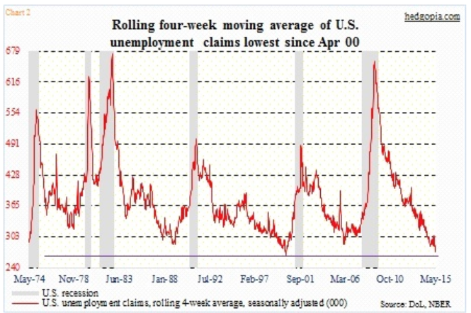
Weekly Jobless Claims – Another Run at the Lows
-7,000 to 255,000 a new 42 year low! headed for Full Unemployment at 5%-Global Recovery a Driver

Slide 13

Bonds-Newfound Strength
*Discounting recent spate of weak economic data and no rate rise for the rest of 2015 brings another rally
*Zero interest rate record broken at 81 months, surpassing 1937-42
*US budget deficit falls to $438 billion, an 8 year low, creating a bond shortage and higher prices
*Stock market rally brings
massive short squeeze in Junk
bonds as hedge funds cover shorts
*Large scale China selling has had
absolutely no impact on the market
*Buy (TBT) on this dip for more
strength in 2016

Slide 14
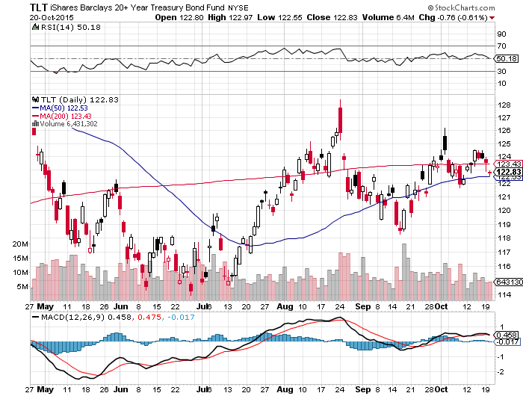
Ten Year Treasuries (TLT) 2.07%
The down trend is in place! Sell Rallies!
Long the (TLT) $128-$133 vertical bear put spread

Slide 15
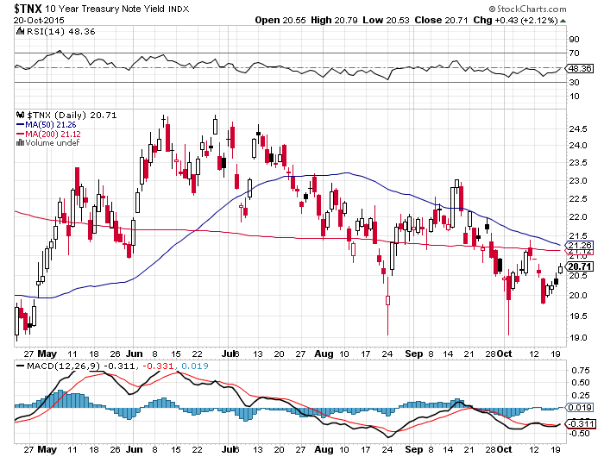
Ten Year Treasury Yield ($TNX) 2.07%
1.90% Support Holds

Slide 16
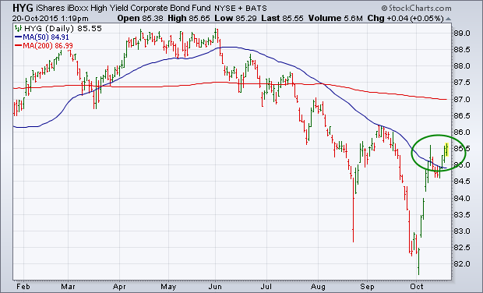
Junk Bonds (HYG) 6.69% Yield
Big Hedge Fund short and Market Bellwether

Slide 17
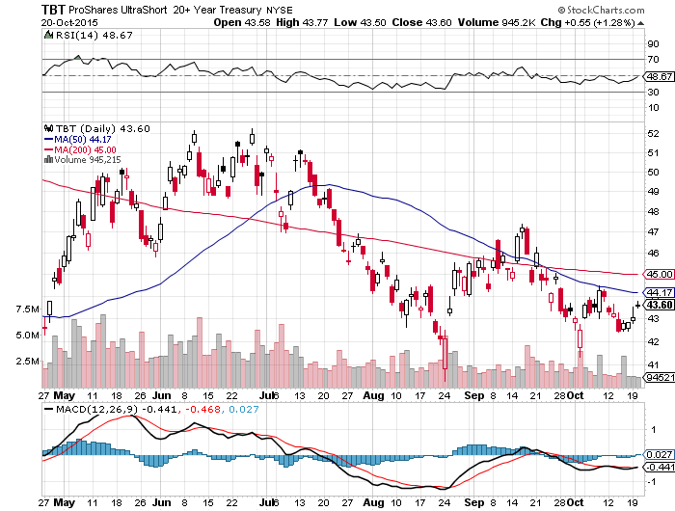
2X Short Treasuries (TBT)-
Big Trade of 2016?
Buy at the Dip, $41 will hold

Slide 18
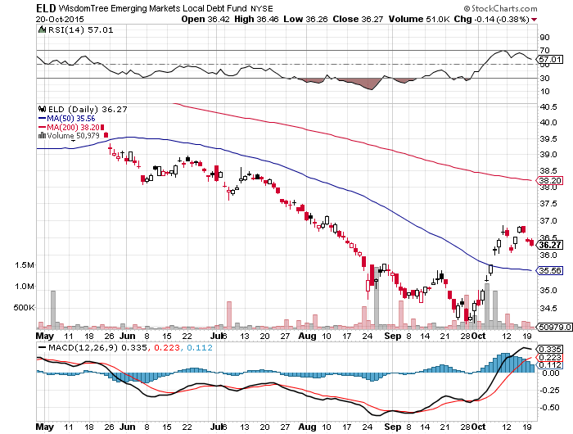
Emerging Market Debt (ELD) 5.81% Yield-
Big hedge funds lining up to sell-Identical chart to junk bonds

Slide 19
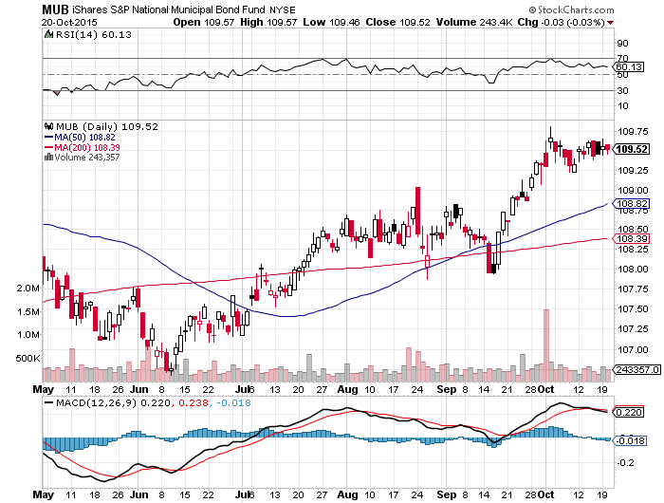
Municipal Bonds (MUB)-1.67% yield
Mix of AAA, AA, and A rated bonds-flight to safety

Slide 20

Stocks-Half Empty to Half Full
*Massive short squeeze sets up (SPX) rally to 2,300 by March, 2016
*Five months of de-risking sets up nice year end rally
*November is the best corporate stock buy back of the year, with 13% occurring, Q4 the best buyback quarter at 30%, is the basis for Q4 rallies
*Ex-energy earnings are still growing, while overall aggregates are falling
*Weak dollar brings major rally in US multinationals, energy, commodity stocks, small caps lag behind
*Stocks that flat lined before are leading the
rally, (HD), (DIS), (AAPL), (GE), (SCTY), (TSLA)
*There is nothing else left to buy

Slide 21
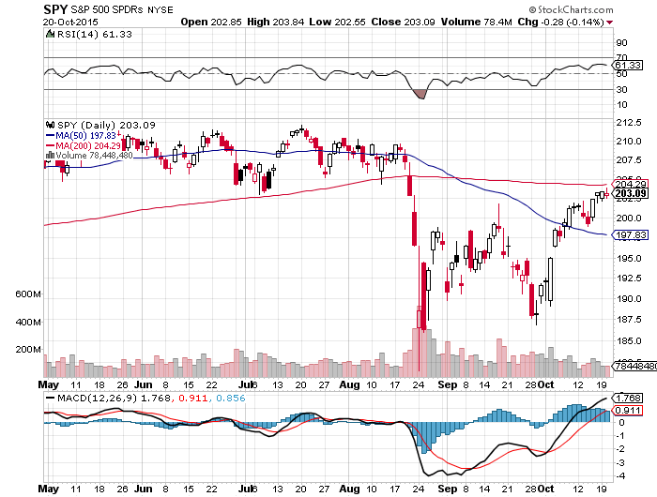
S&P 500-200 Day MA in Play at $204.29
Setting up the Range
Stopped out of long 11/$207-$210 vertical bear put spread for small loss

Slide 22
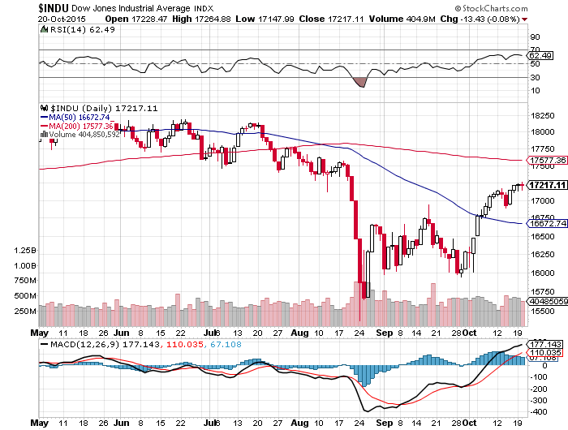
Dow Average- Down -3.5% on the year!

Slide 23
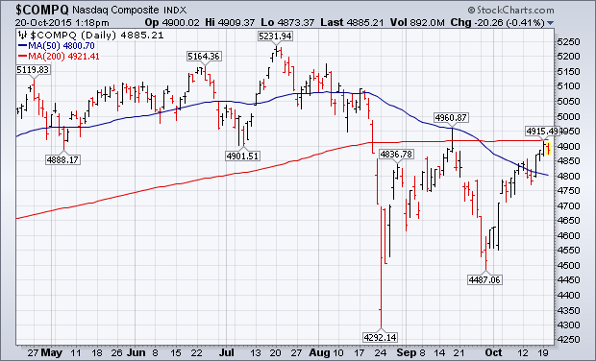
NASDAQ (QQQ)-

Slide 24
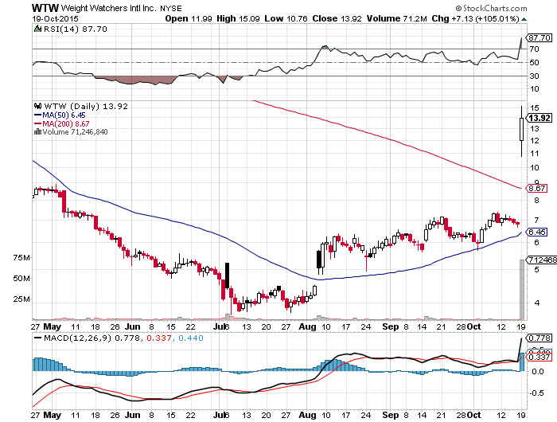
Stock of the Week-Weight Watchers (WTW)
Stock doubles on a 10% Oprah Winfrey stake

Slide 25
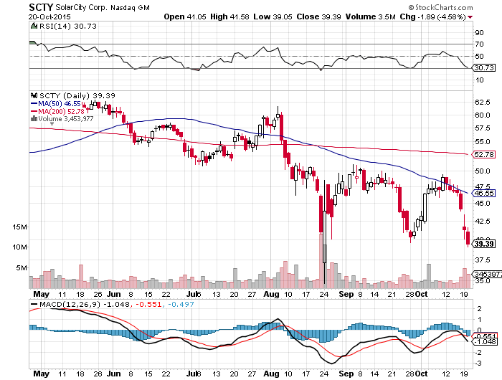
Solar City (SCTY)-Still a Slave to Oil and Tesla News

Slide 26
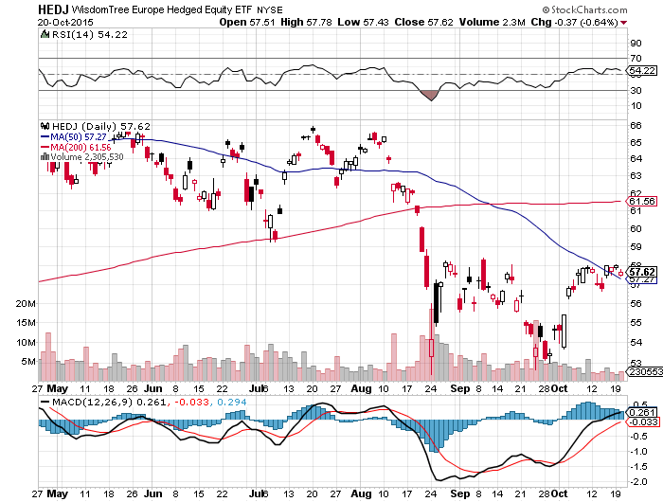
Europe Hedged Equity (HEDJ)-

Slide 27
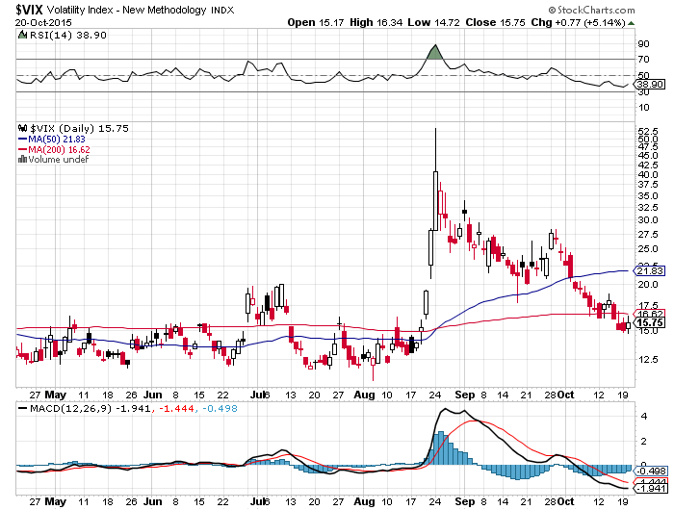
(VIX)-Bleeding Off From Four Year High!
Best Call of the Year!

Slide 28
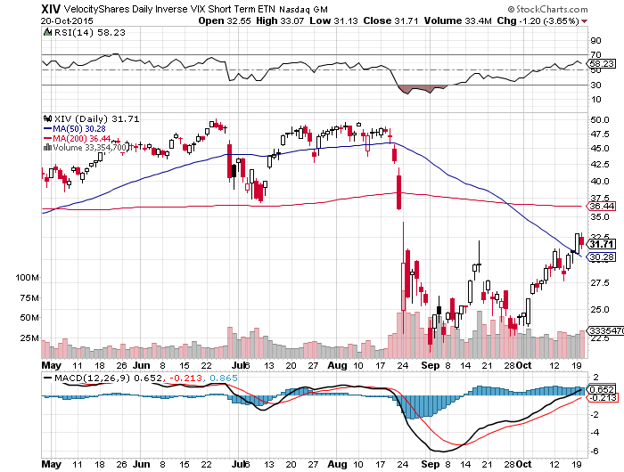
(XIV)-Velocity Shares Daily Inverse VIX Short Term ETN
4 Profitable Round Trips!

Slide 29
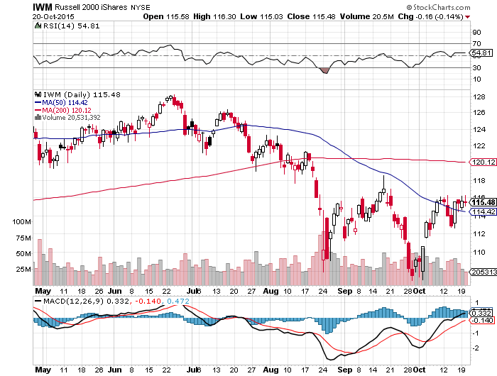
Russell 2000 (IWM)-The Weak Link
No place in a value world

Slide 30
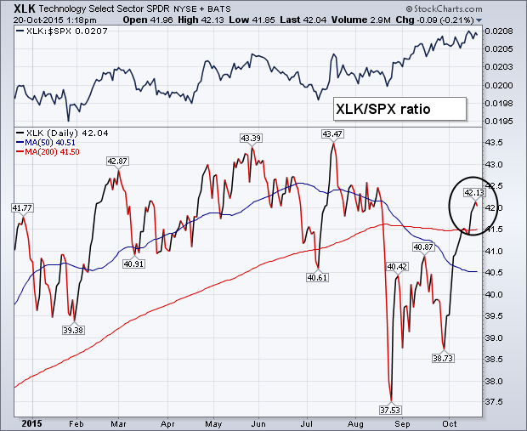
Technology Sector SPDR (XLK), (ROM)
(AAPL), (MSFT), (VZ), (T), (FB), (IBM)
First to Recover 200-Day Moving Average

Slide 31
Industrials Sector SPDR (XLI)-Dow Mainstay
(GE), (MMM), (UNP), (UTX), (BA), (HON)

Slide 32
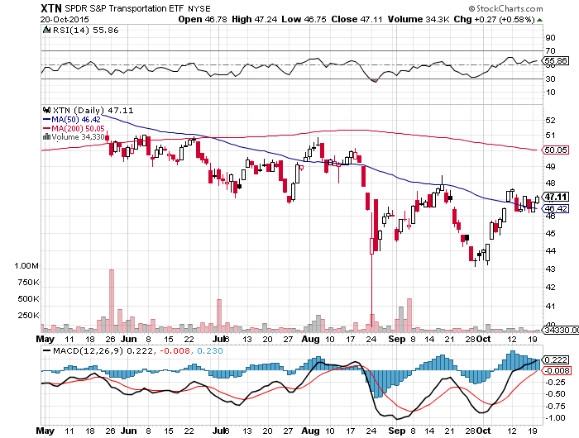
Transports Sector SPDR (XTN)-Another Dow Mainstay
(ALGT), (ALK), (JBLU), (LUV), (CHRW), (DAL),

Slide 33
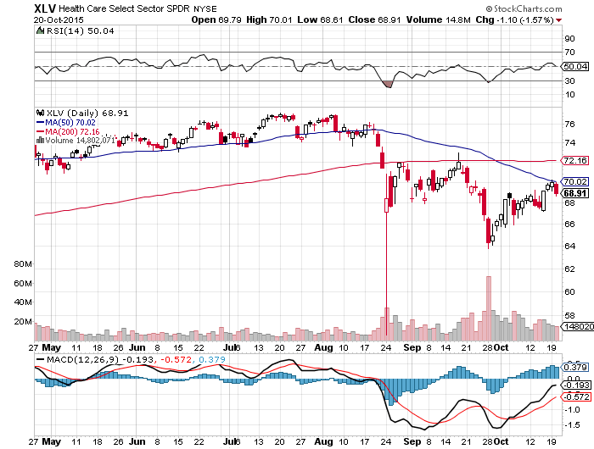
Health Care Sector SPDR (XLV), (RXL)
(JNJ), (PFE), (MRK), (GILD), (ACT), (AMGN)

Slide 34
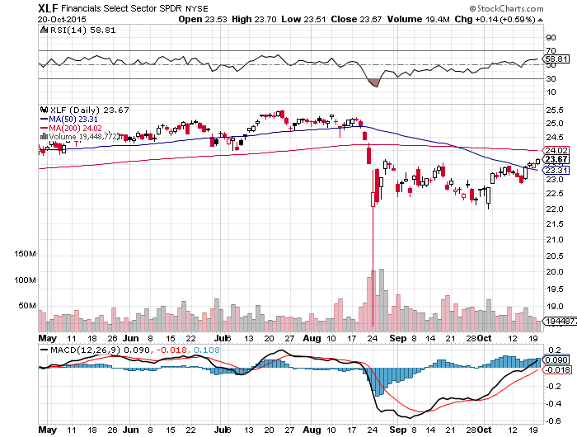
Financial Select SPDR (XLF)-Party Postponed
(BLK/B), (WFC), (JPM), (BAC), (C), (GS)

Slide 35
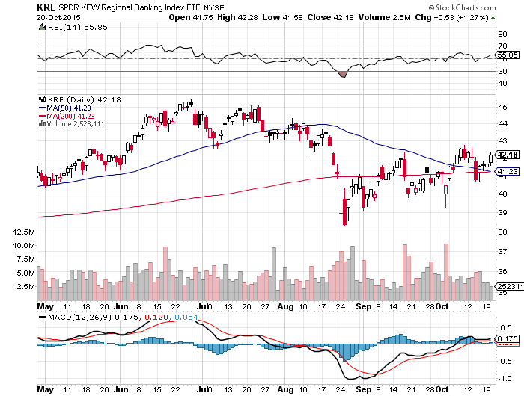
Regional Bank Basket (KRE)-The Fix Disappoints
(MTG), (RDN), (SIVB), (CFG), (CFR), (BXS)

Slide 36
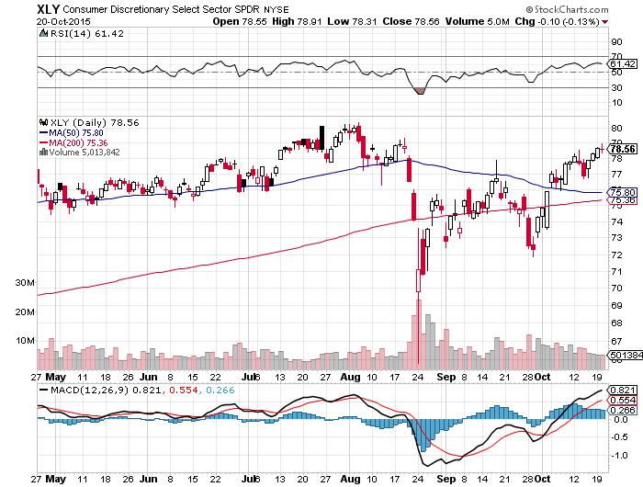
Consumer Discretionary SPDR (XLY)
(DIS), (AMZN), (HD), (CMCSA), (MCD), (SBUX)

Slide 37
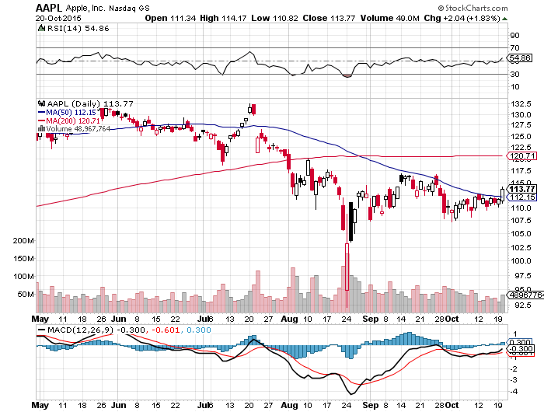
Apple (AAPL) –Announcement Day waiting for the next real catalyst-the iPhone 7

Slide 38
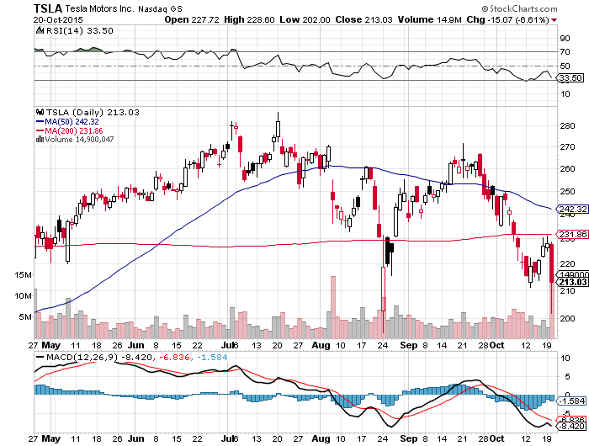
Tesla (TSLA) –
Consumer Report Downgrade Demos Share Price

Slide 39
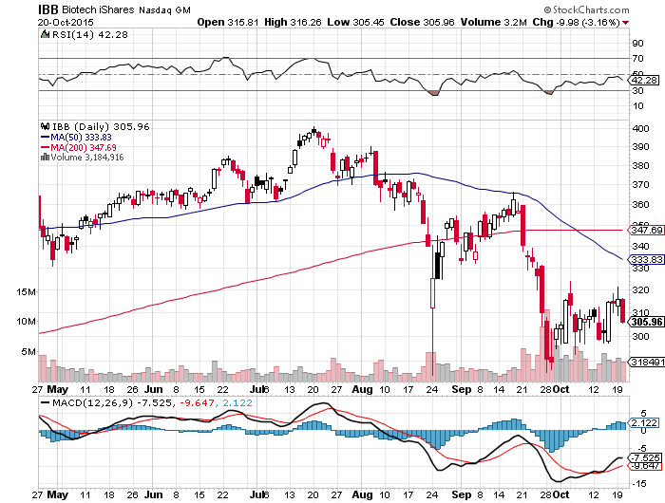
Biotech iShares (IBB)-The Hillary Hit Continues
Government open bidding on drug buys and imports

Slide 40
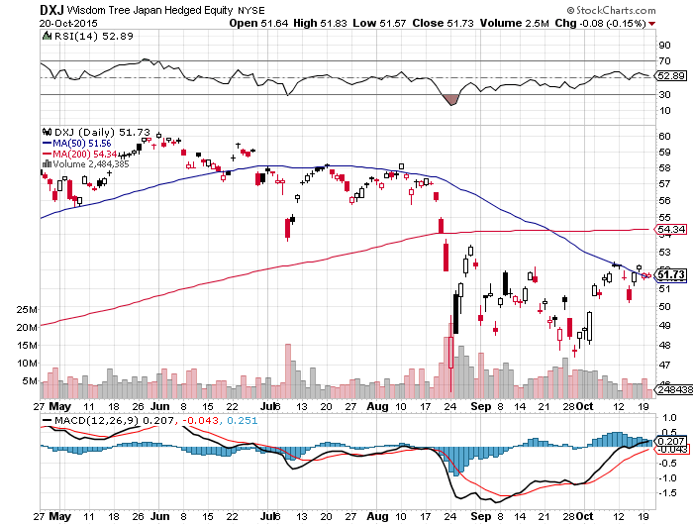
Japan (DXJ)-Hedged Japan Equity

Slide 41
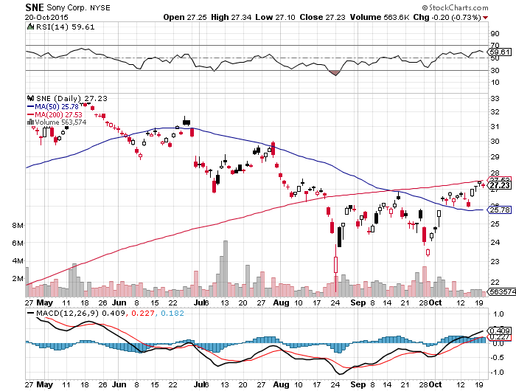
Sony (SNE)-Buy Territory

Slide 42
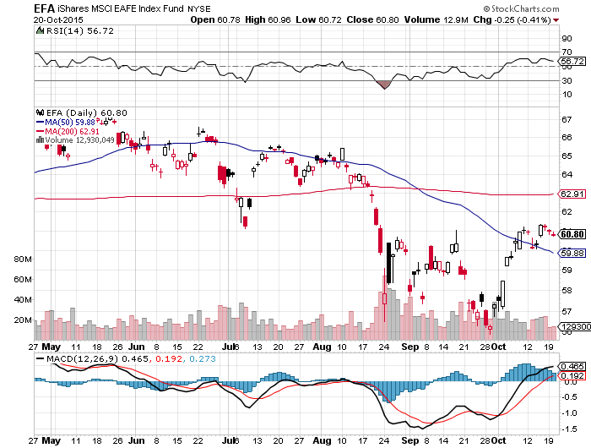
Emerging Markets (EFA)-Bounce on Commodities Rally

Slide 43
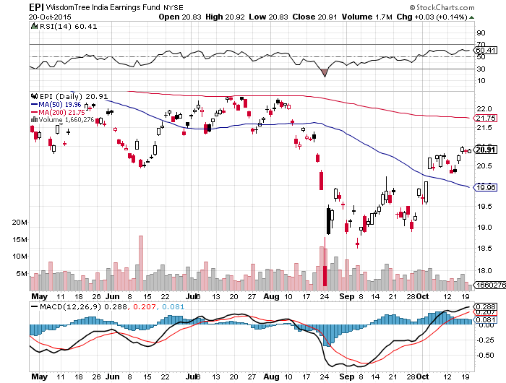
India (EPI)-

Slide 44

Foreign Currencies-Dollar Weakness
*Dimming rate rise prospects cut the legs from under the dollar, triggering rallies in foreign currencies across the board, and putting the dollar bull story on hold
*Commodity dead cat bounce continues, giving new lease on life for Aussie (FXA) and Loonie (FXC)
*Yen threatening upside breakout,
waiting for next round of Japanese QE
*Chinese Yuan (CYB) recovers about
half of 4% devaluation as Chinese stock
market stabilizes

Slide 45
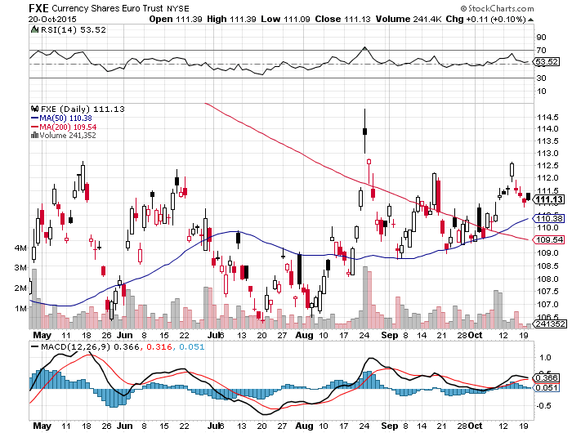
Euro ($XEU), (FXE), (EUO)-Playing Both Asides

Slide 46
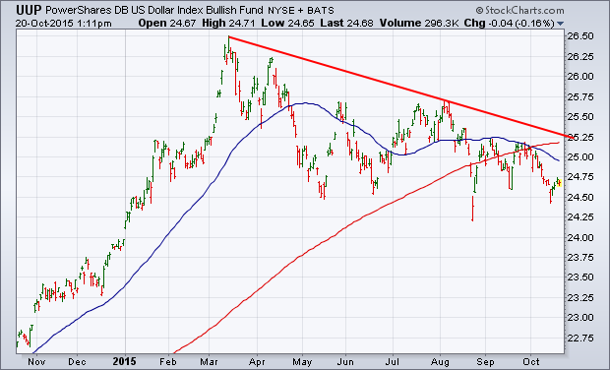
Long Dollar Index (UUP)-

Slide 47
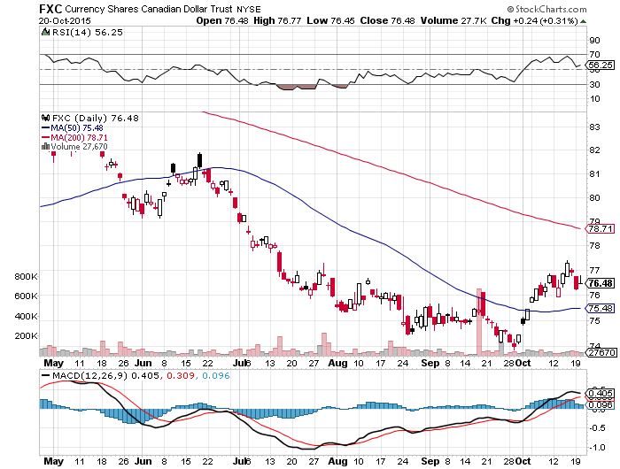
Canadian Dollar (FXC)-Commodity Bounce

Slide 48
Japanese Yen (FXY)-

Slide 49
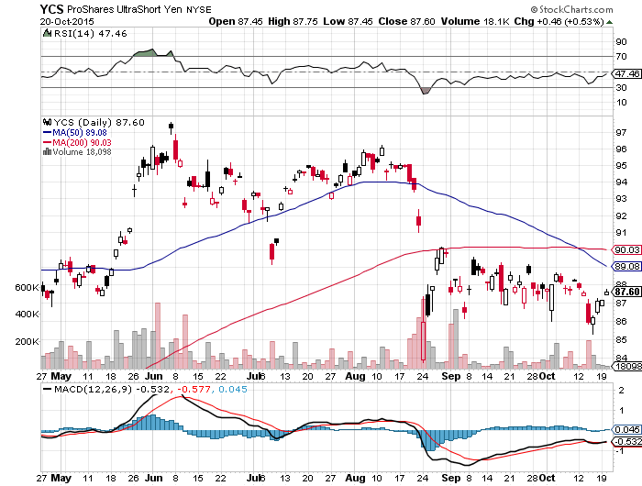
Short Japanese Yen ETF (YCS)

Slide 50
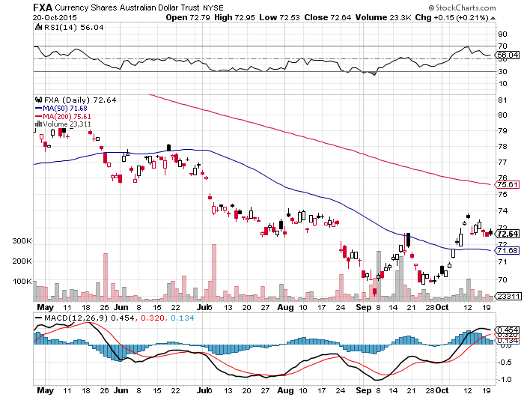
Australian Dollar (FXA) –Bounce

Slide 51
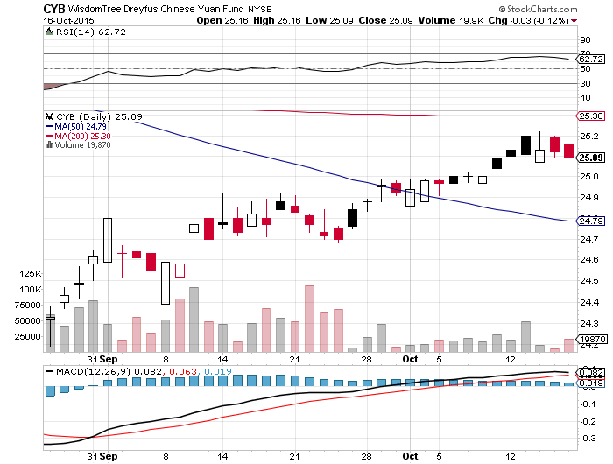
Chinese Yuan- (CYB)-Appreciating Again

Slide 52
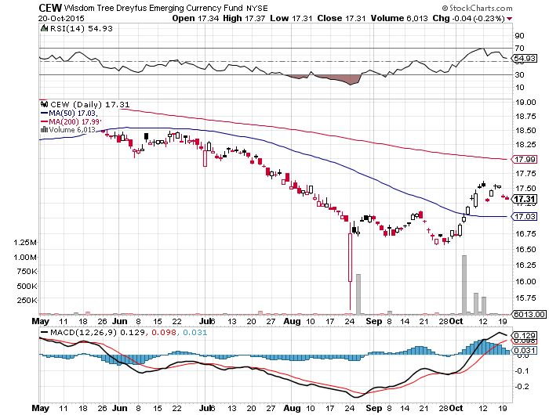
Emerging Market Currencies (CEW)
Another weak dollar beneficiary

Slide 53

Energy-Volatility is King
*The oil markets are now moving from seasonal strength to weakness, should bring the final bottom, speculators now play from the long side
*US Oil Inventories rise a shocking 9.3 million barrels, Saudi inventories at all time high from lack of buyers
*IEA says oil to remain in over supply through 2016, with Iran oil adding to supply
*1,000 wells in North Dakota drilled, but no completed, Bakken production plateaus
*COT report shows market positioning
has gone from long to neutral
*Natural gas has surpassed coal as the
largest generator of electric power
*Solar jobs now beat coal jobs by 2:1

Slide 54
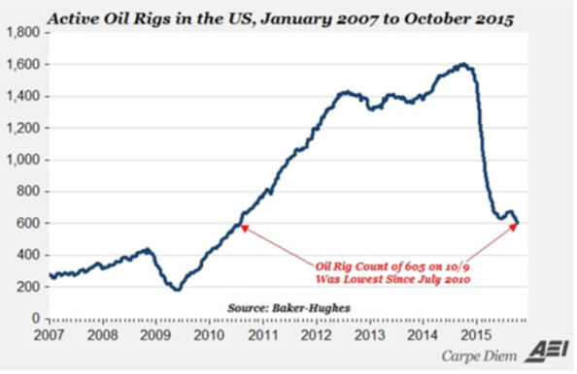
7 Straight Weeks of Rig Count Declines to 595, a 5 year low

Slide 55
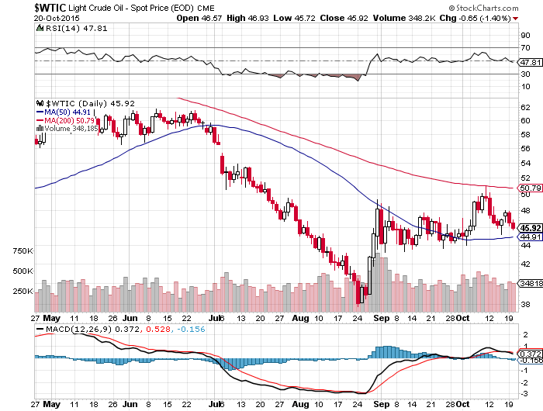
Oil-May Be a Q4 Story-A Buy at $44?

Slide 56
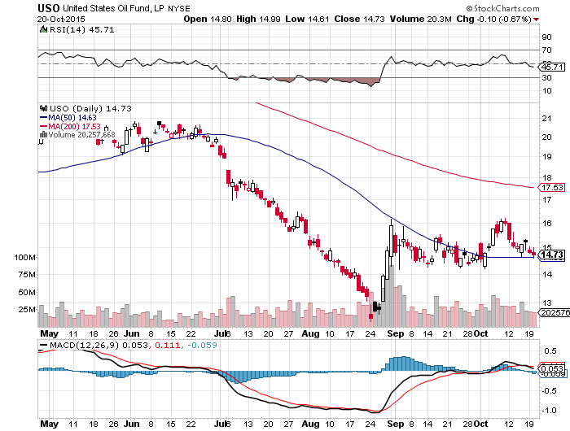
United States Oil Fund (USO)

Slide 57
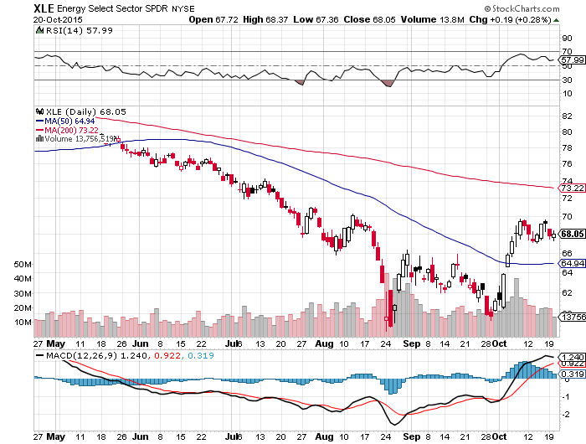
Energy Select Sector SPDR (XLE)
(XOM), (CVX), (SLB), (KMI), (EOG), (COP) stocks lead oil turnaround by 6 months

Slide 58
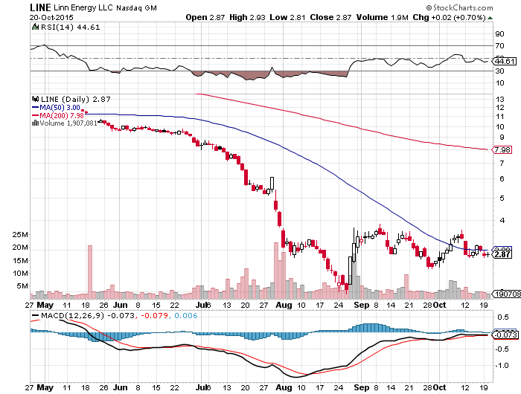
MLP’s (LINE)-Dividend Suspended!
Shares fall to option value

Slide 59
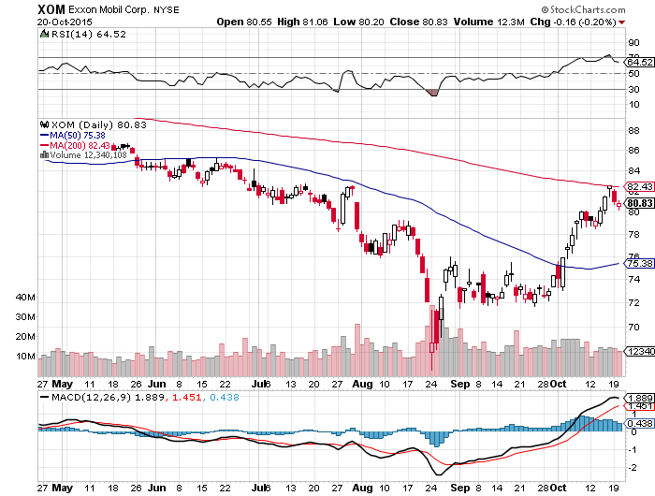
Exxon (XOM)-A Perfect Storm
A massive short covering, weak dollar, oil bottom story

Slide 60
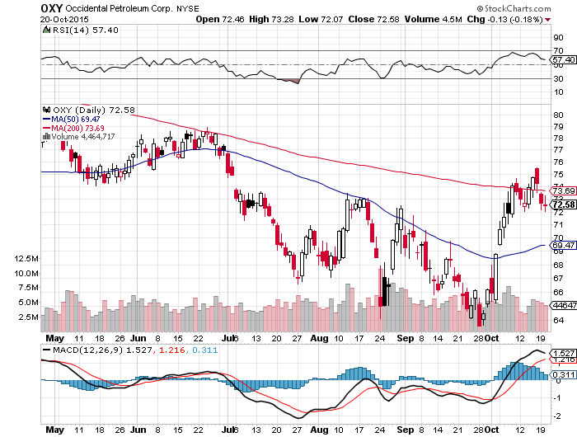
Occidental Petroleum (OXY)-

Slide 61
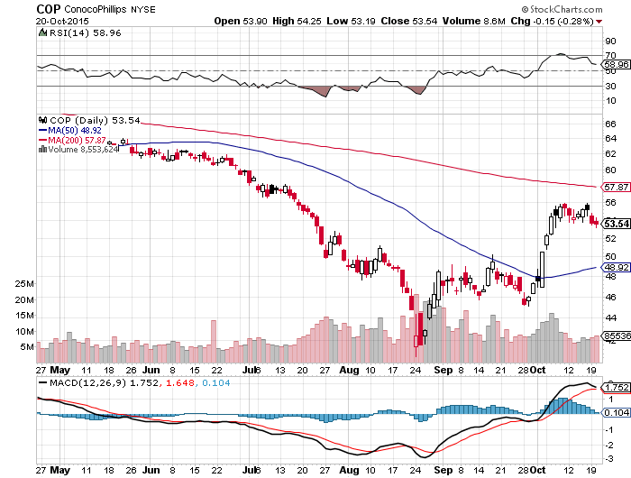
Conoco Phillips (COP)-

Slide 62
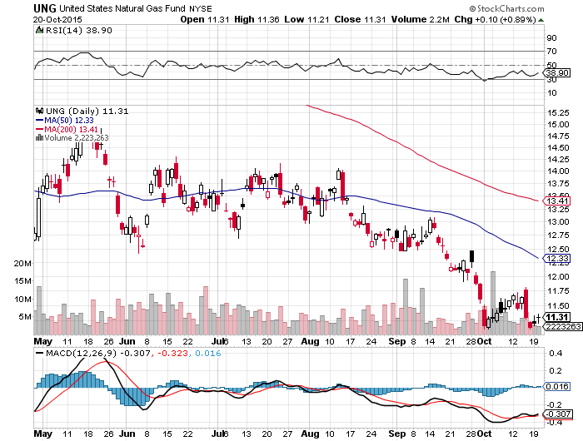
Natural Gas (UNG)-Bouncing along a bottom

Slide 63
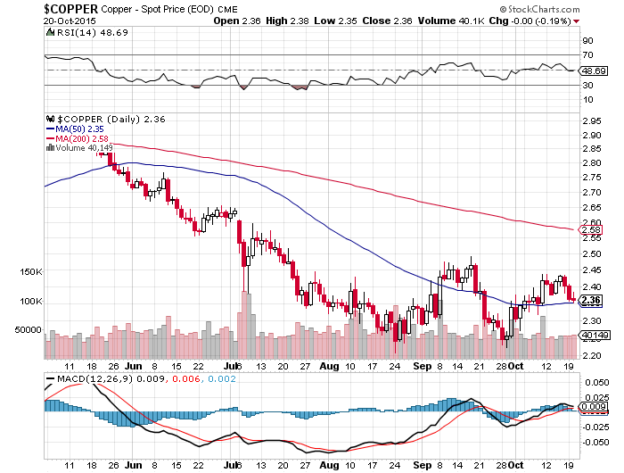
Copper-Commodity Collapse

Slide 64
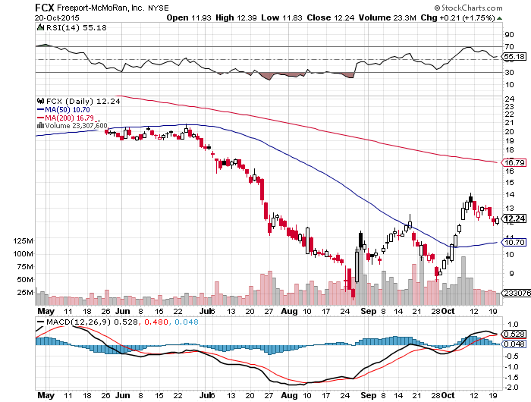
Freeport McMoRan (FCX)-Carl Icahn in Play

Slide 65
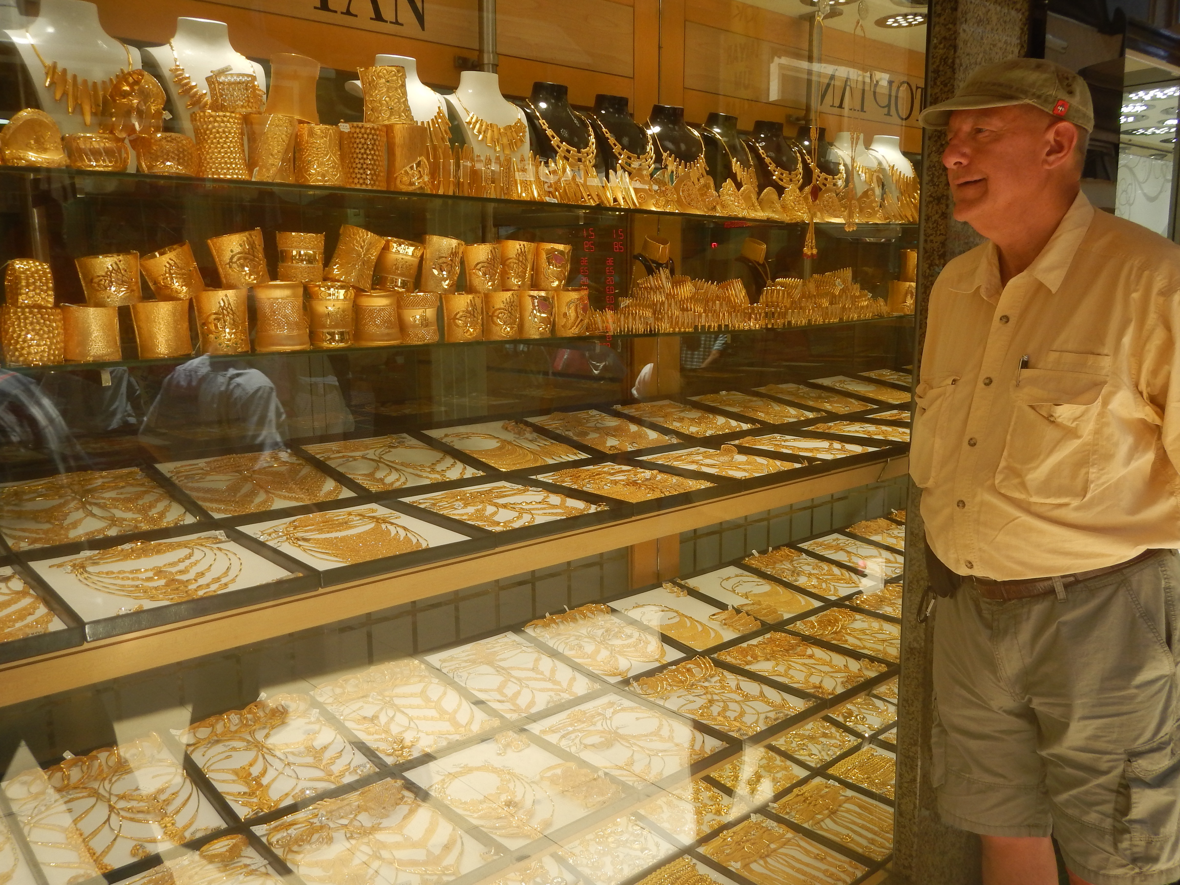
Precious Metals-Short Covering Rally
*Gold Trying to bottom on the charts with a sideways pennant, but is really dependent on a recovery in the rest of the commodity/energy/emerging markets complex
*Russia buys 34 metric tonnes of gold in September , tripling holdings since 2005
*Gold ignores hugely deflationary PPI figures, down -0.5% in September and up only +1.1% YOY, propels high
*Stock market short squeeze bring huge
outperformance by mining stocks
*Gold industry has downsized so much in 4 ½
years that it is providing downside support
*Stay away, gold stocks are
a better play on a dip

Slide 66
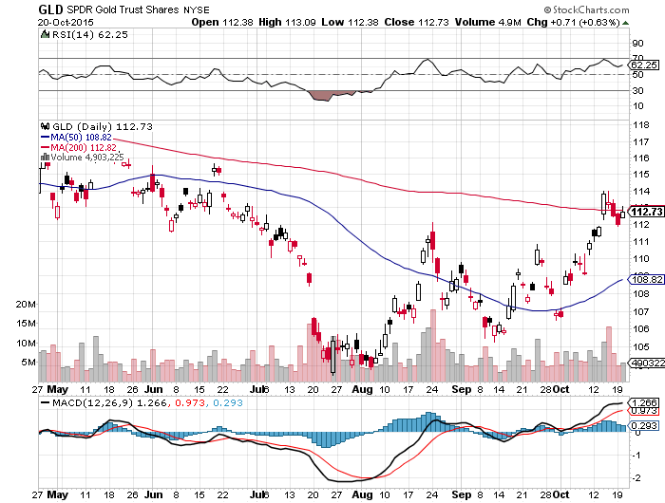
Gold (GLD)- Finally a Weak Dollar Play

Slide 67

Market Vectors Gold Miners ETF- (GDX)

Slide 68

Silver (SLV)-

Slide 69

Silver Miners (SIL)

Slide 70

Platinum (PPLT)-The Volkswagen Effect

Slide 71

Palladium (PALL)-The Non Diesel Play

Slide 72

Agriculture-Looking for El Nino
*Good weather continues perfect harvest conditions in the Midwest
*Strong dollar still a problem, Wheat is $182/metric tonne in Russia vs. $220 from the US
*Grain elevators are full and refusing to accept deliveries, forcing famers to store excess crops on farms
*Specs starting to play ags from the long side, looking towards tighter conditions in 2016
*El Nino is propelling current rally, with
the first big storm causing flash flooding
in Southern California
*Broader oil and commodity bounce
is helping drag up the ags
*Play from the long side here,
but stay close to the exit

Slide 73

(CORN) –

Slide 74

(WEAT)-

Slide 75
Ag Commodities ETF (DBA)-

Slide 76

Real Estate-Shortage of Supply
*Mortgage lending volume drops 27.6% after spiking 25.5% the week before as borrowers rush to beat tightened rules that went into effect October 3
*October homebuilding sentiment jumps 3 points to 64, a decade high, September housing starts up 6.5% to 1.20 million, back to pre crisis levels, permits down 5.0%
*Bond rally brings 30 year fixed mortgage rate down to 3.99%
*Homebuilders to lead stock for rest of 2015
*Traders loading up on these stocks
expecting a strong Spring 2016
*Predicted rush to buy homes to beat
the fed interest rate hike is unfolding
*San Francisco Flintstone house now for
sale for $4.2 million

Slide 77

June S&P/Case–Shiller Home Price Index
+4.7% YOY, Denver, San Francisco, Dallas

Slide 78

US Home Construction Index (ITB)
(DHI), (LEN), (PHM), (TOL), (NVR)

Slide 79

Trade Sheet
So What Do We Do About All This?
*Stocks- buy the big dips in best value names only
*Bonds-the top is in, sell rallies, buy (TBT)
*Commodities-stand aside, buy the next oil down leg
*Currencies- Sell short the Yen and Euro on rallies
*Precious Metals –stand aside, don’t chase
*Volatility-sell short spikes through (XIV)
*The Ags –buy the big dips
*Real estate-buy the homebuilders LT

Slide 80

To buy strategy luncheon tickets
Please go to: www.madhedgefundtrader.com
Next Strategy Webinar
12:00 EST Wednesday,
November 4, 2015
San Francisco, CA
USA!
Good Luck and Good Trading!
Notes:
*

