Slide 1
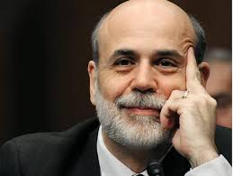
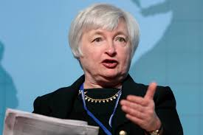
The Mad Hedge Fund Trader “Goodbye QE, Hello QE?”
With John Thomas from San Francisco, CA, February 17, 2016 www.madhedgefundtrader.com
Notes:
*

Slide 2
Trade Alert Performance Making Big Profits in Dire Market Conditions
*January +1.23% Final *July +6.42% Final *February +3.96% MTD *August +1.27% Final *March +3.00% Final *September +11.99% Final *April +6.62% Final *October Final -6.19% *May +5.15% Final *November MTD 5.78% *June +3.68% Final *December -4.94% *2016 Year to Date +5.19% compared to -6.1% for the Dow Average *Trailing 1 year return +38.91%, +196.87% since inception, 2.54% short of all-time high *Average annualized return of 38.1%

Slide 3
Portfolio Review Running Aggressive Risk Management for great returns
Risk On
World is Getting Better
(XIV) | 10.00%
(SPY) 2/$176-$181 call spread | 10.00%
(SPY) 2/$173-$178 call spread | 10.00%
(SPY) 3/$170-$175 calls | 10.00%
Risk Off
World is Getting Worse
(SPY) 3/$200-$205 put spread | -10.00%
(SPY) 4/$182 puts | -5.00%
(SPY) 3/$198-$203 put spread | -10.00%
(FXE) 3/$103-$106 call spread | -10.00%
total net position | 5.00%
Expiration P&L 10.35% YTD

Slide 4
The Method to My Madness A Very Wide Large Short Strangle with multiple cross hedges The bottom line: sleep well at night with low volatility and big profits
*Deep in-the-money (SPY) call spreads hedge the deep in-the-money (SPY) put spreads and visa versa by bringing in extra income *(SPY) 4/$182 outright puts hedge the the deep in-the-money (SPY) call spreads and provide flash crash insurance *(USO) 5/$8 calls hedge the deep in-the-money (SPY) put spreads and (SPY) 4/$182 outright puts *(XIV) hedges the the deep in-the-money (SPY) put spreads and (SPY) 4/$182 outright puts

Slide 5
Paid Subscriber Trailing 12 Month Audited Return +38.91%

Slide 6
62 Months Since Inception Daily Audited Performance Averaged annualized return +38.10%

Slide 7
Strategy Outlook-
*Crowded trades are suddenly becoming uncrowded trades: long FANG, short oil, Euro, copper, gold, junk
*World breaks out with QE fever and negative interest rates (NIRP) *Oil and commodities put in “A” bottom, but not “THE” bottom *US stocks approaching my downside targets for 2016, (SPY) $182 and $174 *No chance of any more Fed rate hikes this year *Gold is the best performing asset class of 2016, up 6%, the bull market is back *Dollar is DOA, better trades elsewhere *El Nino finally gives the ags a break

Slide 8
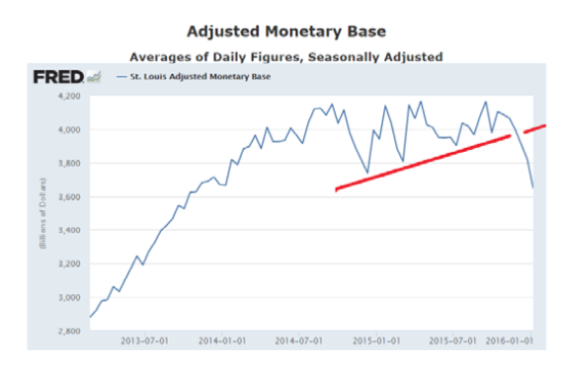
Here is the Problem! No QE = No Bull Market

Slide 9
How This Calamity Ends
*QE in Europe is working, boosting the economy. You see this in the newly strong Euro and better GDP numbers *European recovery brings a Chinese recovery, their biggest export customer *Chinese recovery reduces US volatility *Suddenly, US Investors realize stocks PE is only 15X in a NIRP world *Stable to falling dollar brings emerging country, commodity, and oil recovery *Kaching! The global synchronized recovery is back! BUY!

Slide 10
The Bill Davis View A $1,500 Upgrade for the Mad Day Trader Service
Buys:
Facebook (FB) $96 Target to $117
Akami Tech (AKAM) $48 Target to $66
Martin Marietta (MLM) $132 Target to $138
Gilead Sciences (GILD) $88 Target to $93
Cummins, Inc $97 Target to $113
Intel (INTC) $29.30 Target to $35
Buy on stop
Express Scripts (ESRX) $69.10 Target to $76
Sells:
Apple (AAPL) $100 Target to $87
Boeing (BA) $116 Target to $98
Tesoro (TSO) $80 Target to $68
Incyte (INCY) $74 Target to $60
Nu Skin Ent (NUS) $31 Target to $25
Euronet Services (EEFT) $68 Target to $61

Slide 11
The Global Economy-QE Again! The Immaculate Correction-Bear Market With No Recession
*Decent January nonfarm payroll of 151,000 and 4.9% headline unemployment rate produces a yawn in the market, is proof of no recession. *Consensus forecast for for Q1 US GDP is a bounce back to 2.7%, consumer is in best shape in 13 years, bankruptcies low, debt service at all time low *January US retail sales up a healthy 0.2% as consumers finally start to spend gasoline savings *A recession has NEVER occurred in the face of FALLING oil prices *$2 trillion fall in equity value this year, is starting to have a negative wealth effect on economy *European Q4 GPP comes in at 0.3%, QE is working *Next to come is a “RISK ON” global synchronized growth in H2 2016 once we get through New Year effects

Slide 12
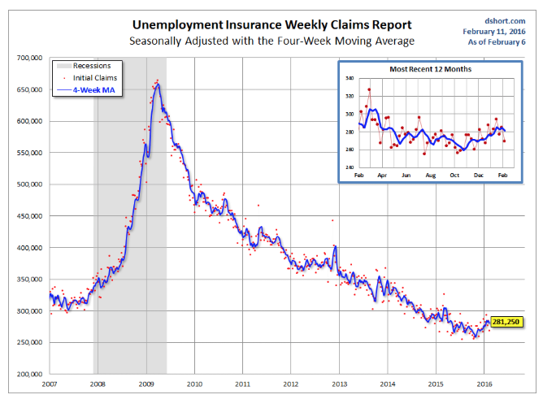
Weekly Jobless Claims –The Most Important Statistic -16,000 to 269,000 The Downtrend Lives!-Show Me the Recession!

Slide 13
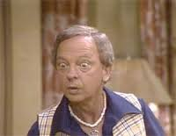
Bonds-Capitulation!
*Short covering panic double tops the (TLT) at $135 *$5.5 trillion in global debt now has negative interest rates, a quarter of the world supply *10 Year Japanese government bonds hit negative interest rates, auction cancelled *Bond yields have now fallen 90 basis points since Fed rate rise, unbelievable! *Foreigners pouring rivers of money into the US as a safe haven *Non energy junk is starting to offer real value *Deutsche Bank buys back $5.5 billion of its own bonds at huge discount

Slide 14
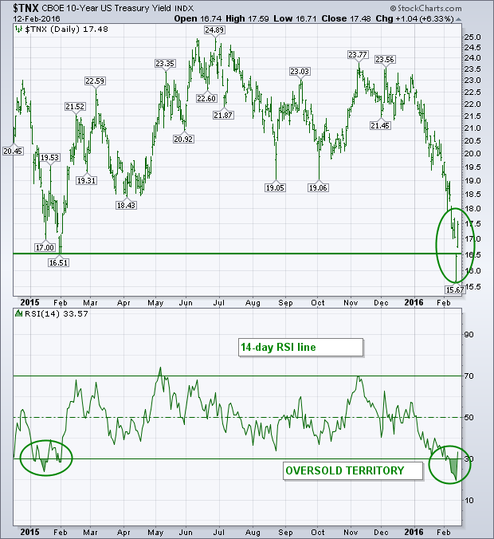
Ten Year Treasury Yield ($TNX) 1.55% The Reversal is In

Slide 15
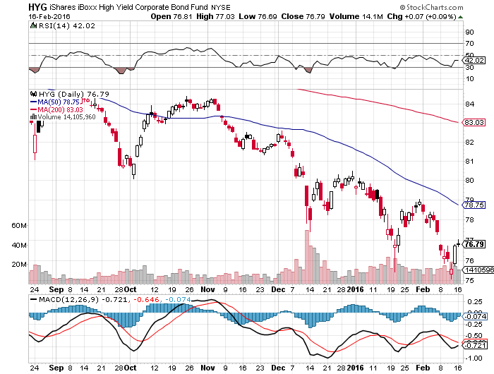
Junk Bonds (HYG) 9.22% Yield A Great Risk Coincident Indicator

Slide 16
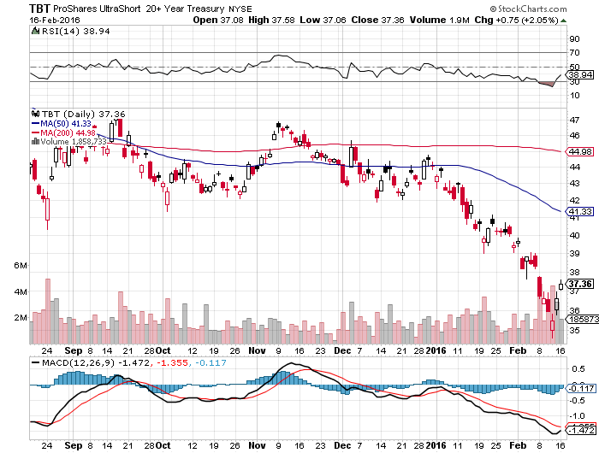
2X Short Treasuries (TBT)-Not Yet the Big Trade of 2016? Back in “BUY” Territory

Slide 17
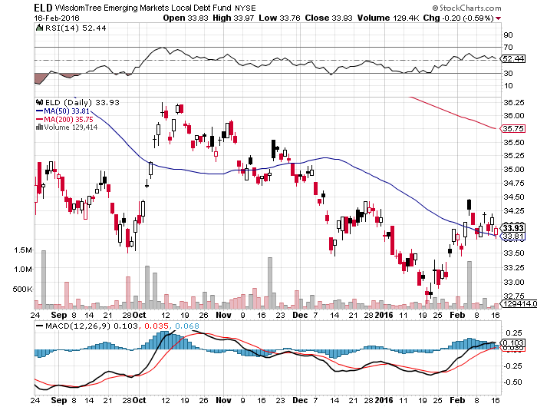
Emerging Market Debt (ELD) 8.39% Yield-

Slide 18
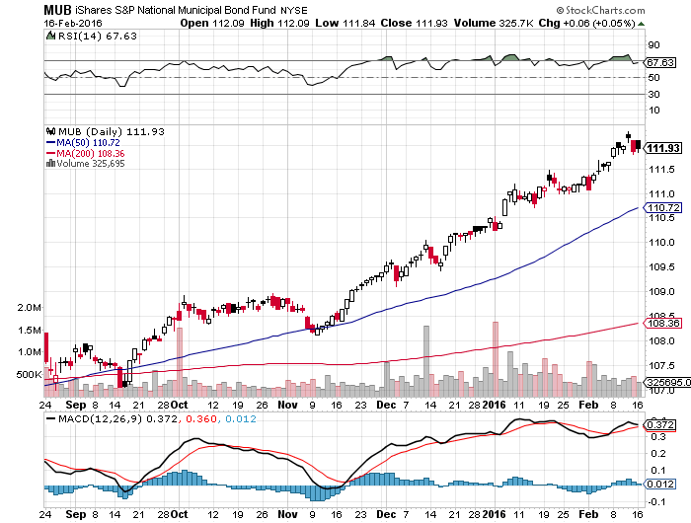
Municipal Bonds (MUB)-1.35% yield-New High Mix of AAA, AA, and A rated bonds-flight to safety

Slide 19
Stocks-Extreme Volatility!!
*Since 1929, there have been 15 bear markets with an average 44% decline over 20 months *Non recessionary bear markets fall only 28% over 6 months *$2 trillion in market cap lost since January 1, about 10% of the total, sovereign wealth selling accelerates as oil falls, with banks as their biggest holdings *But this time its different. This is the first non recessionary bear market WITH ZERO INTEREST RATES! *Corporate buy backs and mergers put a high floor under the market. Investors will pile in when the (SPX) earnings multiple hits 15 and downside momentum breaks at (SPY) $174 *Putting in a bottom in banks: Deutsche Bank buys back $5 billion of its own bonds at near zero interest rates, Jamie Diamond buys $25 million worth of (JPM)

Slide 20
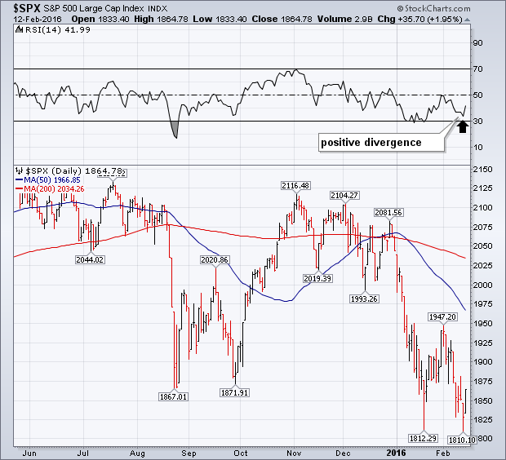
S&P 500-Breakdown! long 2/$173-$178 and 2/$176-$181 vertical bull call spreads long 3/$170-$175 vertical bull call spread long 2/$200-$205 and $198-$203 vertical bear put spread

Slide 21
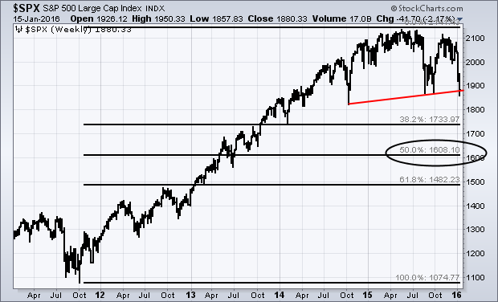
S&P 500-The Really Long View Worst Case $1,740, PE 15X
$1740

Slide 22
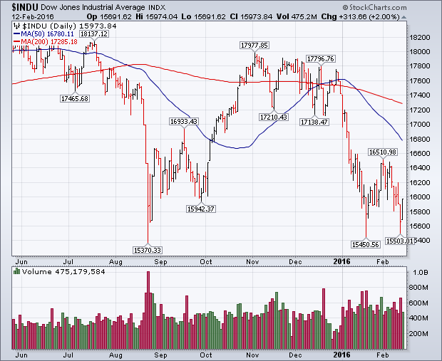
Dow Average-Major Support Bunching Around $15,500

Slide 23
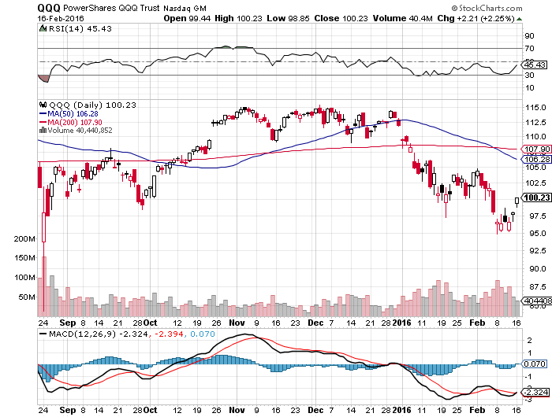
NASDAQ (QQQ)-Break of 200-Day Moving Average! Is now first resistance on any recovery

Slide 24
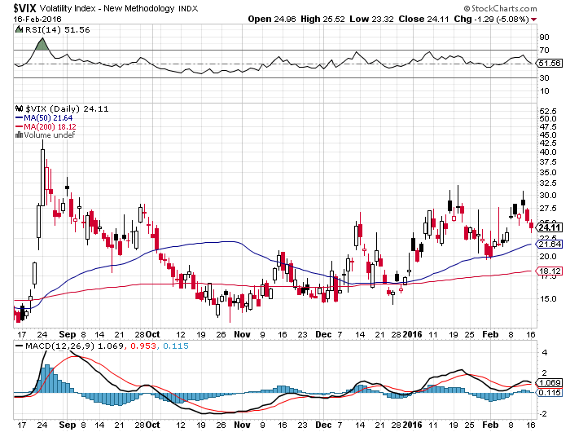
(VIX)-The Spike is Here

Slide 25
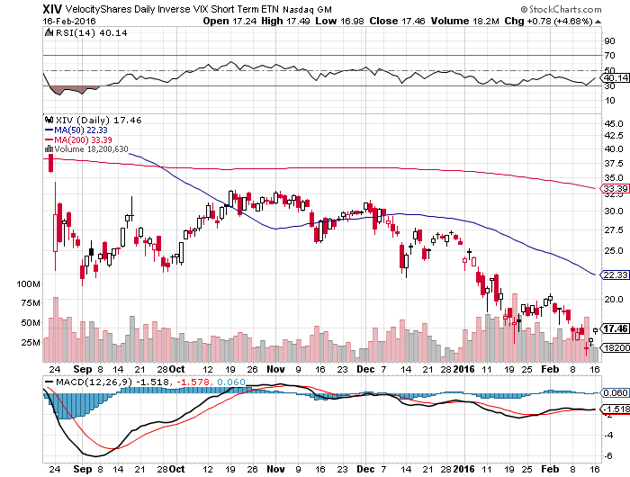
(XIV)-Velocity Shares Daily Inverse VIX Short Term ETN Took Profit on half of position, still 10% long at $23.69, trading against it with (SPY) puts and put spreads LOOKING TO STOP OUT ON NEXT RALLY BECAUSE OF TRACKING ERROR

Slide 26
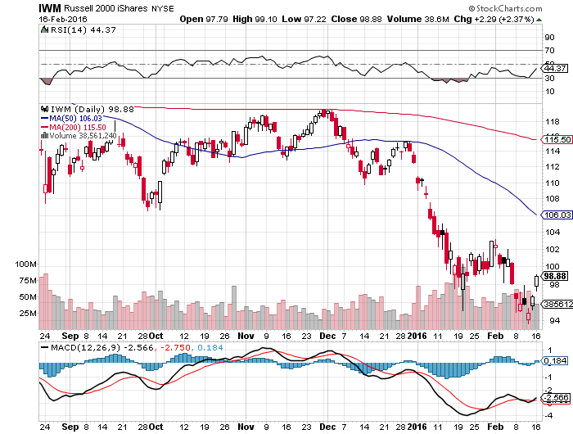
Russell 2000 (IWM)-

Slide 27
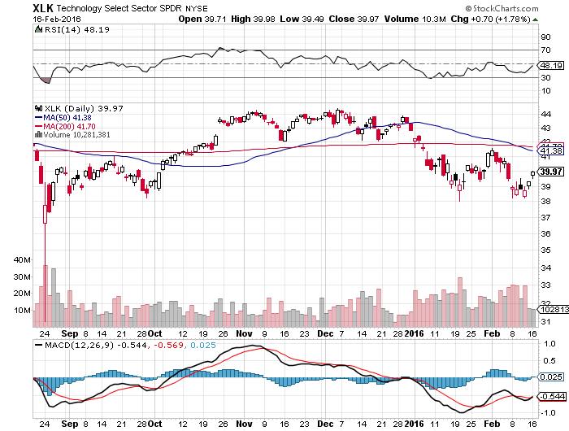
Technology Sector SPDR (XLK), (ROM) (AAPL), (MSFT), (VZ), (T), (FB), (IBM)

Slide 28
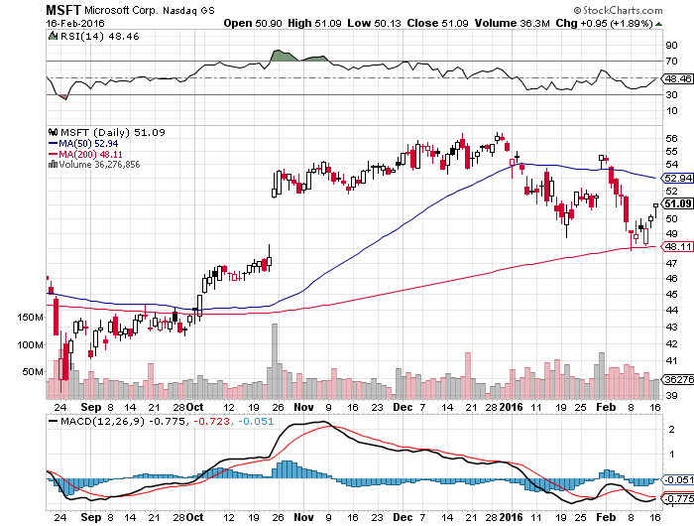
Microsoft (MSFT) took profits on long the 1/$50-$52.50 vertical bull call debit spread

Slide 29
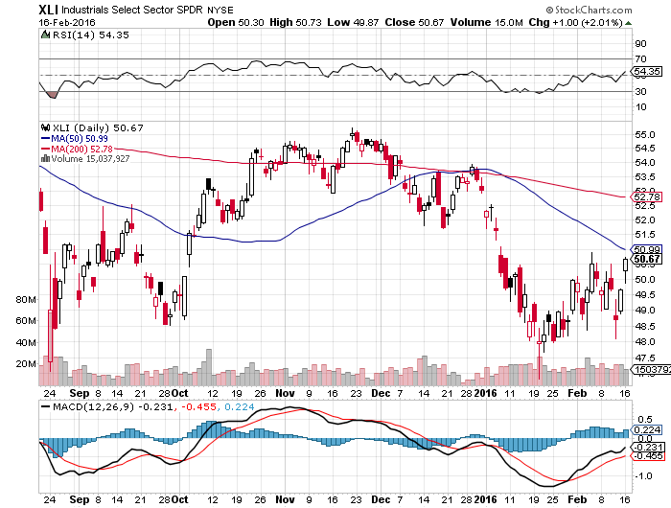
Industrials Sector SPDR (XLI)-Dow Mainstay (GE), (MMM), (UNP), (UTX), (BA), (HON)

Slide 30
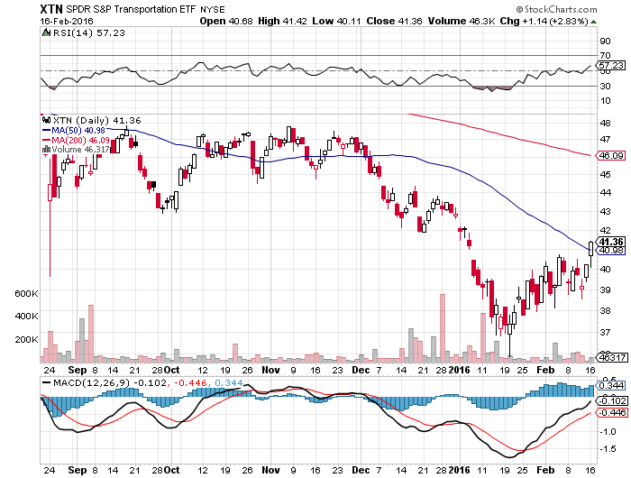
Transports Sector SPDR (XTN)-Another Dow Mainstay (ALGT), (ALK), (JBLU), (LUV), (CHRW), (DAL),

Slide 31
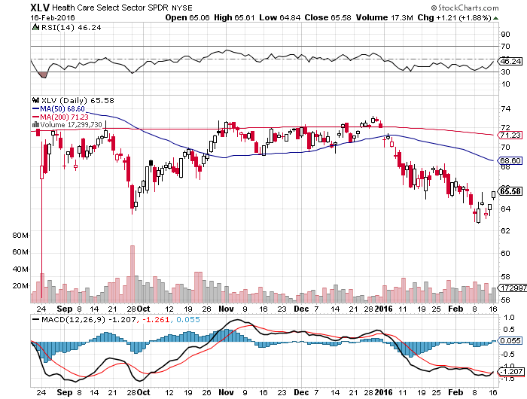
Health Care Sector SPDR (XLV), (RXL) (JNJ), (PFE), (MRK), (GILD), (ACT), (AMGN)

Slide 32
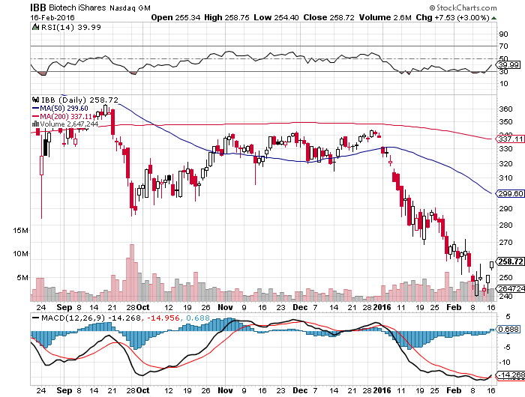
Biotech iShares (IBB)-A Political Football in 2016

Slide 33
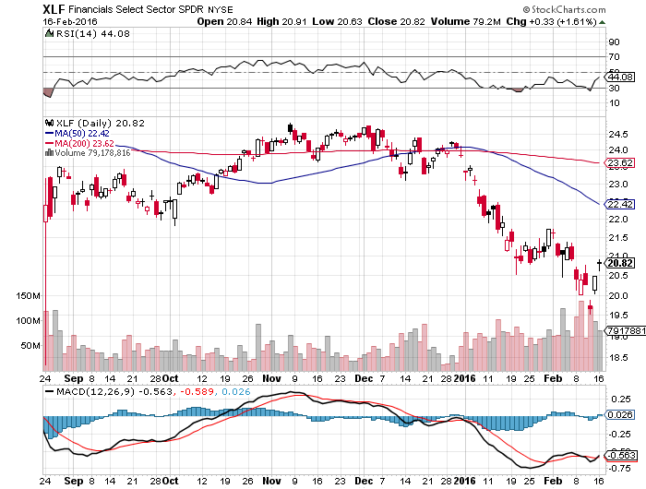
Financial Select SPDR (XLF)- “One and Done” Means “Stay Away” (BLK/B), (WFC), (JPM), (BAC), (C), (GS)

Slide 34
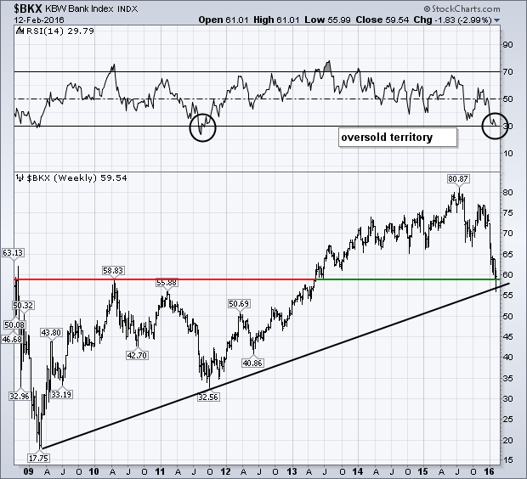
KBW Bank Index ($BKX)- Hit a trend line going back to 2009-Triggered monster rally

Slide 35
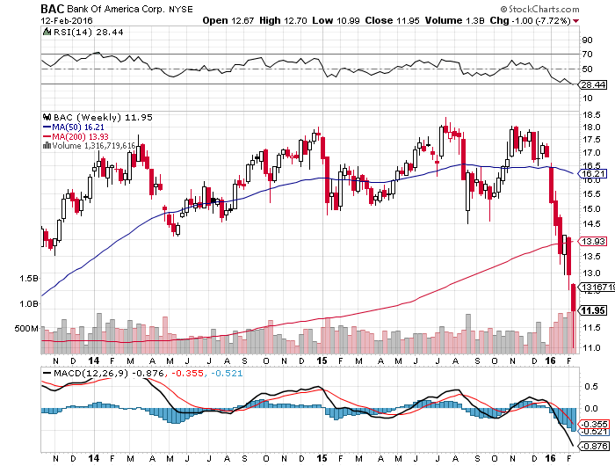
KBW Bank Index ($BKX)- watching the (BAC) 5/$14 calls at 66 CENTS

Slide 36
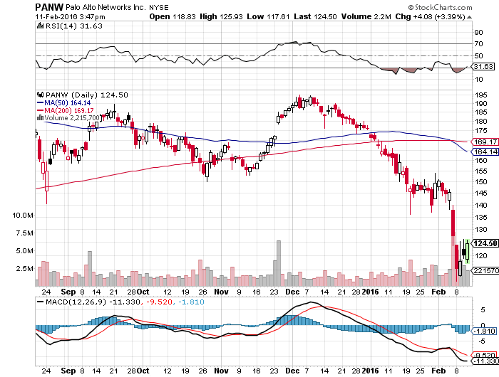
Palo Alto Networks (PANW)- Obama asks for $19 Billion of Cyber Security Upgrades

Slide 37
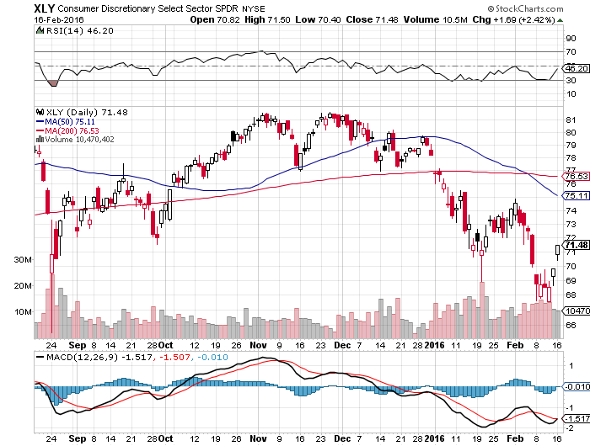
Consumer Discretionary SPDR (XLY) Target to Buy on a dip-Will bounce back fastest (DIS), (AMZN), (HD), (CMCSA), (MCD), (SBUX)

Slide 38
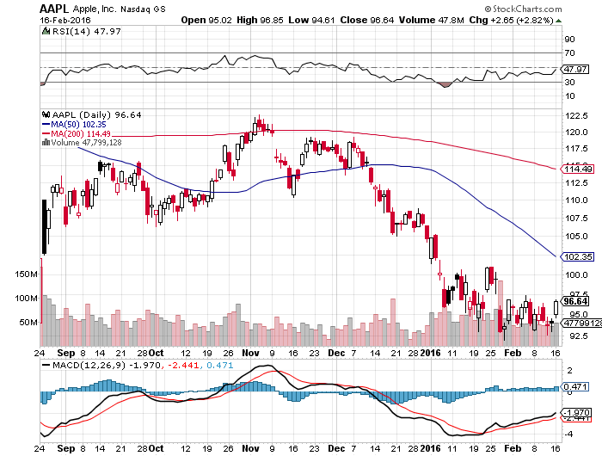
Apple (AAPL) –iPhone production cut 30% Back to waiting for the next real catalyst-the iPhone 7 Buy after Q1 earnings in April to avoid post Christmas dip, $105 billion stock buy backs done

Slide 39
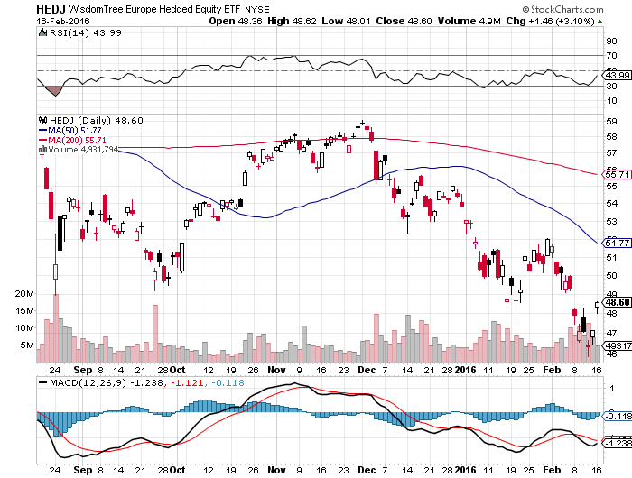
Europe Hedged Equity (HEDJ)-Hedged Japan Equity Great Entry Point setting - Load the boat at $46 on “RISK ON”

Slide 40
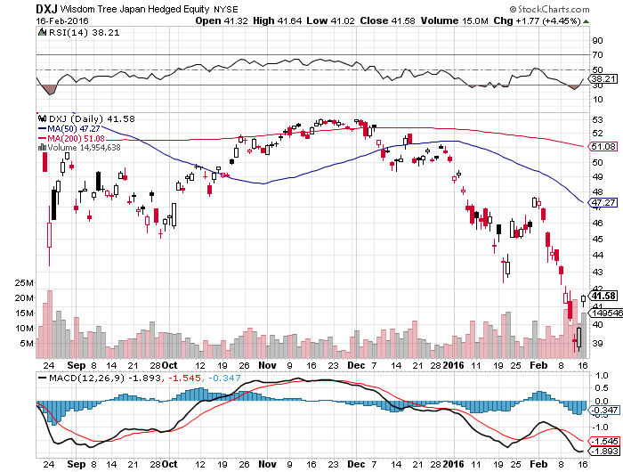
Japan (DXJ)-Hedged Japan Equity Yen Short Covering Rally Crushes the Market

Slide 41
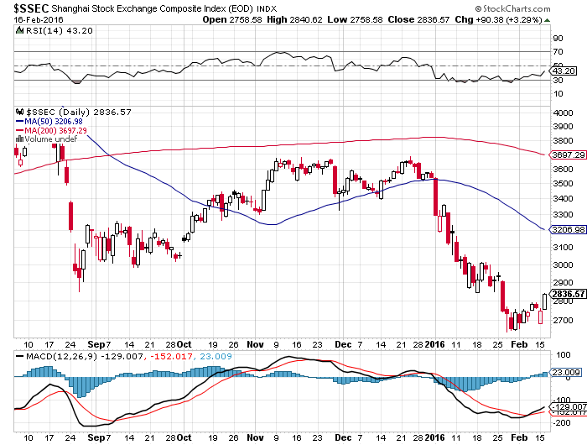
China ($SSEC)- The Bad Boy Market and font of volatility

Slide 42
Foreign Currencies-QE Rules!
*Panic dumping of global positions creates massive unwind of yen and Euro shorts to fund those positions- Buy the Euro on dips *Expect more Japanese QE because the yen at this level will destroy the economy *Ongoing commodity collapse takes commodity currencies to new lows *Slow improvement in European economies could lend further Euro support *With no interest rate moves anywhere, this could be a year of low volatility for currencies *Weak Chinese economy has made shorting the Yuan a new hedge fund favorite

Slide 43
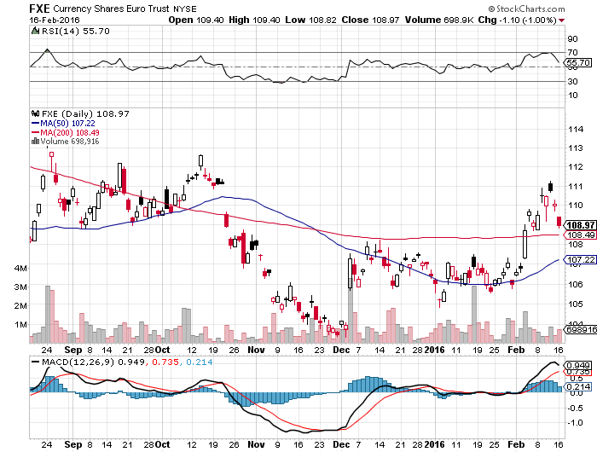
Euro ($XEU), (FXE), (EUO)-Short a Double Position long the (FXE) 3/$103-$106 vertical bull call spread on recovering economy, delayed QE, and NIRP in the price

Slide 44
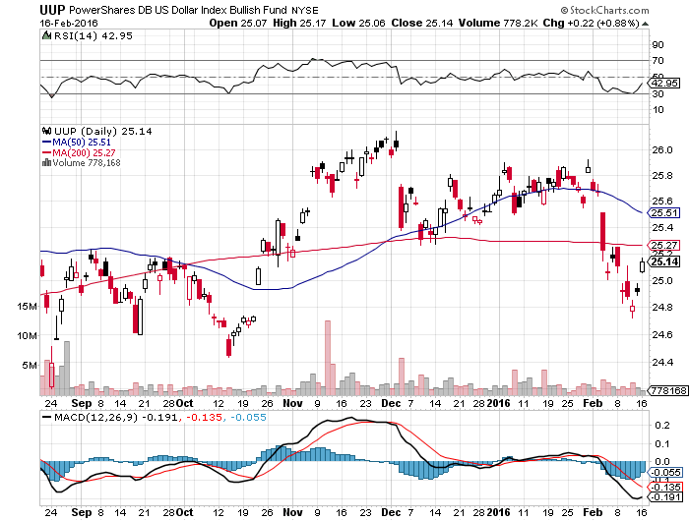
Long Dollar Index (UUP)-Topping out

Slide 45
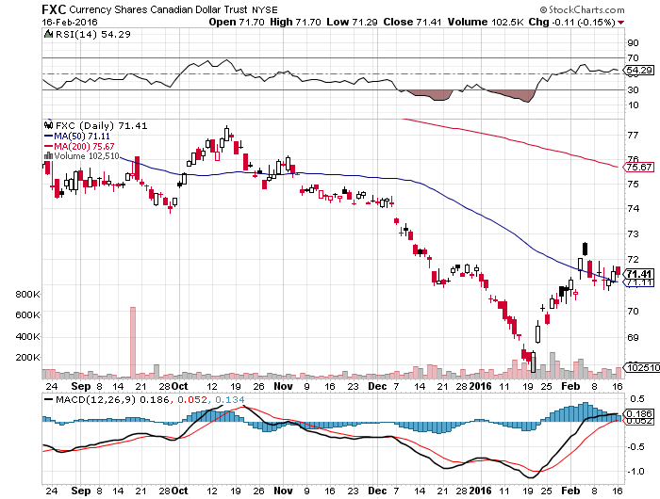
Canadian Dollar (FXC)-Commodity Disaster

Slide 46
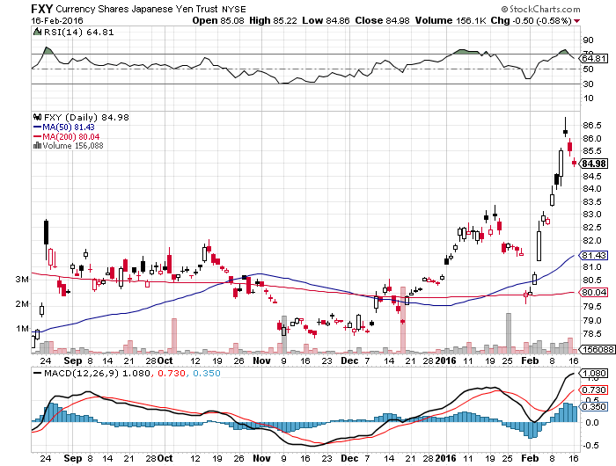
Japanese Yen (FXY)-At a One Year High in “SELL” territory

Slide 47
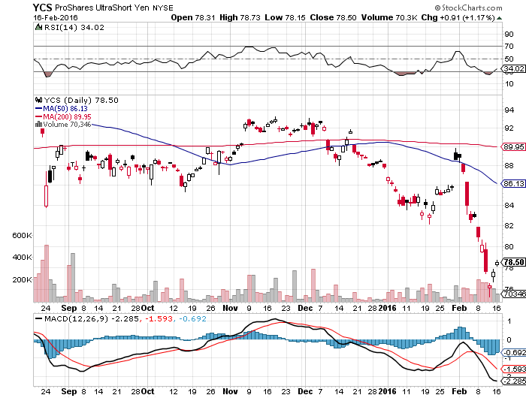
Short Japanese Yen ETF (YCS) in “BUY Territory

Slide 48
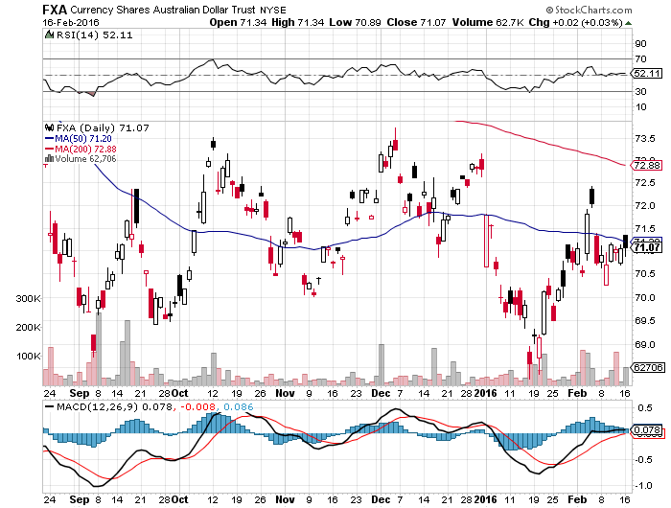
Australian Dollar (FXA)- New Low!

Slide 49
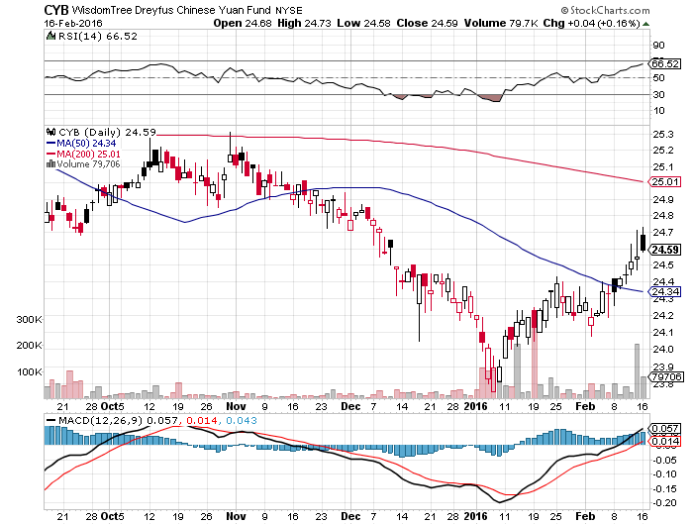
Chinese Yuan- (CYB)-Selling Off on Stock Crash

Slide 50
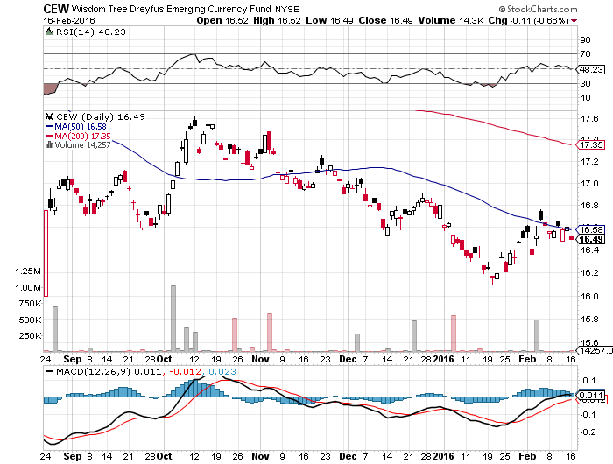
Emerging Market Currencies (CEW)

Slide 51
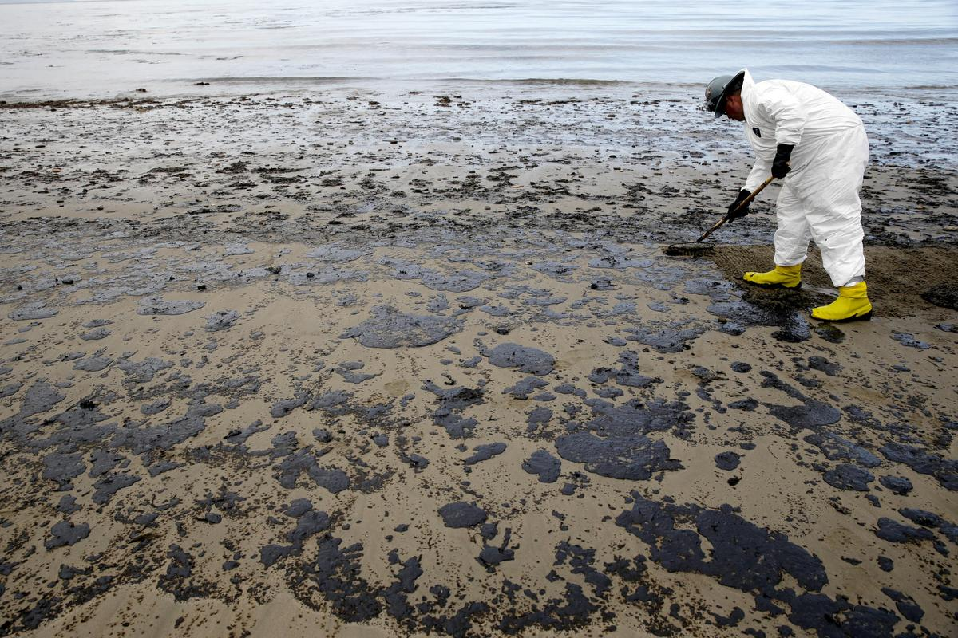
Energy-Oil is Everywhere-Probing for a Bottom
*Saudi-Russian agreement freezes production at all time high, it will be years before demand catches up with supply, setting $20-$44 range for a couple of years, look to buy long dates calls at the low end of this range *President Obama proposes $10/barrel tax on oil imports, has been tried many times before, was also met by offsetting Saudi oil taxes *Only 0.1% of production has been capped by cheap oil *US rigs finally fall sharply, down 49 to 439 in only two weeks, down from the 1,600 top *Russia can’t cap wells because they aren’t insulated, the must continue to over produce *Taking refiners down for seasonal maintenance will cut demand at the worst possible time

Slide 52
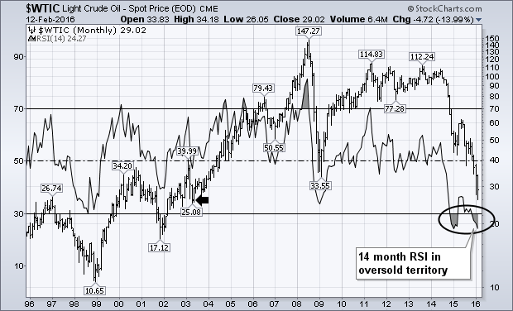
Oil-Won’t Bottom Until later in 2016 Most Oversold Since 2002

Slide 53
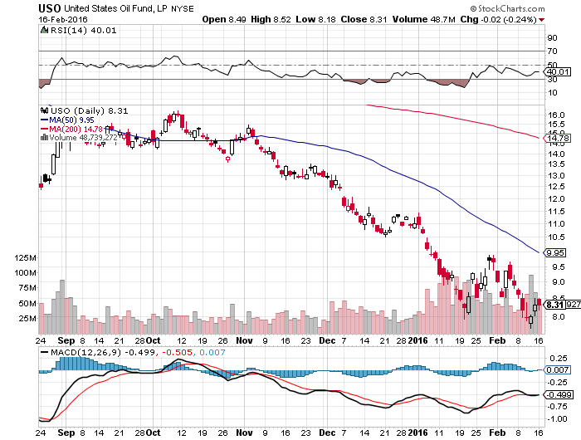
United States Oil Fund (USO) took profits on long the 5/$8.00 calls

Slide 54
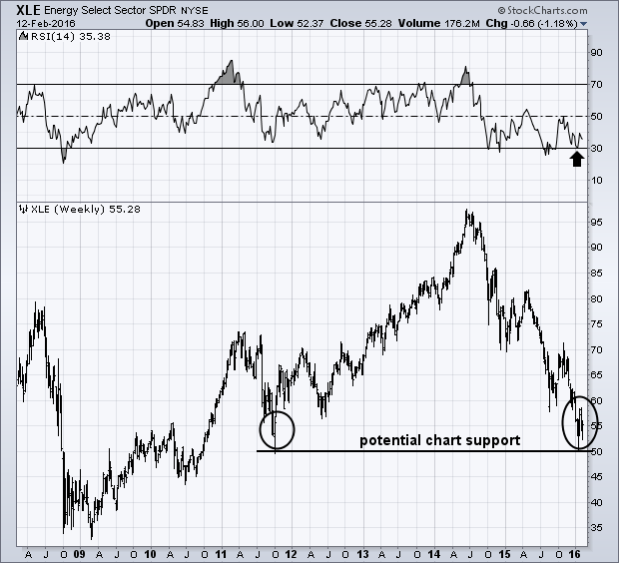
Energy Select Sector SPDR (XLE) (XOM), (CVX), (SLB), (KMI), (EOG), (COP)

Slide 55
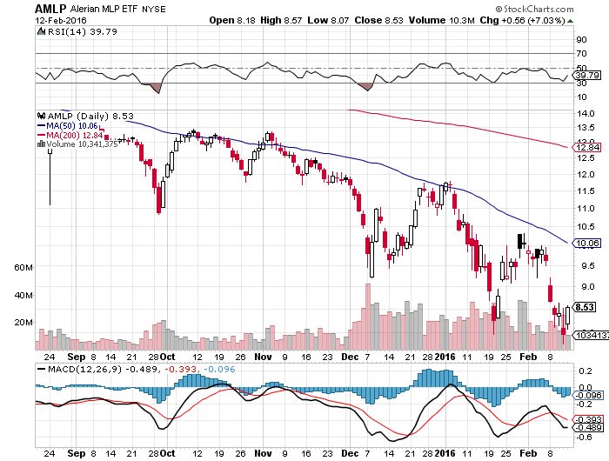
Alerian MLP ETF (AMLP)-11.39% Yield Basket Approach is the Only Safe Play here

Slide 56
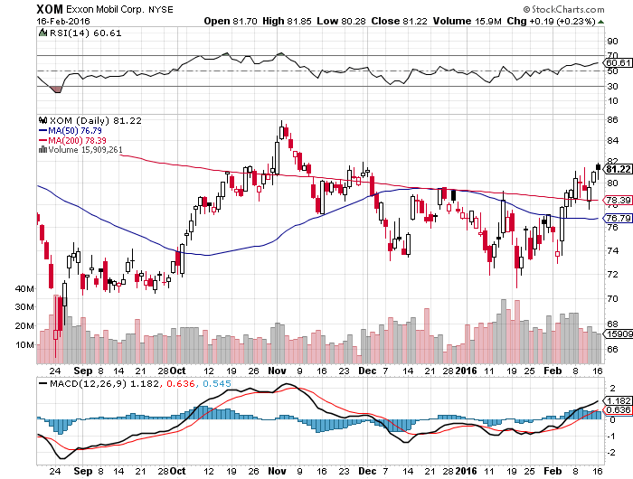
Exxon (XOM)-

Slide 57
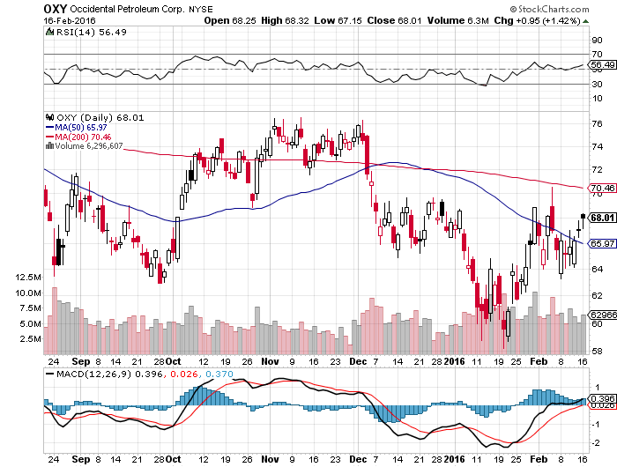
Occidental Petroleum (OXY)-

Slide 58
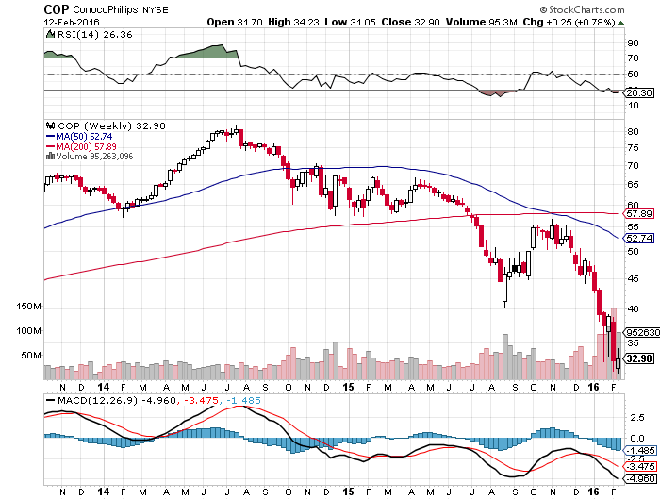
Conoco Phillips (COP)-The Buffet Favorite Down 62% from the top-just cut dividend

Slide 59
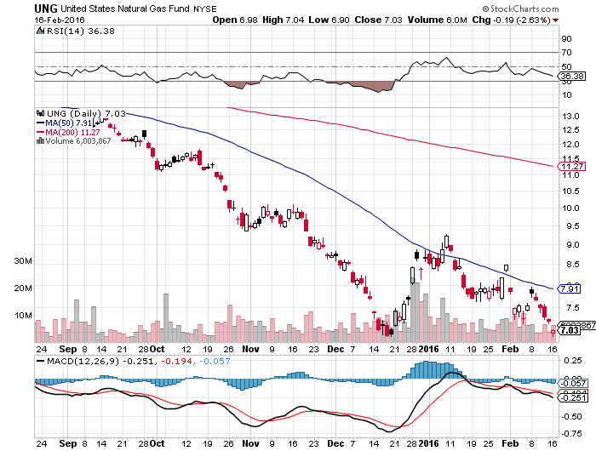
Natural Gas (UNG)-New Lows on Warm Winter

Slide 60
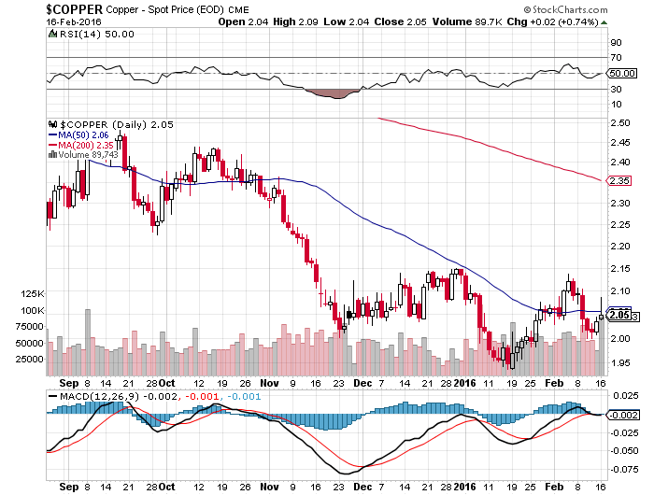
Copper-Trying to Forge a Bottom

Slide 61
Freeport McMoRan (FCX)-Doubled off $3 bottom

Slide 62
Precious Metals-The Bull Lives!-Buy Dips!
*Global panic piles new cash into gold, gold shares (GDX) rocket 40%-100% *Upside break of 200 day moving average signals new bill market *Oil bottom will also call the bottom in the barbarous relic, they’re all linked *Production peaked in Q4, will decline for years, 3% in 2016 and 15%-20% over 3-4 years as no new mines come on stream and ore grades fall *Lack of new discoveries also supporting prices *The new bull market here!

Slide 63
Gold (GLD)-Nailed the Breakout!! Took profits on long the $95-$100 vertical bull call debit spread

Slide 64
Market Vectors Gold Miners ETF- (GDX)

Slide 65
Silver (SLV)-

Slide 66
Silver Miners (SIL)-Finally Kicks In

Slide 67
Platinum (PPLT)-The Volkswagen Effect new chapter of the “Clean Diesel” Scandal

Slide 68
Palladium (PALL)-The Non Diesel Play

Slide 69
Agriculture-An El Nino Boost
*Margin calls forcing farmers to dump grain at low prices, capping any rallies, some Midwest banks are calling in loans as their oil loans go bad *Big storm hits the east coast, misses the prime growing areas of the Midwest, good news for winter crops and bad for prices *Dollar still demolishing US exports *An El Nino boost, but the trend is still down, as with all other commodities *US loses No. wheat export position to Canada because of strong dollar *No trade, there are NO fish to fry

Slide 70
(CORN) – Probing new lows

Slide 71
(WEAT)-New Lows!

Slide 72
Ag Commodities ETF (DBA)- New Lows

Slide 73
Real Estate-The Last Bull Market
*Bond market spike sends 30 year fixed rate to new all time low at 3.50%, mortgage applications rocket by 8.8% in January *US Housing inventory at a 30 year low, impossible to buy a home in a good school district *We are still 40% below normalized housing starts, meaning new construction has to double *Millennials are finally having kids, so new household formation is about to take off *Apartment vacancies on the rise for the first time in a decade as renters shift to buyers *The housing boom has another decade to come *Case Shiller S&P 500 National index continues upward grind

Slide 74
December S&P/Case–Shiller Home Price Index +5.3% YOY, Denver, San Francisco, Dallas

Slide 75
US Home Construction Index (ITB) (DHI), (LEN), (PHM), (TOL), (NVR)

Slide 76
Trade Sheet So What Do We Do About All This?
*Stocks- sell rallies, buy capitulation days *Bonds-the top is near, sell rallies, buy (TBT) *Commodities-stand aside, the bottom is coming *Currencies- Sell short the Yen and Euro on rallies, buy on dips *Precious Metals –buy on dips *Volatility-sell short spikes over $25 through (XIV) *The Ags –stand aside - avoid the disaster *Real estate-buy the homebuilders LT

Slide 77
Next Strategy Webinar 12:00 EST Wednesday, March 2, 2016 San Francisco, CA USA!
Good Luck and Good Trading!
Notes:
*

