Slide 1
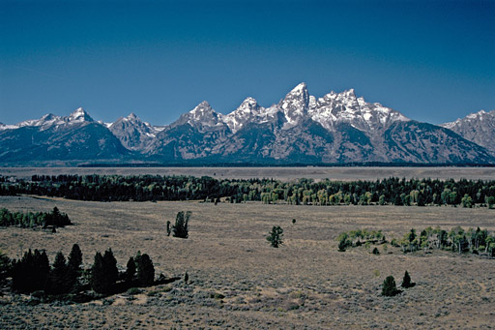
The Mad Hedge Fund Trader
“Top of the Range”
With John Thomas
from San Francisco, CA, March 16, 2016
www.madhedgefundtrader.com
Notes:
*

Slide 2

Trade Alert Performance
Making Big Profits in Dire Market Conditions
*January +1.23% Final *July +6.42% Final
*February +4.50% FINAL *August +1.27% Final
*March -3.52% MTD *September +11.99% Final
*April +6.62% Final *October Final -6.19%
*May +5.15% Final *November MTD 5.78%
*June +3.68% Final *December -4.94%
*2016 Year to Date +2.21%
compared to 0% for the Dow Average
*Trailing 1 year return +35.00%, +193.89% since inception,
5.00% short of all-time high
*Average annualized return of 37.60%

Slide 3
Portfolio Review
Running Aggressive Risk Management
for great returns-March 1, 2016 Position Sheet
current capital at risk
Risk On
World is Getting Better
(FXY) 3/$89-$92 put spread | 10.00%
(FXY) 4/$87-$90 put spread | 10.00%
Risk Off
World is Getting Worse
(SPY) 4/$182 puts | -5.00%
(SPY) 4/$205-$210 put spread | -10.00%
(IWM) $112-$117 put spread | -10.00%
total net position | -5.00%
Expiration P&L
8.94% YTD

Slide 4
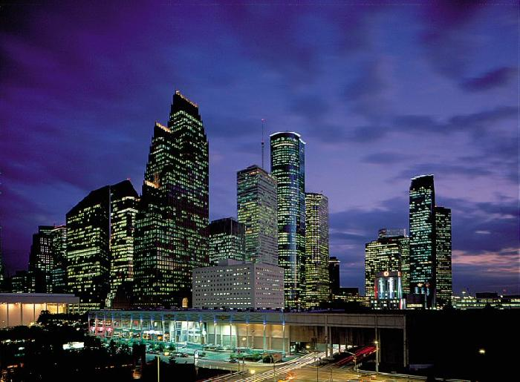
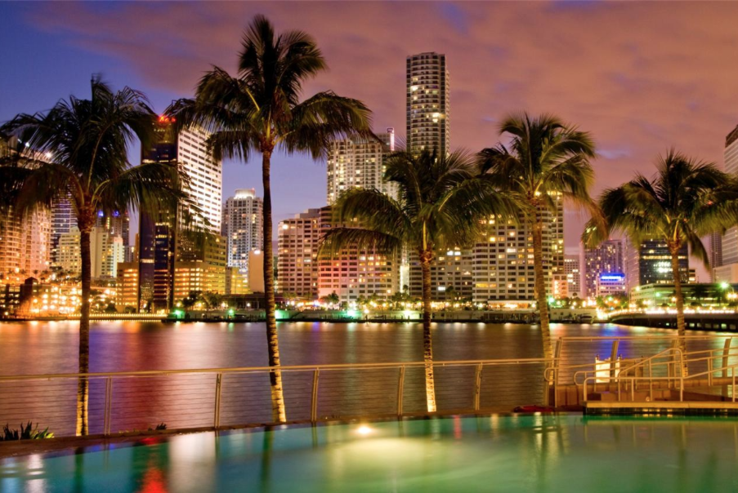
MHFT Global Strategy Luncheons
Buy tickets at www.madhedgefundtrader.com go to “LUNCHES” then “USA”
Houston
April 15, 2016
Miami
May 18, 2016

Slide 5

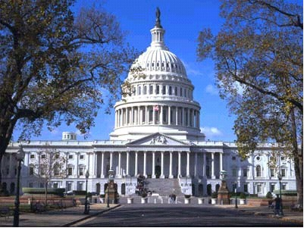
MHFT Global Strategy Luncheons
Buy tickets at www.madhedgefundtrader.com go to “LUNCHES” then “USA”
Atlanta
April 19, 2016
Washington DC
April 20, 2016

Slide 6


MHFT Global Strategy Luncheons
Buy tickets at www.madhedgefundtrader.com go to “LUNCHES” then “USA”
Boston
April 21, 2016
New York City
April 22, 2016

Slide 7
MHFT Global Strategy Luncheons
Buy tickets at www.madhedgefundtrader.com go to “LUNCHES” then “USA”
Chicago
April 25, 2016
tomorrow!

Slide 8

The Method to My Madness
Running a big net short in an overbought market
*Deep in-the-money (SPY) put spreads
call for a market to go sideways or down
*Deep in-the-money (IWM) put spreads
diversify short risk into weak small caps
*(SPY) 4/$182 outright puts give us
extra oomph on the downside
for one more month
*Double Short (FXY)
half to expire at max profit in 2 days
hedges big “RISK OFF” position

Slide 9
Paid Subscriber Trailing 12 Month Audited Return +35.00%

Slide 10
63 Months Since Inception
Daily Audited Performance
Averaged annualized return +37.26%

Slide 11

Short Term Strategy Outlook-
*Global “RISK ON” rally will last only as long as oil keeps rising, expect a big dump on next oil weakness
*Both Europe and Japan are running out of government bonds to buy for QE, owning almost the entire float
*Oil bottom at $26 looking more convincing, but expect a retest in coming weeks
*US stocks have now defined the 2016 wedge formation between (SPX) 1812 and 2050, will take 6 for months to resolve to the upside
*Bonds now baking I more rate rise this year, and maybe 2
*Gold takes a rest after a great run
*Dollar is DOA, continues sideways move, boosting stocks
*El Nino gives no respite to the ags

Slide 12
The Bill Davis View
A $1,500 Upgrade for the Mad Day Trader Service
Buys:
Alphabet (GOOGL) $740 Target to $760
Stamps.com (STMP) $108 Target to $125
Chubb, Ltd (CB) $117 Target to $120
Clorox (CLX) $120 Target to $140
Buy on stop above $120
Costco (COST) $151 Target to $158
Aetna (AET) $112 Target to $117
Zimmer Holdings (ZBH) $101 Target to $108
Sells:
Amgen, Inc. (AMGN) $146 Target to $139
Shake Shack (SHAK) $37 Target to $29
Buffalo Wild Wings (BWLD) $160 Target to $148
Dycom Industries (DY) $58 Target to $50
Fossil Group, Inc (FOSL) $48 Target to $34

Slide 13
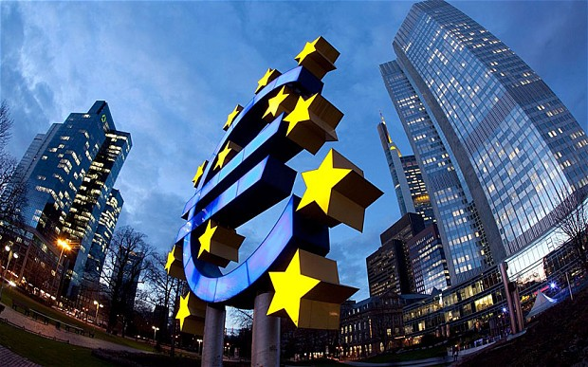
The Global Economy-QE Again!
*ECB president Mario Draghi cuts deposit rate from -0.3% to -0.4%, increases QE from €60 to €80 billion a month, extends to April 2017
*Expect Japan and China to continue with more QE as well
*Jobs are still rocking, with 4.9% unemployment and February nonfarm payroll at a healthy 242,000
*Expect one more oil down leg to trigger global “RISK OFF” move
*All commodities have just had incredible run,
but will peak out seen without Chinese recovery
*Next to come is a “RISK ON” global
synchronized growth in H2 2016
once we get through New Year effects

Slide 14
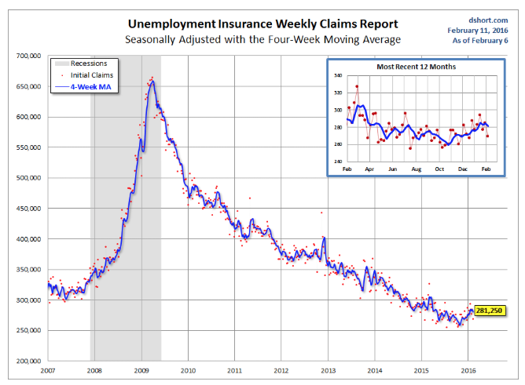
Weekly Jobless Claims –The Most Important Statistic
-10,000 to 259,000
The Downtrend Lives!-Show Me the Recession!

Slide 15

Bonds-Backing Off with “RISK ON”
*Buy this dip to hedge equity longs
*Bonds now pricing a June Fed interest rate rise back in the market, aiming for a second one in the fall.
*Treasury bond yields back up an amazing 45 basis points in 3 weeks
*Newest round of ECB QE bushes more international bonds to negative interest rates
*Emerging market debt makes
a huge recover on commodities rally
*Junk engineers a big recover as well
on global “RISK ON” move
*Huge 1.5%-2% drop in junk and
emerging yields

Slide 16
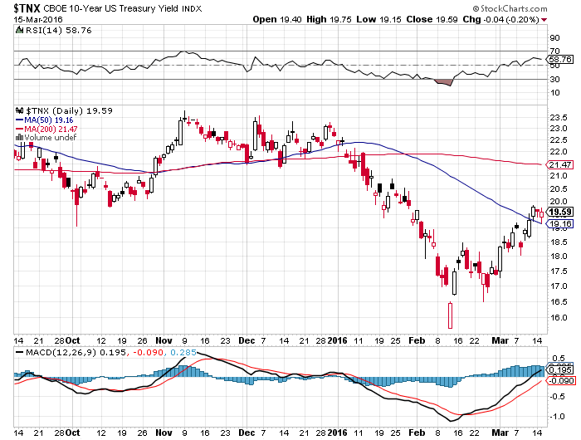
Ten Year Treasury Yield ($TNX) 1.95%
The Reversal is In

Slide 17
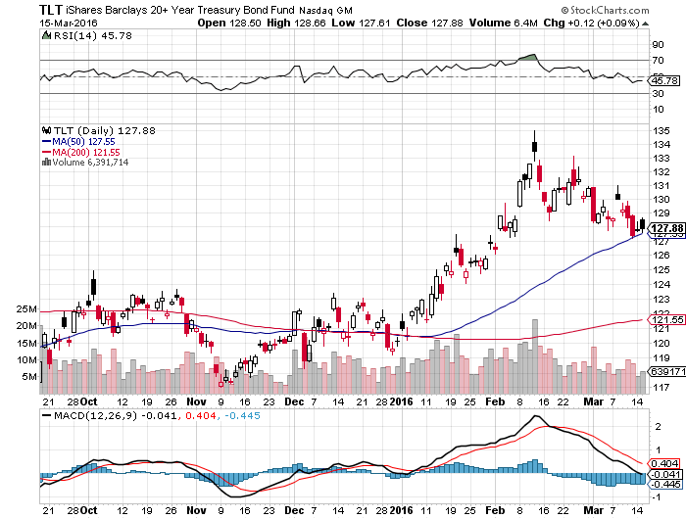
Ten Year Treasury ETF (TLT) 1.95%
The Reversal is In

Slide 18
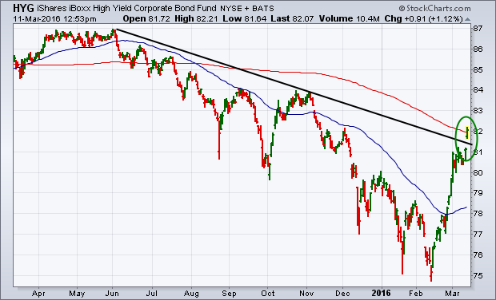
Junk Bonds (HYG) 7.76% Yield
A Great Risk Coincident Indicator

Slide 19
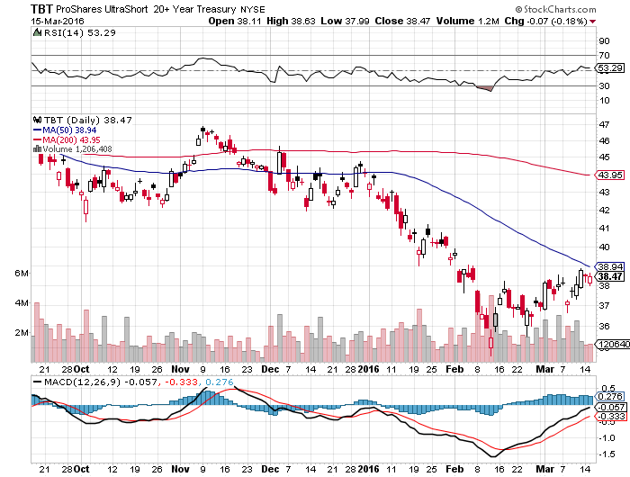
2X Short Treasuries (TBT)-Not Yet the Big Trade of 2016?
Back in “BUY” Territory

Slide 20
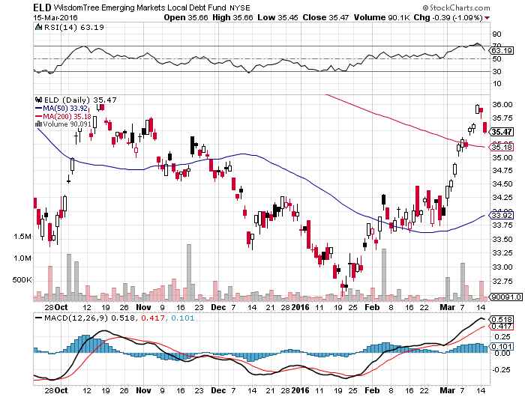
Emerging Market Debt (ELD) 7.72% Yield-

Slide 21
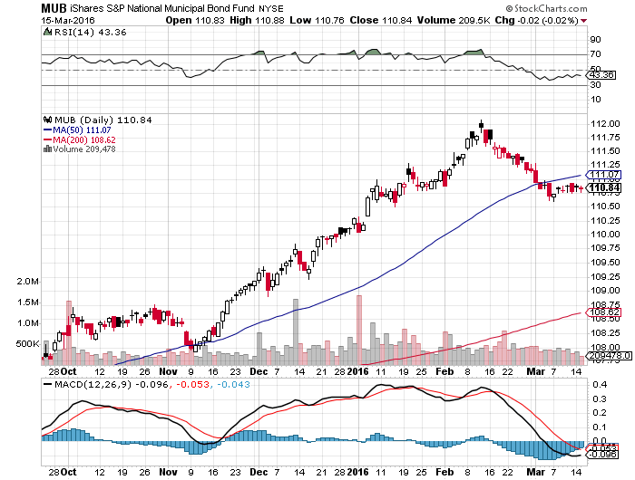
Municipal Bonds (MUB)-1.39% yield-New High
Mix of AAA, AA, and A rated bonds-flight to safety

Slide 22

Stocks-Too Far Too Fast!
*Continued oil rally spills into stocks
*But is not sustainable without better earnings growth
*Shorts are all gone now, but are itching to reestablish, the pain trade is up
*The “Narrowing Wedge” scenario is playing out, with a big triangle formation setting up over the next six months, with lower highs and higher lows between 1812 and 2050
*Election is starting to have an increasing drag on
stock prices, with violence and uncertainty rising
*Only two more months of seasonable
stock strength, “Sell in May” is coming

Slide 23
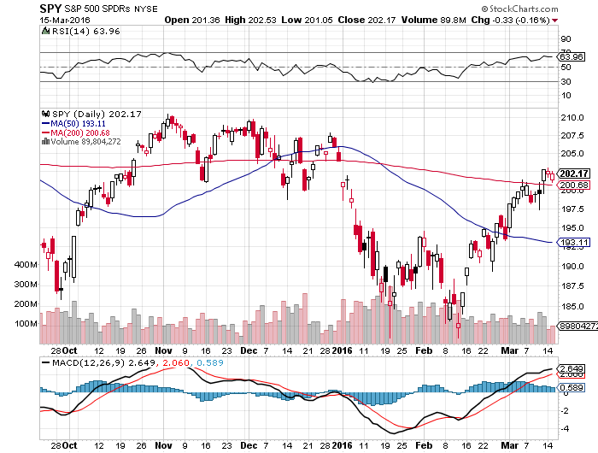
S&P 500-Short Squeeze!
Took profits on 2/$173-$178 and 2/$176-$181 vertical bull call spread took profits on long 3/$170-$175 vertical bull call spread still long 4/$205-$210 vertical bear put spread

Slide 24
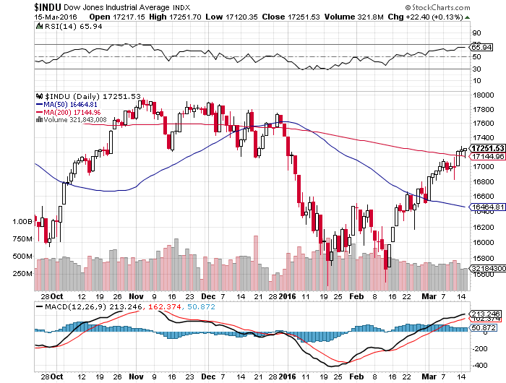
Dow Average-Topping Out Too

Slide 25
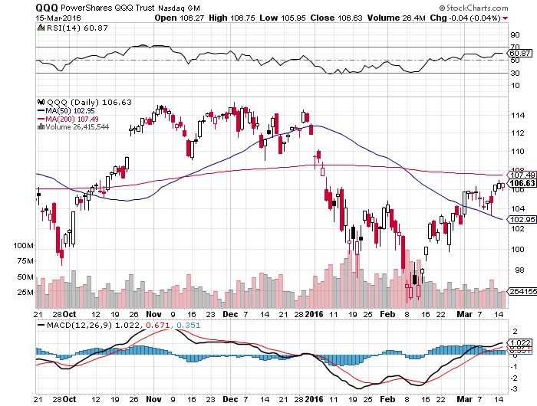
NASDAQ (QQQ)-Break of 500-Day Moving Average!
Is where traders will pour back into

Slide 26
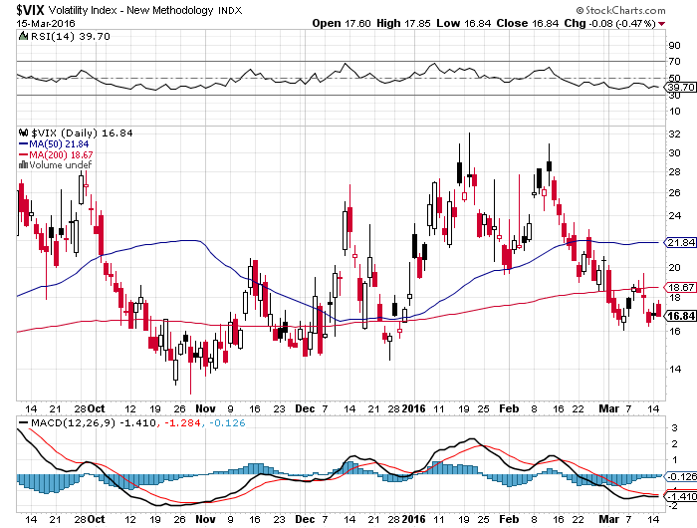
(VIX)-Back to the Bottom

Slide 27
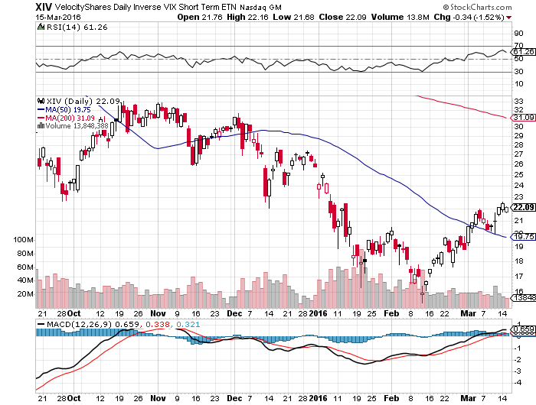
(XIV)-Velocity Shares Daily Inverse VIX Short Term ETN

Slide 28
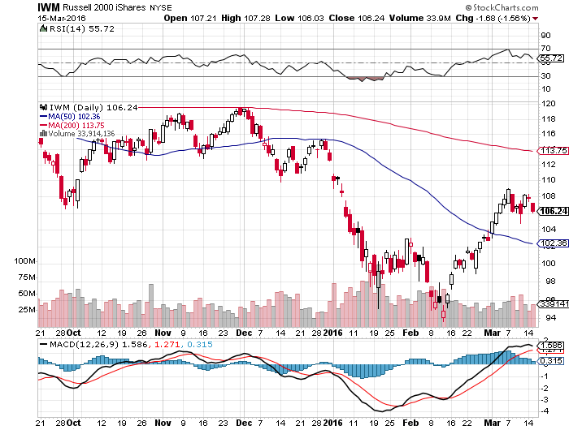
Russell 2000 (IWM)-The Weakest Link
Long the $113-$117 vertical bear put spread

Slide 29
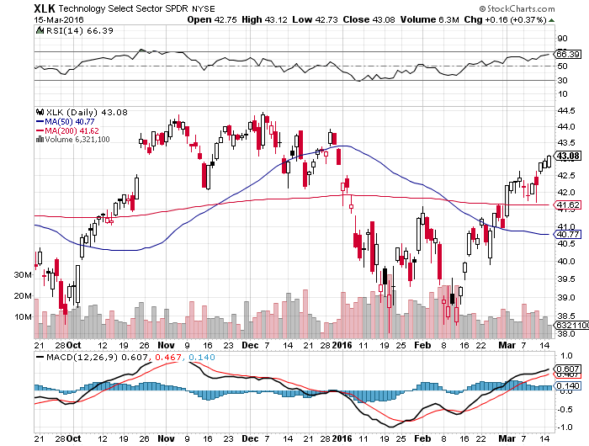
Technology Sector SPDR (XLK), (ROM)
(AAPL), (MSFT), (VZ), (T), (FB), (IBM)

Slide 30
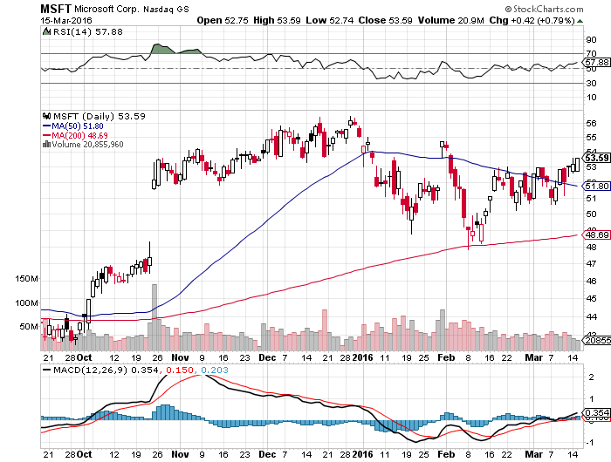
Microsoft (MSFT) looking to go long on next dip

Slide 31
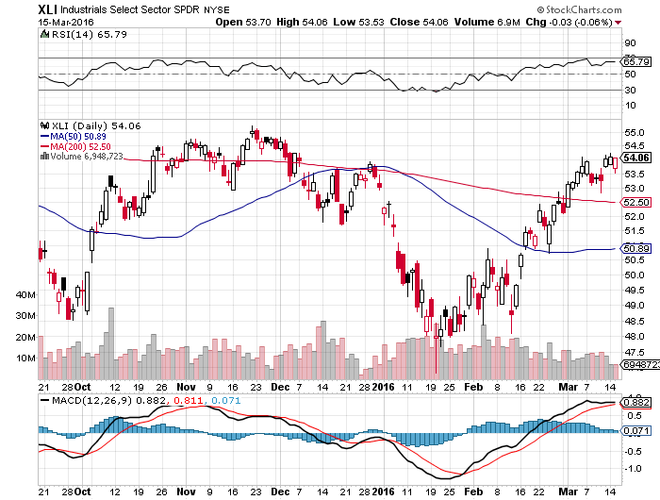
Industrials Sector SPDR (XLI)-Dow Mainstay
(GE), (MMM), (UNP), (UTX), (BA), (HON)

Slide 32
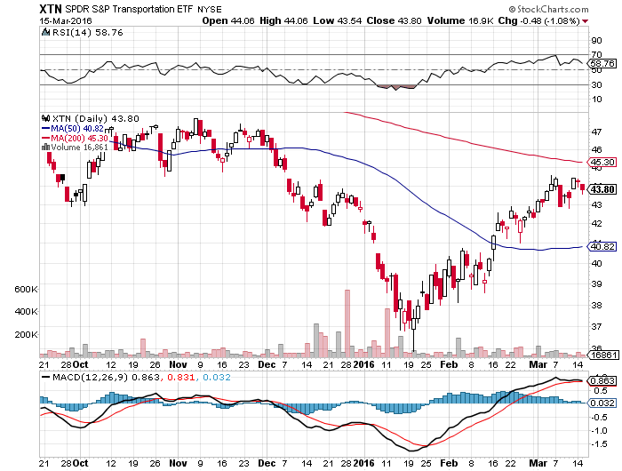
Transports Sector SPDR (XTN)-Another Dow Mainstay
(ALGT), (ALK), (JBLU), (LUV), (CHRW), (DAL),

Slide 33
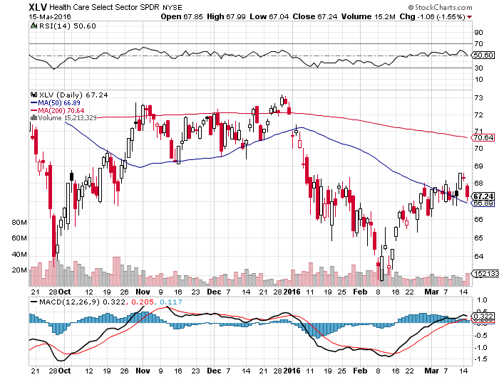
Health Care Sector SPDR (XLV), (RXL)
(JNJ), (PFE), (MRK), (GILD), (ACT), (AMGN)

Slide 34
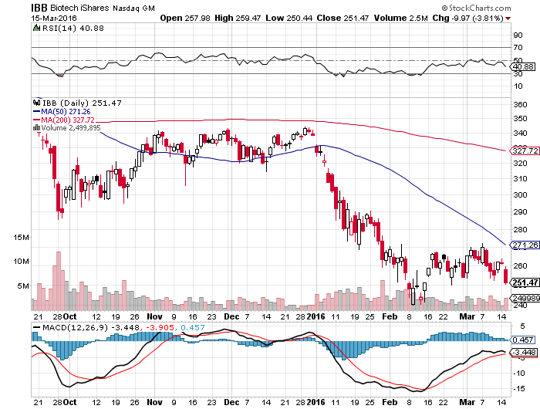
Biotech iShares (IBB)-A Political Football in 2016

Slide 35
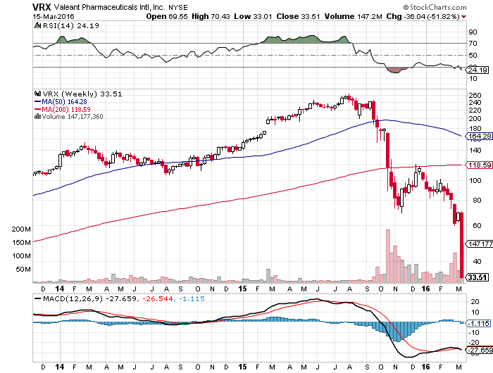
Stock of the Week (VRX)-Down by 87% in six months

Slide 36
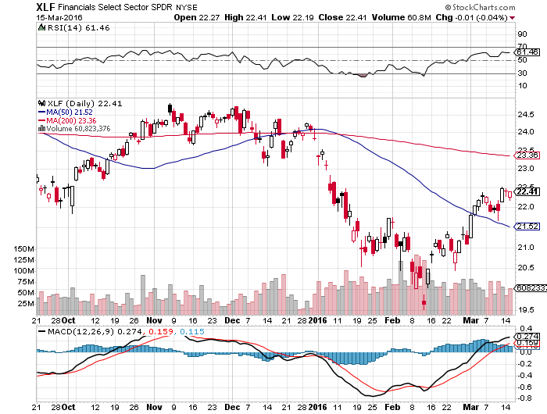
Financial Select SPDR (XLF)-
(BLK/B), (WFC), (JPM), (BAC), (C), (GS)

Slide 37
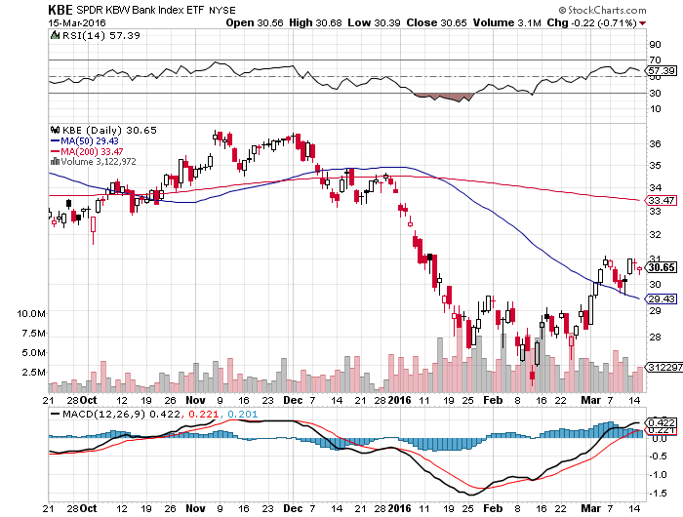
KBW Bank Index (KBE)- love those rising rate prospects

Slide 38
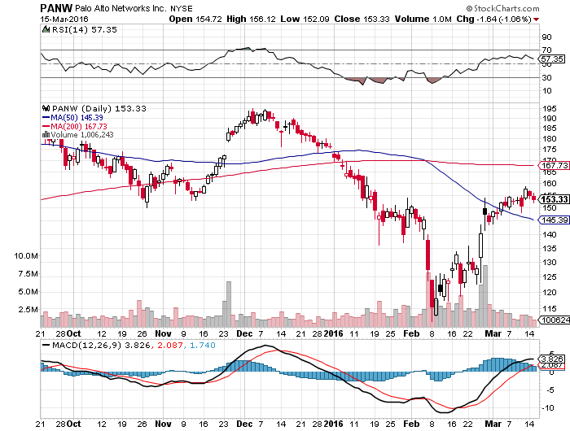
Palo Alto Networks (PANW)-
Up 50% from February 11 Bottom

Slide 39
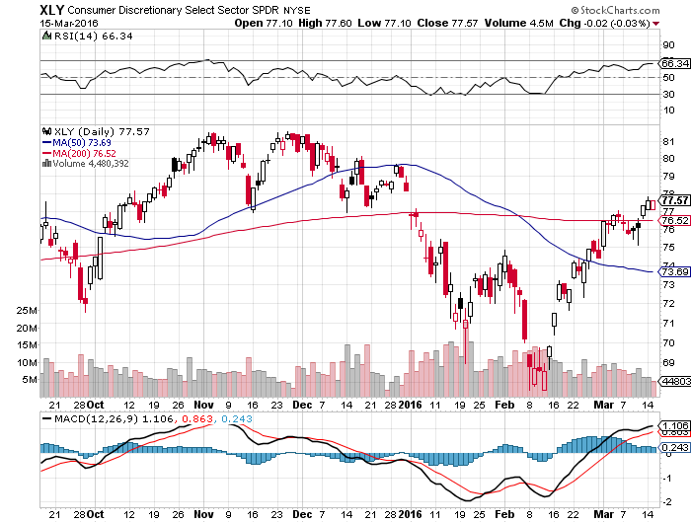
Consumer Discretionary SPDR (XLY)
(DIS), (AMZN), (HD), (CMCSA), (MCD), (SBUX)
A Major Leader of the Rally

Slide 40
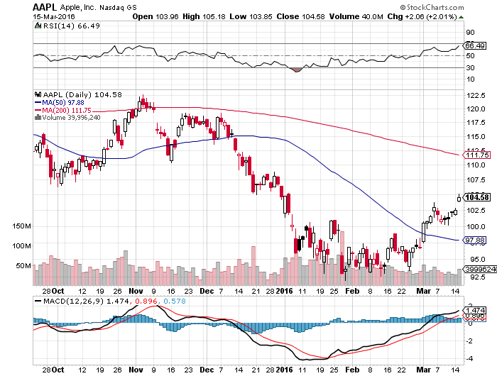
Apple (AAPL) –iPhone production cut 30%
Back to waiting for the next real catalyst-the iPhone 7
Buy after Q1 earnings in April to avoid post Christmas dip, $105 billion stock buy backs done

Slide 41
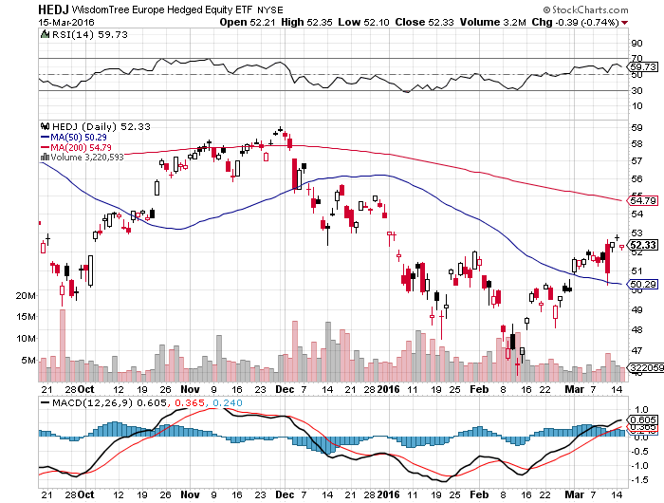
Europe Hedged Equity (HEDJ)-Hedged Japan Equity
Got the Great Entry Point-Now Top of the Range

Slide 42
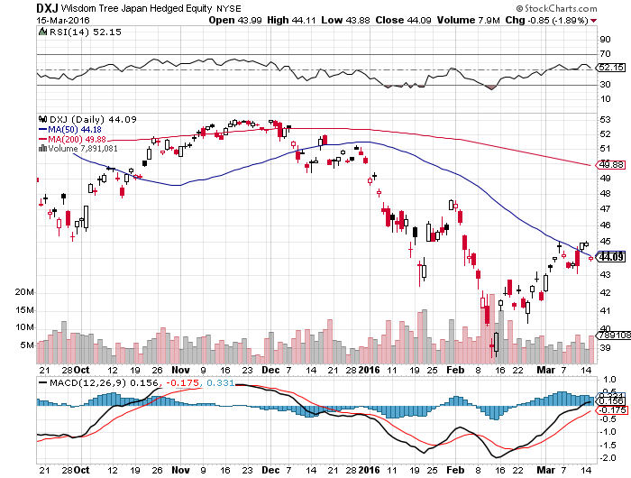
Japan (DXJ)-Hedged Japan Equity
With Euro QE Can Japan be Far Behind?

Slide 43
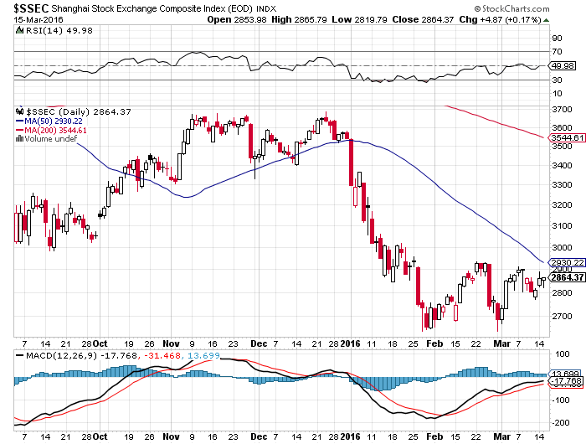
China ($SSEC)-
The Bad Boy Market and font of volatility

Slide 44
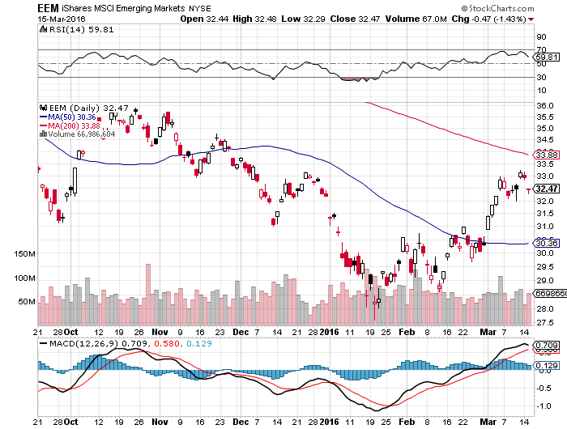
Emerging Markets (EEM)-
Loves the oil and commodity bounce

Slide 45
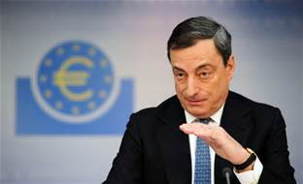
Foreign Currencies-Another Dose of QE
*A new round of ECB QE demolishes the Euro, dollar rockets
*”Brexit” still weighs on pound
*Expect more Japanese QE because the yen at this level will destroy the economy, but BOJ already owns 77% of outstanding government debt, SELL YEN!
*Commodity rebound breathes
new life into commodity currencies,
won’t last forever
*With no interest rate moves anywhere,
this could be a year of low volatility
for currencies

Slide 46
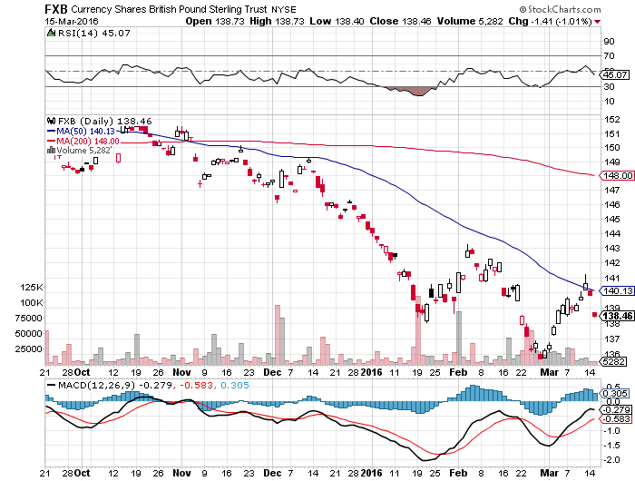
British Pound (FXB)-Political Disaster!

Slide 47
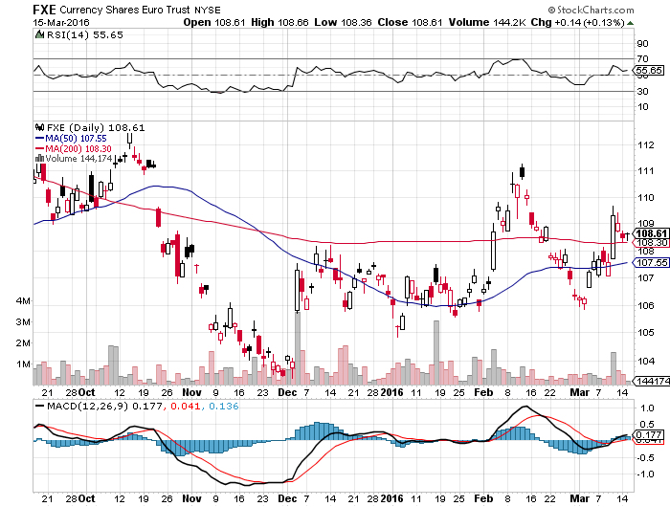
Euro ($XEU), (FXE), (EUO)- stopped out of long the (FXE) 3/$103-$106 vertical bull call spread on “Brexit” fears, prospect of more QWE next week

Slide 48
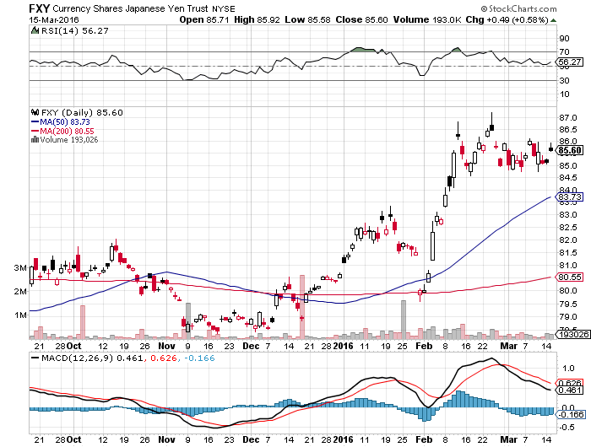
Japanese Yen (FXY)-At a One Year High
Long the (FXY) $89-$92 vertical bear put spread- expires in 2 days looking to roll forward up and out

Slide 49
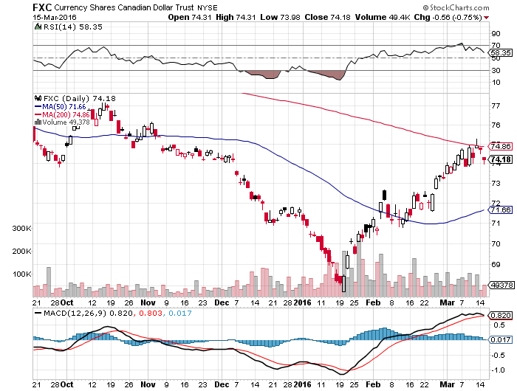
Canadian Dollar (FXC)-Commodity Rebound

Slide 50
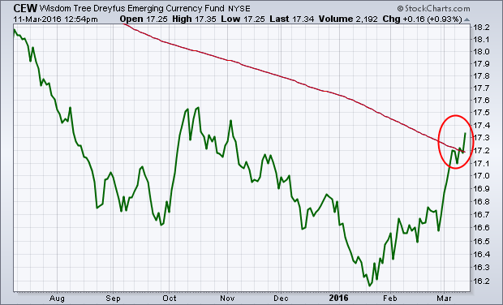
Emerging Market Currencies (CEW)

Slide 51
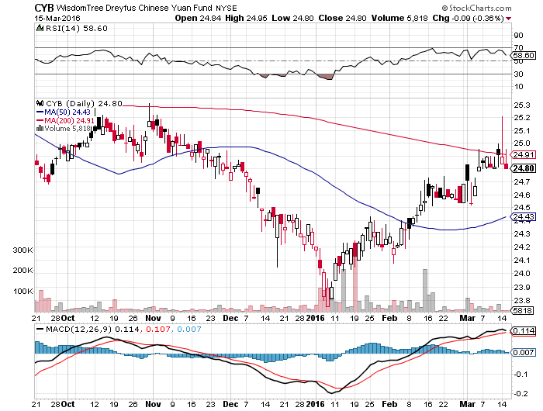
Chinese Yuan- (CYB)-Sell Rallies on Weakening Economy
A New Hedge Fund Favorite

Slide 52
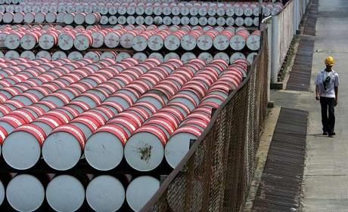
Energy-It Lives!
*Gasoline inventory drop of 4.5 million barrels gives new live to the oil rally, now up 50% from the bottom
*Shrinking contango means $26 is increasingly looking like the final bottom
*India to create strategic petroleum reserve of 17.83 million barrels
*Over 270,000 US energy jobs lost in last 2 years
*Specs now running large net long position in the futures markets
*US rigs finally fall sharply, down to 386,
down from the 2,000 top 5 years ago
*Oil approaching levels where bankers will
demand new hedges to protect loans

Slide 53
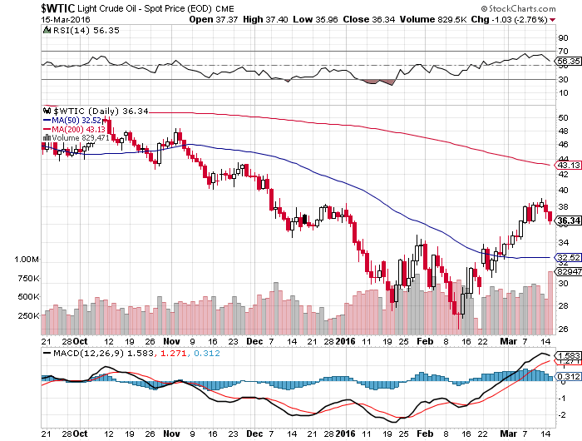
Oil-The Bottom is in, But Expect a Retest

Slide 54
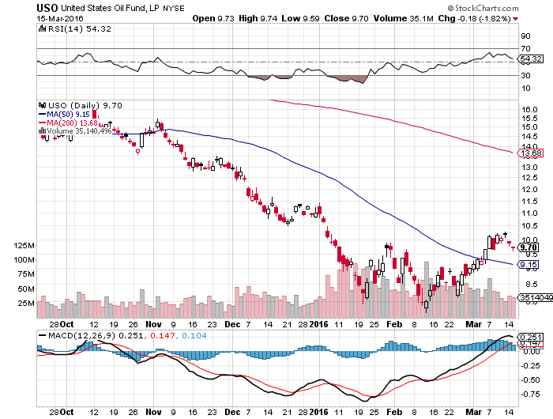
United States Oil Fund (USO) took profits on long the 5/$8.00 calls too soon

Slide 55
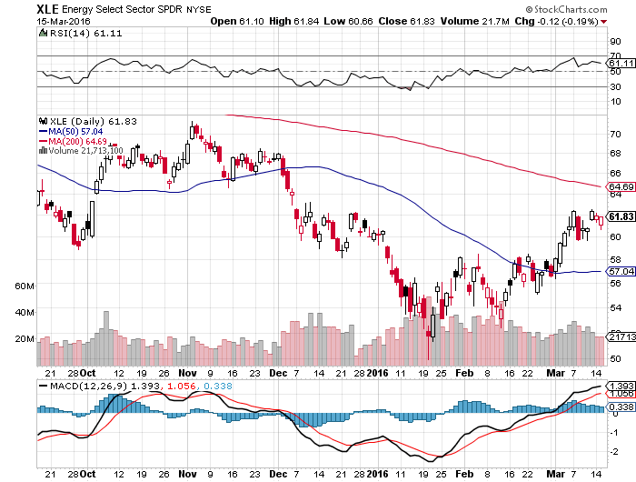
Energy Select Sector SPDR (XLE)
(XOM), (CVX), (SLB), (KMI), (EOG), (COP)

Slide 56
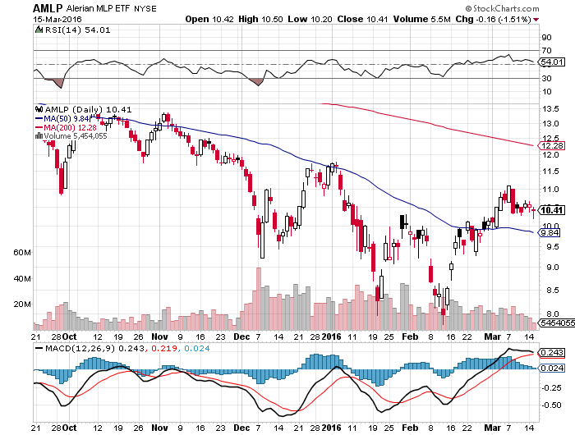
Alerian MLP ETF (AMLP)-11.39% Yield
Basket Approach is the Only Safe Play here

Slide 57
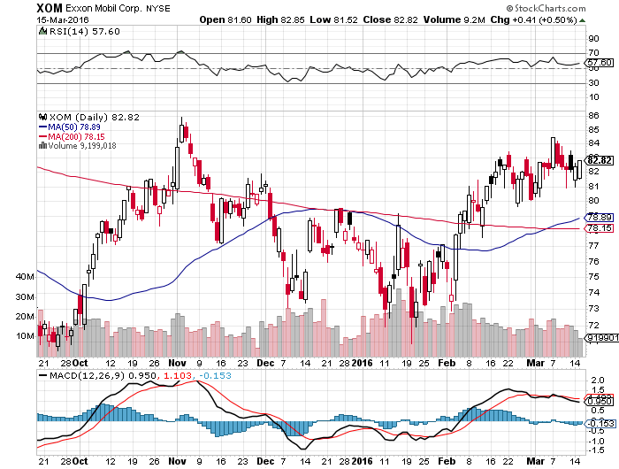
Exxon (XOM)-

Slide 58
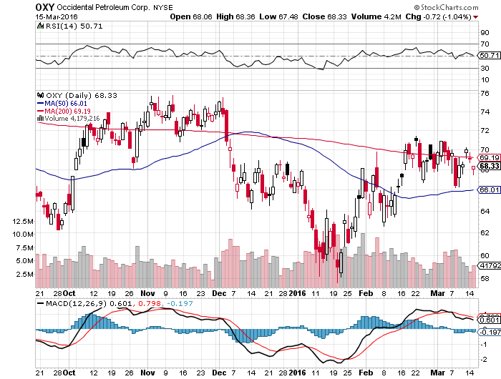
Occidental Petroleum (OXY)-

Slide 59
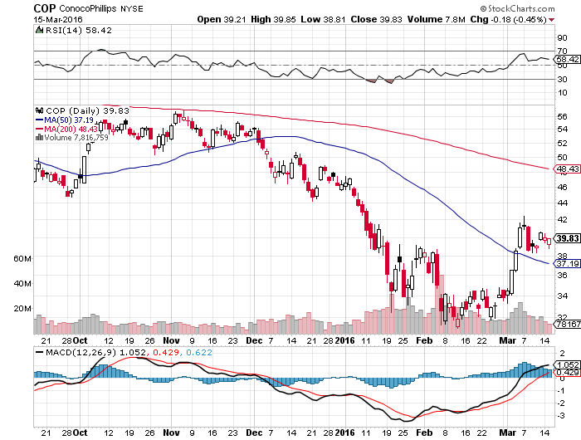
Conoco Phillips (COP)-The Buffet Favorite

Slide 60
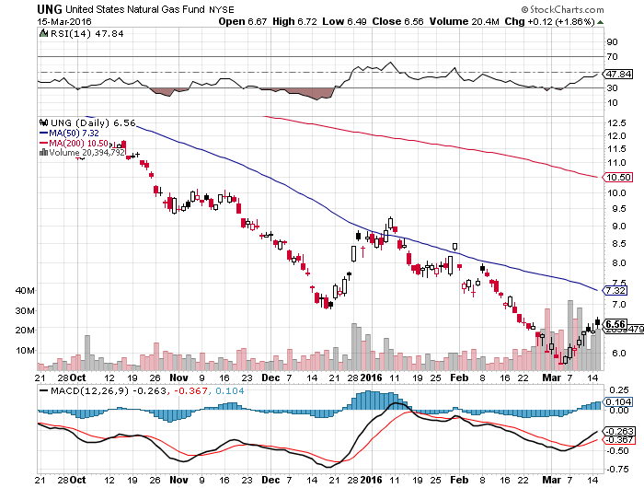
Natural Gas (UNG)-New Lows on Warm Winter

Slide 61

Copper-The Bottom is In

Slide 62

Freeport McMoRan (FCX)-Tripled off $3 bottom

Slide 63

Precious Metals-Taking a Break
*Gold has best start to a year since 1974
*$1.4 billion in new cash piles into the (GLD) ETF since January 1, Blackrock suspends issuance of new gold ETF shares
*However, gold is starting to show signs of upside exhaustion, time to take a break
*Canada sold half of its gold reserves in February, 1.7 million tonnes
*People Bank of China a heavy buyer in
February, picking up 10 metric tonnes
*Spec positions now near highs,
adding risk

Slide 64

Gold (GLD)-Looking for a Dip
Took profits on long the $95-$100 vertical bull call debit spread took profits on long long the $107-$112 vertical bull call spread

Slide 65

Market Vectors Gold Miners ETF- (GDX)

Slide 66

Silver (SLV)-

Slide 67

Silver Miners (SIL)-Finally Kicks In

Slide 68

Platinum (PPLT)-The Volkswagen Effect new chapter of the “Clean Diesel” Scandal

Slide 69

Palladium (PALL)-The Non Diesel Play

Slide 70

Agriculture-An El Nino Boost
*Latest NOAA forecasts call for warm weather in prime growing areas, pressuring prices
*Wheat crops in Texas and Oklahoma coming out of winter dormancy earlier than usual
*Dollar still demolishing US exports,
US wheat is shut out of global market
*Warm winter is presaging another
record year for crop production
*No trade, there are NO fish to fry

Slide 71

(CORN) – More New lows!

Slide 72

(WEAT)-New Lows!

Slide 73

Ag Commodities ETF (DBA)- New Lows

Slide 74

Real Estate-Ticking Along
*Spike in interest rates brings refi’s grinding to a halt, February mortgage applications down 4.8%
*Rising homes prices bring the “flippers” out of the woodwork, 180,000 units in 2015 accounting for 5.5% of national sales, up 75% YOY
*Strong jobs reports are feeding into rising home prices
*US Housing inventory at a 30 year low, impossible to buy a home in a good school district
*We are still 40% below normalized
housing starts, meaning new construction
has to double
*Case Shiller S&P 500 National index
continues upward grind

Slide 75

December S&P/Case–Shiller Home Price Index
+5.7% YOY and accelerating, Denver, San Francisco, Dallas

Slide 76

US Home Construction Index (ITB)
(DHI), (LEN), (PHM), (TOL), (NVR)

Slide 77

Trade Sheet
So What Do We Do About All This?
*Stocks- sell rallies, market is overbought
*Bonds-the top is in, sell next big rally
*Commodities-the bottom is in, buy dips
*Currencies- Sell short the Yen on rallies
*Precious Metals –buy on dips
*Volatility-sell short spikes over $25
*The Ags –stand aside - avoid the disaster
*Real estate-buy the homebuilders LT

Slide 78

To buy lunch tickets, please go to www.madhedgefundtrader.com , click on “LUNCHES,” “USA”, and then your desired lunch
Next Strategy Webinar
12:00 EST Wednesday,
March 30, 2016
San Francisco, CA
USA!
Good Luck and Good Trading!
Notes:
*

