Slide 1
Mad Day Trader
Bill Davis
Webinar – May 4, 2016

Slide 2
Indexes & Earnings

Slide 3
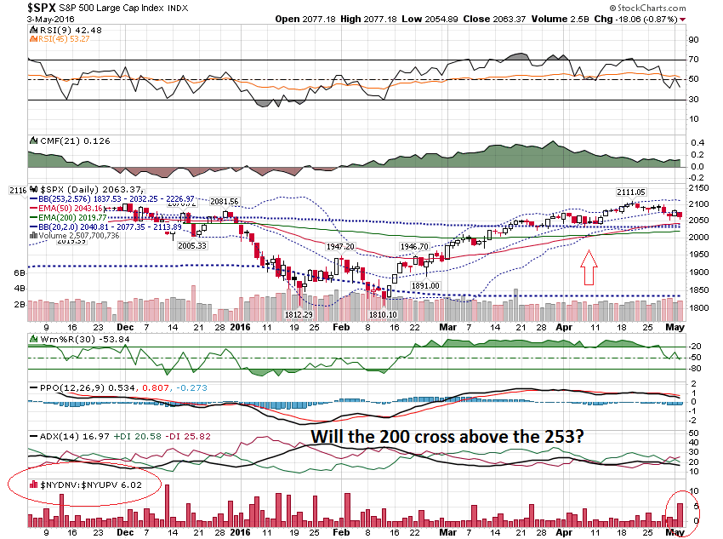

Slide 4
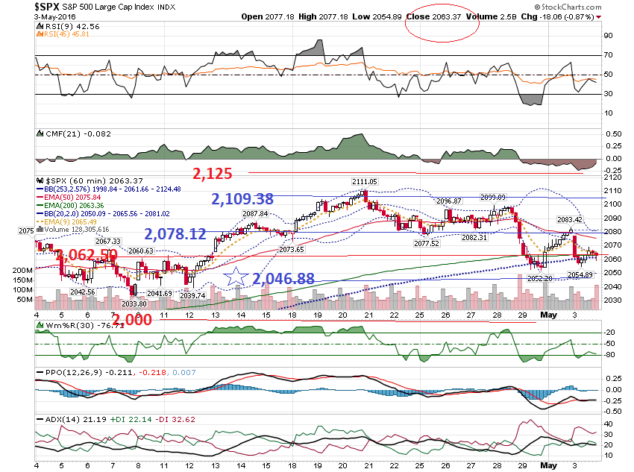

Slide 5
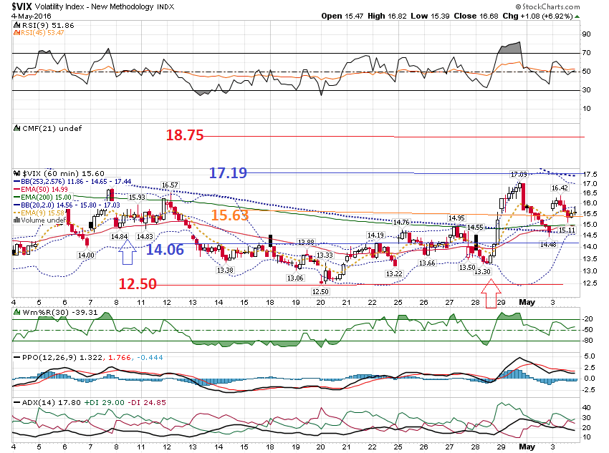

Slide 6
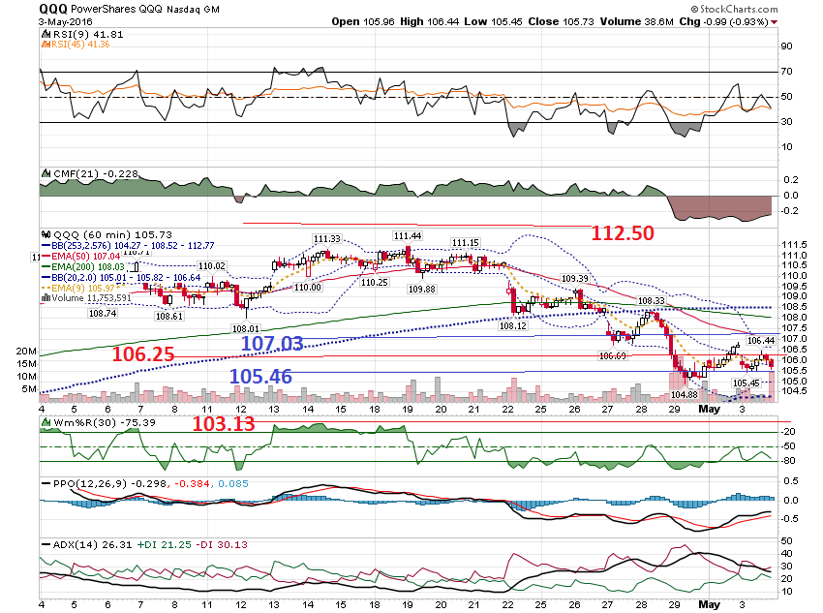

Slide 7
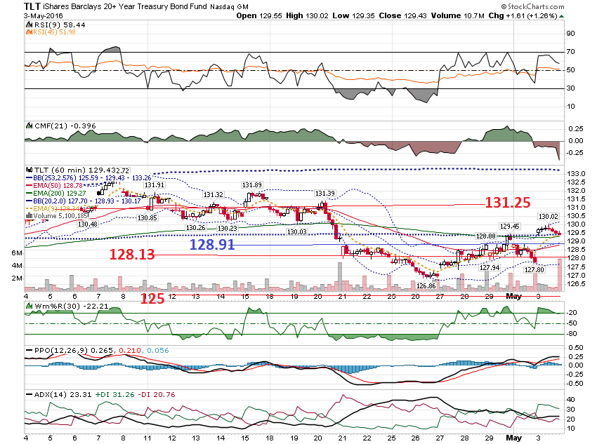

Slide 8
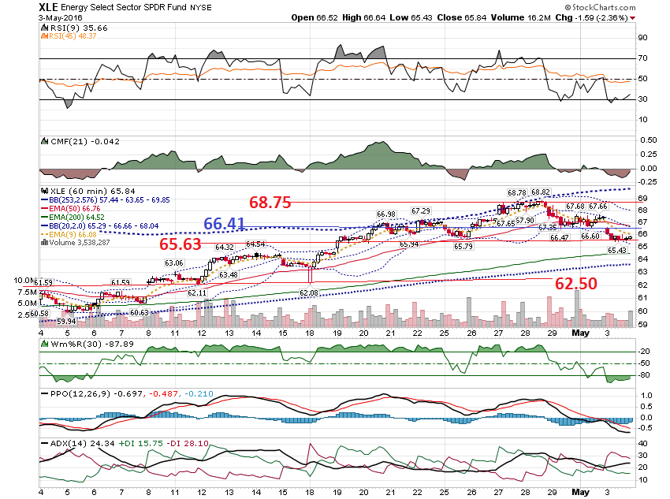

Slide 9
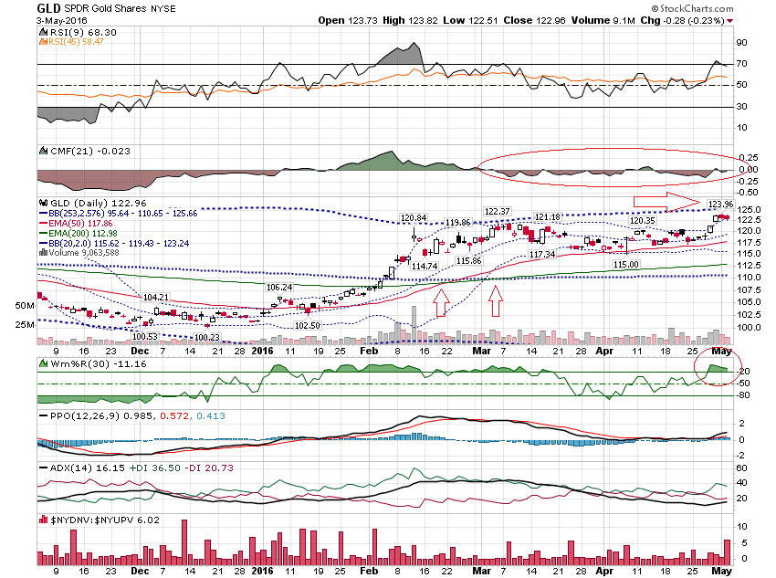

Slide 10
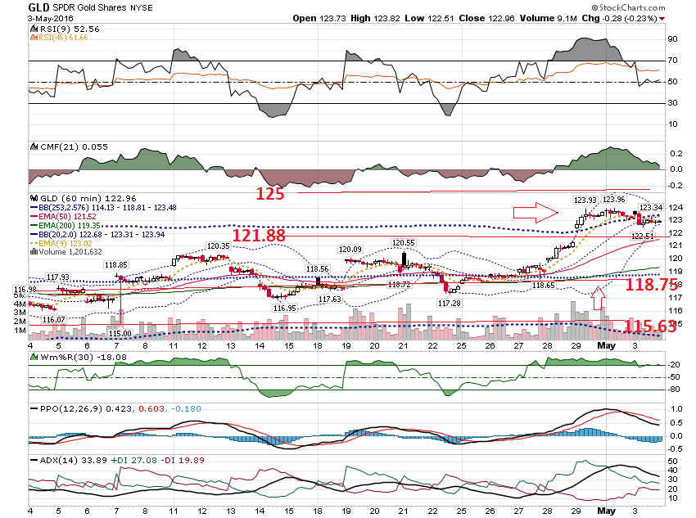

Slide 11
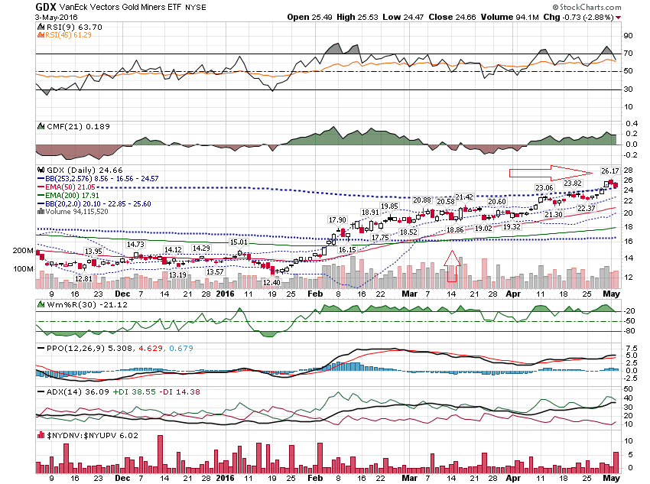

Slide 12
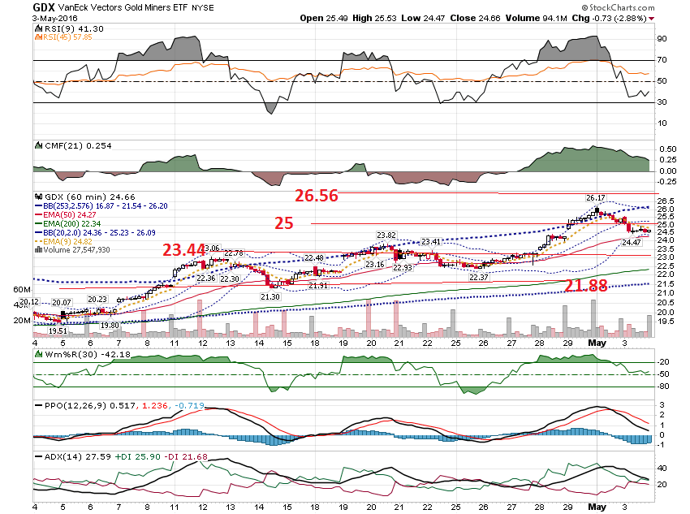

Slide 13
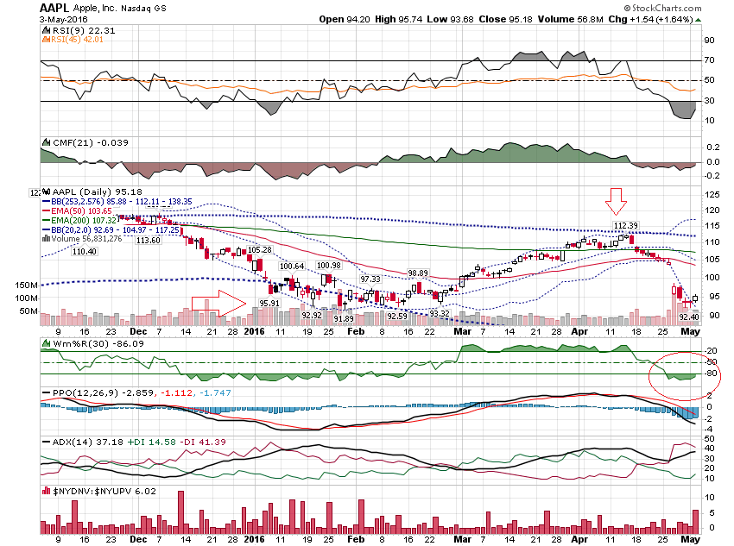

Slide 14
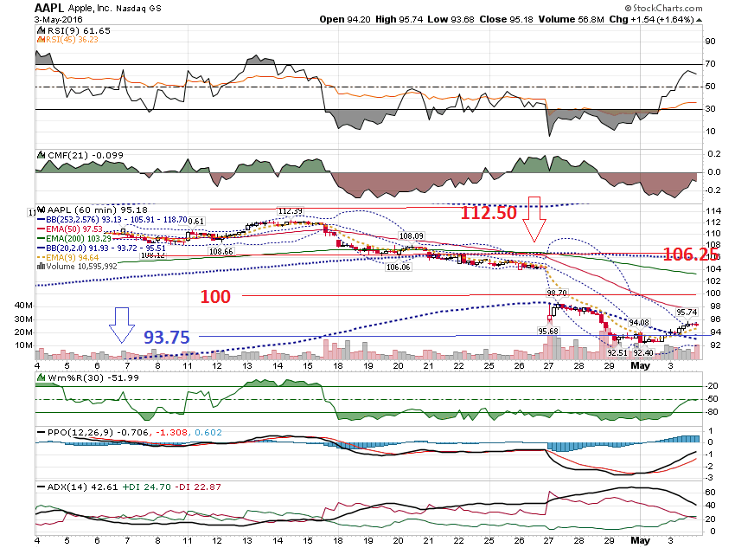

Slide 15
Pre Earnings GOOGL reported April 21st –After last webinar

Slide 16
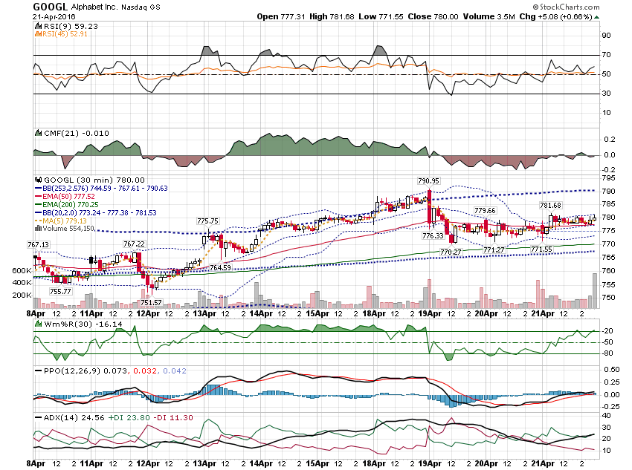

Slide 17
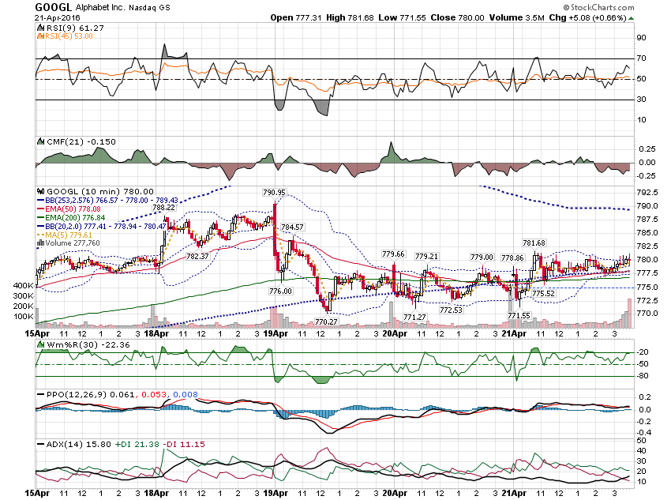

Slide 18
GOOGL 780.00 closed 4/21/16 780 Call - $21.00 780 Put - $21.00 Total $42.00 5.4% add 50% - $63

Slide 19
GOOGL Round to $60 $845 Call - $2.20 $840 Call - $2.65 Credit = $.45 $720 Put - $1.85 $715 Put - $1.50 Credit - $.35

Slide 20
GOOGL Total Credit = $.80 Risk Levels: $720 - $845

Slide 21
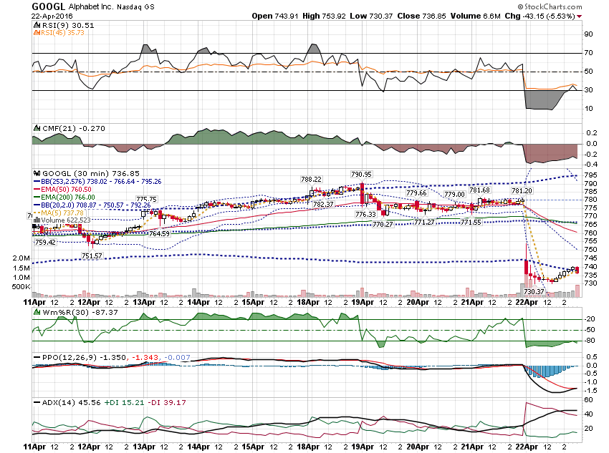

Slide 22
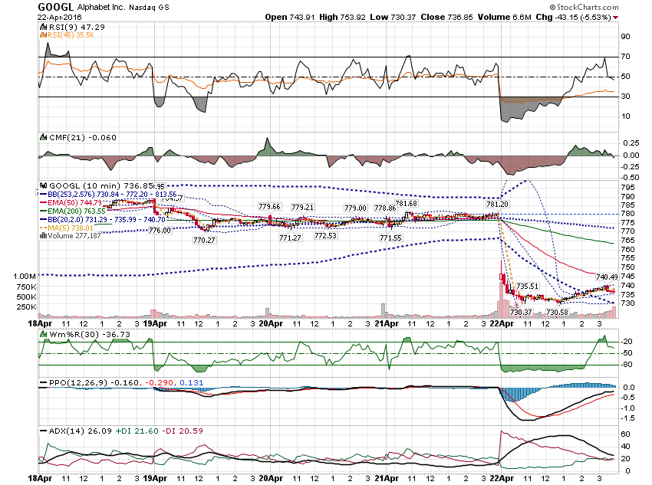

Slide 23
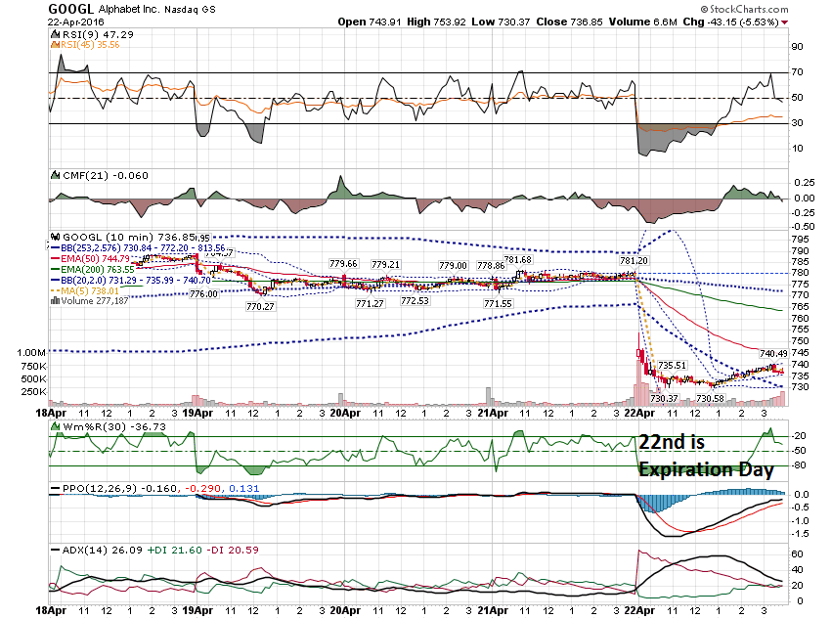

Slide 24
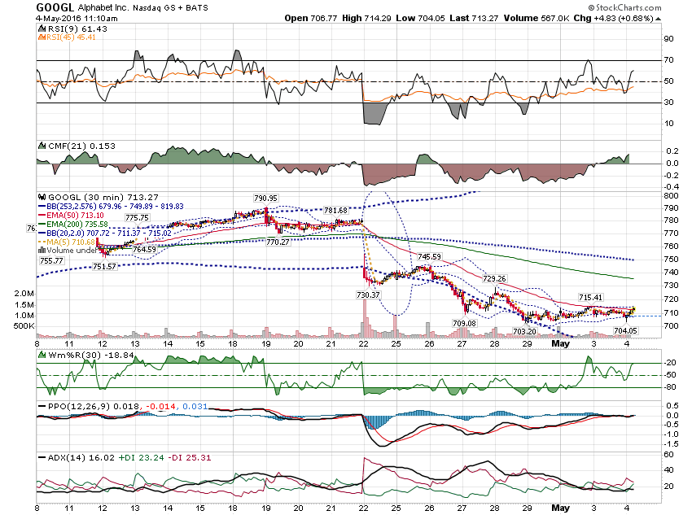

Slide 25
Pre Earnings PCLN

Slide 26
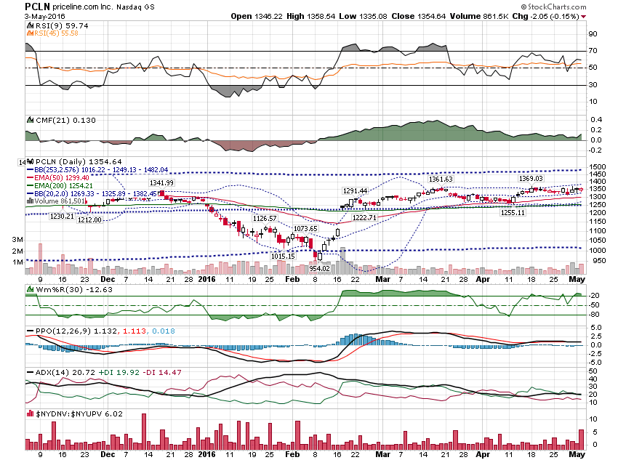

Slide 27
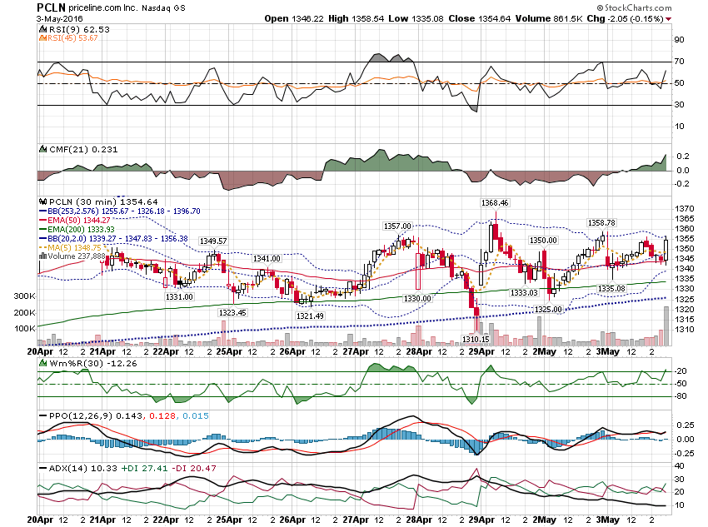

Slide 28
PCLN Pre Earnings - Closed @ $1,354.64 1,350 Call - $45.69 1.350 Put - $41.00 Total = $86.69 % projected = 6.4%

Slide 29
PCLN % projected = 6.4% 150% = 9.6% Round to 10% Move of $96 either way

Slide 30
PCLN Calls: $1,495 call - $3.30 $1,490 call - $3.55 Puts: $1,210 Put - $3.90 $1,205 Put - $3.41

Slide 31
PCLN Call Credit - $.25 Put Credit - $.50 Total Credit = $.75

Slide 32
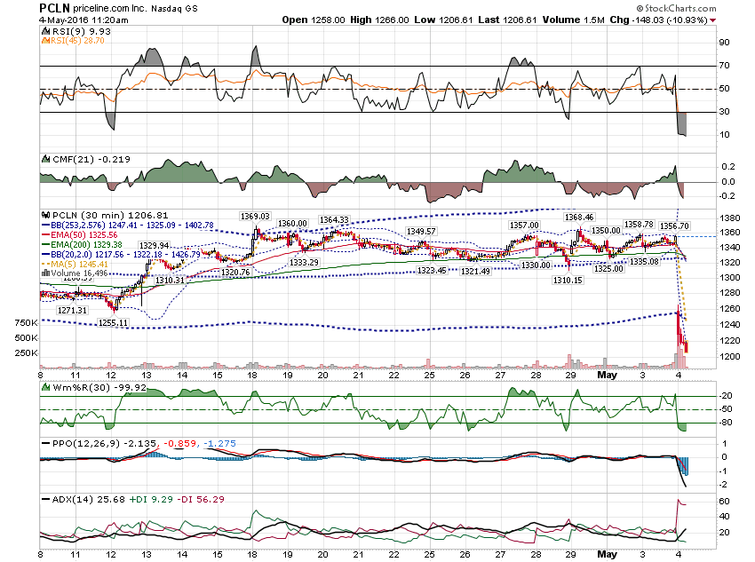

Slide 33
Look at companies in the same industry. EXPE reported last week and move 8.2%. If you uses 12%, the put you sold would be at the $1,190 Strike.

Slide 34
Thanks for watching! Bill Davis Mad Day Trader May 4, 2016 davismdt@gmail.com

