Slide 1

The Mad Hedge Fund Trader
“Calm Before the Storm”
With John Thomas
from San Francisco, CA, August 31, 2016
www.madhedgefundtrader.com
Notes:
*

Slide 2


Slide 3

In the Store
Now for $49
Sectors and stocks that
will lead the market for
the next 20 years
https://members.madhedgefundtrader.com/roaring-twenties-book/

Slide 4

Mad Options Trader
*Net Trading Profits are up 10% in August on the weekly options
*Demand for the new $1,500 a year service will be overwhelming
*Get your upgrade order in now to avoid the
month end crush avoid service cut off
*Email Nancy in Customer support at
support@madhedgefundtrader.com and put
“MOT Upgrade” in the subject line
*Nancy will calculate a pro rata credit for
the balance of your remaining subscription,
and then bill you for your existing subscription
+ MOT

Slide 5
MHFT Global Strategy Luncheons
Buy tickets at www.madhedgefundtrader.com
Portland, Oregon
September 16
Incline Village, Nevada
October 7

Slide 6

MHFT Global Strategy Luncheons
Buy tickets at www.madhedgefundtrader.com
San Francisco, CA
October 21
Las Vegas, Nevada
November 18

Slide 7
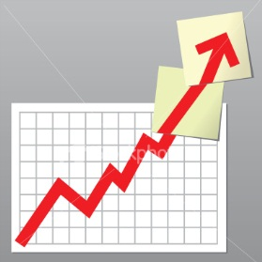
Trade Alert Performance
Still Beating the Dow
*January +1.23% Final *July +0.67% Final
*February +4.50% Final *August +6.76% MTD
*March -2.42% Final *September +11.99% Final
*April -2.10% Final *October -6.19% Final
*May +4.38% Final *November 5.78% Final
*June -0.56% Final *December -4.94% Final
*2016 Year to Date +12.51%
compared to 5.9% for the Dow Average
*Trailing 1 year return +20.19%, +204.19% since inception,
*Average annualized return of 35.35%

Slide 8
Portfolio Review
Keeping a Small Tactical Book and Taking Profits Quickly
Model Trading Book
Asset Class Breakdown
Risk Adjusted Basis
Current Capital at Risk
Risk On
World is Getting Better
no position
Risk Off
World is Getting Worse
(TLT) 9/$143-$146 put spread | -10.00%
(TLT) 9/$142-$145 put spread | -10.00%
(VXX) 9/$30-$33 call spread | -10.00%
total net position | -30.00%
Expiration P&L
16.63%

Slide 9

The Method to My Madness
Being Cautiously Opportunistic
*Starting to take small short dated front month positions against the most extreme moves, avoiding the risk of far month long dated positions
*Taking quick profits as long as markets are stuck in an historically narrow range
*Buy “RISK ON” assets on every substantial dip
*Markets on hold ahead of Friday August Nonfarm
Payroll and a 3 day Labor Day weekend
*The game from here on is to position yourself for
a pre/post US presidential election stock melt up
and a global risk on rally
*Buy the September dip before or after Sept 20
Fed meeting

Slide 10
Paid Subscriber Trailing 12 Month Audited Return +20.85%-
At All Time Highs

Slide 11
69 Months Since Inception
Daily Audited Performance
Averaged annualized return +35.51%

Slide 12

Short Term Strategy Outlook
*Prospect of imminent US interest rate rise now driving all asset classes
*Volatility is trading close to decade lows ahead of September, the most volatile month of the last 30 years
*No chance of a rate rise in 2016, but Fed will tease us in September
*Oil will trade the $40-$50 range for the rest of 2016 and attempt an upside break out going into yearend
*Bonds look like they are topping out here on rate fears,
entire High yield sector has been hit
*Rate rise fears also hitting all precious metals
*Stay away from ags, perfect weather to bring new lows.

Slide 13
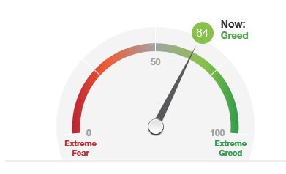
Lower End of Greed Range 80 to 64
CNN Fear and Greed Index

Slide 14

The Global Economy-Choppy
*Janet Yellen says the Fed may, or may not raise rates, then vice chair Stanley Fischer hints they probably WILL raise rates, and maybe TWICE this year WITHIN THE SAME HOUR!
Yikes!
*July US Durable Goods up a strong 4.4%, capital spending rising, with commercial aircraft orders up a stunning 90%, Q2 revised down from 1.2% to 1.1%, Consumer Spending up 0.3%
*German business confidence in the tank
*Japan July CPI is now -0.50% YOY, deflation with
turbocharger, a 3 year low, as strong yen kills
exports, Household Spending also down 0.5% YOY
*Despite all this, US stocks and bonds are still the
most attractive, highest yielding assets in the
world, both should move to new highs
*Fortress American looking strong

Slide 15
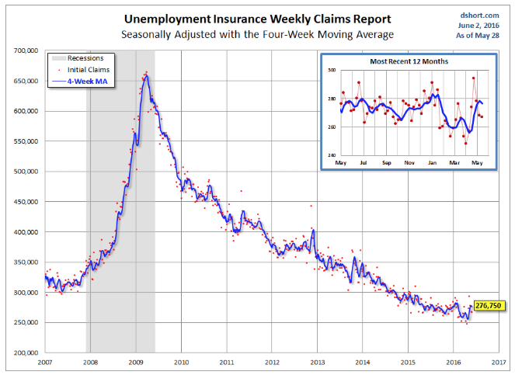
Weekly Jobless Claims –The Most Important Statistic
1,000 to 261,000-Lowest since 1973!
The Downtrend Lives!-Show Me the Recession!

Slide 16

Bonds-Fed Takes Away the Punch Bowl
*Ten year US Treasury yields rally to 1.63% on Fischer “double hike” comments, is the bull market over?
*Rest of the high yield sectors, like REIT’s and telecoms, get hit has well
*If you own bonds, keep emerging market debt, loans, banks loans, non-agency mortgage debt, and junk. Avoid government bonds anywhere like the plague
*JGBs stable at -0.08%, German bunds to -0.09%
*Even emerging market debt sells off
* Junk bonds (HYG) maintain new
year highs, almost alone among
all asset classes
*Watch the price action,
we could be turning here

Slide 17
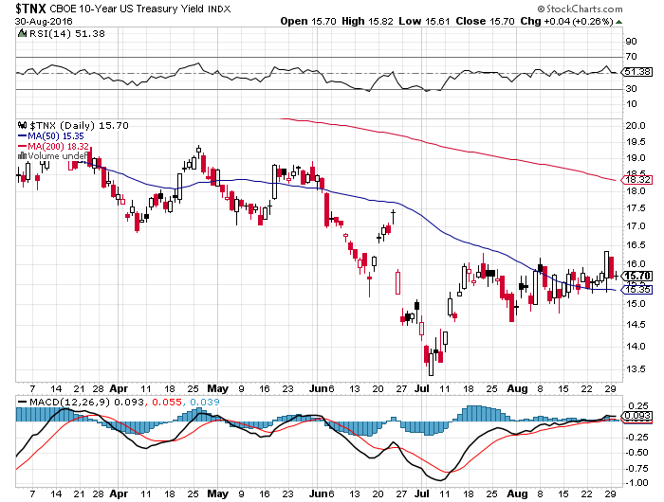
Ten Year Treasury Yield ($TNX) 1.57%
Coiling for an Upside Breakout?

Slide 18
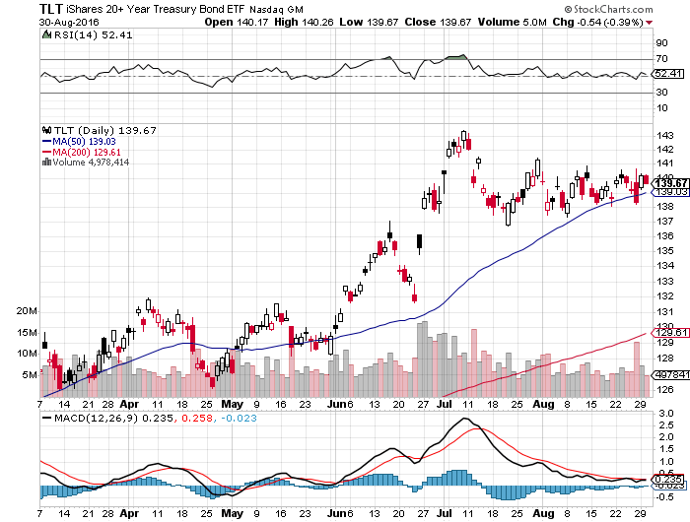
Ten Year Treasury ETF (TLT) 1.56%
The Rate Fear Trade-Expires before next Fed meeting long 9/$143-$146 vertical bear put spread long 9/$142-$145 vertical bear put spread

Slide 19
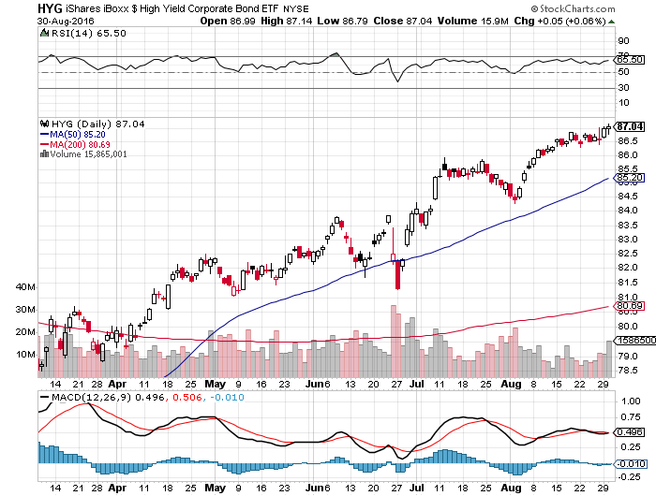
Junk Bonds (HYG) 6.33% Yield
A Great Risk Coincident Indicator-”RISK ON” means new highs, buy all dips

Slide 20
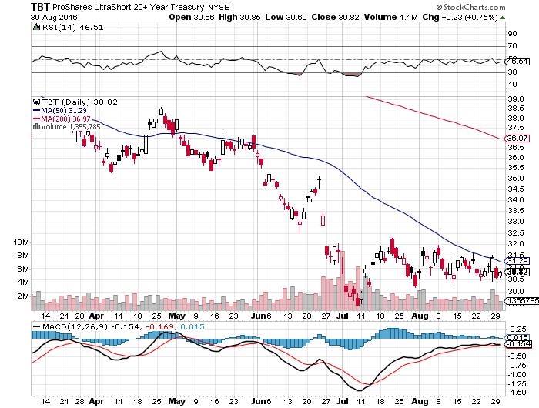
2X Short Treasuries (TBT)-Base Building

Slide 21
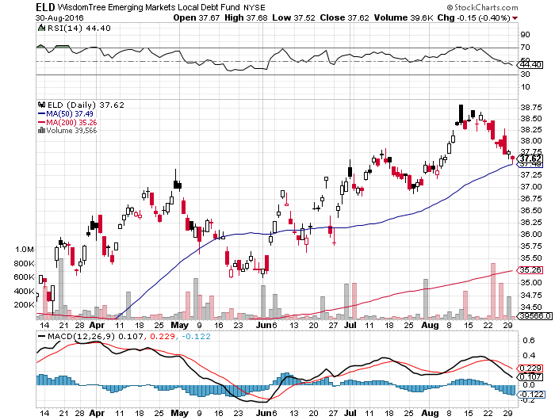
Emerging Market Debt (ELD) 5.75% Yield-

Slide 22
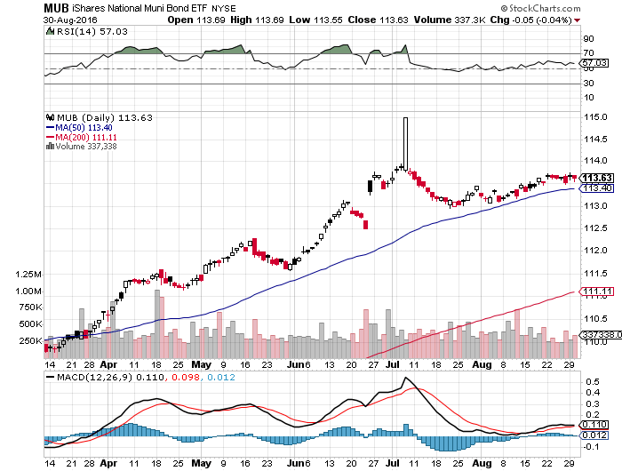
Municipal Bonds (MUB)-1.21% yield-New High
Mix of AAA, AA, and A rated bonds-flight to safety

Slide 23
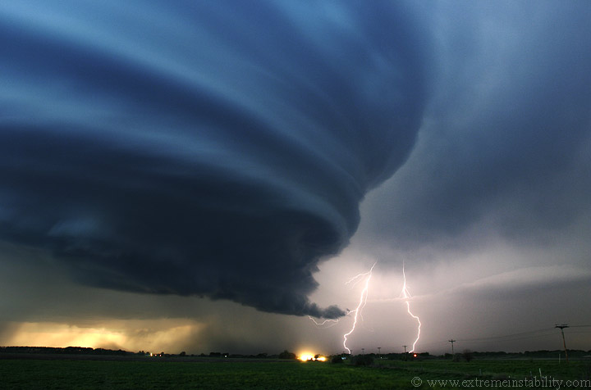
Stocks-Calm Before the Storm
*Traders nervous ahead of September, the worst month of the year for the past 30 years
*Net inflows into US stock mutual funds for the first time this year
*30 day SPX realized volatility his a 20-year low, with VIX short positions at an all time high
*September is historically the best performing VIX month of the year, big move up has been coiling for months
*Banks takeover the leadership, could run for rest of year, especially if Fed delivers two rate hikes
*Emerging markets now the second best sector of
the year for ETF asset allocation
*FANG stocks all close to breaking out to new highs
*The world is looking for a tradable dip to “BUY,”
will September be your last chance this year?

Slide 24
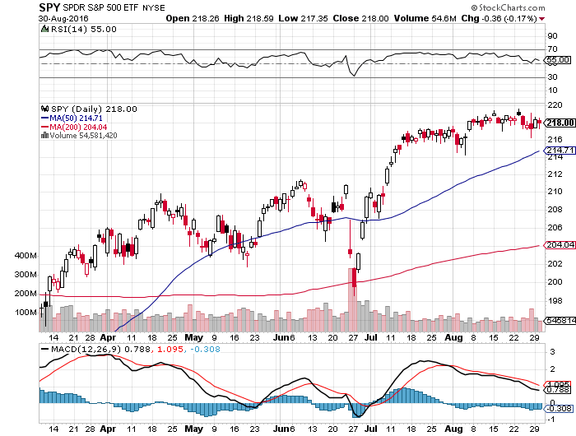
S&P 500-Flat Line

Slide 25
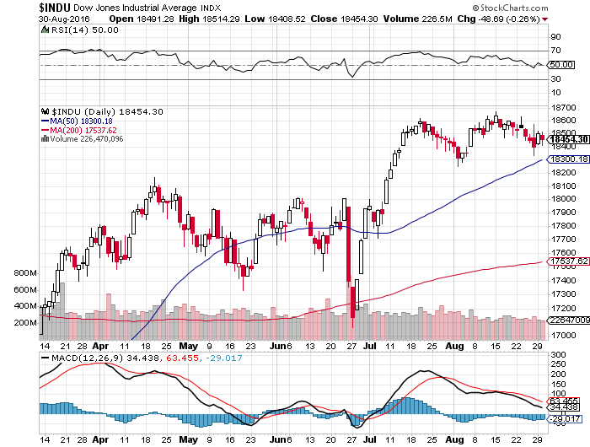
Dow Average-New Highs

Slide 26
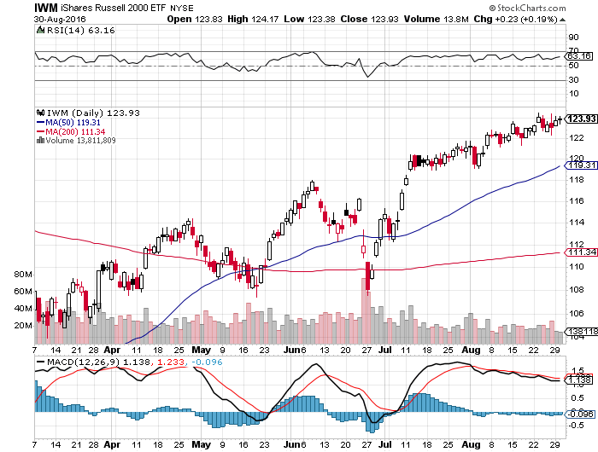
Russell 2000 (IWM)-

Slide 27
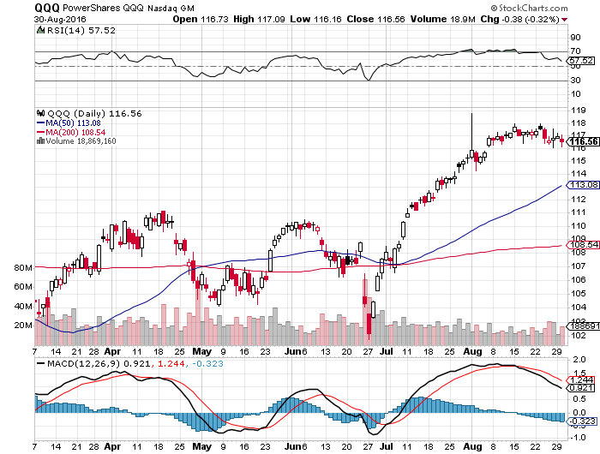
NASDAQ (QQQ)-
FANG is Taking a Break

Slide 28
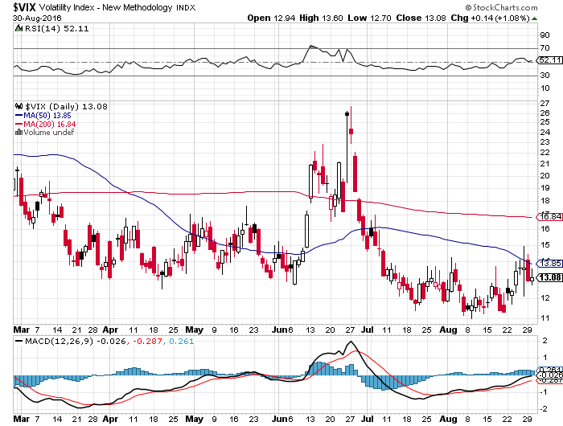
(VIX)-Bouncing Off a Decade Low

Slide 29
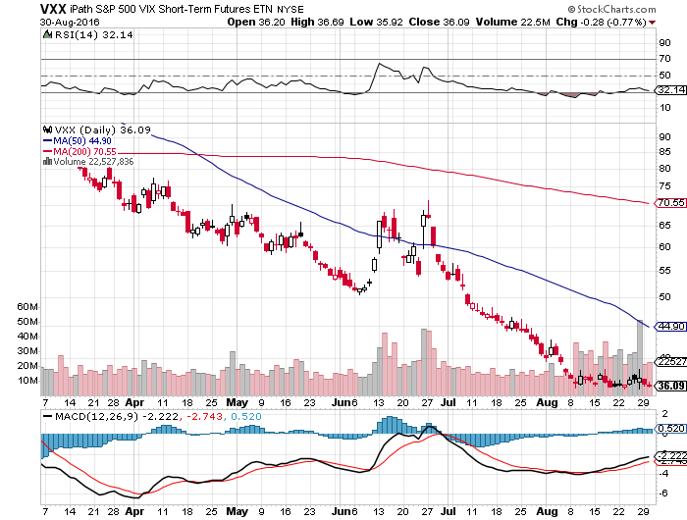
iPath S&P 500 VIX Short Term Futures ETN (VXX) long the 9/$30-$33 vertical bull call spread

Slide 30
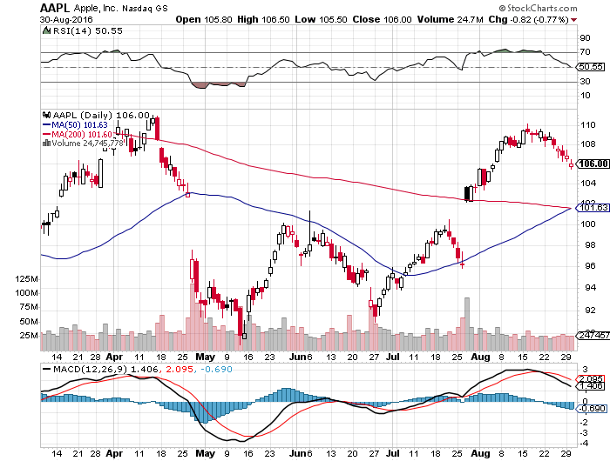
Apple (AAPL) –Buy the Dips
Back to waiting for the next real catalyst-the iPhone 7
$14.5 billion Irish tax will be paid by US government, Sept 7 IPhone 7 announcement

Slide 31
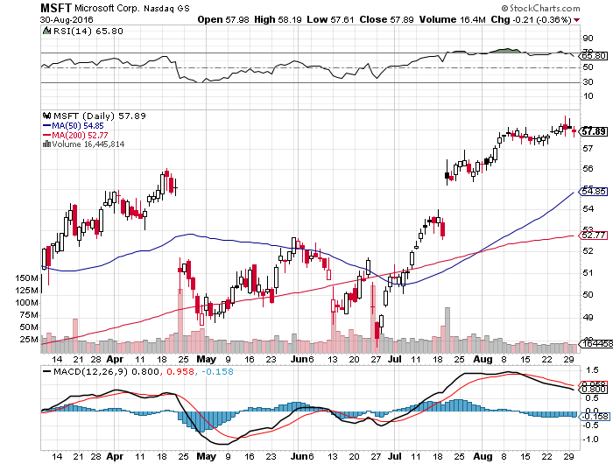
Microsoft (MSFT)
The New Big Cap Tech Leader

Slide 32
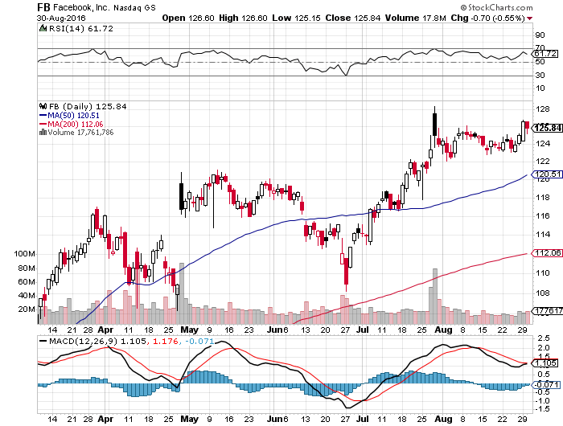
Facebook (FB)-

Slide 33
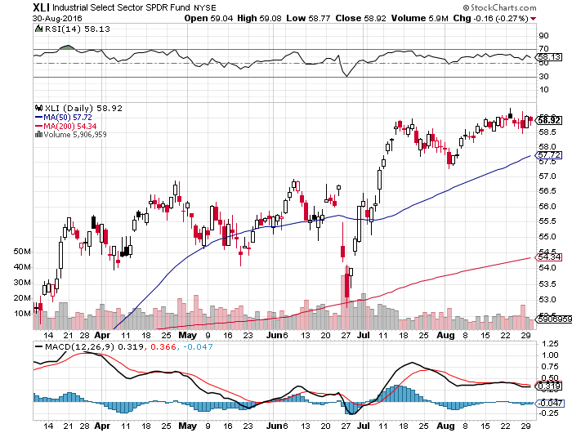
Industrials Sector SPDR (XLI)-Dow Mainstay
(GE), (MMM), (UNP), (UTX), (BA), (HON)

Slide 34
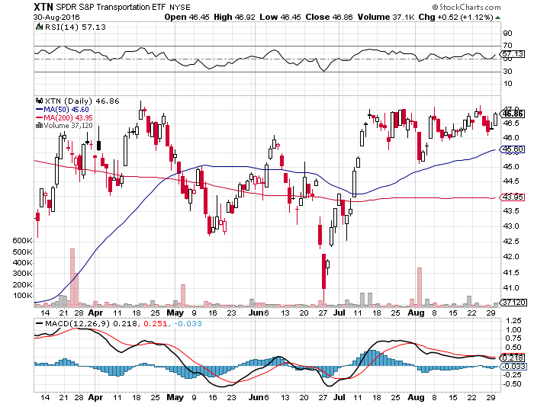
Transports Sector SPDR (XTN)-Upside Breakout Imminent
(ALGT), (ALK), (JBLU), (LUV), (CHRW), (DAL)

Slide 35
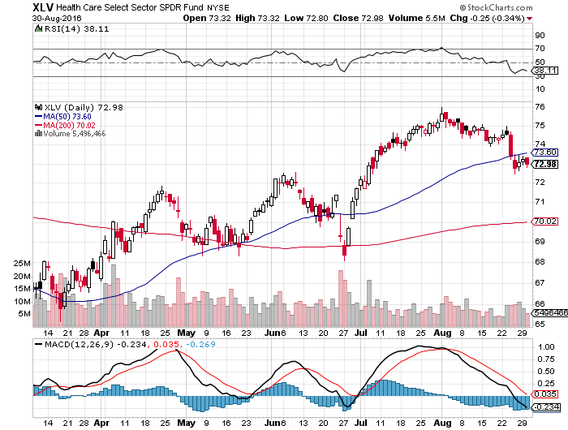
Health Care Sector SPDR (XLV), (RXL)
(JNJ), (PFE), (MRK), (GILD), (ACT), (AMGN)
The Epipen Hit

Slide 36
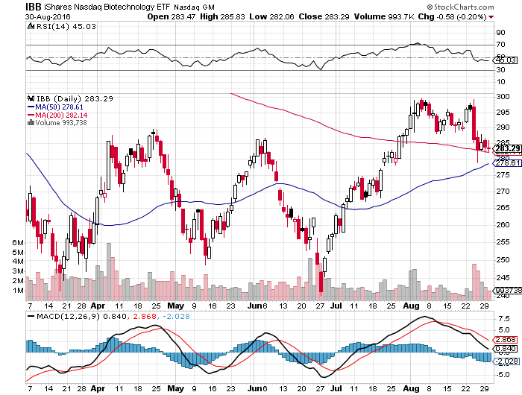
Biotech iShares (IBB)-A Political Football in 2016
Own for 2017

Slide 37
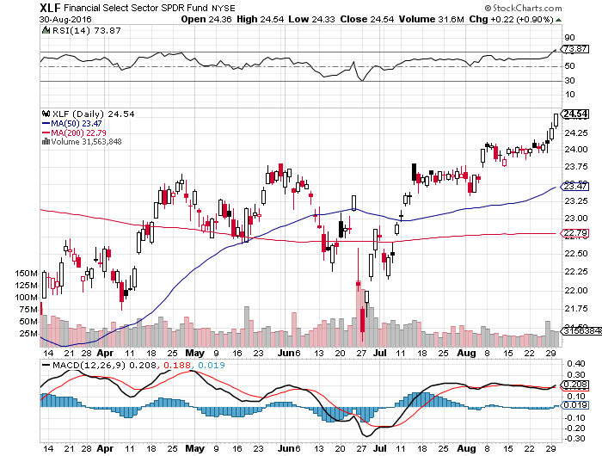
Financial Select SPDR (XLF)-A big Value Play
(BLK/B), (WFC), (JPM), (BAC), (C), (GS)

Slide 38
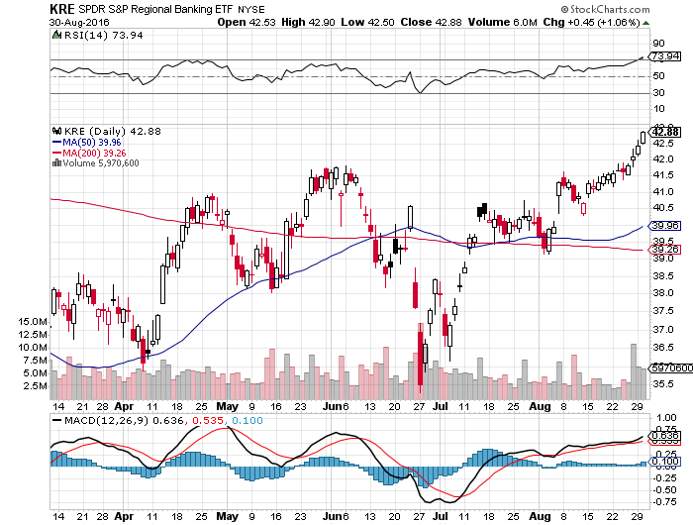
KRE Regional Bank ETF (KRE)-
Breakout Coming

Slide 39
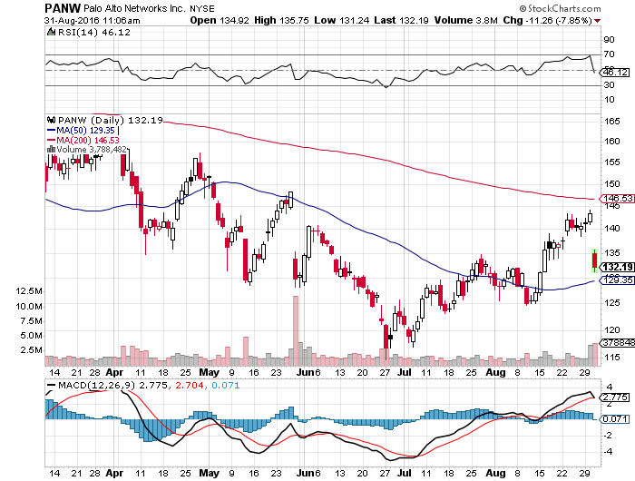
Palo Alto Networks (PANW)- another entry point setting up on conservative guidance-Hacking Isn’t Going Away

Slide 40
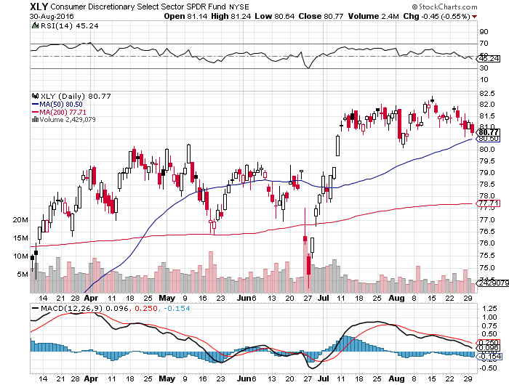
Consumer Discretionary SPDR (XLY)
(DIS), (AMZN), (HD), (CMCSA), (MCD), (SBUX)
A Major Leader of the Rally

Slide 41
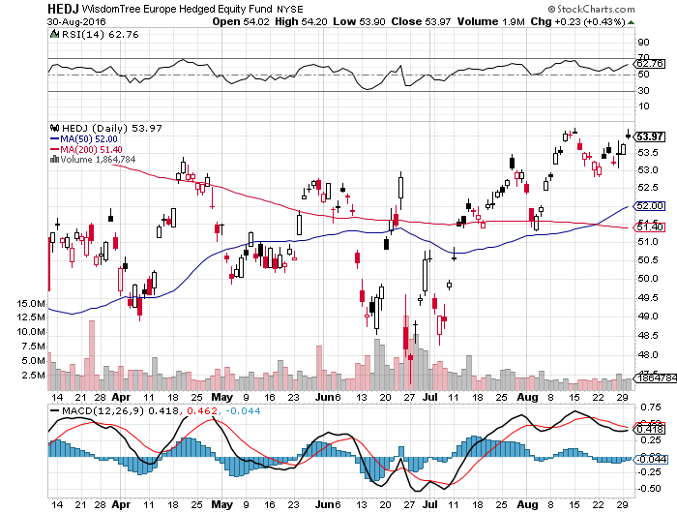
Europe Hedged Equity (HEDJ)-Hedged European Equity

Slide 42
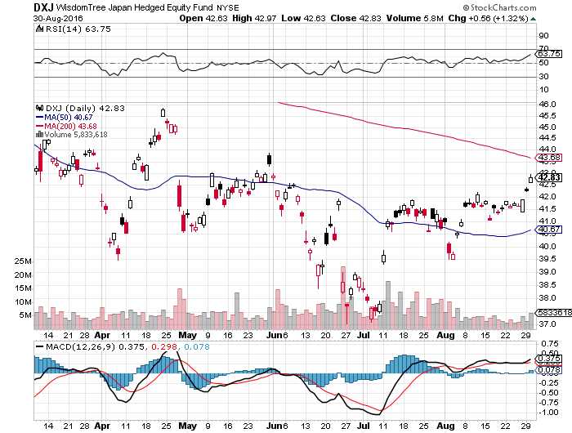
Japan (DXJ)-Hedged Japan Equity
Killed by Strong Yen

Slide 43
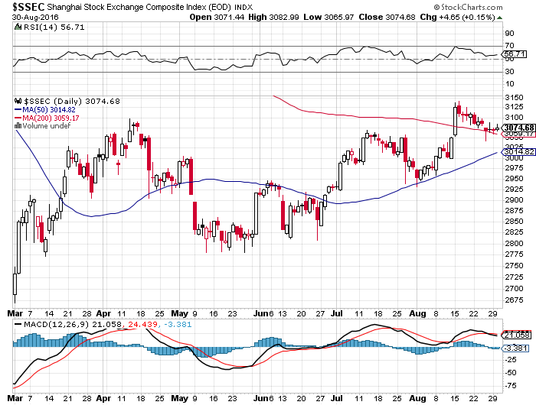
China ($SSEC)-
China Finally Participates

Slide 44
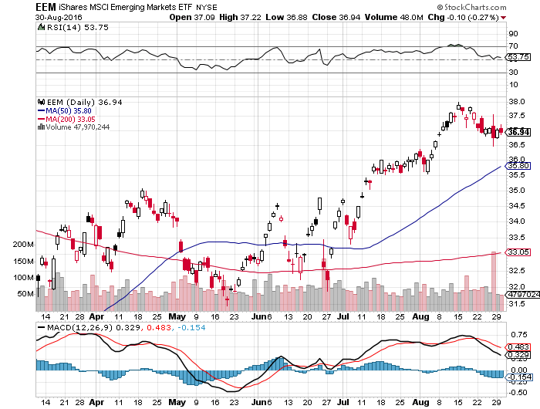
Emerging Markets (EEM)-
Off to the Races

Slide 45
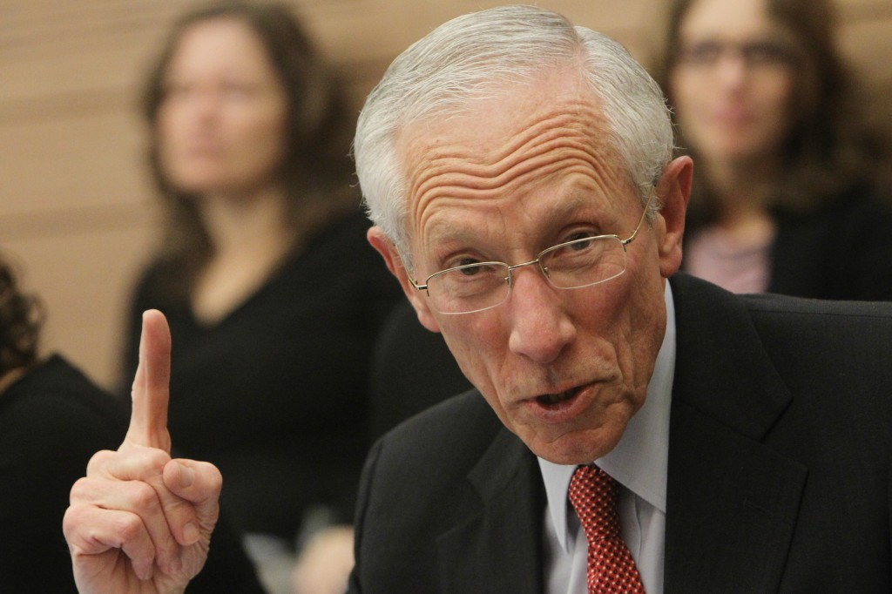
Foreign Currencies-Thank You Stanley Fischer
*Vice chairman Stanley Fischer puts two rate hikes this year on the table, giving the US dollar a new lease on life
Japanese yen now has put in a very convincing double top on the charts-sell rallies
*Outlook of negative rates for longer is pulling down the Euro, taking a run at new multi year lows
*Oil weakness gives Aussie (FXA) and
Loonie (FXC) a heart attack
*Chinese Yuan (CYB) holding
on mixed economic data,
rallying stocks

Slide 46
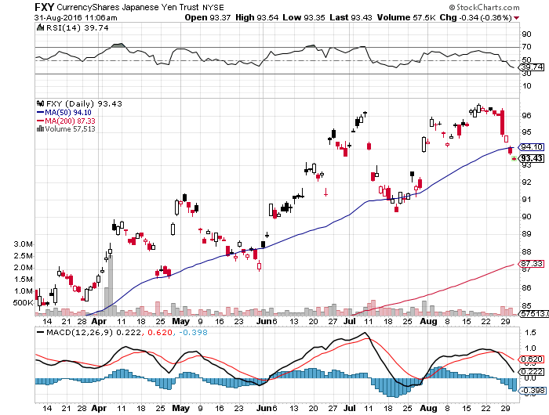
Japanese Yen (FXY)-Rolling Over-Double Top is In took profits on long the 8/$97-100 put spread took profits on long the 9/$99-102 put spread

Slide 47
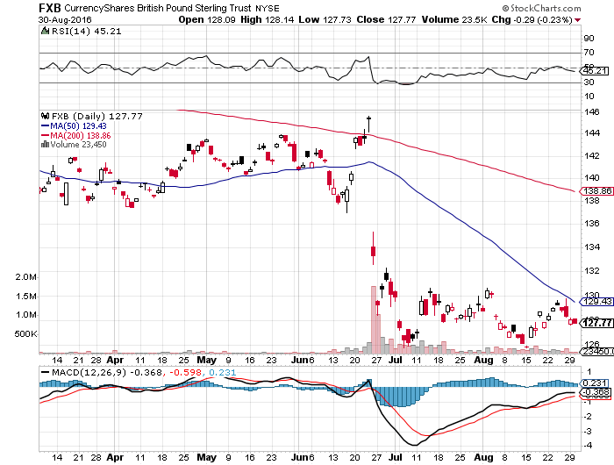
British Pound (FXB)-New Lows on Weakening Economy

Slide 48
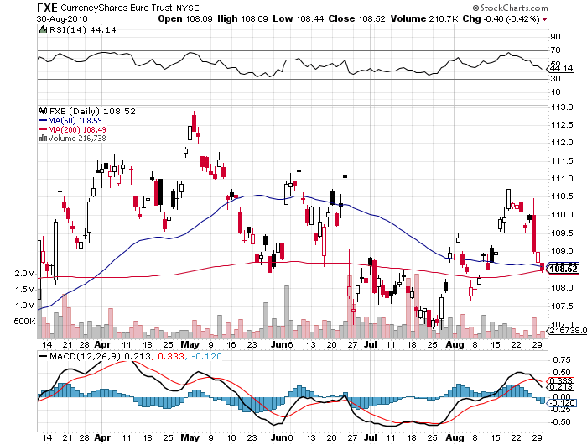
Euro ($XEU), (FXE), (EUO)- Fading Economy took profits on long the 9/$112-$115 vertical bear put spread

Slide 49
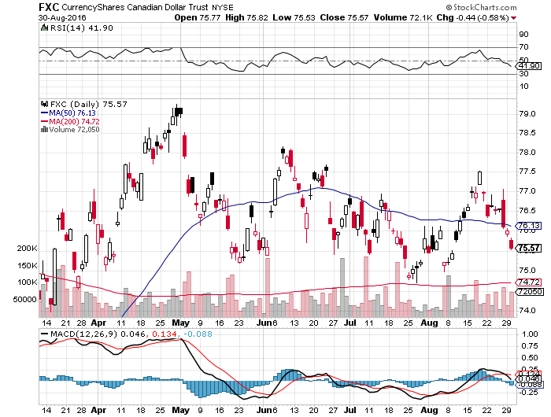
Canadian Dollar (FXC)-Weak Oil Hit

Slide 50
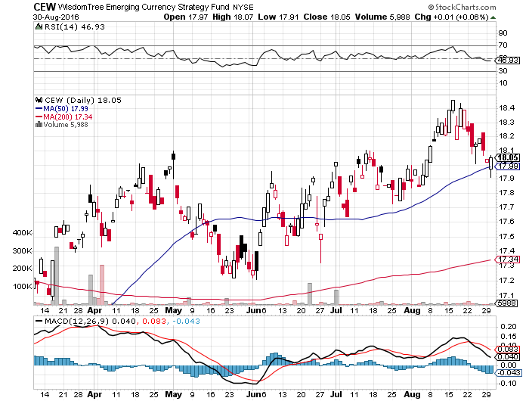
Emerging Market Currencies (CEW)

Slide 51
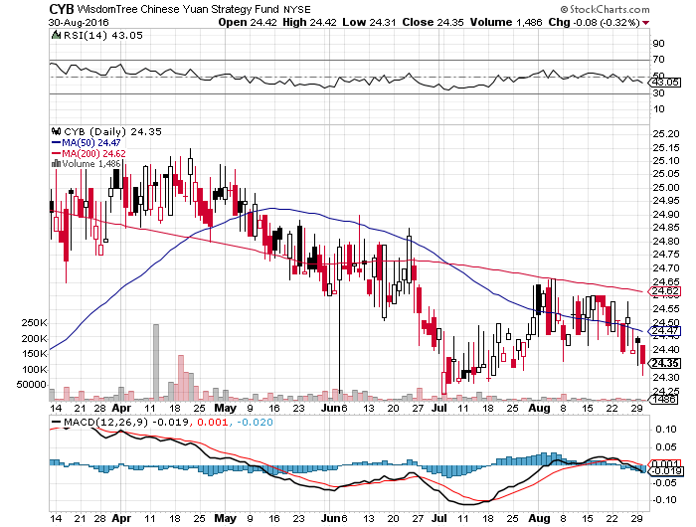
Chinese Yuan- (CYB)-

Slide 52

Energy-Leaving Peak Demand Season
*All US storage is now full at 521 million barrels, up 14% YOY
*Iran making “freezing” noises, helping prices further, unofficial OPEC meeting in Algiers in 3 weeks
*Angola replaces Nigeria as Africa’s largest oil prices as rebels impair production
*Cease fire in Nigeria puts oil back in the penalty box
*Higher prices are bring drillers back into share, who can break even at $40/barrel
Natural gas surpassing coal as a power
source for the first time at 33% of total
*Baker-Hughes US oil rig count down -2 to 489,
first break in months
*Oil now stuck in $40-$52 range,
a break takes us to $35 quickly

Slide 53
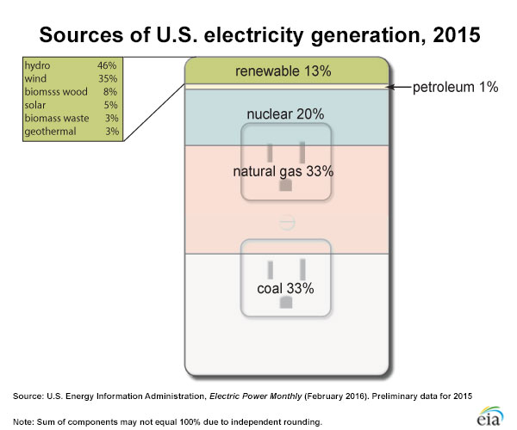

Slide 54
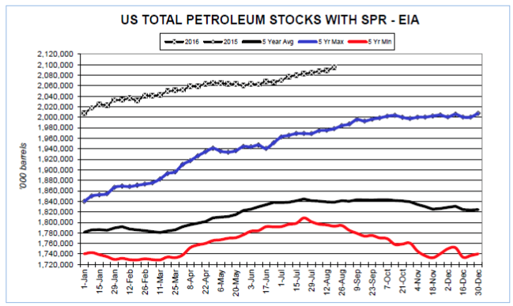

Slide 55
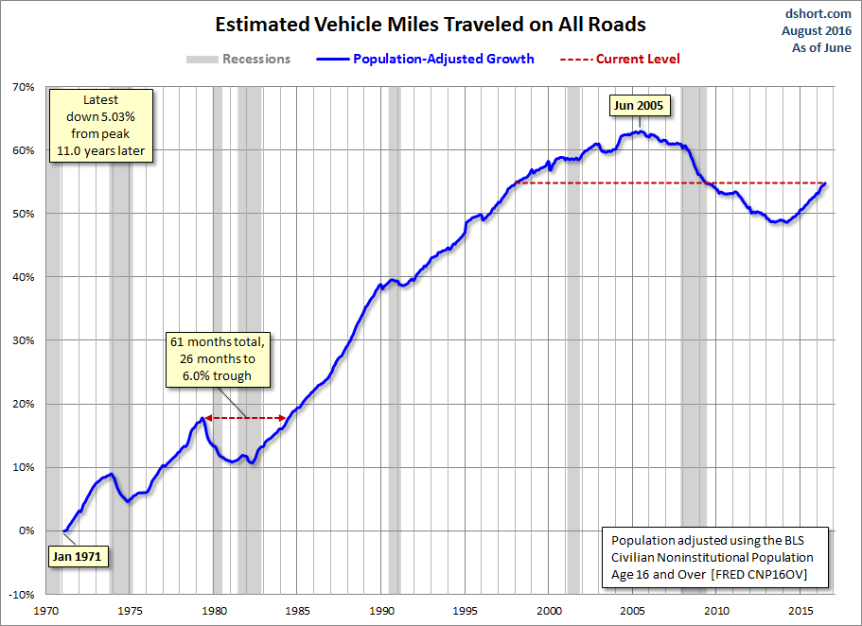
Miles Traveled back up to 1998 Levels

Slide 56
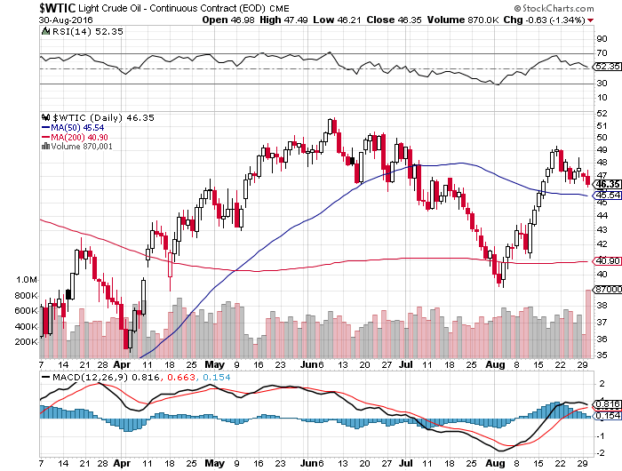
Oil-The Glut Returns

Slide 57
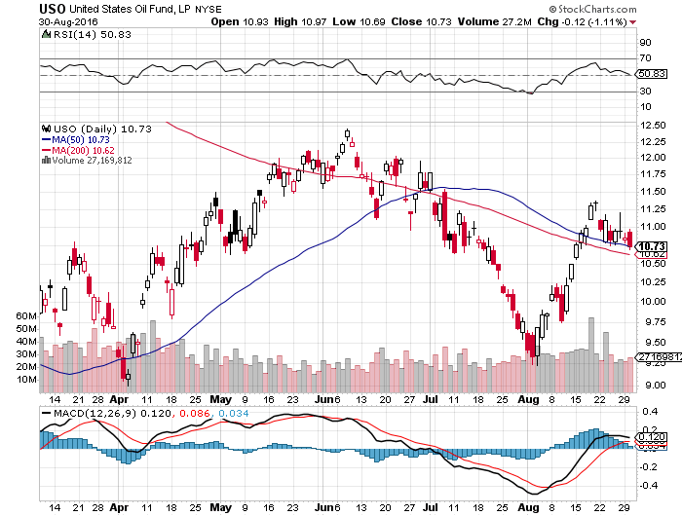
United States Oil Fund (USO)

Slide 58
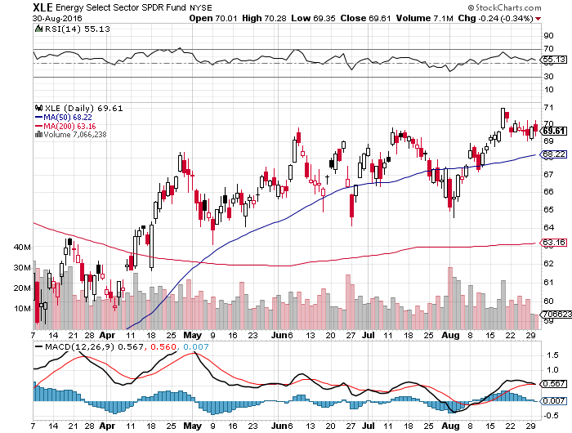
Energy Select Sector SPDR (XLE)
(XOM), (CVX), (SLB), (KMI), (EOG), (COP)

Slide 59
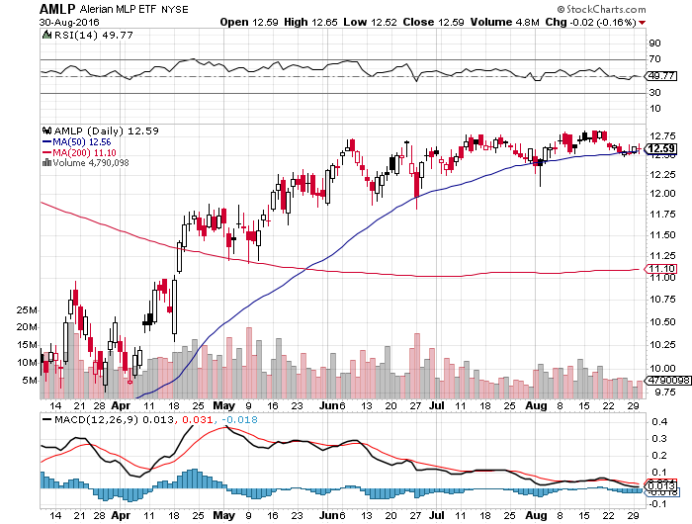
Alerian MLP ETF (AMLP)- 8.89% Yield
Basket Approach is the Only Safe Play here

Slide 60
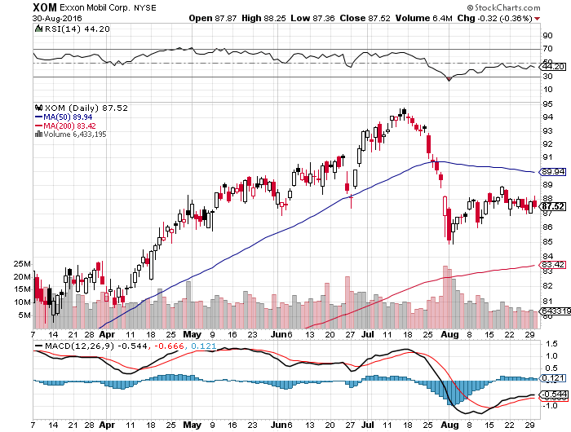
Exxon (XOM)-Dividend is Not Enough

Slide 61
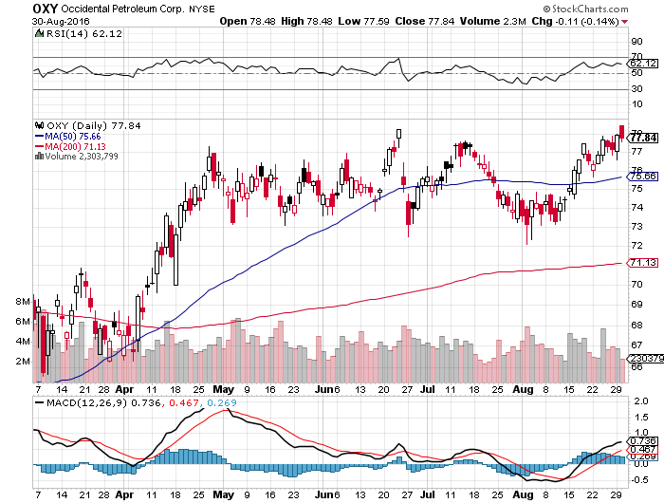
Occidental Petroleum (OXY)-

Slide 62
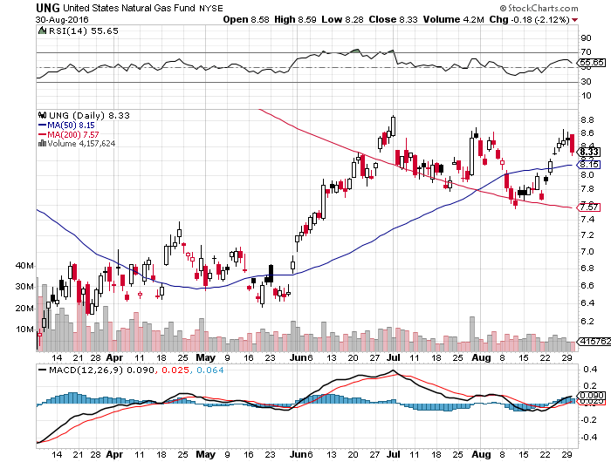
Natural Gas (UNG)-Bumping Against 2016 Highs

Slide 63
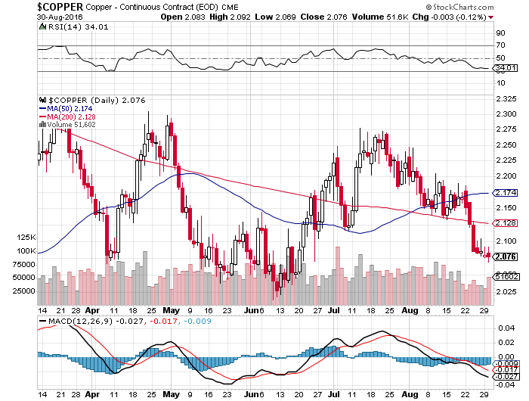
Copper-Capped on Over Supply

Slide 64

Precious Metals-Rate Rise Buzz Kill
*Fed talk of rate hikes takes the sizzle out of gold, as rising rates increase the real cost of ownership
*Hawkish Fed talk brings gold meltdown, (GDX) takes the biggest hit
*Venezuela still leaning heavily on
ever gold run up to $1,350, but will
soon run out of reserves, down from
$16 to $12 billion in a year
*Looking to buy on a bigger dip
*If Fed fails to raise rates in September,
look for a new big leg up

Slide 65
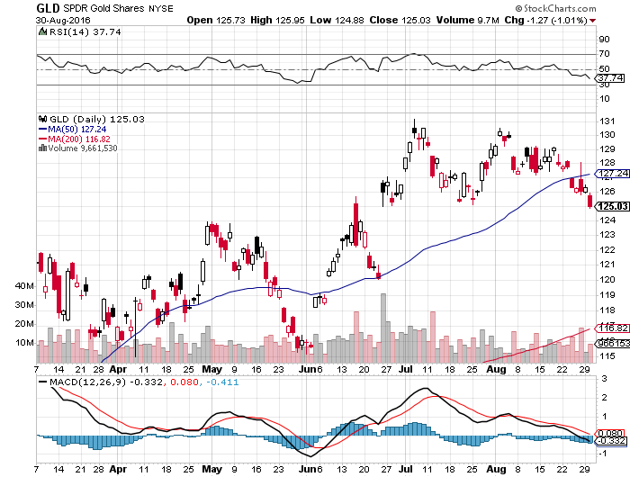
Gold (GLD)-Buy Dips

Slide 66

Market Vectors Gold Miners ETF- (GDX)

Slide 67

Silver (SLV)-

Slide 68

Silver Miners (SIL)-

Slide 69

Agriculture-Major New Lows!
*Enormous crop forecasts break all ags to new multiyear lows, with wheat at a 10 year low!
*Perfect weather pouring gasoline on the fire
*Financial stress in the Midwest is rising, with many regional banks at risk
*Huge carry over crop threaten to spill falling prices into 2017
*(AGU) + (POT) merger talks typical
on a long term bottom
*No trade, there are NO fish to fry
to low to initiate new shorts
*My main job here is to keep traders
away from this sector this year, and
that approach has worked one more time

Slide 70


Slide 71

Potash (POT)- Up 16% in One day

Slide 72

(CORN) – New Lows!

Slide 73

(WEAT) New Lows!

Slide 74

(SOYB) No Longer the Sole Survivor

Slide 75

Real Estate-Is the Bubble Here?
*Rocketing prices in major markets raise the prospects of a return of a real estate bubble
*Shortage of supply is driving prices 5% higher than the inflation rate, is most homeowners best investment of 2016
July New Home Sales (signed contracts) up a huge 12.4% to 654,000, highest since 2007, high end new homes biggest sellers, July Existing Home Sales up +3.2%
*Negative home equity rate drops from 30% to 12% in 5 years, to 5.9 million homes. West coast cities have the lowest, Chicago and Las Vegas the highest.
*July Median home sales price
drops to 294,000 from 296,000
*Only 4.7 months of home supply
on the market, anything under 5.0 is tight
*June Case Shiller -0.1% to 5.1% YOY,
down second month in a row

Slide 76

April S&P 500/Case–Shiller Home Price Index
+5.0% YOY, Portland, Seattle, Denver leaders

Slide 77

General Growth Properties (GGP)
Yield Play Profit Taking

Slide 78

US Home Construction Index (ITB)
(DHI), (LEN), (PHM), (TOL), (NVR)
Another Big Brexit Winner

Slide 79

Trade Sheet
So What Do We Do About All This?
*Stocks- stand aside-wait for a big dip to buy
*Bonds-sell rallies on rate rise risk
*Commodities-buy dips long term
*Currencies- sell Yen and Euro on rallies
*Precious Metals –buy dips after Fed meets
*Volatility-sell short spikes over $25, buy dips to $12
*The Ags –stand aside
*Real estate-buy the homebuilders LT

Slide 80

To buy lunch tickets, please click http://members.madhedgefundtrader
.com/category/luncheons/usa/ and select the city of your choice
Next Strategy Webinar
12:00 EST Wednesday, September 14, 2016
San Francisco, CA
Good Luck and Good Trading!
Notes:
*

