Slide 1

Mad Day Trader
Bill Davis
Webinar – September 7, 2016

Slide 2
Apple

Slide 3
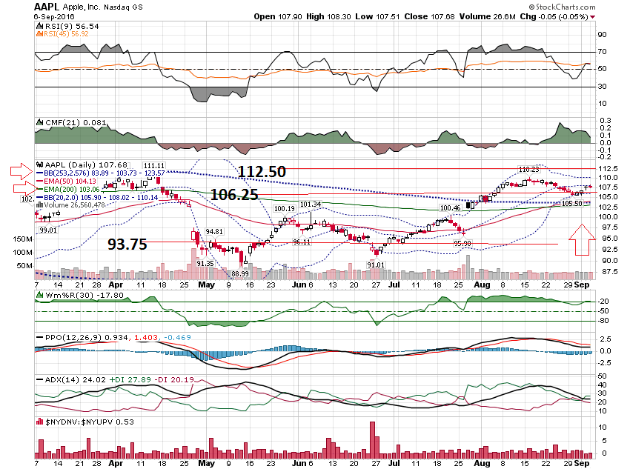

Slide 4
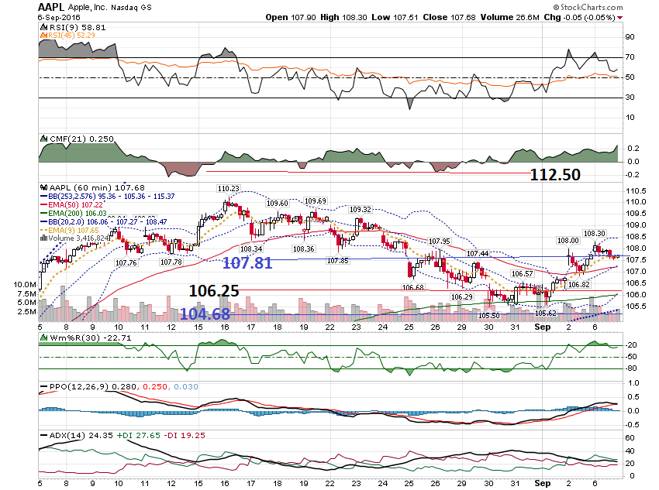

Slide 5
Indexes

Slide 6
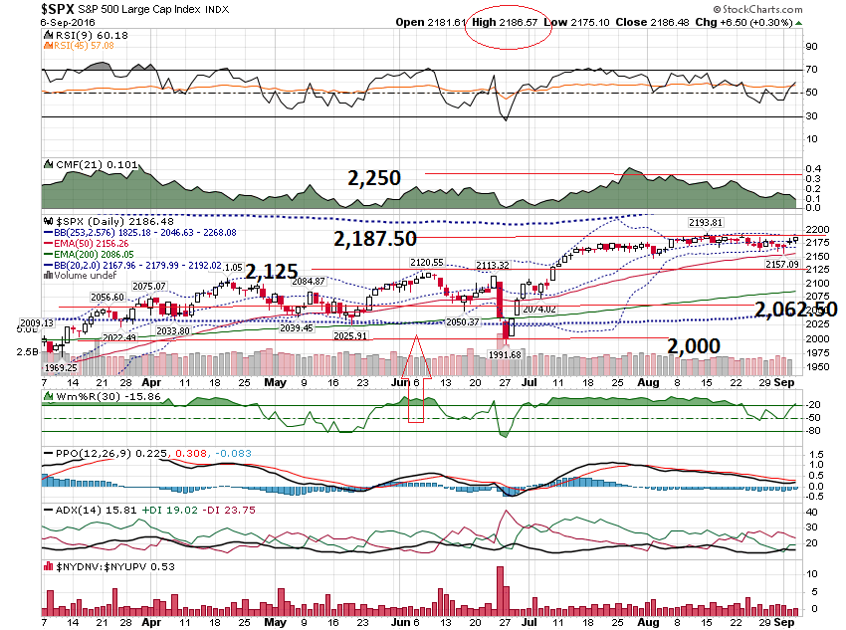

Slide 7
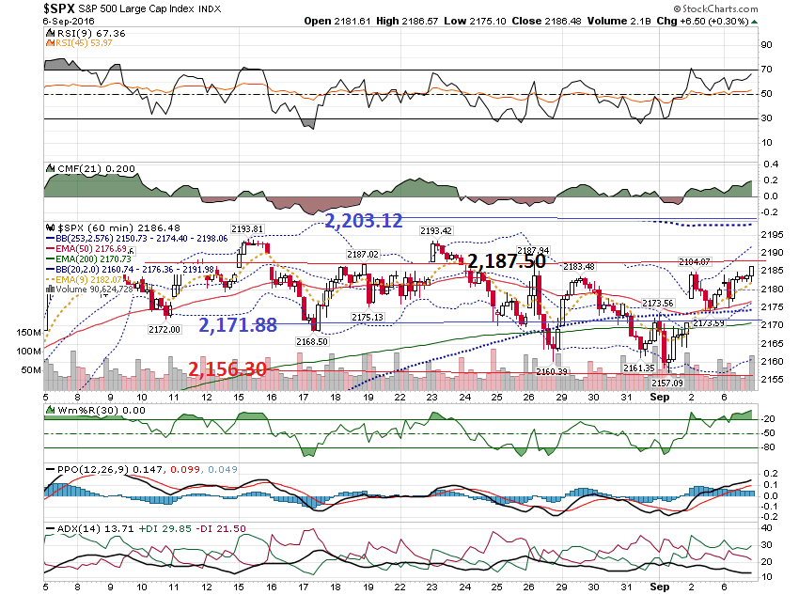

Slide 8
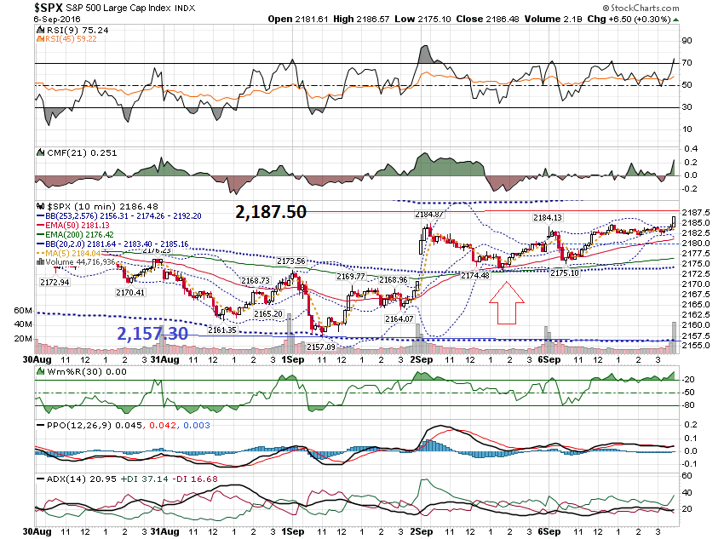

Slide 9
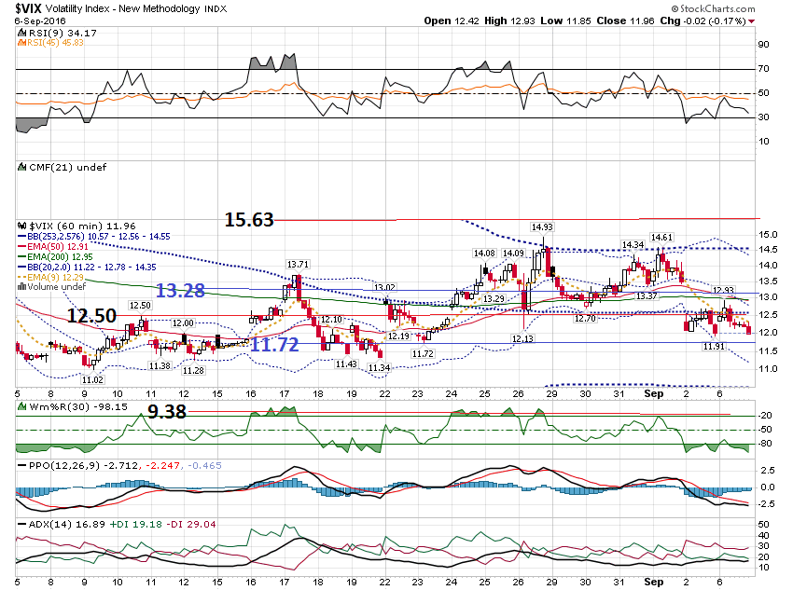

Slide 10
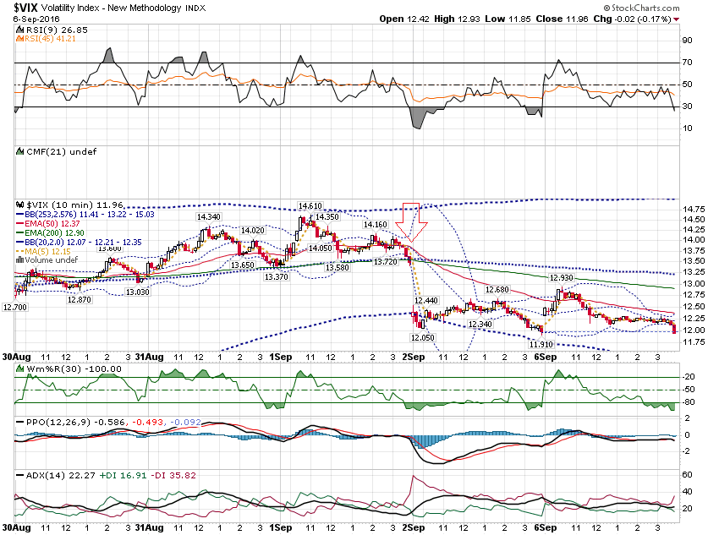

Slide 11
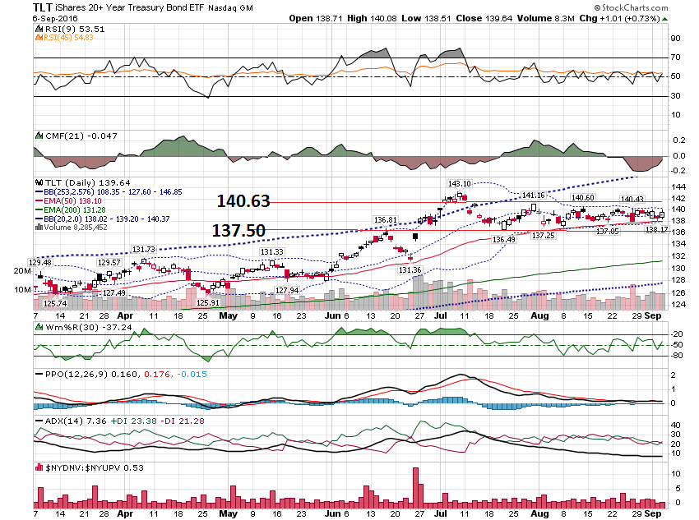

Slide 12
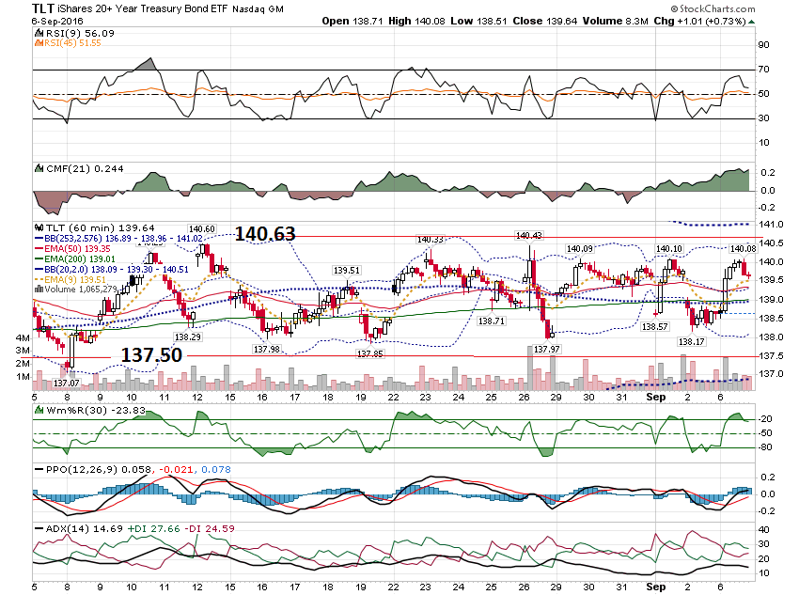

Slide 13
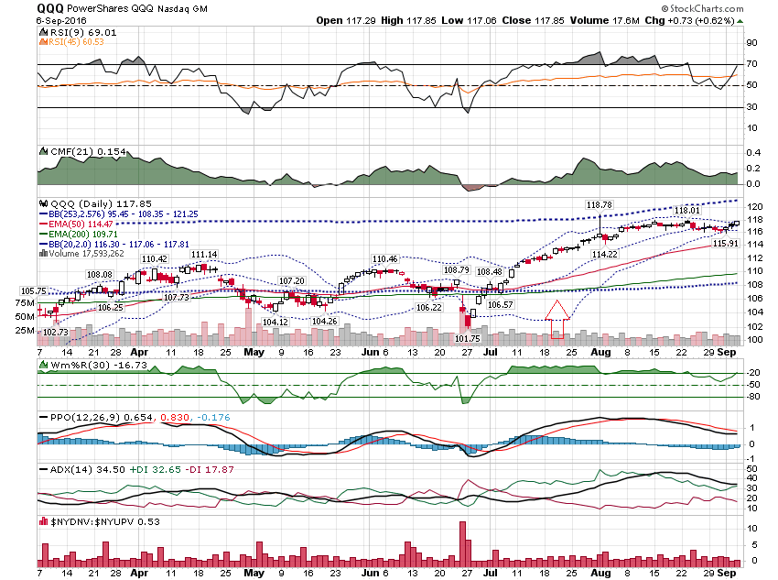

Slide 14
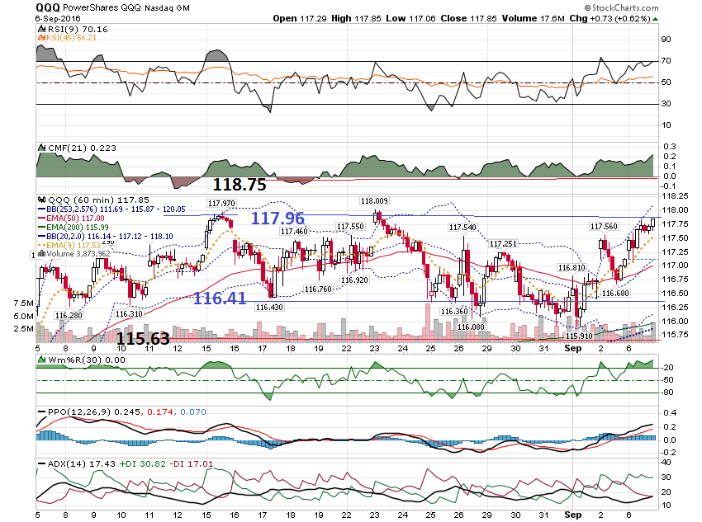

Slide 15
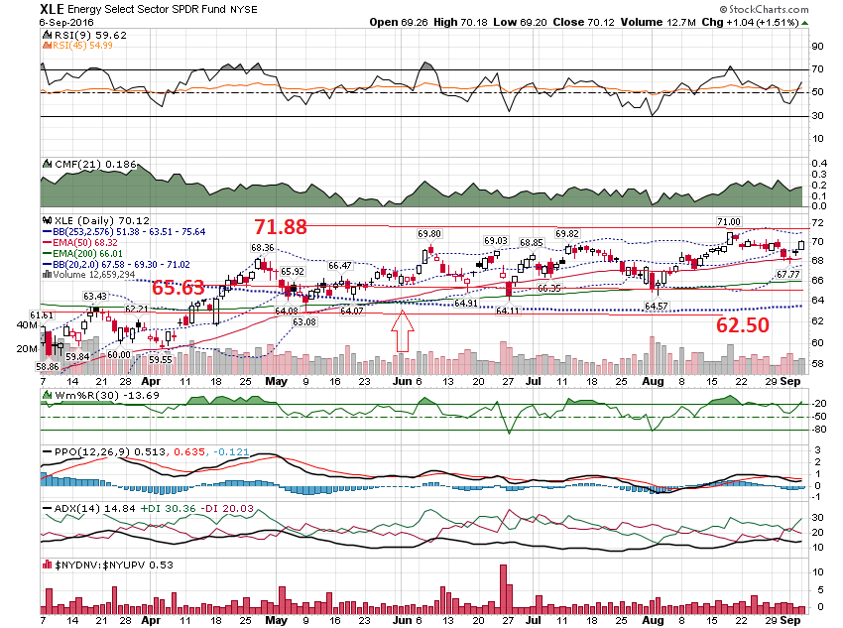

Slide 16
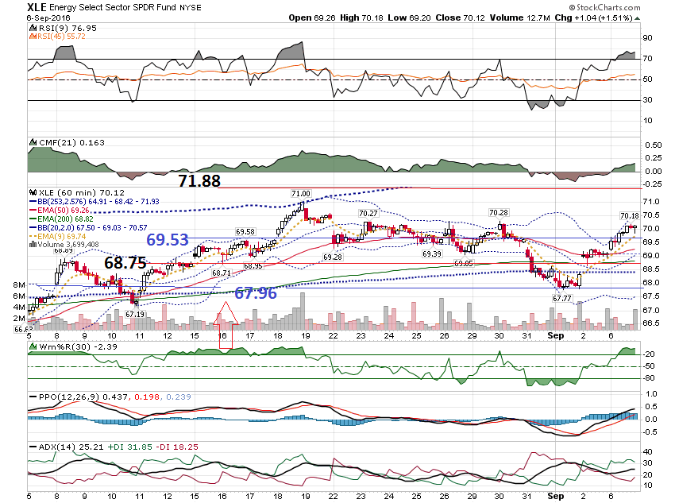

Slide 17
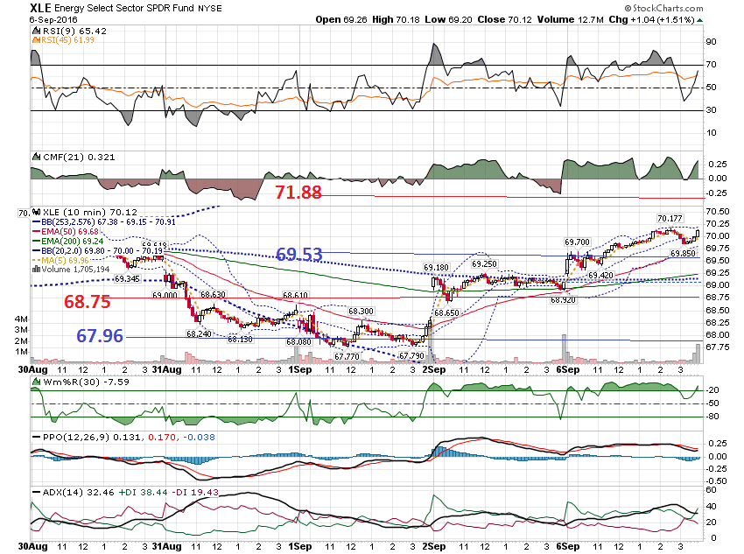

Slide 18
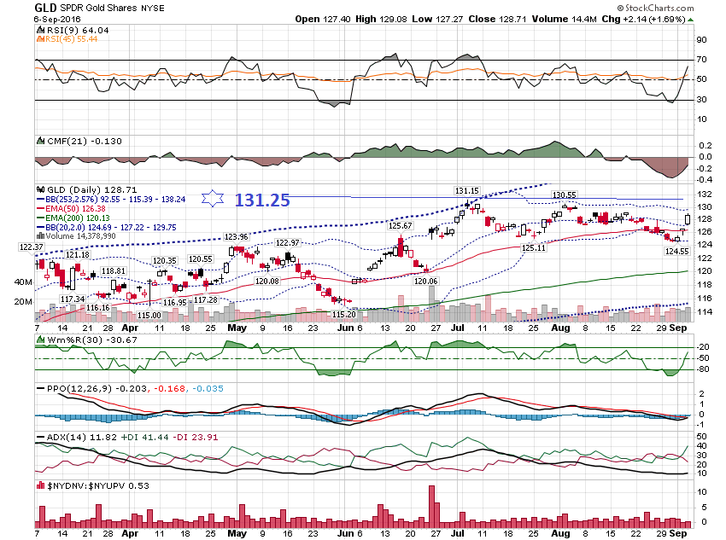

Slide 19
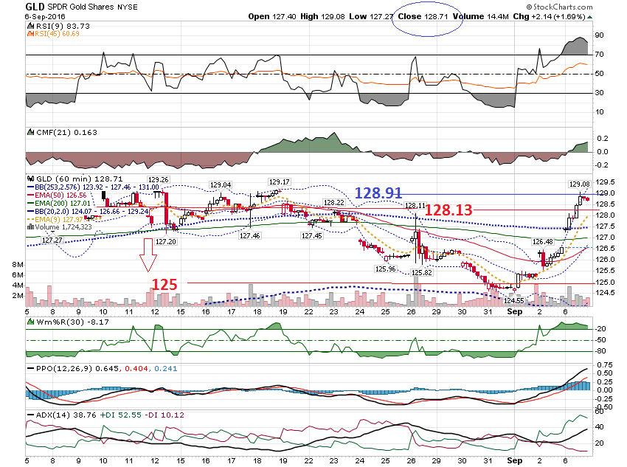

Slide 20
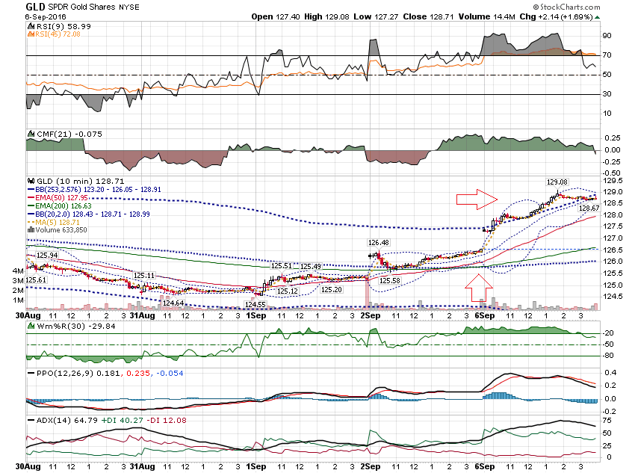

Slide 21
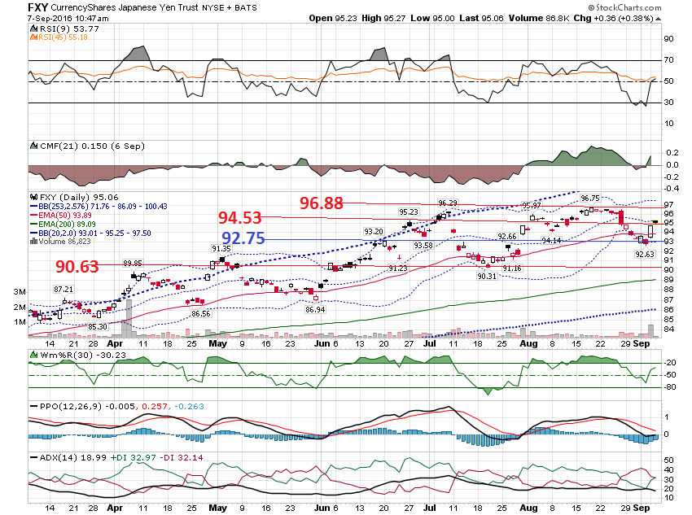

Slide 22
Post Earnings Move-
PANW

Slide 23
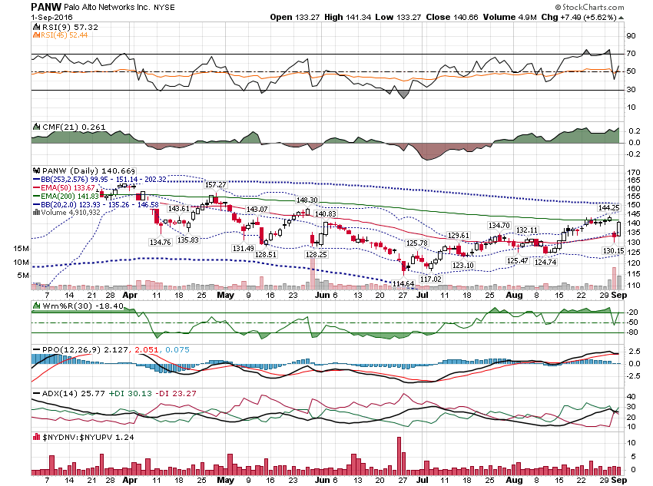

Slide 24
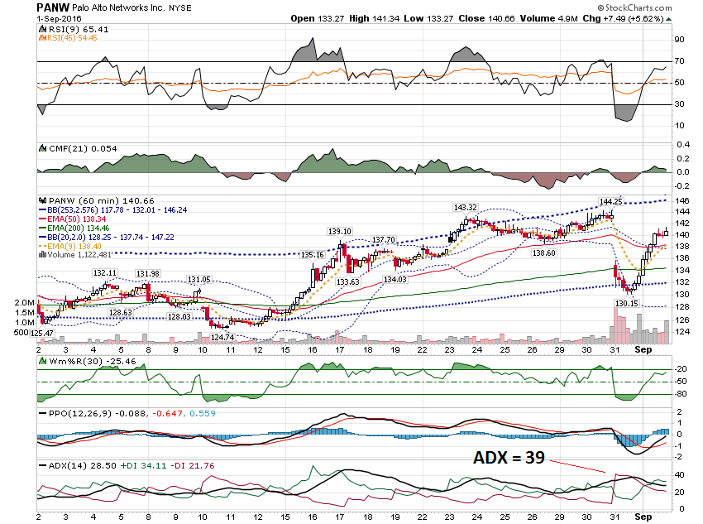

Slide 25
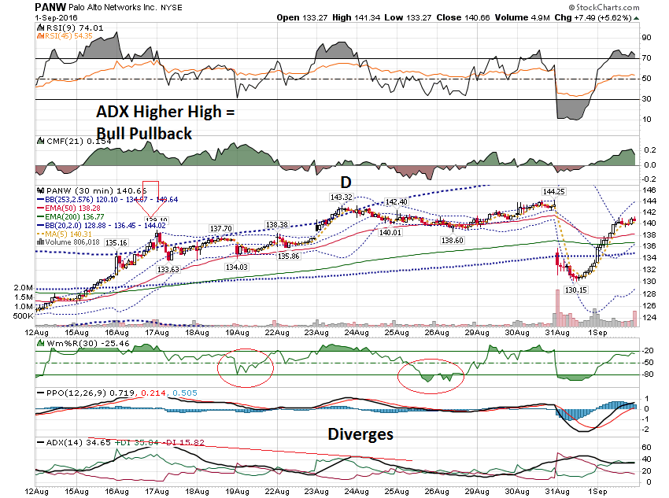

Slide 26
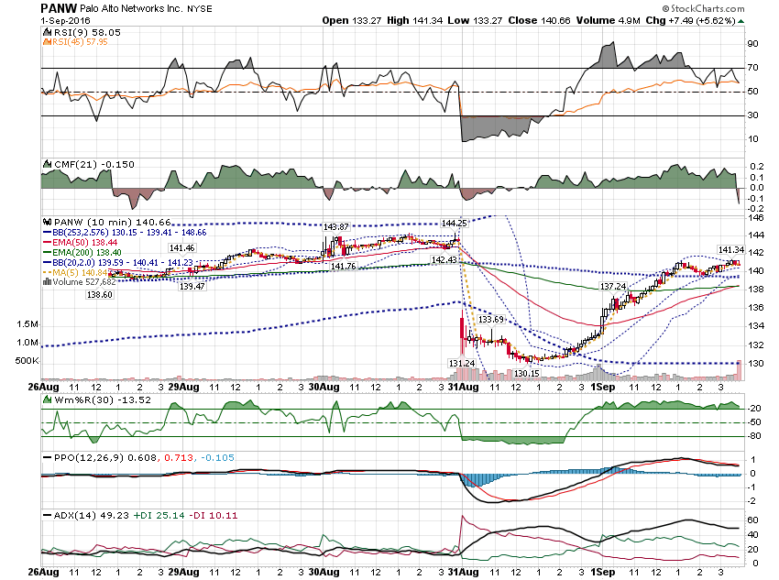

Slide 27
Post Earnings - BDX

Slide 28
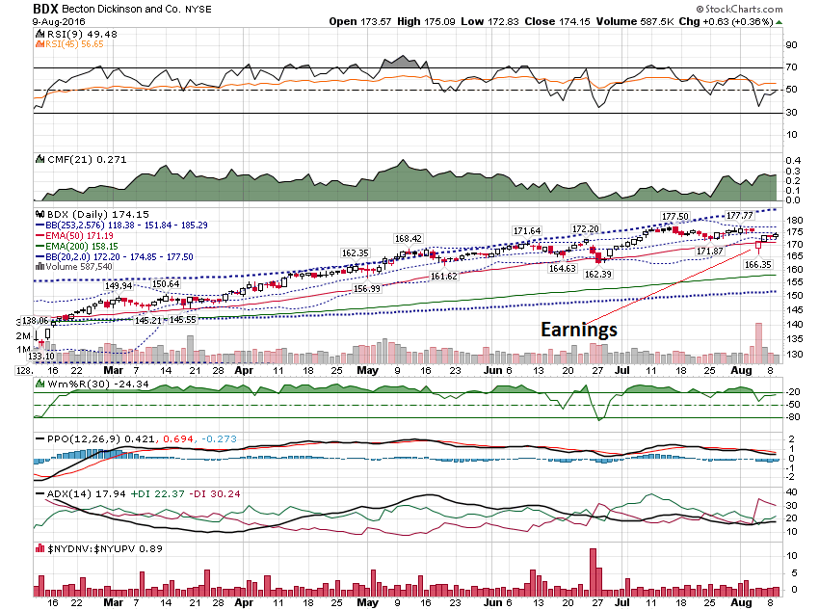

Slide 29
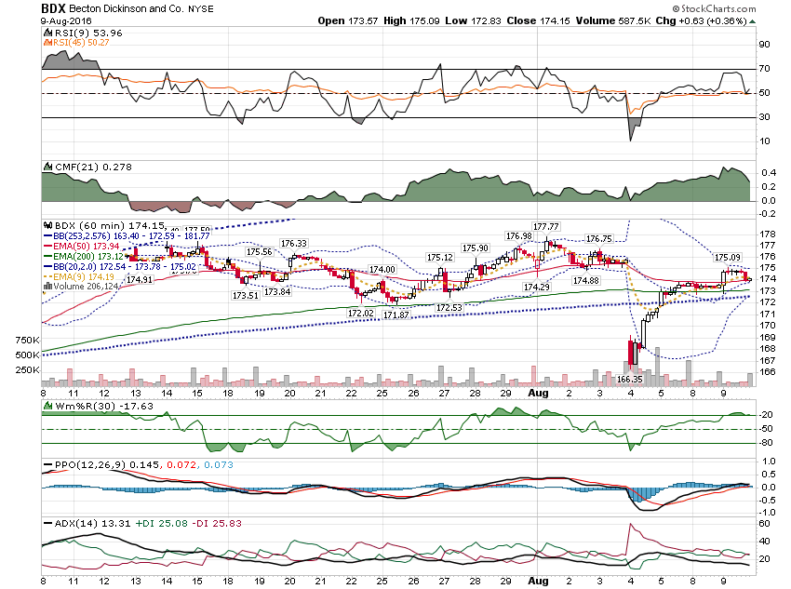

Slide 30
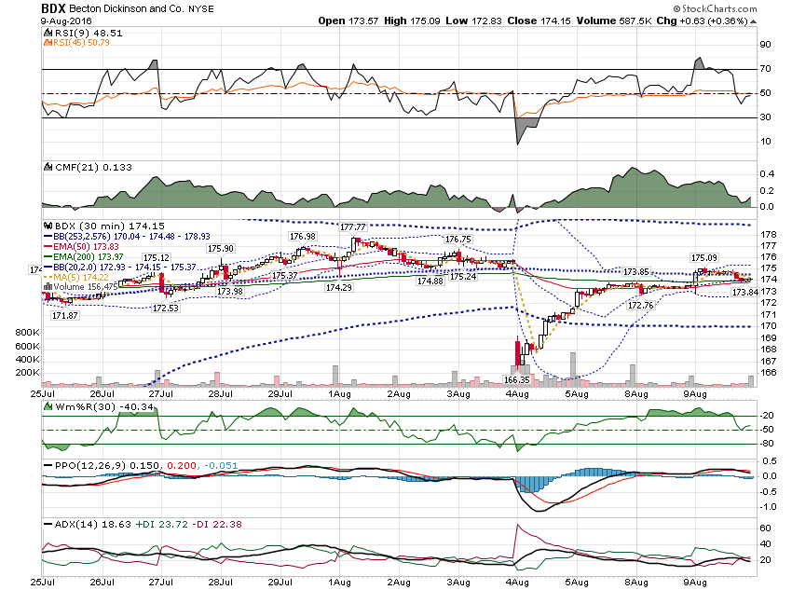

Slide 31
Pre Earnings – NAV
Report 9/8/16 Before Open

Slide 32
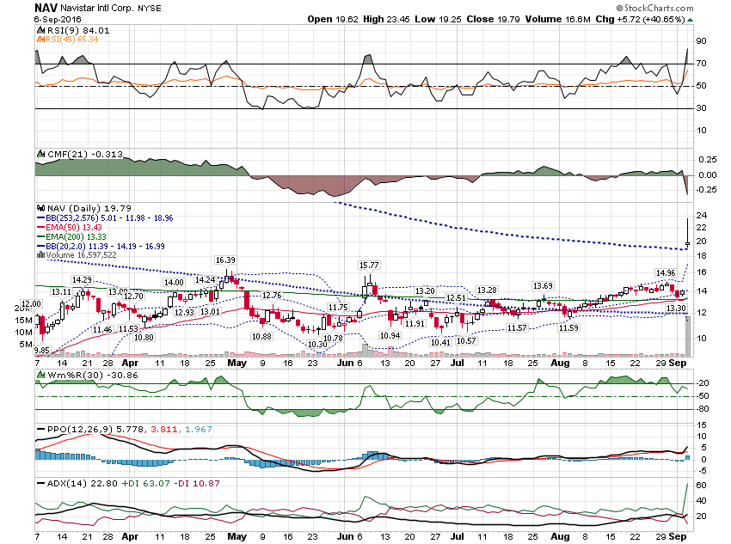

Slide 33
Hi Bill,
I know it's just a gamble, but I was lucky on NAV call buying.
Made 586%!
Best, s o

Slide 34
It was a before earning trade.
I bought 15 calls at $0.7 on 8/23 and sold this morning at $4.5.
I saw NAV was on a firm upward momentum yet also on a consolidation with low ADXR. I set the sell price at the upper band, but I could have made another easy $2~$3 if I knew how high it would go...

Slide 35
Thanks for watching!
Bill Davis
Mad Day Trader
September 7, 2016 davismdt@gmail.com

