Slide 1
The Mad Hedge Fund Trader “Disruption!”
With John Thomas from San Francisco, CA, February 1, 2017 www.madhedgefundtrader.com
Notes:
*

Slide 2
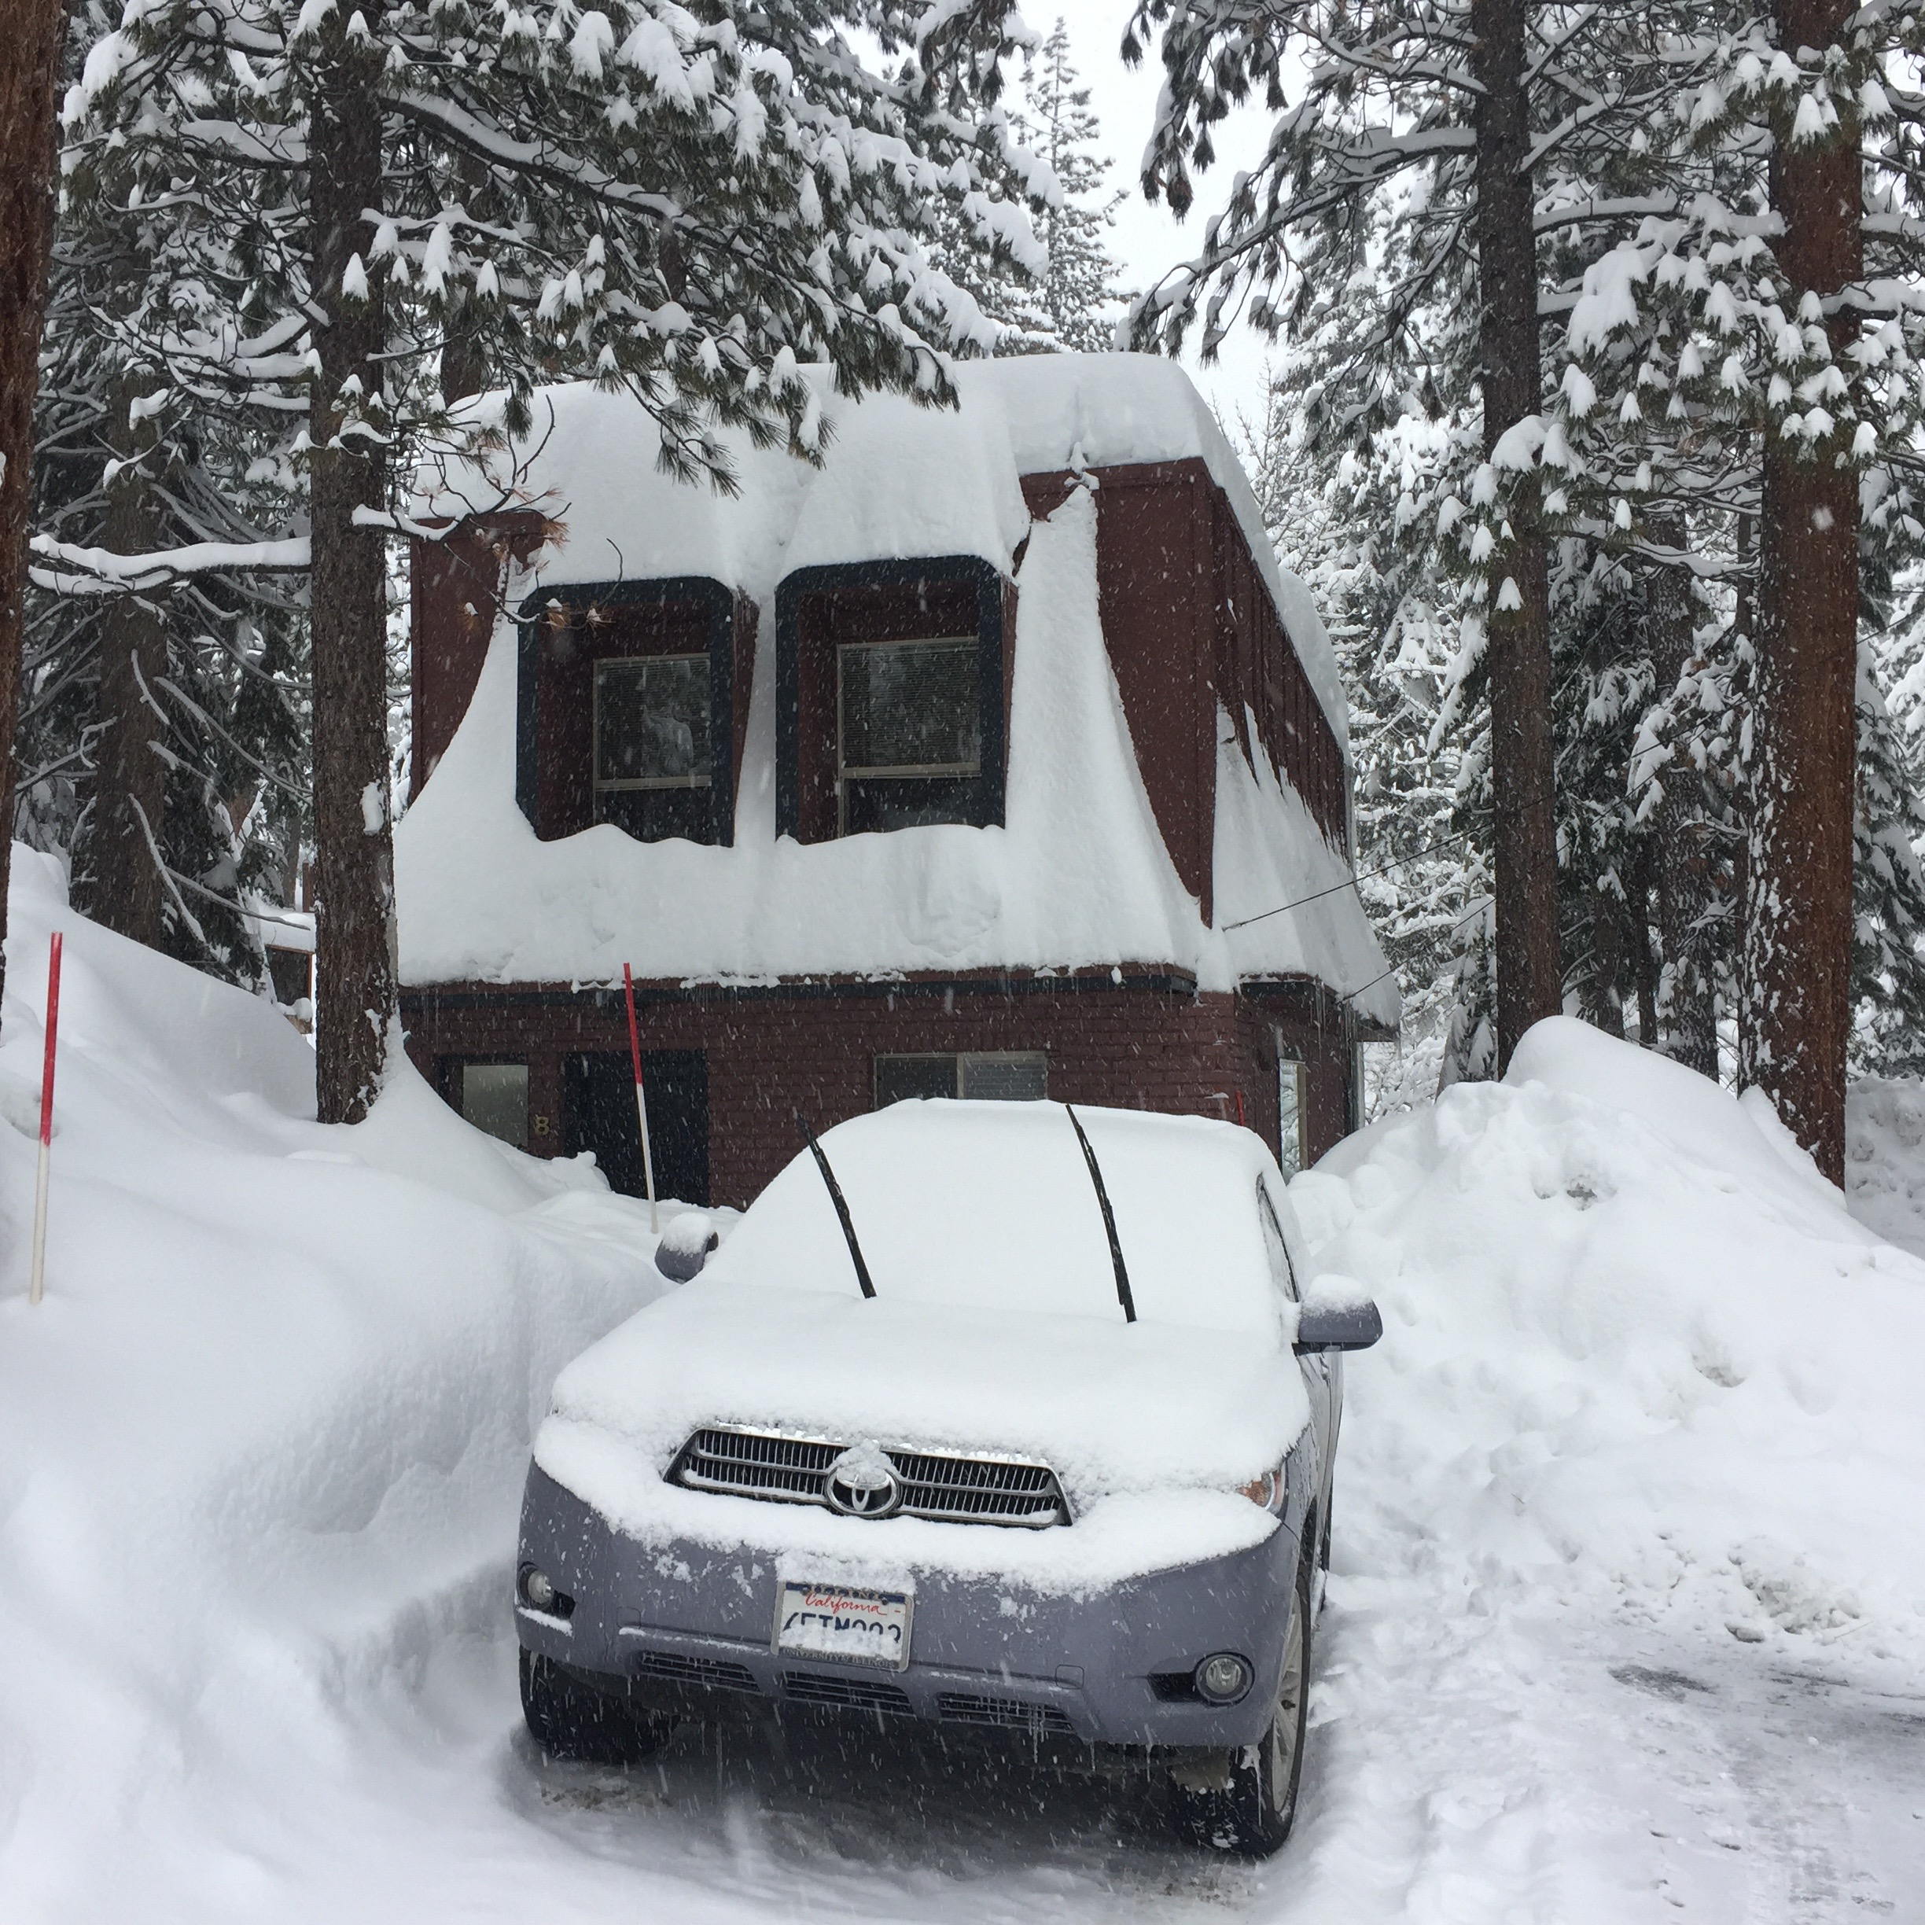

Slide 3
Second Edition
Is Out!
In the Store Now for $49
Sectors and Stocks that Will Lead the Market for the Next 20 Years
https://members.madhedgefundtrader.com/roaring-twenties-book/

Slide 4
Trade Alert Performance Best 4 Weeks of the Past 12 months-New All Time High!!
*January +9.35% Final *July +0.67% Final *February +4.50% Final *August +7.52% Final *March -2.42% Final *September +0.27% Final *April -2.10% Final *October +8.13% Final *May +4.38% Final *November 4.37% Final *June -0.56% Final *December +.84% Final *2016 Year End +26.88%, *2017 Year to Date 9.35% compared to 0.3% for the Dow Average *Trailing 1 year return +35.00%, +227.91% since inception, *Average annualized return of 36.95%

Slide 5
Portfolio Review Small Unhedged Short Portfolio on Top of Big Market Moves 80% Cash
Current Capital at Risk
Risk On
World is Getting Better
Risk Off
World is Getting Worse
(SPY) 2/$233-$236 put spread | -10.00%
(GLD) 2/$108-$111 call spread | -10.00%
Total Net Position | -20.00%
Expiration P&L 10.29%

Slide 6
Paid Subscriber Trailing 12 Month Audited Return 35.39%-Best New Year Opening Since Inception

Slide 7
74 Months Since Inception Daily Audited Performance Averaged Annualized Return +36.95%

Slide 8
The 30,000 Foot View The Really Simple Big Picture
*Markets are screaming for tax cuts and deregulation *But are getting aggressive rollback of social programs and immigration bans instead *Will Trump burn up his political capital before pro market reforms can take place? *Until he proves otherwise market will trade flat to down

Slide 9
The Bill Davis View A $1,500 Upgrade for the Mad Day Trader Service
Buys:
Boeing Co. (BA) $163 Target to $173
Marvell Tech (MRVL) $14 Target to $17
Alphabet (GOOGL) $812 Target to $845
Amgen, Inc (AMGN) $150 Target to $188
Facebook (FB) $128 Target to $135
Vertex Pharm (VRTX) $81 Target to $90
Sells:
Las Vegas Sands (LVS) $53 Target to $47
CommVault Sys (CVLT) $54 Target to $45
Carter Holdings (CRI) $85 Target to $78
Tractor Supply (TSCO) $75 Target to $67
Cognizant Tech (CTSH) $55 Target to $47

Slide 10
The Method to My Madness
*Took profits on all “RISK ON” positions, selling stocks and small caps, and the dollar, and covering shorts in the yen and bonds *Moved to a moderate “RISK OFF” or “TRUMP OFF” position last week, buying gold and selling short stocks *Markets hate uncertainty, which is now exploding across every asset class *Early administration strategy seems to be to deliver the bad news first *”Buy the election, sell the inauguration” is working great *Swinging for singles, not home runs, don’t let the new world order make you greedy

Slide 11
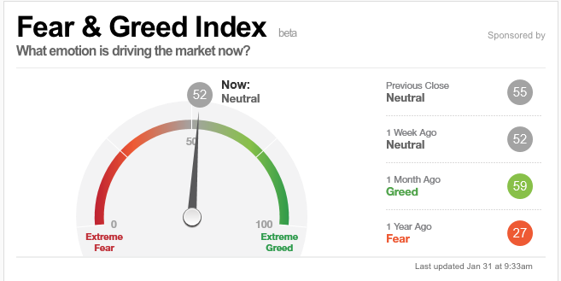
Risk is Neutral-The Bloom is off the Rose

Slide 12
The Global Economy-Shrinking the Pie
*With $200 billion of US exports to Mexico now at risk, and $110 billion to China, the risks of a global slowdown is rising, sending US aircraft makers and farmers into a panic *$45.5 billion US surplus in services is also at risk, sending banks and technology companies into a panic *Technology companies further hurt by immigration ban, creating a programmer shortage *Rising stock market is creating a new wealth effect for the economy *Collapsing currencies are stabilizing, taking the wind out of foreign stock markets *The causes of the next US recession are now in view: high inflation and an interest rate spike triggered by massive new government deficit spending, but may be 2-3 years off, or 6 months off if trade war unfolds!

Slide 13
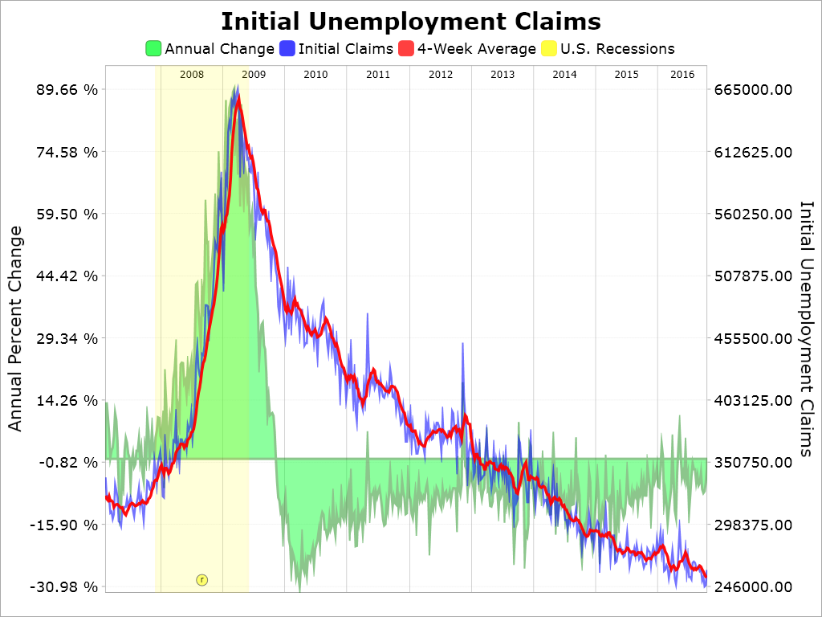
Weekly Jobless Claims –The Most Important Statistic +22,000 to 252,000- After hitting new all time low of 235,000 the month earlier

Slide 14
Stocks-They Hate Disruption
*Focus on immigration, trade war, and social issues at the expense of tax cuts and deregulation is VERY stock negative. Does Trump care? *Ratio of bullish managers at multi decade high, topping the dotcom peak, embedding a lot of risk in the market *Technology gets hurt by immigration, creating programmer shortage, banks also selling off from stalled interest rate rally, no one wants to touch health care because of a Tweet fear *Any sign of a slowing economy could have an outsized downside effect on stock prices *All price gains since November 8 have been from price earnings multiple expansion, creates a very high risk market

Slide 15
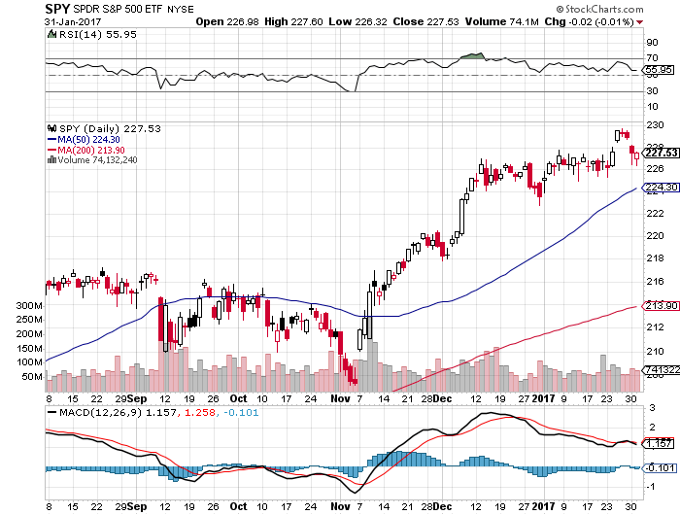
S&P 500-Hitting the Glass Ceiling Deferred 2016 Tax Loss Selling Kicking in took profits on long 11/$220-$223 bear put spread took profits on long 1/$219-$222 bull call spread

Slide 16
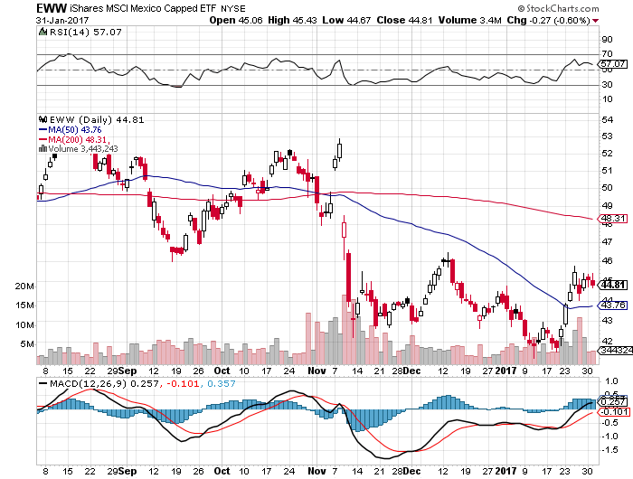
iShares MSCI Mexico ETF (EWW)-Trump Policy Benchmark

Slide 17
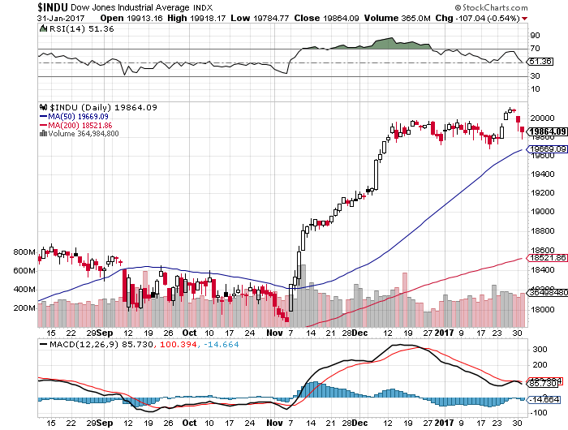
Dow Average-Break Down

Slide 18
Russell 2000 (IWM)-Backing Off took profits on long 11/$125-$128 vertical bear put spread 1/$129-$132 vertical bull call spread expired at maximum profit

Slide 19
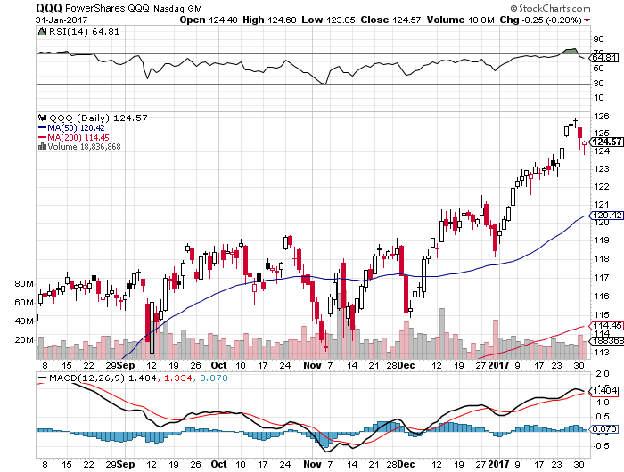
NASDAQ (QQQ)- This Year’s Leader

Slide 20
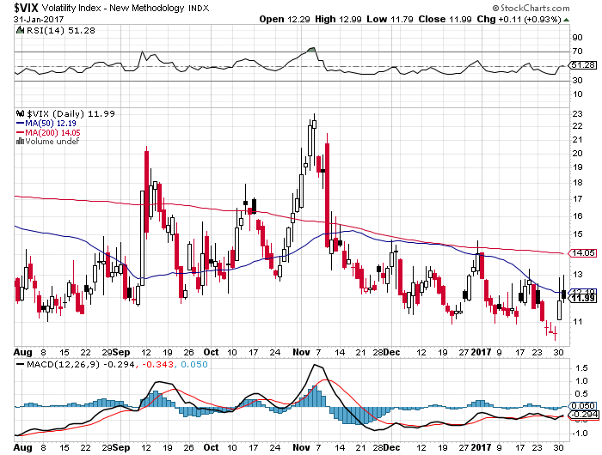
(VIX)-Bounce off the Bottom

Slide 21
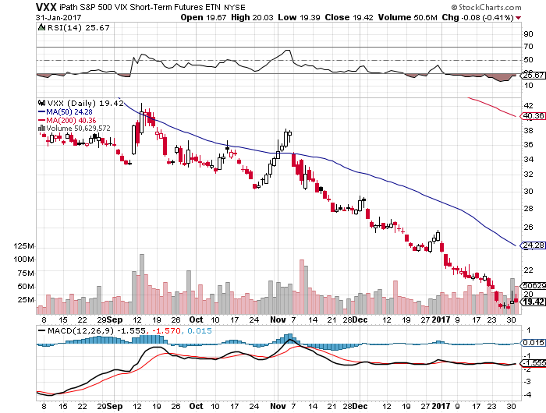
iPath S&P 500 VIX Short-Term Futures ETN (VXX) took profits on long 10/$27-$30 bull call spread

Slide 22
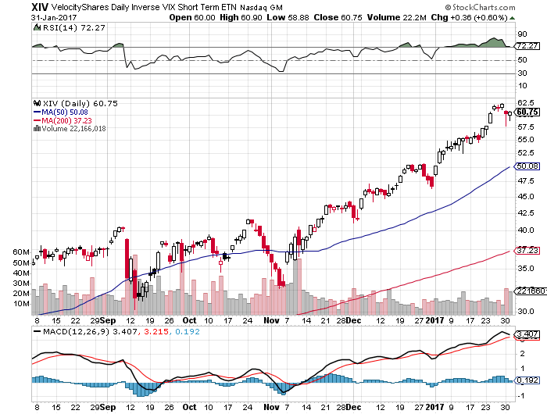
Velocity Shares Daily Inverse VIX Short Term ETN (XIV) took profits on long shares at $32.91 one of the most instantly profitable trades of 2016

Slide 23
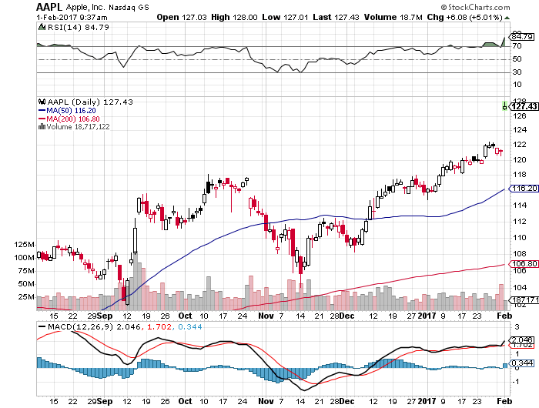
Apple (AAPL) –Back in Fashion took profits on long 1/$111-$114 bull call spread Q3 earnings upside surprise

Slide 24
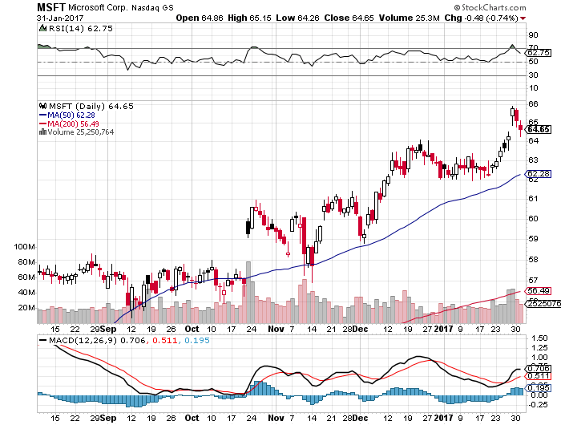
Microsoft (MSFT)

Slide 25
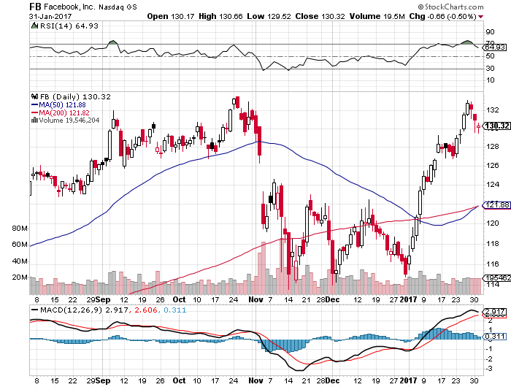
Facebook (FB)- took profits on long 11/$114-$117 vertical bull call spread

Slide 26
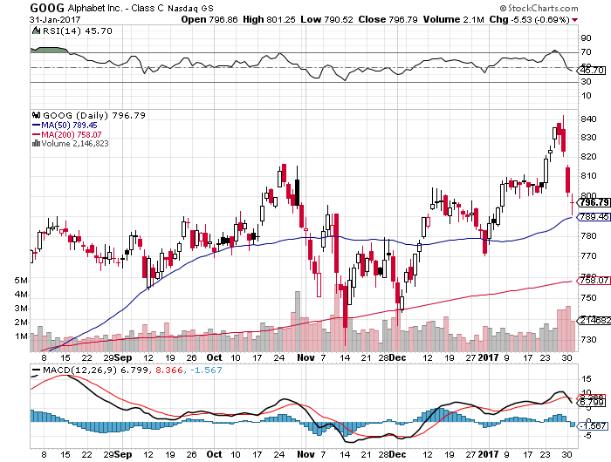
Alphabet (GOOG)-Earnings Shock took profits on long 1/$740-$760 vertical bull call spread

Slide 27
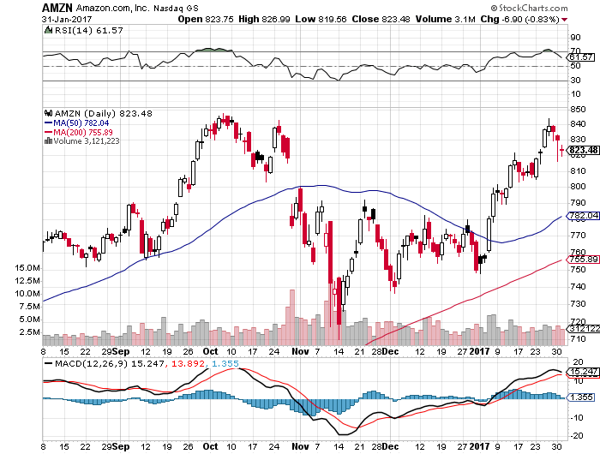
Amazon (AMZN)- took profits on long 1/$740-$760 vertical bull call spread earnings disaster-buy the dip

Slide 28
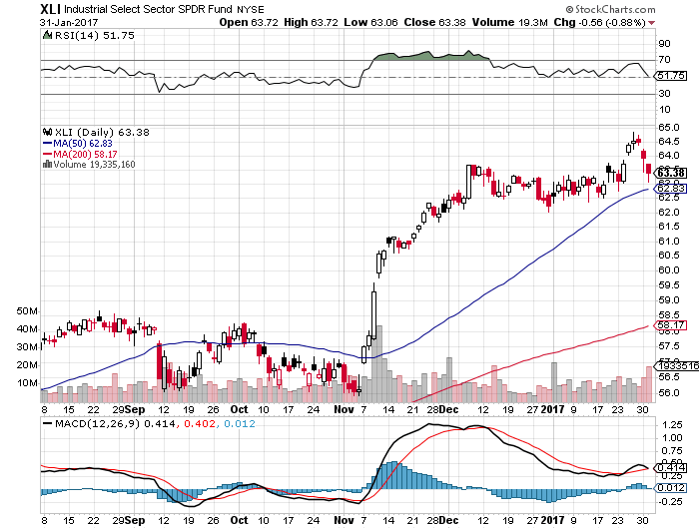
Industrials Sector SPDR (XLI)-Breakout (GE), (MMM), (UNP), (UTX), (BA), (HON)

Slide 29
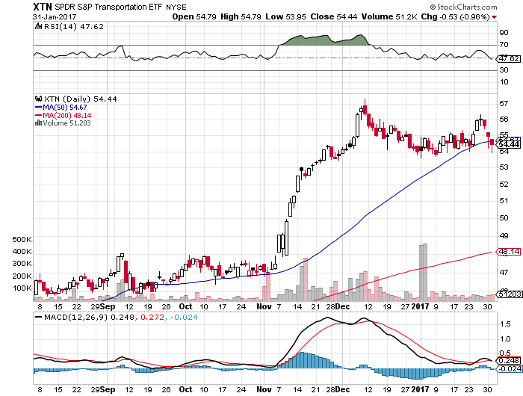
Transports Sector SPDR (XTN)- (ALGT), (ALK), (JBLU), (LUV), (CHRW), (DAL)

Slide 30
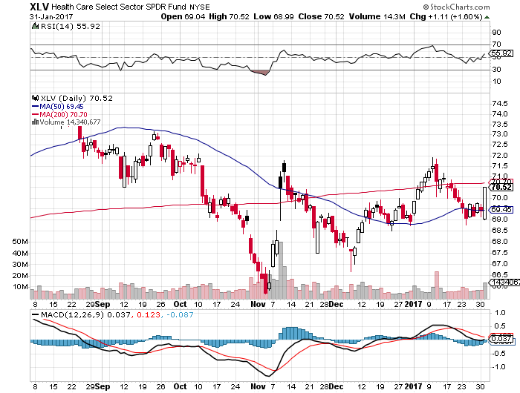
Health Care Sector (XLV), (RXL) (JNJ), (PFE), (MRK), (GILD), (ACT), (AMGN) “Getting away with murder”

Slide 31
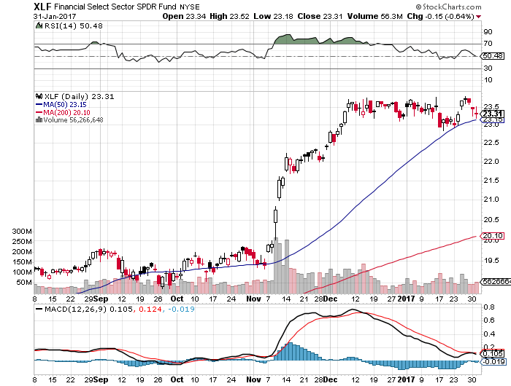
Financial Select SPDR (XLF)- Buy the Rumor, Sell the News (BLK/B), (WFC), (JPM), (BAC), (C), (GS)

Slide 32
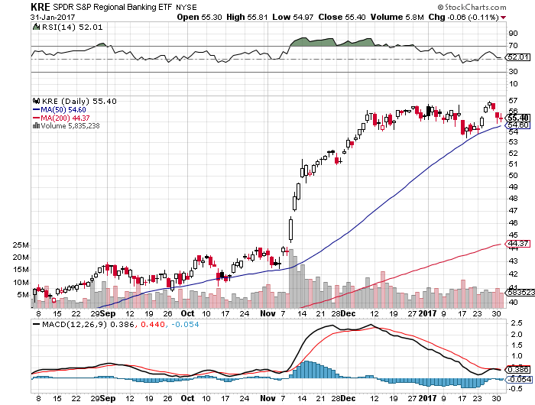
KRE Regional Bank ETF (KRE)-

Slide 33
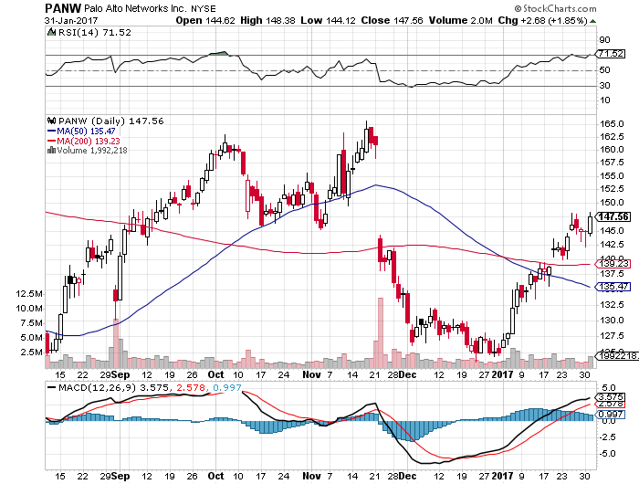
Palo Alto Networks (PANW)- took profits on long 1/$126-$129 bull call spread

Slide 34
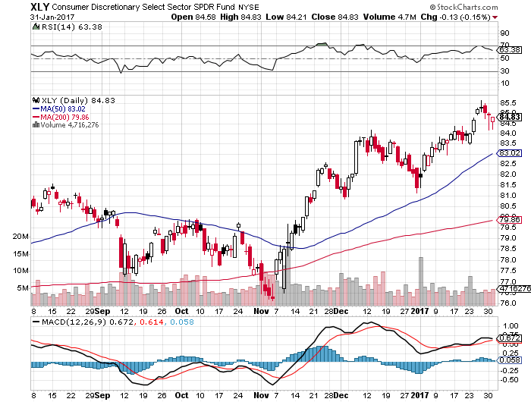
Consumer Discretionary SPDR (XLY) (DIS), (AMZN), (HD), (CMCSA), (MCD), (SBUX)

Slide 35
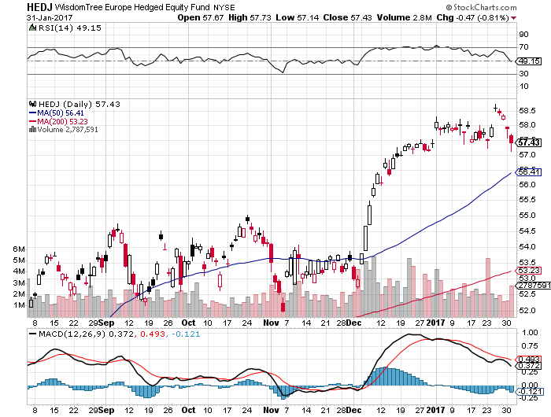
Europe Hedged Equity (HEDJ)-Euro Rally Headache

Slide 36
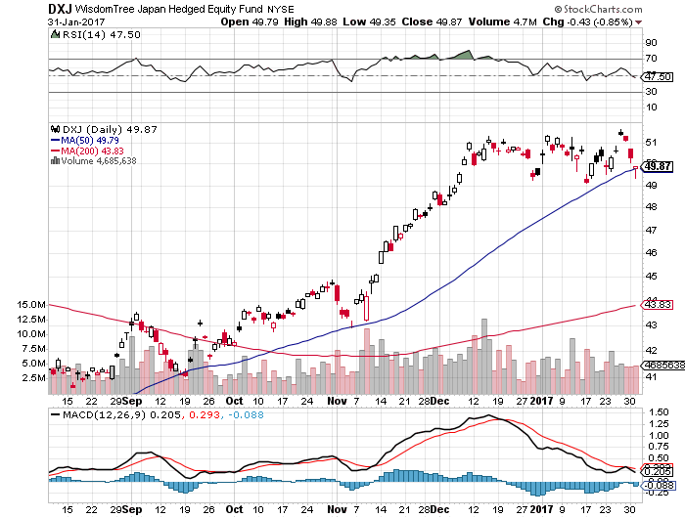
Japan (DXJ)-Yen Rally Headache

Slide 37
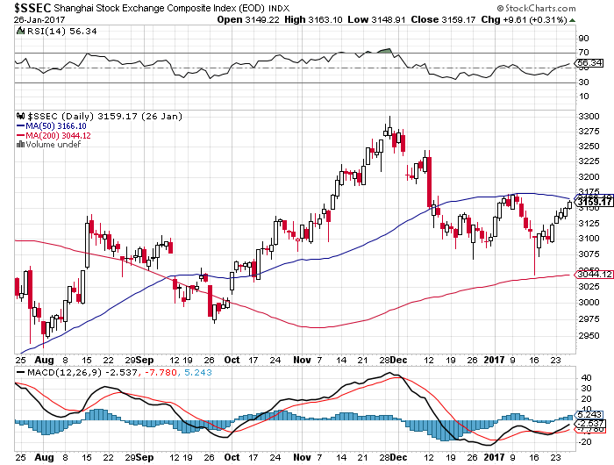
China ($SSEC)- Trade War Focus is Now on Mexico

Slide 38
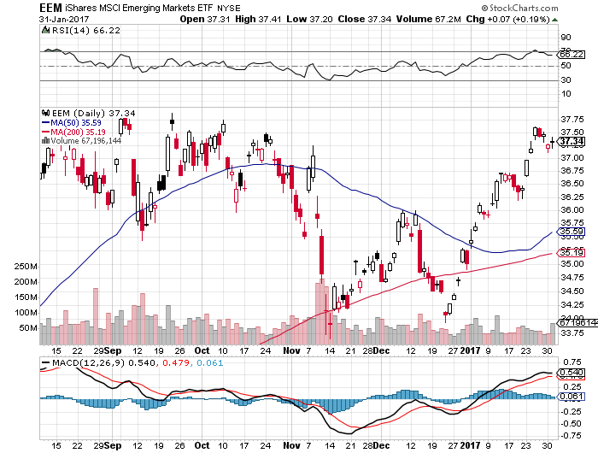
Emerging Markets (EEM)- Big Anti Trump Rally

Slide 39
Bonds-Back in Fashion
* “TRUMP OFF” trade gives new life to bonds *Eroding confidence in trade and economic plans means interest rates stay lower for longer *March 25 basis point Fed rate hike may be falling off the table *2.65% is a key upside resistance point, targeting 3.0%, but could take many months to unfold *We are six months into a 10-20 year bear market in bonds, (TLT) should drop from $120 to under $100 in 2017 *Emerging debt rallies big on “Trump Off” trade

Slide 40
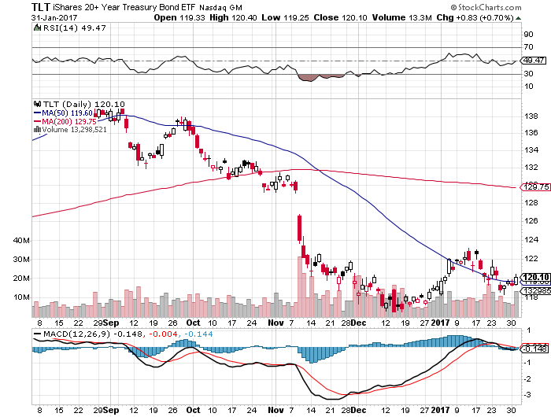
Ten Year Treasury ETF (TLT) 2.48% took profits on long 2/$126-$129 vertical bear put spread took profits on long 1/$123-$126 vertical bear put spread tried to buy 2/$112-$115 vertical bull call spread, but market ran away

Slide 41
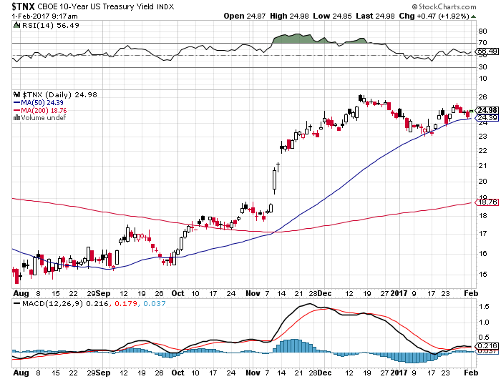
Ten Year Treasury Yield ($TNX) 2.48%

Slide 42
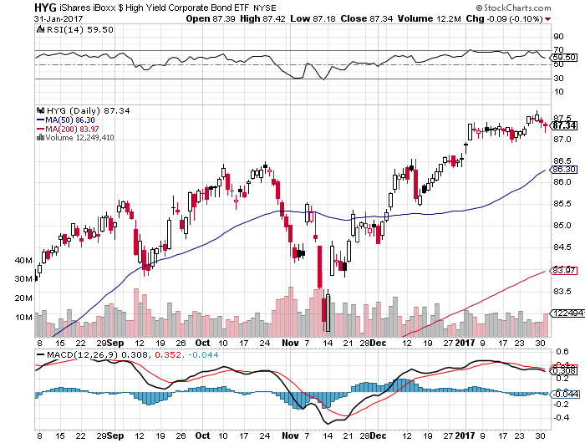
Junk Bonds (HYG) 5.46% Yield A Great Risk Coincident Indicator- Long Term “RISK ON” means new highs, buy all dips

Slide 43
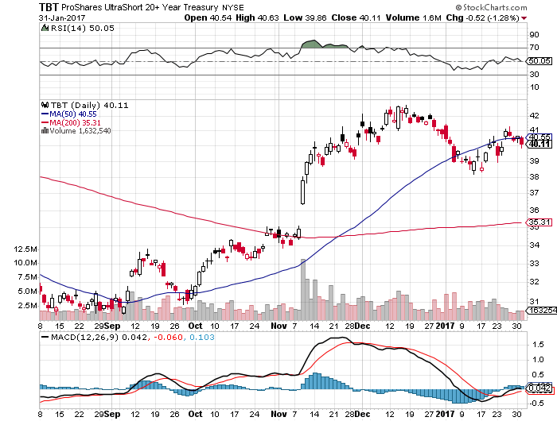
2X Short Treasuries (TBT)

Slide 44
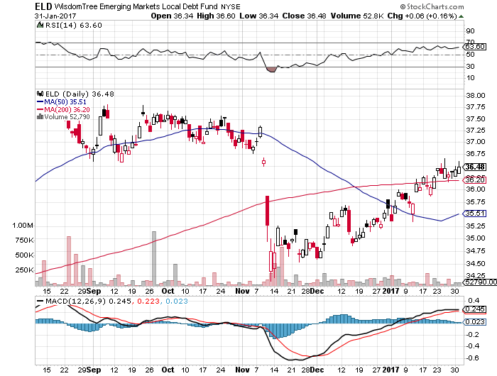
Emerging Market Debt (ELD) 7.13% Yield- crawling back with the anti-Trump trade

Slide 45
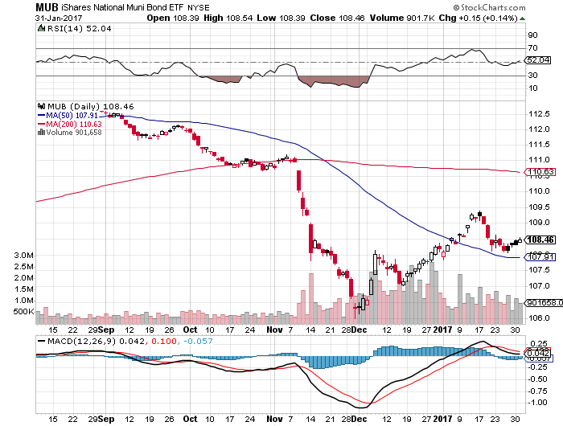
Municipal Bonds (MUB)-2.14% yield-almost doubled Mix of AAA, AA, and A rated bonds

Slide 46
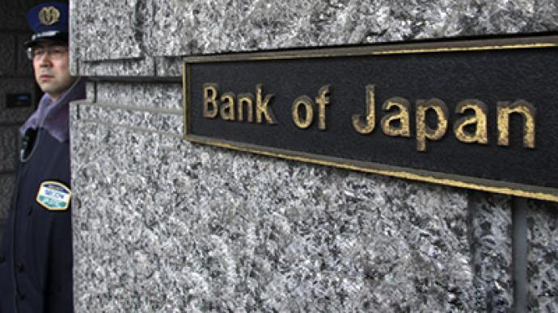
Foreign Currencies-It’s All Politics
*A Trump off move will trigger profit taking on all currency short positions *BOJ maintenance of QE triggers quick yen collapse, which we caught *Shrinking US monetary base is helping the bid for the US dollar *Moderating bond interest rates further sap dollar strength *Interest rate differentials will overwhelmingly favor the dollar for two more years, but it could be a long wait for the next leg *Buy the dollar on any dips, next leg up could come with the March Fed meeting, 25 basis points may be on the table

Slide 47
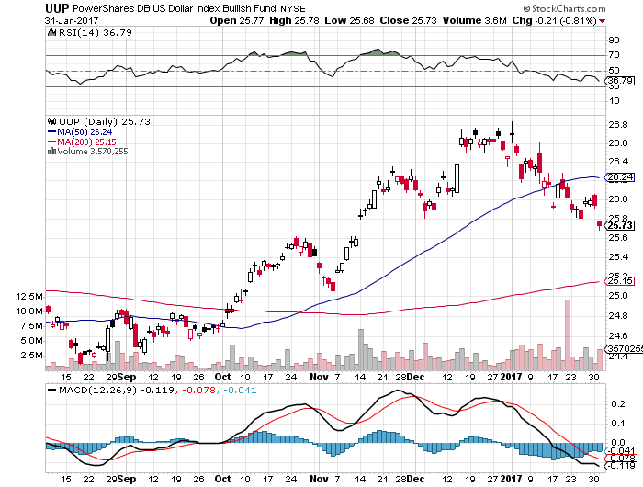
US Dollar Basket-(UUP)

Slide 48
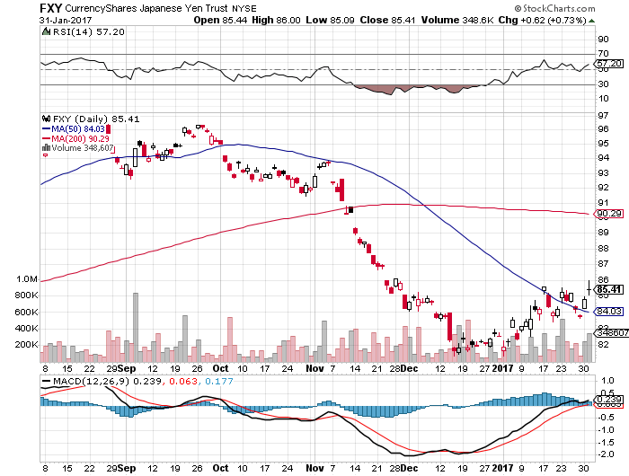
Japanese Yen (FXY)-Taking a Break Took profits on long 2/$88-$91 bear put spread

Slide 49
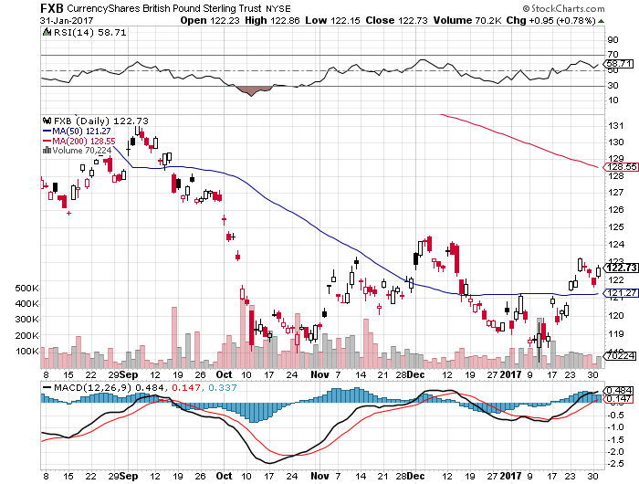
British Pound (FXB)- hard Brexit speech triggers monster melt up

Slide 50
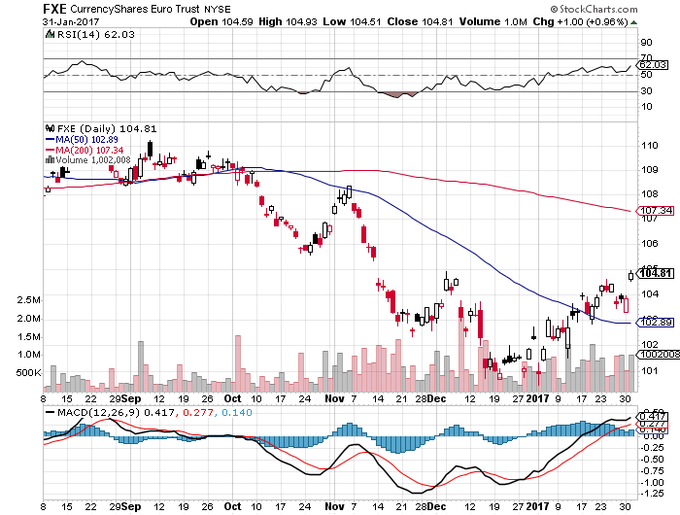
Euro ($XEU), (FXE), (EUO)- Bombs Away took profits on long 9/$112-$115 vertical bear put spread took profits on long $11/$110-$113 vertical bear put spread

Slide 51
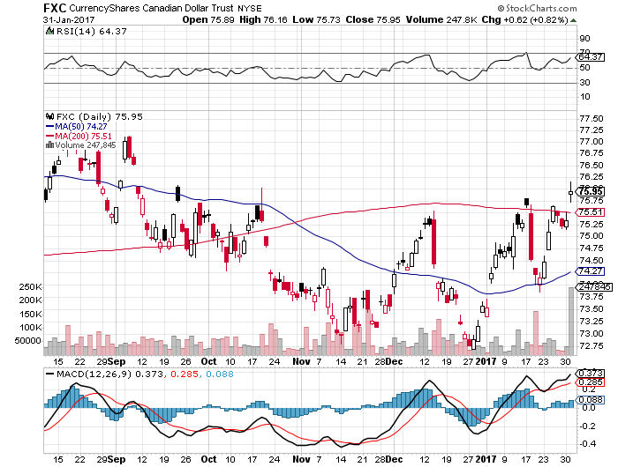
Canadian Dollar (FXC)-

Slide 52
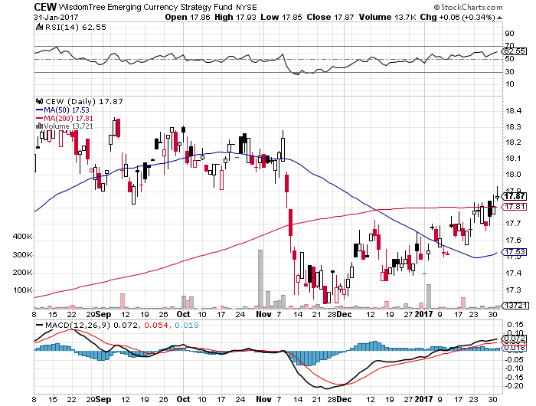
Emerging Market Currencies (CEW)

Slide 53
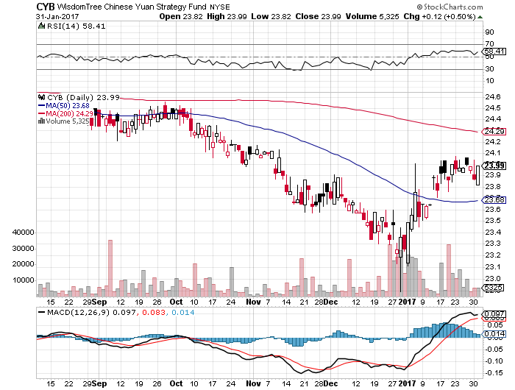
Chinese Yuan- (CYB)-

Slide 54
Energy-Topping Out
*OPEC quota is now fixed at 32.5 million barrels a day, 34.2% of total global production, is targeting lower to support prices *Product inventories rising sharply as US fracking continues to ramp up *Chinese SPR is full, ebbing global demand *Libya has gone from zero to 700,000 b/d in a year *Oil still stuck in $45-$65 range, but we are now testing $54

Slide 55
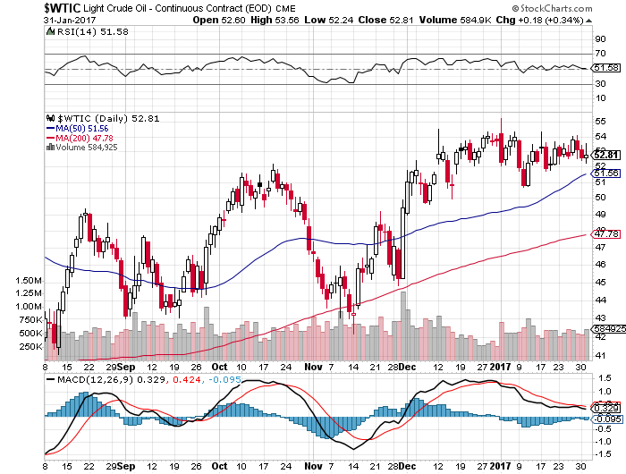
Oil-Top of Range-Topping Out

Slide 56
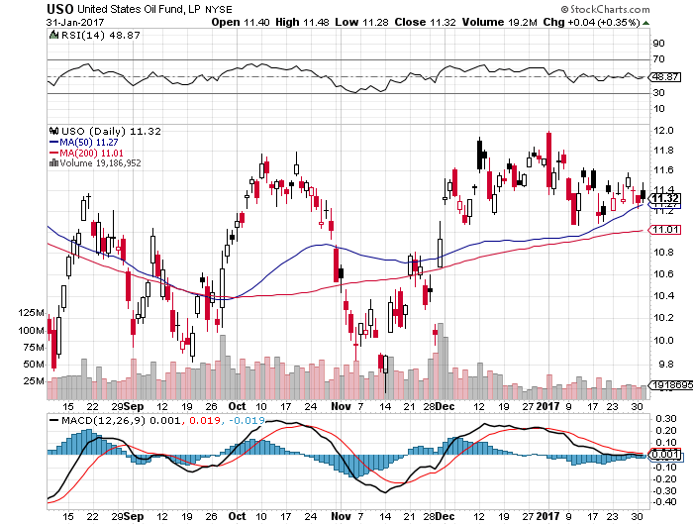
United States Oil Fund (USO) took profits on long (USO) 11/$12.50-$14.00 vertical bear put spread

Slide 57
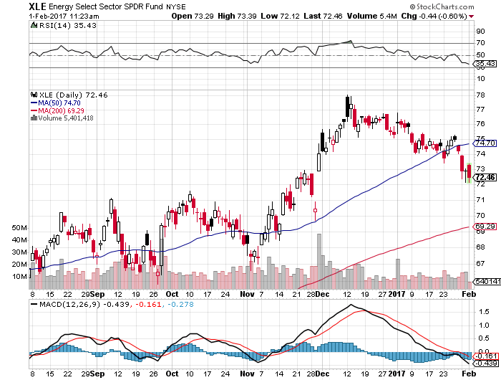
Energy Select Sector SPDR (XLE) (XOM), (CVX), (SLB), (KMI), (EOG), (COP)

Slide 58
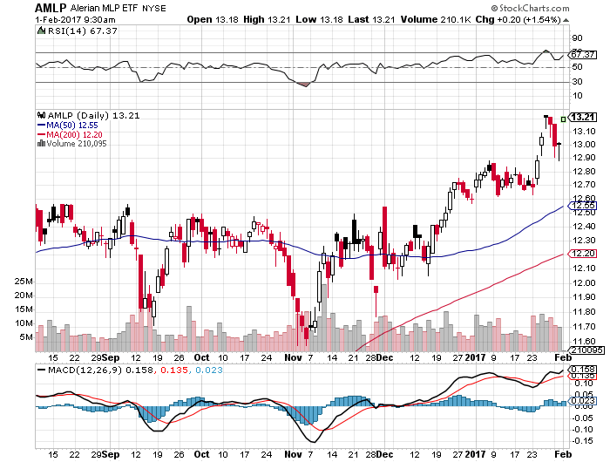
Alerian MLP ETF (AMLP)- Basket Approach is the Only Safe Play Here

Slide 59
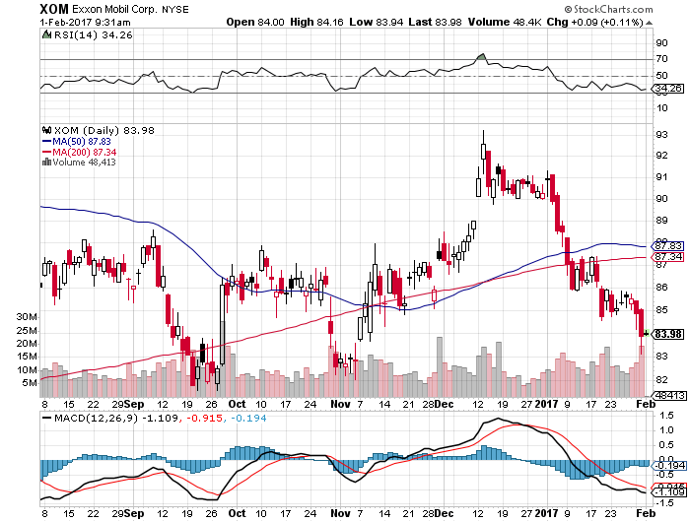
Exxon (XOM)-

Slide 60
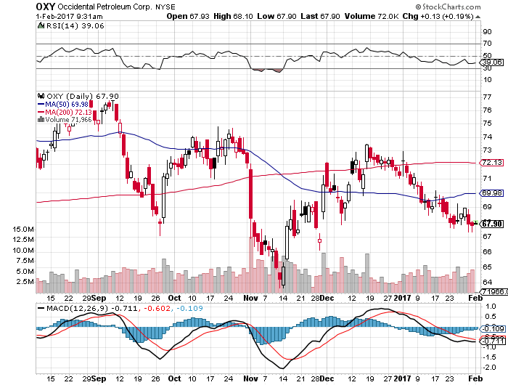
Occidental Petroleum (OXY)-

Slide 61
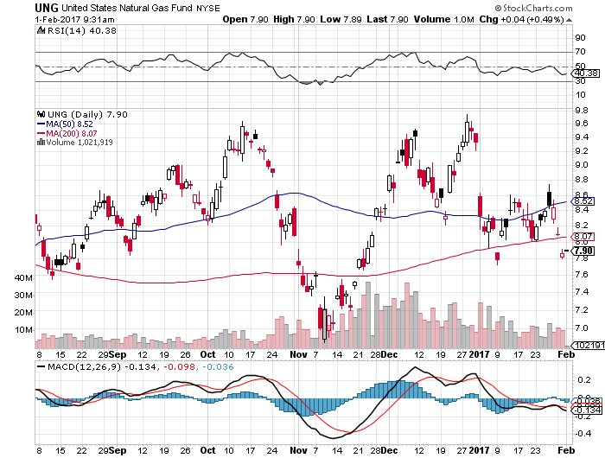
Natural Gas (UNG)-Back to Mid Range down 13% on first day of the year

Slide 62
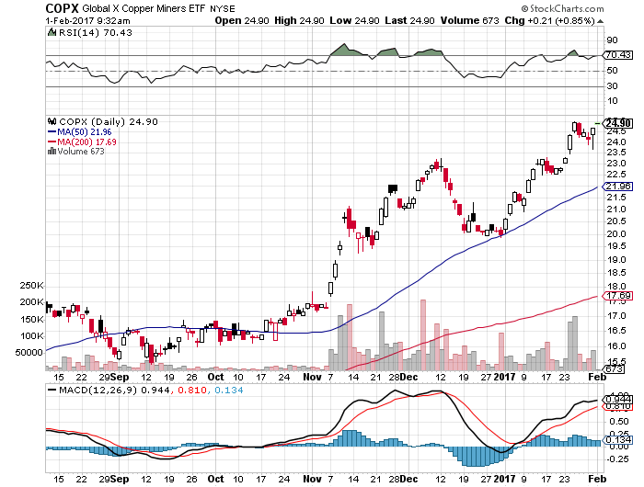
Copper (COPX)-

Slide 63
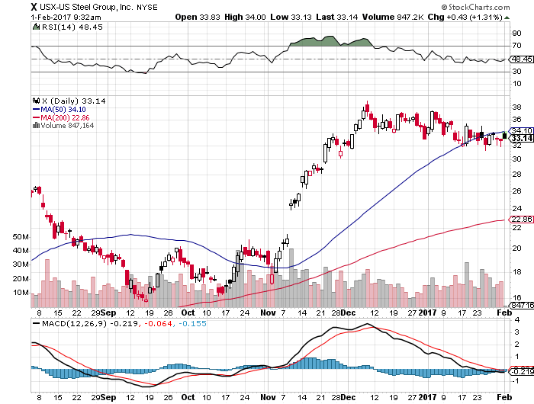
US Steel (X)-Upside Breakout!

Slide 64
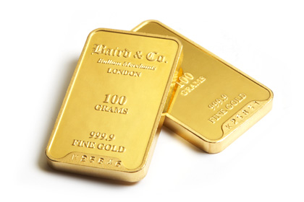
Precious Metals-Disruption is Pro Gold
*Anti-Trump trade gives gold a new lease on life *Chinese New Years puts buyers on hold *Many technical chart services say the bull market has resumed *Speculative positions in gold starting to rebuild from low levels, and producers are cutting back hedges *Venezuela selling off the last of its reserves to forestall crash *Palladium crashes in risks to auto globalization

Slide 65
Gold (GLD)-Head and Shoulders Bottom? took profits on long 11/$112-$115 vertical bull call spread long 2/$108-$111 vertical bull call spread

Slide 66
Palladium ETF- (PALL)-Flash Crash! - Used for catalytic converters

Slide 67
Market Vectors Gold Miners ETF- (GDX)

Slide 68
Silver (SLV)-

Slide 69
Silver Miners (SIL)-

Slide 70
Agriculture-A Guacamole War is Coming!
*Prospect of China trade war weighing on all Ag prices, is offsetting terrible weather *If the ethanol subsidy gets axed, corn prices will crash *Mexico has been the largest buyer of US ags after China, will shift business to Brazil and Argentina in a trade war *Good luck getting guacamole with a 20% Mexican border tax *USDA Supply & Demand Report predicts large scale cuts in all crops in 2017 due to weak prices *Stay away

Slide 71
(CORN) –

Slide 72
(WEAT)-

Slide 73
(SOYB)-

Slide 74
Real Estate-Ticking Up
*Trump’s first act as president was to cancel a scheduled cut in FHA insurance premiums. Are the other huge real estate subsidies now at risk? *December New Home Sales down a shocking 10.4%, as the first post election numbers show the market’s reaction to 536,000, Pending Home Sales +0.30% *Anecdotal data shows that hot local markets are still strong, mortgage applications up 4%, home supply now lowest in 18 years *All price gains at higher end of the market, which is up 10%. *Homes are the best place to hide during an inflation surge *Case-Shiller is ticking up to 5.6%, with absolute prices hitting new all time high, you home equity could be the best investment of the year….again

Slide 75
November S&P 500/Case–Shiller Home Price Index +5.6% YOY, Seattle (+10.4%), Portland (10.1%), Denver (8.7%) still leaders absolute prices hit new all time high

Slide 76
General Growth Properties (GGP) Not Buying the Rally in Yields

Slide 77
US Home Construction Index (ITB) (DHI), (LEN), (PHM), (TOL), (NVR) Another Rising Rate Victim-But Becoming a Favorite Sector to Buy

Slide 78
Trade Sheet-The Complete Opposite So What Do We Do About All This?
*Stocks- Sell rallies on “TRUMP OFF” trade *Bonds-buy dips on “TRUMP OFF” trade *Commodities-sell rallies *Currencies- stand aside, don’t bet against the long term trend *Precious Metals –buy gold *Volatility-buy the dip *The Ags –stand aside *Real estate-stand aside

Slide 79
Next Strategy Webinar 12:00 EST Wednesday, February 15, 2017 San Francisco, CA
Good Luck and Good Trading!
Notes:
*

