Slide 1
The Mad Hedge Fund Trader “Front Running 2018”
With John Thomas from Silicon Valley, CA, January 3, 2017 www.madhedgefundtrader.com
Notes:
*

Slide 3
Trade Alert Performance Biggest Up Month in Ten Years! New All Time High!! 22 Consecutive Profitable Trade Alerts!!
*January +9.35% Final *July +1.95% Final *February +6.39% FINAL *August +18.38% Final *March +4.87% Final *September +7.65% Final *April +1.84% Final *October +1.39% Final *May -0.45% Final *November +2.08% Final *June +0.70% Final *December +3.76% Final *2017 Year to Date 57.91% compared to 19% for the Dow Average 31 of 35 consecutive profitable trade alerts *Trailing One year return +57.91%, +276.47% since inception, *Average annualized return of 34.20%

Slide 4
Portfolio Review No “sweet spot” entry points Risk/Reward is out of balance, 70% cash
NO POSITIONS

Slide 5
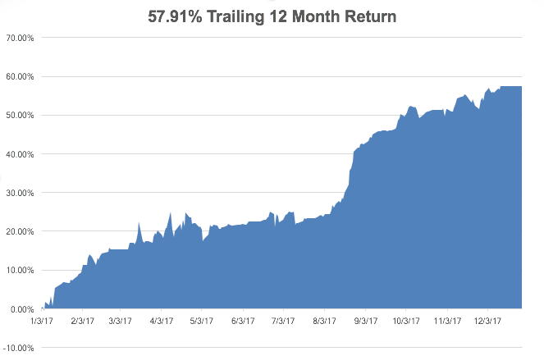
Daily Audited Performance

Slide 6
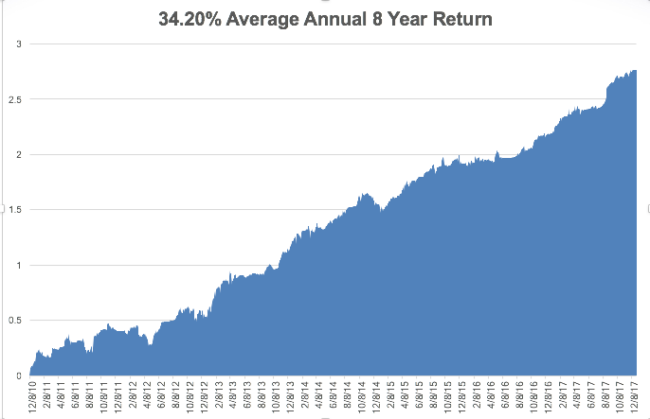
Eight Year Daily Audited Performance

Slide 7
The Method to My Madness
*Global stock market melt up has taken stocks to record valuation and momentum highs, Great Q3 earnings adding fuel to the fire *Sell every bond rally….The Fed put the top in with $4 T bond hoard liquidation *Look for main stock indexes to grind up for 2018 *Keep buying ”RISK OFF” assets, like gold, on dips as a hedge against brief bouts of profit taking in stocks *Sell the FANG’s, the new game is in domestic laggards, reflation plays, and banks *Buy oil stocks on dips, commodities to outperform stocks in 2018 *Sell Japanese yen on any new rallies, top is in

Slide 8
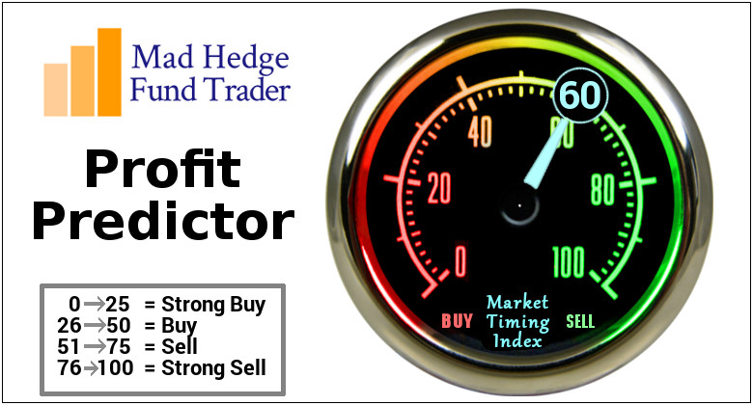
The Mad Hedge Profit Predictor Market Timing Index An artificial intelligence driven algorithm that analyzes 30 different economic, technical, and momentum driven indicators

Slide 9
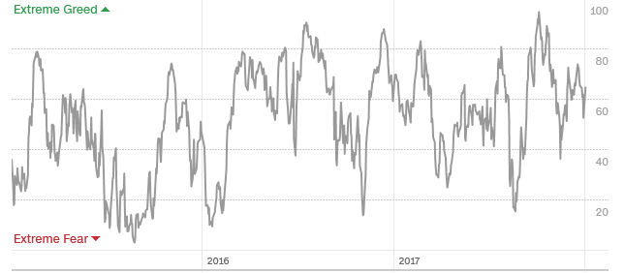
The Mad Hedge Profit Predictor Middle of the Range

Slide 10
The Global Economy-A Signals Go
*Fed minutes out this afternoon giving insight into pace of rate hikes, a noted dove is to be replaced on the board by a noted hawk, increasing the likelihood of more rate rises *Dallas Fed General Activity Index leaps from 19 to 29 *Will the weak first quarter syndrome strike again this year, coming off of a 3.2% Q4 *Euro Markit readings accelerating, surpassing the US *US Polar Vortex having a big impact on the economy, driving up oil, commodity, and grain prices
*It’s all very market positive, and severely limited the downside to the last correction

Slide 11
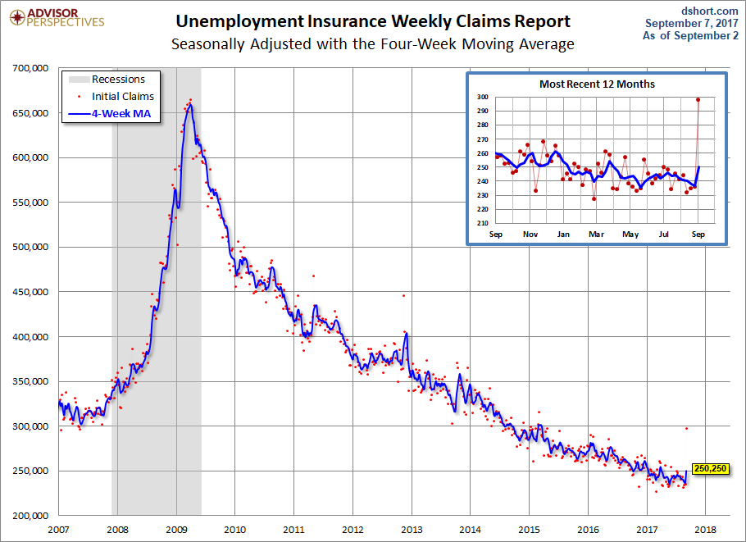
Weekly Jobless Claims –The Most Important Statistic -2,000 to 245,000 coming out of Christmas Hiring New 43 Year Low!

Slide 12
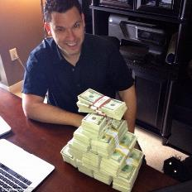
Stocks-Look for Half the Returns With Double the Volatility
*Earnings will still be the major driver in the New Year, up 10% *Look for a major selloff in January as deferred tax selling all hits at once *Company stock buy backs will be given a new lease on life by the tax bill *Sector leadership rotates from FANG’s to financials & industrials, the market leaders of 2018 *Energy, with the highest tax rate, will see the biggest earnings growth in 2018 *Flat line sideways “time” corrections will be followed by substantial upside breakouts ahead of every quarterly earnings period *Volatility Index (VIX) to range from $9-$20 * A synchronized global economic recovery, artificially low interest rates, and the prospect of once a generation tax cuts are a lot to sell against.

Slide 13
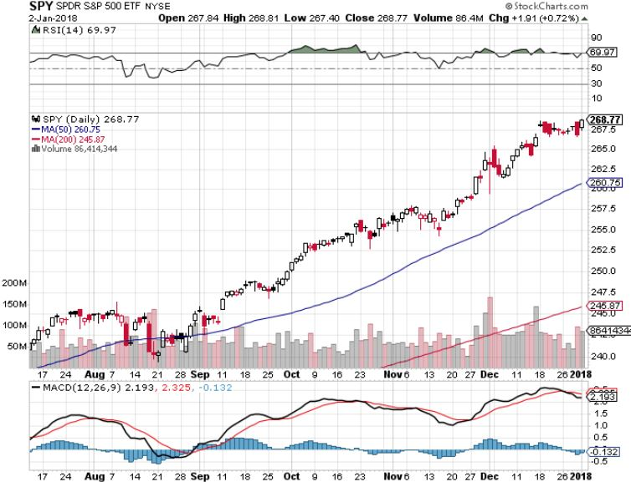
S&P 500-New Highs

Slide 14
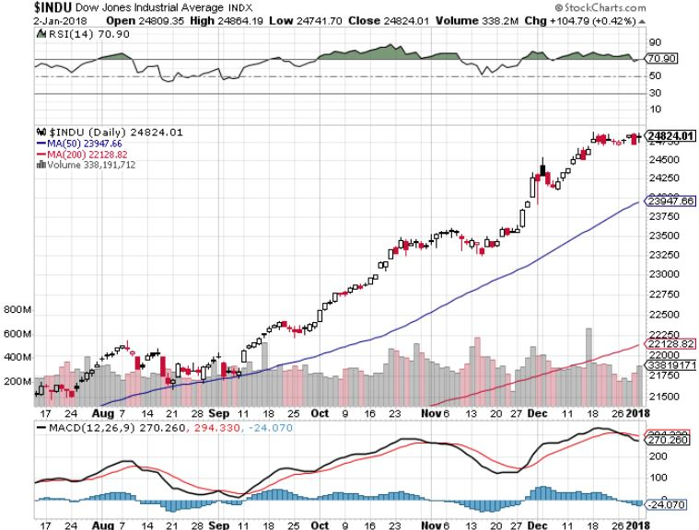
Dow Average-New Highs Haven’t Retraced to the 50 Day MA since May-Very High Risk

Slide 15
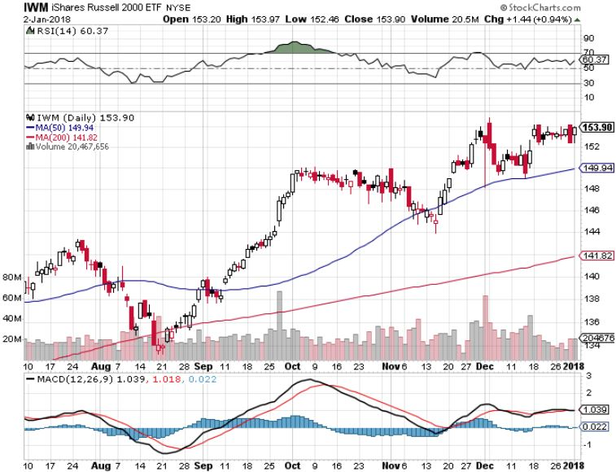
Russell 2000 (IWM)-Peaked Out stopped out of long the (IWM) 12/$152-$155 bear put spread

Slide 16
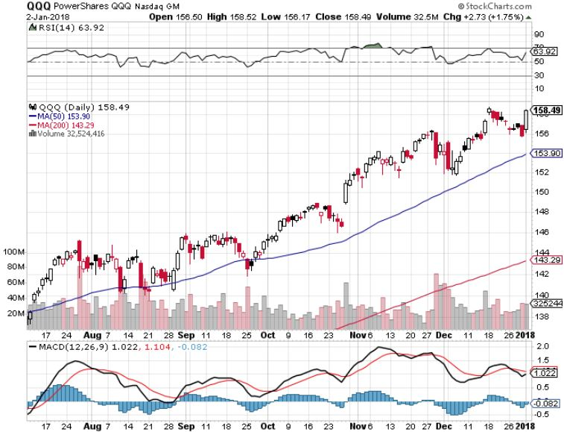
NASDAQ (QQQ)-New Highs

Slide 17
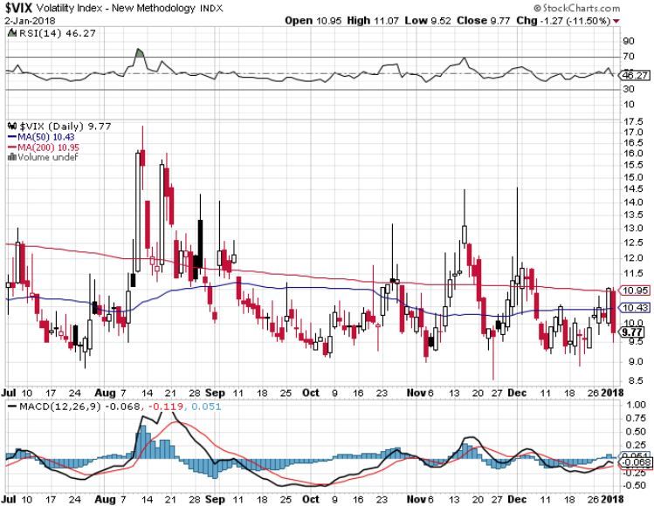
(VIX)-New Low

Slide 18
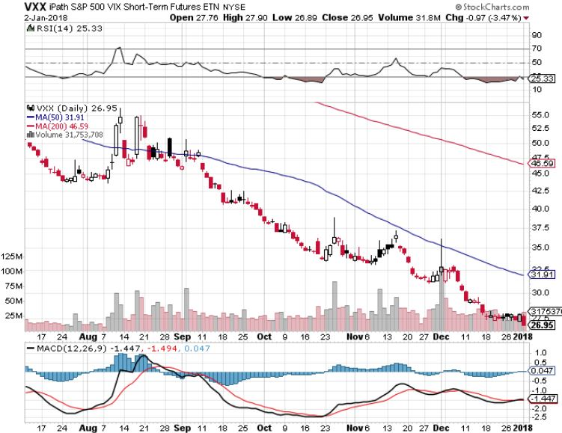
iPath S&P 500 VIX Short-Term Futures ETN (VXX) Begging for New Lows stopped out of long 1/$60 calls as a hedge for rest of portfolio took profits on long 11/$20 calls

Slide 19
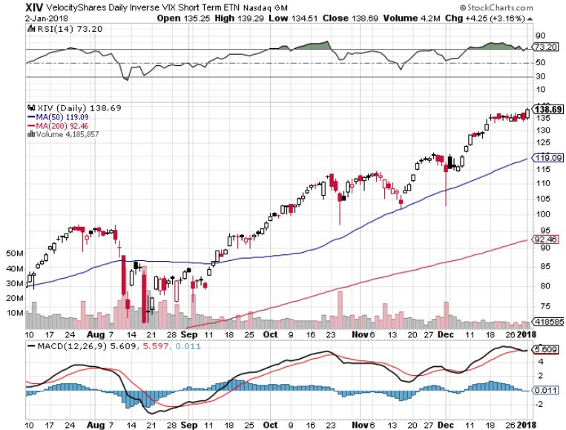
Velocity Shares Daily Inverse VIX Short Term ETN (XIV) One of the most instantly profitable trades of 2016….and 2017 took profits on (XIV) long at $81.45

Slide 20
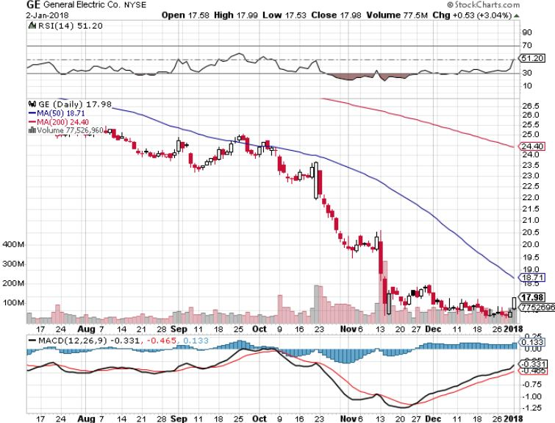
General Electric (GE)-No Recovery

Slide 21
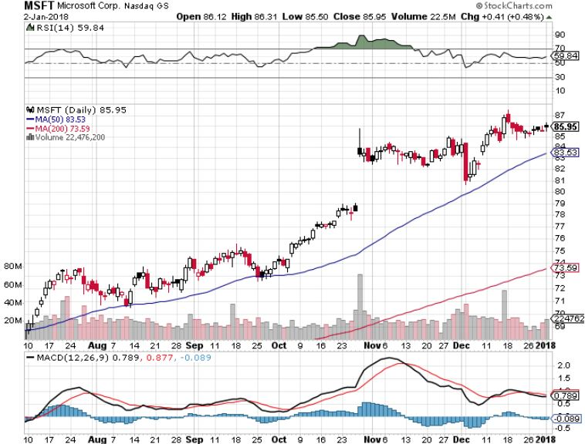
Microsoft (MSFT)

Slide 22
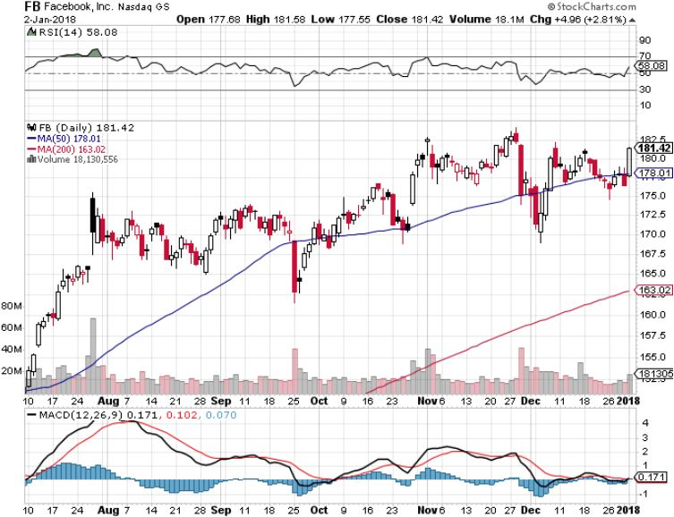
Facebook (FB)-

Slide 23
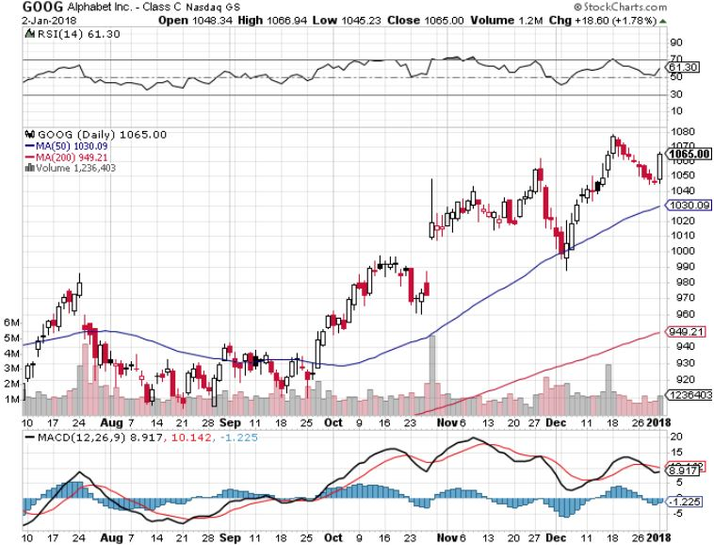
Alphabet (GOOG)-New High

Slide 24
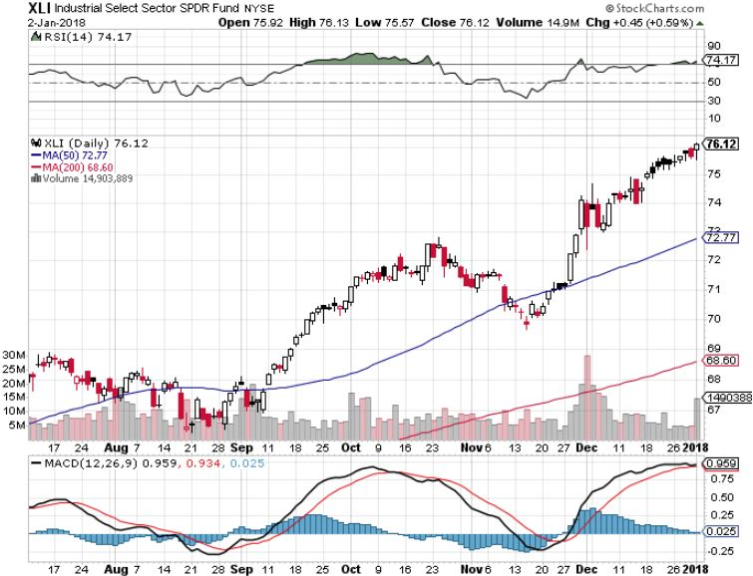
Industrials Sector SPDR (XLI)- (GE), (MMM), (UNP), (UTX), (BA), (HON)

Slide 25
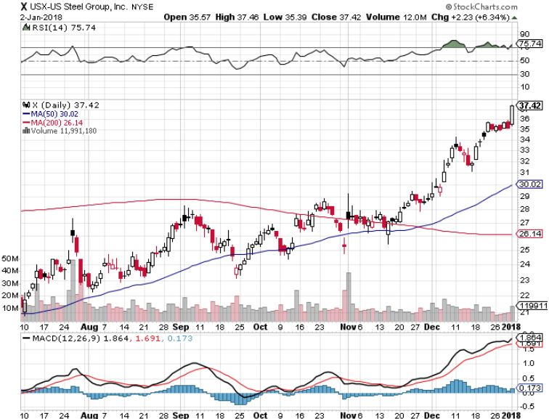
US Steel (X)- took profits on long the 9/$21-$22 vertical bull call spread

Slide 26
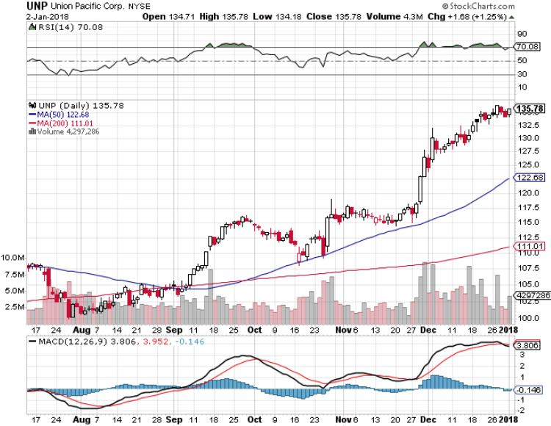
Union Pacific Railroad (UNP)- took profits on long the 9/$100-$102 vertical bull call spread

Slide 27
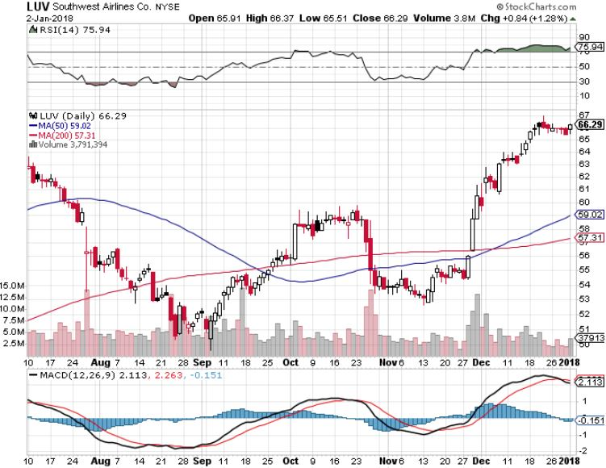
Southwest Airlines (LUV)- Warren Buffett’s Favorite Airline

Slide 28
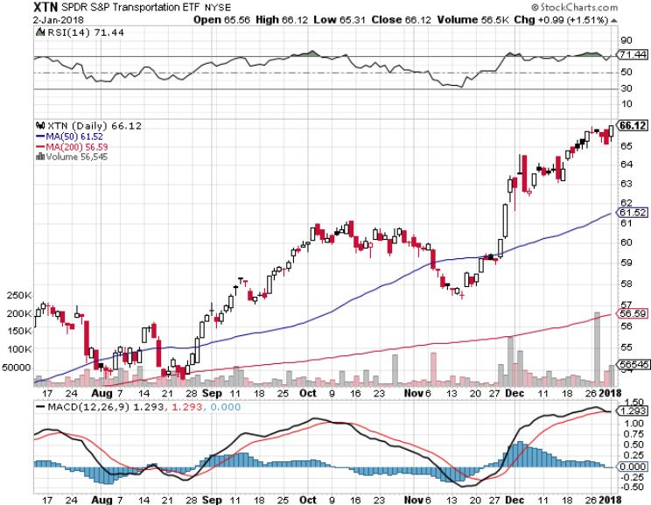
Transports Sector SPDR (XTN)- (ALGT), (ALK), (JBLU), (LUV), (CHRW), (DAL)

Slide 29
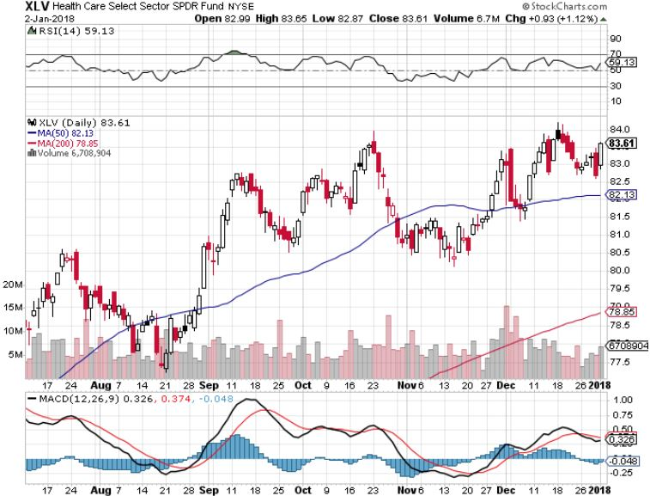
Health Care Sector (XLV), (RXL)-The New FANG? (JNJ), (PFE), (MRK), (GILD), (ACT), (AMGN)

Slide 30
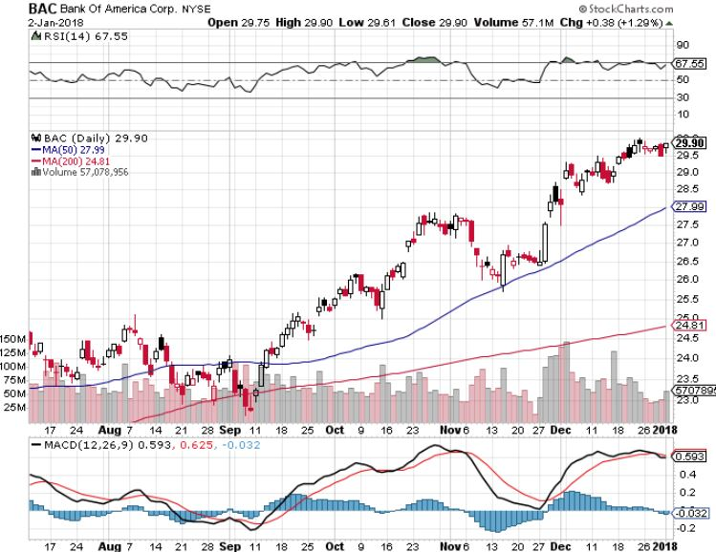
Bank of America (BAC)-New Highs (BLK/B), (WFC), (JPM), (BAC), (C), (GS) long 12/$25.50-$27 bull call spread-expires in 7 trading days

Slide 31
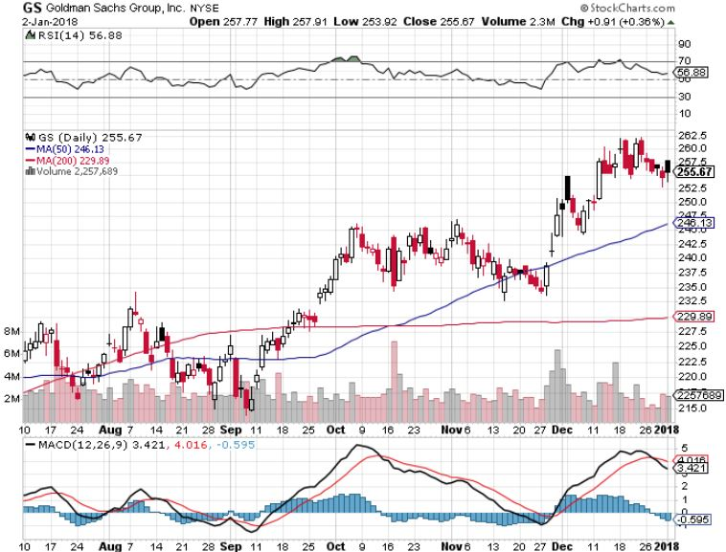
Goldman Sachs (GS)-Interest Rate Drag stopped out of long 10/$220-$225 vertical bull call spread took profits on long 10/$227.50-$232.50 vertical bull call spread took profits on long 9/$205-$210 vertical bull call spread took profits on long 9/$235-$240 vertical bear put spread

Slide 32
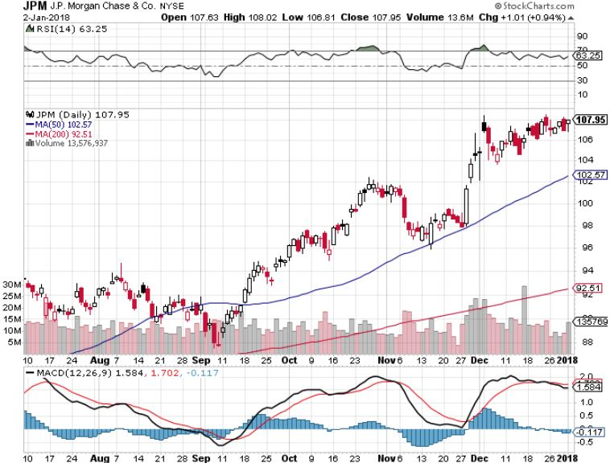
JP Morgan (JPM)-

Slide 33
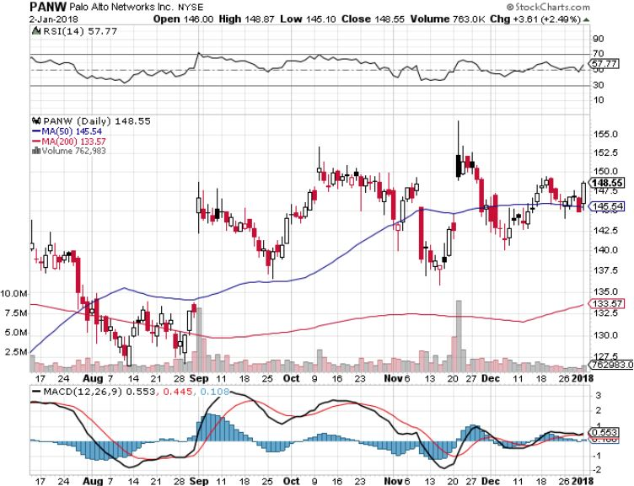
Palo Alto Networks (PANW)-

Slide 34
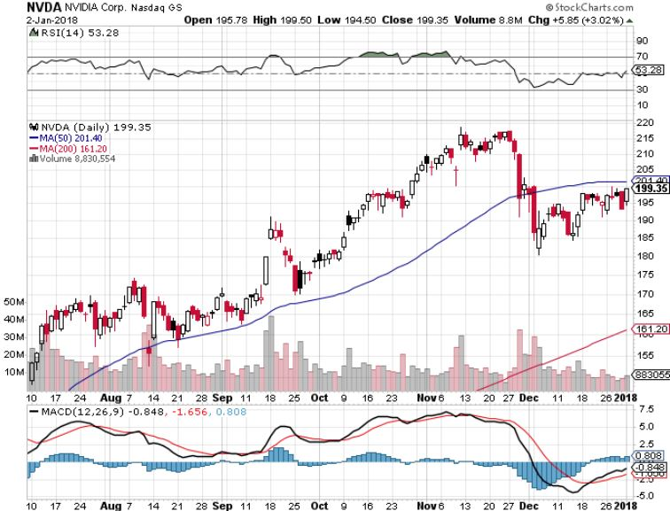
NVIDIA (NVDA)-Rolling Over

Slide 35
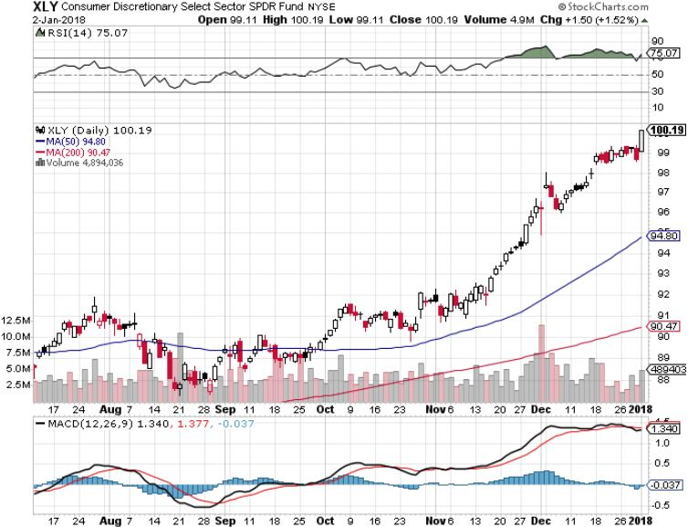
Consumer Discretionary SPDR (XLY) (DIS), (AMZN), (HD), (CMCSA), (MCD), (SBUX)

Slide 36
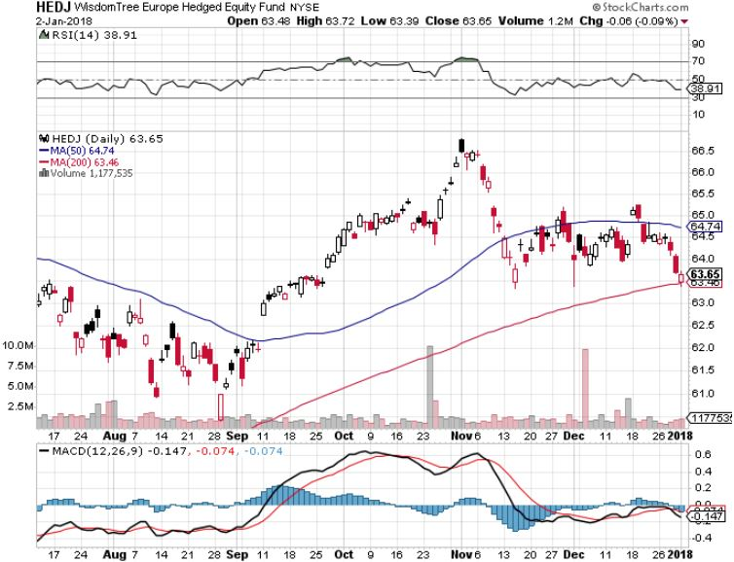
Europe Hedged Equity (HEDJ)-Global Rally

Slide 37
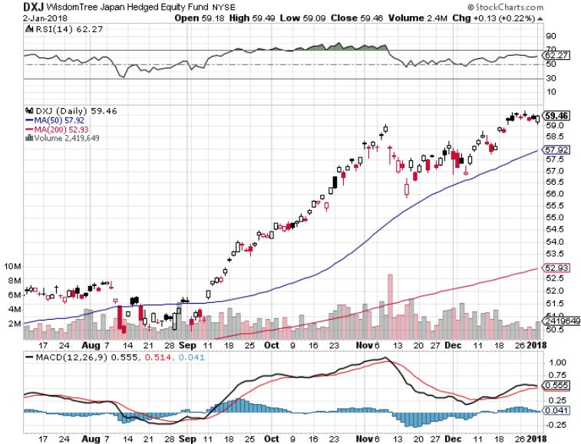
Japan (DXJ)-More Global Rally on Yen Weakness and Abe Election win

Slide 38
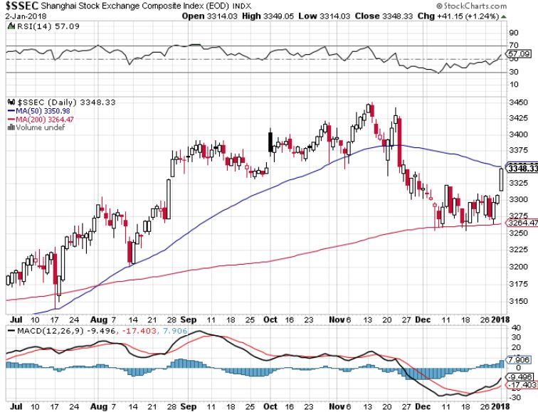
China ($SSEC)-Economic Recovery on Track

Slide 39
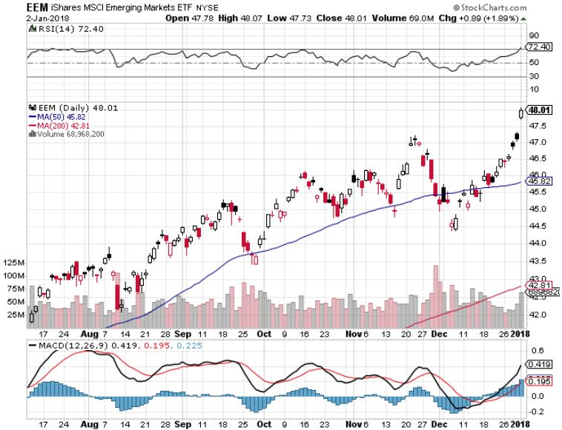
Emerging Markets (EEM)- New High

Slide 40
Bonds-Flight to Safety
*New tax bill promises to demolish the bond market, but it may take some time *Budget deficit now climbing sharply from an Obama low of $450 billion to $700 billion now on its way to $1 trillion *Markets now looking for three 25 basis point interest rate hikes in 2018 *Huge curve flattening dominating the markets, 40 basis point spread between ten and 30 year bonds, is your early pre recession warning *I’m still looking for a bond selloff in 2018 to take yields to 3.00% by yearend *$6 billion a month, or $200 million a day in bond sales to start soon and are overhanging the market with the FED’s QE unwind

Slide 41
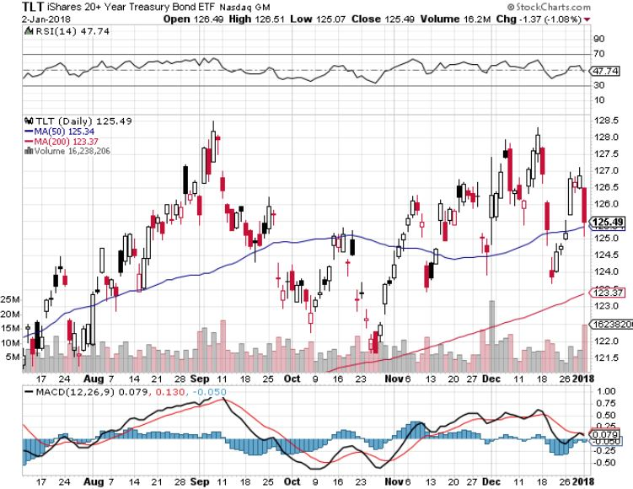
Treasury ETF (TLT) – 2.32%-Double Topping? Long 12/$129-$131 vertical bear put spread-expires in 7 trading days Took profits on long 12/$129-$132 vertical bear put spread long 11/$127-$129 vertical bear put spread expired at max profit took profits on long 10/$126-$128 vertical bear put spread took profits on long 10/$127-29 vertical bear put spread

Slide 42
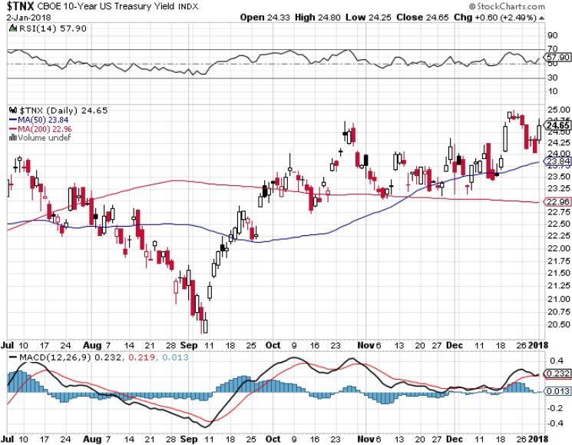
Ten Year Treasury Yield ($TNX) 2.36% Breakdown, Now major Support

Slide 43
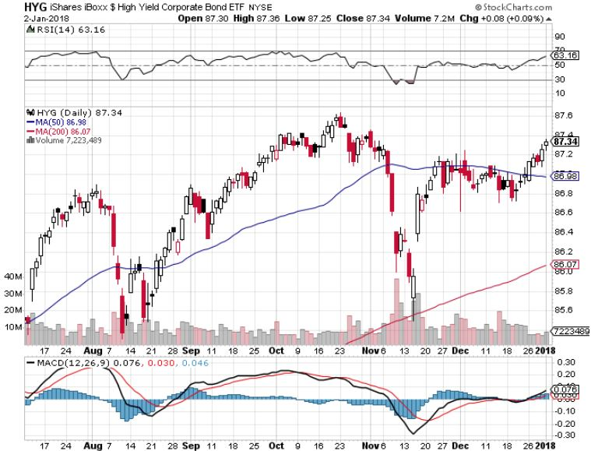
Junk Bonds (HYG) 4.71% Yield A Great Risk Coincident Indicator- Long Term “RISK ON” means new highs, buy all dips

Slide 44
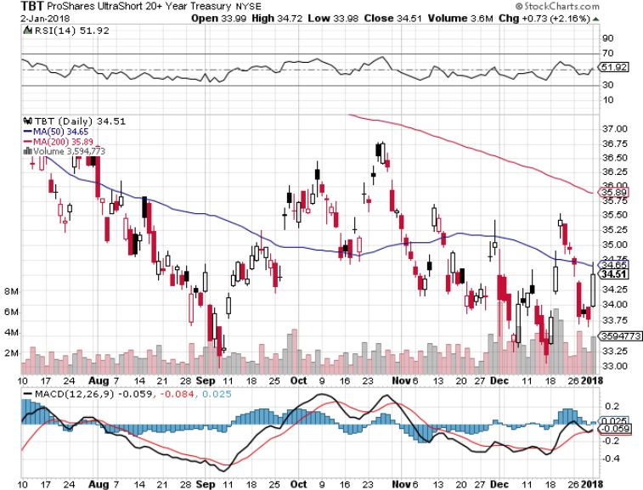
2X Short Treasuries (TBT)-Back In Screaming “BUY” Territory

Slide 45
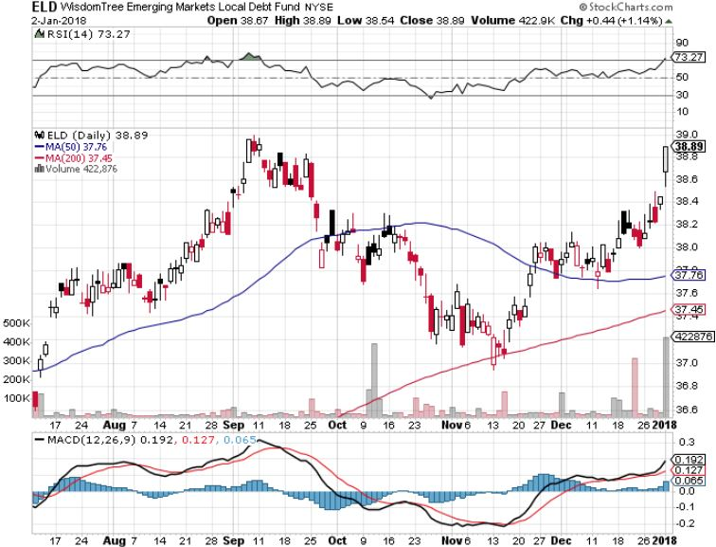
Emerging Market Debt (ELD) 5.66% Yield-

Slide 46
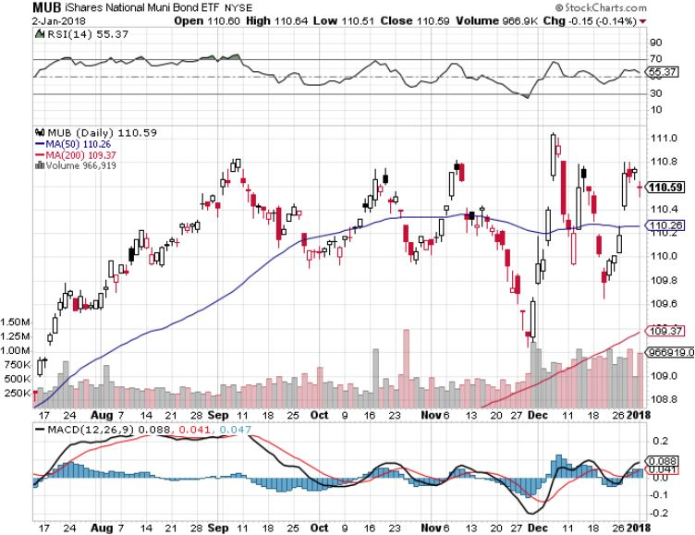
Municipal Bonds (MUB)-1.69%-Gap Up Mix of AAA, AA, and A rated bonds

Slide 47
Foreign Currencies- Divergence
*Interest rate differentials are still the largest drivers of foreign exchange rates. *Look for a weak dollar in the first half and a strong one in the second half as the market focus shifts from exploding deficits to rising rates *Rising US rates guarantees lower Japanese yen (FXY), BOJ to continue QE indefinitely *Rebounding commodity prices are boosting commodity currencies of the Australian dollar (FXA) and the Canadian dollar (FXC) *Higher than US growth rates supporting the Euro (FXE) *Ditto for the Chinese Yuan (CYB), which is also bringing in stronger economic data *Bitcoin see 45% 3 day correction, Russia is launching its own crypto currency to sidestep sanctions

Slide 48
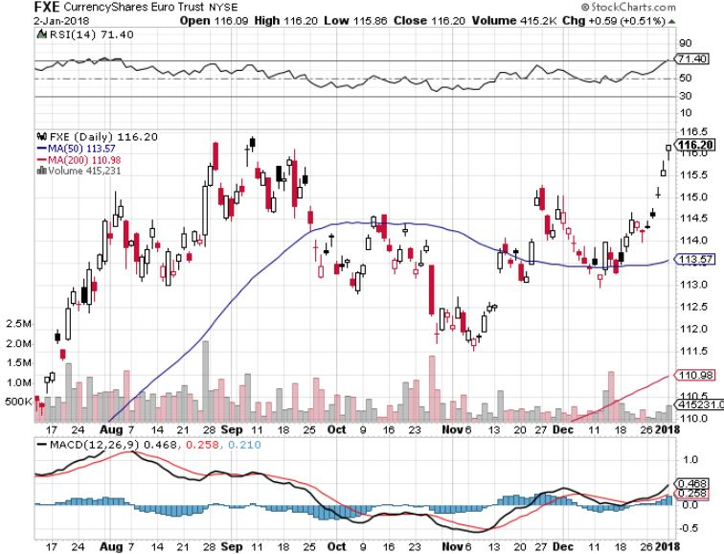
Euro ($XEU), (FXE), (EUO)- Bracketing the Range long (FXE) 12/$116-$118 vertical bear put spread-expires in 7 trading days long (FXE) 12/$111-$113 vertical bull call spread-expires in 7 trading days

Slide 49
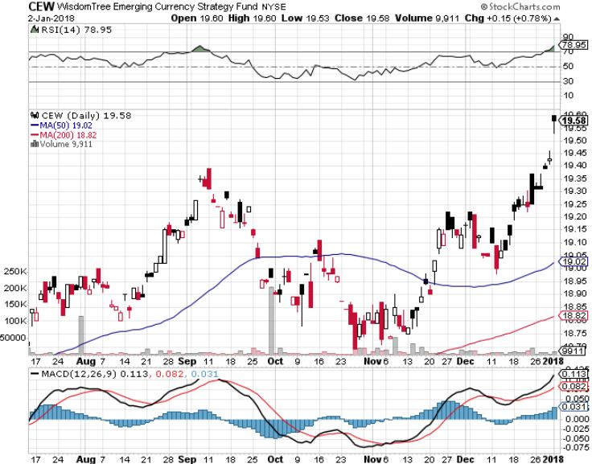
Emerging Market Currencies (CEW)

Slide 50
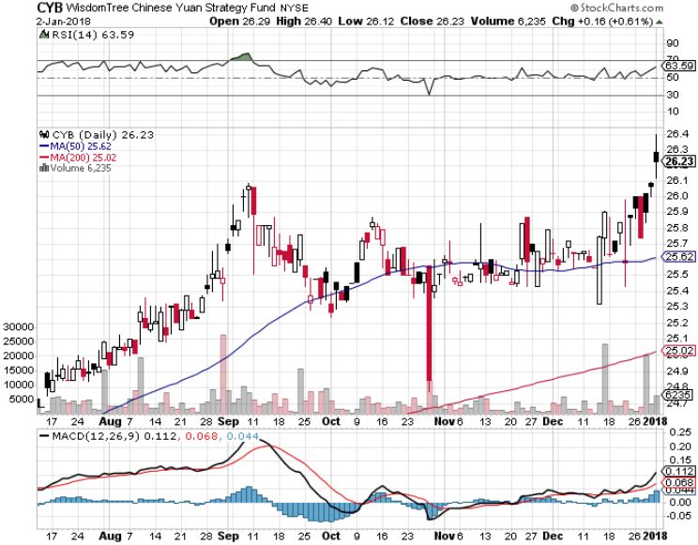
Chinese Yuan- (CYB)-Stabilizing on Government Support

Slide 51
Energy-The Perfect Storm
*OPEC extends production curbs to the end of 2018, will send oil to new 2018 highs in mid $60’s *Chinese oil imports top 9 million b/d, will surpass the US as the world’s largest importer in 2018 *Iran demonstrations threaten to cut 4 million barrels/day from the global oil market *Extreme cold weather also boosting heating oil demand *Terrorist attack on Libyan oil fields further helps oil *Fracking supply is on the rebound *Buy the dips in energy stocks

Slide 52
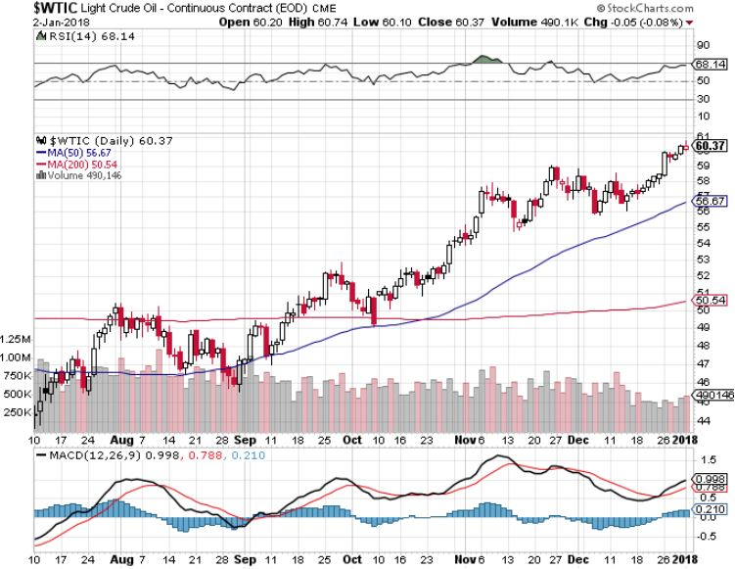
Oil-Topping Out

Slide 53
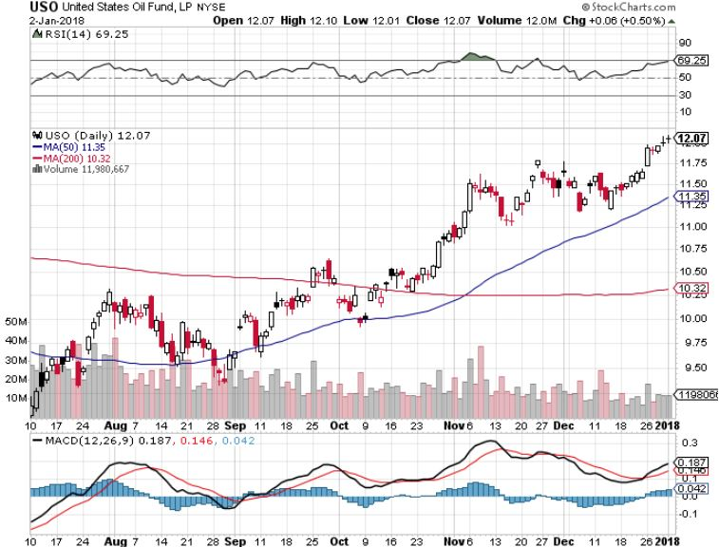
United States Oil Fund (USO)

Slide 54
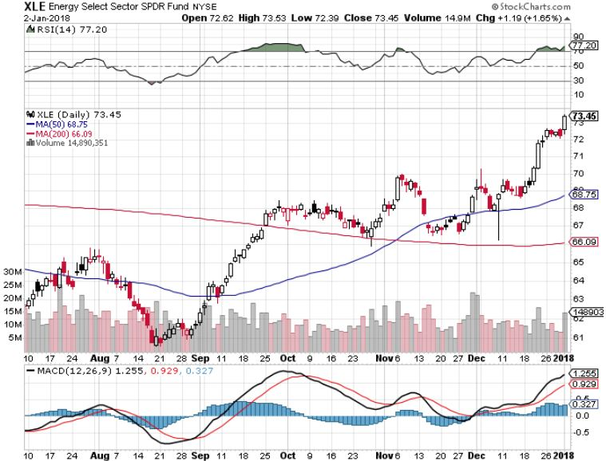
Energy Select Sector SPDR (XLE)-New Lows! (XOM), (CVX), (SLB), (KMI), (EOG), (COP)

Slide 55
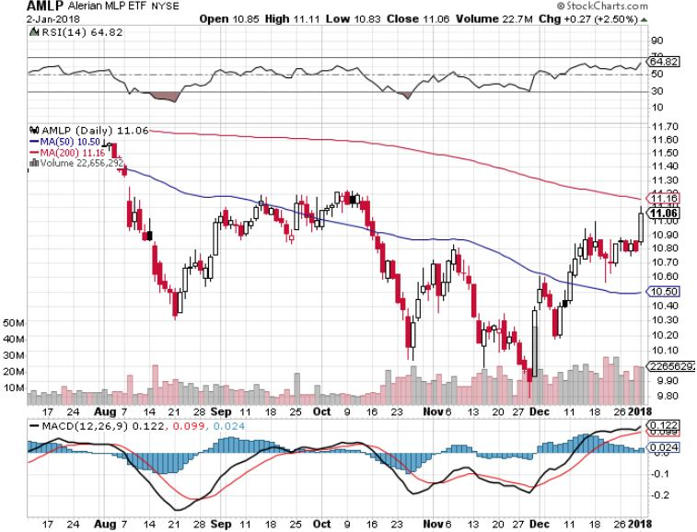
Alerian MLP ETF (AMLP)- Basket Approach is the Only Safe Play Here

Slide 56
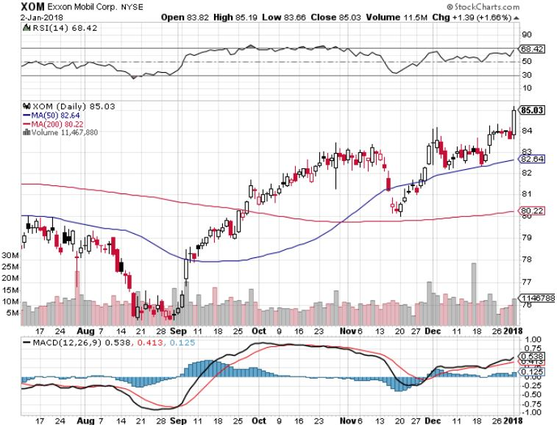
Exxon (XOM)-The Bottom is In

Slide 57
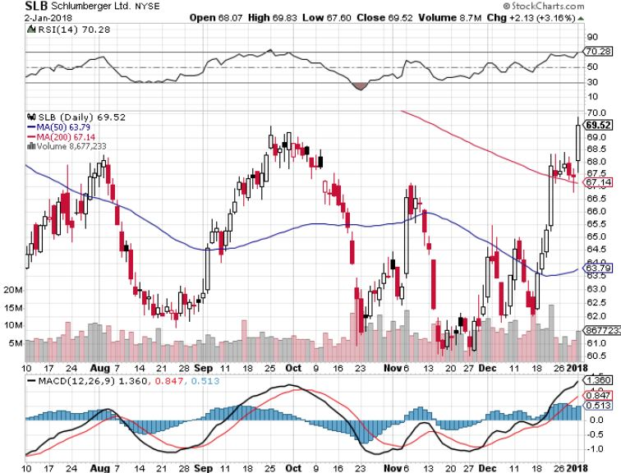
Schlumberger (SLB)-Hard Bounce Back

Slide 58
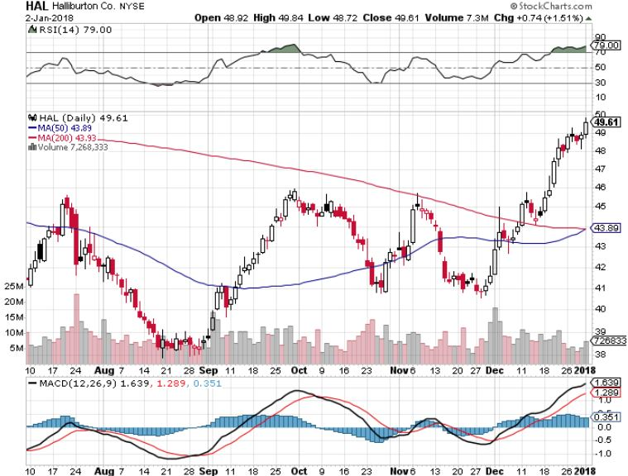
Halliburton (HAL)-Ditto

Slide 59
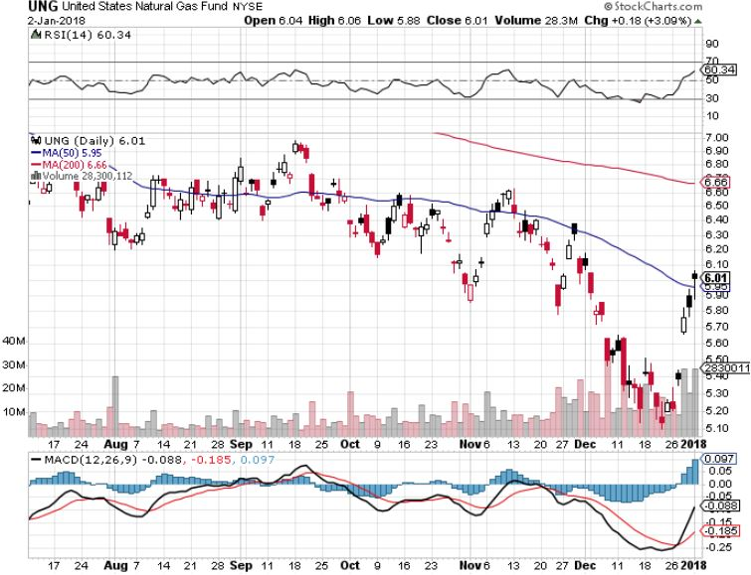
Natural Gas (UNG)-No Joy

Slide 60
Copper (COPX)-China Infrastructure Build Out

Slide 61
Precious Metals-Back in the Spotlight
*Gold closes at 2017 highs, catching a bid from rising global commodity prices *Getting ready for a big jump in January when the sellers’ strike ends? *Continued buying by the Russian Central Bank is putting upward pressure on gold *Bitcoin is definitely stealing away from gold volatility, watch for gold to take off when Bitcoin collapses, down 45% in 3 days *Buy gold and silver stocks on the next big dip, as it is still early days for the bull market

Slide 62
Gold (GLD)-Retest of the Trend hedging trades starting to move again long (GLD) $12/$116-$119 bull call spread-expires in 7 trading days

Slide 63
Market Vectors Gold Miners ETF- (GDX) Took profits on long the 9/$20.50-$21.50 bull call spread

Slide 64
Barrick Gold (ABX) stopped out of long 9/$15-16 call spread

Slide 65
Newmont Mining- (NEM)-Breakout took profits on long the 9/$32-$34 bull call spread

Slide 66
Global X Silver Miners ETF- (SIL)-Breakout took profits on long the 9/$31-$33 bull call spread

Slide 67
Bitcoin-Modern Day Tulips! A new $31 million hack on top of a $280 million one Battling for CFTC futures trading approval

Slide 68
Real Estate-Still Bid
*November Pending Home Sales up 0.2% on shrinking inventory *29% of homes now sell for all cash, up from 27% a year ago *Median Home Price up 51% since 2009 *Loss of mortgage and property tax deductions will have no effect on the market as the structural shortage is too great and they may be back in two years *S&P 500 Case-Shiller maintains strong 6.1%, with absolute prices hitting new all time high, *Your home equity could be the best investment of the year….again

Slide 69
October S&P7500/Case–Shiller Home Price Index +6.2% YOY, Seattle (+12.0%), Las Vegas (+10.2%), San Diego (+8.1%) still leaders price rises accelerating

Slide 70
General Growth Properties (GGP)-New Lows Brookfield (BAM) takeover rumors

Slide 71
US Home Construction Index (ITB) (DHI), (LEN), (PHM), (TOL), (NVR) A Favorite Sector to Buy

Slide 72
Trade Sheet- So What Do We Do About All This?
*Stocks- buy dips *Bonds-sell any and all rallies *Commodities-buy industrials, energy *Currencies-sell yen and Euro on any rallies *Precious Metals –buy big dip *Volatility-stand aside until over $16 *The Ags –stand aside *Real estate-buy dips

Slide 73
Next Strategy Webinar 12:00 EST Wednesday, January 17, 2018 San Francisco, CA madhedgefundtrader.com
Good Luck and Good Trading!
Notes:
*

