Slide 1
Mad Day Trader
Bill Davis
Webinar – April 18, 2018

Slide 2
Long Term

Slide 3
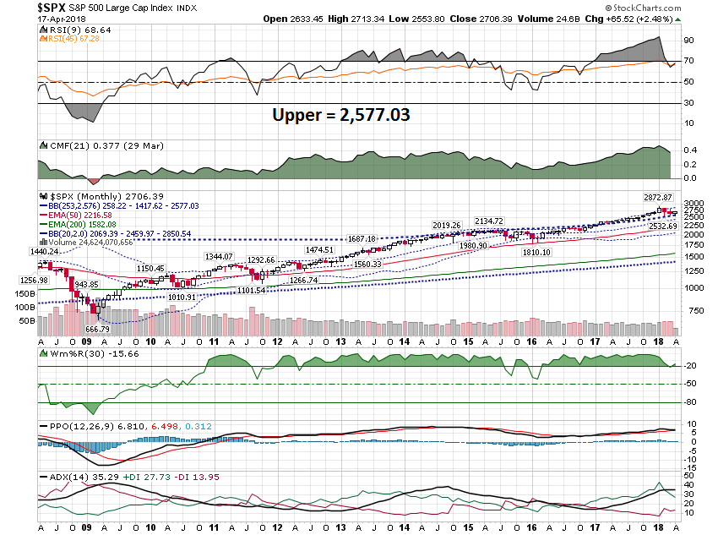

Slide 4
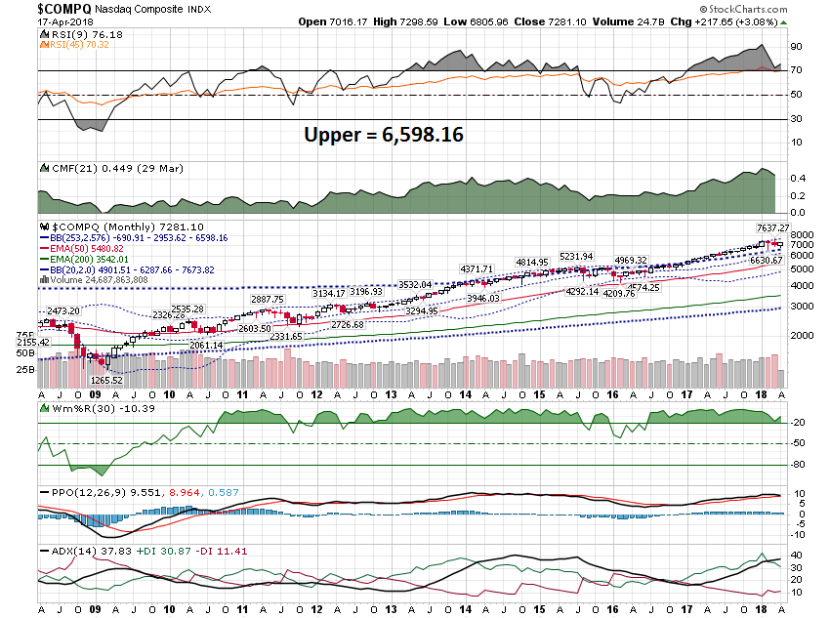

Slide 5
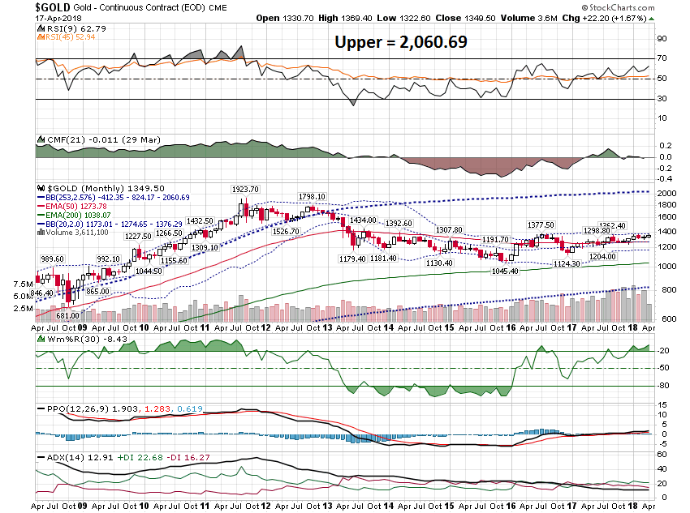

Slide 6
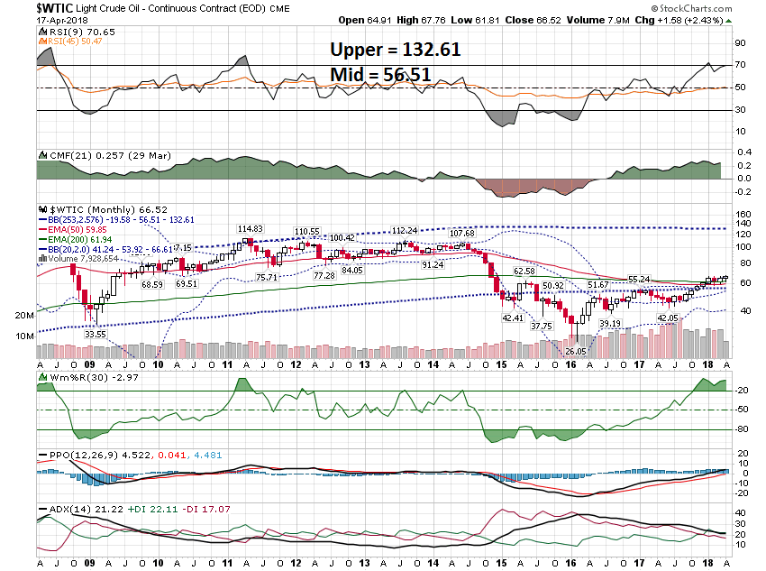

Slide 7
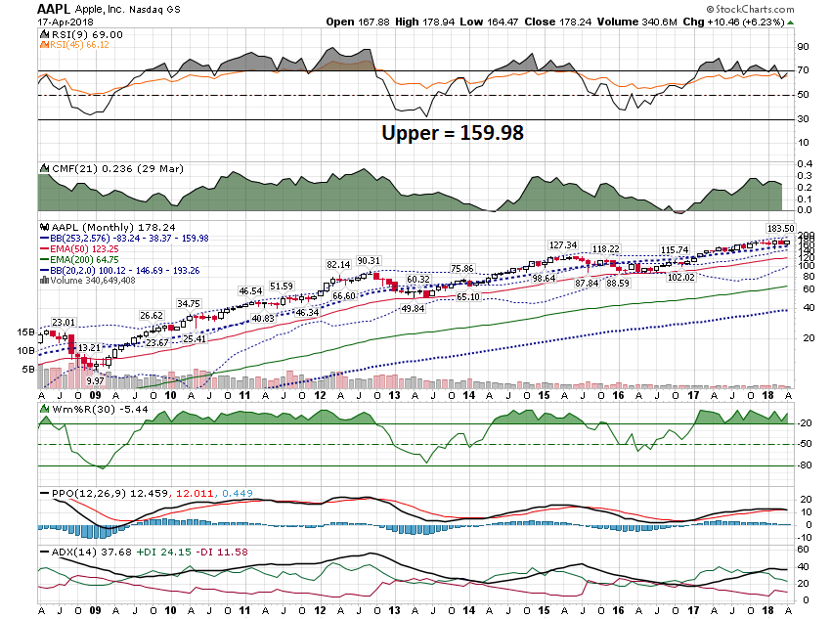

Slide 8
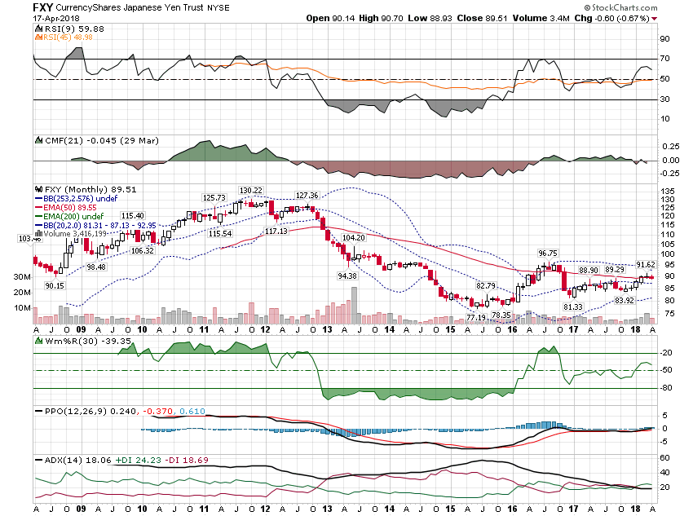

Slide 9
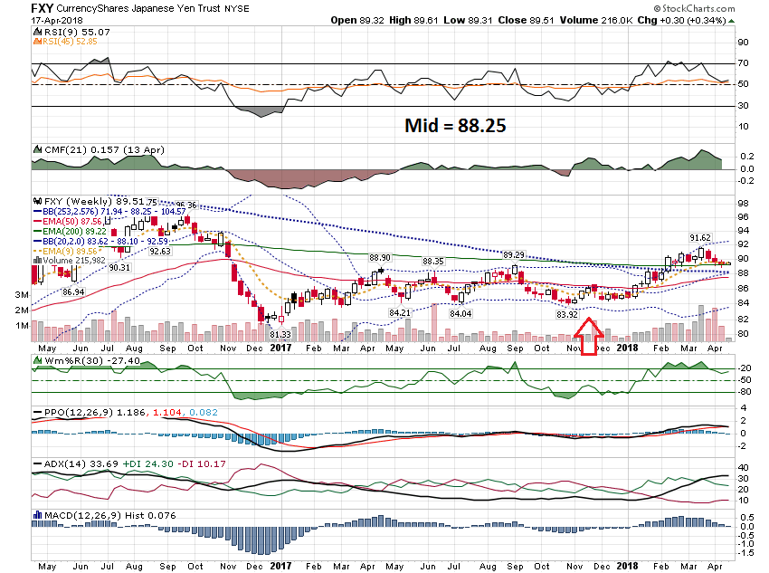

Slide 10
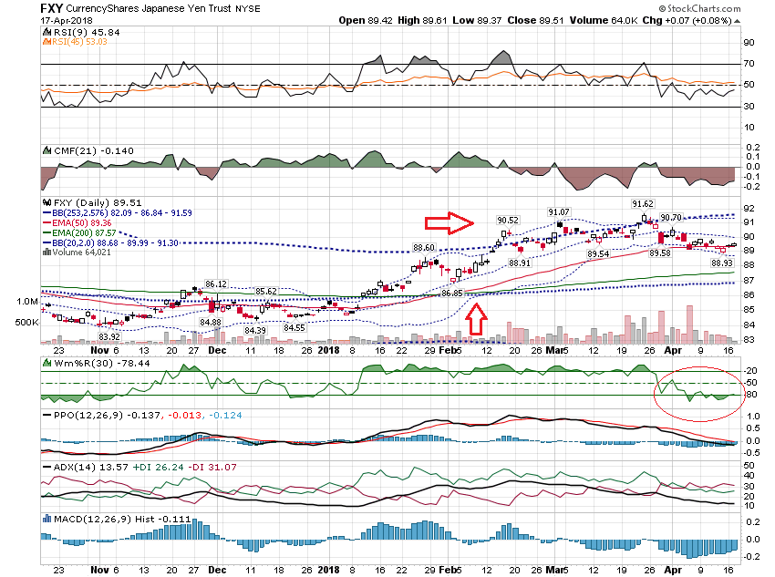

Slide 11
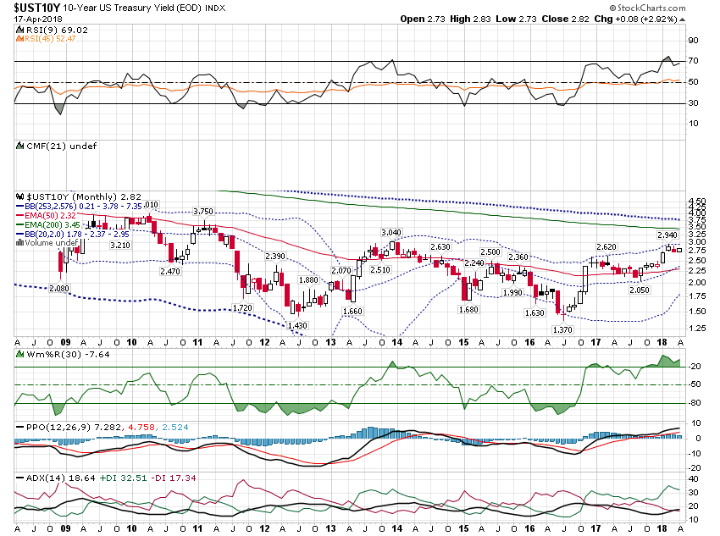

Slide 12
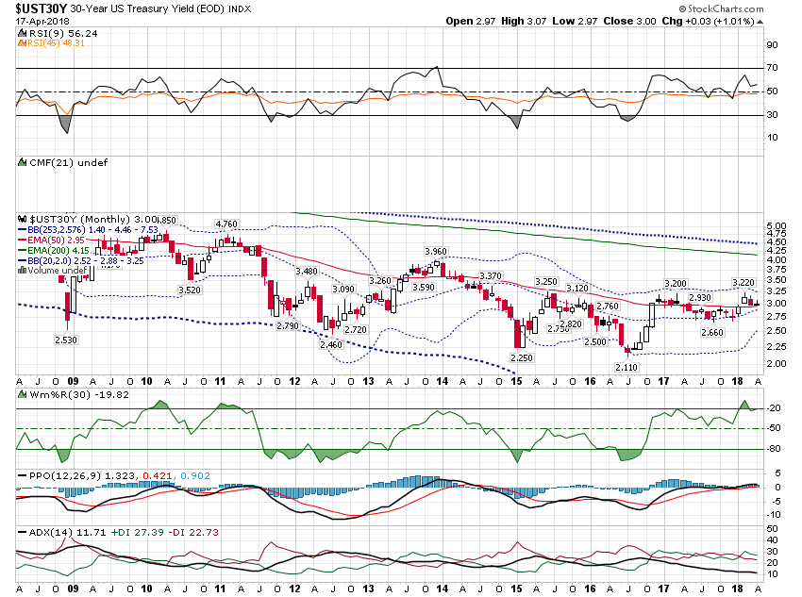

Slide 13
Short Term

Slide 14
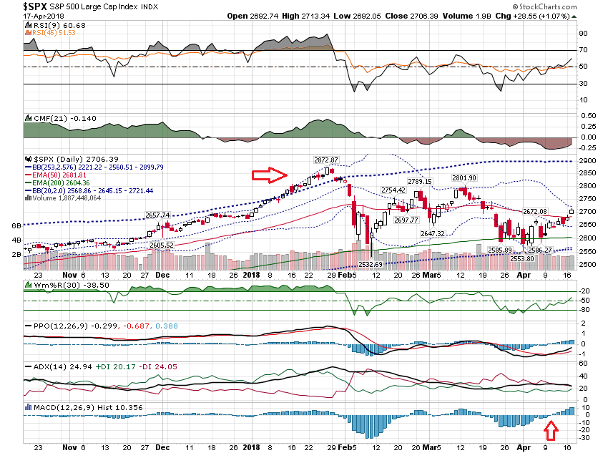

Slide 15
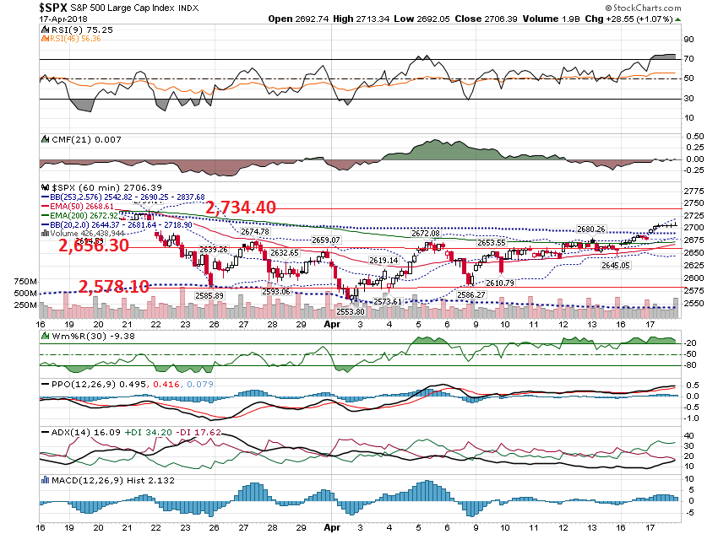

Slide 16
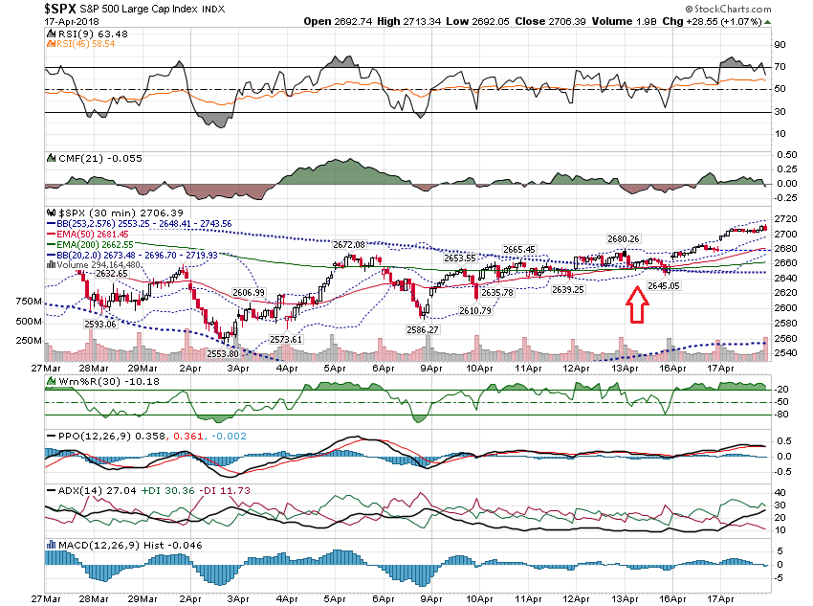

Slide 17
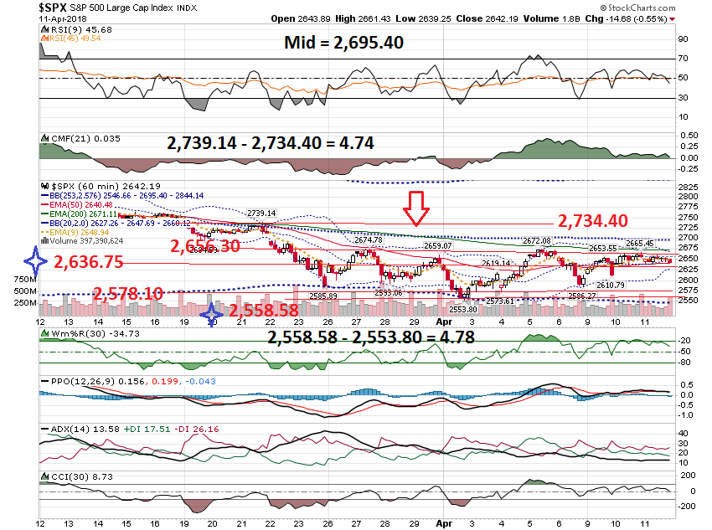

Slide 18
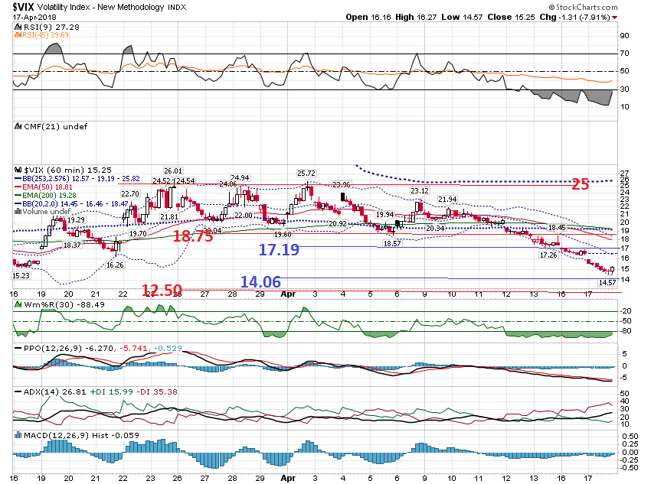

Slide 19
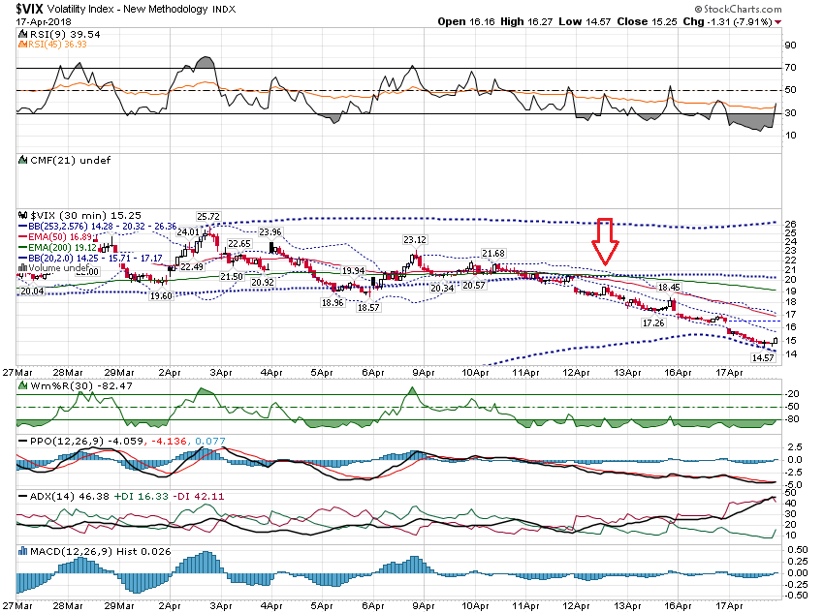

Slide 20
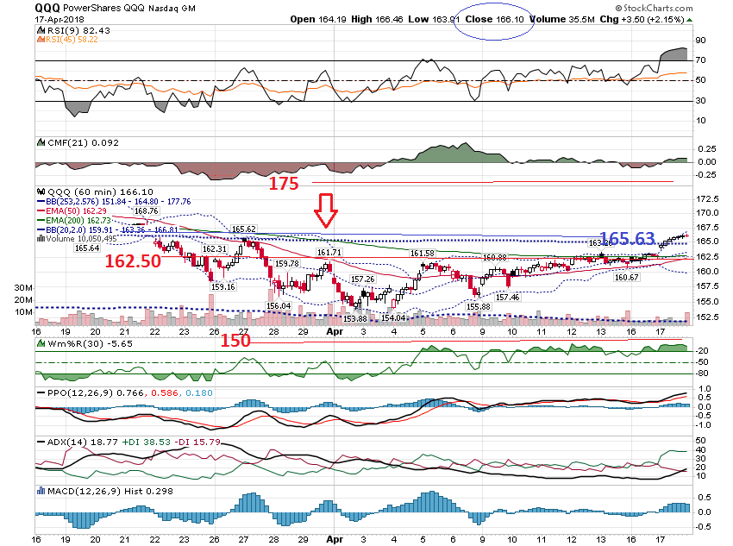

Slide 21
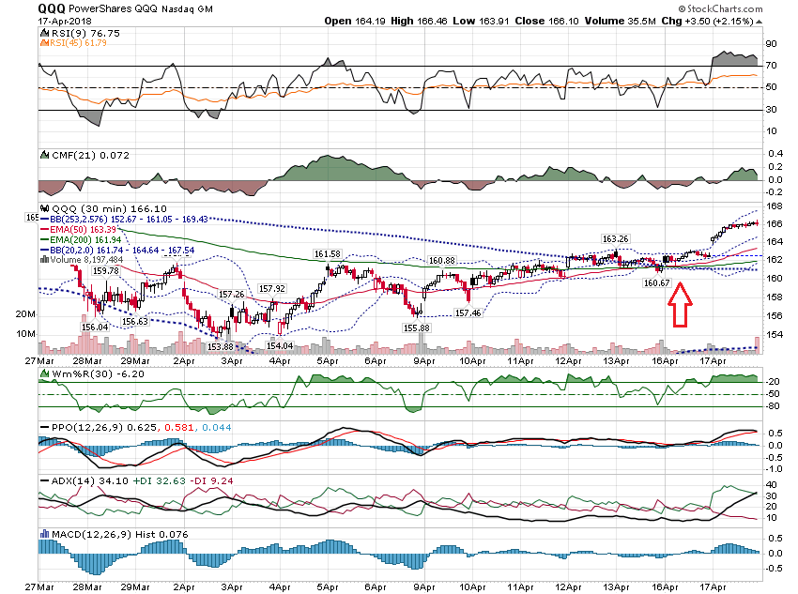

Slide 22
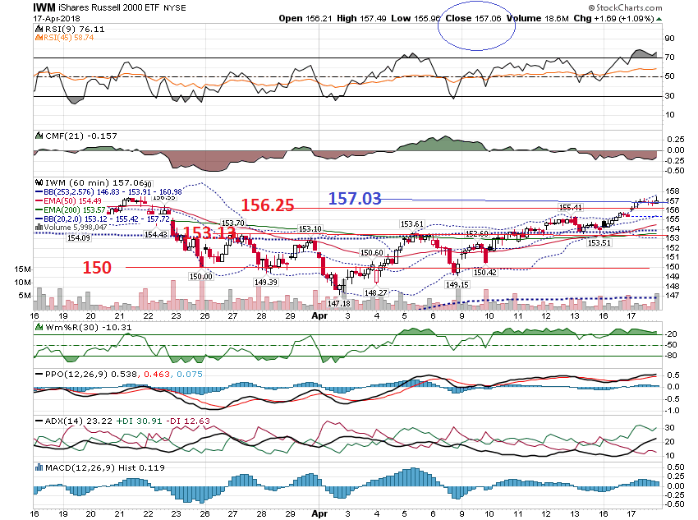

Slide 23
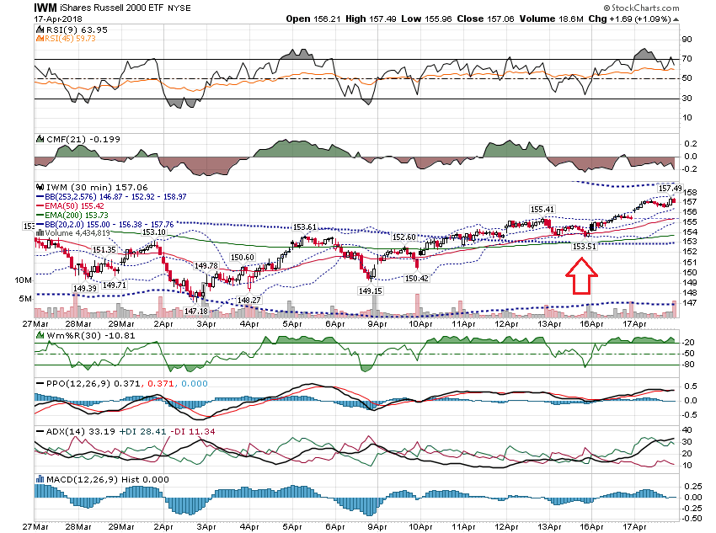

Slide 24
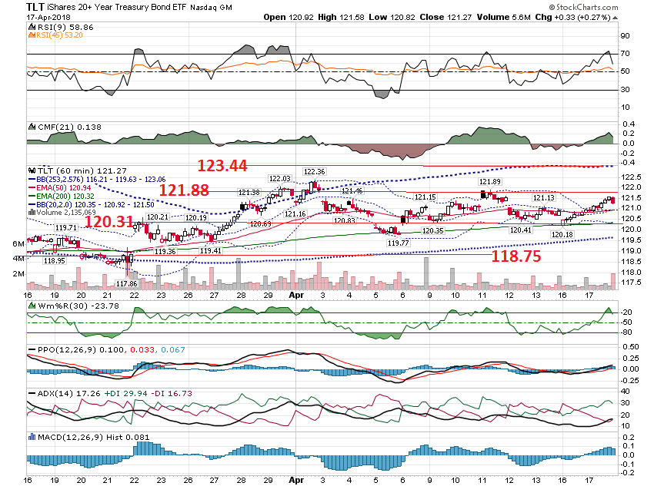

Slide 25
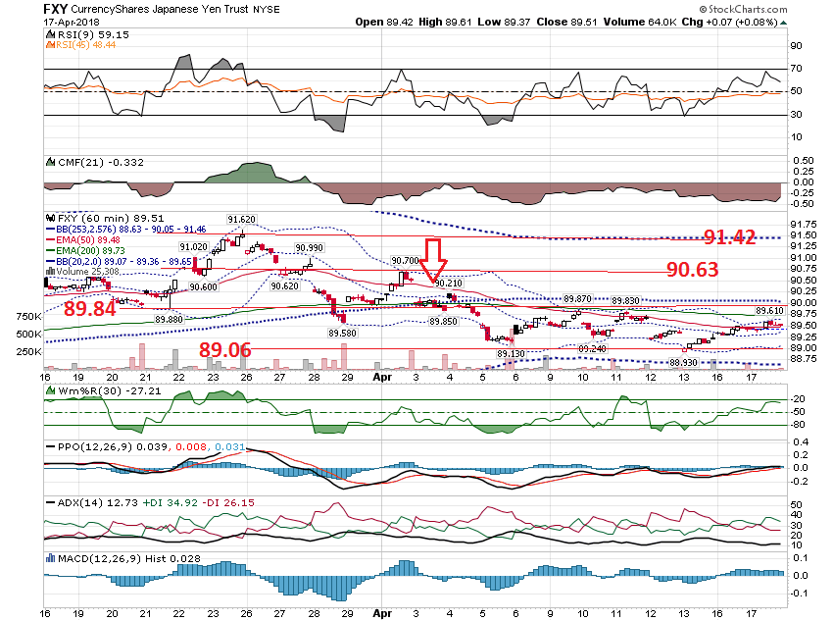

Slide 26
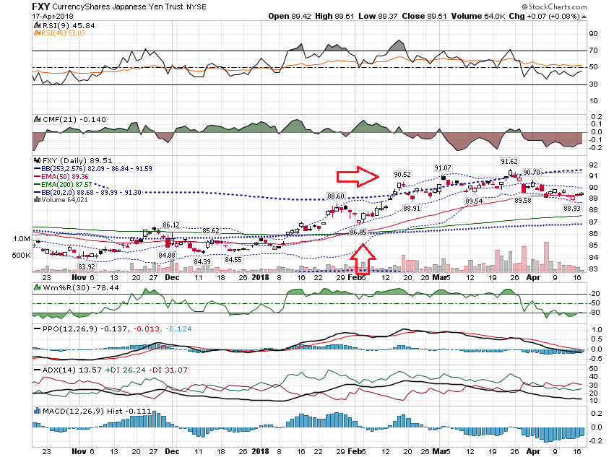

Slide 27
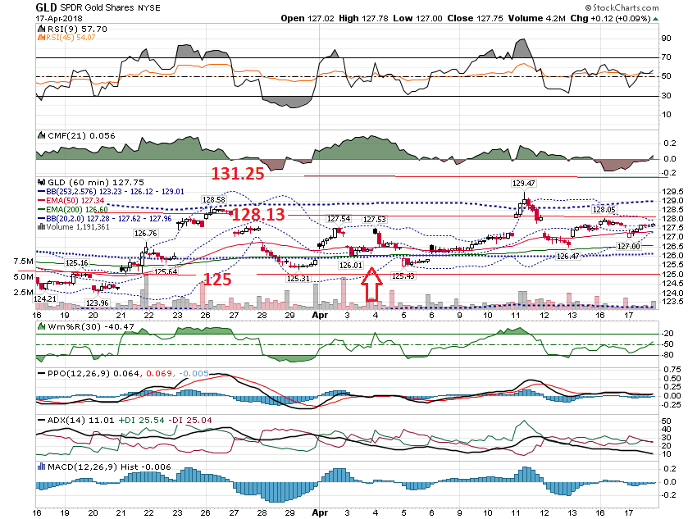

Slide 28
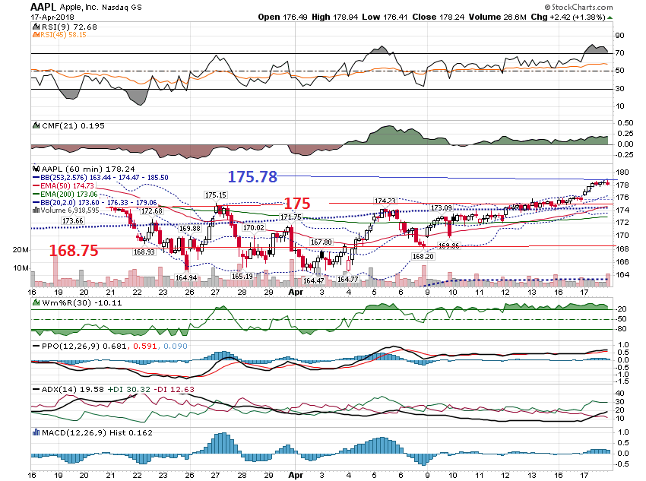

Slide 29
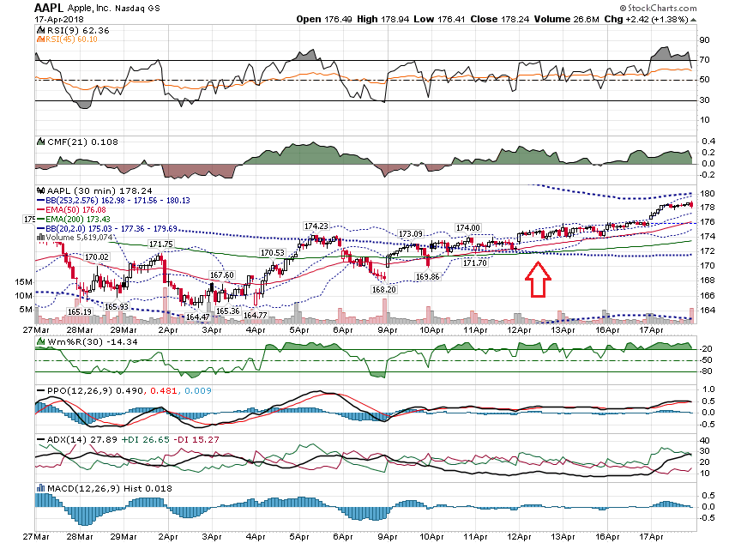

Slide 30
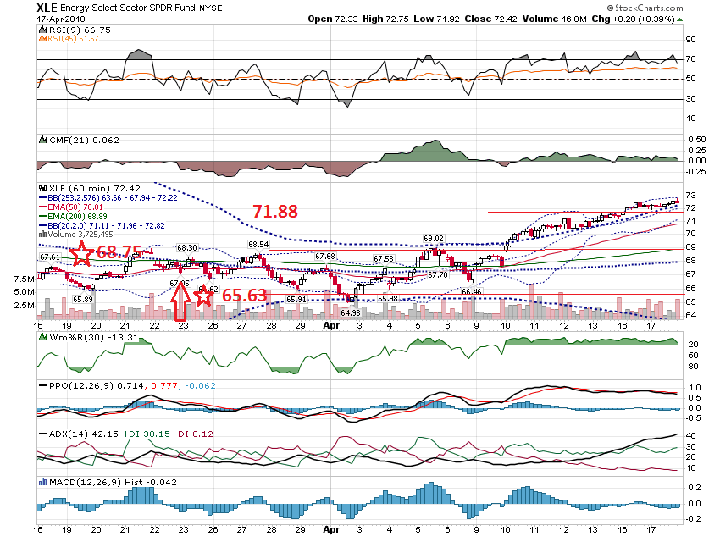

Slide 31
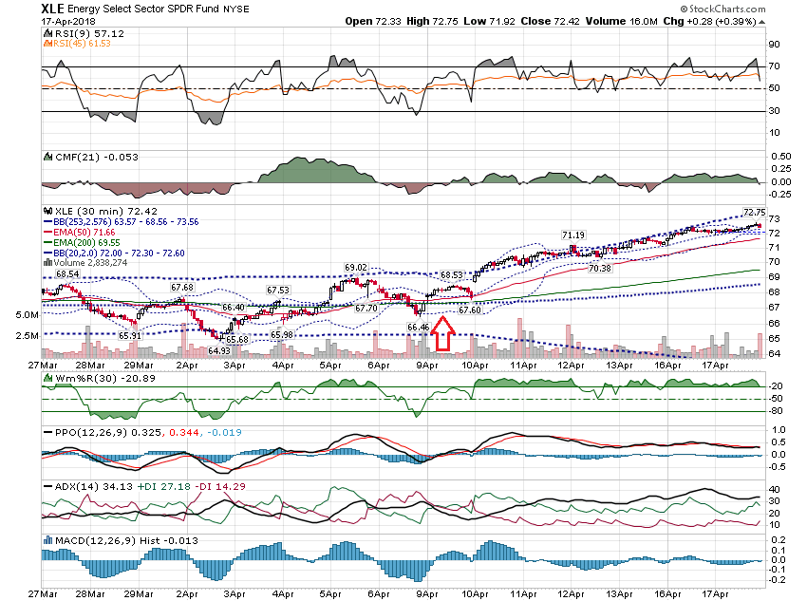

Slide 32
Estimating the Earnings Move

Slide 33
NFLX Example Price $308 Before Earnings Add up the ATM Straddle 307.50 Call - $13.40 307.50 Put Put - $13.05 Total = $26.45 $26.45 / $308 = 8.58% Projected Move = $26.45

Slide 34
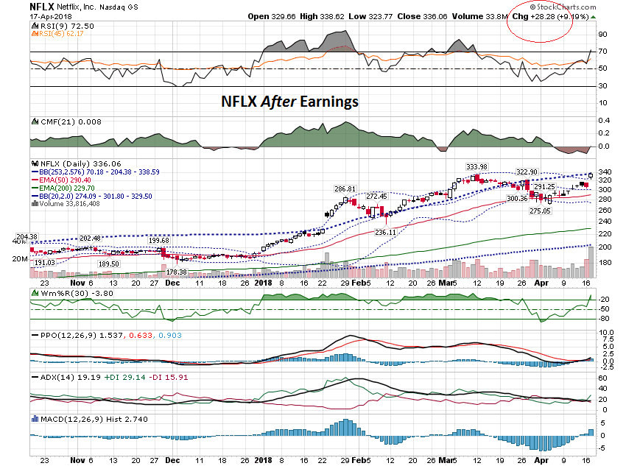

Slide 35
If you bought the ATM Straddle, your profit would be: 28.28 – 26.45 = 1.83 1.83 / 26.45 = 7%

Slide 36
You had a little profit only because the actual move was slightly higher than the projected move. Losses could be large if NFLX did not move at least 8.58%

Slide 37
Here is another way to trade before earnings.

Slide 38
Take the project move and add a 50% cushion. $26.45 x 1.5 = 39.67 Round to $40

Slide 39
$308 - $40 = $268 Round to $270 Sell $270 Put for $1.61 Buy $265 Put for $1.15 Net Credit = $.46 or 46 per Spread 46 / 500 = 9.2%

Slide 40
If you did the Call side too: $308 + $40 = $348 Sell $350 Call for $1.17 Buy $355 Call for $.85 Net Credit = $.32 .32 / $5.00 = 6.4%

Slide 41
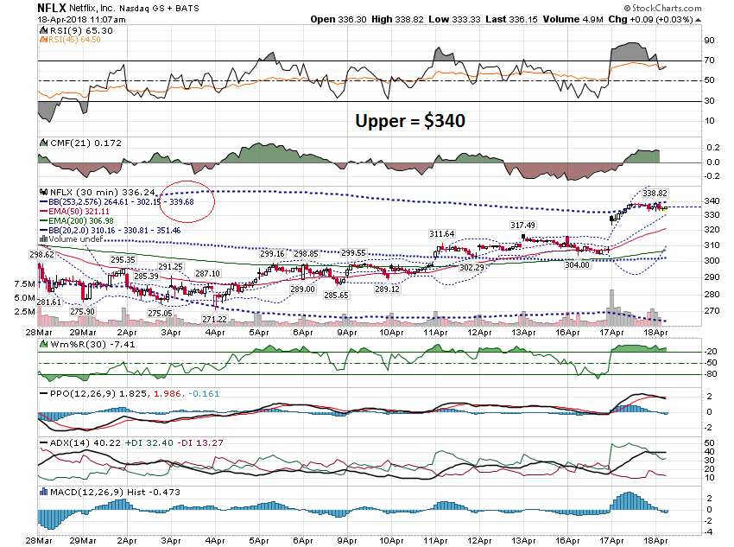

Slide 42
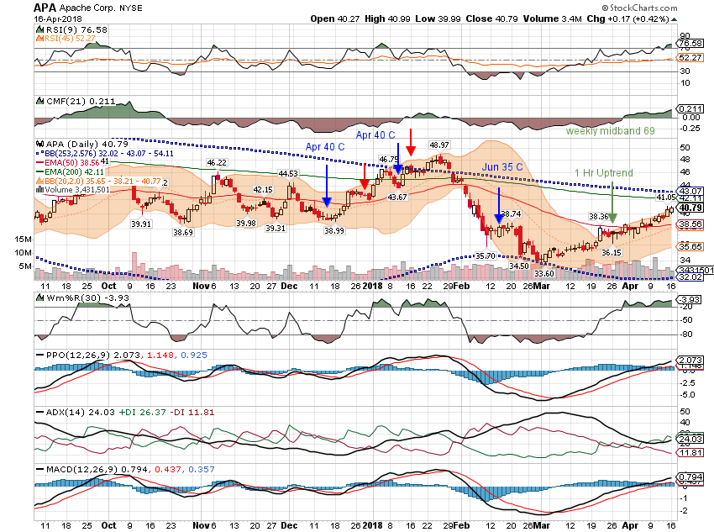

Slide 43
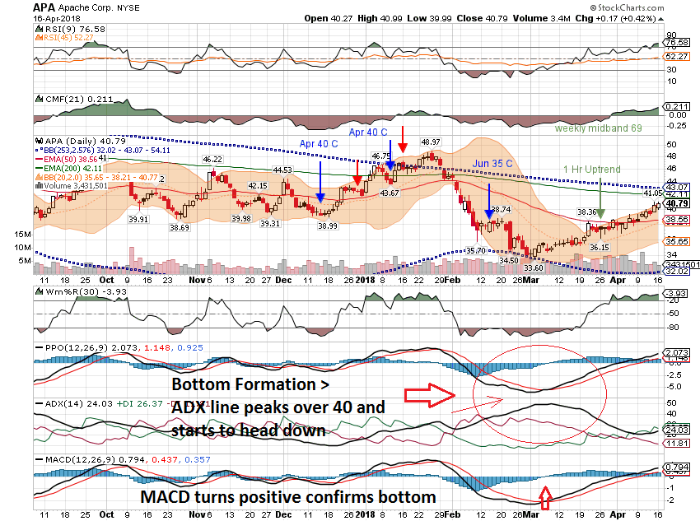

Slide 44
Thanks for watching! Bill Davis Mad Day Trader April 18, 2018 davismdt@gmail.com

