Slide 1
The Mad Hedge Fund Trader “Alarm Bells are Ringing”
With John Thomas from Silicon Valley, CA, February 20, 2019 www.madhedgefundtrader.com
Notes:
*

Slide 2
Trade Alert Performance New All-Time High Hanging tough and beating the market
*January 9.49% Final *July +0.0% Final *February +3.50% MTD *August +2.19% MTD *March +1.13% Final *September 1.38% Final *April +12.54% Final *October +1.37% Final *May +1.07% Final *November -1.83% Final *June +4.15% Final *December -4.13% Final *2019 Year to Date +12.98% compared to +11.6% for the Dow Average *Trailing One year return +32.90%, +312.93% since inception, *Average annualized return of 34.12% for 9 years

Slide 3
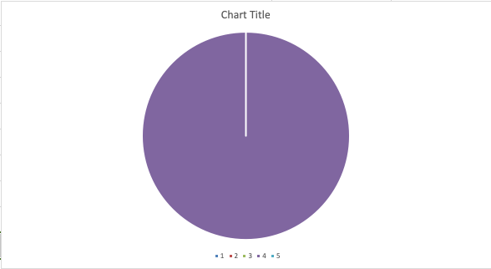
Portfolio Review running small short after great market run
Current Capital at Risk
Risk On
World is Getting Better
NO POSITIONS
Risk Off
(GLD) 3/$119-$122 calls spread | -10.00%
Total Net Position | -10.00%
Expiration P&L 13.36%

Slide 4
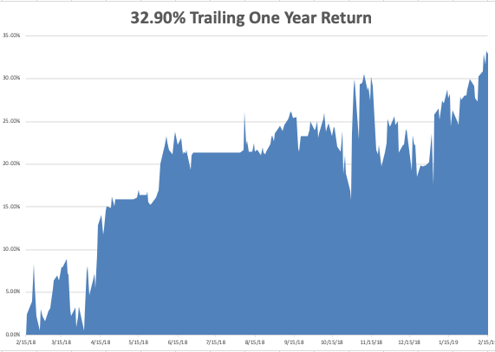
GTD Daily Audited Performance

Slide 5
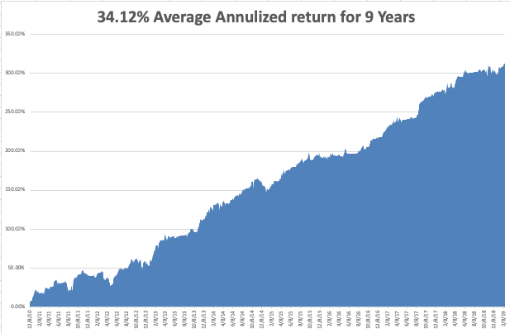
GTD 9 Year Daily Audited Performance

Slide 6
The Method to My Madness
*Only one big positive left: resolution of the China trade war. Once that’s done there is nothing left to support the market buy corporate buybacks and algorithms. *Could trigger the biggest “Sell the news” collapse of all time *Falling earnings are the biggest market challenge for 2019, shrinking multiples are next *Fed keeps pounding away with a dovish message, but for how long? *Oil remains strong on Venezuela collapse and China stimulus *Germany is officially in recession *Interest in gold is booming

Slide 7
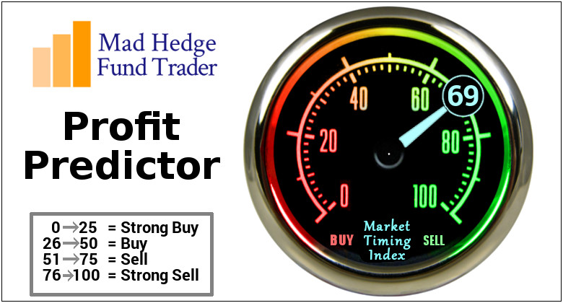
The Mad Hedge Profit Predictor Market Timing Index- An artificial intelligence driven algorithm that analyzes 30 different economic, technical, and momentum driven indicators

Slide 8
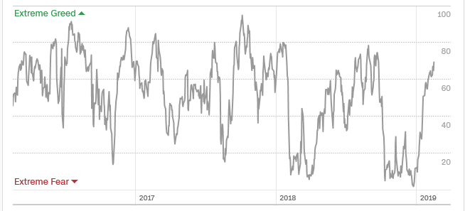
The Mad Hedge Profit Predictor A 5 Month High – YIKES!
SELL
BUY

Slide 9
The Global Economy – Unstable
*Government shut down cuts 75 basis points off of Q1 GDP *Economic data flow have turned from mixed to terrible, issuing a loud recession waning, Retail Sales at a ten year low, NY Fed slashing Growth Estimates under 2%, Car Sales driving off a cliff, Business Confidence at a 2 year low, CPI at a one year low, and Personal Debt is soaring *Collapsing tax revenues mean that Total US Borrowing could hit $2 trillion this year *China cuts bank reserve requirements and tax in a massive effort to float the economy *Trade war induced slowdowns in China and Europe are starting to drag on the US *Newly weakened dollar will boost non-dollar plays, like emerging markets (EEM) and the currencies (FXE) and (FXA), and oil (USO)

Slide 10
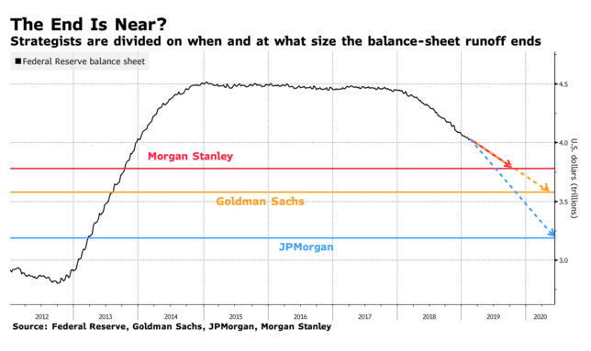
Sucking Liquidity Out of the Economy

Slide 11
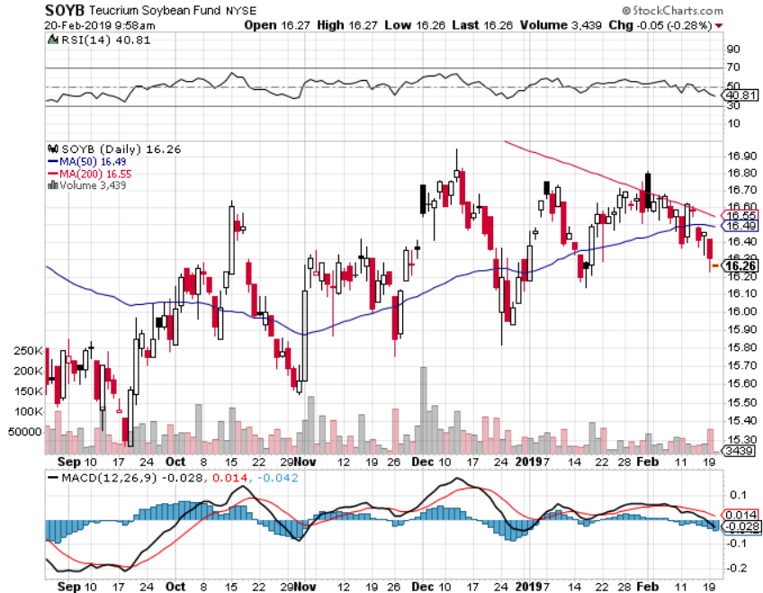
Soybeans (-20%)-Trade War Indicator rolling over price action hits on a big “Sell the news” on China trade deal

Slide 12
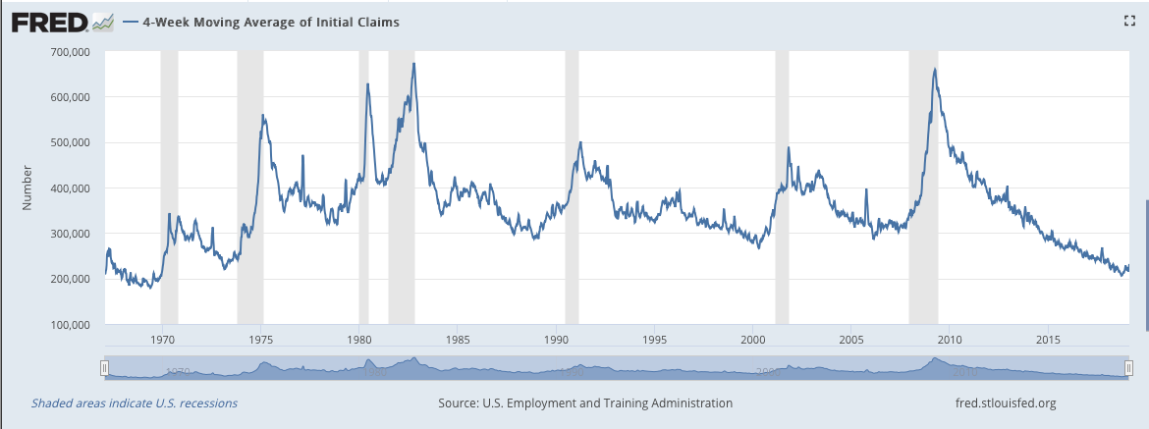
Weekly Jobless Claims –The Most Important Statistic -3,000 to 213,000

Slide 13
The Bill Davis View A $1,500 Upgrade for the Mad Day Trader Service
Buys: | Entry | Target
Jazz Pharmeceuticals (JAZZ)-X | $ 128.00 | $ 150.00
Facebook (FB)-X | $ 160.00 | $ 190.00
Quest Diagnostics (DGX)-X | $ 85.00 | $ 100.00
3M Co. (MMM) | $ 204.00 | $ 215.00
Cummins Inc. (CMI) | $ 150.00 | $ 165.00
Sells:
Tupperware (TUP) | $ 32.00 | $ 24.00
Electronic Arts (EA) | $ 115.00 | $ 80.00
Alibaba Group (BABA) | $ 162.00 | $ 135.00
Molson Coors Brewing (TAP) | $ 64.00 | $ 58.00
Align Technologies (ALGN) | $ 290.00 | $ 250.00

Slide 15
Stocks – “Sell the News”
*Q4 earnings were mixed, but forward guidance is terrible, and investors won’t pay up for falling earnings *Earnings multiple just jumped from 14X to 18X without the growth to support it *Puts a revisit of the Christmas Eve lows back on the table, down 4,000 Dow points *Trade war settlement and end of government shut down could be a threat to the market on a “buy the rumor, sell the news”, the last positive to drive stocks upward *Another $1 trillion in new share buybacks kicks in, corporations will be the biggest buyers of stock in 2019 for the second year in a row *Tech is starting to fade, to be replaced by weak dollar plays like emerging markets, gold, commodities, and energy *Bottom Line: its bet the ranch time on tech longs, but stay away from those with big China exposure, like Apple, and weak dollar plays like energy, and emerging markets

Slide 16
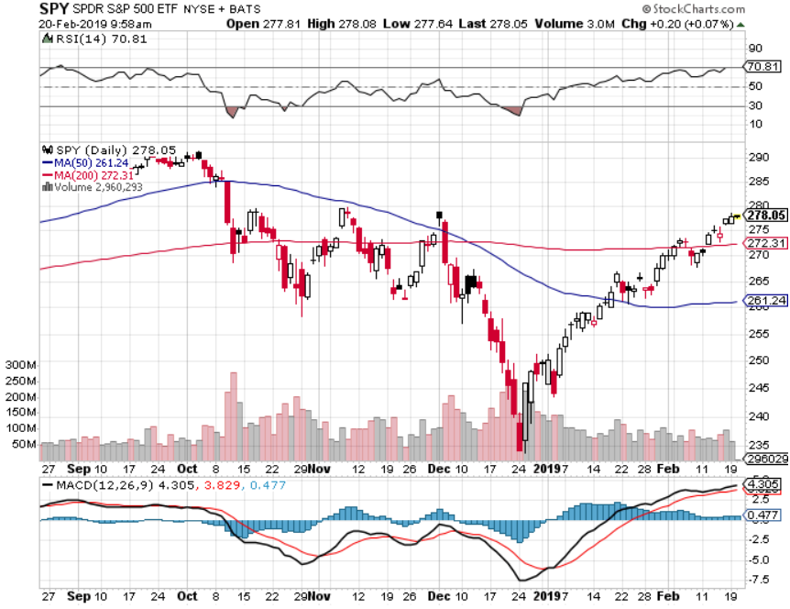
S&P 500- took profits on long 2/$270-$275 bear put spread

Slide 17
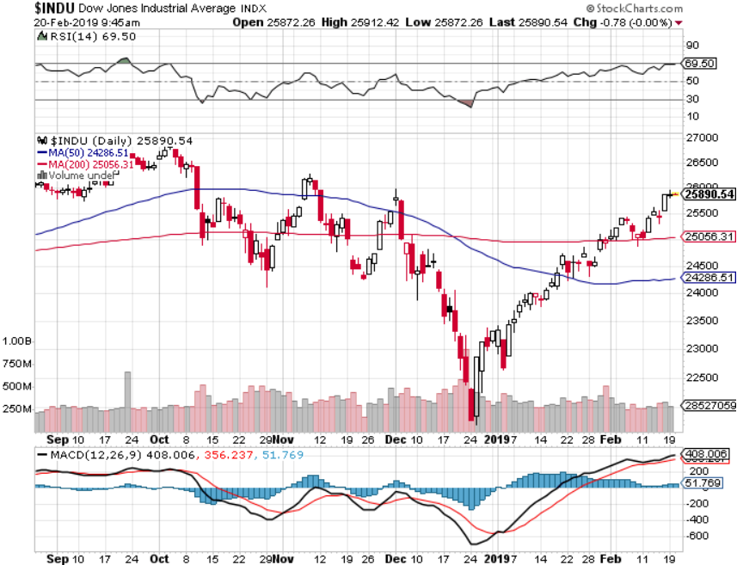
Dow Average-

Slide 18
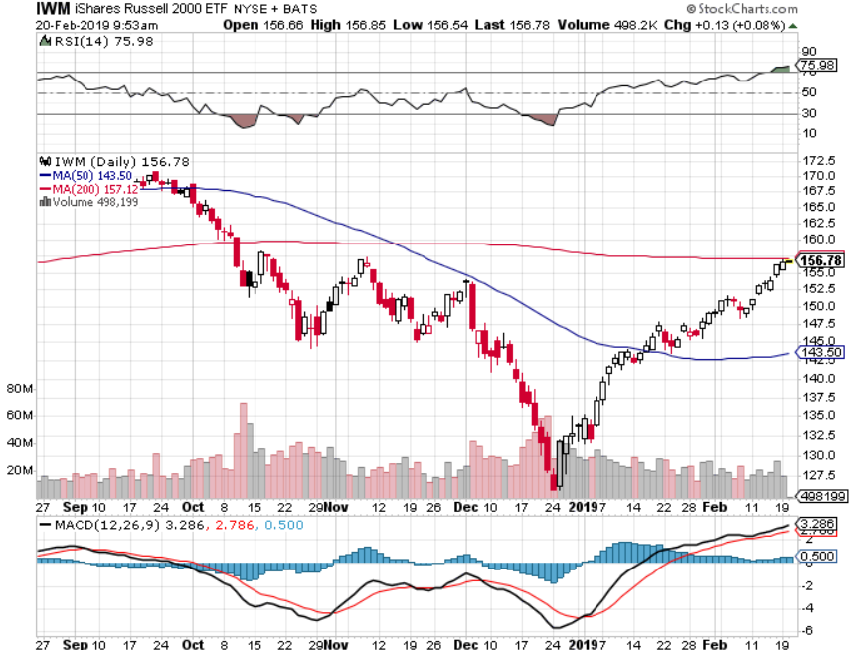
Russell 2000 (IWM)-

Slide 19
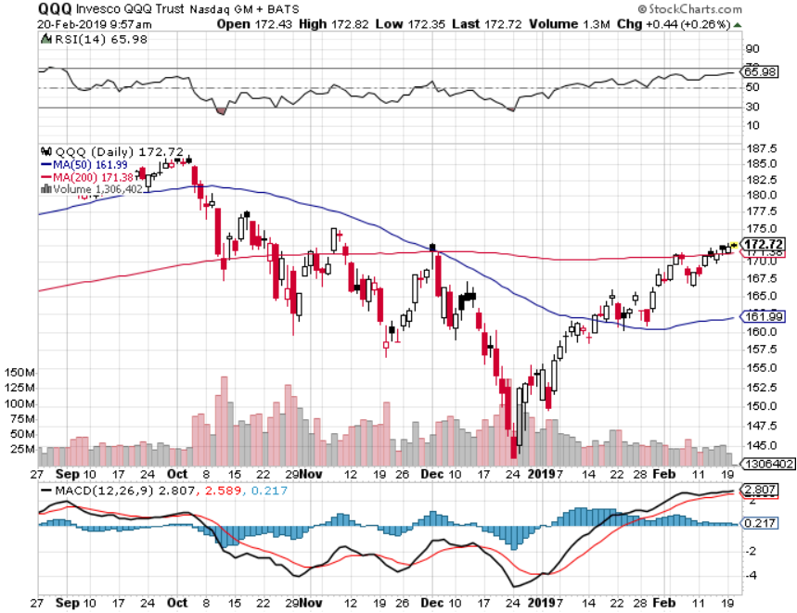
NASDAQ (QQQ)

Slide 20
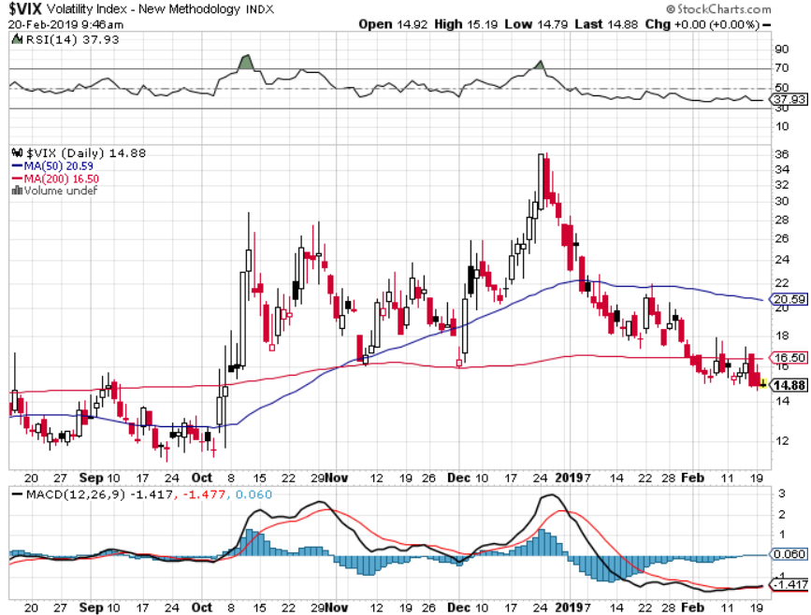
(VIX)- Probing Lows

Slide 21
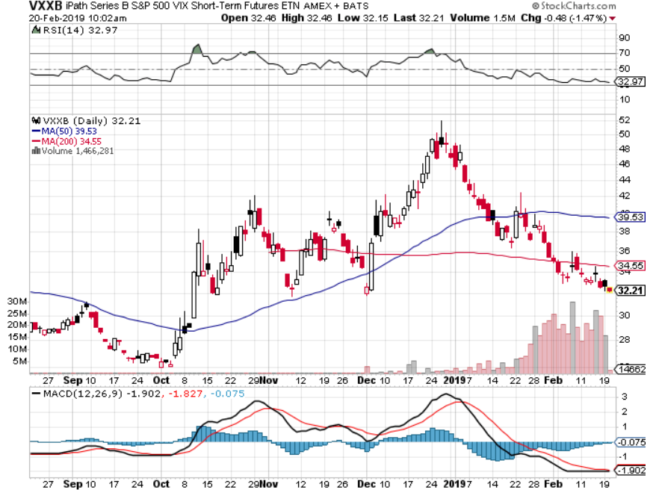
iPath S&P 500 VIX Short-Term Futures ETN (VXX)

Slide 22
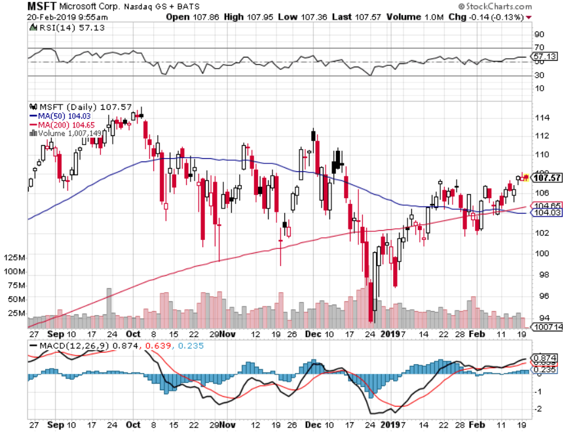
Microsoft (MSFT)- Earnings beat took profits on long 2/$85-$90 call spread

Slide 23
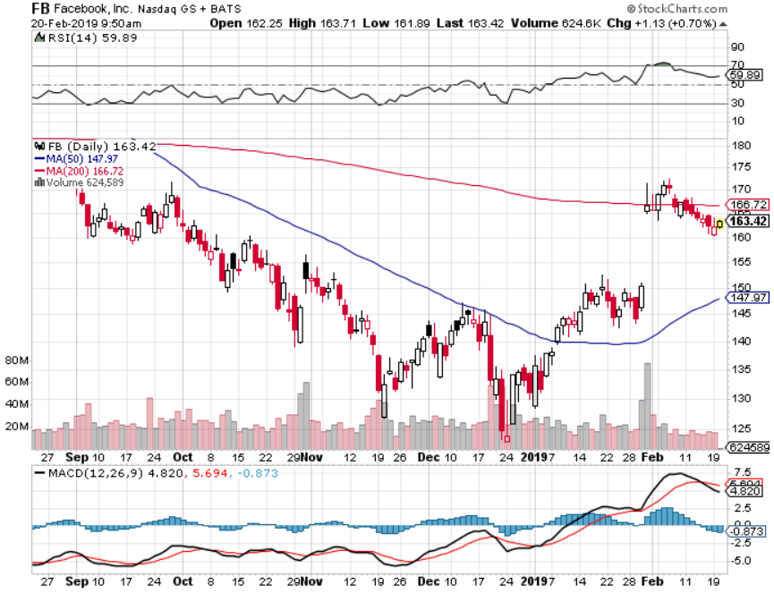
Facebook (FB)- Struggling

Slide 24
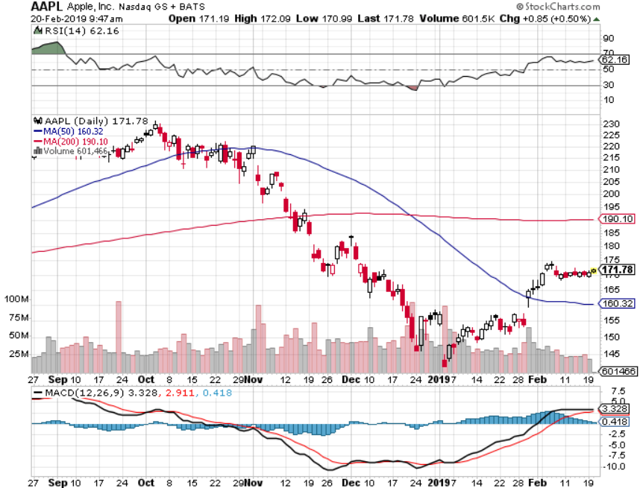
Apple (AAPL)- Underperforming Earnings mixed stopped out of long 11/$175-$180 bear put spread took profits on long 11/$165-$175 bear put spread

Slide 25
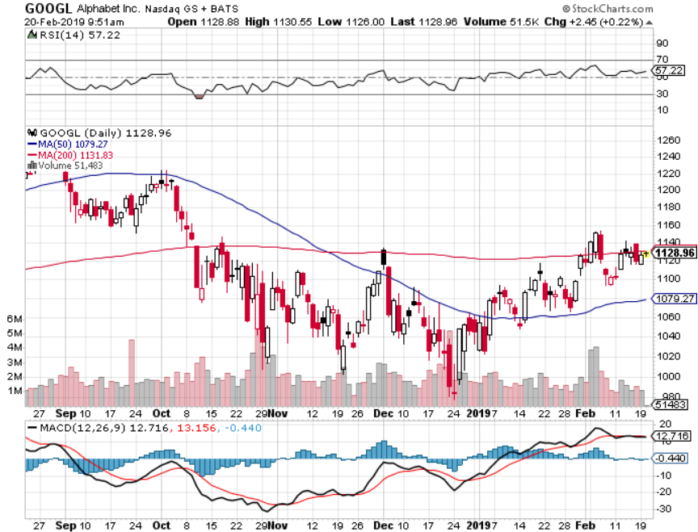
Alphabet (GOOGL)-

Slide 26
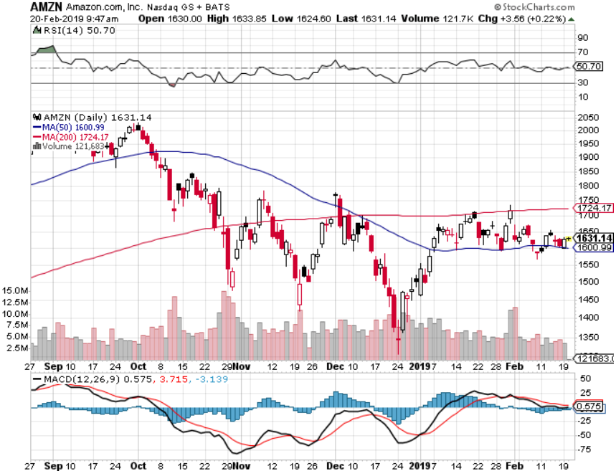
Amazon (AMZN)-Back to Top of Range Cancelled NY HQ2 to duck coming recession took profits on long 2/$1,200-$1,300 call spread

Slide 27
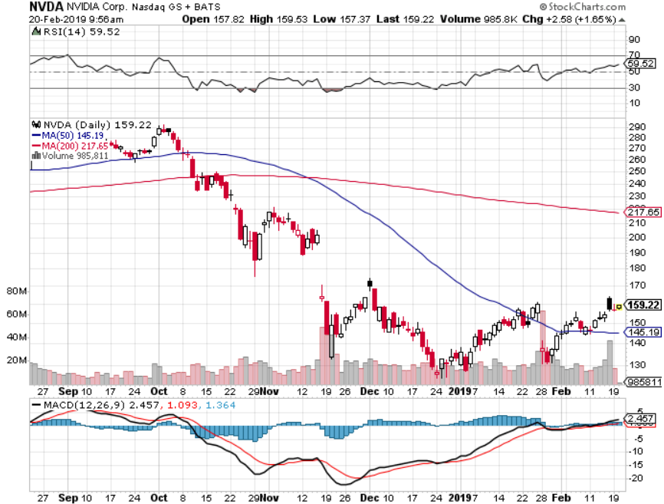
NVIDIA (NVDA)- earnings beat

Slide 28
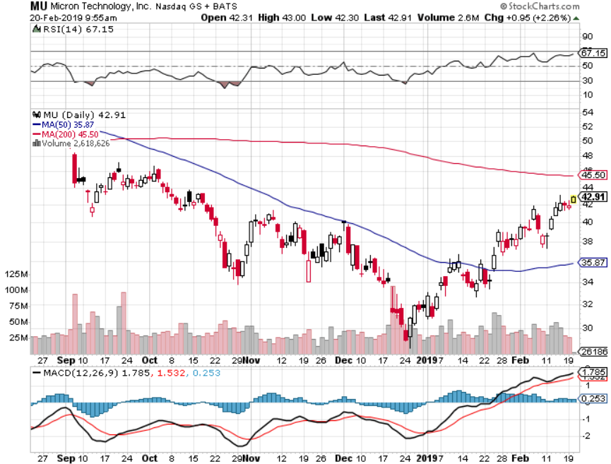
Micron Technology (MU)-

Slide 29
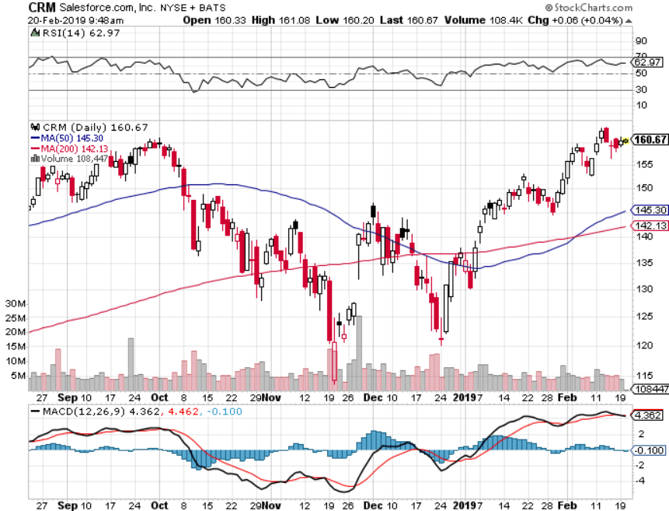
Salesforce (CRM)-Great Earnings-New Highs took profits on long 2/$105-$115 call spread

Slide 30
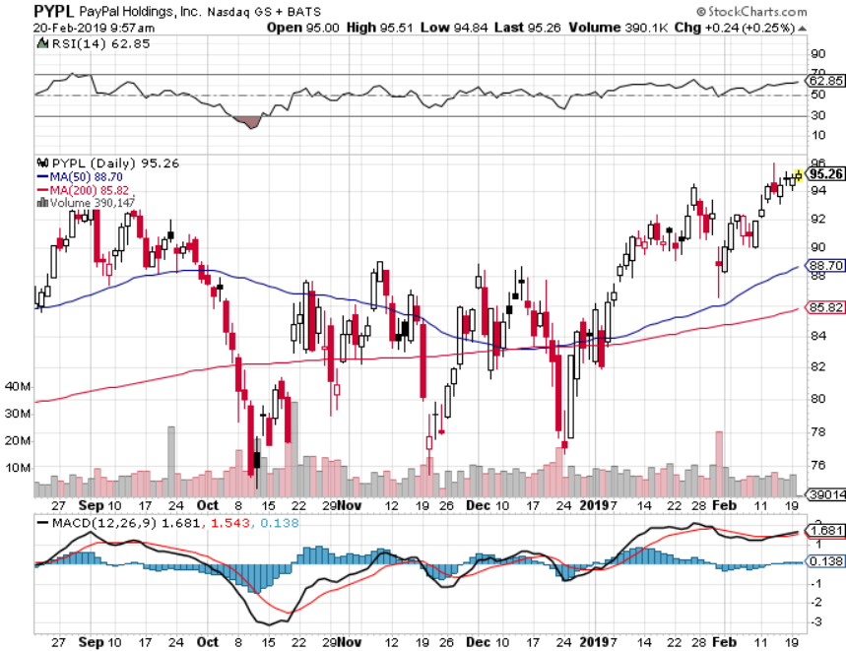
PayPal (PYPL)-

Slide 31
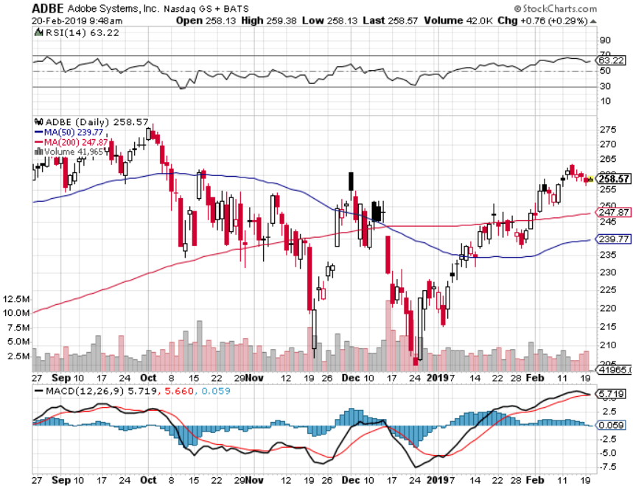
Adobe (ADBE)- The Quality Non-China tech play

Slide 32
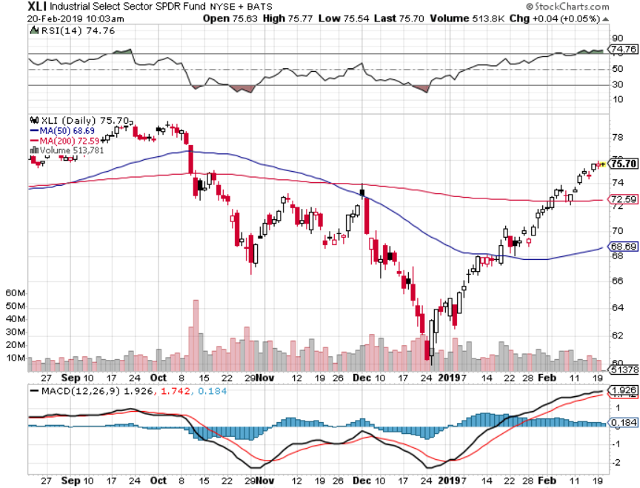
Industrials Sector SPDR (XLI)- (GE), (MMM), (UNP), (UTX), (BA), (HON)

Slide 33
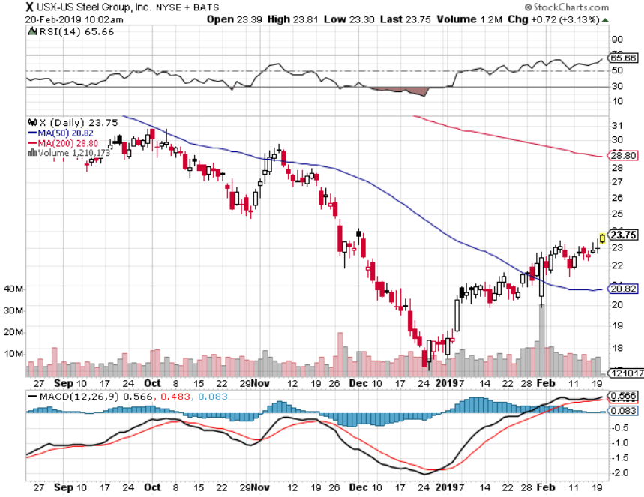
US Steel (X)-Tariffs Trouble Import duties cause users to abandon steel Unwound the entire Trump trade

Slide 34
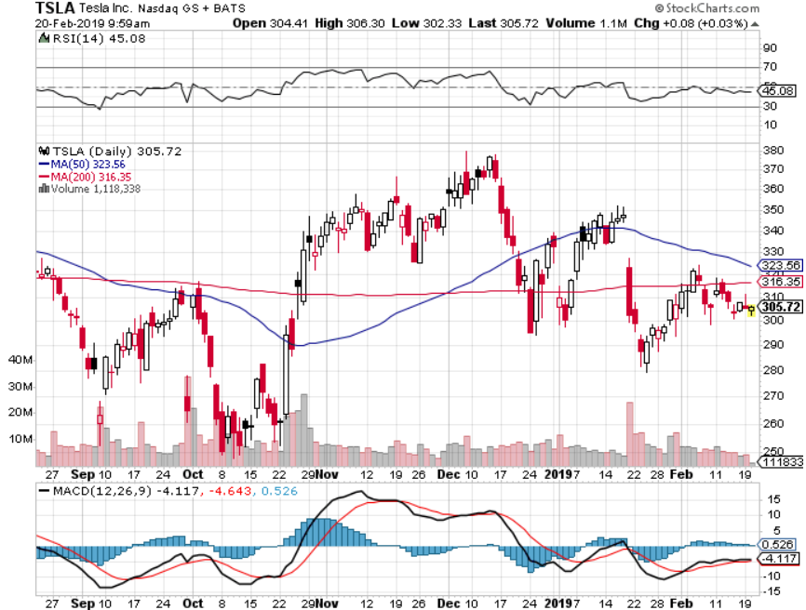
Tesla (TSLA)-Second Quarter of Earnings Cut 7% of Work Force, China airbag recall

Slide 35
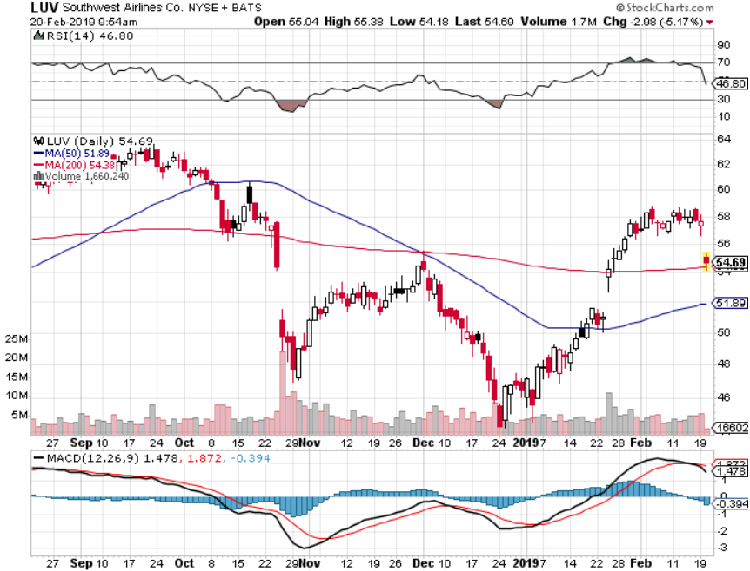
Southwest Airlines (LUV)-No oil help Warren Buffett’s Favorite Airline

Slide 36
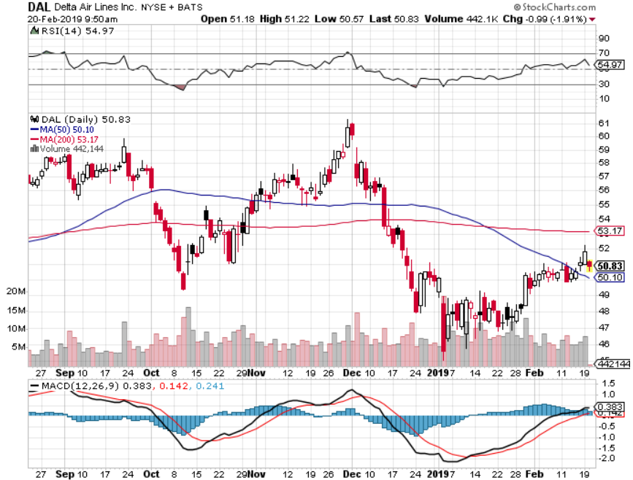
Delta Airlines (DAL)

Slide 37
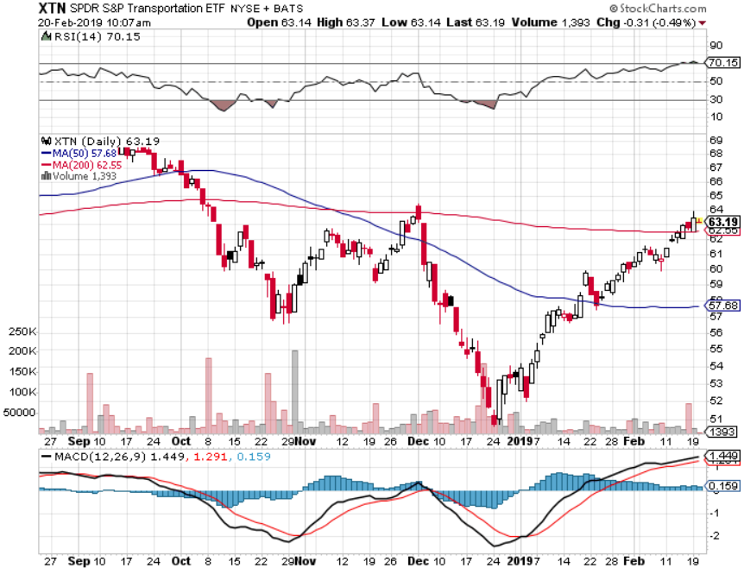
Transports Sector SPDR (XTN)- (ALGT), (ALK), (JBLU), (LUV), (CHRW), (DAL)

Slide 38
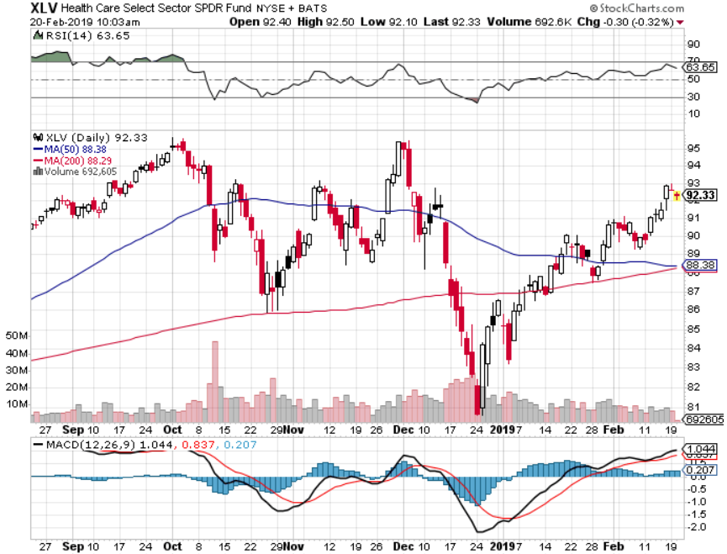
Health Care Sector (XLV), (RXL)-New Highs (JNJ), (PFE), (MRK), (GILD), (ACT), (AMGN)

Slide 39
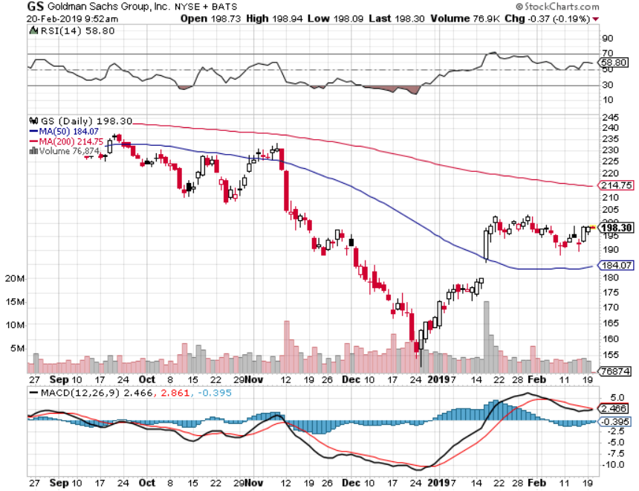
Goldman Sachs (GS)-The Next Buggy Whip maker

Slide 40
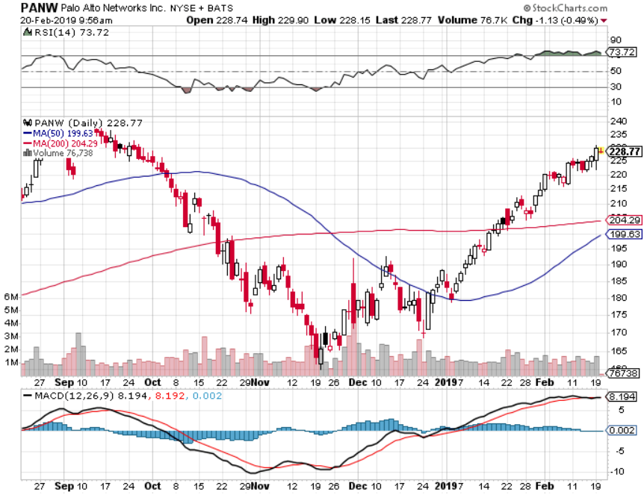
Palo Alto Networks (PANW)- Hacking never goes out of fashion

Slide 41
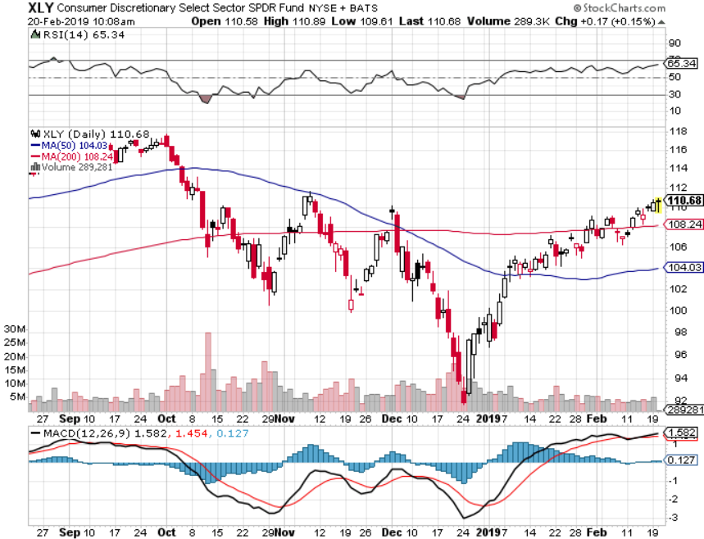
Consumer Discretionary SPDR (XLY) (DIS), (AMZN), (HD), (CMCSA), (MCD), (SBUX)

Slide 42
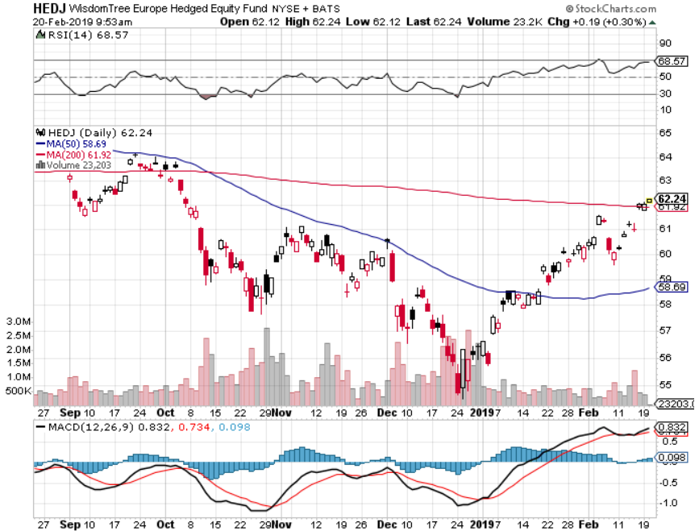
Europe Hedged Equity (HEDJ)-Quadruple top Top

Slide 43
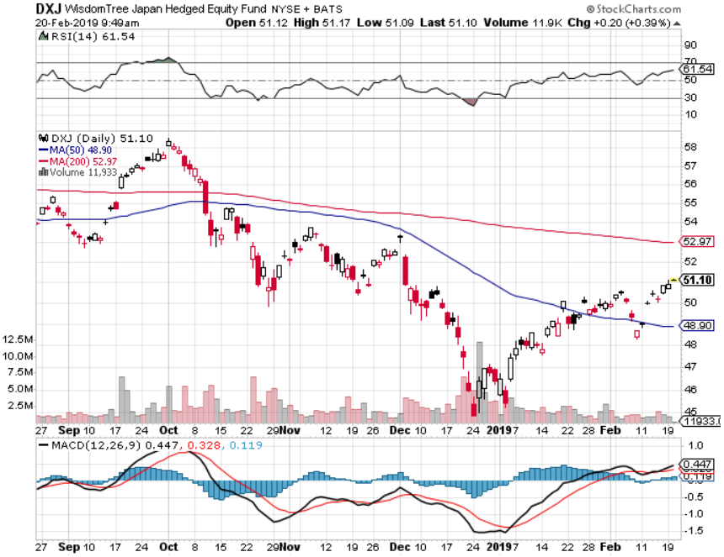
Japan (DXJ)-

Slide 44
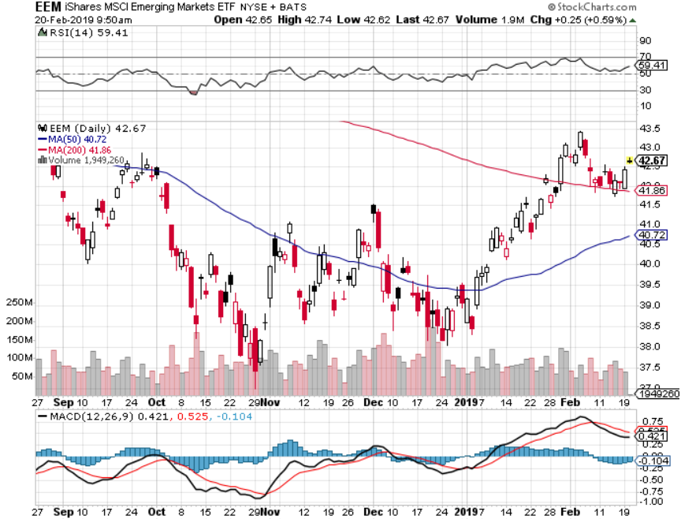
Emerging Markets (EEM)- Time to Buy on Weak Dollar

Slide 45
Bonds – Time Out for the Bear Market
*Worsening economic data has put a floor under bonds *How long will the Fed’s dovish posture will last? *Still looking for 3.50% ten year US Treasury in a year, but what if the peak in this cycle is already in at 3.25%? *Total government issuance plus the Fed’s quantitative tightening totals $1.8 trillion in 2018, and there’s no way the bond market can handle this *Exploding deficits will weigh on bonds for the next decade, sell every rally across the space Bottom Line: Sell every four point rally in the (TLT), but this time, I settled for three

Slide 46
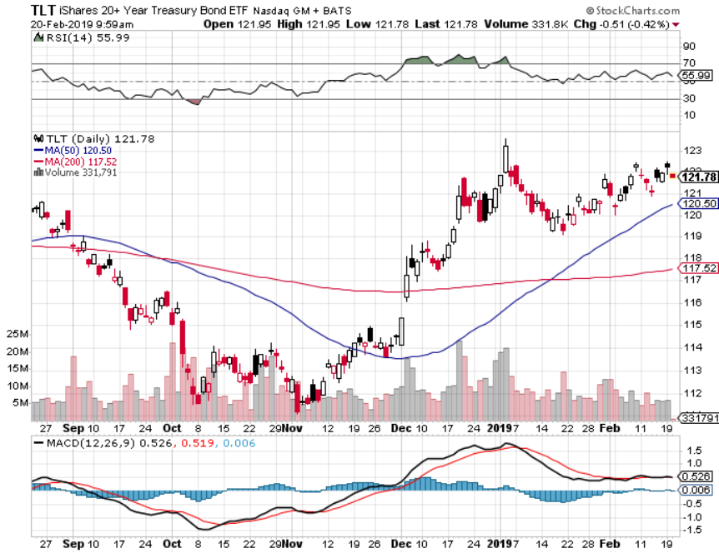
Treasury ETF (TLT) – Bottom of Range Expiration of long 2/$124-$126 call spread at maximum profit point took profits on long 2/$125-$128 call spread again took profits on long 1/$124-$127 call spread took profits on long 2/$125-$128 call spread

Slide 47
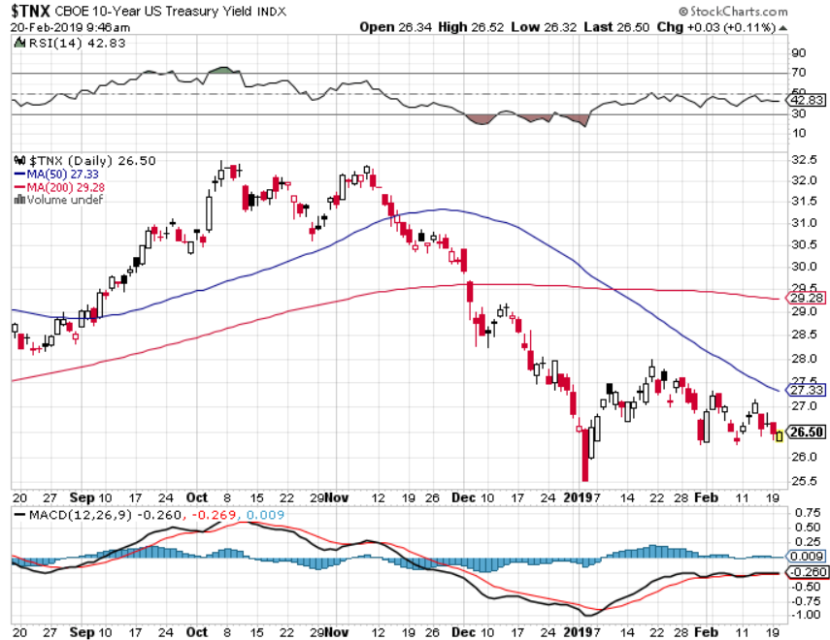
Ten Year Treasury Yield ($TNX) 2.68% Breakdown, Now major Support

Slide 48
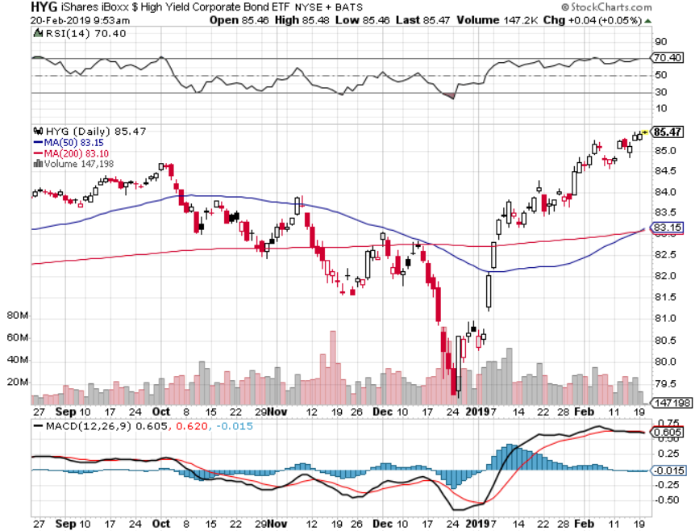
Junk Bonds (HYG) 5.60% Yield

Slide 49
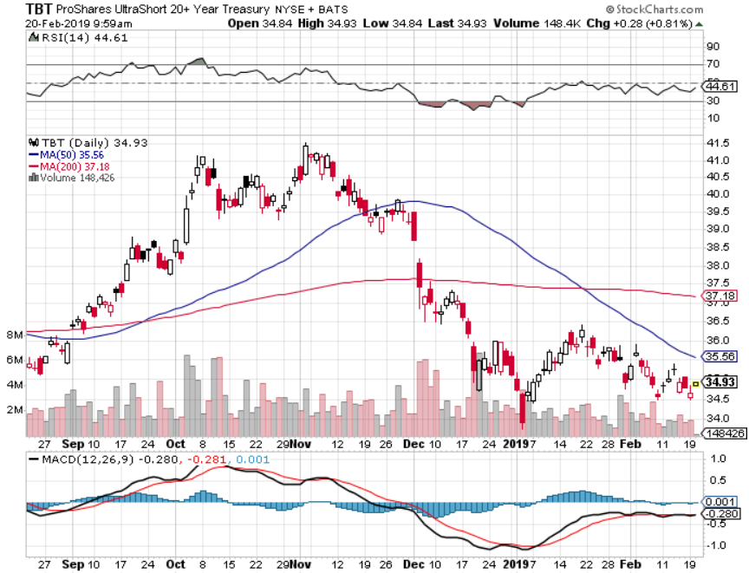
2X Short Treasuries (TBT)-Buy Territory

Slide 50
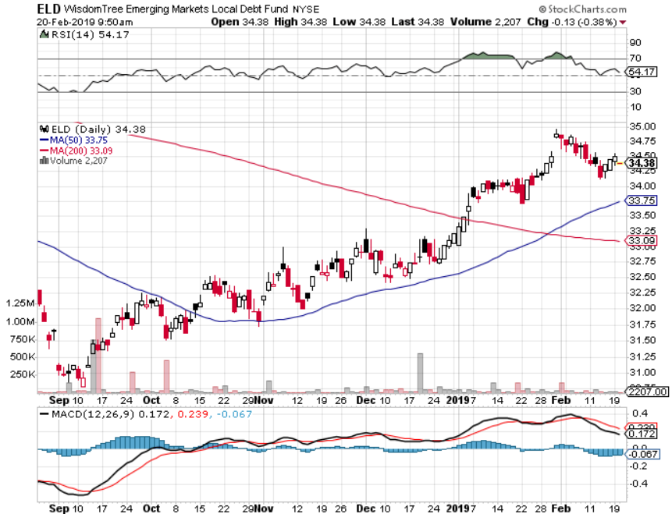
Emerging Market Debt (ELD) 6.02% Yield-

Slide 51
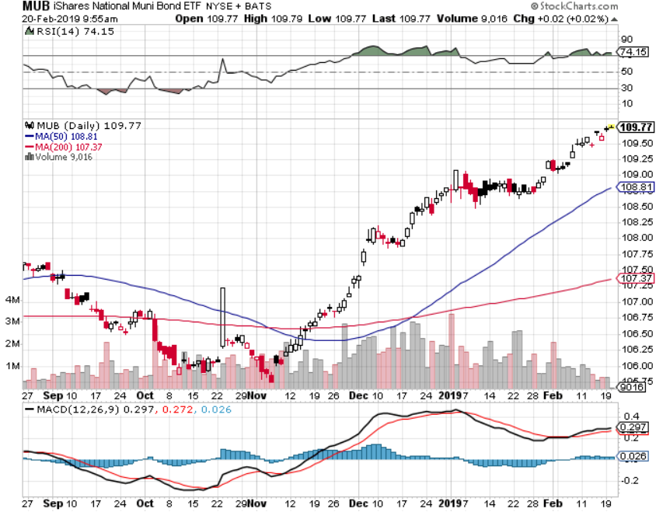
Municipal Bonds (MUB)-2.52% Mix of AAA, AA, and A rated bonds

Slide 52
Foreign Currencies – Sagging Dollar
*Continued Fed dovish drags heavily on the dollar *Is a big positive for weak dollar plays like Gold (GLD) and Emerging markets (EEM) *British pound stages another huge rally on Brexit fail *Massive Chinese economic stimulus drives Yuan higher *Bitcoin hits new low at $3,400 *Bottom Line: sell dollars, buy the Euro (FXE)

Slide 53
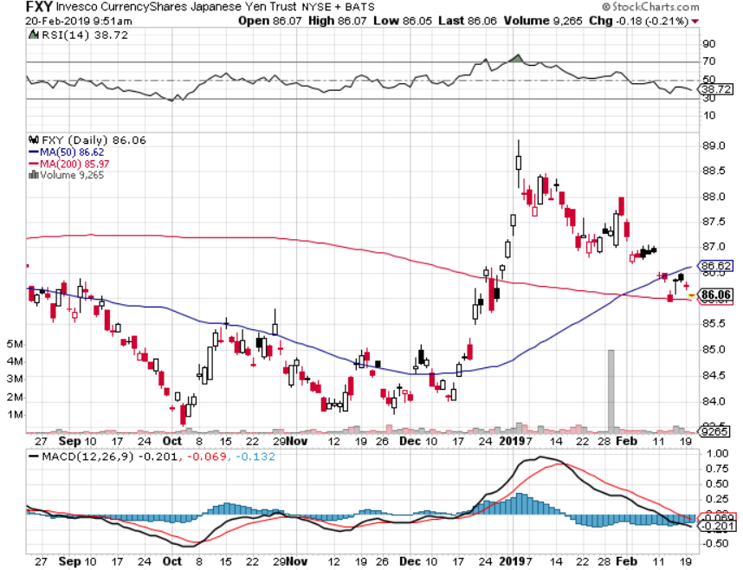
Japanese Yen (FXY), (YCS)

Slide 54
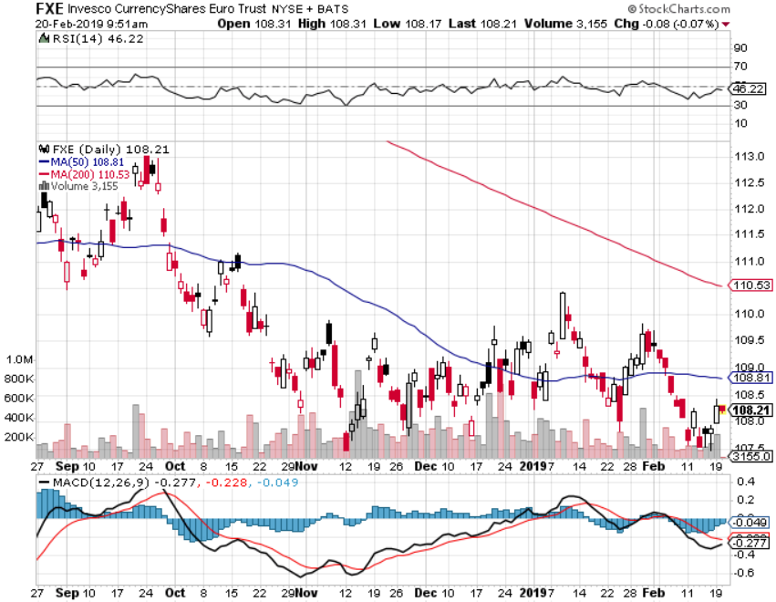
Euro ($XEU), (FXE), (EUO)- Trying to Break Down long 2/$105-$108 call spread

Slide 55
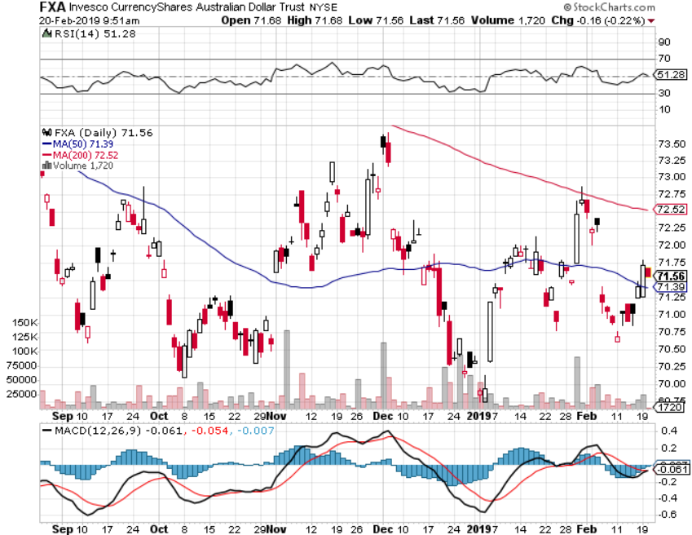
Australian Dollar (FXA)-

Slide 56
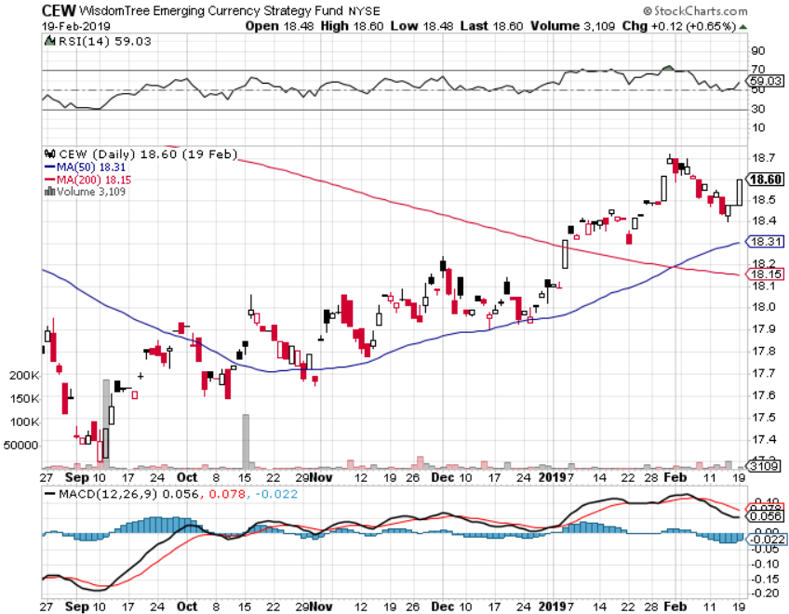
Emerging Market Currencies (CEW)

Slide 57
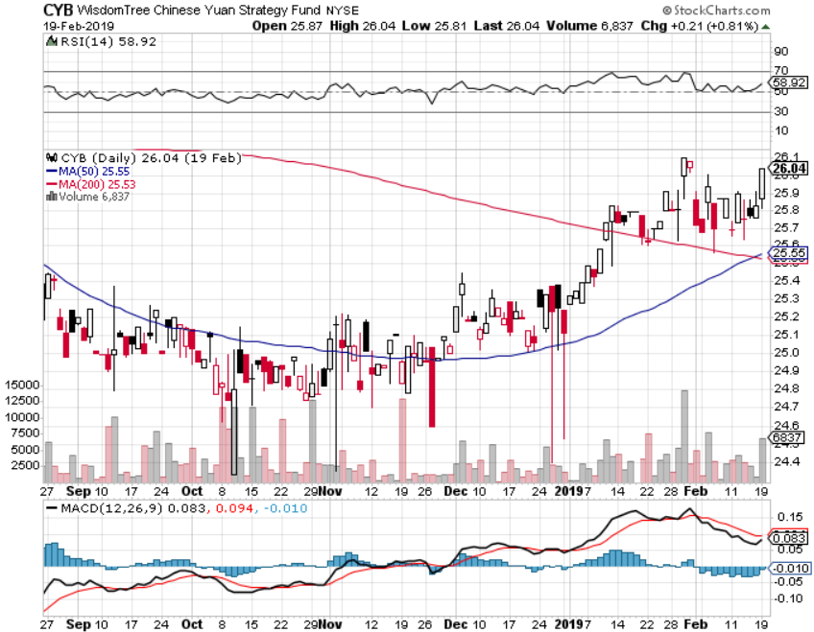
Chinese Yuan- (CYB)-

Slide 58
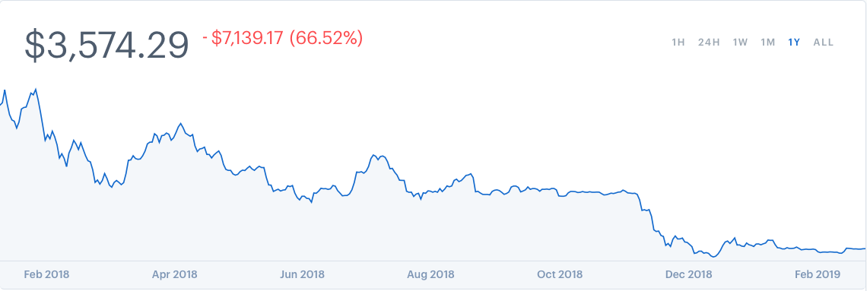
Bitcoin- New Low

Slide 59
Energy – Saudi-Russian Deal
*Reforming of OPEC around Saudi-Russian axis enables better price control *Weak dollar is providing a bid for the entire commodity complex, including oil *Chinese economic stimulus, the largest marginal new buyer of crude is another positive *Copper upside breakout in progress in coming China trade deal *Bottom Line: Buy the dips

Slide 60
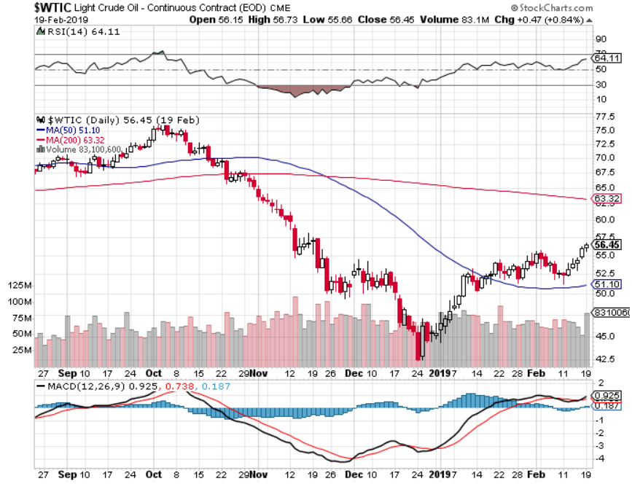
Oil-Bouncing

Slide 61
United States Oil Fund (USO)

Slide 62
Energy Select Sector SPDR (XLE)-No Performance! (XOM), (CVX), (SLB), (KMI), (EOG), (COP)

Slide 63
Halliburton (HAL)-

Slide 64
Natural Gas (UNG)- Major Hedge Fund Blow Up

Slide 65
Copper (COPX)- Upside breakout Trade War Deal Coming

Slide 66
Precious Metals – One Year Highs
*New one year highs as equity traders diversify into gold as a weak dollar play *Central banks who have no faith in the US dollar because of massive new government borrowing are biggest buyers of gold *Dovish Fed is a big help. Gold will keep rising as long as Fed pauses *Hedge fund longs in gold hit new high *The real move for gold won’t begin until we get true inflation, which won’t appear until later this year *Buy Dips

Slide 67
Gold (GLD)- The flight to safety bid is coming

Slide 68
Market Vectors Gold Miners ETF- (GDX) – Yikes!

Slide 69
Barrick Gold (ABX)

Slide 70
Newmont Mining- (NEM)-

Slide 71
Palladium - (PALL)-

Slide 72
Real Estate – Horrible Numbers
*Massive stock rally brings some confidence back into the residential real estate market *Mortgage applications plunge 3.7% as government shutdown throttles real estate closings *Google to spend $13 billion on real estate in 2019 to accommodate server farm expansion *November S&P 500 Case-Shiller drops to 4.7%, annual gain, the lowest gain in seven years *Bottom Line: Stand aside for a trade but buy for long term investment

Slide 73
December Corelogic S&P Case Shiller Home Price Index Las Vegas, Seattle, and San Francisco still showing biggest gains
Tradingeconomics.com

Slide 74
Simon Property Group (SPG)-

Slide 75
US Home Construction Index (ITB) (DHI), (LEN), (PHM), (TOL), (NVR)

Slide 76
Trade Sheet- So What Do We Do About All This?
*Stocks-don’t chase *Bonds-sell any and all rallies *Commodities-buy dips *Currencies-buy dips *Precious Metals – buy dips *Volatility-buy dips to $12 *Real estate-stand aside

Slide 77
Next Strategy Webinar 12:00 EST Wednesday, March 6, 2019 from San Francisco, CA www.madhedgefundtrader.com email me at support@madhedgefundtrader.com
Good Luck and Good Trading!
Notes:
*

