Slide 1
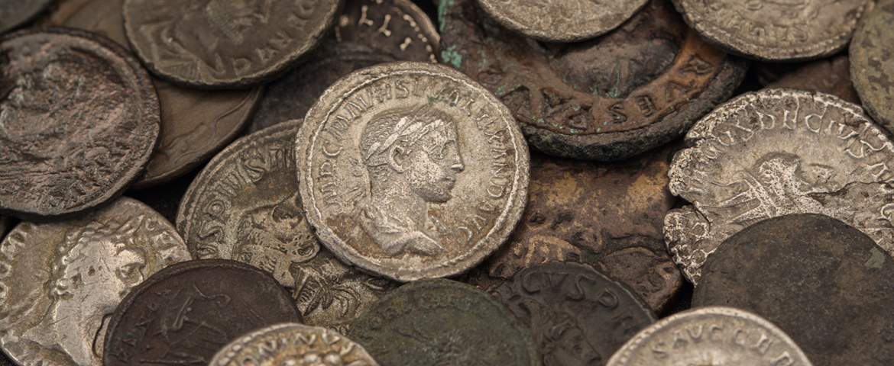
The Mad Hedge Fund Trader “The Gamblers Have Entered the Temple”
With John Thomas from Incline Village, NV, February 3, 2021 www.madhedgefundtrader.com
Notes:
*

Slide 2
Trade Alert Performance New All Time Highs!
*January 10.21% MTD *July +7.93% Final *February +9.66% Final *August -2.08% Final *March -5.50% Final *September 7.95% Final *April +4.55% Final *October +1.51% Final *May +14.19% Final *November +20.41% Final *June +10.38% Final *December +10.20% Final *2020 FINAL +66.64% compared to +7.2% for the Dow Average *2021 Year to Date +19.87% compared to +0.5% for the Dow Average *+442.82% since inception, a new all time high *Average annualized return of 38.89% for 11 years, new all time high

Slide 3
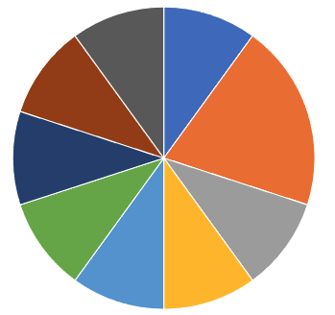
Portfolio Review 100% long invested for next leg up
Current Capital at Risk
Risk On
World is Getting Better
(TLT) 2/$158-$161 put spread | 10.00%
(TSLA) 2/$650-$700 call spread | 20.00%
(JPM) 2/$55-$60 call spread | 10.00%
(MS) 2/$55-$60 call spread | 10.00%
(BA) 2/$150-$160 call spread | 10.00%
(FCX) 2/$21-$23 calls spread | 10.00%
(BLK) 2/$640-$660 call spread | 10.00%
(GS) 2/$240-$260 call spread | 10.00%
(AMD) 2/$75-$80 call spread | 10.00%
Risk Off
World is Getting Worse
Total Net Position | 100.00%
Expiration P&L +24.63 YTD

Slide 4
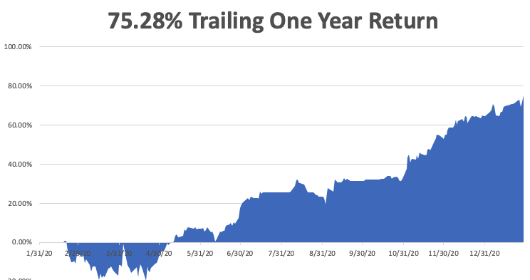

Slide 5
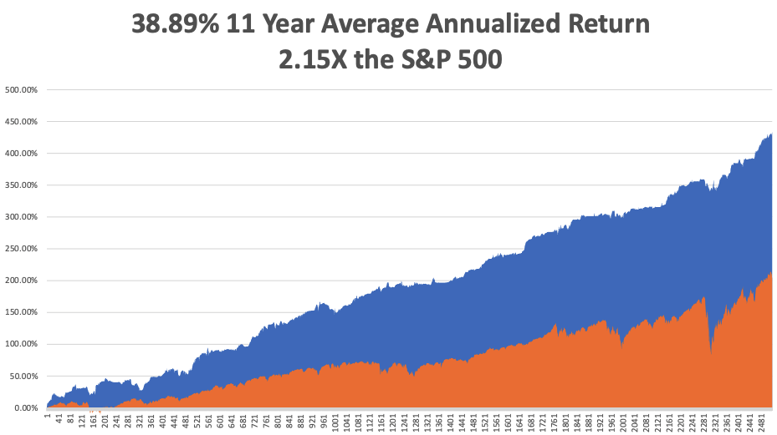
GTD 11 Year Daily Audited Performance

Slide 6
The Method to My Madness The Roaring Twenties are Here
*GameStock fiasco created a great entry point for the market, taking (VIX) up to $38 and setting up very low risk trades *Buy before the $20 trillion hits the market: $10 trillion in stimulus and $10 trillion in new QE at zero rates *It’s now all about a global economic recovery and “RISK ON”, but we are now waiting for the next dip which Covid-19 will give us *Almost all asset classes have not moved for two weeks, it’s a world of flat lines, allowing us to collect massively on time decay *A bond breakdown takes a break, is a huge help for financials *Perennial dollar weakness will give us opportunities to buy foreign currencies, commodities, and emerging markets

Slide 7
Corona Update – Mutations Everywhere
*Distribution is improving slowly, 30 million have been given, about half of what’s in inventory *80,000 American to die over the next three weeks *Every pandemic parameter started shrinking two weeks ago *At least 50 variants now in circulation, the race is to inoculate before the more fatal ones spread *We may be moving towards an annual booster shot to catch all the new variants, like a flue shot *Each city may produce its own variant *Pfizer, Moderna, AstraZeneca, Johnson & Johnson vaccines puts end to the pandemic in sight and there are vaccines from other companies to come *US cases top 26 million, deaths at 450,000 and are still rising at 4,000 a day, and could reach 800,000 at the peak

Slide 8
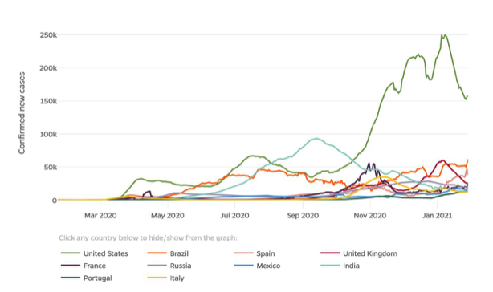

Slide 9
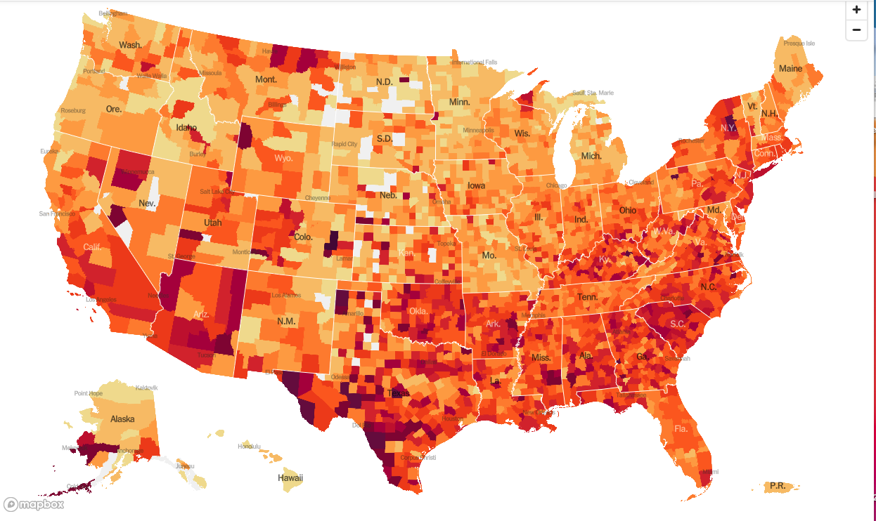

Slide 10
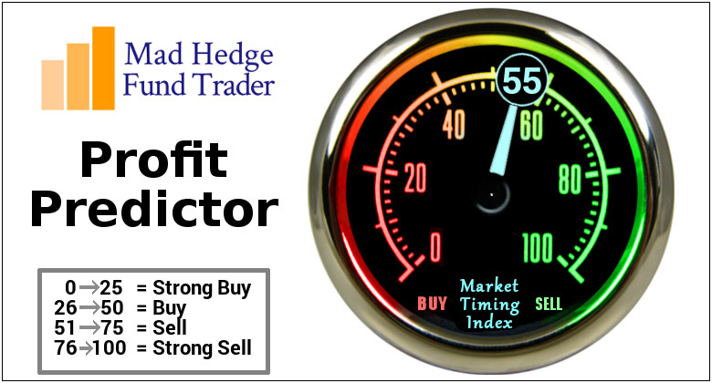
The Mad Hedge Profit Predictor Market Timing Index-Bottom of Range-at a “BUY” An artificial intelligence driven algorithm that analyzes 30 different economic, technical, and momentum driven indicators

Slide 11
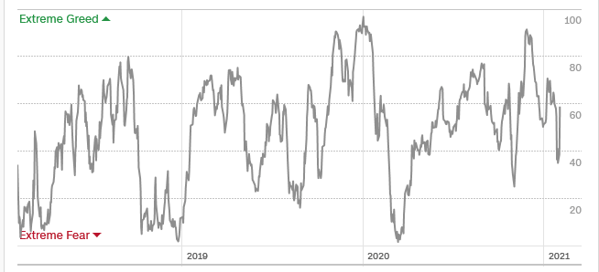
The Mad Hedge Profit Predictor Almost Neutral
SELL
BUY

Slide 12
The Global Economy – Awaiting Redemption
*Biden Economic Plan Boosts Growth Forecasts for 2021, from 6.4% to 6.6%, versus -3.5% for 2020
*No stimulus package means US economy doesn’t recover until 2025 *Fed Leaves interest rates unchanged, see pandemic as main driver of the economy. *US GDP Fell by 3.5% in 2020, wiping out all of 2019 and a good chunk of 2018. The last quarter of 2020 came in at -4.8% *Inflation is Creeping Up and may be the beginning of a decade long trend. It gained from 1.4% to 1.5% * Empire State Manufacturing Index Dives, from 6.0 to 3.5, approaching recessionary levels AGAIN.

Slide 13
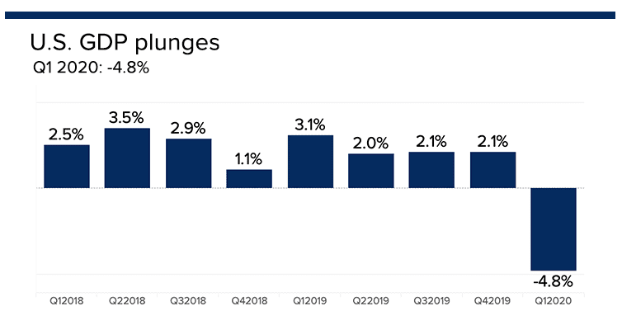

Slide 14
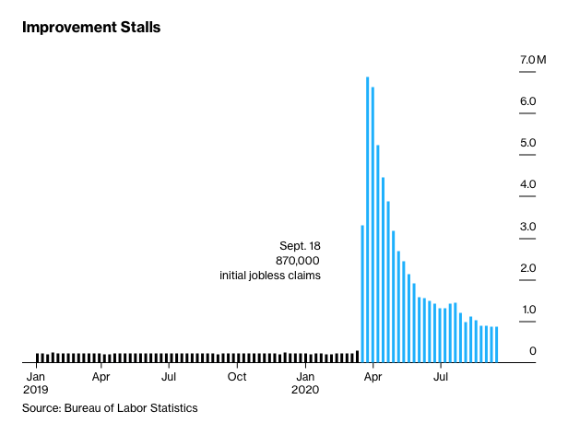
Weekly Jobless Claims – Flatlining at record highs 847,000

Slide 15
Stocks – Reality Check
*GameStock fiasco triggers much needed and long overdue correction, buy the dip *Vaccine distribution has improved to 27 million but is still far from turning the economy *US economy may be back to normal by summer, but stocks and the economy will be anything but normal. Dow 40,000 here we come! *Share buybacks making a big comeback, starting with Apple and the banks *Stick with the barbell strategy, we’ll keep rotating back and forth all year *Use every dip to BUY, it’s a 100% “RISK ON” market *In 2021 both tech and recovery stocks run, meaning everything goes up *We could be entering a wide $2,700 - $3,600 range until the election

Slide 16
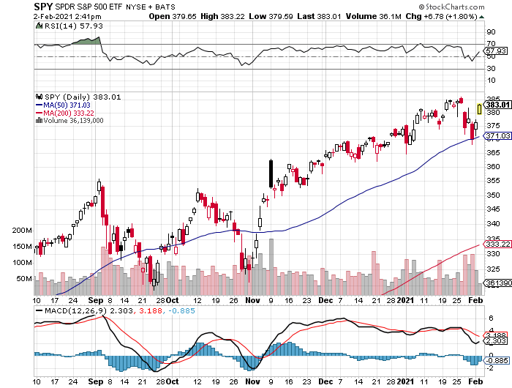
S&P 500 – The Bottom Held-Show How Much Cash is Out of the Market stopped out of long 7/$320-$330 bear put spread took profits on long 6/$235-$245 bull call spread
New Highs
The Bottom 350

Slide 17
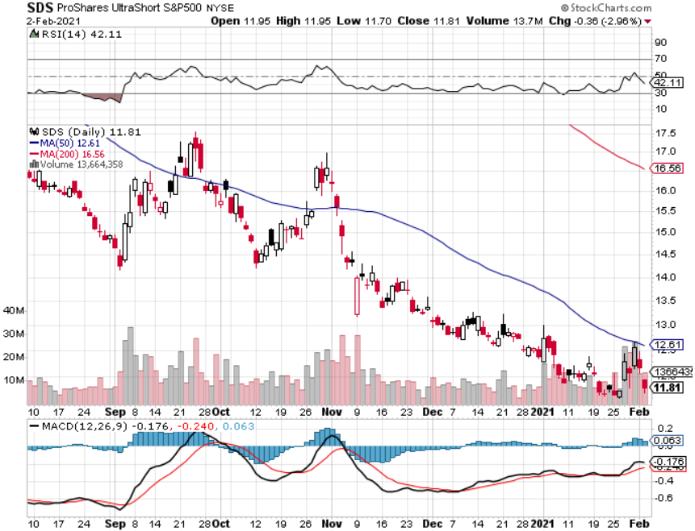
ProShares Ultra Short S&P 500 (SDS)- a Great Hedge for long stocks and bonds Long 2X position has a hedge against longs and bond shorts

Slide 18
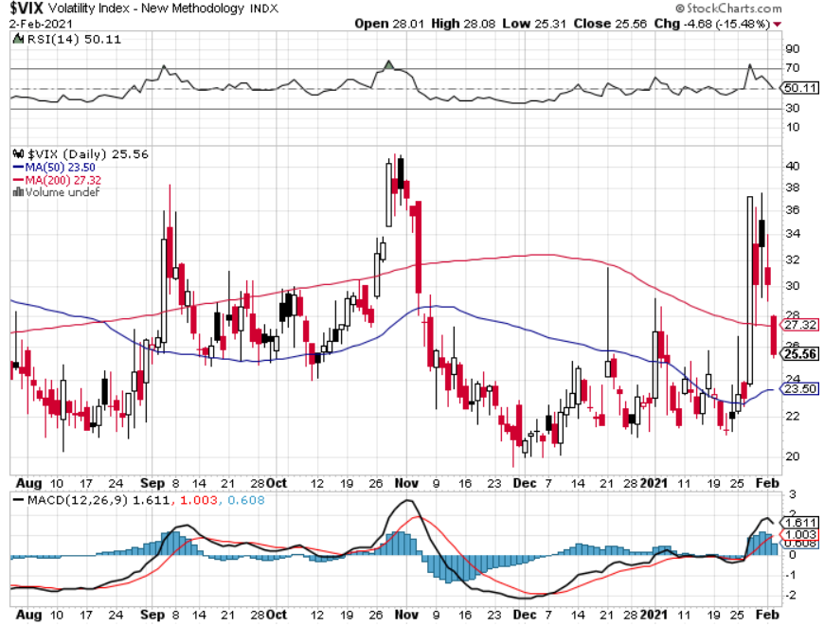
(VIX) – Mega Spike Use Ever Spike to Go 100% Long
GO Long Stocks
GO Long Stocks
GO Long Stocks

Slide 19
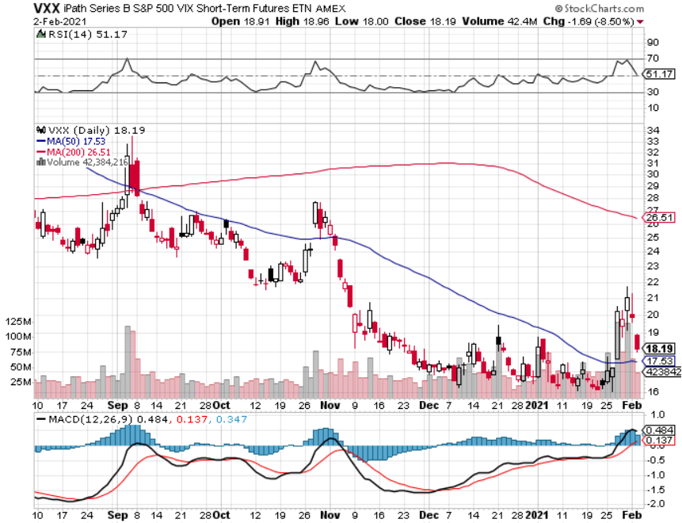
(VXX)-

Slide 20
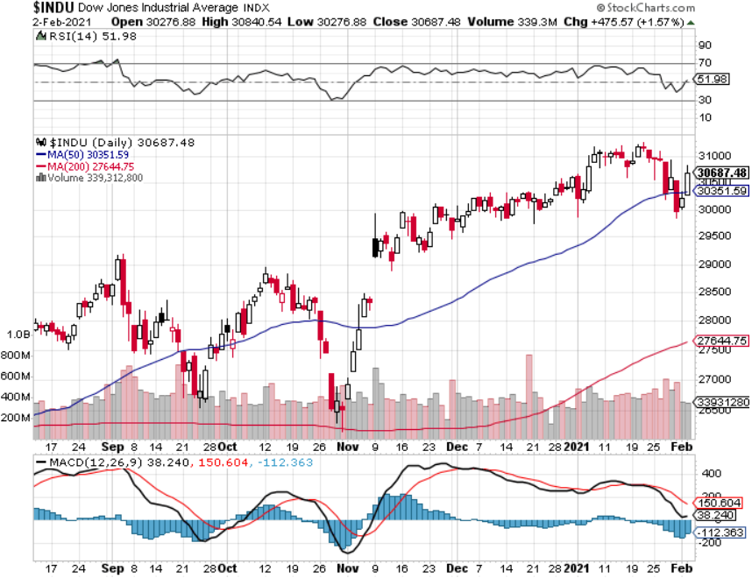
Dow Average ($INDU)-

Slide 21
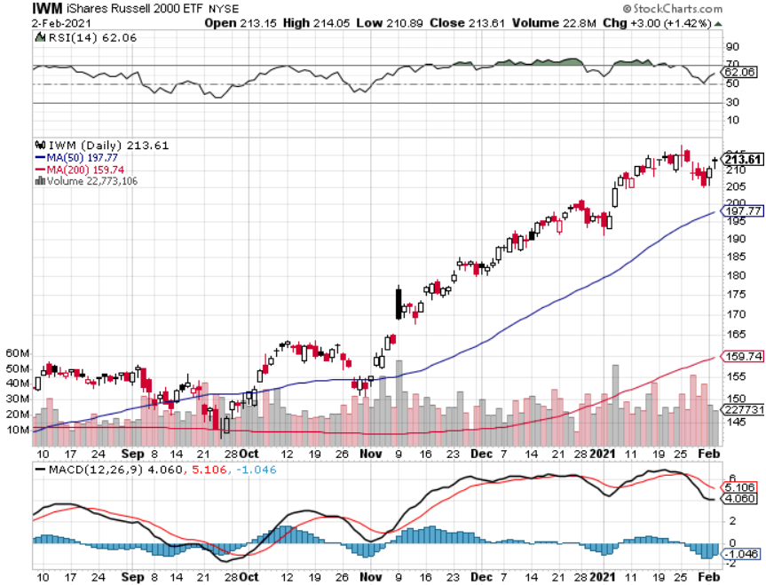
Russell 2000 (IWM)- took profits on Long 10/$137-$142 vertical bull call spread took profits on Long 10/$153-$156 vertical bear put spread

Slide 22
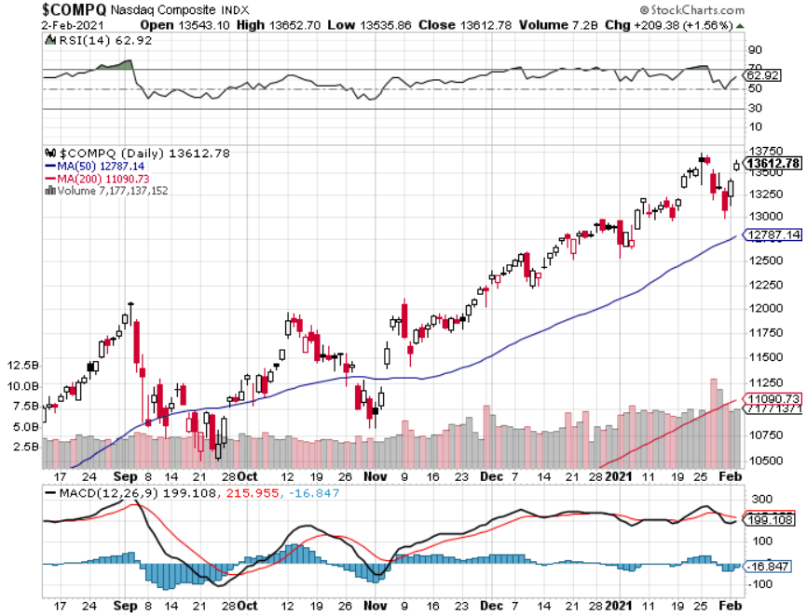
NASDAQ ($COMPQ) –

Slide 23
The Barbell Portfolio
*50% Big Tech - 2% of US Employment but 27% of Market Cap and 38% of Profits 50% Domestic Recovery, including: Railroads Couriers Banks Construction Credit Cards Event organizers Ticket sales Retailers

Slide 24
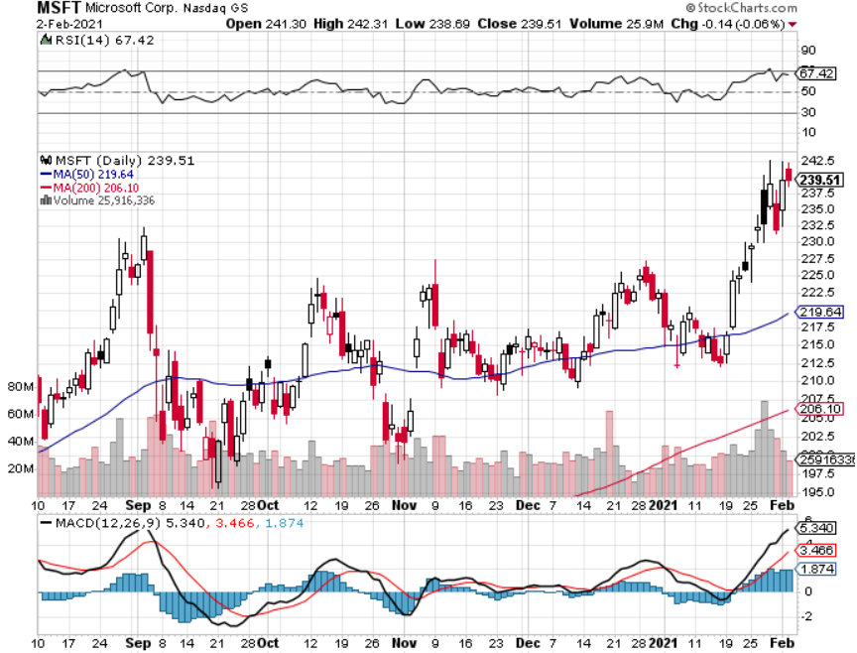
Microsoft (MSFT)- Earnings beat- Looking for Another Entry Point stop loss on long 12/$170-$180 call spread took profits on long 12/$135-$138 call spread

Slide 25
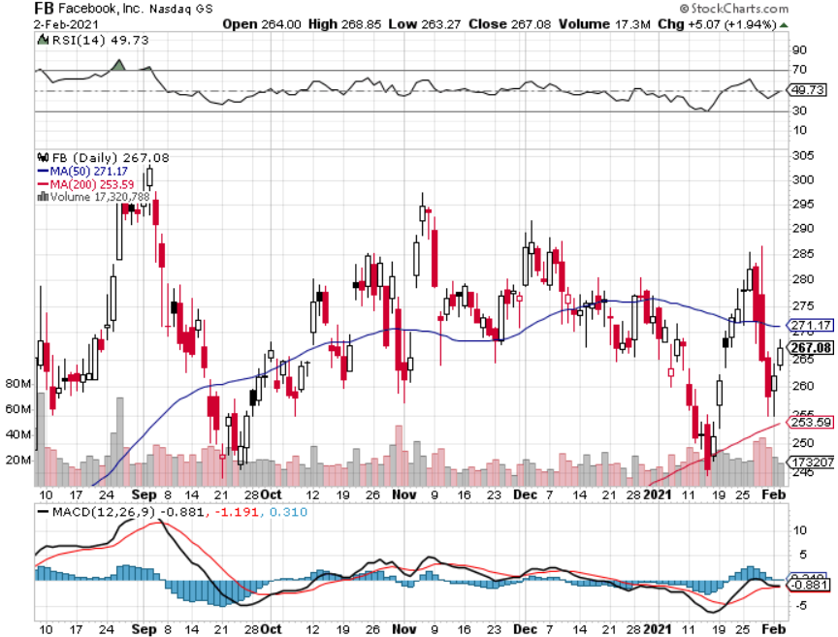
Facebook (FB)-New High took profits on Long 9/$290-$300 vertical bear put spread stopped out of Long 9/$190-$200 vertical bear put spread took profits on Long 9/$145-$155 vertical bull call spread took profits on Long 9/$150-$160 vertical bull call spread

Slide 26
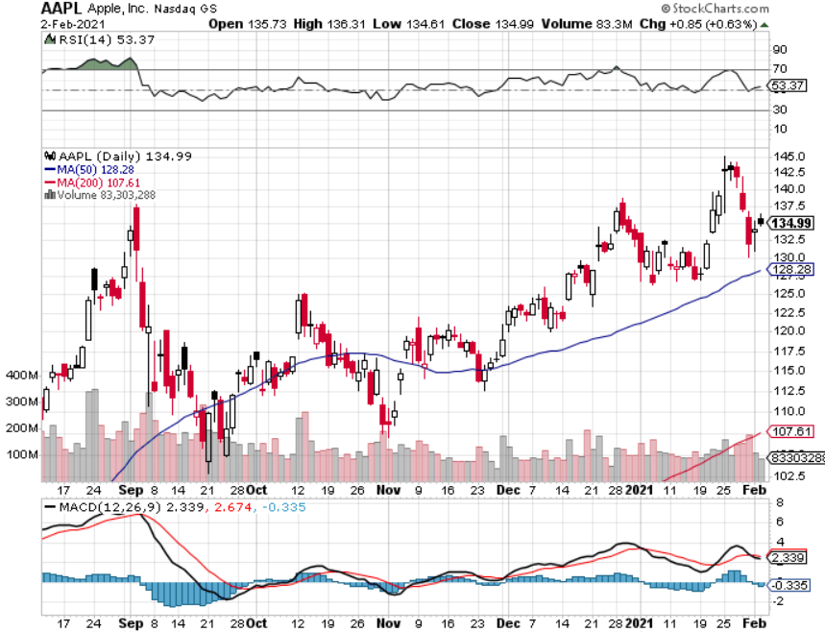
Apple (AAPL)- New 5G iPhone Surge took profits on long 7/$320-$330 call spread took profits on long 4/24/$250-$260 call spread took profits on long 5/$250-$260 call spread

Slide 27
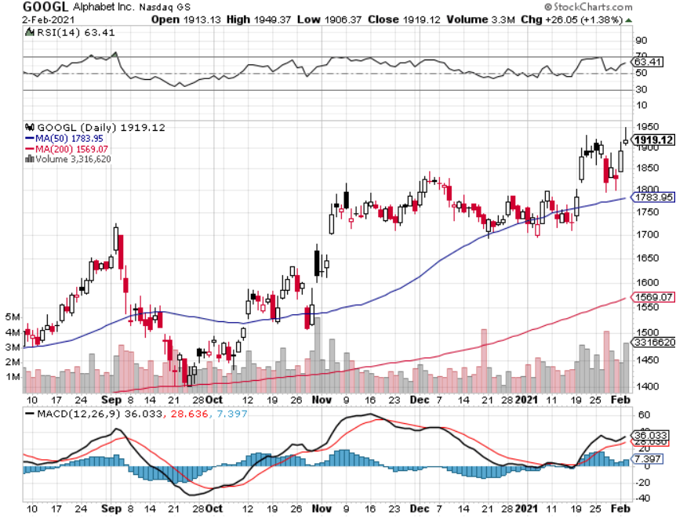
Alphabet (GOOGL) – took profits on long 12/$1,200-$1,230 bull call spread took profits on long 9/$1,030-$1,080 vertical bull call spread

Slide 28
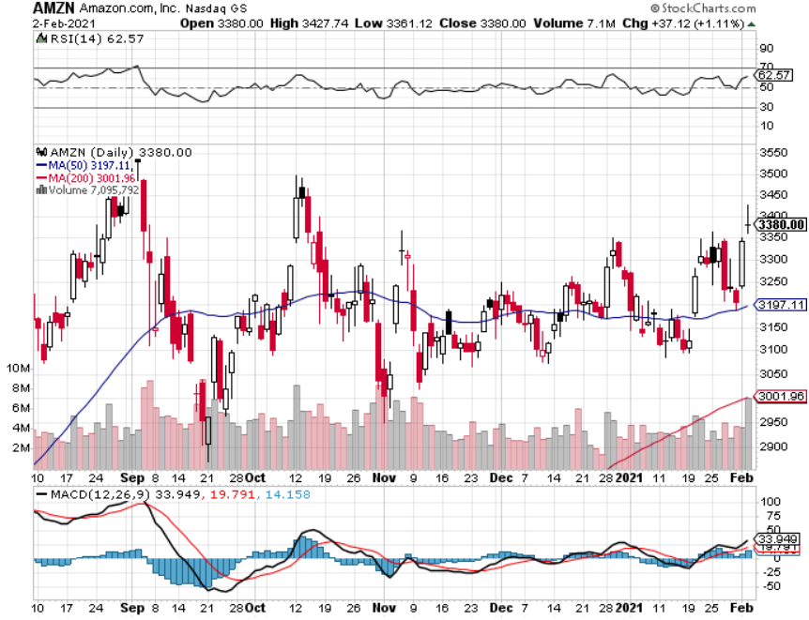
Amazon (AMZN) – Time correction took profits on long 9/$2,800-$2,900 bull call spread

Slide 29
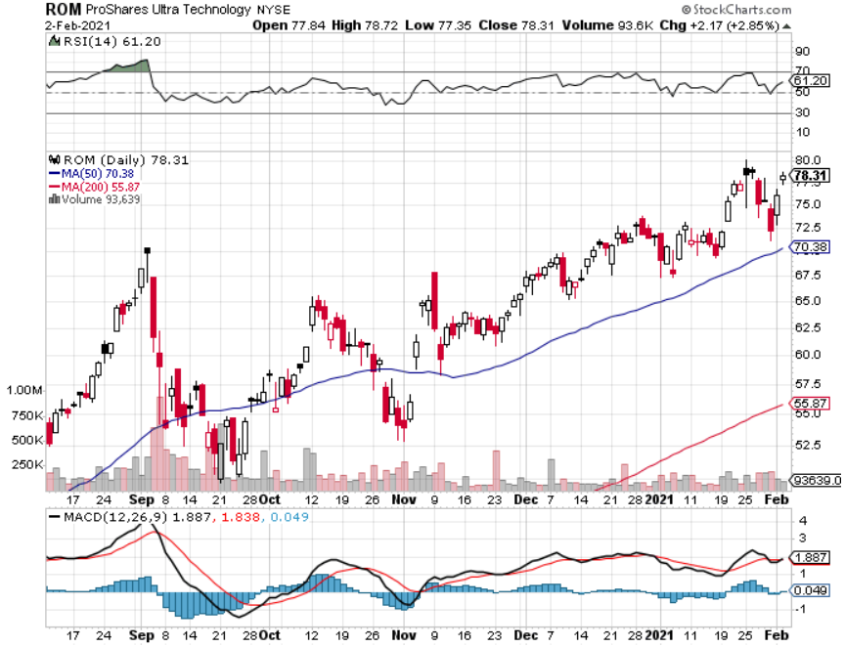
ProShares Ultra Technology (ROM) – Up 270% in 9 Months

Slide 30
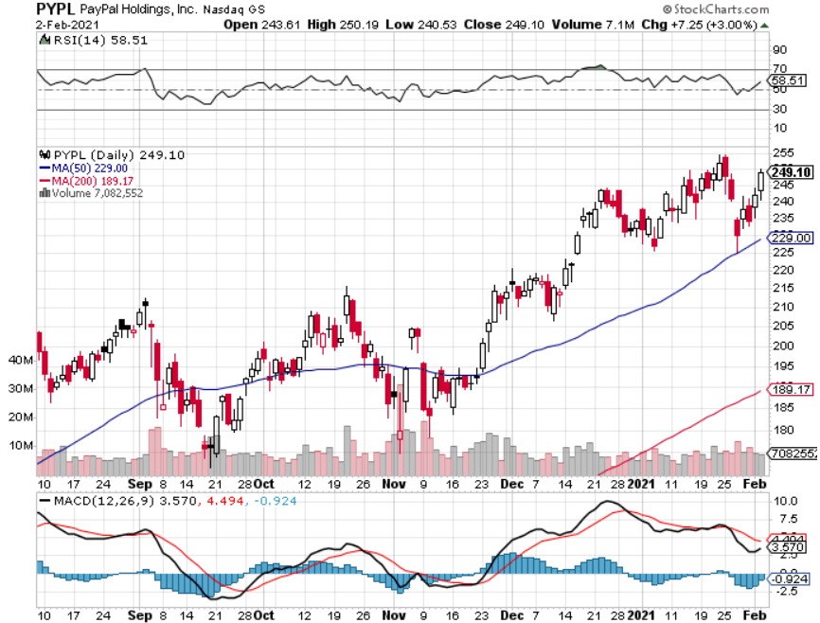
PayPal (PYPL)-Fintech Rules took profits on long 4/$90-$95 call spread

Slide 31
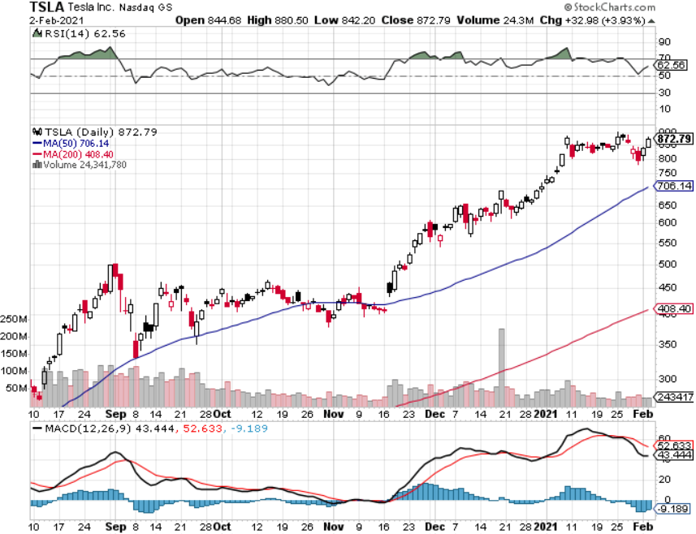
Tesla (TSLA)- Joining the S&P 500- 500,000 Target Achieved Piper Sandler Raises Target to $1,200, Q4 Registrations Soar by 63%, long 2/$650-$700 call spread Took profits on long 2/$600-$650 bull call spread, Took profits on long 2/$550-$600 bull call spread

Slide 32
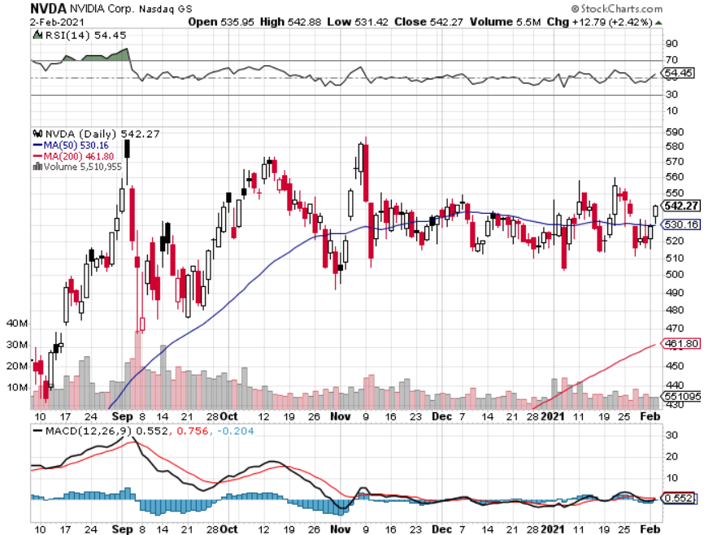
NVIDIA (NVDA) – The Biggest Chip Deal in History A Mad Hedge 10 bagger – Global Semiconductor Shortage Slows Auto Industry,

Slide 33
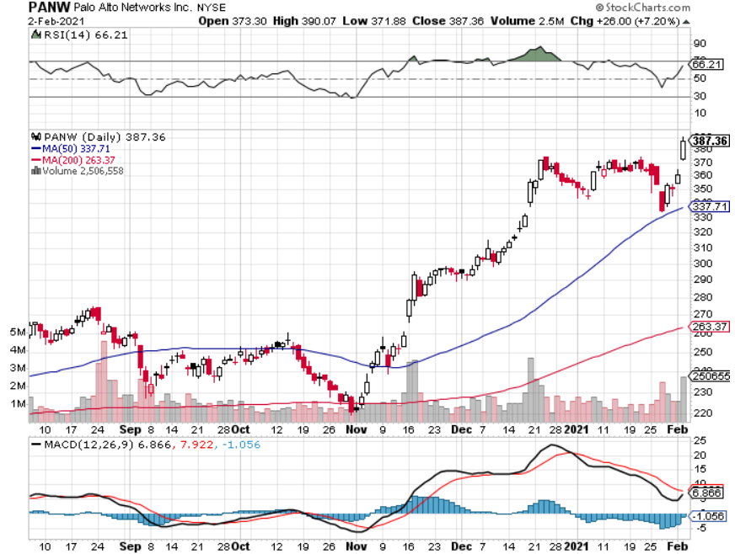
Palo Alto Networks (PANW)- New High Hacking never goes out of fashion

Slide 34
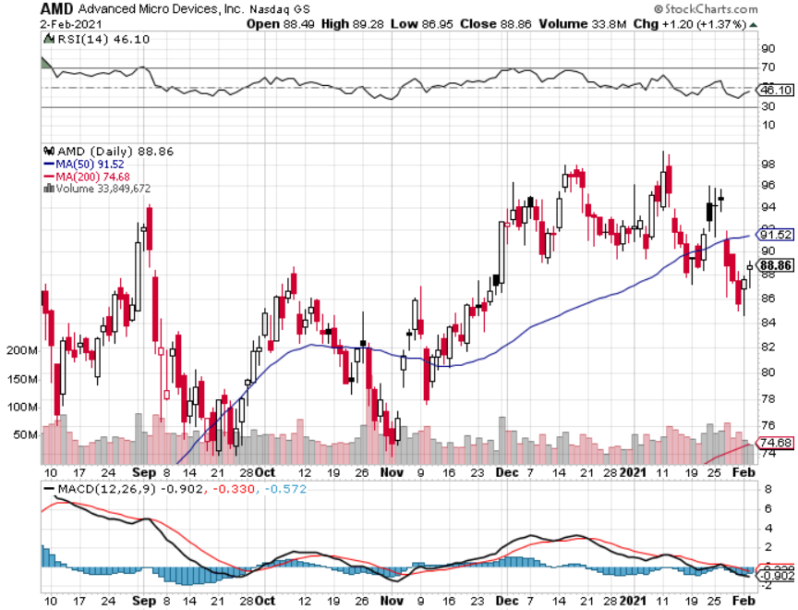
Advanced Micro Devices (AMD)- the next ten bagger - buys Xilinx – Programable logic devices long 2/$75-$80 call spread

Slide 35
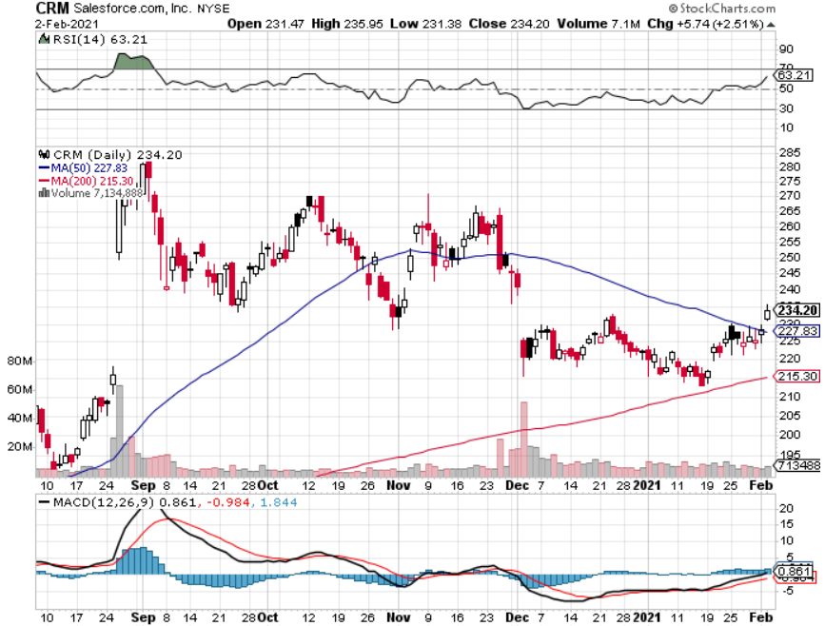
Salesforce (CRM)- Massive Online Migration took profits on long 9/$125-$130 vertical bull call spread took profits on long 8/$125-$130 vertical bull call spread took profits on long 2/$105-$115 call spread

Slide 36
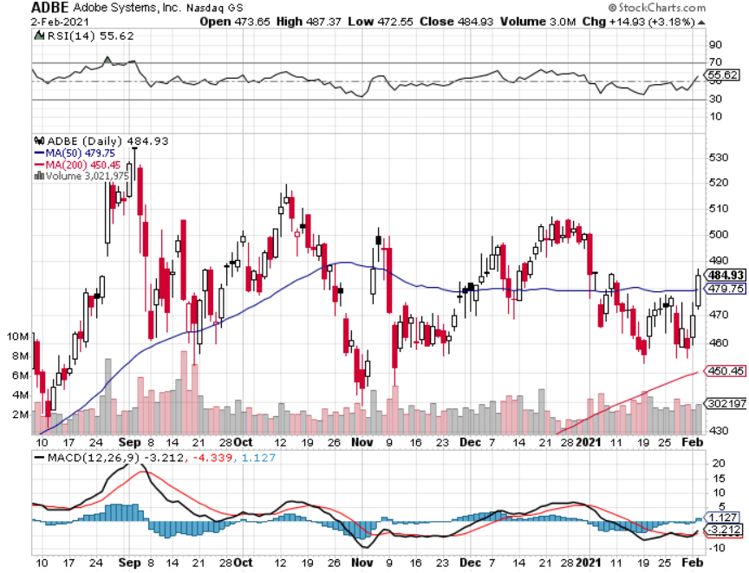
Adobe (ADBE)- Cloud play The Quality Non-China tech play

Slide 37
The Second Half of the Barbell
*Bets on a domestic recovery in 2021 *Upside potential in 2021 far greater than tech *Some of these have not moved for 5 or 10 years *Focuses on economically sensitive cyclical industries *Makes a great counterweight to high growth technology *We could spend all of next year rotating between the two groups

Slide 38
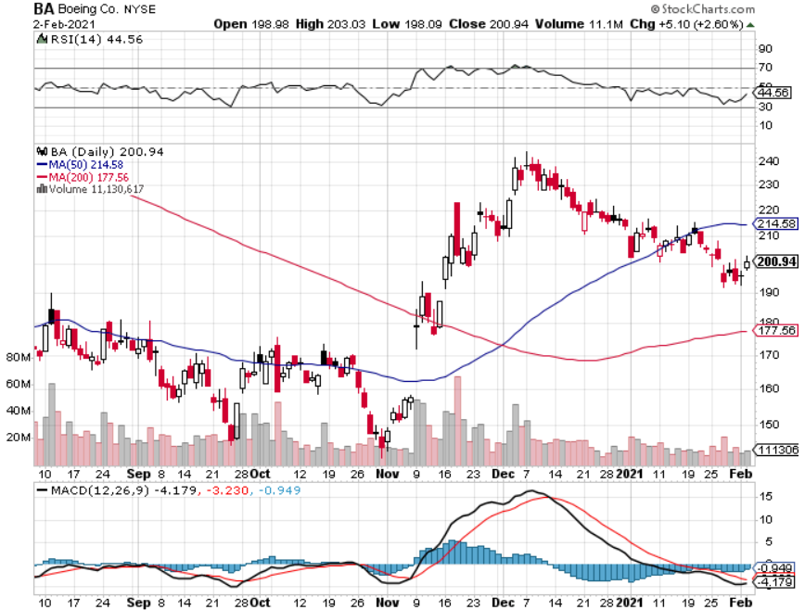
Boeing (BA) – former LEAP Candidate - The 737 MAX Flies Again! long 2/$150-$160 call spread took profits on long 4/$300-$310 call spread took profits on long 4/$315-$335 call spread

Slide 39
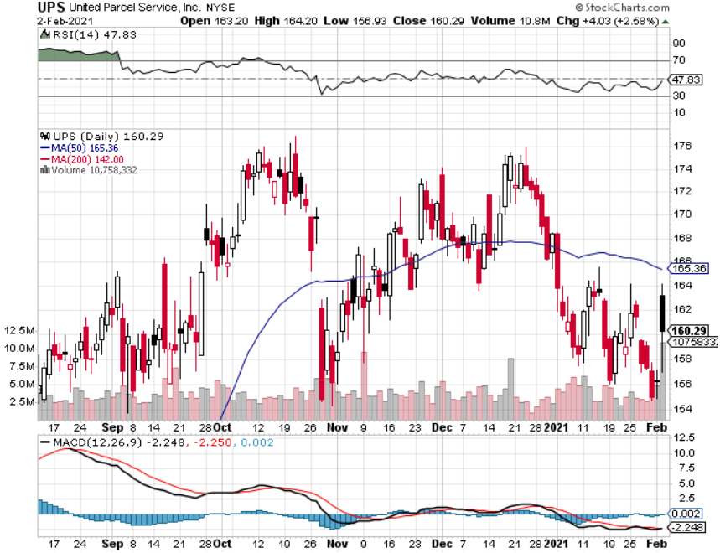
Package Delivery- United Parcel Service (UPS) massive increase in overnight deliveries, announces blowout earnings took profits on long 11/$130-$140 call spread

Slide 40
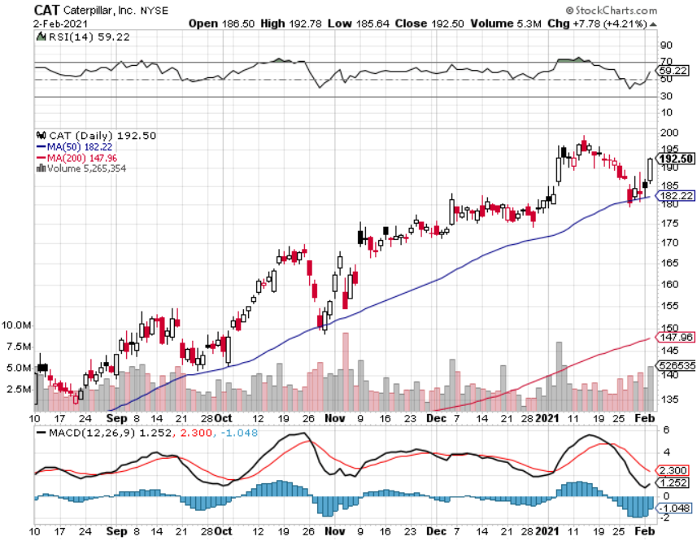
Caterpillar (CAT)- Ag + Infrastructure + Housing long 12/$145-$150 call spread took profits on long 11/$125-$135 call spread

Slide 41
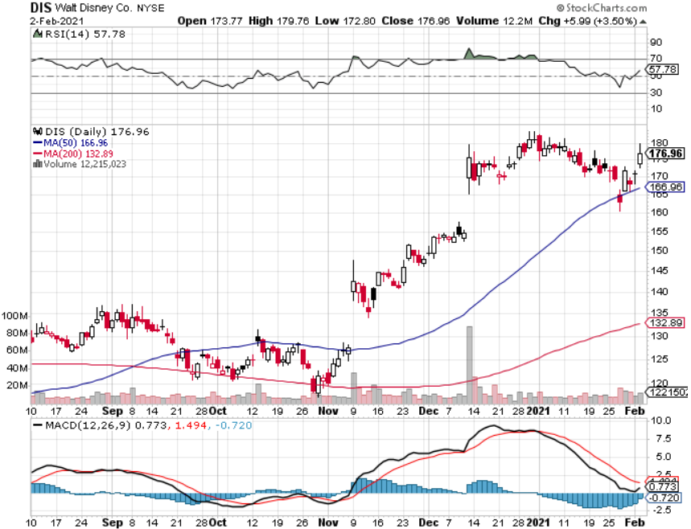
Walt Disney (DIS)- Big Recovery Move took profits on long 6/$85-$90 call spread

Slide 42
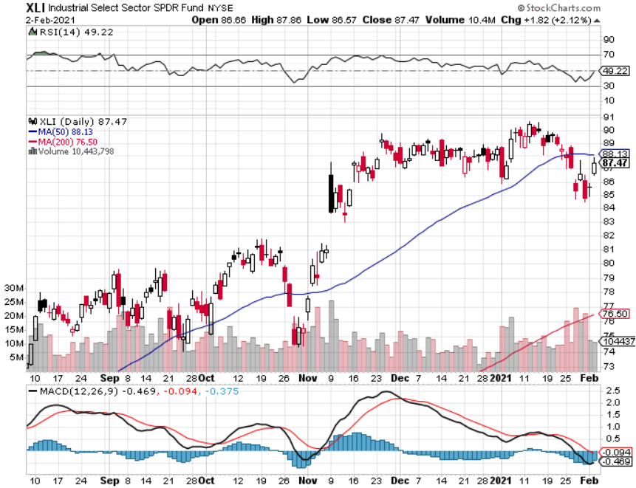
Industrials Sector SPDR (XLI)- (GE), (MMM), (UNP), (UTX), (BA), (HON)

Slide 43
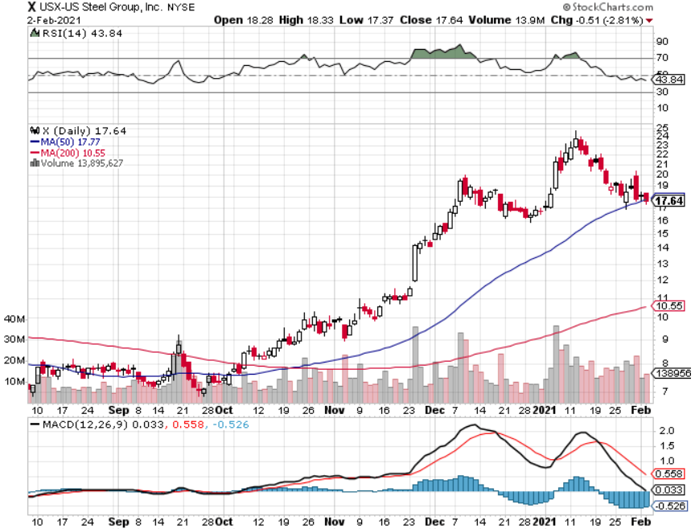
US Steel (X) – Commodity Boom

Slide 44
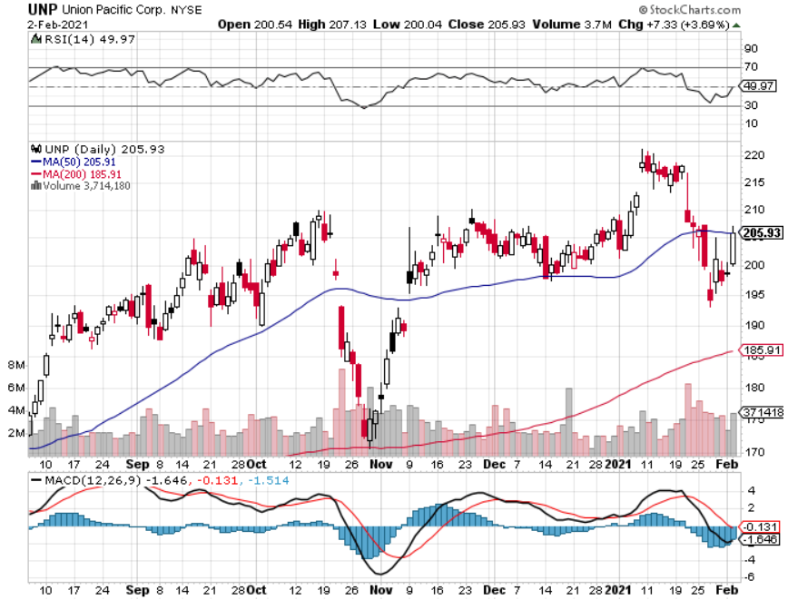
Union Pacific RR (UNP)- More stuff to ship near record earnings announced took profits on 11/$150-$160 call spread

Slide 45
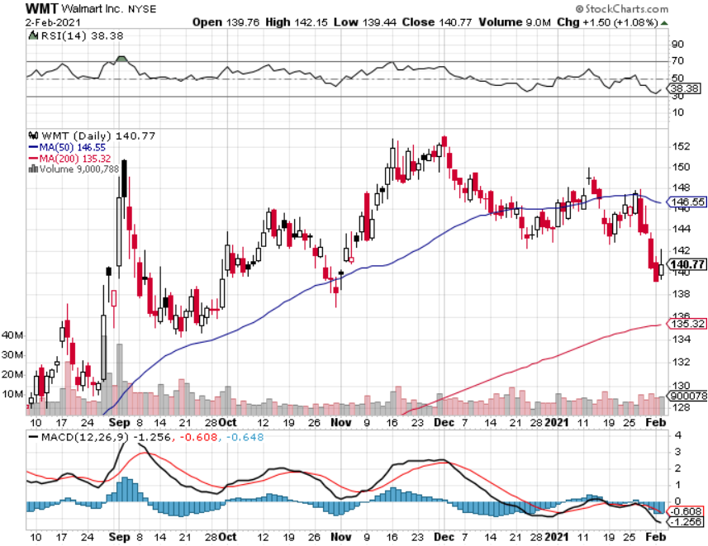
Wal-Mart (WMT)-New High took profit on Long 11/$125-$130 bear put spread took profit on Long 10/$119-$121 bear put spread took profits on Long 8/$114-$117 bear put spread

Slide 46
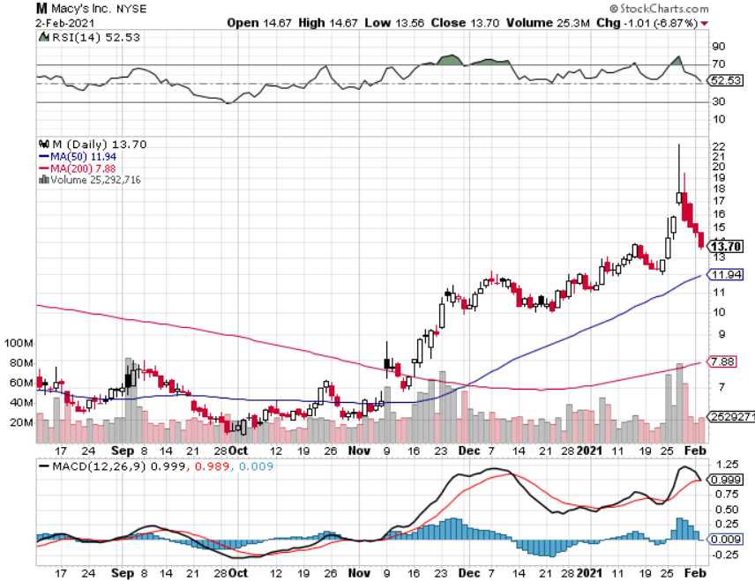
Macys’ (M) – Retail Return from the Grave took profits on Long 8/$23-$25 bear put spread

Slide 47
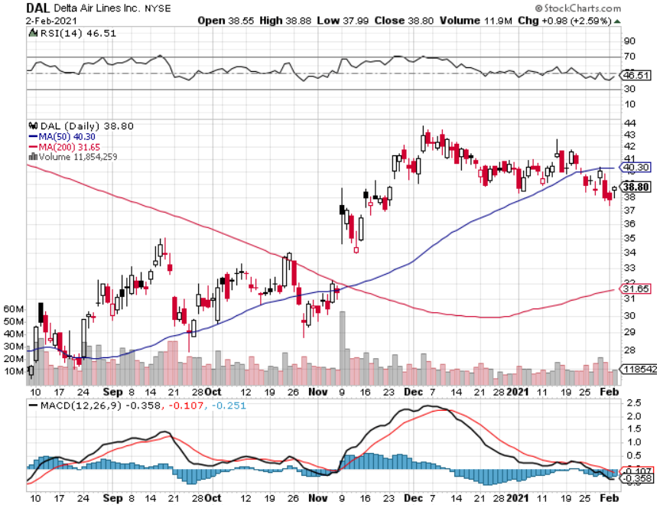
Delta Airlines (DAL) – Subsidy runs out

Slide 48
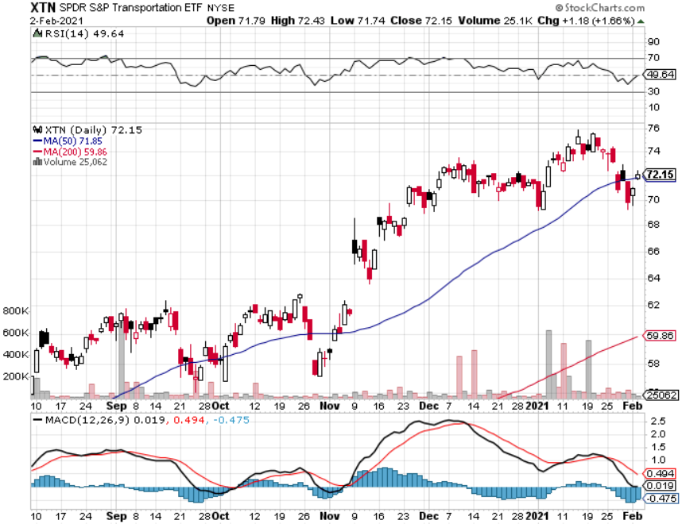
Transports Sector SPDR (XTN)- Worst Hit Sector (ALGT), (ALK), (JBLU), (LUV), (CHRW), (DAL)

Slide 49
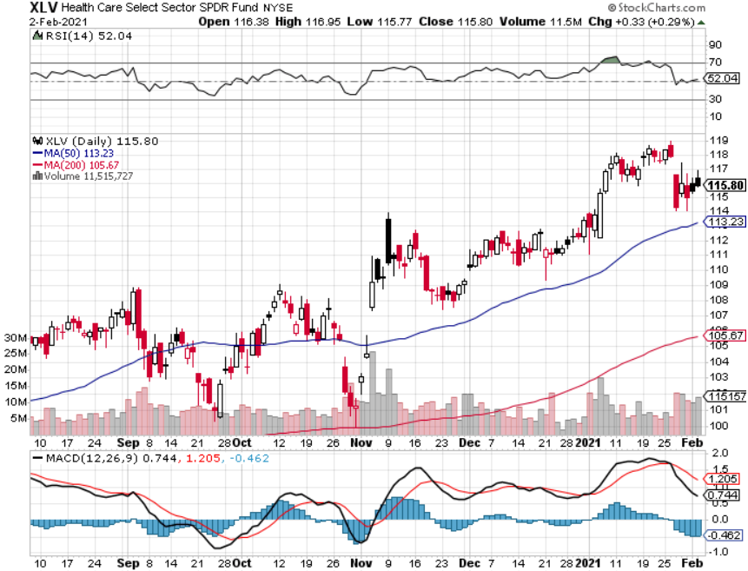
Health Care Sector (XLV), (RXL) (JNJ), (PFE), (MRK), (GILD), (ACT), (AMGN)

Slide 50
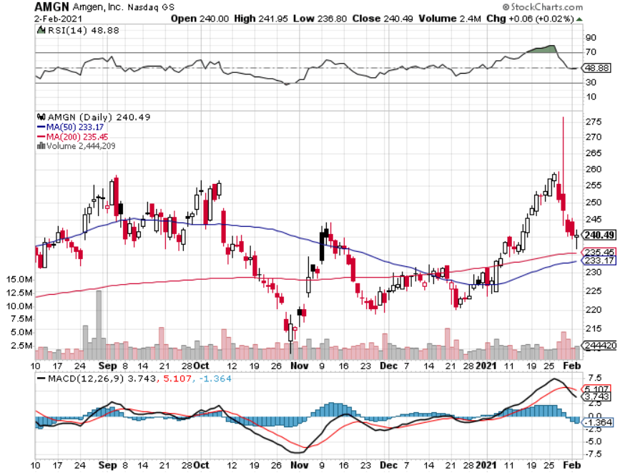
Amgen (AMGN) took profits on long 11/$185-$200 bull call spread

Slide 51
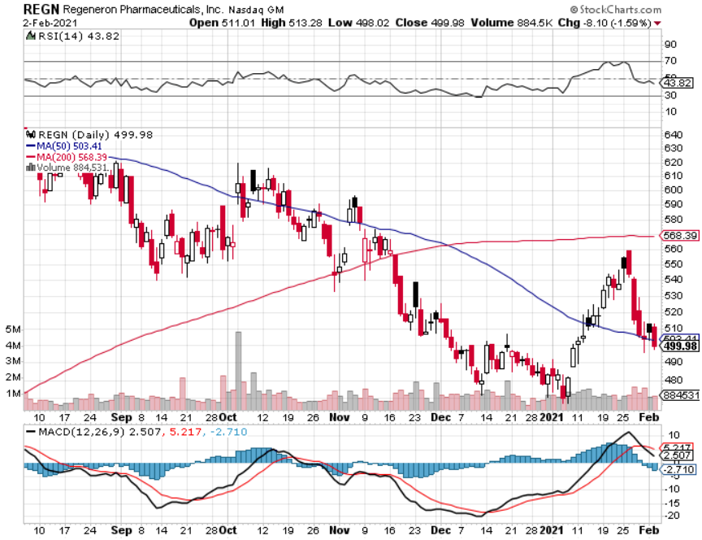
Regeneron (REGN) took profits on long 7/$570-$580 call spread

Slide 52
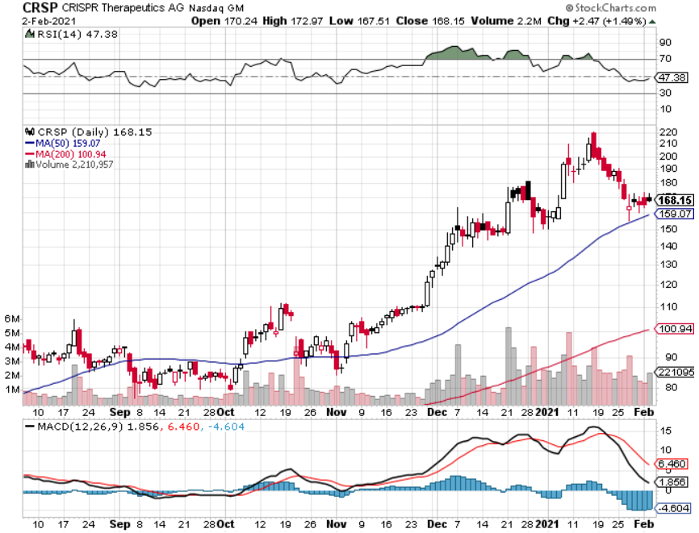
CRISPR Therapeutics (CRSP)

Slide 53
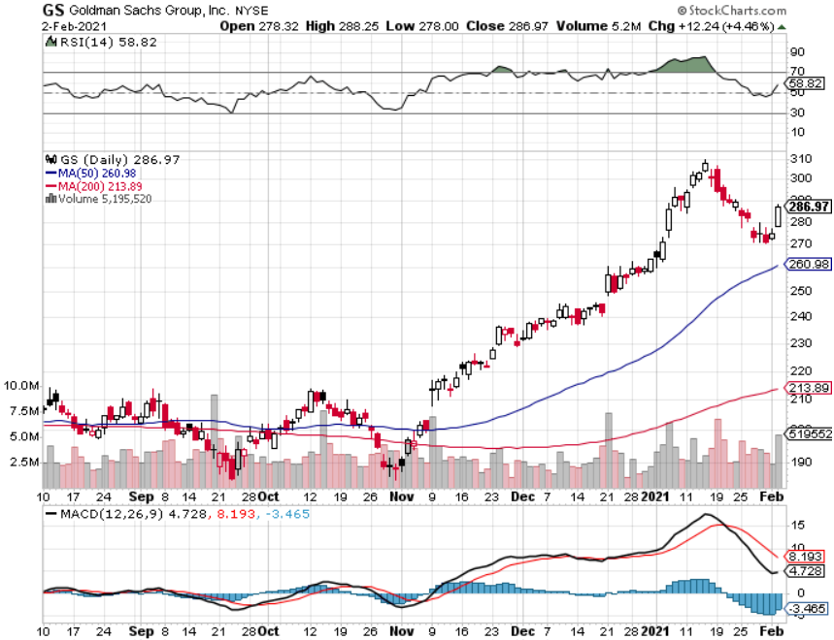
Goldman Sachs (GS) – $3 billion Settlement long 2/$240-$260 call spread

Slide 54
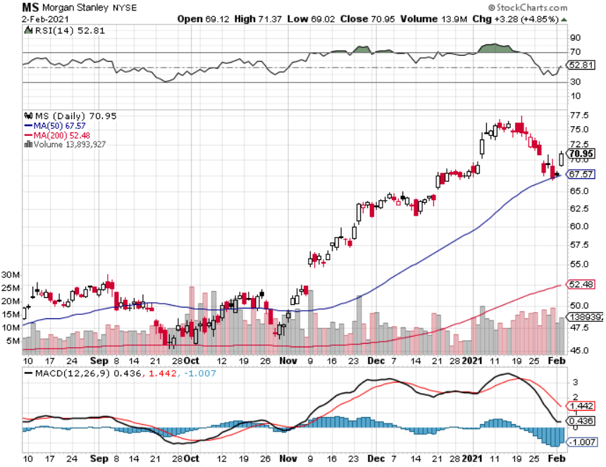
Morgan Stanley (MS) – Blowout Earnings long 2/$55-$60 call spread

Slide 55
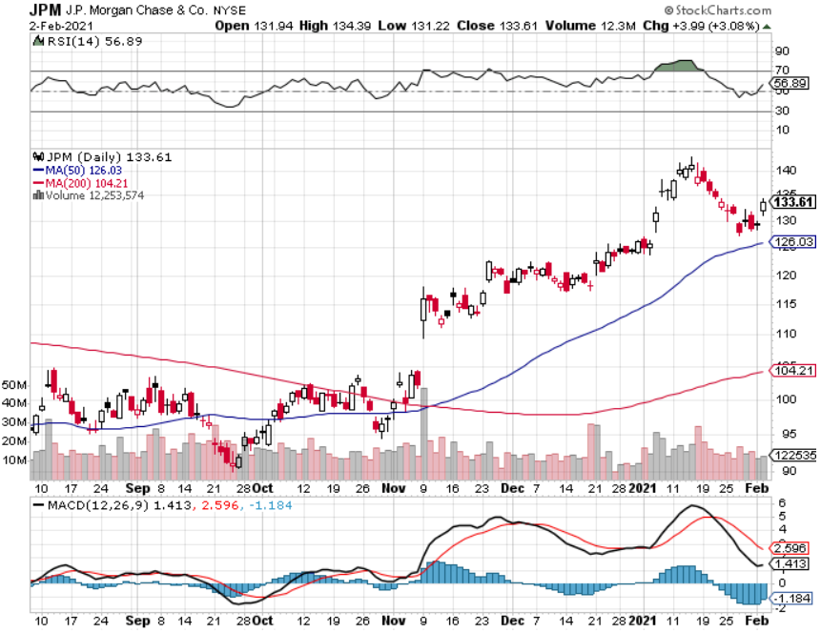
JP Morgan Chase (JPM)-Rising Rates long 2/$110-$115 call spread took profits on long 12/$100-$105 bull call spread took profits on long 11/$85-$90 bull call spread took profit on long 11/$110-$115 bear put spread took profits on long 9/$90-$95 bull call spread

Slide 56
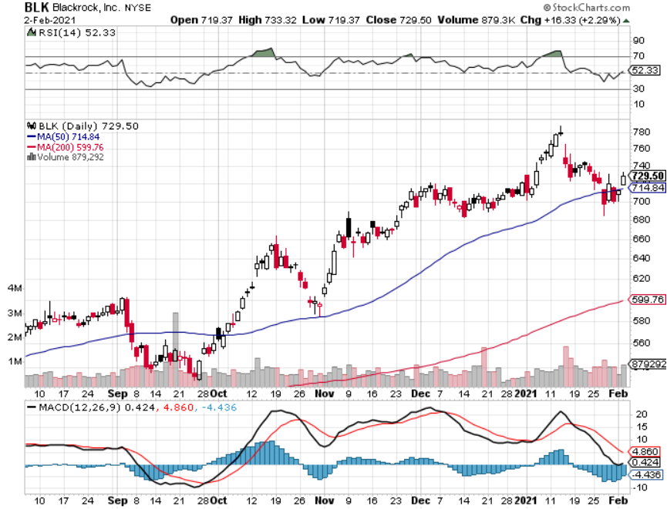
Blackrock (BLK)-Asset Collection Boom long 2/$640-$660 call spread

Slide 57
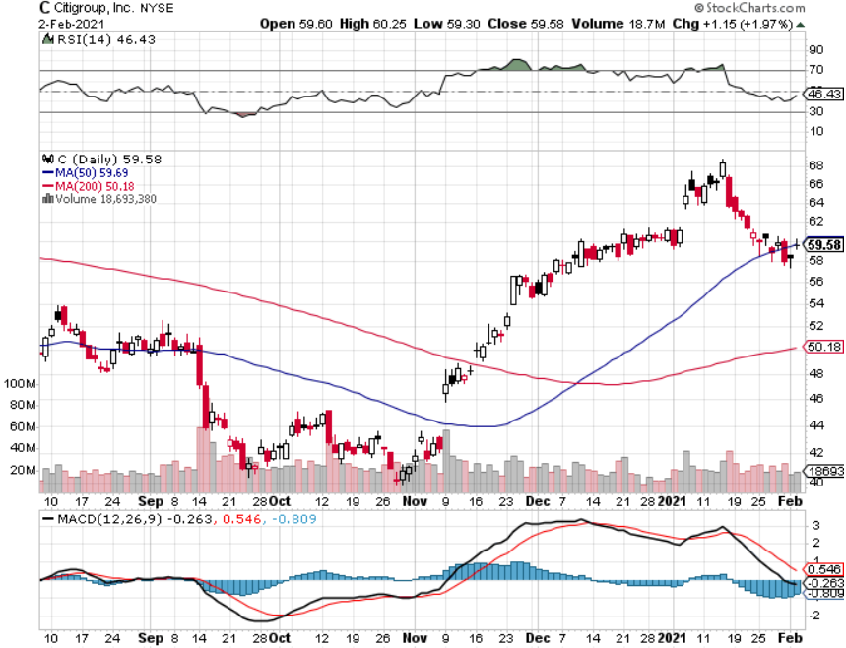
Citigroup (C) – “Recovery” Rotation Play

Slide 58
Visa (V) – “Touchless” Fintech Play stopped out of long 11/$180-$185 bull call spread took profits on long 9/$180-$185 bull call spread

Slide 59
Consumer Discretionary SPDR (XLY) (DIS), (AMZN), (HD), (CMCSA), (MCD), (SBUX)

Slide 60
Europe Hedged Equity (HEDJ)-

Slide 61
Japan (DXJ)-

Slide 62
Emerging Markets (EEM) - Pro trade, Weak Dollar, long recovery Play

Slide 63
Bonds – Stalled
*Bond selloff stalls on flight from risk *With GameStop fiasco over we are now probing lows *Bonds will soon focus on $1.9 trillion stimulus package-all borrowed *Keep selling the (TLT), even on small rallies. This could be the trade of the century. *Weakening dollar has scared away many foreign buyers *It is just a matter of time before we hit a 1.50% yield *US Treasury bond fund (TLT) could plunge from $180 to $105, taking interest rates from 0.31% to 3.25%

Slide 64
Treasury ETF (TLT) – Huge Short Play long 2/$158-$161 put spread took profits on long 2/$159-$162 put spread took profits on long 2/$162-$165 put spread took profits on long 1/$164-$167 put spread took profits on long 12/$164-$167 put spread

Slide 65
Ten Year Treasury Yield ($TNX) – 1.10%

Slide 66
Junk Bonds (HYG) 3.45% Yield to Maturity

Slide 67
2X Short Treasuries (TBT)-Another run at highs

Slide 68
Emerging Market Debt (ELD) 4.20% Yield-

Slide 69
Municipal Bonds (MUB) – 0.85% Mix of AAA, AA, and A rated bonds

Slide 70
Foreign Currencies – Going Nowhere
*Flat interest rates have delivered flat currency rates *Any dollar rallies are temporary and short-term *Bitcoin gives up 30%, breaks $30,000 *Keep selling short all US dollar rallies, its yield support is gone forever

Slide 71
Japanese Yen (FXY), (YCS)

Slide 72
Euro ($XEU), (FXE), (EUO)-

Slide 73
British Pound (FXB)-

Slide 74
Australian Dollar (FXA)- The Global Recovery Play took profits on long 8/$67-$69 call spread

Slide 75
Emerging Market Currencies (CEW)

Slide 76
Chinese Yuan- (CYB)-

Slide 77
Bitcoin- Gone Ballistic, up 10X in 9 Months Volatility is 10X that of (SPX)

Slide 78
Energy – Flatlining
* Oil Hits One Year High, at $55 on strength of economic recovery which starts six months down the road. *Demand won’t reach 2019 levels until well into 2022 *Biden administration will definitely not be as pro-oil as the last one, and ESG investing is accounting for an ever-larger share of capital *Will Biden bring Iran oil back on to the market? *Global commodity boom and weak US dollar is also dragging oil up *Saudi production increase will cap any oil rally….forever *Avoid all energy plays like the plague, it’s the new buggy whip industry as the US de-carbonizes

Slide 79
Oil-($WTIC)

Slide 80
United States Oil Fund (USO) long 10/$9.50-$10 Vertical bull call spread

Slide 81
Energy Select Sector SPDR (XLE)-No Performance! (XOM), (CVX), (SLB), (KMI), (EOG), (COP)

Slide 82
Halliburton (HAL)-

Slide 83
Natural Gas (UNG) -

Slide 84
Precious Metals – Sitting on a Bottom
*Gold has turned into a bond long and and Bitcoin short and I don’t want either *Bitcoin surge is pulling cash out of precious metals *However, any declines will be temporary as QE demand continues *The long-term bull trend still lives, with gold up 20% in 2020, the best in 10 years *Traders are shifting to Silver as an economic, industrial plays *Near zero interest rates and collapsing US dollar is another gold & silver incentive *Bottom Line: buy this dip in gold and precious metals

Slide 85
Gold (GLD)- Short Term downtrend took profits on long 9/$171-$174 call spread took profits on long 8/$169-$172 call spread took profits on long 7/$157-$160 call spread

Slide 86
Market Vectors Gold Miners ETF- (GDX) –

Slide 87
Barrick Gold (GOLD) took profits on long 1/$21-$23 call spread took profits on long 11/$22-$24 call spread

Slide 88
Newmont Mining- (NEM)- took profits on long $55-60 call spread

Slide 89
Silver- (SLV)- took profits on long 11/$19-$20 call spread

Slide 90
Silver Miners - (SIL)-

Slide 91
Wheaton Precious Metals - (WPM)- took profits on long 2/$39-41 call spread

Slide 92
Copper (COPX)-Finally a break

Slide 93
Freeport McMoRan (FCX)-World’s Largest Copper Producer took profits on long 4/$10-$11 call spread took profits on short 4/$114 calls

Slide 94
Real Estate – Still on Fire
*Existing Home Sales Soar to 15-year High, up an amazing 22% YOY in December to a seasonally adjusted 6.76 million units. *Inventories hit all-time lows at only 1.9 months *New Home Sales Disappoint in December, up only 1.6% to 842,000 units. *Pending Home Sales Fall, 0.3% in December, but are still up a staggering 21% YOY. *Housing prices are still exploding to the upside with S&P Case Shiller Rose 9.5% in November, the one-month biggest spike in history

Slide 95
November Corelogic S&P Case Shiller Home Price Index Phoenix (13.8%), Seattle (12.7%), and San Diego (12.3%)
Tradingeconomics.com

Slide 96
Simon Property Group (SPG)- Mall REIT A Huge Vaccine Play

Slide 97
Crown Castle International (CCI) – 3.40% yielding cell phone Tower REIT

Slide 98
US Home Construction Index (ITB) (DHI), (LEN), (PHM), (TOL), (NVR)

Slide 99
Trade Sheet- So What Do We Do About All This?
*Stocks – buy dips aggressively *Bonds – sell rallies aggressively *Commodities-buy dips *Currencies- sell US dollar rallies *Precious Metals – buy dips *Energy – stand aside *Volatility - sell short over $40 *Real estate – buy dips

Slide 100
Next Strategy Webinar 12:00 EST Wednesday, February 17, from Lake Tahoe, NV email me questions at support@madhedgefundtrader.com
Good Luck and Good Trading!
Notes:
*

