Slide 1
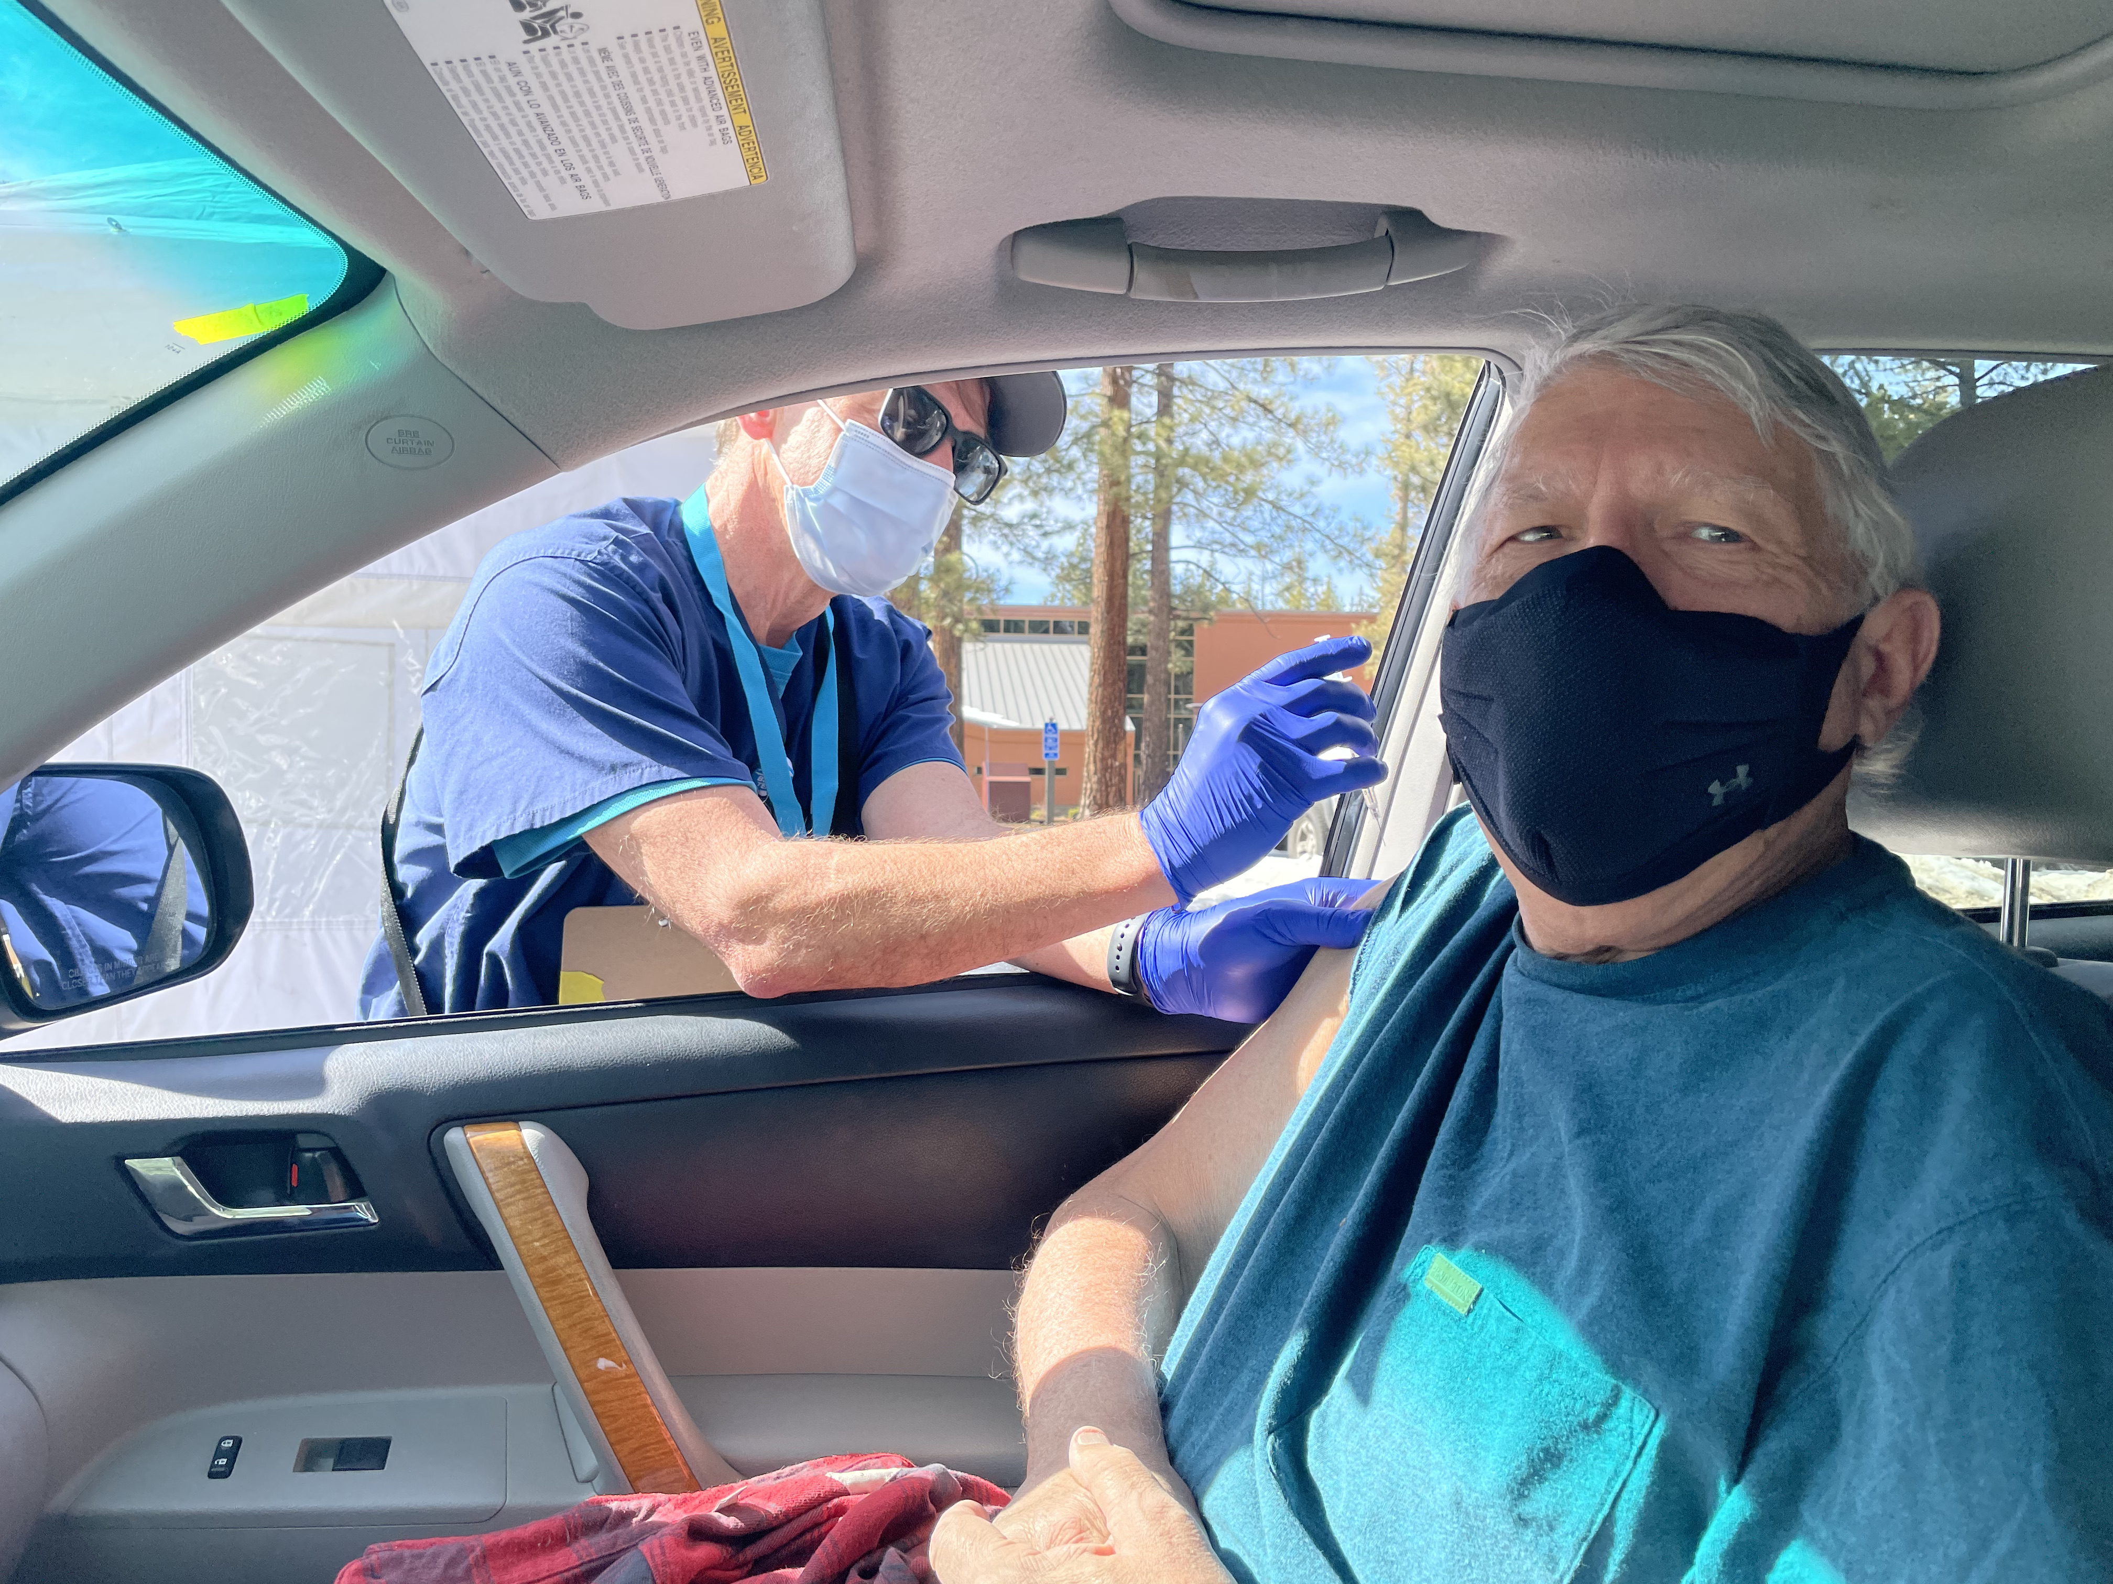
The Mad Hedge Fund Trader “The Pandemic is Over”
With John Thomas from Incline Village, NV, March 3, 2021 www.madhedgefundtrader.com
Notes:
*

Slide 2
Trade Alert Performance New All Time Highs!
*January 10.21% MTD *July +7.93% Final *February -13.28% Final *August -2.08% Final *March +5.80% MTD *September 7.95% Final *April +4.55% Final *October +1.51% Final *May +14.19% Final *November +20.41% Final *June +10.38% Final *December +10.20% Final *2020 FINAL +66.64% compared to +7.2% for the Dow Average *2021 Year to Date +29.29% compared to +3.3% for the Dow Average *+451.84% since inception, a new all time high *Average annualized return of 39.64% for 11 years, new all time high

Slide 3
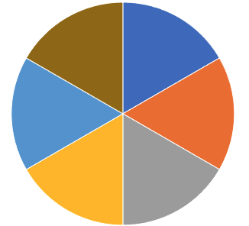
Portfolio Review 60% long Invested in Long Term Bull Market
Current Capital at Risk
Risk On
World is Getting Better
(FCX) 2/$28-$31 calls spread | 10.00%
(XME) 3/$31-$34 call spread | 10.00%
(TLT) 3/$147-$150 put spread | 10.00%
(TLT) 3/$146-$149 put spread | 10.00%
(DIS) 3/$170-$180 call spread | 10.00%
Risk Off
World is Getting Worse
(SPY) 3/$405-$410 put spread | -10.00%
Total Net Position | 40.00%
Expiration P&L +33.56 YTD

Slide 4
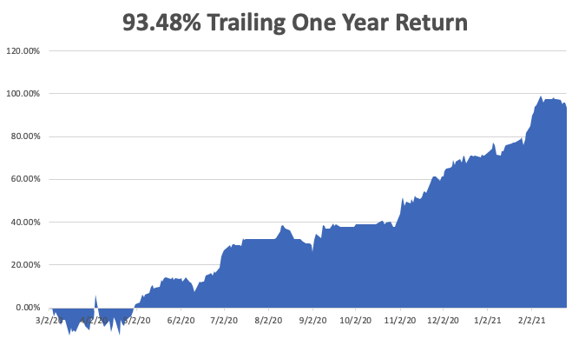

Slide 5
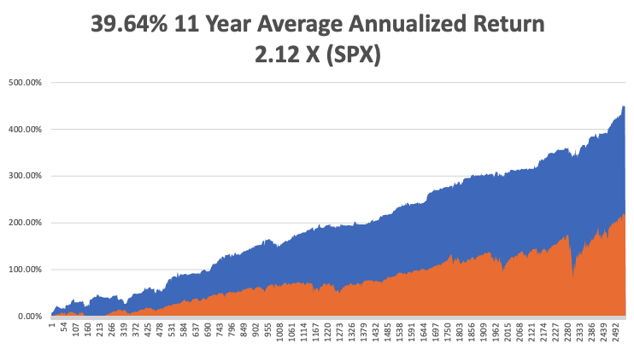
GTD 11 Year Daily Audited Performance

Slide 6
The Method to My Madness The Roaring Twenties are Here
*The 5%-10% correction is here *The best-case scenario for the outcome of the pandemic has happened, justifying the 78% rise in stocks since March 20 *It’s now all about a global economic recovery and “RISK ON”, but we are now waiting for this correction to finish *Commodity boom continues, with industrial metals hitting new highs, dragging oil upward *Bitcoin has become the best risk indicator in the market, down 25% during correction week *A bond breakdown resumes, hitting new 2021 lows *Perennial dollar weakness will give us opportunities to buy foreign currencies, commodities, and emerging markets

Slide 7
Corona Update – Collapse
*Massive distribution effort is proving hugely successful, 75 million shots have been given, or 5 million last weekend, including ME! *New cases have fallen off a cliff, from 250,000 a day to 68,000. The population is acting like herd immunity has already begun! In a year, everyone with either be vaccinated, have had the disease, or be dead. *Every pandemic parameter started shrinking dramatically one month ago *At least 50 variants now in circulation, the race is to inoculate before the more fatal ones spread *We may hit a vaccine glut by May so watch out for (PFE), (JNJ), (MRNA) *US cases top 29 million, deaths topping 513,000 and are down to 1,000 a day

Slide 8
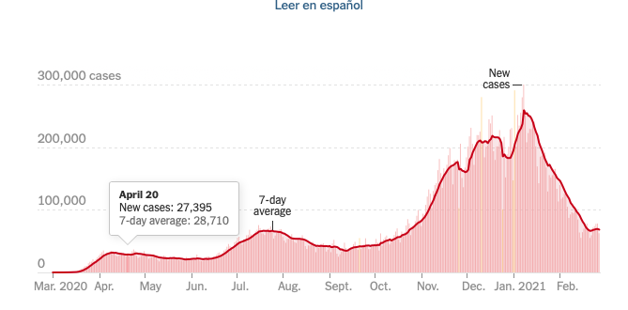

Slide 9
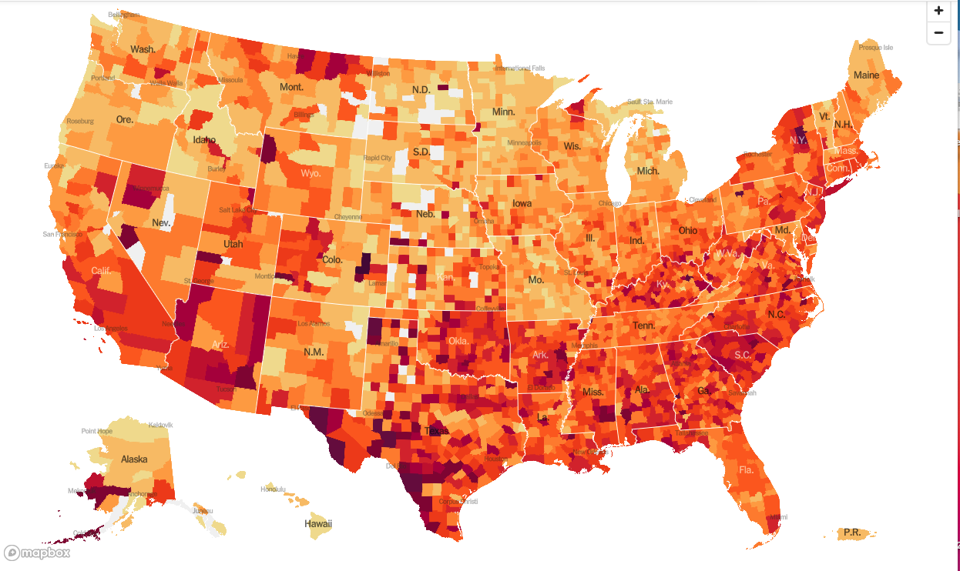
January 20 Infection Rate

Slide 10
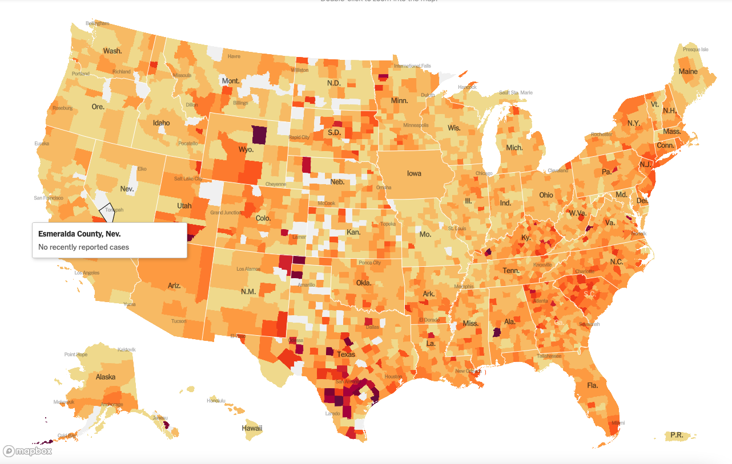
March 3 Infection Rate

Slide 11
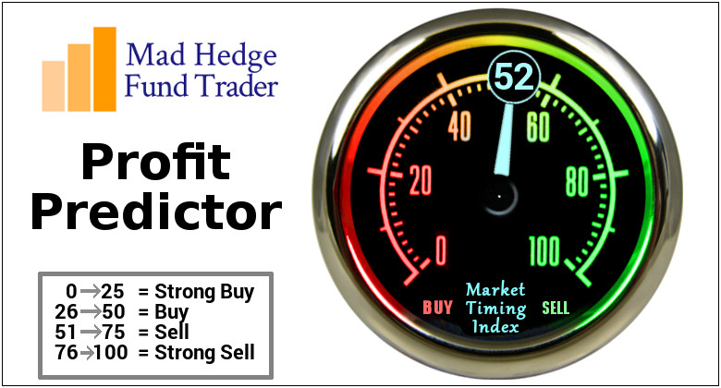
The Mad Hedge Profit Predictor Market Timing Index-Bottom of Range-at a “BUY” An artificial intelligence driven algorithm that analyzes 30 different economic, technical, and momentum driven indicators

Slide 12
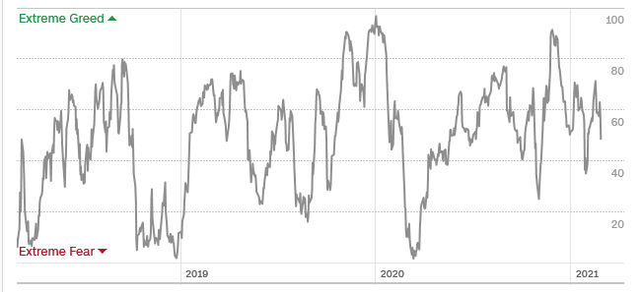
The Mad Hedge Profit Predictor Almost Neutral
SELL
BUY

Slide 13
The Global Economy – The Superheated Numbers are Coming
*Q2 GDP Shrinks a Tad, on its second read, from 4.2% to 4.1%. The coming Q4 could rocket to 7.5% or more with the $1.9 trillion rescue package *Weekly Jobless Claims Sink, to 730,000 *US Producer Prices Soar, giving a hint of coming inflation, now stuck at a non-existent 1.4% annual rate. *Retail Sales Bounce Back, by an eye popping 5.3% in January *Business Inventories Improve, in December from 0.5% to 0.6%, the best reading since September *US to Outperform China, in the coming economic recovery. The good news is that China has already enjoyed a “V” shaped recovery.

Slide 14
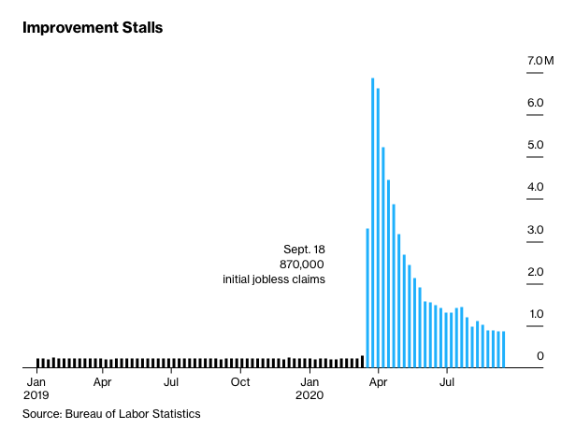
Weekly Jobless Claims – Flatlining at record highs 730,000

Slide 15
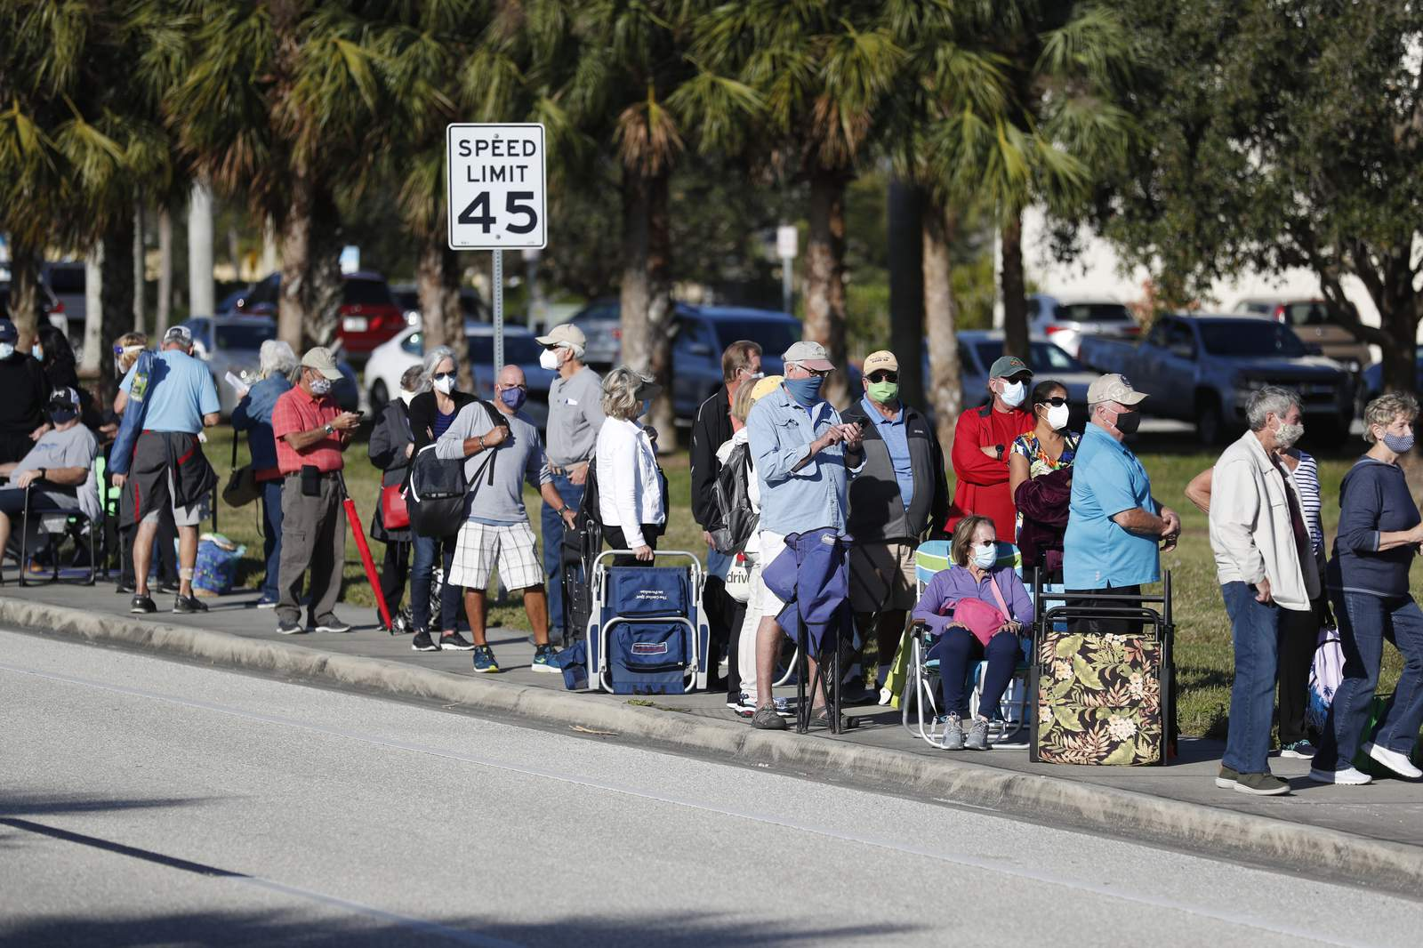
Stocks – New Highs
*Stock rally is showing that the 75% gain in 11 months is now justified. The best-case scenario happened. Coming superheated economic data will bring the next leg up *Stocks are now discounting herd immunity in 3-6 months *Cashing is Still Pouring off the Sidelines, with equity mutual funds attracting some $7.8 billion last week *The $1.9 trillion rescue package could be the turbocharger for hyper growth and greater gains *US economy may be back to normal by summer, but stocks and the economy will be anything but normal. Dow 40,000 here we come! *Stick with the barbell strategy, we’ll keep rotating back and forth all year *In 2021 both tech and recovery stocks run, meaning everything goes up *We could be entering a wide $2,700 - $3,600 range until the election

Slide 16
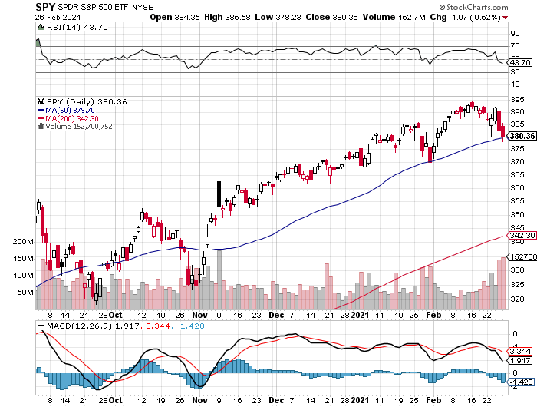
S&P 500 – The Bottom Held-Show How Much Cash is Out of the Market long 3/$405-$410 bear put spread
New Highs
The Bottom 370

Slide 17
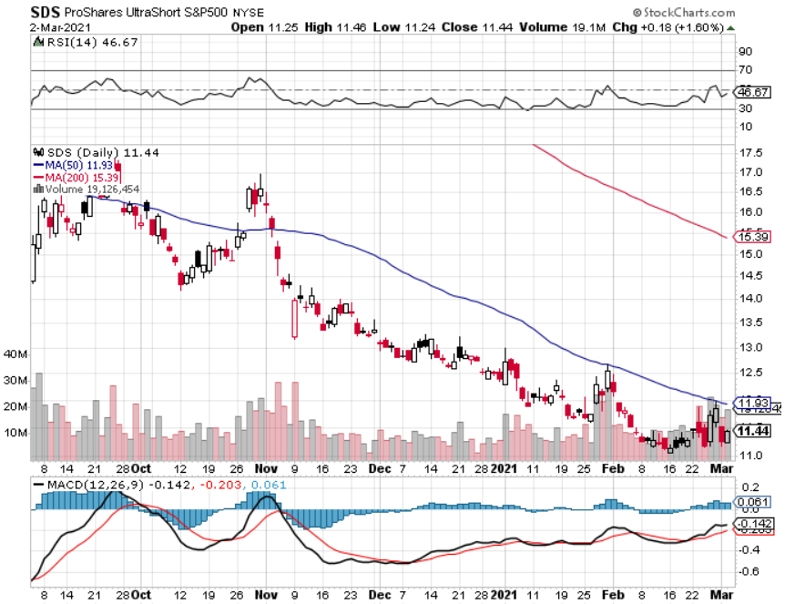
ProShares Ultra Short S&P 500 (SDS)- a Great Hedge for long stocks and bonds Long 2X position has a hedge against longs and bond shorts

Slide 18
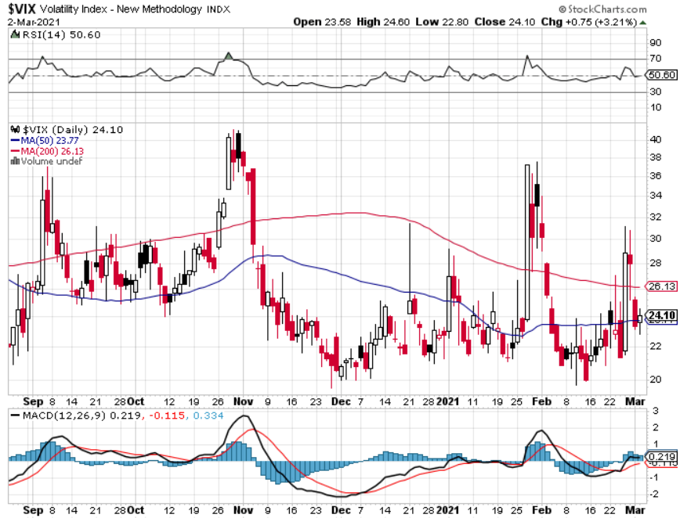
(VIX) – Mega Spike

Slide 19
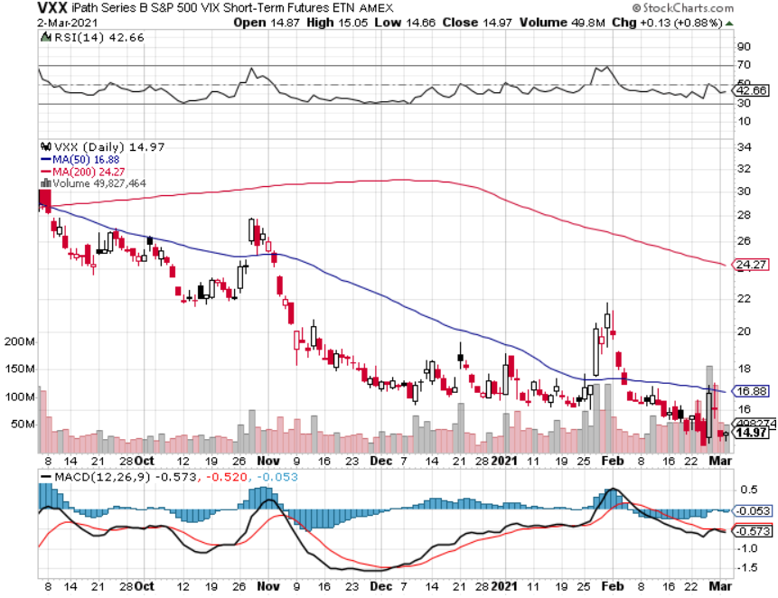
(VXX)-

Slide 20
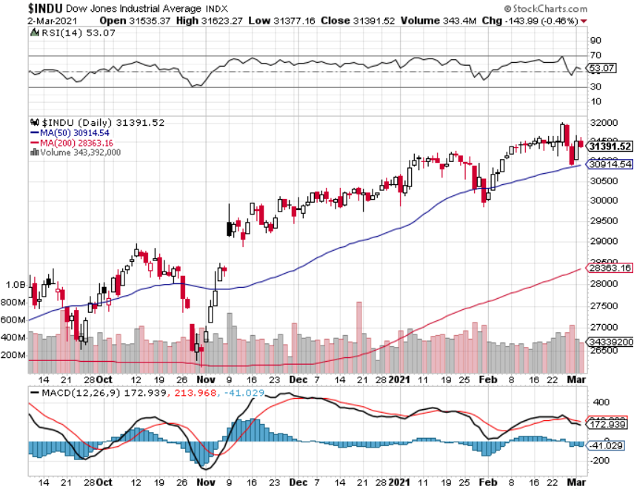
Dow Average ($INDU)-

Slide 21
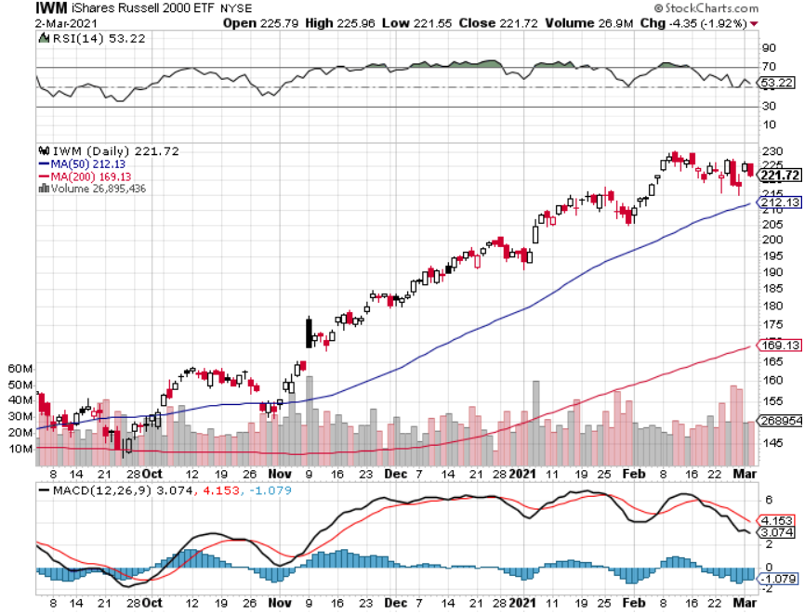
Russell 2000 (IWM)- took profits on Long 10/$137-$142 vertical bull call spread took profits on Long 10/$153-$156 vertical bear put spread

Slide 22
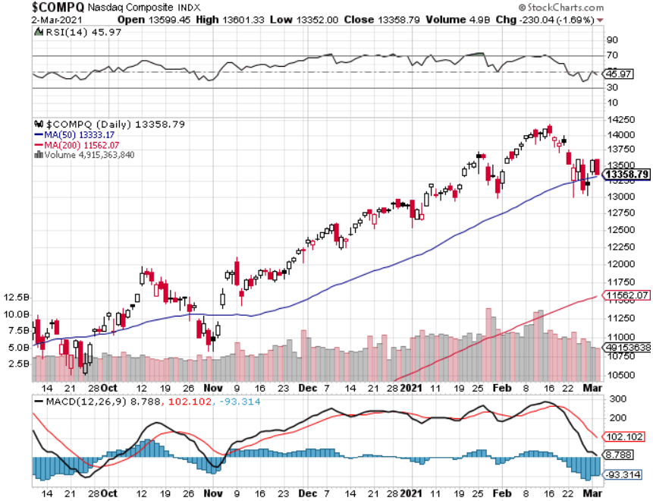
NASDAQ ($COMPQ) –

Slide 23
The Barbell Portfolio
*50% Big Tech - 2% of US Employment but 27% of Market Cap and 38% of Profits 50% Domestic Recovery, including: Railroads Couriers Banks Construction Credit Cards Event organizers Ticket sales Retailers

Slide 24
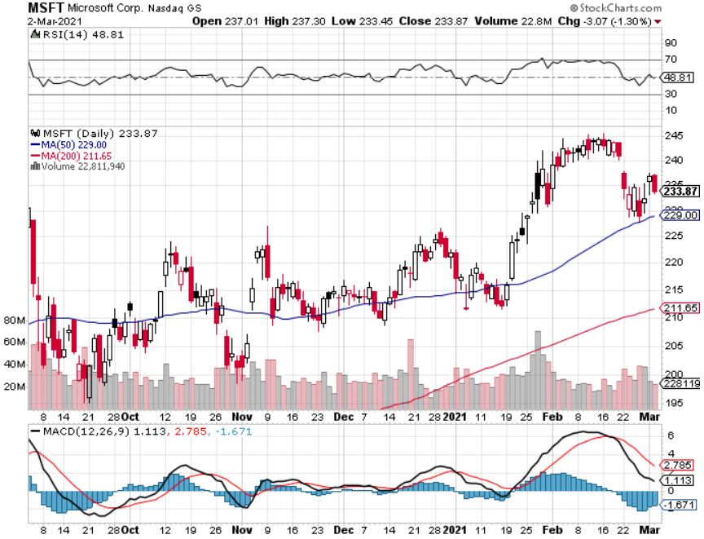
Microsoft (MSFT)- Earnings beat- Looking for Another Entry Point stop loss on long 12/$170-$180 call spread took profits on long 12/$135-$138 call spread

Slide 25
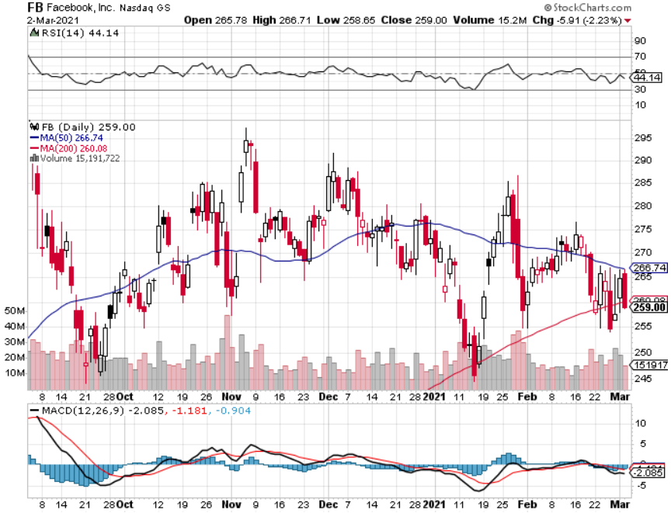
Facebook (FB)-New High took profits on Long 9/$290-$300 vertical bear put spread stopped out of Long 9/$190-$200 vertical bear put spread took profits on Long 9/$145-$155 vertical bull call spread took profits on Long 9/$150-$160 vertical bull call spread

Slide 26
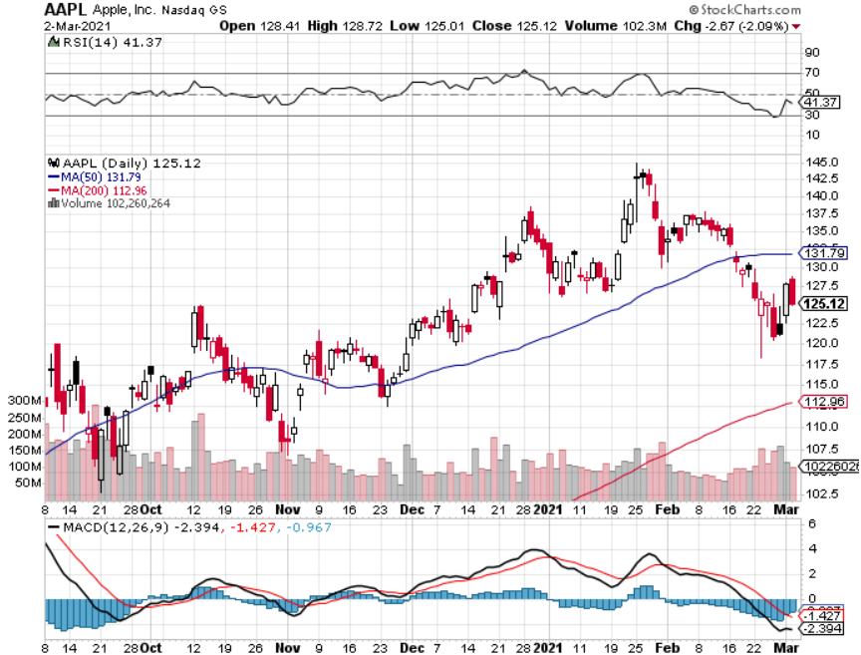
Apple (AAPL)- New 5G iPhone Surge Apple car moving forward with KIA took profits on long 7/$320-$330 call spread took profits on long 4/24/$250-$260 call spread took profits on long 5/$250-$260 call spread

Slide 27
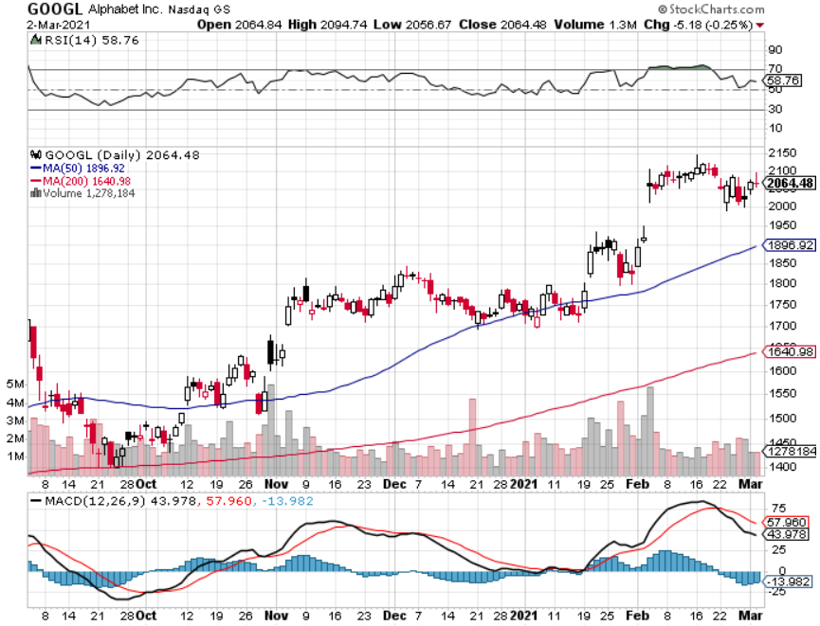
Alphabet (GOOGL) – took profits on long 12/$1,200-$1,230 bull call spread took profits on long 9/$1,030-$1,080 vertical bull call spread

Slide 28
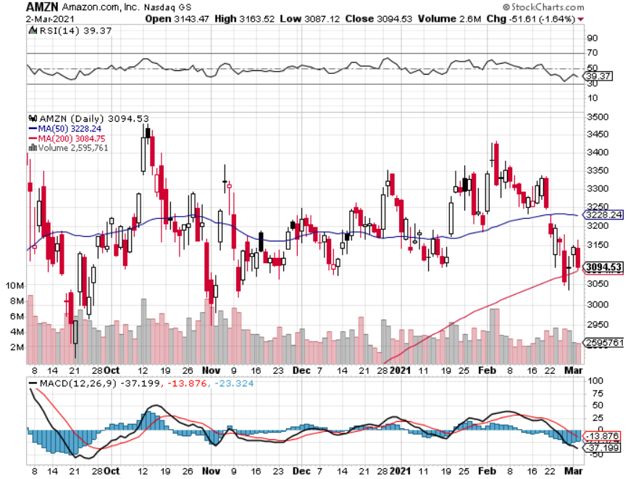
Amazon (AMZN) – Time correction took profits on long 9/$2,800-$2,900 bull call spread

Slide 29
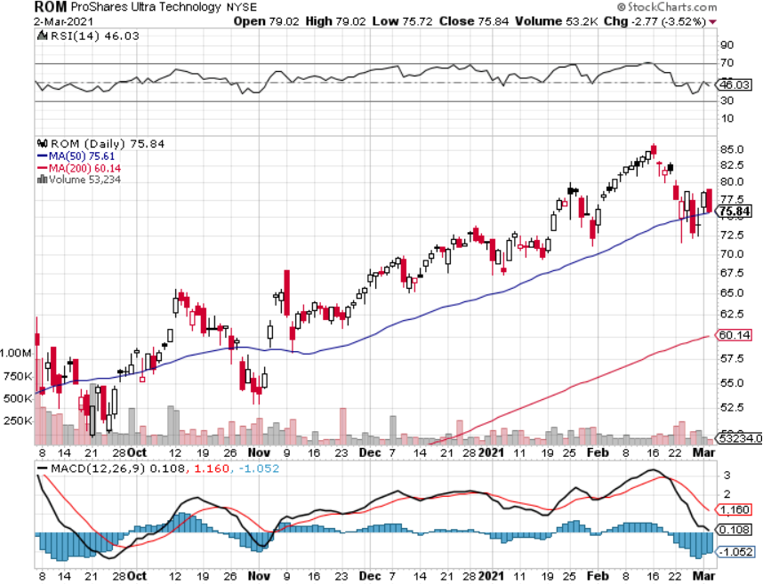
ProShares Ultra Technology (ROM) – Up 270% in 9 Months

Slide 30
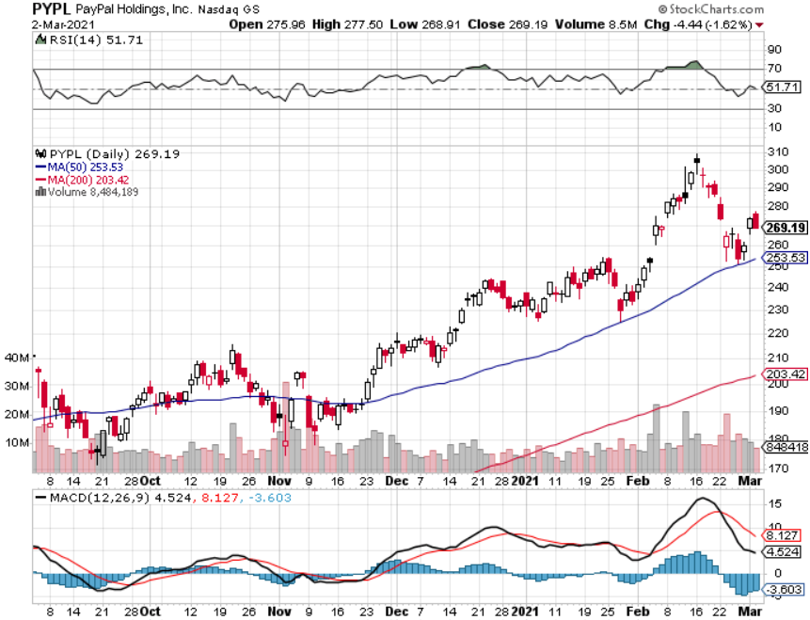
PayPal (PYPL)-Fintech Rules took profits on long 4/$90-$95 call spread

Slide 31
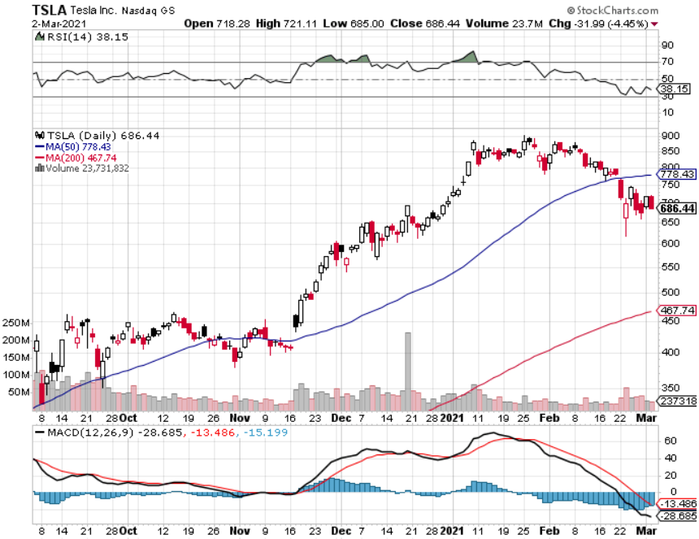
Tesla (TSLA)- Joining the S&P 500- 500,000 Target Achieved Piper Sandler Raises Target to $1,200, took profits on long 2/$650-$700 call spread-expires, stopped out of long 3/$600-$650 call spread Took profits on long 2/$600-$650 bull call spread, Took profits on long 2/$550-$600 bull call spread

Slide 32
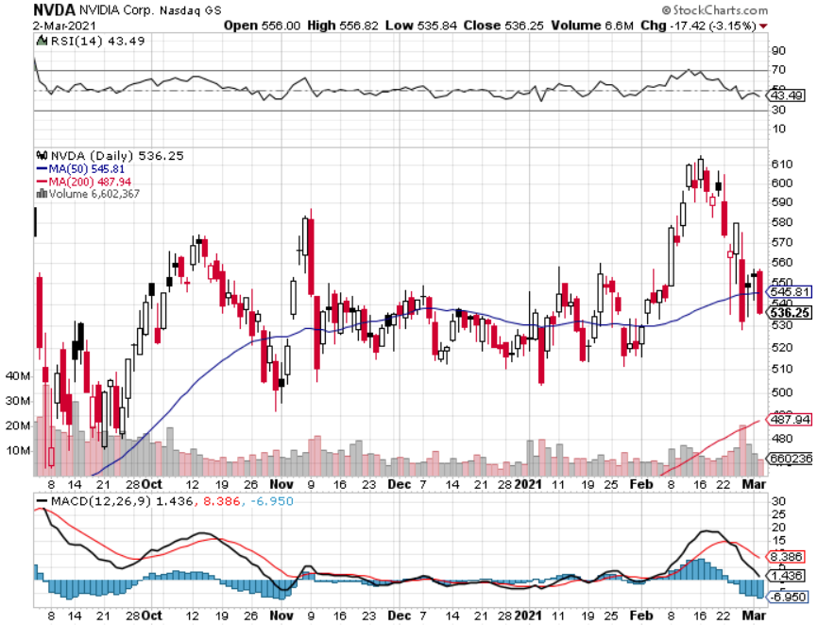
NVIDIA (NVDA) – The Biggest Chip Deal in History A Mad Hedge 10 bagger – Global Semiconductor Shortage Slows Auto Industry,

Slide 33
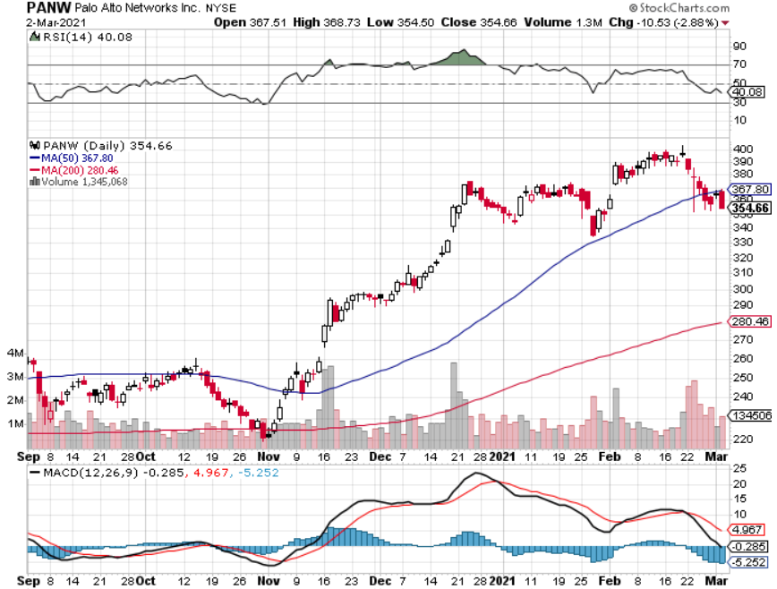
Palo Alto Networks (PANW)- New High Hacking never goes out of fashion

Slide 34
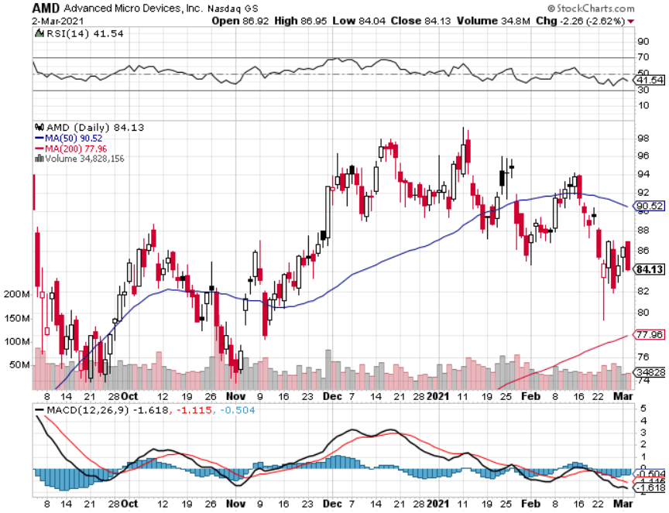
Advanced Micro Devices (AMD)- the next ten bagger - buys Xilinx – Programable logic devices took profits on long 2/$75-$80 call spread

Slide 35
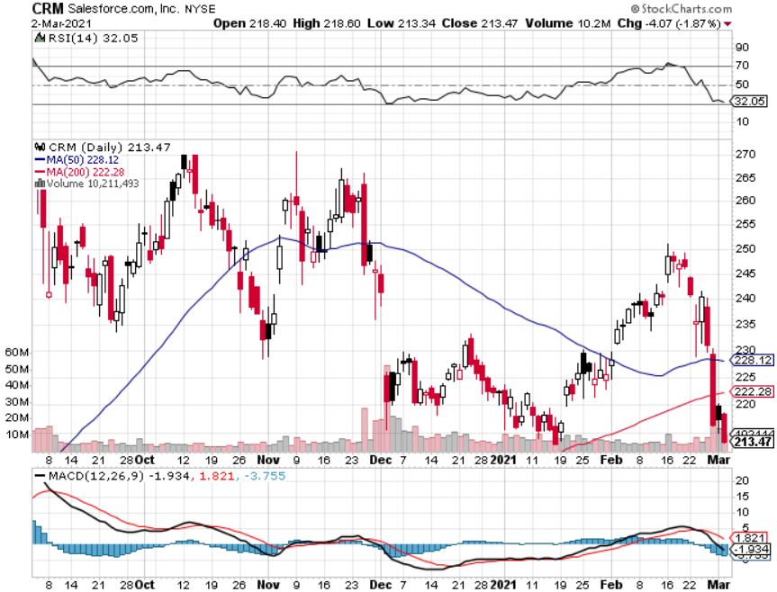
Salesforce (CRM)- Massive Online Migration took profits on long 9/$125-$130 vertical bull call spread took profits on long 8/$125-$130 vertical bull call spread took profits on long 2/$105-$115 call spread

Slide 36
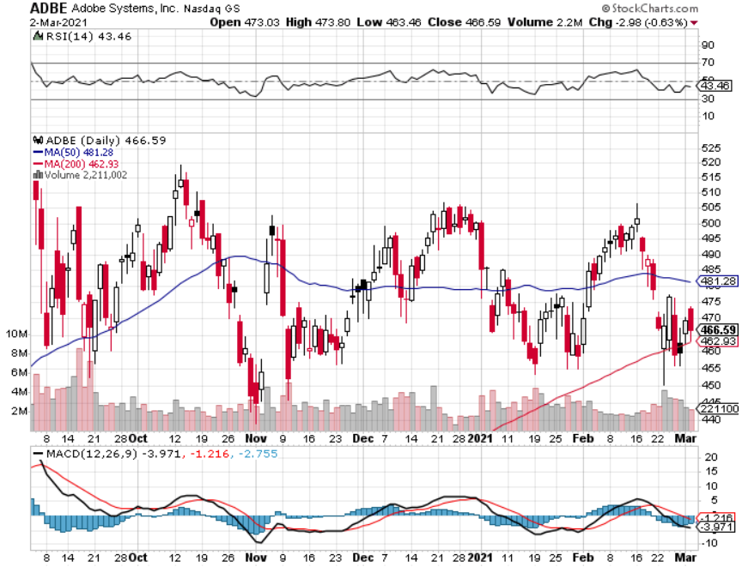
Adobe (ADBE)- Cloud play The Quality Non-China tech play

Slide 37
The Second Half of the Barbell
*Bets on a domestic recovery in 2021 *Upside potential in 2021 far greater than tech *Some of these have not moved for 5 or 10 years *Focuses on economically sensitive cyclical industries *Makes a great counterweight to high growth technology *We could spend all of next year rotating between the two groups

Slide 38
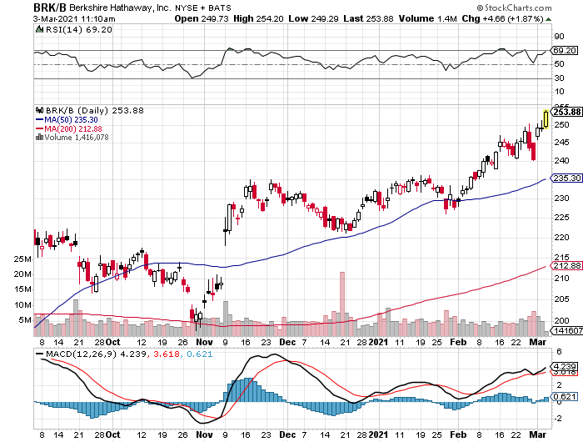
Berkshire Hathaway (BRKB) – The One Stop Barbell Portfolio The one stop domestic recovery play-heavy in financials and (AAPL) Bought $25 billion in own stock in 2021 - Target $300 in 2021 and $400 in 2022

Slide 39
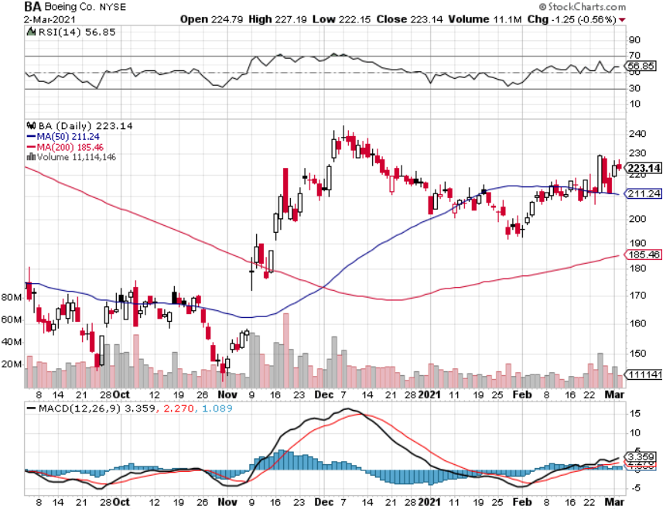
Boeing (BA) – former LEAP Candidate - The 737 MAX Flies Again! took profits on long long 2/$150-$160 call spread took profits on long 4/$300-$310 call spread took profits on long 4/$315-$335 call spread

Slide 40
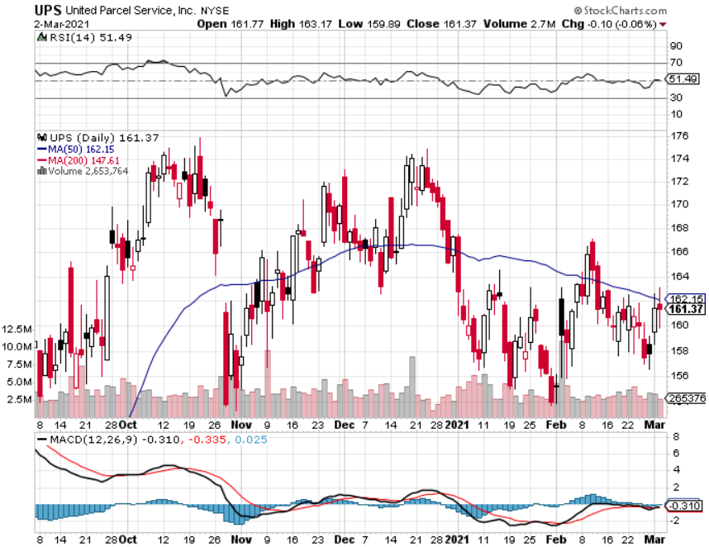
Package Delivery- United Parcel Service (UPS) massive increase in overnight deliveries, announces blowout earnings took profits on long 11/$130-$140 call spread

Slide 41
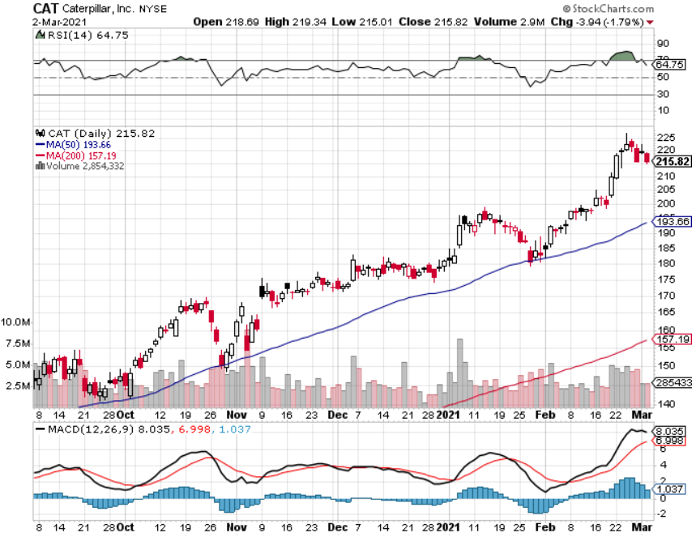
Caterpillar (CAT)- Ag + Infrastructure + Housing took profits on long long 12/$145-$150 call spread took profits on long 11/$125-$135 call spread

Slide 42
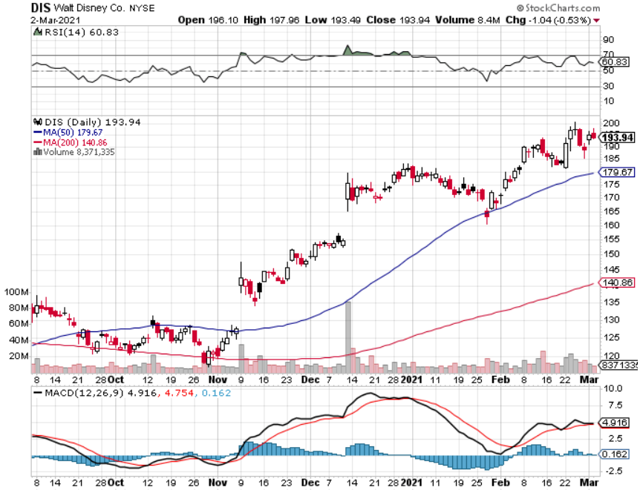
Walt Disney (DIS)- Big Recovery Move long 3/$170-$180 call spread

Slide 43
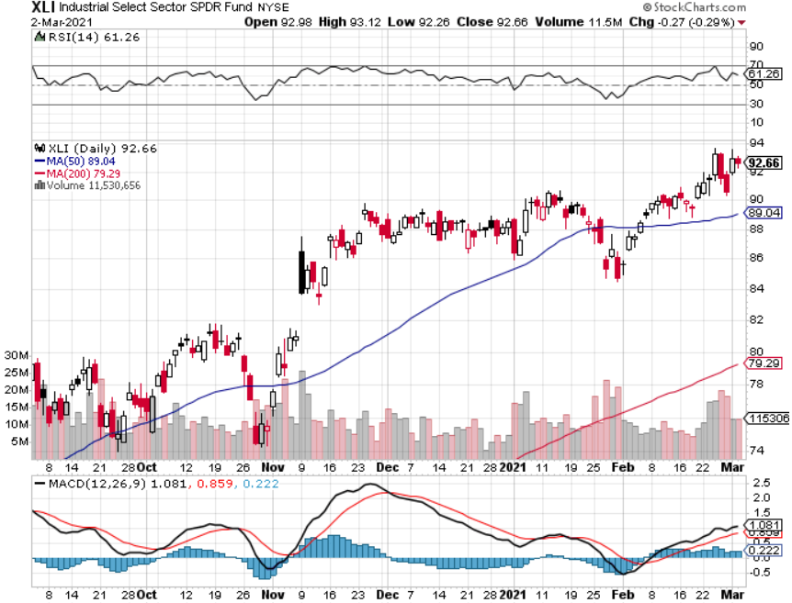
Industrials Sector SPDR (XLI)- (GE), (MMM), (UNP), (UTX), (BA), (HON)

Slide 44
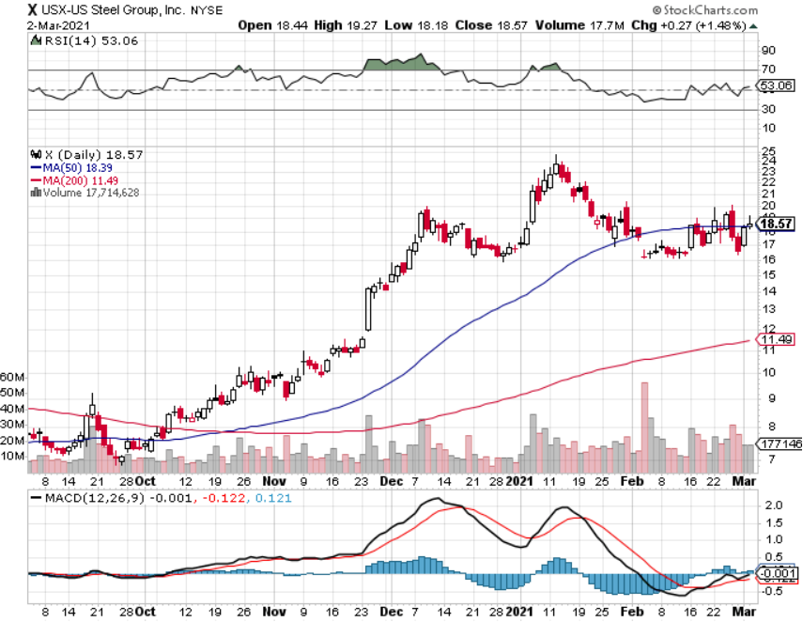
US Steel (X) – Commodity Boom

Slide 45
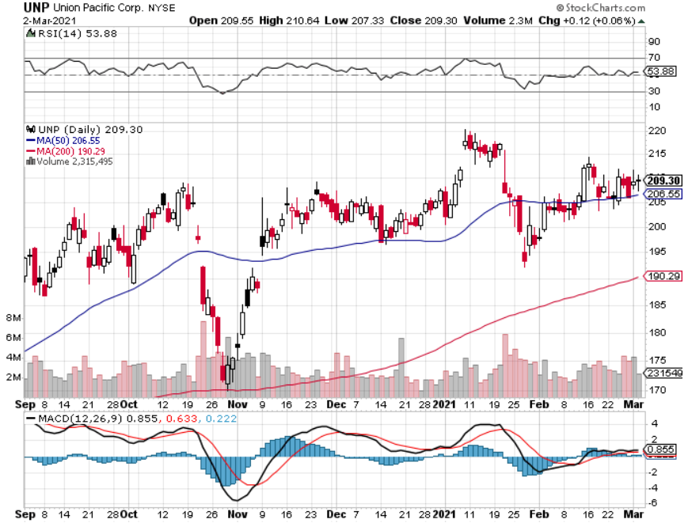
Union Pacific RR (UNP)- More stuff to ship near record earnings announced took profits on 11/$150-$160 call spread

Slide 46
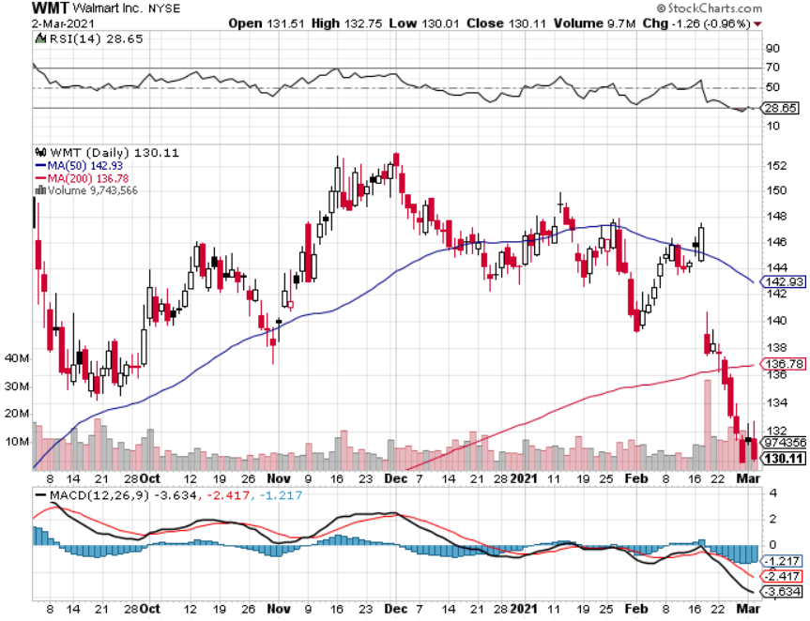
Wal-Mart (WMT)-New High took profit on Long 11/$125-$130 bear put spread took profit on Long 10/$119-$121 bear put spread took profits on Long 8/$114-$117 bear put spread

Slide 47
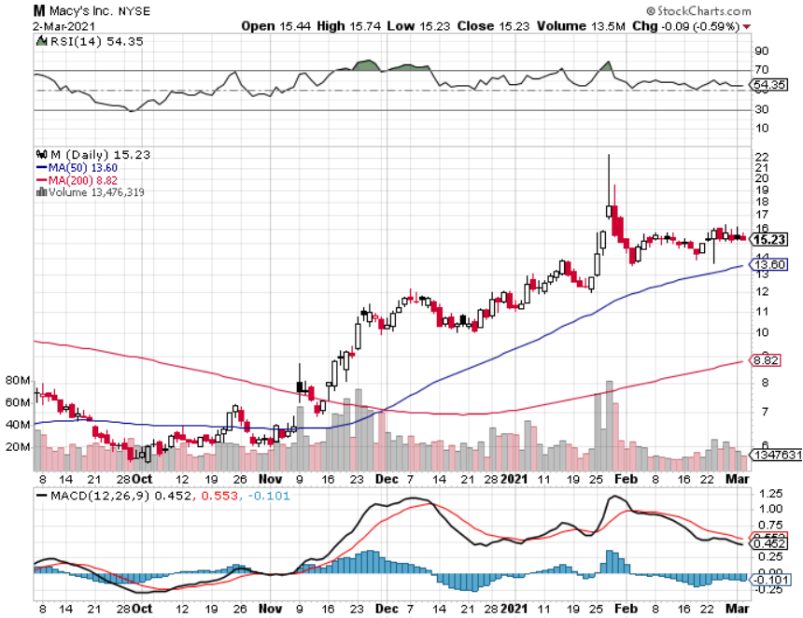
Macys’ (M) – Retail Return from the Grave took profits on Long 8/$23-$25 bear put spread

Slide 48
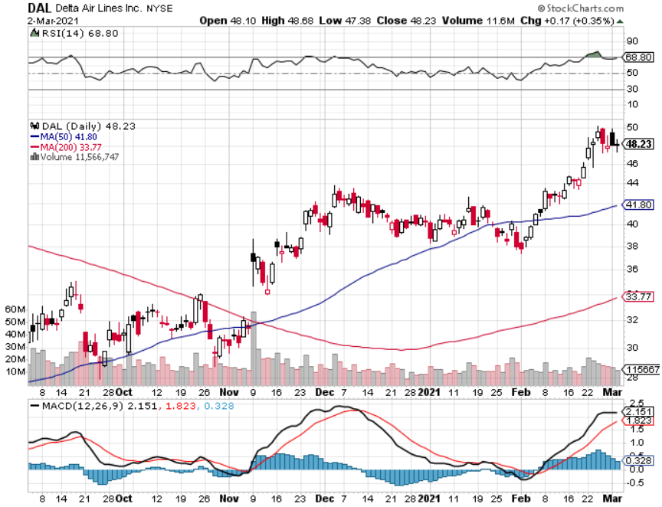
Delta Airlines (DAL) – Subsidy runs out

Slide 49
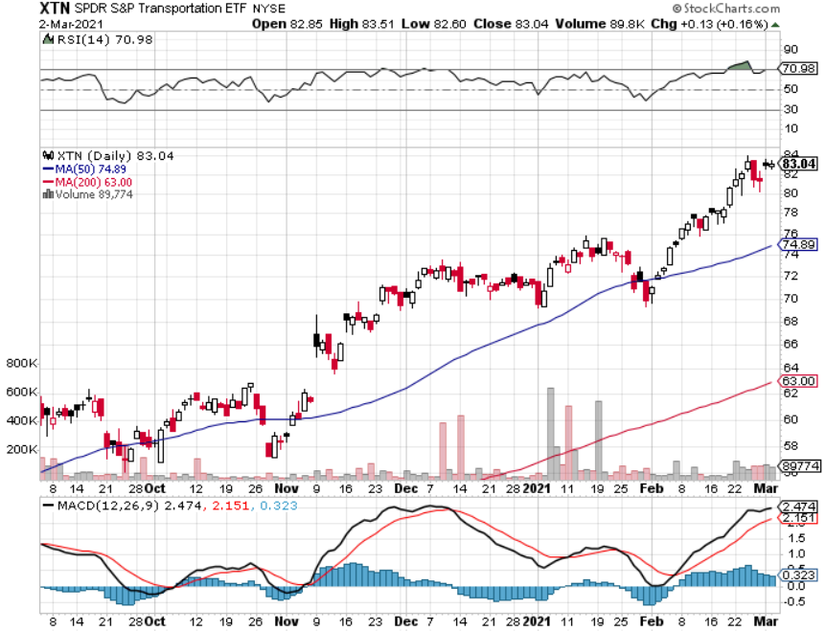
Transports Sector SPDR (XTN)- Worst Hit Sector (ALGT), (ALK), (JBLU), (LUV), (CHRW), (DAL)

Slide 50
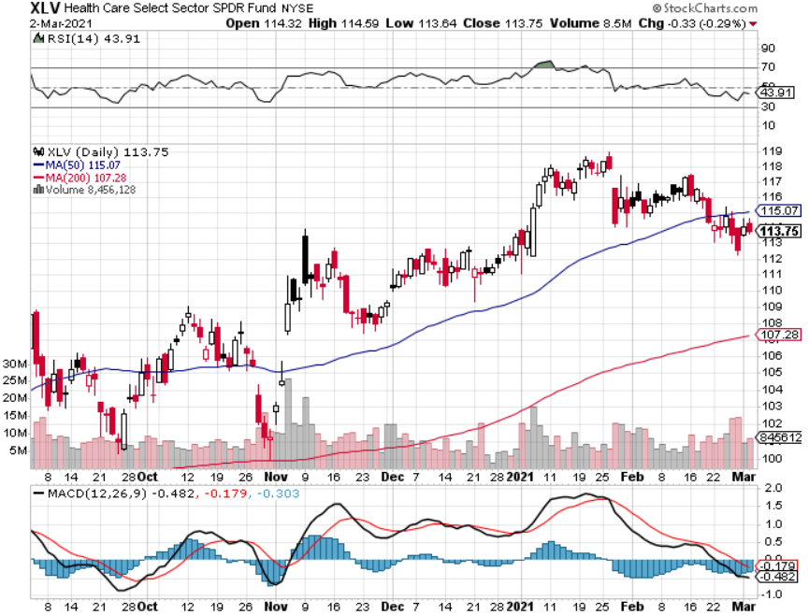
Health Care Sector (XLV), (RXL) (JNJ), (PFE), (MRK), (GILD), (ACT), (AMGN)

Slide 51
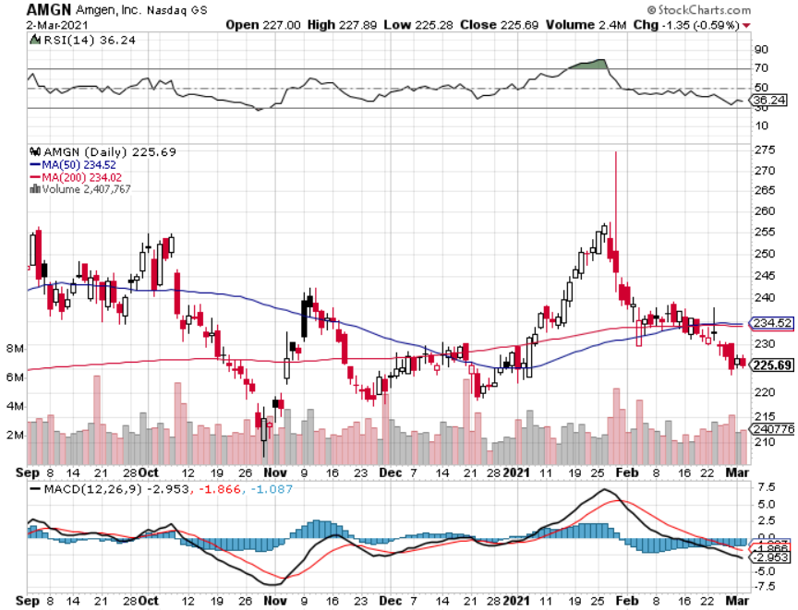
Amgen (AMGN) took profits on long 11/$185-$200 bull call spread

Slide 52
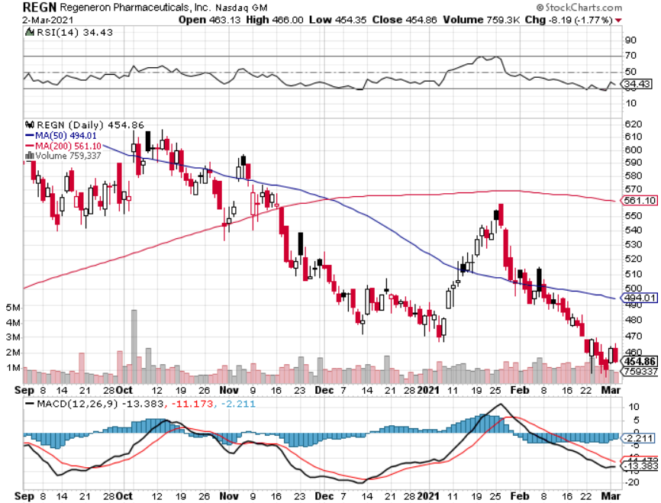
Regeneron (REGN) took profits on long 7/$570-$580 call spread

Slide 53
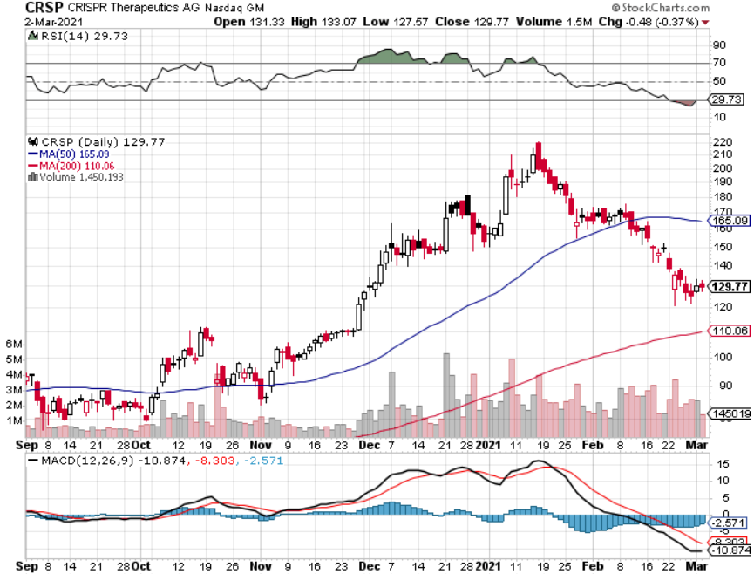
CRISPR Therapeutics (CRSP)

Slide 54
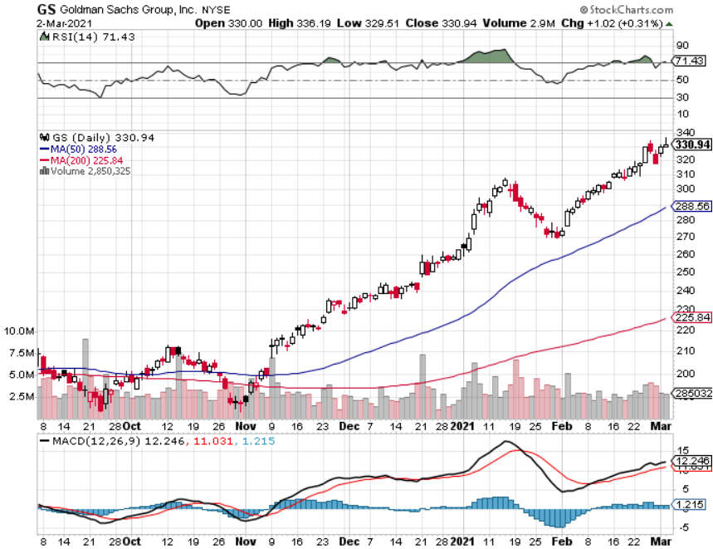
Goldman Sachs (GS) – took profits on long 2/$240-$260 call spread

Slide 55
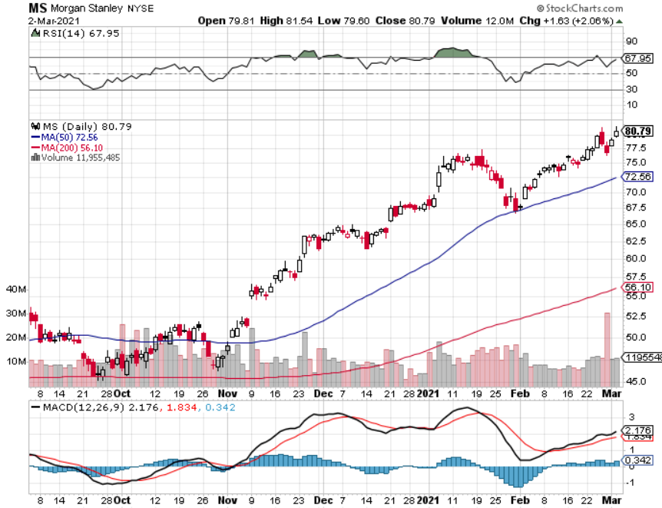
Morgan Stanley (MS) – Blowout Earnings took profits on long 2/$55-$60 call spread

Slide 56
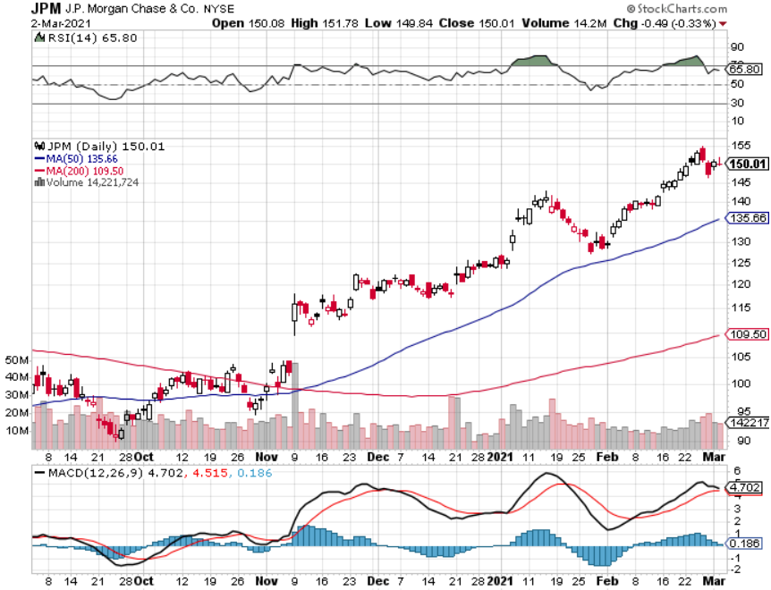
JP Morgan Chase (JPM)-Rising Rates took profits on long 2/$110-$115 call spread took profits on long 12/$100-$105 bull call spread took profits on long 11/$85-$90 bull call spread

Slide 57
Citigroup (C) – “Recovery” Rotation Play

Slide 58
Bank of America (BAC) – took profits on long 2/$28-$30 call spread

Slide 59
Blackrock (BLK)-Asset Collection Boom took profits on long 2/$640-$660 call spread

Slide 60
Visa (V) – “Touchless” Fintech Play stopped out of long 11/$180-$185 bull call spread took profits on long 9/$180-$185 bull call spread

Slide 61
Consumer Discretionary SPDR (XLY) (DIS), (AMZN), (HD), (CMCSA), (MCD), (SBUX)

Slide 62
Coca-Cola (KO)- Dividend Play and bond broxy-3.24% yield took profits on long 2/$44-$47 call spread

Slide 63
Europe Hedged Equity (HEDJ)-

Slide 64
Japan (DXJ)-

Slide 65
Emerging Markets (EEM) - Pro trade, Weak Dollar, long recovery Play

Slide 66
Bonds – Crash!
*Quantitative Easing to Continue, says Fed governor Jay Powell, even if the economy improves *The $120 billion in monthly bond buying remains *The Fed is doing everything possible to create inflation *The (TLT) hits a new 2021 low, taking ten year yields up to 1.62%. *I’m piling money into financials, which love higher interest rates and are an indirect bond short *Buy (JPM), (BAC), (C), (MS), (GS), and (BLK) on dips. *A 2.00% yield on the ten-year US Treasury bond here we come! This is the quality trade of 2021 *US Treasury bond fund (TLT) could plunge from $180 to $105, taking interest rates from 0.31% to 3.25%

Slide 67
Treasury ETF (TLT) – Huge Short Play long 3/$147-$150 put spread, long 2/$146-$149 put spread took profits on long 2/$158-$161 put spread, took profits on long 2/$159-$162 put spread took profits on long 2/$162-$165 put spread

Slide 68
Ten Year Treasury Yield ($TNX) – 1.61%

Slide 69
Junk Bonds (HYG) 3.33% Yield to Maturity

Slide 70
2X Short Treasuries (TBT)-Another run at highs

Slide 71
Emerging Market Debt (ELD) 4.27% Yield-

Slide 72
Municipal Bonds (MUB) – 0.83% Mix of AAA, AA, and A rated bonds

Slide 73
Foreign Currencies – Dollar Spike
*US interest rates feeds straight into a dollar spike, throwing currencies for a loop *Australian Dollars Soars, as predicted, from $58 to $79.6, in 11 months. We could hit parity in 2022. *Jay Powell says no rate rise, prompting dollar dive and strong currencies *Any dollar rallies are temporary and short-term *With equities soaking up the world’s cash, trading volume and volatility is falling in the forex markets *Bitcoin hits new high at $58,000, then plunges to $43,000, down 26% in a week *Keep selling short all US dollar rallies, its yield support is gone forever

Slide 74
Japanese Yen (FXY), (YCS)

Slide 75
Euro ($XEU), (FXE), (EUO)-

Slide 76
British Pound (FXB)-

Slide 77
Australian Dollar (FXA)- The Global Recovery Play took profits on long 8/$67-$69 call spread

Slide 78
Emerging Market Currencies (CEW)

Slide 79
Chinese Yuan- (CYB)-

Slide 80
Bitcoin- Gone Ballistic, Down 25% in a Week

Slide 81
Energy – Texas Disaster-Deregulation Blow Up
*Midwest Storm Upends Energy Markets, with oil popping $8 to $67 and gas deliveries spiking from $4 to $999 *Deregulation of Texas energy markets added $21 billion to consumer energy bills since 1999 *Some 4 million Texas customers were without power, those who did paid $10,000 a day *Fracking has ground to a halt *Windfarms were frozen solid, drinking water ceased *Biden bombing of Iran delays the return of their oil to the market *Avoid all energy plays like the plague, it’s the new buggy whip industry as the US de-carbonizes

Slide 82
Oil-($WTIC)

Slide 83
United States Oil Fund (USO) long 10/$9.50-$10 Vertical bull call spread

Slide 84
Energy Select Sector SPDR (XLE)-No Performance! (XOM), (CVX), (SLB), (KMI), (EOG), (COP)

Slide 85
Halliburton (HAL)-

Slide 86
Natural Gas (UNG) -

Slide 87
Precious Metals – Meltdown
*Gold has turned into the worst trade of 2021 *It has turned into a bond long and and Bitcoin short and I don’t want either *Bitcoin surge is still pulling cash out of precious metals *Traders are shifting to Silver as an industrial play *Near zero interest rates and collapsing US dollar is another gold & silver incentive *Bottom Line: buy this dip in gold and precious metals

Slide 88
Gold (GLD)- Meltdown took profits on long 9/$171-$174 call spread took profits on long 8/$169-$172 call spread took profits on long 7/$157-$160 call spread

Slide 89
Market Vectors Gold Miners ETF- (GDX) –

Slide 90
Barrick Gold (GOLD) took profits on long 1/$21-$23 call spread took profits on long 11/$22-$24 call spread

Slide 91
Newmont Mining- (NEM)- took profits on long $55-60 call spread

Slide 92
Silver- (SLV)- took profits on long 11/$19-$20 call spread

Slide 93
Silver Miners - (SIL)-

Slide 94
Wheaton Precious Metals - (WPM)- took profits on long 2/$39-41 call spread

Slide 95
Copper (COPX)-Finally a break

Slide 96
Freeport McMoRan (FCX)-World’s Largest Copper Producer took profits on long 4/$10-$11 call spread took profits on short 4/$114 calls

Slide 97
Real Estate – Structural Shortage
*Housing Starts Fell, in January, down 6.0% to 1.58 million units *Rising land and lumber costs are cutting into the economics of new construction. *Housing Permits for new construction soared by 10.4% last month *More than half of homes closing in two weeks *Existing Home Sales Soar to 15-year High, up an amazing 22% YOY in December to a seasonally adjusted 6.76 million units. *Inventories hit all-time lows at only 1.9 months *Housing prices are still exploding to the upside with S&P Case Shiller Rose 10.4% in December, the one-month biggest spike in history

Slide 98
November Corelogic S&P Case Shiller Home Price Index Phoenix (14.4%), Seattle (13.6%), and San Diego (13.0%)
Tradingeconomics.com

Slide 99
Simon Property Group (SPG)- Mall REIT A Huge Vaccine Play

Slide 100
Crown Castle International (CCI) – 3.42% yielding cell phone Tower REIT

Slide 101
US Home Construction Index (ITB) (DHI), (LEN), (PHM), (TOL), (NVR)

Slide 102
Trade Sheet- So What Do We Do About All This?
*Stocks – buy dips aggressively *Bonds – sell rallies aggressively *Commodities-buy dips *Currencies- sell US dollar rallies *Precious Metals – buy dips *Energy – stand aside *Volatility - sell short over $40 *Real estate – buy dips

Slide 103
Next Strategy Webinar 12:00 EST Wednesday, March 17, from Lake Tahoe, NV email me questions at support@madhedgefundtrader.com
Good Luck and Good Trading!
Notes:
*

