Slide 1
The Mad Hedge Fund Trader “New Highs”
With John Thomas from Incline Village, NV, March 31, 2021 www.madhedgefundtrader.com
Notes:
*

Slide 2
The Mad Hedge Traders & Investors Summit Videos are Up
*From the March 9,10, and 11 confab *Listen to 27 speakers opine on the best strategies, tactics, and instruments to use in these volatile markets *Watching the videos are FREE *Start, stop, and pause at your leisure *The product discounts offered last week are still valid *Access them all by clicking here at www.madhedge.com , click on CURRENT SUMMIT REPLAYS in the upper right-hand corner, and then choose the speaker of your choice.

Slide 3
Trade Alert Performance New All Time Highs!
*January 10.21% MTD *July +7.93% Final *February +13.28% Final *August -2.08% Final *March +18.61% MTD *September 7.95% Final *April +4.55% Final *October +1.51% Final *May +14.19% Final *November +20.41% Final *June +10.38% Final *December +10.20% Final *2021 Year to Date +42.10% compared to +9.9% for the Dow Average *+464.65% since inception, a new all time high *Average annualized return of 41.30% for 11 years, new all time high

Slide 4
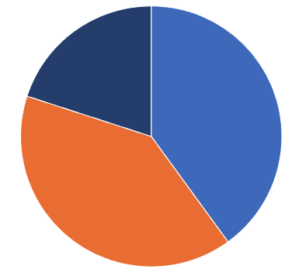
Portfolio Review 50% long Invested in a low volatility Long Term Bull Market
Current Capital at Risk
Risk On
World is Getting Better
(TSLA) 4/$450-$500 call spread | 20.00%
(TLT) 4/$142-$145 put spread | 20.00%
Risk Off
World is Getting Worse
(TLT) 4/$127-$130 call spread | -10.00%
No Current Positions
Total Net Position | 50.00%
Expiration P&L +46.77 YTD

Slide 5
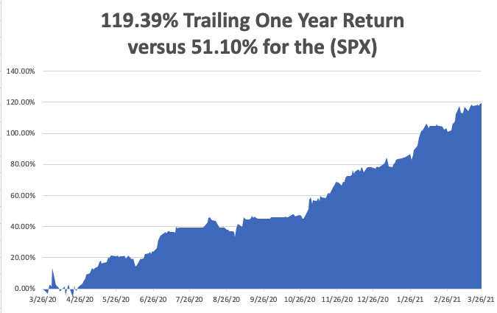

Slide 6
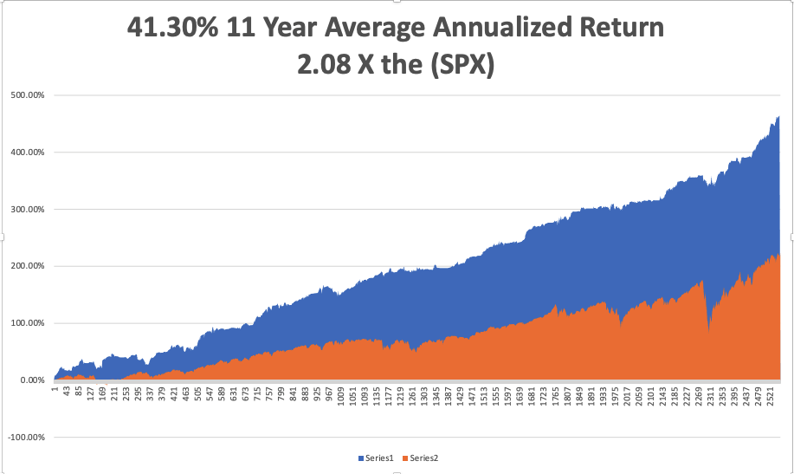
GTD 11 Year Daily Audited Performance

Slide 7
The Method to My Madness The Roaring Twenties are Here
*Bonds are still the driver, with the ten-year yield hitting 1.76% going to a 2.00% top *Any bond reversal will trigger a big tech rally and a bank selloff *It’s now, all about a global economic recovery and “RISK ON” *Commodity boom continues, with industrial metals hitting new highs, dragging oil upward *Bitcoin has become the best risk indicator in the market, topping a new high of $61,000 *A VIX at $18 means that stock moves will be limited in the near future *Historically interest rates are still extremely low and will be until a 3.0% ten-year yield

Slide 8
Corona Update – Light at the End of the Tunnel
*Massive distribution effort is accelerating, reaching 3.5 million vaccinations on Friday *Non-mask states are seeing a rise in cases *All Americans to gain vaccine access by April 15 *All schools to open by August In a year, everyone with either be vaccinated, have had the disease or be dead. *At least 50 variants now in circulation, the race is to inoculate before the more fatal ones spread. Look for an annual booster shot by September with new variants *US cases top 30.2 million, deaths topping 550,000 and have plunged from 4,500 a day to under 1,000 a day

Slide 9
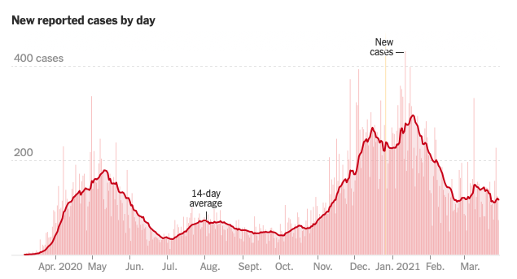
Cause for Worry

Slide 10
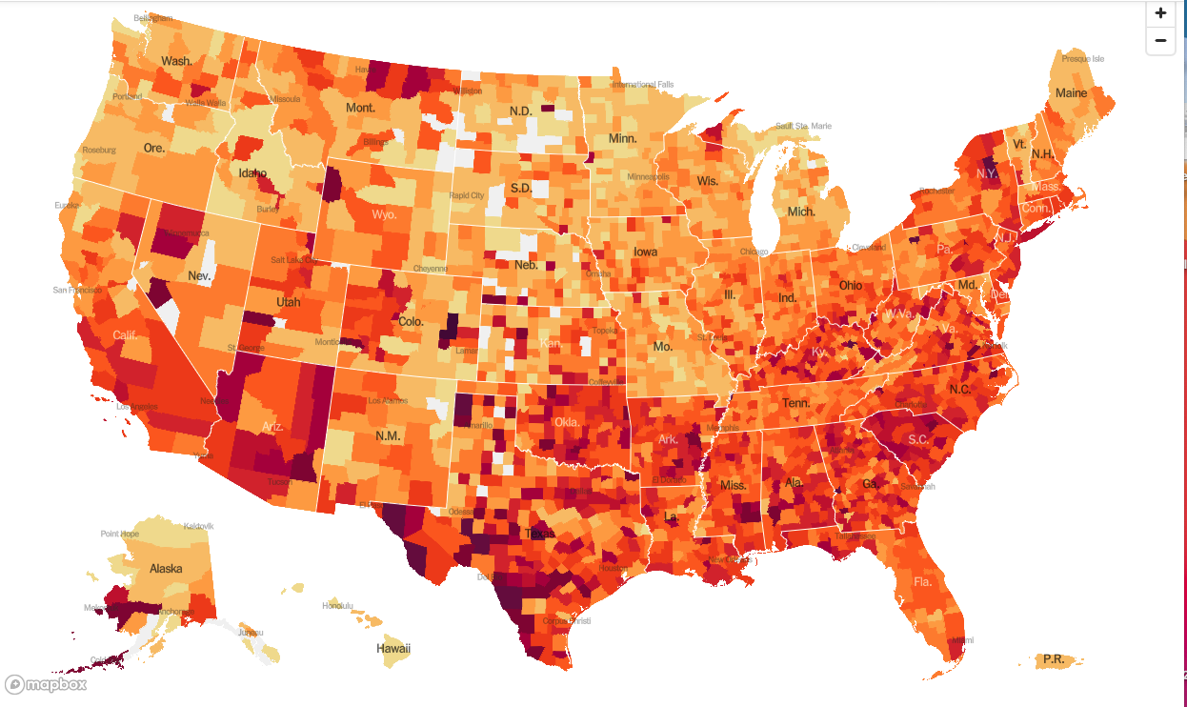
January 20 Infection Rate

Slide 11
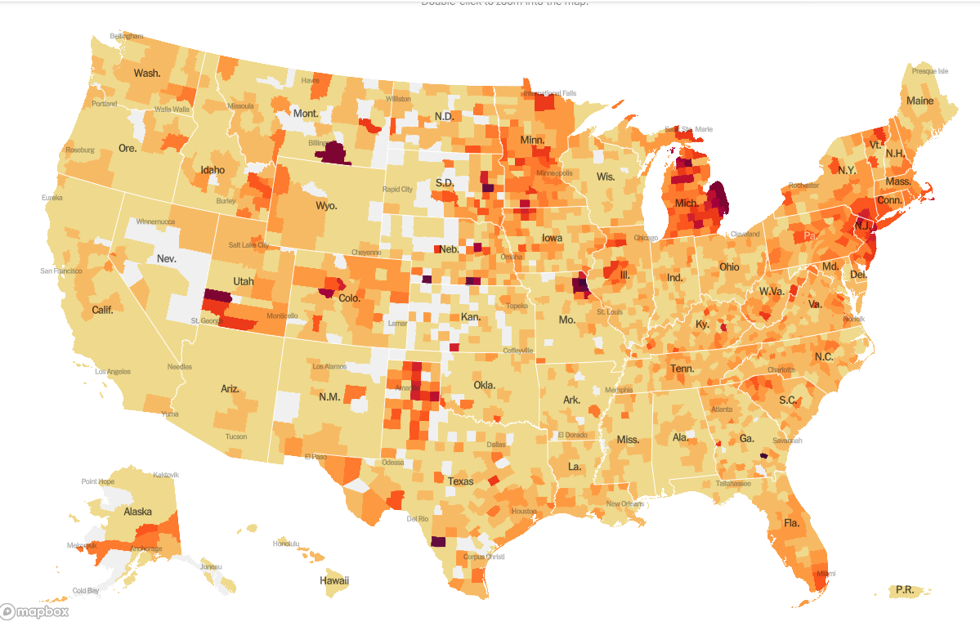
March 31 Infection Rate

Slide 12
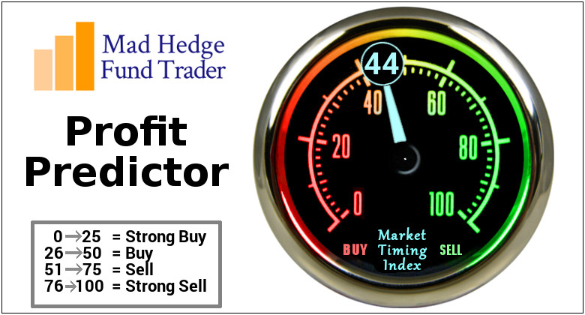
The Mad Hedge Profit Predictor Market Timing Index-Bottom of Range-at a “BUY” An artificial intelligence driven algorithm that analyzes 30 different economic, technical, and momentum driven indicators

Slide 13
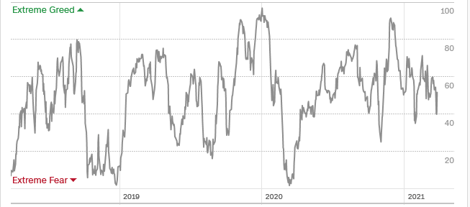
The Mad Hedge Profit Predictor Neutral Chop
SELL
Do Nothing
BUY

Slide 14
The Global Economy – Road to Recovery
*Biden has $3 Trillion More to Spend, providing more rocket fuel for the economy, sees Record 6% GDP Growth for 2021 *A Tax Hike is Next on the Menu. Corporate tax rates are returning from 21% to 28% *Fed to Hold off on Rates Hikes Through 2023, Weekly Jobless Claims Dive by 100,000 *IRS Pushes Back Tax Deadline a Month, from April 15 to May 17 *Fed Increases Bank Reserve Requirements, the first tightening move in years *Suez Canal blockage took a bite our of Chinese and European growth, stopping 10% of international trade * Chinese Industrial Production is on Fire, up 15% YOY, showing the way for America’s own recovery

Slide 15
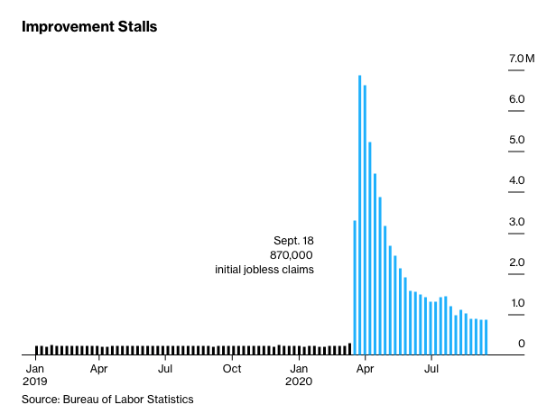
Weekly Jobless Claims – Flatlining at record highs 685,000 - 18.9 million still collecting unemployment checks

Slide 16
Stocks – Margin Call
*It’s going to be All About Stock Picking for the rest of 2021 as major indexes hit new highs *Hedge fund blow up triggers $20 billion sales at market and $10 billion in bank losses *Volatility Index Hits a One Year Low, down from $32 to $18 in two weeks signaling a boring market ahead *Value Stocks are still trouncing Growth Stocks, reversing a decade long trend *CP Rail Buys Kansas City Southern, for $25 billion, putting focus on transports *Blame the Ports for the Chip Shortage *Tech stocks are joined at the hip with bond prices, matching declines tic for tic *Stick with the barbell strategy, we’ll keep rotating back and forth all year *We could be entering a wide $2,700 - $3,600 range until the election

Slide 17
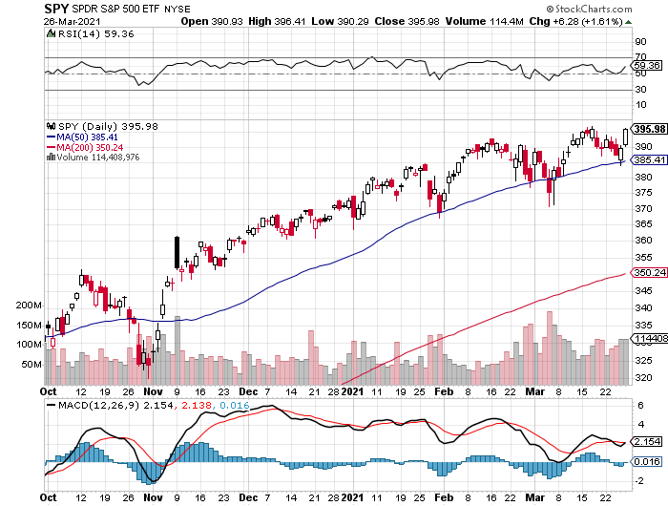
S&P 500 – Got Away with 2 Shorts in a Rising Market took profits on long 3/$405-$410 bear put spread took profits on long 3/$400-$405 bear put spread
New Highs
The Bottom Held 370

Slide 18
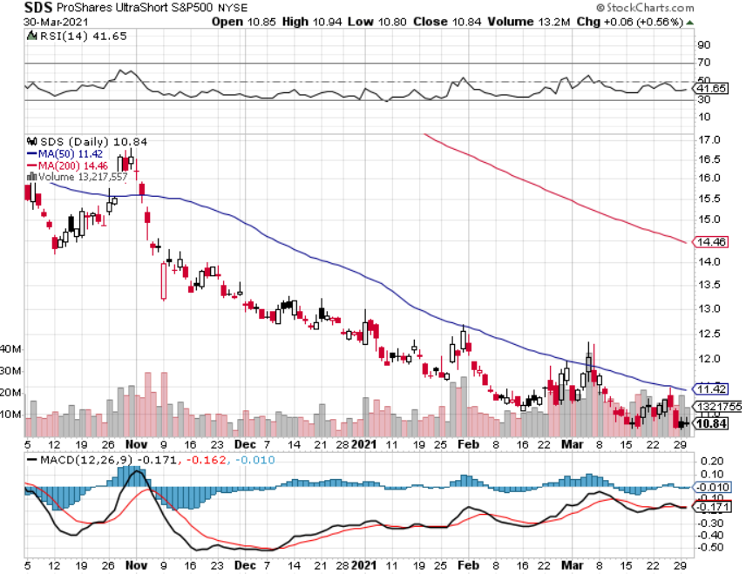
ProShares Ultra Short S&P 500 (SDS)- a Great Hedge for long stocks and bonds Long 2X position has a hedge against longs and bond shorts

Slide 19
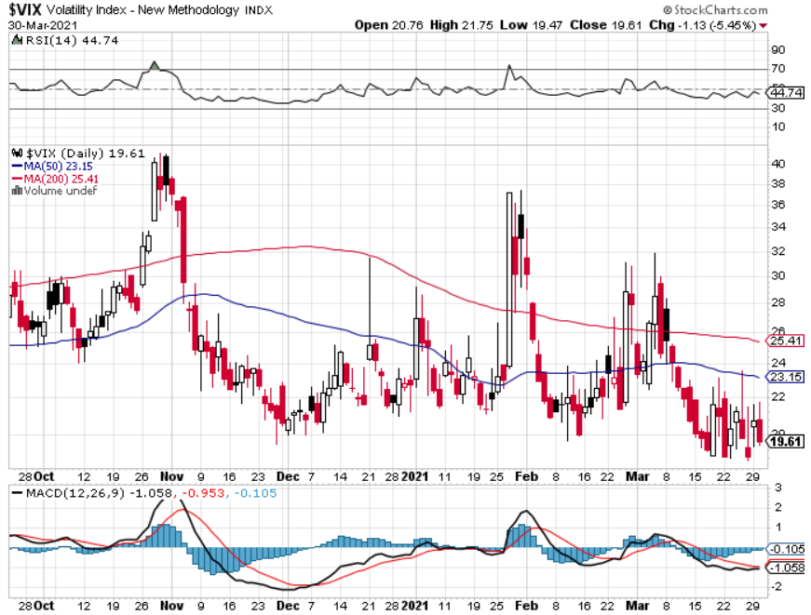
(VIX) – Dying a Slow Death The summer market is early

Slide 20
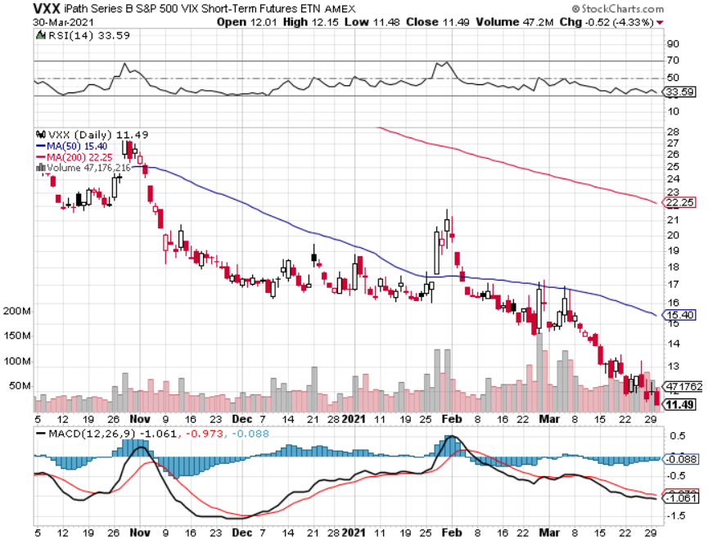
(VXX)-

Slide 21
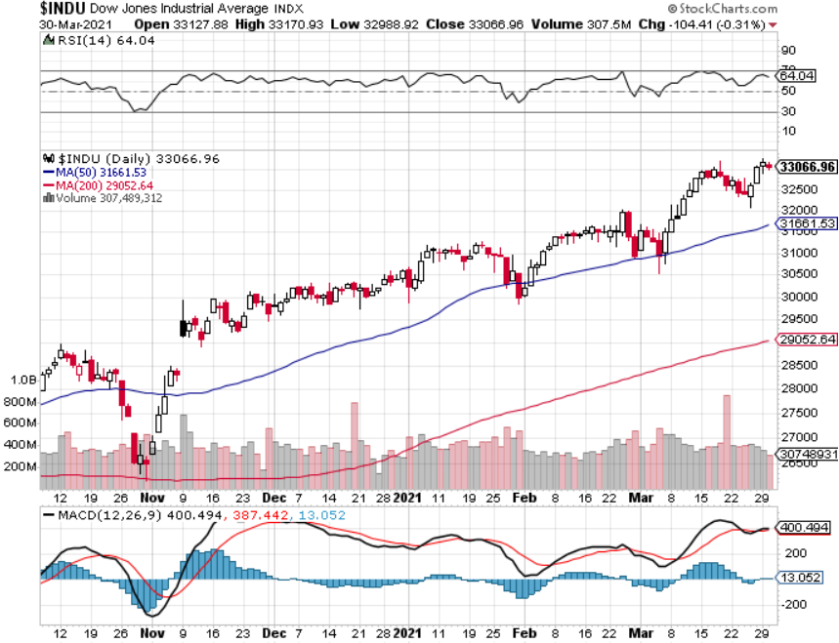
Dow Average ($INDU)-

Slide 22
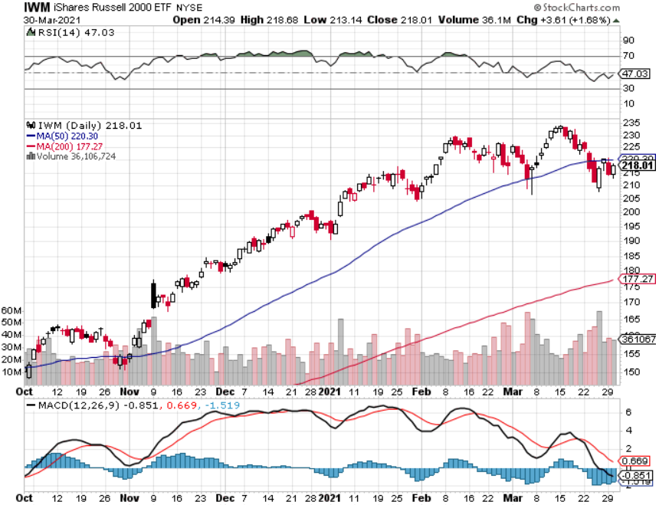
Russell 2000 (IWM)- took profits on Long 10/$137-$142 vertical bull call spread took profits on Long 10/$153-$156 vertical bear put spread

Slide 23
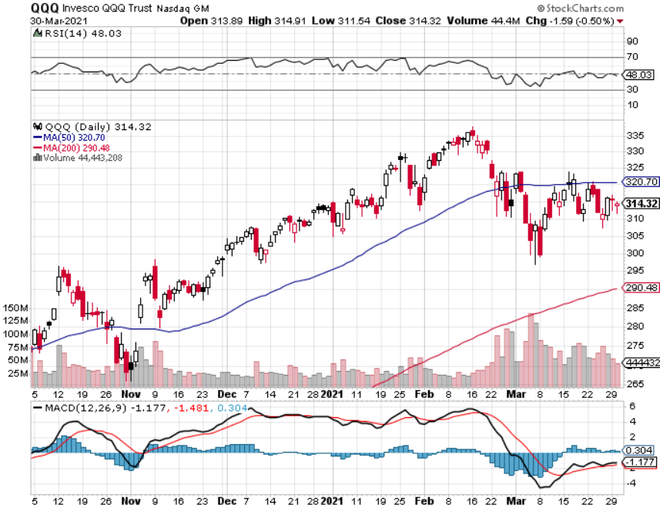
NASDAQ (QQQ) – long (QQQ) 4/$330-$335 put spread long (QQQ) 3/$340-$345 put spread-expires in 2 days covered long (QQQ) $325-$330 put spread

Slide 24
The Barbell Portfolio
*50% Big Tech - 2% of US Employment but 27% of Market Cap and 38% of Profits 50% Domestic Recovery, including: Railroads Couriers Banks Construction Credit Cards Event organizers Ticket sales Retailers

Slide 25
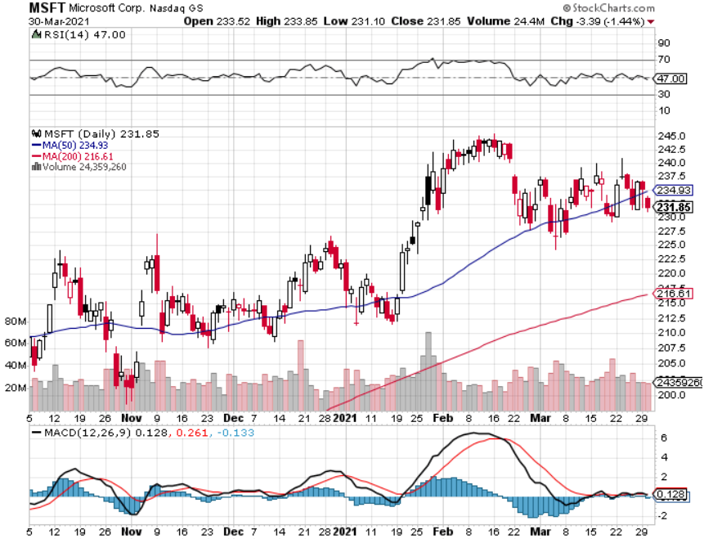
Microsoft (MSFT)- Earnings beat- Looking for Another Entry Point stop loss on long 12/$170-$180 call spread took profits on long 12/$135-$138 call spread

Slide 26
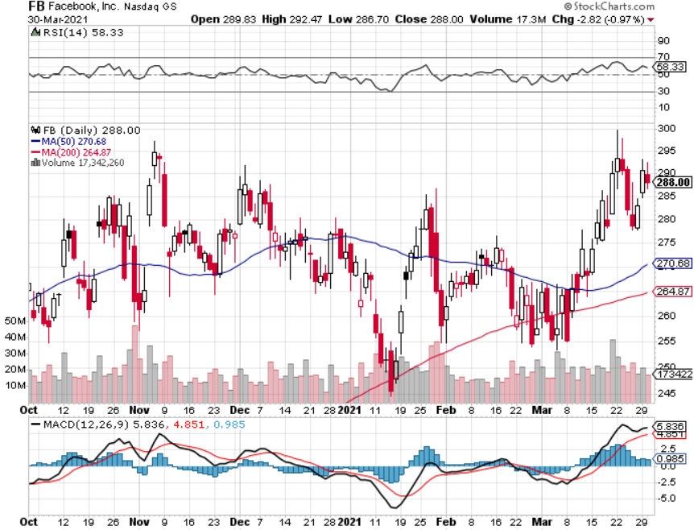
Facebook (FB)- took profits on Long 9/$290-$300 vertical bear put spread stopped out of Long 9/$190-$200 vertical bear put spread took profits on Long 9/$145-$155 vertical bull call spread took profits on Long 9/$150-$160 vertical bull call spread

Slide 27
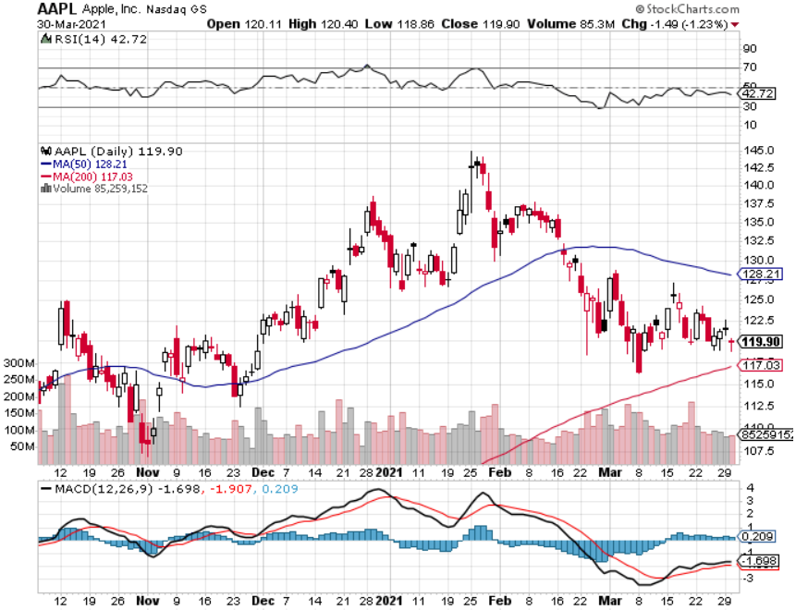
Apple (AAPL)- New 5G iPhone Surge Apple car moving forward with KIA took profits on long 7/$320-$330 call spread took profits on long 4/24/$250-$260 call spread took profits on long 5/$250-$260 call spread

Slide 28
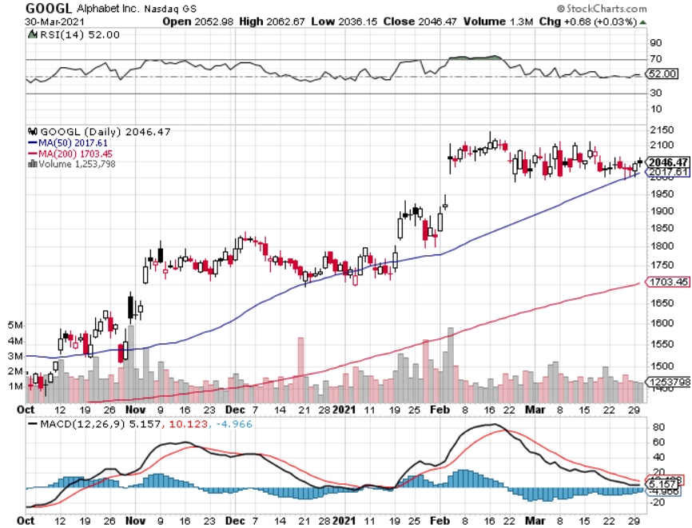
Alphabet (GOOGL) – Ad king on economic recovery 15% of search is travel related took profits on long 12/$1,200-$1,230 bull call spread took profits on long 9/$1,030-$1,080 vertical bull call spread

Slide 29
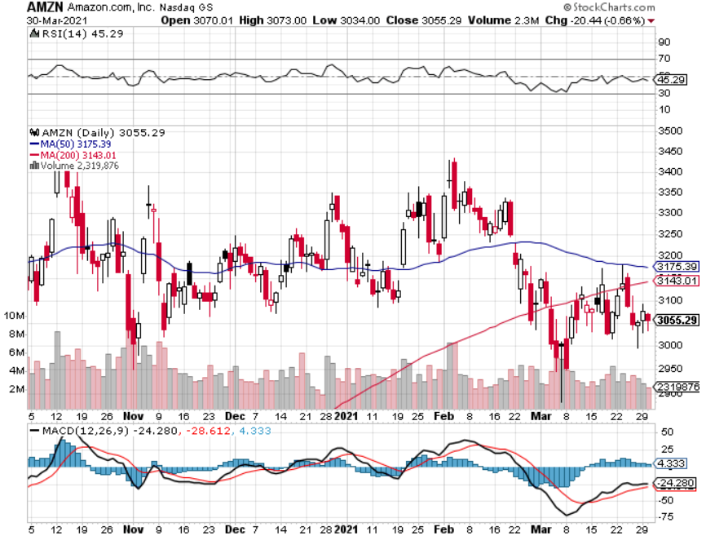
Amazon (AMZN) – Time correction took profits on long 9/$2,800-$2,900 bull call spread

Slide 30
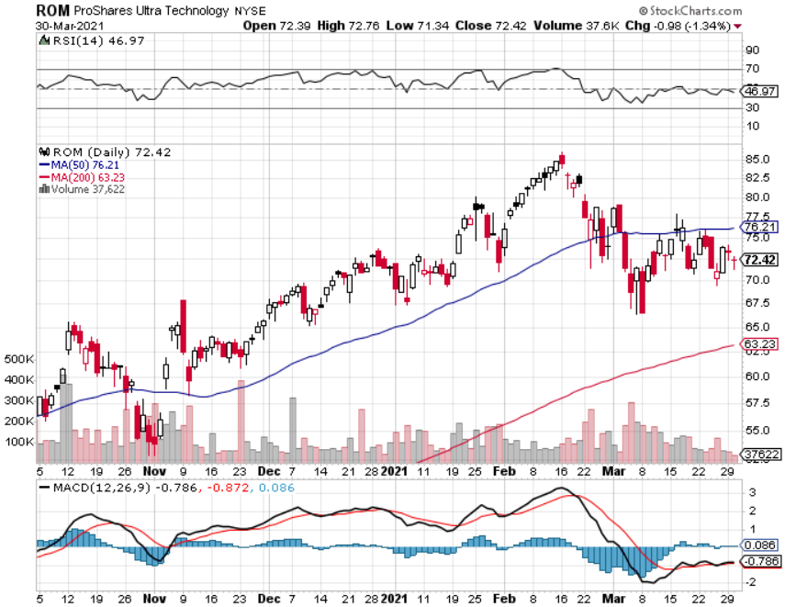
ProShares Ultra Technology (ROM) – Up 270% in 9 Months

Slide 31
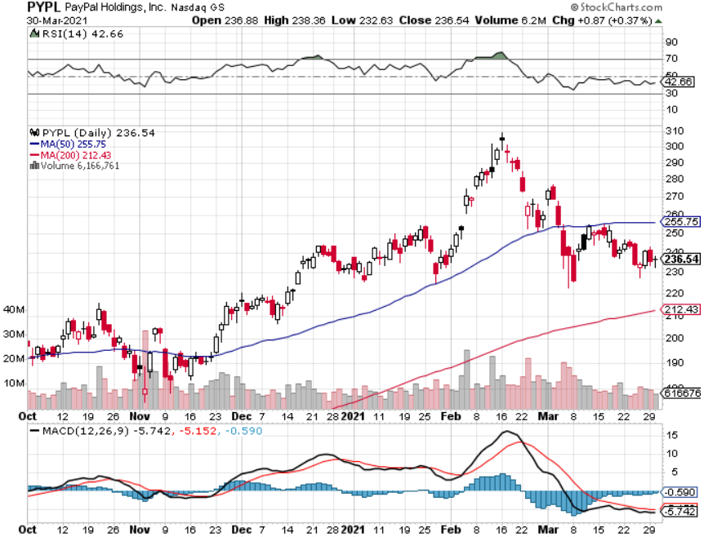
PayPal (PYPL)-Fintech Rules took profits on long 4/$90-$95 call spread

Slide 32
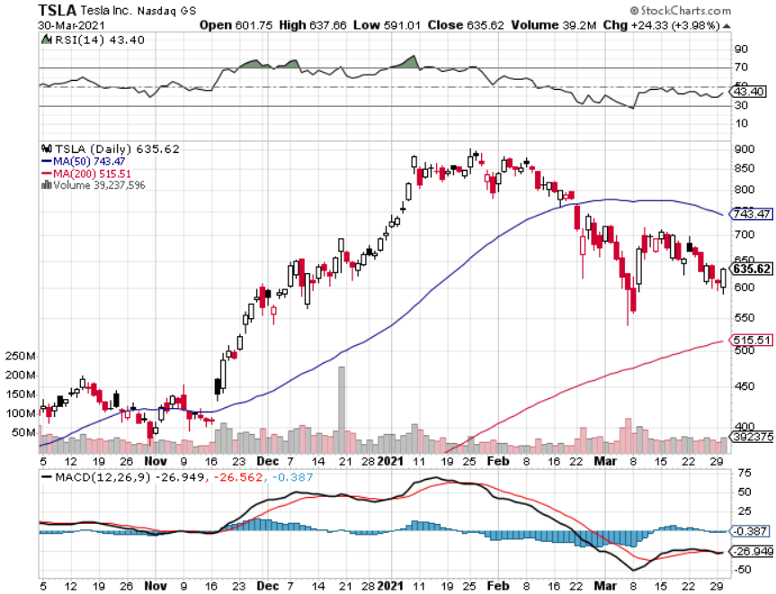
Tesla (TSLA)-Another Tesla $3,000 Target was issued by Ark’s Cathy Wood long 2X 4/$450-$500 call spread – expires in 12 days took profits on long 3/$400-$450 call spread took profits on long 2/$650-$700 call spread-expires, stopped out of long 3/$600-$650 call spread Took profits on long 2/$600-$650 bull call spread, Took profits on long 2/$550-$600 bull call spread

Slide 33
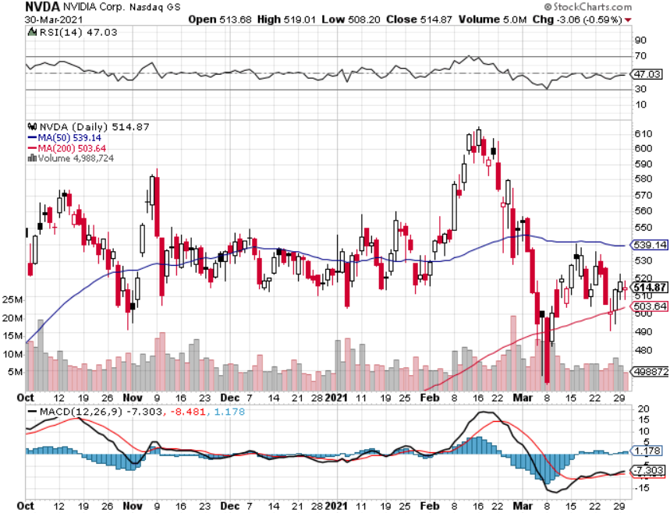
NVIDIA (NVDA) – The Biggest Chip Deal in History A Mad Hedge 10 bagger – Global Semiconductor Shortage Slows Auto Industry,

Slide 34
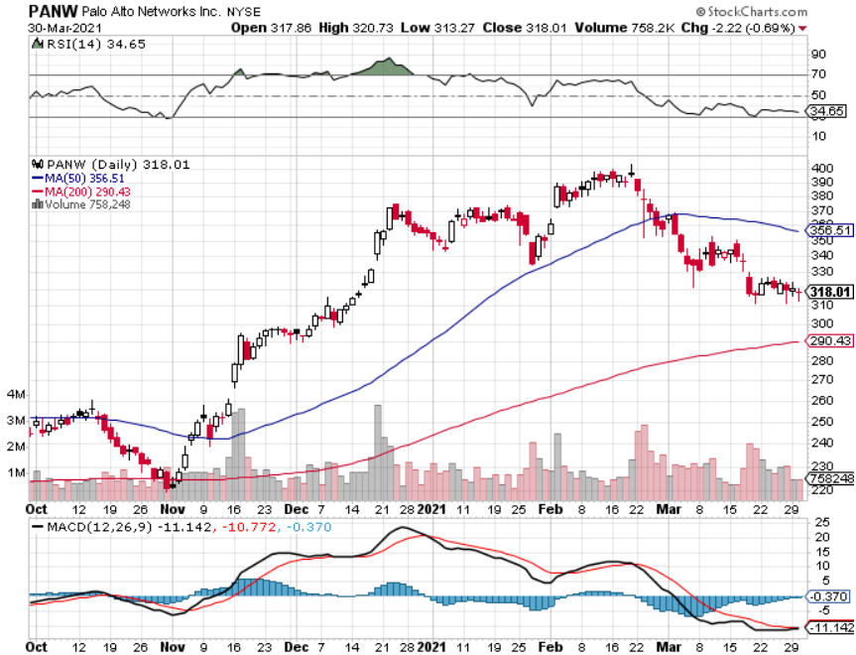
Palo Alto Networks (PANW)- Hacking never goes out of fashion

Slide 35
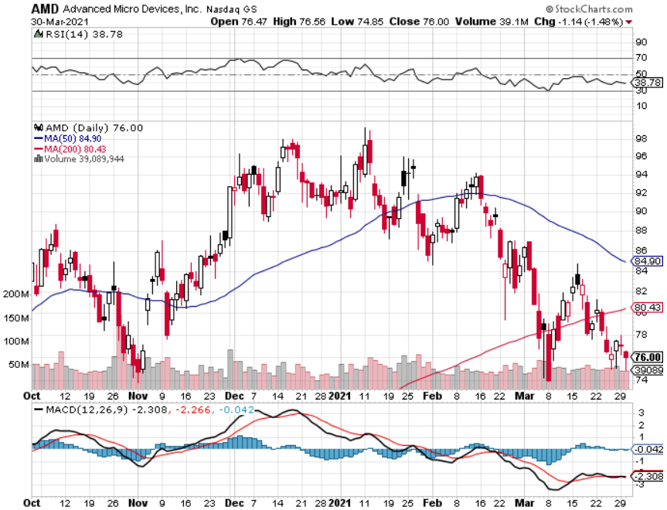
Advanced Micro Devices (AMD)- the next ten bagger - buys Xilinx – Programable logic devices took profits on long 2/$75-$80 call spread

Slide 36
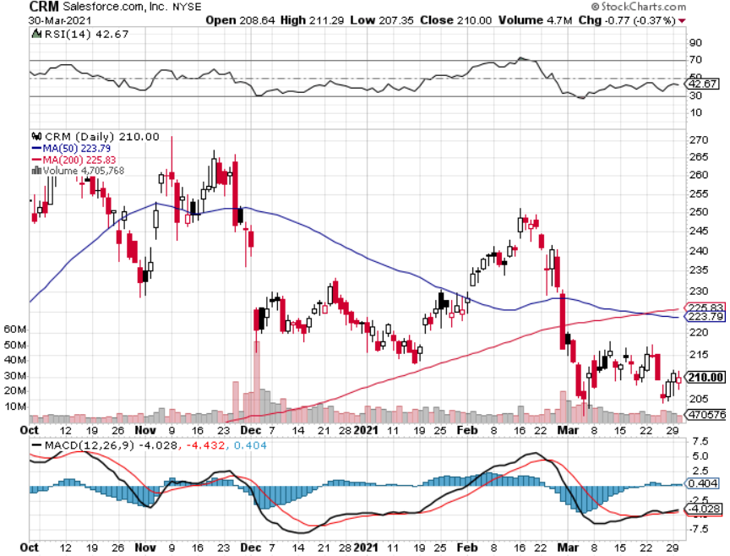
Salesforce (CRM)- Massive Online Migration took profits on long 9/$125-$130 vertical bull call spread took profits on long 8/$125-$130 vertical bull call spread took profits on long 2/$105-$115 call spread

Slide 37
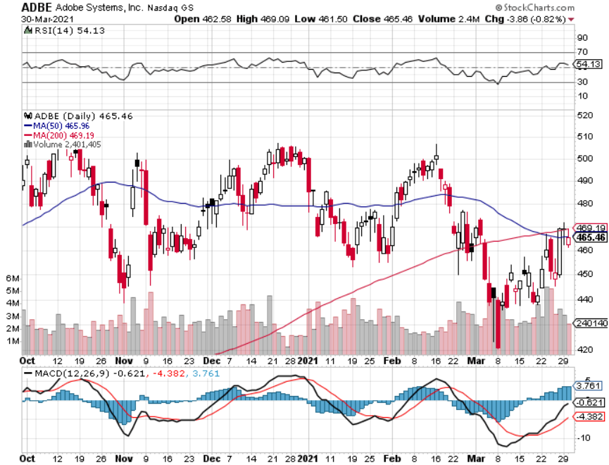
Adobe (ADBE)- Cloud play The Quality Non-China tech play

Slide 38
The Second Half of the Barbell
*Bets on a domestic recovery in 2021 *Upside potential in 2021 far greater than tech *Some of these have not moved for 5 or 10 years *Focuses on economically sensitive cyclical industries *Makes a great counterweight to high growth technology *We could spend all of next year rotating between the two groups

Slide 39
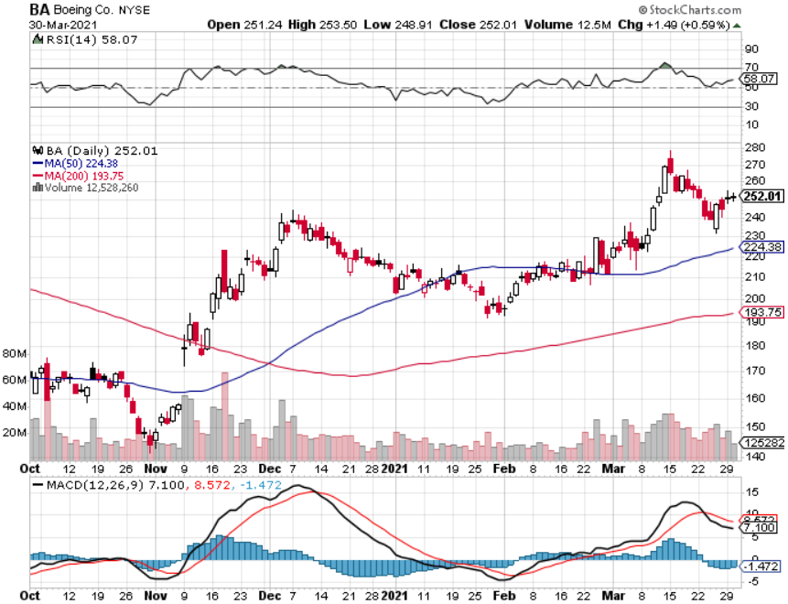
Boeing (BA) – former LEAP Candidate - The 737 MAX Flies Again! First positive deliveries in 14 months, new orders from (UAL) and (ALK) long 3/$146-$149 call spread took profits on long 2/$150-$160 call spread took profits on long 4/$300-$310 call spread took profits on long 4/$315-$335 call spread

Slide 40
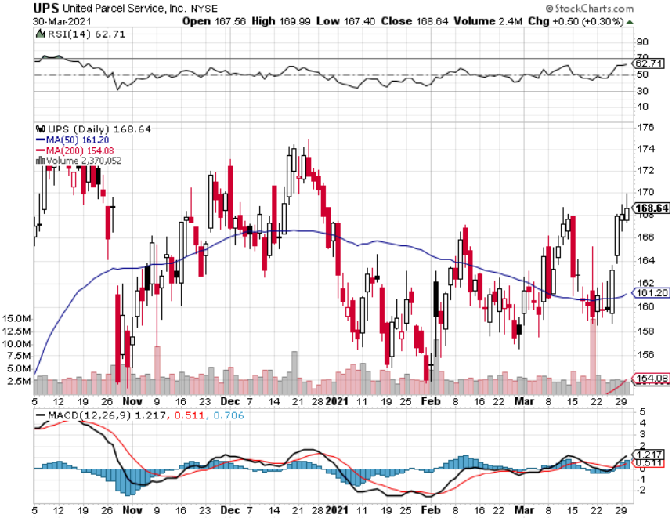
Package Delivery- United Parcel Service (UPS) massive increase in overnight deliveries, announces blowout earnings took profits on long 11/$130-$140 call spread

Slide 41
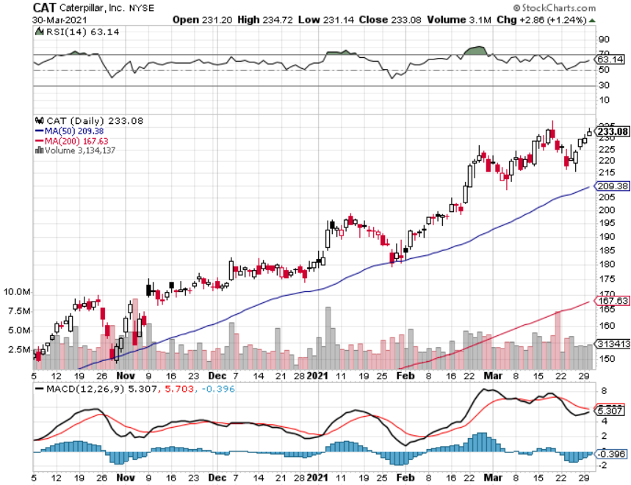
Caterpillar (CAT)- Ag + Infrastructure + Housing took profits on long 12/$145-$150 call spread took profits on long 11/$125-$135 call spread

Slide 42
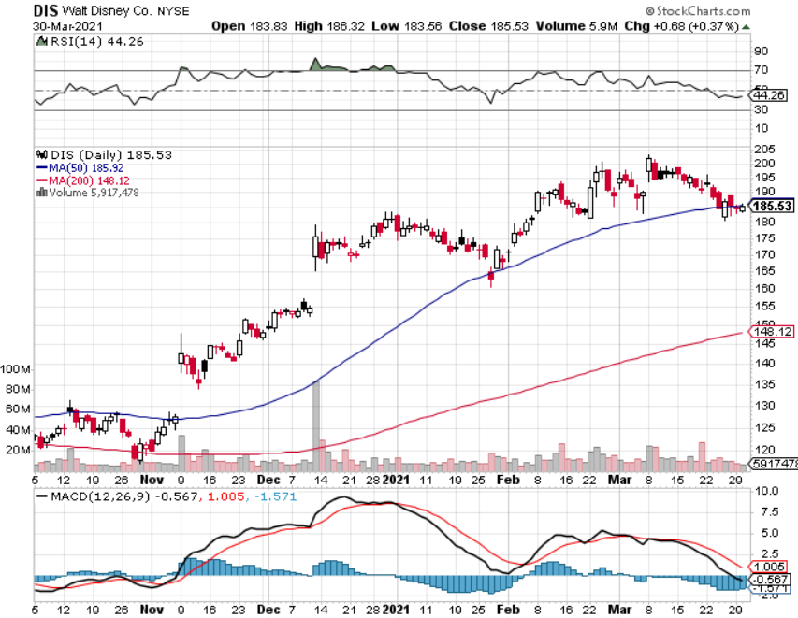
Walt Disney (DIS)- Big Recovery Move Disney Plus Streaming top 100 million subscribers in 15 months long 3/$170-$180 call spread-expires in 2 days

Slide 43
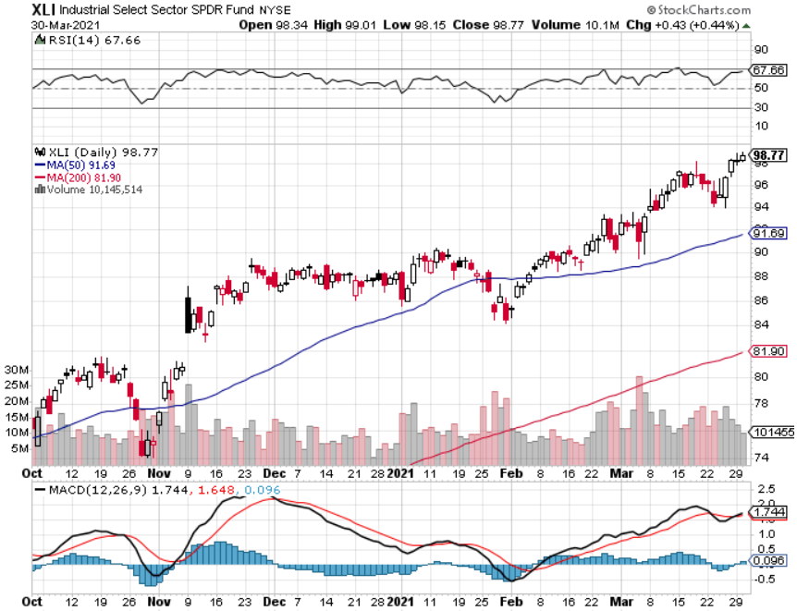
Industrials Sector SPDR (XLI)- (GE), (MMM), (UNP), (UTX), (BA), (HON)

Slide 44
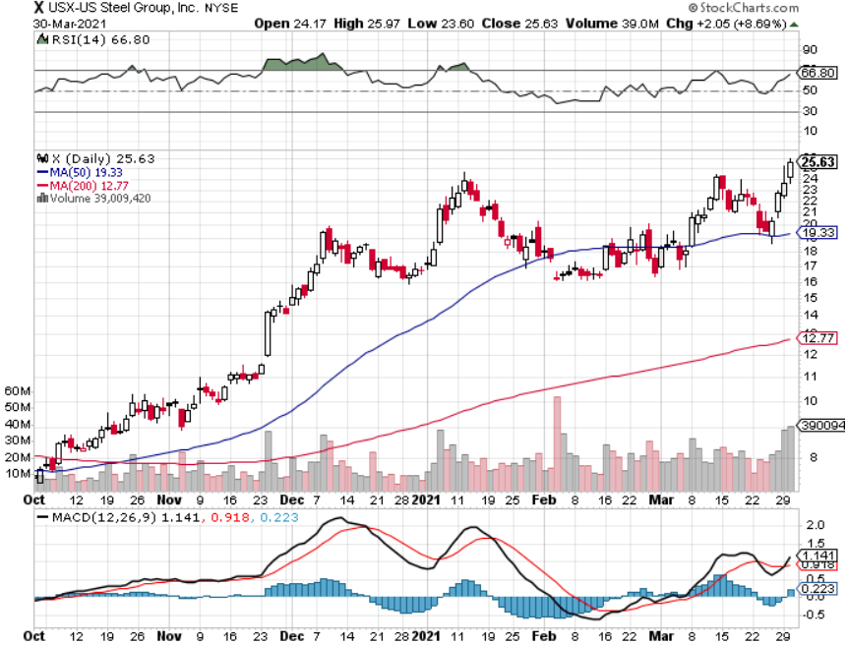
US Steel (X) – Commodity Boom

Slide 45
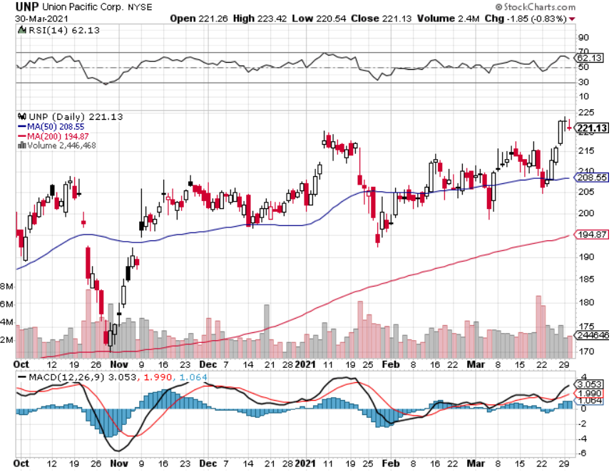
Union Pacific RR (UNP)- More stuff to ship near record earnings announced took profits on 11/$150-$160 call spread

Slide 46
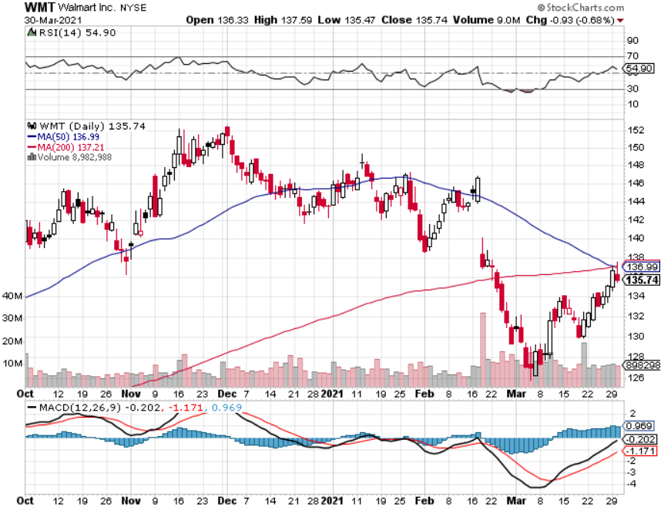
Wal-Mart (WMT)-New High took profit on Long 11/$125-$130 bear put spread took profit on Long 10/$119-$121 bear put spread took profits on Long 8/$114-$117 bear put spread

Slide 47
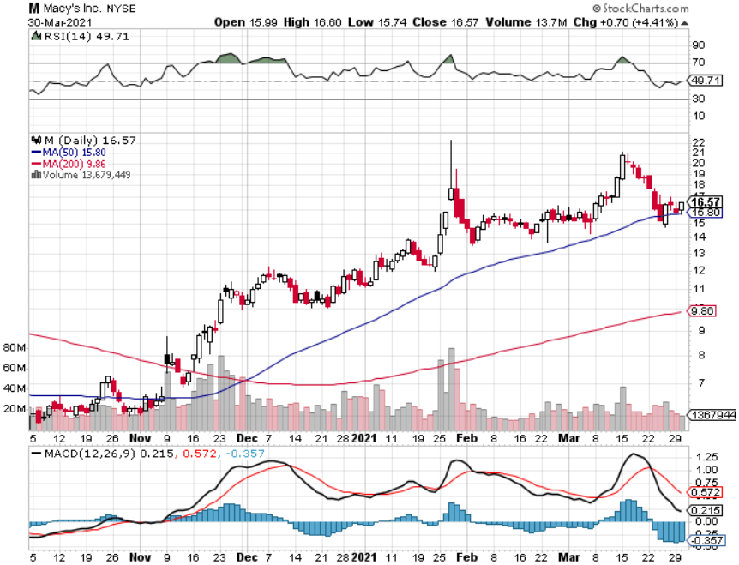
Macys’ (M) – Retail Return from the Grave took profits on Long 8/$23-$25 bear put spread

Slide 48
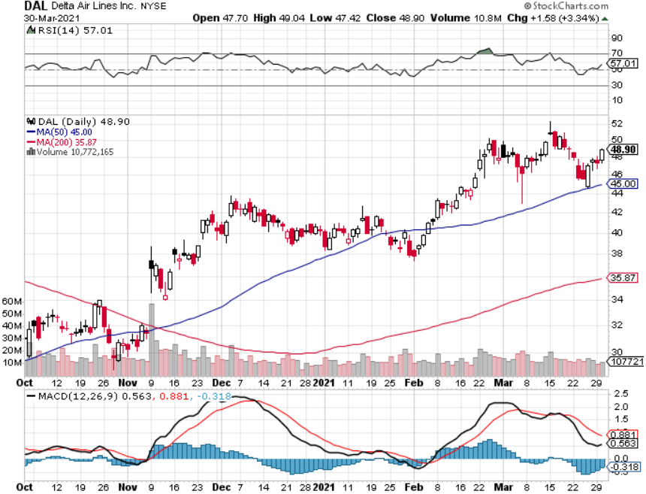
Delta Airlines (DAL) –

Slide 49
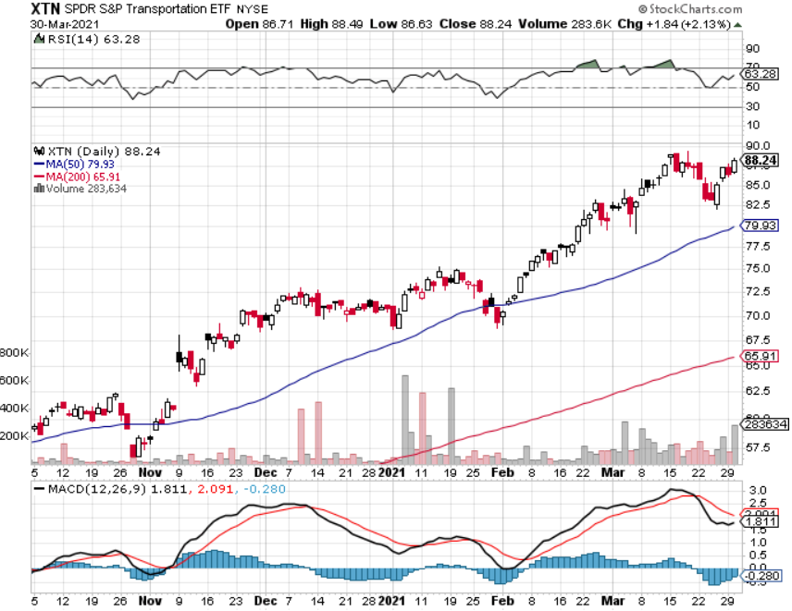
Transports Sector SPDR (XTN)- Worst Hit Sector (ALGT), (ALK), (JBLU), (LUV), (CHRW), (DAL)

Slide 50
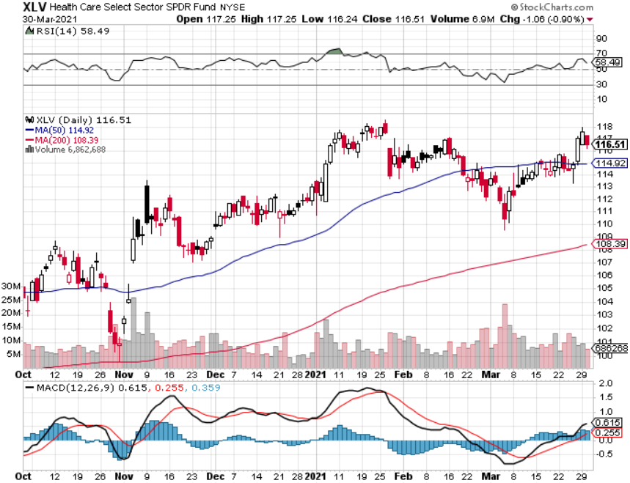
Health Care Sector (XLV), (RXL) (JNJ), (PFE), (MRK), (GILD), (ACT), (AMGN)

Slide 51
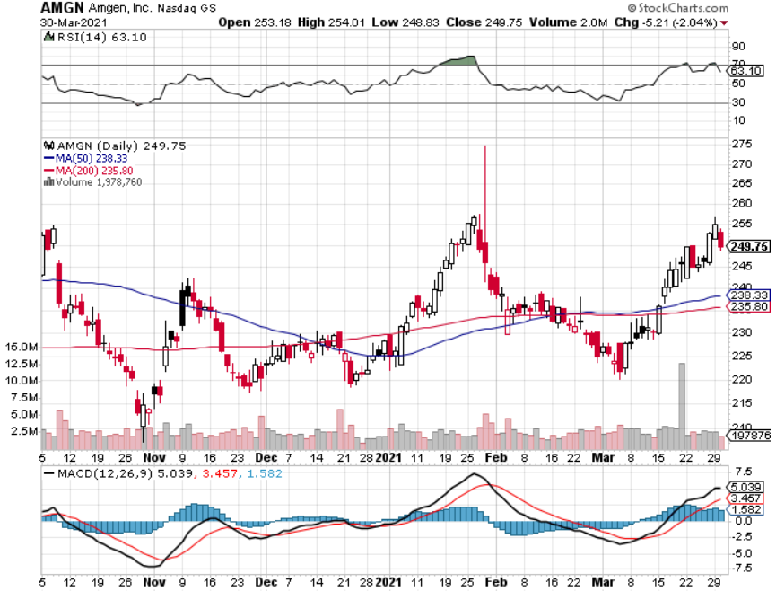
Amgen (AMGN) took profits on long 11/$185-$200 bull call spread

Slide 52
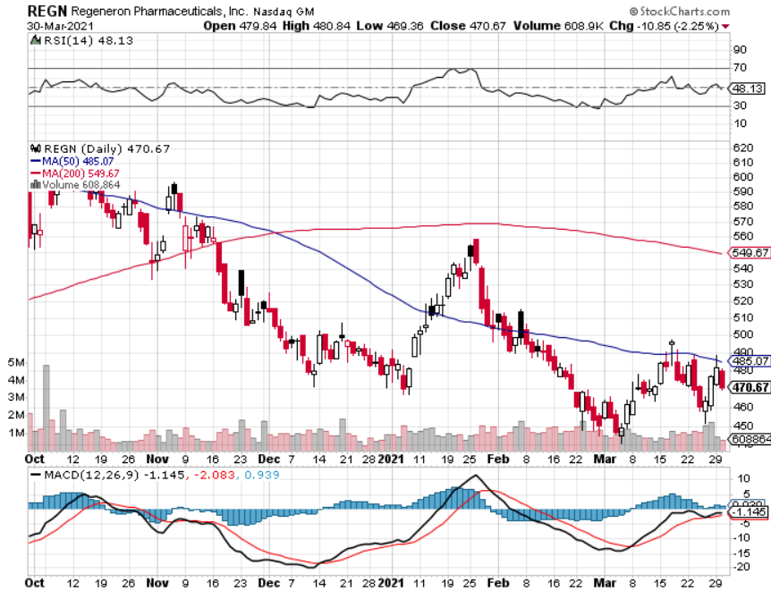
Regeneron (REGN) took profits on long 7/$570-$580 call spread

Slide 53
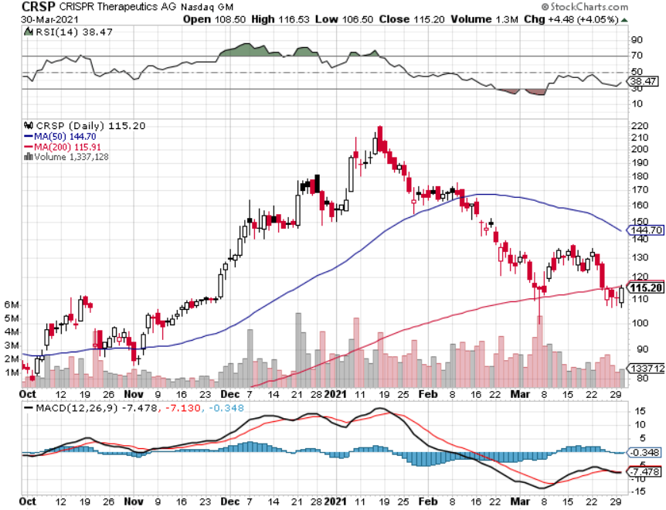
CRISPR Therapeutics (CRSP)

Slide 54
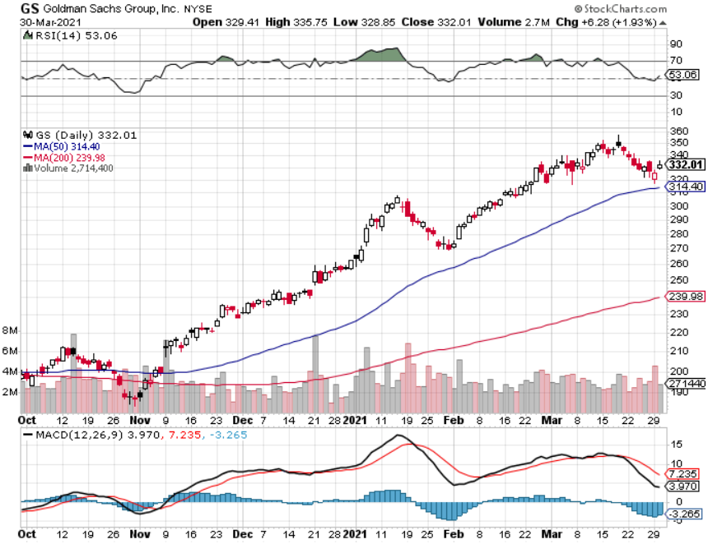
Goldman Sachs (GS) – took profits on long 2/$240-$260 call spread

Slide 55
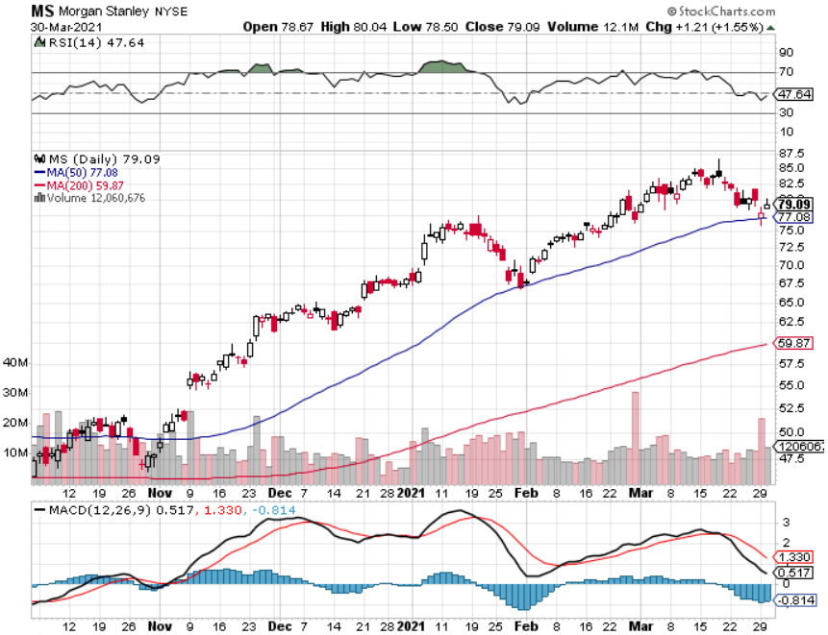
Morgan Stanley (MS) – Blowout Earnings took profits on long 2/$55-$60 call spread

Slide 56
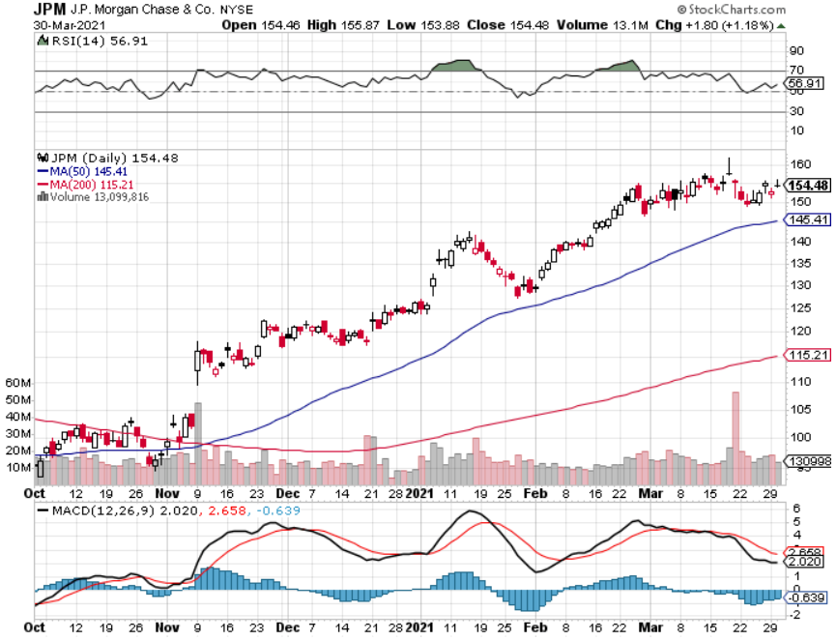
JP Morgan Chase (JPM)-Rising Rates long 2/$135-$140 call spread took profits on long 2/$110-$115 call spread took profits on long 12/$100-$105 bull call spread took profits on long 11/$85-$90 bull call spread

Slide 57
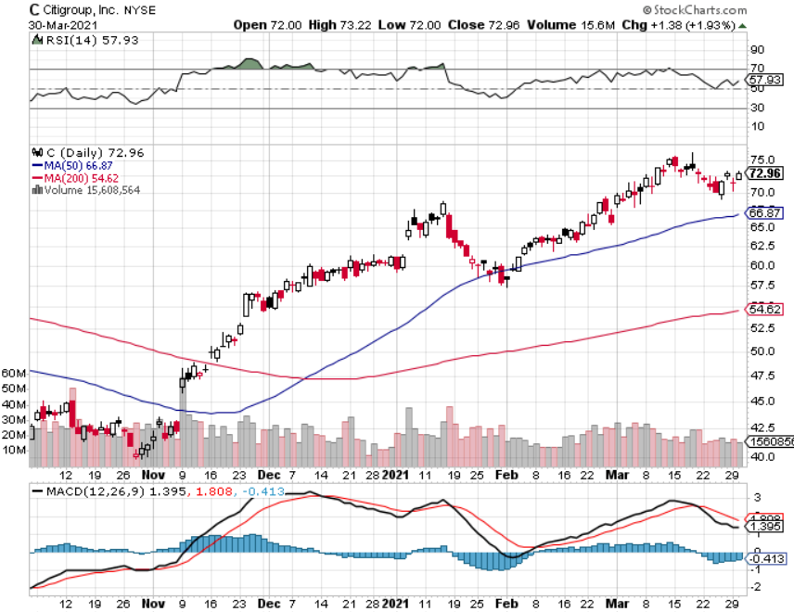
Citigroup (C) – “Recovery” Rotation Play

Slide 58
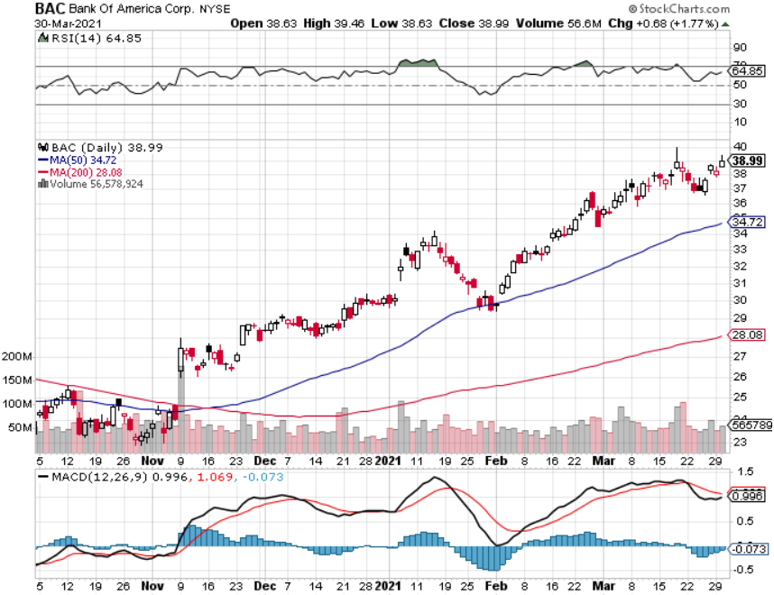
Bank of America (BAC) – took profits on long 2/$28-$30 call spread

Slide 59
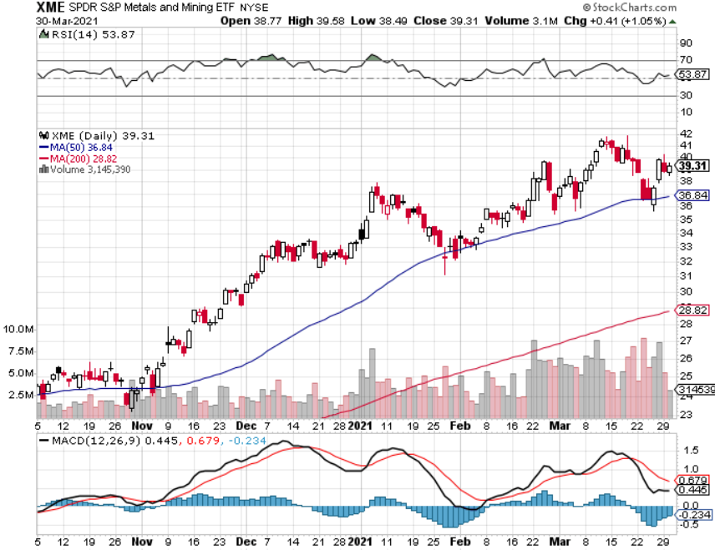
SPDR Metals & Mining ETF (XME) – long 2/$28-$30 call spread

Slide 60
Blackrock (BLK)-Asset Collection Boom took profits on long 3/$31-$34 call spread

Slide 61
Visa (V) – “Touchless” Fintech Play took profits on long 9/$180-$185 bull call spread

Slide 62
Consumer Discretionary SPDR (XLY) (DIS), (AMZN), (HD), (CMCSA), (MCD), (SBUX)

Slide 63
Berkshire Hathaway (BRKB)- Natural Barbell long 3/$230-$240 call spread-expires in 2 days

Slide 64
Europe Hedged Equity (HEDJ)-

Slide 65
Japan (DXJ)-

Slide 66
Emerging Markets (EEM) - Pro trade, Weak Dollar, long recovery Play

Slide 67
Bonds – Yield Spike
* Ten Year Bond Yields Soar to a 1.76%, setting financial stocks on fire and demolishing tech. *Keep a death grip on those bond shorts *Biden’s $3 trillion spending increase plan throws more fat on the fire *The $120 billion in monthly bond buying remains *Buy (JPM), (BAC), (C), (MS), and (GS) on dips. *A 2.00% yield on the ten-year US Treasury bond here we come! This is the quality trade of 2021 *US Treasury bond fund (TLT) could plunge from $180 to $105, taking interest rates from 0.31% to 3.25%

Slide 68
Treasury ETF (TLT) – Huge Short Play 2X long 4/$142-$145 put spread took profits on long 2/$146-$149 put spread took profits on long 3/$147-$150 put spread, took profits on long 2/$158-$161 put spread, took profits on long 2/$159-$162 put spread, took profits on long 2/$162-$165 put spread

Slide 69
Ten Year Treasury Yield ($TNX) – 1.63%

Slide 70
Junk Bonds (HYG) 3.33% Yield to Maturity

Slide 71
2X Short Treasuries (TBT)-Another run at highs

Slide 72
Emerging Market Debt (ELD) 4.27% Yield-

Slide 73
Municipal Bonds (MUB) – 0.83% Mix of AAA, AA, and A rated bonds

Slide 74
Foreign Currencies – The Hit Continues
* Dollar Hits Four Month High, with a major assist from rising US bond interest rates *Currencies thrown for a loop *Watch bond interest rates. When they peak, the buck is toast *Australian Dollars holds on to major gains *Any dollar rallies are temporary and short-term *Bitcoin hits new high at $61,000, then plunges again *Keep selling short all US dollar rallies, its yield support is gone forever

Slide 75
Japanese Yen (FXY), (YCS)

Slide 76
Euro ($XEU), (FXE), (EUO)-

Slide 77
British Pound (FXB)-

Slide 78
Australian Dollar (FXA)- The Global Recovery Play took profits on long 8/$67-$69 call spread

Slide 79
Emerging Market Currencies (CEW)

Slide 80
Chinese Yuan- (CYB)-

Slide 81
Bitcoin- Losing Momentum

Slide 82
Energy – Rolling over
*Oil Dives 15%, on fears of an imminent Saudi production increase and a worsening Covid-19 outlook in Europe *Only the Suez Canal disaster is preventing a faster fall, choking off supply to Europe and creating a recessionary 10% drop in international trade *High prices are bringing a flood of new supply to the point where it will hurt prices *Avoid all energy plays like the plague, it’s the new buggy whip industry as the US de-carbonizes *From here oil is the next big short play, look at two year put LEAPS

Slide 83
Oil-($WTIC)

Slide 84
United States Oil Fund (USO) long 10/$9.50-$10 Vertical bull call spread

Slide 85
Energy Select Sector SPDR (XLE)-No Performance! (XOM), (CVX), (SLB), (KMI), (EOG), (COP)

Slide 86
Halliburton (HAL)-

Slide 87
Natural Gas (UNG) -

Slide 88
Precious Metals – Stalled at a Bottom
*Sharply rising interest rates remain a threat to precious metals *No one believes we have come close to peaking *Gold has turned into the worst trade of 2021 *Is struggling to make a new bottom around here *It has turned into a bond long and and Bitcoin short and I don’t want either *Silver is the better play here on solar and EV demand *Bottom Line: buy this dip in gold and precious metals

Slide 89
Gold (GLD)- Meltdown

Slide 90
Market Vectors Gold Miners ETF- (GDX) –

Slide 91
Barrick Gold (GOLD) took profits on long 1/$21-$23 call spread took profits on long 11/$22-$24 call spread

Slide 92
Newmont Mining- (NEM)- took profits on long $55-60 call spread

Slide 93
Silver- (SLV)- took profits on long 11/$19-$20 call spread

Slide 94
Silver Miners - (SIL)-

Slide 95
Wheaton Precious Metals - (WPM)- took profits on long 2/$39-41 call spread

Slide 96
Copper (COPX)-Finally a break

Slide 97
Freeport McMoRan (FCX)-World’s Largest Copper Producer took profits on long 4/$10-$11 call spread took profits on short 4/$114 calls

Slide 98
Real Estate – Negative Data Deluge
* Existing Home Sales Crash, in February, down 6.6%. *New Housing Starts Collapse, from an expected +2.5% to -10.3%, as high lumber, land, labor, and interest rates take their toll *New Home Sales Dive, off 18.2% in February *Mortgage Rates Rise 50 Basis Points This Year, from 2.76% to 3.36% *Closing costs are soaring, doubling in the hottest markets *Homebuilder Sentiment Drops, 2 points to $82 *Housing prices are still exploding to the upside with S&P Case Shiller Rose 10.4% in December, the one-month biggest spike in history

Slide 99
November Corelogic S&P Case Shiller Home Price Index Phoenix (14.4%), Seattle (13.6%), and San Diego (13.0%)
Tradingeconomics.com

Slide 100
Simon Property Group (SPG)- Mall REIT A Huge Vaccine Play

Slide 101
Crown Castle International (CCI) – 3.42% yielding cell phone Tower REIT

Slide 102
US Home Construction Index (ITB) (DHI), (LEN), (PHM), (TOL), (NVR)

Slide 103
Trade Sheet- So What Do We Do About All This?
*Stocks – buy dips aggressively *Bonds – sell rallies aggressively *Commodities-buy dips *Currencies- sell US dollar rallies *Precious Metals – buy dips *Energy – stand aside *Volatility - sell short over $30 *Real estate – buy dips

Slide 104
Next Strategy Webinar 12:00 EST Wednesday, April 14, from Silicon Valley email me questions at support@madhedgefundtrader.com
Good Luck and Good Trading!
Notes:
*

