Slide 1
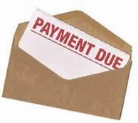
The Mad Hedge Fund Trader
“The Bill Comes Due”
Did Somebody Say Sell in May?
With John Thomas
from Lake Tahoe, NV, May 12, 2021
www.madhedgefundtrader.com
Notes:
*

Slide 2

A 4.7 Earthquake Hits Lake Tahoe

Slide 3

Trade Alert Performance
New All Time Highs!
32 consecutive profitable trade alerts-
57 out of 59 profitable-96.6% success rate in 2021-ony 2 losers
*January 10.21% MTD *July +7.93% Final
*February +13.28% Final *August -2.08% Final
*March +20.60% Final *September 7.95% Final
*April +15.67% Final *October +1.51% Final
*May +2.38% MTD *November +20.41% Final
*June +10.38% Final *December +10.20% Final
*2021 Year to Date +62.14%
compared to +14.50% for the Dow Average
*+484.69% since inception, a new all time high
*Average annualized return of 42.01% for 11 years, new all time high

Slide 4
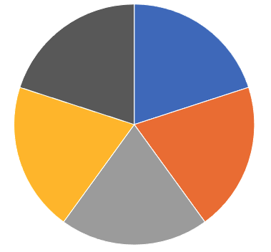
Portfolio Review
60% long Invested, 20% short in a low volatility Long Term Bull Market
Current Capital at Risk
Risk On
World is Getting Better
(TLT) 5/$144-$147 put spread | 10.00%
(TLT) 6/$145-$148 put spread | 10.00%
(UNP) 5/$200-$210 call spread | 10.00%
(DAL) 5/$40-$43 call spread | 10.00%
Risk Off
World is Getting Worse
(SPY) 5/$427-$432 puts spread | -10.00%
Total Net Position | 30.00%
Total Aggregate Position | 50.00%
Expiration P&L
+66.50
YTD

Slide 5
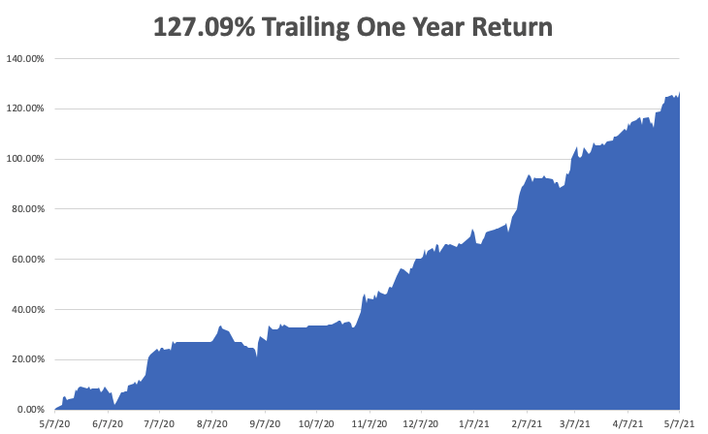

Slide 6
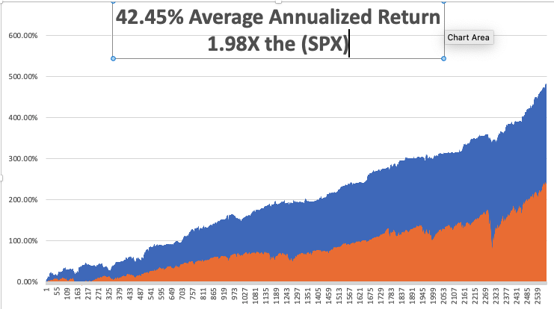
GTD 11 Year Daily Audited Performance

Slide 7

The Method to My Madness
The Roaring Twenties are Here
*Bonds hit top of one year downtrend at 1.48% and then fell hard, taking yields back to 1.68%
*A two-month range trading Bond Market is over, sending financials and commodities higher ad tech lower
*It’s now, all about a global economic recovery and “RISK ON”
*Commodity boom continues to new highs, with industrial metals hitting new highs, the copper shock is here
*Bitcoin has become the best risk indicator in the market,
is now stalled in a range
*A VIX at $25 will bring increasing volatility, start buying at $30
*Historically interest rates are still extremely low and will be until
a 3.0% ten-year yield

Slide 8

Corona Update – End of the Pandemic
*Massive distribution effort is proving hugely successful, 35% of the US population has been fully vaccinated, 45% fully vaccinated, 12–16-year-olds soon to qualify for the Pfizer vaccine
*New cases have fallen off a cliff, from 250,000 a day to 50,000, down 80%. The population is acting like herd immunity has already begun!
*In a year, everyone with either be vaccinated, have had the disease, or be dead.
*Every pandemic parameter started shrinking dramatically on January 20
*At least 50 variants now in circulation, with the most contagious and fatal one now dominant
*We may hit a vaccine glut by May so watch out for (PFE), (JNJ), (MRNA)
*US cases top 32.7 million, deaths topping 582,000 and are
down to 500 a day

Slide 9
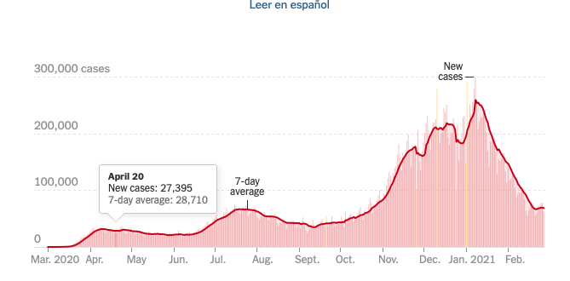

Slide 10
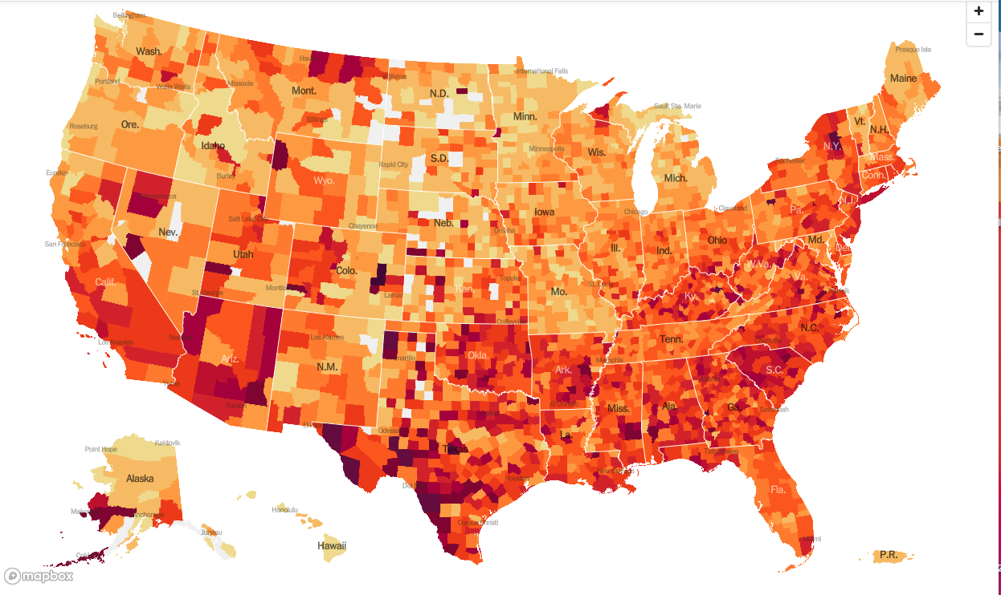
January 20 Infection Rate

Slide 11
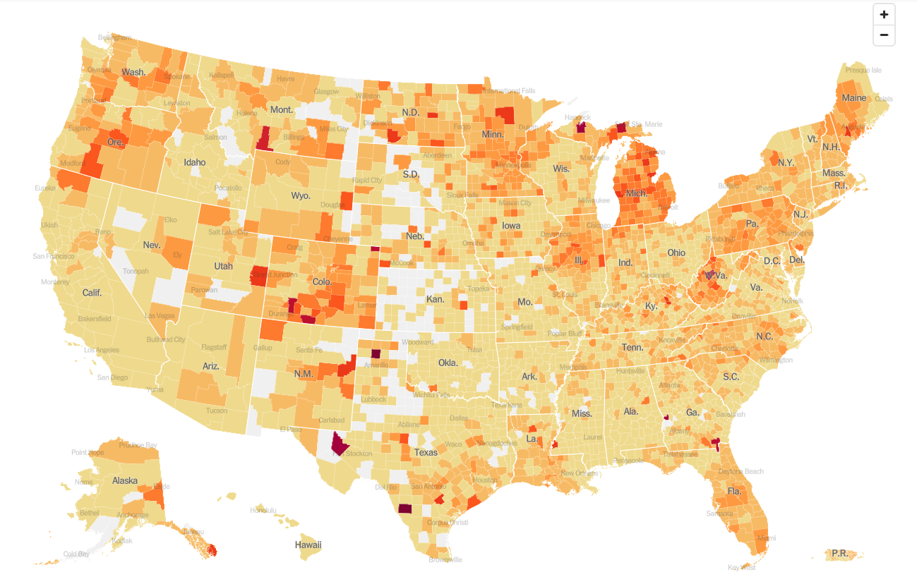
May 12 Infection Rate

Slide 12
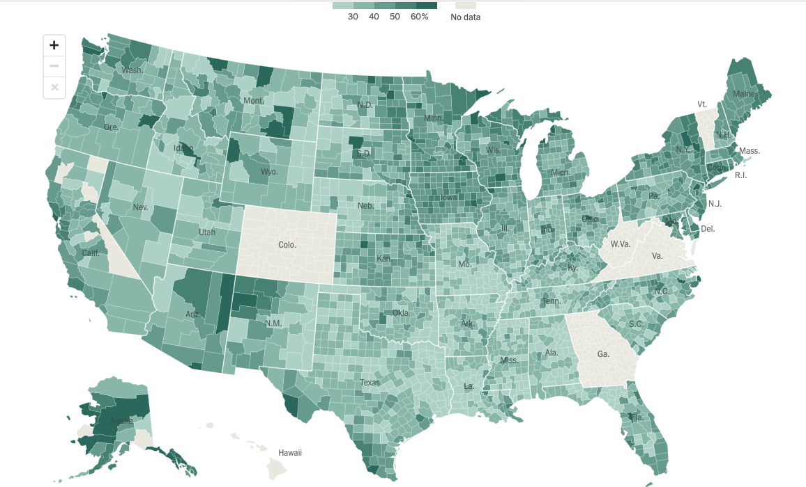
US Vaccination Rate

Slide 13

The Global Economy – Booming
*April Nonfarm Payroll Report is a Huge Disappointment, at 266,000 when up to one million was expected
*Weekly Jobless Claims Plunge to only 488,000
*The headline Unemployment Rate rose to 6.1%. It all highlights the need for more government spending
*US Factory Orders Gain, up 1.1% in March
*US Inventories See Solid Gains, with March up 1.3%
*US Trade Deficit Hits Record High, to $74.4 billion
*Europe’s Q1 GDP Falls By 0.6%

Slide 14
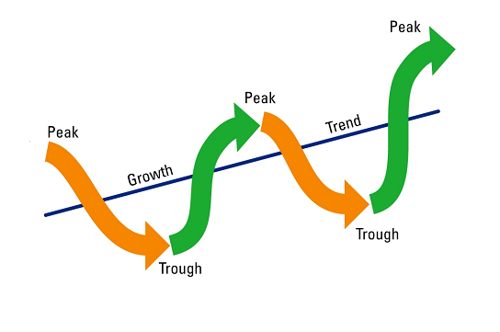
Stocks – Cyclicals are Still In
*Value and Cyclicals are Still the Big Play.
*Biden Puts a 25% Corporate Tax Rate on the Table
*The $1.9 trillion rescue package could be the turbocharger for hyper growth and greater gains and a $2.3 trillion infrastructure deal could keep stocks running for years
*Tech gets slaughtered again on new rising rate fears
*ESG Investing Approaches $2 Trillion
*There’s a New Dark Cloud Over Biotech
*At least another 14% in gains left for 2021,
(SPX) 4,800 here we come
*Stick with the barbell strategy, we’ll keep rotating back
and forth all year between tech & domestic recovery
*We could be entering a wide $2,700 - $3,600 range until the election

Slide 15
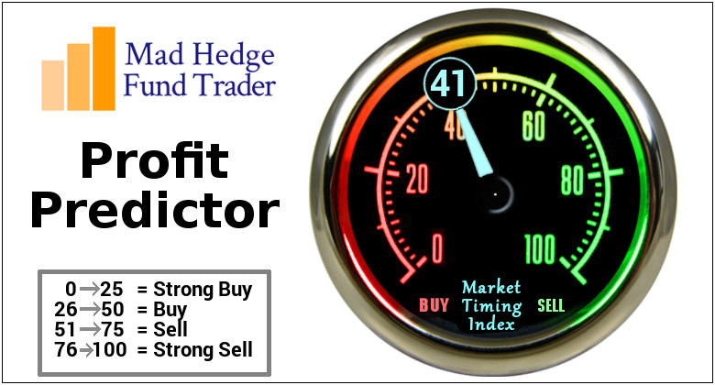
The Mad Hedge Profit Predictor
Market Timing Index-Bottom of Range-at a “BUY”
An artificial intelligence driven algorithm that analyzes 30 different economic, technical, and momentum driven indicators

Slide 16
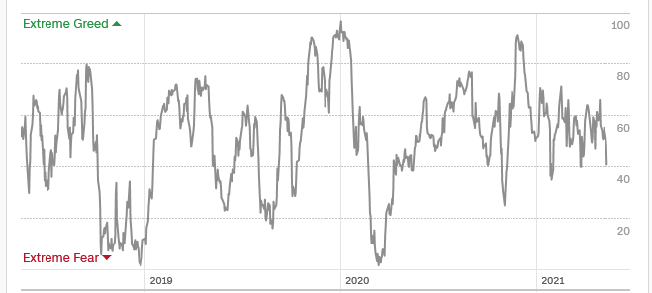
The Mad Hedge Profit Predictor
Springboard for a Monster Rally
SELL
Do
Nothing
BUY

Slide 17
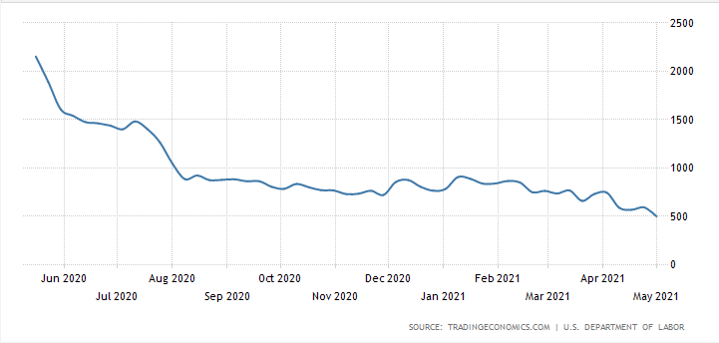
Weekly Jobless Claims – Flatlining at record highs
488,000New Pandemic Low

Slide 18
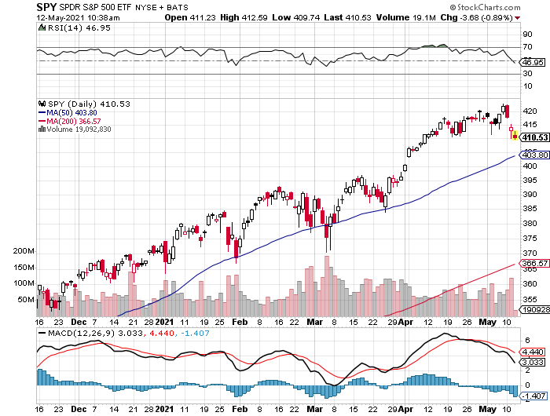
S&P 500 – New Highs long the 5/$427-$432 put spread took profits on long the 5/$440-$430 put spread
New Highs
The Bottom
395
-4%, -7% from top

Slide 19
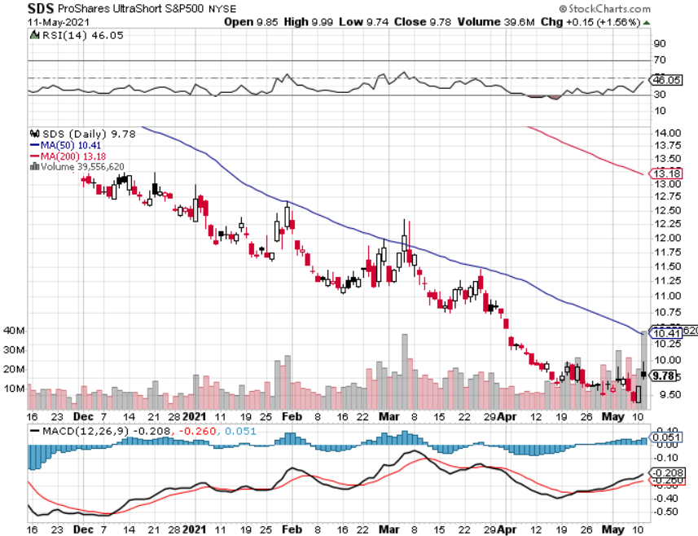
ProShares Ultra Short S&P 500 (SDS)- a Great Hedge for long stocks and bonds
Long 2X position has a hedge against longs and bond shorts

Slide 20
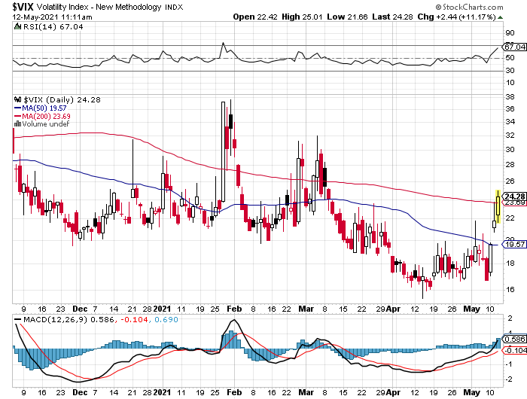
(VIX) – Dying a Slow Death
The summer market is early

Slide 21
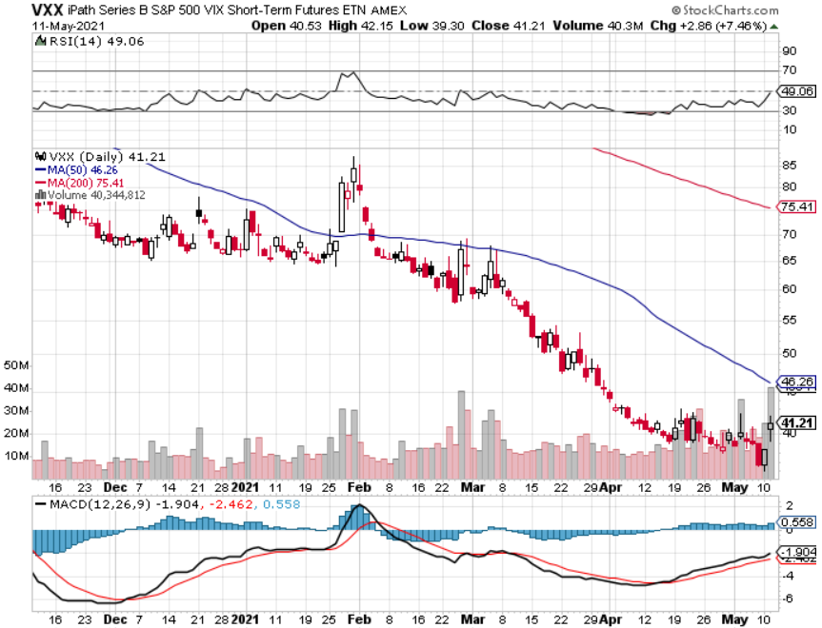
(VXX)-

Slide 22
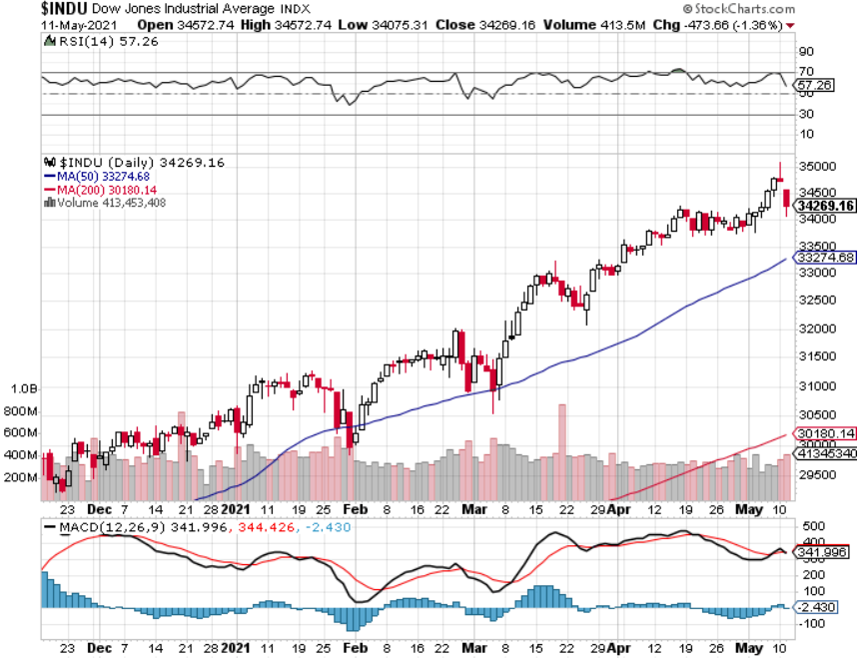
Dow Average ($INDU)-
50% of 2021
Target
in 4 ½ Months

Slide 23
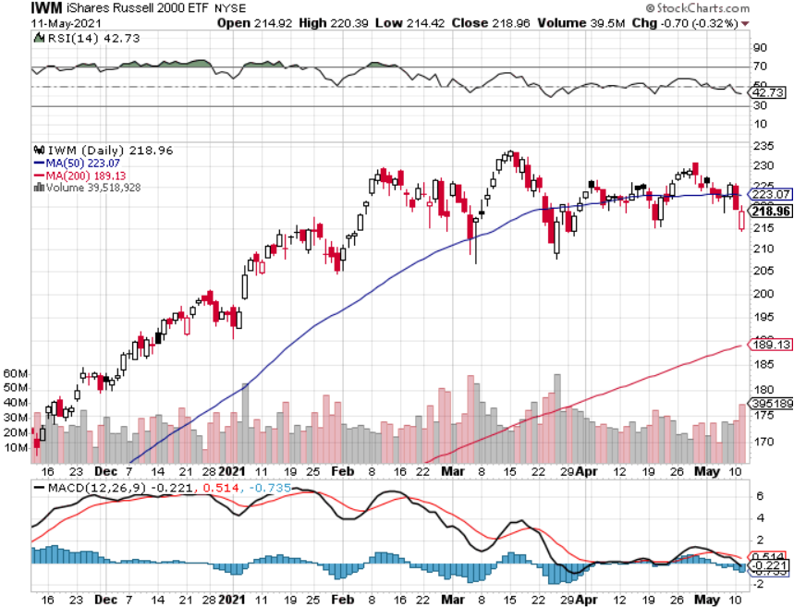
Russell 2000 (IWM)- took profits on Long 10/$137-$142 vertical bull call spread took profits on Long 10/$153-$156 vertical bear put spread

Slide 24
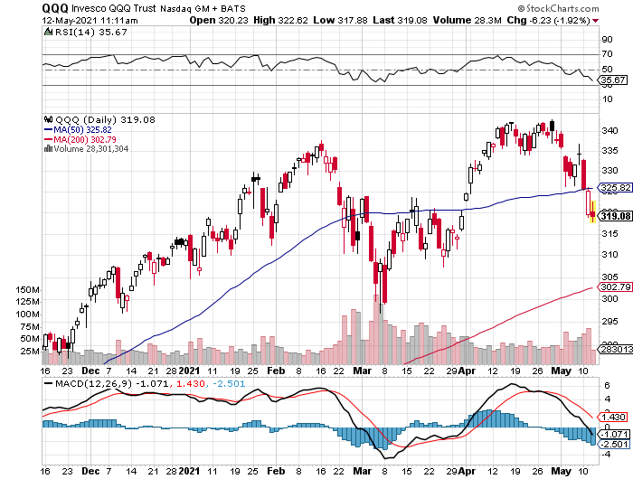
NASDAQ (QQQ) – long (QQQ) 4/$330-$335 put spread took profits on long (QQQ) 3/$340-$345 put spread covered long (QQQ) $325-$330 put spread
Target is
200-Day Moving
Average

Slide 25
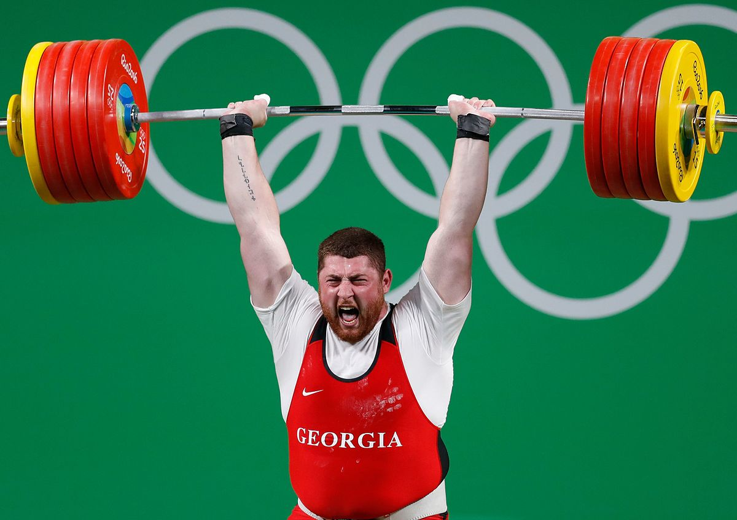
The Barbell Portfolio
*50% Big Tech - 2% of US Employment but 27% of Market Cap and 38% of Profits
50% Domestic Recovery, including:
Railroads
Couriers
Banks
Construction
Credit Cards
Event organizers
Ticket sales
Retailers

Slide 26
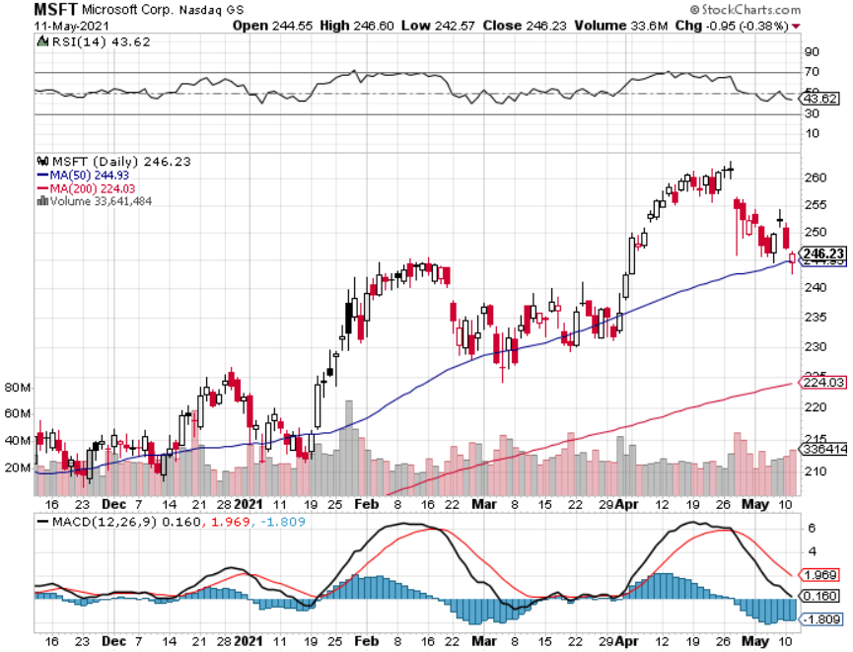
Microsoft (MSFT)- Earnings beat- Looking for Another Entry Point stop loss on long 5/$230-$240 call spread took profits on long 12/$220-$230 call spread stop loss on long 12/$170-$180 call spread took profits on long 12/$135-$138 call spread
Target is
200-Day Moving
Average

Slide 27
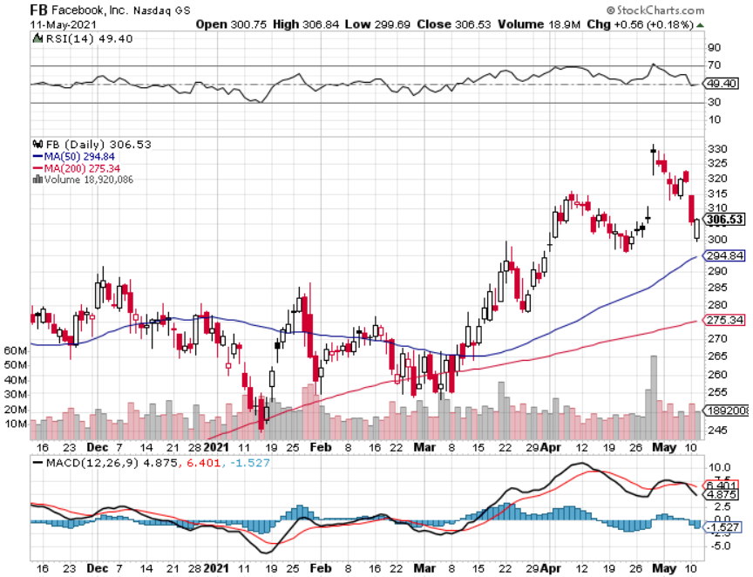
Facebook (FB)- took profits on Long 9/$290-$300 vertical bear put spread stopped out of Long 9/$190-$200 vertical bear put spread took profits on Long 9/$145-$155 vertical bull call spread took profits on Long 9/$150-$160 vertical bull call spread

Slide 28
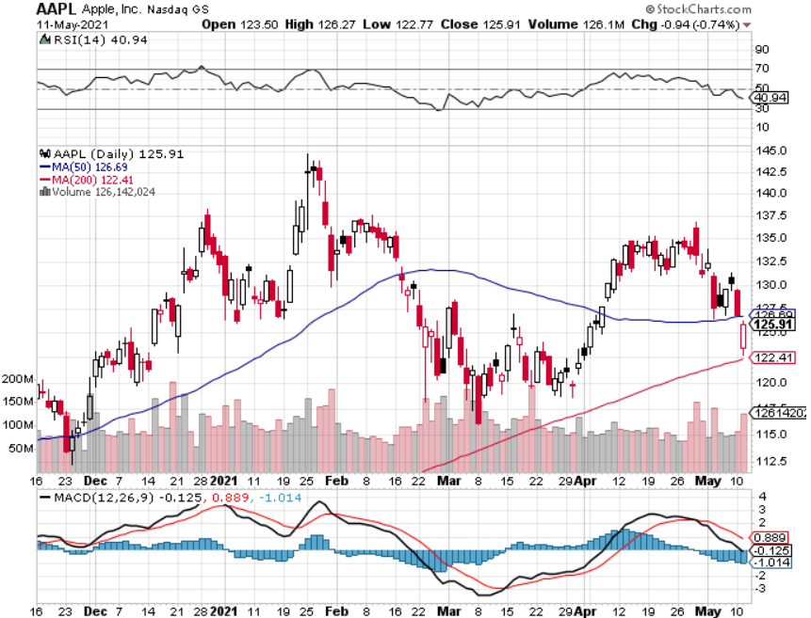
Apple (AAPL)- New 5G iPhone Surge-earnings after close
Apple car moving forward with KIA took profits on long 7/$320-$330 call spread took profits on long 4/24/$250-$260 call spread took profits on long 5/$250-$260 call spread
Target is
$115 Moving
Average

Slide 29
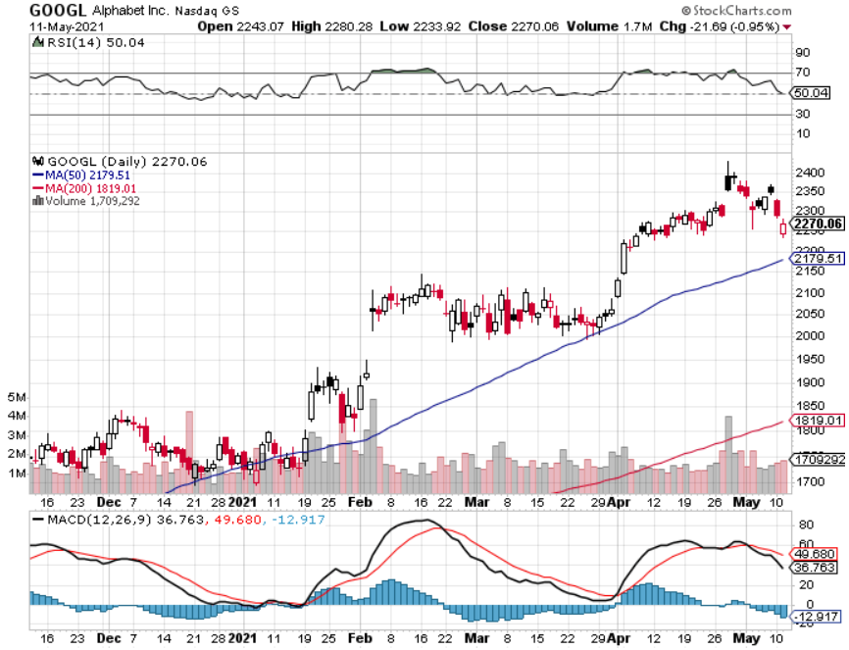
Alphabet (GOOGL) – Ad king on economic recovery
15% of search is travel related took profits on long 12/$1,200-$1,230 bull call spread took profits on long 9/$1,030-$1,080 vertical bull call spread
Target is
$2,000

Slide 30
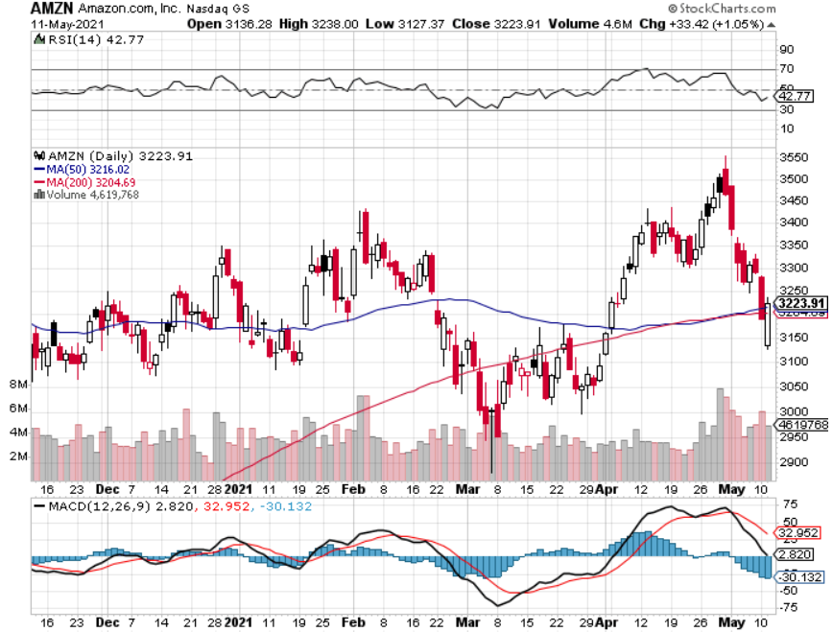
Amazon (AMZN) – Time correction took profits on long 9/$2,800-$2,900 bull call spread
Target is
$2,950

Slide 31
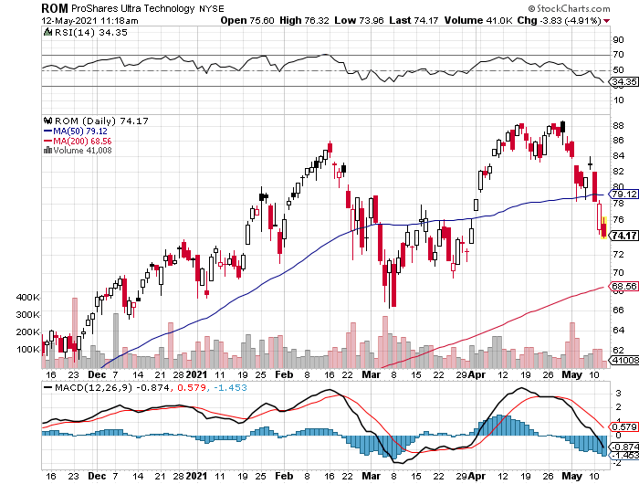
ProShares Ultra Technology (ROM) – Up 163% in 9 Months

Slide 32
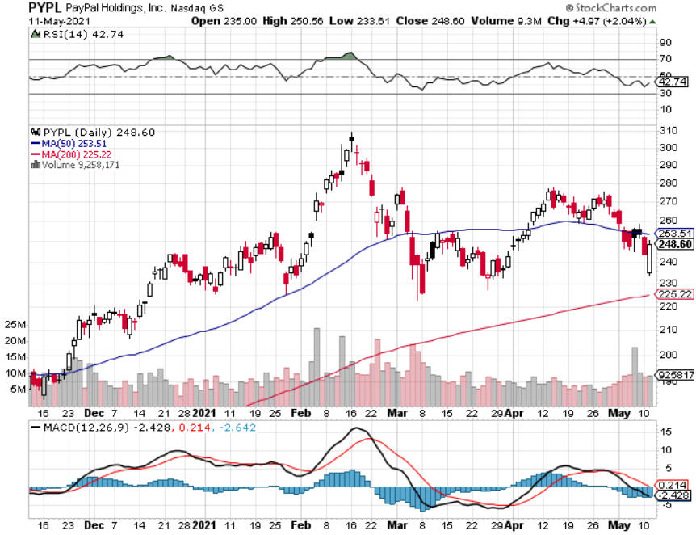
PayPal (PYPL)-Fintech Rules took profits on long 4/$90-$95 call spread
Target is
200-Day Moving
Average

Slide 33
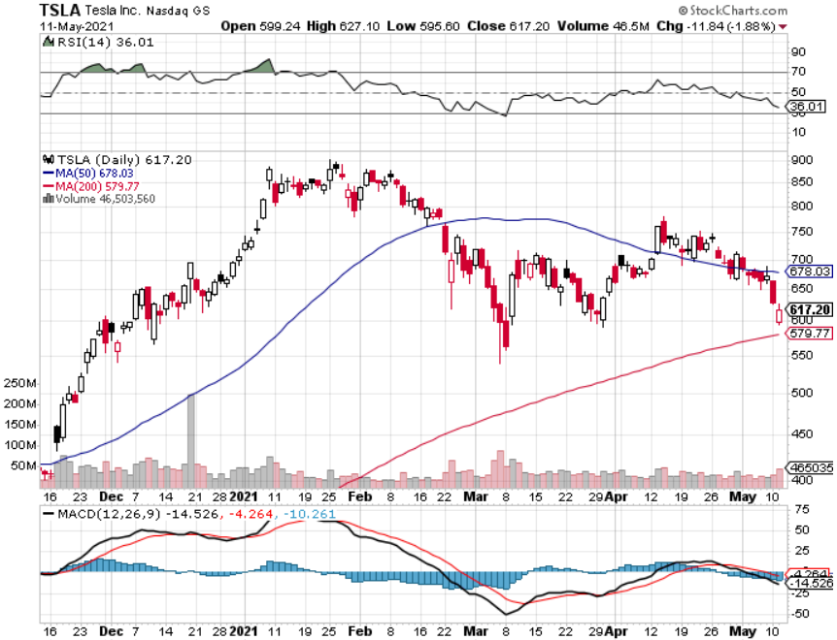
Tesla (TSLA)- Blows Away Q1 Deliveries, with a 184,400 print, or 47.5% high than the 2021 rate
Q1 earnings +48% QOQ, +104% YOY took profits on long 2X 4/$450-$500 call spread took profits on long 3/$400-$450 call spread took profits on long 2/$650-$700 call spread-expires, stopped out of long 3/$600-$650 call spread
Took profits on long 2/$600-$650 bull call spread, Took profits on long 2/$550-$600 bull call spread
Target is
$545

Slide 34
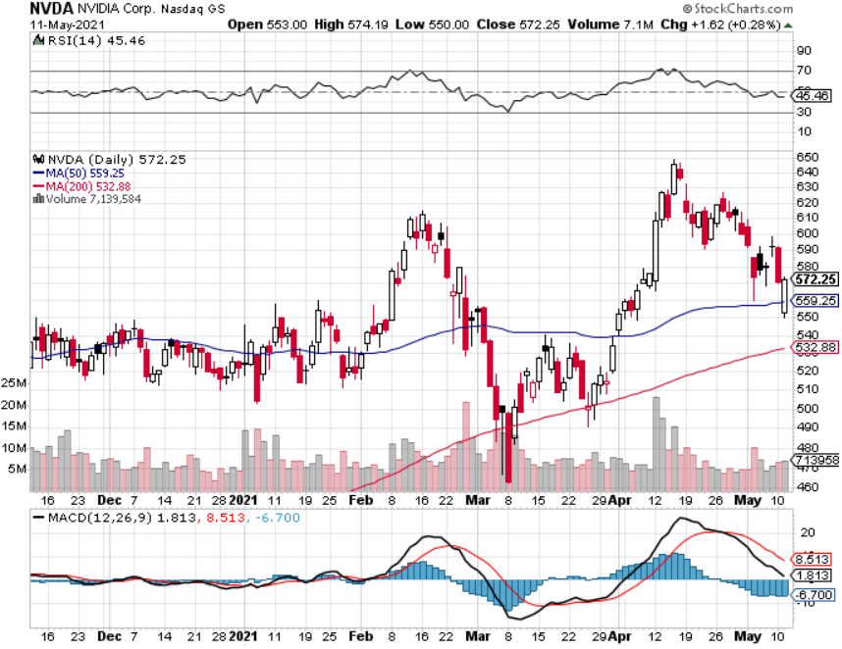
NVIDIA (NVDA) – The Biggest Chip Deal in History
A Mad Hedge 10 bagger – Global Semiconductor Shortage Slows Auto Industry,

Slide 35
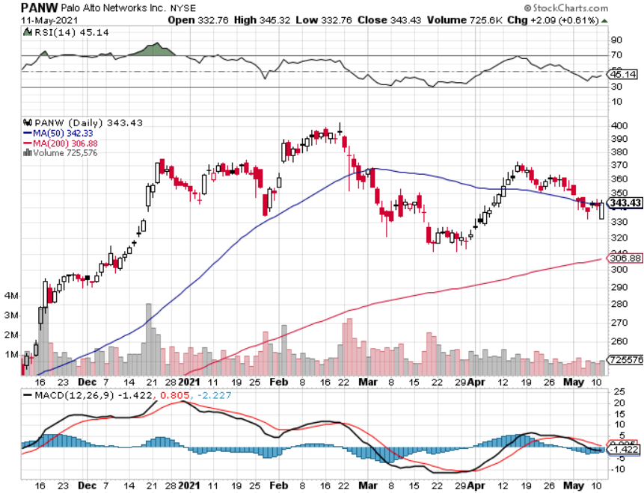
Palo Alto Networks (PANW)-
Hacking never goes out of fashion

Slide 36
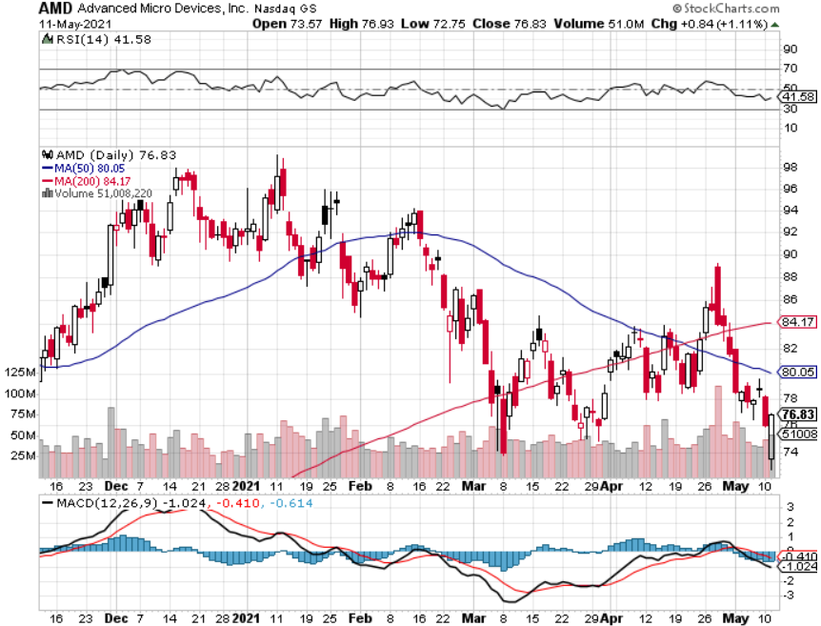
Advanced Micro Devices (AMD)- the next ten bagger - buys Xilinx – Programable logic devices took profits on long 2/$75-$80 call spread

Slide 37
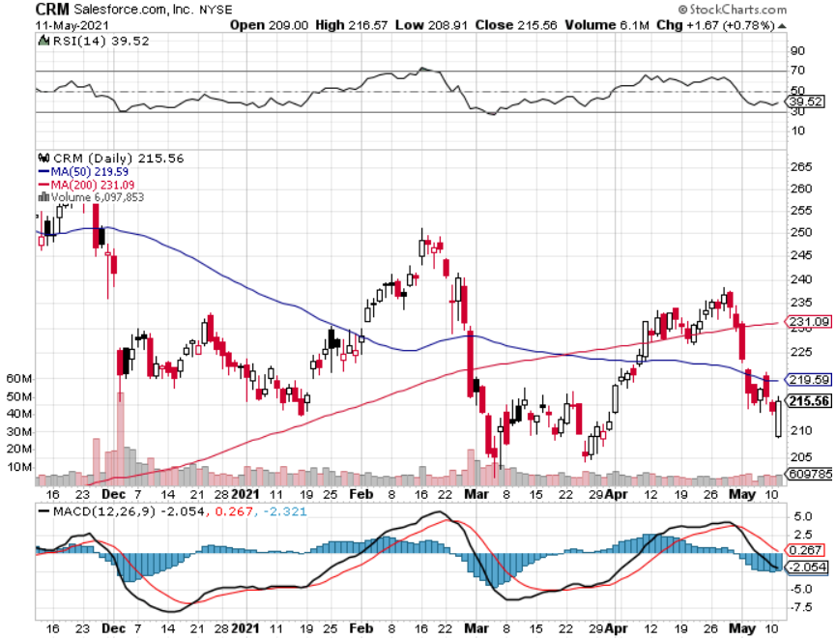
Salesforce (CRM)- Massive Online Migration took profits on long 9/$125-$130 vertical bull call spread took profits on long 8/$125-$130 vertical bull call spread took profits on long 2/$105-$115 call spread

Slide 38
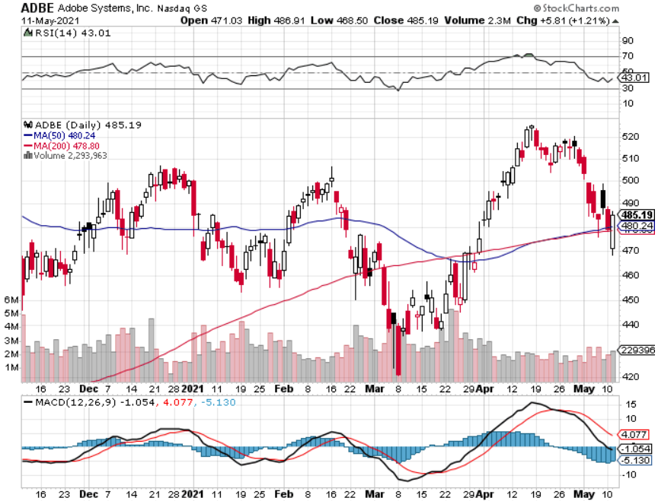
Adobe (ADBE)- Cloud play
The Quality Non-China tech play

Slide 39
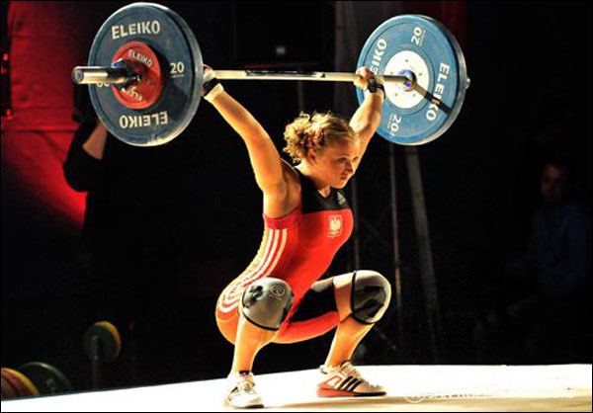
The Second Half of the Barbell
*Bets on a domestic recovery in 2021
*Upside potential in 2021 far greater than tech
*Some of these have not moved for 5 or 10 years
*Focuses on economically sensitive cyclical industries
*Makes a great counterweight to
high growth technology
*We could spend all of next year rotating
between the two groups

Slide 40
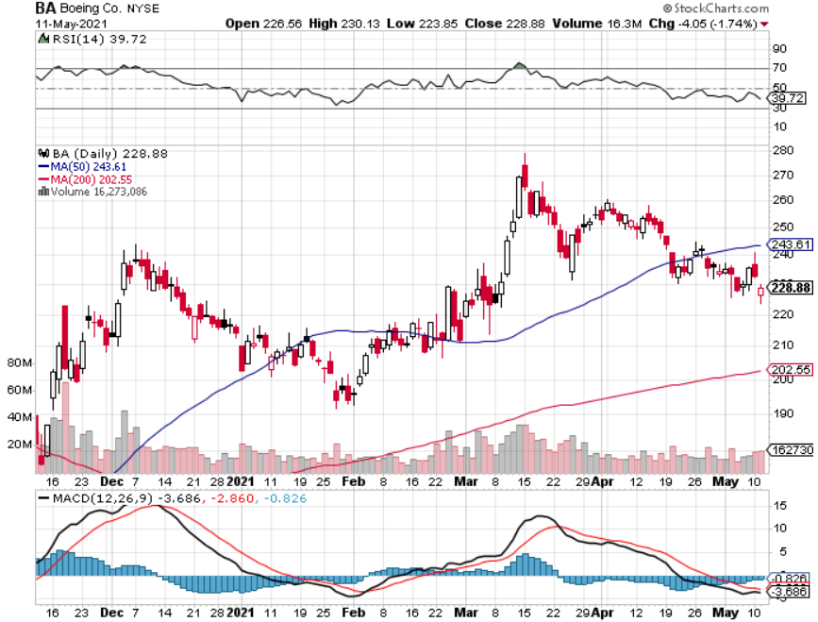
Boeing (BA) – former LEAP Candidate - The 737 MAX Flies Again!
First positive deliveries in 14 months, new orders from (UAL) and (ALK) long 3/$146-$149 call spread took profits on long 2/$150-$160 call spread took profits on long 4/$300-$310 call spread took profits on long 4/$315-$335 call spread

Slide 41
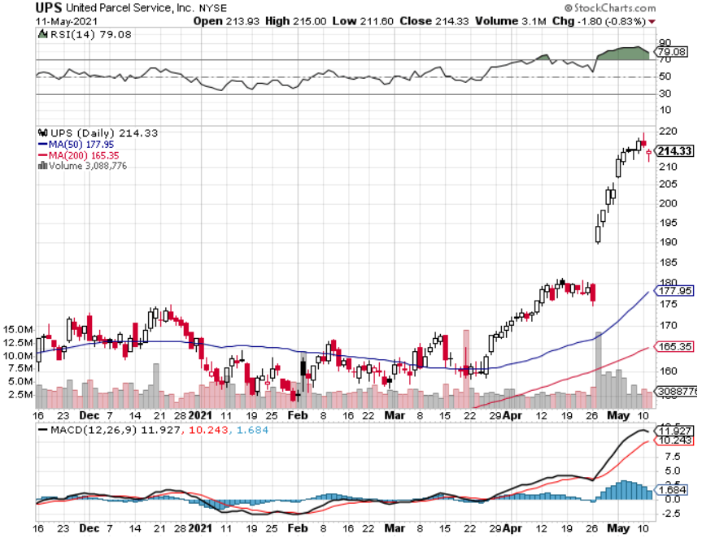
Package Delivery- United Parcel Service (UPS) massive increase in overnight deliveries, announces blowout earnings took profits on long 11/$130-$140 call spread

Slide 42
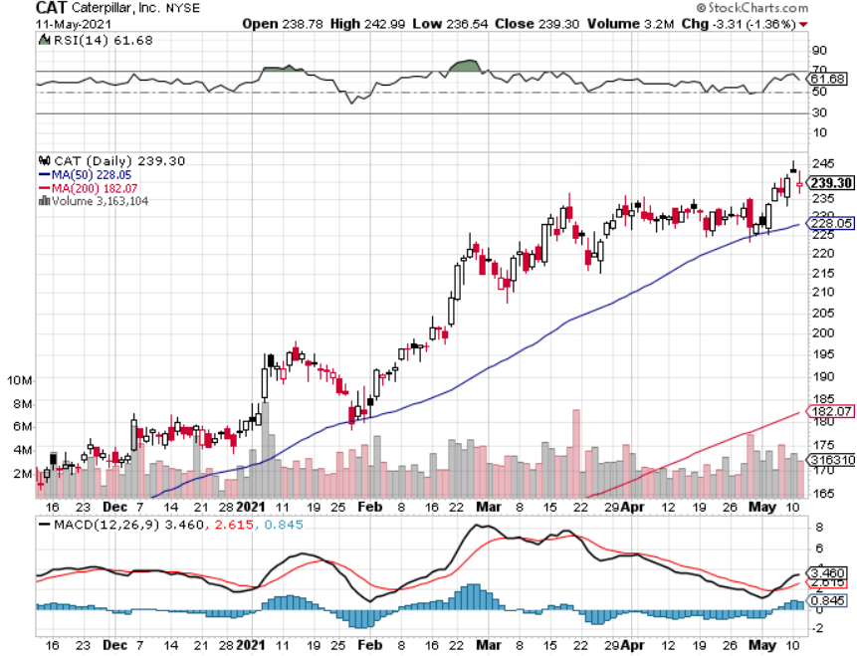
Caterpillar (CAT)- Ag + Infrastructure + Housing took profits on long 12/$145-$150 call spread took profits on long 11/$125-$135 call spread

Slide 43
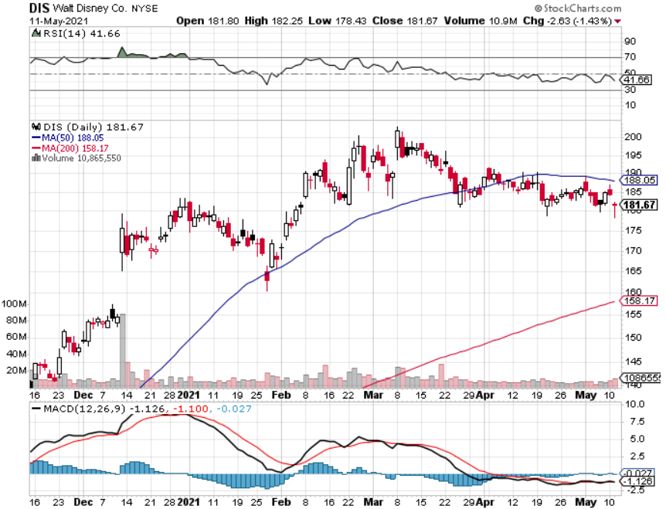
Walt Disney (DIS)- Big Recovery Move
Disney Plus Streaming top 100 million subscribers in 15 months took profits on long 3/$170-$180 call spread

Slide 44
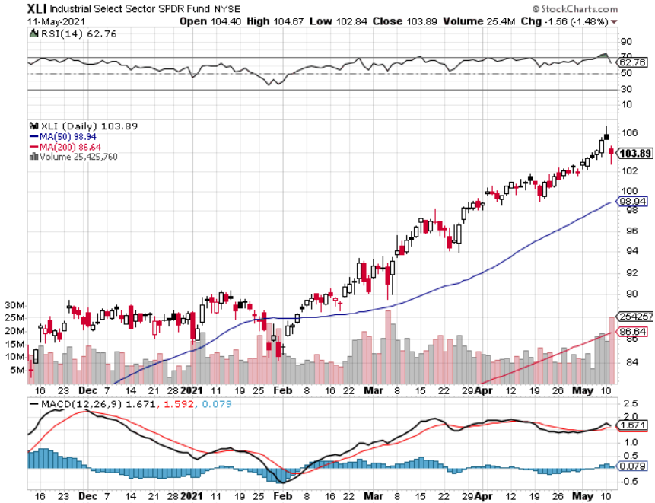
Industrials Sector SPDR (XLI)-
(GE), (MMM), (UNP), (UTX), (BA), (HON)

Slide 45
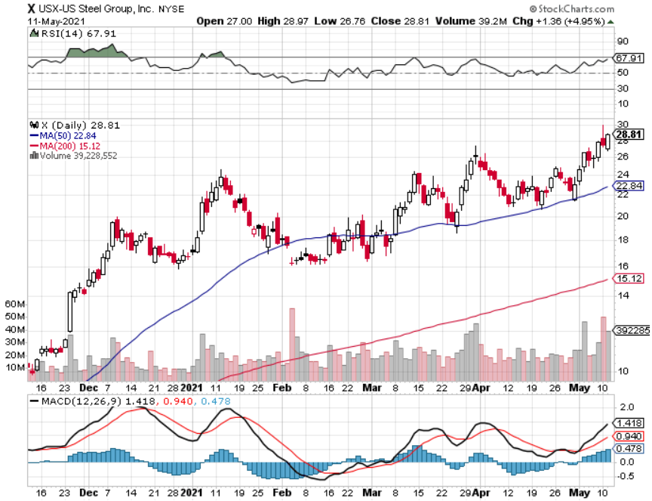
US Steel (X) – Commodity Boom

Slide 46
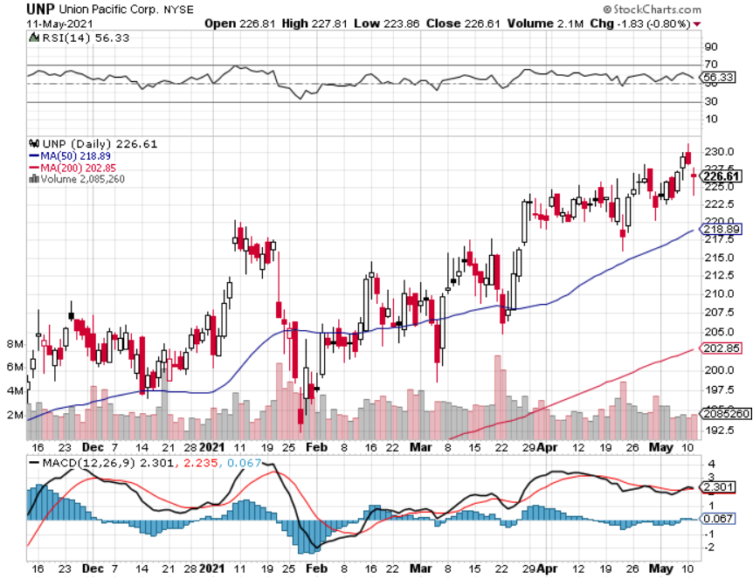
Union Pacific RR (UNP)- More stuff to ship near record earnings announced long 5/$200-$210 call spread – 12 days to expiration took profits on 11/$150-$160 call spread

Slide 47
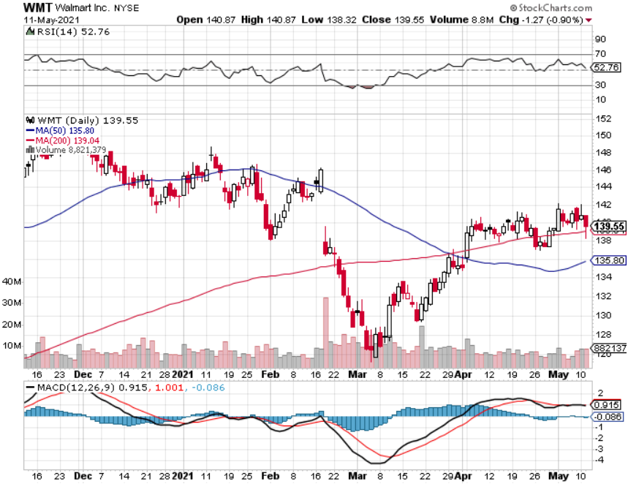
Wal-Mart (WMT)-New High took profit on Long 11/$125-$130 bear put spread took profit on Long 10/$119-$121 bear put spread took profits on Long 8/$114-$117 bear put spread

Slide 48
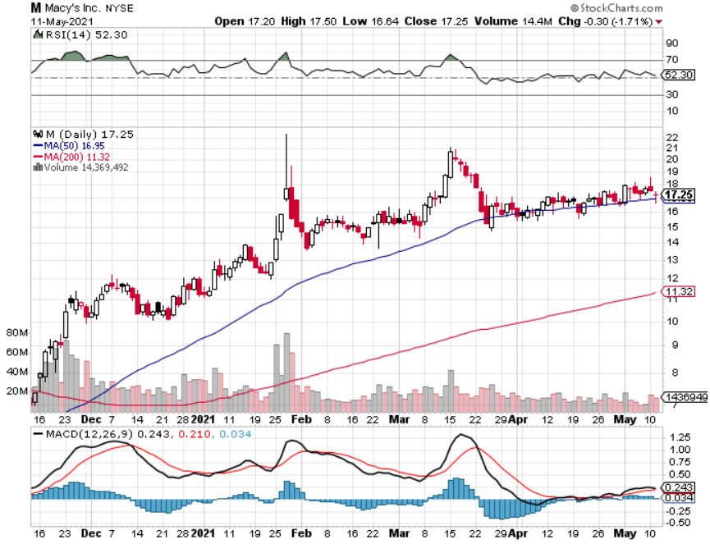
Macys’ (M) – Retail Return from the Grave took profits on Long 8/$23-$25 bear put spread

Slide 49
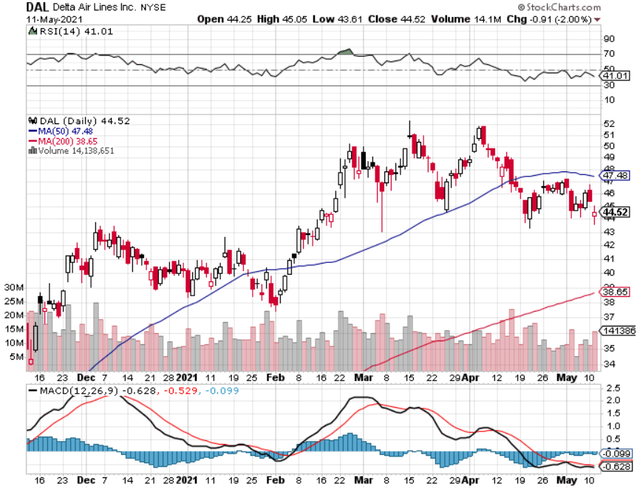
Delta Airlines (DAL) long 5/$40-$43 call spread

Slide 50
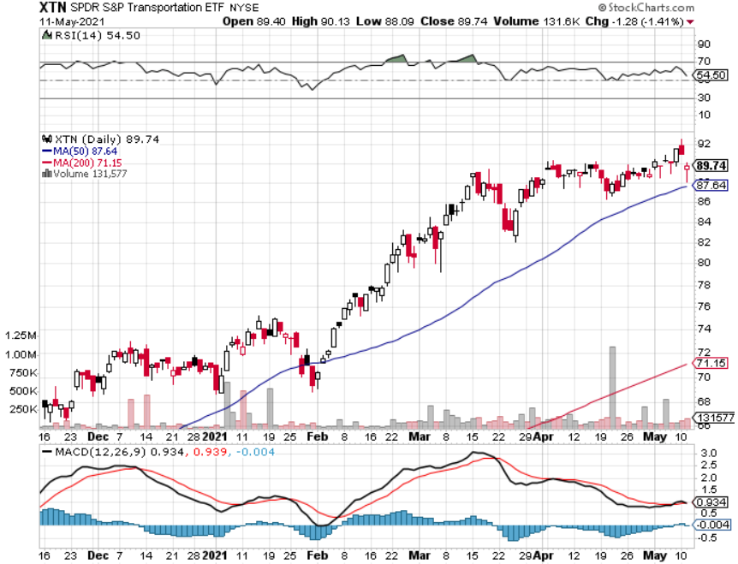
Transports Sector SPDR (XTN)- Worst Hit Sector
(ALGT), (ALK), (JBLU), (LUV), (CHRW), (DAL)

Slide 51
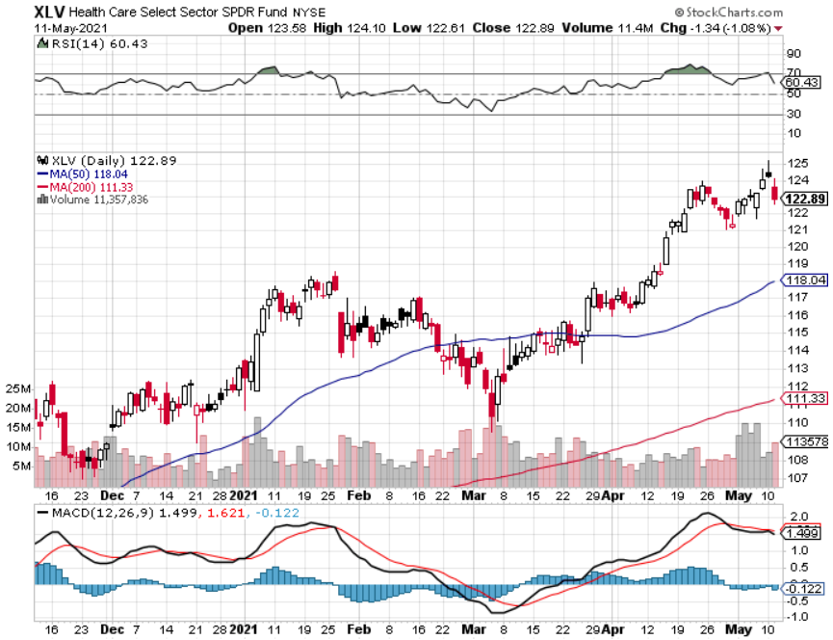
Health Care Sector (XLV), (RXL)
(JNJ), (PFE), (MRK), (GILD), (ACT), (AMGN)

Slide 52
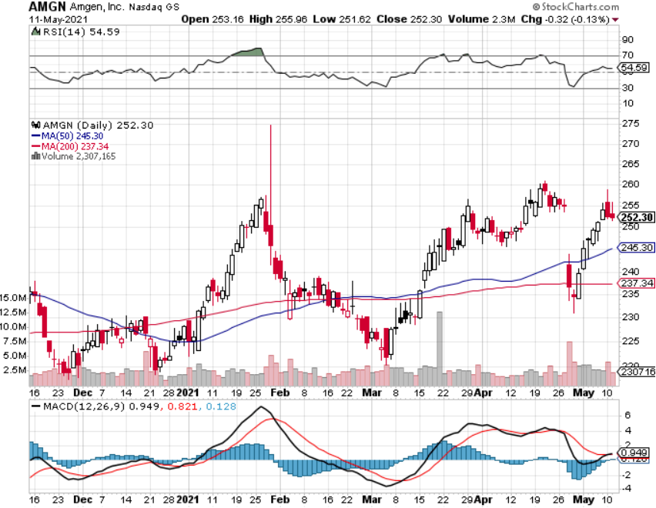
Amgen (AMGN) took profits on long 11/$185-$200 bull call spread

Slide 53
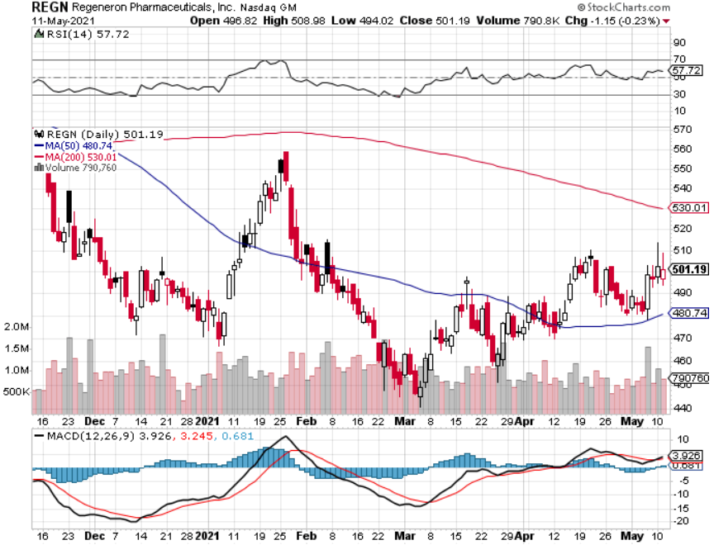
Regeneron (REGN) took profits on long 7/$570-$580 call spread

Slide 54
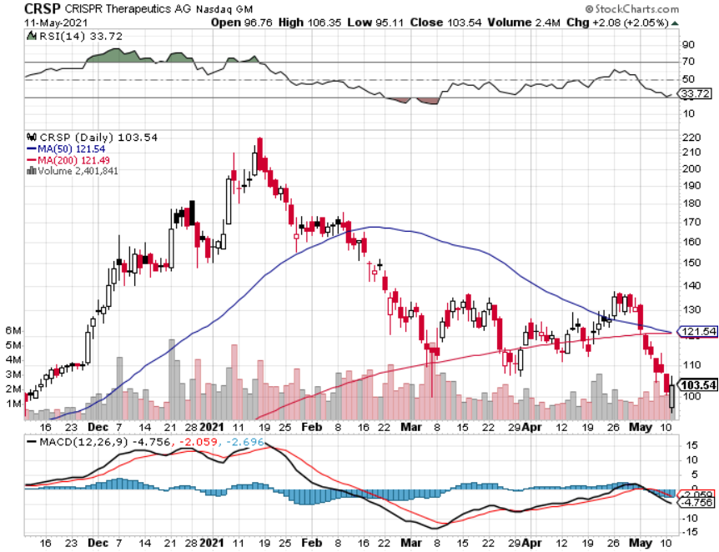
CRISPR Therapeutics (CRSP)

Slide 55
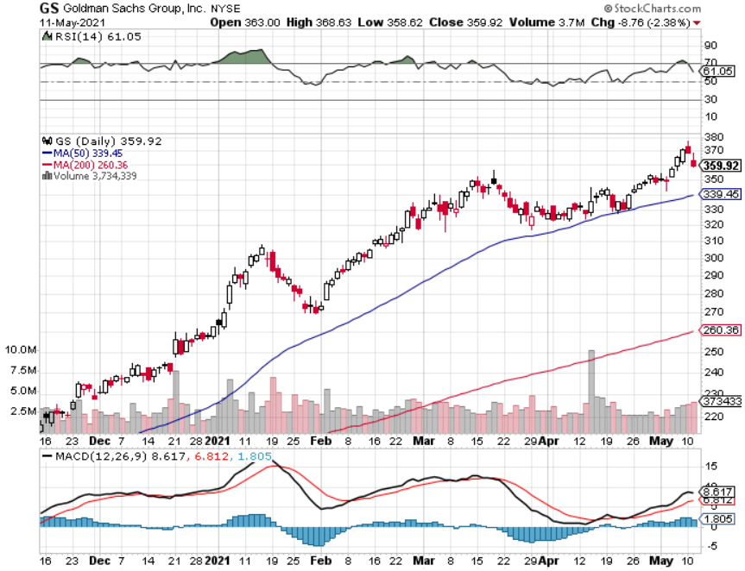
Goldman Sachs (GS) – long 5/$310-$320 call spread - 12 days to expiration took profits on long 2/$240-$260 call spread

Slide 56

Morgan Stanley (MS) – Blowout Earnings took profits on long 2/$55-$60 call spread

Slide 57

JP Morgan Chase (JPM)-Rising Rates long 5/$135-$140 call spread took profits on long 2/$135-$140 call spread took profits on long 2/$110-$115 call spread took profits on long 12/$100-$105 bull call spread took profits on long 11/$85-$90 bull call spread

Slide 58

Citigroup (C) – “Recovery” Rotation Play

Slide 59

Bank of America (BAC) – took profits on long 2/$28-$30 call spread

Slide 60

SPDR Metals & Mining ETF (XME) – long 2/$28-$30 call spread

Slide 61

Blackrock (BLK)-Asset Collection Boom took profits on long 3/$31-$34 call spread

Slide 62

Visa (V) – “Touchless” Fintech Play took profits on long 5/$195-$205 bull call spread took profits on long 9/$180-$185 bull call spread

Slide 63

Consumer Discretionary SPDR (XLY)
(DIS), (AMZN), (HD), (CMCSA), (MCD), (SBUX)

Slide 64

Berkshire Hathaway (BRKB)- Natural Barbell took profits on long 3/$230-$240 call spread

Slide 65

Europe Hedged Equity (HEDJ)-

Slide 66

Japan (DXJ)-

Slide 67

Emerging Markets (EEM) - Pro trade, Weak Dollar, long recovery Play

Slide 68

Bonds – Breakdown
*Bonds breakdown on Friday, delivering major technical damage
*We either retested (TLT) low at $137, is $133 next, or do we break to new one-year lows?
*The $120 billion in monthly bond buying remains
*The Fed is doing everything possible to create inflation, but is failing,
visible in commodities but invisible in labor, which is 70% of the calculation
*I’m piling money into long dated put LEAPS like the
January 2022 $130-$135 or the January 2023 $120-$125
*A 2.00% yield on the ten-year US Treasury bond here
we come! This is the quality trade of 2021
*It’s a global event, with French bond yields turning
positive for the first time in several years.
*US Treasury bond fund (TLT) could plunge from
$180 to $105, taking interest rates from 0.31% to 3.25%

Slide 69

Treasury ETF (TLT) – Huge Short Play took profits on long 5/$143-$146 put spread, took profits on long 5/$144-$147 put spread
6/$145-$148-expire in 34 days took profits on 2X long 4/$142-$145 put spread, 4/$127-$130 call spread took profits on 2X long 5/$142-$145 put spread, took profits on long 2/$146-$149 put spread

Slide 70

Ten Year Treasury Yield ($TNX) – 1.68%

Slide 71

Junk Bonds (HYG) 3.33% Yield to Maturity

Slide 72

2X Short Treasuries (TBT)-Another run at highs

Slide 73

Emerging Market Debt (ELD) 4.27% Yield-

Slide 74

Municipal Bonds (MUB) – 0.93%
Mix of AAA, AA, and A rated bonds

Slide 75
Foreign Currencies – Dollar Collapse
*US Dollar approaching one year low on massive government bond issuance as Q1 strength unwinds rapidly
*A stronger American economy leads to a weaker greenback, as imports surge to a record $77 billion in April
*Europe is getting positive yield support for the first time
in a decade
*Expect more of the same. Buy (FXA) and (FXE) on dips.
*Any dollar rallies are temporary and short-term
*Bitcoin is putting in a massive one-year topping formation
*Keep selling short all US dollar rallies,
its yield support is gone forever,
Buy (FXA) and (FXE) on dips.

Slide 76

Japanese Yen (FXY), (YCS)

Slide 77

Euro ($XEU), (FXE), (EUO)-

Slide 78

British Pound (FXB)-

Slide 79

Australian Dollar (FXA)- The Global Recovery Play took profits on long 8/$67-$69 call spread

Slide 80

Emerging Market Currencies (CEW)

Slide 81

Chinese Yuan- (CYB)-

Slide 82

Bitcoin- Losing Momentum-Upside Momentum is Gone

Slide 83

Energy – Hacker Help
*Oil has been trapped in narrow two-month range. Economic recovery boost is offset by long term bear trend
*Colonial Pipeline hack give gasoline a temporary boost
*The end of oil is upon us, but it may take 30 years to unwind existing infrastructure
*All US car production will be electric by 2035, wiping out
half of all US oil consumption
*Oil consumption will become a China only business,
with them already taking 80% of all Persian Gulf output
*Avoid all energy plays like the plague, it’s the new
buggy whip industry as the US de-carbonizes

Slide 84

Infrastructure Becomes National Security

Slide 85

Oil-($WTIC)

Slide 86

United States Oil Fund (USO) long 10/$9.50-$10 Vertical bull call spread

Slide 87

Energy Select Sector SPDR (XLE)-No Performance!
(XOM), (CVX), (SLB), (KMI), (EOG), (COP)

Slide 88

Halliburton (HAL)-

Slide 89

Natural Gas (UNG) -

Slide 90

Precious Metals – Signs of Life
*Long-term rising interest rates remain a threat to precious metals
*No one believes we have come close to peaking in rates yet
*Gold rallies 10% and silver 20% on a flight to safety bid
*It has turned into a bond long and and Bitcoin
short and I don’t want either
*Silver is the better play here on solar and EV demand
*Gold will eventually recover when US borrowing
becomes so massive it undermines the value of the
US dollar, even in the face of higher interest rates

Slide 91

Gold (GLD)- Meltdown

Slide 92

Market Vectors Gold Miners ETF- (GDX) –

Slide 93

Barrick Gold (GOLD) took profits on long 1/$21-$23 call spread took profits on long 11/$22-$24 call spread

Slide 94

Newmont Mining- (NEM)- took profits on long $55-60 call spread

Slide 95

Silver- (SLV)- took profits on long 11/$19-$20 call spread

Slide 96

Silver Miners - (SIL)-

Slide 97

Wheaton Precious Metals - (WPM)- took profits on long 2/$39-41 call spread

Slide 98

Copper (COPX)-Uptrend Resumes

Slide 99

Real Estate – More of the Same
*Pending Home Sales Dove 10.6%, in February on a historic lack of supply
*Zillow expects home listing to increase as the pandemic winds down, alleviating the worst shortage in history
*In the meantime, the flight from the cities to larger homes continues
*Greatly digitized economy is driving first time home buyers
to much cheaper Midwest, like Kalamazoo, Rapid City,
Iowa City, and Savanah
*Housing prices are still exploding to the upside
with S&P Case Shiller Rose 12% in February,
the one-month biggest spike in history

Slide 100

Crown Castle International (CCI) – 3.42% yielding cell phone Tower REIT

Slide 101

US Home Construction Index (ITB)
(DHI), (LEN), (PHM), (TOL), (NVR)

Slide 102

Trade Sheet-
So What Do We Do About All This?
*Stocks – buy dips aggressively
*Bonds – sell rallies aggressively
*Commodities-buy dips aggressively
*Currencies- sell US dollar rallies
*Precious Metals – buy dips
*Energy – stand aside
*Volatility - sell short over $30
*Real estate – buy dips

Slide 103

Next Strategy Webinar
12:00 EST Wednesday, May 26, from Lake Tahoe email me questions at support@madhedgefundtrader.com
Good Luck and Good Trading!
Notes:
*

