Slide 1
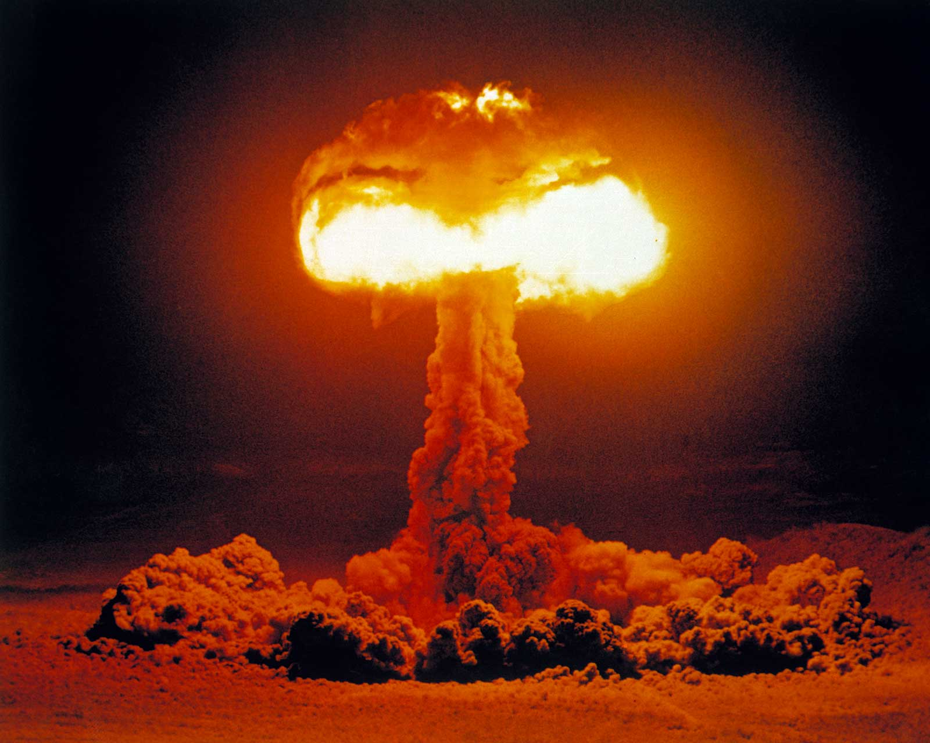
The Mad Hedge Fund Trader “Bitcoin Blowup”
With John Thomas from Silicon Valley, NV, May 26, 2021 www.madhedgefundtrader.com
Notes:
*

Slide 2
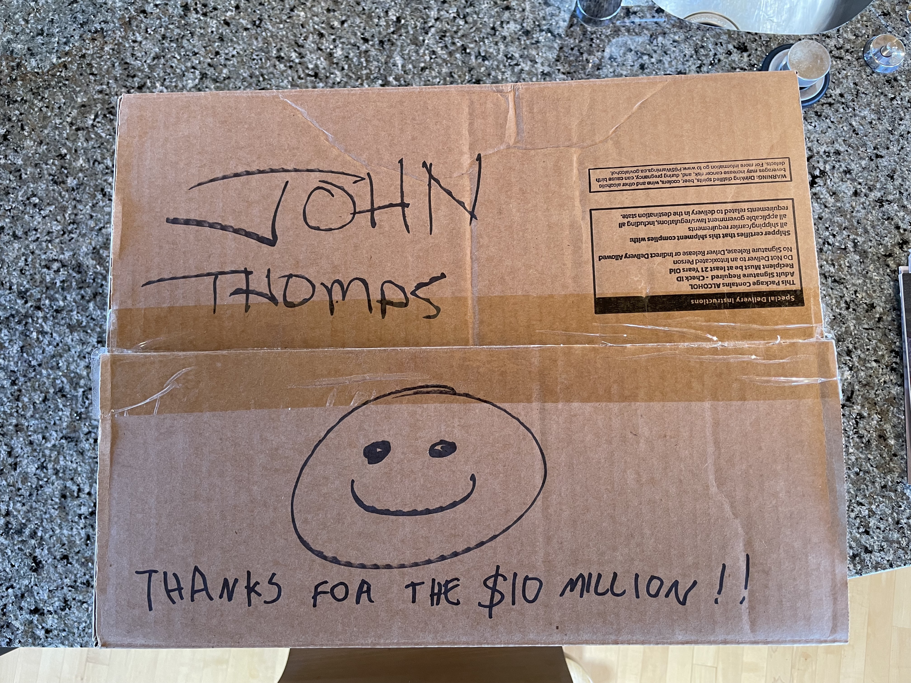
A Free Case of Wine from a Concierge Member

Slide 3
Mad Hedge Trader & Investors Summit June 8-10
*A collection of the 27 best traders and managers in the world, or 8 a day *Back-to-back One-hour presentations followed by an interactive Q&A *Covering all stocks, bonds, commodities, foreign exchange, precious metals, and real estate *It’s the best look at the rest of 2021’s money making opportunities you will get anywhere *An invitation will be sent to you shortly and it is FREE to attend

Slide 4
Trade Alert Performance New All Time Highs! 32 consecutive profitable trade alerts- 57 out of 59 profitable-96.6% success rate in 2021-ony 2 losers
*January 10.21% MTD *July +7.93% Final *February +13.28% Final *August -2.08% Final *March +20.60% Final *September 7.95% Final *April +15.67% Final *October +1.51% Final *May +7.48% MTD *November +20.41% Final *June +10.38% Final *December +10.20% Final *2021 Year to Date +67.24% compared to +12.56% for the Dow Average *+489.79% since inception, a new all time high *Average annualized return of 42.90% for 11 1/2 years, new all time high

Slide 5
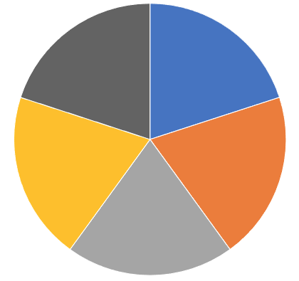
Portfolio Review 40% long Invested, 10% short in a low volatility Long Term Bull Market
Current Capital at Risk
Risk On
World is Getting Better
(TLT) 6/$141-$144 put spread | 10.00%
(SPY) 6/$375-$385 call spread | 10.00%
(BRKB) 6/$230-$240 call spread | 10.00%
(GS) 6/$310-$320 call spread | 10.00%
Risk Off
World is Getting Worse
(SPY) 6/$430-$440 put spread | -10.00%
Total Net Position | 30.00%
Total Aggregate Position | 50.00%
Expiration P&L +71.32 YTD

Slide 6
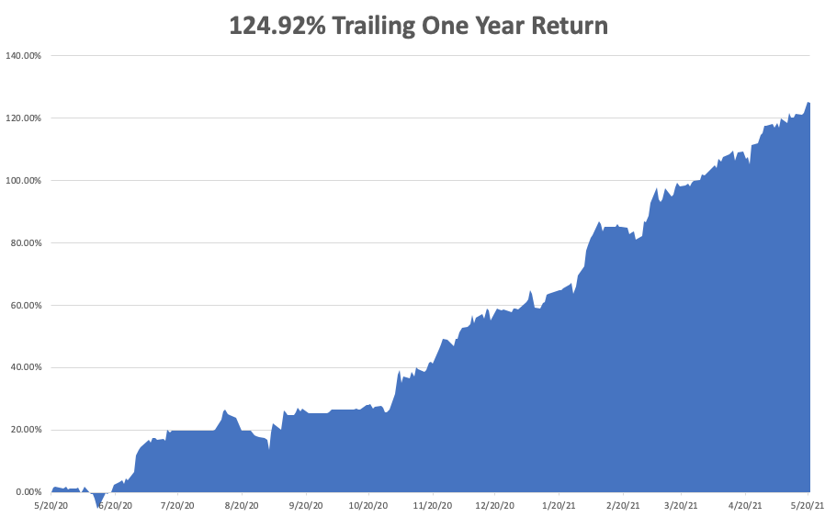

Slide 7
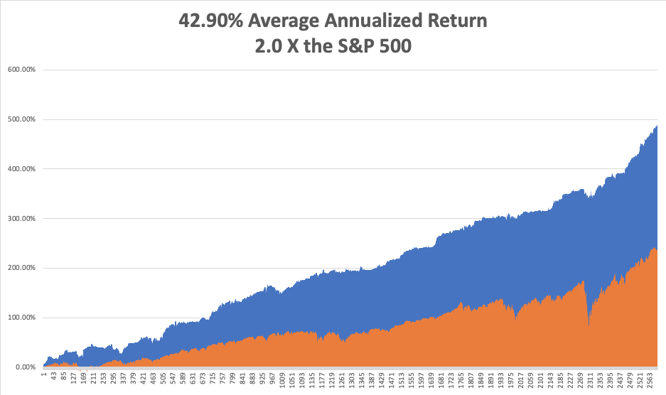
GTD 11 1/2 Year Daily Audited Performance

Slide 8
The Method to My Madness The Roaring Twenties are Here
*Bonds have stalled and have continued a sideways move *A two-month range trading Bond Market may continue, slowing financials and commodities *Slowing rates bring an unfolding tech rally *It’s now, all about a global economic recovery and “RISK ON” *Commodity boom may have peaked on a slowing Chinese economy *Bitcoin has become the best risk indicator in the market, crash was down 55% from the peak in 6 weeks *VIX spikes to $29, then crashes to $18….twice in two weeks *Historically interest rates are still extremely low and will be until a 3.0% ten-year yield

Slide 9
Corona Update – End of the Pandemic
*50% of the US population is vaccinated and 10% have had the disease, bringing immunity up to 60% *New cases have fallen off a cliff, from 250,000 a day to 28,000, down 89%. The population is acting like herd immunity has already begun! *Unvaccinated workers will be unable to get jobs and board planes or public transport *Florida, Texas, and Iowa have made mask mandates ILLEGAL *End of mask mandate is bringing a huge stimulus to the economy….and the stock market! *Variant fear is fading with a peak in cases in India *Vaccine effectiveness is proving out at 99% in the real world as opposed to 95% in clinical trials *US cases top 33.1 million, deaths topping 590,000 and are down to 650 a day

Slide 10
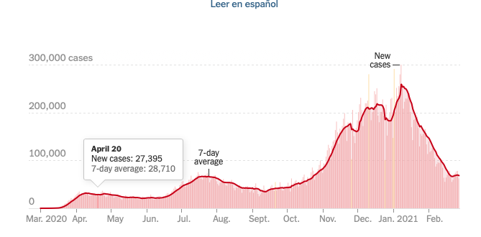

Slide 11
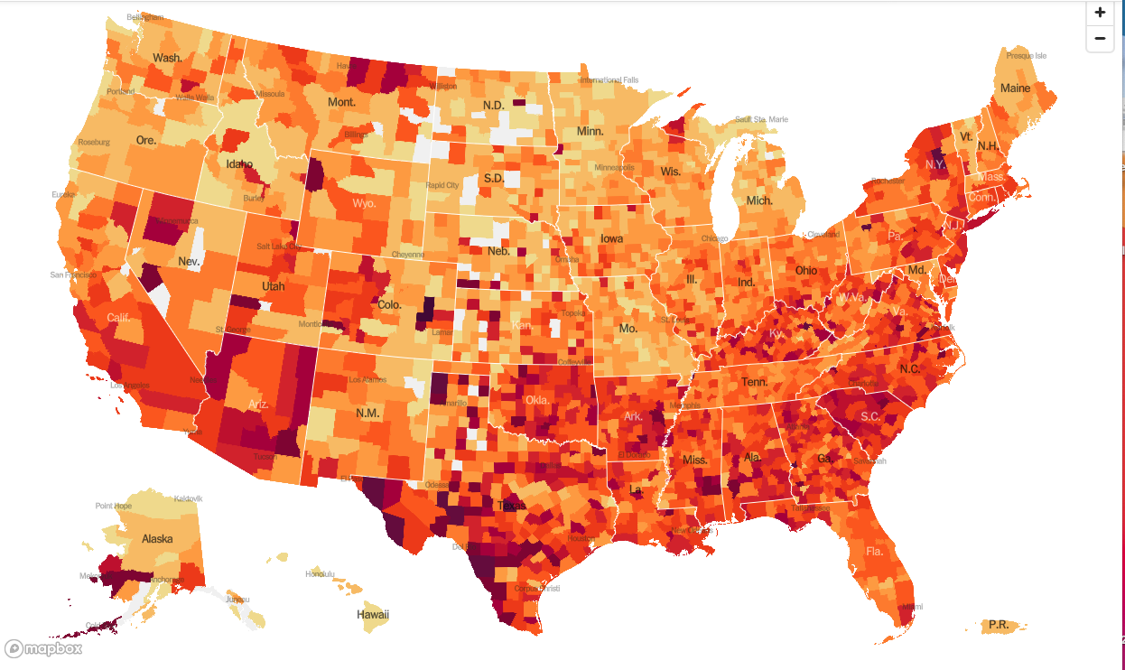
January 20 Infection Rate

Slide 12
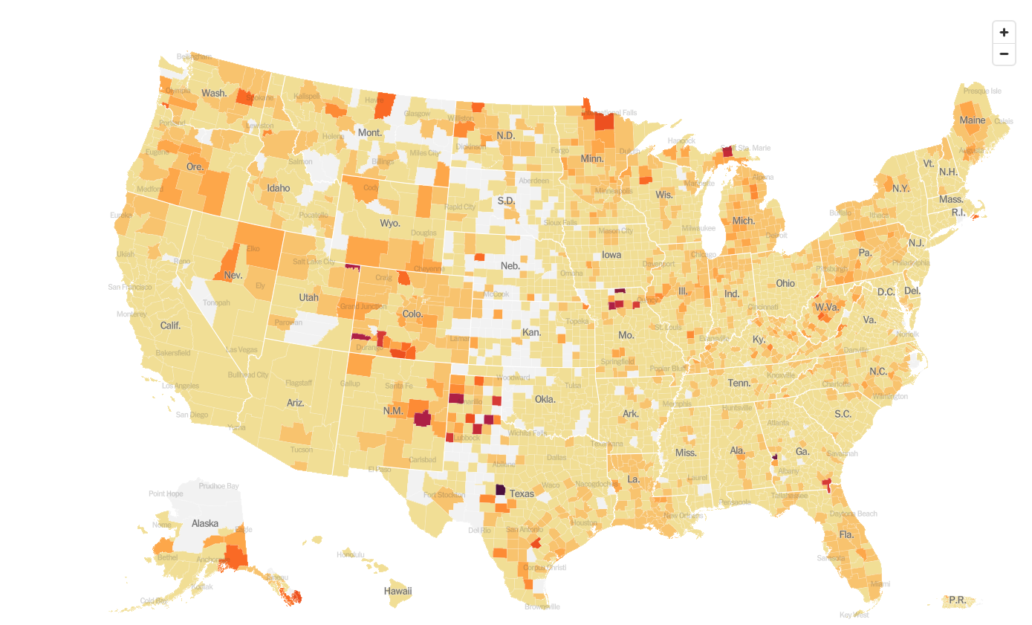
May 26 Infection Rate

Slide 13
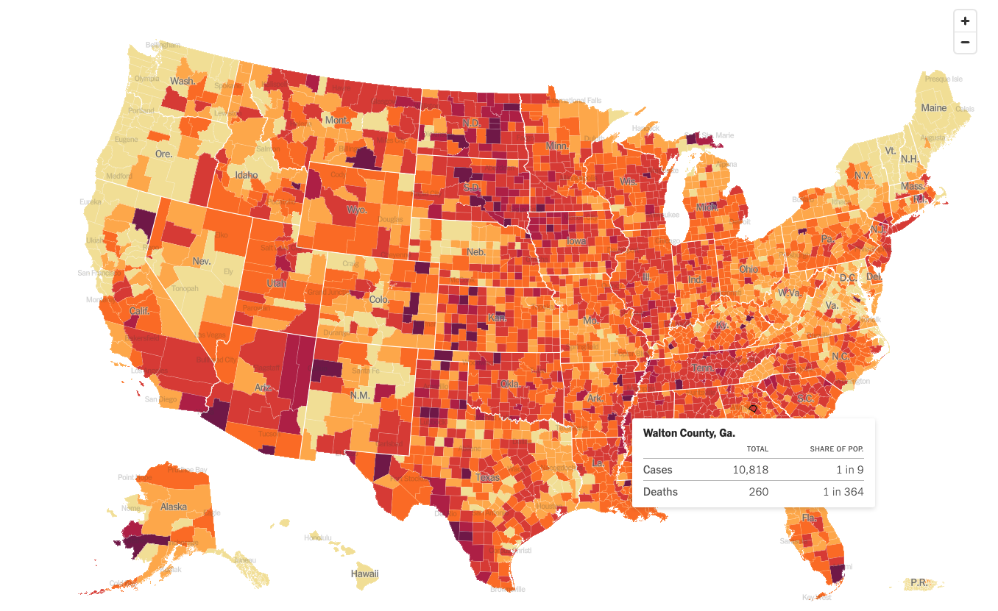
Greatest Chance of Getting Infected Today Trading lives for jobs - May 26

Slide 14
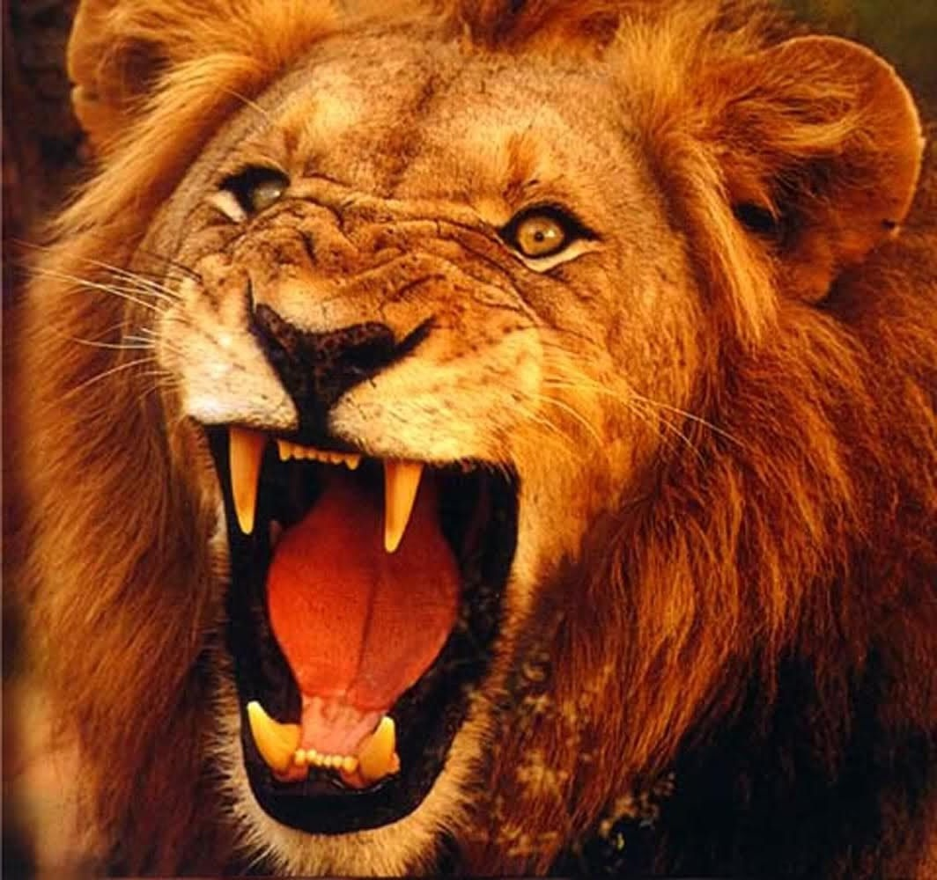
The Global Economy – Roaring
*Fed Hints of Early Rate Rise, trashing both stocks and bonds. *Inflation Explodes, with the Consumer Price Index posting a ballistic 4.2% YOY rate, the fastest gain since 2009. *Inflation Sentiment Hits One Year High, at 4.6% *Money Supply (M2) growing at a record 30% annual rate as stimulus checks pile up in savings accounts *Retail Sales Stall in April, at $120 billion *Weekly Jobless Claims Drop to 444,000, a new post pandemic low. *Corporate Productivity is Booming, making stocks worth more. That is the outcome of the pandemic. *China’s Industrial Production Slows, from 14.1% in March to only 9.8% in April

Slide 15
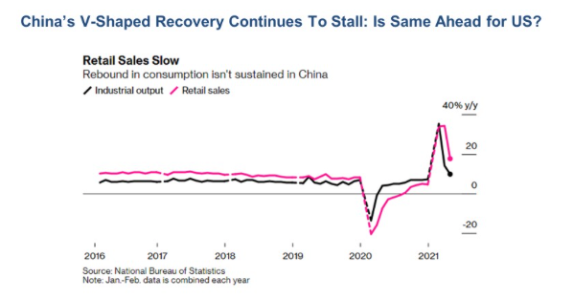

Slide 16
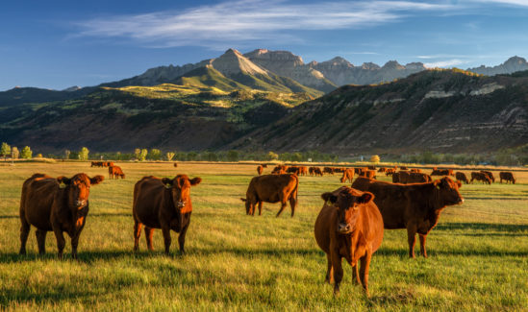
Stocks – Home on the Range
*Bitcoin crash causes secondary stock market selloff of 2,000 Dow points. All the losses are made back in days * Volatility Index (VIX) Soars to $29, then collapses to $17, typical of a sideways trending summer market *Tech falls from 36X to 27X, (SPY) at 21X, value at 17X, against an historical tech premium to (SPY) of 5 points. meaning the tech selloff is almost done *If ten-year US Treasury yields reach the 5.5% peak seen in the last 2007 top, $20 trillion of bonds have to be sold and put into equities *Value and Cyclicals are Still the Big Play *Biden Puts a 25% Corporate Tax Rate on the Table and a 15% global tax *Tech gets a boost from a flat bond market *Stick with the barbell strategy, we’ll keep rotating back and forth all year between tech & domestic recovery *We could be entering a wide $2,700 - $3,600 range until the election

Slide 17
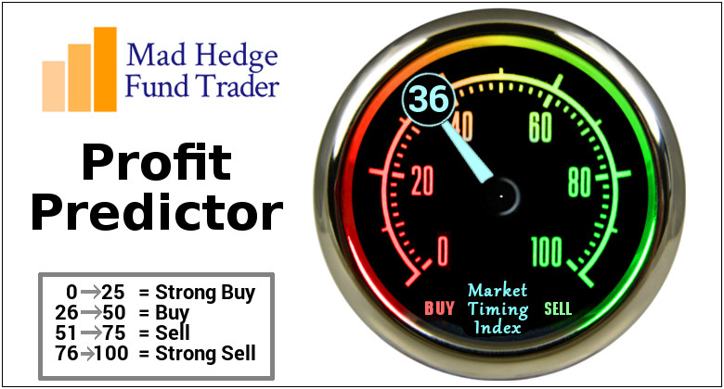
The Mad Hedge Profit Predictor Market Timing Index-Bottom of Range-at a “BUY” An artificial intelligence driven algorithm that analyzes 30 different economic, technical, and momentum driven indicators

Slide 18
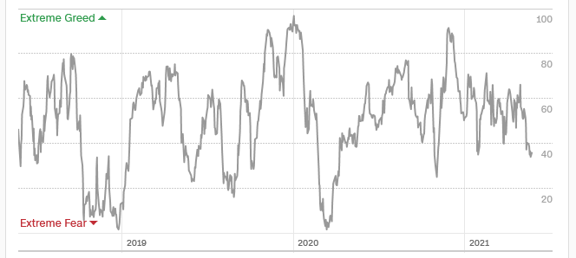
The Mad Hedge Profit Predictor Springboard for a Monster Rally
SELL
Do Nothing
BUY

Slide 19
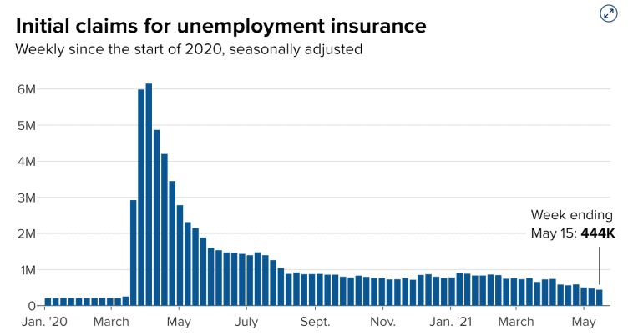
Weekly Jobless Claims – Flatlining at record highs 444,000New Pandemic Low

Slide 20
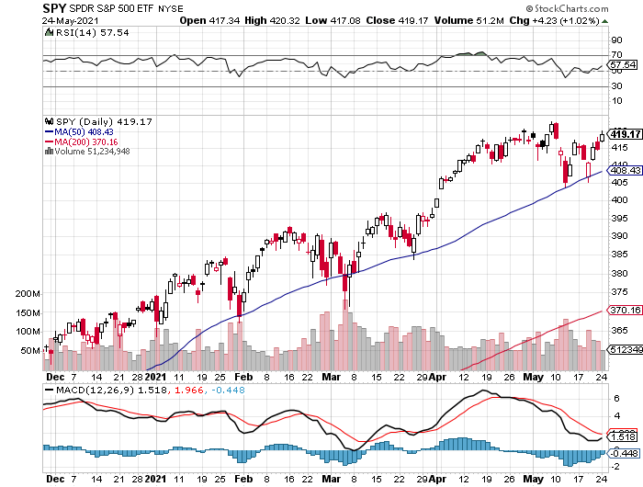
S&P 500 – New Highs long 6/$375-$385 call spread long 6/$430-440 put spread
New Highs Yearend Target $475
The Bottom 405

Slide 21
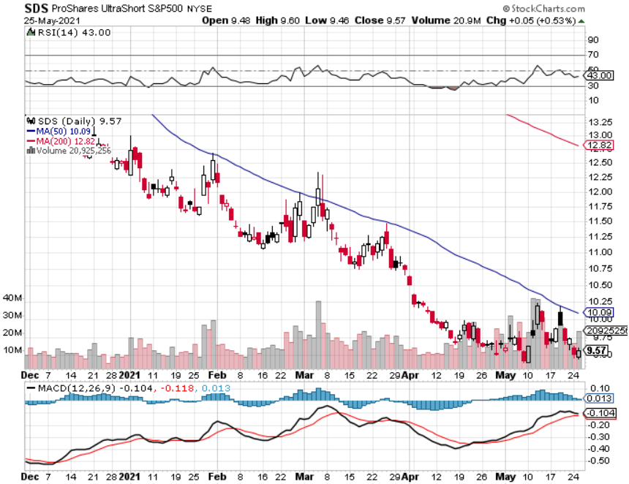
ProShares Ultra Short S&P 500 (SDS)- a Great Hedge for long stocks and bonds Long 2X position has a hedge against longs and bond shorts

Slide 22
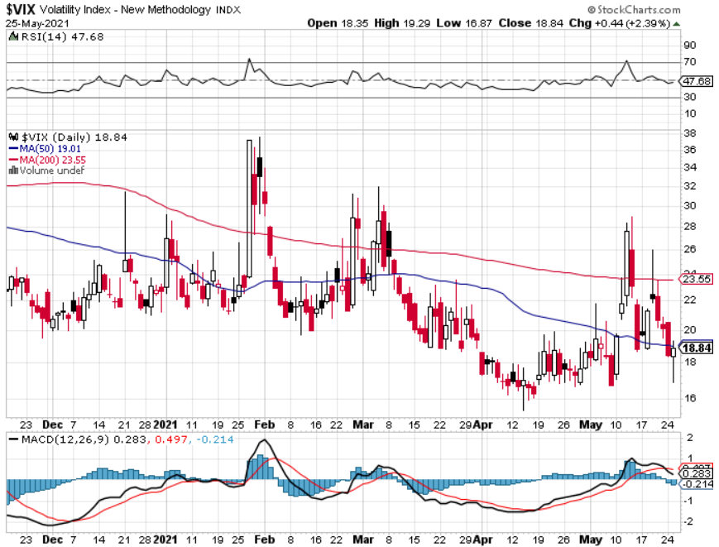
(VIX) – Dying a Slow Death The summer market is early

Slide 23
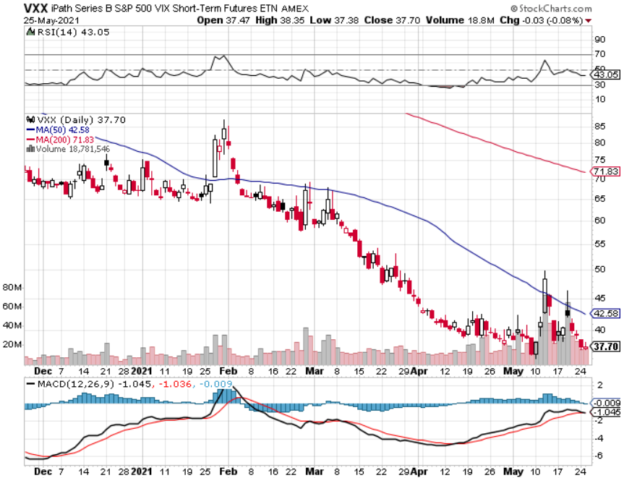
(VXX)-

Slide 24
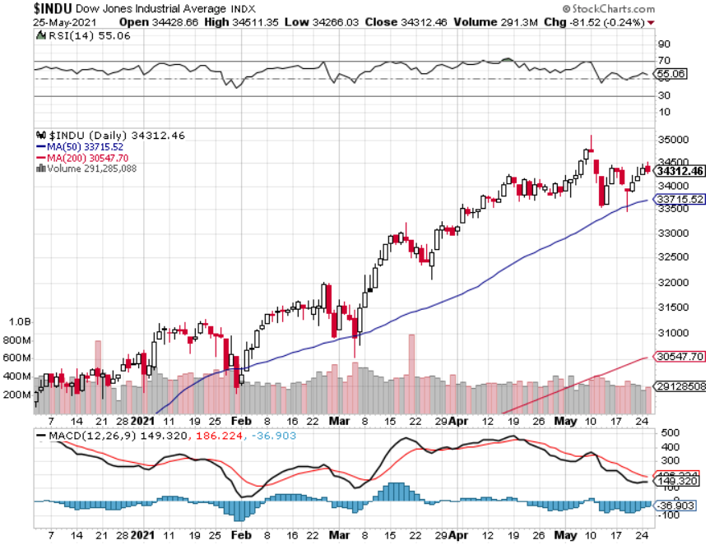
Dow Average ($INDU)- Trapped in a Range

Slide 25
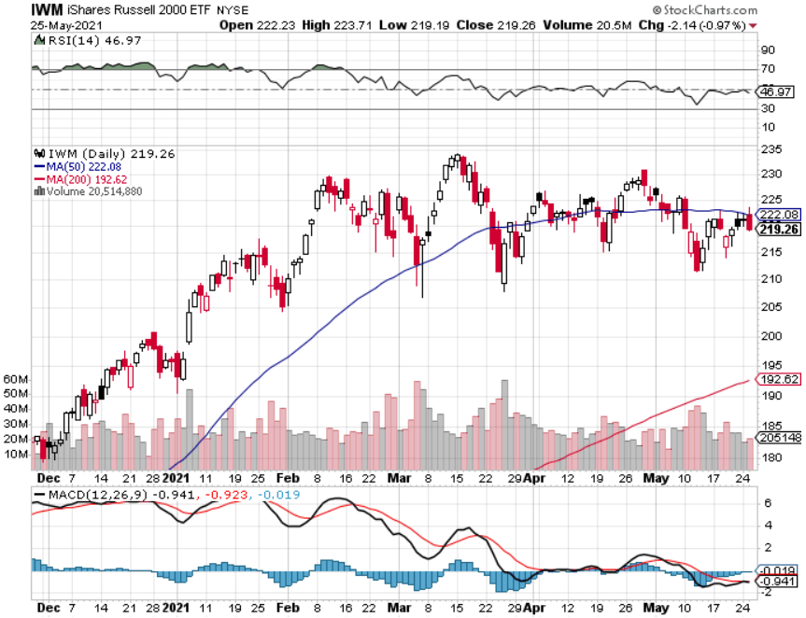
Russell 2000 (IWM)- Trapped in a Longer Range took profits on Long 10/$137-$142 vertical bull call spread took profits on Long 10/$153-$156 vertical bear put spread

Slide 26
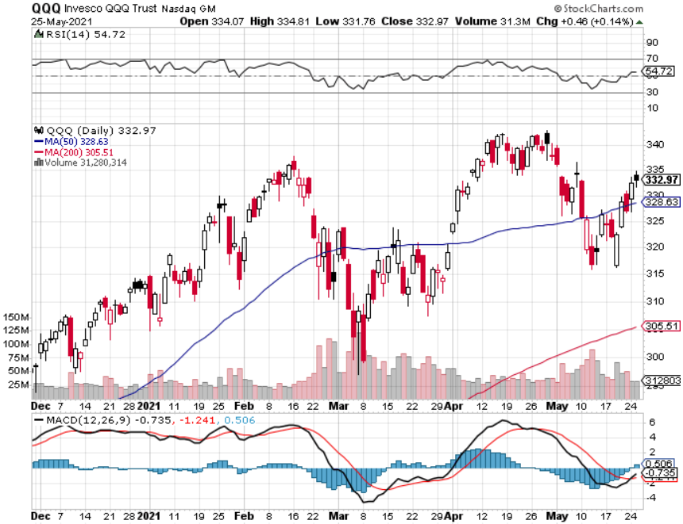
NASDAQ (QQQ) – 9 Month Range with Upside Breakout Coming long (QQQ) 4/$330-$335 put spread took profits on long (QQQ) 3/$340-$345 put spread covered long (QQQ) $325-$330 put spread

Slide 27
The Barbell Portfolio
*50% Big Tech - 2% of US Employment but 27% of Market Cap and 38% of Profits 50% Domestic Recovery, including: Railroads Couriers Banks Construction Credit Cards Event organizers Ticket sales Retailers

Slide 28
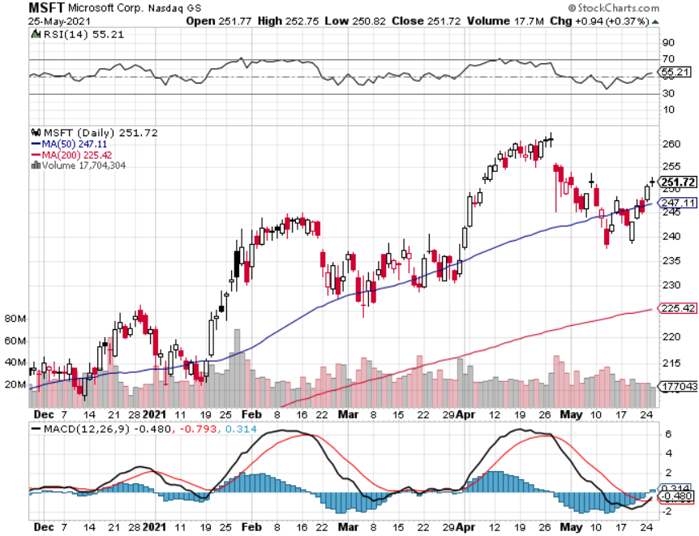
Microsoft (MSFT)- Earnings beat- Looking for Another Entry Point stop loss on long 12/$230-$240 call spread took profits on long 12/$220-$230 call spread

Slide 29
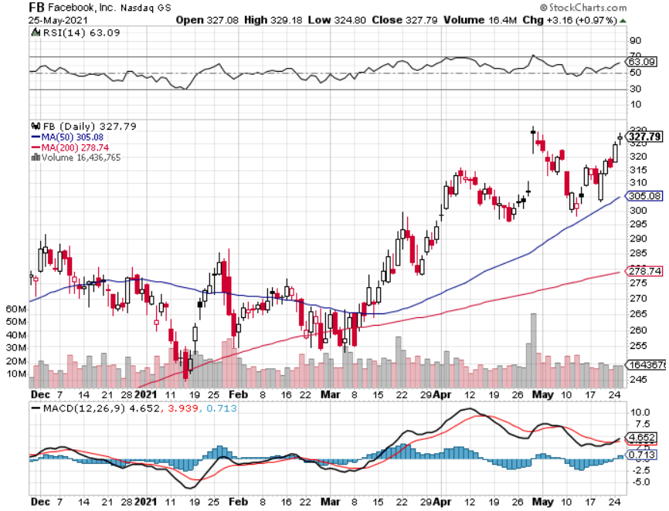
Facebook (FB)- took profits on Long 9/$290-$300 vertical bear put spread stopped out of Long 9/$190-$200 vertical bear put spread took profits on Long 9/$145-$155 vertical bull call spread took profits on Long 9/$150-$160 vertical bull call spread

Slide 30
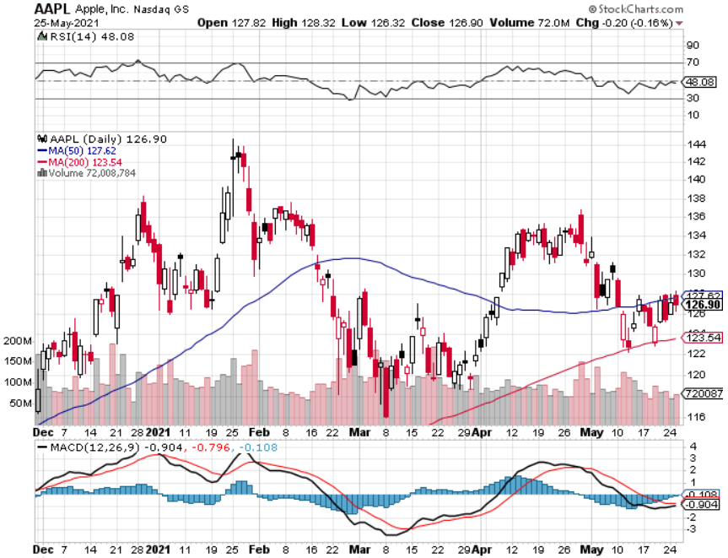
Apple (AAPL)- New 5G iPhone Surge-earnings after close Apple car moving forward with KIA took profits on long 7/$320-$330 call spread took profits on long 4/24/$250-$260 call spread took profits on long 5/$250-$260 call spread

Slide 31
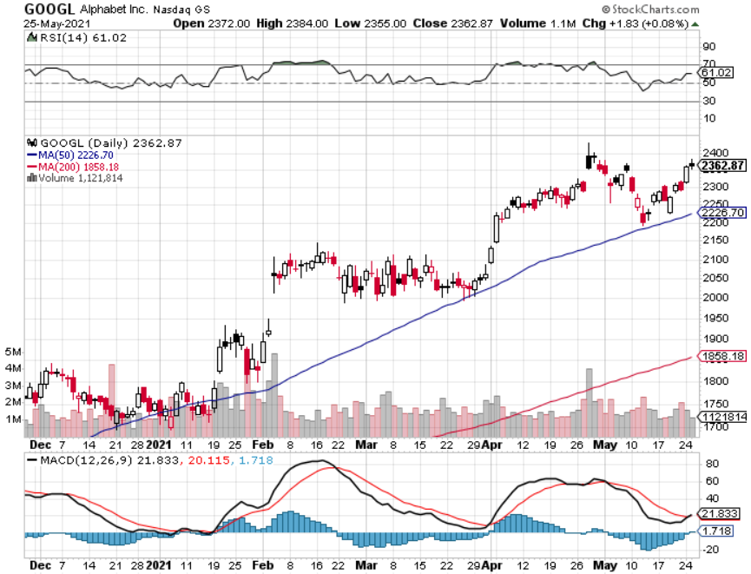
Alphabet (GOOGL) – Ad king on economic recovery 15% of search is travel related took profits on long 12/$1,200-$1,230 bull call spread took profits on long 9/$1,030-$1,080 vertical bull call spread

Slide 32
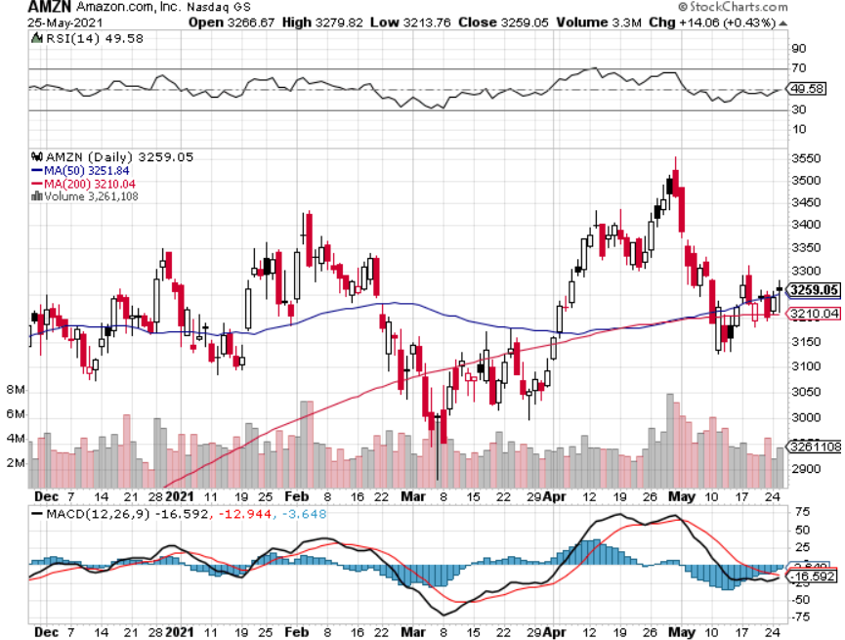
Amazon (AMZN) – Time correction took profits on long 9/$2,800-$2,900 bull call spread

Slide 33
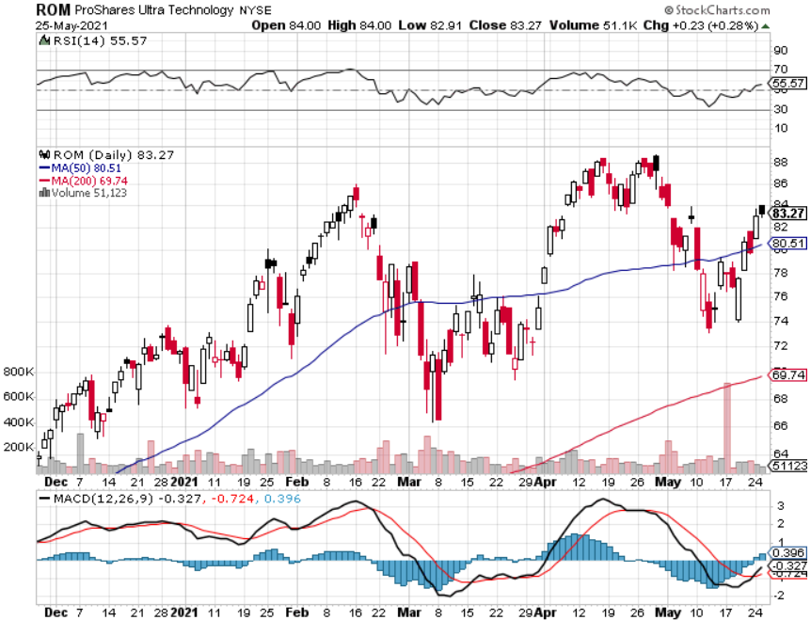
ProShares Ultra Technology (ROM) – Up 163% in 9 Months

Slide 34
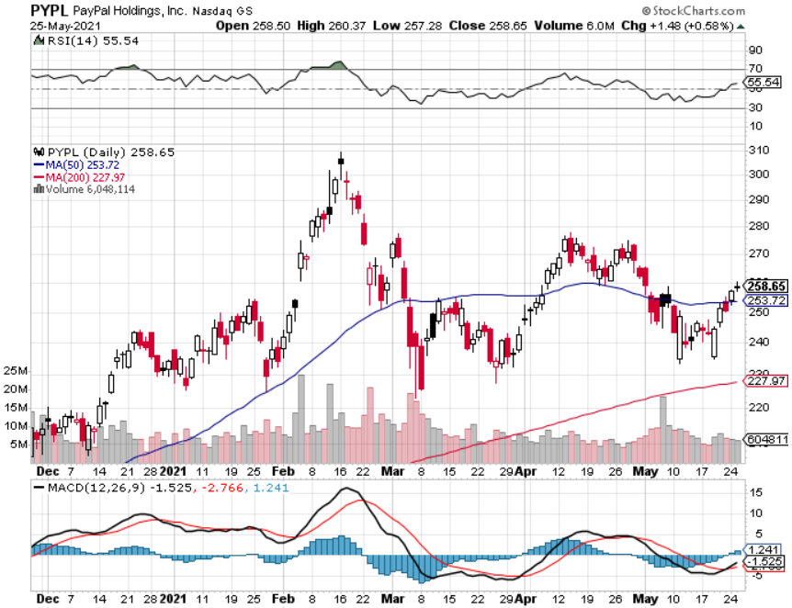
PayPal (PYPL)-Fintech Rules took profits on long 4/$90-$95 call spread

Slide 35
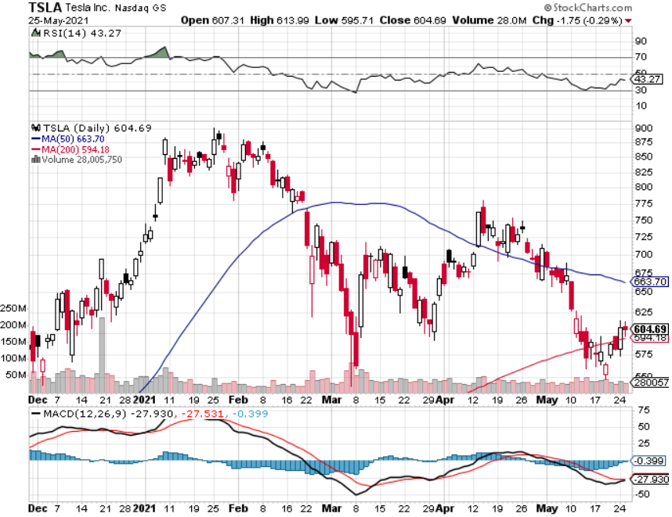
Tesla (TSLA)- Blows Away Q1 Deliveries, with a 184,400 print, or 47.5% high than the 2021 rate Q1 earnings +48% QOQ, +104% YOY took profits on long 2X 4/$450-$500 call spread took profits on long 3/$400-$450 call spread took profits on long 2/$650-$700 call spread-expires, stopped out of long 3/$600-$650 call spread Took profits on long 2/$600-$650 bull call spread, Took profits on long 2/$550-$600 bull call spread

Slide 36
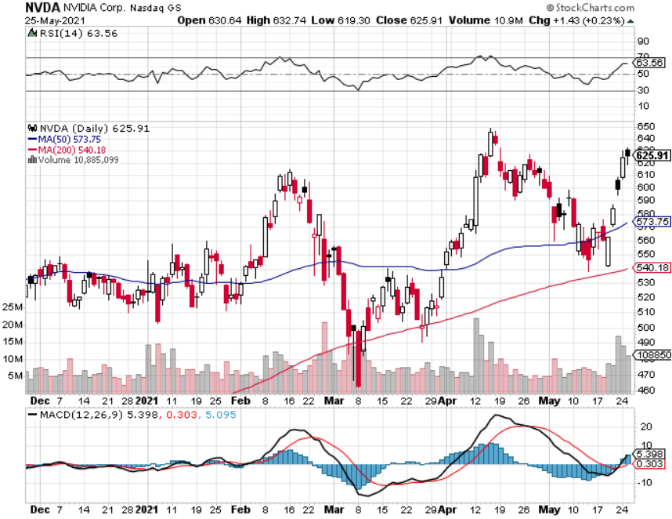
NVIDIA (NVDA) – The Biggest Chip Deal in History A Mad Hedge 10 bagger – Global Semiconductor Shortage Slows Auto Industry,

Slide 37
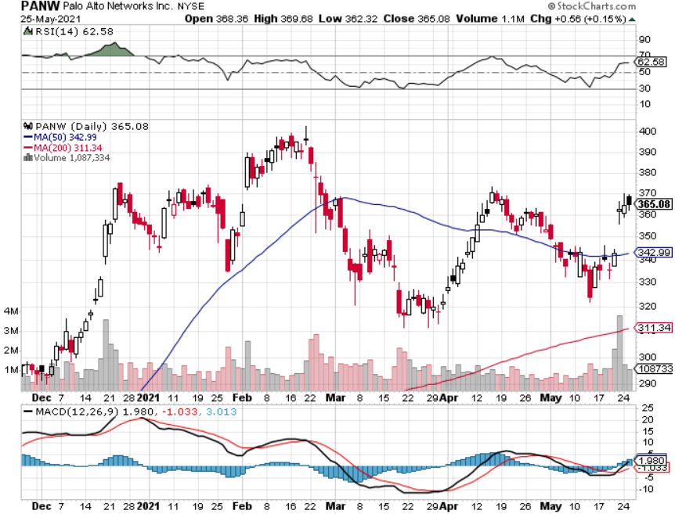
Palo Alto Networks (PANW)- Hacking never goes out of fashion

Slide 38
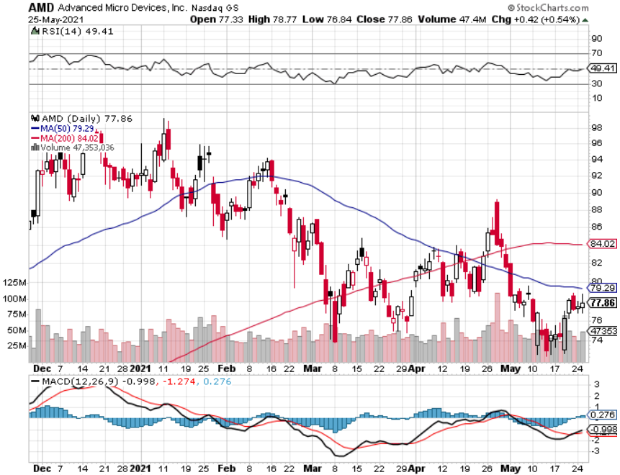
Advanced Micro Devices (AMD)- the next ten bagger - buys Xilinx – Programable logic devices took profits on long 2/$75-$80 call spread

Slide 39
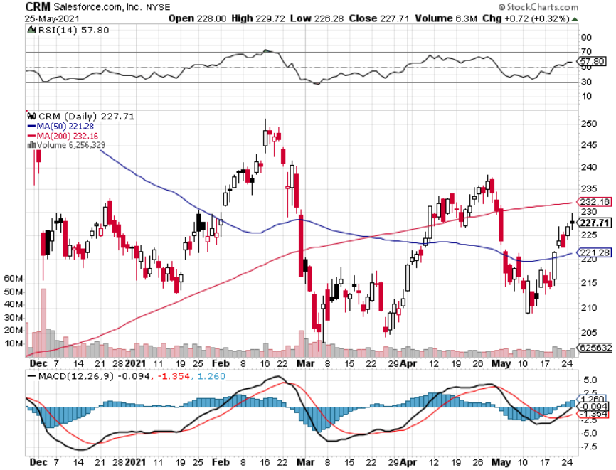
Salesforce (CRM)- Massive Online Migration took profits on long 9/$125-$130 vertical bull call spread took profits on long 8/$125-$130 vertical bull call spread took profits on long 2/$105-$115 call spread

Slide 40
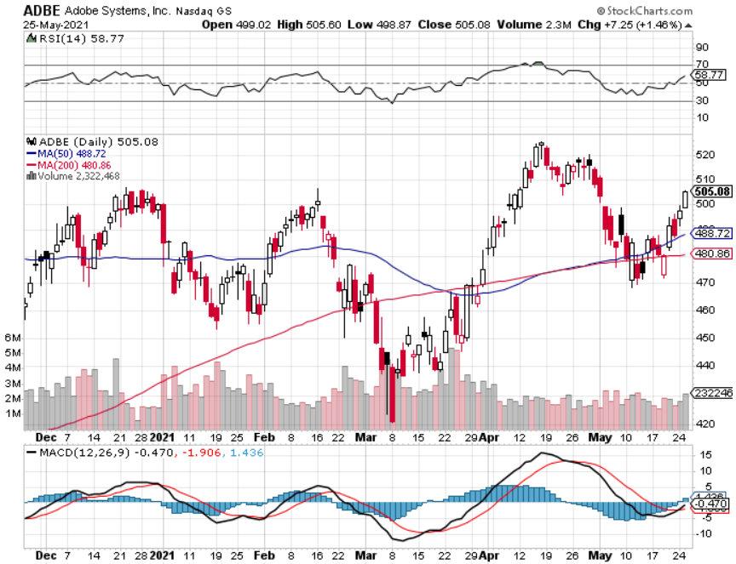
Adobe (ADBE)- Cloud play The Quality Non-China tech play

Slide 41
The Second Half of the Barbell
*Bets on a domestic recovery in 2021 *Upside potential in 2021 far greater than tech *Some of these have not moved for 5 or 10 years *Focuses on economically sensitive cyclical industries *Makes a great counterweight to high growth technology *We could spend all of next year rotating between the two groups

Slide 42
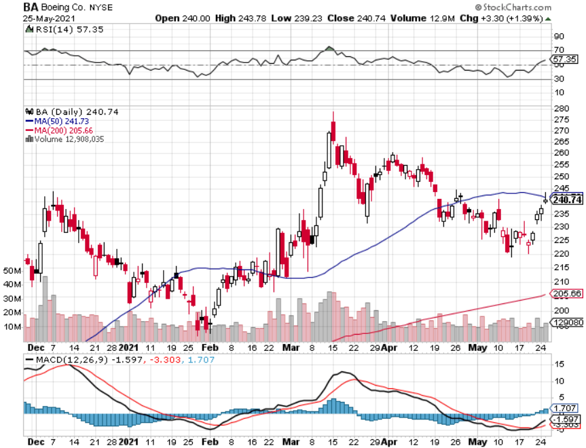
Boeing (BA) – former LEAP Candidate - The 737 MAX Flies Again! First positive deliveries in 14 months, new orders from (UAL) and (ALK) long 3/$146-$149 call spread took profits on long 2/$150-$160 call spread took profits on long 4/$300-$310 call spread took profits on long 4/$315-$335 call spread

Slide 43
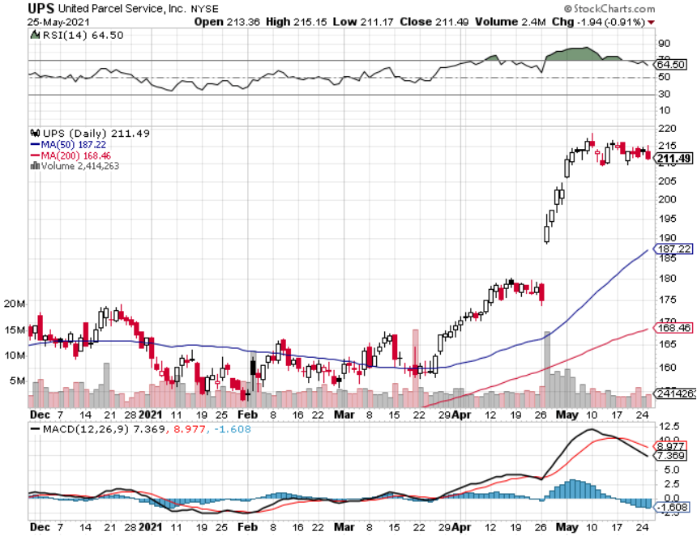
Package Delivery- United Parcel Service (UPS) massive increase in overnight deliveries, announces blowout earnings took profits on long 11/$130-$140 call spread

Slide 44
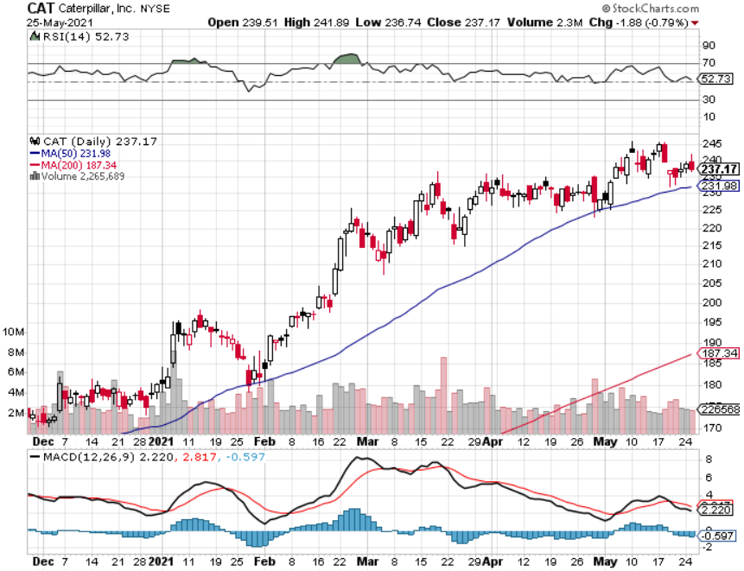
Caterpillar (CAT)- Ag + Infrastructure + Housing took profits on long 12/$145-$150 call spread took profits on long 11/$125-$135 call spread

Slide 45
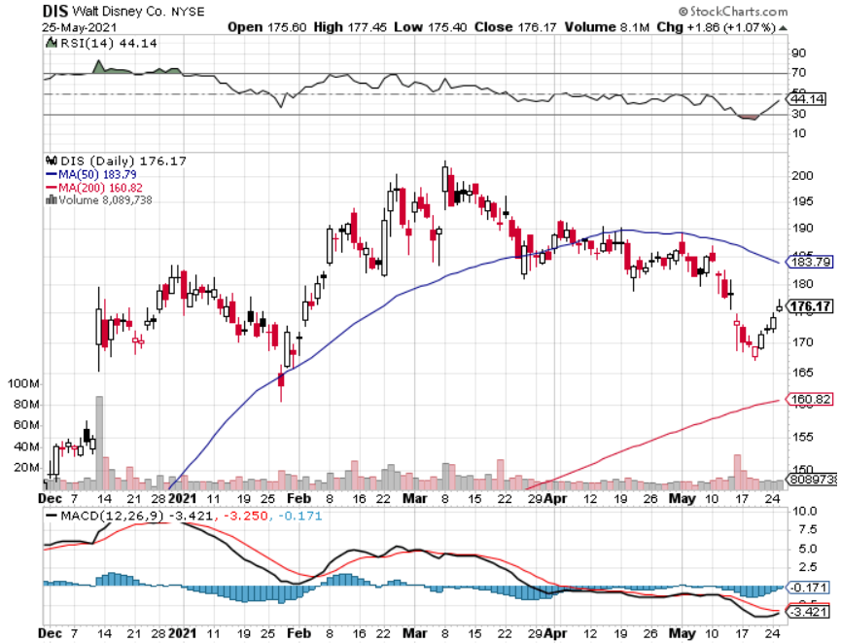
Walt Disney (DIS)- Big Recovery Move Disney Plus Streaming top 100 million subscribers in 15 months took profits on long 3/$170-$180 call spread

Slide 46
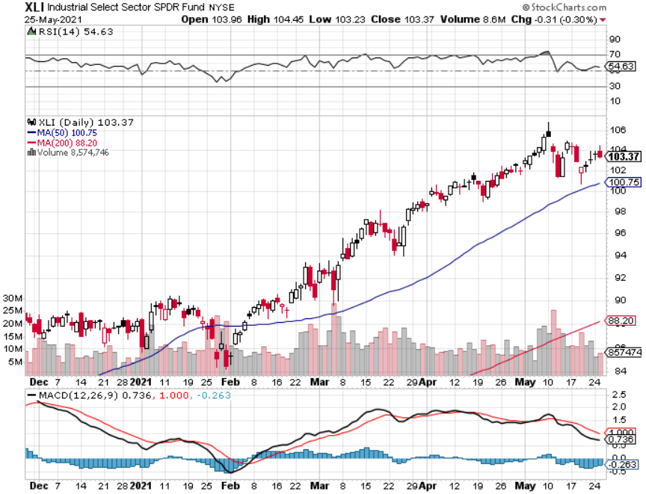
Industrials Sector SPDR (XLI)- (GE), (MMM), (UNP), (UTX), (BA), (HON)

Slide 47
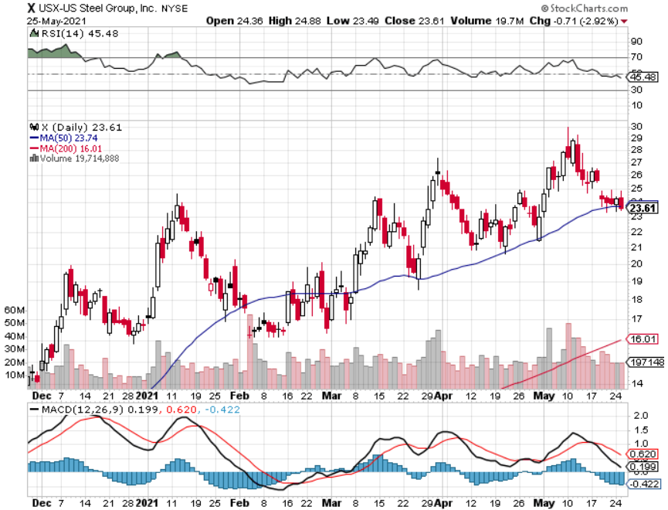
US Steel (X) – Commodity Boom

Slide 48
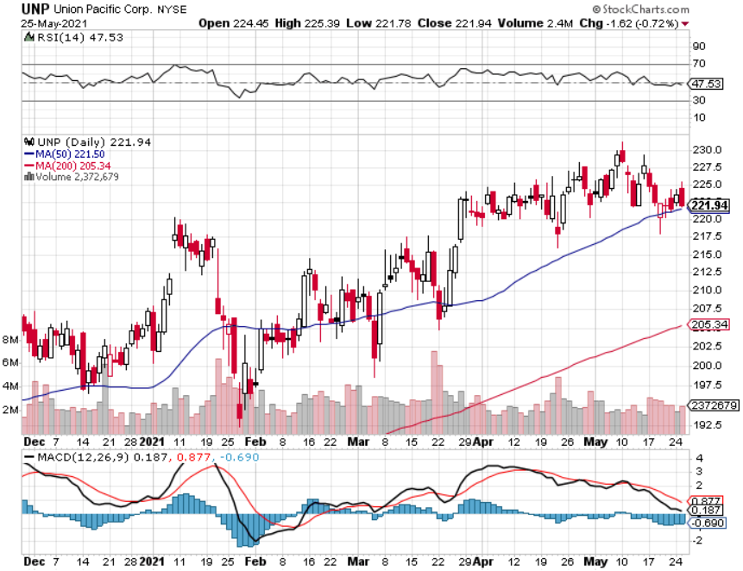
Union Pacific RR (UNP)- More stuff to ship near record earnings announced long 5/$200-$210 call spread – 12 days to expiration took profits on 11/$150-$160 call spread

Slide 49
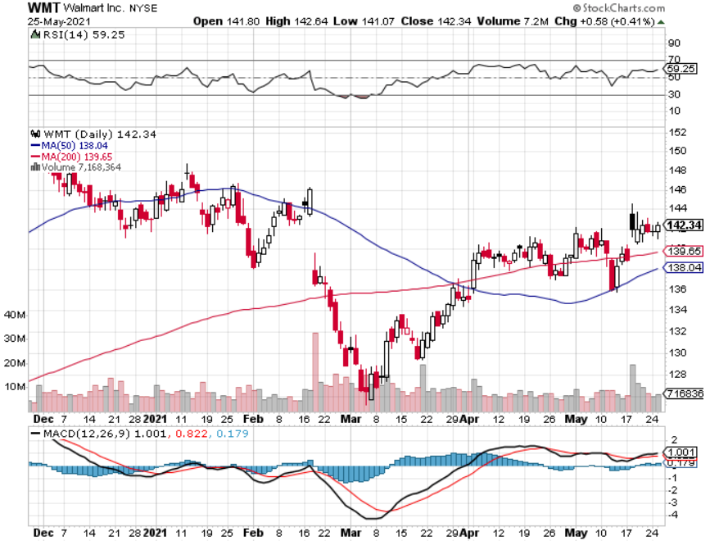
Wal-Mart (WMT)-New High took profit on Long 11/$125-$130 bear put spread took profit on Long 10/$119-$121 bear put spread took profits on Long 8/$114-$117 bear put spread

Slide 50
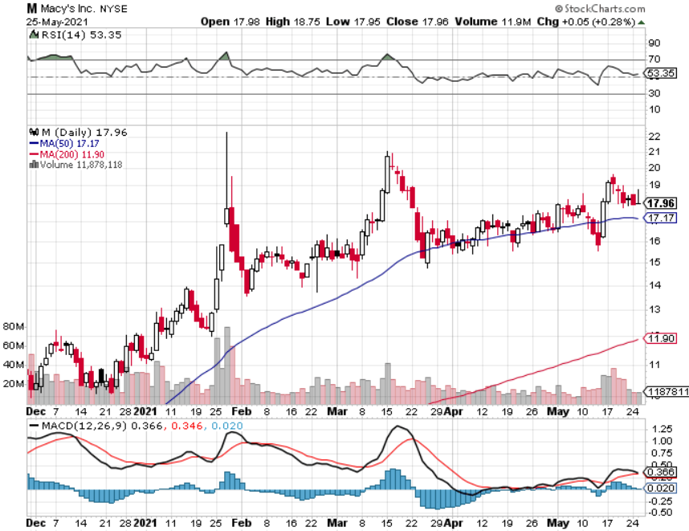
Macys’ (M) – Retail Return from the Grave took profits on Long 8/$23-$25 bear put spread

Slide 51
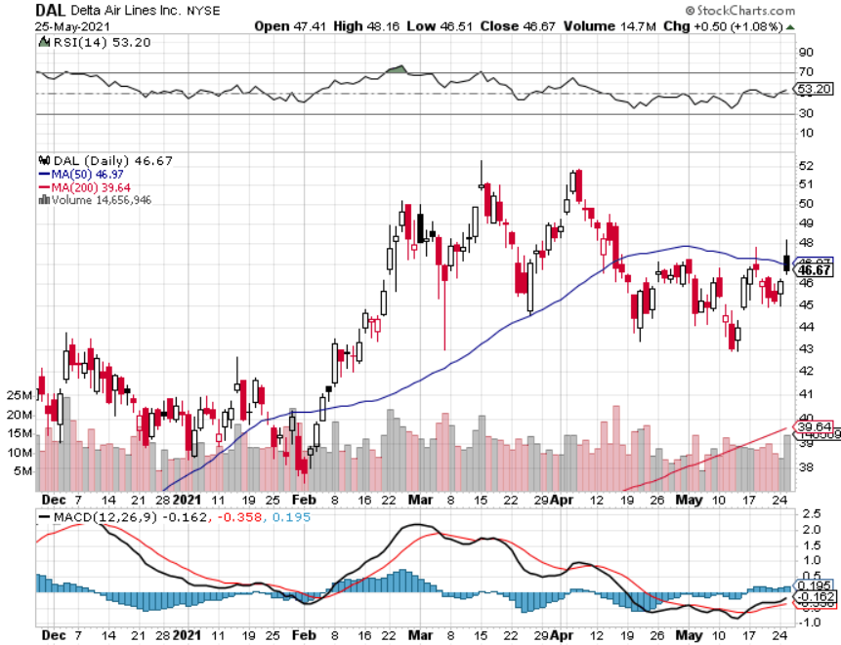
Delta Airlines (DAL) – stopped out of long 6/$40-$43 call spread

Slide 52
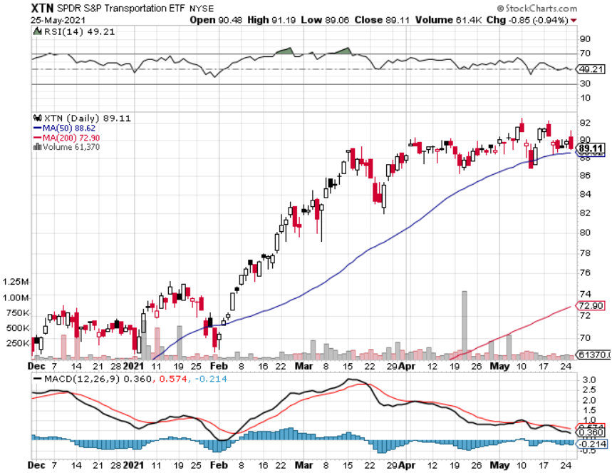
Transports Sector SPDR (XTN)- Worst Hit Sector (ALGT), (ALK), (JBLU), (LUV), (CHRW), (DAL)

Slide 53
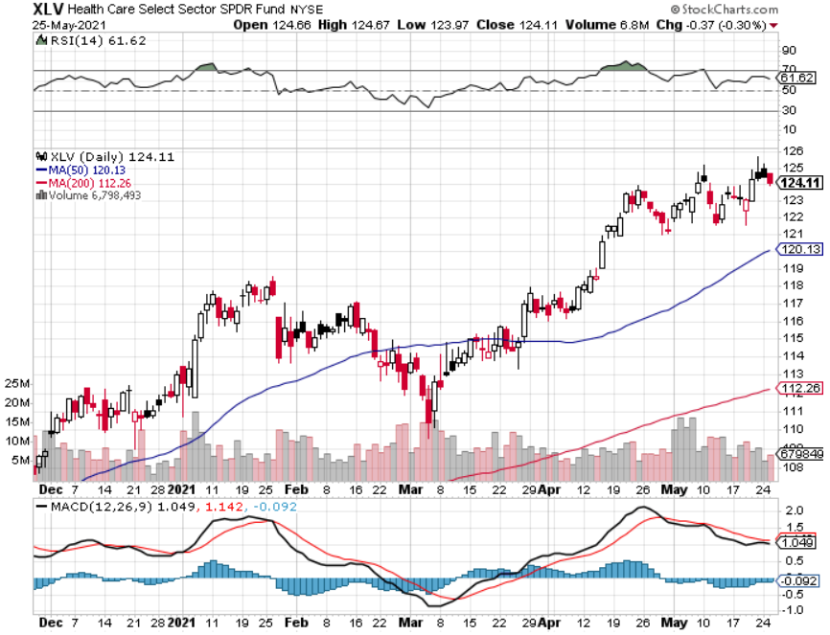
Health Care Sector (XLV), (RXL) (JNJ), (PFE), (MRK), (GILD), (ACT), (AMGN)

Slide 54
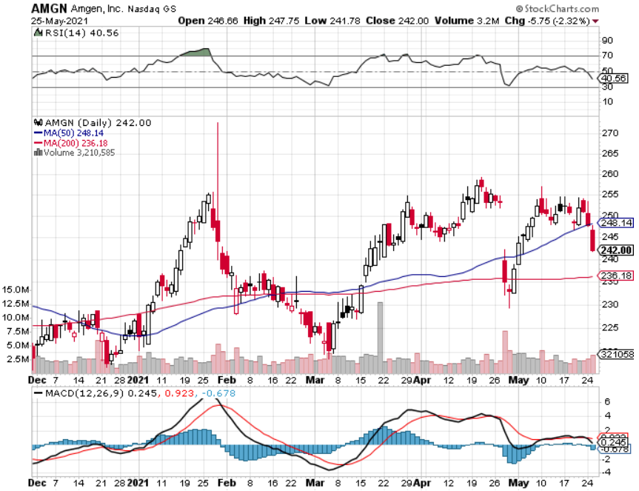
Amgen (AMGN) took profits on long 11/$185-$200 bull call spread

Slide 55
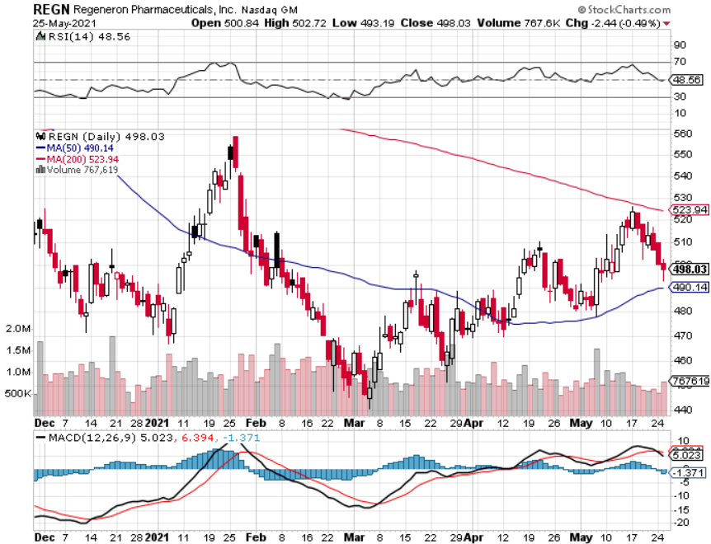
Regeneron (REGN) took profits on long 7/$570-$580 call spread

Slide 56
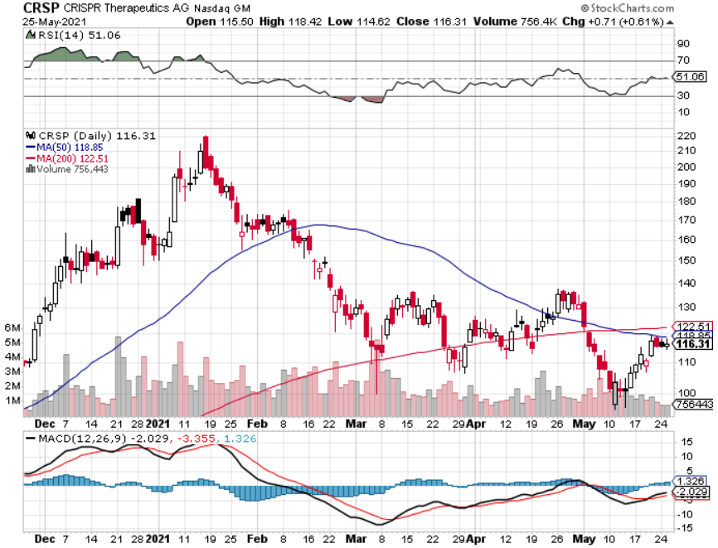
CRISPR Therapeutics (CRSP)

Slide 57
Goldman Sachs (GS) – took profits on long 6/$310-$320 call spread took profits on long 5/$310-$320 call spread took profits on long 2/$240-$260 call spread

Slide 58
Morgan Stanley (MS) – Blowout Earnings took profits on long 2/$55-$60 call spread

Slide 59
JP Morgan Chase (JPM)-Rising Rates long 5/$135-$140 call spread took profits on long 2/$135-$140 call spread took profits on long 2/$110-$115 call spread took profits on long 12/$100-$105 bull call spread took profits on long 11/$85-$90 bull call spread

Slide 60
Citigroup (C) – “Recovery” Rotation Play

Slide 61
Bank of America (BAC) – took profits on long 2/$28-$30 call spread

Slide 62
SPDR Metals & Mining ETF (XME) – long 2/$28-$30 call spread

Slide 63
Blackrock (BLK)-Asset Collection Boom took profits on long 3/$31-$34 call spread

Slide 64
Visa (V) – “Touchless” Fintech Play long 5/$195-$205 bull call spread- expires in 12 days took profits on long 9/$180-$185 bull call spread

Slide 65
Consumer Discretionary SPDR (XLY) (DIS), (AMZN), (HD), (CMCSA), (MCD), (SBUX)

Slide 66
Berkshire Hathaway (BRKB)- Natural Barbell- Trying to Breakout took profits on long 3/$230-$240 call spread

Slide 67
Europe Hedged Equity (HEDJ)-

Slide 68
Japan (DXJ)-

Slide 69
Emerging Markets (EEM) - Pro trade, Weak Dollar, long recovery Play

Slide 70
Bonds – Flatlining
*Bonds hold lows, but can’t rally above $141 on infrastructure bull slowdown and shrinkage *look for another selloff going into the June 10 CPI *The $120 billion in monthly Fed bond buying remains, but the “taper” is looming *Expect more inflation scares but nothing sustainable *I’m piling money into long dated put LEAPS like the (TLT) January 2022 $135-$140 or the January 2023 $125-$130 *A 2.00% yield on the ten-year US Treasury bond here we come! This is the quality trade of 2021 *US Treasury bond fund (TLT) could plunge from $180 a year ago to $105

Slide 71
Treasury ETF (TLT) – Huge Short Play long 5/$143-$146 put spread, long 5/$144-$147 put spread, expires in 7 days 6/$145-$148-expire in 34 days took profits on 2X long 4/$142-$145 put spread, 4/$127-$130 call spread took profits on 2X long 5/$142-$145 put spread, took profits on long 2/$146-$149 put spread

Slide 72
Ten Year Treasury Yield ($TNX) – 1.58%

Slide 73
Junk Bonds (HYG) 3.33% Yield to Maturity

Slide 74
2X Short Treasuries (TBT)-Another run at highs

Slide 75
Emerging Market Debt (ELD) 4.27% Yield-

Slide 76
Municipal Bonds (MUB) – 0.93% Mix of AAA, AA, and A rated bonds

Slide 77
Foreign Currencies – Dollar Collapse
*US Dollar Hits New 2021 Low, as the interest rate rally stalls. *Massive over issuance of debt by the US government to fund the covid recovery is another nail in the coffin. *Europe is getting positive yield support for the first time in a decade *Expect more of the same. Buy (FXA) and (FXE) on dips. *Bitcoin is the Most Crowded State in the World, dropped 55% in 6 weeks and 30% in one day *Keep selling short all US dollar rallies, its yield support is gone forever, Buy (FXA) and (FXE) on dips.

Slide 78
Japanese Yen (FXY), (YCS)

Slide 79
Euro ($XEU), (FXE), (EUO)-

Slide 80
British Pound (FXB)-

Slide 81
Australian Dollar (FXA)- The Global Recovery Play took profits on long 8/$67-$69 call spread

Slide 82
Emerging Market Currencies (CEW)

Slide 83
Chinese Yuan- (CYB)-

Slide 84
Bitcoin- Crash! Down 55% in 6 weeks

Slide 85
Energy – Ransom Payment
*Colonial Pipeline comes back on stream after payment of a $5 million ransom *Oil has been trapped in narrow two-month range. Economic recovery boost is offset by long term bear trend *The end of oil is upon us, but it may take 30 years to unwind existing infrastructure *All US car production will be electric by 2035, wiping out half of all US oil consumption *Oil consumption will become a China only business, with them already taking 80% of all Persian Gulf output *China Slowdown Could Bring oil and Copper Correction *Avoid all energy plays like the plague, it’s the new buggy whip industry as the US de-carbonizes

Slide 86
Oil-($WTIC)

Slide 87
United States Oil Fund (USO) long 10/$9.50-$10 Vertical bull call spread

Slide 88
Energy Select Sector SPDR (XLE)-No Performance! (XOM), (CVX), (SLB), (KMI), (EOG), (COP)

Slide 89
Halliburton (HAL)-

Slide 90
Natural Gas (UNG) -

Slide 91
Precious Metals – Back to Life
*Why is the Gold Hedge Working this Time? *The Barbarous relic is finally giving investors the insurance and the downside hedge they need, after failing to do so during the last correction in February *That’s because interest rates were spiking in the winter but aren’t now. Interest rates are the enemy of all no yielding assets, like precious metals Long-term rising interest rates remain a threat to precious metals *Gold rallies 12% and silver 18% on a flight to safety bid *Gold will eventually recover when US borrowing becomes so massive it undermines the value of the US dollar, even in the face of higher interest rates

Slide 92
Gold (GLD)- Melt Up

Slide 93
Market Vectors Gold Miners ETF- (GDX) –

Slide 94
Barrick Gold (GOLD) took profits on long 1/$21-$23 call spread took profits on long 11/$22-$24 call spread

Slide 95
Newmont Mining- (NEM)- took profits on long $55-60 call spread

Slide 96
Silver- (SLV)- took profits on long 11/$19-$20 call spread

Slide 97
Silver Miners - (SIL)-

Slide 98
Wheaton Precious Metals - (WPM)- took profits on long 2/$39-41 call spread

Slide 99
Copper (COPX)-Uptrend at Risk

Slide 100
Real Estate – Diving Sales
*Existing Home Sales Drop 2.7%, in April to 5.85 million units *Inventories are down 20% YOY to only an unimaginable two-month supply *Sales of homes over $1 million are up an incredible 214% YOY *Housing Starts Dive, as builders run out of materials at reasonable prices. *Single family homes took the big hit, down 13.4% to 1.08 million *Permits are still up 70% YOY from when Covid completely shut the industry down *Builder are including contingency clauses which allow price rises after the sale, a first. *There is a massive flight from cities to region towns, especially resorts, causing prices to double in a year *Homebuilding costs are up 12% YOY, especially for lumber.

Slide 101
S&P Case Shiller Up 13.2% for March Phoenix +20.0%, San Diego 19.1%, Seattle 18.3%

Slide 102
Crown Castle International (CCI) – 3.42% yielding cell phone Tower REIT

Slide 103
US Home Construction Index (ITB) (DHI), (LEN), (PHM), (TOL), (NVR)

Slide 104
Trade Sheet- So What Do We Do About All This?
*Stocks – buy dips aggressively *Bonds – sell rallies aggressively *Commodities-buy dips aggressively *Currencies- sell US dollar rallies *Precious Metals – buy dips *Energy – stand aside *Volatility - sell short over $30 *Real estate – buy dips

Slide 105
Next Strategy Webinar 12:00 EST Wednesday, June 16, from Lake Tahoe email me questions at support@madhedgefundtrader.com
Good Luck and Good Trading!
Notes:
*

