Slide 1
The Mad Hedge Fund Trader “Tech Takes Off”
With John Thomas from Incline Village, NV, June 30, 2021 www.madhedgefundtrader.com
Notes:
*

Slide 2
1,800-pound 16 Inch Shell from the USS New Jersey

Slide 3
Mad Hedge Trader & Investors Summit June 8-10– The Videos are Up!
*A collection of the 27 best traders and managers in the world, or 8 a day *Back-to-back One-hour presentations followed by an interactive Q&A *Covering all stocks, bonds, commodities, foreign exchange, precious metals, and real estate *It’s the best look at the rest of 2021’s money making opportunities you will get anywhere *An invitation will be sent to you shortly and it is FREE to attend

Slide 4
Trade Alert Performance New All Time Highs! 32 consecutive profitable trade alerts- 95% success rate in 2021-ony 5 losers
*January 10.21% MTD *July +7.93% Final *February +13.28% Final *August -2.08% Final *March +20.60% Final *September 7.95% Final *April +15.67% Final *October +1.51% Final *May +8.13% Final *November +20.41% Final *June +0.71% MTD *December +10.20% Final *2021 Year to Date +68.60% compared to +11.89% for the Dow Average *+491.15% since inception, a new all time high *Average annualized return of 42.40% for 11 1/2 years, new all time high`

Slide 5
Portfolio Review 100% Cash in a low volatility Long Term Bull Market
Current Capital at Risk
Risk On
World is Getting Better
No Positions | 0.00%
Risk Off
World is Getting Worse
No Positions | 0.00%
Total Net Position | 0.00%
Total Aggregate Position | 0.00%

Slide 6
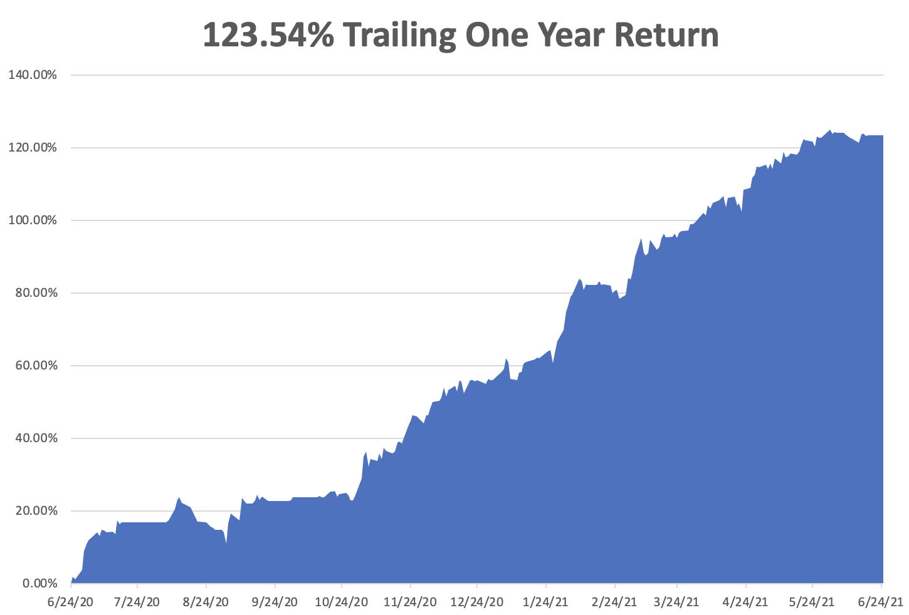

Slide 7
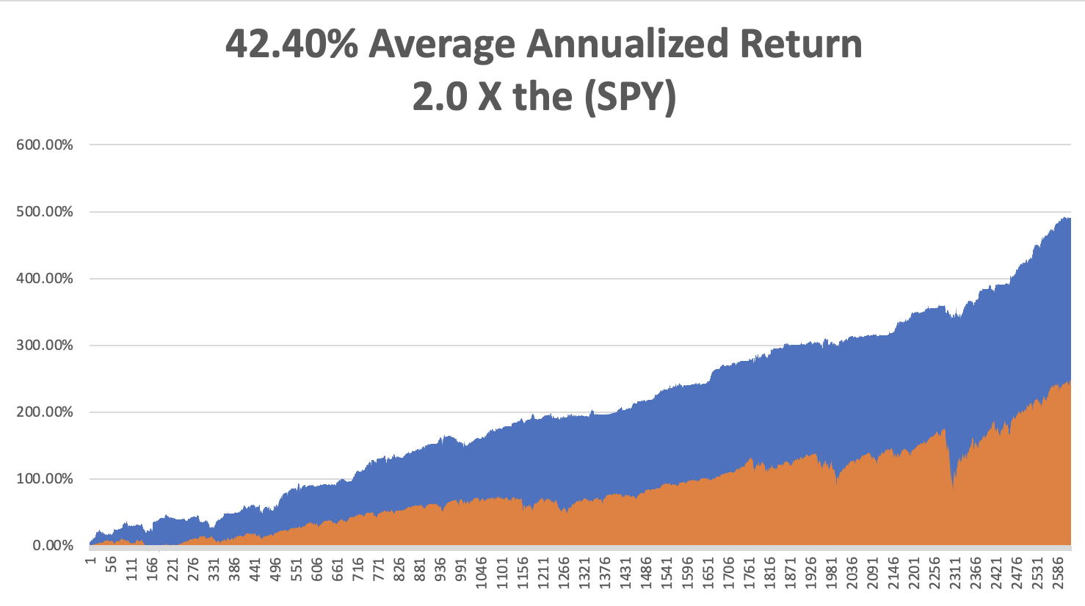
GTD 11 1/2 Year Daily Audited Performance

Slide 8
The Method to My Madness The Roaring Twenties are Here
*Tech takes off and should be the dominant sector for the rest of 2021, ARK funds are back in the spotlight *Commodities Crash, on a soaring US dollar and shrinking interest rates, sending all inflation plays to the penalty box, like financials and precious metals *A counter trend spike up in bond prices and down in rates is temporary at best, hold on to your bond shorts *The economic recovery is now regional, with China first, now the US, and Europe last *Bitcoin head and shoulders is in, look for the next bottom at $10,000-$20,000 *VIX collapses to $14, showing the summer market is here

Slide 9
Corona Update – End of the Pandemic
*50% of the US population is vaccinated and 10% have had the disease, bringing immunity up to 60%. Washington state is offering free joints and McDonalds Big Macs to get vaccinated because rate is slowing *New cases have fallen off a cliff, from 250,000 a day to 12,000, down 94%. The population is acting like herd immunity has already begun! *The way this ends is that a 50% fatal variants comes back to the US to kill off the non vaccinated portion of the US population, as it did in 1918, stampeding the rest to vaccinating *Unvaccinated workers will be unable to get jobs and board planes or public transport, with mass firings taking place of unvaccinated workers in a hospital in Houston *End of mask mandate is bringing a huge stimulus to the economy….and the stock market! *US cases top 33.7 million, deaths topping 605,000 and are down to 400 a day

Slide 10
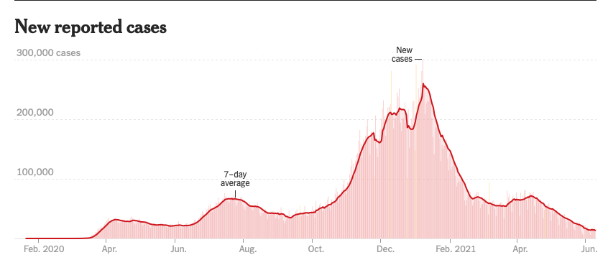
Headed to Zero by September

Slide 11
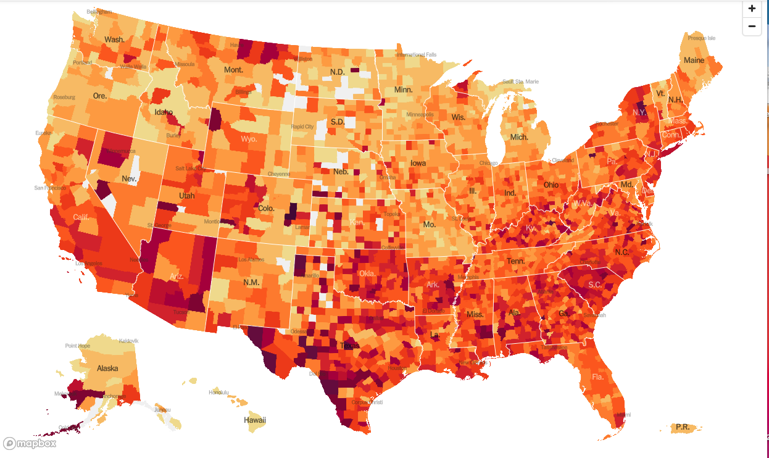
January 20 Infection Rate

Slide 12
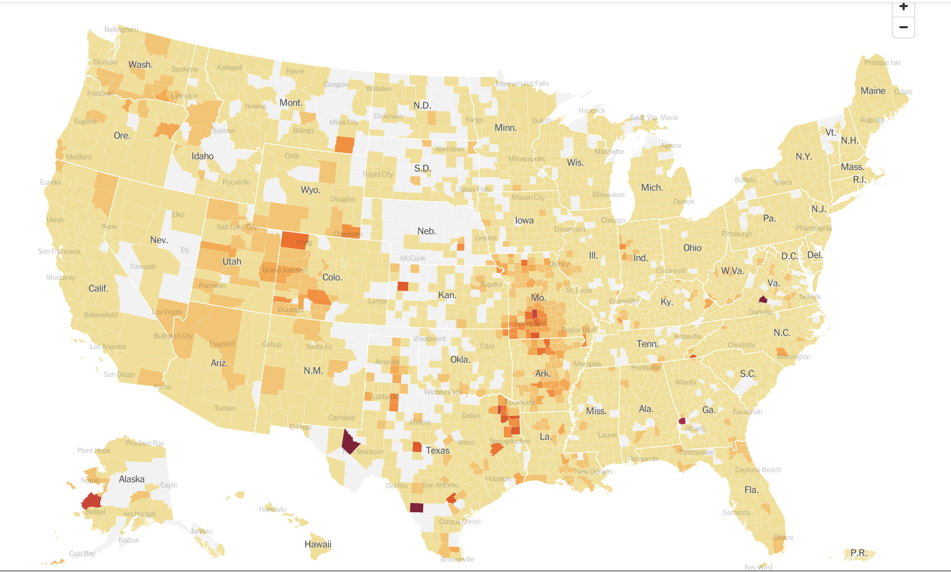
June 30 Infection Rate

Slide 13
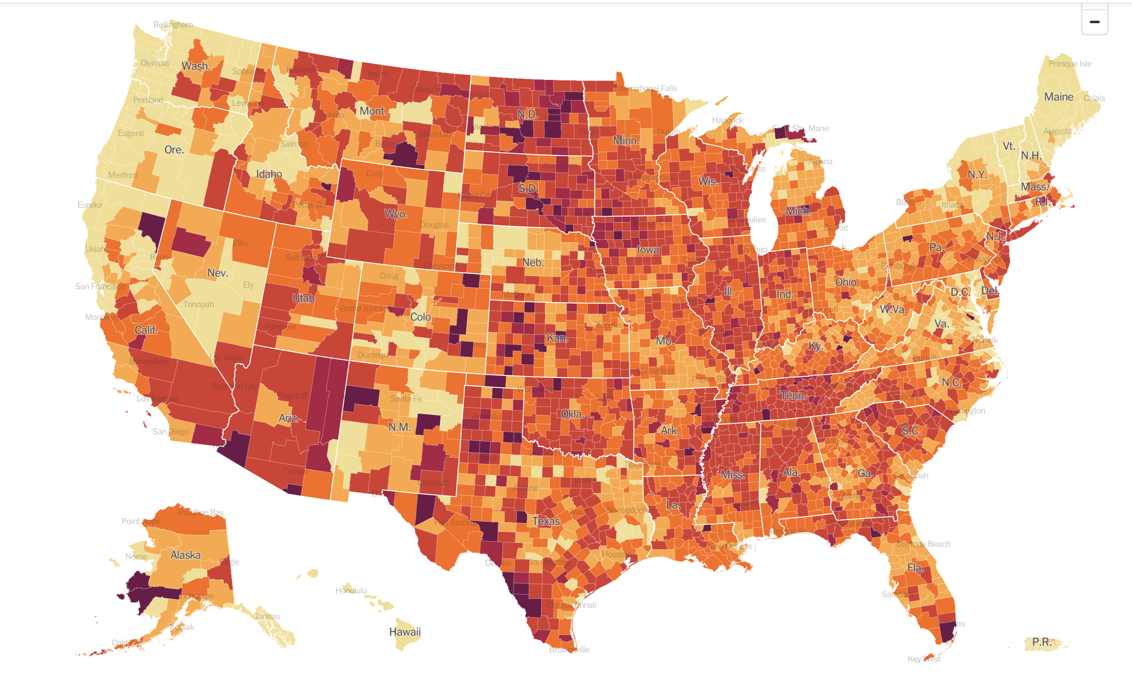
June 30 Per Capita Infections Since 1/1/2020-some counties only 20% vaccinated

Slide 14
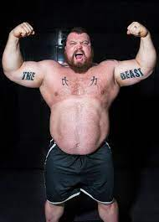
The Global Economy – From Strength to Strength
*The Infrastructure Deal is Done, at $579 billion in new spending, will provide a further boost to the economy *The Fed Takes a Turn, leaning towards more inflation. It is continuing bond purchases at $120 billion a month. It is still sticking with the “transitory” argument on inflation *May Industrial Production is Up a Strong 0.8%, *Factory Activity Fell in June, for the second month in a row according to the Philly Fed
*We May Lose Christmas, as a lack of containers and ships makes transport from China problematic. *US Factory Activity Hits Record High, according to the Markit Flash PMI *Weekly Jobless Claims drop to 411,000, down from the pandemic peak of 900,000 in January

Slide 15
Stocks – Techs Takeover
*Tech Soars, getting a new lease on life with the collapse of interest rates this week *Interest rate collapse sets tech stocks on fire and value and inflation stocks asleep *$1.2 Trillion Poured into Equities in H1, more than double the previous 2007 record *Corporate share buybacks are also approaching new highs *Failure of Facebook antitrust case lights another fire under tech *Microsoft becomes second $2 trillion company, with Amazon close behind *Interest rate collapse sets tech stocks on fire and value and inflation stocks asleep *Stick with the barbell strategy, we’ll keep rotating back and forth all year between tech & domestic recovery *We could be entering a wide $2,700 - $3,600 range until the election

Slide 16
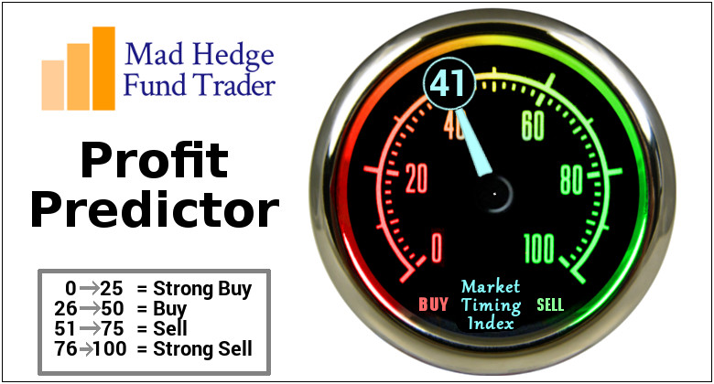
The Mad Hedge Profit Predictor Market Timing Index – Stuck in Neutral An artificial intelligence driven algorithm that analyzes 30 different economic, technical, and momentum driven indicators

Slide 17
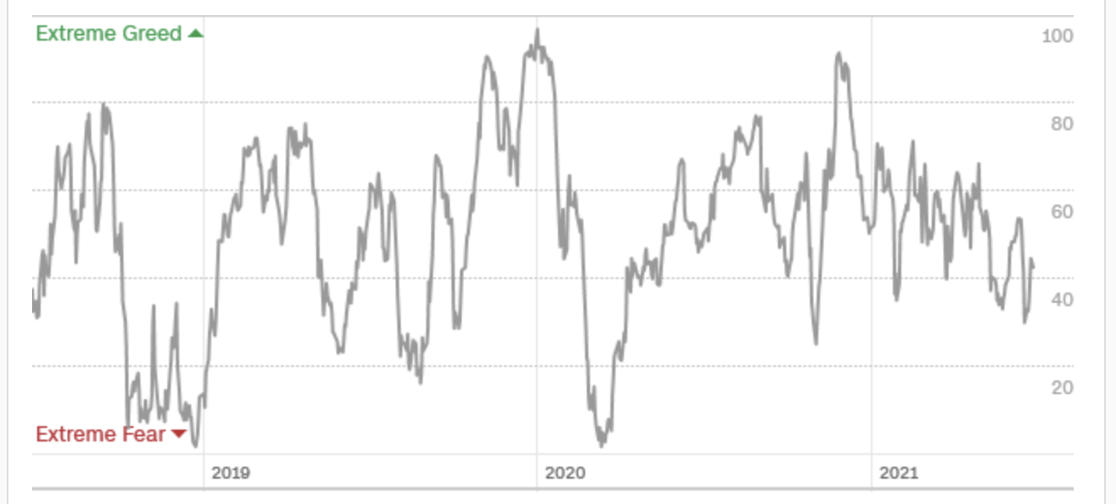
The Mad Hedge Profit Predictor Trapped in a “Do Nothing” Range
SELL
Do Nothing
BUY

Slide 18
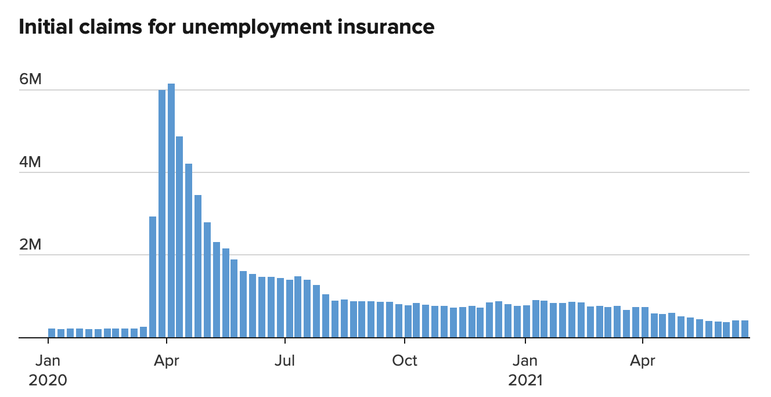
Weekly Jobless Claims – Flatlining at record highs 411,000 – Slight Increase

Slide 19
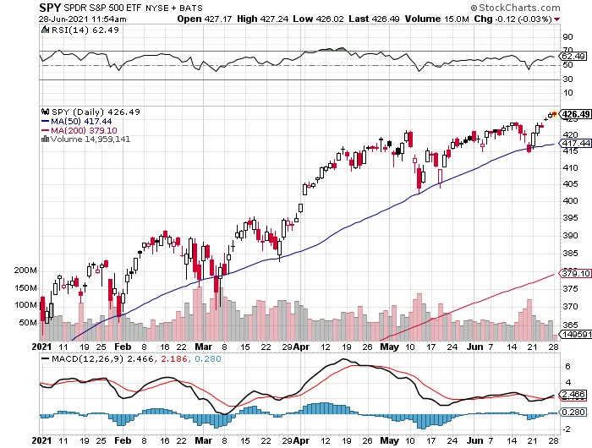
S&P 500 – New Highs long 6/$375-$385 bull call spread-expires in 2 days long 6/$430-440 bear put spread-expires in 2 days
New Highs Yearend Target $475
The Bottom 414

Slide 20
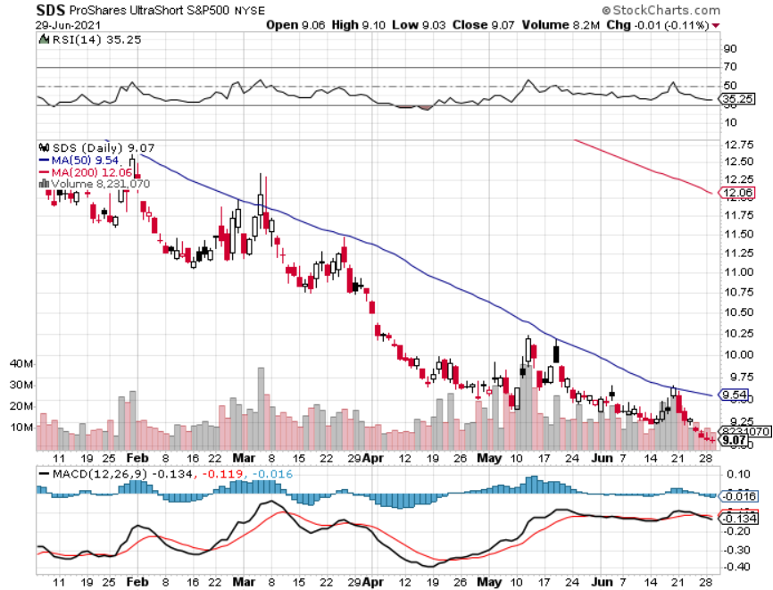
ProShares Ultra Short S&P 500 (SDS)- a Great Hedge for long stocks and bonds Long 2X position has a hedge against longs and bond shorts

Slide 21
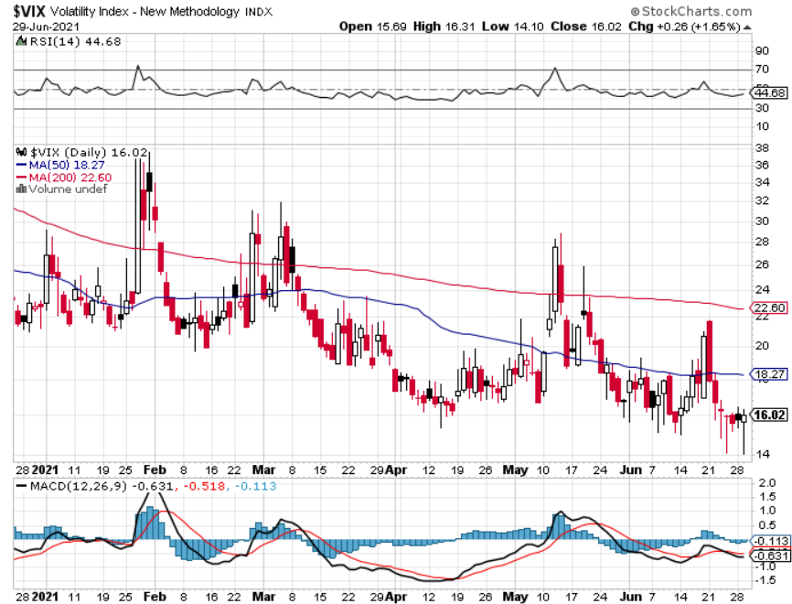
(VIX) – Dying a Slow Death The summer market is early

Slide 22
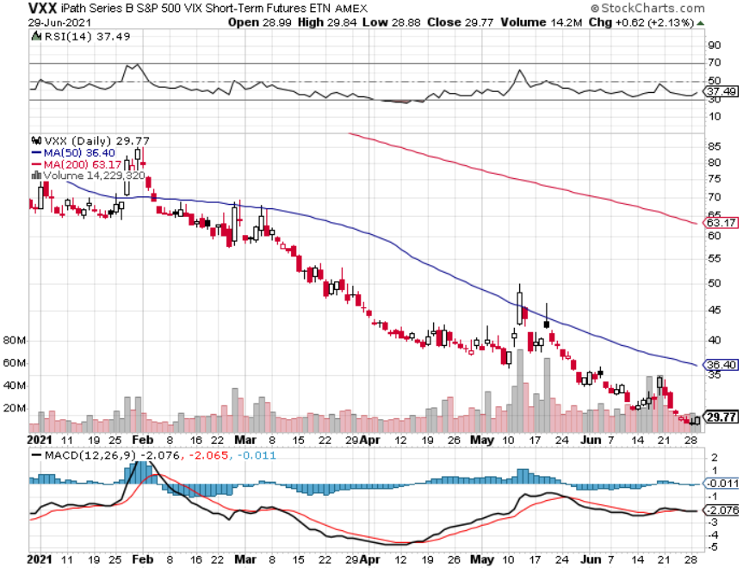
(VXX)-

Slide 23
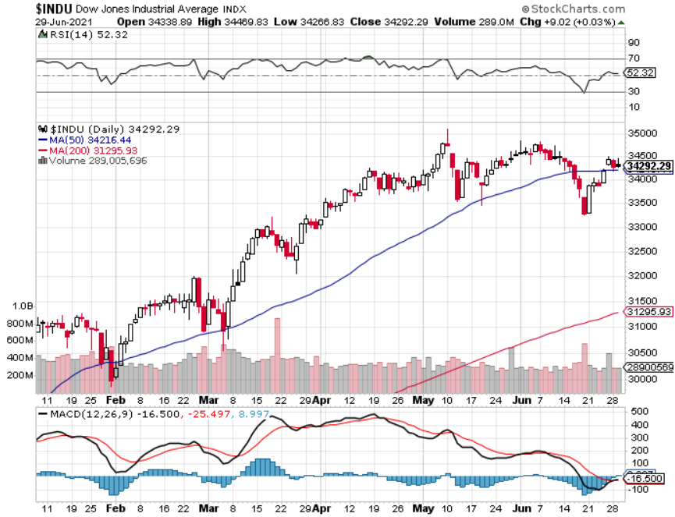
Dow Average ($INDU)- Back to top of range

Slide 24
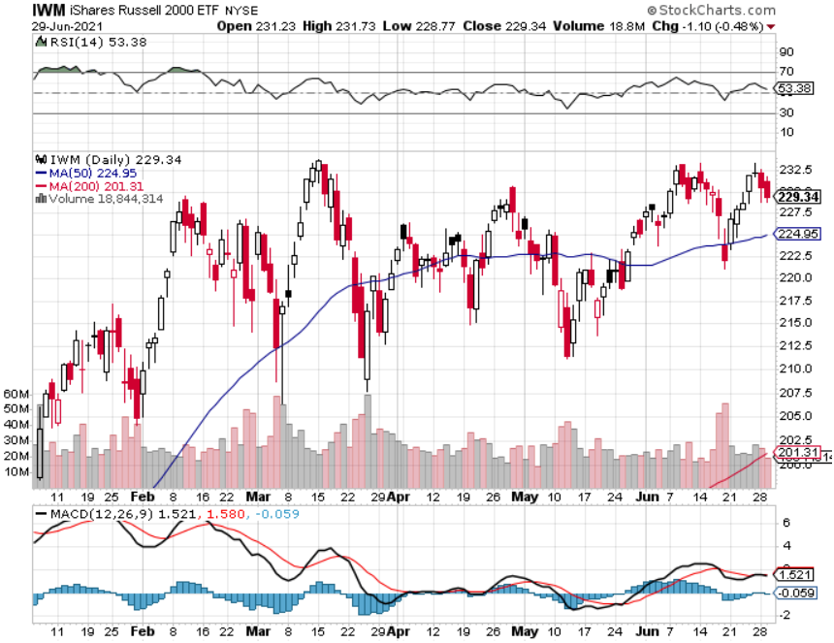
Russell 2000 (IWM)- took profits on Long 10/$137-$142 vertical bull call spread took profits on Long 10/$153-$156 vertical bear put spread

Slide 25
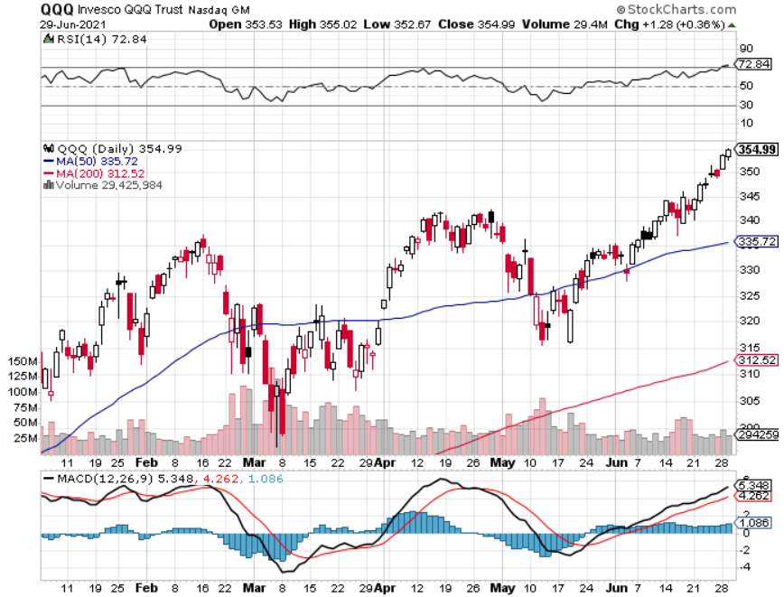
NASDAQ (QQQ) – Gone Ballistic long (QQQ) 4/$330-$335 put spread took profits on long (QQQ) 3/$340-$345 put spread covered long (QQQ) $325-$330 put spread

Slide 26
The Barbell Portfolio
*50% Big Tech - 2% of US Employment but 27% of Market Cap and 38% of Profits 50% Domestic Recovery, including: Railroads Couriers Banks Construction Credit Cards Event organizers Ticket sales Retailers

Slide 27
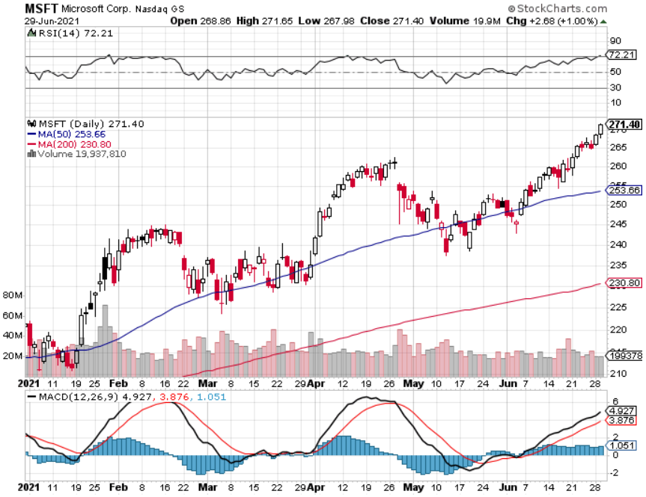
Microsoft (MSFT)-Second $2 trillion company took profits on long 12/$220-$230 call spread stop loss on long 12/$170-$180 call spread took profits on long 12/$135-$138 call spread

Slide 28
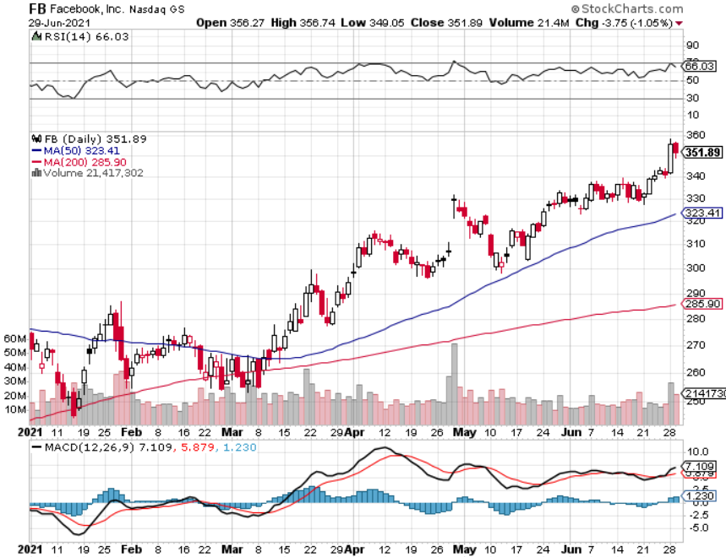
Facebook (FB)-Big Antitrust win took profits on Long 9/$290-$300 vertical bear put spread stopped out of Long 9/$190-$200 vertical bear put spread took profits on Long 9/$145-$155 vertical bull call spread took profits on Long 9/$150-$160 vertical bull call spread

Slide 29
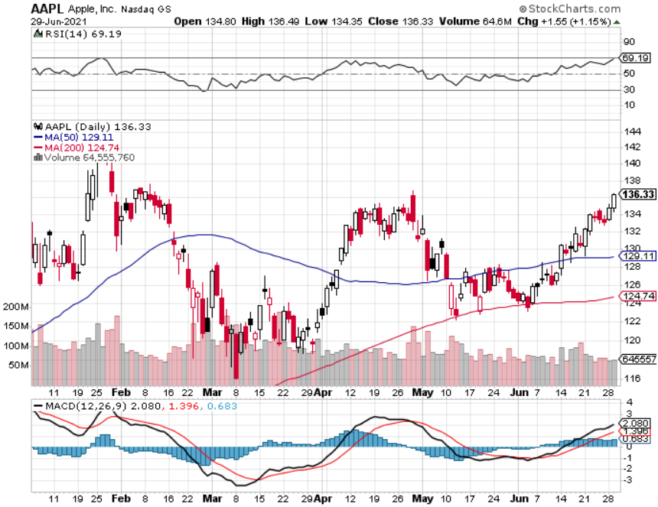
Apple (AAPL)- New 5G iPhone Surge-earnings after close Apple car moving forward with KIA took profits on long 7/$320-$330 call spread took profits on long 4/24/$250-$260 call spread took profits on long 5/$250-$260 call spread

Slide 30
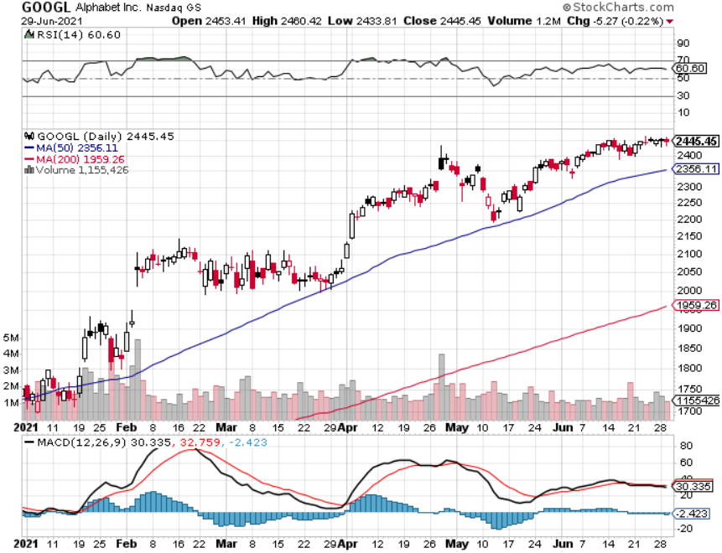
Alphabet (GOOGL) – Ad king on economic recovery 15% of search is travel related took profits on long 12/$1,200-$1,230 bull call spread took profits on long 9/$1,030-$1,080 vertical bull call spread

Slide 31
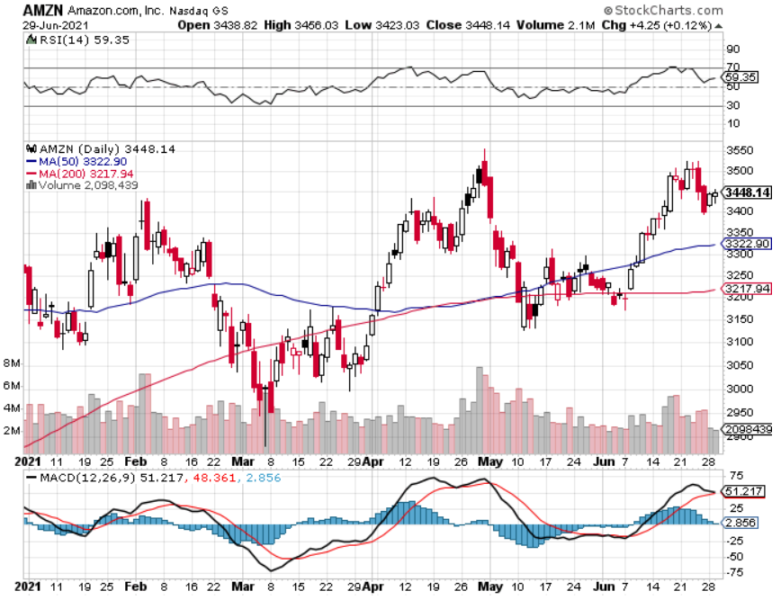
Amazon (AMZN) – Next Upside breakout took profits on long 9/$2,800-$2,900 bull call spread

Slide 32
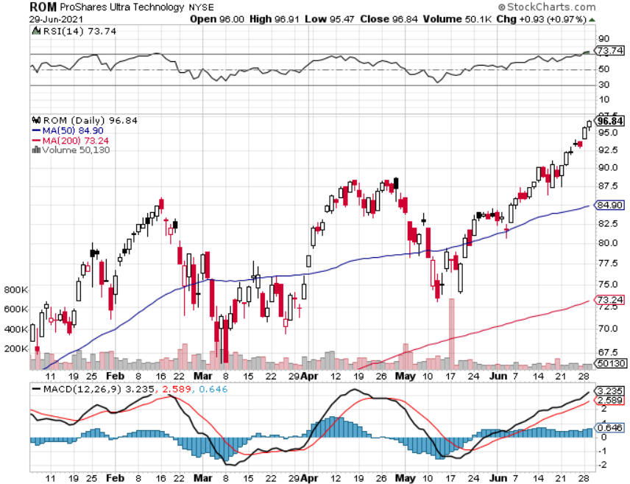
ProShares Ultra Technology (ROM) – Up 47% from March Low

Slide 33
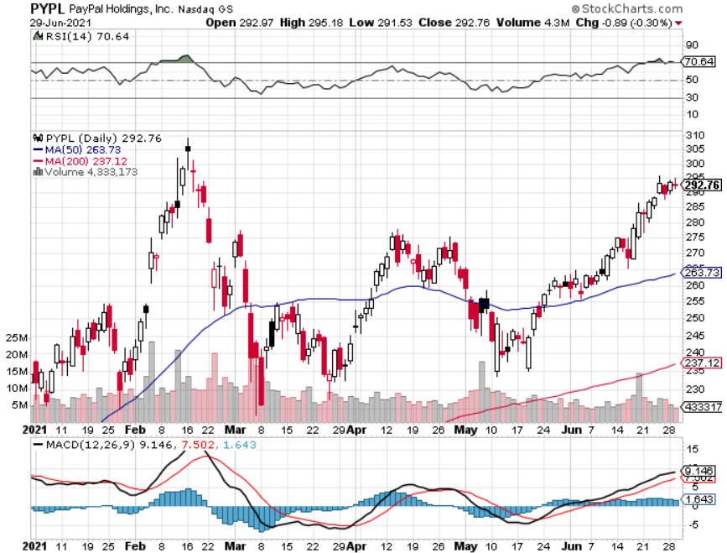
PayPal (PYPL)-Fintech Rules took profits on long 4/$90-$95 call spread

Slide 34
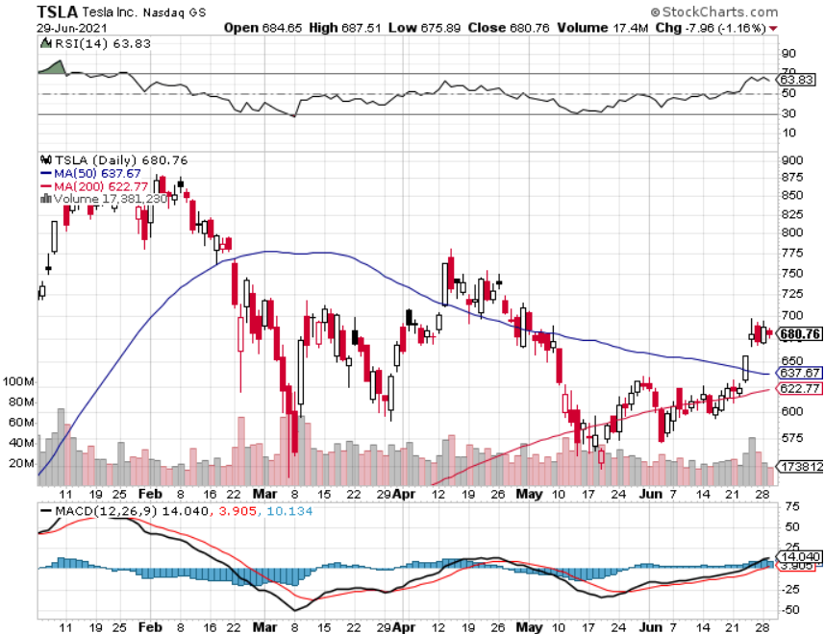
Tesla (TSLA)- Blows Away Q1 Deliveries, with a 184,400 print, or 47.5% high than the 2021 rate Q1 earnings +48% QOQ, +104% YOY took profits on long 2X 4/$450-$500 call spread took profits on long 3/$400-$450 call spread took profits on long 2/$650-$700 call spread-expires, stopped out of long 3/$600-$650 call spread Took profits on long 2/$600-$650 bull call spread, Took profits on long 2/$550-$600 bull call spread

Slide 35
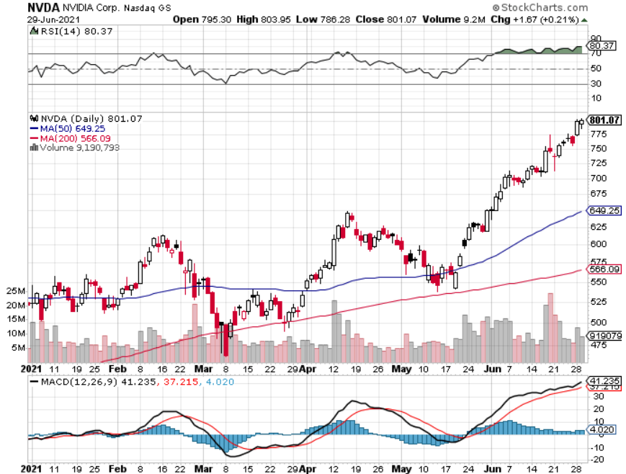
NVIDIA (NVDA) – The Biggest Chip Deal in History A Mad Hedge 10 bagger – Global Semiconductor Shortage Slows Auto Industry,

Slide 36
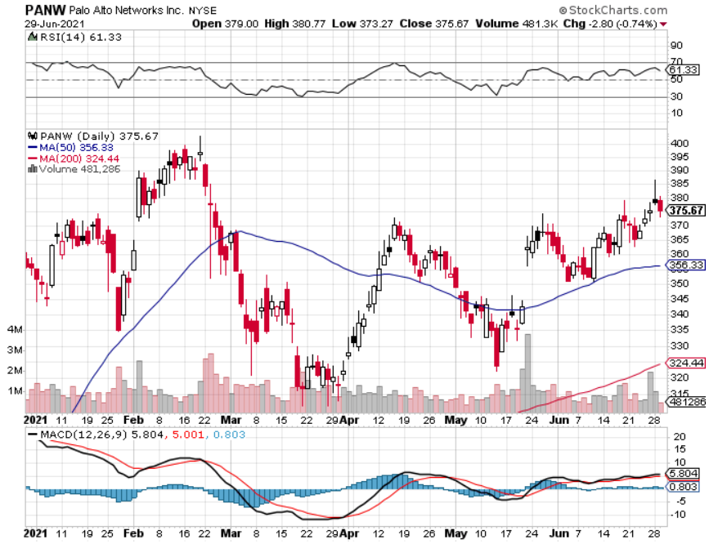
Palo Alto Networks (PANW)- Hacking never goes out of fashion

Slide 37
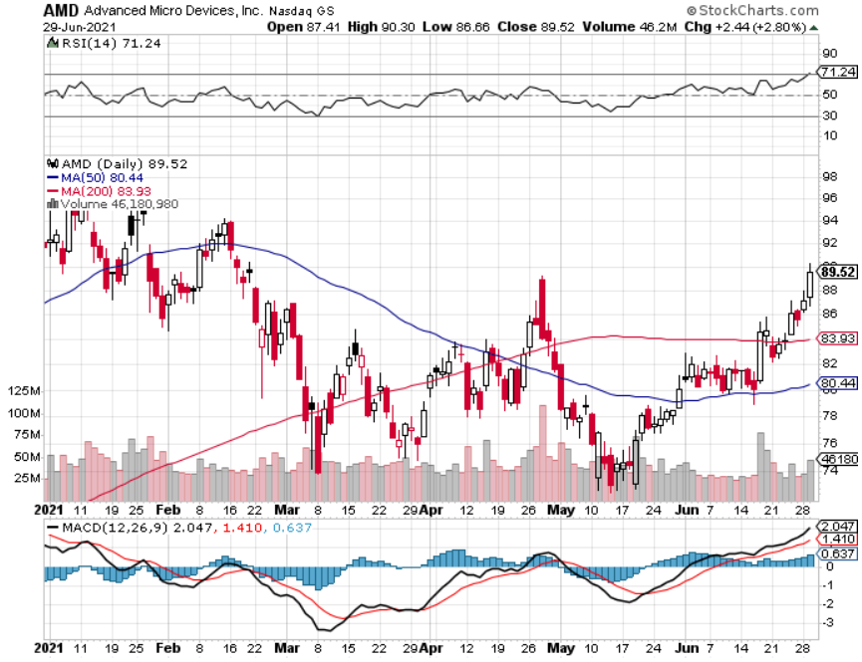
Advanced Micro Devices (AMD)- Google server farms the next ten bagger - buys Xilinx – Programable logic devices took profits on long 2/$75-$80 call spread

Slide 38
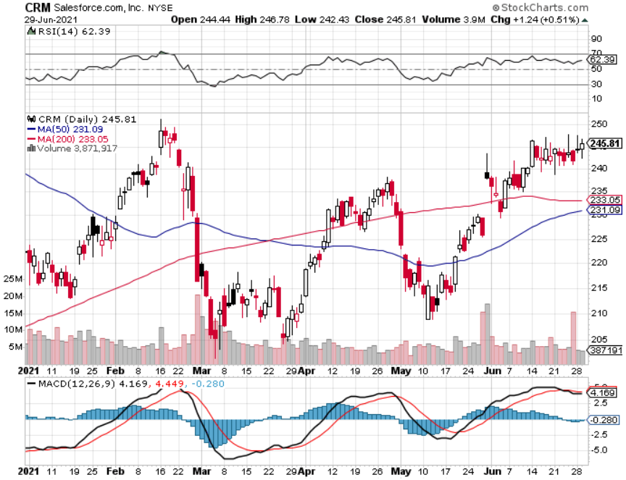
Salesforce (CRM)- Massive Online Migration took profits on long 9/$125-$130 vertical bull call spread took profits on long 8/$125-$130 vertical bull call spread took profits on long 2/$105-$115 call spread

Slide 39
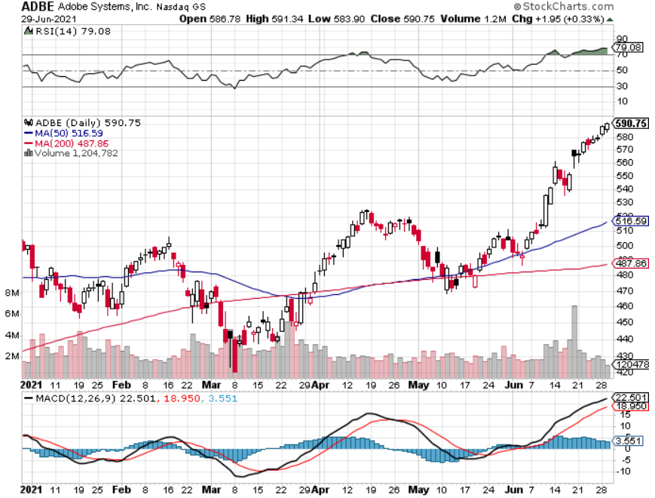
Adobe (ADBE)- Cloud play The Quality Non-China tech play

Slide 40
The Second Half of the Barbell
*Bets on a domestic recovery in 2021 *Upside potential in 2021 far greater than tech *Some of these have not moved for 5 or 10 years *Focuses on economically sensitive cyclical industries *Makes a great counterweight to high growth technology *We could spend all of next year rotating between the two groups

Slide 41
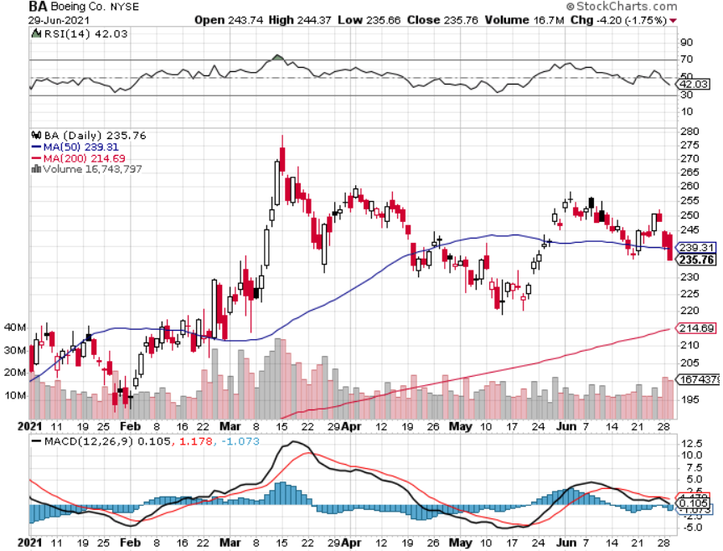
Boeing (BA) – former LEAP Candidate - The 737 MAX Flies Again! FAA Certification delay on 777X long 3/$146-$149 call spread took profits on long 2/$150-$160 call spread took profits on long 4/$300-$310 call spread took profits on long 4/$315-$335 call spread

Slide 42
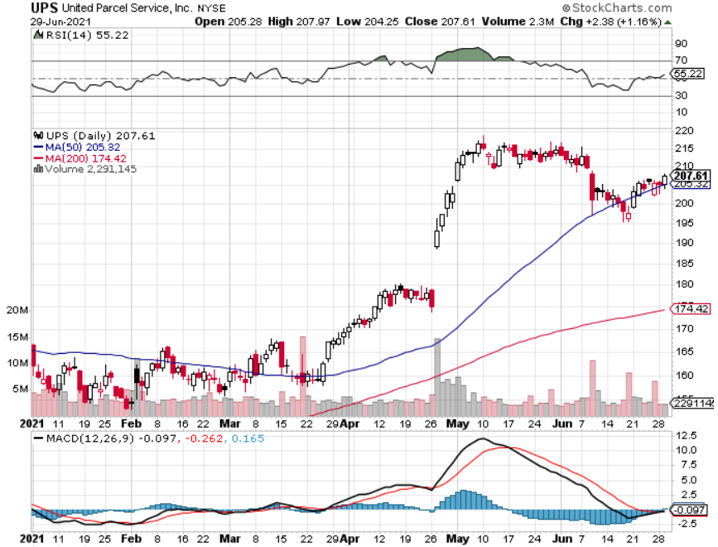
Package Delivery- United Parcel Service (UPS) massive increase in overnight deliveries, announces blowout earnings took profits on long 11/$130-$140 call spread

Slide 43
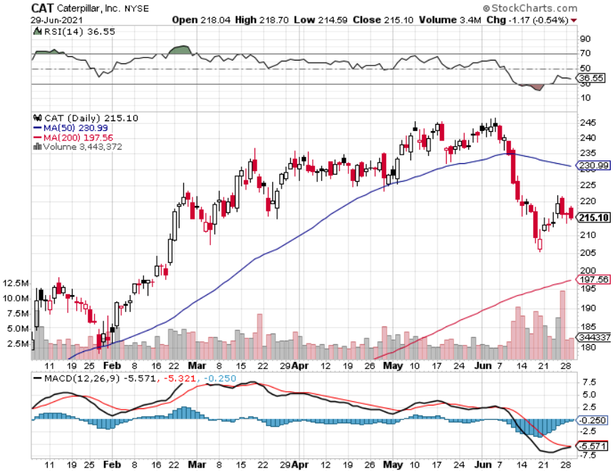
Caterpillar (CAT)- Ag + Infrastructure + Housing took profits on long 12/$145-$150 call spread took profits on long 11/$125-$135 call spread

Slide 44
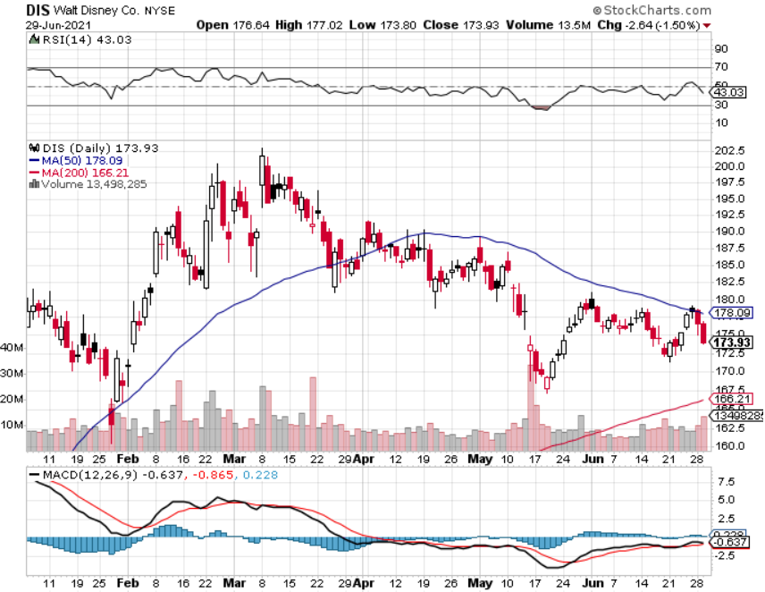
Walt Disney (DIS)- Big Recovery Move Disney Plus Streaming top 100 million subscribers in 15 months took profits on long 3/$170-$180 call spread

Slide 45
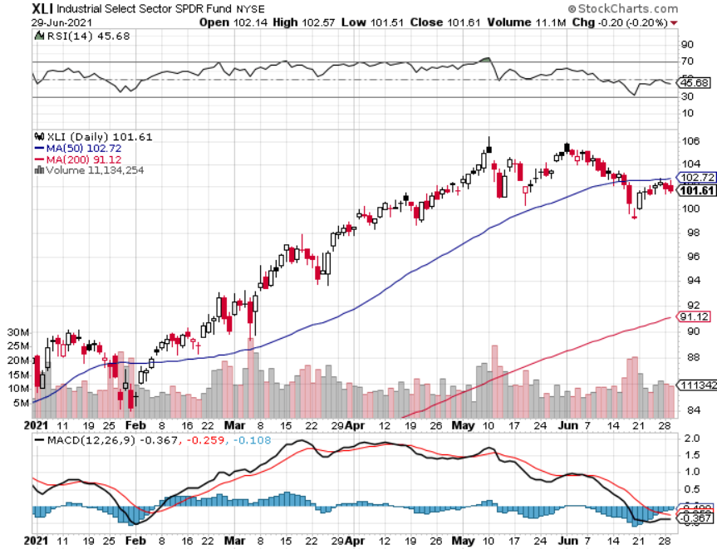
Industrials Sector SPDR (XLI)- (GE), (MMM), (UNP), (UTX), (BA), (HON)

Slide 46
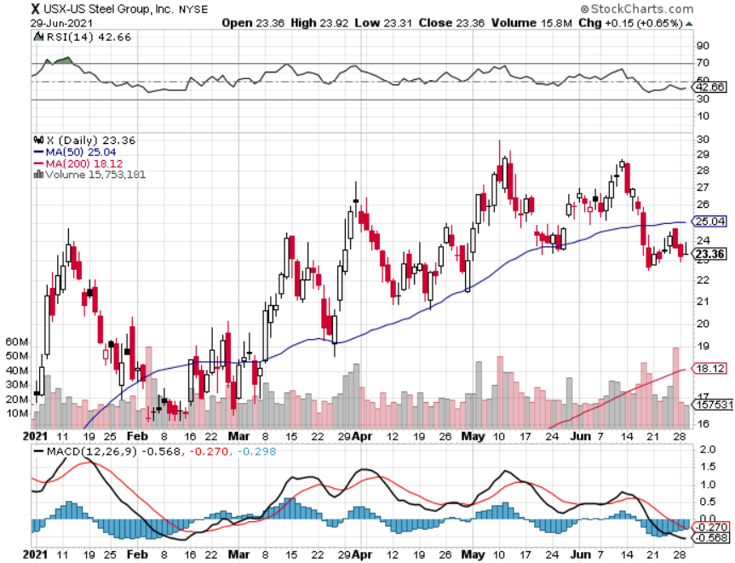
US Steel (X) – Commodity Boom

Slide 47
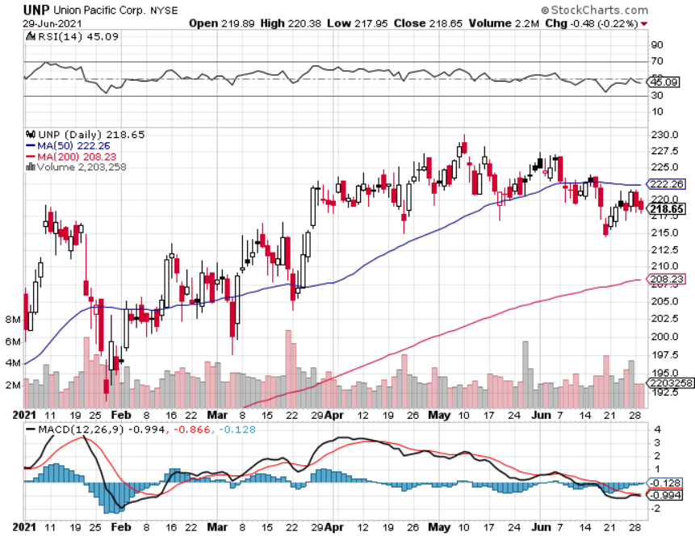
Union Pacific RR (UNP)- More stuff to ship near record earnings announced long 5/$200-$210 call spread – 12 days to expiration took profits on 11/$150-$160 call spread

Slide 48
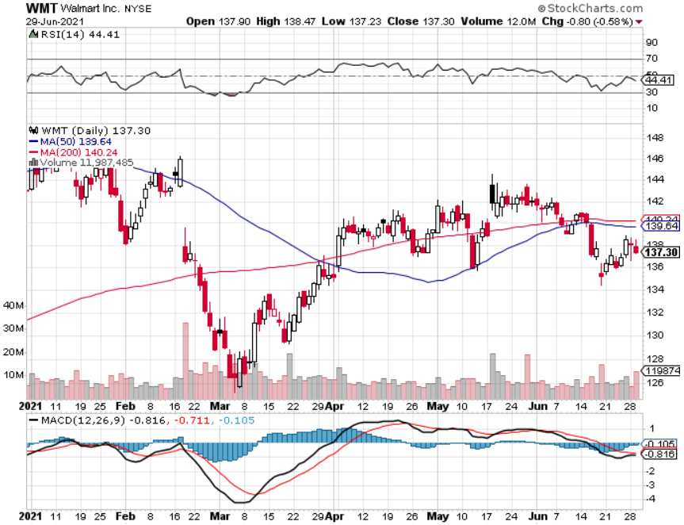
Wal-Mart (WMT)-New High took profit on Long 11/$125-$130 bear put spread took profit on Long 10/$119-$121 bear put spread took profits on Long 8/$114-$117 bear put spread

Slide 49
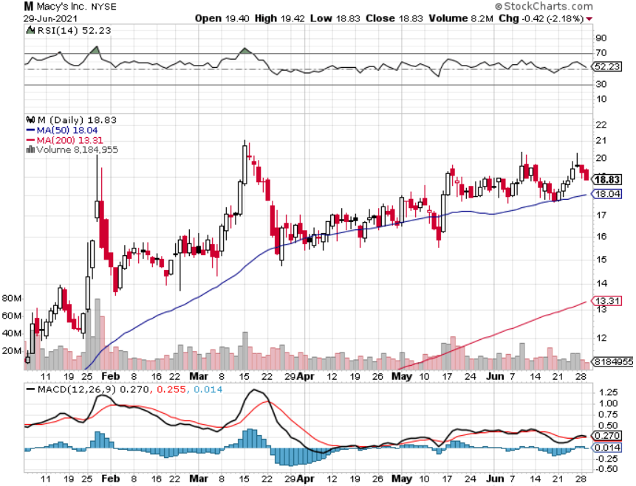
Macys’ (M) – Retail Return from the Grave took profits on Long 8/$23-$25 bear put spread

Slide 50
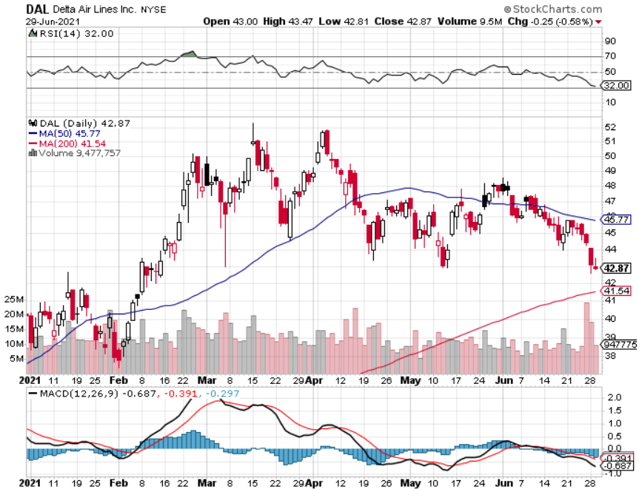
Delta Airlines (DAL) – Revenge travel is on

Slide 51
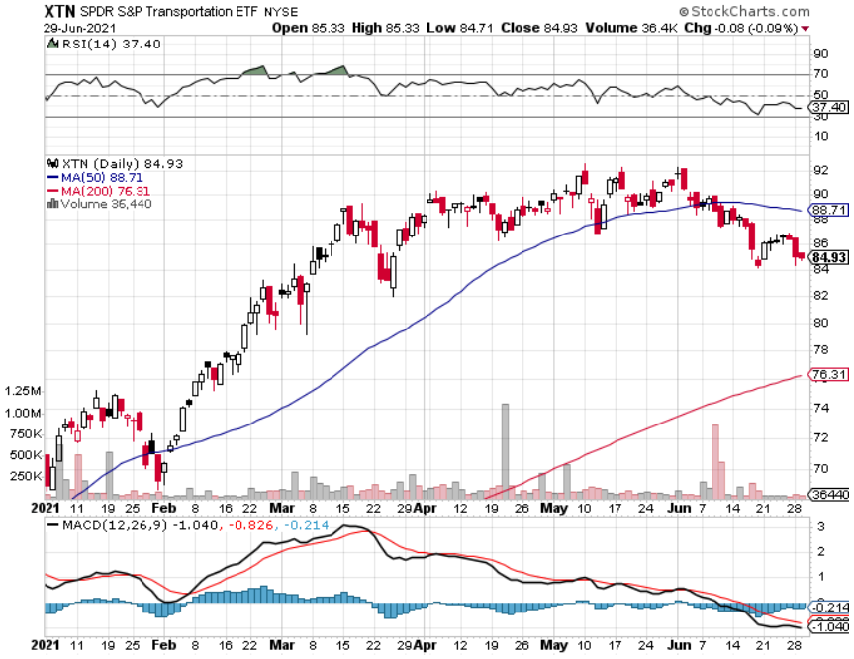
Transports Sector SPDR (XTN)- Worst Hit Sector (ALGT), (ALK), (JBLU), (LUV), (CHRW), (DAL)

Slide 52
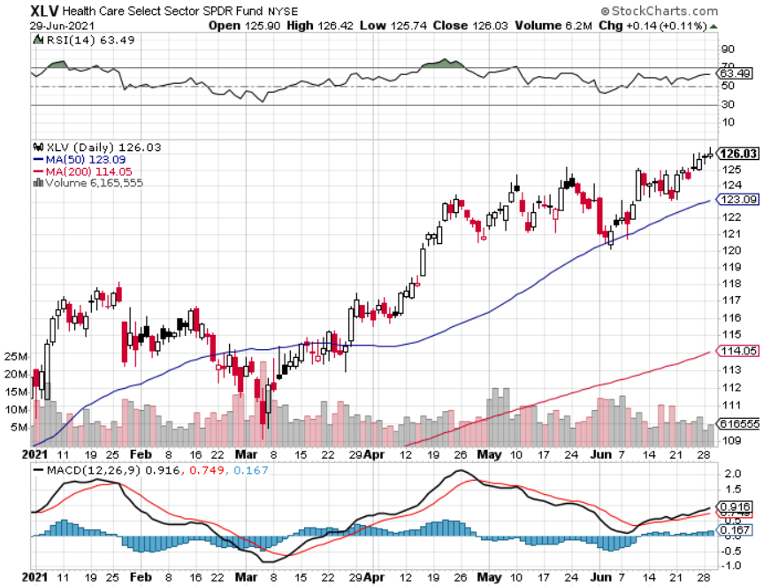
Health Care Sector (XLV), (RXL) (JNJ), (PFE), (MRK), (GILD), (ACT), (AMGN)

Slide 53
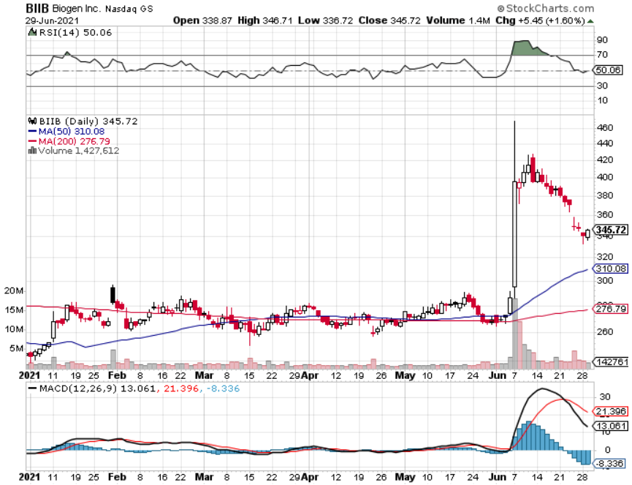
Biogen (BIIB) Why you do Biotech

Slide 54
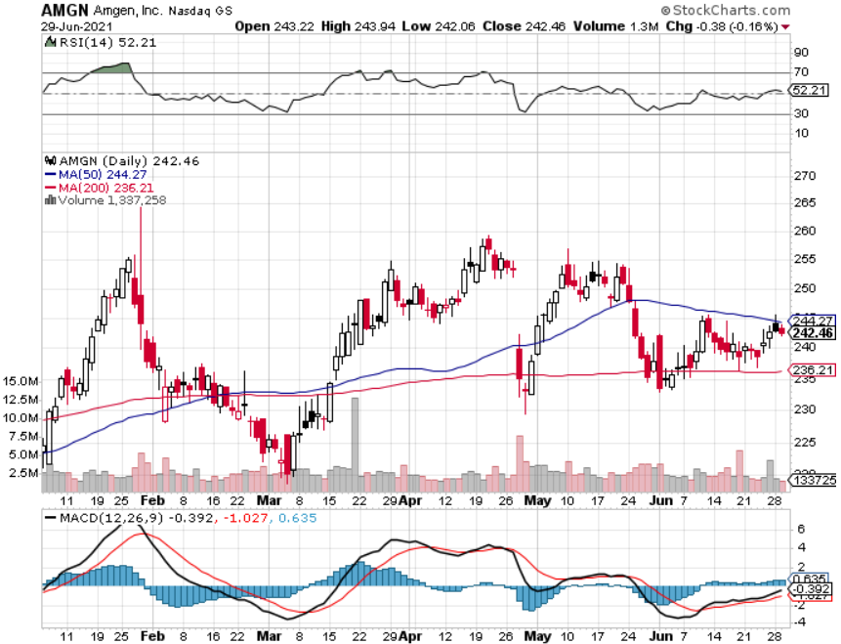
Amgen (AMGN) took profits on long 11/$185-$200 bull call spread

Slide 55
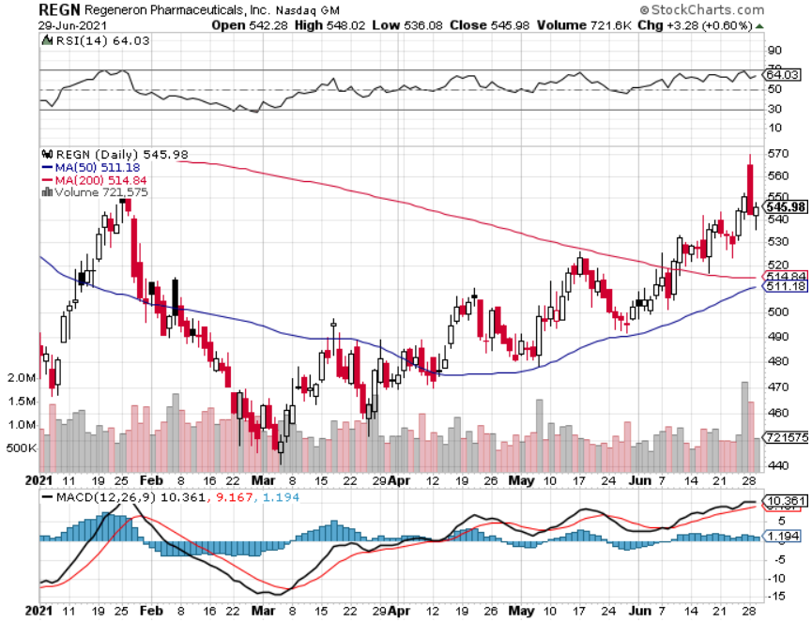
Regeneron (REGN) took profits on long 7/$570-$580 call spread

Slide 56
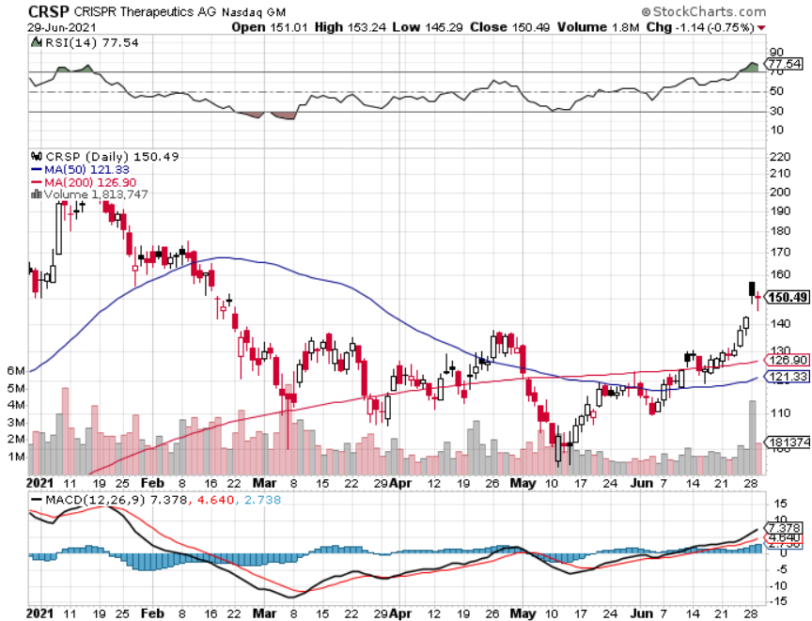
CRISPR Therapeutics (CRSP) – Another reasons to do Biotech New Tie up for Liver Failure Drug

Slide 57
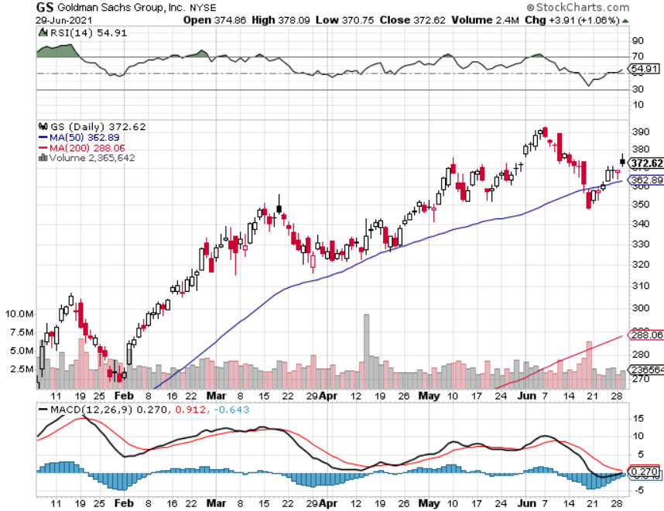
Goldman Sachs (GS) – Back to the office! took profits on long 6/$310-$320 call spread took profits on long 5/$310-$320 call spread took profits on long 2/$240-$260 call spread

Slide 58
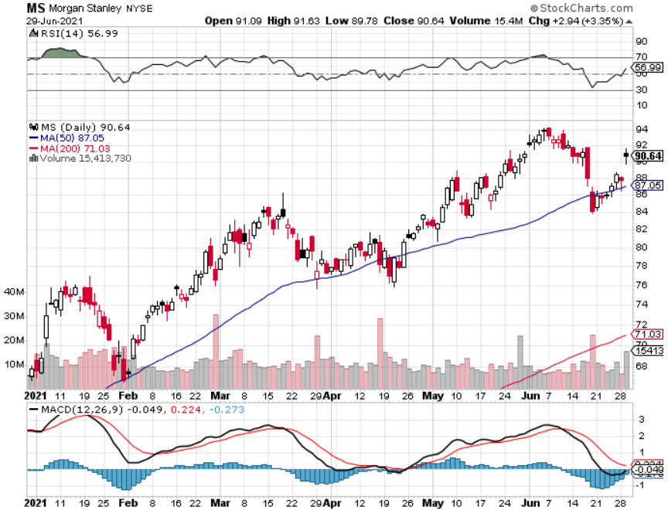
Morgan Stanley (MS) – Doubled Dividend took profits on long 2/$55-$60 call spread

Slide 59
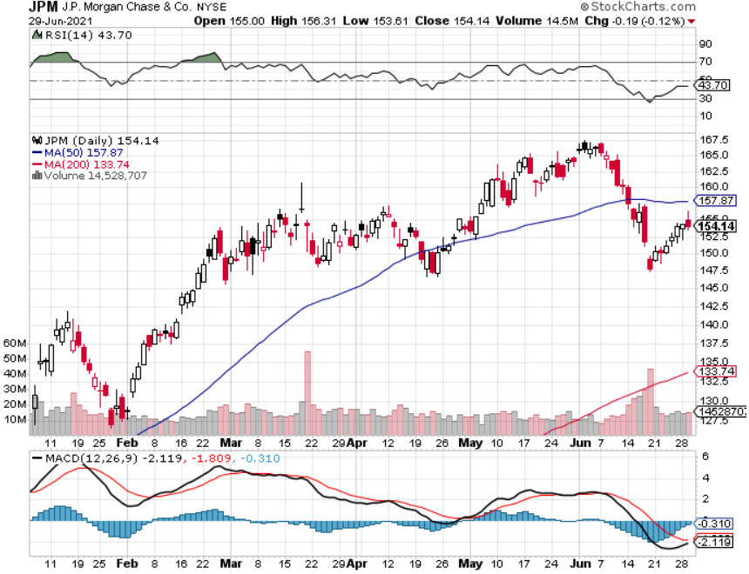
JP Morgan Chase (JPM)-Share buybacks are back! long 5/$135-$140 call spread took profits on long 2/$135-$140 call spread took profits on long 2/$110-$115 call spread took profits on long 12/$100-$105 bull call spread took profits on long 11/$85-$90 bull call spread

Slide 60
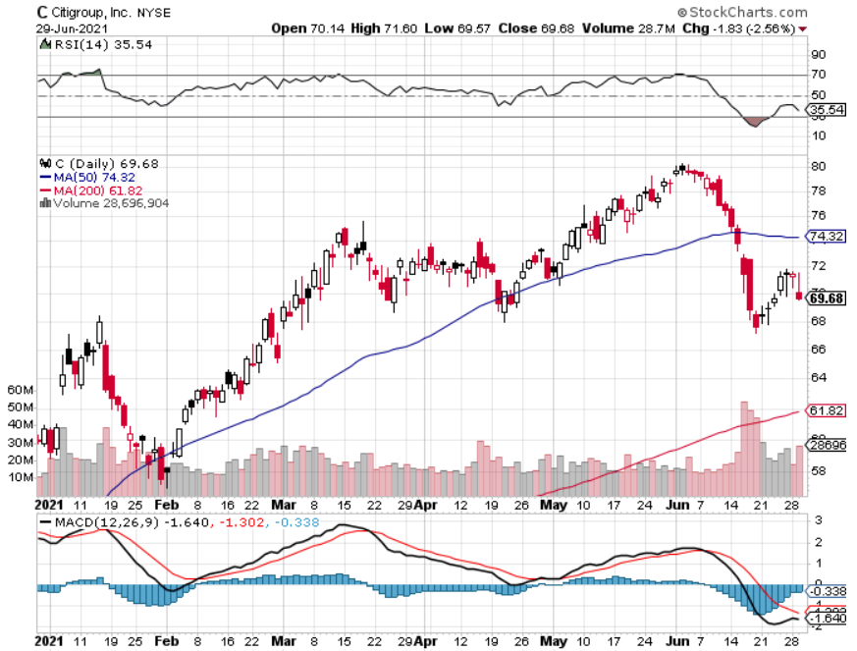
Citigroup (C) – “Recovery” Rotation Play

Slide 61
Bank of America (BAC) – took profits on long 2/$28-$30 call spread

Slide 62
SPDR Metals & Mining ETF (XME) – long 2/$28-$30 call spread

Slide 63
Blackrock (BLK)-Asset Collection Boom took profits on long 3/$31-$34 call spread

Slide 64
Visa (V) – “Touchless” Fintech Play long 5/$195-$205 bull call spread- expires in 12 days took profits on long 9/$180-$185 bull call spread

Slide 65
Consumer Discretionary SPDR (XLY) (DIS), (AMZN), (HD), (CMCSA), (MCD), (SBUX)

Slide 66
Berkshire Hathaway (BRKB)- Natural Barbell maintaining share buy backs at $25 billion a year took profits on long 3/$230-$240 call spread

Slide 67
Europe Hedged Equity (HEDJ)-

Slide 68
Japan (DXJ)-

Slide 69
Emerging Markets (EEM) - Pro trade, Weak Dollar, long recovery Play

Slide 70
Bonds – Retreat
*Retreat from 5% CPI over reaction causes bonds to retreat four points, the maintain a narrow range *Nobody is taking a 1.40% yield against a 5% inflation rate delivering a negative 3.6% real yield because they think it’s a great deal *$6 trillion in spending has been approved but not spent so it is piling into banks which must buy bonds for capital reserves *Wait for the rally to burn out, then add more downside LEAPS *A 2.00% yield on the ten-year US Treasury bond here we come! This is the quality trade of 2021 *US Treasury bond fund (TLT) could plunge from $180 a year ago to $105 by 2023

Slide 71
Treasury ETF (TLT) – One Too Many Visits to the Well stopped out of long 5/$143-$146 put spread, took profits long 5/$143-$146 put spread, took profits long 5/$144-$147 put spread, took profits on 6/$145-$148 took profits on 2X long 4/$142-$145 put spread, 4/$127-$130 call spread took profits on 2X long 5/$142-$145 put spread, took profits on long 2/$146-$149 put spread

Slide 72
Ten Year Treasury Yield ($TNX) – 1.42%

Slide 73
Junk Bonds (HYG) 3.47% Yield to Maturity

Slide 74
2X Short Treasuries (TBT)-Another run at highs

Slide 75
Emerging Market Debt (ELD) 4.27% Yield-

Slide 76
Municipal Bonds (MUB) – 0.93% Mix of AAA, AA, and A rated bonds

Slide 77
Foreign Currencies – Dollar Maintaining Gains
*US Dollar maintains recent gains but has lost its momentum *Long-term fundamentals continue to worsen, a dollar short could be the new ten-year trade *Massive over issuance of debt by the US government to fund the covid recovery is another nail in the coffin in addition to a n exploding trade deficit *Europe is getting positive yield support for the first time in a decade *Expect more of the same. Buy (FXA) and (FXE) on dips. *Bitcoin Battles at $30,000, for the fourth time in two months, at one point falling to a $24,000 low *Keep selling short all US dollar rallies, its yield support is gone forever, Buy (FXA) and (FXE) on dips.

Slide 78
Japanese Yen (FXY), (YCS)

Slide 79
Euro ($XEU), (FXE), (EUO)-

Slide 80
British Pound (FXB)-

Slide 81
Australian Dollar (FXA)- The Global Recovery Play took profits on long 8/$67-$69 call spread

Slide 82
Emerging Market Currencies (CEW)

Slide 83
Chinese Yuan- (CYB)-

Slide 84
Bitcoin- Head and Shoulders Top $10,000 in play

Slide 85
Energy – Peaking Out
*Oil hits solid resistance at $76, a new one year high *Extreme economic strength could keep it high for a while *The end of oil is upon us, but it may take 30 years to unwind existing infrastructure *All US car production will be electric by 2035, wiping out half of all US oil consumption *Oil consumption will become a China only business, with them already taking 80% of all Persian Gulf output *China Slowdown Could Bring oil and Copper Correction *Avoid all energy plays like the plague, it’s the new buggy whip industry as the US de-carbonizes

Slide 86
Oil-($WTIC)

Slide 87
United States Oil Fund (USO) long 10/$9.50-$10 Vertical bull call spread

Slide 88
Energy Select Sector SPDR (XLE)-No Performance! (XOM), (CVX), (SLB), (KMI), (EOG), (COP)

Slide 89
Halliburton (HAL)-

Slide 90
Natural Gas (UNG) -

Slide 91
Precious Metals – Trying to Bottom
*Fed’s promise of an end to inflation delivers a hit for gold *5% CPI knocks the wind out of precious metals and all commodities, with lumber down by half Long-term rising interest rates remain a threat to precious metals *Silver is still the bigger and better long term play *Every EV needs 2 ounces of silver, and production will soar from 700,000 units in 2020 to 25 million by 2030 *Gold will eventually recover when US borrowing becomes so massive it undermines the value of the US dollar, even in the face of higher interest rates

Slide 92
Gold (GLD)- Meltdown

Slide 93
Market Vectors Gold Miners ETF- (GDX) –

Slide 94
Barrick Gold (GOLD) took profits on long 1/$21-$23 call spread took profits on long 11/$22-$24 call spread

Slide 95
Newmont Mining- (NEM)- took profits on long $55-60 call spread

Slide 96
Silver- (SLV)- took profits on long 11/$19-$20 call spread

Slide 97
Silver Miners - (SIL)-

Slide 98
Wheaton Precious Metals - (WPM)- took profits on long 2/$39-41 call spread

Slide 99
Copper (COPX)-Uptrend Resumes

Slide 100
Real Estate – New Highs
*Housing Starts Up Only 3.6% in May, to a seasonally adjusted 1.57 million units, with sky high lumber and other materials prices a major drag *New Permits hit a seven-month low *Existing Home Sales Down for the Fourth Month, down 0.9% to an annualized 5.8 million in May *Shortage of supply remains the big problem with inventories at an incredible 2.5 months *Some 89% of the homes sold were on the market for less than a month *New Home Sales Dive 5.9%, thanks to shortage of supply and high prices *S&P Case Shiller National Home Price Index Hits new high, up 14.6%

Slide 101
S&P Case Shiller Up 14.6% for April Phoenix +22.3%, San Diego 21.6%, Seattle 20.2%

Slide 102
Crown Castle International (CCI) – 2.70% yielding cell phone Tower REIT

Slide 103
US Home Construction Index (ITB) (DHI), (LEN), (PHM), (TOL), (NVR)

Slide 104
Trade Sheet- So What Do We Do About All This?
*Stocks – buy dips aggressively *Bonds – sell rallies aggressively *Commodities-buy dips aggressively *Currencies- sell US dollar rallies *Precious Metals – buy dips *Energy – stand aside *Volatility - sell short over $30 *Real estate – buy dips

Slide 105
Next Strategy Webinar 12:00 EST Wednesday, June 30, from Lake Tahoe email me questions at support@madhedgefundtrader.com
Good Luck and Good Trading!
Notes:
*

