Slide 1
The Mad Hedge Fund Trader “Navigating the Markets”
With John Thomas from Incline Village, NV, July 28, 2021 www.madhedgefundtrader.com
Notes:
*

Slide 3
Mad Hedge Trader & Investors Summit June 8-10– The Videos are Up!
*A collection of the 27 best traders and managers in the world *Back-to-back One-hour presentations followed by an interactive Q&A *Covering all stocks, bonds, commodities, foreign exchange, precious metals, and real estate *It’s the best look at the rest of 2021’s money making opportunities you will get anywhere *An invitation will be sent to you shortly and it is FREE to attend

Slide 4
Trade Alert Performance New All Time Highs! 32 Consecutive Profitable Trade Alerts- 95% Success Rate in 2021-Only 5 Losers
*January 10.21% MTD *July +1.79% MTD *February +13.28% Final *August -2.08% Final *March +20.60% Final *September 7.95% Final *April +15.67% Final *October +1.51% Final *May +8.13% Final *November +20.41% Final *June +0.71% Final *December +10.20% Final *2021 Year to Date +70.39% compared to +13.30% for the Dow Average *+492.94% since inception, a new all time high *Average annualized return of 42.25% for 12 years, new all time high`

Slide 5
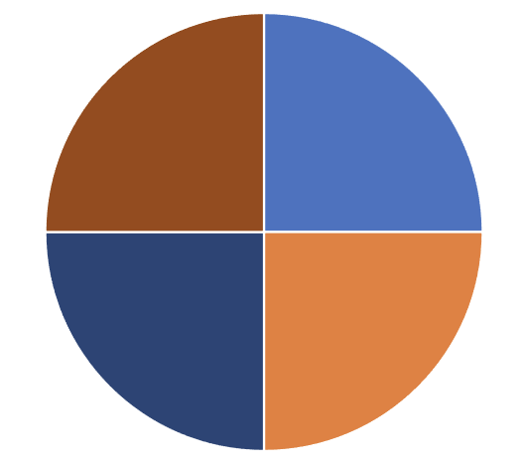
Portfolio Review 60% Cash in a Low Volatility Long Term Bull Market
Current Capital at Risk
Risk On
World is Getting Better
(TLT) 8/$157-$160 put psread | 10.00%
(JPM) 8/$300-$320 call spread | 10.00%
Risk Off
World is Getting Worse
(SPY) 8/$445-$450 put spread | -10.00%
(SPY) 8/$445-$450 put spread | -10.00%
Total Net Position | 0.00%
Total Aggregate Position | 40.00%
Expiration Value 76.96%

Slide 6
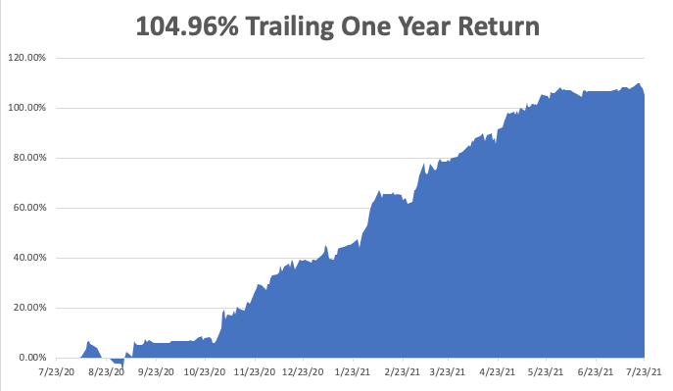

Slide 7
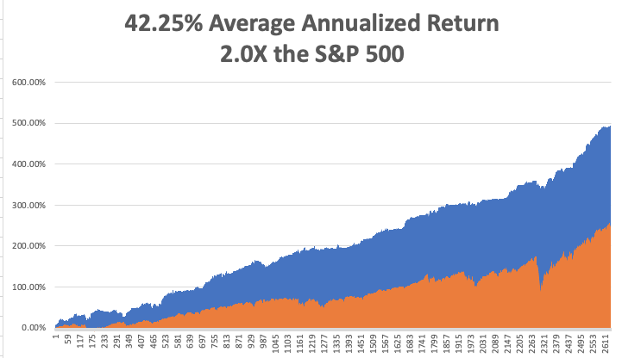
GTD 12 Year Daily Audited Performance

Slide 8
The Method to My Madness The Roaring Twenties are Here
*Bond prices have peaked, and interest rates bottomed. Next to come is a multiyear bear market in bonds. *Inflation plays are stalling, like banks, and commodities *Keep your tech stocks, as outer year earnings are being wildly underestimated *Median term, both sides of the barbell are working *The economic recovery is now regional, with China first, now the US, and Europe last, but goes global in 2020 *Bitcoin continues to fight the battle at $30,000 *VIX collapses to $15, showing the summer market is here

Slide 9
Corona Update – End of the Pandemic
*70% of the US population is vaccinated and 10% have had the disease, bringing immunity up to 78%. *New cases have tripled, from 15,000 a day to 45,000. And are up 800% in the least vaccinated states like Alabama overwhelming hospitals, but could peal in a month *Need for booster shot is rising among the earliest vaccinated Fourth wave has triggered panic vaccinations in the Midwest with 500,000 in one day *98% of new cases are among the unvaccinated, making Covid a disease of Trump supporters and children only, killing about 2,000 voters a week *Tokyo Olympics bans spectators, sending Dow down 500 points *Pfizer vaccine will be available for 5-11 years olds before school starts in August *US cases top 33.9 million, deaths topping 607,000 and deaths are down to 250 a day, down 95.6% from peak

Slide 10
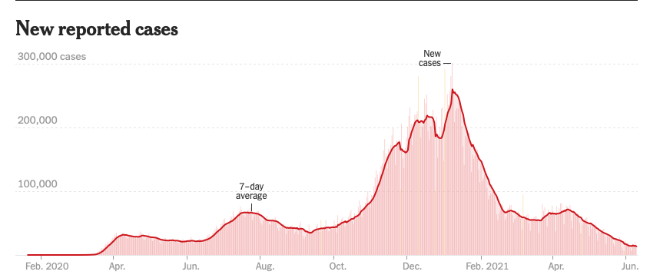
Bump on the Way to Zero the Fourth Wave
Next Peak

Slide 11
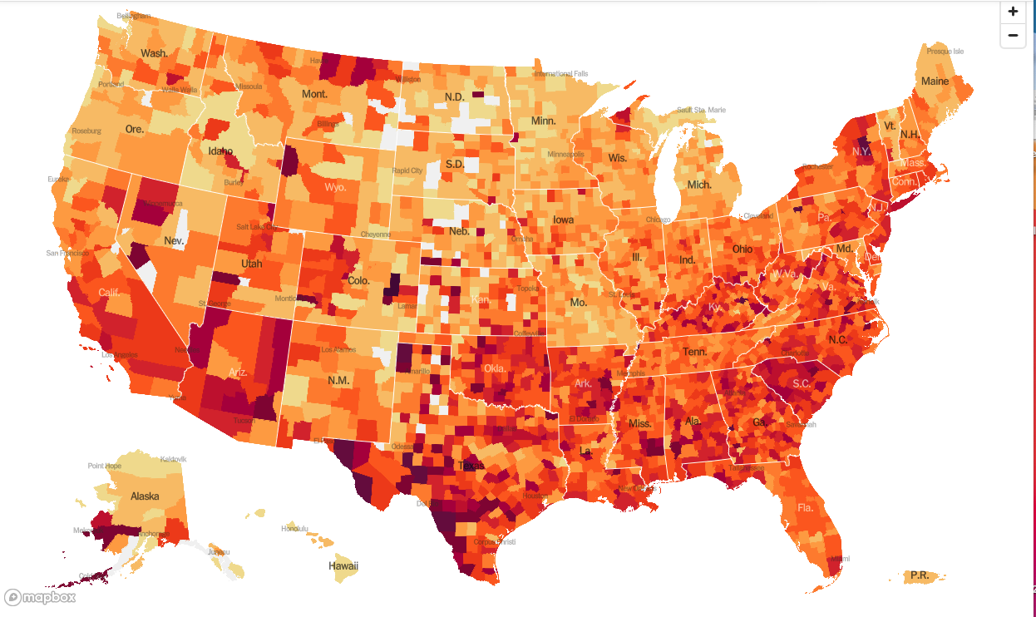
January 20 Infection Rate

Slide 12
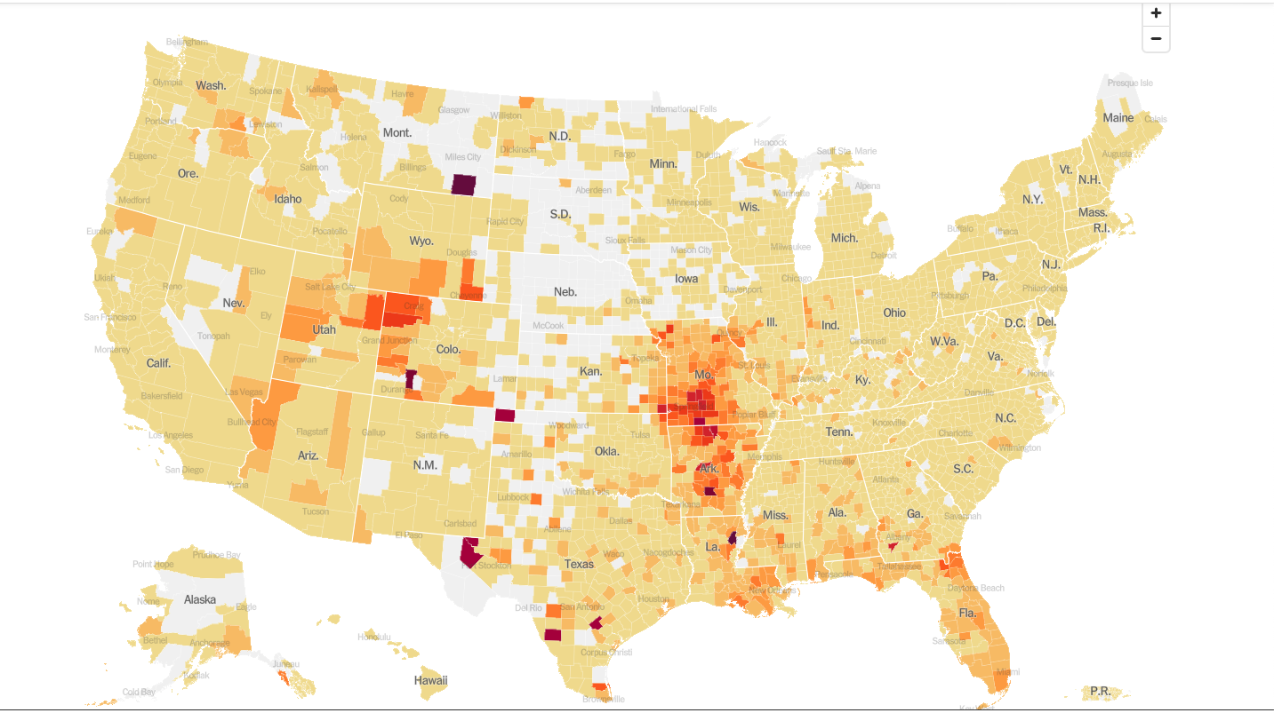
July 28 Infection Rate

Slide 13
The Global Economy – Powering On
*Senate Agrees to $3.5 Trillion Spending Plan, providing great news for stocks and terrible news for bonds *Any Tightening is a Ways Off, says Fed governor Jerome Powell in his congressional testimony *Producer Prices Show Biggest Gain Since 2008, the index up a hot 1.0% *US Retail Sales Come Rocketing Back, with a 0.6% gain *Bank of America Lowers US GDP from 7.0% to 6.5%, and 2022 to 5.5% *That was the Shortest Recession in History, in 2020, lasting only two months *Next to come: Synchronized global recovery in 2020 and another year of bull market

Slide 14
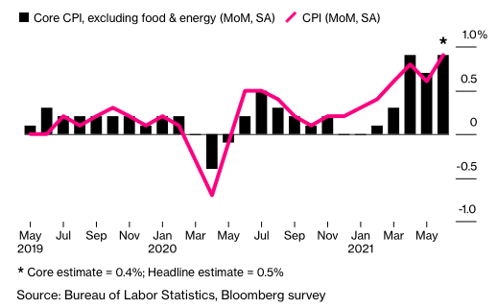

Slide 15
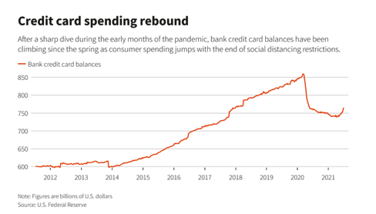

Slide 16
Stocks – Grinding Up
*Dow That Was the Worst Day of the Year, down 725 points on the day and 1,000 at the lows. It’s just another correction in a long-term bull market that still has years to run *$17 trillion sitting in bank accounts and $4.5 trillion in money market funds waiting to go into equities and the balances are increasing at a rapid rate *The Four Biggest US Banks Deliver Spectacular Earnings, posting a combined $33 billion in profits *Share Buy Backs are Turbocharging this Market, which could reach an eye-popping record $2 trillion in 2021 *FANGS are now leading the market and may continue for the rest of the year, but may take a short term hit on month end earnings announcements *China to Ban US Listing, preferring Hong Kong instead *Stick with the barbell strategy, we’ll keep rotating back and forth all year between tech & domestic recovery

Slide 17
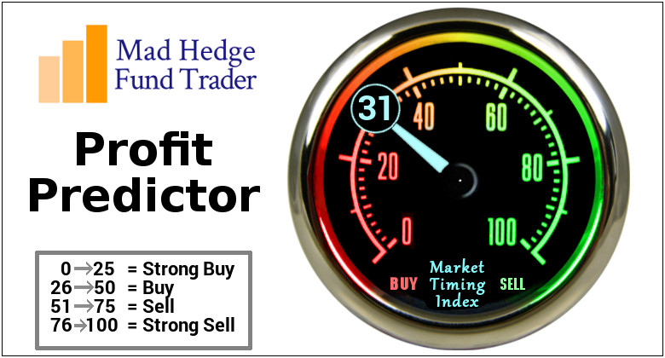
The Mad Hedge Profit Predictor Market Timing Index – Stuck in Neutral An artificial intelligence driven algorithm that analyzes 30 different economic, technical, and momentum driven indicators

Slide 18
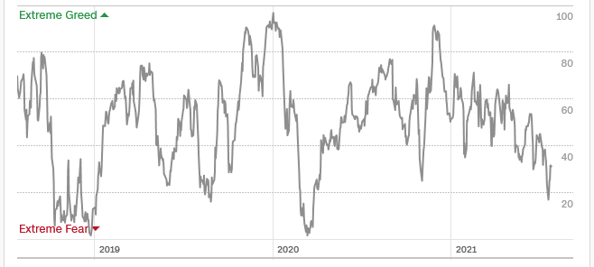
The Mad Hedge Profit Predictor Moving into a “BUY” Range
SELL
Do Nothing
BUY

Slide 19
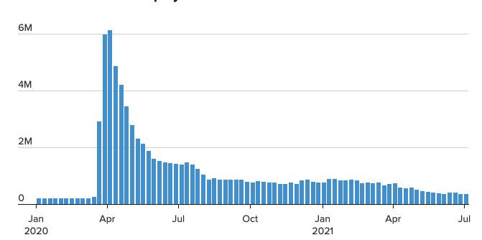
Weekly Jobless Claims – Flatlining at Record Highs 419,000, up 51,000

Slide 20
Stocks – Palpitations!
*Dow That Was the Worst Day of the Year, down 725 points on the day and 1,000 at the lows. It’s just another correction in a long-term bull market that still has years to run *The Four Biggest US Banks Deliver Spectacular Earnings, posting a combined $33 billion in profits *Share Buy Backs are Turbocharging this Market, which could reach an eye-popping record $2 trillion in 2021 *Smart Phones Will Deliver the Next Big Chip Shortage, even if the chip shortage for cars abates. The bad news? There are 22 times more phones produced each year that cars *FANGS are playing catch up and may continue for the rest of the year, but may take a short term hit on month end earnings announcements *China to Ban US Listing, preferring Hong Kong instead *Stick with the barbell strategy, we’ll keep rotating back and forth all year between tech & domestic recovery

Slide 21
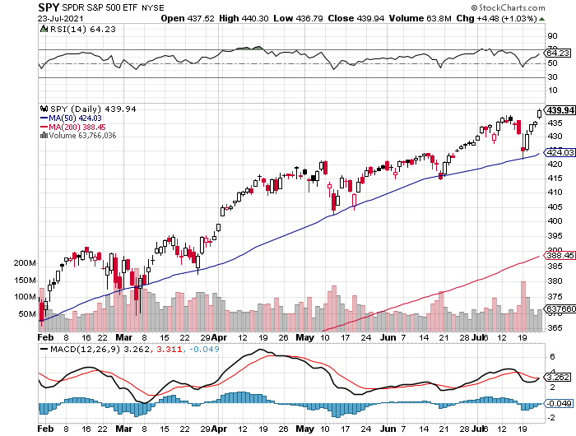
S&P 500 – New Highs took profits on long 6/$375-$385 bull call spread took profits on long 6/$430-440 bear put spread
New Highs Yearend Target $475
The Bottom 420

Slide 22
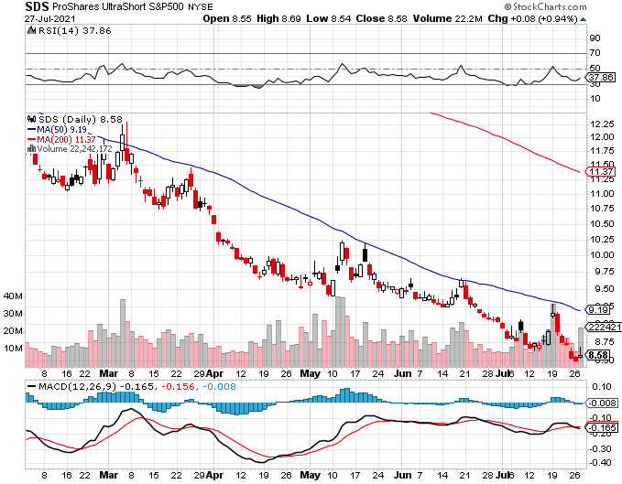
ProShares Ultra Short S&P 500 (SDS)- A Great Hedge for Long Stocks and Bonds Long 2X Position has a Hedge Against Longs and Bond Shorts

Slide 23
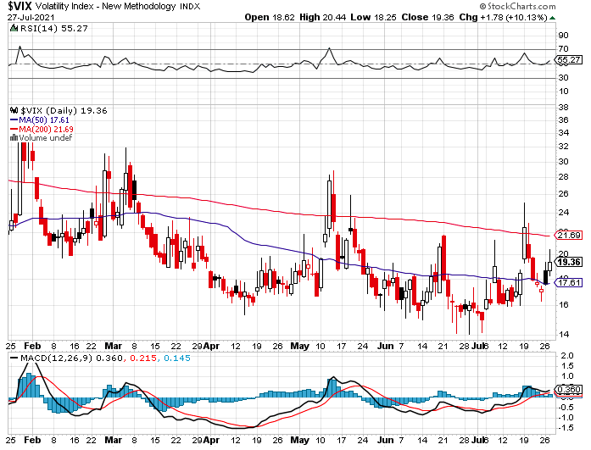
(VIX) – Dying a Slow Death Classic Summer Market

Slide 24
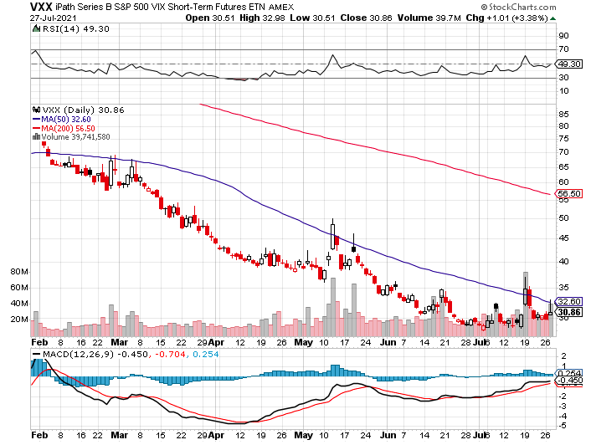
(VXX)-

Slide 25
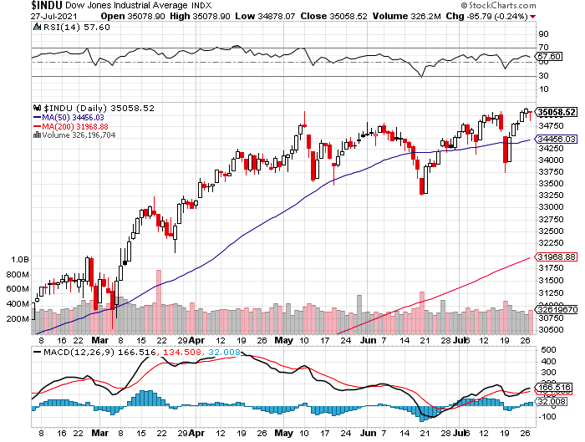
Dow Average ($INDU)-

Slide 26
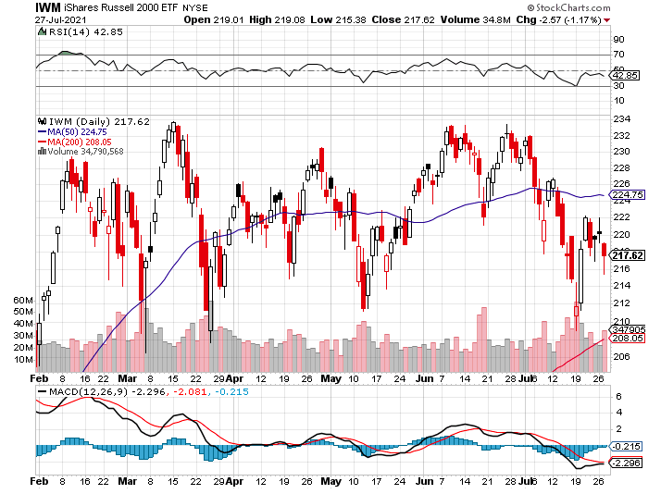
Russell 2000 (IWM)- took profits on Long 10/$137-$142 vertical bull call spread took profits on Long 10/$153-$156 vertical bear put spread

Slide 27
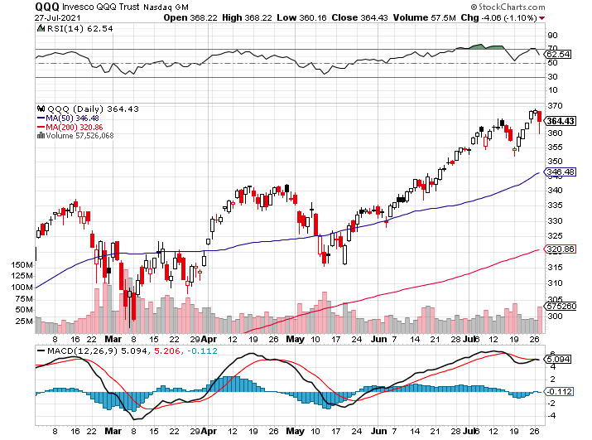
NASDAQ (QQQ) – long (QQQ) 4/$330-$335 put spread took profits on long (QQQ) 3/$340-$345 put spread covered long (QQQ) $325-$330 put spread

Slide 28
The Barbell Portfolio
*50% Big Tech - 2% of US Employment but 27% of Market Cap and 38% of Profits 50% Domestic Recovery, including: Railroads Couriers Banks Construction Credit Cards Event organizers Ticket sales Retailers

Slide 29
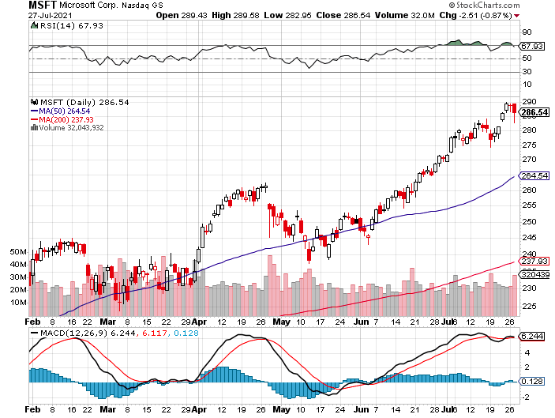
Microsoft (MSFT)- Pentagon Cancels Microsoft Jedi Cloud Deal took profits on long 12/$220-$230 call spread stop loss on long 12/$170-$180 call spread took profits on long 12/$135-$138 call spread

Slide 30
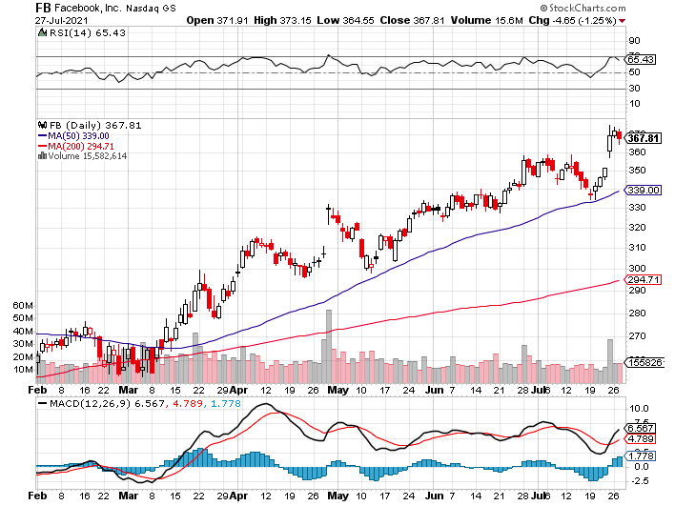
Facebook (FB)- Wins Antitrust Suit took profits on Long 9/$290-$300 vertical bear put spread stopped out of Long 9/$190-$200 vertical bear put spread took profits on Long 9/$145-$155 vertical bull call spread took profits on Long 9/$150-$160 vertical bull call spread

Slide 31
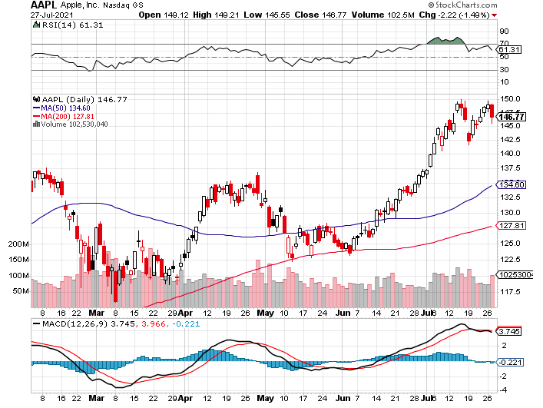
Apple (AAPL)- New 5G iPhone Surge-earnings After Close Apple Car Moving Forward with KIA took profits on long 7/$320-$330 call spread took profits on long 4/24/$250-$260 call spread took profits on long 5/$250-$260 call spread

Slide 32
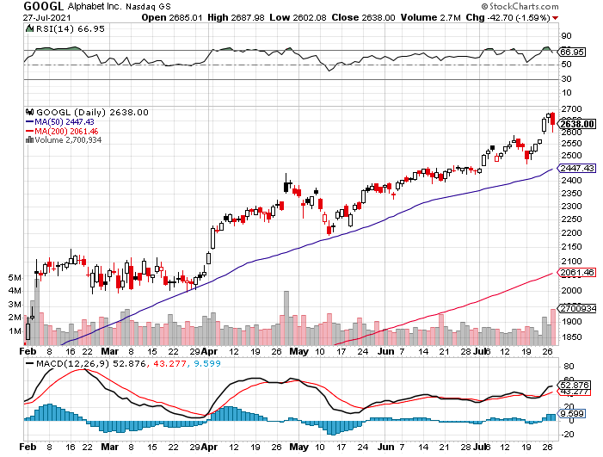
Alphabet (GOOGL) – Ad King on Economic Recovery 15% of Search is Travel Related took profits on long 12/$1,200-$1,230 bull call spread took profits on long 9/$1,030-$1,080 vertical bull call spread

Slide 33
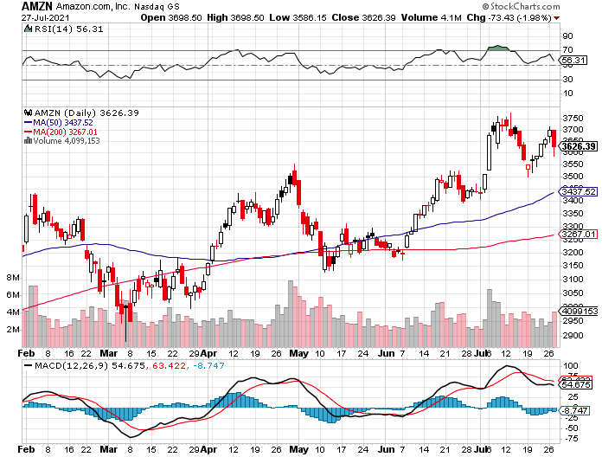
Amazon (AMZN) – New Highs took profits on long 9/$2,800-$2,900 bull call spread

Slide 34
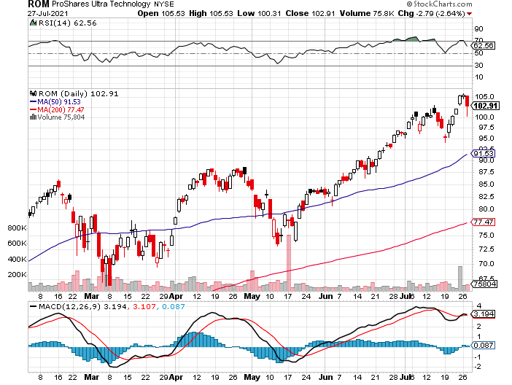
ProShares Ultra Technology (ROM) – New Highs

Slide 35
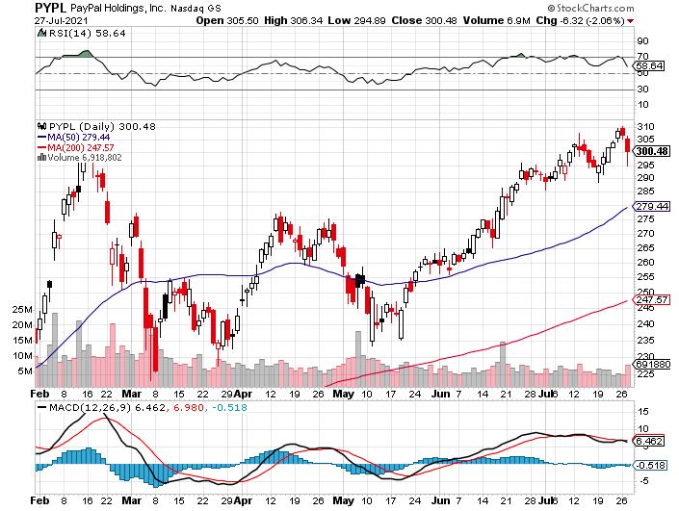
PayPal (PYPL)-Fintech Rules-New Highs took profits on long 4/$90-$95 call spread

Slide 36
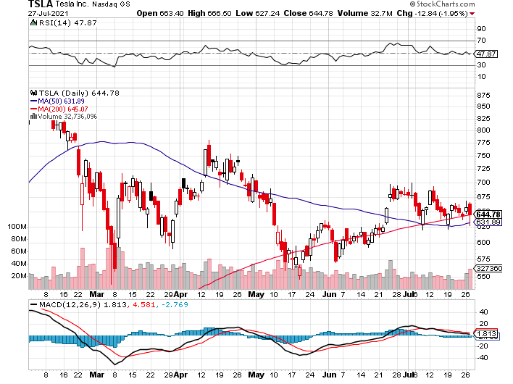
Tesla (TSLA)- took profits on long 2X 4/$450-$500 call spread, took profits on long 3/$400-$450 call spread took profits on long 2/$650-$700 call spread-expires, stopped out of long 3/$600-$650 call spread Took profits on long 2/$600-$650 bull call spread, Took profits on long 2/$550-$600 bull call spread

Slide 37
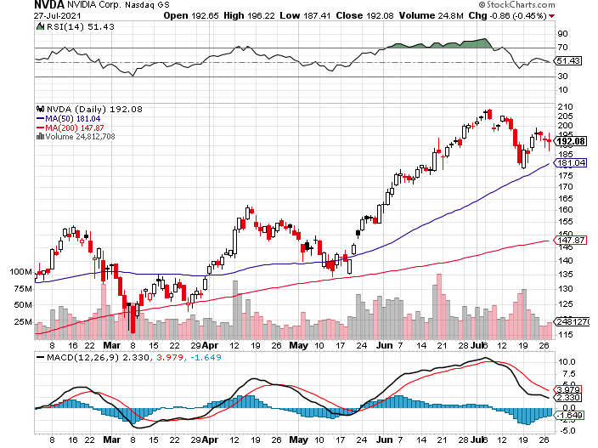
NVIDIA (NVDA) – New Highs A Mad Hedge 10 bagger – Global Semiconductor Shortage Slows Auto Industry,

Slide 38
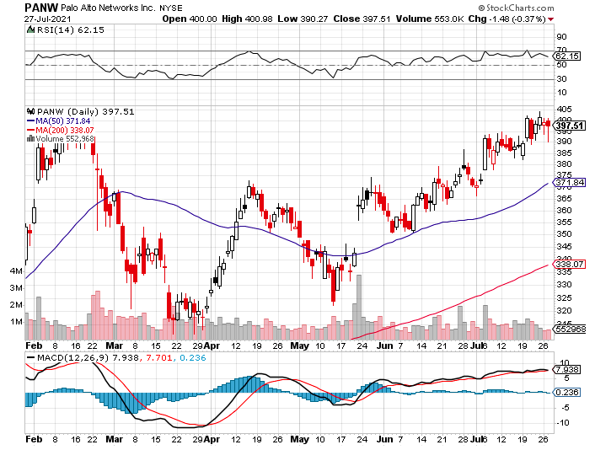
Palo Alto Networks (PANW)- Hacking never goes out of fashion

Slide 39
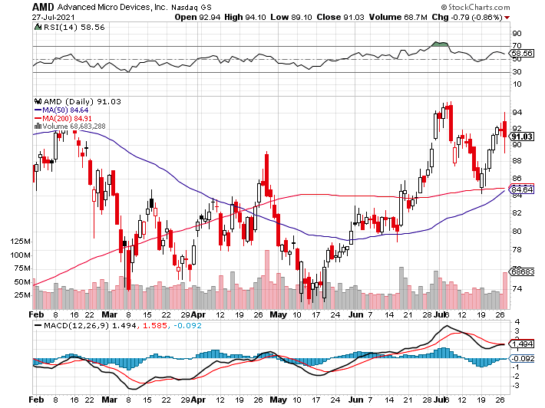
Advanced Micro Devices (AMD)- The next ten bagger - buys Xilinx – programable logic devices took profits on long 2/$75-$80 call spread

Slide 40
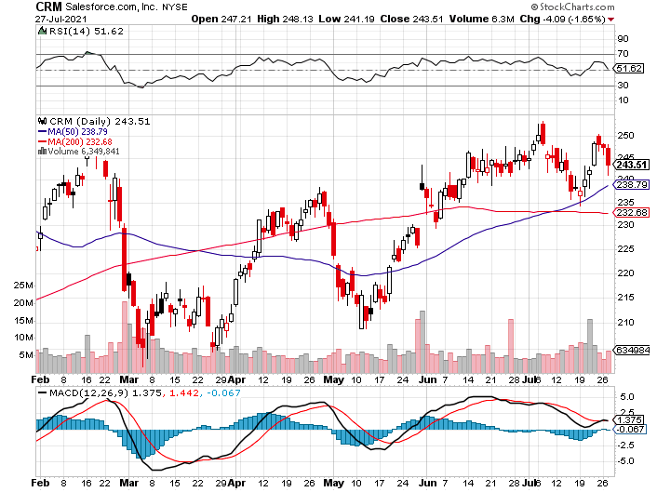
Salesforce (CRM)- Massive Online Migration took profits on long 9/$125-$130 vertical bull call spread took profits on long 8/$125-$130 vertical bull call spread took profits on long 2/$105-$115 call spread

Slide 41
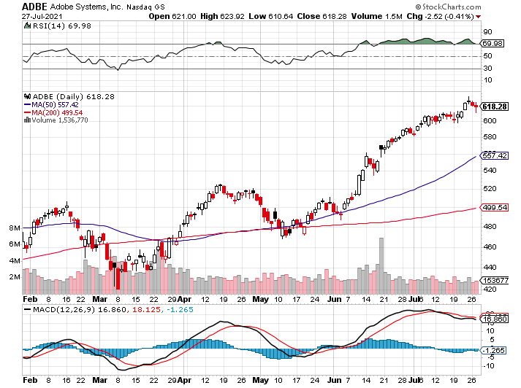
Adobe (ADBE)- Cloud play The Quality Non-China Tech Play

Slide 42
The Second Half of the Barbell
*Bets on a domestic recovery in 2021 *Upside potential in 2021 far greater than tech *Some of these have not moved for 5 or 10 years *Focuses on economically sensitive cyclical industries *Makes a great counterweight to high-growth technology *We could spend all of next year rotating between the two groups

Slide 43
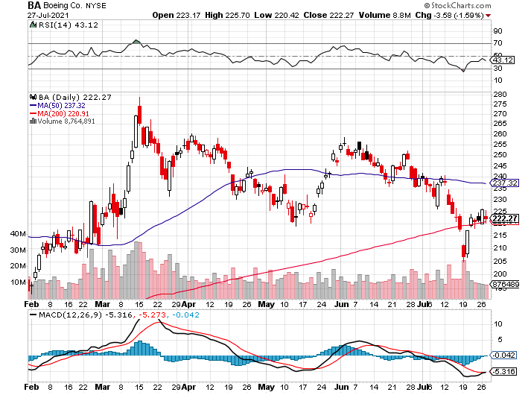
Boeing (BA) – Former LEAP Candidate – Headaches again long 3/$146-$149 call spread took profits on long 2/$150-$160 call spread

Slide 44
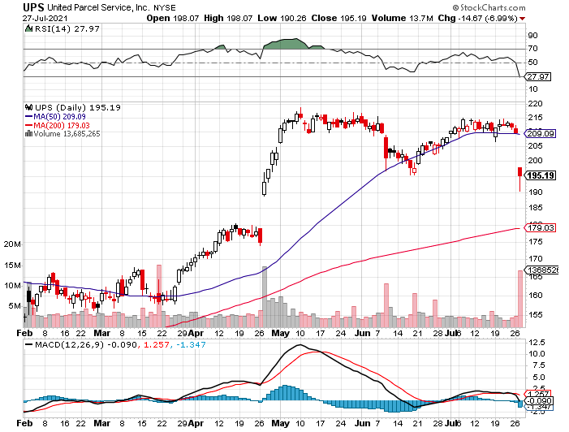
Package Delivery- United Parcel Service (UPS) - Package Delivery massive increase in overnight deliveries, announces blowout earnings, vaccine deliveries took profits on long 11/$130-$140 call spread

Slide 45
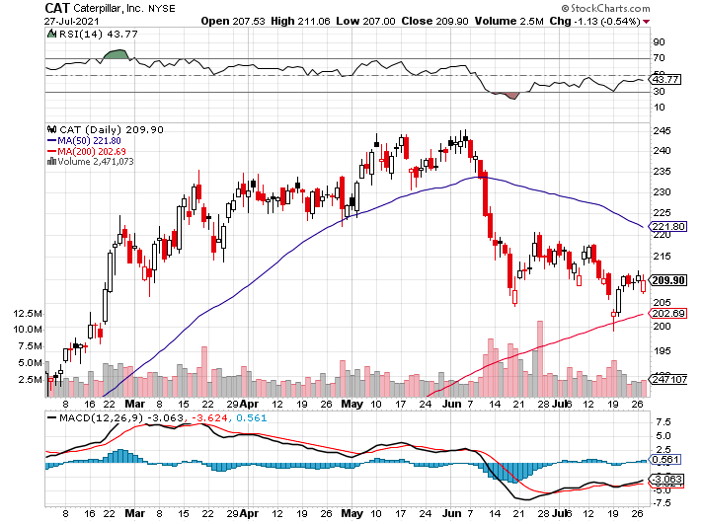
Caterpillar (CAT)- Ag + Infrastructure + Housing took profits on long 12/$145-$150 call spread took profits on long 11/$125-$135 call spread

Slide 46
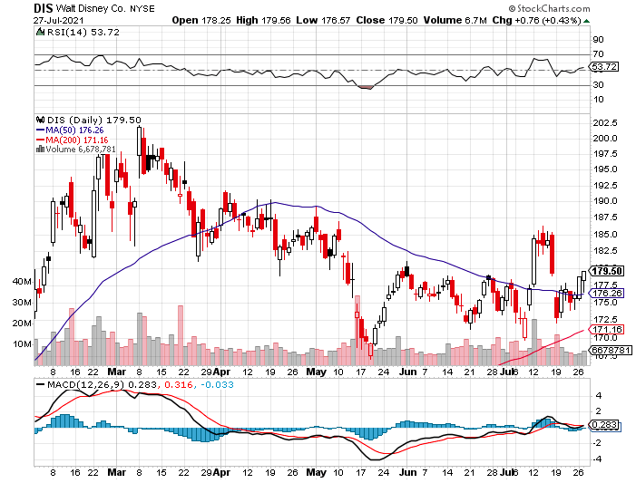
Walt Disney (DIS)- Big Recovery Move Covid 4th Wave Delta Drag took profits on long 3/$170-$180 call spread

Slide 47
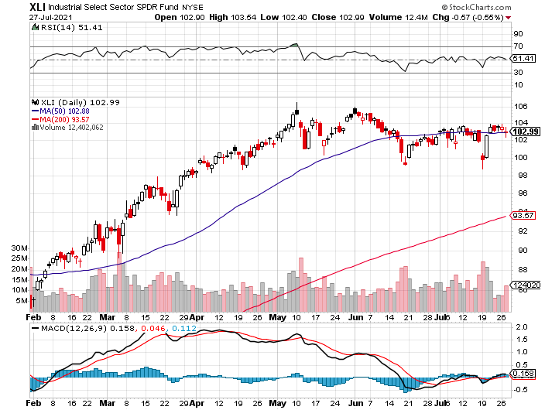
Industrials Sector SPDR (XLI)- (GE), (MMM), (UNP), (UTX), (BA), (HON)

Slide 48
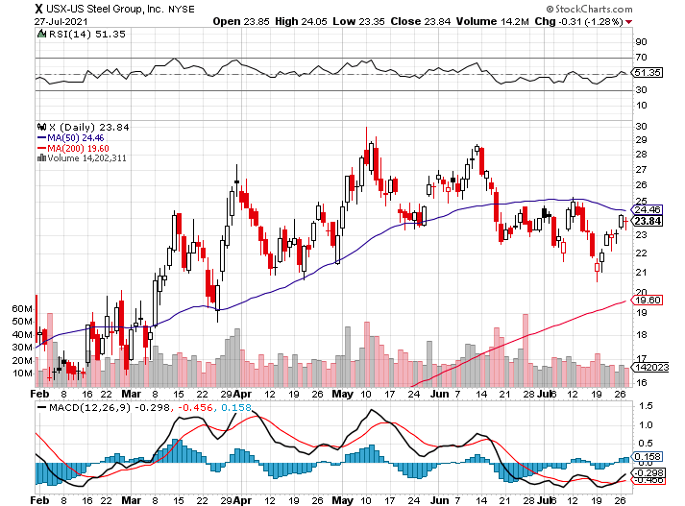
US Steel (X) – Commodity Drag

Slide 49
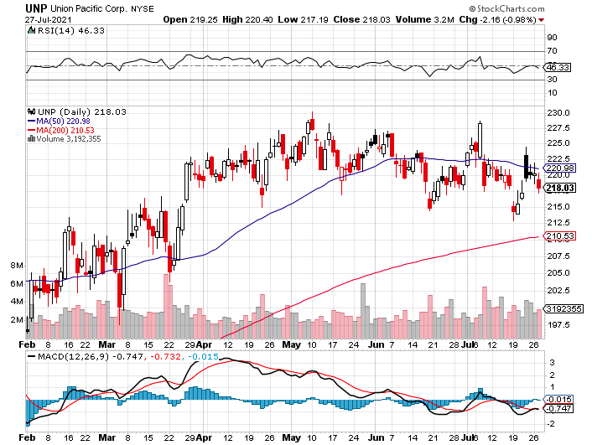
Union Pacific RR (UNP)- Big Stuff to Ship Near record earnings announced long 5/$200-$210 call spread – 12 days to expiration took profits on 11/$150-$160 call spread

Slide 50
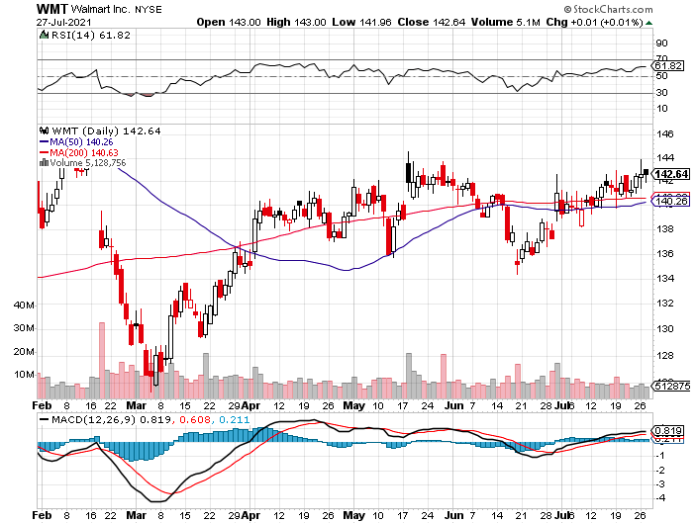
Wal-Mart (WMT)-New High took profit on Long 11/$125-$130 bear put spread took profit on Long 10/$119-$121 bear put spread took profits on Long 8/$114-$117 bear put spread

Slide 51
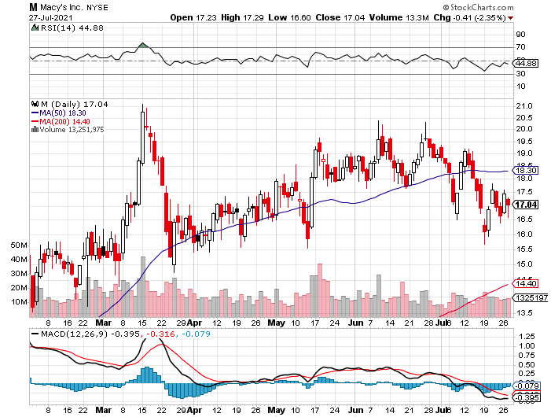
Macys’ (M) – Retail Return from the Grave took profits on Long 8/$23-$25 bear put spread

Slide 52
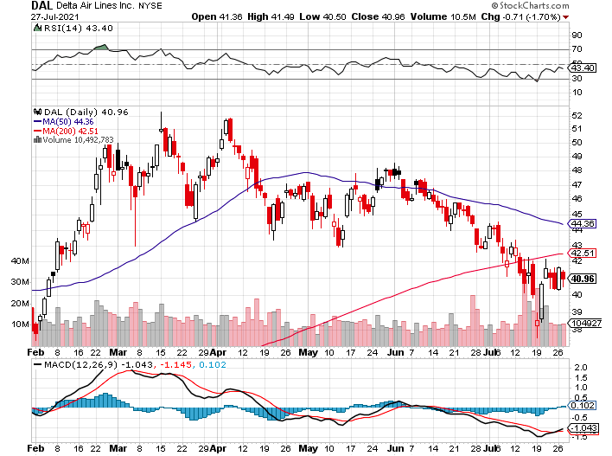
Delta Airlines (DAL) –

Slide 53
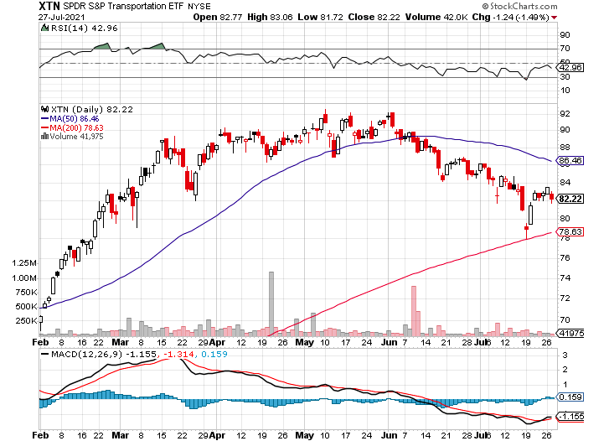
Transports Sector SPDR (XTN)- Worst Hit Sector (ALGT), (ALK), (JBLU), (LUV), (CHRW), (DAL)

Slide 54
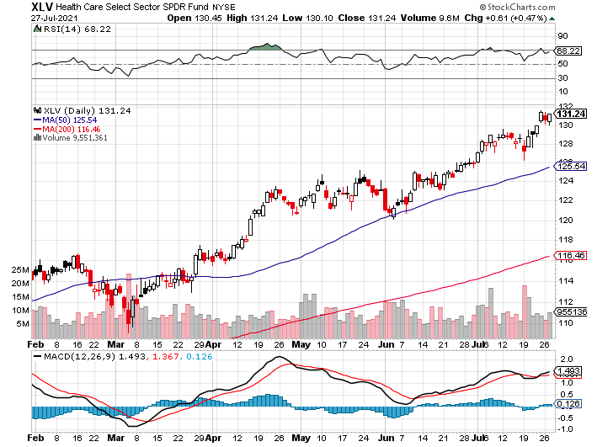
Health Care Sector (XLV), (RXL) (JNJ), (PFE), (MRK), (GILD), (ACT), (AMGN)

Slide 55
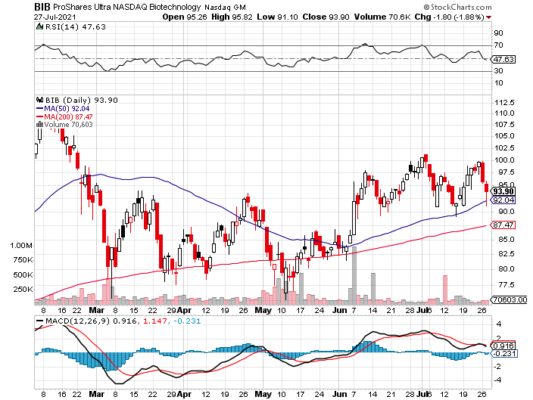
Biogen (BIIB) Why you do Biotech

Slide 56
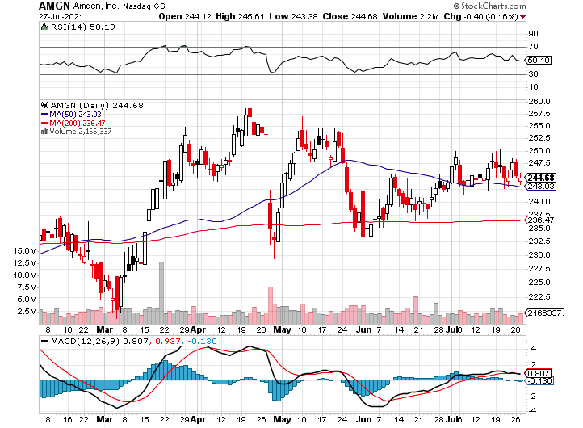
Amgen (AMGN) took profits on long 11/$185-$200 bull call spread

Slide 57
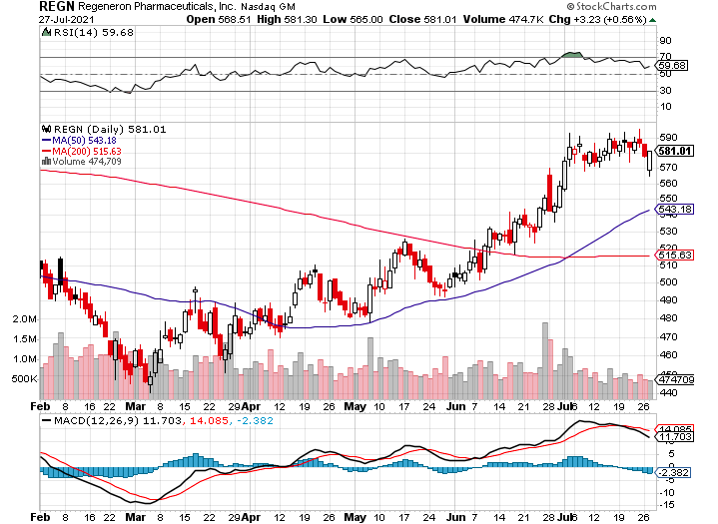
Regeneron (REGN) took profits on long 7/$570-$580 call spread

Slide 58
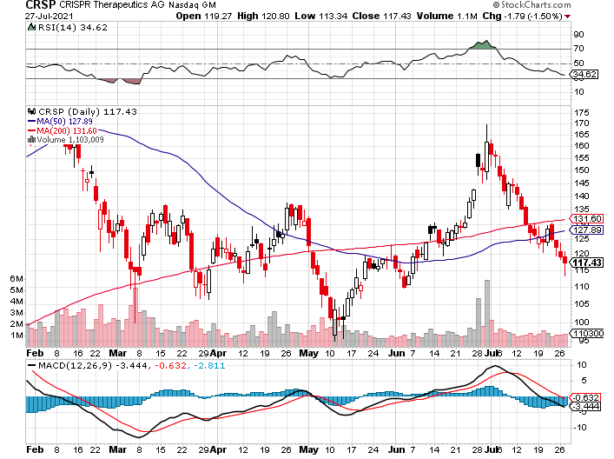
CRISPR Therapeutics (CRSP) New Tie up for Liver Failure Drug

Slide 59
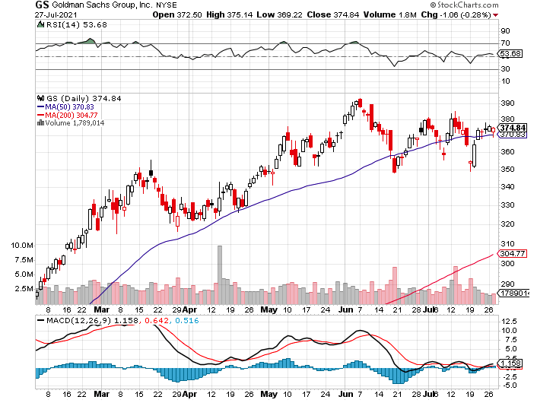
Goldman Sachs (GS) – took profits on long 6/$310-$320 call spread took profits on long 5/$310-$320 call spread took profits on long 2/$240-$260 call spread

Slide 60
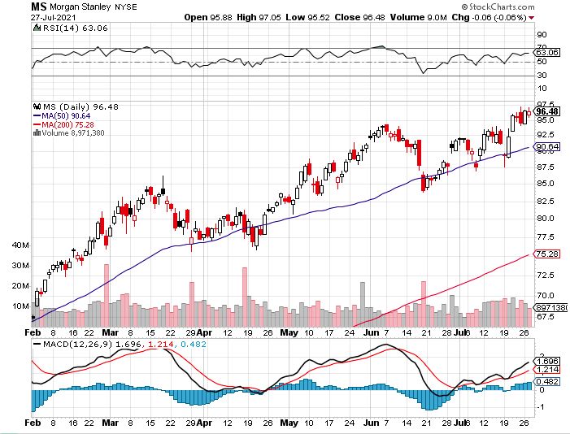
Morgan Stanley (MS) – Doubled Dividend took profits on long 2/$55-$60 call spread

Slide 61
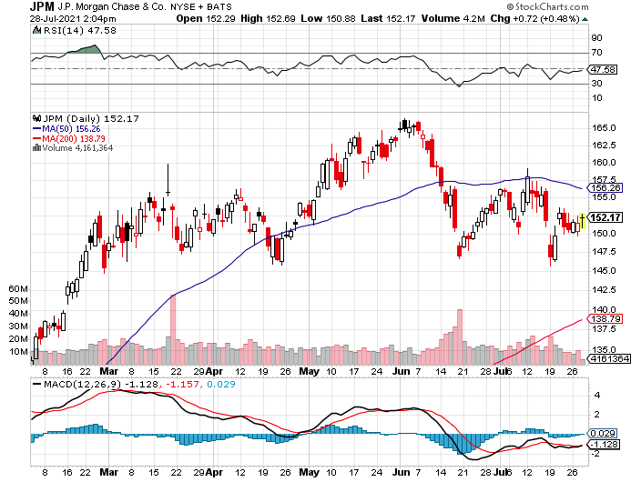
JP Morgan Chase (JPM)-Back to Life long 8/$140-$145 call spread took profits on long 7/$140-$145 call spread took profits on long 5/$135-$140 call spread took profits on long 2/$135-$140 call spread took profits on long 2/$110-$115 call spread

Slide 62
Citigroup (C) – “Recovery” Rotation Play

Slide 63
Bank of America (BAC) – took profits on long 2/$28-$30 call spread

Slide 64
SPDR Metals & Mining ETF (XME) – long 2/$28-$30 call spread

Slide 65
Blackrock (BLK)-Asset Collection Boom took profits on long 3/$31-$34 call spread

Slide 66
Visa (V) – “Touchless” Fintech Play took profits on long long 5/$195-$205 bull call spread took profits on long 9/$180-$185 bull call spread

Slide 67
Consumer Discretionary SPDR (XLY) (DIS), (AMZN), (HD), (CMCSA), (MCD), (SBUX)

Slide 68
Berkshire Hathaway (BRKB)- Natural Barbell Maintaining share buy backs at $25 billion a year took profits on long 3/$230-$240 call spread

Slide 69
Europe Hedged Equity (HEDJ)-

Slide 70
Japan (DXJ)-

Slide 71
Emerging Markets (EEM) - Pro trade, Weak Dollar, Long Recovery Play

Slide 72
Bonds – Topped Out
*Panic capitulation short covering delivers final top in a four-month bond market rally, 30 year bond auction was a complete disaster, much was stuck with dealers *Multi-year bear market in bonds will resume in fall with Fed taper. *Nobody is taking a 1.10% yield against a 5.4% inflation rate delivering a negative 4.3% real yield because they think it’s a great deal *Add more downside LEAPS NOW, the January 2022 (TLT) $145-$150 vertical bear put spread delivers a 75% profit in six months *A 2.00% yield on the ten-year US Treasury bond here we come! This is the quality trade of 2021 *Only non-economic buyers in the market, like central banks, commercial banks, foreign investors, and life insurance companies *US Treasury bond fund (TLT) could plunge from $180 a year ago to $105 by 2023

Slide 73
Treasury ETF (TLT) – The Top is In long 8/$157-$160 put spread, took profits on long 7/$152-$155 put spread stopped out of long 5/$143-$146 put spread, took profits long 5/$143-$146 put spread, took profits long 5/$144-$147 put spread, took profits on 6/$145-$148

Slide 74
Ten Year Treasury Yield ($TNX) – 1.42%

Slide 75
Junk Bonds (HYG) 3.47% Yield to Maturity

Slide 76
2X Short Treasuries (TBT)-Another Run at Highs

Slide 77
Emerging Market Debt (ELD) 4.27% Yield-

Slide 78
Municipal Bonds (MUB) – 0.93% Mix of AAA, AA, and A rated bonds

Slide 79
Foreign Currencies – Dollar Topping Out
*US Dollar maintains recent gains but has lost its momentum and could be peaking here *Long-term fundamentals continue to worsen, a dollar short could be the new ten-year trade *Massive over issuance of debt by the US government to fund the covid recovery is another nail in the coffin in addition to a n exploding trade deficit *Europe is getting positive yield support for the first time in a decade *Expect more of the same. Buy (FXA) and (FXE) on dips. *Bitcoin Battles at $30,000, for the fourth time in two months, at one point falling to a $24,000 low *Keep selling short all US dollar rallies, its yield support is gone forever, Buy (FXA) and (FXE) on dips.

Slide 80
Japanese Yen (FXY), (YCS)

Slide 81
Euro ($XEU), (FXE), (EUO)-

Slide 82
British Pound (FXB)-

Slide 83
Australian Dollar (FXA)- The Global Recovery Play took profits on long 8/$67-$69 call spread

Slide 84
Emerging Market Currencies (CEW)

Slide 85
Chinese Yuan- (CYB)-

Slide 86
Bitcoin- Head and Shoulders Top $10,000 in play

Slide 87
Energy – OPEC Struggle
*OPEC Deal Crushes Oil, sending Texas tea down 6% *The agreement will phase out the 5.4 million barrels a day in Covid cuts *OPEC also wants to head off a rise in US fracking and this is the best way to do it. *The end of oil is upon us, but it may take 30 years to unwind existing infrastructure *All US car production will be electric by 2035, wiping out half of all US oil consumption *Avoid all energy plays like the plague, it’s the new buggy whip industry as the US de-carbonizes

Slide 88
Oil-($WTIC)

Slide 89
United States Oil Fund (USO) long 10/$9.50-$10 Vertical bull call spread

Slide 90
Energy Select Sector SPDR (XLE)-No Performance! (XOM), (CVX), (SLB), (KMI), (EOG), (COP)

Slide 91
Halliburton (HAL)-

Slide 92
Natural Gas (UNG) -

Slide 93
Precious Metals – Trying to Bottom
*Fed’s promise of an end to inflation delivers a hit for gold, the next big move in inflation will be down from the current 5.4% Long-term rising interest rates remain a threat to precious metals *Silver is still the bigger and better long-term play *Every EV needs 2 ounces of silver, and production will soar from 700,000 units in 2020 to 25 million by 2030 *Gold will eventually recover when US borrowing becomes so massive it undermines the value of the US dollar, even in the face of higher interest rates

Slide 94
Gold (GLD)- Meltdown

Slide 95
Market Vectors Gold Miners ETF- (GDX) –

Slide 96
Barrick Gold (GOLD) took profits on long 1/$21-$23 call spread took profits on long 11/$22-$24 call spread

Slide 97
Newmont Mining- (NEM)- took profits on long $55-60 call spread

Slide 98
Silver- (SLV)- took profits on long 11/$19-$20 call spread

Slide 99
Silver Miners - (SIL)-

Slide 100
Wheaton Precious Metals - (WPM)- took profits on long 2/$39-41 call spread

Slide 101
Copper (COPX)-Uptrend Resumes 100 Million EV’s by 2040, 25 Million by 2026, Compared to Only 1 Million Now

Slide 102
Real Estate – Priced Out of the Market
*30-year fixed rate mortgage rate falls below 2.90%, keeping the pot boiling *Existing Home Sales are up 1.4% in June, to 5.86 million units *New Home Sales 6.6%, but prices are up 6%. *Inventories are down 18.8% YOY to 1.25 million units to a 2.6-month supply. The Northeast was the leader, up 2.8% *Median home prices are still soaring, to $363,000 and up an eye-popping 23.4% YOY. *Sales of homes priced over $1 million are up 147%. Some 14% of homes are now sold to investors, while 23% were to all cash buyers *S&P Case Shiller Smashes all Records, up 17% YOY

Slide 104
S&P Case Shiller Up 14.6% for April Phoenix (25.9%), San Diego (24.7%), and Seattle (23.4%) lead

Slide 105
Crown Castle International (CCI) – 2.70% Yielding Cell Phone Tower REIT

Slide 106
US Home Construction Index (ITB) (DHI), (LEN), (PHM), (TOL), (NVR)

Slide 107
Trade Sheet- So What Do We Do About All This?
*Stocks – buy dips aggressively *Bonds – sell rallies aggressively *Commodities-buy dips aggressively *Currencies- sell US dollar rallies *Precious Metals – buy dips *Energy – stand aside *Volatility - sell short over $30 *Real estate – buy dips

Slide 108
Next Strategy Webinar 12:00 EST Wednesday, August 11, from Lake Tahoe Email me questions at support@madhedgefundtrader.com
Good Luck and Good Trading!
Notes:
*

