Slide 1
The Mad Hedge Fund Trader “Goodbye Delta”
With John Thomas Reno, NV, August 25, 2021 www.madhedgefundtrader.com
Notes:
*

Slide 2
The Cow Won

Slide 3
Trade Alert Performance New All Time Highs! 32 consecutive profitable trade alerts- 93.5% success rate in 2021-ony 5 losers
*January 10.21% MTD *July +0.61% Final *February +13.28% Final *August +6.96% MTD *March +20.60% Final *September 7.95% Final *April +15.67% Final *October +1.51% Final *May +8.13% Final *November +20.41% Final *June +0.71% Final *December +10.20% Final *2021 Year to Date +76.17% compared to +14.78% for the Dow Average *+498.72% since inception, a new all time high *Average annualized return of 42.76% for 12 years, new all time high`

Slide 4
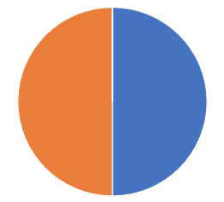
Portfolio Review 80% Cash in a low volatility Long Term Bull Market
Current Capital at Risk
Risk On
World is Getting Better
(TLT) 9/$155-$158 put spread | 10.00%
(SPY) 9/$410-$420 call spread | 10.00%
Risk Off
World is Getting Worse
No positions | 0.00%
Total Net Position | 20.00%
Total Aggregate Position | 20.00%
Expiration Value 77.44%

Slide 5
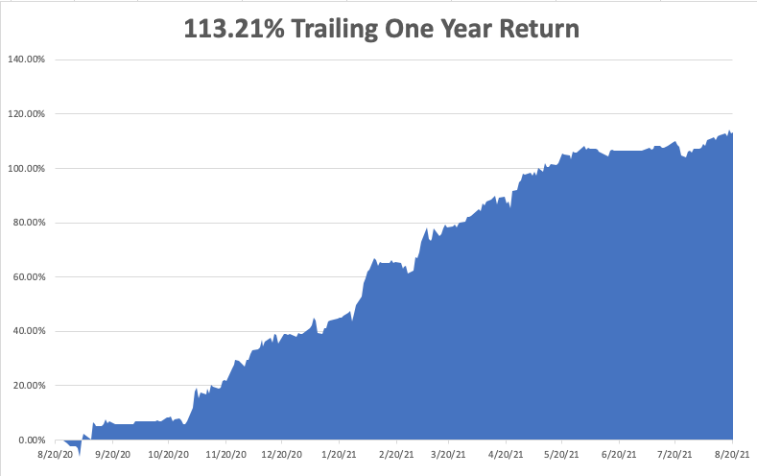

Slide 6
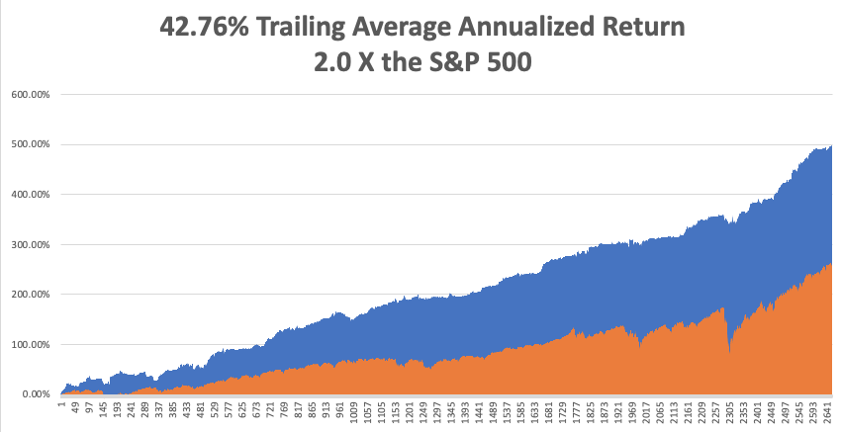
GTD 12 Year Daily Audited Performance

Slide 7
The Method to My Madness The Roaring Twenties are Here
*Markets see the delta variant peaking now, and the the next bull market in everything has begun *Bond prices have peaked, and interest rates bottomed. Next to come is a multiyear bear market in bonds. *Keep your tech stocks, as outer year earnings are being wildly underestimated *Medium term, both sides of the barbell are working *The economic recovery is now regional, with China first, now the US, and Europe last, but goes global in 2022 *Bitcoin wins the battle at $30,000, rockets 50% *VIX still at $15, showing the summer market persists, but could go lower in an “everything” rally

Slide 8
Corona Update – End of the Pandemic
*Pfizer Shots get full FDA approval, allowing national vaccine mandates by governments and private companies, 3rd booster shot for immunocompromised and everyone in months 6 months after 1st shot *70% of the US population is vaccinated and 10% have had the disease, bringing immunity up to 80%.California is at 90%. Biden mandates military vaccinations, bringing in another 5 million *New cases are up 9X, from 15,000 a day to 140,000, with one third in Florida and Texas where mask mandates are banned, and Mississippi now the most infected place in the world *It appears that vaccinated people can spread the disease, even though they don’t get it by carrying it in their nose *No deaths from delta variant report among those vaccinated. *Pfizer vaccine will be available for 5-11 years olds in September *US cases top 38 million, deaths topping 630,000 and deaths are back up to 1,500 a day

Slide 9
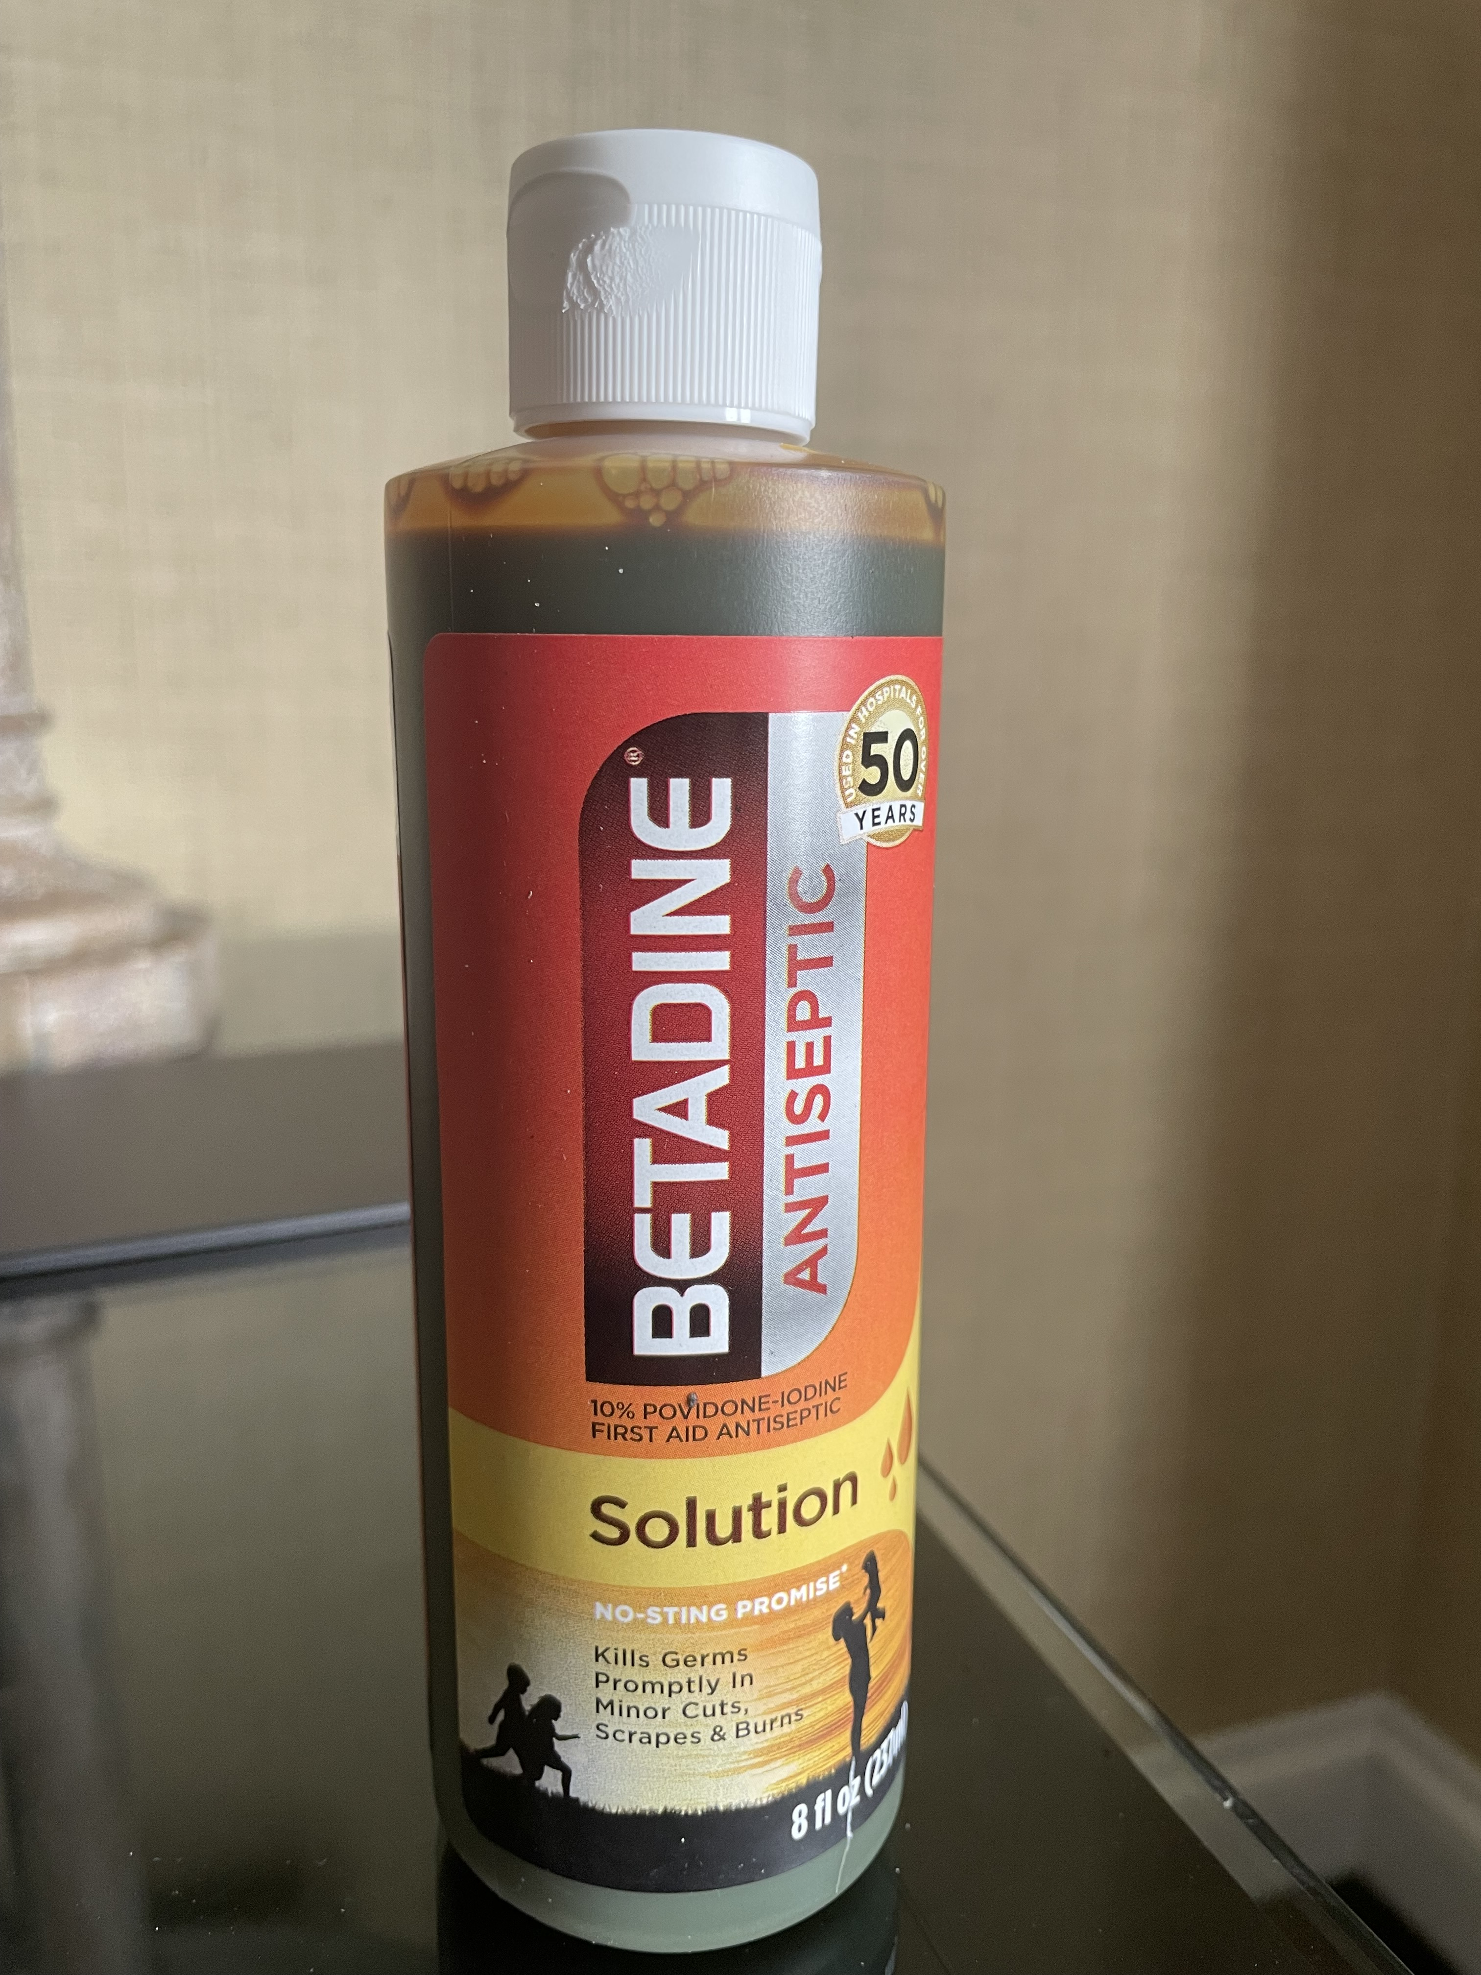
Buy a Bottle of Betadine Take a Q-Tip Swab each nostril 10 times where the delta variant lives Prevents you from spreading the virus Even though you are vaccinated and have no disease or symptoms

Slide 10
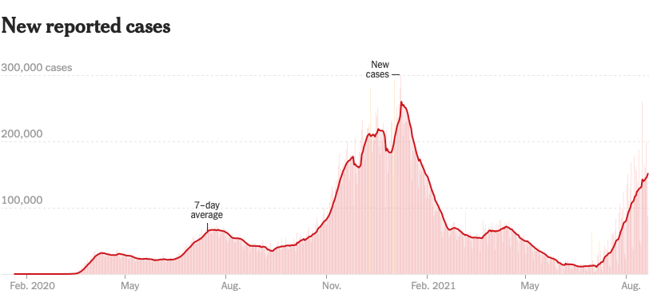
Bump on the Way to Zero the Fourth Wave – The Self-Inflicted Injury
Next Peak

Slide 11
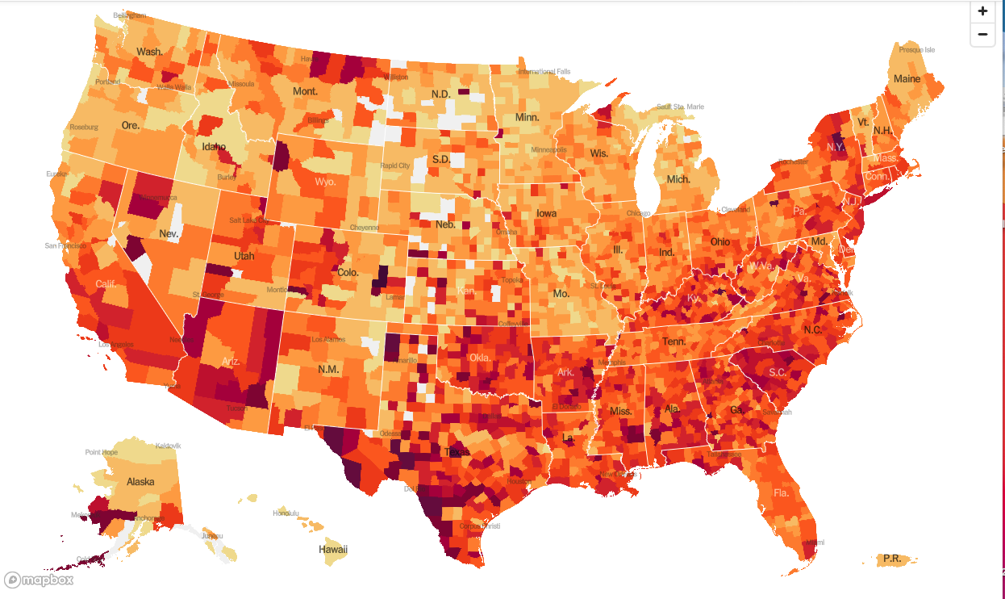
January 20 Infection Rate

Slide 12
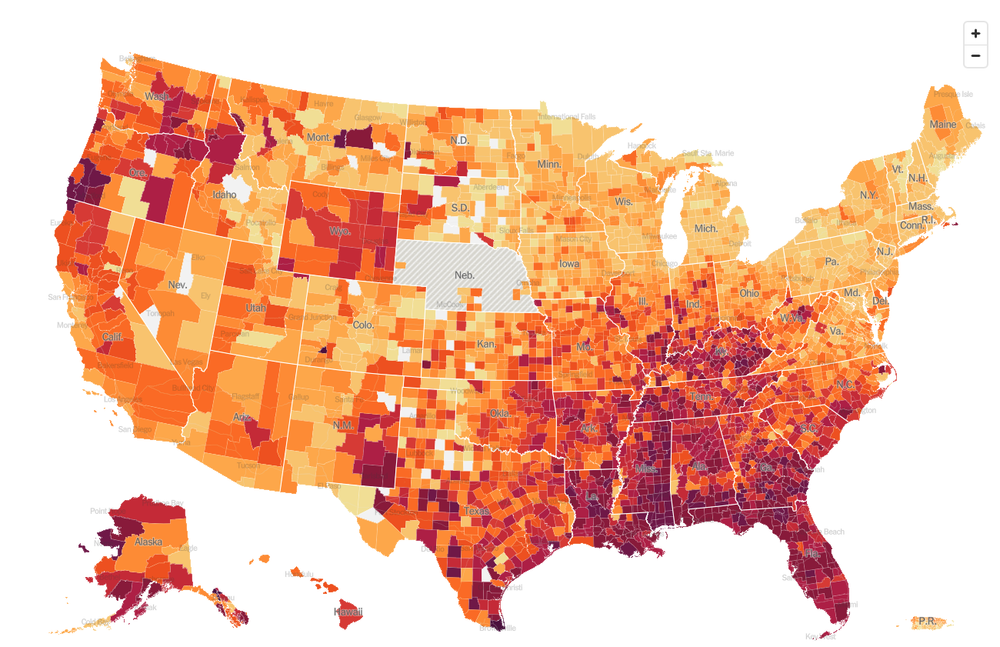
August 25 Infection Rate

Slide 13
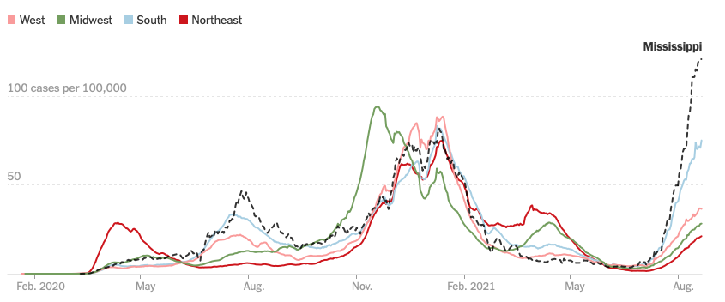

Slide 14
The Global Economy – Delta Blues
*Fed Minutes Show a Taper is in the Works, almost certainly cutting monthly bond purchases before yearend *$550 Billion Infrastructure Bill Passes Senate *Industrial Production Jumps, up 0.9%, the best since March. Capacity Utilization soars to 76.1%, the best in 18 months, *July Inflation Read at a Hot 5.4%, *US Budget Deficit Hits a Record $302 Billion in July *US Consumer Sentiment Dives to ten year low *July Retail Sales Disappoints, down 1.1%

Slide 15
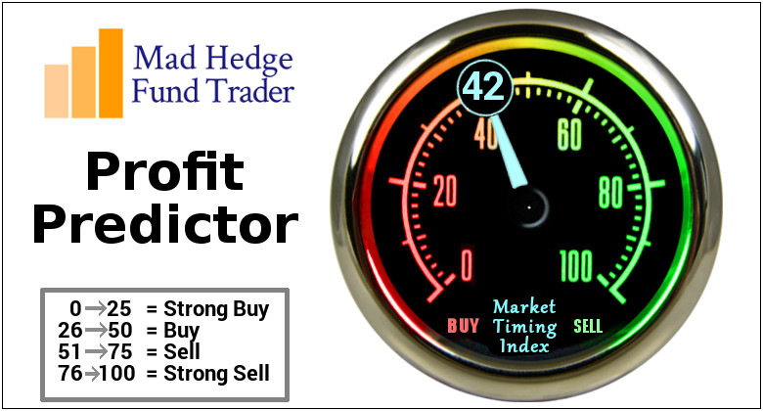
The Mad Hedge Profit Predictor Market Timing Index – Waiting for a Selloff An artificial intelligence driven algorithm that analyzes 30 different economic, technical, and momentum driven indicators

Slide 16
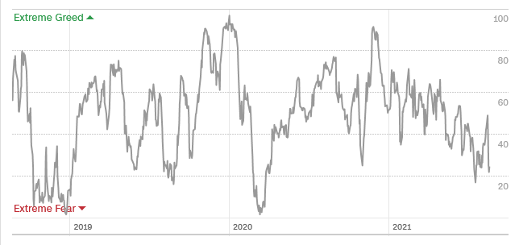
The Mad Hedge Profit Predictor Moving into a “BUY” Range
SELL
Do Nothing
BUY

Slide 17
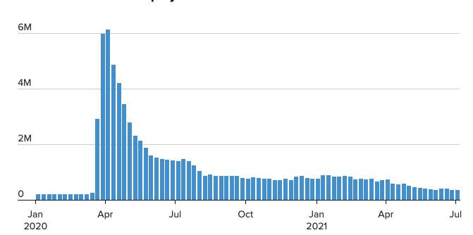
Weekly Jobless Claims – New Lows 348,000

Slide 18
Stocks – Indecisive
*US corporate profits to soar from $1.9 trillion in 2020 to $10 trillion in 2021 *Equity Mutual Funds See Third Week of Inflows, some $2.67 billion *Share Buy Back Companies are Beating the Market, and total will top $1 trillion in 2020 *Delta surge may have only days to run, and when it ends, all asset classes will surge with an “everything” rally. Bitcoin’s recent 50% rally is front running this move *(SPY) Multiples hit 28X, but are like to get more expensive that cheaper *FANGS are now leading the market and may continue for the rest of the year, but may take a short term hit on month end earnings announcements *Stick with the barbell strategy, we’ll keep rotating back and forth all year between tech & domestic recovery

Slide 19
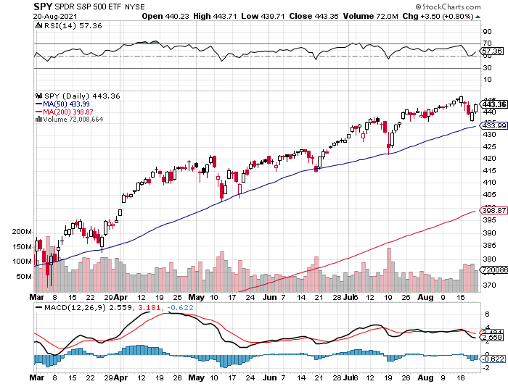
S&P 500 – New Highs and No Pullback took profits on long 6/$375-$385 bull call spread took profits on long 6/$430-440 bear put spread
New Highs Yearend Target $475
The Bottom 420

Slide 20
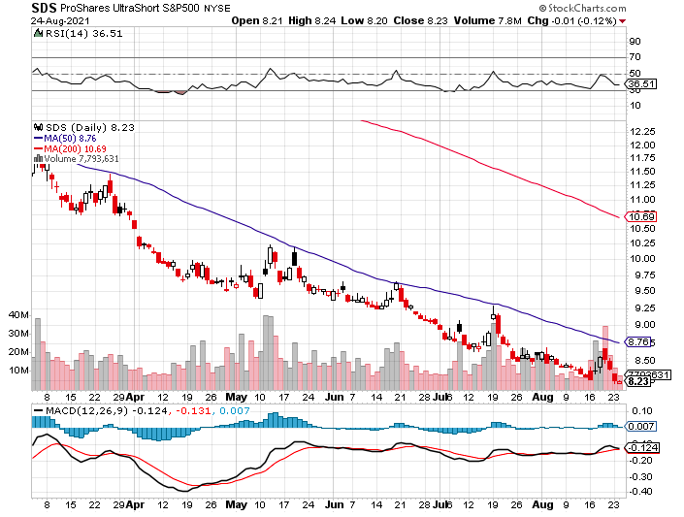
ProShares Ultra Short S&P 500 (SDS)- a great hedge for long stocks and bonds long 2X position has a hedge against longs and bond shorts

Slide 21
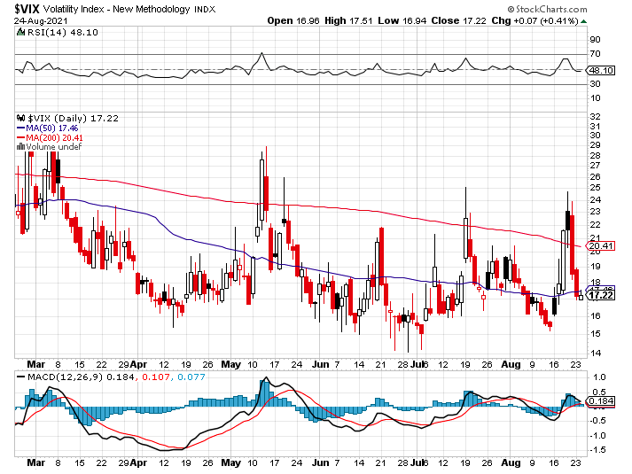
(VIX) – Dying a Slow Death classic summer market

Slide 22
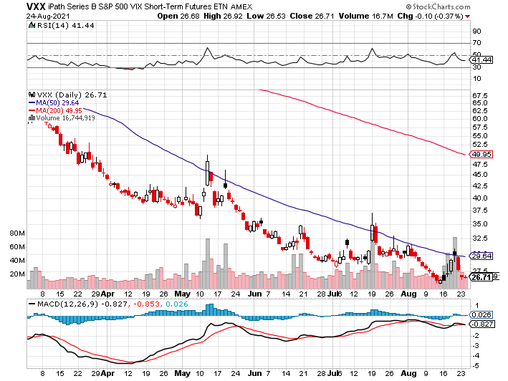
(VXX)-

Slide 23
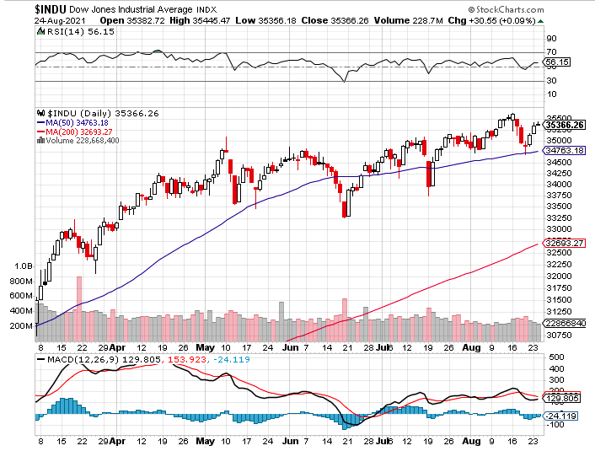
Dow Average ($INDU)-

Slide 24
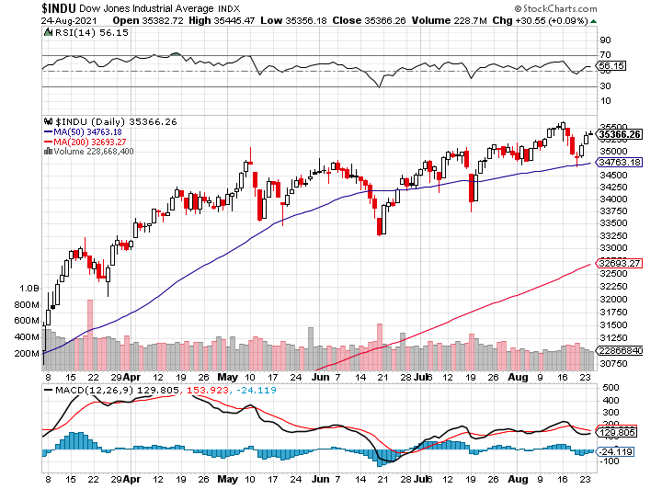
Russell 2000 (IWM)- took profits on Long 10/$137-$142 vertical bull call spread took profits on Long 10/$153-$156 vertical bear put spread

Slide 25
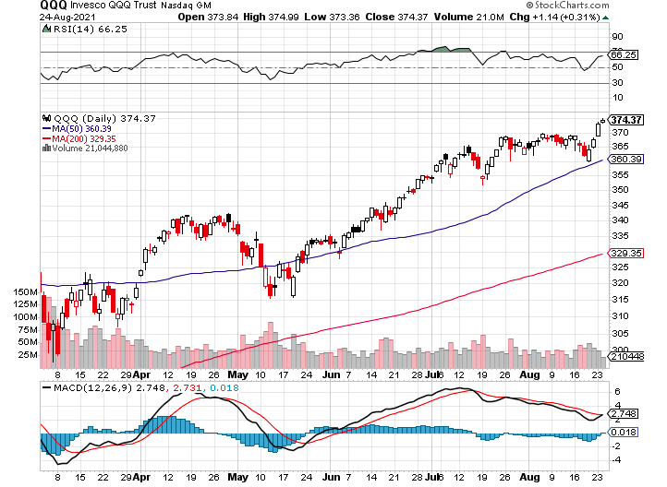
NASDAQ (QQQ) – long (QQQ) 4/$330-$335 put spread took profits on long (QQQ) 3/$340-$345 put spread covered long (QQQ) $325-$330 put spread

Slide 26
The Barbell Portfolio
*50% Big Tech - 2% of US Employment but 27% of Market Cap and 38% of Profits 50% Domestic Recovery, including: Railroads Couriers Banks Construction Credit Cards Event organizers Ticket sales Retailers

Slide 27
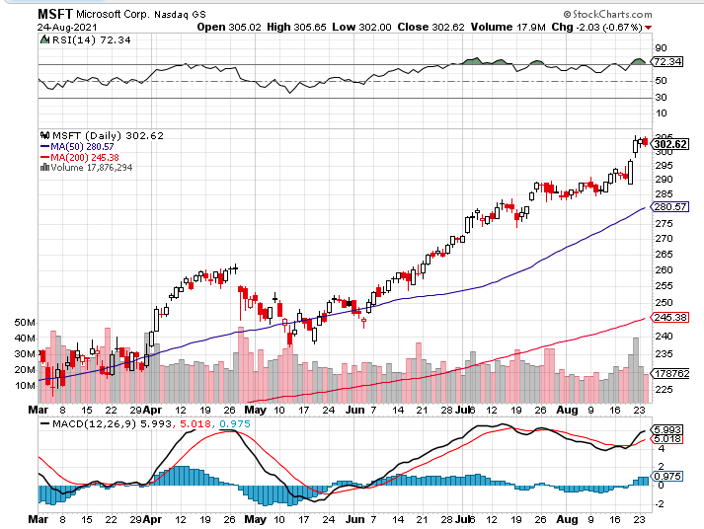
Microsoft (MSFT)- Pentagon Cancels Microsoft Jedi Cloud Deal took profits on long 12/$220-$230 call spread stop loss on long 12/$170-$180 call spread took profits on long 12/$135-$138 call spread

Slide 28
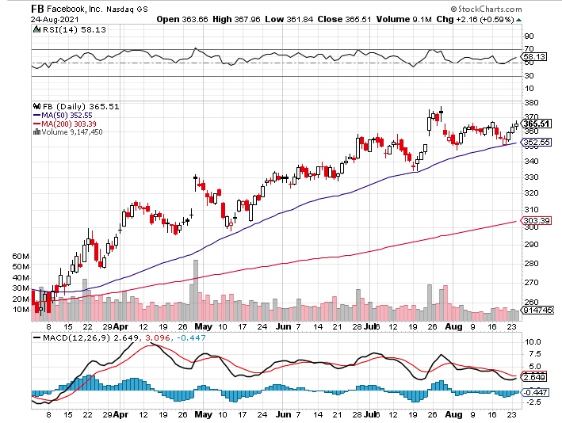
Facebook (FB)- Wins antitrust suit took profits on Long 9/$290-$300 vertical bear put spread stopped out of Long 9/$190-$200 vertical bear put spread took profits on Long 9/$145-$155 vertical bull call spread took profits on Long 9/$150-$160 vertical bull call spread

Slide 29
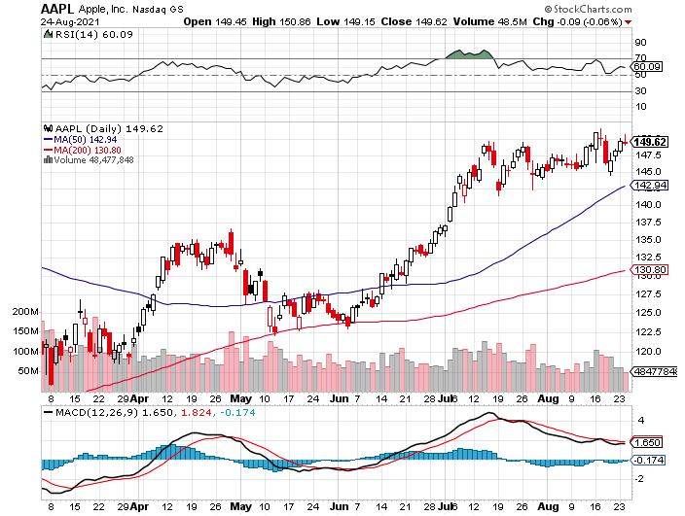
Apple (AAPL)- New 5G iPhone Surge-earnings after close Apple car moving forward with KIA took profits on long 7/$320-$330 call spread took profits on long 4/24/$250-$260 call spread took profits on long 5/$250-$260 call spread

Slide 30
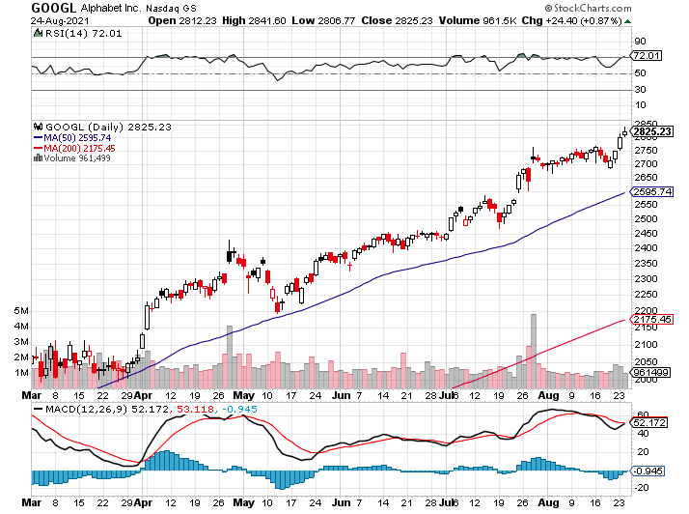
Alphabet (GOOGL) – Ad king on economic recovery 15% of search is travel related took profits on long 12/$1,200-$1,230 bull call spread took profits on long 9/$1,030-$1,080 vertical bull call spread

Slide 31
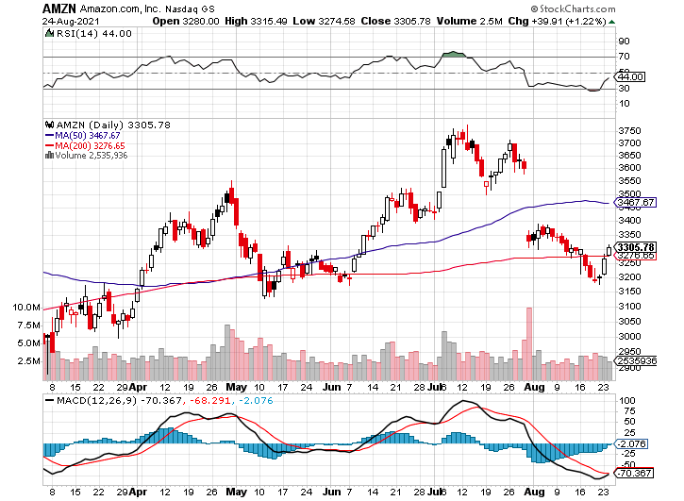
Amazon (AMZN) – New Highs took profits on long 9/$2,800-$2,900 bull call spread

Slide 32
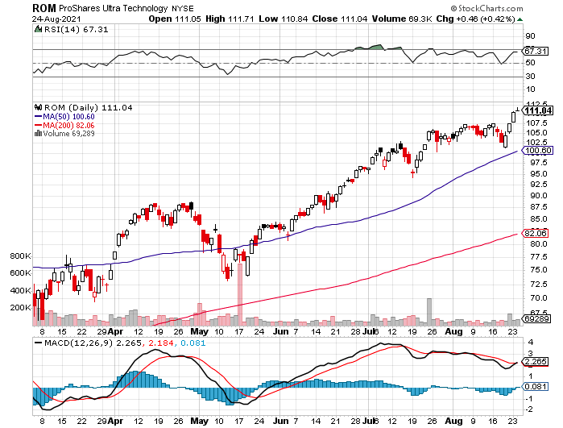
ProShares Ultra Technology (ROM) – New Highs

Slide 33
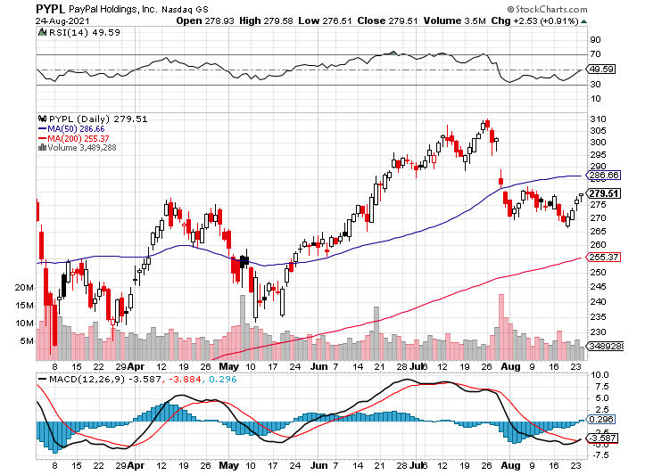
PayPal (PYPL)-Fintech Rules-New Highs took profits on long 4/$90-$95 call spread

Slide 34
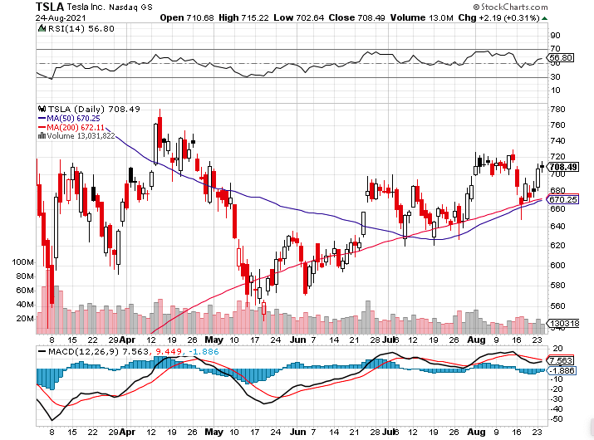
Tesla (TSLA)- Feds Investigate Autopilot took profits on long 2X 4/$450-$500 call spread, took profits on long 3/$400-$450 call spread took profits on long 2/$650-$700 call spread-expires, stopped out of long 3/$600-$650 call spread Took profits on long 2/$600-$650 bull call spread, Took profits on long 2/$550-$600 bull call spread

Slide 35
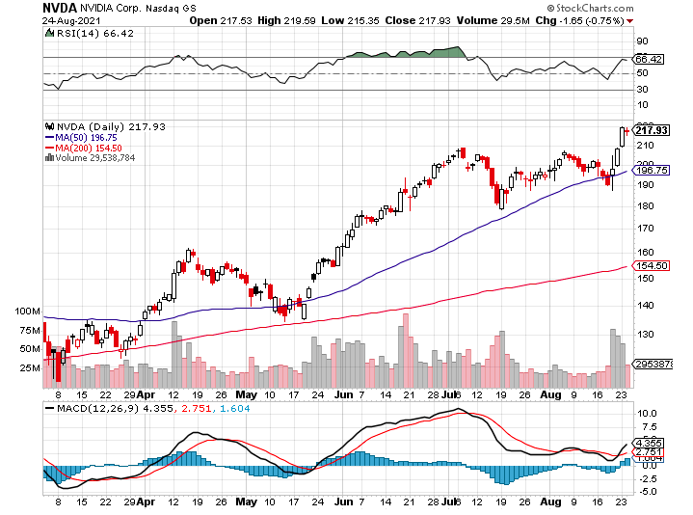
NVIDIA (NVDA) – New Highs on Great Earnings A Mad Hedge 10 bagger – Global Semiconductor Shortage Slows Auto Industry, Graphic card sales up 87% in Q2

Slide 36
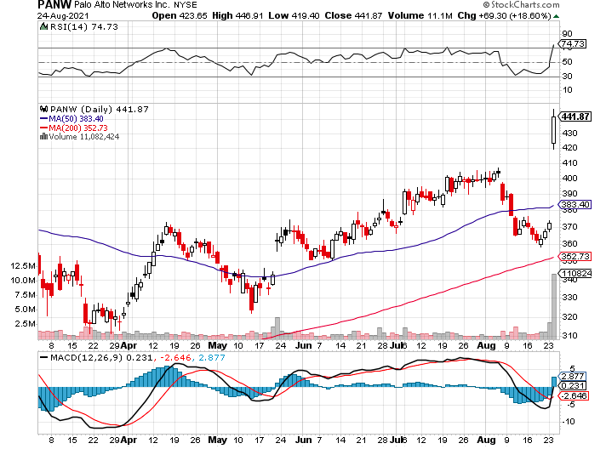
Palo Alto Networks (PANW)- Hacking never goes out of fashion

Slide 37
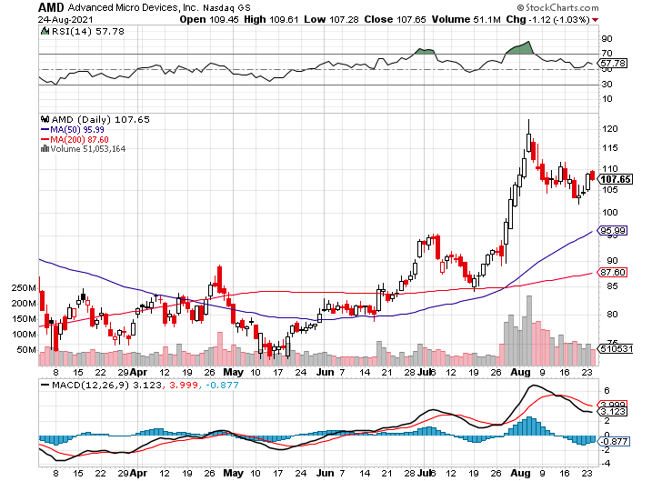
Advanced Micro Devices (AMD)- programable logic devices took profits on long 2/$75-$80 call spread

Slide 38
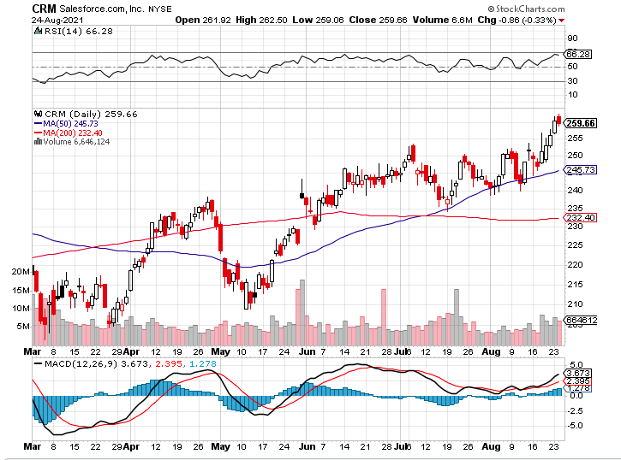
Salesforce (CRM)- Massive Online Migration took profits on long 9/$125-$130 vertical bull call spread took profits on long 8/$125-$130 vertical bull call spread took profits on long 2/$105-$115 call spread

Slide 39
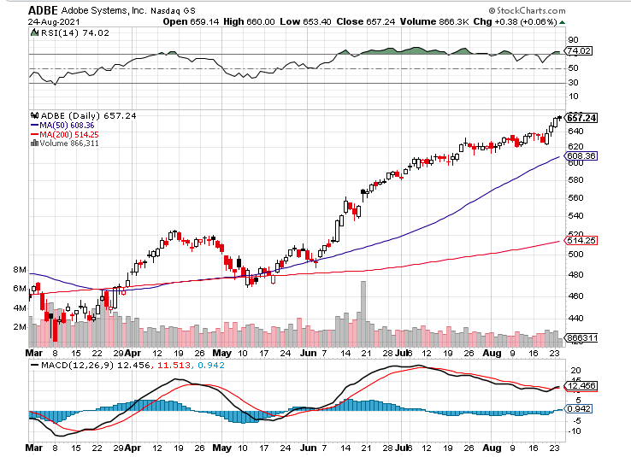
Adobe (ADBE)- Cloud play The Quality Non-China tech play

Slide 40
The Second Half of the Barbell
*Bets on a domestic recovery in 2021 *Upside potential in 2021 far greater than tech *Some of these have not moved for 5 or 10 years *Focuses on economically sensitive cyclical industries *Makes a great counterweight to high-growth technology *We could spend all of next year rotating between the two groups

Slide 41
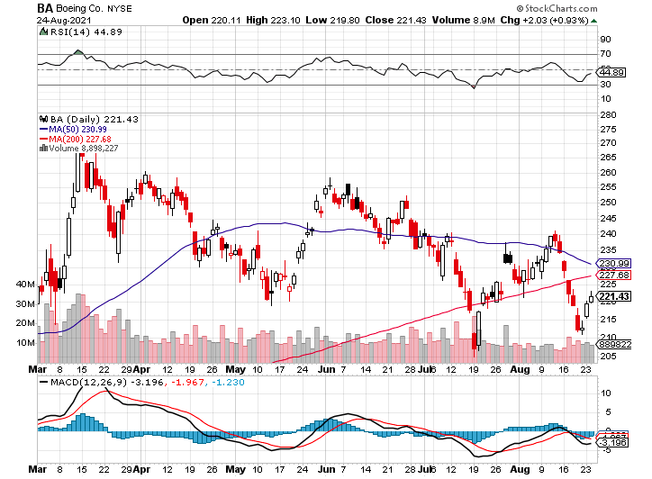
Boeing (BA) – former LEAP Candidate – Headaches again long 3/$146-$149 call spread took profits on long 2/$150-$160 call spread

Slide 42
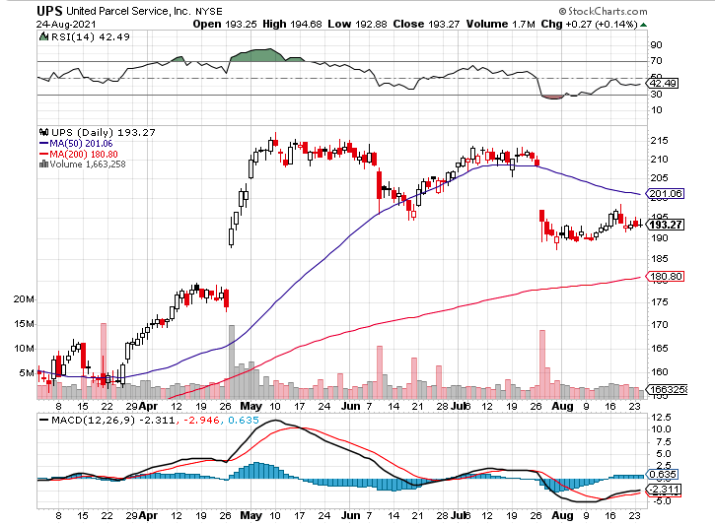
Package Delivery- United Parcel Service (UPS) - Package Delivery massive increase in overnight deliveries, announces blowout earnings, vaccine deliveries took profits on long 11/$130-$140 call spread

Slide 43
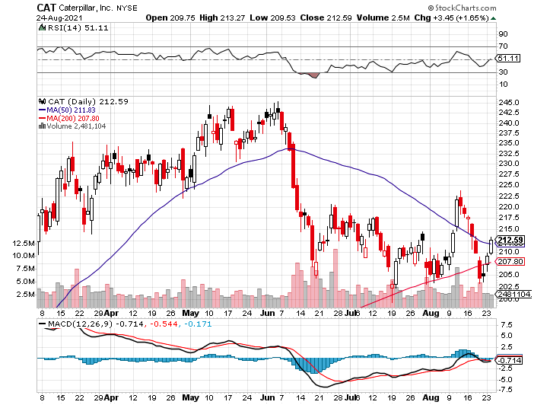
Caterpillar (CAT)- Ag + Infrastructure + Housing took profits on long 12/$145-$150 call spread took profits on long 11/$125-$135 call spread

Slide 44
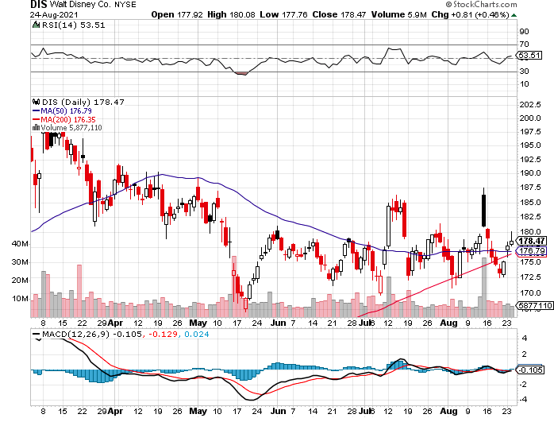
Walt Disney (DIS)- Big Recovery Move Covid 4th Wave Delta Drag took profits on long 3/$170-$180 call spread

Slide 45
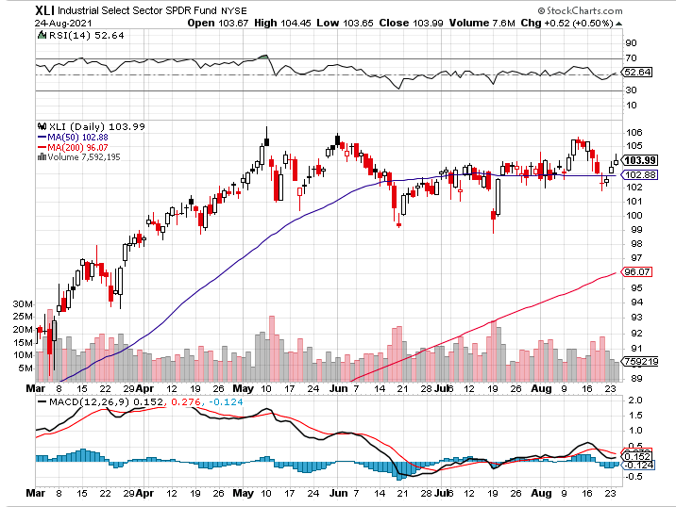
Industrials Sector SPDR (XLI)- (GE), (MMM), (UNP), (UTX), (BA), (HON)

Slide 46
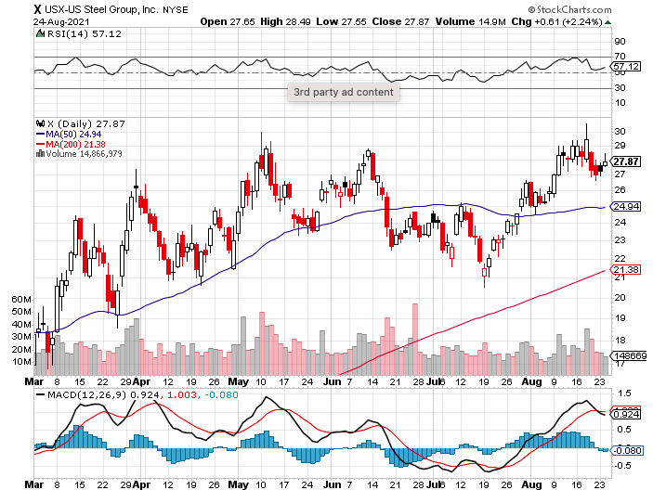
US Steel (X) – Commodity Drag

Slide 47
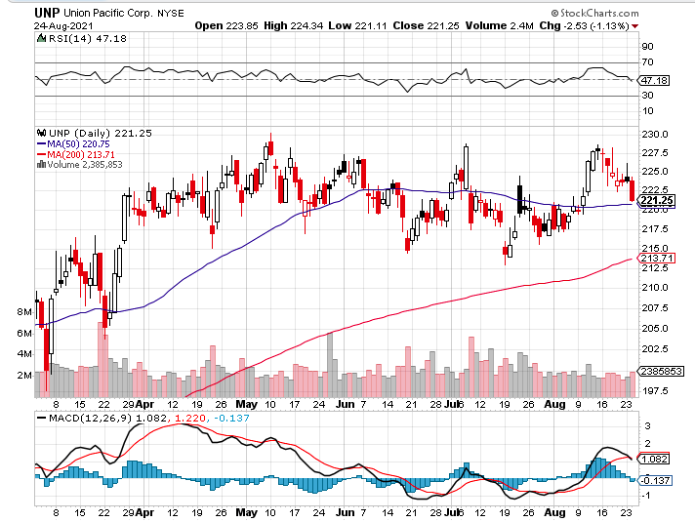
Union Pacific RR (UNP)- Big Stuff to Ship near record earnings announced long 5/$200-$210 call spread – 12 days to expiration took profits on 11/$150-$160 call spread

Slide 48
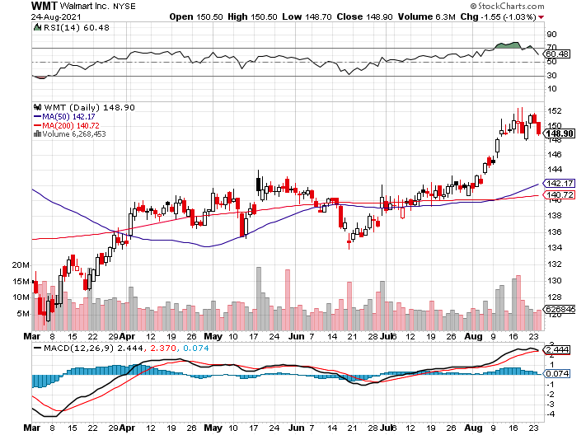
Wal-Mart (WMT)-New High took profit on Long 11/$125-$130 bear put spread took profit on Long 10/$119-$121 bear put spread took profits on Long 8/$114-$117 bear put spread

Slide 49
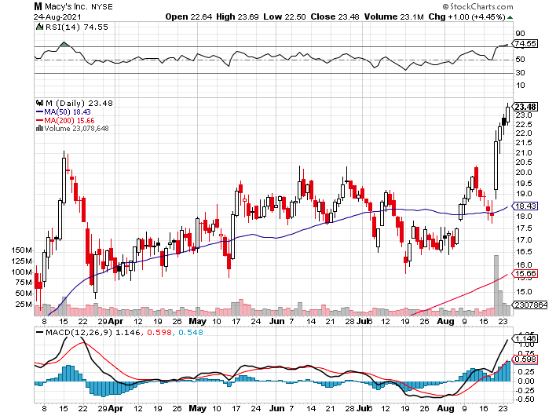
Macys’ (M) – Retail Return from the Grave took profits on Long 8/$23-$25 bear put spread

Slide 50
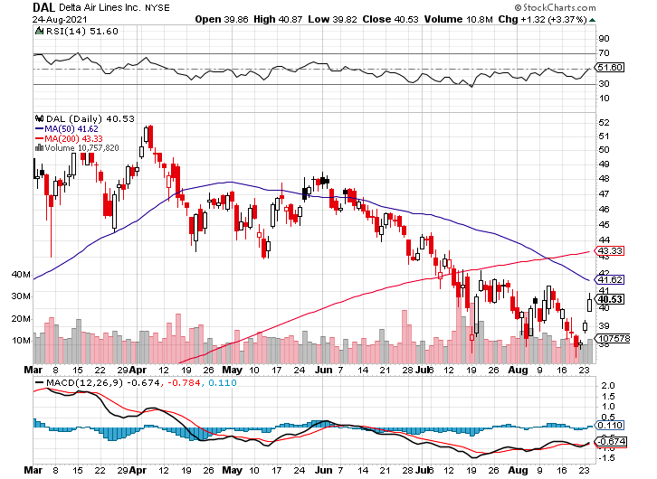
Delta Airlines (DAL) –

Slide 51
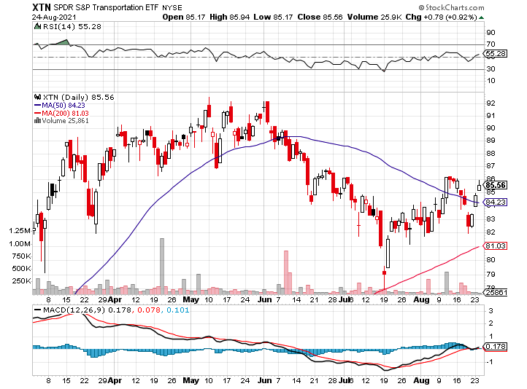
Transports Sector SPDR (XTN)- Worst Hit Sector (ALGT), (ALK), (JBLU), (LUV), (CHRW), (DAL)

Slide 52
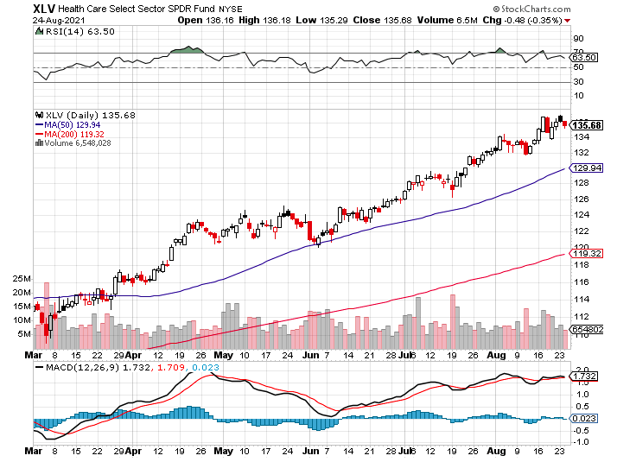
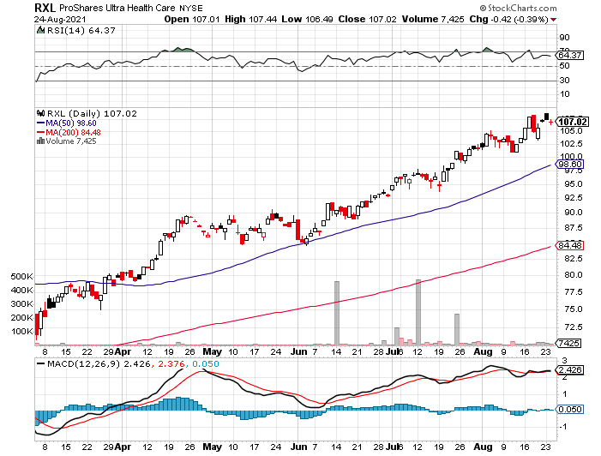
Health Care Sector (XLV), (RXL) (JNJ), (PFE), (MRK), (GILD), (ACT), (AMGN)

Slide 53
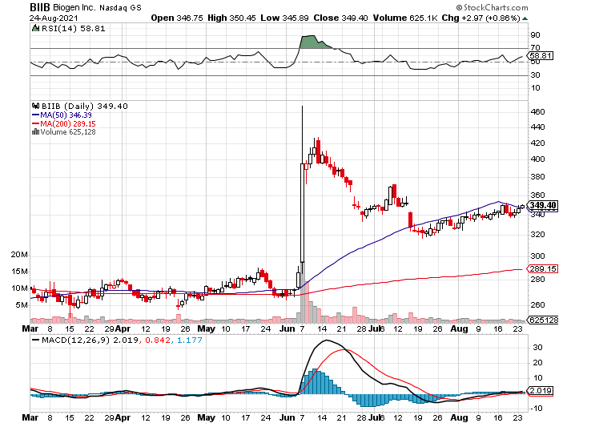
Biogen (BIIB) Why you do Biotech

Slide 54
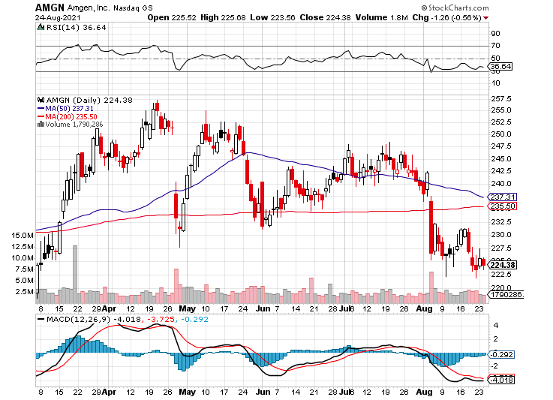
Amgen (AMGN) took profits on long 11/$185-$200 bull call spread

Slide 55
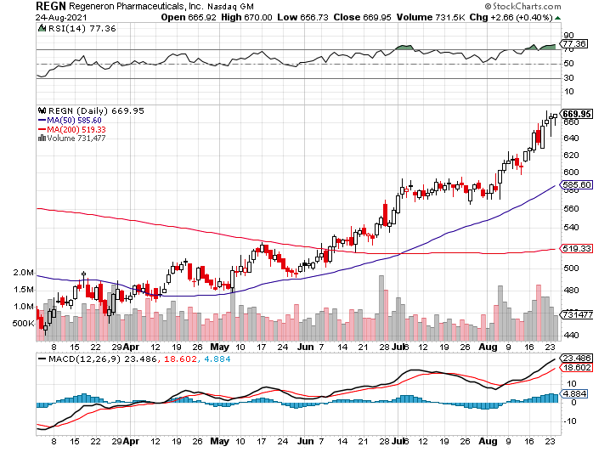
Regeneron (REGN) took profits on long 7/$570-$580 call spread

Slide 56
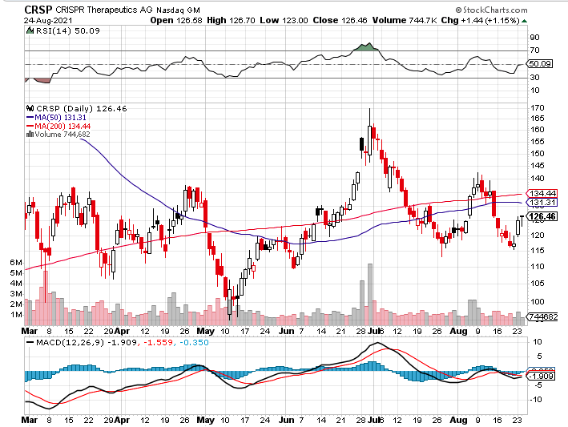
CRISPR Therapeutics (CRSP)

Slide 57
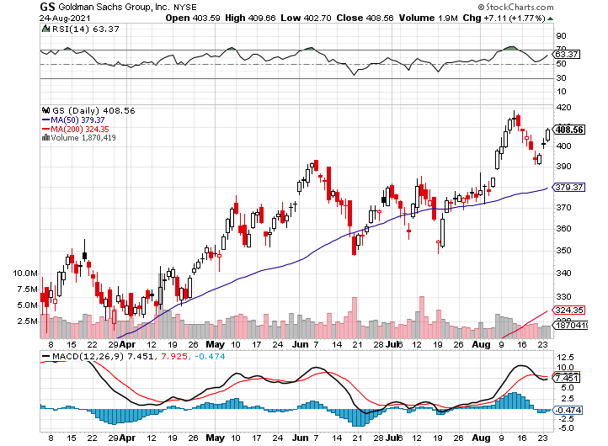
Goldman Sachs (GS) – took profits on long 8/$325-$335 call spread took profits on long 6/$310-$320 call spread took profits on long 5/$310-$320 call spread took profits on long 2/$240-$260 call spread

Slide 58
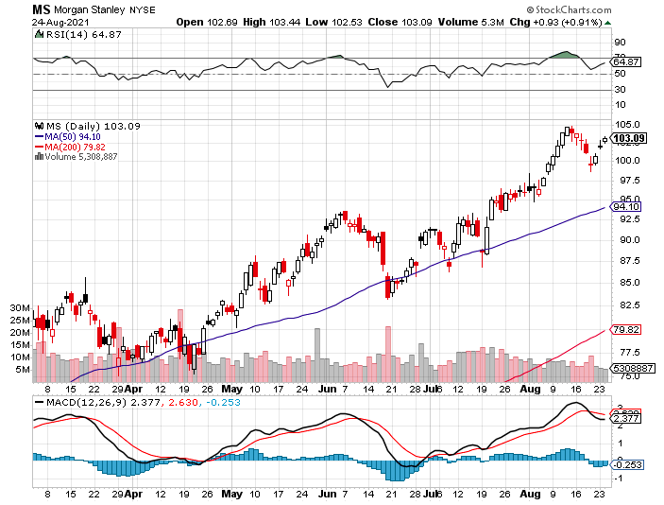
Morgan Stanley (MS) – Doubled Dividend took profits on long 2/$55-$60 call spread

Slide 59
JP Morgan Chase (JPM)-Back to Life took profits on long 8/$140-$145 call spread took profits on long 7/$140-$145 call spread took profits on long 5/$135-$140 call spread took profits on long 2/$135-$140 call spread took profits on long 2/$110-$115 call spread

Slide 60
Citigroup (C) – “Recovery” Rotation Play

Slide 61
Bank of America (BAC) – took profits on long 2/$28-$30 call spread

Slide 62
SPDR Metals & Mining ETF (XME) – long 2/$28-$30 call spread

Slide 63
Blackrock (BLK)-Asset Collection Boom took profits on long 3/$31-$34 call spread

Slide 64
Visa (V) – “Touchless” Fintech Play took profits on long 5/$220-$225 bull call spread took profits on long long 5/$195-$205 bull call spread took profits on long 9/$180-$185 bull call spread

Slide 65
Consumer Discretionary SPDR (XLY) (DIS), (AMZN), (HD), (CMCSA), (MCD), (SBUX)

Slide 66
Berkshire Hathaway (BRKB)- Natural Barbell cut back buy backs at $6 billion a year, announced spectacular earnings took profits on long 3/$230-$240 call spread

Slide 67
Europe Hedged Equity (HEDJ)-

Slide 68
Japan (DXJ)-

Slide 69
Emerging Markets (EEM) - Pro trade, Weak Dollar, Long Recovery Play

Slide 70
Bonds – Hanging on Jackson Hole
*All eyes are on Jackson Hole and any Fed tapering hints *Ballistic July Nonfarm Payroll report brings forward taper of $120 billion a month in Fed bond buying. One more hot month in September and they’ll do it *Nobody is taking a 1.30% yield against a 5.4% inflation rate delivering a negative 4.1% real yield because they think it’s a great deal *Add more downside LEAPS NOW, the January 2022 (TLT) $155-$150 vertical bear put spread delivers a 75% profit in six months *A 2.00% yield on the ten-year US Treasury bond here we come! This is the quality trade for the rest of 2021 *US Treasury bond fund (TLT) could plunge from $180 a year ago to $105 by 2023

Slide 71
Treasury ETF (TLT) – The Top is In long 9/$155-$157 put spread took profits on long 8/$157-$160 put spread, took profits on long 8/$156-$159 put spread, took profits on long 7/$152-$155 put spread stopped out of long 5/$143-$146 put spread, took profits long 5/$143-$146 put spread

Slide 72
Ten Year Treasury Yield ($TNX) – 1.25%

Slide 73
Junk Bonds (HYG) 3.47% Yield to Maturity

Slide 74
2X Short Treasuries (TBT)-Another run at highs

Slide 75
Emerging Market Debt (ELD) 4.27% Yield-

Slide 76
Municipal Bonds (MUB) – 0.93% Mix of AAA, AA, and A rated bonds

Slide 77
Foreign Currencies – Bitcoin Surge
*US Dollar hits four month high on impending delta rebound *Long-term fundamentals continue to worsen, a dollar short could be the new ten-year trade *Massive over issuance of debt by the US government to fund the covid recovery is another nail in the coffin in addition to an exploding trade deficit *Euro and yen break to new 2021 lows, British pound and Australian dollar lose steam *Stand aside for now, then buy Buy (FXA) and (FXE) on dips. *Bitcoin challenging $50,000, putting a double top at $66,000 in play

Slide 78
Japanese Yen (FXY), (YCS)

Slide 79
Euro ($XEU), (FXE), (EUO)-

Slide 80
British Pound (FXB)-

Slide 81
Australian Dollar (FXA)- The Global Recovery Play took profits on long 8/$67-$69 call spread

Slide 82
Emerging Market Currencies (CEW)

Slide 83
Chinese Yuan- (CYB)-

Slide 84
Bitcoin-Challenging $66,000 The Post Delta Rally Has Started-Up 50% in a month

Slide 85
Energy – Dead Cat Bounce
*Oil Dives on Delta Surge, off $15, or 20% in two months *Then a $3 dead cat bounce off the end of delta coming in sight *Delta is now rampaged throughout China, the world’s largest consumer of Texas tea *Buy the dip at your own risk, any longs are counter trend trades *The end of oil is upon us, but it may take 30 years to unwind existing infrastructure *All US car production will be electric by 2035 wiping out half of all US oil consumption, 20 million b/d down to 10 million b/d *Avoid all energy plays like the plague, it’s the new buggy whip industry as the US de-carbonizes

Slide 86
Oil-($WTIC)

Slide 87
United States Oil Fund (USO) long 10/$9.50-$10 Vertical bull call spread

Slide 88
Energy Select Sector SPDR (XLE)-No Performance! (XOM), (CVX), (SLB), (KMI), (EOG), (COP)

Slide 89
Halliburton (HAL)-

Slide 90
Natural Gas (UNG) -

Slide 91
Precious Metals – New Lows
*Gold has Entered “BUY” Territory, after being beaten like a rented mule for four months *Pick up some GDX LEAPS for maximum upside leverage *Long-term rising interest rates remain a threat to precious metals *Silver is still the bigger and better long-term play *Palantir Buys Gold Bars, to protect against “black swans,” picking up $50.1 million of 100 oz bars this month *Gold will eventually recover when US borrowing becomes so massive it undermines the value of the US dollar, even in the face of higher interest rates

Slide 92
Gold (GLD)- Meltdown

Slide 93
Market Vectors Gold Miners ETF- (GDX) –

Slide 94
Barrick Gold (GOLD) took profits on long 1/$21-$23 call spread took profits on long 11/$22-$24 call spread

Slide 95
Newmont Mining- (NEM)- took profits on long $55-60 call spread

Slide 96
Silver- (SLV)- took profits on long 11/$19-$20 call spread

Slide 97
Silver Miners - (SIL)-

Slide 98
Wheaton Precious Metals - (WPM)- took profits on long 2/$39-41 call spread

Slide 99
Copper (COPX)-Uptrend Resumes Copper Unions Vote to Strike in Chile, cutting off 33% of the global supply

Slide 100
Real Estate – Leveling Out
*Homebuilder Sentiment Dives, down 5 points to 75, as high prices cure high prices. Anything above 50 is still positive * Housing Starts Hit Three Month Low, down 7% in July to 1.53 million units. Materials and labor shortages are the issue. *Second largest mortgage lender, United Wholesale Mortgage, now accepting Bitcoin *Existing Home Sales Rise 2% in July for the second month in a row and,1.5% YOY. *Inventories are down 12%. *Prices are up 18% YOY * New Home Sales are Up 708,000, while inventories are back to a normal 6.5 months. *S&P Case Shiller Smashes all Records, up 17% YOY

Slide 101
S&P Case Shiller Up 16.6% for May Phoenix (25.9%), San Diego (24.7%), and Seattle (23.4%) lead

Slide 102
Crown Castle International (CCI) – 2.70% yielding cell phone tower REIT

Slide 103
US Home Construction Index (ITB) (DHI), (LEN), (PHM), (TOL), (NVR)

Slide 104
Trade Sheet- So What Do We Do About All This?
*Stocks – buy dips aggressively *Bonds – sell rallies aggressively *Commodities-buy dips aggressively *Currencies- sell US dollar rallies *Precious Metals – buy dips *Energy – stand aside *Volatility - sell short over $30 *Real estate – buy dips

Slide 105
Next Strategy Webinar 12:00 EST Wednesday, September 8, from Silicon Valley email me questions at support@madhedgefundtrader.com
Good Luck and Good Trading!
Notes:
*

