Slide 1
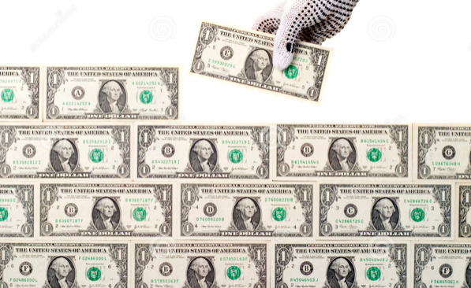
The Mad Hedge Fund Trader
“Wall of Money”
With John Thomas
from Incline Village, NV, August 11, 2021
www.madhedgefundtrader.com
Notes:
*

Slide 2


Slide 3

Trade Alert Performance
New All Time Highs!
32 consecutive profitable trade alerts-
93.5% success rate in 2021-ony 5 losers
*January 10.21% MTD *July +0.61% Final
*February +13.28% Final *August +4.03% Final
*March +20.60% Final *September 7.95% Final
*April +15.67% Final *October +1.51% Final
*May +8.13% Final *November +20.41% Final
*June +0.71% Final *December +10.20% Final
*2021 Year to Date +73.24%
compared to +14.90% for the Dow Average
*+495.79% since inception, a new all time high
*Average annualized return of 42.43% for 12 years, new all time high`

Slide 4
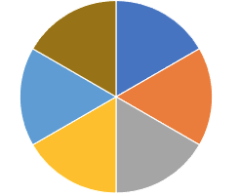
Portfolio Review
60% Cash in a Low Volatility Long Term Bull Market
Current Capital at Risk
Risk On
World is Getting Better
(TLT) 8/$157-$160 put psread | 10.00%
(TLT) 8/$156-$159 put psread | 10.00%
(JPM) 8/$300-$320 call spread | 10.00%
(V) 8/$220-$225 call spread | 10.00%
(GS) $355-$365 call spread | 10.00%
Risk Off
World is Getting Worse
(SPY) 8/$445-$450 put spread | -10.00%
Total Net Position | 40.00%
Expiration Value
77.12%

Slide 5
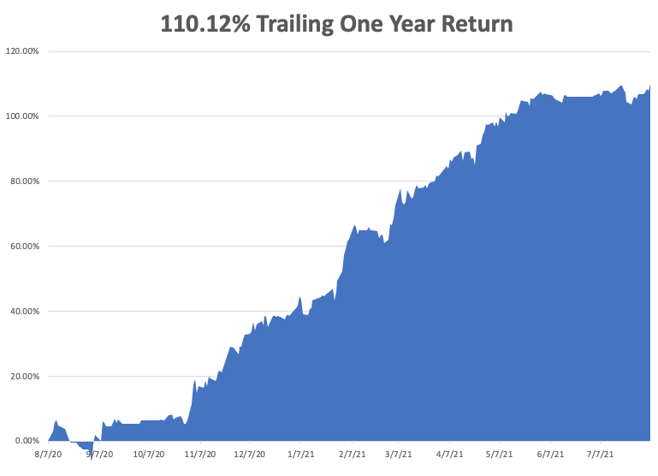

Slide 6
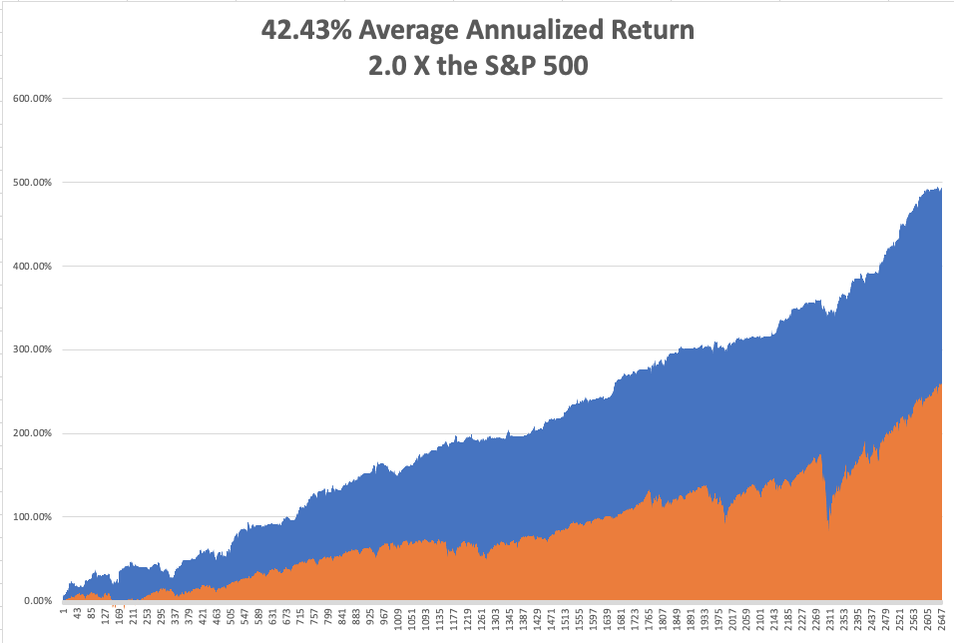
GTD 12 Year Daily Audited Performance

Slide 7

The Method to My Madness
The Roaring Twenties are Here
*The Delta recovery is imminent, could trigger the next bull market in everything
*Bond prices have peaked, and interest rates bottomed. Next to come is a multiyear bear market in bonds.
*Inflation plays are stalling, like banks, and commodities are recovering
*Keep your tech stocks, as outer year earnings are being wildly underestimated
*Medium term, both sides of the barbell are working
*The economic recovery is now regional, with China first,
now the US, and Europe last, but goes global in 2020
*Bitcoin wins the battle at $30,000, rockets 50%
*VIX still at $16, showing the summer market persists

Slide 8

Corona Update – End of the Pandemic
*60% of the US population is vaccinated and 10% have had the disease, bringing immunity up to 70%. Biden mandates military vaccinations, bring in another $5 million
*New cases are up 7X, from 15,000 a day to 120,000, with one third in Florida and Texas where mask mandates are banned, and Louisiana which is the most infected place in the world
*It appears that vaccinated people can spread the disease, even though they don’t get it
*Pfizer booster shots are out in September
*No deaths from delta variant report among those vaccinated.
*Pfizer vaccine will be available for 5-11 years olds in September
*US cases top 36 million, deaths topping 618,000 and deaths are
back up to 2,000 a day
*Florida surge is 40 days old, UK surge lasted 45 days

Slide 9
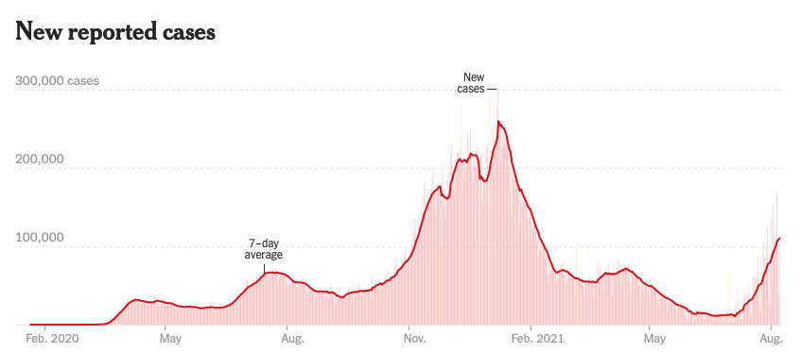
Bump on the Way to Zero
the Fourth Wave – The Self-Inflicted Injury
Next Peak

Slide 10
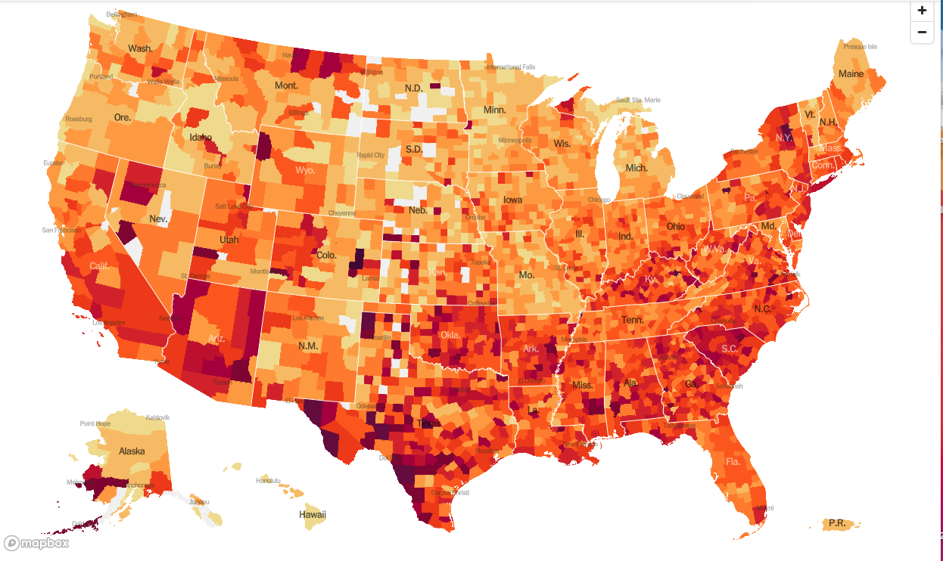
January 20 Infection Rate

Slide 11
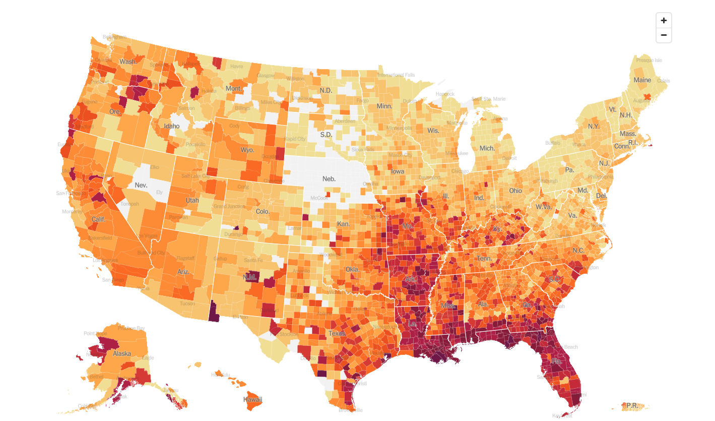
August 11 Infection Rate

Slide 12
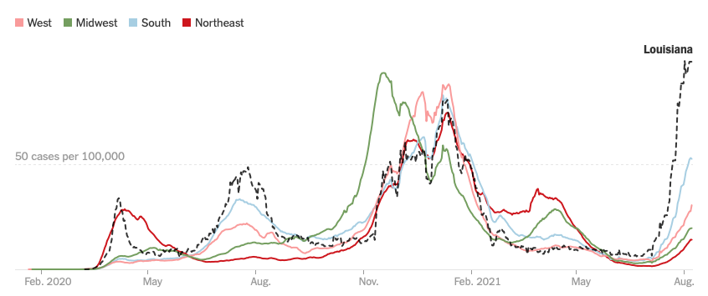

Slide 13
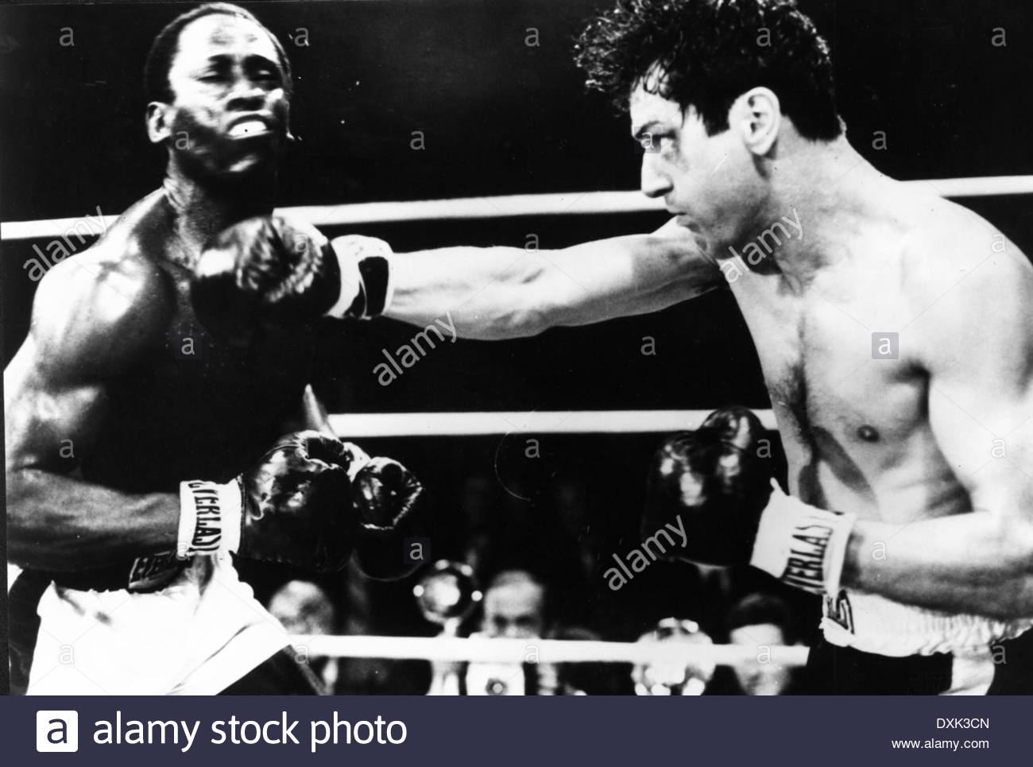
The Global Economy – Delta Hit
*July Nonfarm Payroll Report Explodes to 943,000, taking the Headline Unemployment Rate down an amazing half point to 5.4%. Leisure & Hospitality was up a staggering 380,000
*Weekly Jobless Claims Come in at 385,000, taking another run at post pandemic lows
*Infrastructure Deal to Be Signed, at $550 billion worth of road, bridge, water, and power projects
*July inflation rate still hot at 5.4%
*US Q2 GDP Comes in at 6.5%. Supply chain restraints were
the main explanation for the shortfall.
*All aspects of the economy are showing sigs of delta slowing
*Next to come: Synchronized Global Recovery in 2022
and another year of bull market

Slide 14
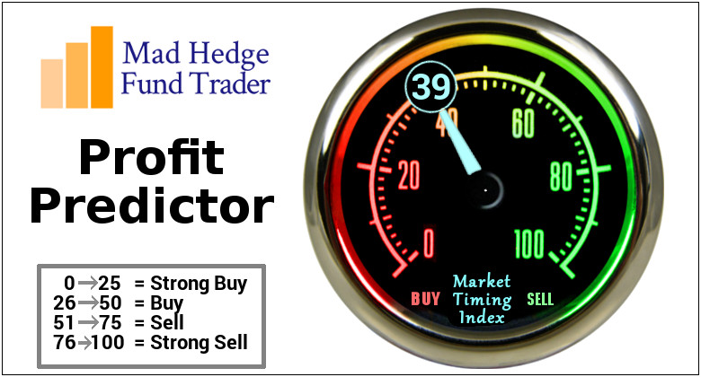
The Mad Hedge Profit Predictor
Market Timing Index – Stuck in Neutral
An artificial intelligence driven algorithm that analyzes 30 different economic, technical, and momentum driven indicators

Slide 15
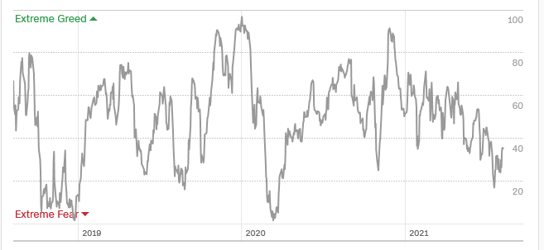
The Mad Hedge Profit Predictor
In a “BUY” Range
SELL
Do
Nothing
BUY

Slide 16
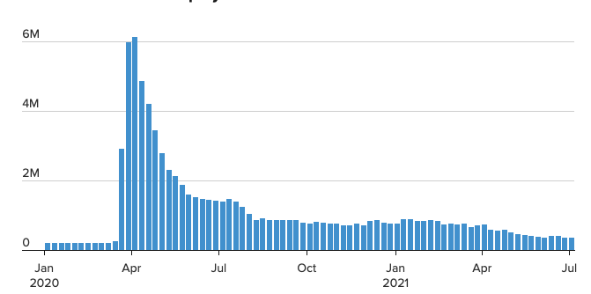
Weekly Jobless Claims – New Lows
385,000

Slide 17

Stocks – Next to Come: The Delta Rally
*Delta surge may have only days to run, and when it ends, all asset classes will surge with an “everything” rally. Bitcoin’s recent 50% rally is front running this move
*$17 trillion sitting in bank accounts and $4.5 trillion in money market funds waiting to go into equities and the balances are increasing at a rapid rate
*(SPY) Multiples hit 28X, but are like to get more expensive that cheaper
*Share Buy Backs are Turbocharging this Market, which could reach an eye-popping record $21 trillion in 2021
*FANGS are now leading the market and may continue
for the rest of the year, but may take a short term hit
on month end earnings announcements
*Biden to Target 50% EV Sales by 2030
in the US market, compared to 4% now
*Stick with the barbell strategy, we’ll keep rotating back
and forth all year between tech & domestic recovery

Slide 18
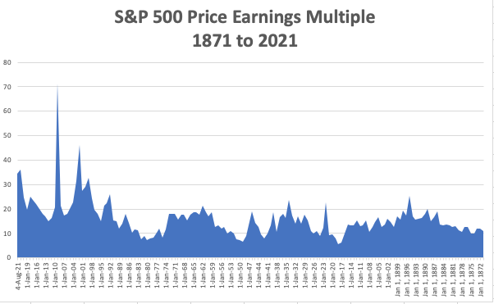
You are
here Now

Slide 19
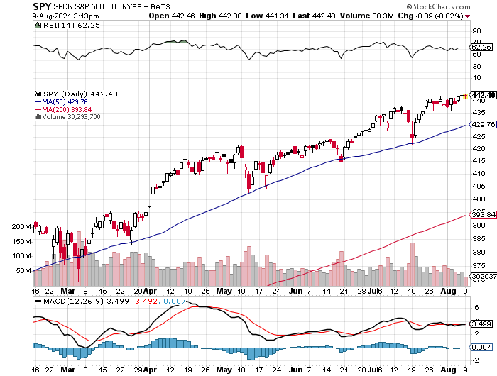
S&P 500 – New Highs and No Pullback took profits on long 6/$375-$385 bull call spread took profits on long 6/$430-440 bear put spread
New Highs
Yearend
Target
$475
The Bottom
420

Slide 20
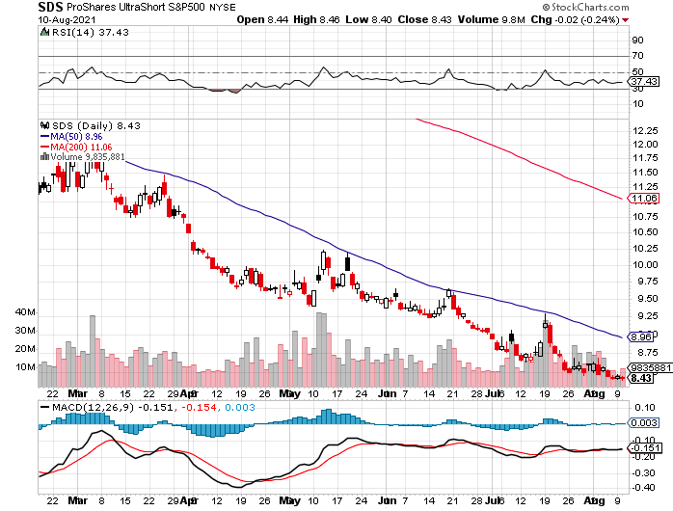
ProShares Ultra Short S&P 500 (SDS)-
A Great Hedge for Long Stocks and Bonds
Long 2X Position has a Hedge Against Longs and Bond Shorts

Slide 21
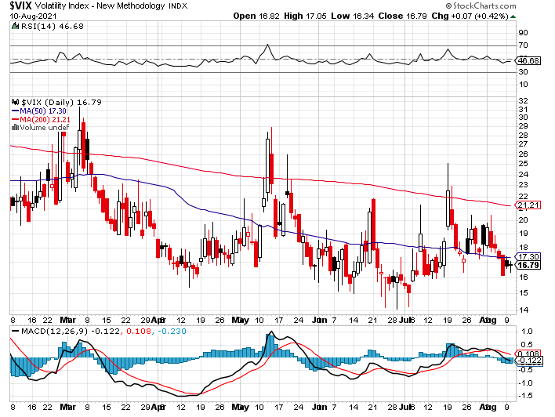
(VIX) – Dying a Slow Death
Classic Summer Market

Slide 22
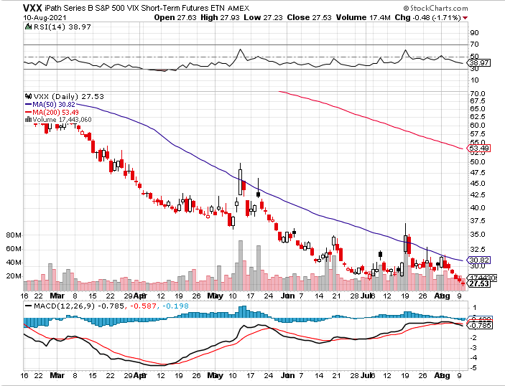
(VXX)-

Slide 23
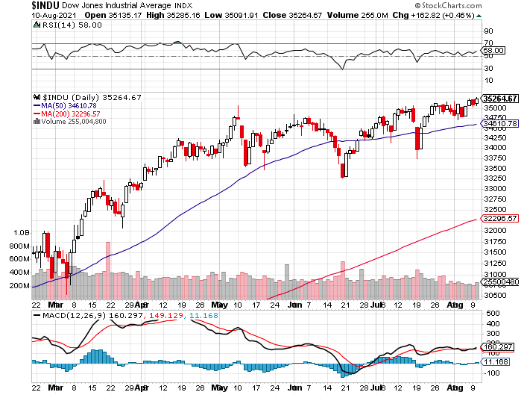
Dow Average ($INDU)-

Slide 24
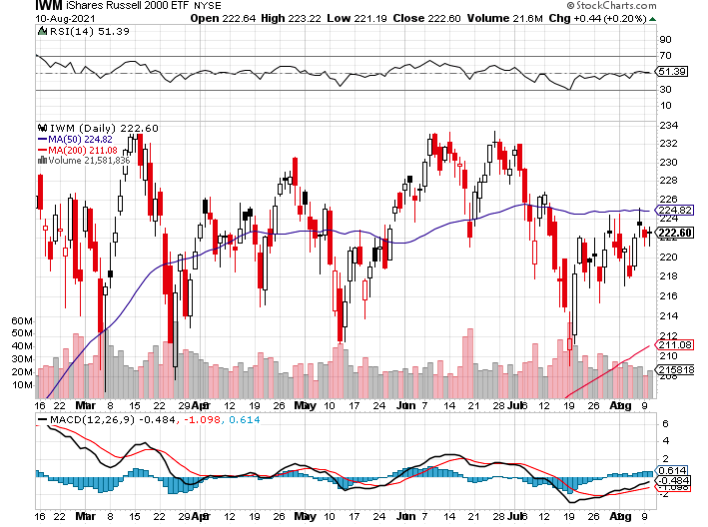
Russell 2000 (IWM)- took profits on Long 10/$137-$142 vertical bull call spread took profits on Long 10/$153-$156 vertical bear put spread

Slide 25
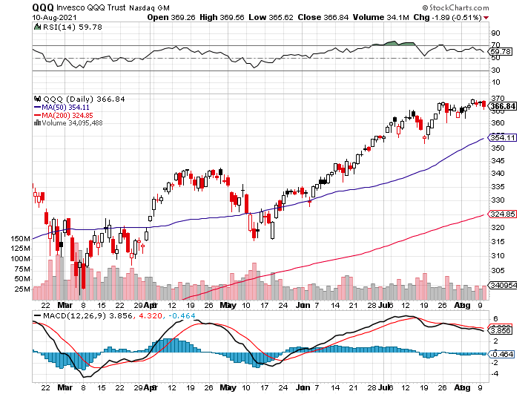
NASDAQ (QQQ) – long (QQQ) 4/$330-$335 put spread took profits on long (QQQ) 3/$340-$345 put spread covered long (QQQ) $325-$330 put spread

Slide 26
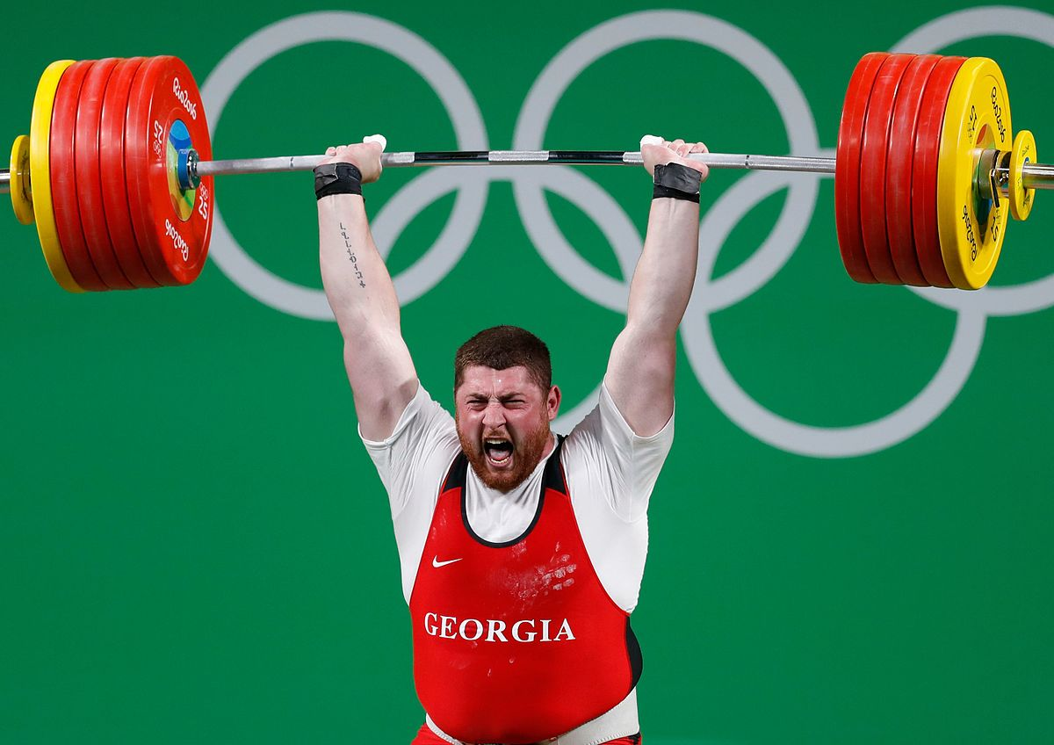
The Barbell Portfolio
*50% Big Tech - 2% of US Employment but 27% of Market Cap and 38% of Profits
50% Domestic Recovery, including:
Railroads
Couriers
Banks
Construction
Credit Cards
Event organizers
Ticket sales
Retailers

Slide 27
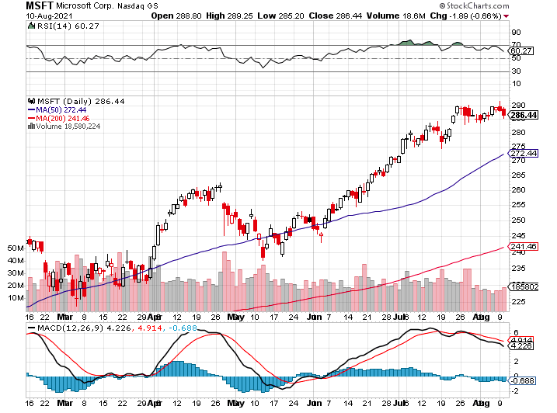
Microsoft (MSFT)- Pentagon Cancels Microsoft Jedi Cloud Deal took profits on long 12/$220-$230 call spread stop loss on long 12/$170-$180 call spread took profits on long 12/$135-$138 call spread

Slide 28
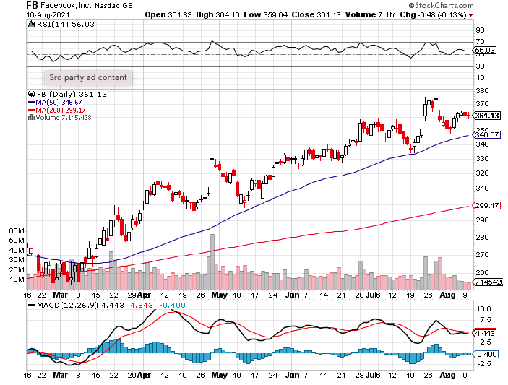
Facebook (FB)- Wins antitrust suit took profits on Long 9/$290-$300 vertical bear put spread stopped out of Long 9/$190-$200 vertical bear put spread took profits on Long 9/$145-$155 vertical bull call spread took profits on Long 9/$150-$160 vertical bull call spread

Slide 29
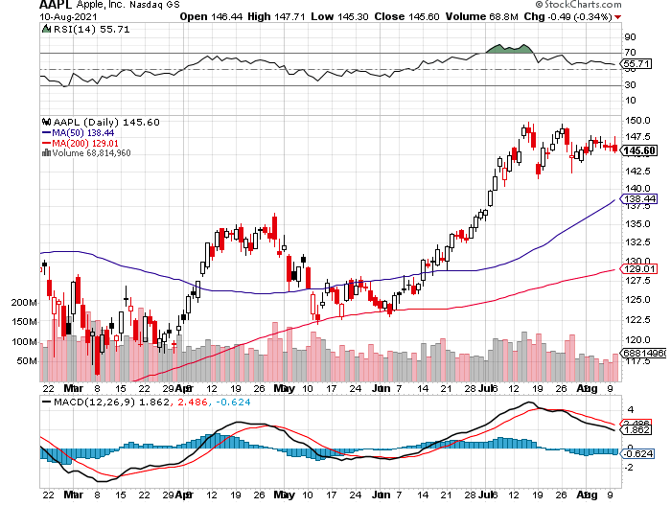
Apple (AAPL)- New 5G iPhone Surge-earnings after close
Apple car moving forward with KIA took profits on long 7/$320-$330 call spread took profits on long 4/24/$250-$260 call spread took profits on long 5/$250-$260 call spread

Slide 30
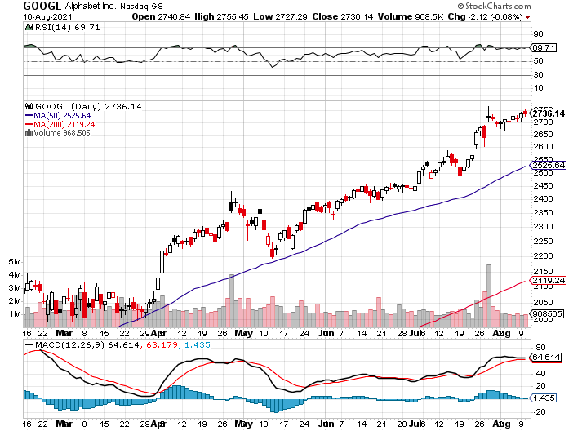
Alphabet (GOOGL) – Ad king on Economic Recovery
15% of search is travel related took profits on long 12/$1,200-$1,230 bull call spread took profits on long 9/$1,030-$1,080 vertical bull call spread

Slide 31
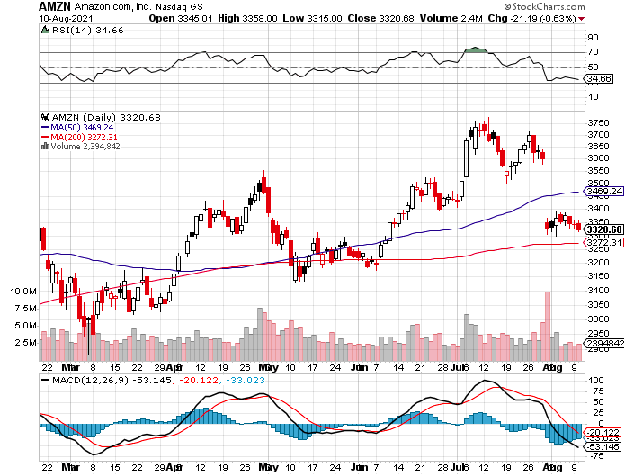
Amazon (AMZN) – New Highs took profits on long 9/$2,800-$2,900 bull call spread

Slide 32
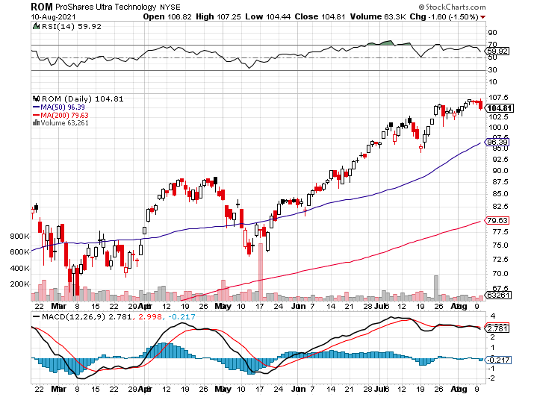
ProShares Ultra Technology (ROM) – New Highs

Slide 33
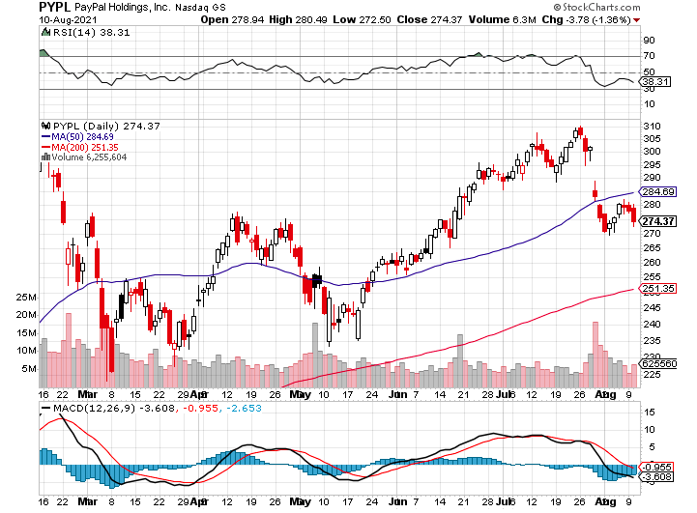
PayPal (PYPL)-Fintech Rules-New Highs took profits on long 4/$90-$95 call spread

Slide 34
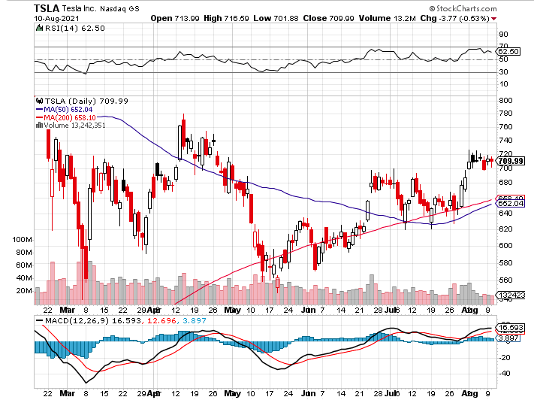
Tesla (TSLA)- took profits on long 2X 4/$450-$500 call spread, took profits on long 3/$400-$450 call spread took profits on long 2/$650-$700 call spread-expires, stopped out of long 3/$600-$650 call spread
Took profits on long 2/$600-$650 bull call spread, Took profits on long 2/$550-$600 bull call spread

Slide 35
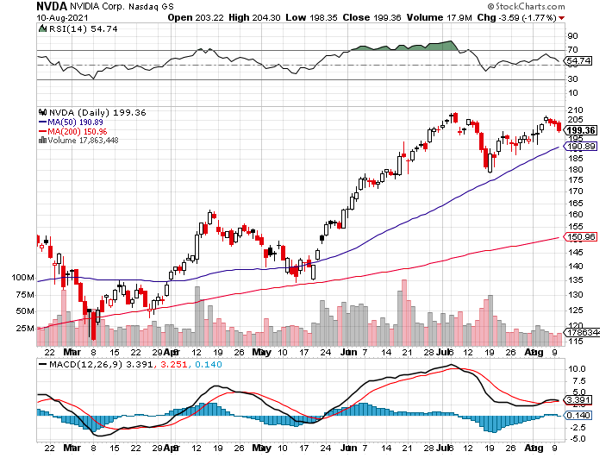
NVIDIA (NVDA) – New Highs
A Mad Hedge 10 Bagger – Global Semiconductor Shortage Slows Auto Industry,

Slide 36
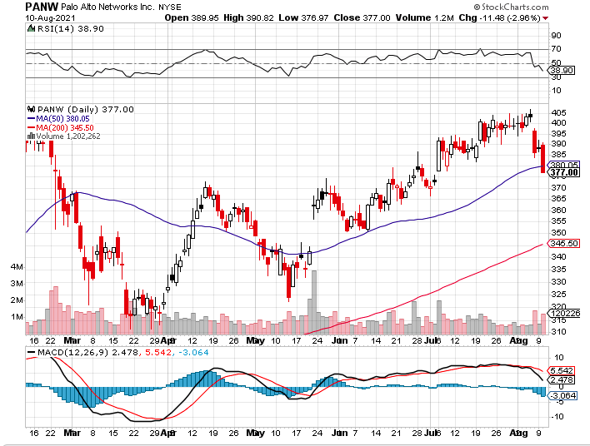
Palo Alto Networks (PANW)-
Hacking never goes out of fashion

Slide 37
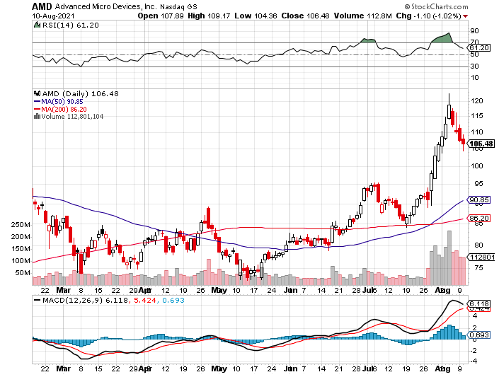
Advanced Micro Devices (AMD)- the next ten bagger - buys Xilinx – programable logic devices took profits on long 2/$75-$80 call spread

Slide 38
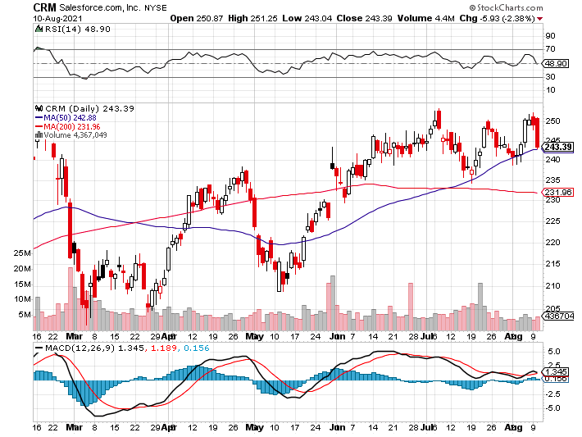
Salesforce (CRM)- Massive Online Migration took profits on long 9/$125-$130 vertical bull call spread took profits on long 8/$125-$130 vertical bull call spread took profits on long 2/$105-$115 call spread

Slide 39
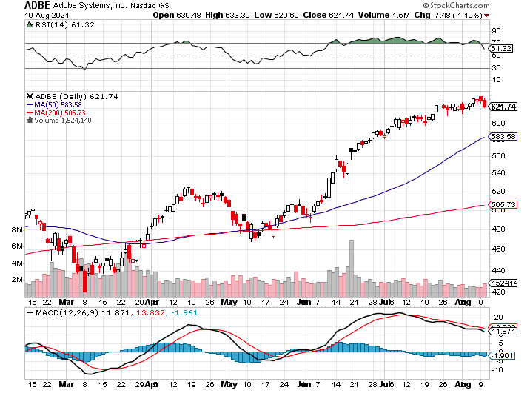
Adobe (ADBE)- Cloud play
The Quality Non-China Tech Play

Slide 40
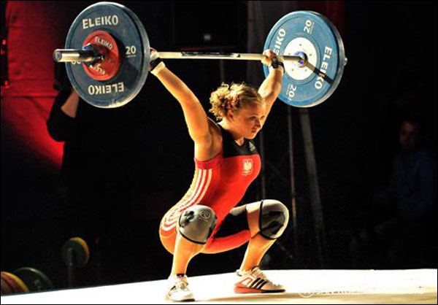
The Second Half of the Barbell
*Bets on a domestic recovery in 2021
*Upside potential in 2021 far greater than tech
*Some of these have not moved for 5 or 10 years
*Focuses on economically sensitive cyclical industries
*Makes a great counterweight to
high-growth technology
*We could spend all of next year rotating
between the two groups

Slide 41
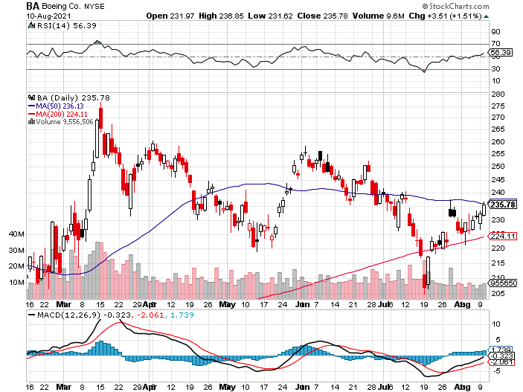
Boeing (BA) – former LEAP Candidate – Headaches again long 3/$146-$149 call spread took profits on long 2/$150-$160 call spread

Slide 42
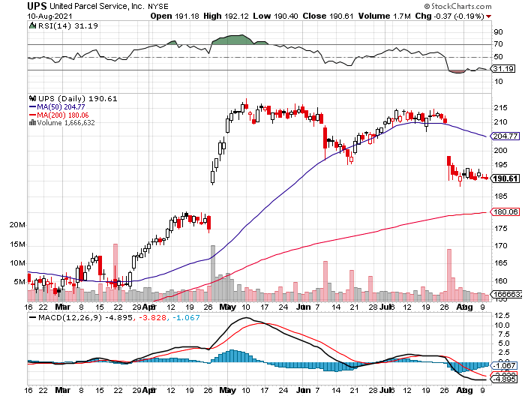
Package Delivery- United Parcel Service (UPS) - Package Delivery massive increase in overnight deliveries, announces blowout earnings, vaccine deliveries took profits on long 11/$130-$140 call spread

Slide 43
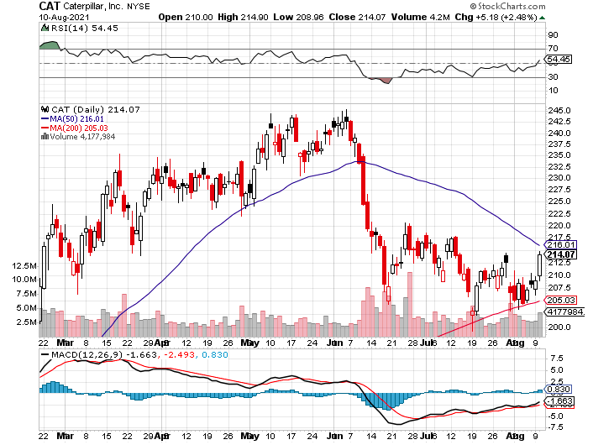
Caterpillar (CAT)- Ag + Infrastructure + Housing took profits on long 12/$145-$150 call spread took profits on long 11/$125-$135 call spread

Slide 44
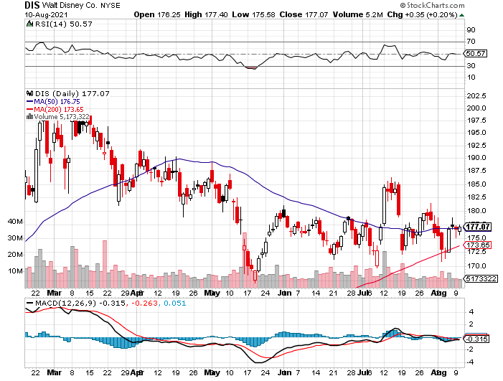
Walt Disney (DIS)- Big Recovery Move
Covid 4th Wave Delta Drag took profits on long 3/$170-$180 call spread

Slide 45
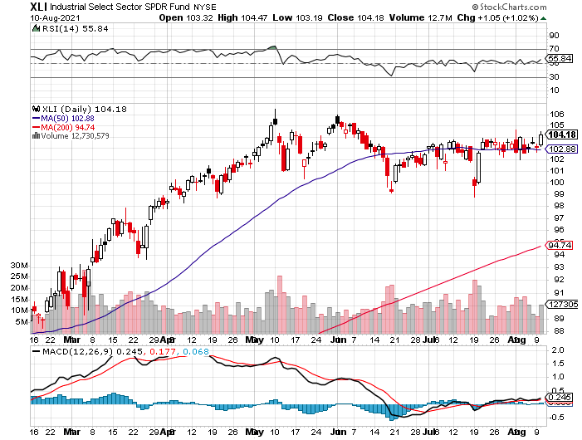
Industrials Sector SPDR (XLI)-
(GE), (MMM), (UNP), (UTX), (BA), (HON)

Slide 46
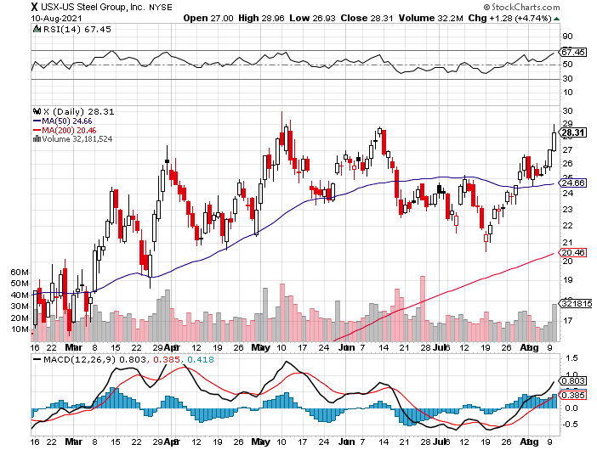
US Steel (X) – Commodity Drag

Slide 47
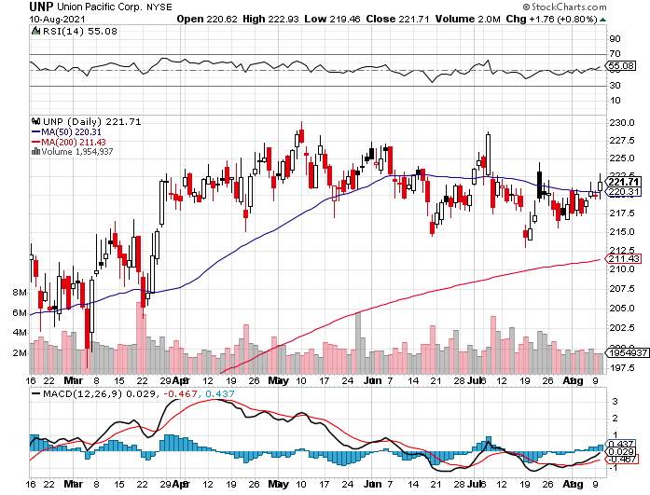
Union Pacific RR (UNP)- Big Stuff to Ship near record earnings announced long 5/$200-$210 call spread – 12 days to expiration took profits on 11/$150-$160 call spread

Slide 48
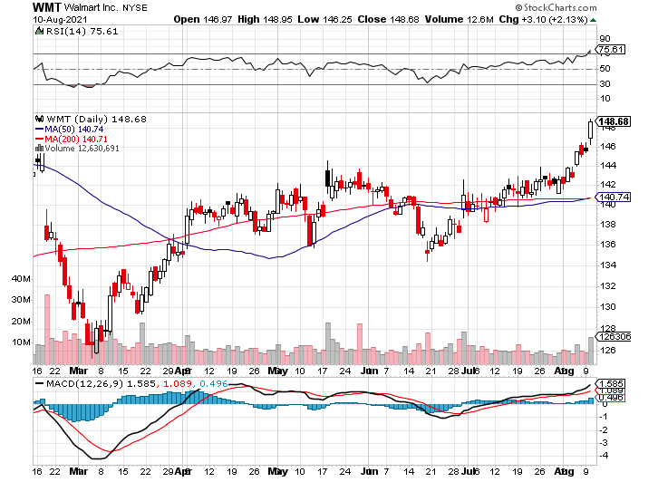
Wal-Mart (WMT)-New High took profit on Long 11/$125-$130 bear put spread took profit on Long 10/$119-$121 bear put spread took profits on Long 8/$114-$117 bear put spread

Slide 49
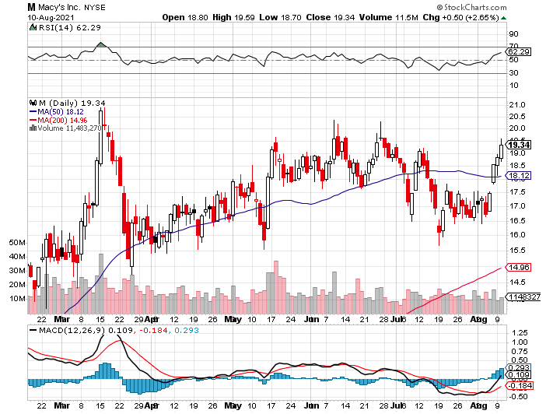
Macys’ (M) – Retail Return from the Grave took profits on Long 8/$23-$25 bear put spread

Slide 50
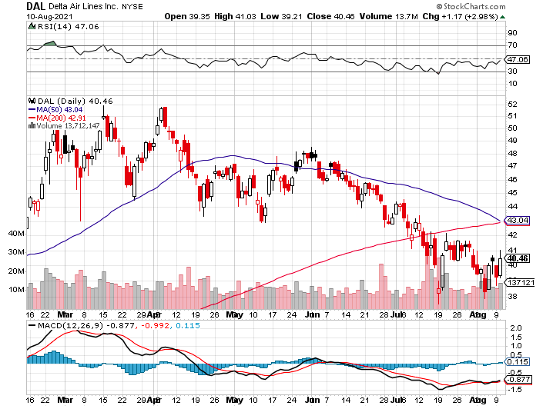
Delta Airlines (DAL) –

Slide 51
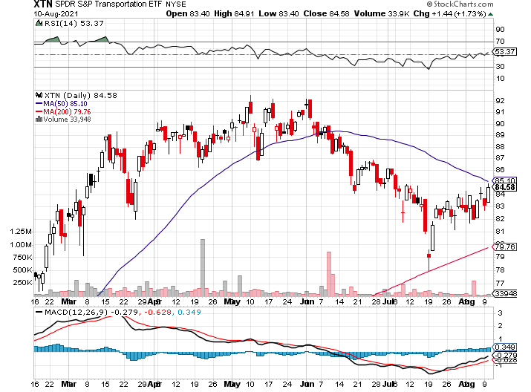
Transports Sector SPDR (XTN)- Worst Hit Sector
(ALGT), (ALK), (JBLU), (LUV), (CHRW), (DAL)

Slide 52
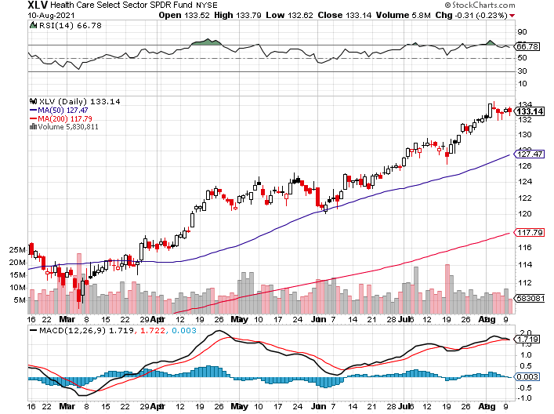
Health Care Sector (XLV)
(JNJ), (PFE), (MRK), (GILD), (ACT), (AMGN)

Slide 53
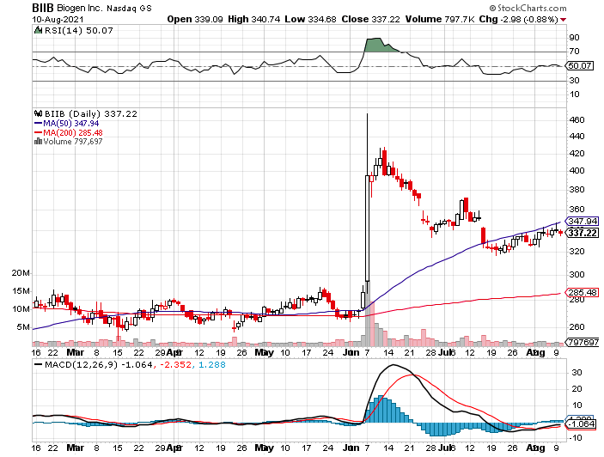
Biogen (BIIB)
Why you do Biotech

Slide 54
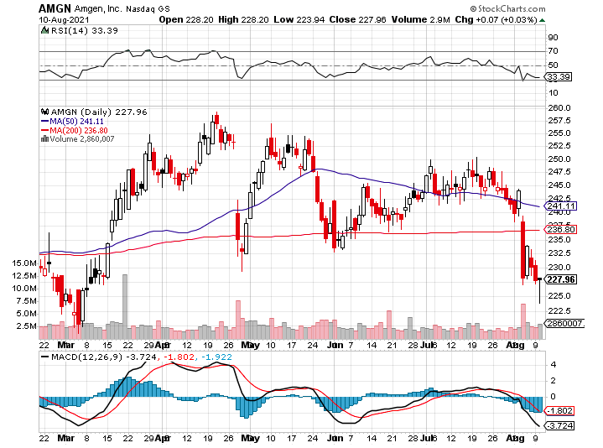
Amgen (AMGN) took profits on long 11/$185-$200 bull call spread

Slide 55
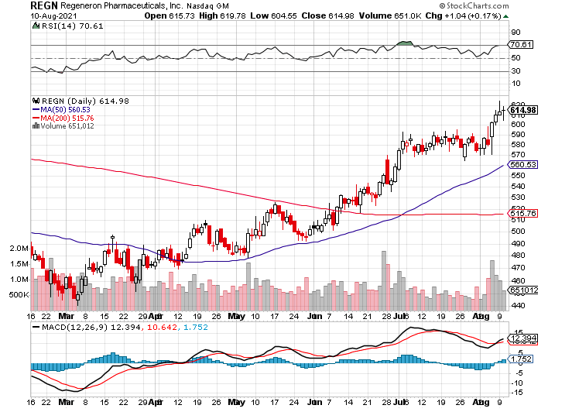
Regeneron (REGN) took profits on long 7/$570-$580 call spread

Slide 56

CRISPR Therapeutics (CRSP)
Off to the Races on Moderna Move

Slide 57

Goldman Sachs (GS) – Melt Up took profits on long 6/$310-$320 call spread took profits on long 5/$310-$320 call spread took profits on long 2/$240-$260 call spread

Slide 58

Morgan Stanley (MS) – Doubled Dividend took profits on long 2/$55-$60 call spread

Slide 59

JP Morgan Chase (JPM)-Back to Life long 8/$140-$145 call spread took profits on long 7/$140-$145 call spread took profits on long 5/$135-$140 call spread took profits on long 2/$135-$140 call spread took profits on long 2/$110-$115 call spread

Slide 60

Citigroup (C) – “Recovery” Rotation Play

Slide 61

Bank of America (BAC) – took profits on long 2/$28-$30 call spread

Slide 62

SPDR Metals & Mining ETF (XME) – long 2/$28-$30 call spread

Slide 63

Blackrock (BLK)-Asset Collection Boom took profits on long 3/$31-$34 call spread

Slide 64

Visa (V) – “Touchless” Fintech Play took profits on long long 5/$195-$205 bull call spread took profits on long 9/$180-$185 bull call spread

Slide 65

Consumer Discretionary SPDR (XLY)
(DIS), (AMZN), (HD), (CMCSA), (MCD), (SBUX)

Slide 66

Berkshire Hathaway (BRKB)- Natural Barbell maintaining share buy backs at $25 billion a year, announced spectacular earnings took profits on long 3/$230-$240 call spread

Slide 67

Europe Hedged Equity (HEDJ)-

Slide 68

Japan (DXJ)-

Slide 69

Emerging Markets (EEM) - Pro trade, Weak Dollar, Long Recovery Play

Slide 70

Bonds – Tapper Talk is Back!
*Ballistic July Nonfarm Payroll report brings forward tapper of $120 billion a month in Fed bond buying. One more hot month in August and they’ll do it
*Fed’s Rosengren says Fed stimulus not creating jobs, just inflation
*Nobody is taking a 1.30% yield against a 5.4% inflation rate delivering a negative 4.1% real yield because they think it’s a great deal
*Add more downside LEAPS NOW, the January 2022
(TLT) $145-$150 vertical bear put spread delivers a
75% profit in six months
*A 2.00% yield on the ten-year US Treasury bond here
we come! This is the quality trade for the rest of 2021
*Only non-economic buyers in the market, like central banks,
commercial banks, foreign investors, and life insurance companies
*US Treasury bond fund (TLT) could plunge from
$180 a year ago to $105 by 2023

Slide 71

Treasury ETF (TLT) – The Top is In long 8/$157-$160 put spread, long 8/$156-$159 put spread, took profits on long 7/$152-$155 put spread stopped out of long 5/$143-$146 put spread, took profits long 5/$143-$146 put spread,

Slide 72

Ten Year Treasury Yield ($TNX) – 1.35%

Slide 73

Junk Bonds (HYG) 3.47% Yield to Maturity

Slide 74

2X Short Treasuries (TBT)-Another run at Highs

Slide 75

Emerging Market Debt (ELD) 4.27% Yield-

Slide 76

Municipal Bonds (MUB) – 0.93%
Mix of AAA, AA, and A rated bonds

Slide 77

Foreign Currencies – Dollar Pop
*Hot July Nonfarm Payroll report sends dollar soaring, is responding favorably to a stronger economy and higher interest rates
*Long-term fundamentals continue to worsen, a dollar short could be the new ten-year trade
*Massive over issuance of debt by the US government to fund the covid recovery is another nail in the coffin in addition to a n exploding trade deficit
*Euro and yen break to new 2021 lows, British pound and Australian dollar lose steam
*Stand aside for now, then buy Buy (FXA) and (FXE) on dips.
*Ready for Your Bitcoin Form 1099?

Slide 78

Japanese Yen (FXY), (YCS)

Slide 79

Euro ($XEU), (FXE), (EUO)-

Slide 80

British Pound (FXB)-

Slide 81

Australian Dollar (FXA)- The Global Recovery Play took profits on long 8/$67-$69 call spread

Slide 82

Emerging Market Currencies (CEW)

Slide 83

Chinese Yuan- (CYB)-

Slide 84

Bitcoin- Head and Shoulders Top
The Post Delta Rally Has Started-Up 50% in a month

Slide 85

Energy – The Delta Dive
*Oil Dives on Delta Surge, off $9, or 12% in a week, the lowest in three weeks
*Delta is now rampaging throughout China, the world’s largest consumer of Texas tea, putting $63 in play
*The end of oil is upon us, but it may take 30 years to unwind
existing infrastructure
*All US car production will be electric by 2035
wiping out half of all US oil consumption
*Avoid all energy plays like the plague, it’s the new
buggy whip industry as the US de-carbonizes

Slide 86

Oil-($WTIC)

Slide 87

United States Oil Fund (USO) long 10/$9.50-$10 Vertical bull call spread

Slide 88

Energy Select Sector SPDR (XLE)-No Performance!
(XOM), (CVX), (SLB), (KMI), (EOG), (COP)

Slide 89

Halliburton (HAL)-

Slide 90

Natural Gas (UNG) -

Slide 91

Precious Metals – New Lows
*Gold Hits Four Month Low, breaking key support. Bitcoin is clearly stealing its thunder, which as risen by 50% in two weeks.
*Long-term rising interest rates remain a
threat to precious metals
*Silver is still the bigger and better long-term play
*Every EV needs 2 ounces of silver, and production
will soar from 700,000 units in 2020 to 25 million
by 2030
*Gold will eventually recover when US borrowing
becomes so massive it undermines the value of the
US dollar, even in the face of higher interest rates

Slide 92

Gold (GLD)- Meltdown

Slide 93

Market Vectors Gold Miners ETF- (GDX) –

Slide 94

Barrick Gold (GOLD) took profits on long 1/$21-$23 call spread took profits on long 11/$22-$24 call spread

Slide 95

Newmont Mining- (NEM)- took profits on long $55-60 call spread

Slide 96

Silver- (SLV)- took profits on long 11/$19-$20 call spread

Slide 97

Silver Miners - (SIL)-

Slide 98

Wheaton Precious Metals - (WPM)- took profits on long 2/$39-41 call spread

Slide 99

Copper (COPX)-Uptrend Resumes
Copper Unions Vote to Strike in Chile, cutting off 33% of the global supply

Slide 100

Real Estate – Topping Out?
*Pending Home Sales Drop 1.9% in June on a signed contract bases.
*High prices are curing high prices
*The south and west posted the biggest declines
*Single family homes have dropped for three months in a row to a one year low
*New Homes Sales Plunge to 676,000, down 6.6%
*Existing Home Sales are up 1.4% in June, to 5.86 million units
*Inventories are down 18.8% YOY to 1.25 million
units to a 2.6-month supply.
*S&P Case Shiller Smashes all Records, up 17% YOY

Slide 101

S&P Case Shiller
Up 16.6% for May
Phoenix (25.9%), San Diego (24.7%), and Seattle (23.4%) lead

Slide 102

Crown Castle International (CCI) – 2.70% yielding cell phone tower REIT

Slide 103

US Home Construction Index (ITB)
(DHI), (LEN), (PHM), (TOL), (NVR)

Slide 104

Trade Sheet-
So What Do We Do About All This?
*Stocks – buy dips aggressively
*Bonds – sell rallies aggressively
*Commodities-buy dips aggressively
*Currencies- sell US dollar rallies
*Precious Metals – buy dips
*Energy – stand aside
*Volatility - sell short over $30
*Real estate – buy dips

Slide 105

Next Strategy Webinar
12:00 EST Wednesday, August 25, from Lake Tahoe email me questions at support@madhedgefundtrader.com
Good Luck and Good Trading!
Notes:
*

