Slide 1
The Mad Hedge Fund Trader “The Endless Bid”
With John Thomas Reno, NV, September 9, 2021 www.madhedgefundtrader.com
Notes:
*

Slide 2
Mad Hedge Trader & Investors Summit September 14-16 – Register at https://www.madhedge.com
*A collection of the 27 best traders and managers in the world, or 8 a day *Back-to-back One-hour presentations followed by an interactive Q&A *It’s a smorgasbord of trading strategies, pick the one that is right for you *Covering all stocks, bonds, commodities, foreign exchange, precious metals, and real estate *It’s the best look at the rest of 2021’s money making opportunities you can get anywhere *An invitation will be sent to you shortly and it is FREE to attend

Slide 3
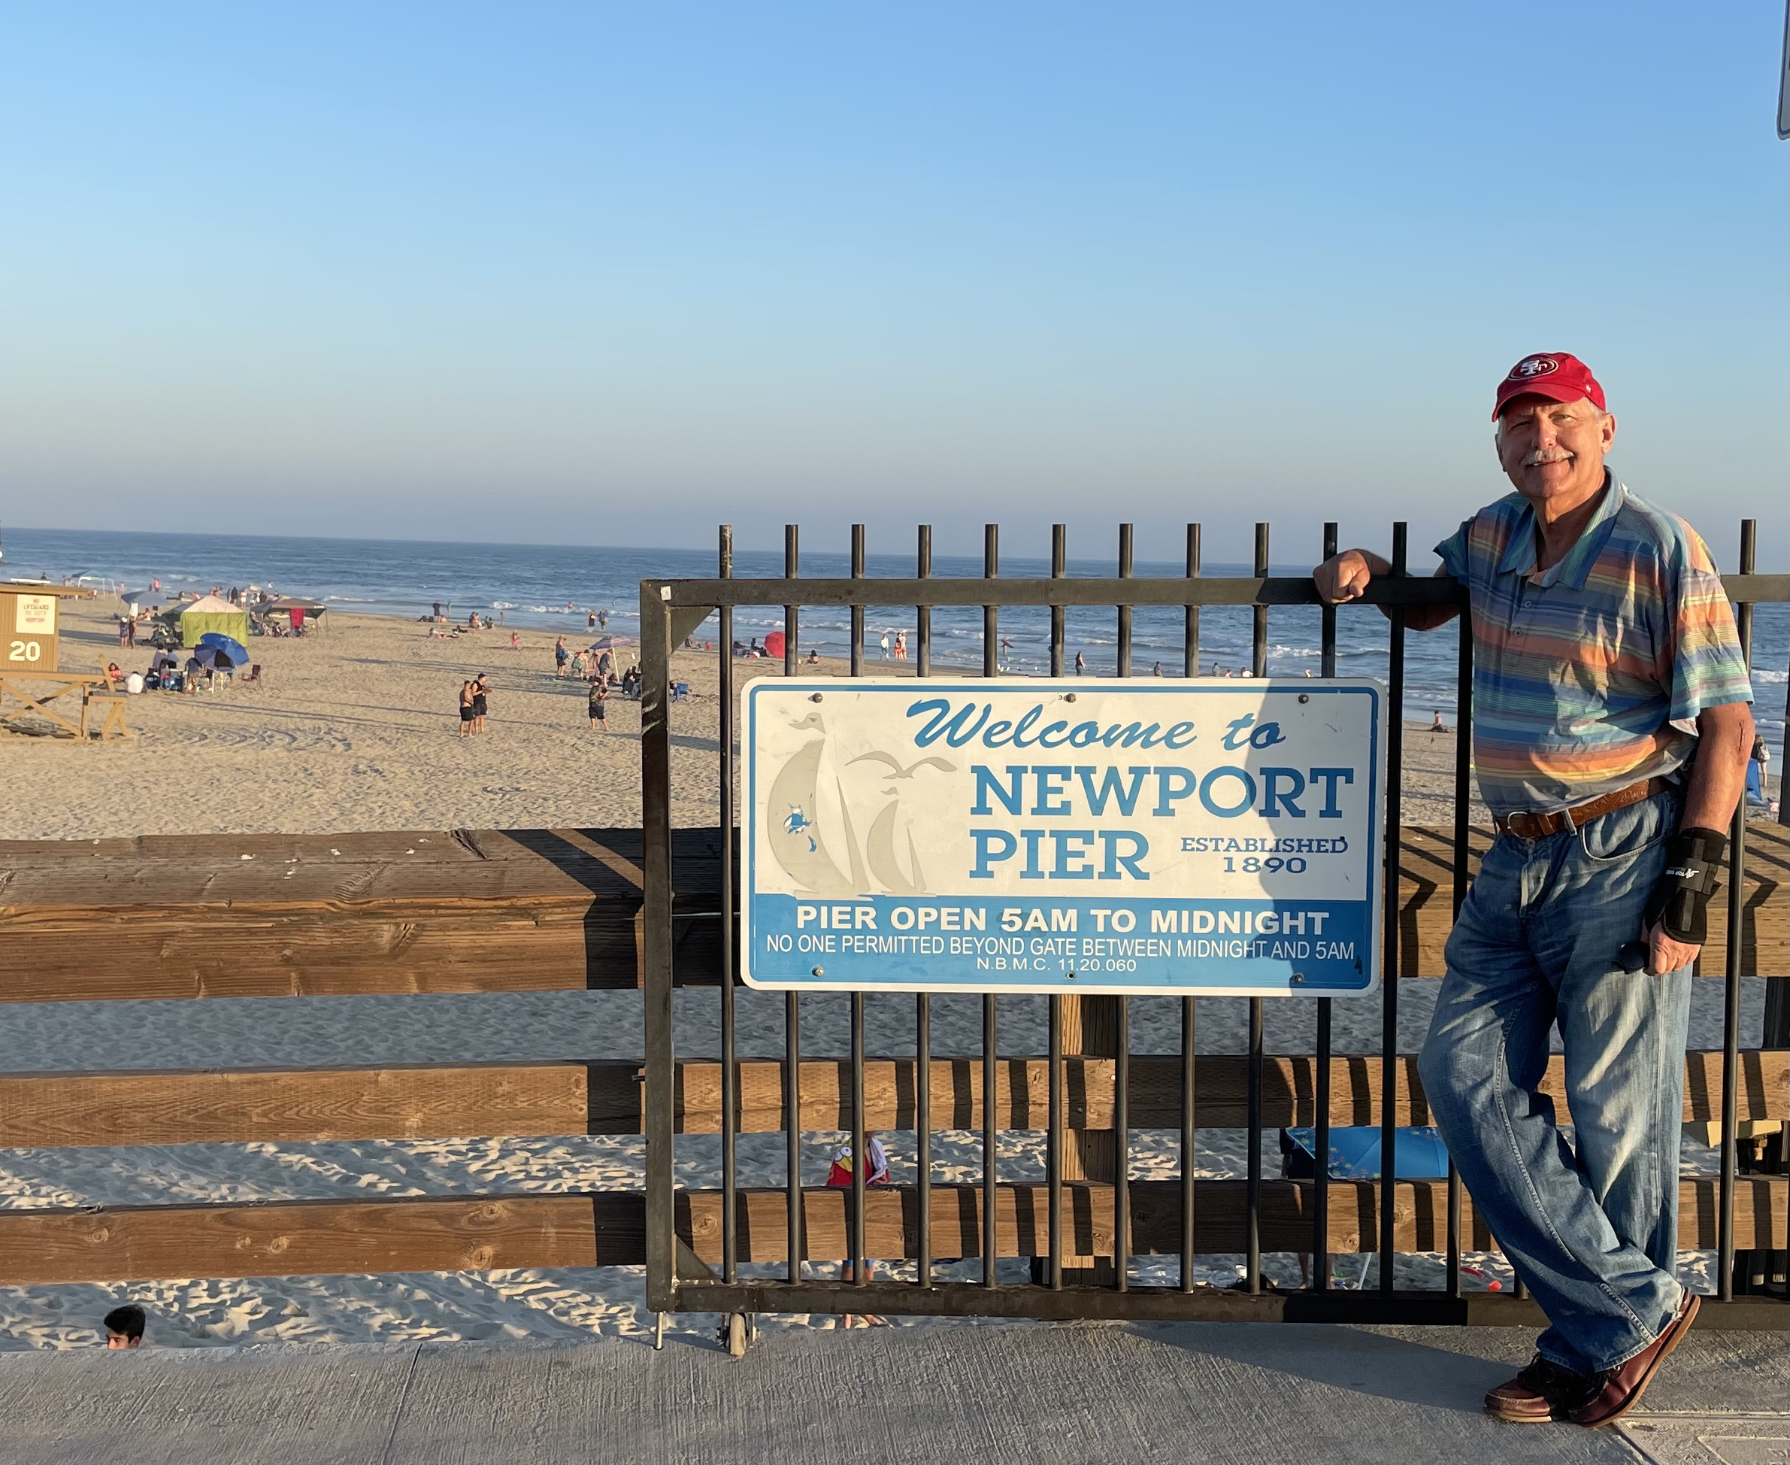

Slide 4
Trade Alert Performance New All Time Highs! 32 consecutive profitable trade alerts- 93.5% success rate in 2021-ony 5 losers
*January 10.21% MTD *July +0.61% Final *February +13.28% Final *August +9.36% Final *March +20.60% Final *September .01% MTD *April +15.67% Final *October +1.51% Final *May +8.13% Final *November +20.41% Final *June +0.71% Final *December +10.20% Final *2021 Year to Date +77.32% compared to +12.50% for the Dow Average *+499.87% since inception, a new all time high *Average annualized return of 42.48% for 12 years, new all time high`

Slide 5
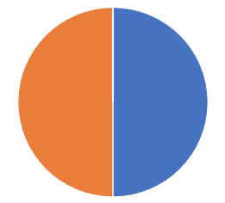
Portfolio Review 80% Cash in a low volatility Long Term Bull Market
Current Capital at Risk
Risk On
World is Getting Better
(TLT) 9/$155-$158 put spread | 10.00%
(SPY) 9/$410-$420 call spread | 10.00%
Risk Off
World is Getting Worse
No positions | 0.00%
Total Net Position | 20.00%
Total Aggregate Position | 20.00%
Expiration Value 77.44%

Slide 6
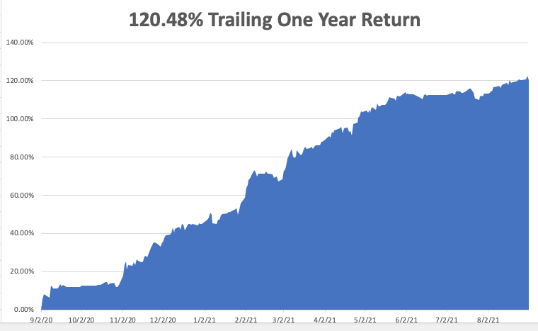

Slide 7
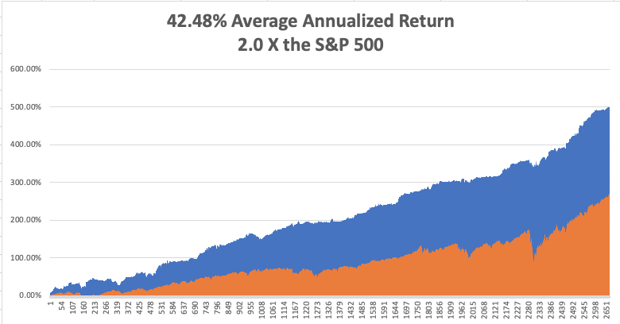
GTD 12 Year Daily Audited Performance

Slide 8
The Method to My Madness The Roaring Twenties are Here
*Markets see the delta variant peaking now, and the the next bull market in everything has begun *Bond prices have peaked, and interest rates bottomed. Next to come is a multiyear bear market in bonds. *Keep your tech stocks, as outer year earnings are being wildly underestimated. Investors are responding to high stock prices through buying more tech *Medium term, both sides of the barbell are working *End of unemployment benefits will make more workers available and accelerating growth *Bitcoin interest is growing exponentially, is sucking cash out of all other asset classes *VIX still at $15, showing the summer market persists, but could go lower in an “everything” rally

Slide 9
Corona Update – End of the Pandemic
*Pfizer Shots get full FDA approval for3rd booster shot imminent, as are shots for kids under 12 *80% of the US population has covid antibodies, and 90% in San Francisco *New cases are up 10X, from 15,000 a day to 150,000, with most of the south seeing new all-time highs *It appears that vaccinated people can spread the disease, even though they don’t get it by carrying it in their nose. Betadine you nose to stop the spread *No deaths from delta variant report among those vaccinated *One in five new infections now in kids *14 states now have law suites attempting to ban mask mandates *US cases top 40 million, deaths topping 650,000 and deaths are back up to 1,000 a day

Slide 10
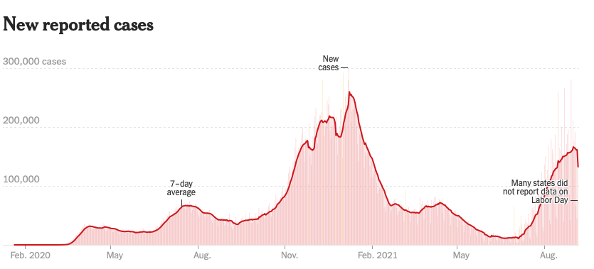
Bump on the Way to Zero the Fourth Wave – The Self-Inflicted Injury
Next Peak

Slide 11
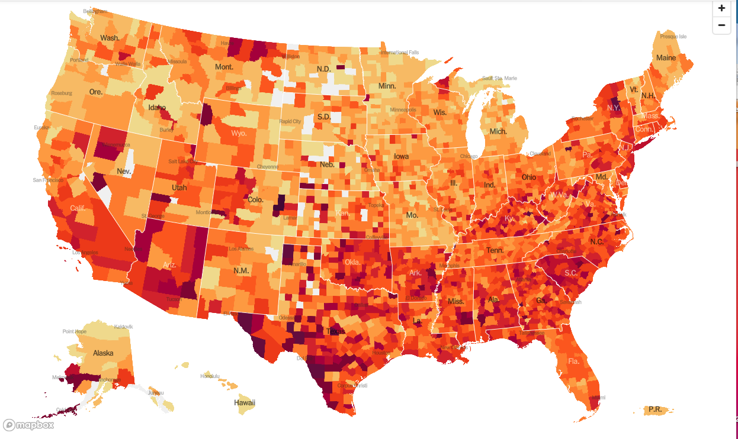
January 20 Infection Rate

Slide 12
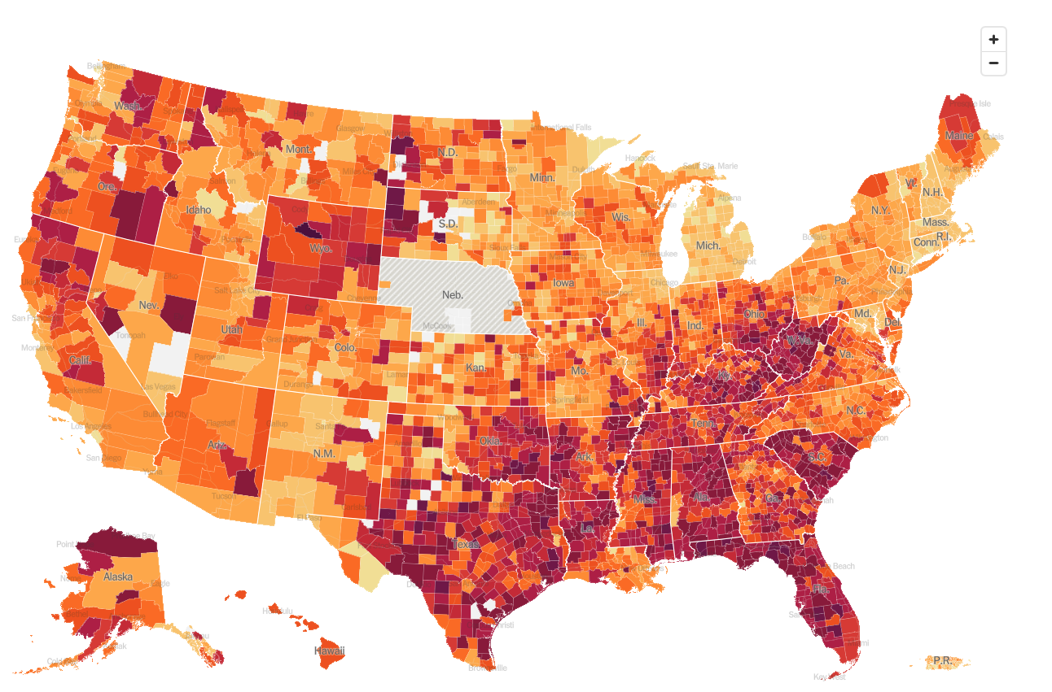
September 9 Infection Rate

Slide 13
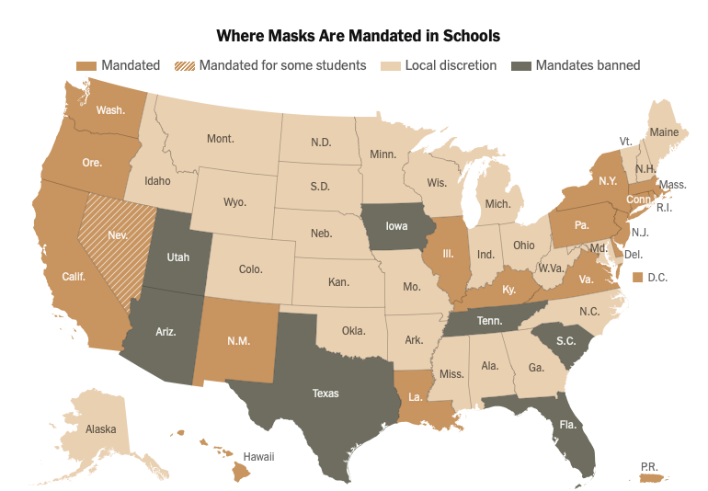

Slide 14
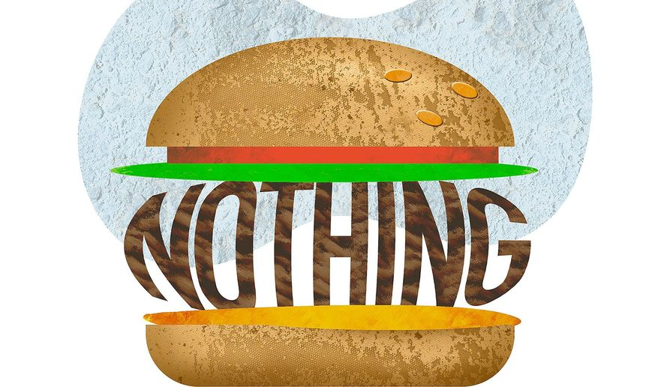
The Global Economy – Jackson Hole Was a Nothing Burger
*August Nonfarm Payroll Report bombs, delivering only 220,000 jobs, off by a half million
*ADP Comes in Weak, presaging lower interest rates. Private Employment came in at only 374,000, about half of what was expected. *The headline Unemployment Rate fell 0.2% to 5.2% a new post pandemic low. * Jackson Hole Meeting Stated Today, the annual confab of central bank governors, investment bankers, and hangers on, is a big nothing burger, but the taper is coming *Chicago PMI has a Big Miss, coming in at 66.8 versus an expected 69.4. *Air Travel is Falling Off, with airport security screening dropping to only 1.35 million, the lowest since May 11. *The Supreme Court Says Evictions are On, in a landmark ruling last week. Some 2 million tenants owe $15 billion in back rent

Slide 15
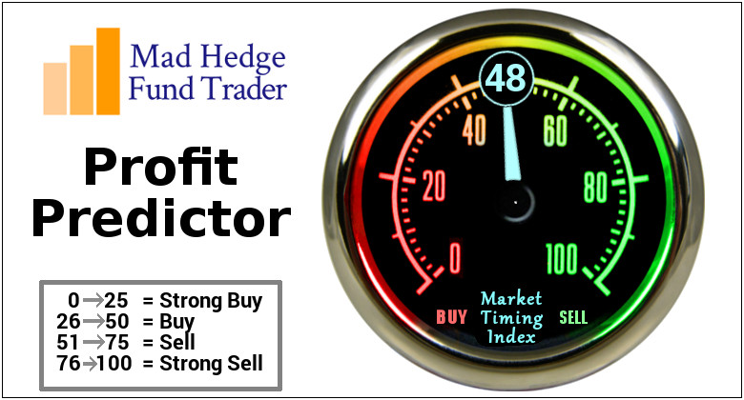
The Mad Hedge Profit Predictor Market Timing Index – Waiting for a Selloff An artificial intelligence driven algorithm that analyzes 30 different economic, technical, and momentum driven indicators

Slide 16
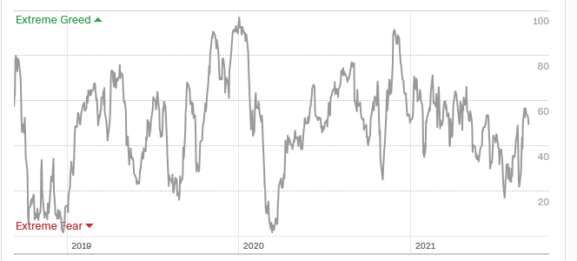
The Mad Hedge Profit Predictor Moving into a “BUY” Range
SELL
Do Nothing
BUY

Slide 17
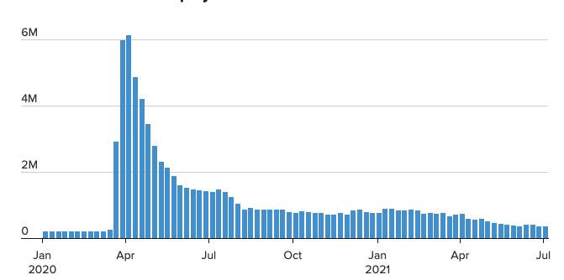
Weekly Jobless Claims – New Lows 348,000

Slide 18
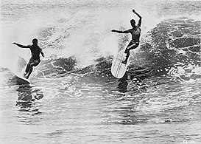
Stocks – Endless Bid
*US corporate profits to soar from $1.9 trillion in 2020 to $10 trillion in 2021 *Stocks Hit New August Highs the Most in History, surpassing the 1929 record at 12 times. The only negative three-month period seen since 1929 are August, September, and October. * SEC Scrutinizes ESG, indicating that some of these green funds are not so green * PayPal to Enter Stock Trading, sending the stock up a ballistic $15 in two days. *Delta surge has peaked, so all asset classes will surge with an “everything” rally *SEC is Cracking Down on Market Gaming by multiple apps aimed at Millennials. *FANGS are now leading the market and may continue for the rest of the year, but may take a short term hit on month end earnings announcements *Stick with the barbell strategy, we’ll keep rotating back and forth all year between tech & domestic recovery

Slide 19
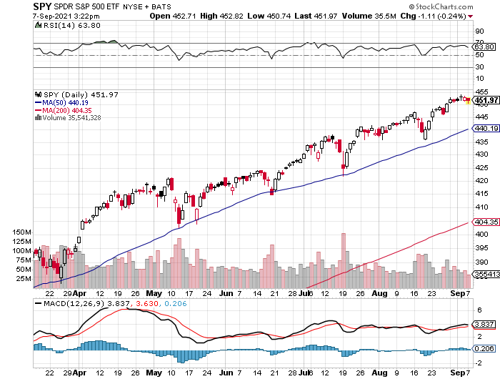
S&P 500 – New Highs and No Pullback took profits on long 6/$375-$385 bull call spread took profits on long 6/$430-440 bear put spread
New Highs Yearend Target $475
The Bottom 435

Slide 20
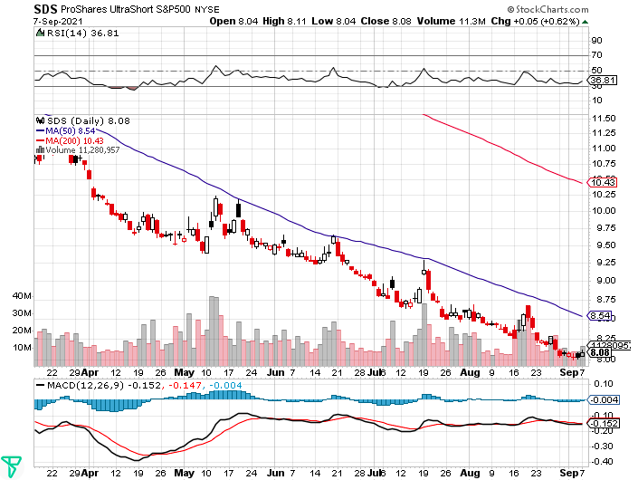
ProShares Ultra Short S&P 500 (SDS)- a great hedge for long stocks and bonds long 2X position has a hedge against longs and bond shorts

Slide 21
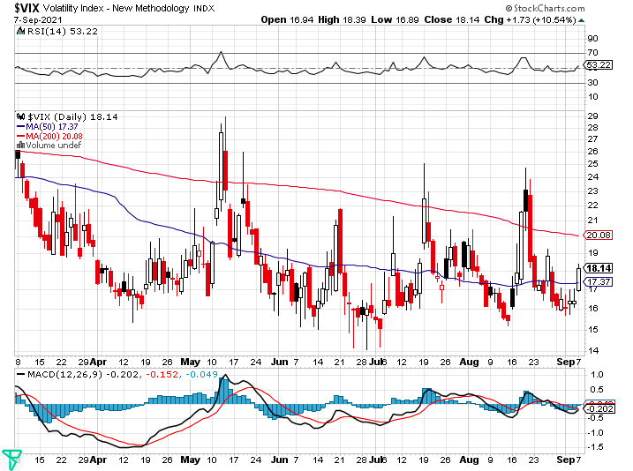
(VIX) – Dying a Slow Death classic summer market

Slide 22
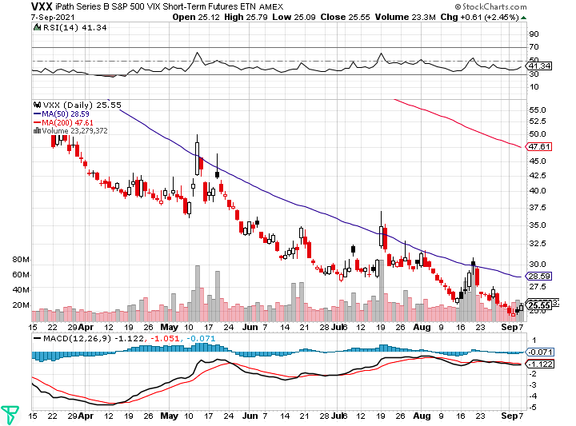
(VXX)-

Slide 23
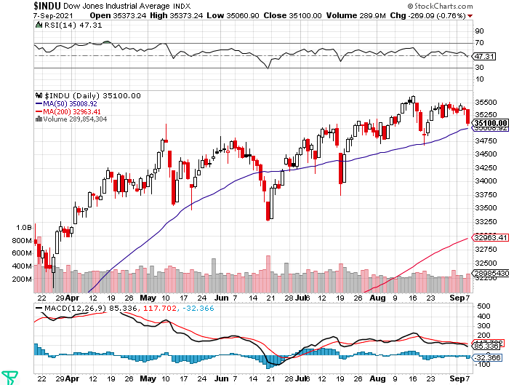
Dow Average ($INDU)-

Slide 24
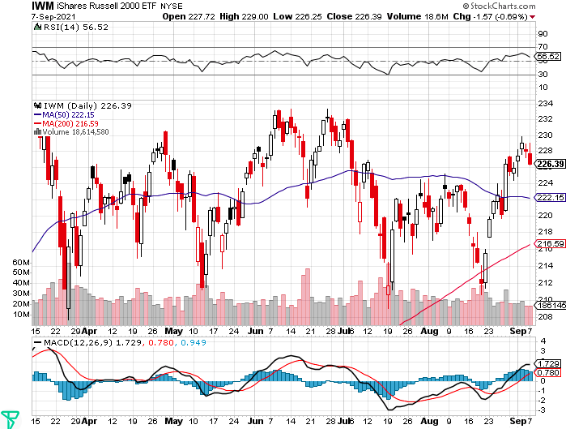
Russell 2000 (IWM)- took profits on Long 10/$137-$142 vertical bull call spread took profits on Long 10/$153-$156 vertical bear put spread

Slide 25
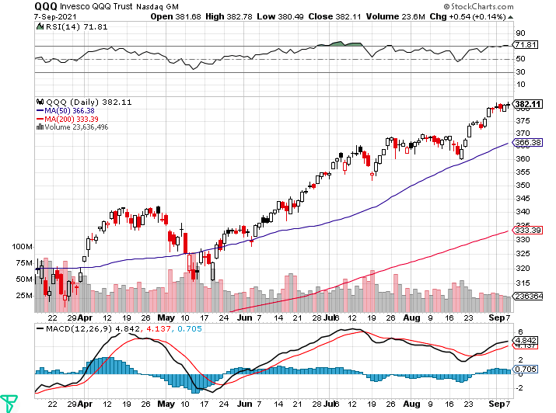
NASDAQ (QQQ) – long (QQQ) 4/$330-$335 put spread took profits on long (QQQ) 3/$340-$345 put spread covered long (QQQ) $325-$330 put spread

Slide 26
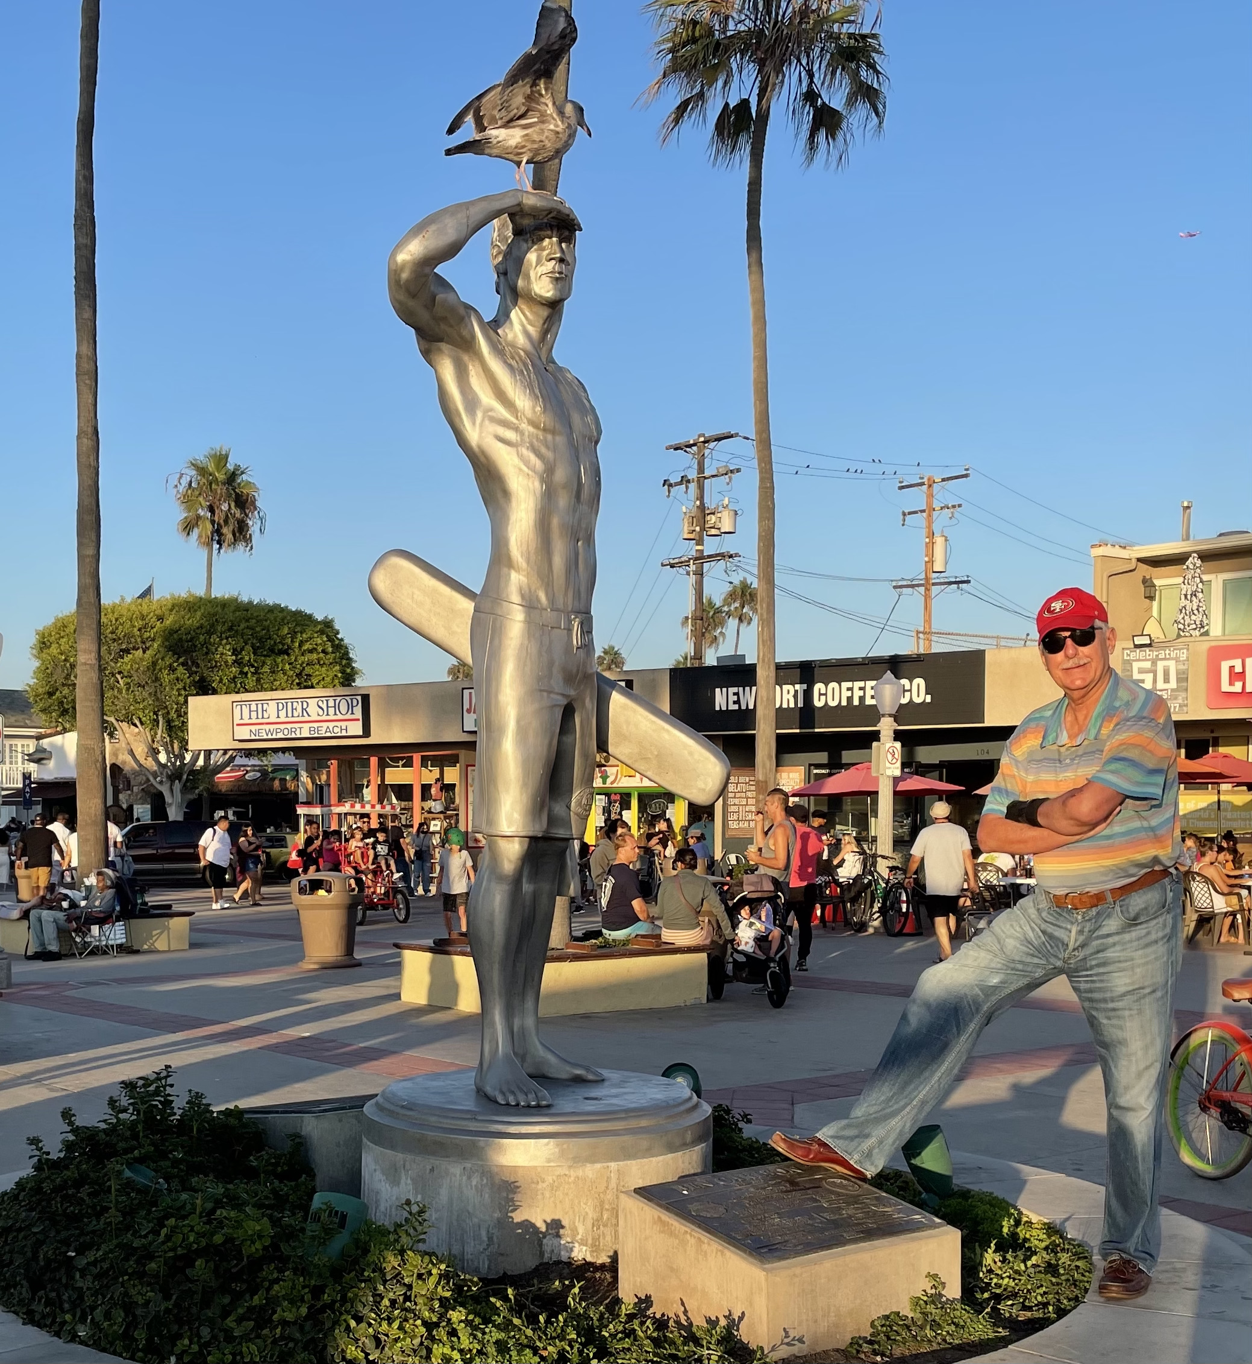

Slide 27
The Barbell Portfolio
*50% Big Tech - 2% of US Employment but 27% of Market Cap and 38% of Profits 50% Domestic Recovery, including: Railroads Couriers Banks Construction Credit Cards Event organizers Ticket sales Retailers

Slide 28
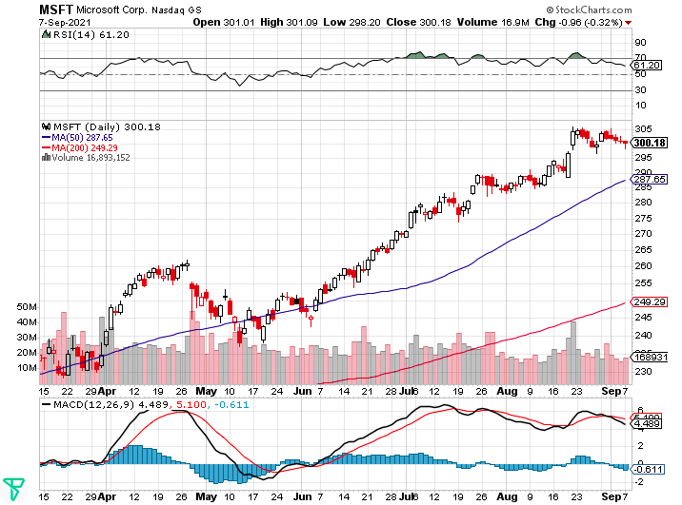
Microsoft (MSFT)- Pentagon Cancels Microsoft Jedi Cloud Deal took profits on long 12/$220-$230 call spread stop loss on long 12/$170-$180 call spread took profits on long 12/$135-$138 call spread

Slide 29
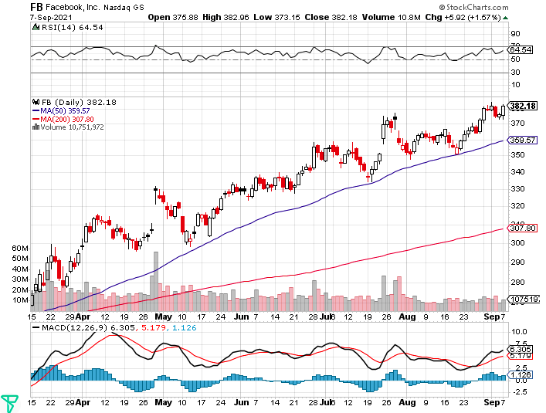
Facebook (FB)- Wins antitrust suit took profits on Long 9/$290-$300 vertical bear put spread stopped out of Long 9/$190-$200 vertical bear put spread took profits on Long 9/$145-$155 vertical bull call spread took profits on Long 9/$150-$160 vertical bull call spread

Slide 30
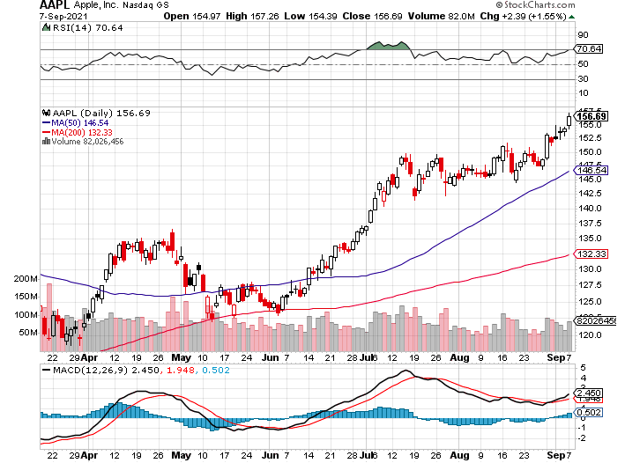
Apple (AAPL)- New 5G iPhone Surge-earnings after close Apple car moving forward with KIA took profits on long 7/$320-$330 call spread took profits on long 4/24/$250-$260 call spread took profits on long 5/$250-$260 call spread

Slide 31
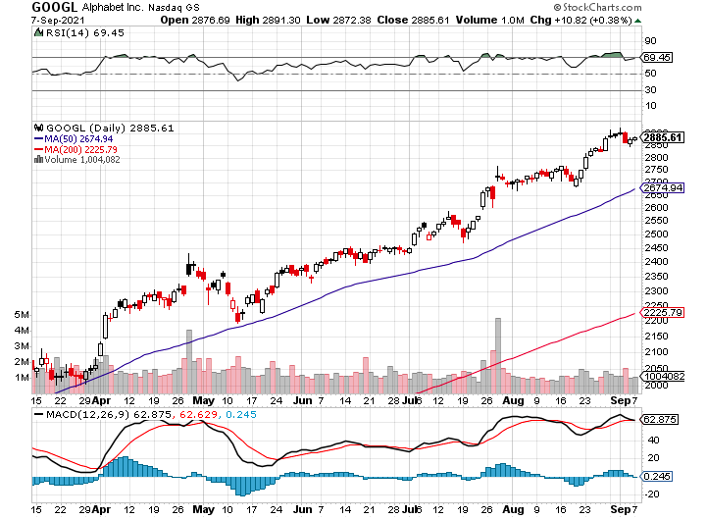
Alphabet (GOOGL) – Ad king on economic recovery 15% of search is travel related took profits on long 12/$1,200-$1,230 bull call spread took profits on long 9/$1,030-$1,080 vertical bull call spread

Slide 32
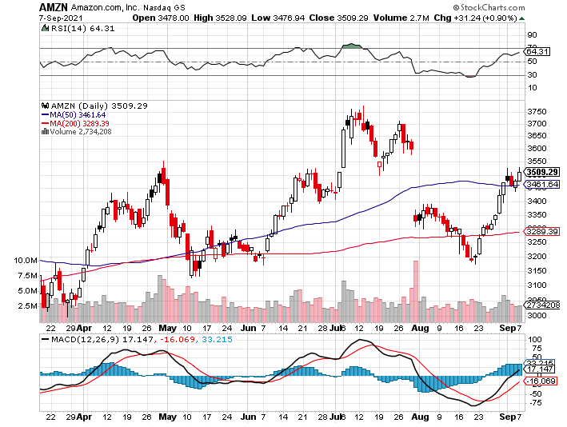
Amazon (AMZN) – New Highs took profits on long 9/$2,800-$2,900 bull call spread

Slide 33
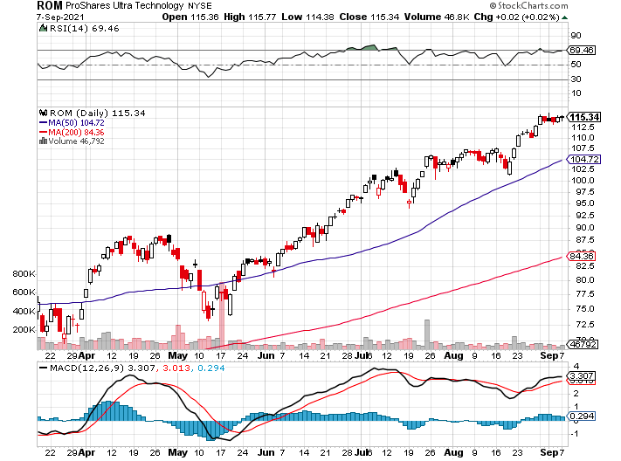
ProShares Ultra Technology (ROM) – New Highs

Slide 34
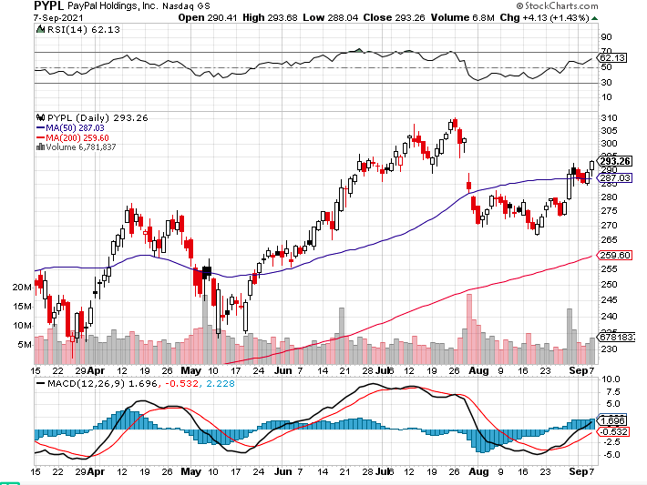
PayPal (PYPL)-Fintech Rules-New Highs took profits on long 4/$90-$95 call spread

Slide 35
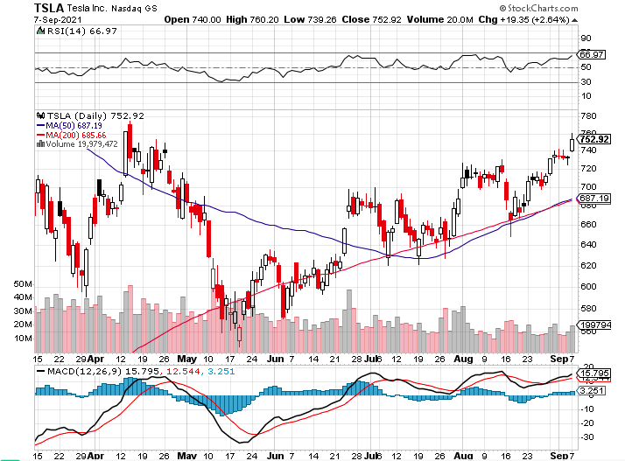
Tesla (TSLA)- Feds Investigate Autopilot took profits on long 2X 4/$450-$500 call spread, took profits on long 3/$400-$450 call spread took profits on long 2/$650-$700 call spread-expires, stopped out of long 3/$600-$650 call spread Took profits on long 2/$600-$650 bull call spread, Took profits on long 2/$550-$600 bull call spread

Slide 36
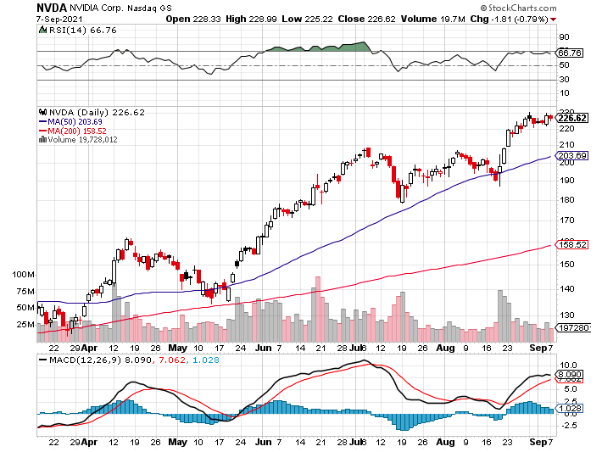
NVIDIA (NVDA) – New Highs on Great Earnings A Mad Hedge 10 bagger – Global Semiconductor Shortage Slows Auto Industry, Graphic card sales up 87% in Q2

Slide 37
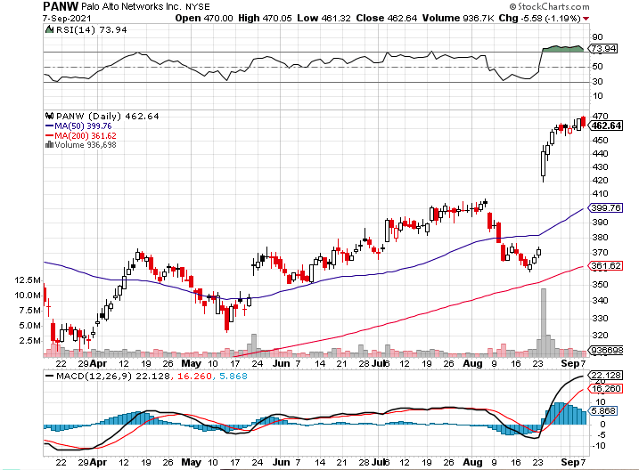
Palo Alto Networks (PANW)- Hacking never goes out of fashion

Slide 38
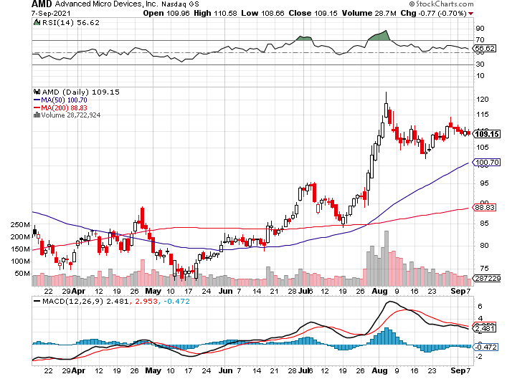
Advanced Micro Devices (AMD)- programable logic devices took profits on long 2/$75-$80 call spread

Slide 39
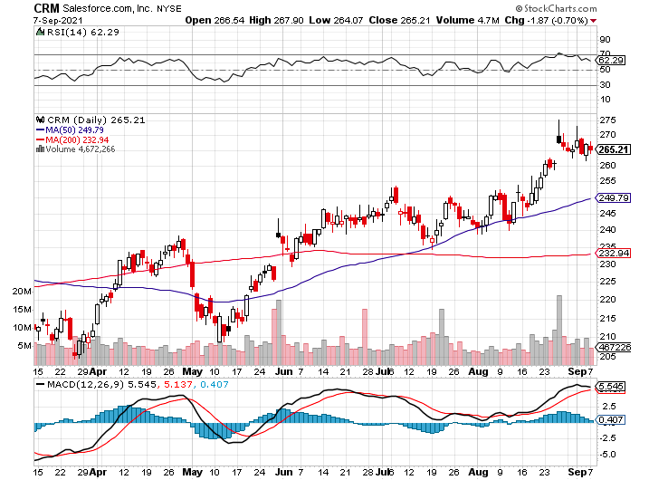
Salesforce (CRM)- Massive Online Migration took profits on long 9/$125-$130 vertical bull call spread took profits on long 8/$125-$130 vertical bull call spread took profits on long 2/$105-$115 call spread

Slide 40
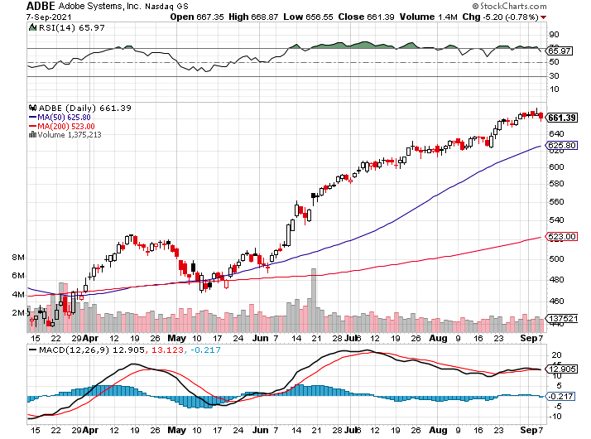
Adobe (ADBE)- Cloud play The Quality Non-China tech play

Slide 41
The Second Half of the Barbell
*Bets on a domestic recovery in 2021 *Upside potential in 2021 far greater than tech *Some of these have not moved for 5 or 10 years *Focuses on economically sensitive cyclical industries *Makes a great counterweight to high-growth technology *We could spend all of next year rotating between the two groups

Slide 42
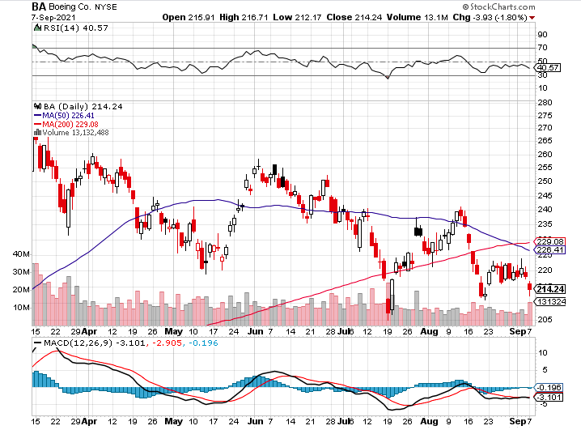
Boeing (BA) – former LEAP Candidate – Headaches again long 3/$146-$149 call spread took profits on long 2/$150-$160 call spread

Slide 43
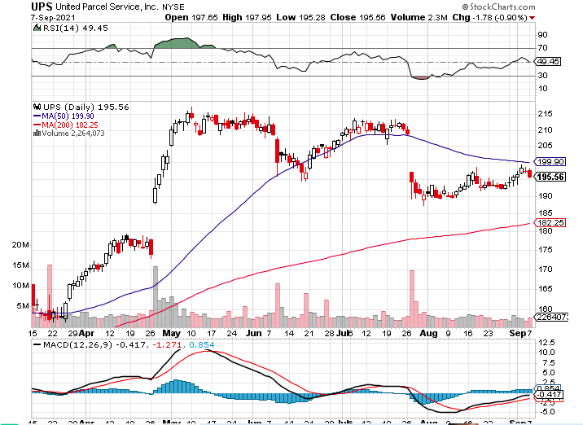
Package Delivery- United Parcel Service (UPS) - Package Delivery massive increase in overnight deliveries, announces blowout earnings, vaccine deliveries took profits on long 11/$130-$140 call spread

Slide 44
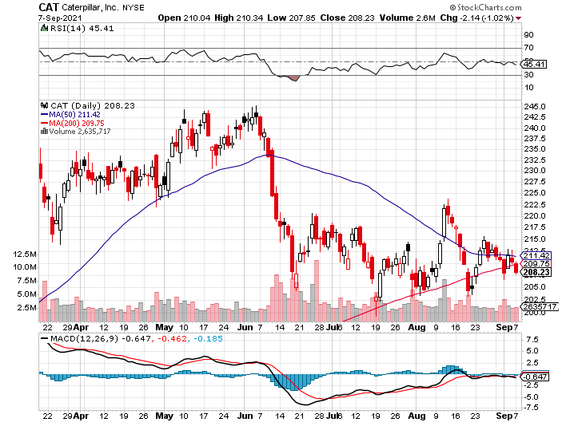
Caterpillar (CAT)- Ag + Infrastructure + Housing took profits on long 12/$145-$150 call spread took profits on long 11/$125-$135 call spread

Slide 45
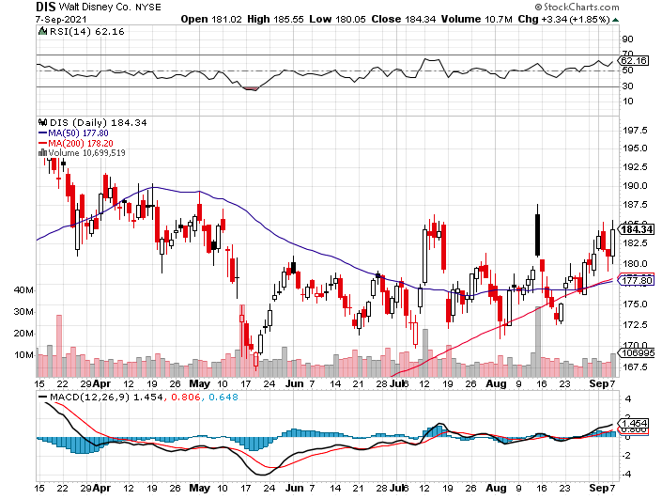
Walt Disney (DIS)- Big Recovery Move Covid 4th Wave Delta Drag took profits on long 3/$170-$180 call spread

Slide 46
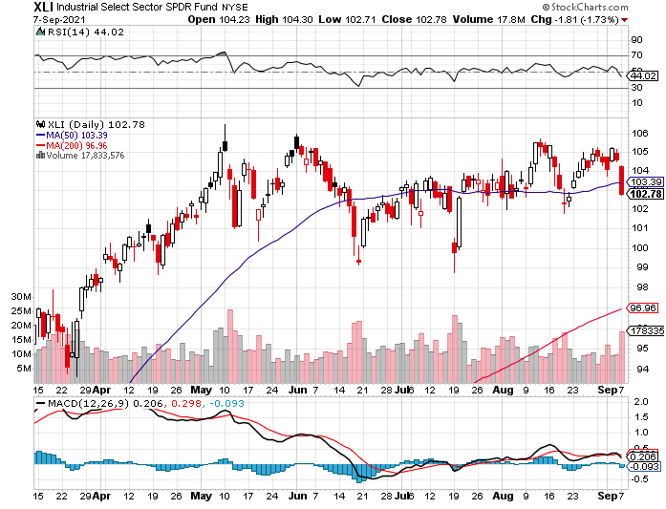
Industrials Sector SPDR (XLI)- (GE), (MMM), (UNP), (UTX), (BA), (HON)

Slide 47
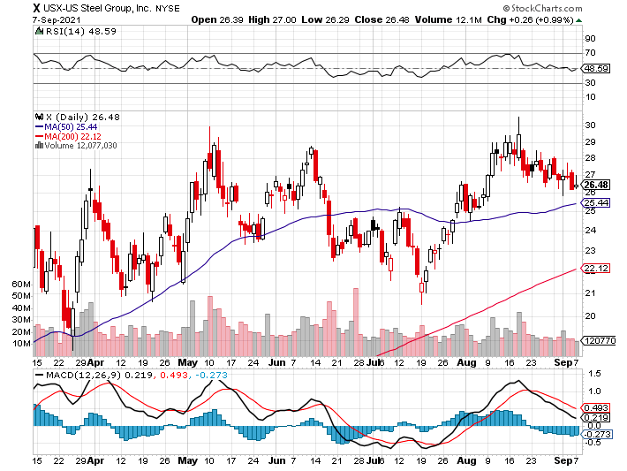
US Steel (X) – Commodity Drag

Slide 48
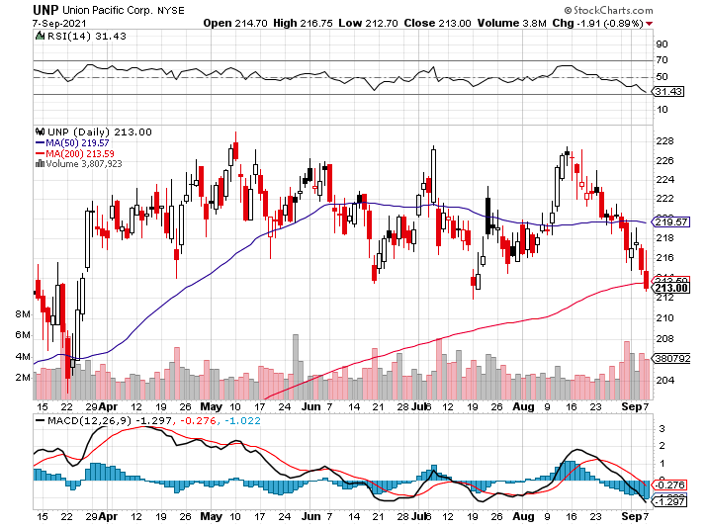
Union Pacific RR (UNP)- Big Stuff to Ship near record earnings announced long 5/$200-$210 call spread – 12 days to expiration took profits on 11/$150-$160 call spread

Slide 49
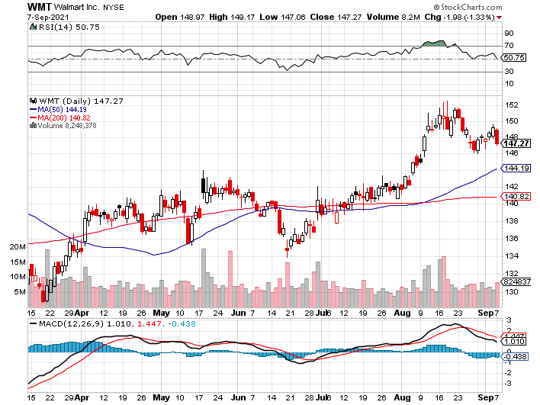
Wal-Mart (WMT)-New High took profit on Long 11/$125-$130 bear put spread took profit on Long 10/$119-$121 bear put spread took profits on Long 8/$114-$117 bear put spread

Slide 50
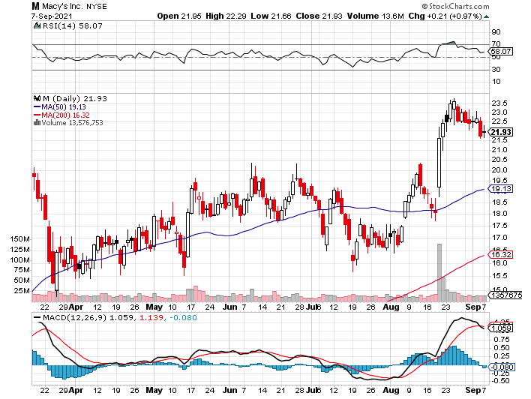
Macys’ (M) – Retail Return from the Grave took profits on Long 8/$23-$25 bear put spread

Slide 51
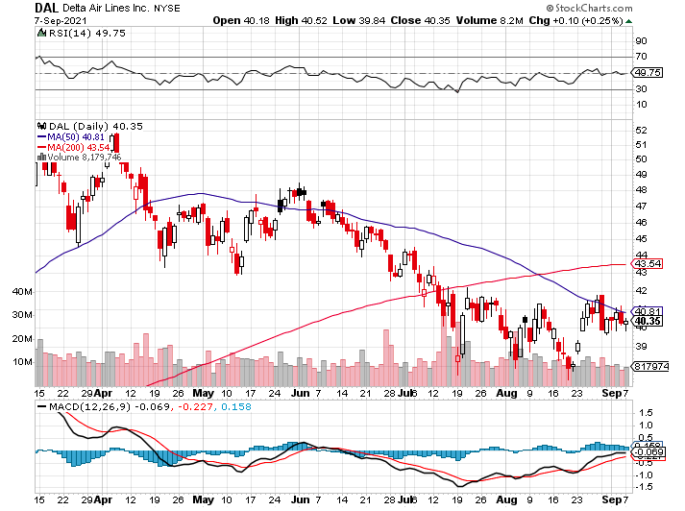
Delta Airlines (DAL) –

Slide 52
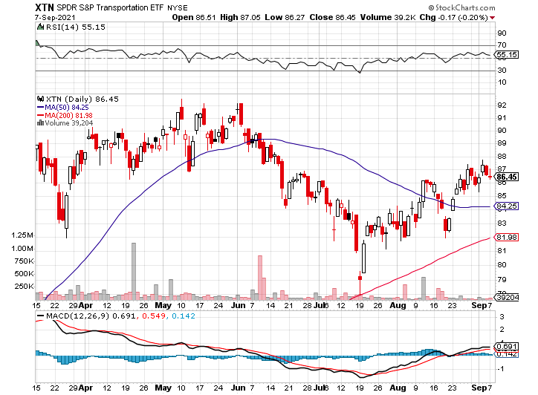
Transports Sector SPDR (XTN)- Worst Hit Sector (ALGT), (ALK), (JBLU), (LUV), (CHRW), (DAL)

Slide 53
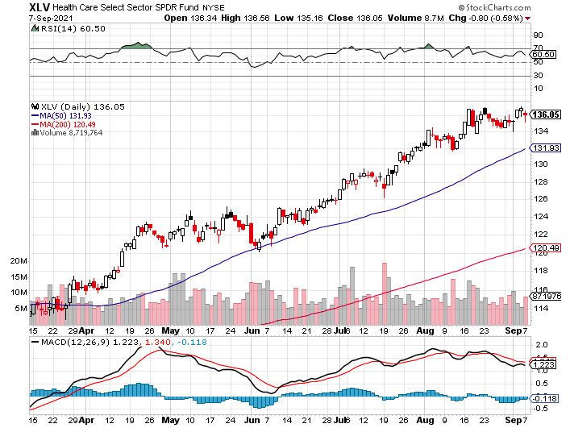
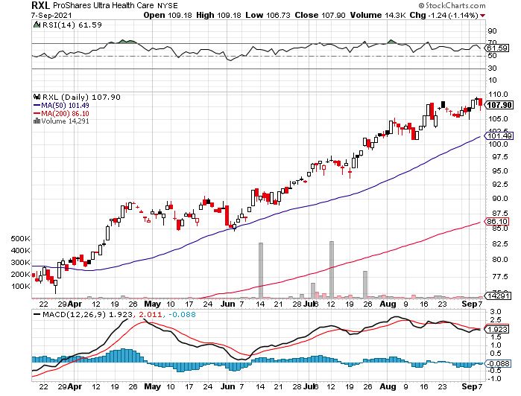
Health Care Sector (XLV), (RXL) (JNJ), (PFE), (MRK), (GILD), (ACT), (AMGN)

Slide 54
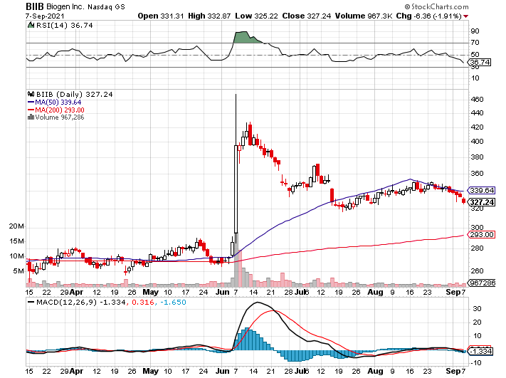
Biogen (BIIB) Why you do Biotech

Slide 55
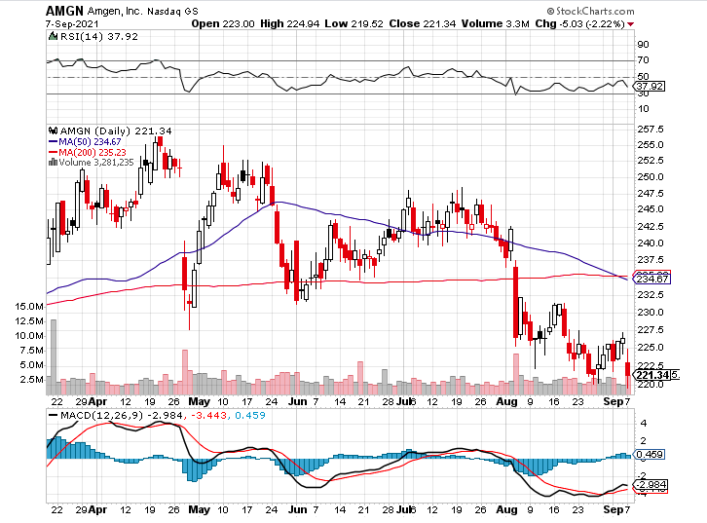
Amgen (AMGN) took profits on long 11/$185-$200 bull call spread

Slide 56
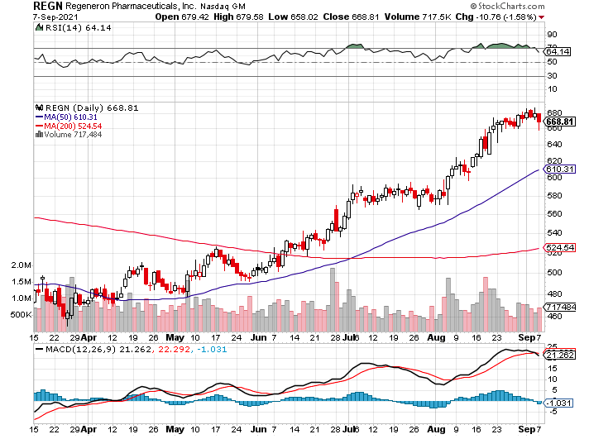
Regeneron (REGN) took profits on long 7/$570-$580 call spread

Slide 57
CRISPR Therapeutics (CRSP)

Slide 58
Goldman Sachs (GS) – took profits on long 8/$325-$335 call spread took profits on long 6/$310-$320 call spread took profits on long 5/$310-$320 call spread took profits on long 2/$240-$260 call spread

Slide 59
Morgan Stanley (MS) – Doubled Dividend took profits on long 2/$55-$60 call spread

Slide 60
JP Morgan Chase (JPM)-Back to Life took profits on long 8/$140-$145 call spread took profits on long 7/$140-$145 call spread took profits on long 5/$135-$140 call spread took profits on long 2/$135-$140 call spread took profits on long 2/$110-$115 call spread

Slide 61
Citigroup (C) – “Recovery” Rotation Play

Slide 62
Bank of America (BAC) – took profits on long 2/$28-$30 call spread

Slide 63
SPDR Metals & Mining ETF (XME) – long 2/$28-$30 call spread

Slide 64
Blackrock (BLK)-Asset Collection Boom took profits on long 3/$31-$34 call spread

Slide 65
Visa (V) – “Touchless” Fintech Play took profits on long 5/$220-$225 bull call spread took profits on long long 5/$195-$205 bull call spread took profits on long 9/$180-$185 bull call spread

Slide 66
Consumer Discretionary SPDR (XLY) (DIS), (AMZN), (HD), (CMCSA), (MCD), (SBUX)

Slide 67
Berkshire Hathaway (BRKB)- Natural Barbell cut back buy backs at $6 billion a year, announced spectacular earnings took profits on long 3/$230-$240 call spread

Slide 68
Europe Hedged Equity (HEDJ)-

Slide 69
Japan (DXJ)-

Slide 70
Emerging Markets (EEM) - Pro trade, Weak Dollar, Long Recovery Play

Slide 72
Bonds – Jackson Hole Flops
*But bonds collapse anyway *Feeble August Nonfarm Payroll report should have caused bonds to soar, but they collapsed instead *It just shows how weak the underlying fundamentals are *Massive new bond government issuance this week is a factor *Add more downside LEAPS NOW, the January 2022 (TLT) $155-$150 vertical bear put spread delivers a 75% profit in six months *A 2.00% yield on the ten-year US Treasury bond here we come! This is the quality trade for the rest of 2021 *US Treasury bond fund (TLT) could plunge from $180 a year ago to $105 by 2023

Slide 73
Treasury ETF (TLT) – The Top is In long 9/$155-$158 put spread took profits on long 8/$157-$160 put spread, took profits on long 8/$156-$159 put spread, took profits on long 7/$152-$155 put spread stopped out of long 5/$143-$146 put spread, took profits long 5/$143-$146 put spread

Slide 74
Ten Year Treasury Yield ($TNX) – 1.25%

Slide 75
Junk Bonds (HYG) 3.47% Yield to Maturity

Slide 76
2X Short Treasuries (TBT)-Another run at highs

Slide 77
Emerging Market Debt (ELD) 4.27% Yield-

Slide 78
Municipal Bonds (MUB) – 0.93% Mix of AAA, AA, and A rated bonds

Slide 79
Bitcoin – Correction Time Buy the Mad Hedge Bitcoin Letter at https://www.madhedgefundtrader.com/store/
*El Salvador launches Bitcoin as a national currency, and it promptly dropped 10% *Everyone in the country received $30 worth of Bitcoin which they promptly sold *Several other countries with weak currencies are watching closely and may adopt *It would accelerate badly needed digitization in these economies *Just the physical printing of paper money is costing hundreds of million a year *The next big play in Bitcoin will be to front run the launch of new ETF’s *A dozen Crypto ETF’s have applications in with the SEC *Major support on charts at $44,000 where every pro is doubling up

Slide 80
Bitcoin ($BTCUSD) – Wake Up Time

Slide 81
Bitcoin ($BTCUSD) – +125% in Three Months

Slide 82
Foreign Currencies – Dollar Dive
*US Dollar flips from top to bottom of recent range on bitcoin surge *The US Dollar Will Crash in coming years, says Jeffry Gundlach and I think he is right. Emerging markets will become the next big play but not quite yet. *Long-term fundamentals continue to worsen, a dollar short could be the new ten-year trade *Massive over issuance of debt by the US government to fund the covid recovery is another nail in the coffin in addition to an exploding trade deficit *Euro and yen get a new bid, British pound and Australian dollar turn hot *Buy Buy (FXA) and (FXE) on dips. *Bitcoin hit with 10% correction of El Salvador adoption is a classic buy the rumor and sell the news. All the pros piled in on the dip

Slide 83
Japanese Yen (FXY), (YCS)

Slide 84
Euro ($XEU), (FXE), (EUO)-

Slide 85
British Pound (FXB)-

Slide 86
Australian Dollar (FXA)- The Global Recovery Play took profits on long 8/$67-$69 call spread

Slide 87
Emerging Market Currencies (CEW)

Slide 88
Chinese Yuan- (CYB)-

Slide 89
Bitcoin-Challenging $66,000 The Bitcoin ETF Launch is Setting Up

Slide 90
Energy – Thank You Ida!
*Oil Jumps on Hurricane IDA, with a sharp 8.9% rally *Delta is now rampaged throughout China, the world’s largest consumer of Texas tea *Buy the dip at your own risk, any longs are counter trend trades *The end of oil is upon us, but it may take 30 years to unwind existing infrastructure *All US car production will be electric by 2035 wiping out half of all US oil consumption, 20 million b/d down to 10 million b/d *Avoid all energy plays like the plague, it’s the new buggy whip industry as the US de-carbonizes

Slide 91
Oil-($WTIC)

Slide 92
United States Oil Fund (USO) long 10/$9.50-$10 Vertical bull call spread

Slide 93
Energy Select Sector SPDR (XLE)-No Performance! (XOM), (CVX), (SLB), (KMI), (EOG), (COP)

Slide 94
Halliburton (HAL)-

Slide 95
Natural Gas (UNG) -

Slide 96
Precious Metals – Another Hit
*Gold takes another hit off the back of the US Treasury bond selloff *Gold is reflecting the coming sharp rise in interest rates *Stay away until this plays out *Silver is still the bigger and better long-term play *Bitcoin and other cryptos are sucking all the speculative new cash out of the precious metals markets *Gold will eventually recover when US borrowing becomes so massive it undermines the value of the US dollar, even in the face of higher interest rates

Slide 97
Gold (GLD)- Meltdown

Slide 98
Market Vectors Gold Miners ETF- (GDX) –

Slide 99
Barrick Gold (GOLD) took profits on long 1/$21-$23 call spread took profits on long 11/$22-$24 call spread

Slide 100
Newmont Mining- (NEM)- took profits on long $55-60 call spread

Slide 101
Silver- (SLV)- took profits on long 11/$19-$20 call spread

Slide 102
Silver Miners - (SIL)-

Slide 103
Wheaton Precious Metals - (WPM)- took profits on long 2/$39-41 call spread

Slide 104
Copper (COPX)-Uptrend Resumes Copper Unions Vote to Strike in Chile, cutting off 33% of the global supply

Slide 105
Real Estate – On Fire….Literally
*Existing Home Sales Rise 2% in July for the second month in a row and 1.5% YOY *New Home Sales are Up 708,000, or up 1.5%, just under pre-covid levels *Inventories are down 12%. *Prices are up 18% YOY with the bulk of the gains happening at the top end of the market. *Pending Home Sales Drop, for the second straight month on a signed contract basis, down 1.8% in July *The Lumber Crash is Saving $40,000 per Home, says Toll Brothers (TOL) *Airbnb to House 20,000 Afghan Refugees. *S&P Case Shiller Smashes all Records, up 17% YOY

Slide 107
Sold For $685,000, $35,000 over asking, WHILE ON FIRE!

Slide 108
S&P Case Shiller Up 16.6% for May Phoenix (25.9%), San Diego (24.7%), and Seattle (23.4%) lead

Slide 109
Crown Castle International (CCI) – 2.70% yielding cell phone tower REIT

Slide 110
US Home Construction Index (ITB) (DHI), (LEN), (PHM), (TOL), (NVR)

Slide 111
Trade Sheet- So What Do We Do About All This?
*Stocks – buy dips aggressively *Bonds – sell rallies aggressively *Commodities-buy dips aggressively *Currencies- sell US dollar rallies *Precious Metals – buy dips *Energy – stand aside *Volatility - sell short over $30 *Real estate – buy dips *Bitcoin – buy dips

Slide 112
Next Strategy Webinar 12:00 EST Wednesday, September 23, from Silicon Valley email me questions at support@madhedgefundtrader.com
Good Luck and Good Trading!
Notes:
*

