Slide 1
The Mad Hedge Fund Trader “China in the Bull Shop”
With John Thomas Reno, NV, September 22, 2021 www.madhedgefundtrader.com
Notes:
*

Slide 2
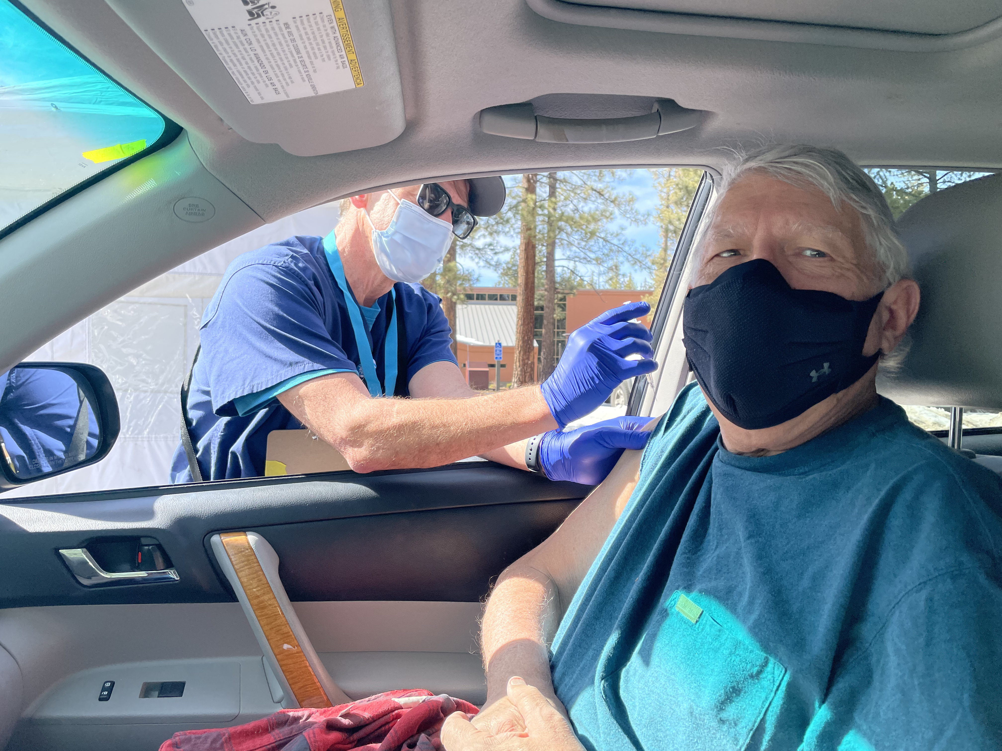
Thank You Mr. Booster – Back to 99% Immunity

Slide 3
Mad Hedge Trader & Investors Summit September 14-16 – Register at https://www.madhedge.com The Videos are UP!
*A collection of the 27 best traders and managers in the world, or 8 a day *Back-to-back One-hour presentations followed by an interactive Q&A *It’s a smorgasbord of trading strategies, pick the one that is right for you *Covering all stocks, bonds, commodities, foreign exchange, precious metals, and real estate *It’s the best look at the rest of 2021’s money making opportunities you can get anywhere *An invitation will be sent to you shortly and it is FREE to attend

Slide 4
Trade Alert Performance New All Time Highs! 32 consecutive profitable trade alerts- 93.5% success rate in 2021-ony 5 losers
*January 10.21% MTD *July +0.61% Final *February +13.28% Final *August +9.36% Final *March +20.60% Final *September -1.10% MTD *April +15.67% Final *October +1.51% Final *May +8.13% Final *November +20.41% Final *June +0.71% Final *December +10.20% Final *2021 Year to Date +77.47% compared to +11.10% for the Dow Average *+499.11% since inception, a new all time high *Average annualized return of 42.86% for 12 years, new all time high`

Slide 5
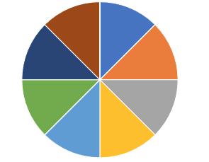
Portfolio Review 80% Cash in a low volatility Long Term Bull Market
Current Capital at Risk
Risk On
World is Getting Better
(DIS) 10/$165-$175 call spread | 10.00%
(TLT) 10/$165-$175 call spread | 10.00%
(SPY) 10/$410-$420 call spread | 10.00%
(GS) 10/$320-$330 call spread | 10.00%
(JPM) 10/$130-$140 call spread | 10.00%
(BLK) 10/$770-$790 call spread | 10.00%
(MS) 10/$85-$90 call spread | 10.00%
(BRKB) 10/$255-$265 call spread | 10.00%
Risk Off
World is Getting Worse
No positions | 0.00%
Total Net Position | 80.00%
Expiration Value 82.70%

Slide 6
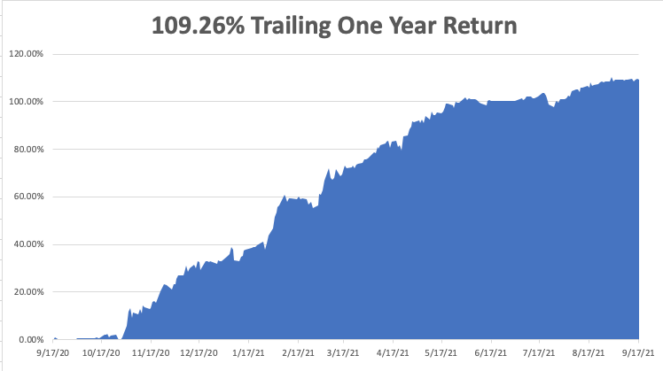

Slide 7
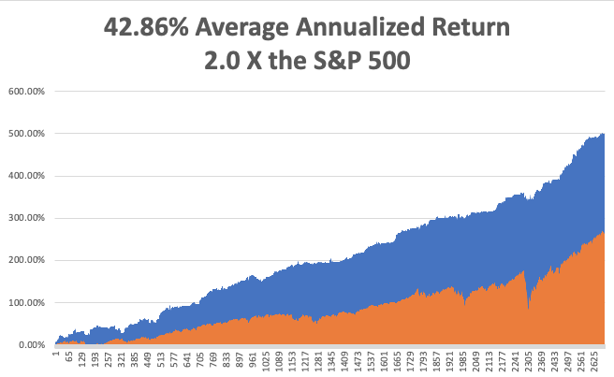
GTD 12 Year Daily Audited Performance

Slide 8
The Method to My Madness The Roaring Twenties are Here
*China Evergrande bankruptcy sets up first market correction in a year *It also sets up the first good buying opportunity, but don’t fire until you see the whites of their eyes *Bond prices try to peak again but fail, and interest rates bottom. Next to come is a multiyear bear market in bonds. *Rising rates will bring modestly lower technology prices are are still a long-term hold *Medium term, both sides of the barbell are working *Bitcoin takes a 10% hit, opening up another “BUY” here *VIX still at $28 shows the time to buy is near

Slide 9
Corona Update –
*Pfizer Shots get full FDA approval for 3rd booster shot for only 65’s, shots for kids under 12 coming in October *30% of new gases are now in kids under 12 *70 million still unvaccinated *80% of the US population has covid antibodies, and 90% in San Francisco *New cases are up 10X, from 15,000 a day to 150,000, with most of the south seeing new all-time highs *No deaths from delta variant report among those vaccinated *14 states now have law suites attempting to ban mask mandates *Best immunity is from getting covid, then getting vaccinated *US cases top 42 million, deaths topping 672,000 and deaths are back up to 1,500 a day

Slide 10
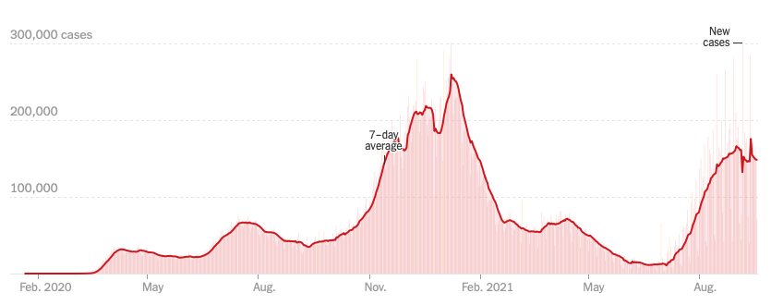
Bump on the Way to Zero the Fourth Wave – The Self-Inflicted Injury

Slide 11
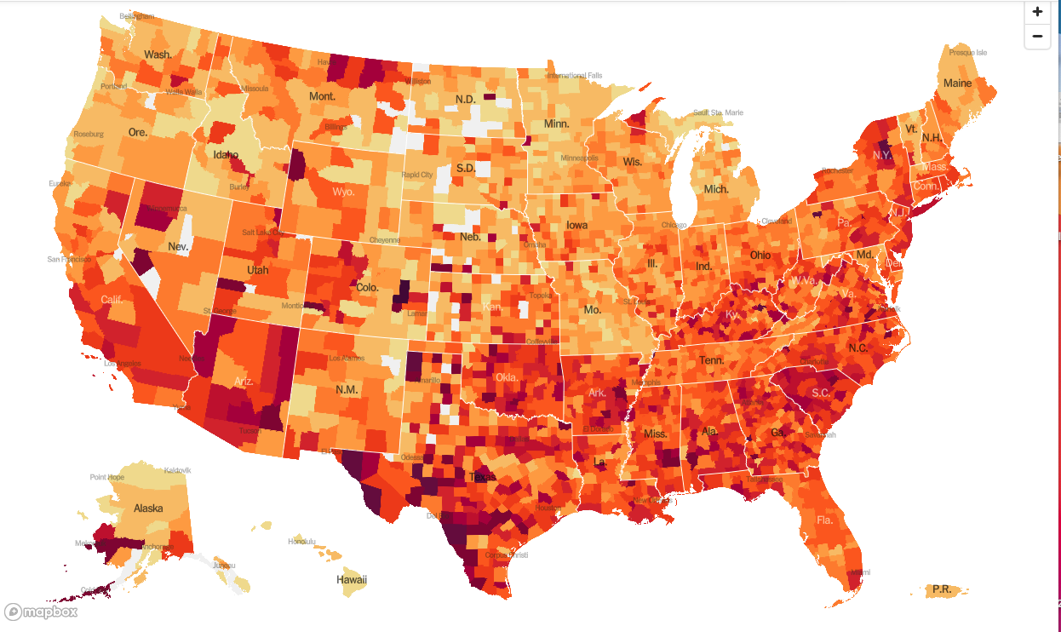
January 20 Infection Rate

Slide 12
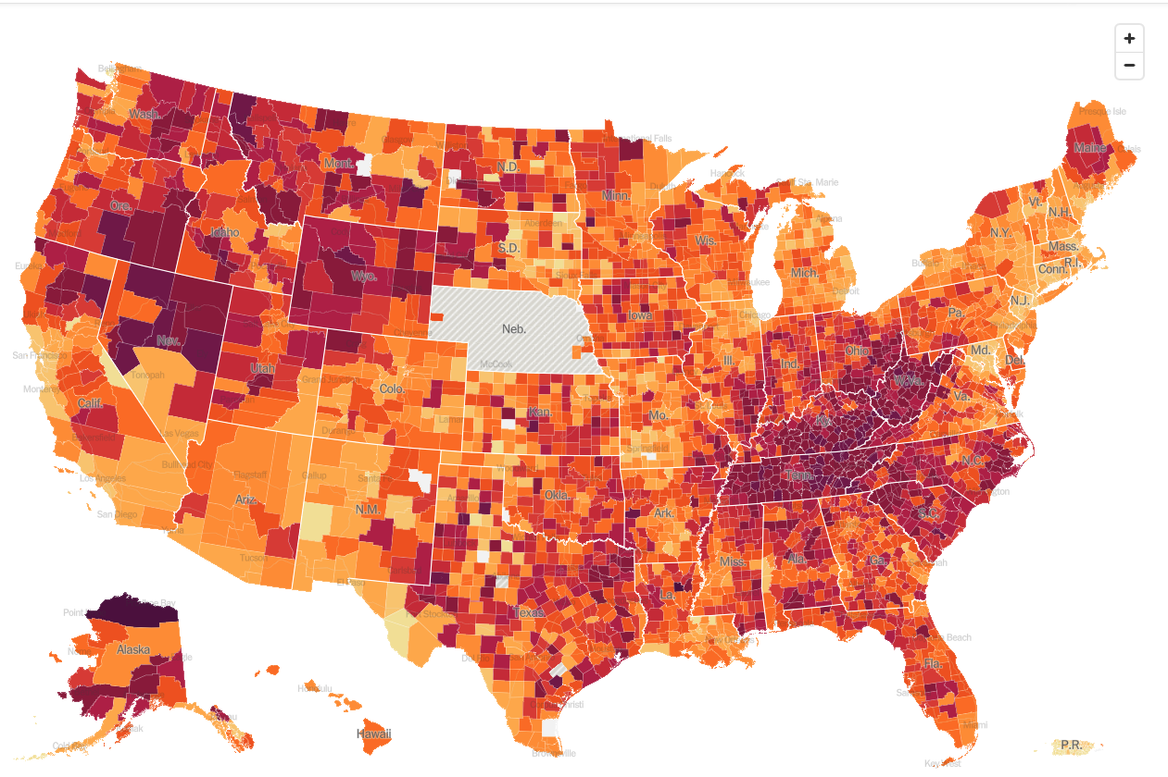
September 22 Infection Rate

Slide 13
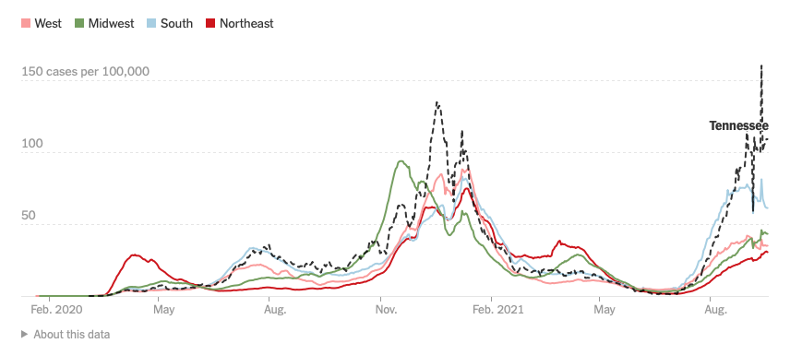

Slide 14
The Global Economy – Mixed Picture
*The Consumer Price Index Rose by 5.3% YOY, and up 0.3% in August, It was a seven-month low, *US Consumer Sentiment Remains Weak, the University of Michigan Index dropping from 78.5 to 77.1 in September *Weekly Jobless Claims Come in at 332,000, a new post pandemic low *US Retail Sales Jump in August, up 0.7% *US Producer Prices Come in Hot, up 8.3% YOY and 0.7% in August, an 11-year high *JOLTS comes in at a Blockbuster 10.9 Million in July, a new record high *China Inflation Hits 13 Year High, up 9.5% YOY *German Economy to Grow 2.1% in 2021, and a further 4.9% in 2022

Slide 15
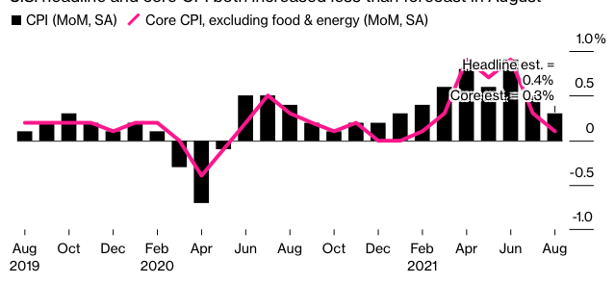

Slide 16
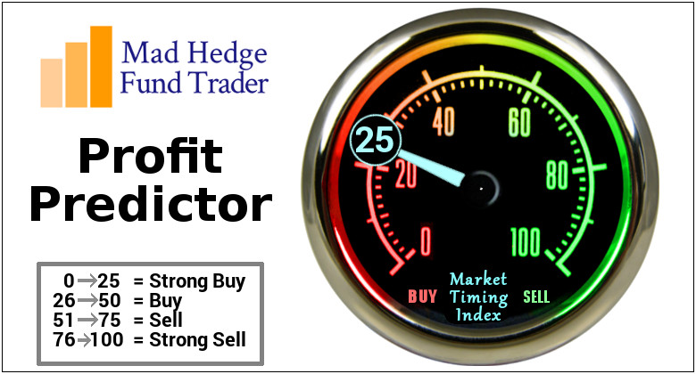
The Mad Hedge Profit Predictor Market Timing Index – Waiting for a Selloff An artificial intelligence driven algorithm that analyzes 30 different economic, technical, and momentum driven indicators

Slide 17
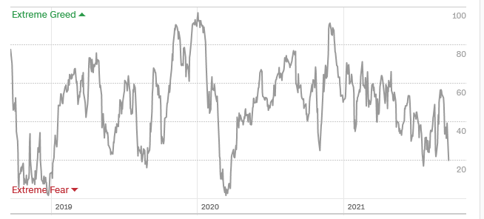
The Mad Hedge Profit Predictor Moving into a “BUY” Range
SELL
Do Nothing
BUY

Slide 18
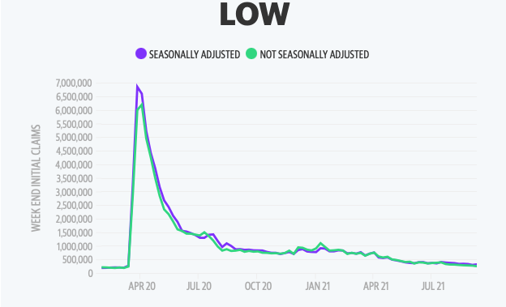
Weekly Jobless Claims – New Lows 312,000 – New Post Pandemic Low

Slide 19
Stocks – Wake Up Call
*Financials are the next big play from here, the big beneficiaries of falling interest rates in coming months *Millennials Will Drive Stocks from here as they will see the fastest growth in disposable assets of any generation. *Cash is Trash says hedge fund legend Ray Dalio *China Destroys Casino Stocks, threatening to increase oversight of their Macao operations *House Looking at a Top 26.5% Corporate Tax Rate, well up from the current 21% but not as high as the 28% that was feared. *Delta surge has peaked, so all asset classes will surge with an “everything” rally, once we digest the China Evergrande crash *Stick with the barbell strategy, we’ll keep rotating back and forth all year between tech & domestic recovery

Slide 20
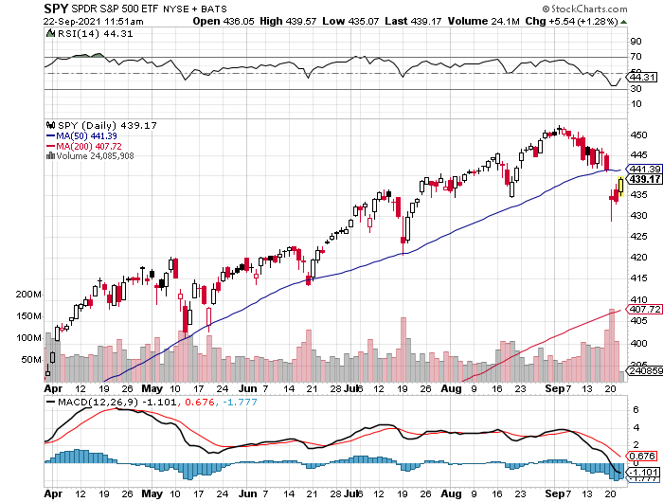
S&P 500 – New Highs and No Pullback took profits on long 6/$375-$385 bull call spread took profits on long 6/$430-440 bear put spread
New Highs Yearend Target $475
The Bottom 414

Slide 21
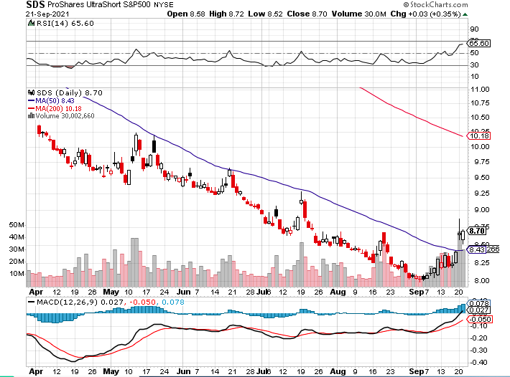
ProShares Ultra Short S&P 500 (SDS)- a great hedge for long stocks and bonds long 2X position has a hedge against longs and bond shorts

Slide 22
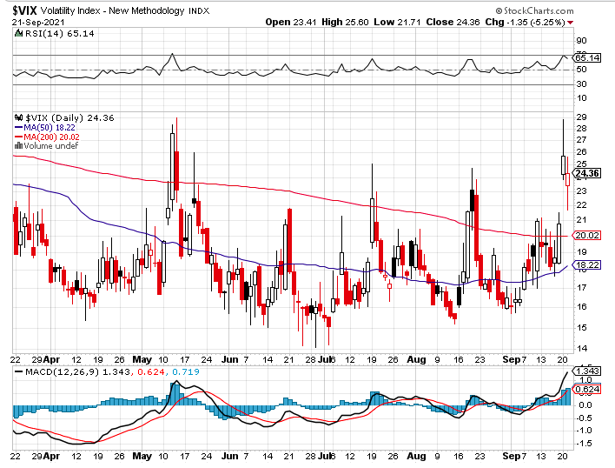
(VIX) – Dying a Slow Death classic summer market

Slide 23
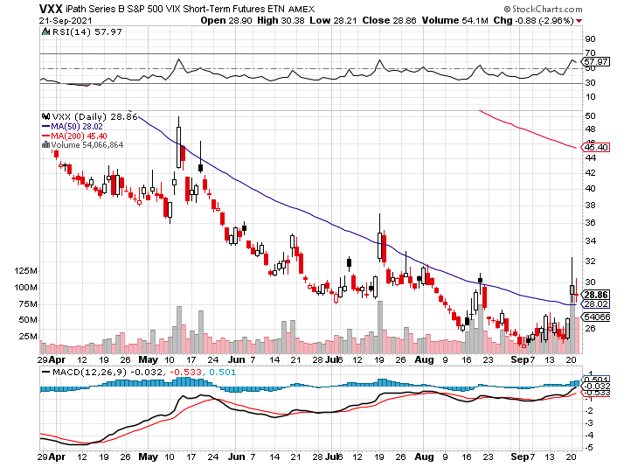
(VXX)-

Slide 24
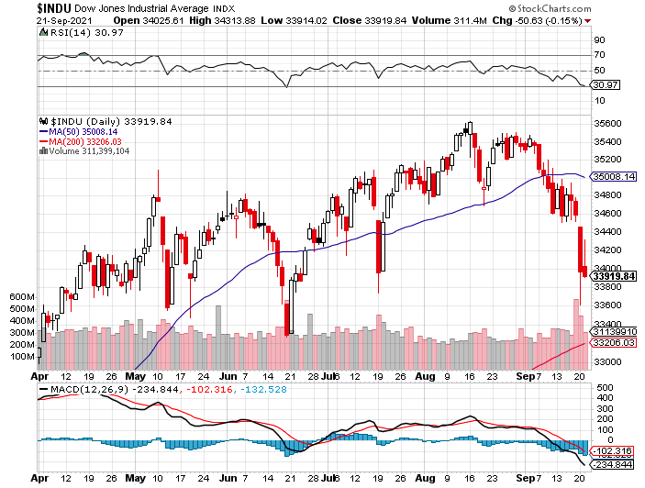
Dow Average ($INDU)-

Slide 25
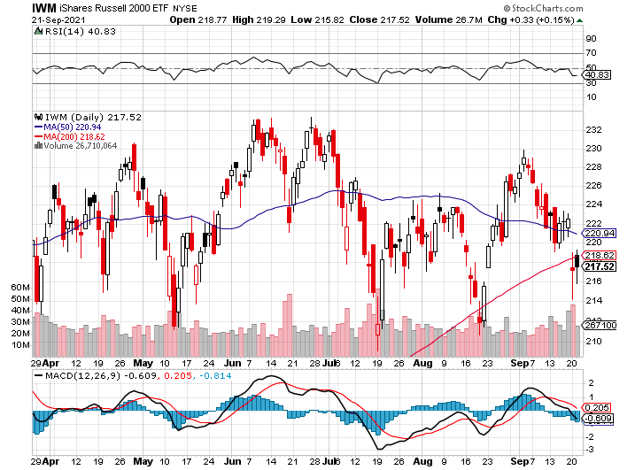
Russell 2000 (IWM)- took profits on Long 10/$137-$142 vertical bull call spread took profits on Long 10/$153-$156 vertical bear put spread

Slide 26
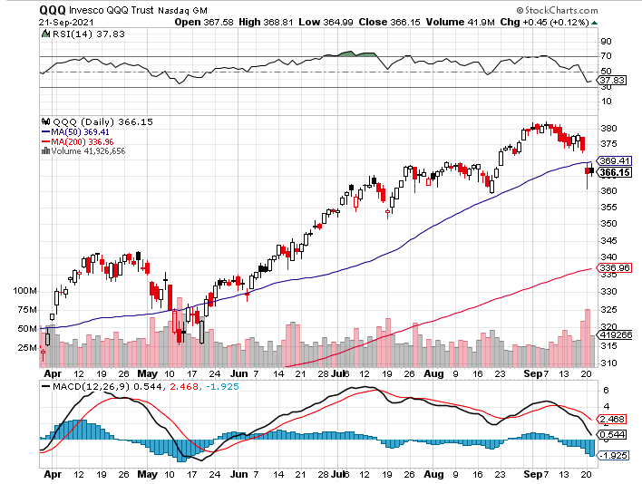
NASDAQ (QQQ) – long (QQQ) 4/$330-$335 put spread took profits on long (QQQ) 3/$340-$345 put spread covered long (QQQ) $325-$330 put spread

Slide 27
The Barbell Portfolio
*50% Big Tech - 2% of US Employment but 27% of Market Cap and 38% of Profits 50% Domestic Recovery, including: Railroads Couriers Banks Construction Credit Cards Event organizers Ticket sales Retailers

Slide 28
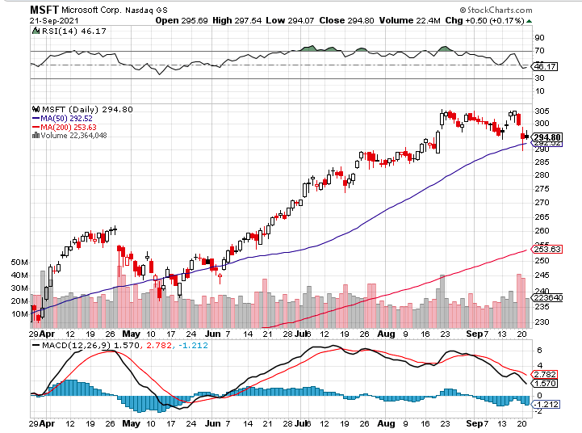
Microsoft (MSFT)- Microsoft to Raise Dividend by 11% and increased a $60 billion stock buyback program took profits on long 12/$220-$230 call spread stop loss on long 12/$170-$180 call spread took profits on long 12/$135-$138 call spread

Slide 29
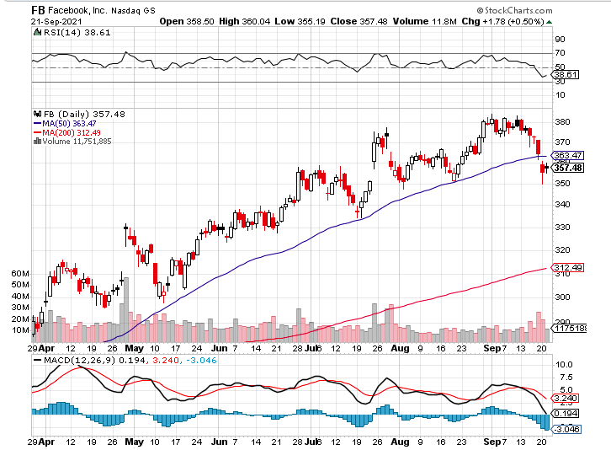
Facebook (FB)- Wins antitrust suit took profits on Long 9/$290-$300 vertical bear put spread stopped out of Long 9/$190-$200 vertical bear put spread took profits on Long 9/$145-$155 vertical bull call spread took profits on Long 9/$150-$160 vertical bull call spread

Slide 30
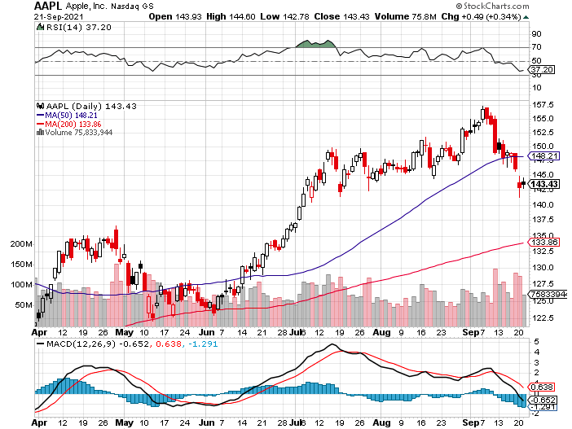
Apple (AAPL)- Launches iPhone 13, with a better camera, faster chips, and longer battery life, Antitrust Comes Home to Roost at Apple took profits on long 7/$320-$330 call spread took profits on long 4/24/$250-$260 call spread took profits on long 5/$250-$260 call spread

Slide 31
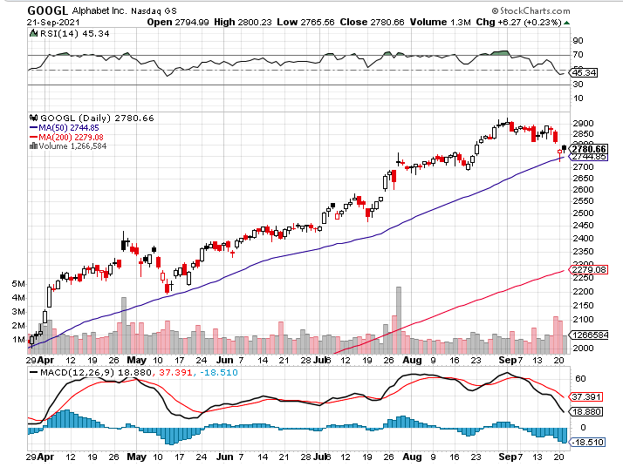
Alphabet (GOOGL) – Ad king on economic recovery 15% of search is travel related took profits on long 12/$1,200-$1,230 bull call spread took profits on long 9/$1,030-$1,080 vertical bull call spread

Slide 32
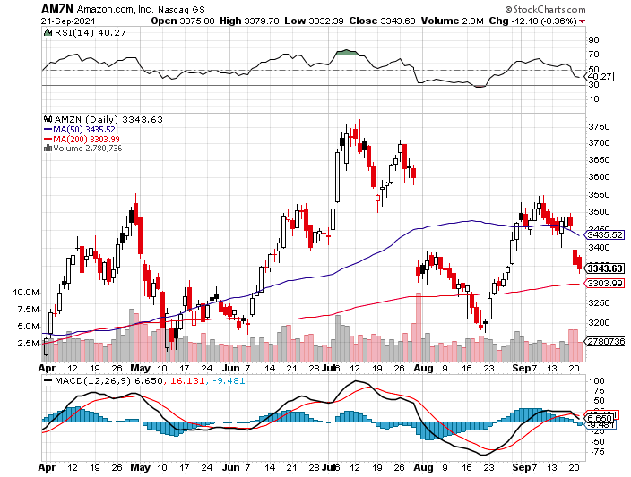
Amazon (AMZN) – Amazon to Hire 125,000 and boost wages to $18 an hour took profits on long 9/$2,800-$2,900 bull call spread

Slide 33
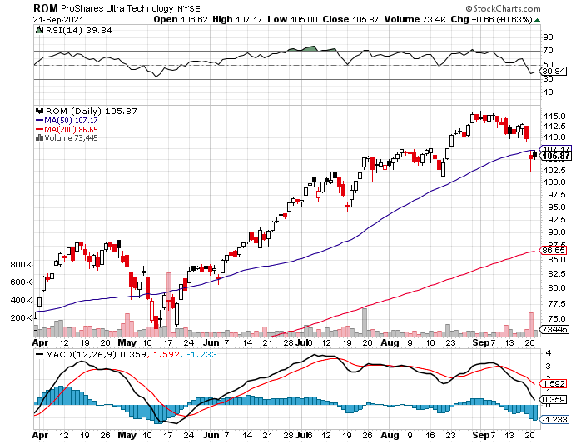
ProShares Ultra Technology (ROM) – New Highs

Slide 34
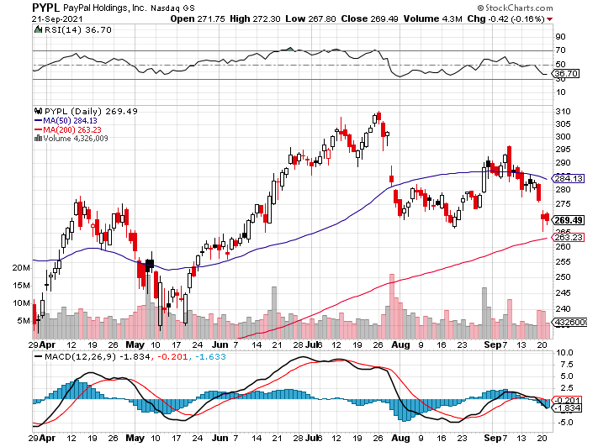
PayPal (PYPL)- PayPal Goes Global ….again, buying Japan’s Paidy for $2.7 billion took profits on long 4/$90-$95 call spread

Slide 35
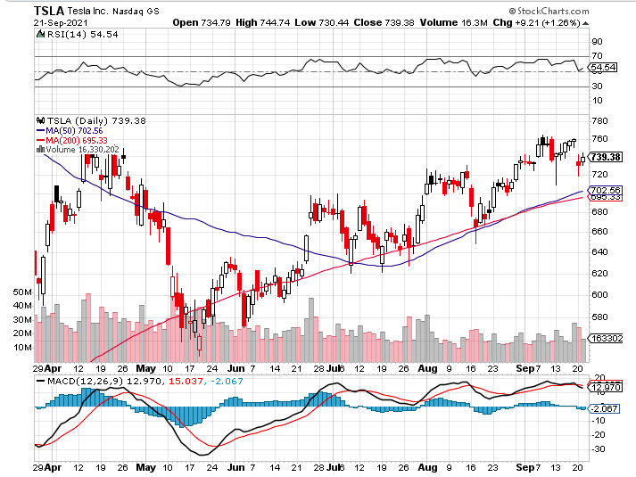
Tesla (TSLA)-Tesla to Get EV Tax Credit Restored Tesla to Make Own Chips took profits on long 2X 4/$450-$500 call spread, took profits on long 3/$400-$450 call spread took profits on long 2/$650-$700 call spread-expires, stopped out of long 3/$600-$650 call spread Took profits on long 2/$600-$650 bull call spread, Took profits on long 2/$550-$600 bull call spread

Slide 36
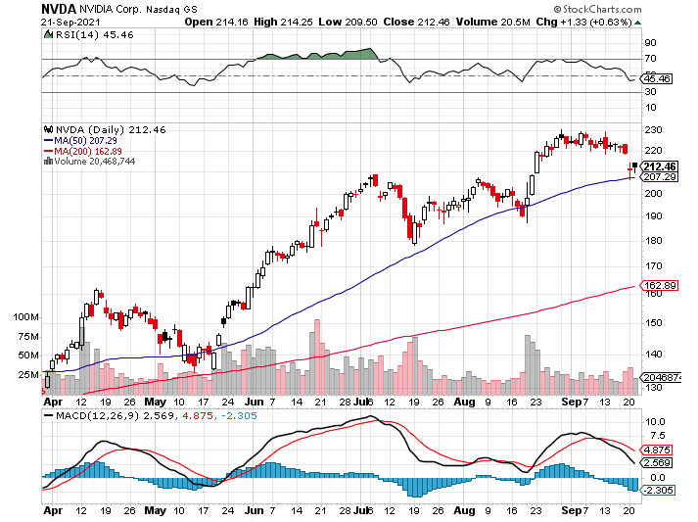
NVIDIA (NVDA) – New Highs on Great Earnings A Mad Hedge 10 bagger – Global Semiconductor Shortage Slows Auto Industry, Graphic card sales up 87% in Q2

Slide 37
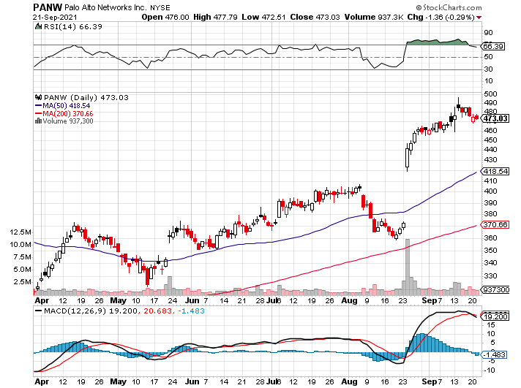
Palo Alto Networks (PANW)- Hacking never goes out of fashion

Slide 38
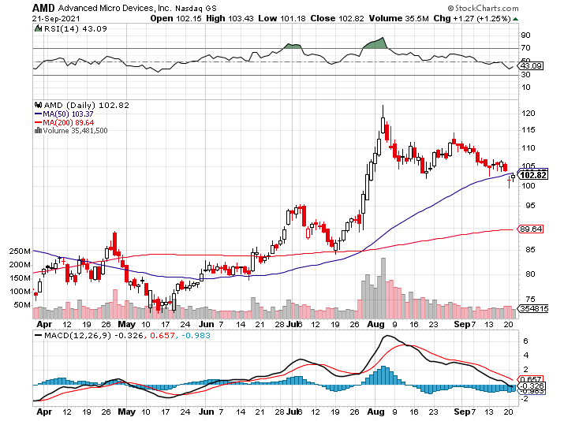
Advanced Micro Devices (AMD)- programable logic devices took profits on long 2/$75-$80 call spread

Slide 39
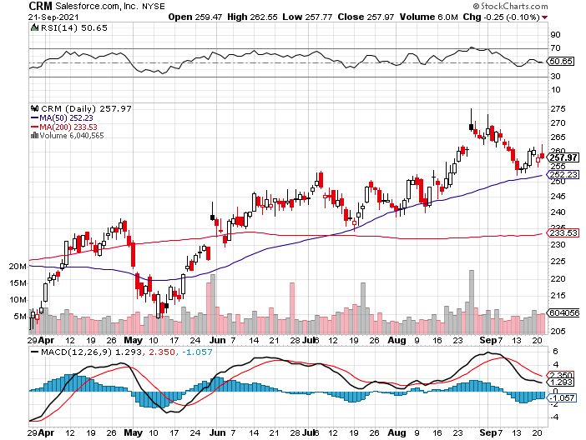
Salesforce (CRM)- Massive Online Migration took profits on long 9/$125-$130 vertical bull call spread took profits on long 8/$125-$130 vertical bull call spread took profits on long 2/$105-$115 call spread

Slide 40
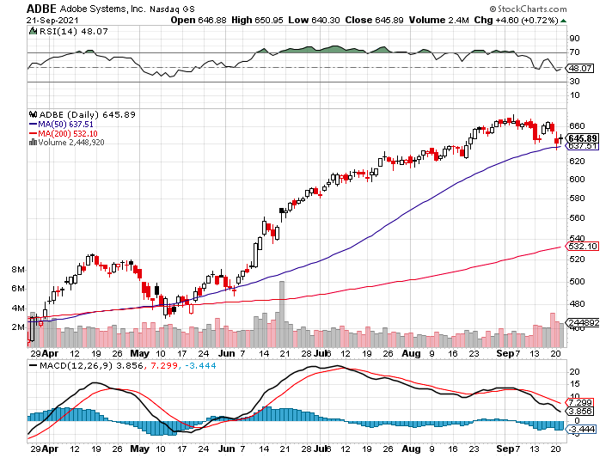
Adobe (ADBE)- Cloud play The Quality Non-China tech play

Slide 41
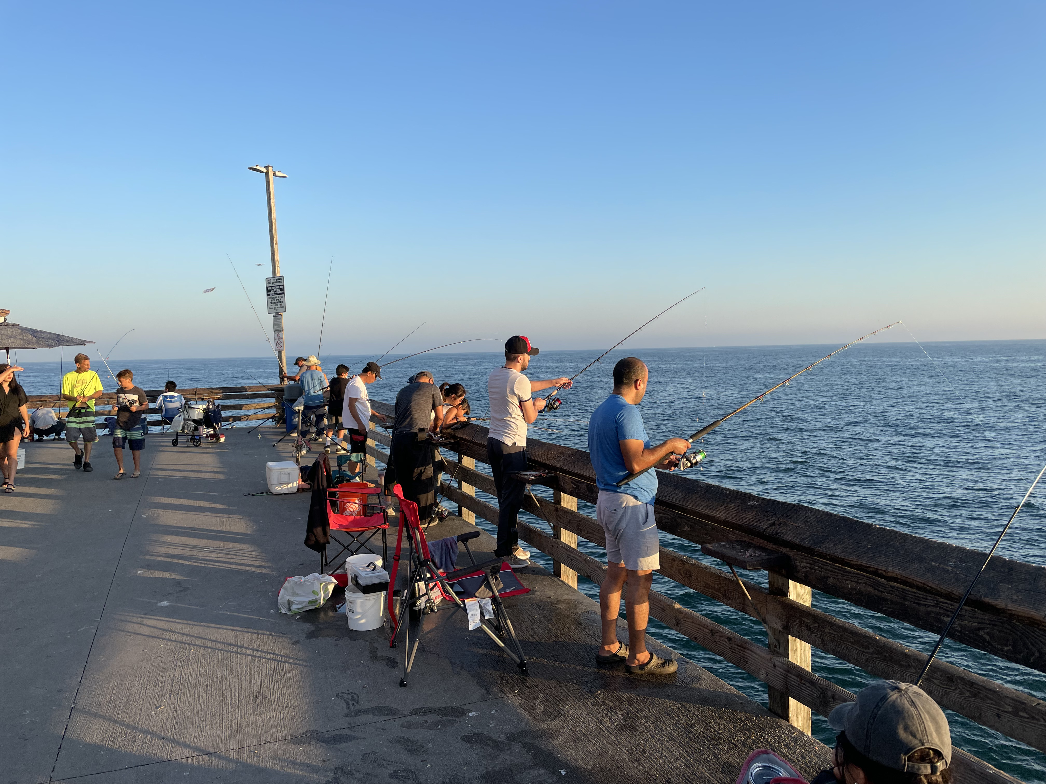

Slide 42
The Second Half of the Barbell
*Bets on a domestic recovery in 2021 Q4 *Upside potential in 2021 far greater than tech *Some of these have not moved for 5 or 10 years *Focuses on economically sensitive cyclical industries *Makes a great counterweight to high-growth technology *We could spend all of next year rotating between the two groups

Slide 43
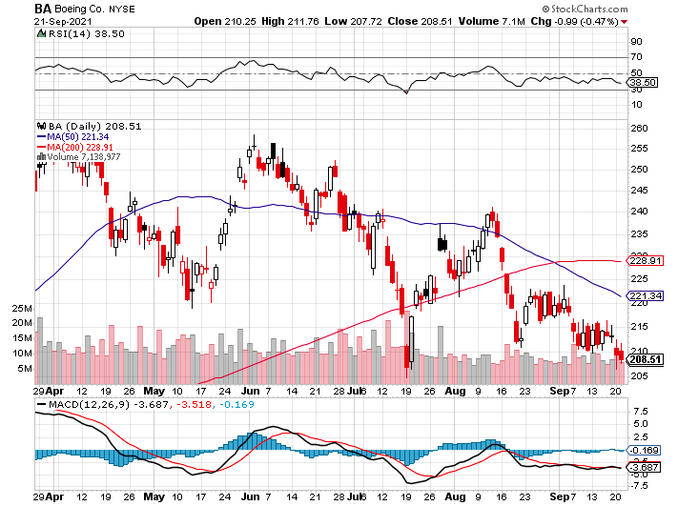
Boeing (BA) – former LEAP Candidate – Headaches again long 3/$146-$149 call spread took profits on long 2/$150-$160 call spread

Slide 44
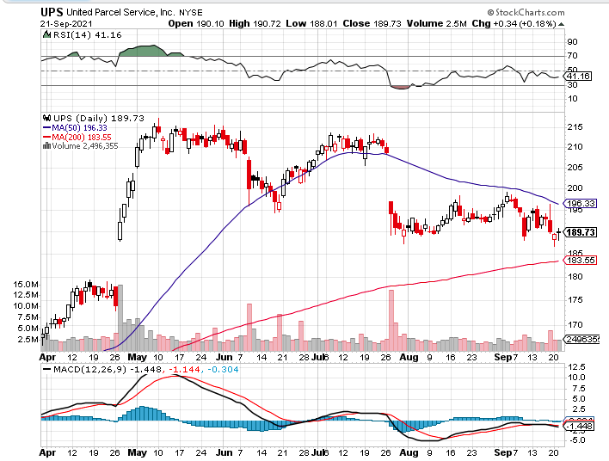
Package Delivery- United Parcel Service (UPS) - Package Delivery massive increase in overnight deliveries, announces blowout earnings, vaccine deliveries took profits on long 11/$130-$140 call spread

Slide 45
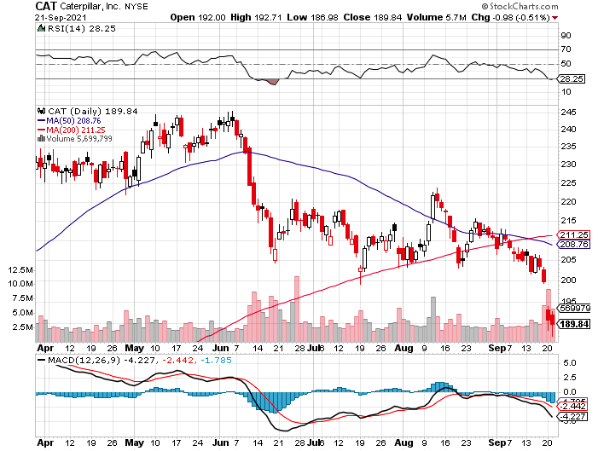
Caterpillar (CAT)- Ag + Infrastructure + Housing took profits on long 12/$145-$150 call spread took profits on long 11/$125-$135 call spread

Slide 46
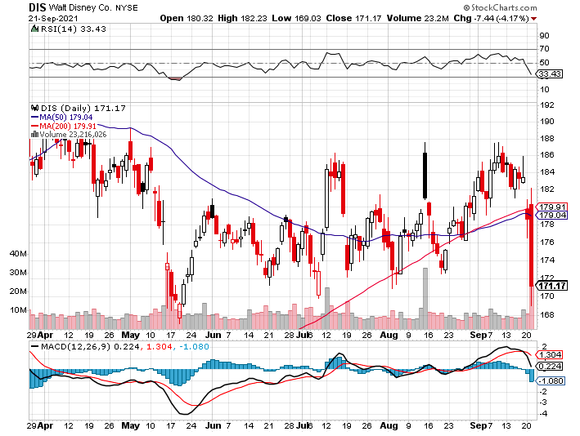
Walt Disney (DIS)- Big Recovery Move Covid 4th Wave Delta Drag took profits on long 3/$170-$180 call spread

Slide 47
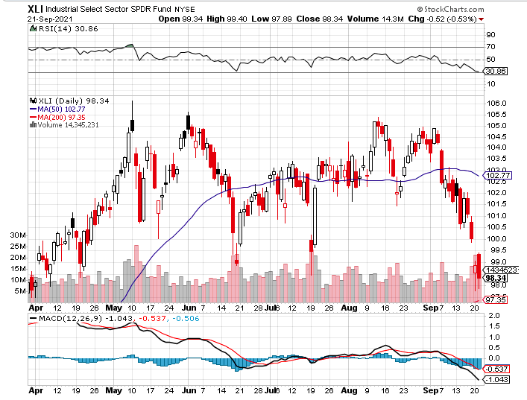
Industrials Sector SPDR (XLI)- (GE), (MMM), (UNP), (UTX), (BA), (HON)

Slide 48
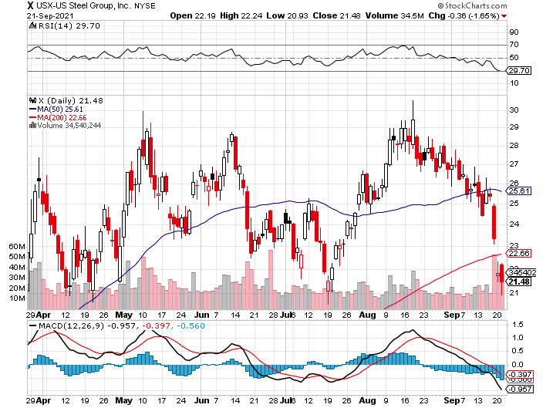
US Steel (X) – Commodity Drag

Slide 49
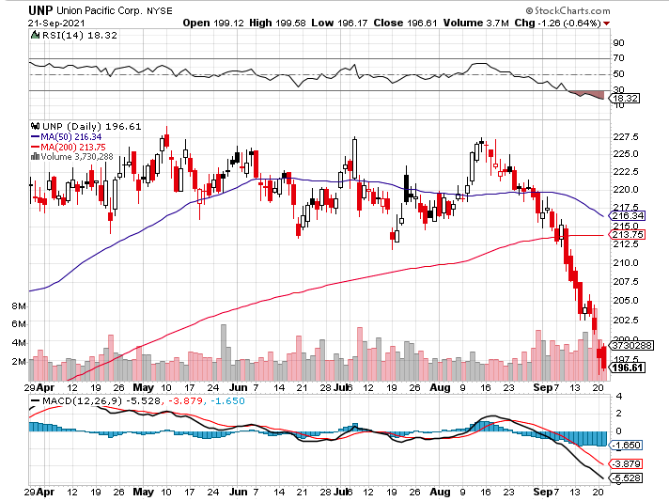
Union Pacific RR (UNP)- Big Stuff to Ship near record earnings announced long 5/$200-$210 call spread – 12 days to expiration took profits on 11/$150-$160 call spread

Slide 50
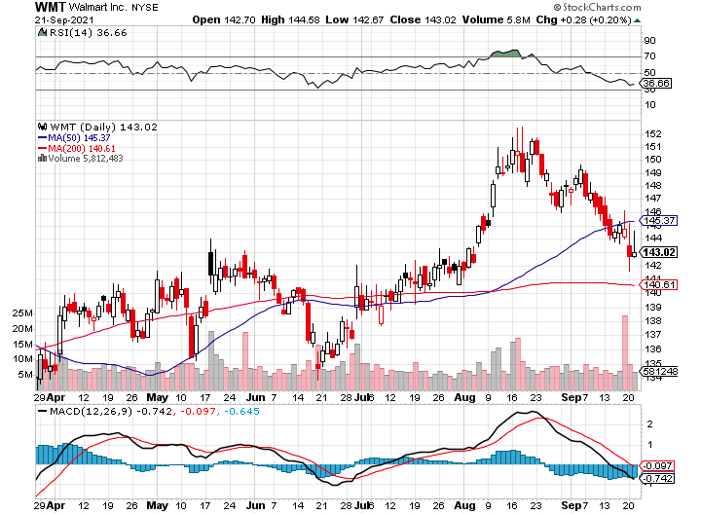
Wal-Mart (WMT)-New High took profit on Long 11/$125-$130 bear put spread took profit on Long 10/$119-$121 bear put spread took profits on Long 8/$114-$117 bear put spread

Slide 51
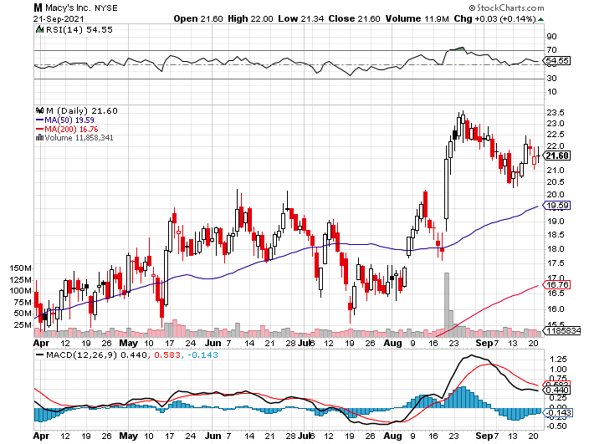
Macys’ (M) – Retail Return from the Grave took profits on Long 8/$23-$25 bear put spread

Slide 52
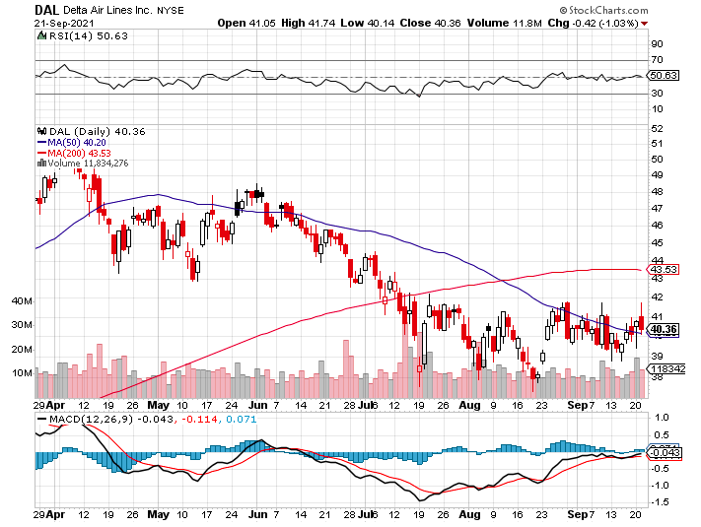
Delta Airlines (DAL) –

Slide 53
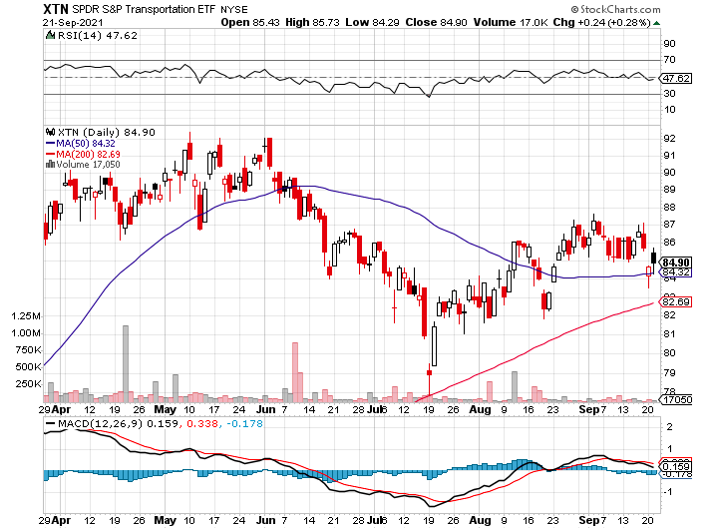
Transports Sector SPDR (XTN)- Worst Hit Sector (ALGT), (ALK), (JBLU), (LUV), (CHRW), (DAL)

Slide 54
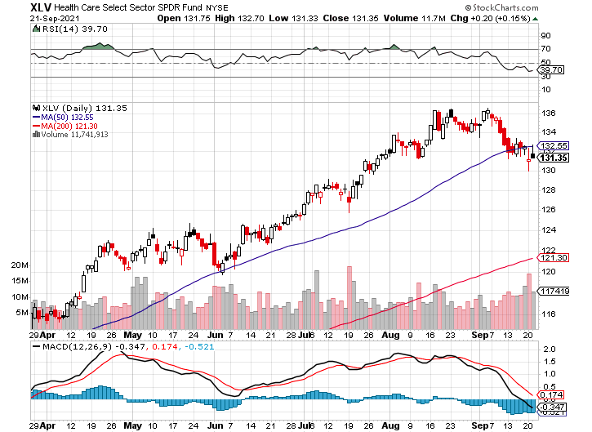
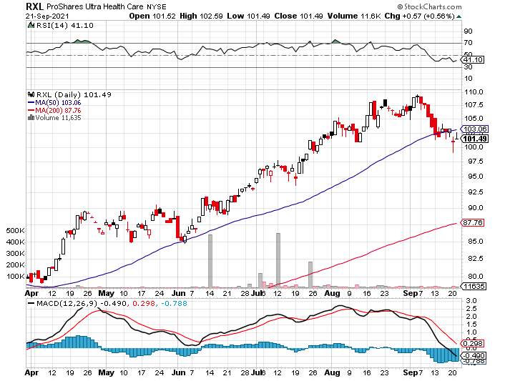
Health Care Sector (XLV), (RXL) (JNJ), (PFE), (MRK), (GILD), (ACT), (AMGN)

Slide 55
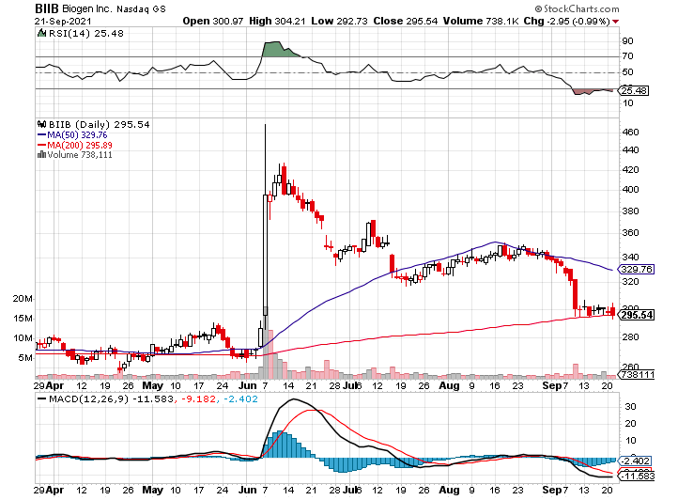
Biogen (BIIB) Why you do Biotech

Slide 56
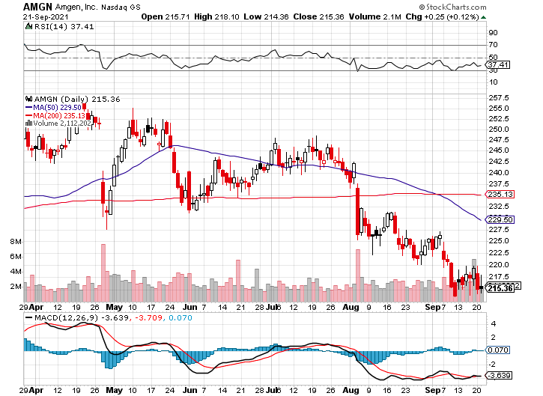
Amgen (AMGN) took profits on long 11/$185-$200 bull call spread

Slide 57
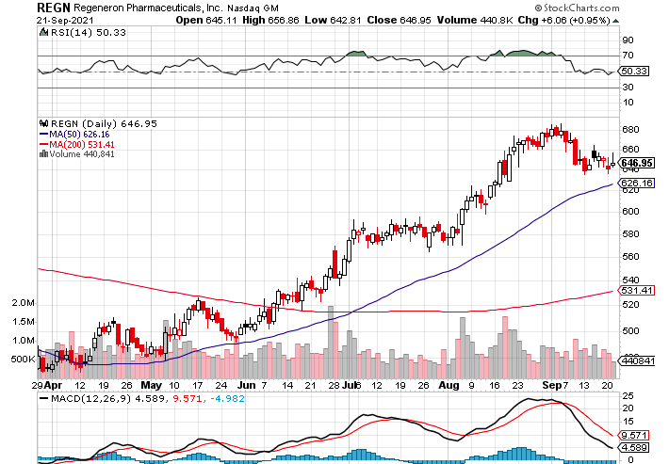
Regeneron (REGN) took profits on long 7/$570-$580 call spread

Slide 58
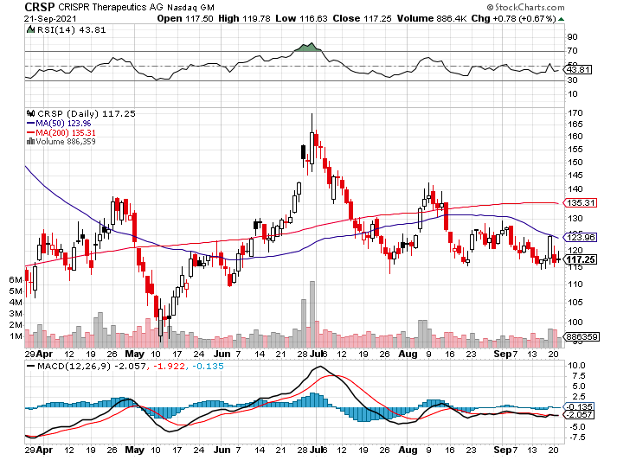
CRISPR Therapeutics (CRSP)

Slide 59
Goldman Sachs (GS) – took profits on long 8/$325-$335 call spread took profits on long 6/$310-$320 call spread took profits on long 5/$310-$320 call spread took profits on long 2/$240-$260 call spread

Slide 60
Morgan Stanley (MS) – Doubled Dividend took profits on long 2/$55-$60 call spread

Slide 61
JP Morgan Chase (JPM)-Back to Life took profits on long 8/$140-$145 call spread took profits on long 7/$140-$145 call spread took profits on long 5/$135-$140 call spread took profits on long 2/$135-$140 call spread took profits on long 2/$110-$115 call spread

Slide 62
Citigroup (C) – “Recovery” Rotation Play

Slide 63
Bank of America (BAC) – took profits on long 2/$28-$30 call spread

Slide 64
SPDR Metals & Mining ETF (XME) – long 2/$28-$30 call spread

Slide 65
Blackrock (BLK)-Asset Collection Boom took profits on long 3/$31-$34 call spread

Slide 66
Visa (V) – “Touchless” Fintech Play took profits on long 5/$220-$225 bull call spread took profits on long long 5/$195-$205 bull call spread took profits on long 9/$180-$185 bull call spread

Slide 67
Consumer Discretionary SPDR (XLY) (DIS), (AMZN), (HD), (CMCSA), (MCD), (SBUX)

Slide 68
Berkshire Hathaway (BRKB)- Natural Barbell cut back buy backs at $6 billion a year, announced spectacular earnings took profits on long 3/$230-$240 call spread

Slide 69
Europe Hedged Equity (HEDJ)-

Slide 70
Japan (DXJ)-

Slide 71
Emerging Markets (EEM) - Pro trade, Weak Dollar, Long Recovery Play

Slide 73
Bonds – China Worries
*All eyes on Fed today, will Jay give us a hint about the taper? *Europe Tapers, cutting back monthly Eurobond purchases ∈60-∈70 billion a month. *China route sets up temporary bond spike *Congress’s failure to raise debt ceiling puts more pressure on the market *Add more downside LEAPS NOW, the January 2022 (TLT) $155-$150 vertical bear put spread delivers a 75% profit in six months *A 2.00% yield on the ten-year US Treasury bond here we come! This is the quality trade for the rest of 2021 *US Treasury bond fund (TLT) could plunge from $180 a year ago to $105 by 2023

Slide 74
Treasury ETF (TLT) – The Top is In long 10/$155-$158 put spread, took profits on 9/$155-$158 put spread took profits on long 8/$157-$160 put spread, took profits on long 8/$156-$159 put spread, took profits on long 7/$152-$155 put spread stopped out of long 5/$143-$146 put spread, took profits long 5/$143-$146 put spread

Slide 75
Ten Year Treasury Yield ($TNX) – 1.32%

Slide 76
Junk Bonds (HYG) 3.47% Yield to Maturity

Slide 77
2X Short Treasuries (TBT)-Another run at highs

Slide 78
Emerging Market Debt (ELD) 4.27% Yield-

Slide 79
Municipal Bonds (MUB) – 0.93% Mix of AAA, AA, and A rated bonds

Slide 80
Foreign Currencies – The Chop Continues
*Head & Shoulders top setting up for the dollar *Could set up a broader longer term selloff *Long-term fundamentals continue to worsen, a dollar short could be the new ten-year trade *Massive over issuance of debt by the US government to fund the covid recovery is another nail in the coffin in addition to an exploding trade deficit *Buy Buy (FXA) and (FXE) on dips. *Bitcoin hit with 10% correction of El Salvador adoption is a classic buy the rumor and sell the news. All the pros piled in on the dip

Slide 81
Japanese Yen (FXY), (YCS)

Slide 82
Euro ($XEU), (FXE), (EUO)-

Slide 83
British Pound (FXB)-

Slide 84
Australian Dollar (FXA)- The Global Recovery Play took profits on long 8/$67-$69 call spread

Slide 85
Emerging Market Currencies (CEW)

Slide 86
Chinese Yuan- (CYB)-

Slide 87
Bitcoin – China Hit Buy the Mad Hedge Bitcoin Letter at https://www.madhedgefundtrader.com/store/
*Coinbase is Borrowing $2 Billion to further expand its crypto presence *China shock knocks cryptos for a 10% hit *Switzerland open exchanges to Bitcoin trading *Robinhood adding crypto ap to allow customers to send and receive Bitcoin * * *

Slide 88
Bitcoin ($BTCUSD) – Wake Up Time

Slide 89
Etherium (ETHE) – +125% in Three Months

Slide 91
Energy –
*China Releases from its Strategic Oil Reserve, sending oil to the mat. *New York to Ban Gasoline Powered Cars by 2035 *Buy the dip at your own risk, any longs are counter trend trades *The end of oil is upon us, but it may take 30 years to unwind existing infrastructure *All US car production will be electric by 2035 wiping out half of all US oil consumption, 20 million b/d down to 10 million b/d *Avoid all energy plays like the plague, it’s the new buggy whip industry as the US de-carbonizes

Slide 92
Oil-($WTIC)

Slide 93
United States Oil Fund (USO) long 10/$9.50-$10 Vertical bull call spread

Slide 94
Energy Select Sector SPDR (XLE)-No Performance! (XOM), (CVX), (SLB), (KMI), (EOG), (COP)

Slide 95
Halliburton (HAL)-

Slide 96
Natural Gas (UNG) -

Slide 97
Precious Metals – No Flight to Safety
*Biggest risk off day of 2021 and gold doesn’t budge *Bitcoin is clearly sucking capital out of precious metals *Stay away until this plays out *Silver is still the bigger and better long-term play *Gold will eventually recover when US borrowing becomes so massive it undermines the value of the US dollar, even in the face of higher interest rates

Slide 98
Gold (GLD)- Meltdown

Slide 99
Market Vectors Gold Miners ETF- (GDX) –

Slide 100
Barrick Gold (GOLD) took profits on long 1/$21-$23 call spread took profits on long 11/$22-$24 call spread

Slide 101
Newmont Mining- (NEM)- took profits on long $55-60 call spread

Slide 102
Silver- (SLV)- took profits on long 11/$19-$20 call spread

Slide 103
Silver Miners - (SIL)-

Slide 104
Wheaton Precious Metals - (WPM)- took profits on long 2/$39-41 call spread

Slide 105
Copper (COPX)-Uptrend Resumes Copper Unions Vote to Strike in Chile, cutting off 33% of the global supply

Slide 106
Real Estate – Still Bubbling
*America is Missing 5 Million Homes, which went missing when most small developer went bust during the 2008-2009 housing crash. *Banks increasing discrimination against lending on homes in high fire and flood zones. *Homebuilder Sentiment Rises for first time in 3 months, from 75 to 76 in September, thanks to lumber price crash. *Zillow moves big into AI, using it to price and even buy homes *Housing Starts for August up 3.9% with apartment buildings the big driver *Building Permits for August up 6.0% *Lennar disappoints on supply chain problems, hammering stock *S&P Case Shiller Smashes all Records, up 17% YOY

Slide 107
S&P Case Shiller Up 16.6% for May Phoenix (25.9%), San Diego (24.7%), and Seattle (23.4%) lead

Slide 108
Crown Castle International (CCI) – 2.70% yielding cell phone tower REIT

Slide 109
US Home Construction Index (ITB) (DHI), (LEN), (PHM), (TOL), (NVR)

Slide 110
Trade Sheet- So What Do We Do About All This?
*Stocks – buy dips aggressively *Bonds – sell rallies aggressively *Commodities-buy dips aggressively *Currencies- sell US dollar rallies *Precious Metals – buy dips *Energy – stand aside *Volatility - sell short over $30 *Real estate – buy dips *Bitcoin – buy dips

Slide 111
Next Strategy Webinar 12:00 EST Wednesday, September 22, from Silicon Valley email me questions at support@madhedgefundtrader.com
Good Luck and Good Trading!
Notes:
*

