Slide 1

The Mad Hedge Fund Trader “Shopping Time”
With John Thomas Silicon Valley, CA, October 6, 2021 www.madhedgefundtrader.com
Notes:
*

Slide 2


Slide 3

Trade Alert Performance New All Time Highs! 32 consecutive profitable trade alerts- 93.5% success rate in 2021-ony 5 losers
*January 10.21% MTD *July +0.61% Final *February +13.28% Final *August +9.36% Final *March +20.60% Final *September 1.03% Final *April +15.67% Final *October +3.17% MTD *May +8.13% Final *November +20.41% Final *June +0.71% Final *December +10.20% Final *2021 Year to Date +82.77% compared to +10.94% for the Dow Average *+505.32% since inception, a new all time high *Average annualized return of 42.44% for 12 years, new all time high

Slide 4
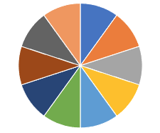
Portfolio Review 100% invested in financials in a high volatility Long Term Bull Market
Current Capital at Risk
Risk On
World is Getting Better
(SPY) 10/$410-$420 call spread | 10.00%
(GS) 10/$320-$330 call spread | 10.00%
(GS) 11/$330-$350 call spread | 10.00%
(JPM) 10/$130-$140 call spread | 10.00%
(BLK) 10/$770-$790 call spread | 10.00%
(MS) 10/$85-$90 call spread | 10.00%
(MS) 11/$85-$90 call spread | 10.00%
(BRKB) 10/$255-$265 call spread | 10.00%
(C) 10/$62-$65 call spread | 10.00%
(BAC) 11/$37-$40 call spread | 10.00%
Risk Off
World is Getting Worse
Total Net Position | 100.00%
Expiration Value 90.08%

Slide 5
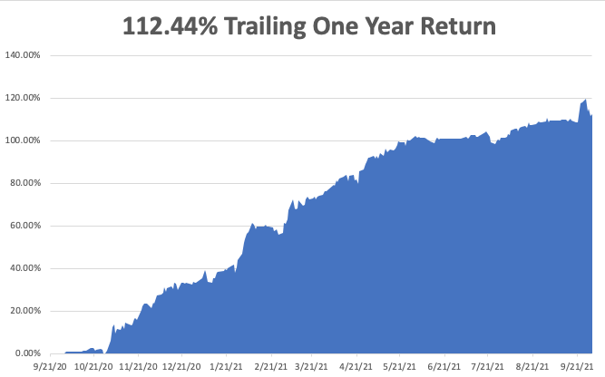

Slide 6
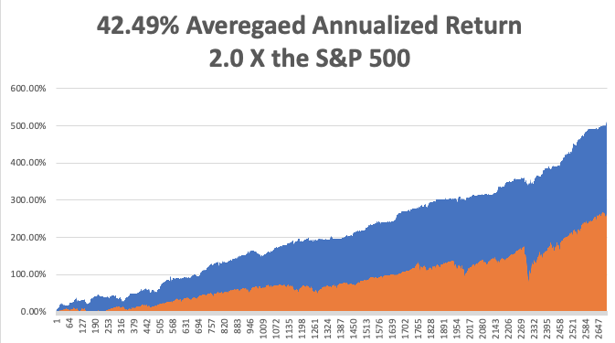
GTD 12 Year Daily Audited Performance

Slide 7

The Method to My Madness The Roaring Twenties are Here
*Profits are growing 5.5 times faster than any possible end of QE. The wall of money is growing. QE is $1.44 trillion a year versus corporate profits rocketing by $8 trillion *Soaring interest rates prompt much need stock market correction *I went all in with a great buying opportunity for financials *The multiyear bear market in bonds is here, cash in with those shorts *Rising rates will bring modestly lower technology prices are are still a long-term hold *Medium term, both sides of the barbell are working *Bitcoin rallies a 10% on China ban, imminent SEC approval *VIX at $29 shows the time to buy is here

Slide 8

Corona Update – A New Advance
*Merck’s Molnupiravir pill cuts covid hospitalization death rate by 50% *30% of new cases are now in kids under 12 *70 million still unvaccinated, but 95% of California is vaccinated or immune *80% of the US population has covid antibodies, and 95% in San Francisco *No deaths from delta variant report among those vaccinated *14 states now have law suites attempting to ban mask mandates *Best immunity is from getting covid, then getting vaccinated *US cases top 42 million, deaths topping 7,000 and deaths are back up to 2,000 a day

Slide 9
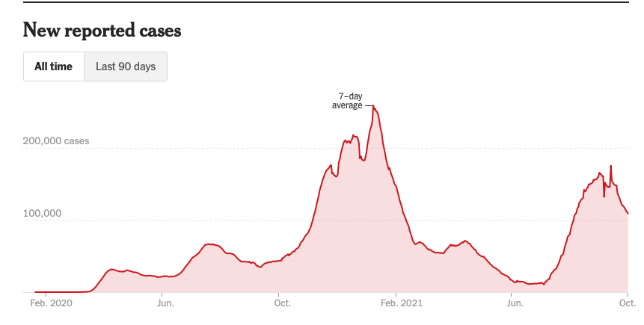
Bump on the Way to Zero the Fourth Wave – The Self-Inflicted Injury

Slide 10
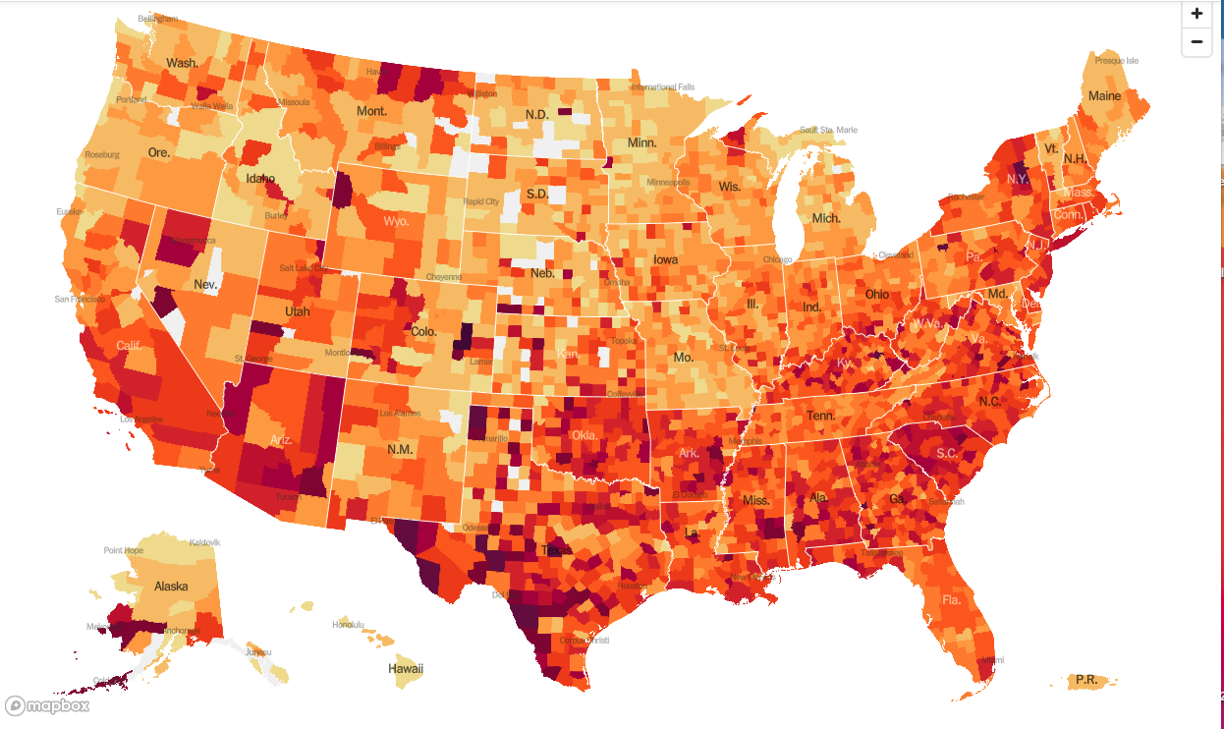
January 20 Infection Rate

Slide 11
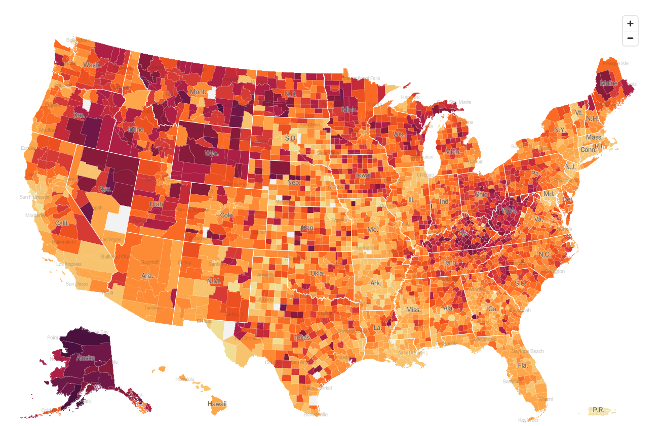
October 6 Infection Rate

Slide 12
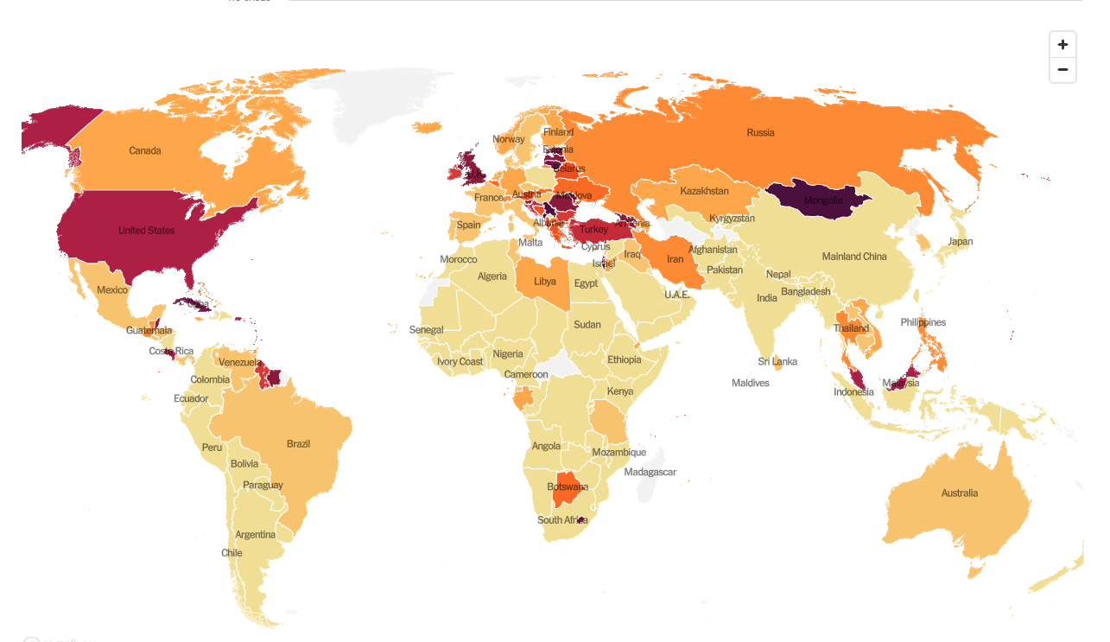

Slide 13
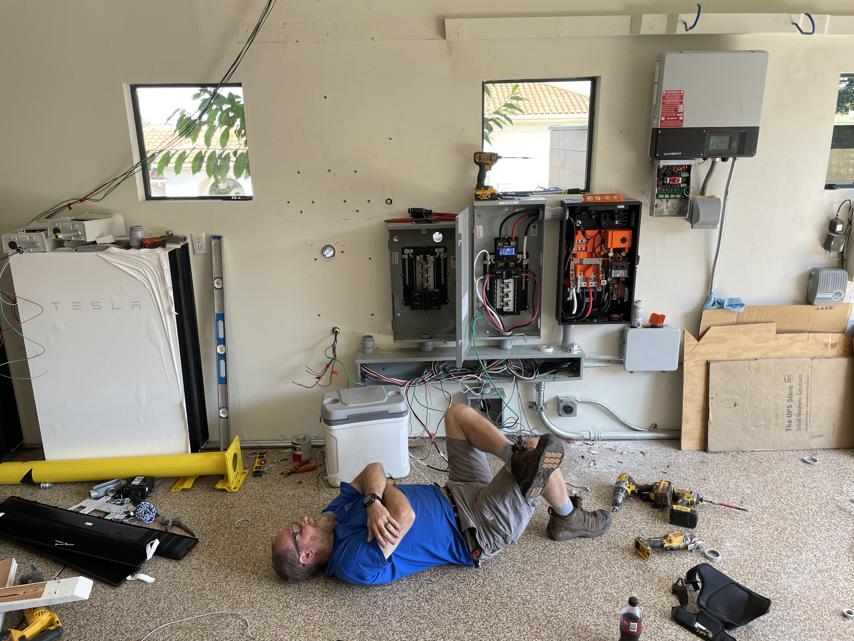

Slide 14

The Global Economy – Looking in the Rear-View Mirror supply chain problems now in the price
*China’s Largest Real Estate Developer Goes Bust, China Evergrande Group, with $300 billion in debt. *US Consumer Sentiment Remains Weak, the University of Michigan Index dropping from 78.5 to 77.1 in September
*Leading Economic Indicators jump in August, coming in at 0.9%. *Manufacturing PMI Drops, from 61.7 estimated to 60.5 *Consumer Confidence Dives, in September *Q2 US GDP Rises to 6.7%, a 38 year high in its final read * China PMI Falls Under 50, to 49.6, signifying a shrinking economy

Slide 15
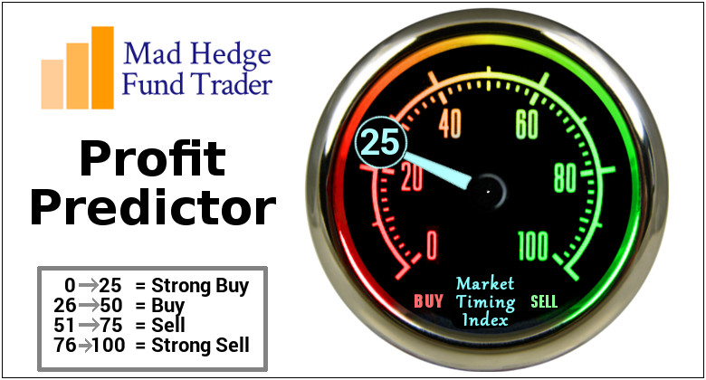
The Mad Hedge Profit Predictor Market Timing Index – Waiting for a Selloff An artificial intelligence driven algorithm that analyzes 30 different economic, technical, and momentum driven indicators

Slide 16
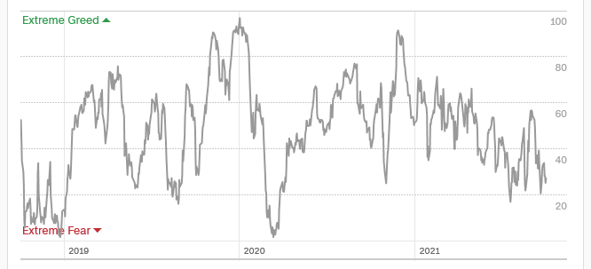
The Mad Hedge Profit Predictor Moving into a “BUY” Range
SELL
Do Nothing
BUY

Slide 17
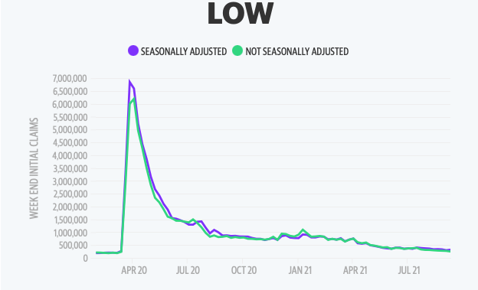
Weekly Jobless Claims – New Lows 362,000 – up 20,000

Slide 18

Stocks – Probing for a bottom
*With a wall of money growing rapidly, pour money into the lowest valued stocks like financials *Tech Stocks Dive under pressure from rising interest rates *In the meantime, bank stocks, which benefit from rising rates, are having their best year since 1997. *China Energy Shortage Causes Apple and Tesla Cutback *Capital Goods Jump by 0.5% in August with computers and electronics leading the charge *Ford Announced Massive $11.4 Billion in US EV Factories in Kentucky and Tennessee *US Auto Sales Dive on Chip Shortage, off 14% in Q3. General Motors sales could fall as much as 31.5% *Stick with the barbell strategy, we’ll keep rotating back and forth all year between tech & domestic recovery

Slide 19
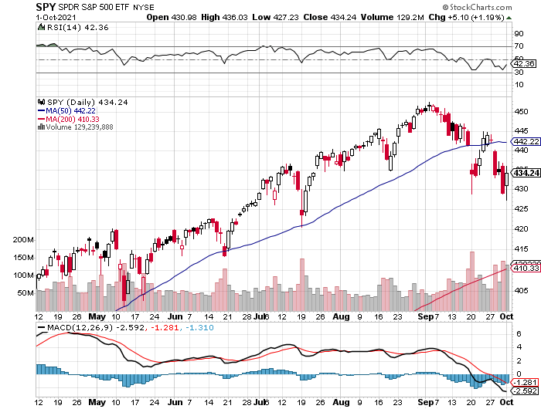
S&P 500 – A Correction at Last! long 10/$410-$420 bull call spread – expires in 7 trading days stopped out of long 10/$419-$429 bull call spread took profits on long 6/$375-$385 bull call spread
New Highs Yearend Target $475
The Bottom 414
10% Correction

Slide 20
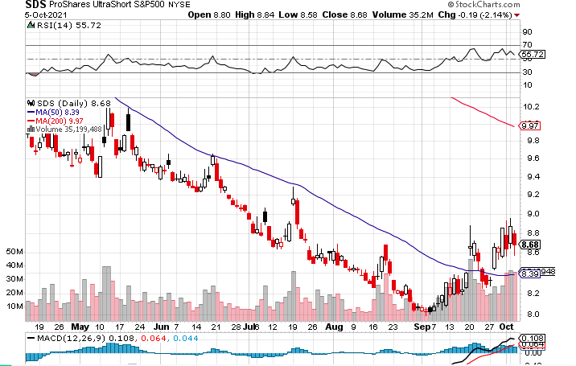
ProShares Ultra Short S&P 500 (SDS)- a great hedge for long stocks and bonds long 2X position has a hedge against longs and bond shorts

Slide 21
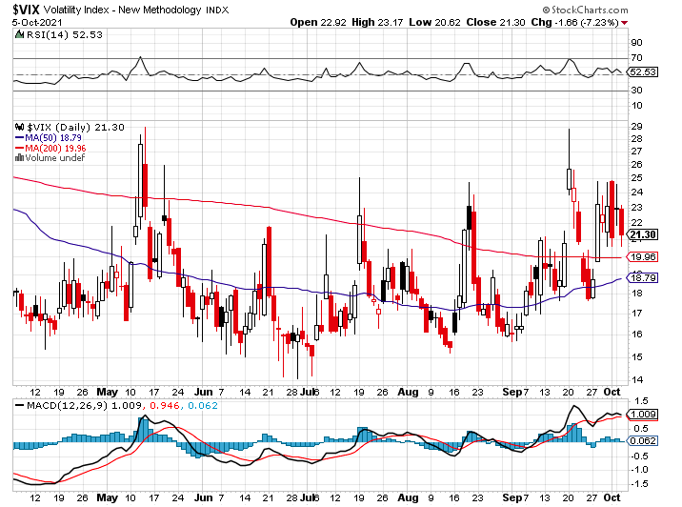
(VIX) – Dying a Slow Death classic summer market

Slide 22
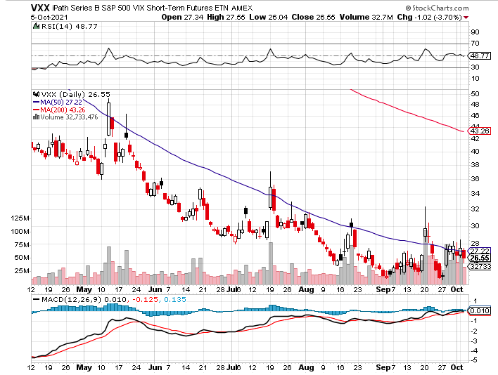
(VXX)-

Slide 23
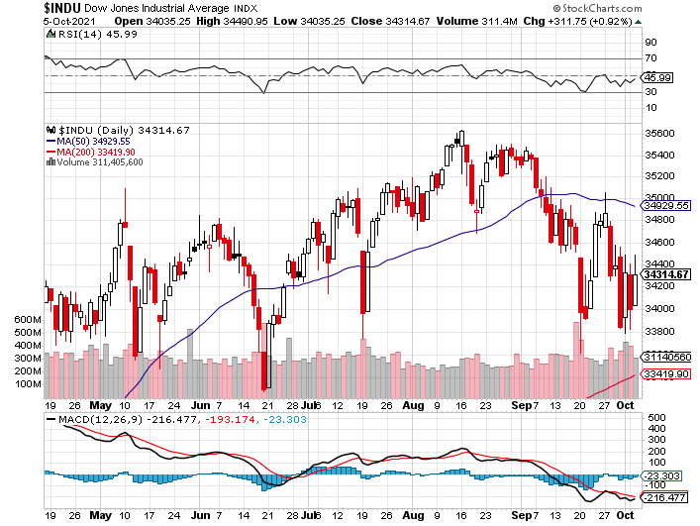
Dow Average ($INDU)-

Slide 24
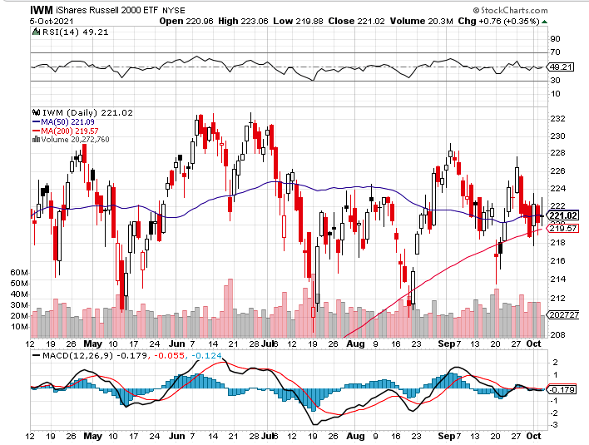
Russell 2000 (IWM)- took profits on Long 10/$137-$142 vertical bull call spread took profits on Long 10/$153-$156 vertical bear put spread

Slide 25
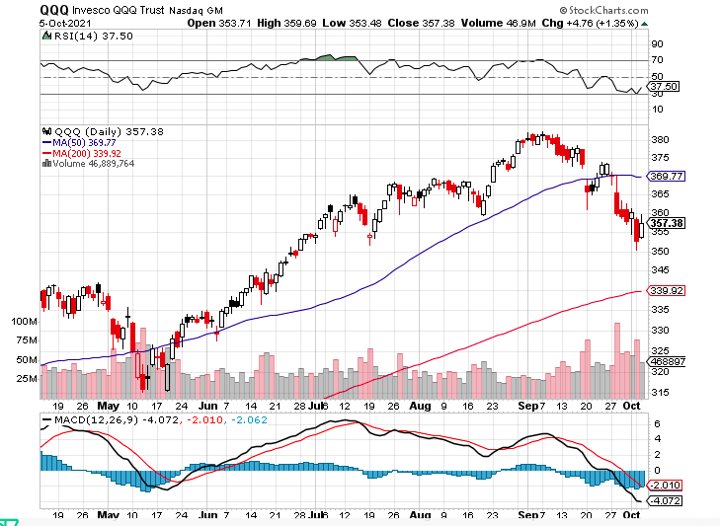
NASDAQ (QQQ) – long (QQQ) 4/$330-$335 put spread took profits on long (QQQ) 3/$340-$345 put spread covered long (QQQ) $325-$330 put spread

Slide 26
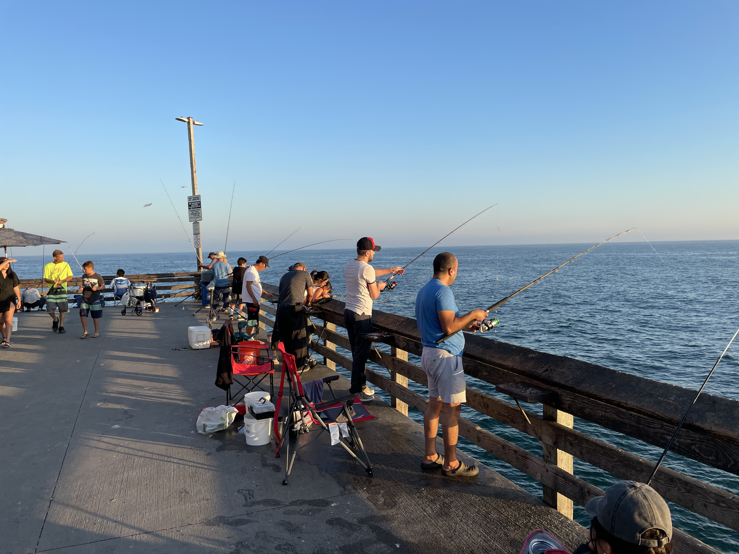

Slide 27
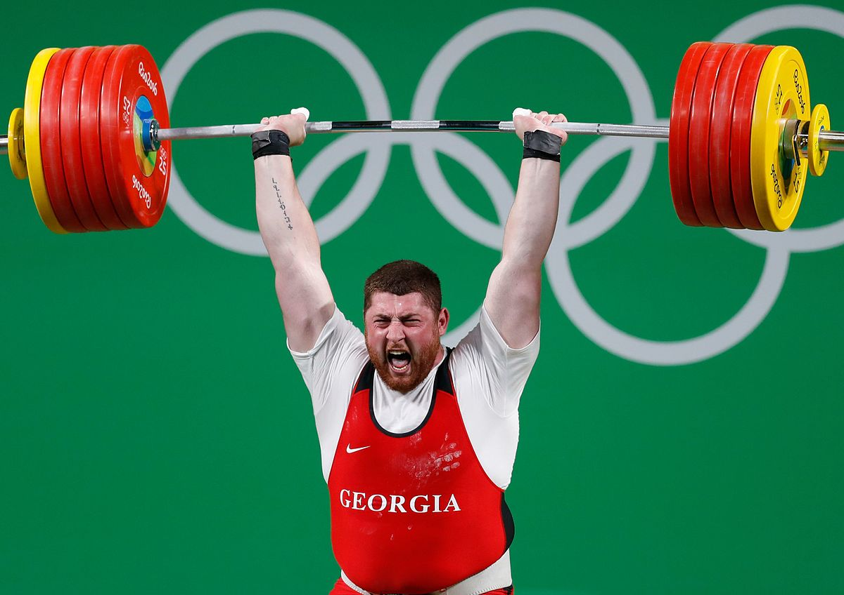
The Barbell Portfolio
*50% Big Tech - 2% of US Employment but 27% of Market Cap and 38% of Profits 50% Domestic Recovery, including: Railroads Couriers Banks Construction Credit Cards Event organizers Ticket sales Retailers

Slide 28
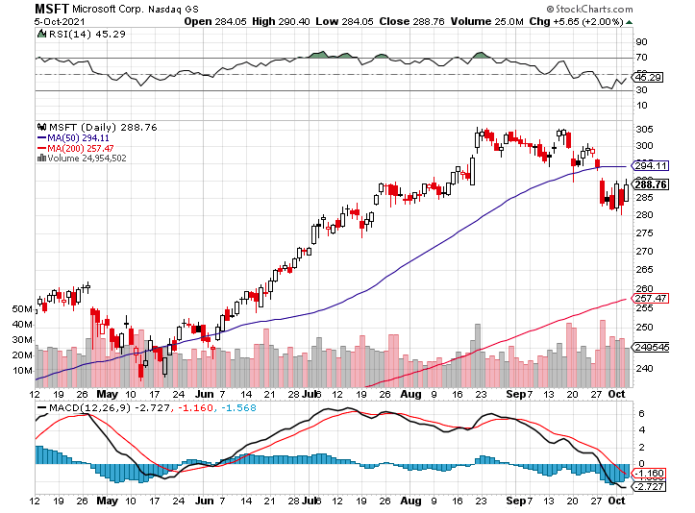
Microsoft (MSFT)- Microsoft to Raise Dividend by 11% and increased a $60 billion stock buyback program took profits on long 12/$220-$230 call spread stop loss on long 12/$170-$180 call spread took profits on long 12/$135-$138 call spread

Slide 29
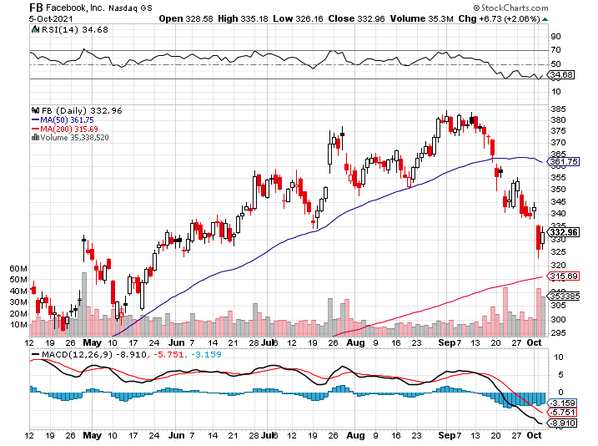
Facebook (FB)-Perfect Storm took profits on Long 9/$290-$300 vertical bear put spread stopped out of Long 9/$190-$200 vertical bear put spread took profits on Long 9/$145-$155 vertical bull call spread took profits on Long 9/$150-$160 vertical bull call spread

Slide 30
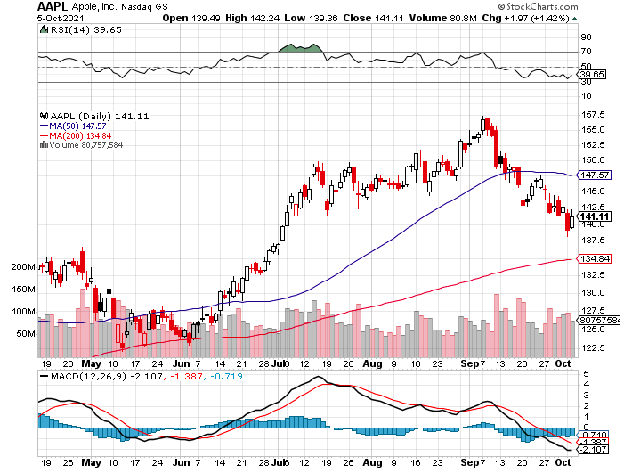
Apple (AAPL)- Launches iPhone 13, with a better camera, faster chips, and longer battery life, Antitrust Comes Home to Roost at Apple took profits on long 7/$320-$330 call spread took profits on long 4/24/$250-$260 call spread took profits on long 5/$250-$260 call spread

Slide 31
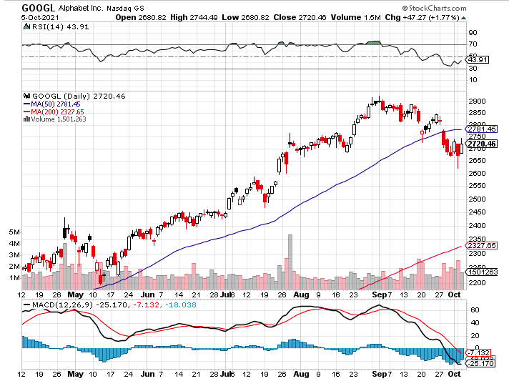
Alphabet (GOOGL) – Ad king on economic recovery 15% of search is travel related took profits on long 12/$1,200-$1,230 bull call spread took profits on long 9/$1,030-$1,080 vertical bull call spread

Slide 32
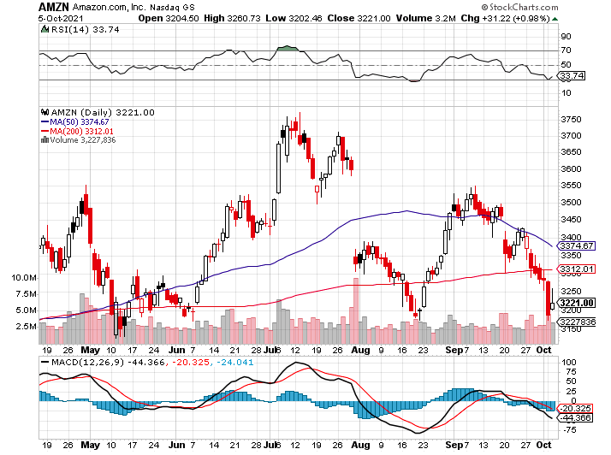
Amazon (AMZN) – Amazon to Hire 125,000 and boost wages to $18 an hour took profits on long 9/$2,800-$2,900 bull call spread

Slide 33
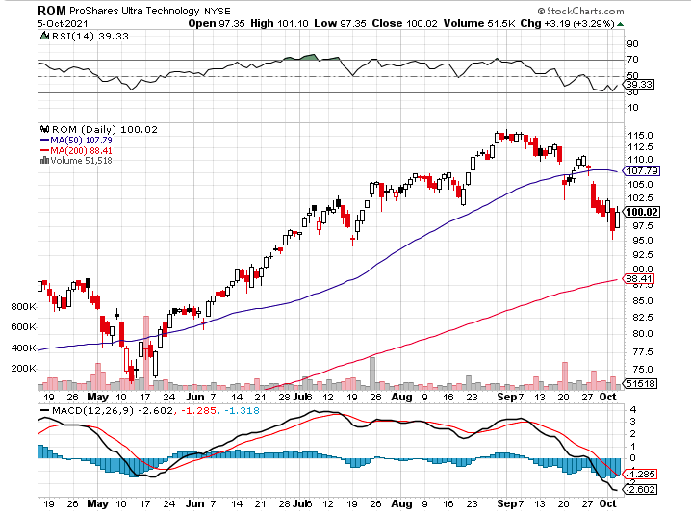
ProShares Ultra Technology (ROM) – New Highs

Slide 34
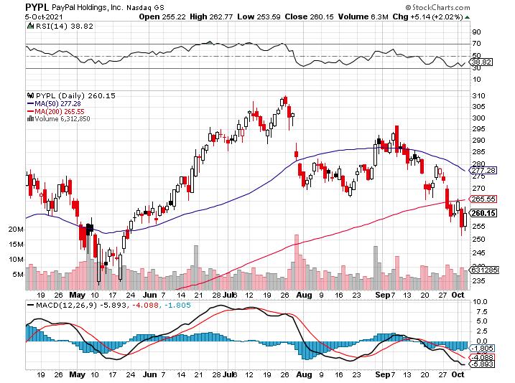
PayPal (PYPL)- PayPal Goes Global ….again, buying Japan’s Paidy for $2.7 billion took profits on long 4/$90-$95 call spread

Slide 35
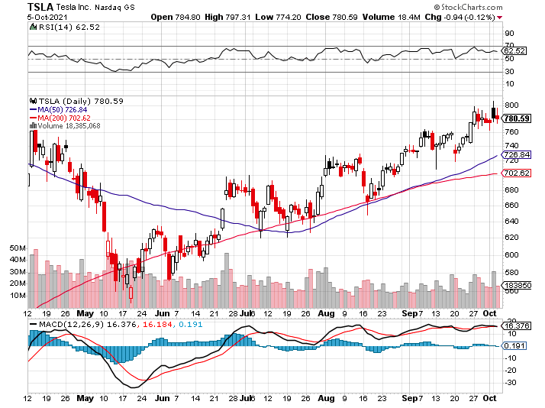
Tesla (TSLA)- The Tesla Street to Street Beta is Out 242,300 Q3 sales beat expectations took profits on long 2X 4/$450-$500 call spread, took profits on long 3/$400-$450 call spread took profits on long 2/$650-$700 call spread-expires, stopped out of long 3/$600-$650 call spread Took profits on long 2/$600-$650 bull call spread, Took profits on long 2/$550-$600 bull call spread

Slide 36
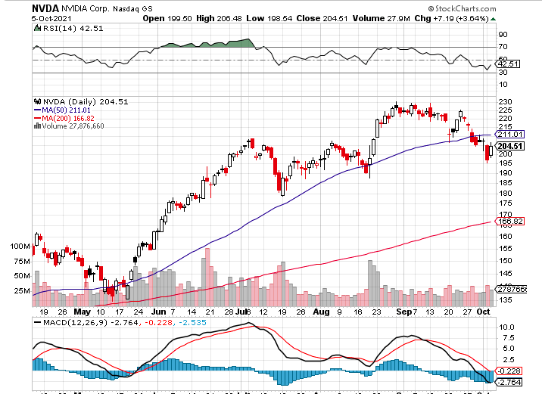
NVIDIA (NVDA) – A Mad Hedge 10 bagger – Global Semiconductor Shortage Slows Auto Industry, Graphic card sales up 87% in Q2

Slide 37
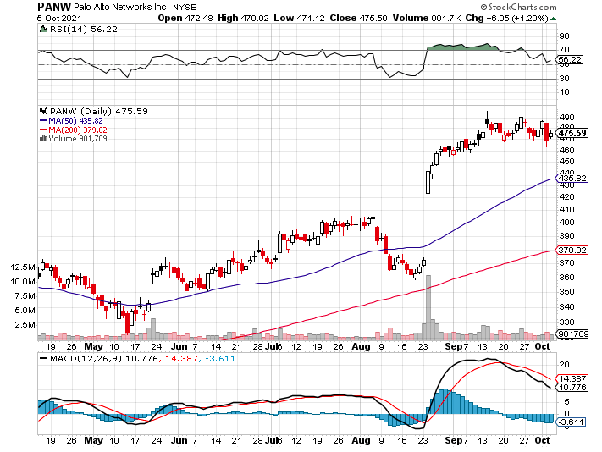
Palo Alto Networks (PANW)- Hacking never goes out of fashion

Slide 38
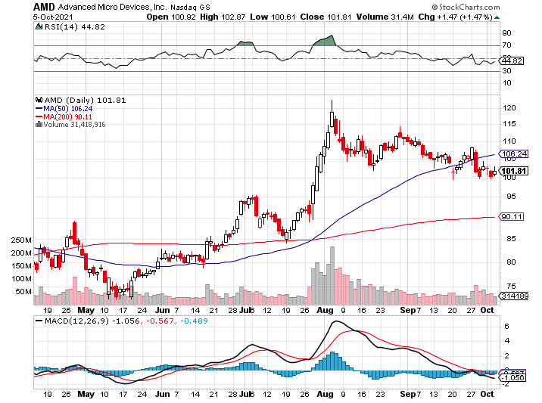
Advanced Micro Devices (AMD)- programable logic devices took profits on long 2/$75-$80 call spread

Slide 39
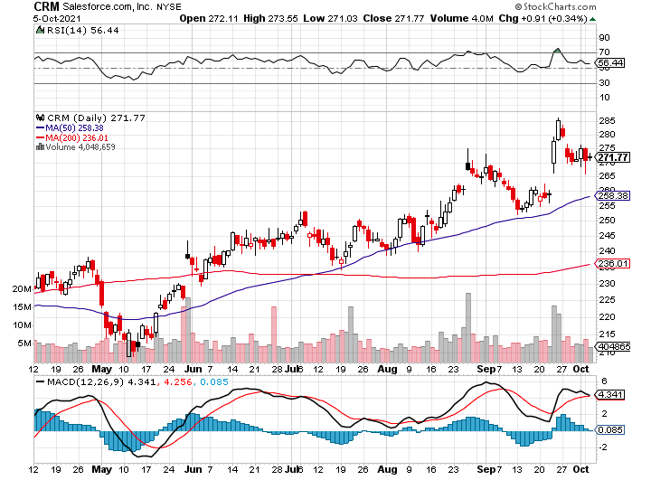
Salesforce (CRM)- Massive Online Migration took profits on long 9/$125-$130 vertical bull call spread took profits on long 8/$125-$130 vertical bull call spread took profits on long 2/$105-$115 call spread

Slide 40
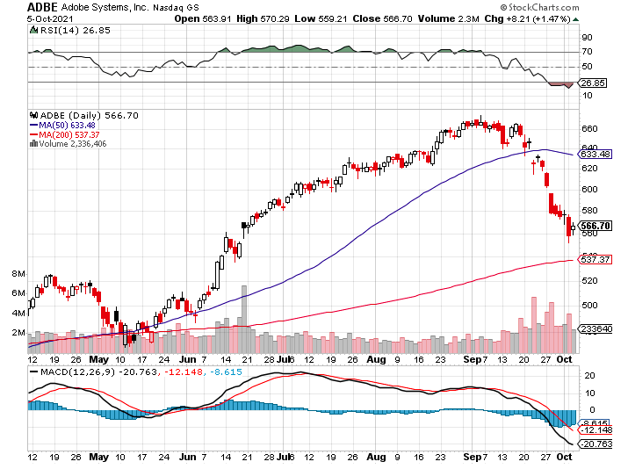
Adobe (ADBE)- Cloud play The Quality Non-China tech play

Slide 41
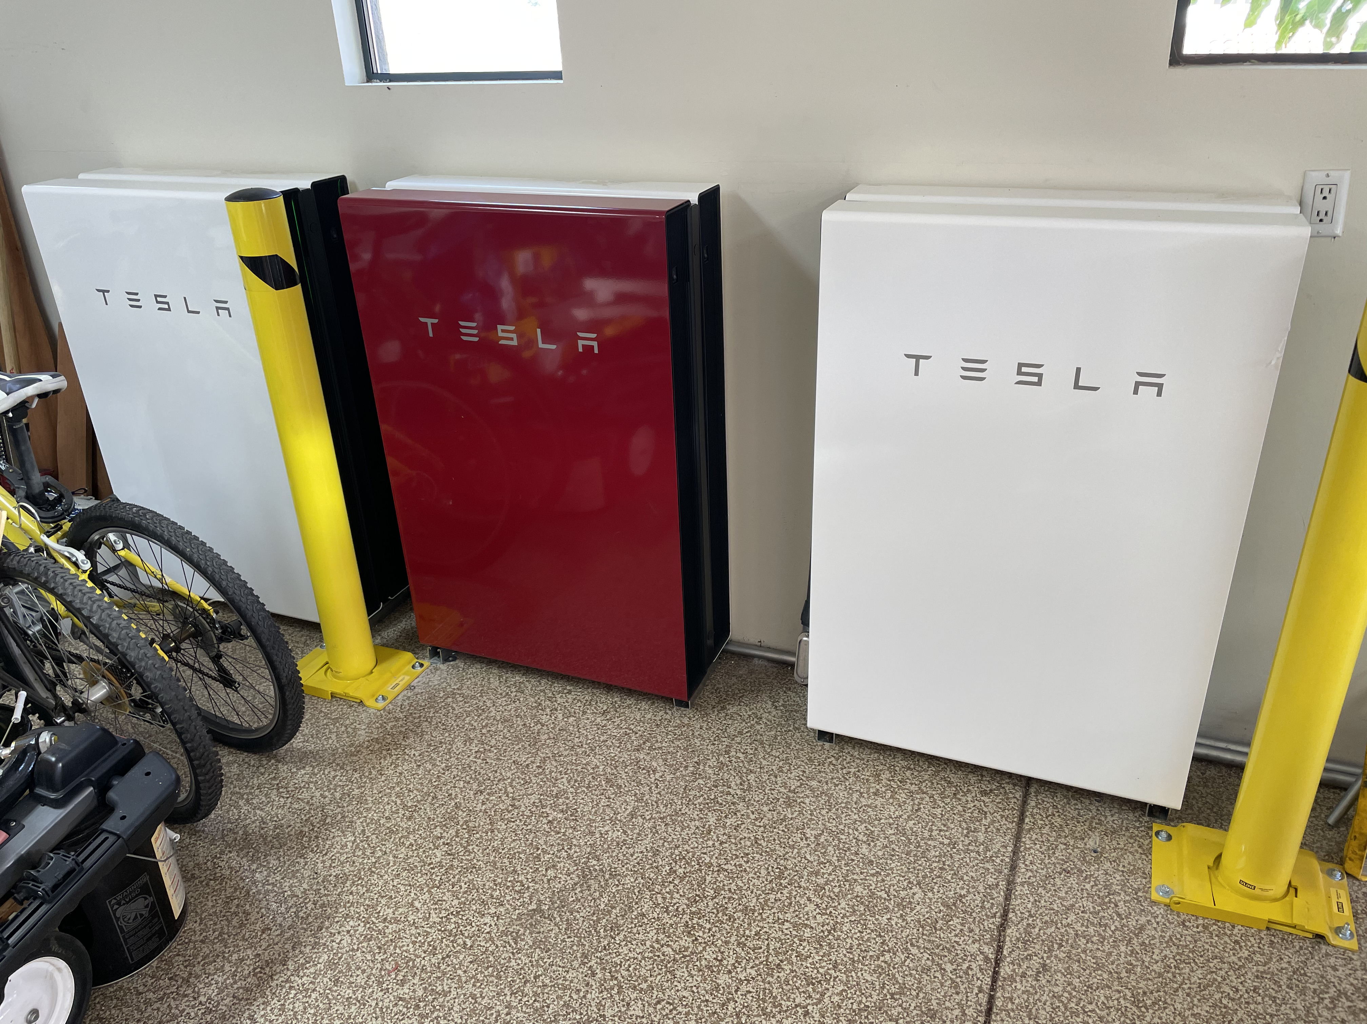

Slide 42
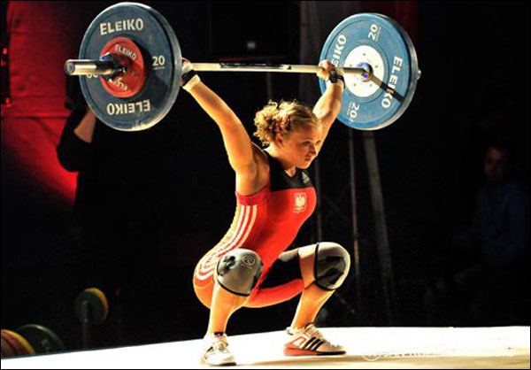
The Second Half of the Barbell
*Bets on a domestic recovery in 2021 Q4 *Upside potential in 2021 far greater than tech *Some of these have not moved for 5 or 10 years *Focuses on economically sensitive cyclical industries *Makes a great counterweight to high-growth technology *We could spend all of next year rotating between the two groups

Slide 43
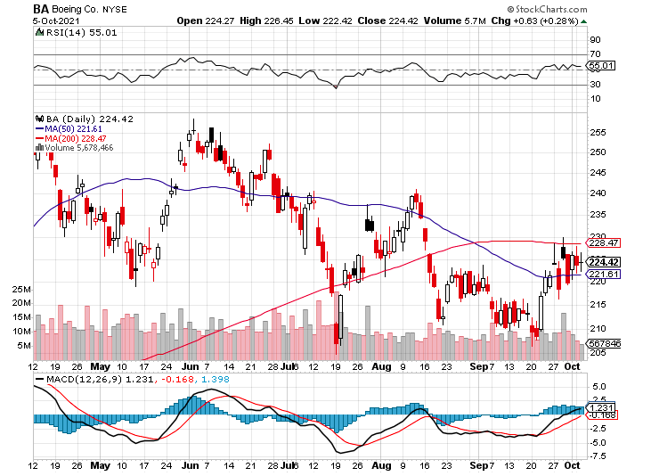
Boeing (BA) – former LEAP Candidate – Headaches again long 3/$146-$149 call spread took profits on long 2/$150-$160 call spread

Slide 44
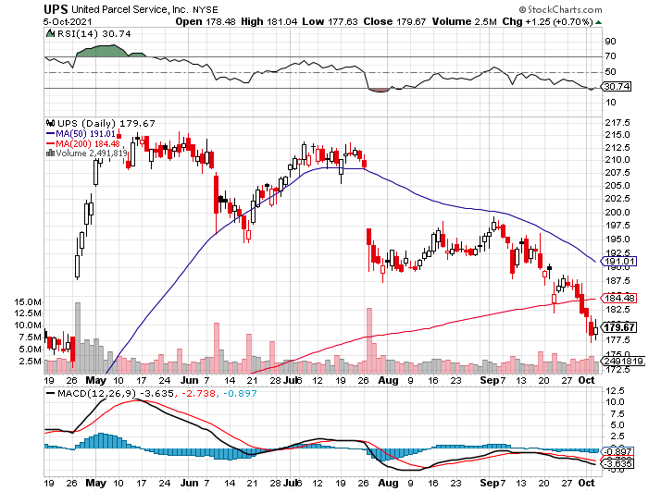
Package Delivery- United Parcel Service (UPS) - Package Delivery the goodbye Christmas trade took profits on long 11/$130-$140 call spread

Slide 45
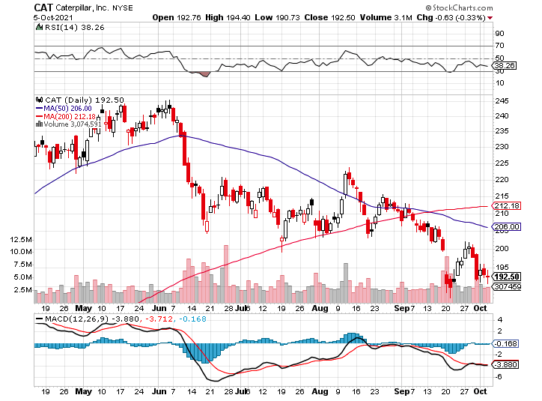
Caterpillar (CAT)-Has Become a China stock took profits on long 12/$145-$150 call spread took profits on long 11/$125-$135 call spread

Slide 46
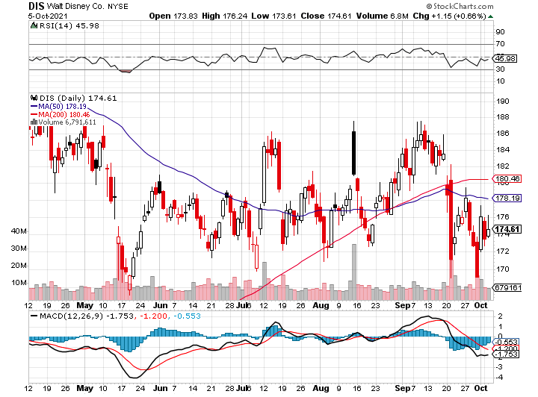
Walt Disney (DIS)- Big Recovery Move Covid 4th Wave Delta Drag stopped out of long 10/$165-$175 call spread took profits on long 3/$170-$180 call spread

Slide 47
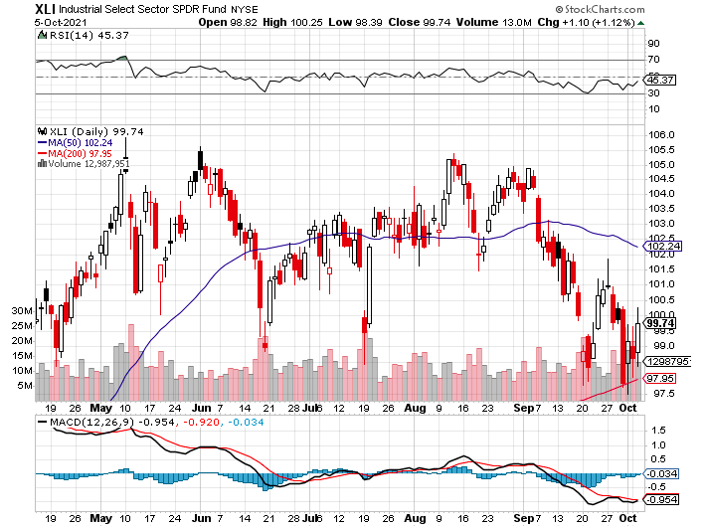
Industrials Sector SPDR (XLI)- (GE), (MMM), (UNP), (UTX), (BA), (HON)

Slide 48
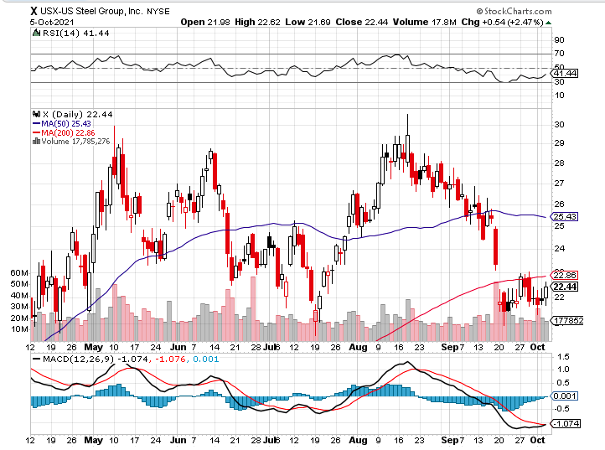
US Steel (X) – Commodity Drag

Slide 49
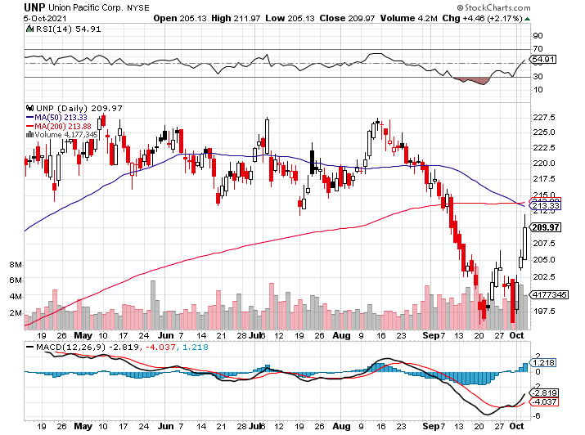
Union Pacific RR (UNP)- Big Stuff to Ship near record earnings announced long 5/$200-$210 call spread – 12 days to expiration took profits on 11/$150-$160 call spread

Slide 50
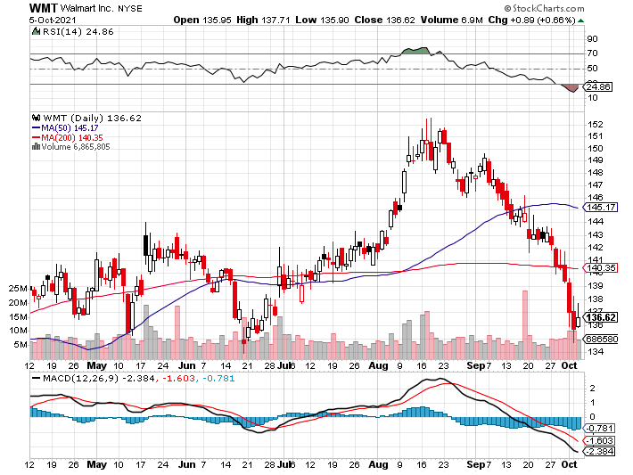
Wal-Mart (WMT)-New High took profit on Long 11/$125-$130 bear put spread took profit on Long 10/$119-$121 bear put spread took profits on Long 8/$114-$117 bear put spread

Slide 51
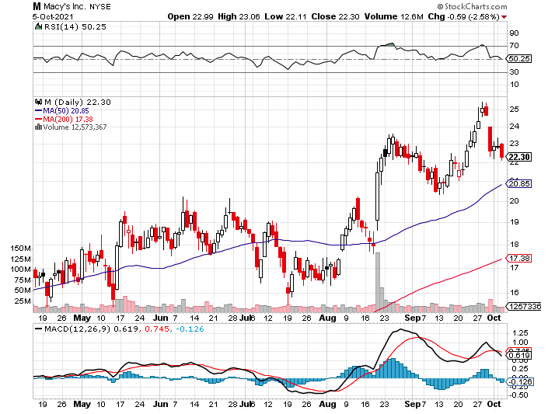
Macys’ (M) – Retail Return from the Grave took profits on Long 8/$23-$25 bear put spread

Slide 52
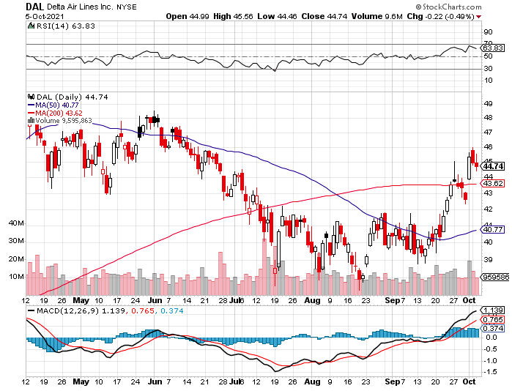
Delta Airlines (DAL) –

Slide 53
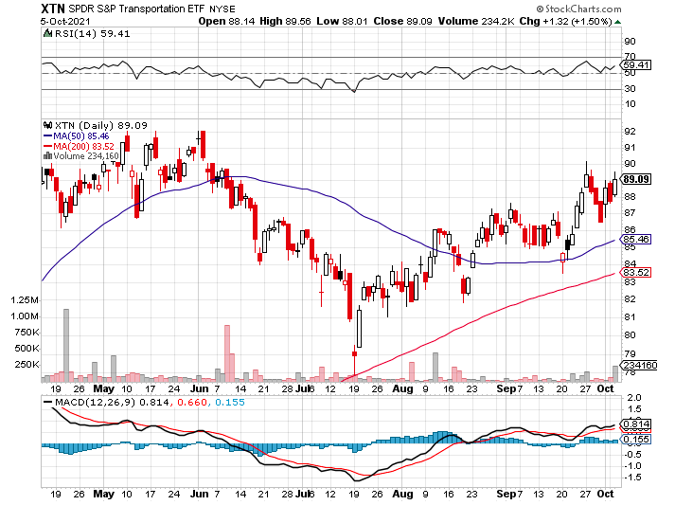
Transports Sector SPDR (XTN)- Worst Hit Sector (ALGT), (ALK), (JBLU), (LUV), (CHRW), (DAL)

Slide 54
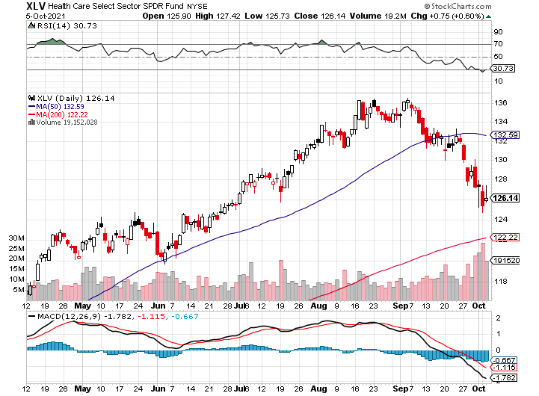
Health Care Sector (XLV), (RXL) (JNJ), (PFE), (MRK), (GILD), (ACT), (AMGN)

Slide 55
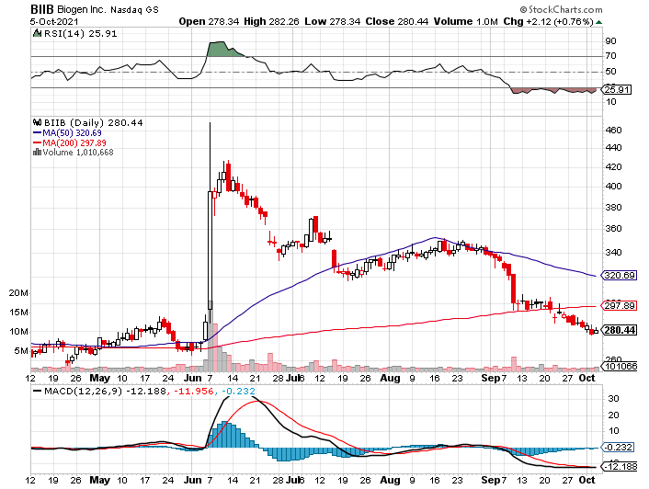
Biogen (BIIB) Why you invest in Biotech

Slide 56
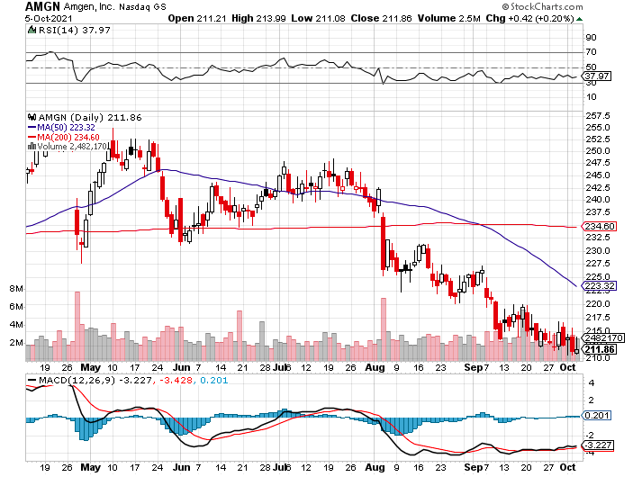
Amgen (AMGN) took profits on long 11/$185-$200 bull call spread

Slide 57
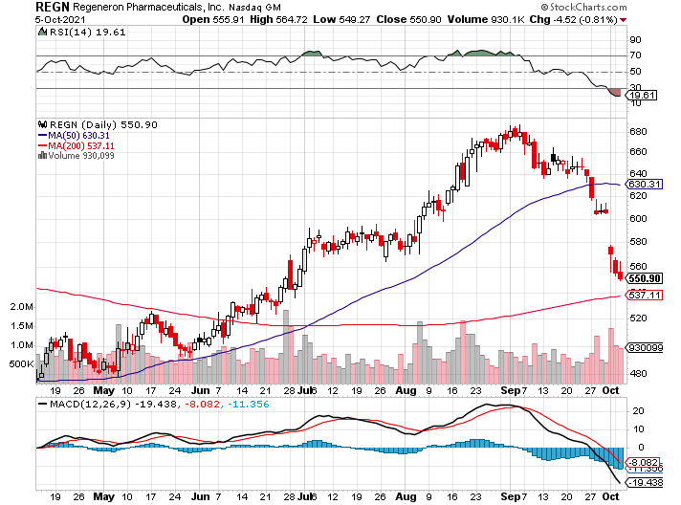
Regeneron (REGN) took profits on long 7/$570-$580 call spread

Slide 58

CRISPR Therapeutics (CRSP)

Slide 59

Goldman Sachs (GS) – long 10/$320-$330 call spread-expires in 7 trading days long 11/$330-$350 call spread took profits on long 8/$325-$335 call spread

Slide 60

Morgan Stanley (MS) – Doubled Dividend long 10/$85-$90 call spread - expires in 7 trading days long 11/$85-$90 call spread profits on long 2/$55-$60 call spread

Slide 61

JP Morgan Chase (JPM)-Back to Life long 10/$130-$140 call spread - expires in 7 trading days took profits on long 8/$140-$145 call spread took profits on long 7/$140-$145 call spread

Slide 62

Citigroup (C) – “Recovery” Rotation Play long 10/$62-65 call spread - expires in 7 trading days

Slide 63

Bank of America (BAC) – long 11/$37-$40 call spread profits on long 2/$28-$30 call spread

Slide 64

SPDR Metals & Mining ETF (XME) – long 2/$28-$30 call spread

Slide 65

Blackrock (BLK)-Asset Collection Boom long 3/$770-$790 call spread - expires in 7 trading days took profits on long 3/$310-$340 call spread

Slide 66

Visa (V) – “Touchless” Bitcoin Drag took profits on long 5/$220-$225 bull call spread took profits on long long 5/$195-$205 bull call spread took profits on long 9/$180-$185 bull call spread

Slide 67

Consumer Discretionary SPDR (XLY) (DIS), (AMZN), (HD), (CMCSA), (MCD), (SBUX)

Slide 68

Berkshire Hathaway (BRKB)- Natural Barbell cut back buy backs at $6 billion a year, announced spectacular earnings long 10/$255-$265 call spread - expires in 7 trading days took profits on long 3/$230-$240 call spread

Slide 69

Europe Hedged Equity (HEDJ)-

Slide 70

Japan (DXJ)-

Slide 71

Emerging Markets (EEM) - Pro trade, Weak Dollar, Long Recovery Play

Slide 72

Bonds – Three Month Yield High
*Bonds Crash, down $3.4 points after Jay Powell’s super bearish comments from Wednesday soak in *The 50-day moving average has been smashed and the next target is the 200-day at $1344.59 *Watch the 50-day roll over from here on *My final target is a 1.76% yield on the ten-year US Treasury bond by January *Add more downside LEAPS on rallies, the January 2022 (TLT) $155-$150 vertical bear put spread delivers a 50% profit in six months *A 2.00% yield on the ten-year US Treasury bond here we come! This is the quality trade for the rest of 2021 *US Treasury bond fund (TLT) could plunge from $180 a year ago to $105 by 2023

Slide 73

Treasury ETF (TLT) – No Positions! took profits on long 10/$154-$157 put spread, took profits on long 10/$137-$140 call spread profits on long 10/$155-$158 put spread, took profits on 9/$155-$158 put spread took profits on long 8/$157-$160 put spread, took profits on long 8/$156-$159 put spread,

Slide 74

Ten Year Treasury Yield ($TNX) – 1.52%

Slide 75

Junk Bonds (HYG) 3.47% Yield to Maturity

Slide 76

2X Short Treasuries (TBT)-Another run at highs

Slide 77

Emerging Market Debt (ELD) 4.27% Yield-

Slide 78

Municipal Bonds (MUB) – 0.93% Mix of AAA, AA, and A rated bonds

Slide 79


Slide 80

Foreign Currencies – Dollar Up
*Rising interest rates hold out prospect of a strong dollar for months *Currency with the fastest appreciating interest rates always does best *When rates stop rising dollar will fall *Long-term fundamentals are still poor, a dollar short could be the new ten-year trade *Massive over issuance of debt by the US government to fund the covid recovery is another nail in the coffin in addition to an exploding trade deficit *Stand aside from (FXA) and (FXE)

Slide 81


Japanese Yen (FXY), (YCS)

Slide 82



Euro ($XEU), (FXE), (EUO)-

Slide 83

British Pound (FXB)-

Slide 84

Australian Dollar (FXA)- The Global Recovery Play took profits on long 8/$67-$69 call spread

Slide 85

Emerging Market Currencies (CEW)

Slide 86

Chinese Yuan- (CYB)-

Slide 87

Bitcoin – Golden Crosses Setting Up Everywhere Buy the Mad Hedge Bitcoin Letter at https://www.madhedgefundtrader.com/store/
*China Bans Crypto, triggering a 7% plunge in Bitcoin. Financial systems the government can’t control are forbidden in the Forbidden City. *It’s all part of a flight out of a restricted Yuan into unrestricted crypto by wealthy Chinese *China used to account for 99% of all Bitcoin mining and now it is approaching zero *The business will flock to the US, Canada, and any other country with cheap electricity. It’s a short-term negative for crypto but a long term positive. *The First Trust Skybridge Crypto Industry & Digital Economy ETF (CRPT) launched, a basket of crypto plays *Defi platform Compound wishes they didn’t have such fat fingers They accidently sent out $90 million *Buy Bitcoin and Ethereum on the dip

Slide 88


Slide 89

Mad Hedge Market Timing Index Components
*traditional technical analysis, including moving averages and RSI’s *flow of funds withing the crypto mining community *actions of the “whales”- 20% of Bitcoin is owned by the top 100 accounts *growth of the global money supply and other liquidity measures *action of other highly correlating assets

Slide 90

Bitcoin ($BTCUSD) – Wake Up Time

Slide 91

Ethereum (ETHE) –

Slide 92

MicroStrategy (MSTR) –

Slide 93

Amplify Transformational Data Sharing ETF (BLOK) – Cross Imminent

Slide 94

Energy – Nat Gas Crisis
*China Releases from its Strategic Oil Reserve, sending oil to the mat. *Russia Squeezes European Gas Supplies. Norway is stepping in to fill the gap but it’s not enough. *Norway is stepping in to fill the gap but it’s not enough. *Britain is also reaching the end of a 50-year supply in North Sea gas. *It could create yet another drag on Europe economy *The end of oil is upon us, but it may take 30 years to unwind existing infrastructure *Avoid all energy plays like the plague, it’s the new buggy whip industry as the US de-carbonizes

Slide 95

Oil-($WTIC)

Slide 96

United States Oil Fund (USO) long 10/$9.50-$10 Vertical bull call spread

Slide 97

Energy Select Sector SPDR (XLE)-No Performance! (XOM), (CVX), (SLB), (KMI), (EOG), (COP)

Slide 98

Halliburton (HAL)-

Slide 99

Natural Gas (UNG) -

Slide 100

Precious Metals – Barely a Pulse
*Big stock market dump delivers only a modest gold rally *Rising interest rates bode poorly for precious metals as it raises the opportunity cost for non-yielding assets *Bitcoin is clearly sucking capital out of precious metals *Stay away until this plays out *Silver is still the bigger and better long-term play *Gold will eventually recover when US borrowing becomes so massive it undermines the value of the US dollar, even in the face of higher interest rates

Slide 101

Gold (GLD)- Meltdown

Slide 102

Market Vectors Gold Miners ETF- (GDX) –

Slide 103

Barrick Gold (GOLD) took profits on long 1/$21-$23 call spread took profits on long 11/$22-$24 call spread

Slide 104

Newmont Mining- (NEM)- took profits on long $55-60 call spread

Slide 105

Silver- (SLV)- took profits on long 11/$19-$20 call spread

Slide 106

Silver Miners - (SIL)-

Slide 107

Wheaton Precious Metals - (WPM)- took profits on long 2/$39-41 call spread

Slide 108

Copper (COPX)-Uptrend Resumes Copper Unions Vote to Strike in Chile, cutting off 33% of the global supply

Slide 109


Slide 110

Real Estate – Buyer’s Panic
*4-6 Interest Rate Rises by 2024 which may start as early as 2024, says Fed governor Jay Powell. *Homebuilder Sentiment Rises for first time in 5 months, from 75 to 76 in September, thanks to the lumber price crash. *Housing Starts for August up 3.9% with apartment buildings the big driver. Single family homes fell. *Building Permits up 6.0% and are a 50% increase from the summer lows *New Home Sales Jump by 1.5% in August to a seasonally adjusted 740,000 units. Existing Home Sales Drop, by 2% in August to 5.88 million units annualized *Mortgage Rates Top 3.10%, for the 30-year fixed rate loan *Google Buys $2.1 Billion in New York Office Space, *S&P Case Shiller Smashes all Records, up 17% YOY

Slide 111


Slide 112

S&P Case Shiller Up 18.7% for June Phoenix (29.3%), San Diego (27.1%), and Seattle (25.0%) lead

Slide 113


Slide 114

Crown Castle International (CCI) – 2.70% yielding cell phone tower REIT

Slide 115

US Home Construction Index (ITB) (DHI), (LEN), (PHM), (TOL), (NVR)

Slide 116


Slide 117

Trade Sheet- So What Do We Do About All This?
*Stocks – buy dips aggressively *Bonds – sell rallies aggressively *Commodities-stand aside *Currencies- stand aside *Precious Metals – stand aside *Energy – stand aside *Volatility - sell short over $30 *Real estate – buy dips *Bitcoin – buy dips

Slide 118

Next Strategy Webinar 12:00 EST Wednesday, October 20, from Silicon Valley email me questions at support@madhedgefundtrader.com
Good Luck and Good Trading!
Notes:
*

