Slide 1
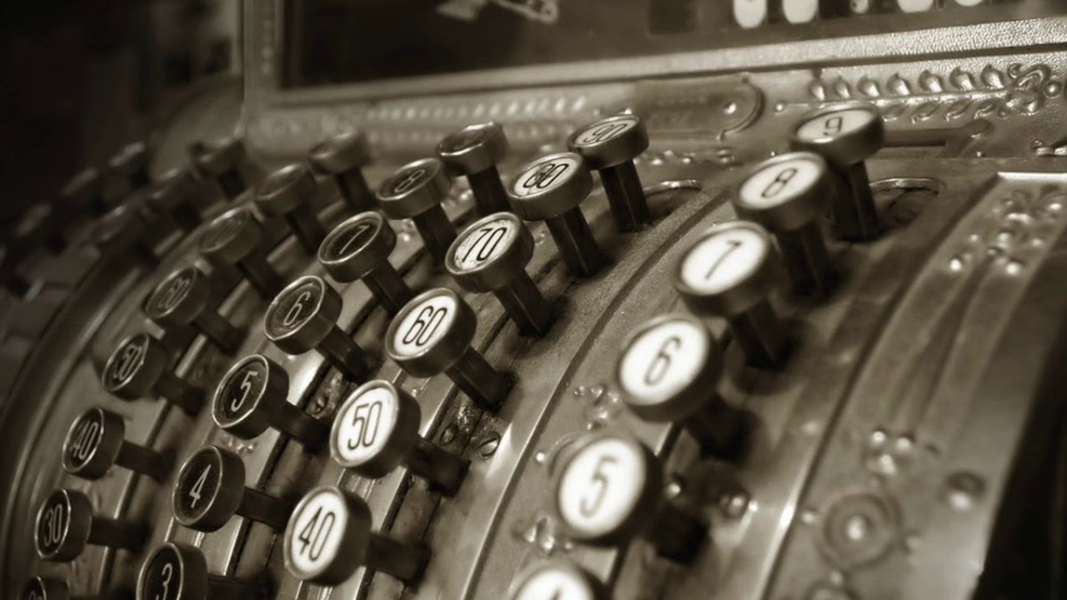
The Mad Hedge Fund Trader “Ringing the Cash Register”
With John Thomas Silicon Valley, CA, October 20, 2021 www.madhedgefundtrader.com
Notes:
*

Slide 3
Trade Alert Performance New All Time Highs! 32 consecutive profitable trade alerts- 93.5% success rate in 2021-ony 7 losers
*January 10.21% MTD *July +0.61% Final *February +13.28% Final *August +9.36% Final *March +20.60% Final *September 1.03% Final *April +15.67% Final *October +8.91% MTD *May +8.13% Final *November +20.41% Final *June +0.71% Final *December +10.20% Final *2021 Year to Date +88.51% compared to +15.4% for the Dow Average *+511.06% since inception, a new all time high *Average annualized return of 43.14% for 12 years, new all time high

Slide 4
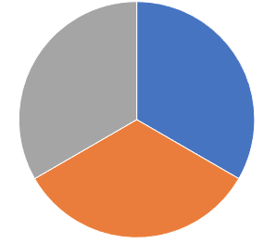
Portfolio Review 30% invested in financials in a low volatility Long Term Bull Market 70% cash
Current Capital at Risk
Risk On
World is Getting Better
(GS) 11/$330-$350 call spread | 10.00%
(MS) 11/$85-$90 call spread | 10.00%
(BAC) 11/$37-$40 call spread | 10.00%
Risk Off
World is Getting Worse
Total Net Position | 30.00%
Total Aggregate Position | 30.00%
Expiration Value 88.87%

Slide 5
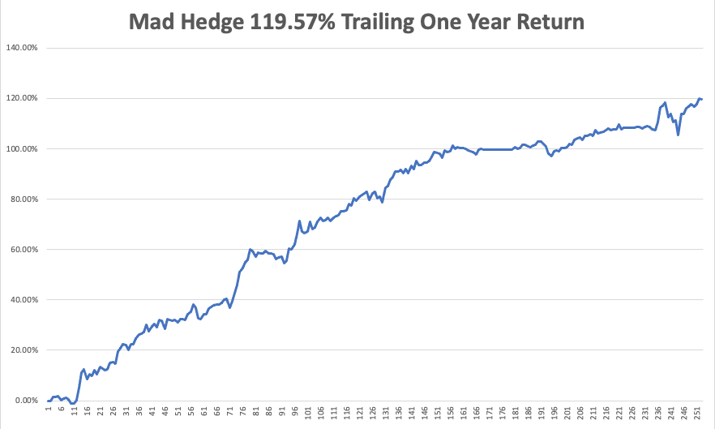

Slide 6
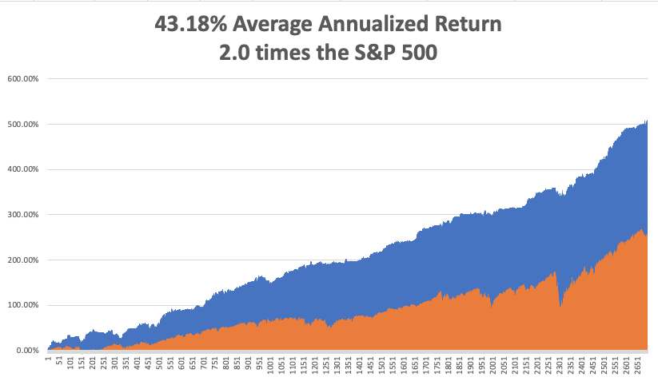
GTD 12 Year Daily Audited Performance

Slide 7
The Method to My Madness The Roaring Twenties are Here
*Profits are growing 5.5 times faster than any possible end of QE. *The wall of money is growing. QE is $1.44 trillion a year versus corporate profits rocketing by $8 trillion *Soaring interest rates prompt much need stock market correction *The correction is over, keep buying every 2.5% dip for the rest of the year *The multiyear bear market in bonds is here, cash in with those shorts *Rising rates will bring modestly lower technology prices are are still a long-term hold *Medium term, both sides of the barbell are working *Bitcoin hits new eight month high *VIX at $15 shows happy days are here again

Slide 8
Corona Update – The peak is In
*Merck’s Molnupiravir pill cuts covid hospitalization death rate by 50% *30% of new gases are now in kids under 12 *70 million still unvaccinated *80% of the US population has covid antibodies, and 90% in San Francisco *No deaths from delta variant report among those vaccinated *14 states now have law suites attempting to ban mask mandates *Best immunity is from getting covid, then getting vaccinated *US cases top 45 million, deaths topping 725,000 and deaths are back up to 1,000 a day

Slide 9
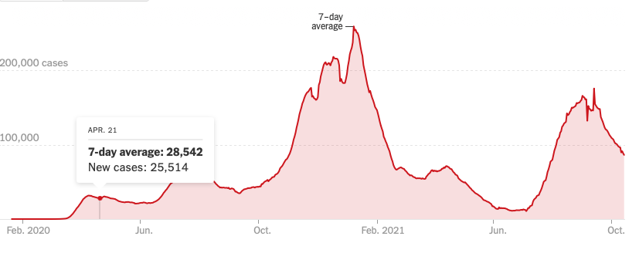
Bump on the Way to Zero the Fourth Wave – The Self-Inflicted Injury

Slide 10
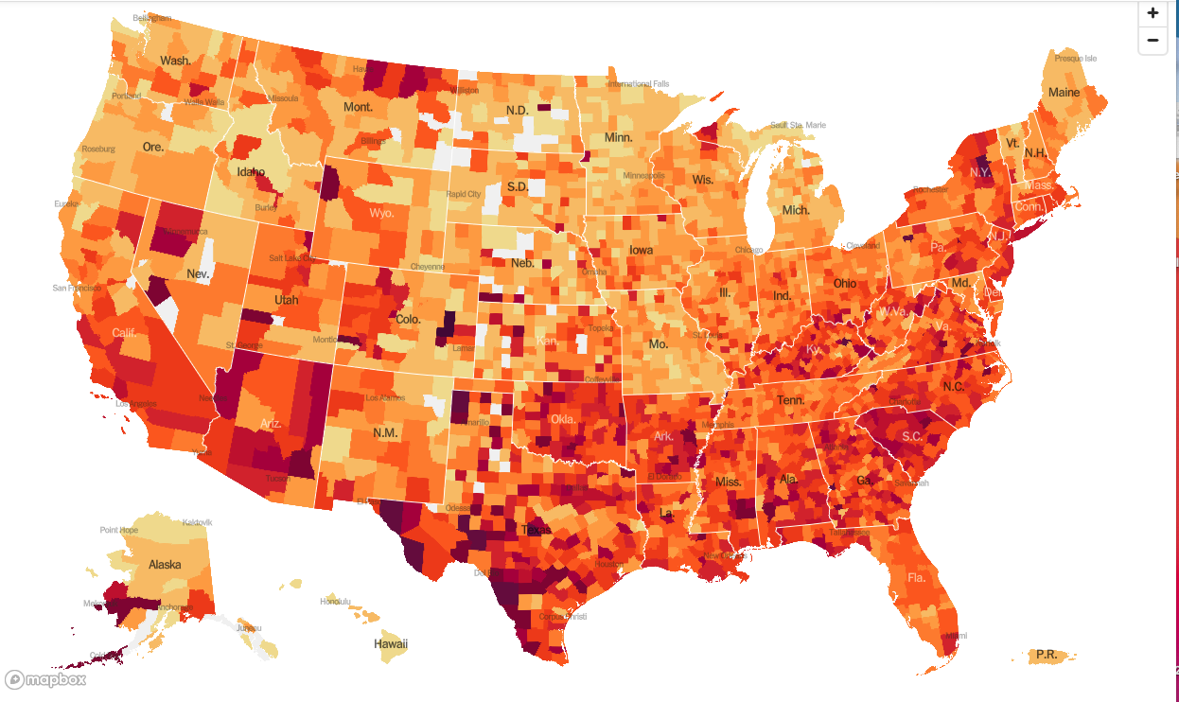
January 20 Infection Rate

Slide 11
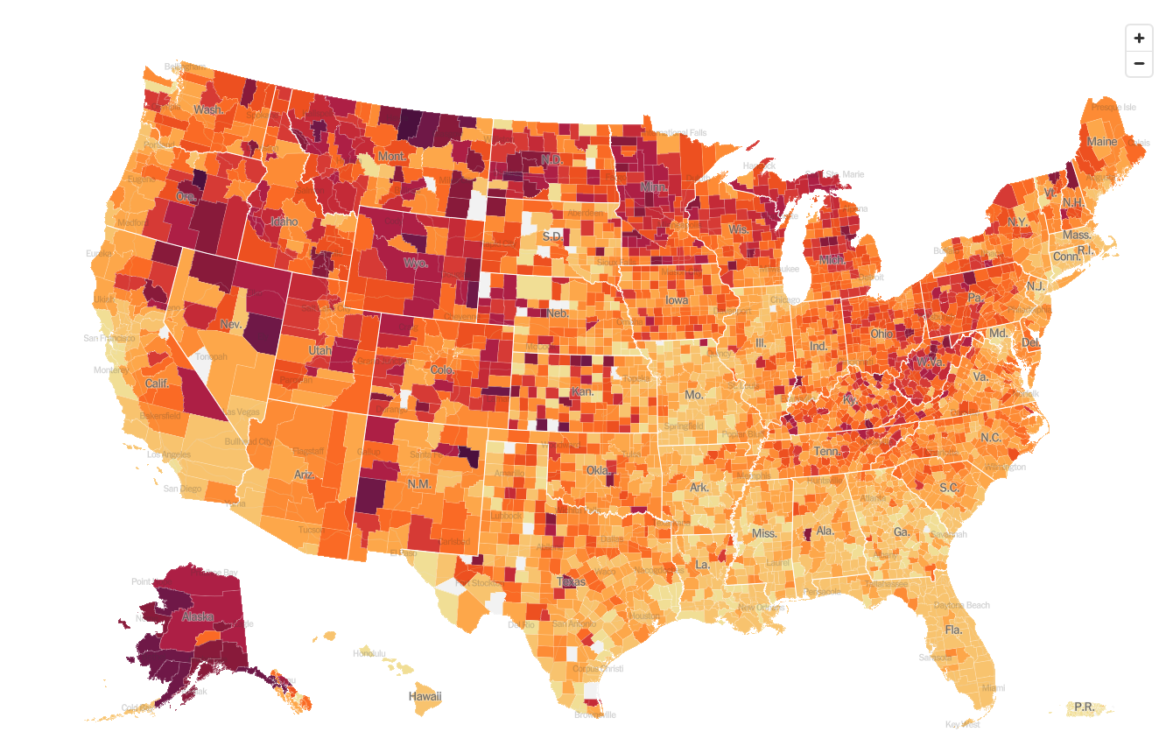
October 20 Infection Rate

Slide 12
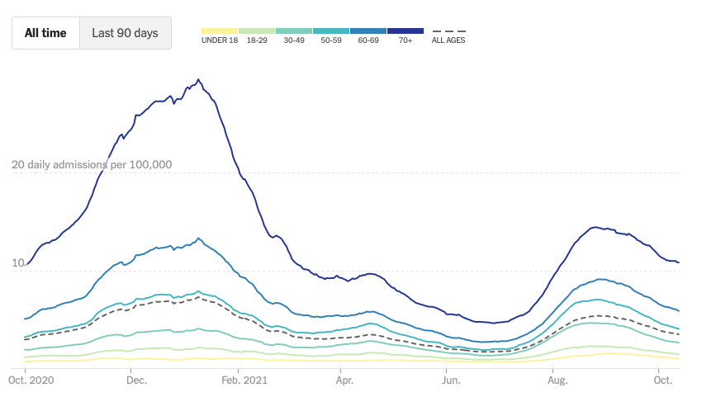
By Age Group

Slide 13
By Region

Slide 15
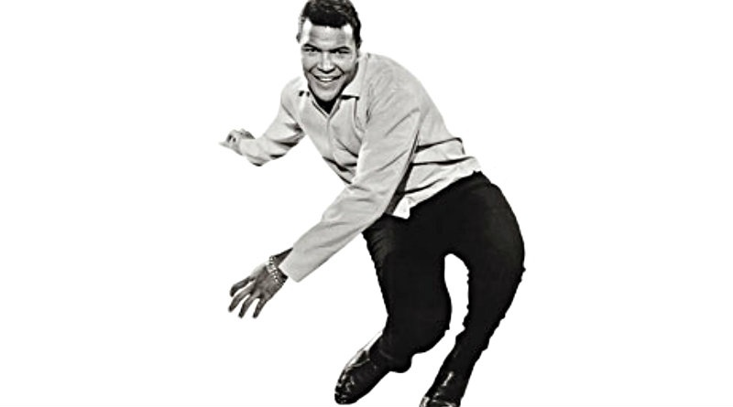
The Global Economy – Ready for a Turn
*After a delta and supply chain induced mini recession in the summer, a turnaround in the economy is imminent *Nonfarm Payroll Bombs in September, coming in at only 194,000. That follows a weak 235,000 in August. The headline Unemployment Rate dropped to a new post pandemic low of 4.8%, *Weekly Jobless Claims Plunge to 293,000, a new post pandemic low *Wages are Going Through the Roof for those willing to work *JOLTS Comes in at 10.4 Million indicating that the labor shortage is getting more severe *IMF Cuts Global Growth Forecast to 5.9% *CPI Hits 5.4%, and was up 0.4% in September, a high for this cycle *Fed Minutes Show Taper to Start in November

Slide 16
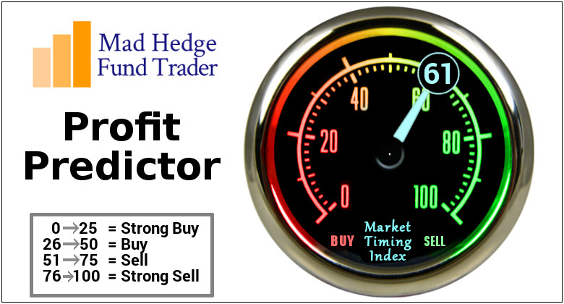
The Mad Hedge Profit Predictor Market Timing Index – Waiting for a Selloff An artificial intelligence driven algorithm that analyzes 30 different economic, technical, and momentum driven indicators

Slide 17
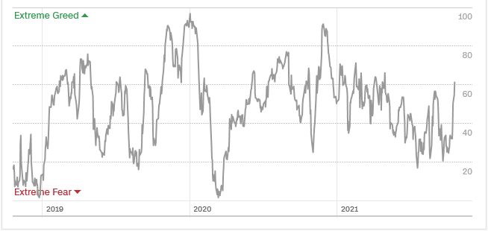
The Mad Hedge Profit Predictor Upside Breakout
SELL
Do Nothing
BUY

Slide 18
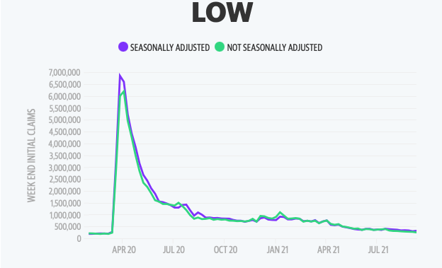
Weekly Jobless Claims – New Lows 362,000 –

Slide 20
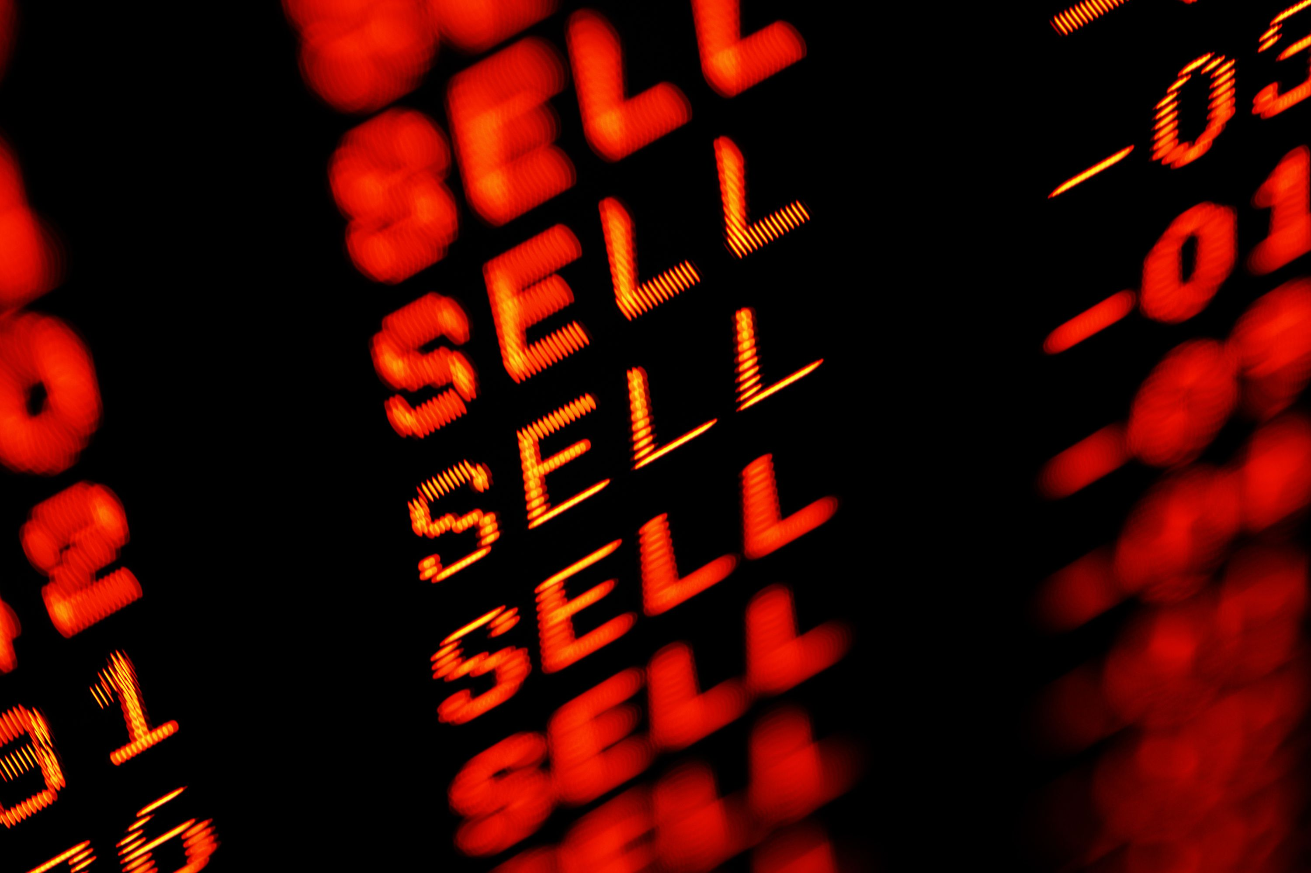
Stocks – Probing for a bottom
*Big Banks Report Blowout Earnings and are firing on all cylinders. *With a wall of money growing rapidly, pour money into the lowest valued stocks like financials *Tech Stocks stabilize, earnings will reflect severe parts shortages that will hang over the stocks for the rest of 2021 *Social Security benefits rising by 5.9% in 2020, or $1 trillion, and a lot is going into stocks *Huge Rally in copper hint that supper cycle may be resuming, buy (FCX) *Millennials to inherit $68 trillion by 2030 and most will go into the stock market and Bitcoin *Stick with the barbell strategy, we’ll keep rotating back and forth all year between tech & domestic recovery

Slide 21
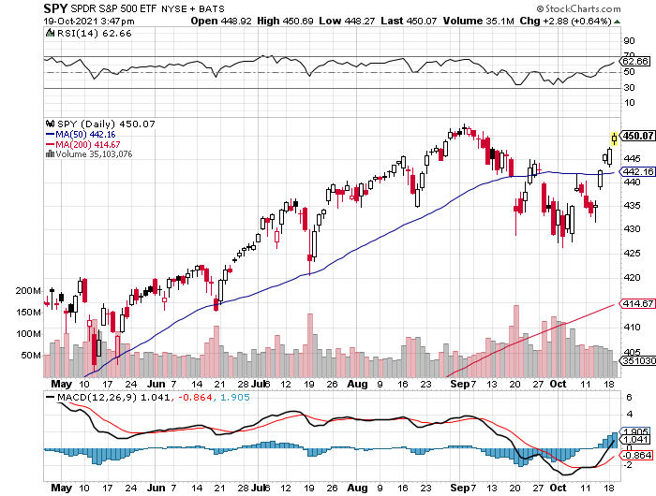
S&P 500 – A Correction at Last! long 10/$410-$420 bull call spread – expires in 7 trading days stopped out of long 10/$419-$429 bull call spread took profits on long 6/$375-$385 bull call spread
New Highs Yearend Target $475
The Bottom 427
5.3% Correction

Slide 22
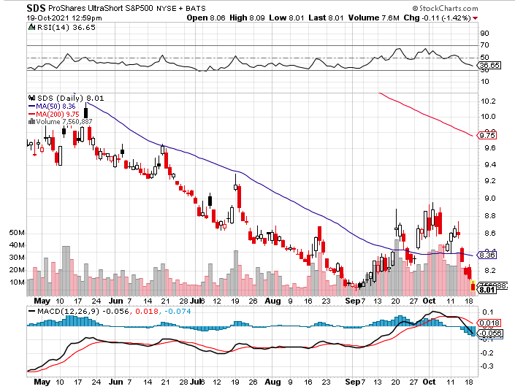
ProShares Ultra Short S&P 500 (SDS)- a great hedge for long stocks and bonds long 2X position has a hedge against longs and bond shorts

Slide 23
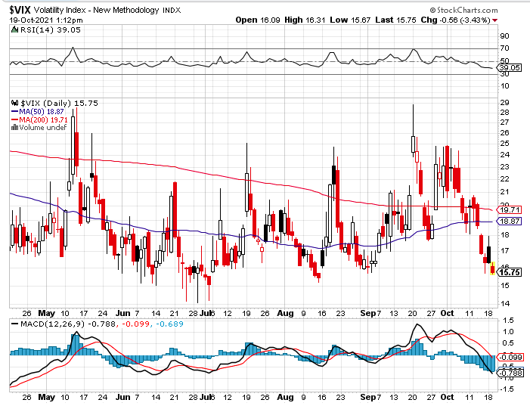
(VIX) – Dying a Slow Death classic summer market

Slide 24
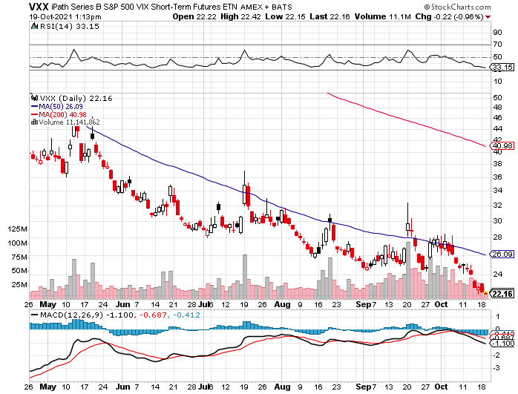
(VXX)-

Slide 25
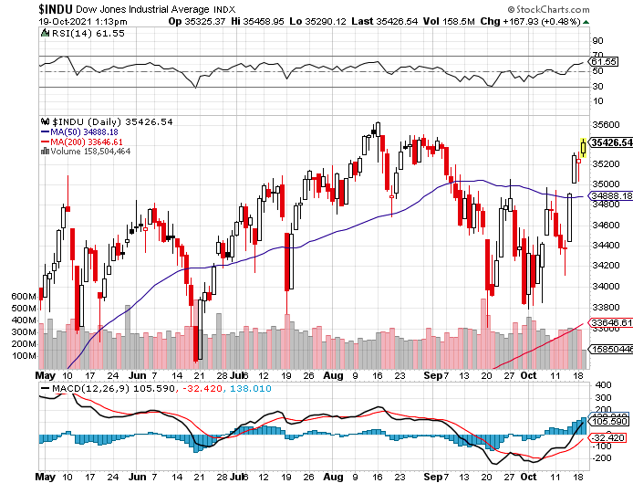
Dow Average ($INDU)-

Slide 26
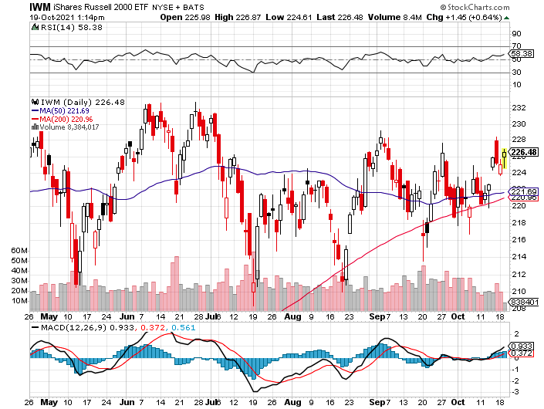
Russell 2000 (IWM)- took profits on Long 10/$137-$142 vertical bull call spread took profits on Long 10/$153-$156 vertical bear put spread

Slide 27
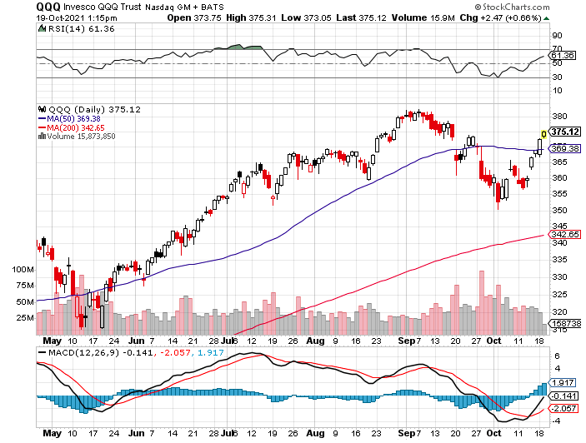
NASDAQ (QQQ) – long (QQQ) 4/$330-$335 put spread took profits on long (QQQ) 3/$340-$345 put spread covered long (QQQ) $325-$330 put spread

Slide 29
The Barbell Portfolio
*50% Big Tech - 2% of US Employment but 27% of Market Cap and 38% of Profits 50% Domestic Recovery, including: Railroads Couriers Banks Construction Credit Cards Event organizers Ticket sales Retailers

Slide 30
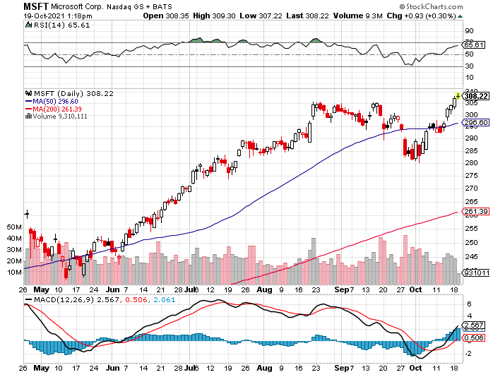
Microsoft (MSFT)- Microsoft to Raise Dividend by 11% and increased a $60 billion stock buyback program took profits on long 12/$220-$230 call spread stop loss on long 12/$170-$180 call spread took profits on long 12/$135-$138 call spread

Slide 31
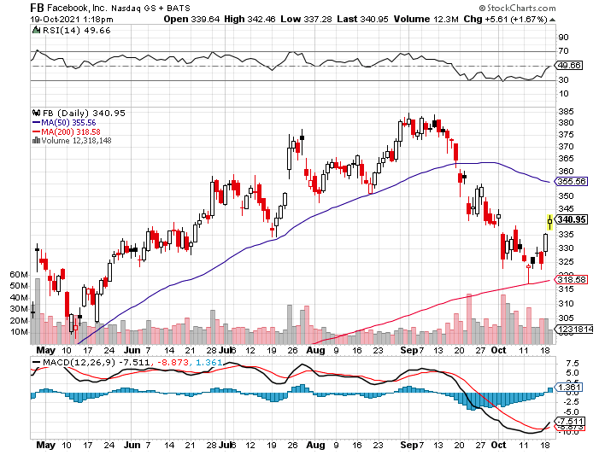
Facebook (FB)- Wins antitrust suit took profits on Long 9/$290-$300 vertical bear put spread stopped out of Long 9/$190-$200 vertical bear put spread took profits on Long 9/$145-$155 vertical bull call spread took profits on Long 9/$150-$160 vertical bull call spread

Slide 32
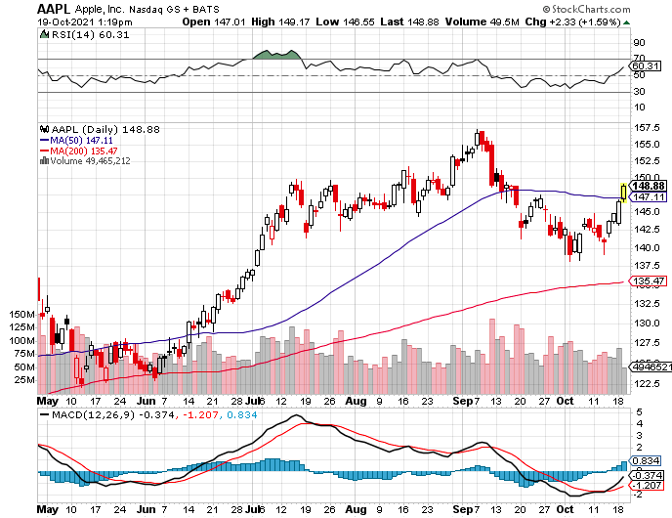
Apple (AAPL)- Launches iPhone 13, with a better camera, faster chips, and longer battery life, Antitrust Comes Home to Roost at Apple took profits on long 7/$320-$330 call spread took profits on long 4/24/$250-$260 call spread took profits on long 5/$250-$260 call spread

Slide 33
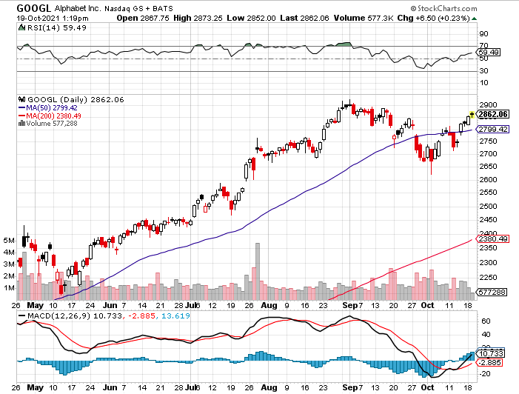
Alphabet (GOOGL) – Ad king on economic recovery 15% of search is travel related took profits on long 12/$1,200-$1,230 bull call spread took profits on long 9/$1,030-$1,080 vertical bull call spread

Slide 34
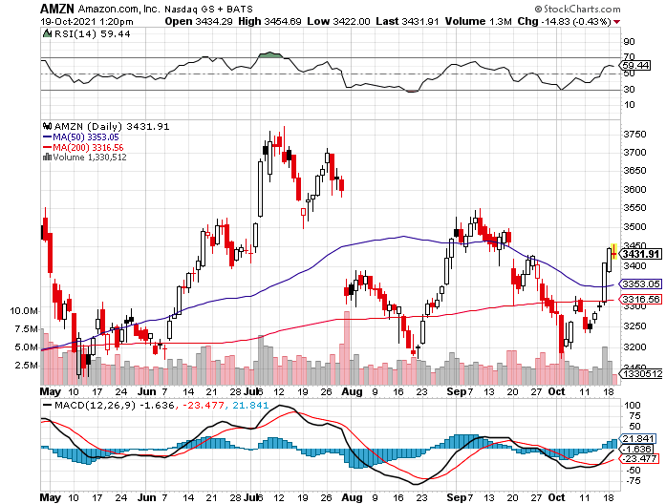
Amazon (AMZN) – Amazon to Hire 125,000 and boost wages to $18 an hour took profits on long 9/$2,800-$2,900 bull call spread

Slide 35
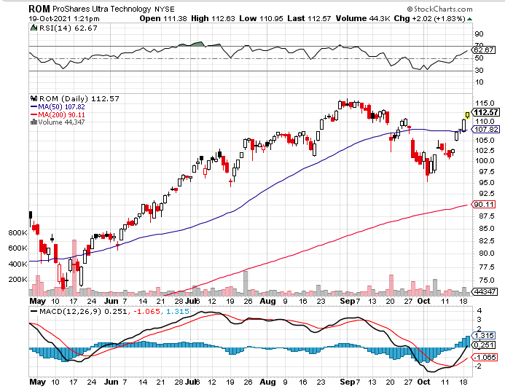
ProShares Ultra Technology (ROM) – New Highs

Slide 36
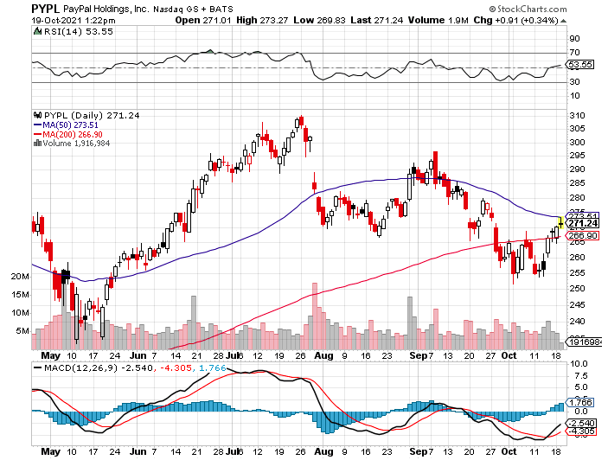
PayPal (PYPL)- PayPal Goes Global ….again, buying Japan’s Paidy for $2.7 billion took profits on long 4/$90-$95 call spread

Slide 37
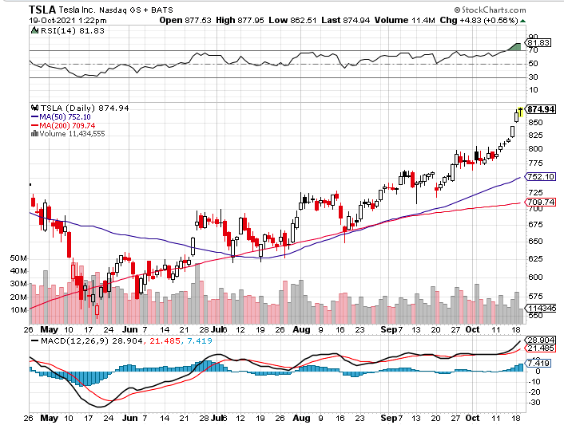
Tesla (TSLA)-Moving HQ to Auston, TX 242,300 Q3 sales beat expectations-Elon Musk now worth $230 Billion took profits on long 2X 4/$450-$500 call spread, took profits on long 3/$400-$450 call spread took profits on long 2/$650-$700 call spread-expires, stopped out of long 3/$600-$650 call spread Took profits on long 2/$600-$650 bull call spread, Took profits on long 2/$550-$600 bull call spread

Slide 38
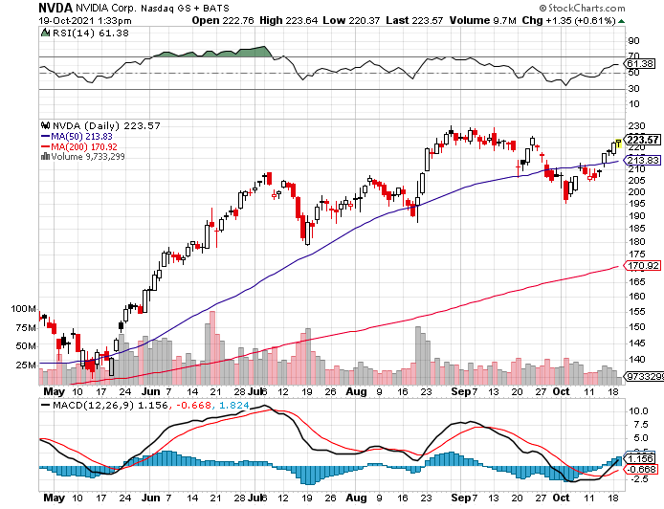
NVIDIA (NVDA) – A Mad Hedge 10 bagger – Global Semiconductor Shortage Slows Auto Industry, Graphic card sales up 87% in Q2

Slide 39
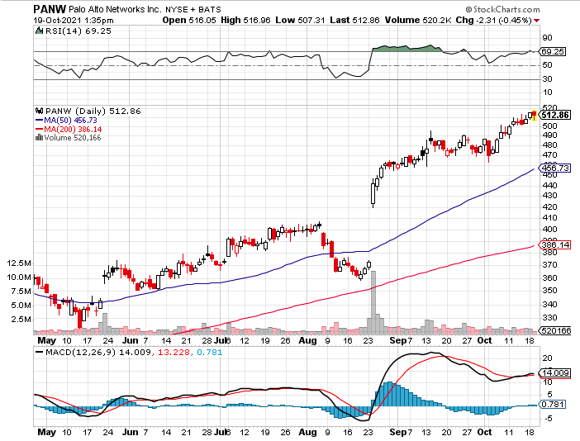
Palo Alto Networks (PANW)- Hacking never goes out of fashion

Slide 40
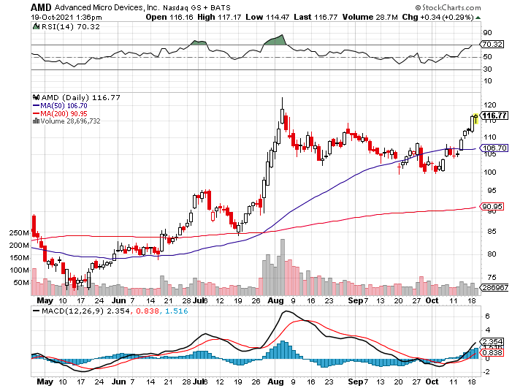
Advanced Micro Devices (AMD)- programable logic devices took profits on long 2/$75-$80 call spread

Slide 41
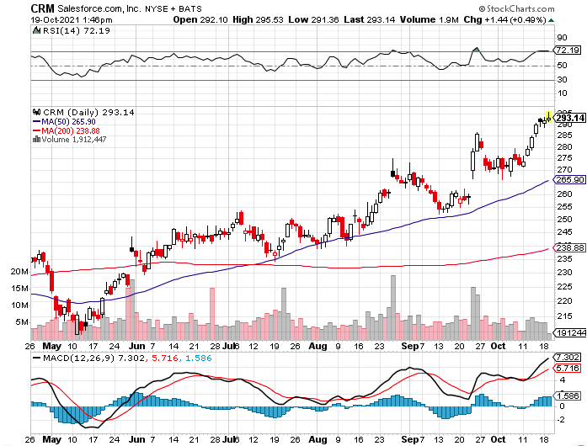
Salesforce (CRM)- Massive Online Migration took profits on long 9/$125-$130 vertical bull call spread took profits on long 8/$125-$130 vertical bull call spread took profits on long 2/$105-$115 call spread

Slide 42
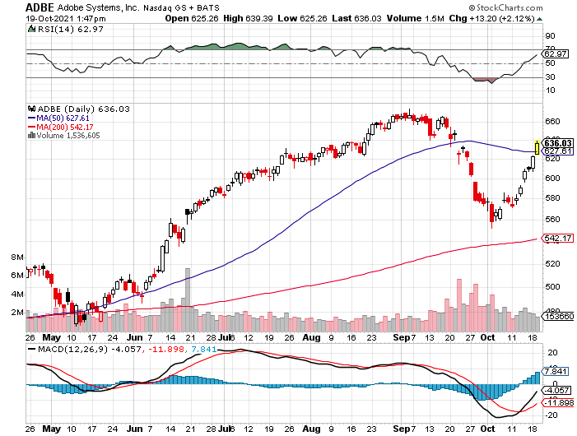
Adobe (ADBE)- Cloud play The Quality Non-China tech play

Slide 44
The Second Half of the Barbell
*Bets on a domestic recovery in 2021 Q4 *Upside potential in 2021 far greater than tech *Some of these have not moved for 5 or 10 years *Focuses on economically sensitive cyclical industries *Makes a great counterweight to high-growth technology *We could spend all of next year rotating between the two groups

Slide 45
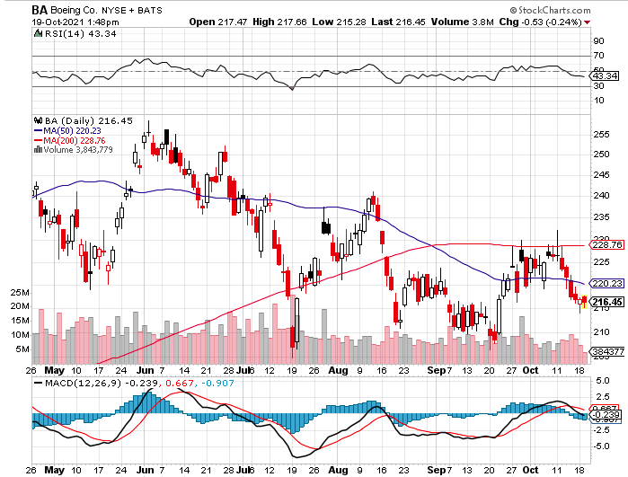
Boeing (BA) – former LEAP Candidate – Headaches again long 3/$146-$149 call spread took profits on long 2/$150-$160 call spread

Slide 46
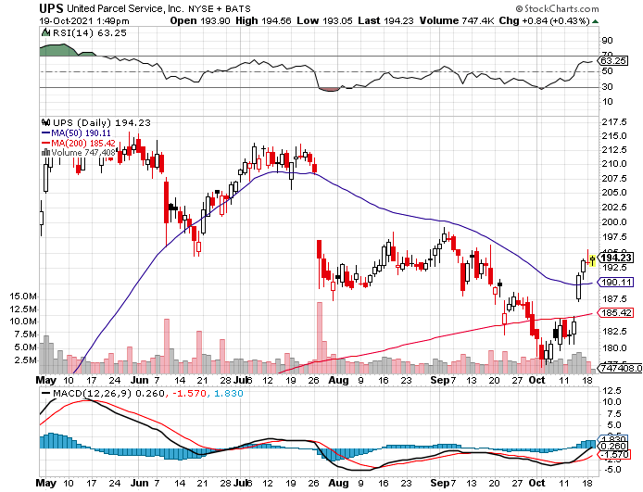
Package Delivery- United Parcel Service (UPS) - Package Delivery massive increase in overnight deliveries, announces blowout earnings, vaccine deliveries took profits on long 11/$130-$140 call spread

Slide 47
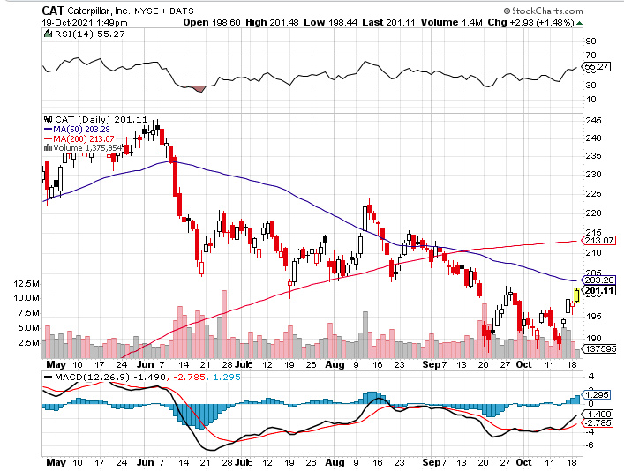
Caterpillar (CAT)- Ag + Infrastructure + Housing took profits on long 12/$145-$150 call spread took profits on long 11/$125-$135 call spread

Slide 48
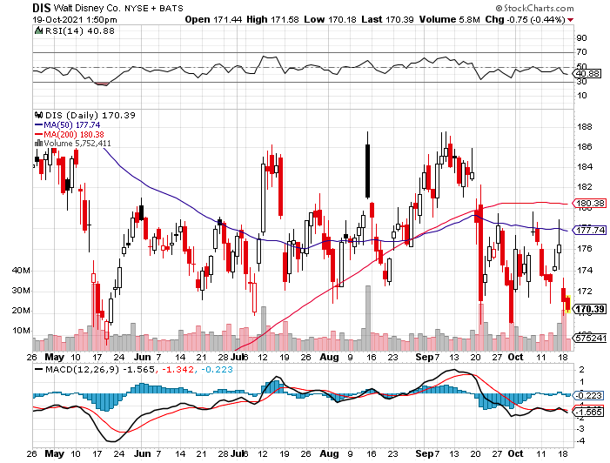
Walt Disney (DIS)- Big Recovery Move Covid 4th Wave Delta Drag stopped out of long 10/$165-$175 call spread took profits on long 3/$170-$180 call spread

Slide 49
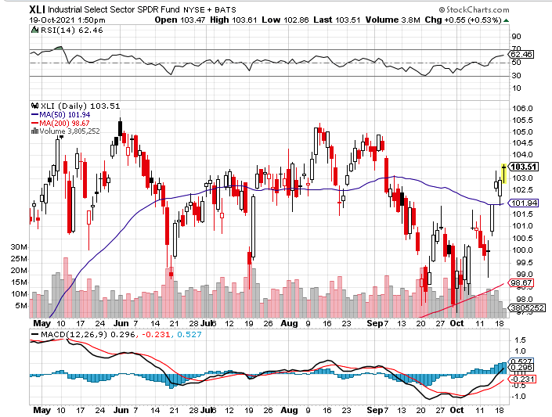
Industrials Sector SPDR (XLI)- (GE), (MMM), (UNP), (UTX), (BA), (HON)

Slide 50
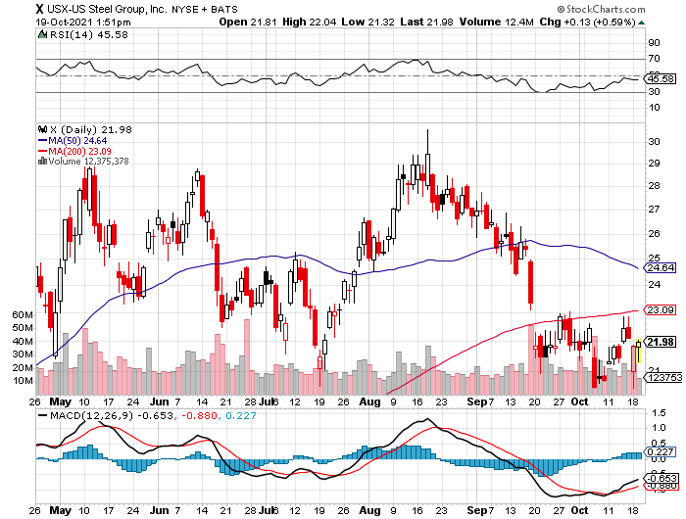
US Steel (X) – Commodity Drag

Slide 51
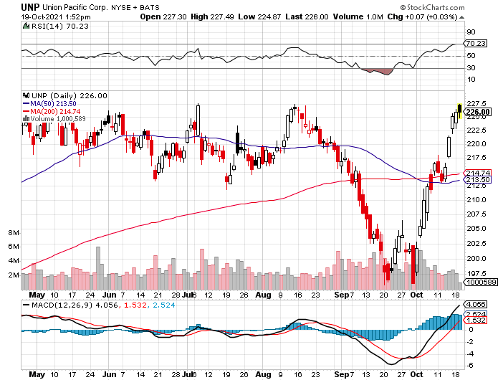
Union Pacific RR (UNP)- Big Stuff to Ship near record earnings announced long 5/$200-$210 call spread – 12 days to expiration took profits on 11/$150-$160 call spread

Slide 52
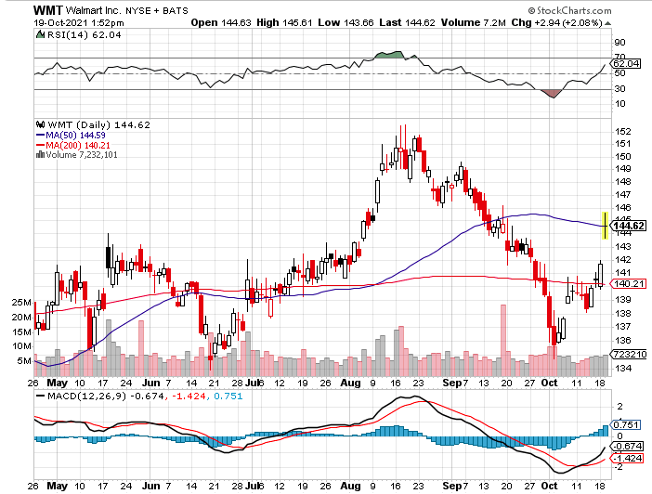
Wal-Mart (WMT)-New High took profit on Long 11/$125-$130 bear put spread took profit on Long 10/$119-$121 bear put spread took profits on Long 8/$114-$117 bear put spread

Slide 53
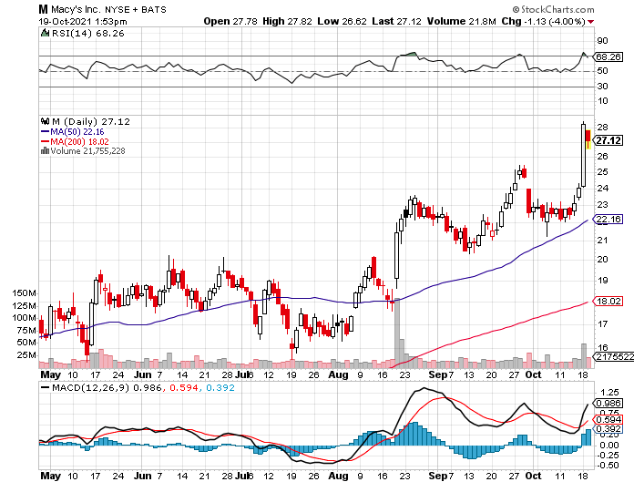
Macys’ (M) – Retail Return from the Grave took profits on Long 8/$23-$25 bear put spread

Slide 54
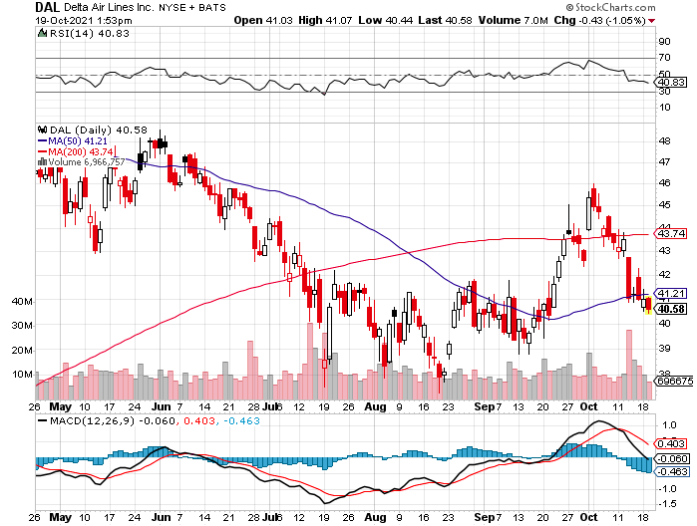
Delta Airlines (DAL) –

Slide 55
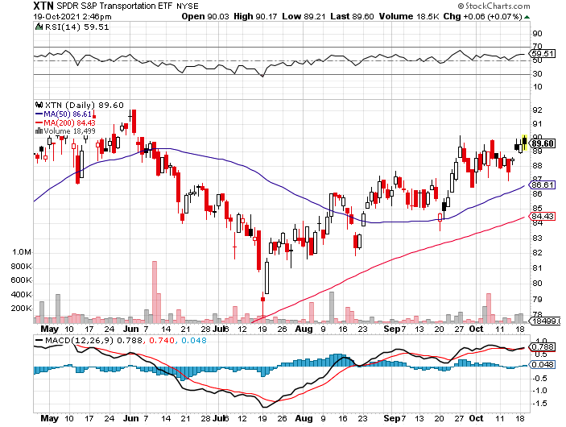
Transports Sector SPDR (XTN)- Worst Hit Sector (ALGT), (ALK), (JBLU), (LUV), (CHRW), (DAL)

Slide 56
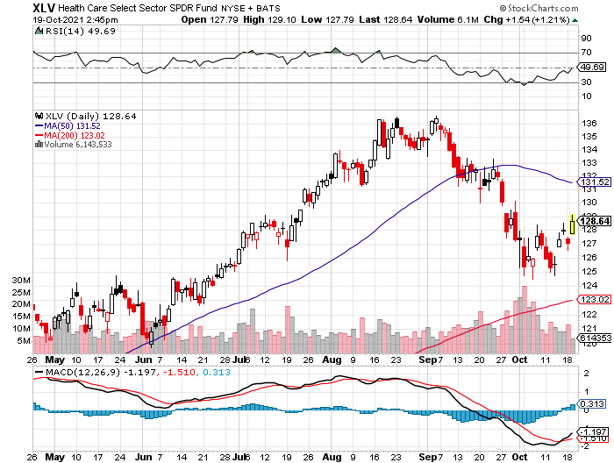
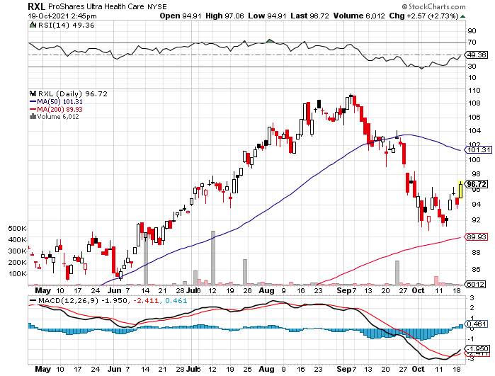
Health Care Sector (XLV), (RXL) (JNJ), (PFE), (MRK), (GILD), (ACT), (AMGN)

Slide 57
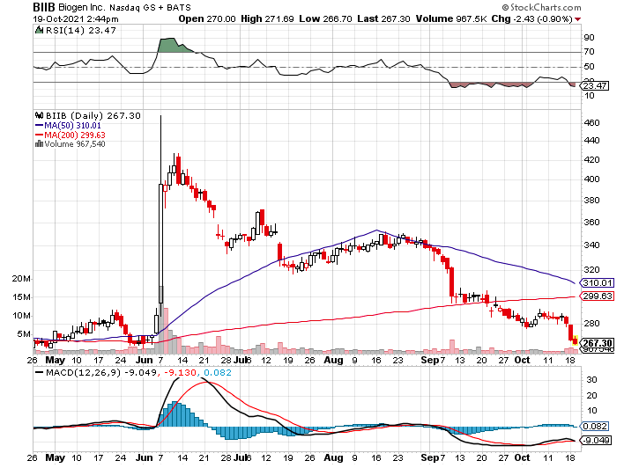
Biogen (BIIB) Why you invest in Biotech

Slide 58
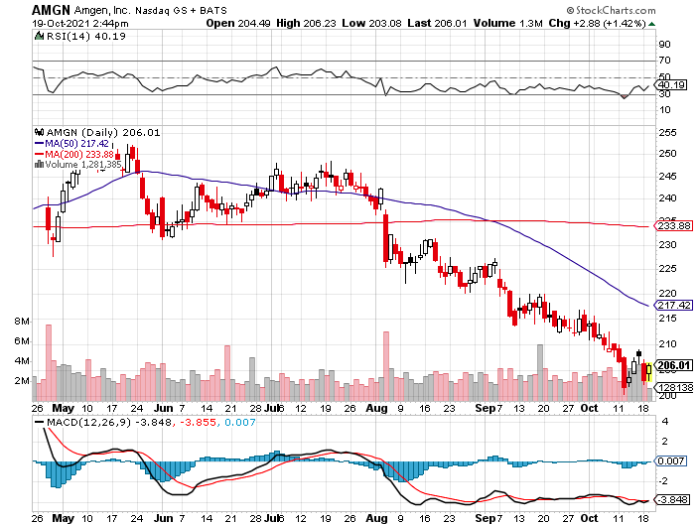
Amgen (AMGN) took profits on long 11/$185-$200 bull call spread

Slide 59
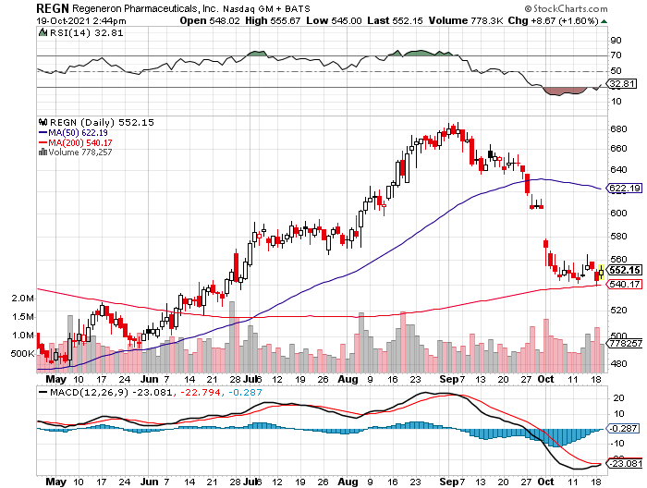
Regeneron (REGN) took profits on long 7/$570-$580 call spread

Slide 60
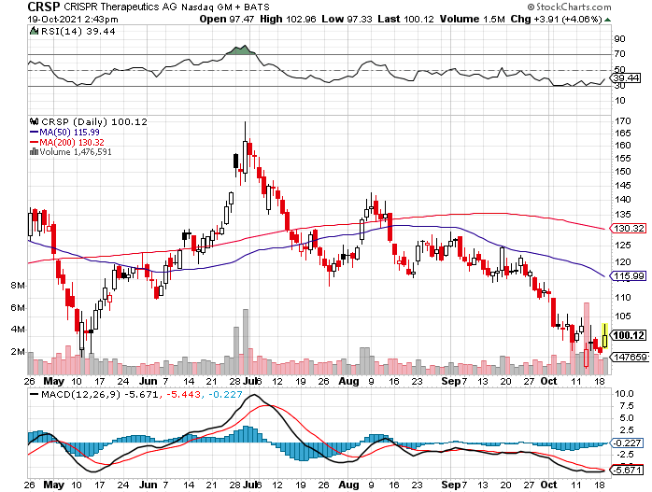
CRISPR Therapeutics (CRSP)

Slide 61
Goldman Sachs (GS) – took profits on long 10/$320-$330 call spread long 11/$330-$350 call spread took profits on long 8/$325-$335 call spread

Slide 62
Morgan Stanley (MS) – Doubled Dividend took profits on long 10/$85-$90 call spread long 11/$85-$90 call spread profits on long 2/$55-$60 call spread

Slide 63
JP Morgan Chase (JPM)-Back to Life took profits on long 10/$130-$140 call spread took profits on long 8/$140-$145 call spread took profits on long 7/$140-$145 call spread

Slide 64
Citigroup (C) – “Recovery” Rotation Play took profits on long 10/$62-65 call spread

Slide 65
Bank of America (BAC) – long 11/$37-$40 call spread profits on long 2/$28-$30 call spread

Slide 66
SPDR Metals & Mining ETF (XME) – long 2/$28-$30 call spread

Slide 67
Blackrock (BLK)-Asset Collection Boom took profits on long 3/$770-$790 call spread took profits on long 3/$310-$340 call spread

Slide 68
Visa (V) – “Touchless” Bitcoin Drag took profits on long 5/$220-$225 bull call spread took profits on long long 5/$195-$205 bull call spread took profits on long 9/$180-$185 bull call spread

Slide 69
Consumer Discretionary SPDR (XLY) (DIS), (AMZN), (HD), (CMCSA), (MCD), (SBUX)

Slide 70
Berkshire Hathaway (BRKB)- Natural Barbell cut back buy backs at $6 billion a year, announced spectacular earnings took profits on long 10/$255-$265 call spread took profits on long 3/$230-$240 call spread

Slide 71
Europe Hedged Equity (HEDJ)-

Slide 72
Japan (DXJ)-

Slide 73
Emerging Markets (EEM) - Pro trade, Weak Dollar, Long Recovery Play

Slide 75
Bonds – Yields Hit 8 Month High
*Bonds hit indigestion after a record $11 dive after Powell’s bearish comments, recover half of loss *The technical damage is enormous, and my next downside target is $135 *My final target is a 1.76% yield on the ten-year US Treasury bond by January *Add more downside LEAPS on rallies, the January 2022 (TLT) $155-$150 vertical bear put spread delivers a 50% profit in six months *A 2.00% yield on the ten-year US Treasury bond here we come! This is the quality trade for the rest of 2021 *US Treasury bond fund (TLT) could plunge from $180 a year ago to $105 by 2023

Slide 76
Treasury ETF (TLT) – No Positions! took profits on long 10/$154-$157 put spread, took profits on long 10/$137-$140 call spread profits on long 10/$155-$158 put spread, took profits on 9/$155-$158 put spread took profits on long 8/$157-$160 put spread, took profits on long 8/$156-$159 put spread,

Slide 77
Ten Year Treasury Yield ($TNX) – 1.48%

Slide 78
Junk Bonds (HYG) 3.47% Yield to Maturity

Slide 79
2X Short Treasuries (TBT)-Another run at highs

Slide 80
Emerging Market Debt (ELD) 4.27% Yield-

Slide 81
Municipal Bonds (MUB) – 0.93% Mix of AAA, AA, and A rated bonds

Slide 83
Foreign Currencies – The Dollar Maintains
*US Dollar Soars, on a continuing rise in interest rates. It’s also getting a not flight to safety bid on the stock market’s down days. The Japanese yen (FXY) has been especially hard hit. *Rising interest rates hold out prospect of a strong dollar for months *Currency with the fastest appreciating interest rates always does best *When rates stop rising dollar will fall *Long-term fundamentals are still poor, a dollar short could be the new ten-year trade *Massive over issuance of debt by the US government to fund the covid recovery is another nail in the coffin in addition to an exploding trade deficit *Stand aside from (FXA) and (FXE)

Slide 84
Japanese Yen (FXY), (YCS)

Slide 85
Euro ($XEU), (FXE), (EUO)-

Slide 86
British Pound (FXB)-

Slide 87
Australian Dollar (FXA)- The Global Recovery Play took profits on long 8/$67-$69 call spread

Slide 88
Emerging Market Currencies (CEW)

Slide 89
Chinese Yuan- (CYB)-

Slide 91
Bitcoin – Taking Off Buy the Mad Hedge Bitcoin Letter at https://www.madhedgefundtrader.com/store/
*Bitcoin blasts to new eight month high, smashing all upside resistance *(BITO) launches with first Bitcoin futures futures ETF, opening up trillions more to move into the space *The business will flock to the US, Canada, and any other country with cheap electricity. It’s a short-term negative for crypto but a long term positive. *The First Trust Skybridge Crypto Industry & Digital Economy ETF (CRPT) launched, a basket of crypto plays *New all-time high is at hand, next target is $100,000 *Buy Bitcoin and Ethereum on the dip

Slide 93
Mad Hedge Market Timing Index Components
*traditional technical analysis, including moving averages and RSI’s *flow of funds withing the crypto mining community *actions of the “whales”- 20% of Bitcoin is owned by the top 100 accounts *growth of the global money supply and other liquidity measures *action of other highly correlating assets

Slide 94
Bitcoin ($BTCUSD) – Wake Up Time

Slide 95
Ethereum (ETHE) –

Slide 96
MicroStrategy (MSTR) –

Slide 97
Amplify Transformational Data Sharing ETF (BLOK) – Cross Imminent

Slide 98
Energy – New High
*Inflation and OPEC discipline drive oil to $83 a barrel *Russia Squeezes European Gas Supplies. Norway is stepping in to fill the gap but it’s not enough. *Norway is stepping in to fill the gap but it’s not enough. *Britain is also reaching the end of a 50-year supply in North Sea gas. *It could create yet another drag on Europe economy *The end of oil is upon us, but it may take 30 years to unwind existing infrastructure *Avoid all energy plays like the plague, it’s the new buggy whip industry as the US de-carbonizes

Slide 99
Oil-($WTIC)

Slide 100
United States Oil Fund (USO) long 10/$9.50-$10 Vertical bull call spread

Slide 101
Energy Select Sector SPDR (XLE)-No Performance! (XOM), (CVX), (SLB), (KMI), (EOG), (COP)

Slide 102
Halliburton (HAL)-

Slide 103
Natural Gas (UNG) -

Slide 105
Precious Metals – Bouncing Along a Bottom
*Big stock market dump delivers only a modest gold rally *Rising interest rates bode poorly for precious metals as it raises the opportunity cost for non-yielding assets *Bitcoin is clearly sucking capital out of precious metals *Stay away until this plays out *Silver is still the bigger and better long-term play *Gold will eventually recover when US borrowing becomes so massive it undermines the value of the US dollar, even in the face of higher interest rates

Slide 106
Gold (GLD)- Meltdown

Slide 107
Market Vectors Gold Miners ETF- (GDX) –

Slide 108
Barrick Gold (GOLD) took profits on long 1/$21-$23 call spread took profits on long 11/$22-$24 call spread

Slide 109
Newmont Mining- (NEM)- took profits on long $55-60 call spread

Slide 110
Silver- (SLV)- took profits on long 11/$19-$20 call spread

Slide 111
Silver Miners - (SIL)-

Slide 112
Wheaton Precious Metals - (WPM)- took profits on long 2/$39-41 call spread

Slide 113
Copper (COPX)-Uptrend Resumes Copper Unions Vote to Strike in Chile, cutting off 33% of the global supply

Slide 114
Real Estate –
*Housing Starts Fall, by 1.6% in September *Foreclosures are surging now that abeyances are ending *Second largest real estate lender dumps plans to take payments in Bitcoin *Single Family Rents are Surging especially for the top end of the market. *Nationally, rents rose 9.3% in August, year over year, up from a 2.2% year-over-year increase in August 2020,

Slide 116
S&P Case Shiller Up 18.7% for June Phoenix (29.3%), San Diego (27.1%), and Seattle (25.0%) lead

Slide 117
Crown Castle International (CCI) – 2.70% yielding cell phone tower REIT

Slide 118
US Home Construction Index (ITB) (DHI), (LEN), (PHM), (TOL), (NVR)

Slide 120
Trade Sheet- So What Do We Do About All This?
*Stocks – buy dips aggressively *Bonds – sell rallies aggressively *Commodities-stand aside *Currencies- stand aside *Precious Metals – stand aside *Energy – stand aside *Volatility - sell short over $30 *Real estate – buy dips *Bitcoin – buy dips

Slide 121
Next Strategy Webinar 12:00 EST Wednesday, November 3, from Silicon Valley email me questions at support@madhedgefundtrader.com
Good Luck and Good Trading!
Notes:
*

