Slide 1
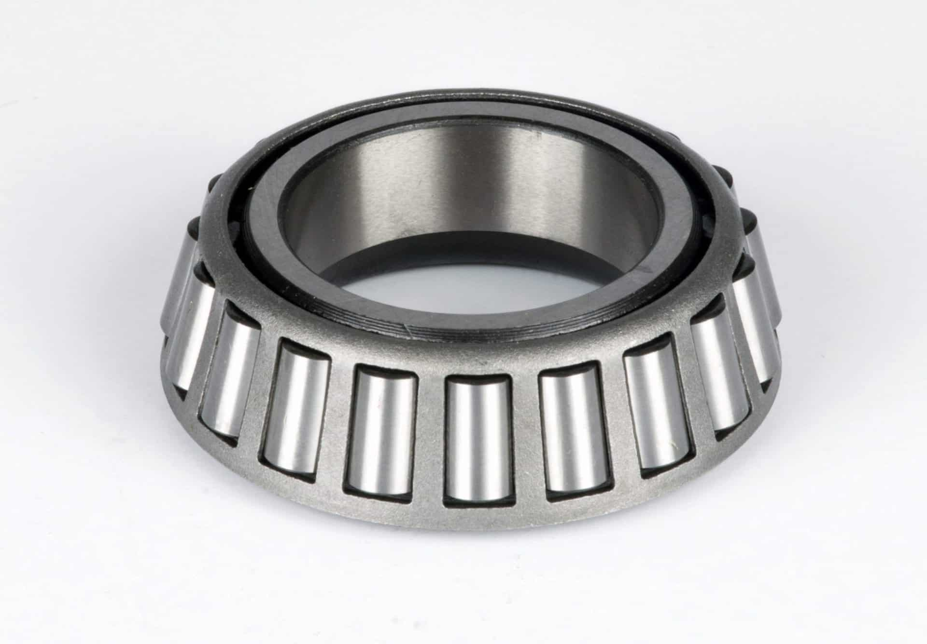
The Mad Hedge Fund Trader
“It’s Taper Time”
With John Thomas
Silicon Valley, CA, November 3, 2021
www.madhedgefundtrader.com
Notes:
*

Slide 2
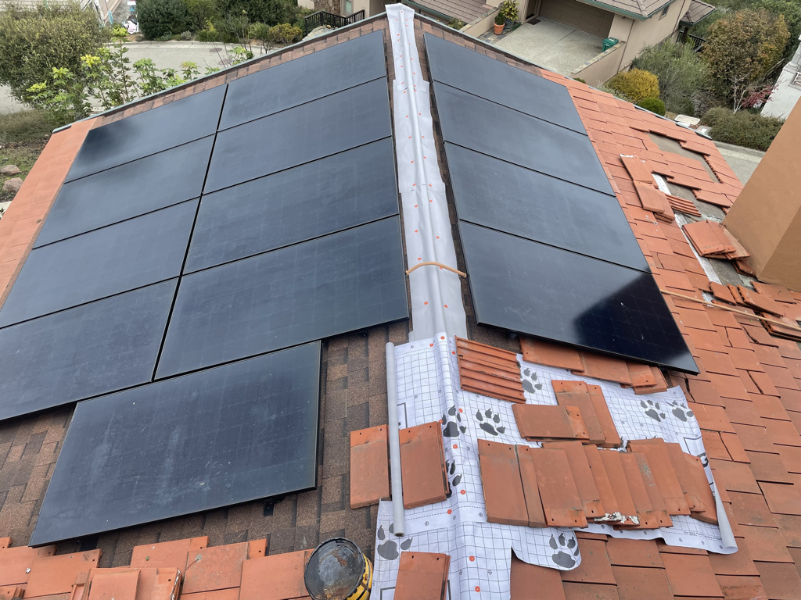

Slide 3

Trade Alert Performance
New All Time Highs!
32 consecutive profitable trade alerts-
93.5% success rate in 2021-ony 7 losers
*January 10.21% MTD *July +0.61% Final
*February +13.28% Final *August +9.36% Final
*March +20.60% Final *September 1.03% Final
*April +15.67% Final *October +8.91% MTD
*May +8.13% Final *November +3.32% Final
*June +0.71% Final *December +10.20% Final
*2021 Year to Date +91.87%
compared to +17.6% for the Dow Average
*+514.42% since inception, a new all time high
*Average annualized return of 43.14% for 12 years, new all time high

Slide 4
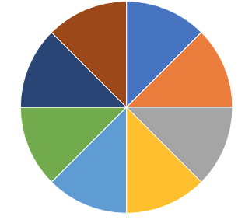
Portfolio Review
80% invested in financials in a low volatility Long Term Bull Market
20% cash
Current Capital at Risk
Risk On
World is Getting Better
(GS) 11/$330-$350 call spread | 10.00%
(GS) 11/$385-$395 call spread | 10.00%
(MS) 11/$85-$90 call spread | 10.00%
(MS) 11/$95-$98 call spread | 10.00%
(BAC) 11/$37-$40 call spread | 10.00%
(TLT) 11/$150-$153 put spread | 10.00%
(ROM) 11/$105-$110 call spread | 10.00%
(BRKB) 11/$275-$280 call spread | 10.00%
Risk Off
World is Getting Worse
Total Net Position | 80.00%
Total Aggregate Position | 80.00%
Expiration Value
98.08%

Slide 5
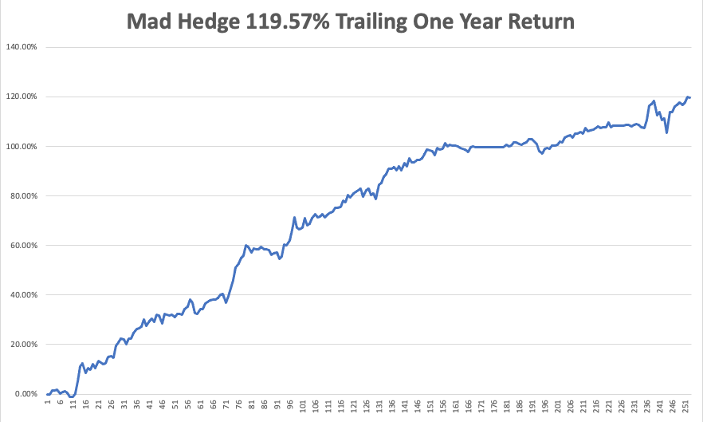

Slide 6
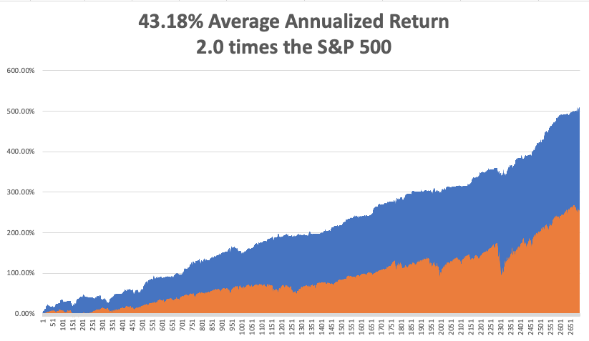
GTD 12 Year Daily Audited Performance

Slide 7

The Method to My Madness
The Roaring Twenties are Here
*Blowout tech earnings paving the way for a yearend rally in tech
*Accelerating US government will crush the bond market, opening the floodgate for banks. Brokers, and fund managers
*Delta is in free fall, boosting the economy from a 2% growth rate back to 6%
*Medium term, both sides of the barbell are working
*Bitcoin maintains highs off the back of massive institutional cash flows
*VIX at $16 shows risk is low
*50/50 chance that Fed taper happens today, triggering
monster yearend rally

Slide 8

Corona Update – The peak is In
*Covid deaths top 5 million worldwide
*30% of new cases are now in kids under 12, and 5-11 year olds can get vaccinated from next week
*68 million still unvaccinated
*80% of the US population has covid antibodies, and 90% in San Francisco
*No deaths from delta variant report among those vaccinated
*Best immunity is from getting covid, then getting vaccinated
*US cases top 46 million, deaths topping 747,000 and deaths are
back down to 1,000 a day

Slide 9
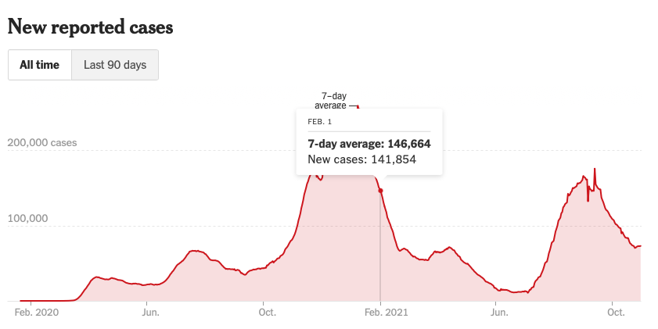
Bump on the Way to Zero

Slide 10
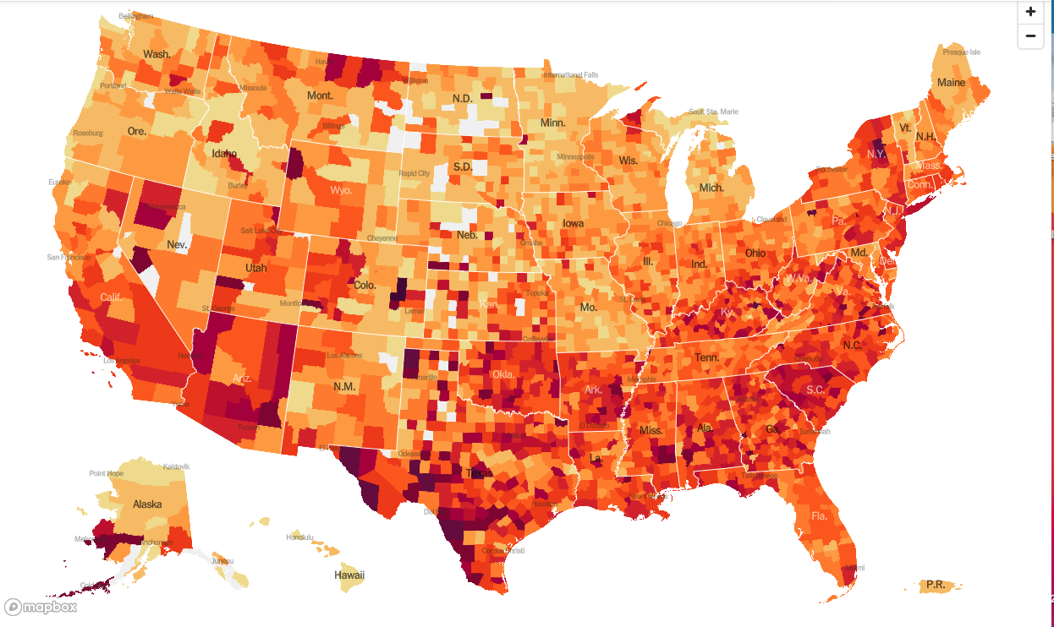
January 20 Infection Rate

Slide 11
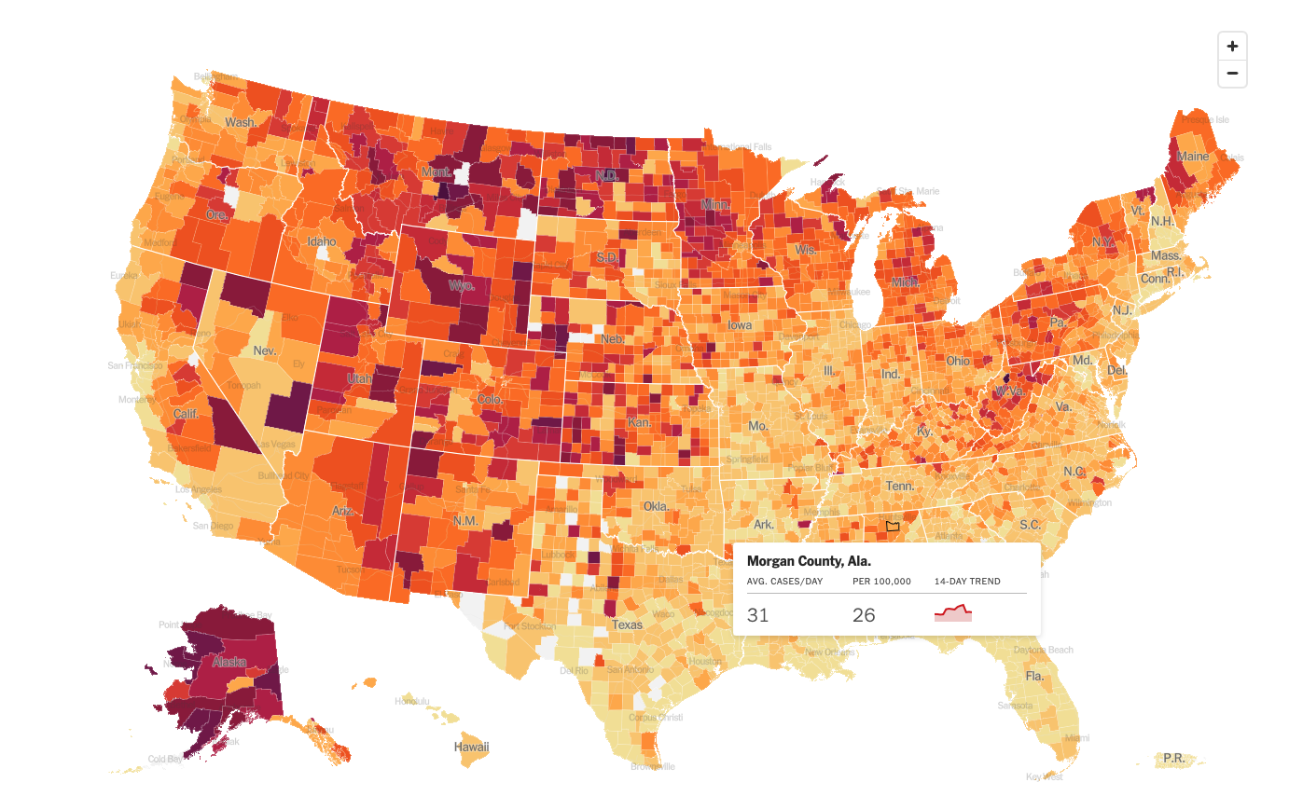
November 3 Infection Rate

Slide 12
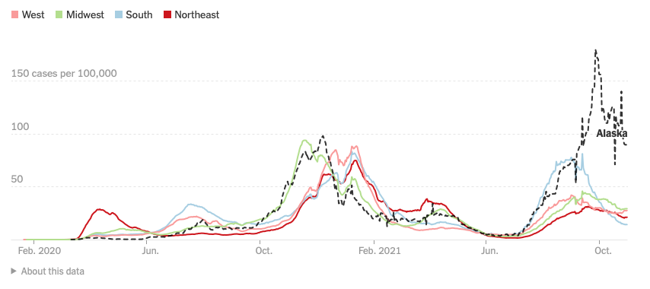
By Region

Slide 13

The Global Economy – Gaining Strength
*Q3 GDP Comes in at a Weak 2.0%, down from a 6% rate in Q2, thanks to the ravages of the delta virus, now in the rearview mirror
*Inflation is Rampaging, according to the Department of Commerce, which saw a sizzling 4.4% rate in September
*US Retail Sales Jump, up 0.7% in September. Chip constrained Autos surprised with a 0.5% increase
*If the Rescue Package Passes in whatever size, it will push another $1,75 trillion into the economy
*Green Infrastructure Will be the Major Driver of Global Growth says Goldman Sachs, with $6 trillion invested to decarbonize the world
*PMI’s Jump, with Manufacturing falling slightly from
60.7 to 59.2 and Services, which account for the bulk
of the US economy, were up 54.9 to 58.2
*Consumer Confidence Jumps to 113.8 versus 108 expected in October

Slide 14
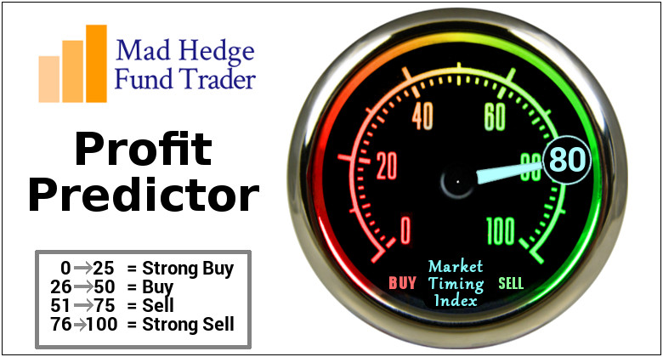
The Mad Hedge Profit Predictor
Market Timing Index – Moving to the Highs
An artificial intelligence driven algorithm that analyzes 30 different economic, technical, and momentum driven indicators

Slide 15
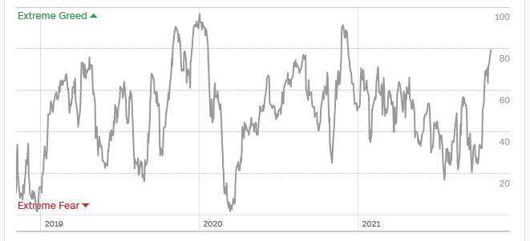
The Mad Hedge Profit Predictor
Moving into a “SELL” Range-But could stay there for months
SELL
Do
Nothing
BUY

Slide 16
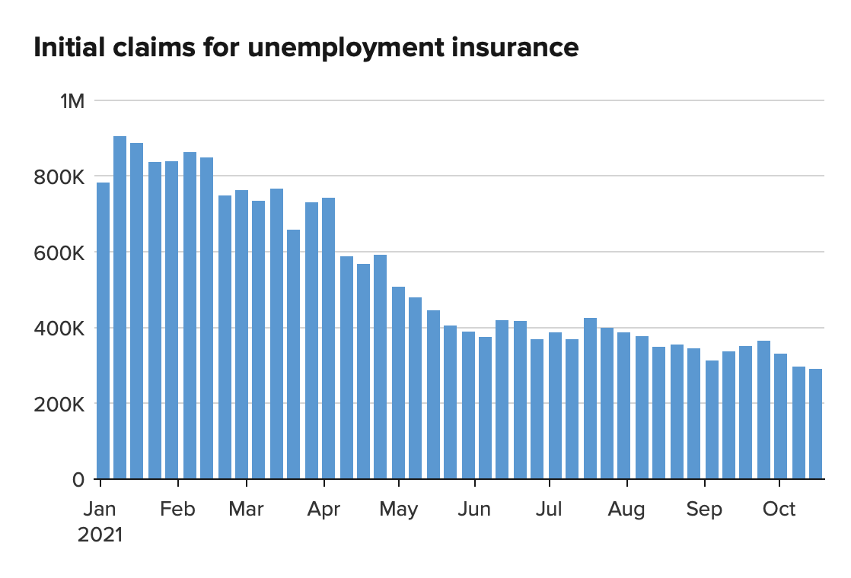
Weekly Jobless Claims – New Lows
281,000 – New Post Pandemic Low

Slide 17


Slide 18
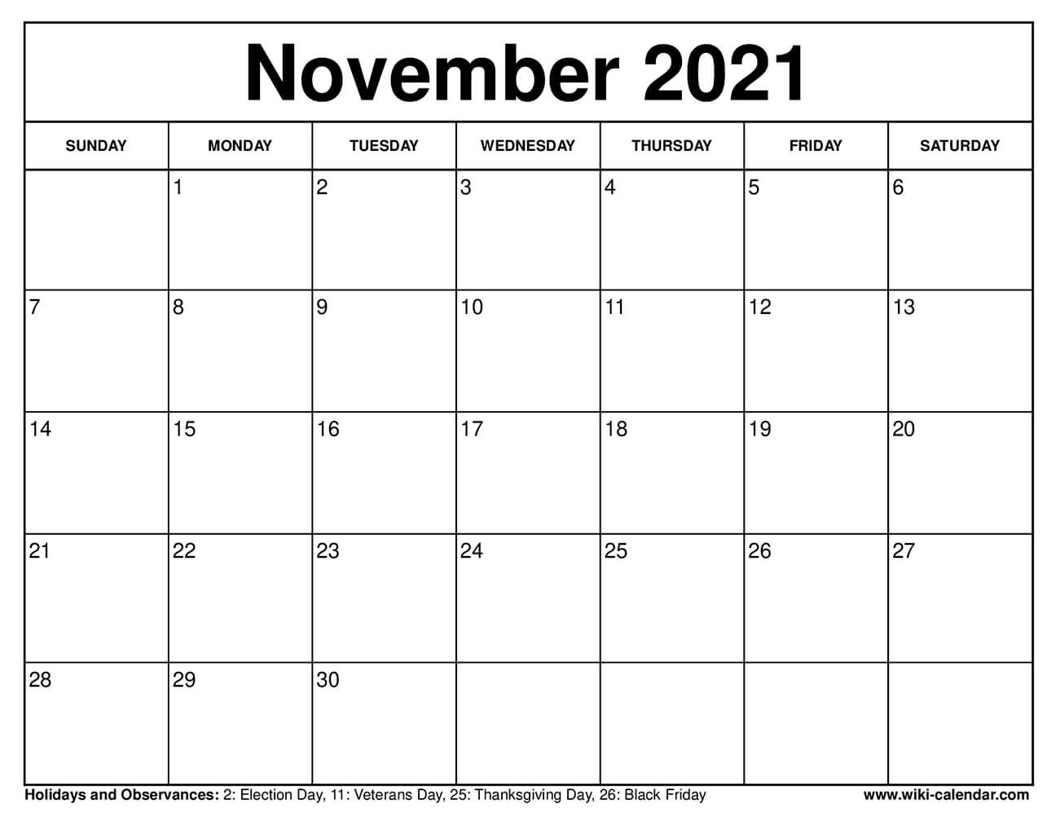
Stocks – Buying Season has Started
*Seasonals turn positive, launching the most profitable six months of trading for the year
*Bears are Throwing in the Towel, giving up on any further downside for the foreseeable future, and the mea culpas are coming hot and heavy. The wall of money wins again.
*Stocks may melt up straight until the end of 2021
*Brokers report Blowout Earnings and are firing on all cylinders. Buy (MS) and (GS)
*Technology is not selling off when it should, means the uptrend has resumed
*Fed taper could happen on Wednesday, but will be more than offset
by a gargantuan $1.75 trillion spending bill, and is already in the price
*Stick with the barbell strategy, we’ll keep rotating back
and forth all year between tech & domestic recovery

Slide 19
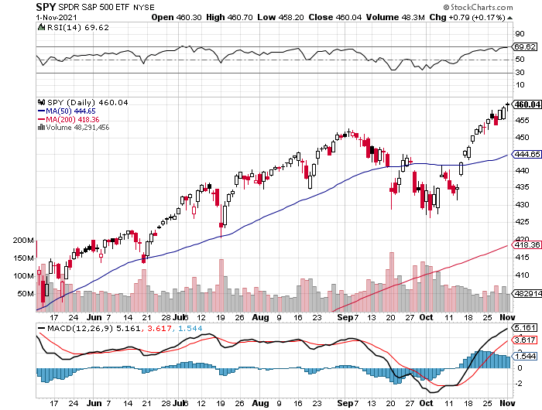
S&P 500 – Year End Melt Up!
Took profits on long 10/$410-$420 bull call spread stopped out of long 10/$419-$429 bull call spread took profits on long 6/$375-$385 bull call spread
New Highs
Yearend
Target
$475
The Bottom
440

Slide 20
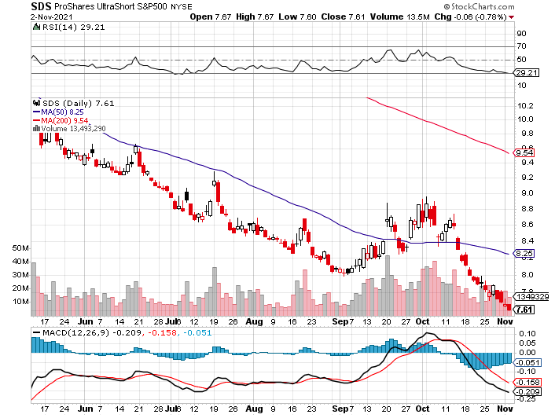
ProShares Ultra Short S&P 500 (SDS)- a great hedge for long stocks and bonds long 2X position has a hedge against longs and bond shorts

Slide 21
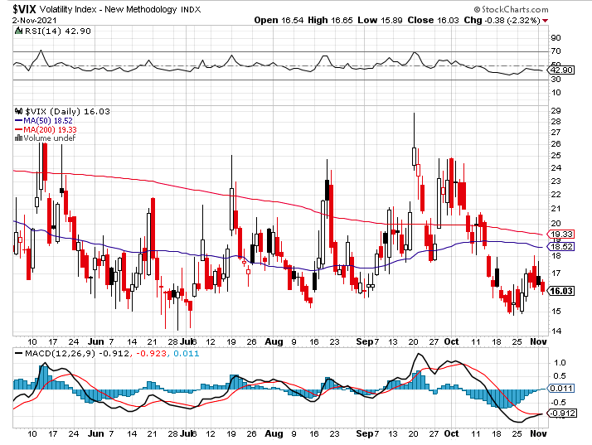
(VIX) – Dying a Slow Death classic summer market

Slide 22
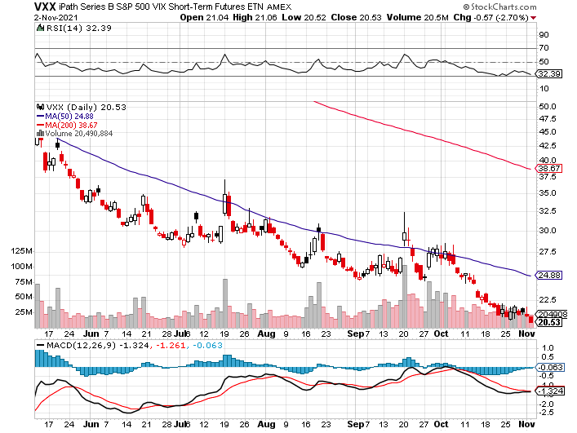
(VXX)-

Slide 23
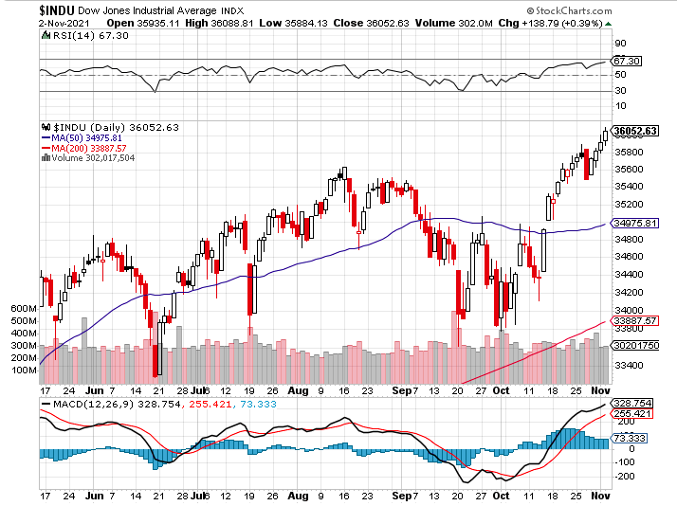
Dow Average ($INDU)-

Slide 24
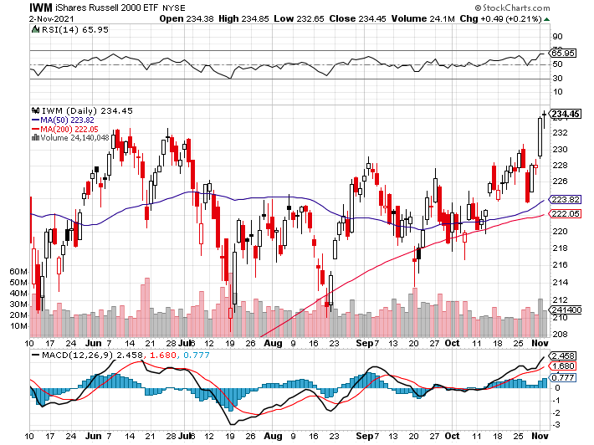
Russell 2000 (IWM)- took profits on Long 10/$137-$142 vertical bull call spread took profits on Long 10/$153-$156 vertical bear put spread

Slide 25
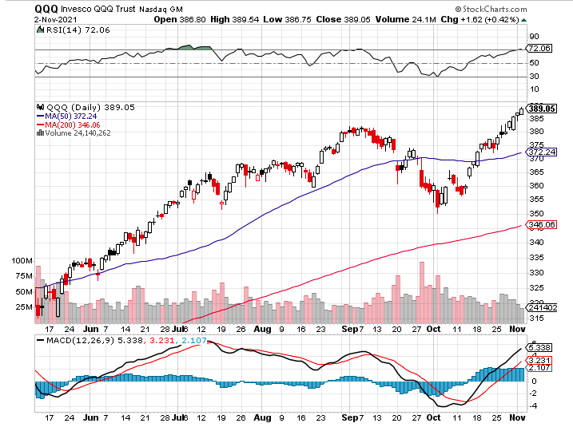
NASDAQ (QQQ) – long (QQQ) 4/$330-$335 put spread took profits on long (QQQ) 3/$340-$345 put spread covered long (QQQ) $325-$330 put spread

Slide 26
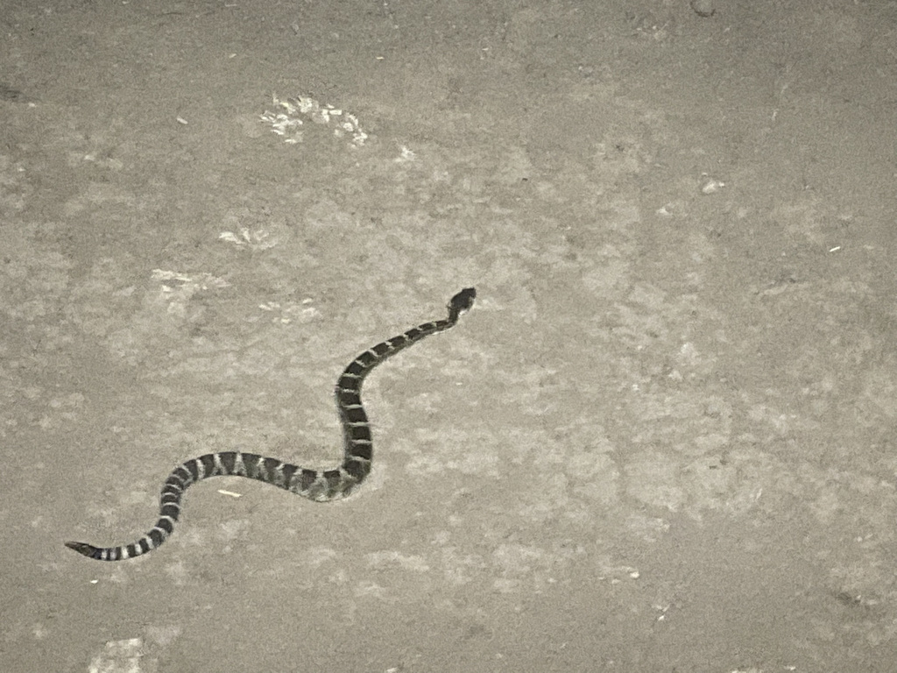

Slide 27
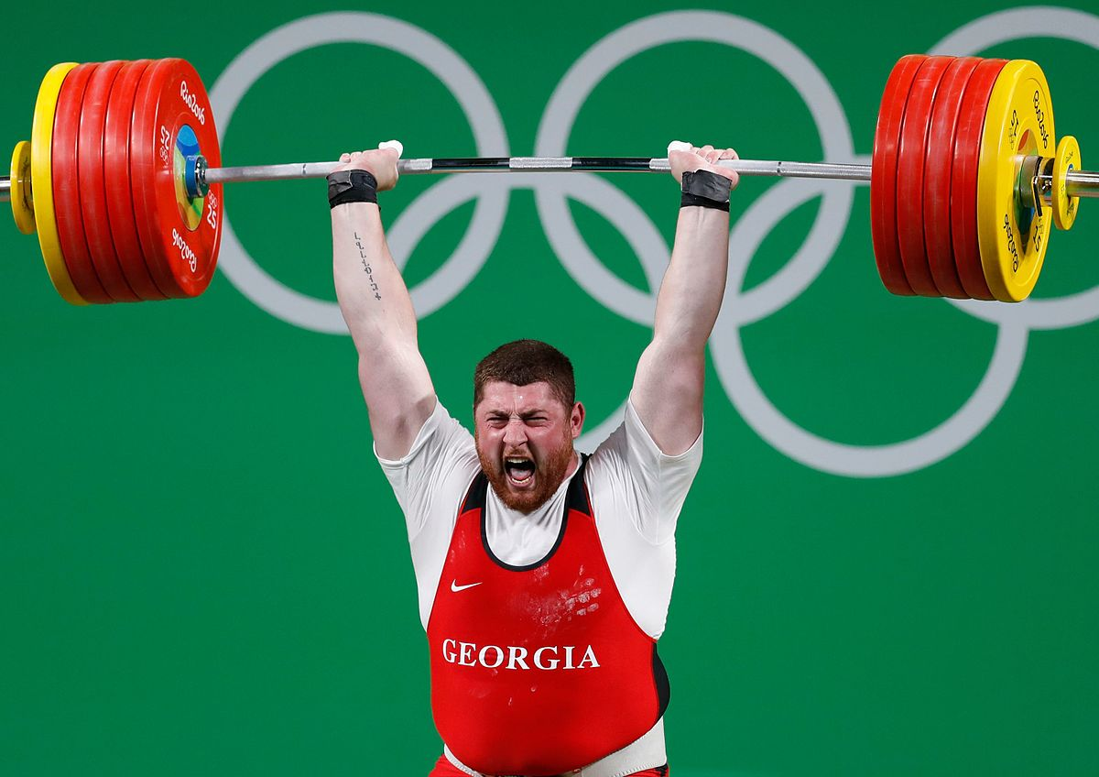
The Barbell Portfolio
*50% Big Tech - 2% of US Employment but 27% of Market Cap and 38% of Profits
50% Domestic Recovery, including:
Railroads
Couriers
Banks
Construction
Credit Cards
Event organizers
Ticket sales
Retailers

Slide 28
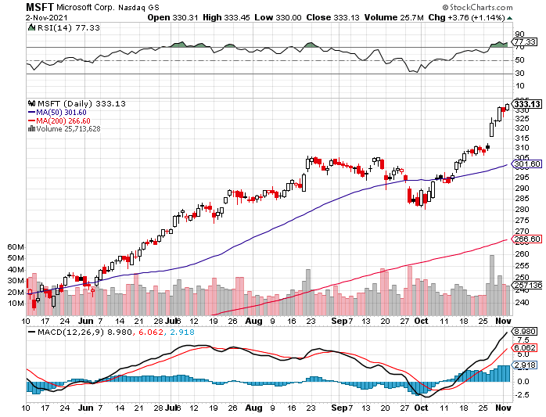
Microsoft (MSFT)-
Microsoft to Raise Dividend by 11% and increased a $60 billion stock buyback program took profits on long 12/$220-$230 call spread stop loss on long 12/$170-$180 call spread took profits on long 12/$135-$138 call spread

Slide 29
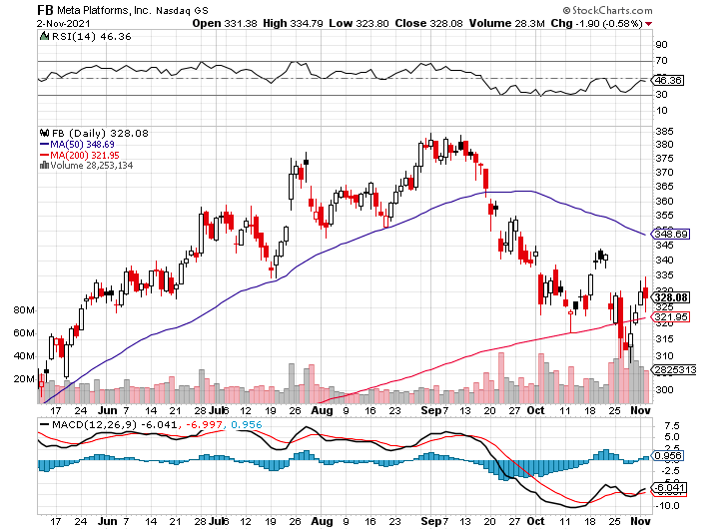
Facebook (FB)- Changes Name to “Meta” took profits on Long 9/$290-$300 vertical bear put spread stopped out of Long 9/$190-$200 vertical bear put spread took profits on Long 9/$145-$155 vertical bull call spread took profits on Long 9/$150-$160 vertical bull call spread

Slide 30
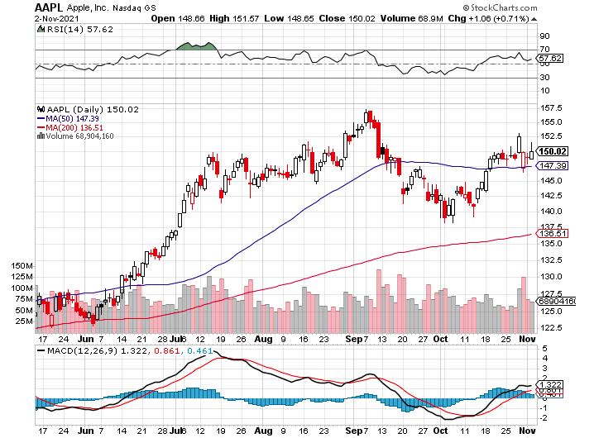
Apple (AAPL)-
Launches iPhone 13, with a better camera, faster chips, and longer battery life, Antitrust Comes Home to Roost at Apple took profits on long 7/$320-$330 call spread took profits on long 4/24/$250-$260 call spread took profits on long 5/$250-$260 call spread

Slide 31
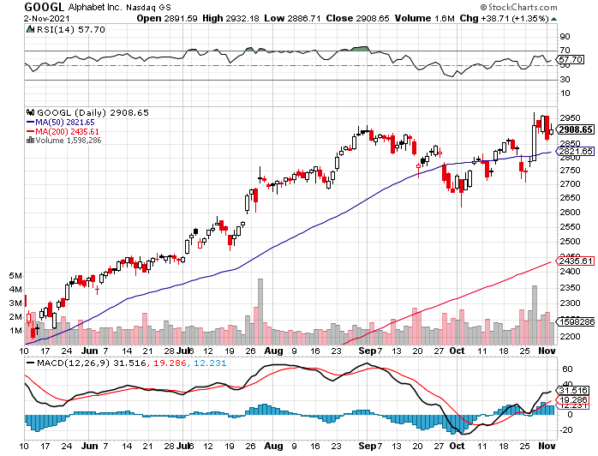
Alphabet (GOOGL) – Ad king on economic recovery
15% of search is travel related took profits on long 12/$1,200-$1,230 bull call spread took profits on long 9/$1,030-$1,080 vertical bull call spread

Slide 32
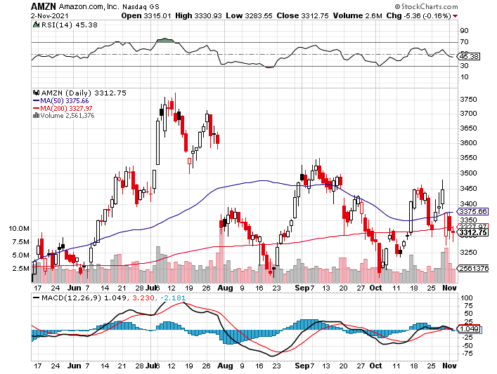
Amazon (AMZN) –
Amazon to Hire 125,000 and boost wages to $18 an hour took profits on long 9/$2,800-$2,900 bull call spread

Slide 33
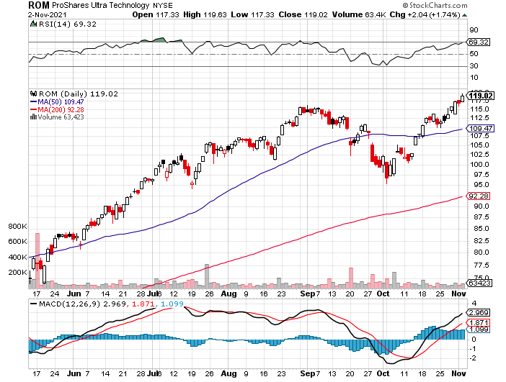
ProShares Ultra Technology (ROM) – New Highs

Slide 34
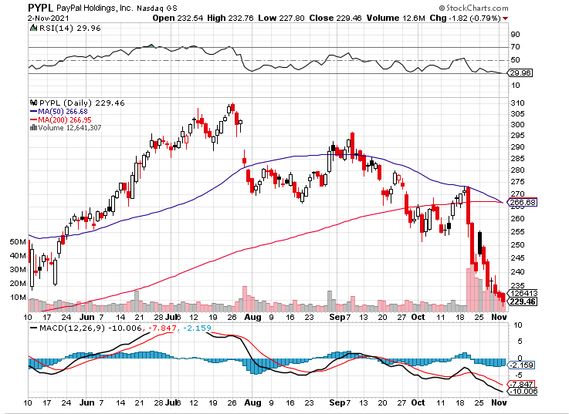
PayPal (PYPL) - Cancels Pinterest Buy took profits on long 4/$90-$95 call spread

Slide 35
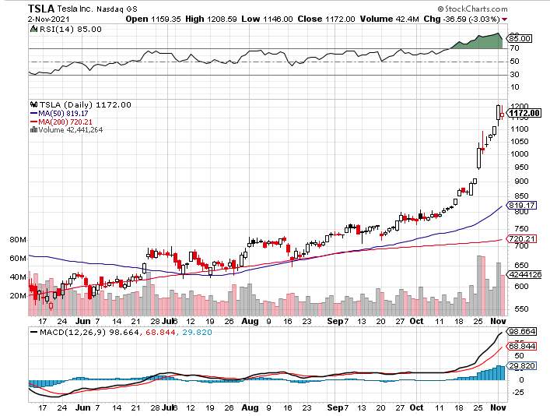
Tesla (TSLA)-Profits Smash Records in Q3 reporting a shocking $1.62 billion profit on $13.76 billion in revenues took profits on long 2X 4/$450-$500 call spread, took profits on long 3/$400-$450 call spread took profits on long 2/$650-$700 call spread-expires, stopped out of long 3/$600-$650 call spread
Took profits on long 2/$600-$650 bull call spread, Took profits on long 2/$550-$600 bull call spread

Slide 36
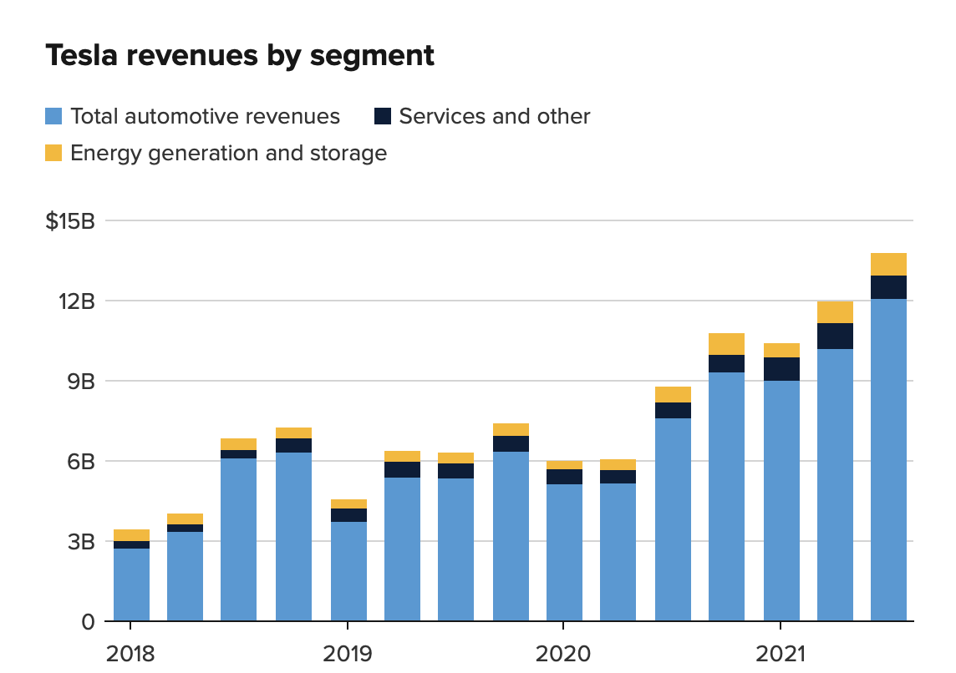

Slide 37
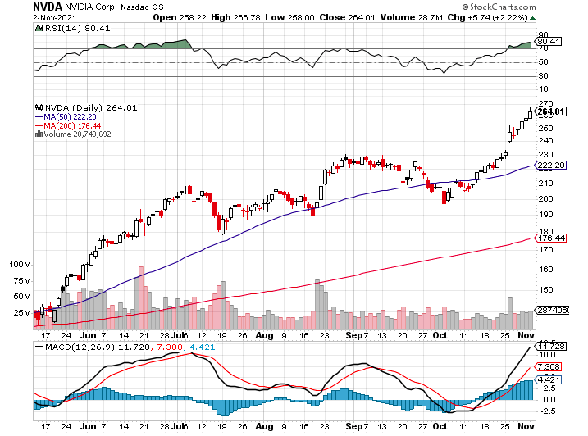
NVIDIA (NVDA) –
A Mad Hedge 10 bagger – Global Semiconductor Shortage Slows Auto Industry,
Graphic card sales up 87% in Q2

Slide 38
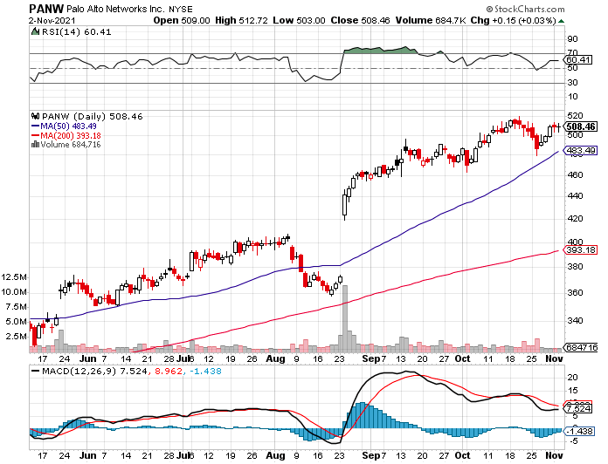
Palo Alto Networks (PANW)-
Hacking never goes out of fashion

Slide 39
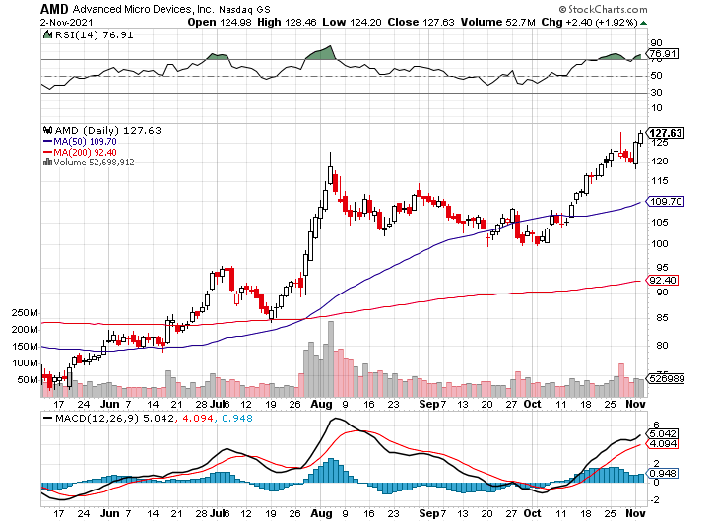
Advanced Micro Devices (AMD)- programable logic devices took profits on long 2/$75-$80 call spread

Slide 40
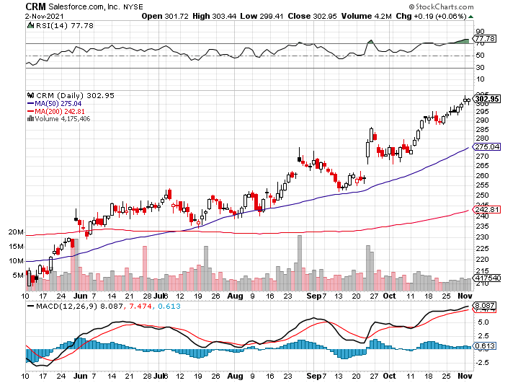
Salesforce (CRM)- Massive Online Migration took profits on long 9/$125-$130 vertical bull call spread took profits on long 8/$125-$130 vertical bull call spread took profits on long 2/$105-$115 call spread

Slide 41
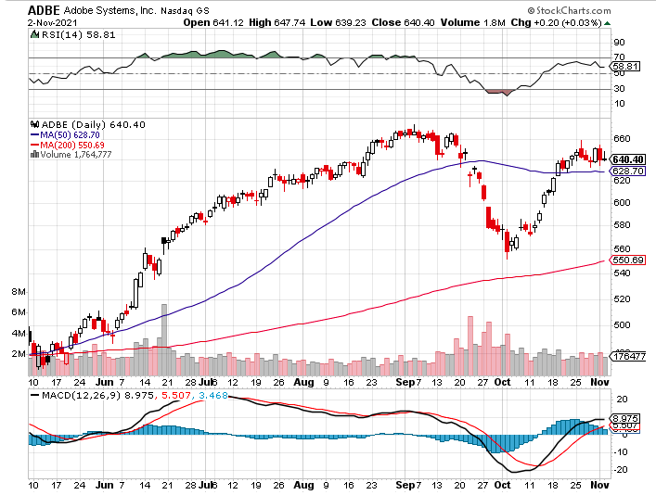
Adobe (ADBE)- Cloud play
The Quality Non-China tech play

Slide 42
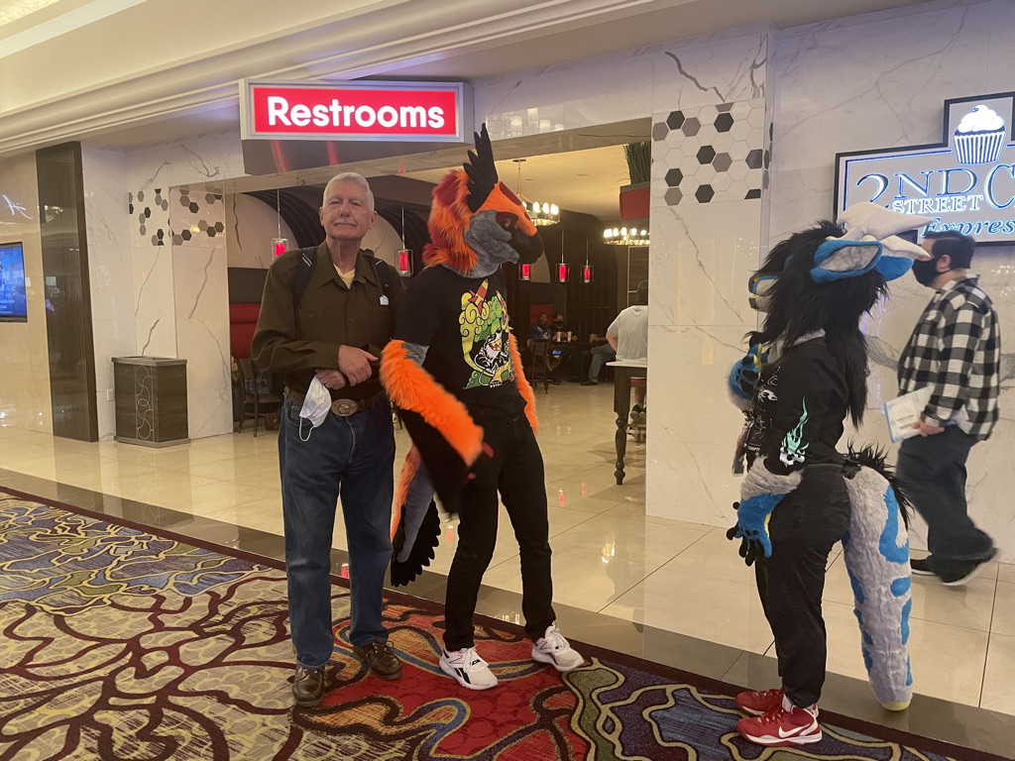

Slide 43
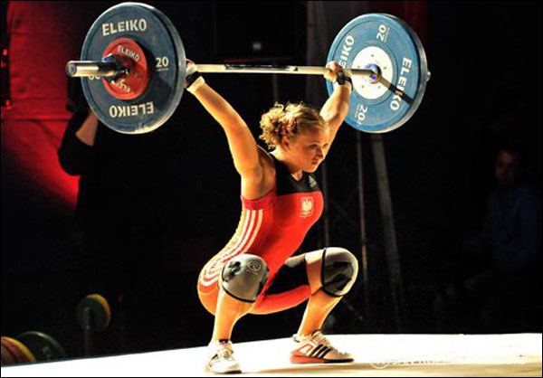
The Second Half of the Barbell
*Bets on a domestic recovery in 2021 Q4
*Upside potential in 2021 far greater than tech
*Some of these have not moved for 5 or 10 years
*Focuses on economically sensitive cyclical industries
*Makes a great counterweight to
high-growth technology
*We could spend all of next year rotating
between the two groups

Slide 44
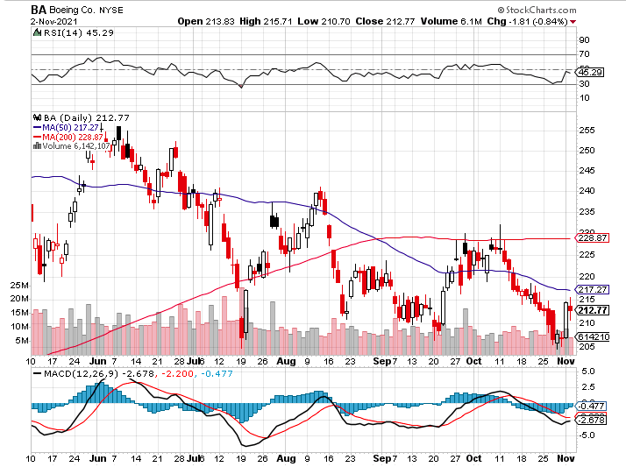
Boeing (BA) – former LEAP Candidate – Headaches again long 3/$146-$149 call spread took profits on long 2/$150-$160 call spread

Slide 45
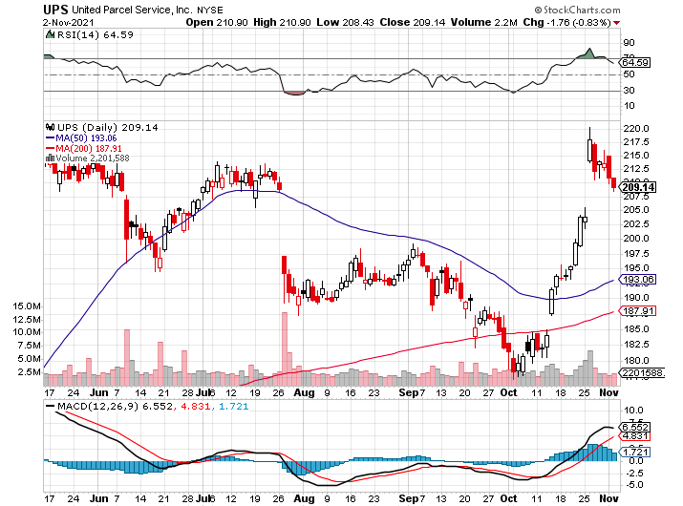
Package Delivery- United Parcel Service (UPS) - Package Delivery massive increase in overnight deliveries, announces blowout earnings, vaccine deliveries took profits on long 11/$130-$140 call spread

Slide 46
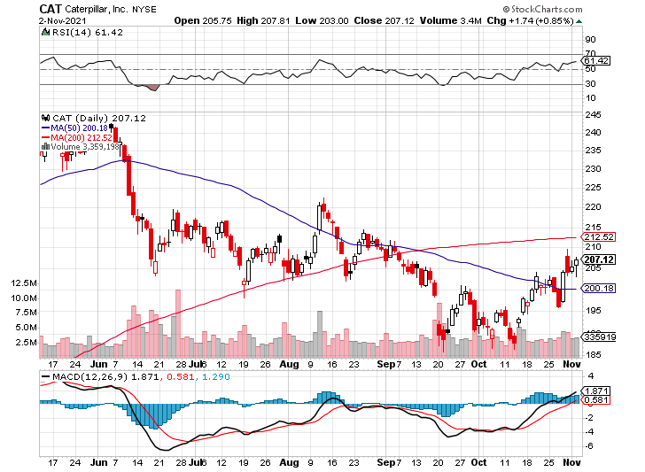
Caterpillar (CAT)- Ag + Infrastructure + Housing took profits on long 12/$145-$150 call spread took profits on long 11/$125-$135 call spread

Slide 47
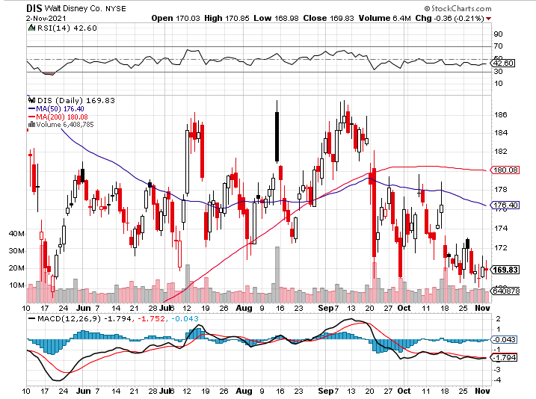
Walt Disney (DIS)- Big Recovery Move
Covid 4th Wave Delta Drag stopped out of long 10/$165-$175 call spread took profits on long 3/$170-$180 call spread

Slide 48
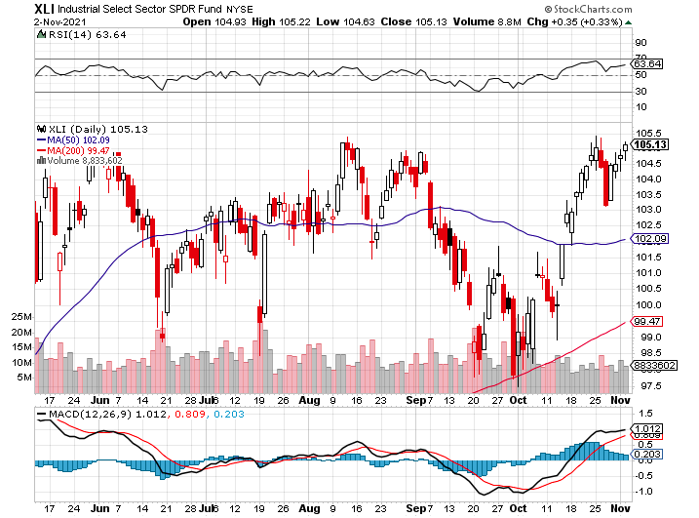
Industrials Sector SPDR (XLI)-
(GE), (MMM), (UNP), (UTX), (BA), (HON)

Slide 49
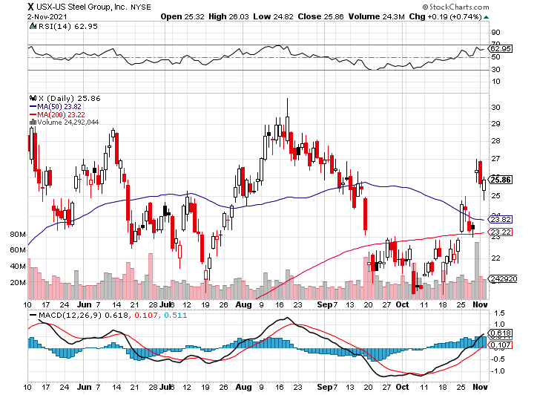
US Steel (X) – Commodity Drag

Slide 50
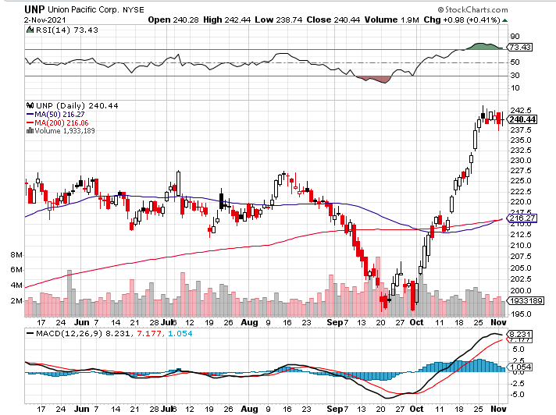
Union Pacific RR (UNP)- Big Stuff to Ship near record earnings announced long 5/$200-$210 call spread – 12 days to expiration took profits on 11/$150-$160 call spread

Slide 51
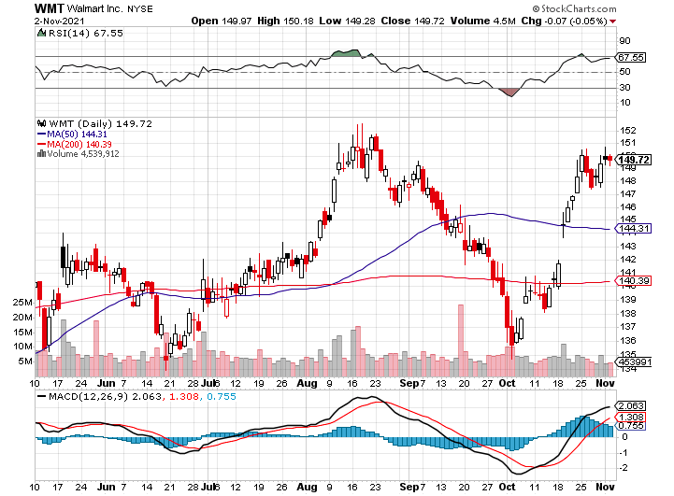
Wal-Mart (WMT)-New High took profit on Long 11/$125-$130 bear put spread took profit on Long 10/$119-$121 bear put spread took profits on Long 8/$114-$117 bear put spread

Slide 52
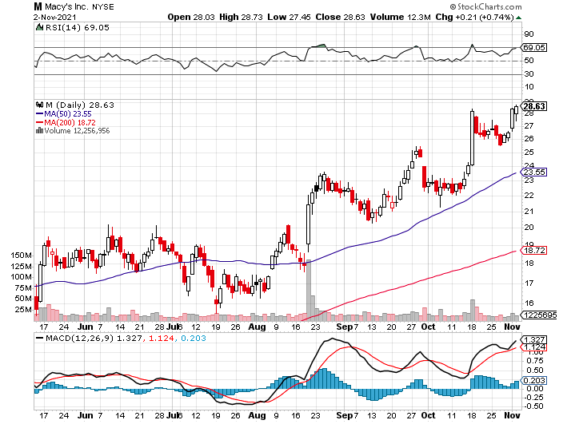
Macys’ (M) – Retail Return from the Grave took profits on Long 8/$23-$25 bear put spread

Slide 53
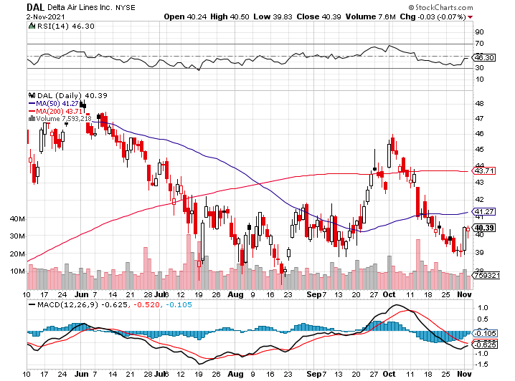
Delta Airlines (DAL) –

Slide 54
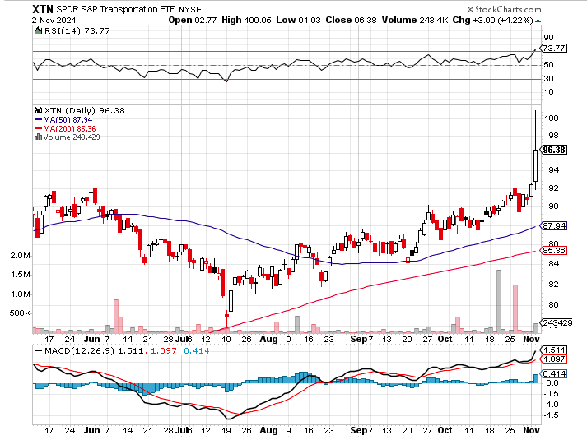
Transports Sector SPDR (XTN)- Worst Hit Sector
(ALGT), (ALK), (JBLU), (LUV), (CHRW), (DAL)

Slide 55
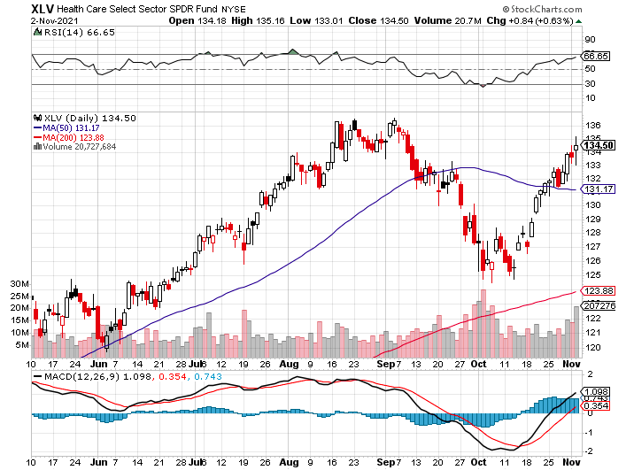

Health Care Sector (XLV), (RXL)
(JNJ), (PFE), (MRK), (GILD), (ACT), (AMGN)

Slide 56

Biogen (BIIB)
Why you invest in Biotech

Slide 57

Amgen (AMGN) took profits on long 11/$185-$200 bull call spread

Slide 58

Regeneron (REGN) took profits on long 7/$570-$580 call spread

Slide 59

CRISPR Therapeutics (CRSP)

Slide 60

Goldman Sachs (GS) – took profits on long 10/$320-$330 call spread long 11/$330-$350 call spread took profits on long 8/$325-$335 call spread

Slide 61

Morgan Stanley (MS) – Doubled Dividend took profits on long 10/$85-$90 call spread long 11/$85-$90 call spread profits on long 2/$55-$60 call spread

Slide 62

JP Morgan Chase (JPM)-Back to Life took profits on long 10/$130-$140 call spread took profits on long 8/$140-$145 call spread took profits on long 7/$140-$145 call spread

Slide 63

Citigroup (C) – “Recovery” Rotation Play took profits on long 10/$62-65 call spread

Slide 64

Bank of America (BAC) – long 11/$37-$40 call spread profits on long 2/$28-$30 call spread

Slide 65

SPDR Metals & Mining ETF (XME) – long 2/$28-$30 call spread

Slide 66

Blackrock (BLK)-Asset Collection Boom took profits on long 3/$770-$790 call spread took profits on long 3/$310-$340 call spread

Slide 67

Visa (V) – “Touchless” Bitcoin Drag took profits on long 5/$220-$225 bull call spread took profits on long long 5/$195-$205 bull call spread took profits on long 9/$180-$185 bull call spread

Slide 68

Consumer Discretionary SPDR (XLY)
(DIS), (AMZN), (HD), (CMCSA), (MCD), (SBUX)

Slide 69

Berkshire Hathaway (BRKB)- Natural Barbell cut back buy backs at $6 billion a year, announced spectacular earnings took profits on long 10/$255-$265 call spread took profits on long 3/$230-$240 call spread

Slide 70

Europe Hedged Equity (HEDJ)-

Slide 71

Japan (DXJ)-

Slide 72

Emerging Markets (EEM) - Pro trade, Weak Dollar, Long Recovery Play

Slide 73


Slide 74
Bonds – Melt Up
*Bonds Melt Up, creating one of the best trade entry points of the year
* A successful 30 year auction this week that took yields from 1.71% down to 1.52% in a heartbeat
*Australia’s Bond Market Melts Down, so will the US be next?
*My final target is a 1.76% yield on the ten-year US Treasury bond by January
*Add more downside LEAPS on rallies, the December 2022
(TLT) $150-$155 vertical bear put spread delivers a
100% profit in six months
*A 2.00% yield on the ten-year US Treasury bond here
we come! This is the quality trade for the rest of 2021
*US Treasury bond fund (TLT) could plunge from
$180 a year ago to $105 by 2023

Slide 75

Treasury ETF (TLT) – No Positions! took profits on long 10/$154-$157 put spread, took profits on long 10/$137-$140 call spread profits on long 10/$155-$158 put spread, took profits on 9/$155-$158 put spread took profits on long 8/$157-$160 put spread, took profits on long 8/$156-$159 put spread,

Slide 76

Ten Year Treasury Yield ($TNX) – 1.48%

Slide 77

Junk Bonds (HYG) 3.47% Yield to Maturity

Slide 78

2X Short Treasuries (TBT)-Another run at highs

Slide 79

Emerging Market Debt (ELD) 4.27% Yield-

Slide 80

Municipal Bonds (MUB) – 0.93%
Mix of AAA, AA, and A rated bonds

Slide 81


Slide 82

Foreign Currencies – The Dollar Catches its Breathe
*The US Trade Deficit is Soaring, since we have the strongest economy in the world that everyone is else is selling into
*In September, it jumped by 9.2% to an eye-popping $96.3 billion.
*US Dollar Soars, on a continuing rise in interest rates. It’s also getting a not flight to safety bid on the stock market’s down days. The Japanese yen (FXY) has been especially hard hit.
*Currency with the fastest appreciating interest rates always does best
*Long-term fundamentals are still poor, a dollar short could be the
new ten-year trade
*Massive over issuance of debt by the US government
to fund the covid recovery is another nail in the coffin
in addition to an exploding trade deficit
*Buy (FXA) and (FXE) on dips

Slide 83


Japanese Yen (FXY), (YCS)

Slide 84



Euro ($XEU), (FXE), (EUO)-

Slide 85

British Pound (FXB)-

Slide 86

Australian Dollar (FXA)- The Global Recovery Play took profits on long 8/$67-$69 call spread

Slide 87

Emerging Market Currencies (CEW)

Slide 88

Chinese Yuan- (CYB)-

Slide 89


Slide 90

Bitcoin – Consolidating Gains
Buy the Mad Hedge Bitcoin Letter at https://www.madhedgefundtrader.com/store/
*Bitcoin Breaks to a New All-Time High. Suddenly everyone has realized that are under invested in the fastest appreciating asset in the market
*The First Bitcoin Strategy ETF (BITO) Launches, the ProShares Bitcoin Futures Fund, after major haggling with the SEC
*The instruments qualify trillions of dollars more to pour into the sector, especially those subject to the Investment Act of 1940
*Shiba Inu Altcoin Soars 50% in a Day
*Crypto Currencies Sees Record Inflows Last Week,
for the 7th straight week in a row,
according to data collected by digital asset manager Coinshares
*Buy Bitcoin and Ethereum on the dip

Slide 91


Slide 92

Bitcoin ($BTCUSD) – Wake Up Time

Slide 93

Ethereum (ETHE) – New All Time High

Slide 94

MicroStrategy (MSTR) –

Slide 95

Amplify Transformational Data Sharing ETF (BLOK) – Cross Imminent

Slide 96


Slide 97

Energy –
*Gas Prices Hit Seven Year High, increasing the pain at the pump
*More rises are to come as $87/barrel oil feeds into the system
*Avoid energy stocks. They could be peaking here.
*Saudi Arabia Makes Big Hydrogen Play, with a $60 billion investment
If you can’t sell oil to a greening way, then convert it to hydrogen and sell that
*US drillers are paying out dividends instead of Investing
in new drilling, reading the writing on the way
*The end of oil is upon us, but it may take 30 years to unwind
existing infrastructure
*Avoid all energy plays like the plague, it’s the new
buggy whip industry as the US de-carbonizes

Slide 98

Oil-($WTIC)

Slide 99

United States Oil Fund (USO) long 10/$9.50-$10 Vertical bull call spread

Slide 100

Energy Select Sector SPDR (XLE)-No Performance!
(XOM), (CVX), (SLB), (KMI), (EOG), (COP)

Slide 101

Halliburton (HAL)-

Slide 102

Natural Gas (UNG) -

Slide 103


Slide 104

Precious Metals – Still Dead
*Big stock market dump delivers only a modest gold rally
*Rising interest rates bode poorly for precious metals as it raises the opportunity cost for non-yielding assets
*Bitcoin is clearly sucking capital out of precious metals
*Stay away until this plays out
*Silver is still the bigger and better long-term play
*Gold will eventually recover when US borrowing
becomes so massive it undermines the value of the
US dollar, even in the face of higher interest rates

Slide 105

Gold (GLD)- Meltdown

Slide 106

Market Vectors Gold Miners ETF- (GDX) –

Slide 107

Barrick Gold (GOLD) took profits on long 1/$21-$23 call spread took profits on long 11/$22-$24 call spread

Slide 108

Newmont Mining- (NEM)- took profits on long $55-60 call spread

Slide 109

Silver- (SLV)- took profits on long 11/$19-$20 call spread

Slide 110

Silver Miners - (SIL)-

Slide 111

Wheaton Precious Metals - (WPM)- took profits on long 2/$39-41 call spread

Slide 112

Copper (COPX)-Uptrend Resumes
Copper Unions Vote to Strike in Chile, cutting off 33% of the global supply

Slide 113

Real Estate – Still on Fire
*Pending Home Sales Fall, down 2.3% is September, thanks to a sharp rise in mortgage rates that month
*New Home Sales Pop, to 800,000
*Annual median prices jump at an annual 18.7% to $408,000
*The share of homes selling over $1 million increased from 5% to 9% in a year
*It cost $500,000 to get a starter home in an Oakland slum these days
*Homebuilders Sentiment Soars to 80
*Mortgage Rates Hit 8 Month High, demolishing refi demand,
with the 30-year fixed hitting 3.30%
*S&P Case Shiller is Still Rocketing,
the National Home Price Index up 19.8% YOY in August.

Slide 114

S&P Case Shiller
Up 18.7% for June
Phoenix (33.3%), San Diego (26.2%), and Tampa (25.9%) lead

Slide 115

Crown Castle International (CCI) – 2.70% yielding cell phone tower REIT

Slide 116

US Home Construction Index (ITB)
(DHI), (LEN), (PHM), (TOL), (NVR)

Slide 117


Slide 118

Trade Sheet-
So What Do We Do About All This?
*Stocks – buy dips aggressively
*Bonds – sell rallies aggressively
*Commodities-stand aside
*Currencies- stand aside
*Precious Metals – stand aside
*Energy – stand aside
*Volatility - sell short over $30
*Real estate – buy dips
*Bitcoin – buy dips

Slide 119
Next Strategy Webinar
12:00 EST Wednesday, November 17, from Silicon Valley email me questions at support@madhedgefundtrader.com
Good Luck and Good Trading!
Notes:
*

