Slide 1
The Mad Hedge Fund Trader “The Perfect Yearend Storm”
With John Thomas Silicon Valley, CA, November 17, 2021 www.madhedgefundtrader.com
Notes:
*

Slide 3
Trade Alert Performance New All Time Highs! 32 consecutive profitable trade alerts- 93.5% success rate in 2021-ony 7 losers
*January 10.21% MTD *July +0.61% Final *February +13.28% Final *August +9.36% Final *March +20.60% Final *September 1.03% Final *April +15.67% Final *October +8.91% MTD *May +8.13% Final *November +5.98% Final *June +0.71% Final *December +10.20% Final *2021 Year to Date +94.53% compared to +17.9% for the Dow Average *+517.08% since inception, a new all time high *Average annualized return of 43.26% for 12 years, new all time high

Slide 4
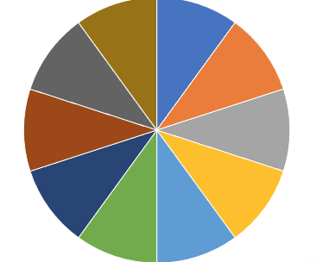
Portfolio Review 100% invested in financials, 10% tech, 10% short bonds in a low volatility Long Term Bull Market
Risk On
World is Getting Better
(GS) 11/$330-$350 call spread | 10.00%
(GS) 11/$385-$395 call spread | 10.00%
(MS) 11/$85-$90 call spread | 10.00%
(MS) 11/$95-$98 call spread | 10.00%
(BAC) 11/$37-$40 call spread | 10.00%
(BAC) 11/$43-$46 call spread | 10.00%
(TLT) 11/$150-$153 put spread | 10.00%
(ROM) 11/$105-$110 call spread | 10.00%
(BRKB) 11/$275-$280 call spread | 10.00%
(BRKB) 11/$277.50-$282.50 call spread | 10.00%
Risk Off
World is Getting Worse
Total Net Position | 100.00%
Expiration Value 101.68%

Slide 5
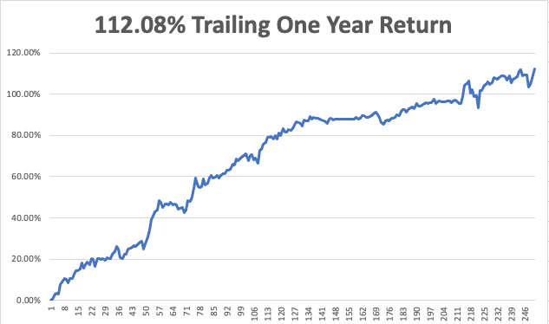

Slide 6
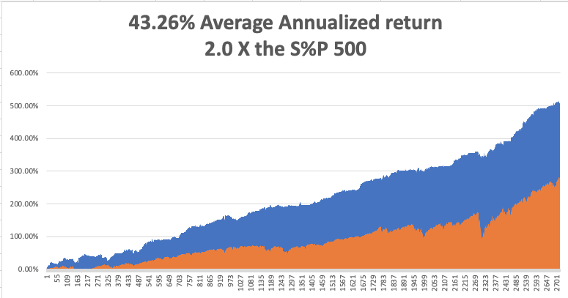
GTD 12 Year Daily Audited Performance

Slide 7
The Method to My Madness The Roaring Twenties are Here
*The yearend rally promised by blowout tech and financial earnings has delivered a monster yearend rally *It could run for two more months, or four in an extreme case *$1.2 trillion in new money is now hitting the economy *US government debt now at $30 trillion is crushing the bond market *Delta is in free fall, boosting the economy from a 2% growth rate back to 6% or more *Medium term, both sides of the barbell are working *Bitcoin maintains highs off the back of massive institutional cash flows *VIX at $16 shows risk is low *First Fed interest rate hike in 5 years has been moved up to June

Slide 8
Corona Update – The peak is In
*The US Reopens, provided you have two covid shots and a test within the last three days. *California inoculates 1 million kids in the first week *80% of the US population has covid antibodies, and 90% in San Francisco *No deaths from delta variant report among those vaccinated *Best immunity is from getting covid, then getting vaccinated *US cases top 46 million, deaths topping 765,000 and deaths are back down to 1,000 a day

Slide 9
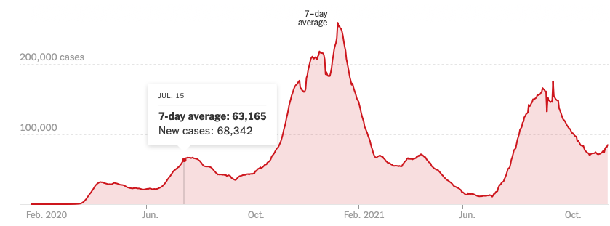
Bump on the Way to Zero

Slide 10
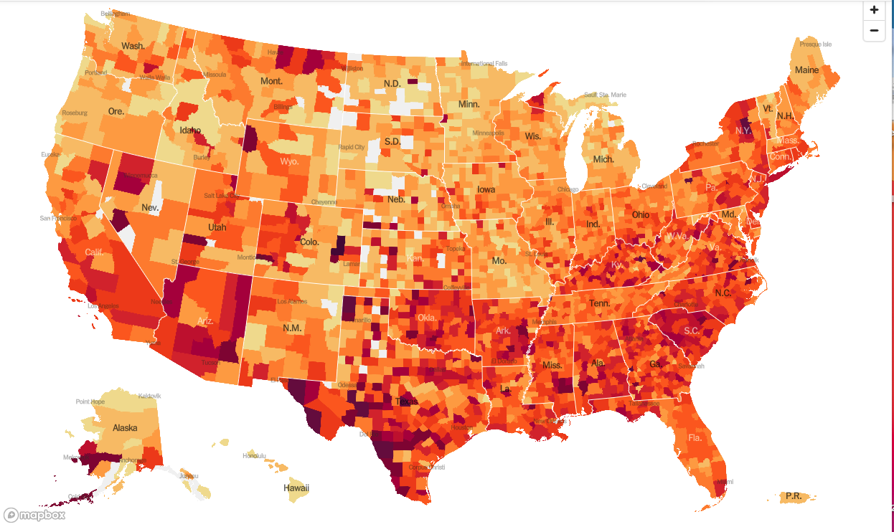
January 20 Infection Rate

Slide 11
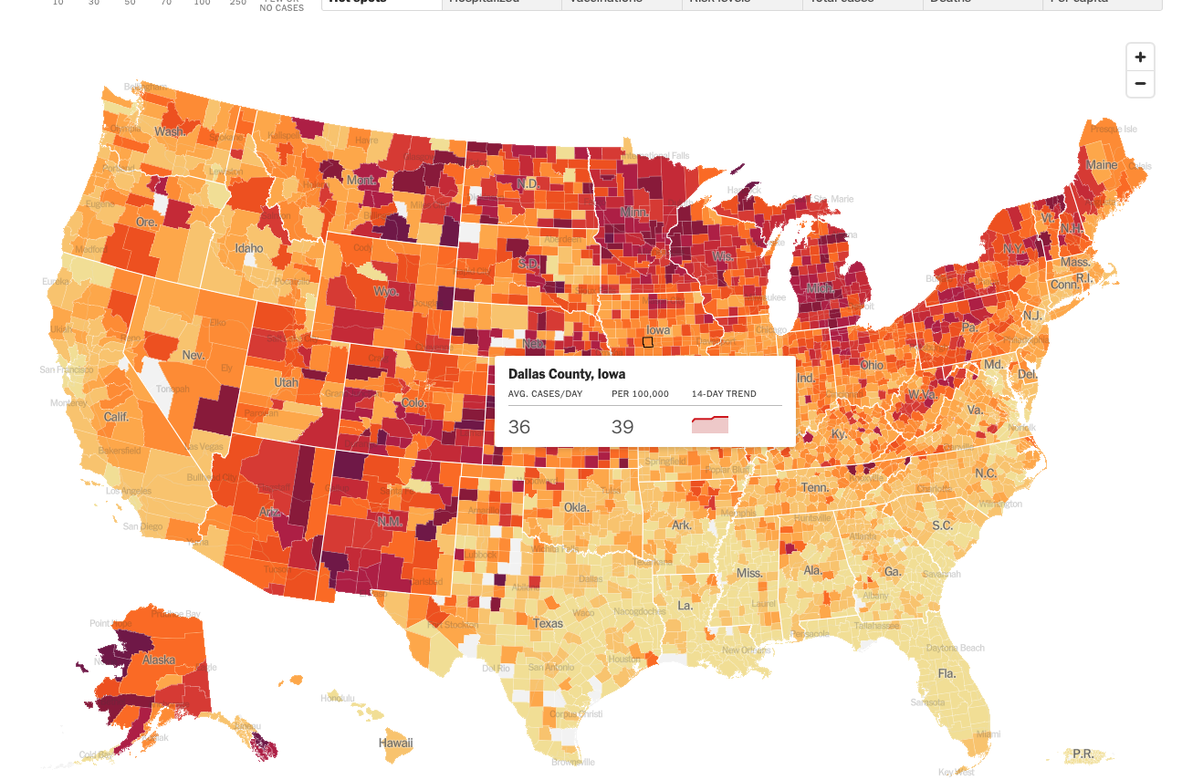
November 17 Infection Rate

Slide 12
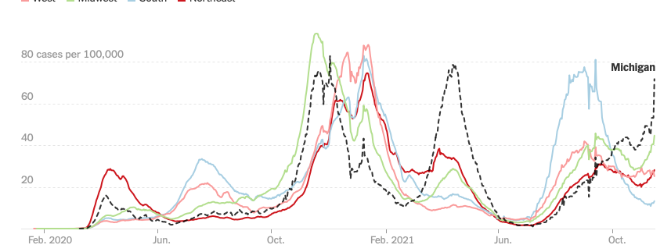

Slide 13
The Global Economy – Reviving
*The $1.2 Trillion Infrastructure Budget Passes, adding another 6% in GDP growth for the next two years *Inflation Soars with a Red Hot 6.2% CPI Print in October, the highest in 31 years *ADP Soars, with private companies adding 571,000 jobs in October *ISM Services Rocket in October from an expected 62.0 to 66.7 *Nonfarm Payroll Report Explodes to the Upside at 531,000 in October *Producer Prices Soar, up an eye popping 8.1%, matching record highs 11 years ago. *An American Baby Boom is Coming, with sales of pregnancy tests through the roof. Be long stocks in 2042

Slide 14
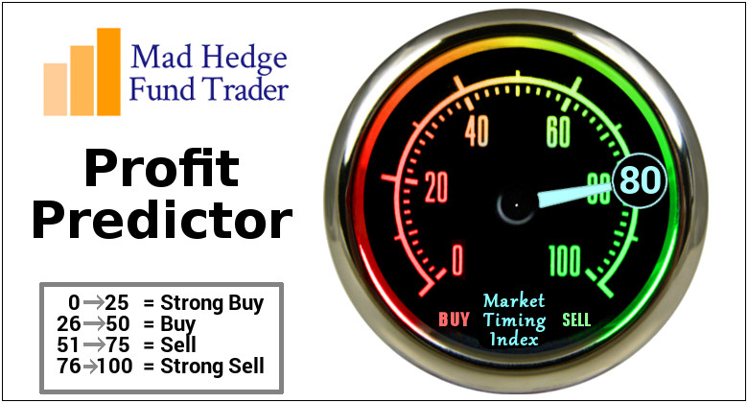
The Mad Hedge Profit Predictor Market Timing Index – Moving to the Highs An artificial intelligence driven algorithm that analyzes 30 different economic, technical, and momentum driven indicators

Slide 15
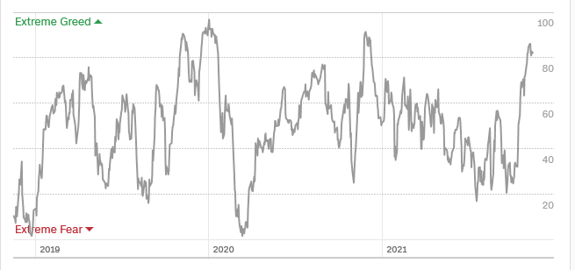
The Mad Hedge Profit Predictor Moving into a “SELL” Range
SELL
Do Nothing
BUY

Slide 16
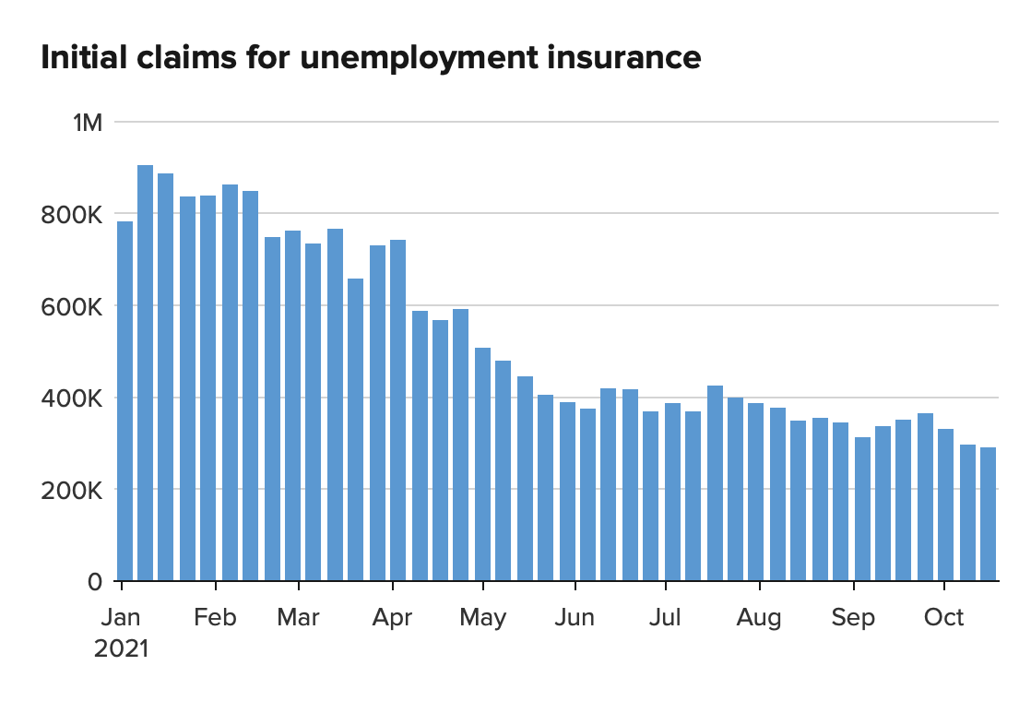
Weekly Jobless Claims – New Lows 269,000 – New Post Pandemic Low

Slide 18
Stocks – How High Can We Go?
*The bull continues, making my 2021 yearend target of $475 within easy reach * US Stock Buy Backs Hit Record in Q3, topping a staggering $224 billion, and the best is yet to come as companies try *Stocks may melt up straight until the end of 2021 well into 2022 *Financials and big tech are on fire *Those who waited for the 10% correction in September never got it and are now chasing the market in big size *Stick with the barbell strategy, we’ll keep rotating back and forth all year between tech & domestic recovery

Slide 19
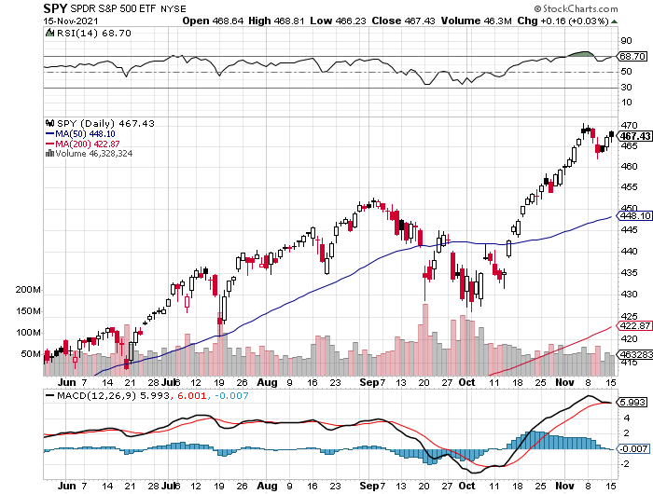
S&P 500 – Year End Melt Up! Took profits on long 10/$410-$420 bull call spread stopped out of long 10/$419-$429 bull call spread took profits on long 6/$375-$385 bull call spread
New Highs Yearend Target $475
The Bottom 453

Slide 20
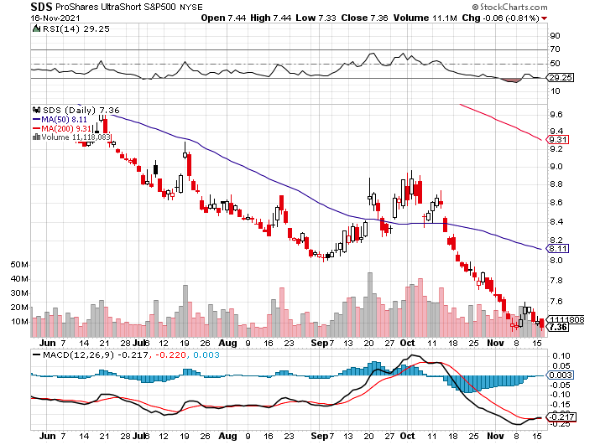
ProShares Ultra Short S&P 500 (SDS)- a great hedge for long stocks and bonds long 2X position has a hedge against longs and bond shorts

Slide 21
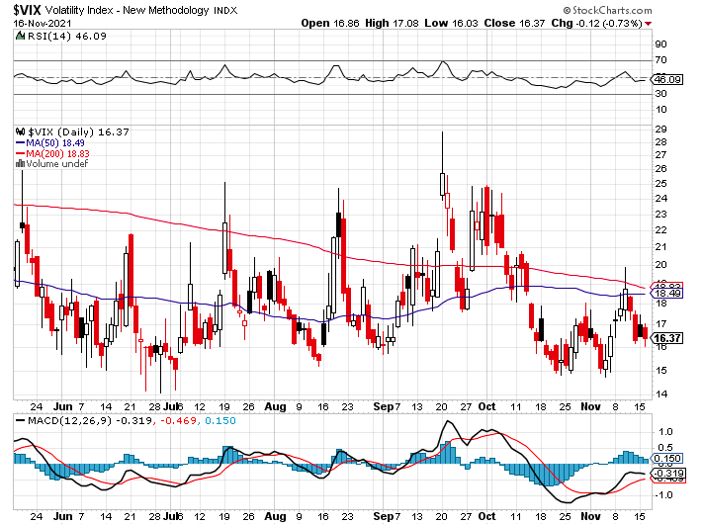
(VIX) – Dying a Slow Death classic summer market

Slide 22
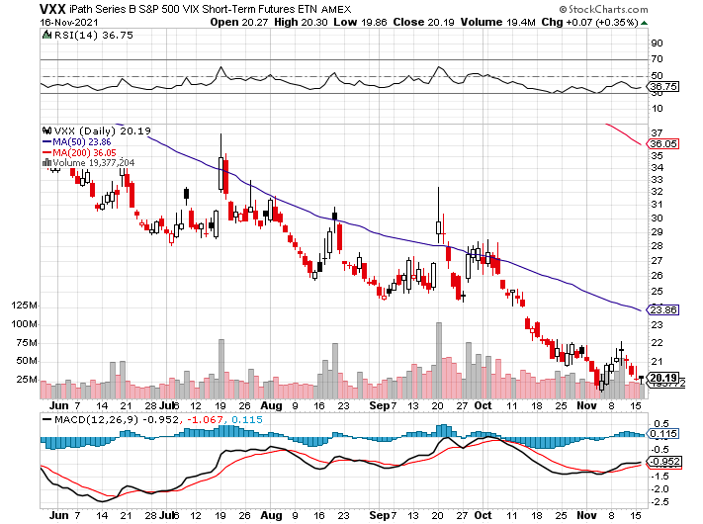
(VXX)-

Slide 23
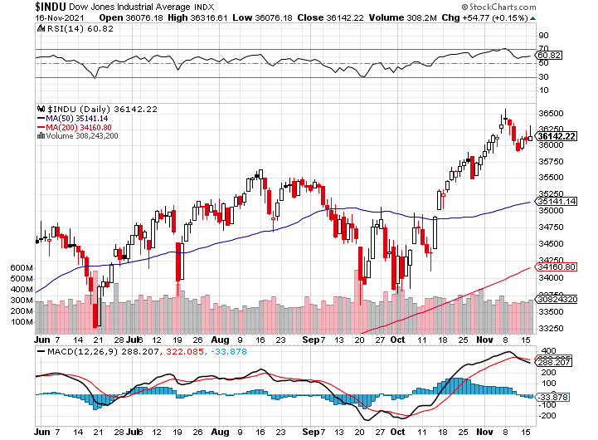
Dow Average ($INDU)-

Slide 24
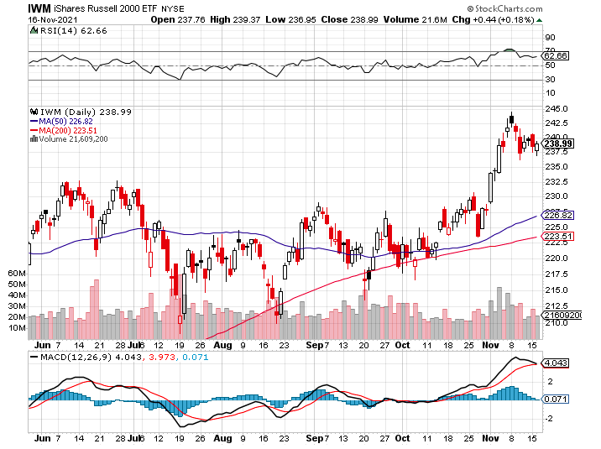
Russell 2000 (IWM)- took profits on Long 10/$137-$142 vertical bull call spread took profits on Long 10/$153-$156 vertical bear put spread

Slide 25
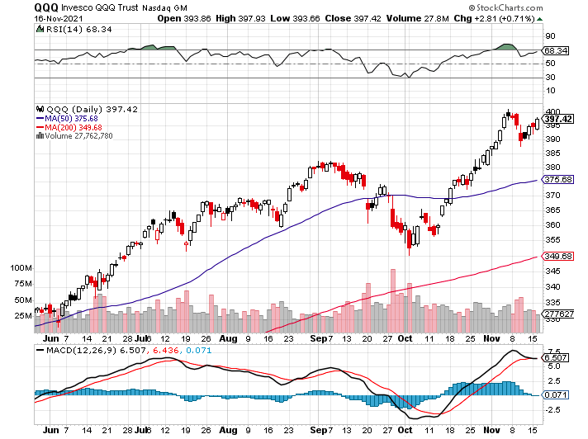
NASDAQ (QQQ) – long (QQQ) 4/$330-$335 put spread took profits on long (QQQ) 3/$340-$345 put spread covered long (QQQ) $325-$330 put spread

Slide 26
The Barbell Portfolio
*50% Big Tech - 2% of US Employment but 27% of Market Cap and 38% of Profits 50% Domestic Recovery, including: Railroads Couriers Banks Construction Credit Cards Event organizers Ticket sales Retailers

Slide 27
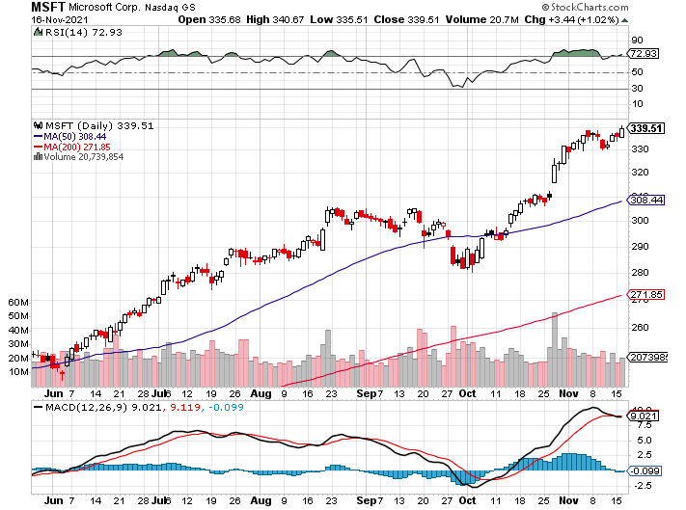
Microsoft (MSFT)- Microsoft to Raise Dividend by 11% and increased a $60 billion stock buyback program took profits on long 12/$220-$230 call spread stop loss on long 12/$170-$180 call spread took profits on long 12/$135-$138 call spread

Slide 28
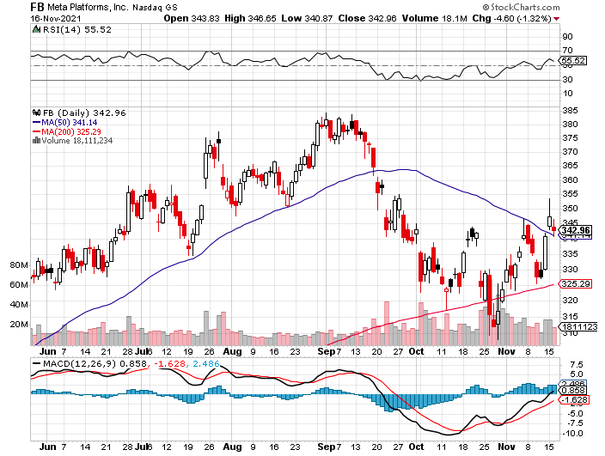
Facebook (FB)- Changes Name to “Meta” took profits on Long 9/$290-$300 vertical bear put spread stopped out of Long 9/$190-$200 vertical bear put spread took profits on Long 9/$145-$155 vertical bull call spread took profits on Long 9/$150-$160 vertical bull call spread

Slide 29
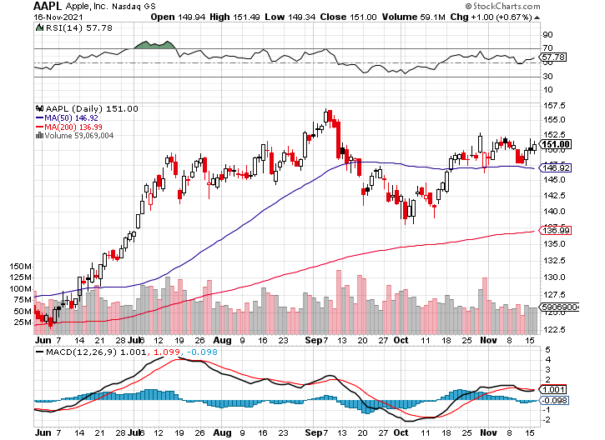
Apple (AAPL)- Launches iPhone 13, with a better camera, faster chips, and longer battery life, Antitrust Comes Home to Roost at Apple took profits on long 7/$320-$330 call spread took profits on long 4/24/$250-$260 call spread took profits on long 5/$250-$260 call spread

Slide 30
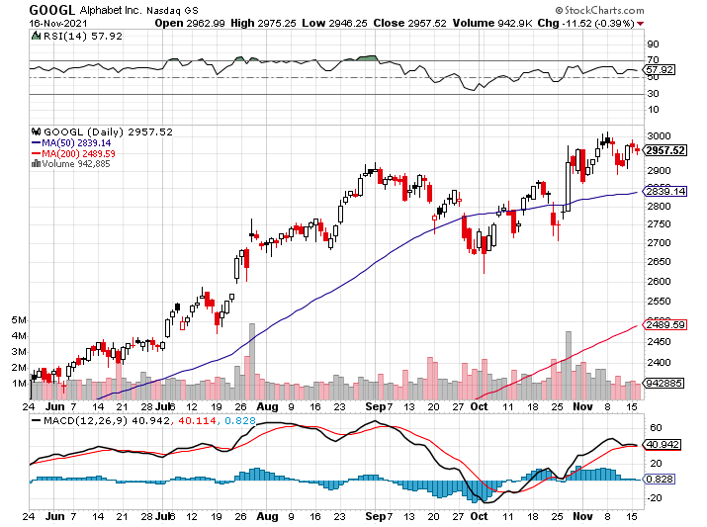
Alphabet (GOOGL) – Ad king on economic recovery 15% of search is travel related took profits on long 12/$1,200-$1,230 bull call spread took profits on long 9/$1,030-$1,080 vertical bull call spread

Slide 31
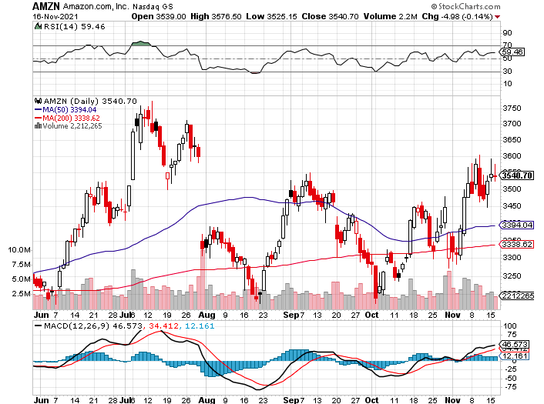
Amazon (AMZN) – Amazon to Hire 125,000 and boost wages to $18 an hour took profits on long 9/$2,800-$2,900 bull call spread

Slide 32
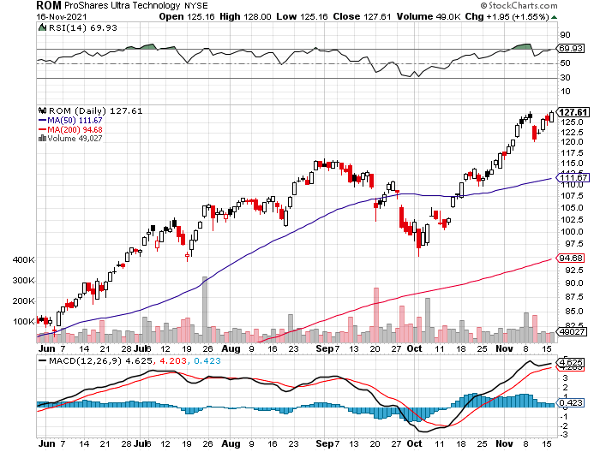
ProShares Ultra Technology (ROM) – New Highs

Slide 33
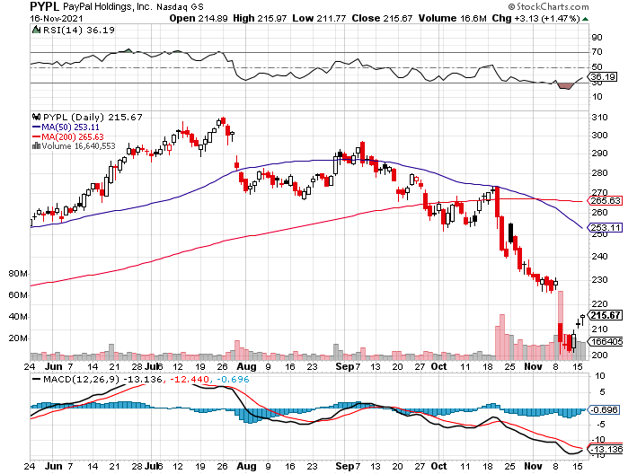
PayPal (PYPL) - Cancels Pinterest Buy took profits on long 4/$90-$95 call spread

Slide 34
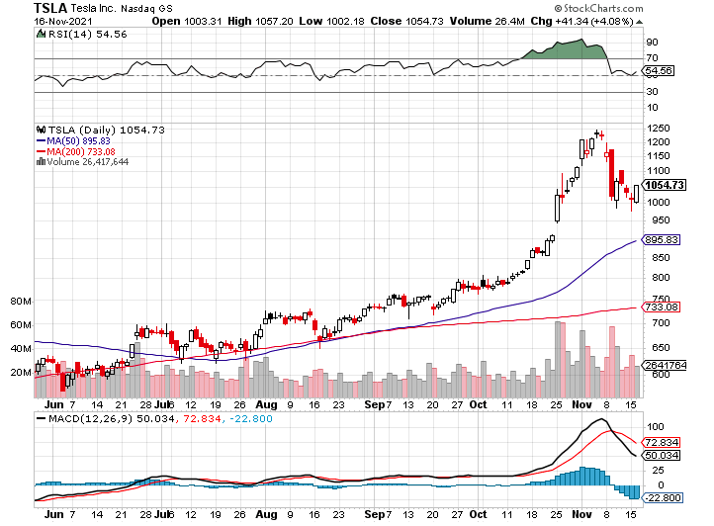
Tesla (TSLA) - Hits $1.2 Trillion in Market Cap The Elon Must Sells $7 billion worth of stock to pay taxes took profits on long 2X 4/$450-$500 call spread, took profits on long 3/$400-$450 call spread took profits on long 2/$650-$700 call spread-expires, stopped out of long 3/$600-$650 call spread Took profits on long 2/$600-$650 bull call spread, Took profits on long 2/$550-$600 bull call spread

Slide 35
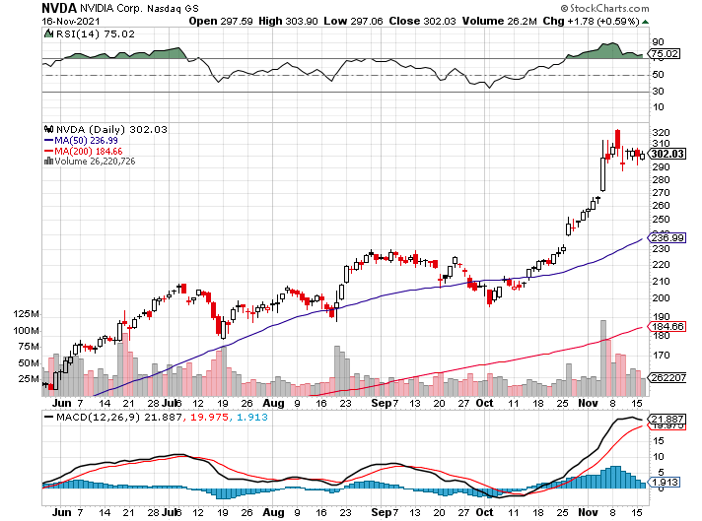
NVIDIA (NVDA) – A Mad Hedge 10 bagger – Global Semiconductor Shortage Slows Auto Industry, Graphic card sales up 87% in Q2

Slide 36
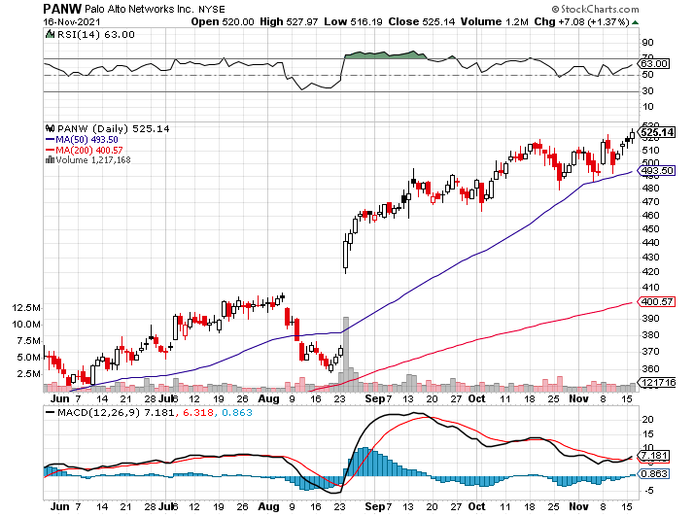
Palo Alto Networks (PANW)- Hacking never goes out of fashion

Slide 37
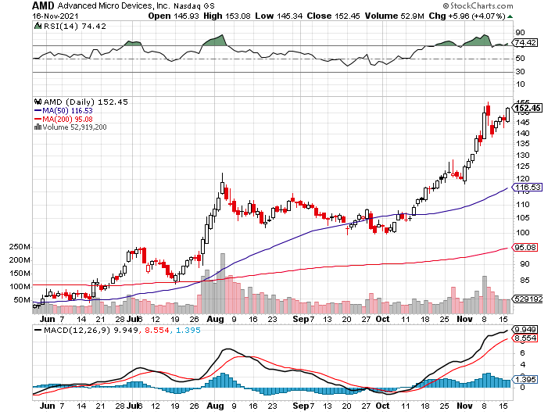
Advanced Micro Devices (AMD)- programable logic devices took profits on long 2/$75-$80 call spread

Slide 38
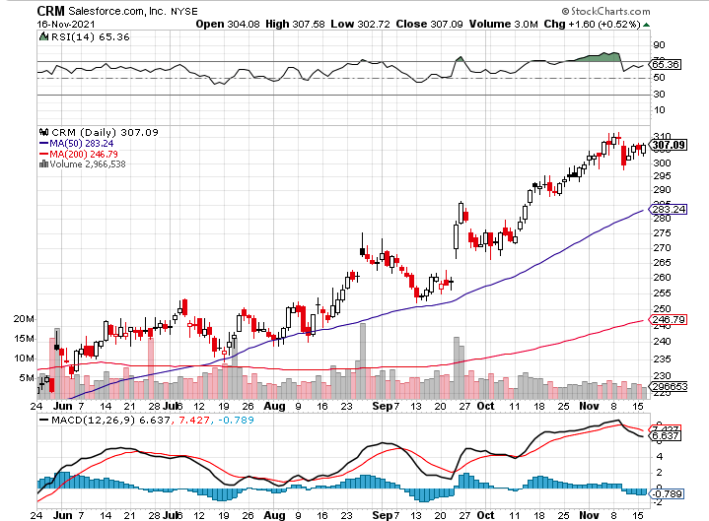
Salesforce (CRM)- Massive Online Migration took profits on long 9/$125-$130 vertical bull call spread took profits on long 8/$125-$130 vertical bull call spread took profits on long 2/$105-$115 call spread

Slide 39
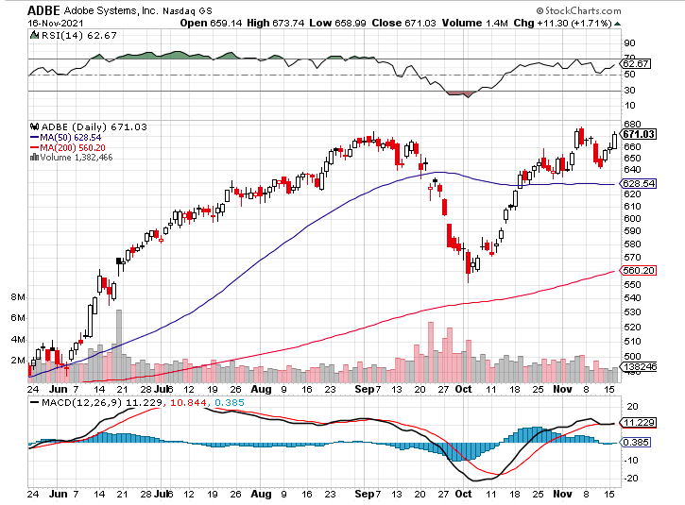
Adobe (ADBE)- Cloud play The Quality Non-China tech play

Slide 40
The Second Half of the Barbell
*Bets on a domestic recovery in 2021 Q4 *Upside potential in 2021 far greater than tech *Some of these have not moved for 5 or 10 years *Focuses on economically sensitive cyclical industries *Makes a great counterweight to high-growth technology *We could spend all of next year rotating between the two groups

Slide 41
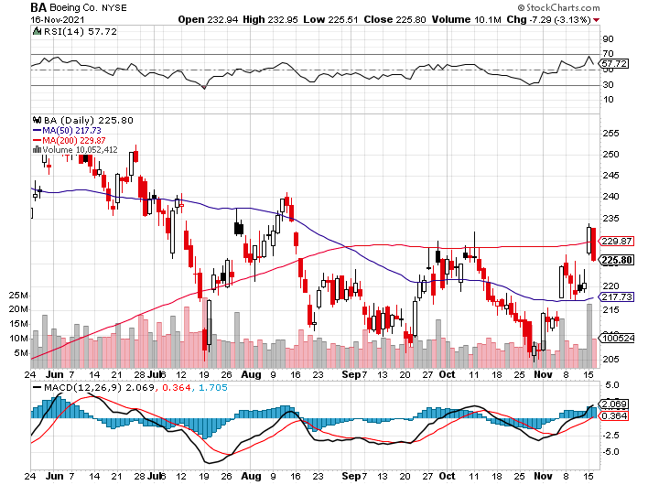
Boeing (BA) – former LEAP Candidate – Headaches again long 3/$146-$149 call spread took profits on long 2/$150-$160 call spread

Slide 42
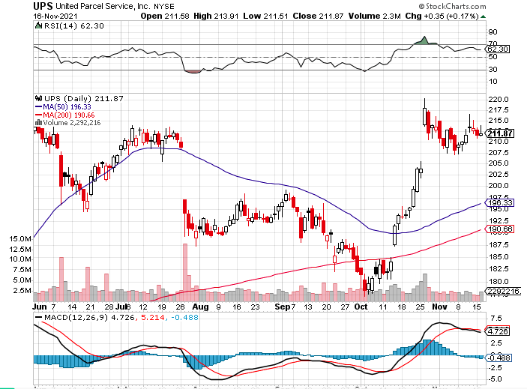
Package Delivery- United Parcel Service (UPS) - Package Delivery massive increase in overnight deliveries, announces blowout earnings, vaccine deliveries took profits on long 11/$130-$140 call spread

Slide 43
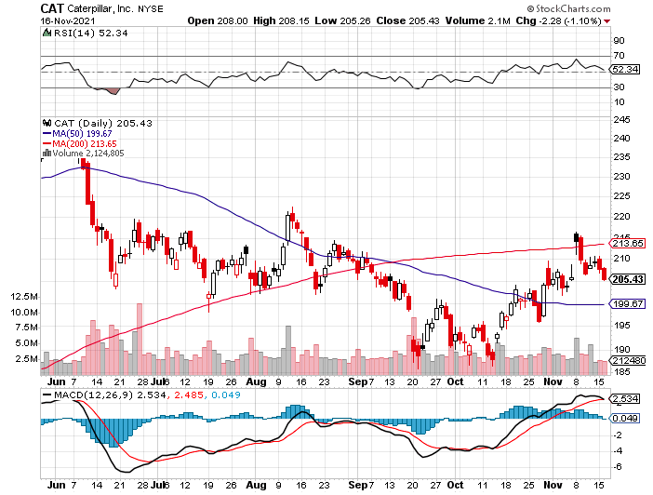
Caterpillar (CAT)- Ag + Infrastructure + Housing took profits on long 12/$145-$150 call spread took profits on long 11/$125-$135 call spread

Slide 44
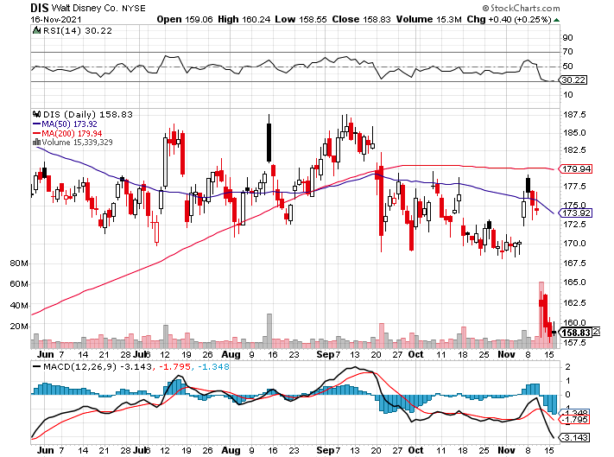
Walt Disney (DIS)- Earnings fail Streaming Growth Shortfall stopped out of long 10/$165-$175 call spread took profits on long 3/$170-$180 call spread

Slide 45
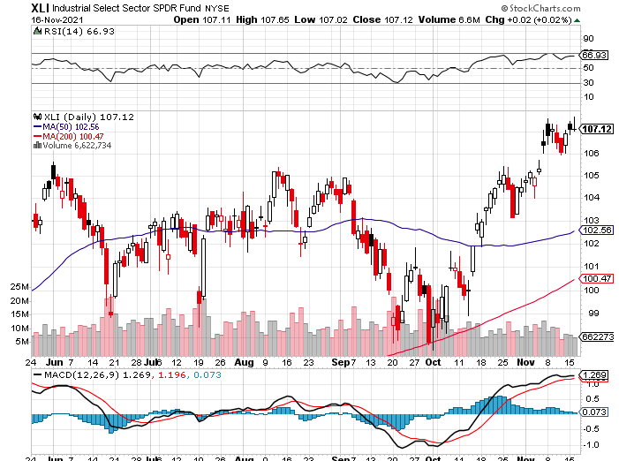
Industrials Sector SPDR (XLI)- (GE), (MMM), (UNP), (UTX), (BA), (HON)

Slide 46
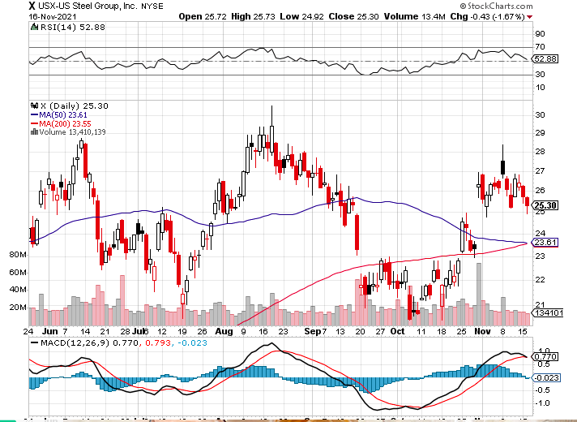
US Steel (X) – Commodity Drag

Slide 47
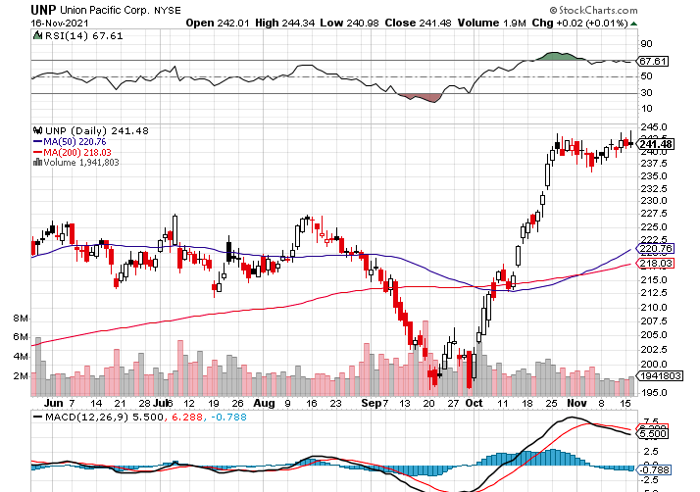
Union Pacific RR (UNP)- Big Stuff to Ship near record earnings announced long 5/$200-$210 call spread – 12 days to expiration took profits on 11/$150-$160 call spread

Slide 48
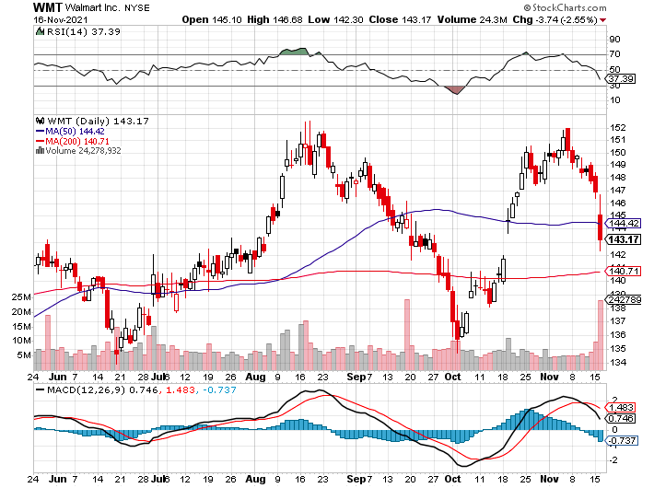
Wal-Mart (WMT)-New High took profit on Long 11/$125-$130 bear put spread took profit on Long 10/$119-$121 bear put spread took profits on Long 8/$114-$117 bear put spread

Slide 49
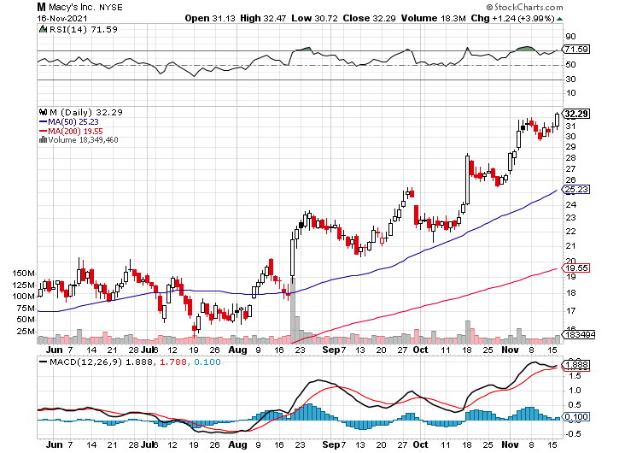
Macys’ (M) – Retail Return from the Grave took profits on Long 8/$23-$25 bear put spread

Slide 50
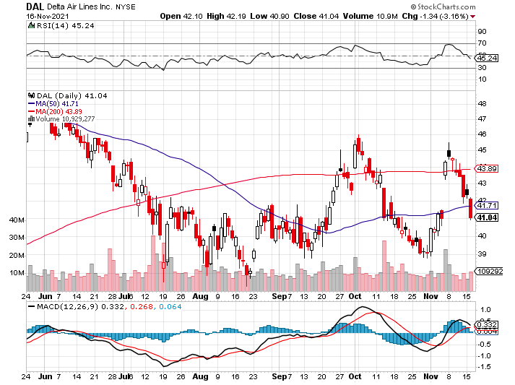
Delta Airlines (DAL) –

Slide 51
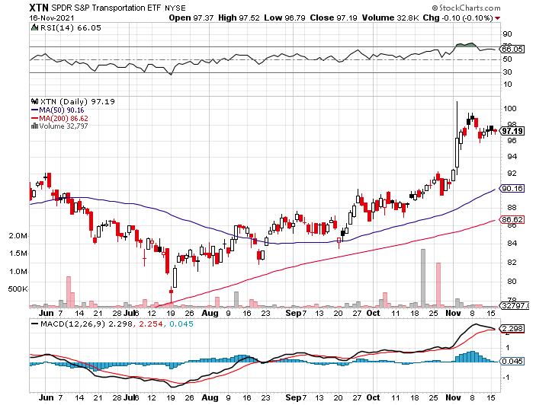
Transports Sector SPDR (XTN)- Worst Hit Sector (ALGT), (ALK), (JBLU), (LUV), (CHRW), (DAL)

Slide 52
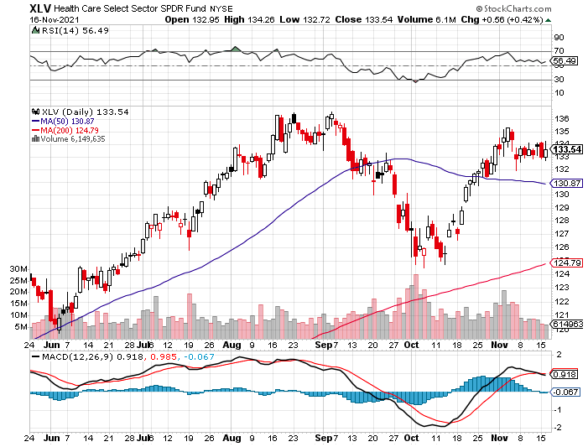
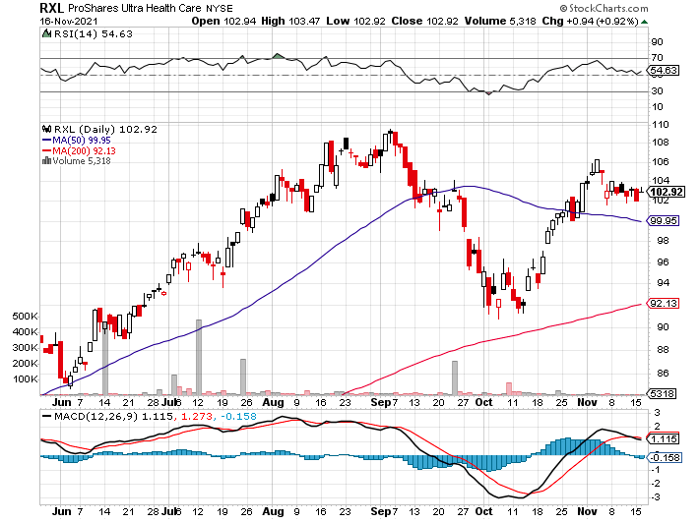
Health Care Sector (XLV), (RXL) (JNJ), (PFE), (MRK), (GILD), (ACT), (AMGN)

Slide 53
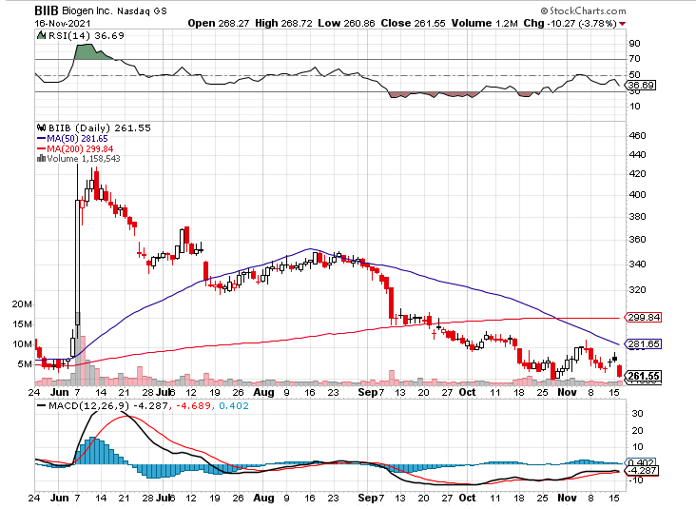
Biogen (BIIB) Why you invest in Biotech

Slide 54
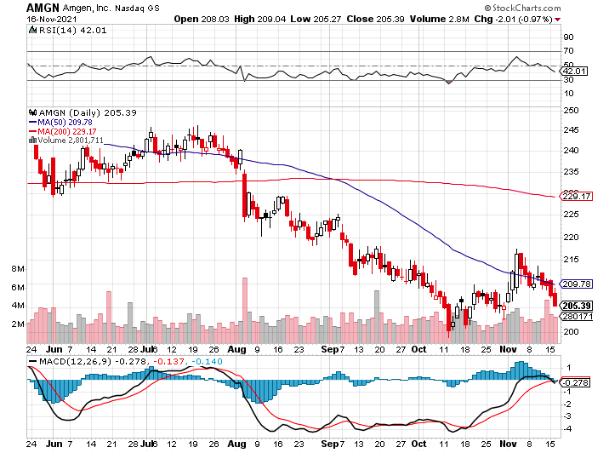
Amgen (AMGN) took profits on long 11/$185-$200 bull call spread

Slide 55
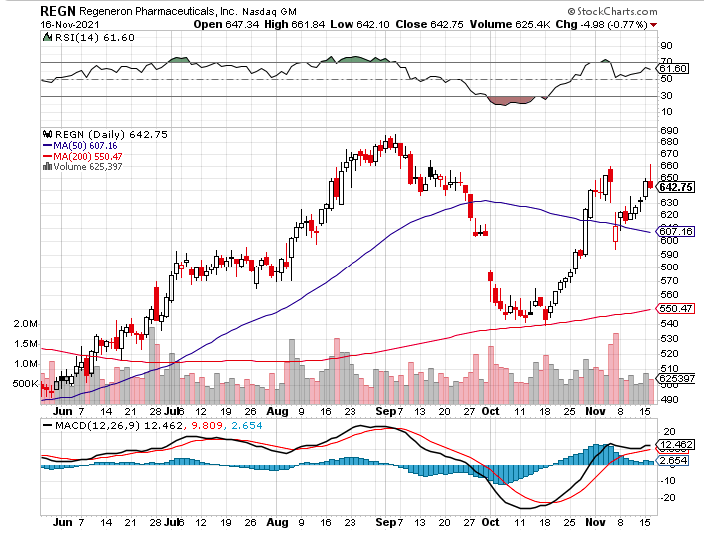
Regeneron (REGN) took profits on long 7/$570-$580 call spread

Slide 56
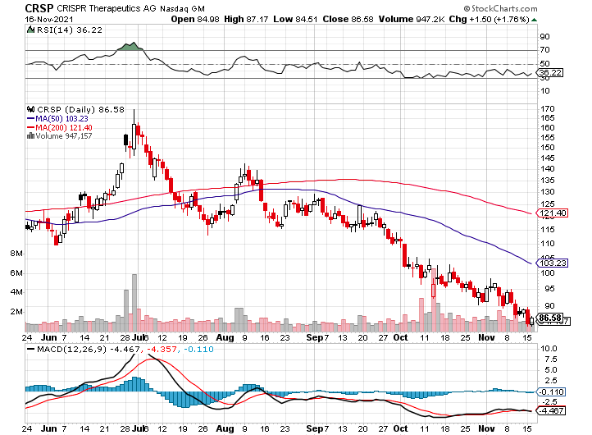
CRISPR Therapeutics (CRSP)

Slide 57
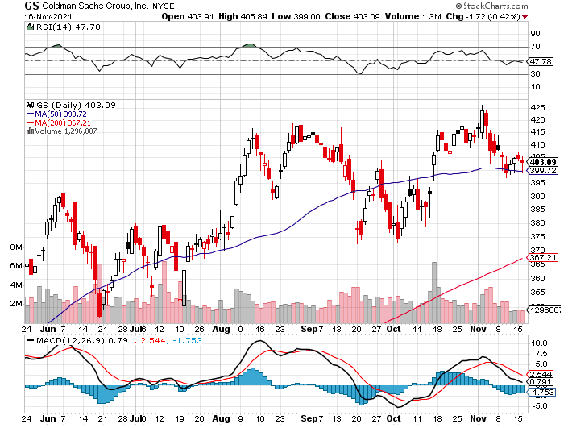
Goldman Sachs (GS) – long 11/$330-$350 call spread-expires in 2 days long 11/$385-$395 call spread- expires in 2 days took profits on long 10/$320-$330 call spread took profits on long 8/$325-$335 call spread

Slide 58
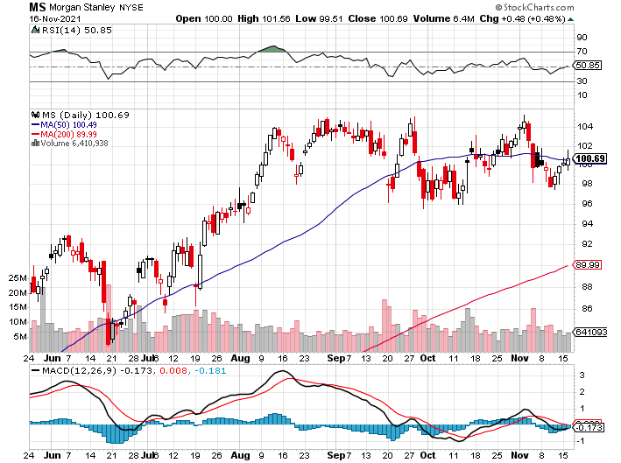
Morgan Stanley (MS) – Doubled Dividend long 11/$85-$90 call spread- expires in 2 days long 11/$95-$98 call spread- expires in 2 days took profits on long 10/$85-$90 call spread profits on long 2/$55-$60 call spread

Slide 59
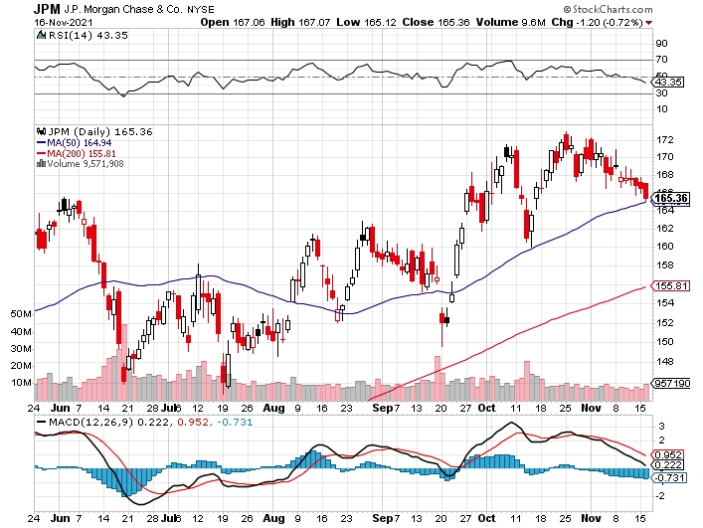
JP Morgan Chase (JPM)-Back to Life took profits on long 10/$130-$140 call spread took profits on long 8/$140-$145 call spread took profits on long 7/$140-$145 call spread

Slide 60
ProShares Ultra Technology ETF (ROM) – 2X Long Technology ETF took profits on long 10/$62-65 call spread

Slide 61
Bank of America (BAC) – long 11/$43-$45 call spread – expires in 2 trading days long 11/$37-$40 call spread – expires in 2 trading days took profits on long 2/$28-$30 call spread

Slide 62
SPDR Metals & Mining ETF (XME) – long 2/$28-$30 call spread

Slide 63
Blackrock (BLK)-Asset Collection Boom took profits on long 3/$770-$790 call spread took profits on long 3/$310-$340 call spread

Slide 64
Visa (V) – “Touchless” Bitcoin Drag took profits on long 5/$220-$225 bull call spread took profits on long long 5/$195-$205 bull call spread took profits on long 9/$180-$185 bull call spread

Slide 65
Consumer Discretionary SPDR (XLY) (DIS), (AMZN), (HD), (CMCSA), (MCD), (SBUX)

Slide 66
Berkshire Hathaway (BRKB)- Natural Barbell resume buy backs at $25 billion a year, Profits Jump 18%, long 10/$275-$280 call spread – expires in 2 days long 10/$272.50-$277.50 call spread – expires in 2 days took profits on long 10/$255-$265 call spread took profits on long 3/$230-$240 call spread

Slide 67
Europe Hedged Equity (HEDJ)-

Slide 68
Japan (DXJ)-

Slide 69
Emerging Markets (EEM) - Pro trade, Weak Dollar, Long Recovery Play

Slide 71
Bonds – Meltdown
*Markets suffer the worst 30-year auction since 1990, crushing bonds by $7.00 in three days. Cover your short-term shorts here *US Treasury Boosts Q4 Borrowing Forecasts, from $703 billion to $1.015 trillion *Bonds hated the $1.2 trillion infrastructure package which Biden signed on Monday, all of which will have to initially borrowed *My final target is a 1.76% yield on the ten-year US Treasury bond by January *Add more downside LEAPS on rallies, the December 2022 (TLT) $150-$155 vertical bear put spread delivers a 47% profit in a year *A 2.00% yield on the ten-year US Treasury bond here we come! This is the quality trade for the rest of 2021 *US Treasury bond fund (TLT) could plunge from $180 a year ago to $105 by 2023

Slide 72
Treasury ETF (TLT) – Meltdown long 11/$150-$153 put spread – expires in 2 trading days took profits on long 10/$154-$157 put spread, took profits on long 10/$137-$140 call spread profits on long 10/$155-$158 put spread, took profits on 9/$155-$158 put spread took profits on long 8/$157-$160 put spread, took profits on long 8/$156-$159 put spread,

Slide 73
Ten Year Treasury Yield ($TNX) – 1.63%

Slide 74
Junk Bonds (HYG) 4.32% Yield to Maturity

Slide 75
2X Short Treasuries (TBT)-Another run at highs

Slide 76
Emerging Market Debt (ELD) 5.81% Yield-

Slide 77
Emerging Market Debt (ELD) 5.81% Yield- Mix of AAA, AA, and A rated bonds

Slide 79
Foreign Currencies – The Dollar’s Revenge
*US Dollar loves the infrastructure package, hits new one year high *New $1.2 trillion in spending assure higher interest rates sooner *I’m glad I’ve done no forex trades this year because I have been wrong *The forex market will notice monster US twin deficits someday, but no today *The Japanese yen (FXY) has been especially hard hit. *Currency with the fastest appreciating interest rates always does best *Long-term fundamentals are still poor, a dollar short could be the new ten-year trade *Stand aside from forex for now, there are getting fish to fry

Slide 80
Japanese Yen (FXY), (YCS)

Slide 81
Euro ($XEU), (FXE), (EUO)-

Slide 82
British Pound (FXB)-

Slide 83
Australian Dollar (FXA)- The Global Recovery Play took profits on long 8/$67-$69 call spread

Slide 84
Emerging Market Currencies (CEW)

Slide 85
Chinese Yuan- (CYB)-

Slide 87
Bitcoin – Taproot Thrills Buy the Mad Hedge Bitcoin Letter at https://www.madhedgefundtrader.com/store/
*Bitcoin Breaks to a New All-Time High on Taproot fork *Is the first major change to the Bitcoin code in four years *Offers better security and third-party app integration, making it more competitive with Ethereum * Ethereum Hits New All-Time High * SEC Blocks Pure Bitcoin ETF, knocking 6% off the crypto currency *Buy Bitcoin and Ethereum on the dip

Slide 89
Bitcoin ($BTCUSD) – Wake Up Time

Slide 90
Ethereum (ETHE) –

Slide 91
MicroStrategy (MSTR) –

Slide 92
Amplify Transformational Data Sharing ETF (BLOK) – Cross Imminent

Slide 94
Energy – The Heat Comes Out of the Market
*Oil cools off as prices fall below $80/barrel *Fears of a Biden Strategic Petroleum Reserve release are pressing the market, 714 million barrels or a 36 day supply *Avoid energy stocks. They could be peaking here *Europe still facing a major natural gas crisis *US drillers are paying out dividends instead of Investing in new drilling, reading the writing on the wall *The end of oil is upon us, but it may take 30 years to unwind existing infrastructure *Avoid all energy plays like the plague, it’s the new buggy whip industry as the US de-carbonizes

Slide 95
Oil-($WTIC)

Slide 96
United States Oil Fund (USO) long 10/$9.50-$10 Vertical bull call spread

Slide 97
Energy Select Sector SPDR (XLE)-No Performance! (XOM), (CVX), (SLB), (KMI), (EOG), (COP)

Slide 98
Halliburton (HAL)-

Slide 99
Natural Gas (UNG) -

Slide 101
Precious Metals – The Death of Gold
*Is the Death of Gold Here? Bitcoin has risen by more than 6X in a year, while the barbarous relic is unchanged *Gold has been the worst performing asset of 2021 *Gold provided absolutely no downside protection during the pandemic crash *If $9 trillion of investment demand decamps for the crypto world, leaving only jewelry demand, $9 trillion could go into Bitcoin. *Rising interest rates bode poorly for precious metals as it raises the opportunity cost for non-yielding assets *Bitcoin is clearly sucking capital out of precious metals *Stay away until this plays out *Silver is still the bigger and better long-term play

Slide 102
Gold (GLD)- Meltdown

Slide 103
Market Vectors Gold Miners ETF- (GDX) –

Slide 104
Barrick Gold (GOLD) took profits on long 1/$21-$23 call spread took profits on long 11/$22-$24 call spread

Slide 105
Newmont Mining- (NEM)- took profits on long $55-60 call spread

Slide 106
Silver- (SLV)- took profits on long 11/$19-$20 call spread

Slide 107
Silver Miners - (SIL)-

Slide 108
Wheaton Precious Metals - (WPM)- took profits on long 2/$39-41 call spread

Slide 109
Copper (COPX)-Uptrend Resumes Copper Unions Vote to Strike in Chile, cutting off 33% of the global supply

Slide 110
Real Estate – Hotter than Hot
* Traders are Hitting the Home ATM, taking out refi’s to place money into the stock market and Bitcoin. Some $62 billion was cashed out in Q2, the most since 2007. * A Flood of Foreign Real Estate Buyers is About to hit the US as the travel ban ends * Zillow Shuts Down Home Flipping Business after racking up some $569 million in losses * 14 Million Have Refinanced This Year, a new record *Builder Sentiment Jumps, up 3 points to 83, according to the National Association of Homebuilders. *A decade long structural shortage of housing is a huge tailwind *New homebuilders are resorting to lotteries and quotas to keep from running out of inventory *S&P Case Shiller is Still Rocketing, the National Home Price Index up 19.8% YOY in August.

Slide 111
S&P Case Shiller Up 18.7% for June Phoenix (33.3%), San Diego (26.2%), and Tampa (25.9%) lead

Slide 112
Crown Castle International (CCI) – 2.70% yielding cell phone tower REIT

Slide 113
US Home Construction Index (ITB) (DHI), (LEN), (PHM), (TOL), (NVR)

Slide 115
Trade Sheet- So What Do We Do About All This?
*Stocks – buy dips aggressively *Bonds – sell rallies aggressively *Commodities-stand aside *Currencies- stand aside *Precious Metals – stand aside *Energy – stand aside *Volatility - sell short over $30 *Real estate – buy dips *Bitcoin – buy dips

Slide 116
Next Strategy Webinar 12:00 EST Wednesday, December 1, from Silicon Valley email me questions at support@madhedgefundtrader.com
Good Luck and Good Trading!
Notes:
*

