Slide 1
The Mad Hedge Fund Trader “Santa Gets Omicron”
With John Thomas Silicon Valley, CA, December 15, 2021 www.madhedgefundtrader.com
Notes:
*

Slide 3
JOIN ME ON CUNARD’S MS QUEEN VICTORIA FOR MY JULY 9, 2022 SEMINAR AT SEA
*Accompany John Thomas on a seven-day Norwegian Fiord Cruise on the 90,000 tonne Cunard HM Queen Victoria *Luncheon tickets in my private cabin are $499 *Cruise bookings can be had for as little as $995 *I’ll be giving you my up-to-date view on stocks, bonds, currencies, commodities, precious metals, Bitcoin, and real estate. *The ship has seven restaurants, thirteen bars, three swimming pools, a ballroom, and a theatre.

Slide 4
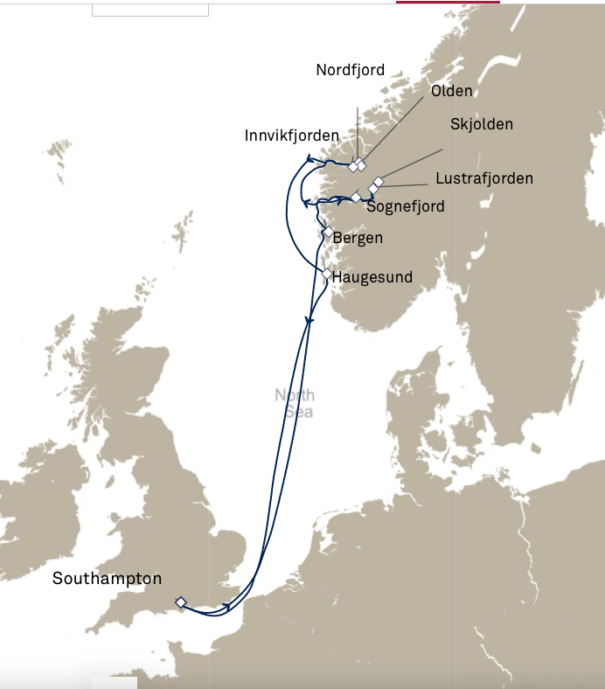

Slide 5
Trade Alert Performance New All Time Highs! 32 consecutive profitable trade alerts- 93.5% success rate in 2021-ony 7 losers
*January 10.21% MTD *July +0.61% Final *February +13.28% Final *August +9.36% Final *March +20.60% Final *September 1.03% Final *April +15.67% Final *October +8.91% MTD *May +8.13% Final *November -11.79% Final *June +0.71% Final *December +9.47% Final *2021 Year to Date +86.23% compared to +16.50% for the Dow Average *+508.78% since inception, a new all time high *Average annualized return of 42.40% for 12 years, new all time high

Slide 6
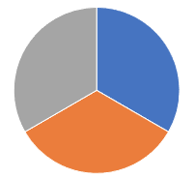
Portfolio Review 100% invested in financials, 10% tech, 10% short bonds in a low volatility Long Term Bull Market
Current Capital at Risk
Risk On
World is Getting Better
(JPM) 12/$148-$152.50 call spread | 10.00%
(GS) 12/$340-$360 call spread | 10.00%
(BAC) $39/$42 call spread | 10.00%
Risk Off
World is Getting Worse
NO POSITIONS
Total Net Position | 30.00%
Expiration Value 86.95%

Slide 7
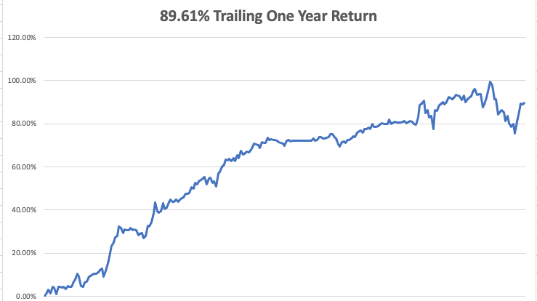

Slide 8
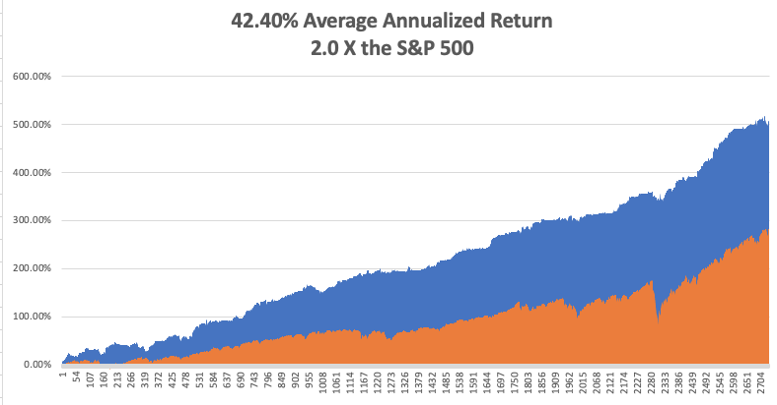
GTD 12 Year Daily Audited Performance

Slide 9
The Method to My Madness The Roaring Twenties are Here
*Fed announcement today as long as nothing dramatic comes out *$4.5 trillion in new money is now hitting the economy in 2022-23 *Inflation could be peaking here as the supply chain catches up *Bonds could see another repeat of the January $20 crash as hedge funds add new positions for 2022 *Only one personal has died from Omicron despite being more contagious *Medium term, both sides of the barbell are working *Bitcoin sees 30% correction and the bottom may be at hand *VIX over $30 is the ideal entry point for new positions *First Fed interest rate hike in 5 years has been moved up to June, March triggers a 10% correction

Slide 10
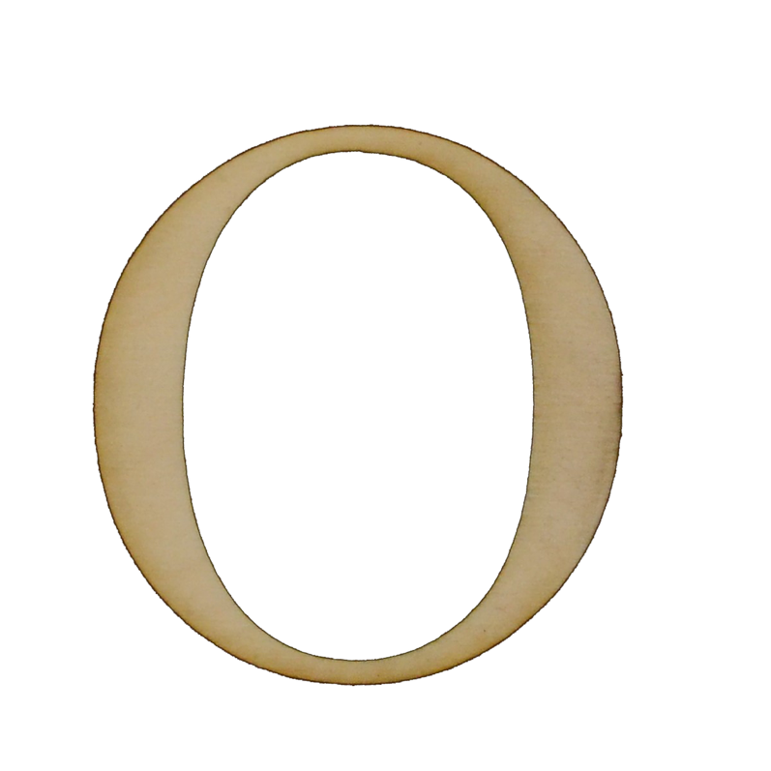
Corona Update – Now It’s Omicron
*Omicron variant grows exponentially, striking fear into the markets *There is no evidence that it can’t be stopped by vaccines, especially boosters *A year ago, hospitalizations hit 120,000/day. Now it’s only 60,000/day *Omicron will only kill the anti vaxer's *Omicron is hitting children worse than adults because they are the largest unvaccinated population *Pandemic is still going to zero by summer *US cases top 49 million, deaths topping 800,000 and deaths are back down to 1,000 a day

Slide 11
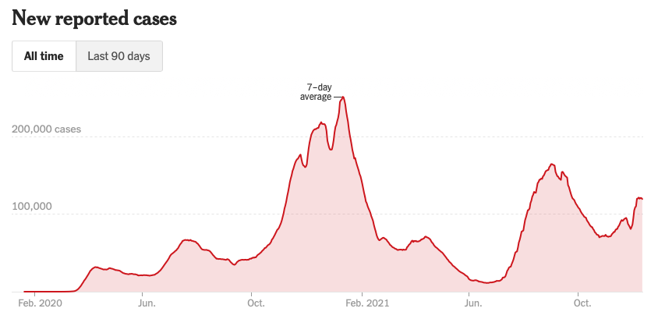
Bump on the Way to Zero

Slide 12
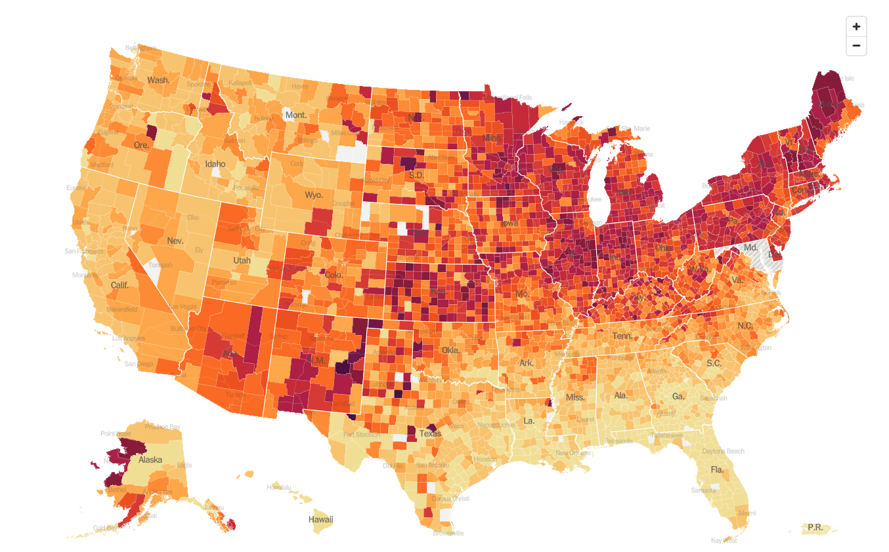
December 15 Infection Rate

Slide 13
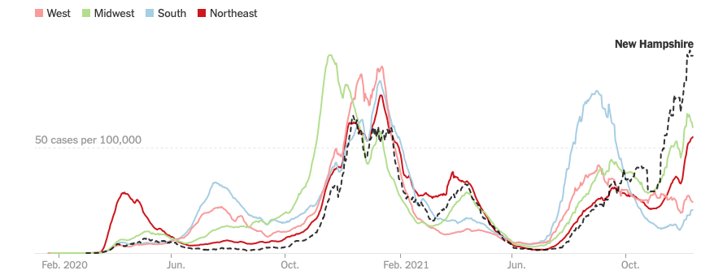

Slide 14
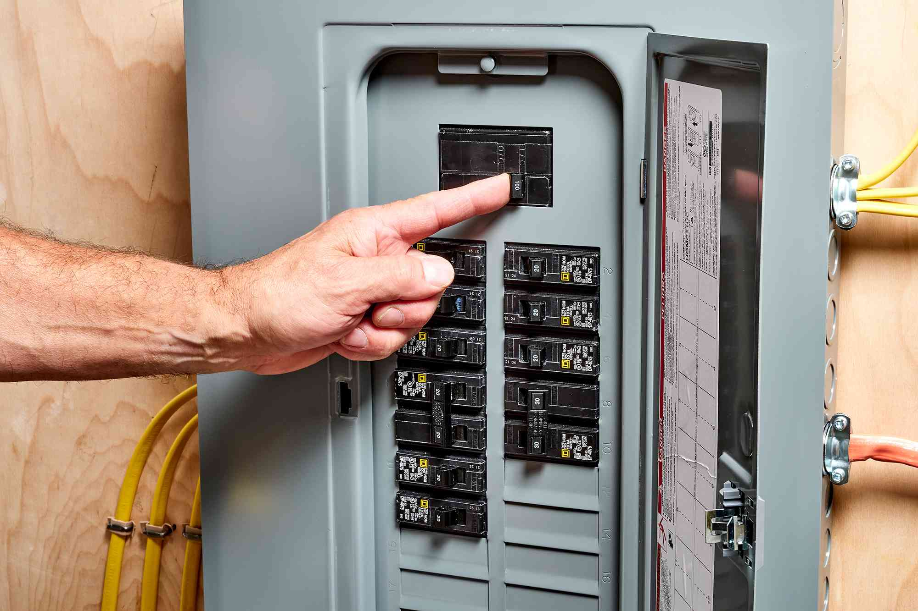
The Global Economy – Powering On
*Nonfarm Payroll Report Disappoints in November, coming in at 210,000. Over 600,000 was expected. *The Headline Unemployment Rate fell to 4.2%, a new post pandemic low *ADP Soars to 11 Million Job Openings *Construction Spending is Up, gaining 0.2% in October *Weekly Jobless Claims Dive to 184,000, down an amazing 43,000 on the week, a new post pandemic low and a 52-year low *Producer Price Index Soars at an 9.6% Annual Rate, the biggest in 11 years

Slide 15
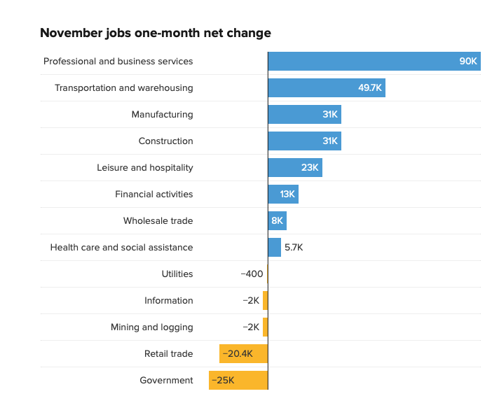

Slide 16
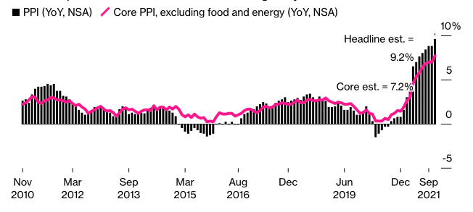

Slide 17
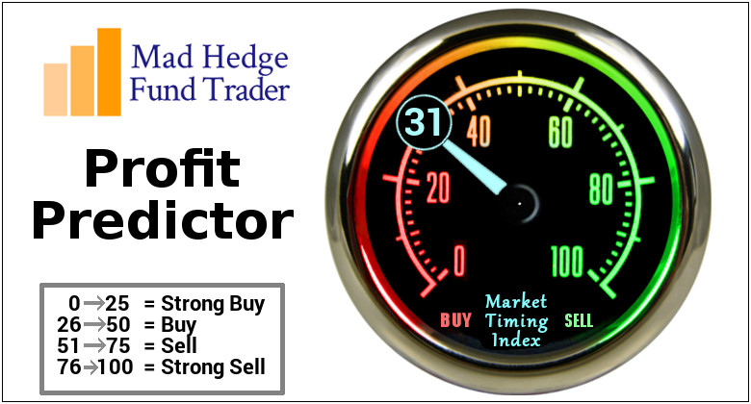
The Mad Hedge Profit Predictor Market Timing Index – Buy Territory An artificial intelligence driven algorithm that analyzes 30 different economic, technical, and momentum driven indicators

Slide 18
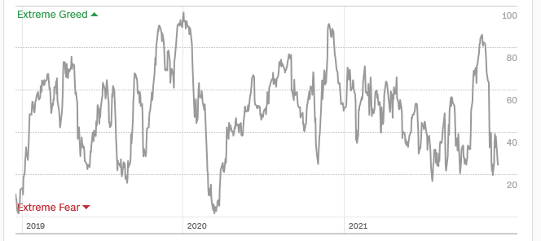
The Mad Hedge Profit Predictor Moving into a “SELL” Range
SELL
Do Nothing
BUY

Slide 19
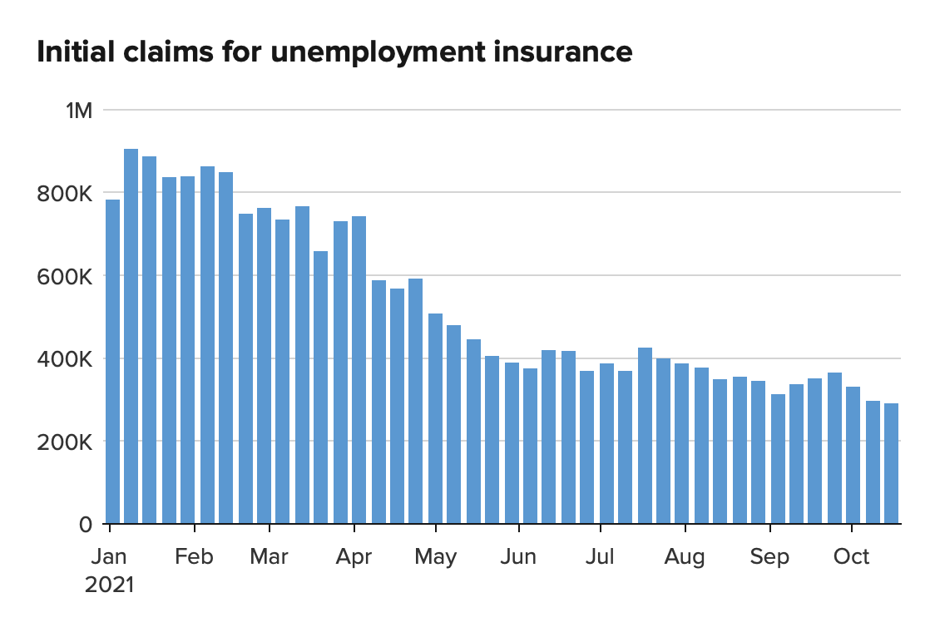
Weekly Jobless Claims – New Lows 199,000 – 31 Year Low

Slide 21
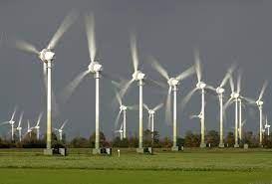
Stocks – Rotating Correction
*Rotating sector corrections belie main indexes near all-time highs *Five stocks led to the upside, while individual meme stocks, SPACS, story stocks, and non earning companies were down 50% or more *Major long term trend lines may get tested, but the bull market still lives *Fintech stocks trashed because “buy now, pay later” turned into “but now, never pay,” with 9% defaulting and 24% paying late *Big tech is holding up remarkably well, thanks to lower interest rates *Financials hold up well, creating a base to jump from in 2022 when interest rates rise *Stick with the barbell strategy, we’ll keep rotating back and forth all year between tech & domestic recovery

Slide 22
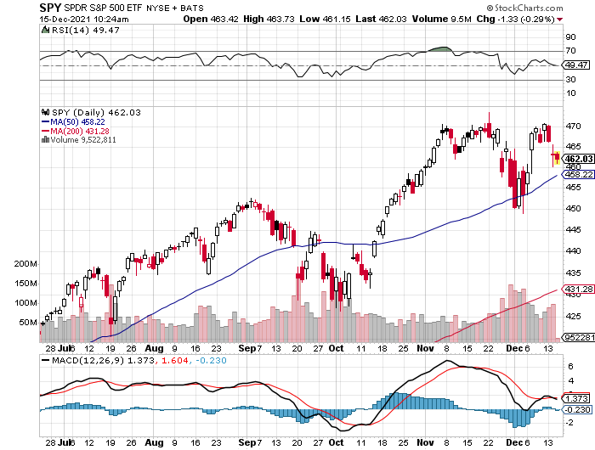
S&P 500 – Year End Melt Up! Took profits on long 10/$410-$420 bull call spread stopped out of long 10/$419-$429 bull call spread took profits on long 6/$375-$385 bull call spread
New Highs Yearend Target $475
The Bottom 450
Sell Everything on a Break
Your 5% correction becomes a 10% correction

Slide 23
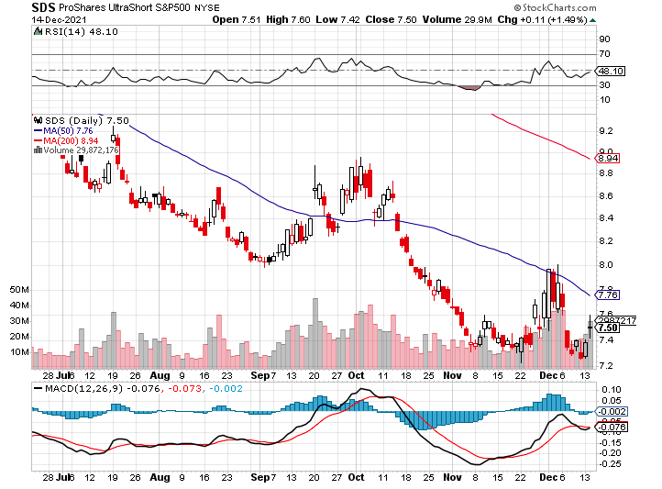
ProShares Ultra Short S&P 500 (SDS)- a great hedge for long stocks and bonds long 2X position has a hedge against longs and bond shorts

Slide 24
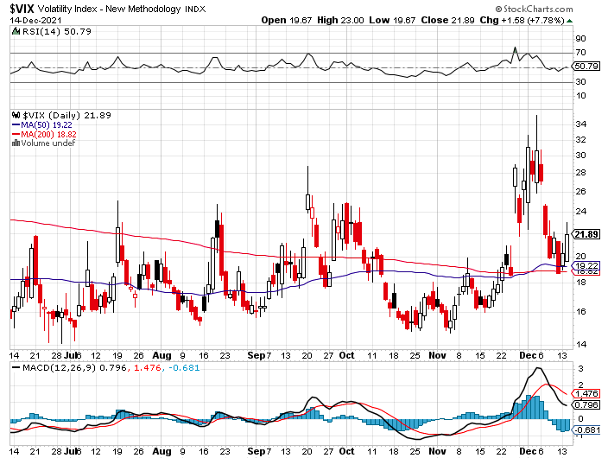
(VIX) – Coming Back to Life Rising Spikes

Slide 25
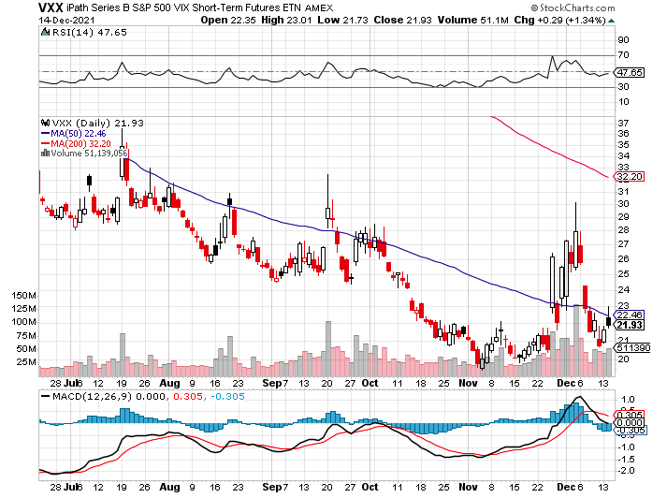
(VXX)-

Slide 26
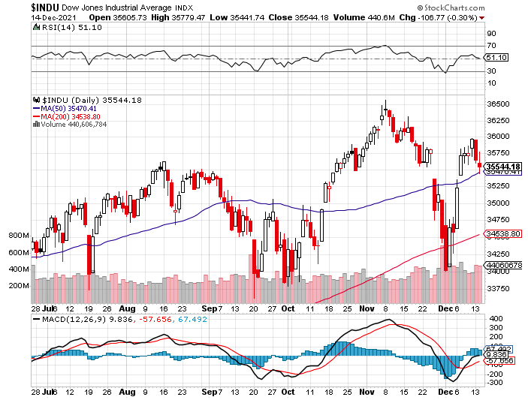
Dow Average ($INDU)-

Slide 27
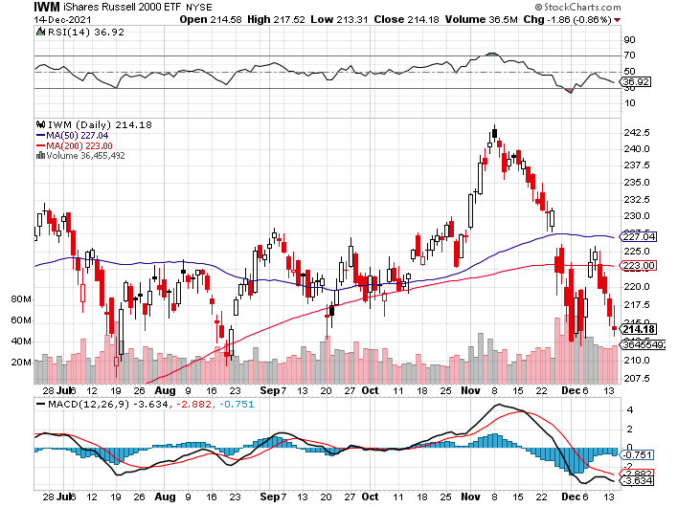
Russell 2000 (IWM)- took profits on Long 10/$137-$142 vertical bull call spread took profits on Long 10/$153-$156 vertical bear put spread

Slide 28
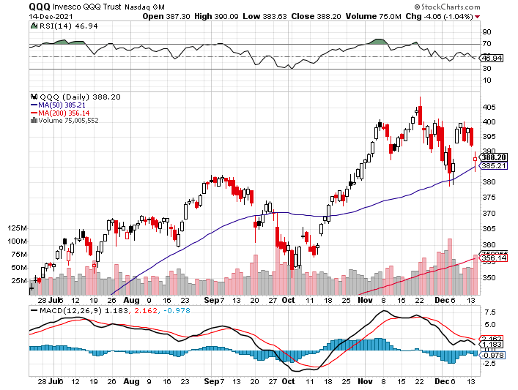
NASDAQ (QQQ) – long (QQQ) 4/$330-$335 put spread took profits on long (QQQ) 3/$340-$345 put spread covered long (QQQ) $325-$330 put spread

Slide 30
The Barbell Portfolio
*50% Big Tech - 2% of US Employment but 27% of Market Cap and 38% of Profits 50% Domestic Recovery, including: Railroads Couriers Banks Construction Credit Cards Event organizers Ticket sales Retailers

Slide 31
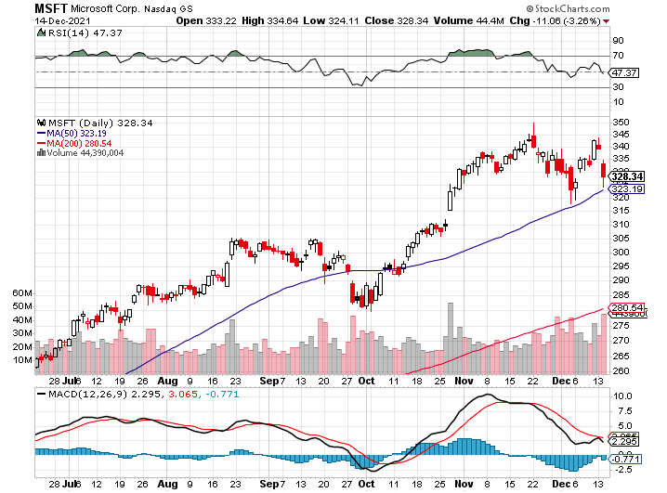
Microsoft (MSFT)- Microsoft to Raise Dividend by 11% and increased a $60 billion stock buyback program took profits on long 12/$220-$230 call spread stop loss on long 12/$170-$180 call spread took profits on long 12/$135-$138 call spread

Slide 32
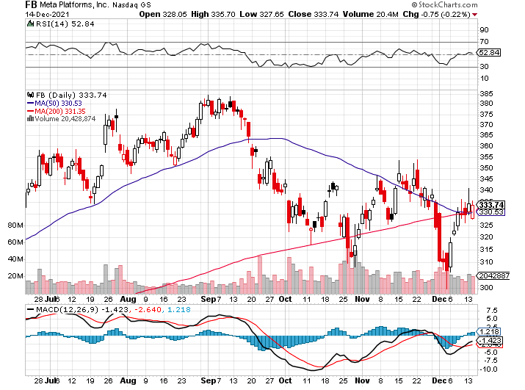
Facebook (FB)- Changes Name to “Meta” took profits on Long 9/$290-$300 vertical bear put spread stopped out of Long 9/$190-$200 vertical bear put spread took profits on Long 9/$145-$155 vertical bull call spread took profits on Long 9/$150-$160 vertical bull call spread

Slide 33
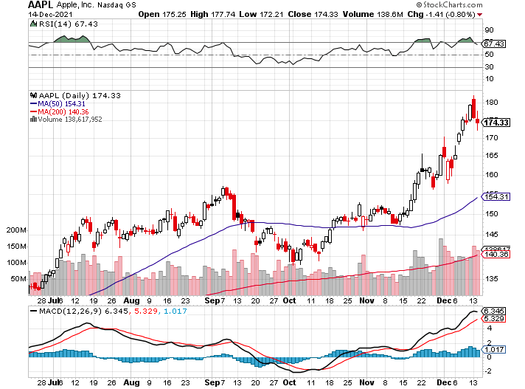
Apple (AAPL)- the First $3 Trillion Market Cap-$ Trillion in 2022 took profits on long 7/$320-$330 call spread took profits on long 4/24/$250-$260 call spread took profits on long 5/$250-$260 call spread

Slide 34
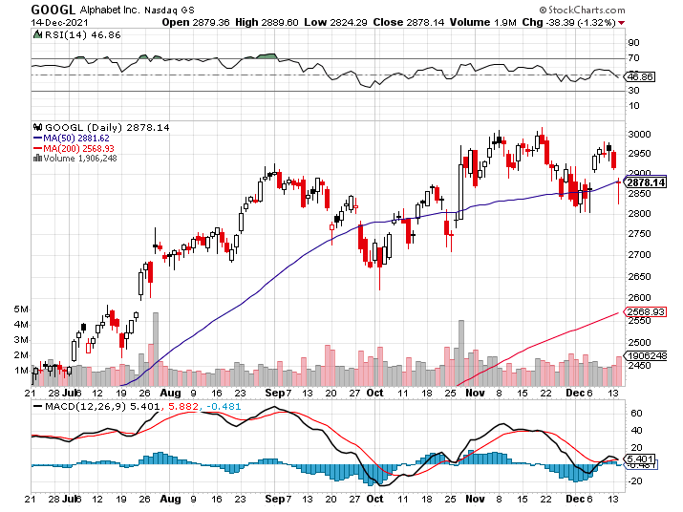
Alphabet (GOOGL) – Ad king on economic recovery 15% of search is travel related took profits on long 12/$1,200-$1,230 bull call spread took profits on long 9/$1,030-$1,080 vertical bull call spread

Slide 35
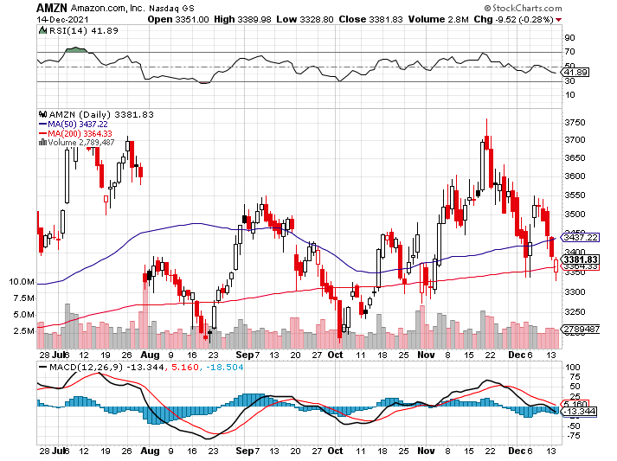
Amazon (AMZN) – Supply Chain Problems Amazon to Hire 125,000 and boost wages to $18 an hour took profits on long 9/$2,800-$2,900 bull call spread

Slide 36
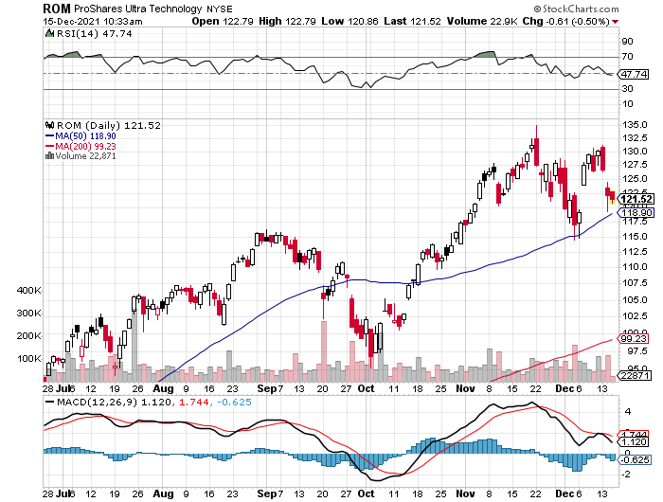
ProShares Ultra Technology (ROM) – Double Top?

Slide 37
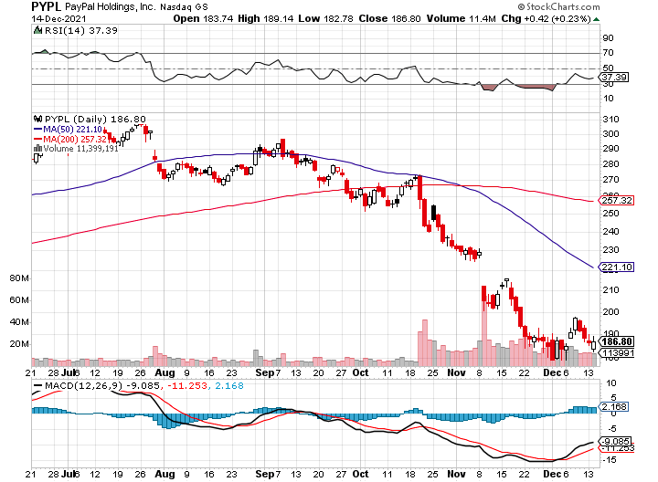
PayPal (PYPL) – “Buy Now Pay Later” took profits on long 4/$90-$95 call spread

Slide 38
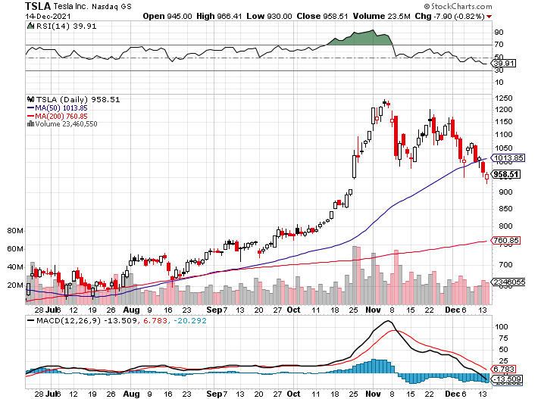
Tesla (TSLA) - Hits $1.2 Trillion in Market Cap Tesla Also Quits Taking New Orders outside North America-Musk Selling $13 billion took profits on long 2X 4/$450-$500 call spread, took profits on long 3/$400-$450 call spread took profits on long 2/$650-$700 call spread-expires, stopped out of long 3/$600-$650 call spread Took profits on long 2/$600-$650 bull call spread, Took profits on long 2/$550-$600 bull call spread

Slide 40
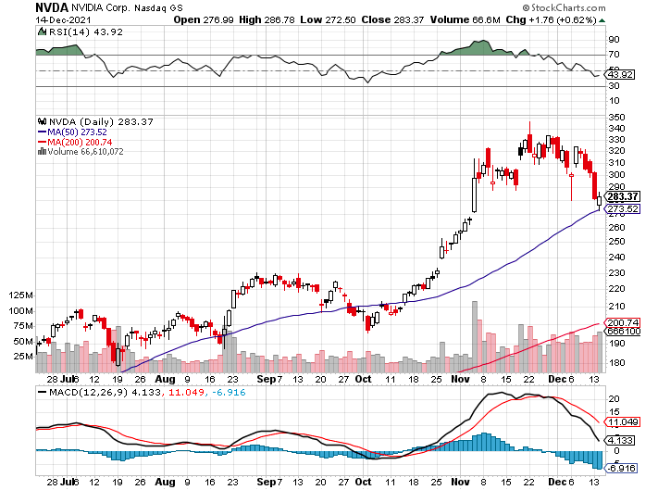
NVIDIA (NVDA) – A Mad Hedge 10 bagger – Global Semiconductor Shortage Slows Auto Industry, Graphic card sales up 87% in Q2

Slide 41
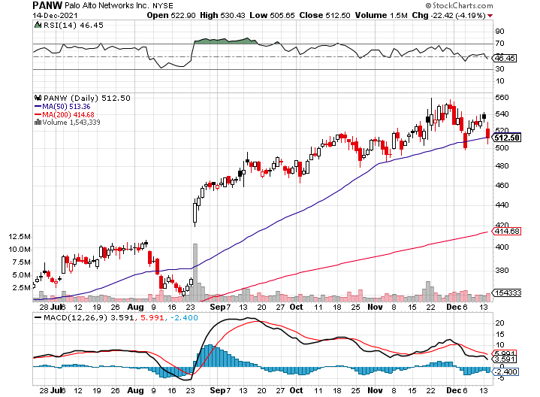
Palo Alto Networks (PANW)- Hacking never goes out of fashion

Slide 42
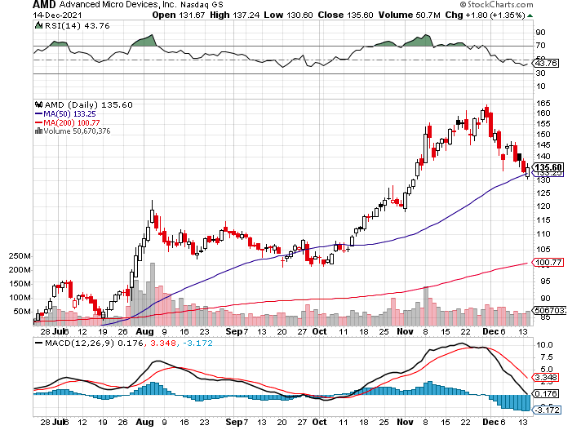
Advanced Micro Devices (AMD)- programable logic devices took profits on long 2/$75-$80 call spread

Slide 43
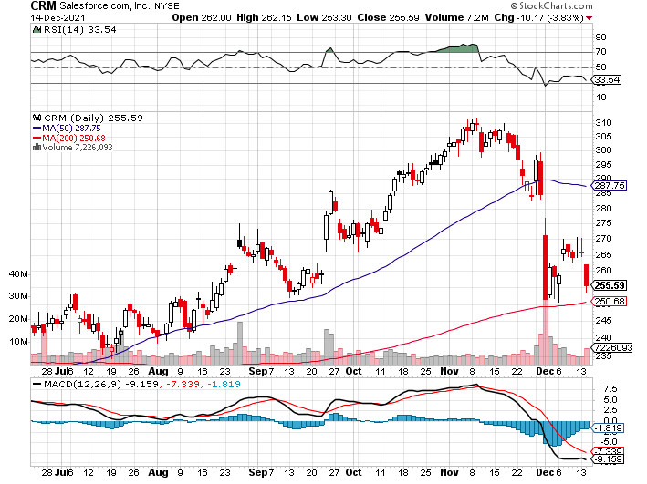
Salesforce (CRM)- Massive Online Migration took profits on long 9/$125-$130 vertical bull call spread took profits on long 8/$125-$130 vertical bull call spread took profits on long 2/$105-$115 call spread

Slide 44
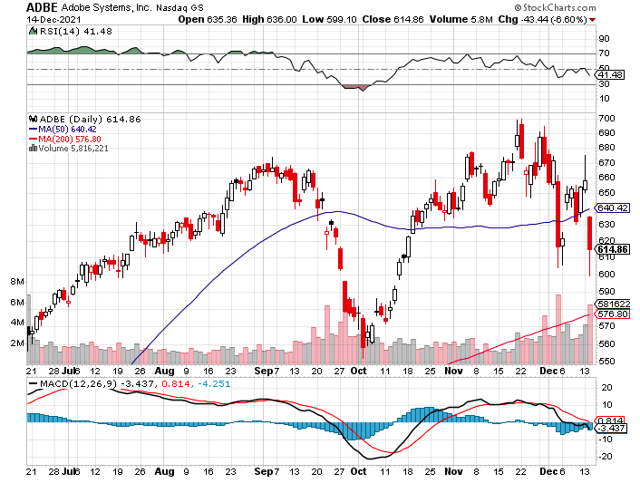
Adobe (ADBE)- Cloud play The Quality Non-China tech play

Slide 46
The Second Half of the Barbell
*Bets on a domestic recovery in 2021 Q4 *Upside potential in 2021 far greater than tech *Some of these have not moved for 5 or 10 years *Focuses on economically sensitive cyclical industries *Makes a great counterweight to high-growth technology *We could spend all of next year rotating between the two groups

Slide 47
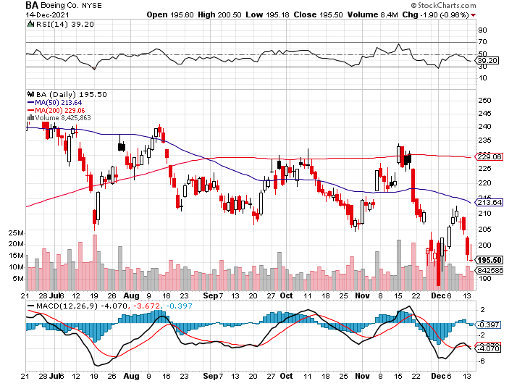
Boeing (BA) –LEAP Candidate China Orders Boeing 737 Max Back into the Air Boeing Wins a Major Order, for 30 737 MAX’s long 3/$146-$149 call spread took profits on long 2/$150-$160 call spread

Slide 48
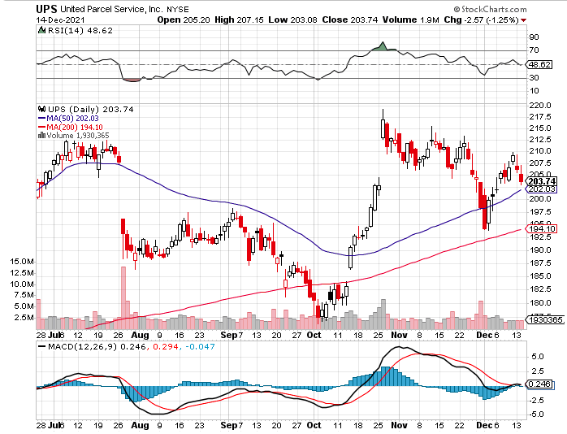
Package Delivery- United Parcel Service (UPS) - Package Delivery massive increase in overnight deliveries, announces blowout earnings, vaccine deliveries took profits on long 11/$130-$140 call spread

Slide 49
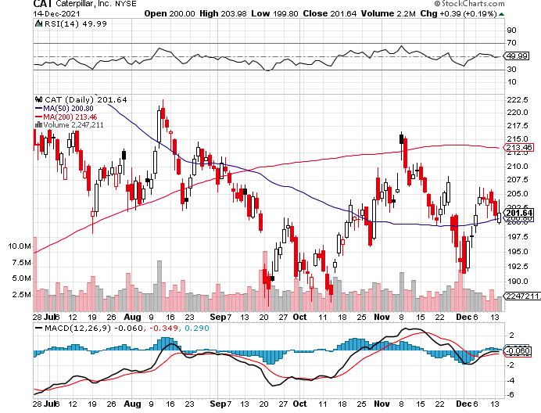
Caterpillar (CAT)- Ag + Infrastructure + Housing took profits on long 12/$145-$150 call spread took profits on long 11/$125-$135 call spread

Slide 50
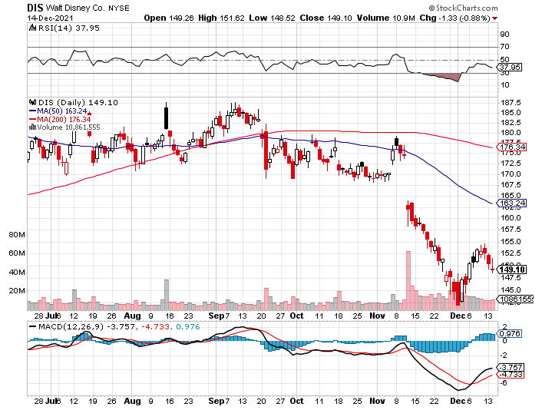
Walt Disney (DIS)- Omicroned Streaming Growth Shortfall stopped out of long 10/$165-$175 call spread took profits on long 3/$170-$180 call spread

Slide 51
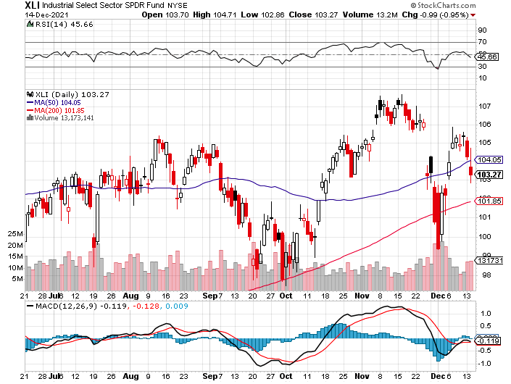
Industrials Sector SPDR (XLI)- (GE), (MMM), (UNP), (UTX), (BA), (HON)

Slide 52
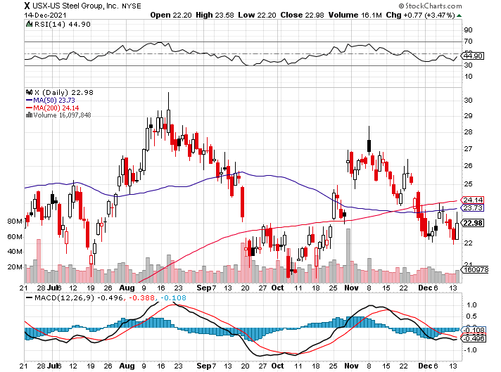
US Steel (X) – Commodity Drag

Slide 53
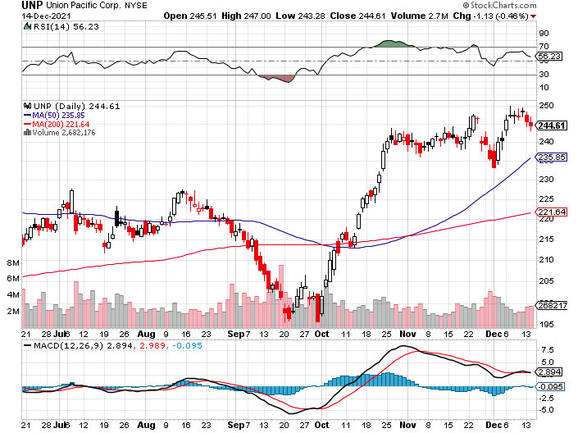
Union Pacific RR (UNP)- Big Stuff to Ship near record earnings announced took profits on long 5/$200-$210 call spread took profits on 11/$150-$160 call spread

Slide 54
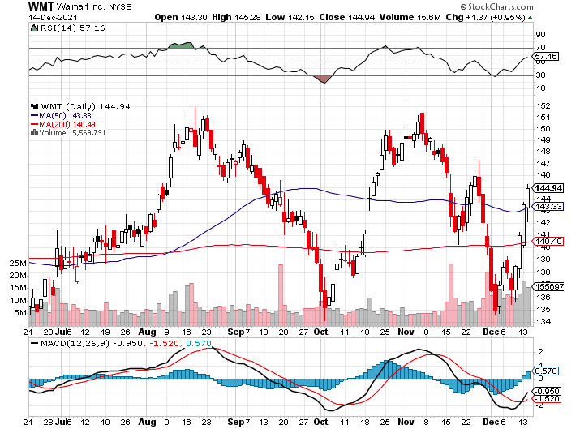
Wal-Mart (WMT)- took profit on Long 11/$125-$130 bear put spread took profit on Long 10/$119-$121 bear put spread took profits on Long 8/$114-$117 bear put spread

Slide 55
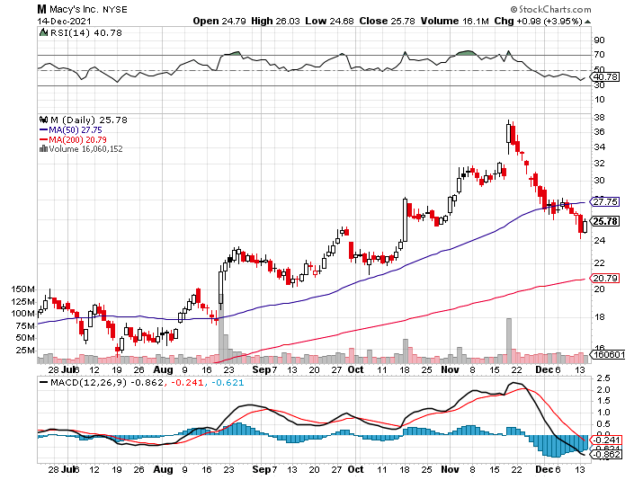
Macys’ (M) – Retail Punished-Overordering? took profits on Long 8/$23-$25 bear put spread

Slide 56
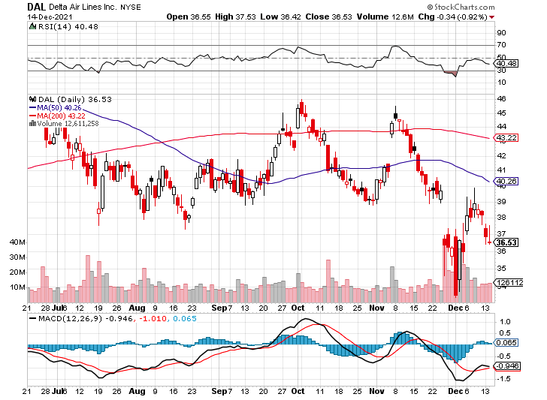
Delta Airlines (DAL) –

Slide 57
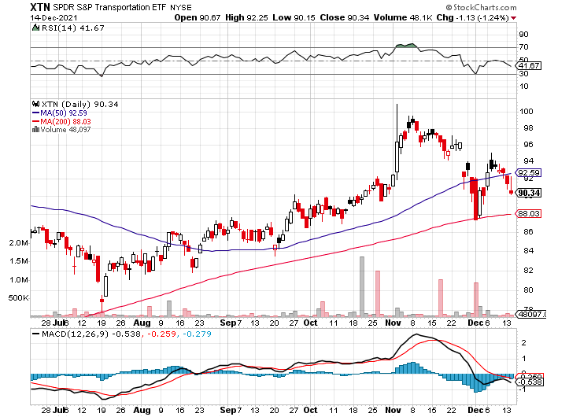
Transports Sector SPDR (XTN)- Worst Hit Sector (ALGT), (ALK), (JBLU), (LUV), (CHRW), (DAL)

Slide 58
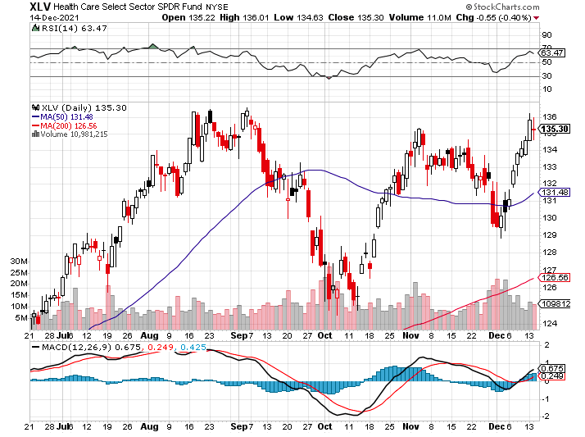
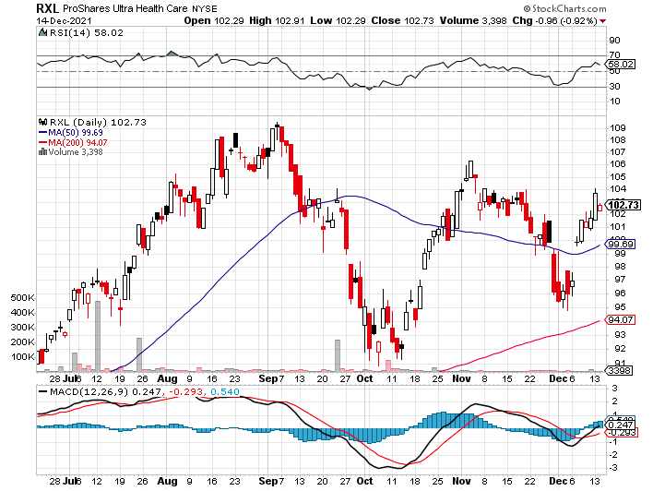
Health Care Sector (XLV), (RXL) (JNJ), (PFE), (MRK), (GILD), (ACT), (AMGN)

Slide 59
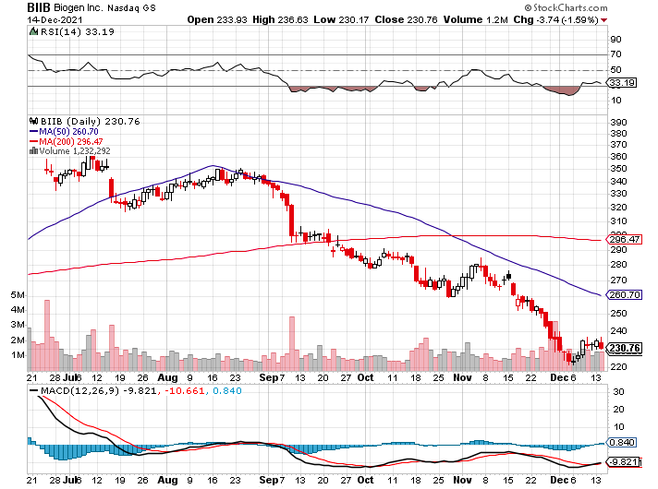
Biogen (BIIB) Why you invest in Biotech

Slide 60
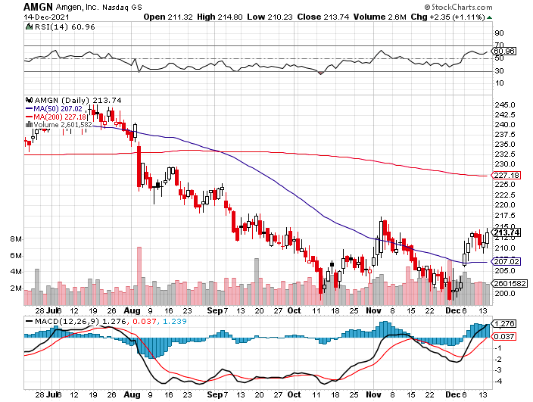
Amgen (AMGN) took profits on long 11/$185-$200 bull call spread

Slide 61
CRISPR Therapeutics (CRSP)

Slide 62
Goldman Sachs (GS) – Record Bonuses 12/$330-$350 call spread-expires in 2 days took profits 11/$330-$350 call spread stop loss on long 11/$385-$395 call spreads took profits on long 10/$320-$330 call spread took profits on long 8/$325-$335 call spread

Slide 63
Morgan Stanley (MS) – Doubled Dividend took profits on long 11/$85-$90 call spread stop loss on long 11/$95-$98 call spread took profits on long 10/$85-$90 call spread profits on long 2/$55-$60 call spread

Slide 64
JP Morgan Chase (JPM)-200-day holding 12/$148-$152.50 call spread - expires in 2 days took profits on long 10/$130-$140 call spread took profits on long 8/$140-$145 call spread took profits on long 7/$140-$145 call spread

Slide 65
Bank of America (BAC) – long 12/$39-$42 call spread expires in 2 days stop loss on long 11/$43-$45 call spread took profits on 11/$37-$40 call spread took profits on long 2/$28-$30 call spread

Slide 66
SPDR Metals & Mining ETF (XME) – long 2/$28-$30 call spread

Slide 67
Blackrock (BLK)-Asset Collection Boom took profits on long 3/$770-$790 call spread took profits on long 3/$310-$340 call spread

Slide 68
Visa (V) – “Touchless” Bitcoin Drag took profits on long 5/$220-$225 bull call spread took profits on long long 5/$195-$205 bull call spread took profits on long 9/$180-$185 bull call spread

Slide 69
Consumer Discretionary SPDR (XLY) (DIS), (AMZN), (HD), (CMCSA), (MCD), (SBUX)

Slide 70
Berkshire Hathaway (BRKB)- Natural Barbell resume buy backs at $25 billion a year, Profits Jump 18%, long 10/$275-$280 call spread long 10/$272.50-$277.50 call spread took profits on long 10/$255-$265 call spread took profits on long 3/$230-$240 call spread

Slide 71
Europe Hedged Equity (HEDJ)-

Slide 72
Japan (DXJ)-

Slide 73
Emerging Markets (EEM) - Pro trade, Weak Dollar, Long Recovery Play

Slide 76
Bonds – Wonder Why Your Bond Short Hasn’t Worked?
*Yearend short covering of positions gone wrong is a major driver of the markets right now *The Debt Crisis is Diverted, with congress cutting a deal to fund the US Government until February 18 *Fed to Double the Rate of Taper, soon cutting monthly bond purchases from $120 million a month to zero *US bond funds took in a staggering $612 billion during the first 11 months of 2021, and all time high *Bond funds deliver 0.8% returns in 2021, the worst real returns in 40 years. *The previous record was the $486 billion absorbed in 2019. *In a year, yield on the ten-year US Treasury bond will be at 2.50% or higher *US Treasury bond fund (TLT) could plunge from $180 in 2020 to $105 by 2023

Slide 77
Treasury ETF (TLT) – Levitating took profits on long 12/$152-$155 put spread, took profits on 11/$150-$153 put spread took profits on long 10/$154-$157 put spread, took profits on long 10/$137-$140 call spread profits on long 10/$155-$158 put spread, took profits on 9/$155-$158 put spread took profits on long 8/$157-$160 put spread, took profits on long 8/$156-$159 put spread,

Slide 78
Ten Year Treasury Yield ($TNX) – 1.45%

Slide 79
Junk Bonds (HYG) 4.32% Yield to Maturity

Slide 80
2X Short Treasuries (TBT)-Another run at highs

Slide 81
Emerging Market Debt (ELD) 5.81% Yield-

Slide 84
Foreign Currencies – Dollar New Highs
*US Dollar loves the Omicron Variant, hits new one year high *New $4.5 trillion in spending assure higher interest rates sooner, so does a double taper rate *I’m glad I’ve done no forex trades this year because I have been wrong *The forex market will notice monster US twin deficits someday, but no today *The Japanese yen (FXY) has been especially hard hit. *Currency with the fastest appreciating interest rates always does best *Long-term fundamentals are still poor, a dollar short could be the new ten-year trade, but not yet *Stand aside from forex for now, there are getting fish to fry

Slide 85
Japanese Yen (FXY), (YCS)

Slide 86
Euro ($XEU), (FXE), (EUO)-

Slide 87
British Pound (FXB)-

Slide 88
Australian Dollar (FXA)- The Global Recovery Play took profits on long 8/$67-$69 call spread

Slide 89
Emerging Market Currencies (CEW)

Slide 90
Chinese Yuan- (CYB)-

Slide 92
Bitcoin – ”RISK OFF” Hit Buy the Mad Hedge Bitcoin Letter at https://www.madhedgefundtrader.com/store/
* Bitcoin Hits 200-Day Moving Average, at $45,720, after a global “RISK OFF” move across all asset classes *Visa Launches a Crypto Service, to assist mainstream retailers in accepting Bitcoin, Ethereum, and other DeFi coins. *Omicron variant threatens a new mini recession and crypto is no place to hide *Major Bitcoin plays like (MSTR), (BLOK), and (BITO) are entering “BUY” territory *Long term “BUY” signal for Bitcoin still intact *Buy Bitcoin and Ethereum on the dip

Slide 93
Bitcoin ($BTCUSD) – Wake Up Time

Slide 94
Ethereum (ETHE) –

Slide 95
MicroStrategy (MSTR) –

Slide 96
Amplify Transformational Data Sharing ETF (BLOK) – Cross Imminent

Slide 98
Energy –
*OPEC+ Agrees to Oil Production Increase, in January *Screaming from its largest customer, China, prompted the move *Some 400,000 barrels a day will be placed on the market *Oil fell 2.5% on the news *The Saudis want to keep Texas tea under $100 a barrel, the price that causes recessions and less long-term consumption *The end of oil is upon us, but it may take 30 years to unwind existing infrastructure *Avoid all energy plays like the plague, it’s the new buggy whip industry as the US de-carbonizes

Slide 99
Oil-($WTIC)

Slide 100
United States Oil Fund (USO) long 10/$9.50-$10 Vertical bull call spread

Slide 101
Energy Select Sector SPDR (XLE)-No Performance! (XOM), (CVX), (SLB), (KMI), (EOG), (COP)

Slide 102
Halliburton (HAL)-

Slide 103
Natural Gas (UNG) -

Slide 105
Precious Metals – No Trade
*Not a hint of downside protection offered by gold in this global selloff *Gold has been the worst performing asset of 2021 *Gold provided absolutely no downside protection during the pandemic crash *If $9 trillion of investment demand decamps for the crypto world, leaving only jewelry demand, $9 trillion could go into Bitcoin. *Rising interest rates bode poorly for precious metals as it raises the opportunity cost for non-yielding assets *Bitcoin is clearly sucking capital out of precious metals *Stay away until this plays out *Silver is still the bigger and better long-term play

Slide 106
Gold (GLD)- Meltdown

Slide 107
Market Vectors Gold Miners ETF- (GDX) –

Slide 108
Barrick Gold (GOLD) took profits on long 1/$21-$23 call spread took profits on long 11/$22-$24 call spread

Slide 109
Newmont Mining- (NEM)- took profits on long $55-60 call spread

Slide 110
Silver- (SLV)- took profits on long 11/$19-$20 call spread

Slide 111
Silver Miners - (SIL)-

Slide 112
Wheaton Precious Metals - (WPM)- took profits on long 2/$39-41 call spread

Slide 113
Copper (COPX)-Uptrend Resumes Copper Unions Vote to Strike in Chile, cutting off 33% of the global supply

Slide 115
Real Estate – No Respite
*US Home Prices to Keep Rising, but at only half the 2021 rate *Manhattan Rents See Record Surge, with median rents soaring by 23% *CPI Sizzles at 6.8% YOY, the highest since 1982, put the focus on housing as an inflation hedge *Homeowners sitting on record $9.4 trillion in equity, or $178,000 per person, let the refi’s begin! *24% of all American mortgages have interest rates under 3%, making them immune to interest rate rises *Builder Sentiment Rises to 84 against a 50 boom/bust *S&P Case Shiller delivers a stunning 19.5% gain for September, a new all time high

Slide 116
S&P Case Shiller Up 19.5% for September Phoenix (33.1%), Tampa (27.2%), Miami 25.2% lead

Slide 117
Crown Castle International (CCI) – 2.70% yielding cell phone tower REIT

Slide 118
US Home Construction Index (ITB) (DHI), (LEN), (PHM), (TOL), (NVR)

Slide 120
Trade Sheet- So What Do We Do About All This?
*Stocks – buy dips aggressively *Bonds – sell rallies aggressively *Commodities-stand aside *Currencies- stand aside *Precious Metals – stand aside *Energy – stand aside *Volatility - sell short over $30 *Real estate – buy dips *Bitcoin – buy dips

Slide 121
Next Strategy Webinar 12:00 EST Wednesday, January 5 from Incline Village, NV email me questions at support@madhedgefundtrader.com
Good Luck and Good Trading!
Notes:
*

